Slide 1




Local decoder for the toric code via signal exchange
Paletta, L., Leverrier, A., Mirrahimi, M. Vuillot, C. High-performance local decoders for defect matching in 1D. npj Quantum Inf (2026)
Paletta, L. Local decoder for the toric code via signal exchange. arXiv preprint arXiv:2603.02328 (2026)
FTQT, Benasque, 2026
Now at Technical University of Munich

Slide 2
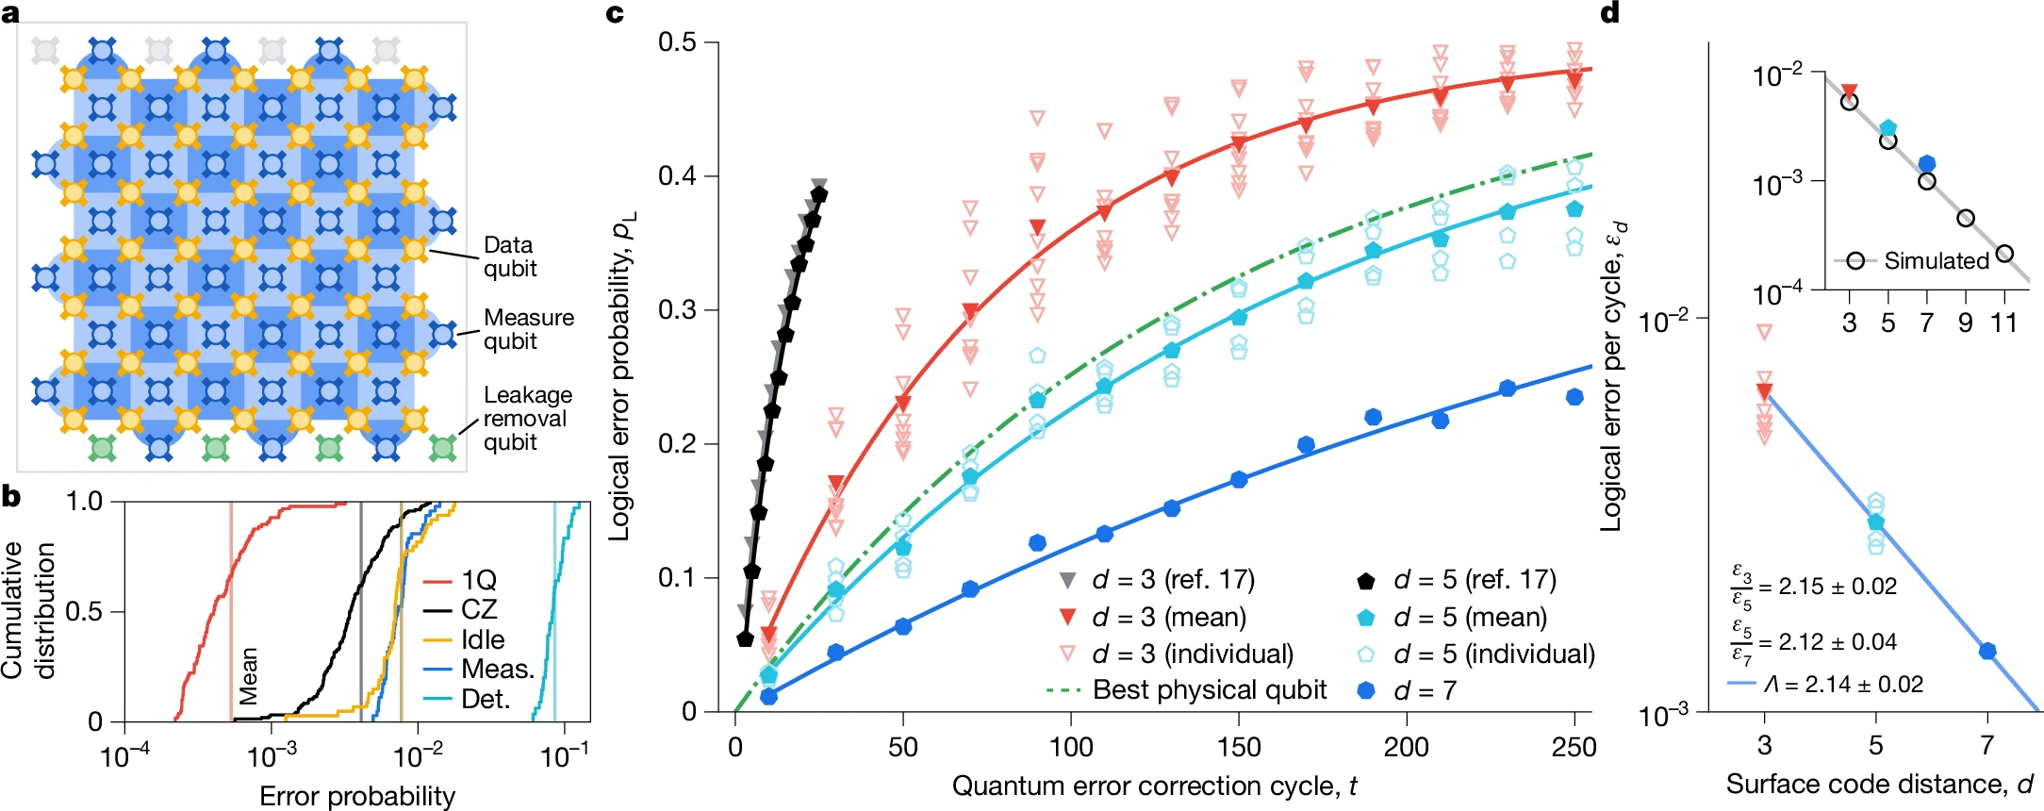



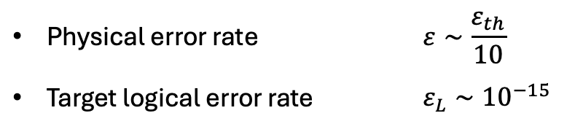


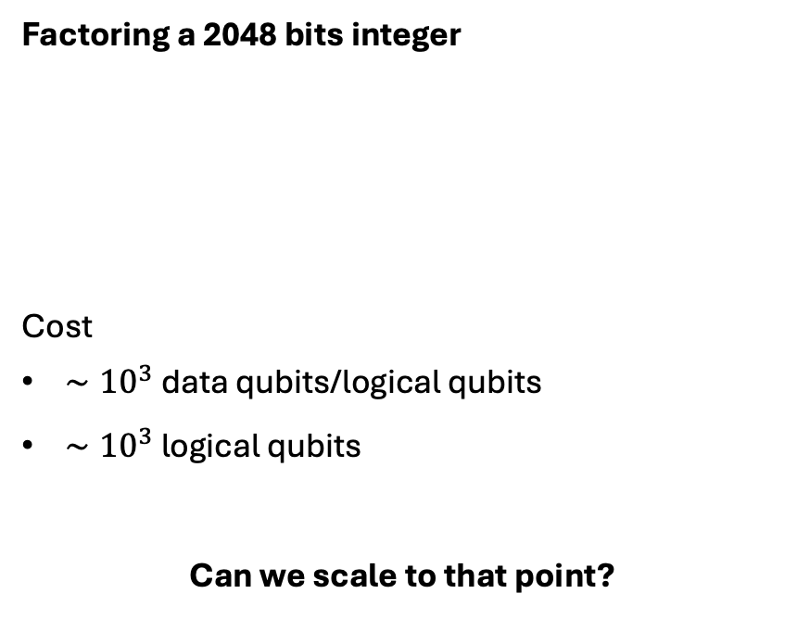
The cost of fault-tolerant quantum computation
Experimental demonstration of QEC
Factoring a 2048 bits integer
Cost
$∼{10}^{3}$ data qubits/logical qubits
$∼{10}^{3}$ logical qubits
Can we scale to that point?
$$XXXX$$
$$ZZZZ$$
Sent to decoder
Physical error rate | $$ε∼\frac{ε_{th}}{10}$$
Target logical error rate | $$ε_{L}∼{10}^{−15}$$
$$d=7$$
$$ε∼\frac{ε_{th}}{2}$$
$∼{10}^{6}$ qubits
Reduced logical error rate
Google, 2025
Gidney, 2025

Slide 3
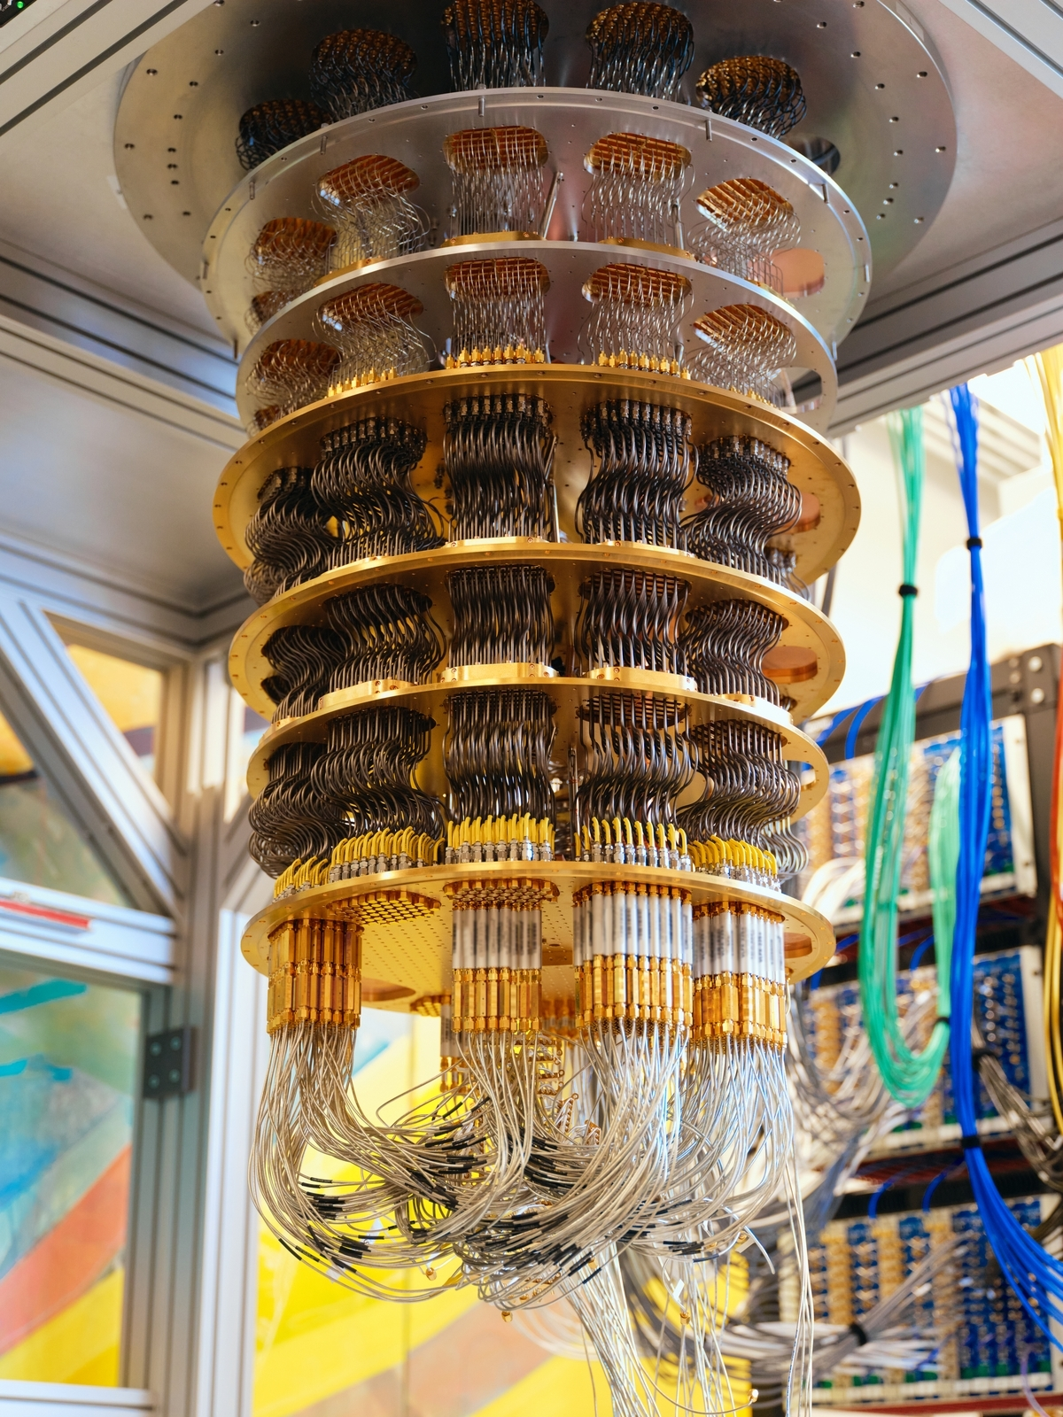
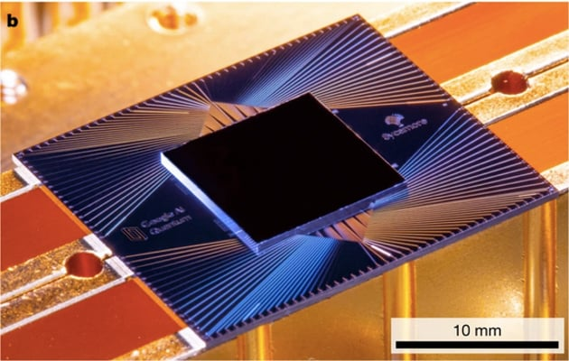
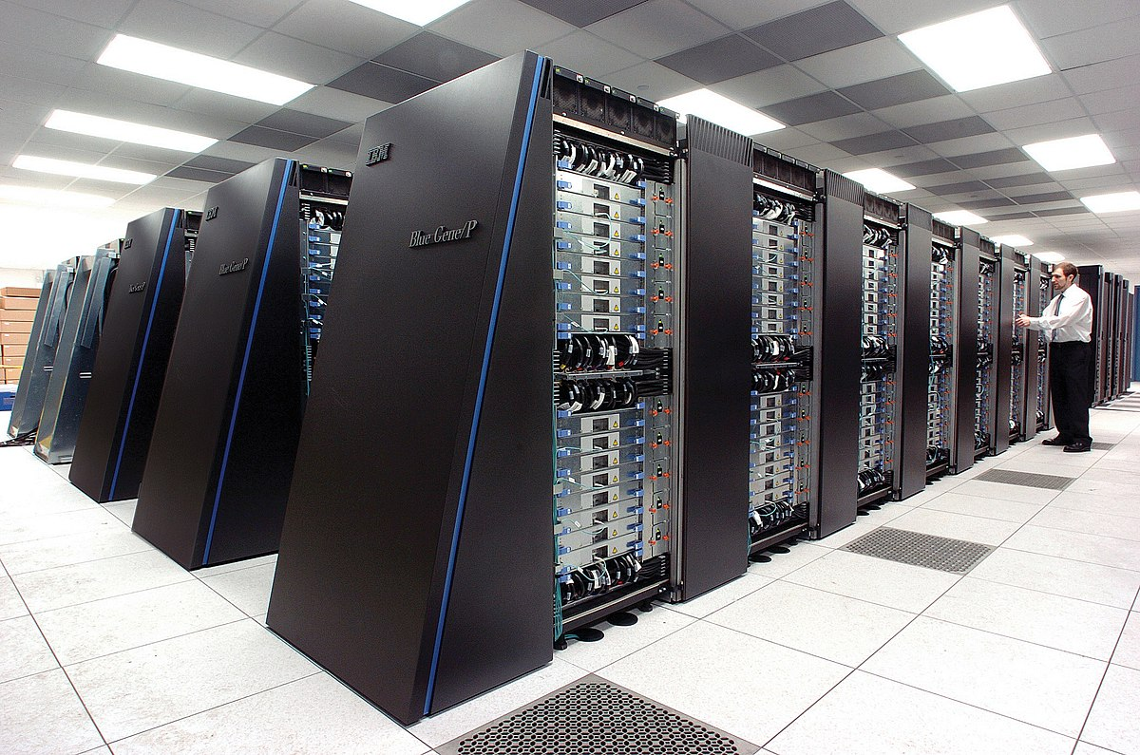

Scaling a quantum computing architecture
Challenges:
A lot of qubits!
The ‘wire problem’
Real-time decoding
Logical gates
$←$ Topic of the talk
error syndrome
Cryostat
correction
Superconducting circuit (Google Sycamore)
Classical computer

Slide 4
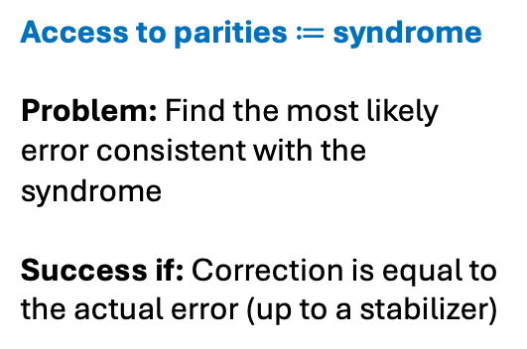






The decoding problem
Kitaev’s toric code
Example of an $X$ error configuration
Access to parities $≔$ syndrome
Problem: Find the most likely error consistent with the syndrome
Success if: Correction is equal to the actual error (up to a stabilizer)
$XXXX$ check $≔S_{X,c}$
$$−1$$
$$−1$$
$$−1$$
$ZZZZ$ check $≔S_{Z,v}$
$$𝒞=\left\{\left|ψ\right\rangle , S | ψ\right\rangle =|ψ⟩\}$$
$$−1$$
Known decoders:
Minimum-weight perfect matching
Union-Find
Renormalisation-group
…
Centralized classical computer
Kitaev, 2006

Slide 5



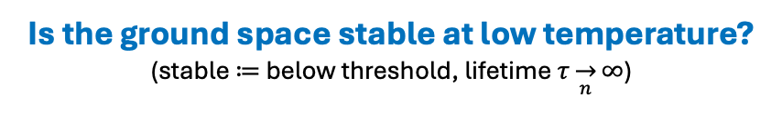
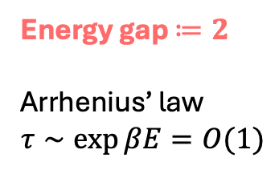

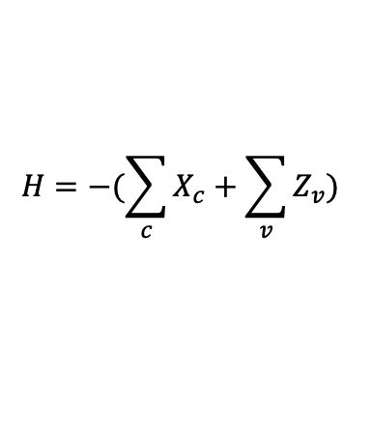

Do we actually need classical computation?
Introduction to self-correction
The toric code in not self-correcting!
$XXXX$ check $≔X_{c}$
Energy gap $≔2$
Arrhenius’ law
$$τ∼\exp{βE=O(1)}$$
$ZZZZ$ check $≔Z_{v}$
$$H=−(\sum_{c}{X_{c}}+\sum_{v}{Z_{v}})$$
Theorem (Bravyi-Terhal): all 2D stabilizer codes have constant energy gap.
‘Code space $=$ ground space’
Is the ground space stable at low temperature?
(stable $≔$ below threshold, lifetime $τ\overset{→}{n}∞$)
No quantum hard-drive in dim $≤2$
Douçot et al, 2005
Brown et al, 2016
Bravyi and Terhal, 2008

Slide 6
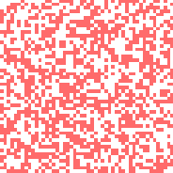

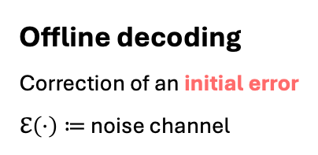
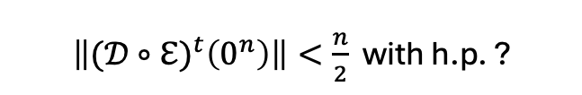

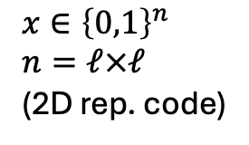
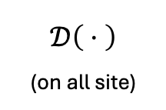
Between self-correction and global decoders
Local decoders
Toom’s rule as a classical example
information layer (quantum)
Offline decoding
Correction of an initial error
$ℇ\left(⋅\right)≔$ noise channel
0 | 0 | 0 | 1 | 0
0 | 1 | 0 | 0 | 0
0 | 0 | 0 | 0 | 0
0 | 1 | 0 | 0 | 1
1 | 1 | 0 | 1 | 1
$$x∈{\left\{0,1\right\}}^{n}$$
$$n=ℓ×ℓ$$
(2D rep. code)
(classical)
decoder layer
$𝒟^{t}\left(ℇ(0^{n})\right)→0^{n}$ with h.p. ?
Global update from a local rule
Classical automaton
simple classical computation
local communication
small classical memory
 | 1
1 | 0
 | 1
1 | 1
Online decoding
Stability of the codespace under repeated errors
$$𝒟\left( ⋅ \right)$$
(on all site)
 | 0
0 | 1
 | 0
0 | 0
$\left\|{(𝒟∘ℇ)}^{t}\left(0^{n}\right)\right\|<\frac{n}{2}$ with h.p. ?
Toom, 1978

Slide 7
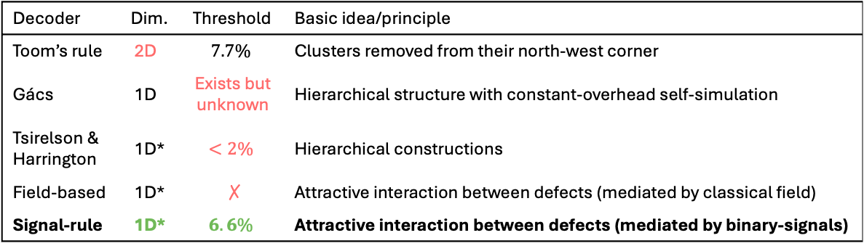

Starting with the repetition code
Decoder | Dim. | Threshold | Basic idea/principle
Toom’s rule | 2D | $$7.7\%$$ | Clusters removed from their north-west corner
Gács | 1D | Exists but unknown | Hierarchical structure with constant-overhead self-simulation
Tsirelson & Harrington | 1D* | $$<2\%$$ | Hierarchical constructions
Field-based | 1D* | ✗ | Attractive interaction between defects (mediated by classical field)
Signal-rule | 1D* | $$6.6\%$$ | Attractive interaction between defects (mediated by binary-signals)
$∼$ 4D toric code
Gács, 1986
Tsirelson, 2006
Harrington, 2004
Relevant to the 2D toric code
Herold et al, 2015
This work

Slide 8
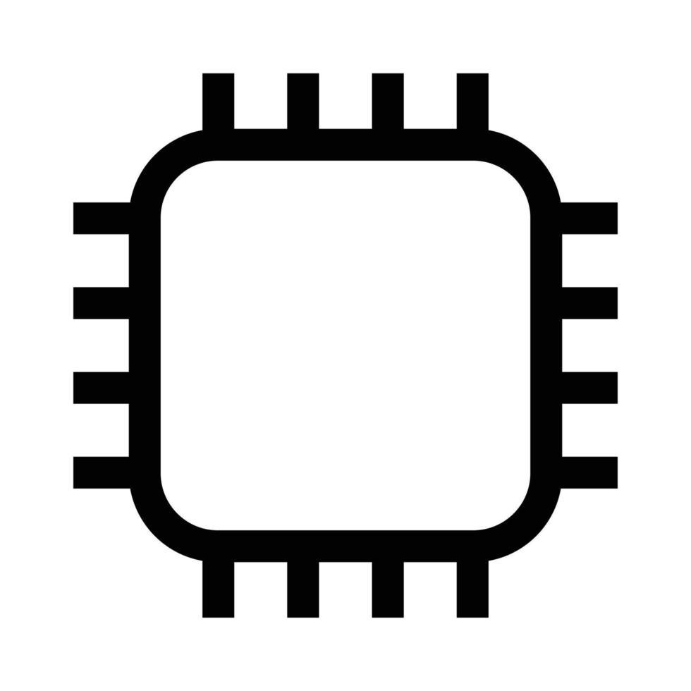
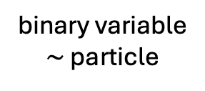




Layout of the system
check
Quantum
qubit
Classical
1
0
binary variable
$\sim$ particle
$$b_{1}∈ℤ_{2}$$
cell
1
0
$$b_{2}∈ℤ_{2}$$
$$⋮$$
1
0
$$b_{k}∈ℤ_{2}$$
local update rule $\sim$ creation/annihilation/propagation of particles

Slide 9

A single particle decoder
$$t=0$$
Repeat
Emission of forward-signals by defects
Propagation of forward-signals by 1 to the right
Defect displacement (correction)

Slide 10
A single particle decoder
$$t=0$$
Repeat
Emission of forward-signals by defects
Propagation of forward-signals by 1 to the right
Defect displacement (correction)

Slide 11
A single particle decoder
$$t=0$$
Repeat
Emission of forward-signals by defects
Propagation of forward-signals by 1 to the right
Defect displacement (correction)

Slide 12
A single particle decoder
$$t=0$$
Repeat
Emission of forward-signals by defects
Propagation of forward-signals by 1 to the right
Defect displacement (correction)

Slide 13

A single particle decoder
$$t=1$$
Repeat
Emission of forward-signals by defects
Propagation of forward-signals by 1 to the right
Defect displacement (correction)

Slide 14
A single particle decoder
$$t=1$$
Repeat
Emission of forward-signals by defects
Propagation of forward-signals by 1 to the right
Defect displacement (correction)

Slide 15
A single particle decoder
$$t=1$$
Repeat
Emission of forward-signals by defects
Propagation of forward-signals by 1 to the right
Defect displacement (correction)

Slide 16

A single particle decoder
$$t=2$$
Repeat
Emission of forward-signals by defects
Propagation of forward-signals by 1 to the right
Defect displacement (correction)

Slide 17
A single particle decoder
$$t=2$$
Repeat
Emission of forward-signals by defects
Propagation of forward-signals by 1 to the right
Defect displacement (correction)

Slide 18
A single particle decoder
$$t=2$$
Repeat
Emission of forward-signals by defects
Propagation of forward-signals by 1 to the right
Defect displacement (correction)

Slide 19

A single particle decoder
$$t=3$$
Repeat
Emission of forward-signals by defects
Propagation of forward-signals by 1 to the right
Defect displacement (correction)

Slide 20

A single particle decoder
$$t=4$$
Repeat
Emission of forward-signals by defects
Propagation of forward-signals by 1 to the right
Defect displacement (correction)

Slide 21
A single particle decoder
$$t=4$$
Accumulation of forward-signals
The memory–forgetting tradeoff
need to remember for some time to locally correct large errors …
… but without forgetting, memory quickly saturates
We propose a forgetting mechanism using new particles types!

Slide 22
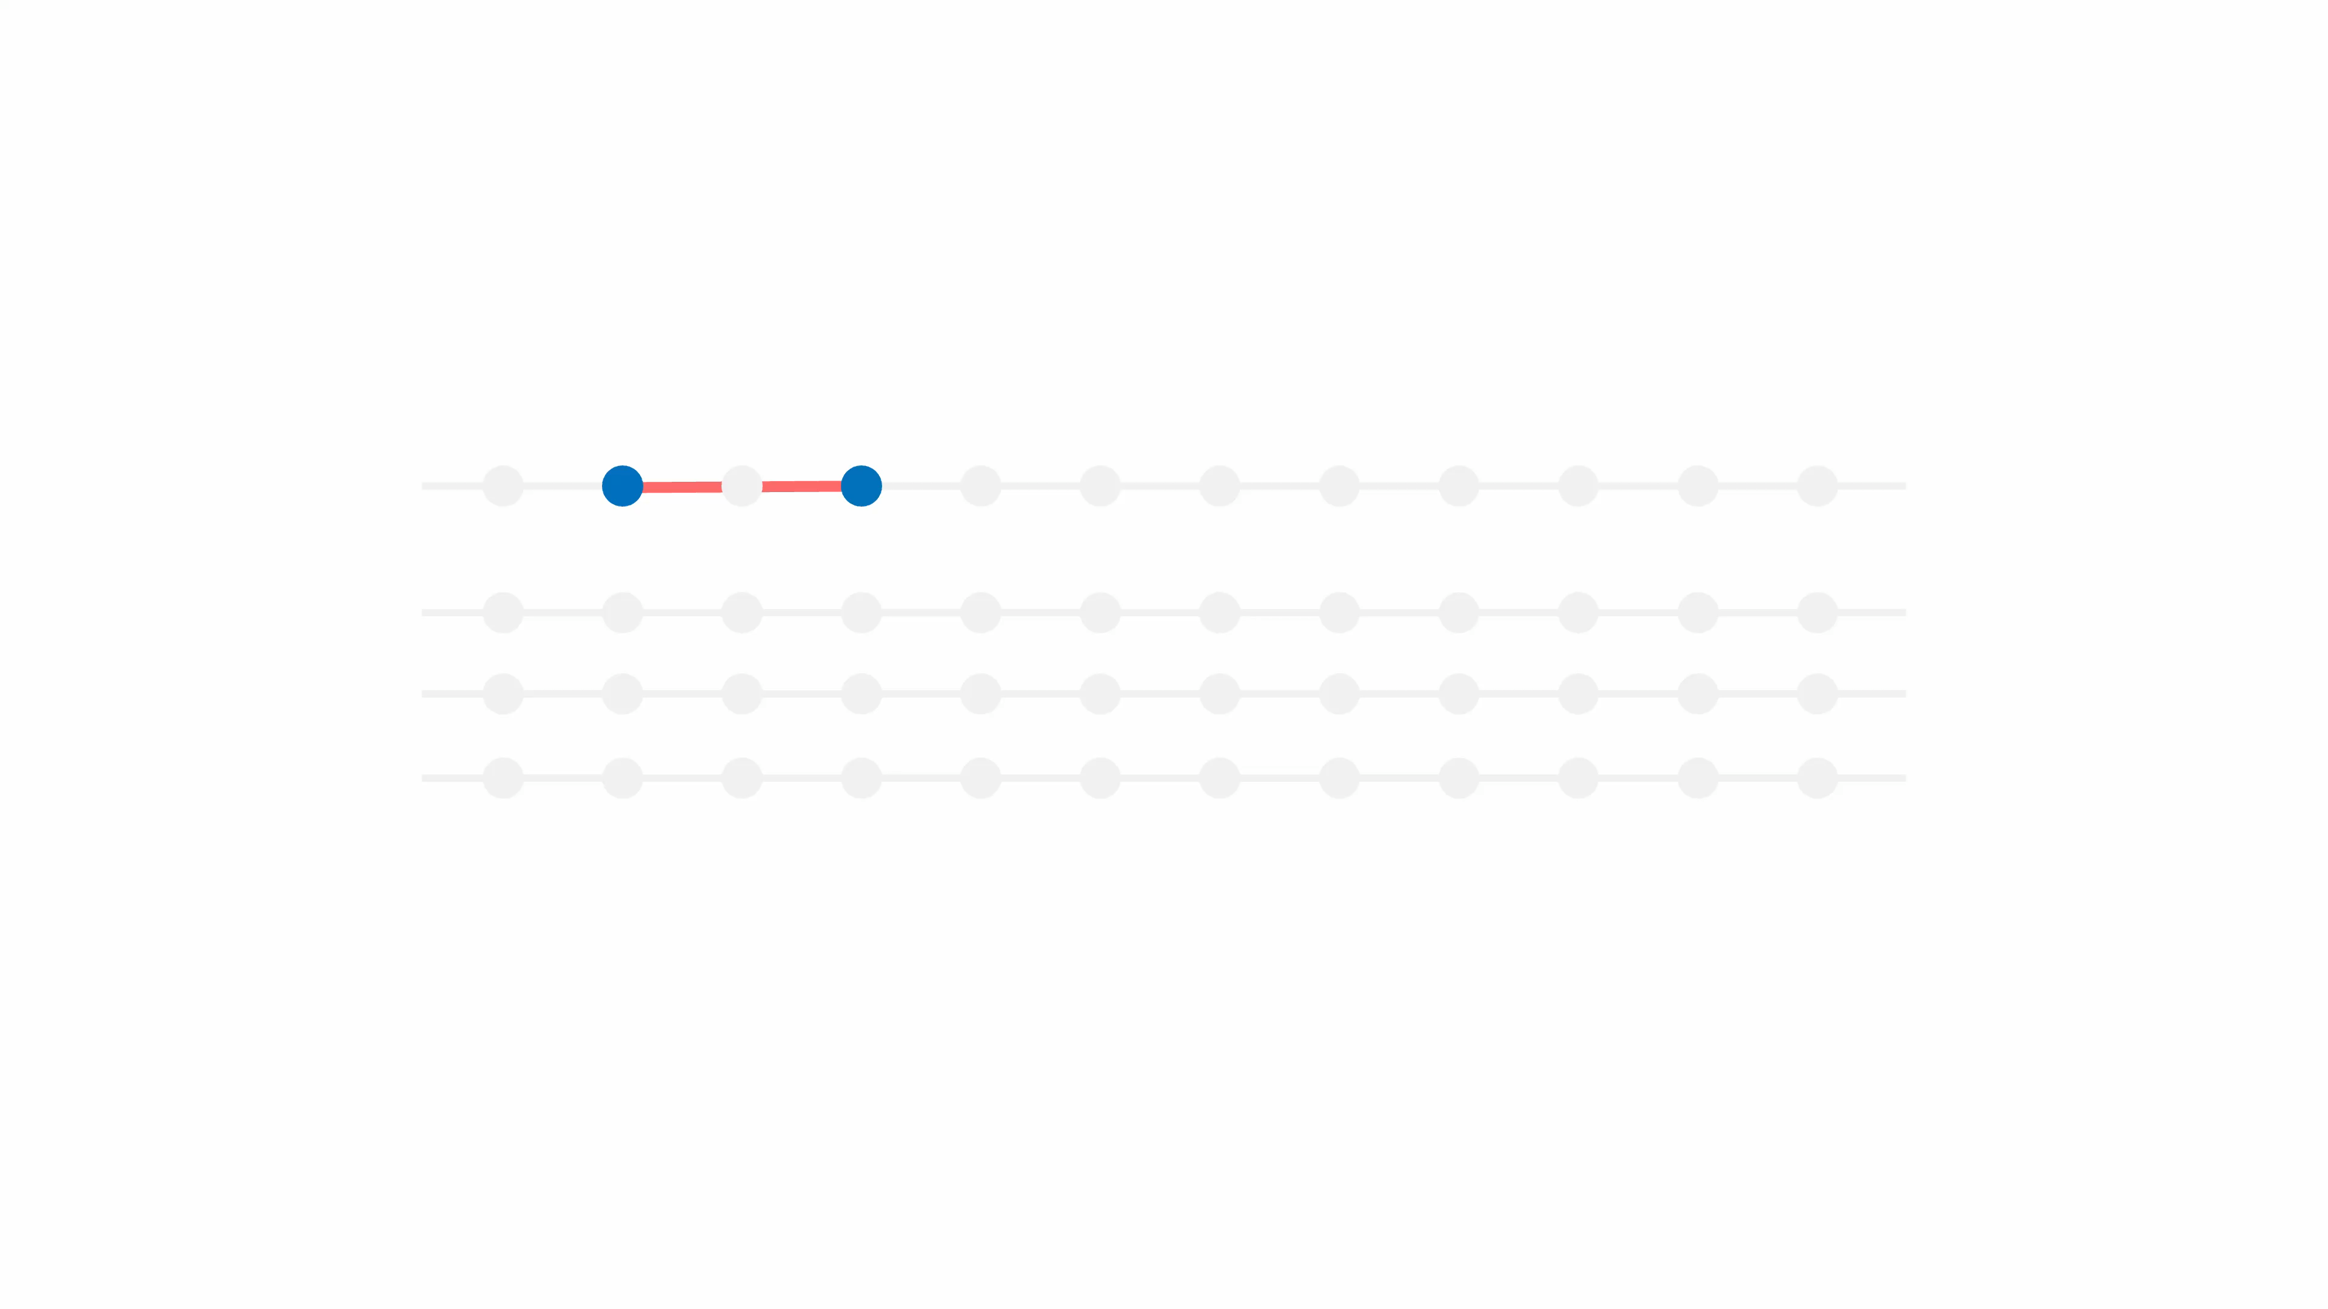

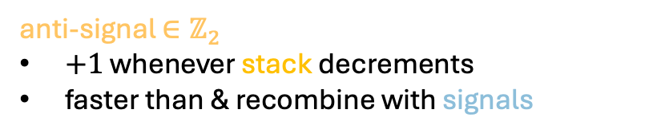
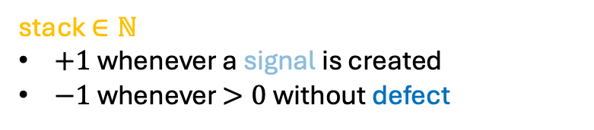

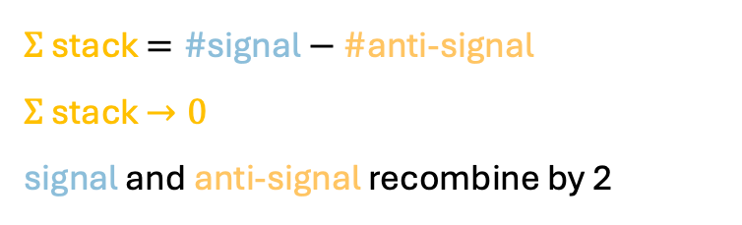
Example of self-resetting decoder
defect
fwd-signal
anti-signal
stack $∈ℕ$
stack $∈ℕ$
$+1$ whenever a signal is created
$−1$ whenever $>0$ without defect
$Σ$ stack $=\#$signal $− \#$anti-signal
$Σ$ stack $→0$
signal and anti-signal recombine by 2
$$⟹$$
anti-signal $∈ℤ_{2}$
$+1$ whenever stack decrements
faster than & recombine with signals
decoder returns to its initial config.

Slide 23
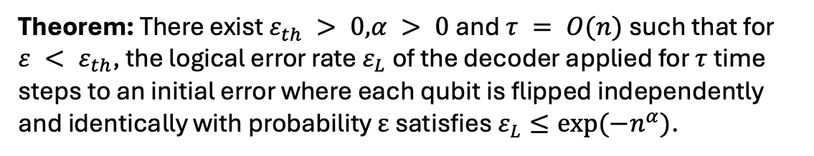
Offline decoding threshold theorem in 1D
Say that the decoder has failed if at the end:
Wrong matching OR Some signals have not been erased
Theorem: There exist $ε_{th} > 0$,$α > 0$and $τ = O(n)$such that for $ε < ε_{th}$, the logical error rate $ε_{L}$ of the decoder applied for $τ$ time steps to an initial error where each qubit is flipped independently and identically with probability ε satisfies $ε_{L}≤exp(−n^{α})$.

Slide 24
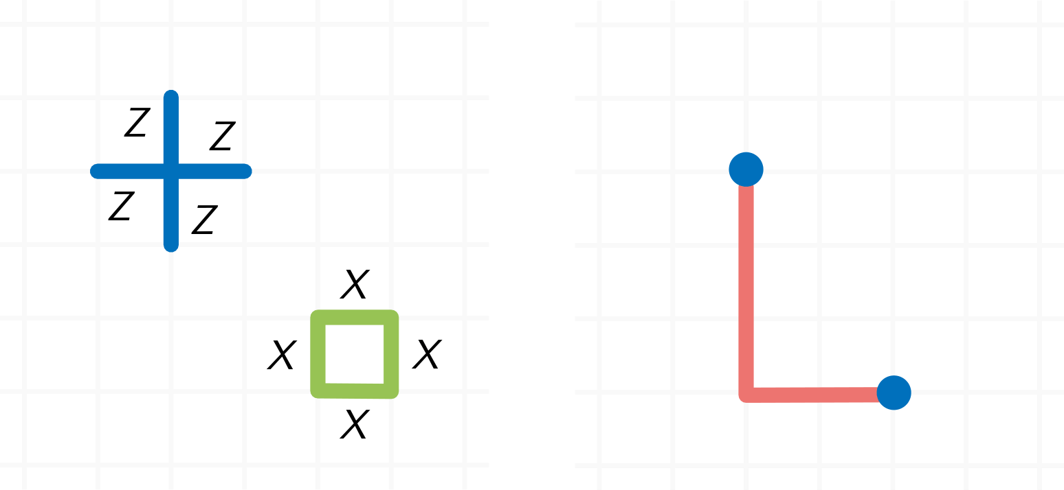

Generalization to higher dimensions
Need for higher-dimensional « wavefront » …
Degeneracy leads to multiple possible corrections
1
2
OK
1
$∼$ orbit mvt .
… from point-like particles? (with charge conservation)
How to build agreement between defect displacement without global communication?

Slide 25
Spanning the entire 2D plane
New particles: type-1 and type-2 signals
Example of signal generation rules
1: span 1D
1-stack
span the entire plane!
increment
&
2: span the ortho direction
create when decrement
defect
1-anti-signal
2-stack
create when decrement
Forgetting about stacks and anti-signals …
create
recombine
1-fwd-signal
2-anti-signal
recombine
2-fwd-signal
Particles divided by nature, type and propagation direction

Slide 26
Assymetric signal propagation build agreements
Forgetting about stacks and anti-signals …
Attraction bassin
Local corrections in agreement
1-Forward-Signals
Create 1-fwd-signals from defect sites; increment 1-stacks (ii)
Propagate 1-fwd-signals by 1 (viii)
2-Forward-Signals
Create 2-fwd-signals from 1-fwd-signals and defects; increment 2-stacks (iii)
Propagate 2-fwd-signals by 1 (viii)
Local update rule:

Slide 27
Complete rule set
Defect Matching
Neighboring defects are matched via local Pauli correction (i)
2. 1-Forward-Signals
Create 1-fwd-signals from defect sites; increment 1-stacks (ii)
Propagate 1-fwd-signals by 1 (viii)
3. 2-Forward-Signals
Create 2-fwd-signals from 1-fwd-signals and defects; increment 2-stacks (iii)
Propagate 2-fwd-signals by 1 (viii)
4. Defect Attraction
Defects encountering 1/2-fwd-signals are attracted via local Pauli correction (iv)
5. Anti-Signals
Decrement 1-stacks without defect to create 1-anti-signals (v)
Decrement 2-stacks without 1-fwd-signals to create 2-anti-signals (vi)
Propagate and recombine matching anti/fwd-signals ×3 (vii, viii)

Slide 28
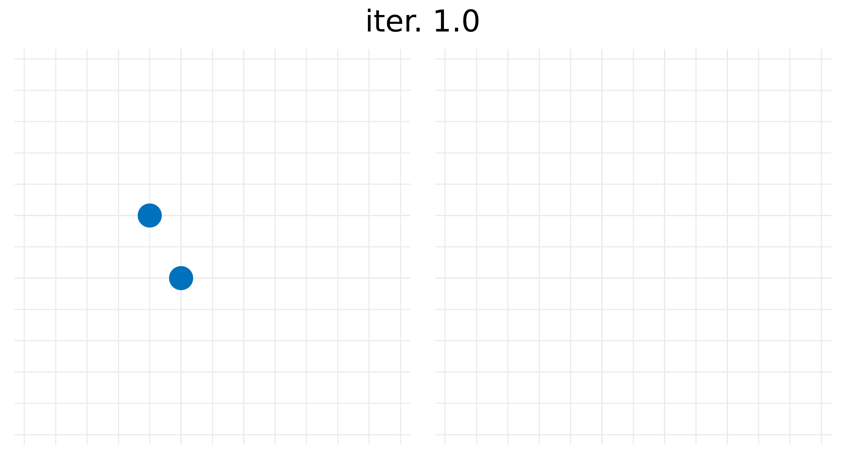
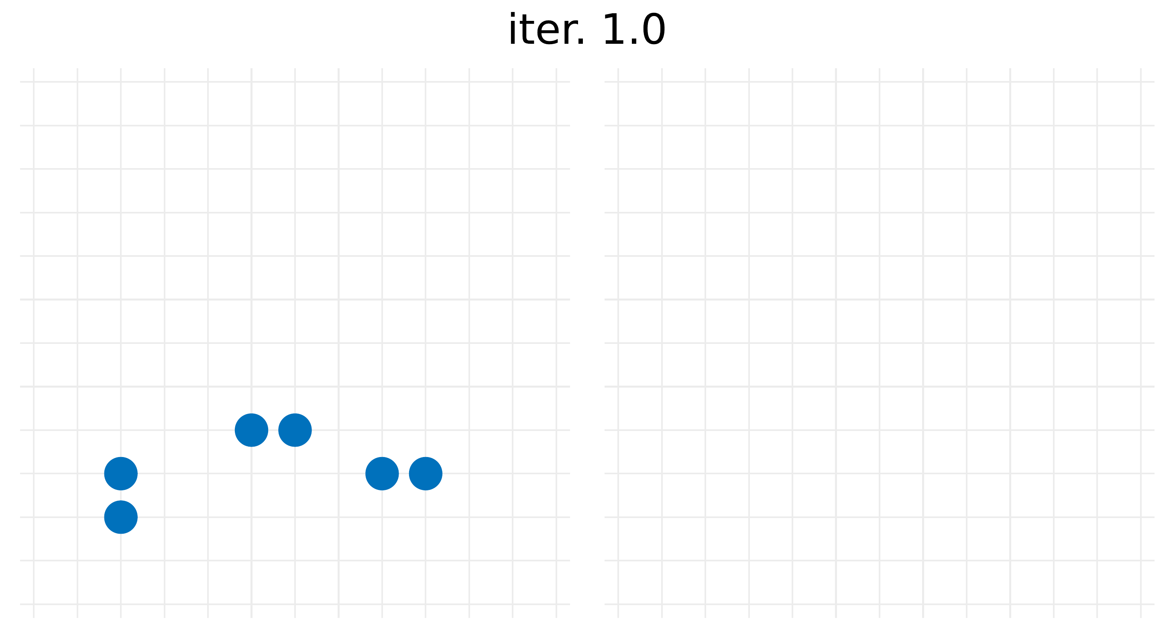

Some animations
offline decoding
Signal flow
increment
defect
2-stack
create
create when decrement
2-anti-signal
recombine
online decoding $:ε_{d}=ε_{m}=1\%$
2-signal
Local state space
defect & signals*
stack & anti-signals*
*one signal max shown per site for clarity

Slide 29




Numerics
Logical error rate in the online regime
Scaling with $d$
(pseudo?)threshold
$$γ_{5}$$
$$γ_{9}$$
Ansatz: $ε_{L}={\frac{A}{d}\left(\frac{ε}{ε_{th}}\right)}^{γ_{d}}$

Slide 30
Open problems on local decoders
Follow up
optimization over the space of signal-rules?
good hardware implementation?
Interesting related problems
decode in constant time and/or constant bit per site?
minimum-weight decoding via a local rule?

