Slide 1
Cup products and CCZ

Slide 2
Outline
Motivation and definitions: CCZ
Classical analogue and examples
Cohomology invariants
Cup products, copy-cup gate
More examples

Slide 3

Summary
We want cohomology invariants
  Cohomology invariants $⇒$ CCZ
Cup products are one solution.

Slide 4

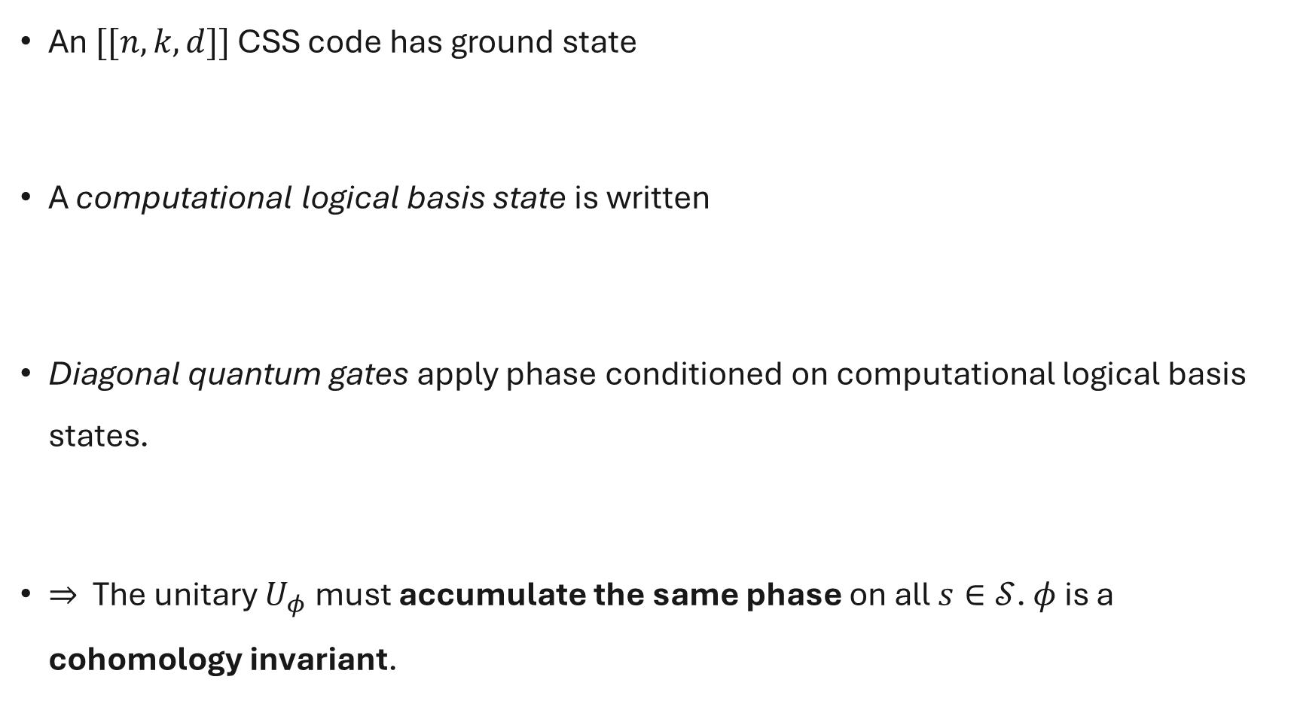
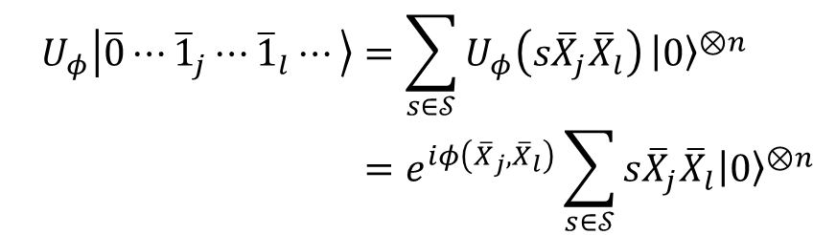
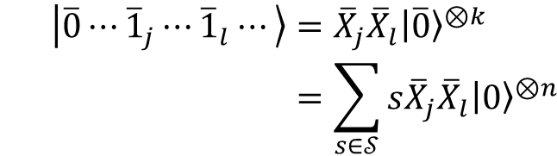
Diagonal quantum gates
An $[[n,k,d]]$ CSS code has ground state
A computational logical basis state is written
Diagonal quantum gates apply phase conditioned on computational logical basis states.
$⇒$ The unitary $U_{φ}$ must accumulate the same phase on all $s∈𝒮$. $φ$ is a cohomology invariant.
$${\left|\overline{0}\right\rangle }^{⊗k}=\sum_{s∈𝒮}{s{\left|0\right\rangle }^{⊗n}}$$
$$\left|\overline{0}⋯{\overline{1}}_{j}⋯{\overline{1}}_{l}⋯\right\rangle ={\overline{X}}_{j}{\overline{X}}_{l}{\left|\overline{0}\right\rangle }^{⊗k} \\ =\sum_{s∈𝒮}{s{\overline{X}}_{j}{\overline{X}}_{l}{\left|0\right\rangle }^{⊗n}}$$
$$U_{φ}\left|\overline{0}⋯{\overline{1}}_{j}⋯{\overline{1}}_{l}⋯\right\rangle =\sum_{s∈𝒮}{U_{φ}\left(s{\overline{X}}_{j}{\overline{X}}_{l}\right)}{\left|0\right\rangle }^{⊗n} \\ =e^{iφ\left({\overline{X}}_{j},{\overline{X}}_{l}\right)}\sum_{s∈𝒮}{s{\overline{X}}_{j}{\overline{X}}_{l}{\left|0\right\rangle }^{⊗n}}$$

Slide 5




Cup product (informal)
For a cochain complex
$$C=⋯→C^{i}→C^{i+1}→⋯$$
A cup product is some function on cochains
$$∪:C^{p}×C^{q}→C^{p+q} \\ a_{p}∪b_{q}→c_{p+q}$$
for all $p,q.$
$$δ$$
$$δ$$
$$δ$$
[1] Zhou, L. The cup product operation, YouTube.
[2] Nanda, V., Computational algebraic topology.

Slide 6





Cup product (simplexes)
$$∪:C^{p}×C^{q}→C^{p+q}$$
$C^{0}$: vertices
$C^{1}$: oriented edges
$C^{2}$: oriented triangles
A simplicial complex
$$C^{0}→C^{1}→C^{2}→⋯$$
has cochains
$$C^{0}:\left\{v_{1},v_{2},v_{3},⋯\right\} \\ C^{1}:\left\{\left(v_{1},v_{2}\right),⋯\right\} \\ C^{2}:\left\{\left(v_{1},v_{2},v_{3}\right),⋯\right\}$$
$$δ$$
$$δ$$
$$δ$$
[1] Zhou, L. The cup product operation, YouTube.
[2] Nanda, V., Computational algebraic topology.

Slide 7
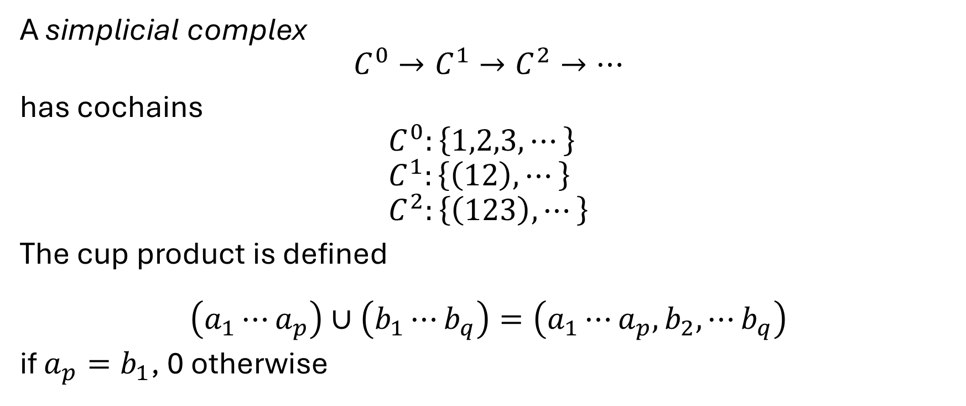
Cup product (simplexes)
$$∪:C^{p}×C^{q}→C^{p+q}$$
$C^{0}$: vertices
$C^{1}$: oriented edges
$C^{2}$: oriented triangles
A simplicial complex
$$C^{0}→C^{1}→C^{2}→⋯$$
has cochains
$$C^{0}:\left\{1,2,3,⋯\right\} \\ C^{1}:\left\{\left(12\right),⋯\right\} \\ C^{2}:\left\{\left(123\right),⋯\right\}$$
The cup product is defined
$$\left(a_{1}⋯a_{p}\right)∪\left(b_{1}⋯b_{q}\right)=\left(a_{1}⋯a_{p},b_{2},⋯b_{q}\right)$$
if $a_{p}=b_{1}$, 0 otherwise
$$δ$$
$$δ$$
$$δ$$
[1] Zhou, L. The cup product operation, YouTube.
[2] Nanda, V., Computational algebraic topology.

Slide 8
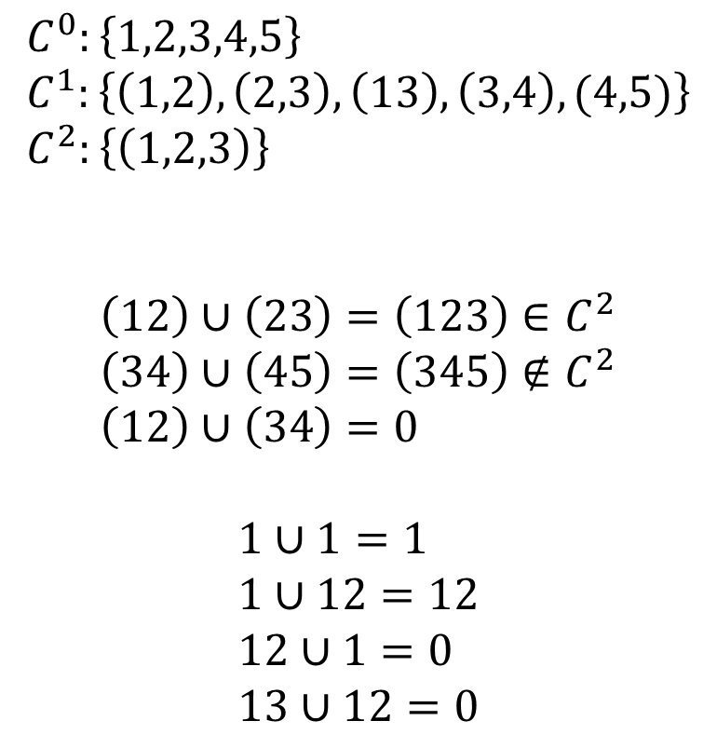
Cup product (simplexes)
$$∪:C^{p}×C^{q}→C^{p+q}$$
$$C^{0}:\left\{1,2,3,4,5\right\} \\ C^{1}:\left\{\left(1,2\right),\left(2,3\right),\left(13\right),\left(3,4\right),(4,5)\right\} \\ C^{2}:\left\{\left(1,2,3\right)\right\}$$
$$\left(12\right)∪\left(23\right)=\left(123\right)∈C^{2} \\ \left(34\right)∪\left(45\right)=\left(345\right)∉C^{2} \\ \left(12\right)∪\left(34\right)=0$$
$$1∪1=1 \\ 1∪12=12 \\ 12∪1=0 \\ 13∪12=0$$
5
1
4
2
3

Slide 9
Cup product (simplexes)
$$∪:C^{p}×C^{q}→C^{p+q}$$
$$C^{0}:\left\{1,2,3,4,5\right\} \\ C^{1}:\left\{\left(1,2\right),\left(2,3\right),\left(13\right),\left(3,4\right),(4,5)\right\} \\ C^{2}:\left\{\left(1,2,3\right)\right\}$$
$$\left(12\right)∪\left(23\right)=\left(123\right)∈C^{2} \\ \left(34\right)∪\left(45\right)=\left(345\right)∉C^{2} \\ \left(12\right)∪\left(34\right)=0$$
$$1∪1=1 \\ 1∪12=12 \\ 12∪1=0 \\ 13∪12=0$$
5
1
4
2
3
Cup product depends on orientation

Slide 10
Cup product (simplexes)
$$∪:C^{p}×C^{q}→C^{p+q}$$
Consider the toric code

Slide 11
Cup product (simplexes)
$$∪:C^{p}×C^{q}→C^{p+q}$$
Consider the toric code
1
2
3
1
4
4
5
6
1
1
2
3

Slide 12



Cup product (simplexes)
$$∪:C^{p}×C^{q}→C^{p+q}$$
$$415, 263∈C^{2}$$
Consider the toric code
1
2
3
1
4
4
5
6
1
1
2
3

Slide 13
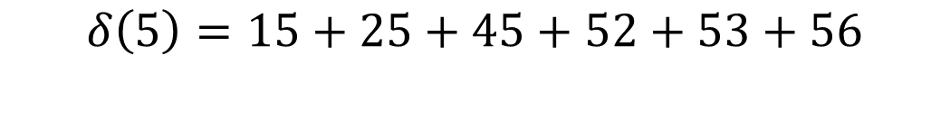


Cup product (simplexes)
$$∪:C^{p}×C^{q}→C^{p+q}$$
$$δ\left(5\right)=15+25+45+52+53+56$$
Consider the toric code
1
2
3
1
4
4
5
6
1
1
2
3

Slide 14




Cup product (simplexes)
$$∪:C^{p}×C^{q}→C^{p+q}$$
$$δ\left(26\right)=526+263$$
Consider the toric code
1
2
3
1
4
4
5
6
1
1
2
3

Slide 15



Cup product (simplexes)
$$∪:C^{p}×C^{q}→C^{p+q}$$
$$δ\left(45\right)=415+425$$
Consider the toric code
1
2
3
1
4
4
5
6
1
1
2
3

Slide 16
Cup product (simplexes)
$$∪:C^{p}×C^{q}→C^{p+q}$$
$$δ\left(5\right)=15+25+45+52+53+56$$
Consider the toric code
1
2
3
1
4
4
5
6
1
1
2
3

Slide 17



Cup product (simplexes)
$$∪:C^{p}×C^{q}→C^{p+q}$$
$$δ\left(5\right)=15+25+45+52+53+56$$
$$δ\left(5\right)∪δ\left(5\right)=152+253$$
Consider the toric code
1
2
3
1
4
4
5
6
1
1
2
3

Slide 18




Cup product (simplexes)
$$∪:C^{p}×C^{q}→C^{p+q}$$
$$δ\left(5\right)=15+25+45+52+53+56$$
$$δ\left(5\right)∪δ\left(5\right)=152+253 \\ =δ(15+45+25)$$
Consider the toric code
1
2
3
1
4
4
5
6
1
1
2
3

Slide 19
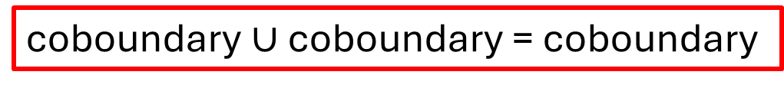

Cup product (simplexes)
$$∪:C^{p}×C^{q}→C^{p+q}$$
$$δ\left(5\right)=15+25+45+52+53+56$$
$$δ\left(5\right)∪δ\left(5\right)=152+253 \\ =δ\left(15+45+25\right)$$
Consider the toric code
1
2
3
1
4
4
5
6
coboundary $∪$ coboundary = coboundary
1
1
2
3

Slide 20

Cup product (simplexes)
$$∪:C^{p}×C^{q}→C^{p+q}$$
coboundary $∪$ coboundary = coboundary

Slide 21
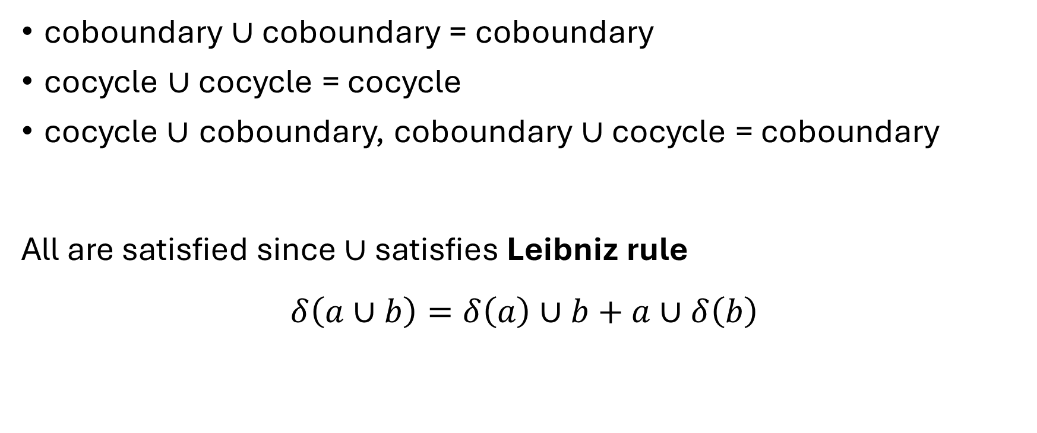
Cup product (simplexes)
$$∪:C^{p}×C^{q}→C^{p+q}$$
coboundary $∪$ coboundary = coboundary
cocycle $∪$ cocycle = cocycle
cocycle$∪$ coboundary, coboundary $∪$ cocycle = coboundary
All are satisfied since $∪$ satisfies Leibniz rule
$$δ\left(a∪b\right)=δ\left(a\right)∪b+a∪δ\left(b\right)$$

Slide 22
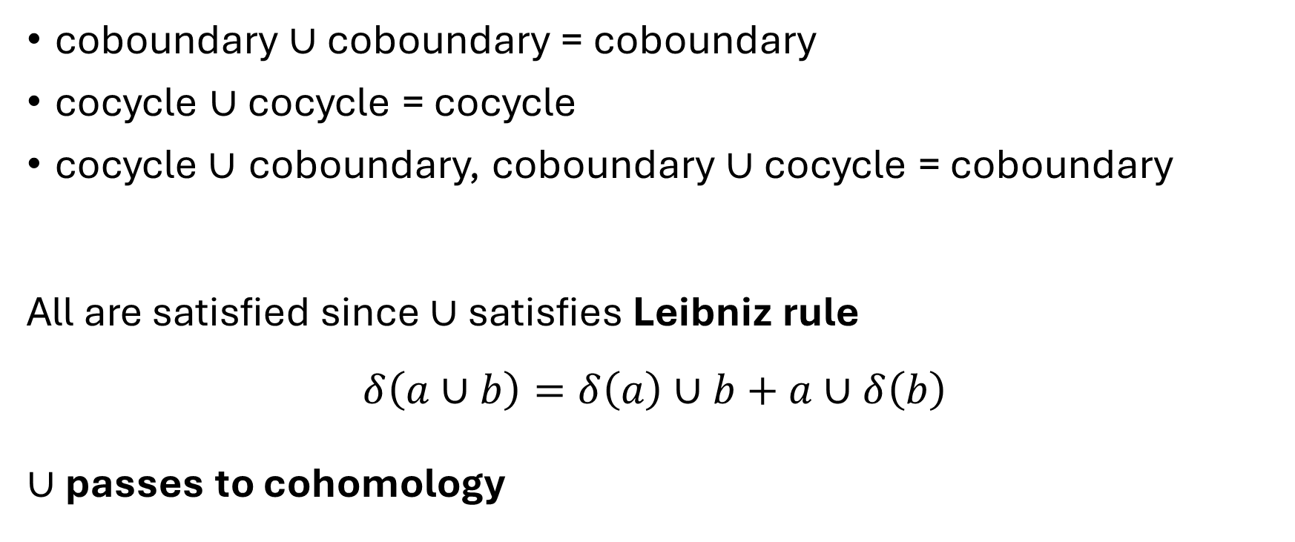
Cup product (simplexes)
$$∪:C^{p}×C^{q}→C^{p+q}$$
coboundary $∪$ coboundary = coboundary
cocycle $∪$ cocycle = cocycle
cocycle$∪$ coboundary, coboundary $∪$ cocycle = coboundary
All are satisfied since $∪$ satisfies Leibniz rule
$$δ\left(a∪b\right)=δ\left(a\right)∪b+a∪δ\left(b\right)$$
$∪$ passes to cohomology

Slide 23
Cup product (simplexes)
$$∪:H^{p}×H^{q}→H^{p+q}$$
coboundary $∪$ coboundary = coboundary
cocycle $∪$ cocycle = cocycle
cocycle$∪$ coboundary, coboundary $∪$ cocycle = coboundary
All are satisfied since $∪$ satisfies Leibniz rule
$$δ\left(a∪b\right)=δ\left(a\right)∪b+a∪δ\left(b\right)$$
$∪$ passes to cohomology

Slide 24



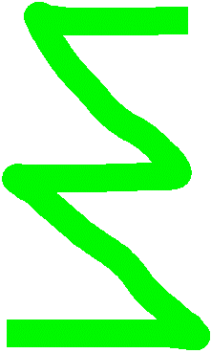


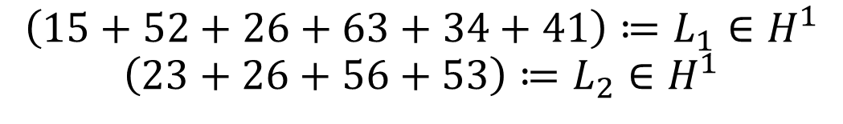
Cup product (simplexes)
$$∪:H^{p}×H^{q}→H^{p+q}$$
$$\left(15+52+26+63+34+41\right)≔L_{1}∈H^{1}$$
$$\left(23+26+56+53\right)≔L_{2}∈H^{1}$$
Consider the toric code
1
2
3
1
$$L_{1}$$
4
4
5
6
1
1
2
$$L_{2}$$
3

Slide 25


Cup product (simplexes)
$$∪:H^{p}×H^{q}→H^{p+q}$$
$$\left(15+52+26+63+34+41\right)≔L_{1}∈H^{1}$$
$$\left(23+26+56+53\right)≔L_{2}∈H^{1}$$
$$L_{1}∪L_{2}=[526]∈H^{2} \\ L_{2}∪L_{2}=0 \\ L_{1}∪L_{1}=415+152+526+634+341 \\ =δ\left(…\right)$$
Consider the toric code
1
2
3
1
$$L_{1}$$
4
4
5
6
1
1
2
$$L_{2}$$
3

Slide 26

Cup product (simplexes)
$$∪:H^{p}×H^{q}→H^{p+q}$$
$$\left(15+52+26+63+34+41\right)≔L_{1}∈H^{1}$$
$$\left(23+26+56+53\right)≔L_{2}∈H^{1}$$
$$L_{1}∪L_{2}=[526]∈H^{2} \\ L_{2}∪L_{2}=\left[0\right]∈H^{2} \\ L_{1}∪L_{1}=415+152+526+634+341 \\ =δ\left(…\right)$$
Consider the toric code
1
2
3
1
$$L_{1}$$
4
4
5
6
1
1
2
$$L_{2}$$
3

Slide 27
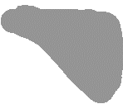

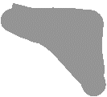




Cup product (simplexes)
$$∪:H^{p}×H^{q}→H^{p+q}$$
$$\left(15+52+26+63+34+41\right)≔L_{1}∈H^{1}$$
$$\left(23+26+56+53\right)≔L_{2}∈H^{1}$$
$$L_{1}∪L_{2}=[526]∈H^{2} \\ L_{2}∪L_{2}=\left[0\right]∈H^{2} \\ L_{1}∪L_{1}=415+152+526+634+341 \\ =δ\left(…\right)=\left[0\right]∈H^{2}$$
Consider the toric code
1
2
3
1
$$L_{1}$$
4
4
5
6
1
1
2
$$L_{2}$$
3

Slide 28

Cup product (simplexes)
$$∪:H^{p}×H^{q}→H^{p+q}$$
$$\left(15+52+26+63+34+41\right)≔L_{1}∈H^{1}$$
$$\left(23+26+56+53\right)≔L_{2}∈H^{1}$$
$$L_{1}∪L_{2}=[526]∈H^{2} \\ L_{2}∪L_{2}=\left[0\right]∈H^{2} \\ L_{1}∪L_{1}=415+152+526+634+341 \\ =δ\left(…\right)=\left[0\right]∈H^{2}$$
Cup product counts intersections
Consider the toric code
1
2
3
1
$$L_{1}$$
4
4
5
6
1
1
2
$$L_{2}$$
3

Slide 29
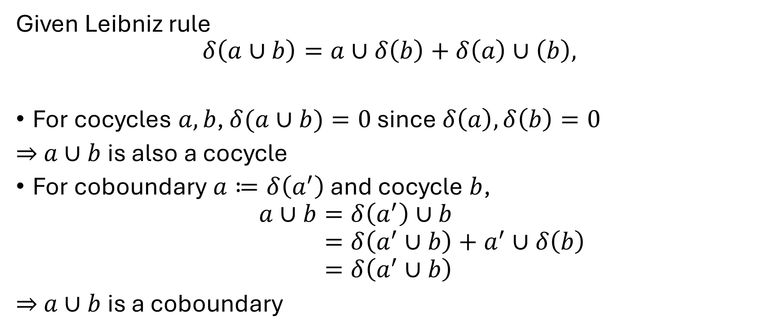
Cup product (simplexes)
$$∪:H^{p}×H^{q}→H^{p+q}$$
Given Leibniz rule
$$δ\left(a∪b\right)=a∪δ\left(b\right)+δ\left(a\right)∪\left(b\right),$$
For cocycles $a,b$, $δ(a∪b)=0$ since $δ\left(a\right),δ\left(b\right)=0$
$⇒$ $a∪b$ is also a cocycle
For coboundary $a≔δ\left(a^{′}\right)$ and cocycle $b$,
$$a∪b=δ\left(a^{′}\right)∪b \\ =δ\left(a^{′}∪b\right)+a^{′}∪δ\left(b\right) \\ =δ\left(a^{′}∪b\right)$$
$⇒$ $a∪b$ is a coboundary

Slide 30

Summary
Simplicial cup product obeys Leibniz rule $⇒$ passes to cohomology
$\left(H^{∗}\left(C\right),+\right)$ cohomology groups $⇒$ $\left(H^{∗}\left(C\right),+,∪\right)$ cohomology rings
Lets us ‘multiply’ cochains, invariant to coboundaries

Slide 31
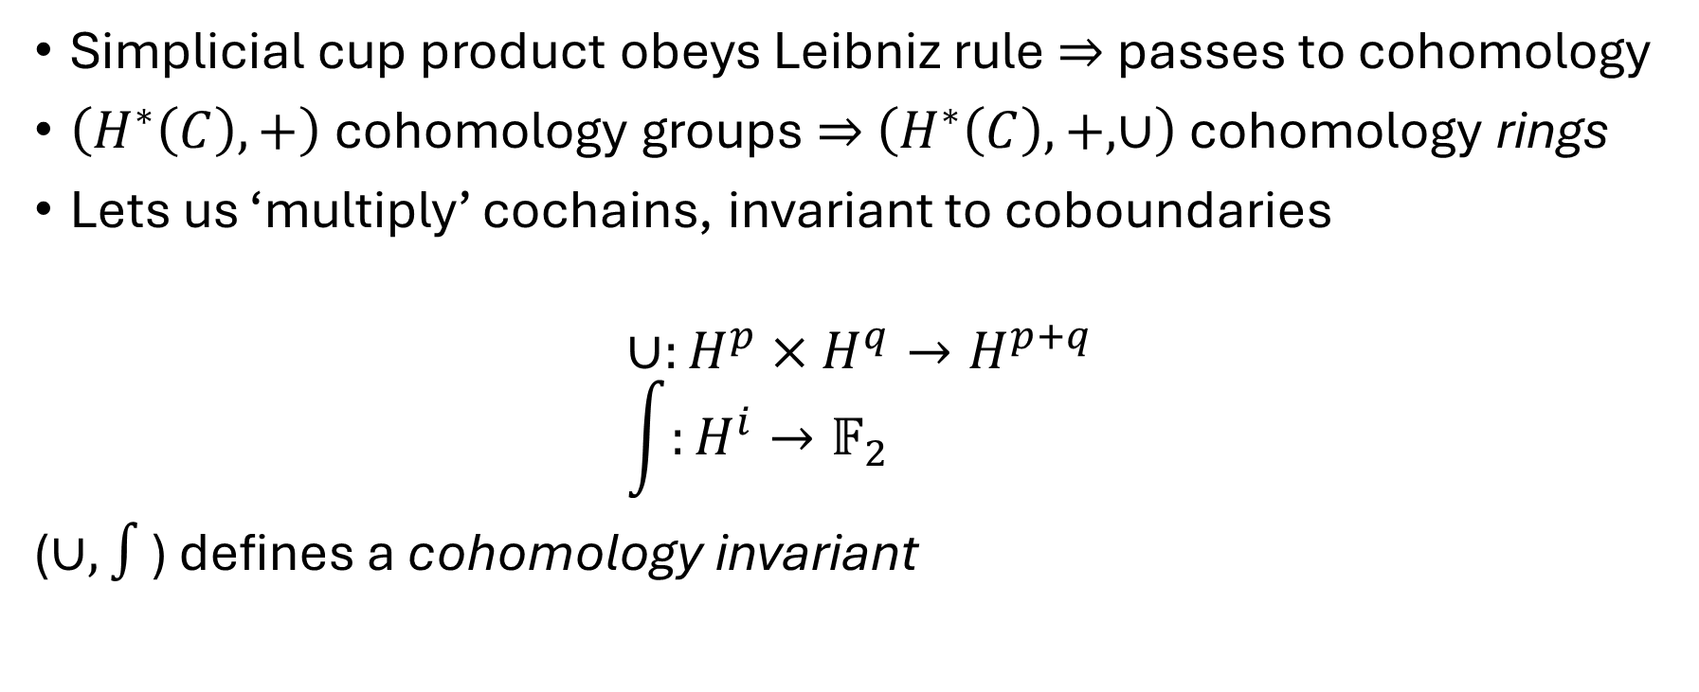
Summary
Simplicial cup product obeys Leibniz rule $⇒$ passes to cohomology
$\left(H^{∗}\left(C\right),+\right)$ cohomology groups $⇒$ $\left(H^{∗}\left(C\right),+,∪\right)$ cohomology rings
Lets us ‘multiply’ cochains, invariant to coboundaries
$$∪:H^{p}×H^{q}→H^{p+q} \\ \int{:H^{i}→𝔽_{2}}$$
($∪,∫$) defines a cohomology invariant

Slide 32
Cup products on classical codes
Cup products on simplicial complexes require oriented graphs

Slide 33
Cup products on classical codes
Cup products on simplicial complexes require oriented graphs

Slide 34


Cup products on classical codes
Cup products on simplicial complexes require oriented graphs
Classical codes: hypergraphs $C^{0}→C^{1}$
$$δ$$

Slide 35

Cup products on classical codes
Cup products on simplicial complexes require oriented graphs
Classical codes: hypergraphs $C^{0}→C^{1}$
$δ_{in},δ_{out},δ_{free}$
$$δ$$

Slide 36
Cup products on classical codes
Cup products on simplicial complexes require oriented graphs
Classical codes: hypergraphs $C^{0}→C^{1}$
$δ_{in},δ_{out},δ_{free}$
$$δ$$

Slide 37
Cup products on classical codes
Cup products on simplicial complexes require oriented graphs
Classical codes: hypergraphs $C^{0}→C^{1}$
$δ_{in},δ_{out},δ_{free}$
$$δ$$

Slide 38
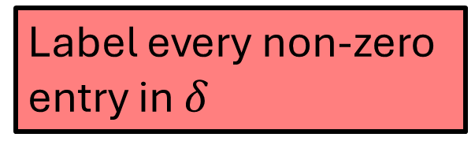
Cup products on classical codes
Cup products on simplicial complexes require oriented graphs
Classical codes: hypergraphs $C^{0}→C^{1}$
$δ_{in},δ_{out},δ_{free}$
$$δ$$
Label every non-zero entry in $δ$

Slide 39

Cup products on classical codes
Cup products on simplicial complexes require oriented graphs
Classical codes: hypergraphs $C^{0}→C^{1}$
$δ_{in},δ_{out},δ_{free}$
$$δ$$
Label every non-zero entry in $δ$

Slide 40



Cup products on classical codes
Cup products on simplicial complexes require oriented graphs
Classical codes: hypergraphs $C^{0}→C^{1}$
$δ_{in},δ_{out},δ_{free}$
$v_{0}∪e_{1}=e_{1}$ if $e_{1}∈δ_{out}\left(v_{0}\right)$
$$δ$$
Label every non-zero entry in $δ$

Slide 41

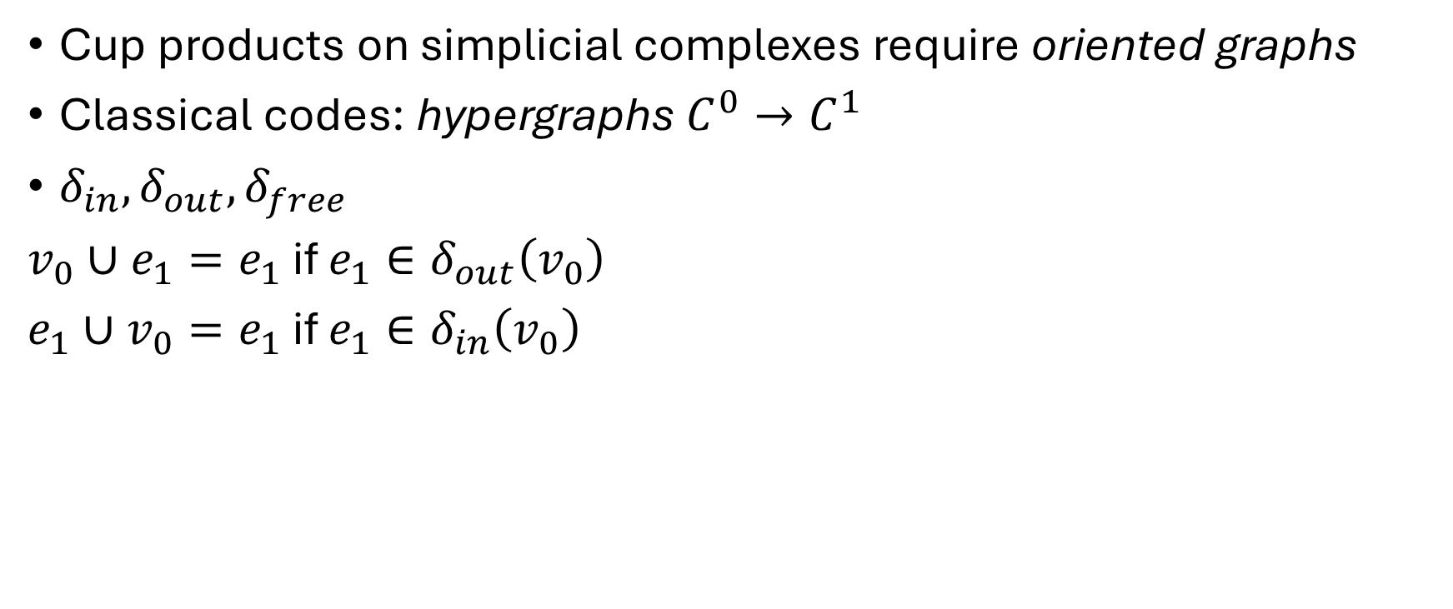


Cup products on classical codes
Cup products on simplicial complexes require oriented graphs
Classical codes: hypergraphs $C^{0}→C^{1}$
$δ_{in},δ_{out},δ_{free}$
$v_{0}∪e_{1}=e_{1}$ if $e_{1}∈δ_{out}\left(v_{0}\right)$
$e_{1}∪v_{0}=e_{1}$ if $e_{1}∈δ_{in}\left(v_{0}\right)$
$$δ$$
Label every non-zero entry in $δ$

Slide 42
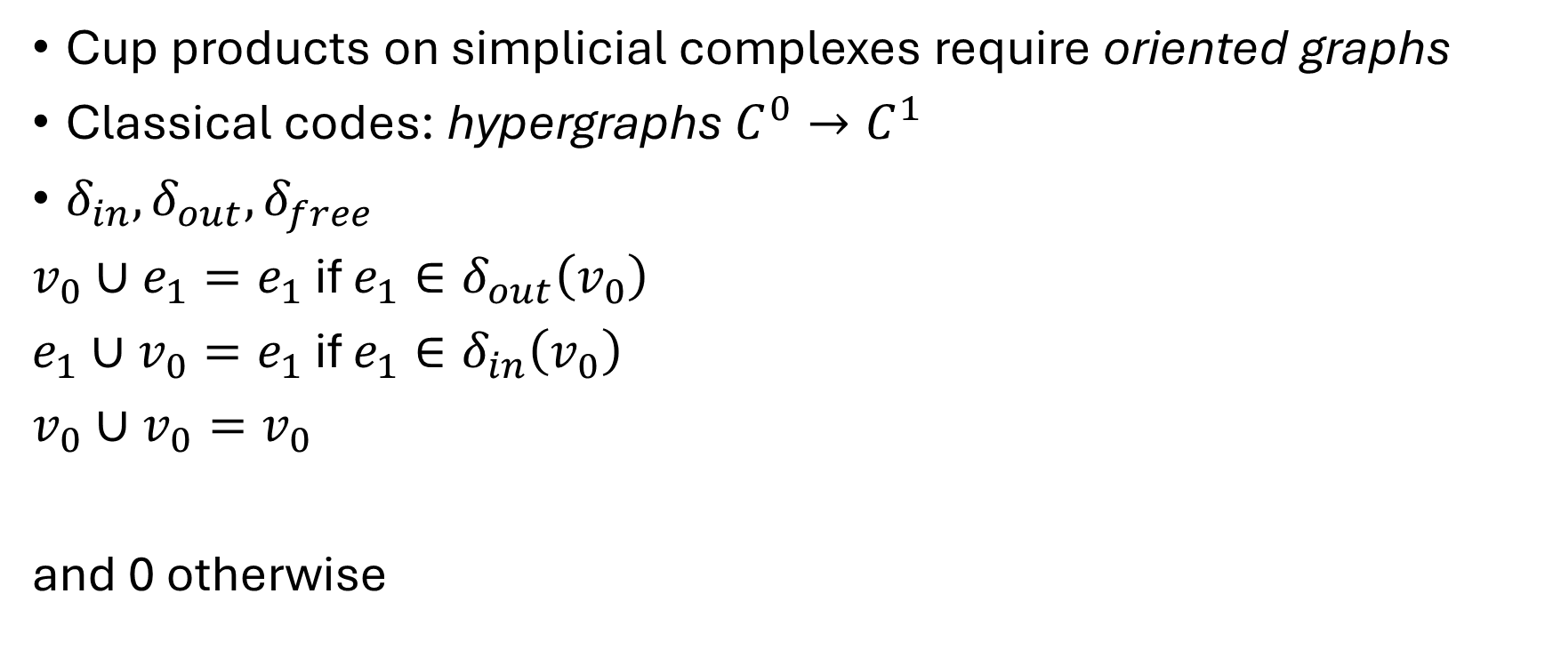

Cup products on classical codes
Cup products on simplicial complexes require oriented graphs
Classical codes: hypergraphs $C^{0}→C^{1}$
$δ_{in},δ_{out},δ_{free}$
$v_{0}∪e_{1}=e_{1}$ if $e_{1}∈δ_{out}\left(v_{0}\right)$
$e_{1}∪v_{0}=e_{1}$ if $e_{1}∈δ_{in}\left(v_{0}\right)$
$v_{0}∪v_{0}=v_{0}$
and 0 otherwise
$$δ$$
Label every non-zero entry in $δ$

Slide 43
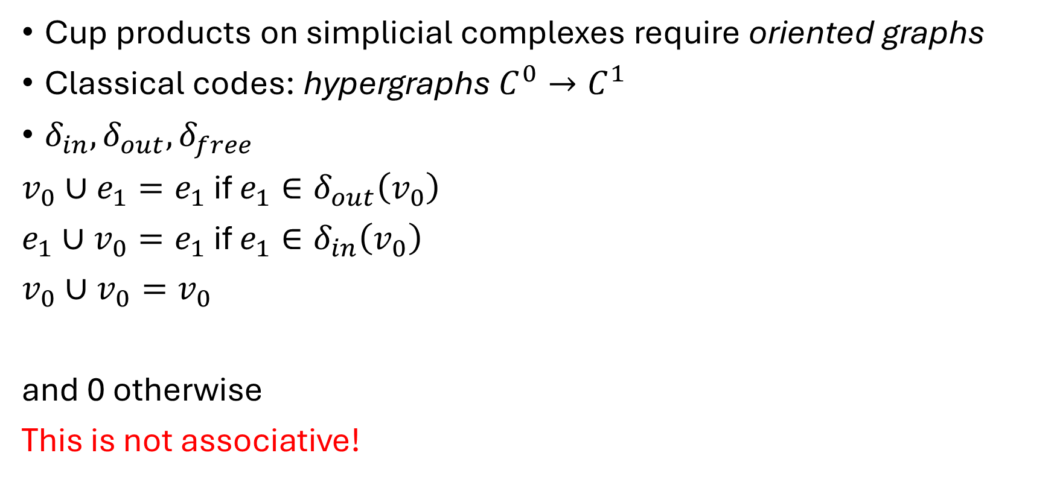
Cup products on classical codes
Cup products on simplicial complexes require oriented graphs
Classical codes: hypergraphs $C^{0}→C^{1}$
$δ_{in},δ_{out},δ_{free}$
$v_{0}∪e_{1}=e_{1}$ if $e_{1}∈δ_{out}\left(v_{0}\right)$
$e_{1}∪v_{0}=e_{1}$ if $e_{1}∈δ_{in}\left(v_{0}\right)$
$v_{0}∪v_{0}=v_{0}$
and 0 otherwise
This is not associative!
$$δ$$
Label every non-zero entry in $δ$

Slide 44

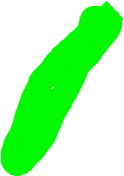



Cup products on classical codes
Cup products on simplicial complexes require oriented graphs
Classical codes: hypergraphs $C^{0}→C^{1}$
$δ_{in},δ_{out},δ_{free}$
$v_{0}∪e_{1}=e_{1}$ if $e_{1}∈δ_{out}\left(v_{0}\right)$
$e_{1}∪v_{0}=e_{1}$ if $e_{1}∈δ_{in}\left(v_{0}\right)$
$v_{0}∪v_{0}=v_{0}$
and 0 otherwise
This is not associative!
$$δ$$
Label every non-zero entry in $δ$
$$c^{0}$$
$$b^{1}$$
$$a^{0}$$

Slide 45
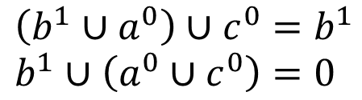
Cup products on classical codes
Cup products on simplicial complexes require oriented graphs
Classical codes: hypergraphs $C^{0}→C^{1}$
$δ_{in},δ_{out},δ_{free}$
$v_{0}∪e_{1}=e_{1}$ if $e_{1}∈δ_{out}\left(v_{0}\right)$
$e_{1}∪v_{0}=e_{1}$ if $e_{1}∈δ_{in}\left(v_{0}\right)$
$v_{0}∪v_{0}=v_{0}$
and 0 otherwise
This is not associative!
$$δ$$
Label every non-zero entry in $δ$
$$c^{0}$$
$$b^{1}$$
$$\left(b^{1}∪a^{0}\right)∪c^{0}=b^{1} \\ b^{1}∪\left(a^{0}∪c^{0}\right)=0$$
$$a^{0}$$

Slide 46
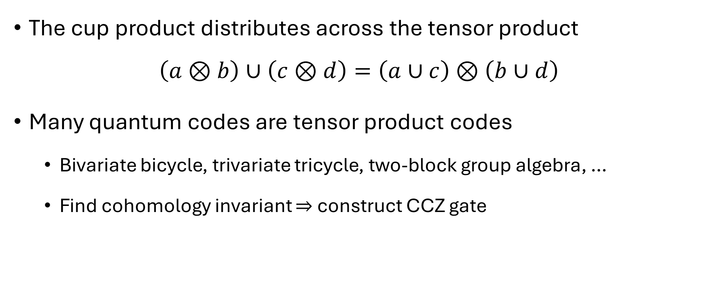
Cup products on tensor products
The cup product distributes across the tensor product
$$\left(a⊗b\right)∪\left(c⊗d\right)=\left(a∪c\right)⊗\left(b∪d\right)$$
Many quantum codes are tensor product codes
  Bivariate bicycle, trivariate tricycle, two-block group algebra, …
  Find cohomology invariant $⇒$ construct CCZ gate

Slide 47
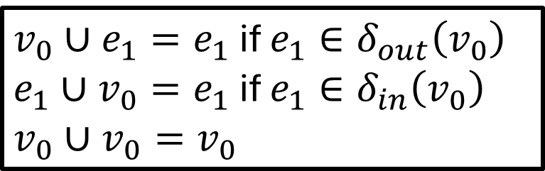
Cup products on tensor products
$v_{0}∪e_{1}=e_{1}$ if $e_{1}∈δ_{out}\left(v_{0}\right)$
$e_{1}∪v_{0}=e_{1}$ if $e_{1}∈δ_{in}\left(v_{0}\right)$
$v_{0}∪v_{0}=v_{0}$
Consider the toric code

Slide 48

Cup products on tensor products
$v_{0}∪e_{1}=e_{1}$ if $e_{1}∈δ_{out}\left(v_{0}\right)$
$e_{1}∪v_{0}=e_{1}$ if $e_{1}∈δ_{in}\left(v_{0}\right)$
$v_{0}∪v_{0}=v_{0}$
Consider the toric code
$$×$$

Slide 49
Cup products on tensor products
$v_{0}∪e_{1}=e_{1}$ if $e_{1}∈δ_{out}\left(v_{0}\right)$
$e_{1}∪v_{0}=e_{1}$ if $e_{1}∈δ_{in}\left(v_{0}\right)$
$v_{0}∪v_{0}=v_{0}$
Consider the toric code
$$×$$

Slide 50
Cup products on tensor products
$v_{0}∪e_{1}=e_{1}$ if $e_{1}∈δ_{out}\left(v_{0}\right)$
$e_{1}∪v_{0}=e_{1}$ if $e_{1}∈δ_{in}\left(v_{0}\right)$
$v_{0}∪v_{0}=v_{0}$
Consider the toric code
$$×$$

Slide 51
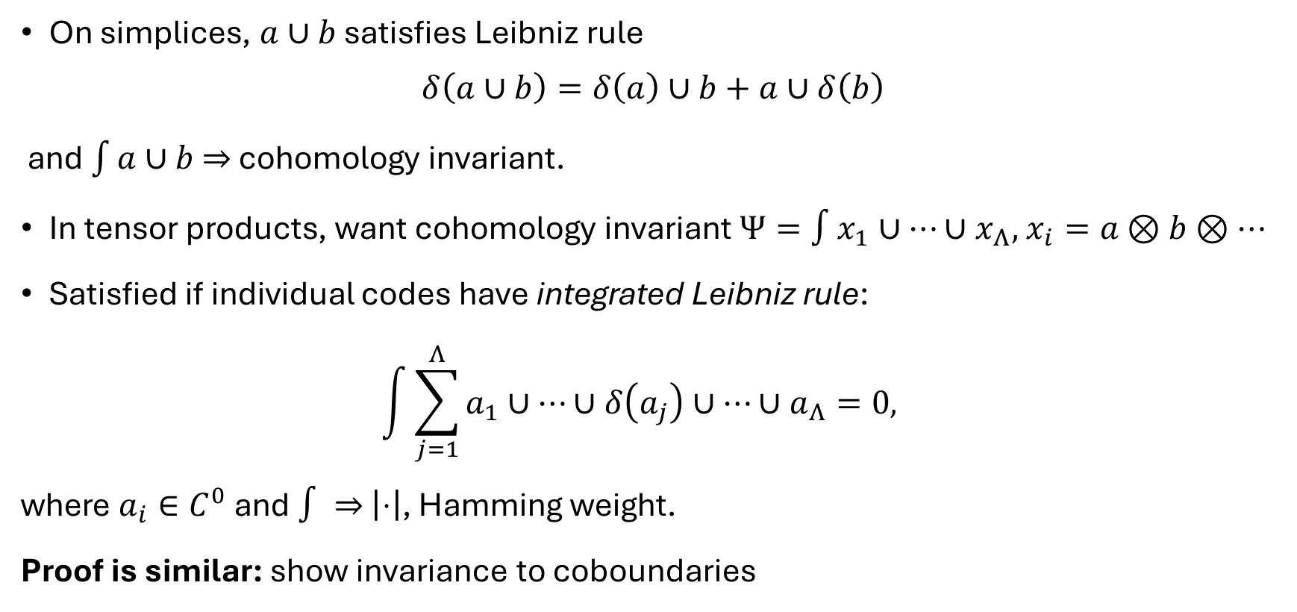
Cohomology invariants on tensor products
On simplices, $a∪b$ satisfies Leibniz rule
$$δ\left(a∪b\right)=δ\left(a\right)∪b+a∪δ\left(b\right)$$
and $\int{a∪b}$ $⇒$ cohomology invariant.
In tensor products, want cohomology invariant $Ψ=∫x_{1}∪⋯∪x_{Λ},$ $x_{i}=a⊗b⊗⋯$
Satisfied if individual codes have integrated Leibniz rule:
$\int{\sum_{j=1}^{Λ}{a_{1}∪⋯∪δ\left(a_{j}\right)∪⋯∪a_{Λ}}}=0,$
where $a_{i}∈C^{0}$ and $∫⇒$ $\left|⋅\right|$, Hamming weight.
Proof is similar: show invariance to coboundaries

Slide 52
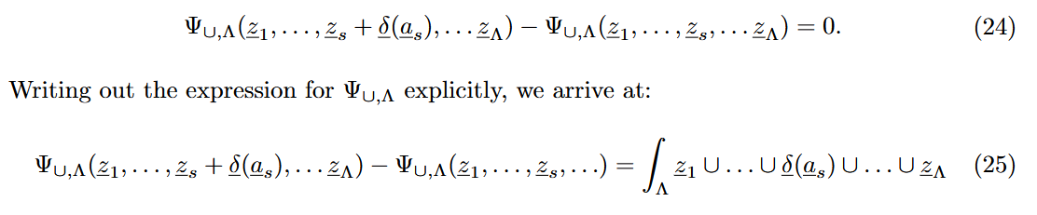
Cohomology invariants on tensor products
On simplices, $a∪b$ satisfies Leibniz rule
$$δ\left(a∪b\right)=δ\left(a\right)∪b+a∪δ\left(b\right)$$
and $\int{a∪b}$ $⇒$ cohomology invariant.
In tensor products, want cohomology invariant $Ψ=∫x_{1}∪⋯∪x_{Λ},$ $x_{i}=a⊗b⊗⋯$
Satisfied if individual codes have integrated Leibniz rule:
$\int{\sum_{j=1}^{Λ}{a_{1}∪⋯∪δ\left(a_{j}\right)∪⋯∪a_{Λ}}}=0,$
where $a_{i}∈C^{0}$ and $∫⇒$ $\left|⋅\right|$, Hamming weight.
Proof is similar: show invariance to coboundaries

Slide 53
Cup product (simplexes)
$$∪:H^{p}×H^{q}→H^{p+q}$$
Given Leibniz rule
$$δ\left(a∪b\right)=a∪δ\left(b\right)+δ\left(a\right)∪\left(b\right),$$
For cocycles $a,b$, $δ(a∪b)=0$ since $δ\left(a\right),δ\left(b\right)=0$
$⇒$ $a∪b$ is also a cocycle
For coboundary $a≔δ\left(a^{′}\right)$ and cocycle $b$,
$$a∪b=δ\left(a^{′}\right)∪b \\ =δ\left(a^{′}∪b\right)+a^{′}∪δ\left(b\right) \\ =δ\left(a^{′}∪b\right)$$
$⇒$ $a∪b$ is a coboundary

Slide 54

Cohomology invariants on tensor products
On simplices, $a∪b$ satisfies Leibniz rule
$$δ\left(a∪b\right)=δ\left(a\right)∪b+a∪δ\left(b\right)$$
Satisfied if individual codes have integrated Leibniz rule:
$$\int{\sum_{j=1}^{Λ}{a_{1}∪⋯∪δ\left(a_{j}\right)∪⋯∪a_{Λ}}}=0,$$

Slide 55
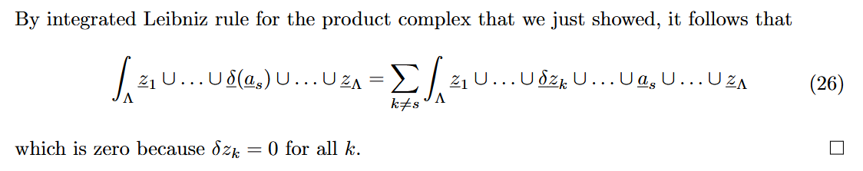

Cohomology invariants on tensor products
On simplices, $a∪b$ satisfies Leibniz rule
$$δ\left(a∪b\right)=δ\left(a\right)∪b+a∪δ\left(b\right)$$
Satisfied if individual codes have integrated Leibniz rule:
$$\int{\sum_{j=1}^{Λ}{a_{1}∪⋯∪δ\left(a_{j}\right)∪⋯∪a_{Λ}}}=0,$$
where $a_{i}∈C^{0}$ and $∫⇒$ $\left|⋅\right|$, Hamming weight.
Proof is similar: show invariance to coboundaries

Slide 56
Summary
We want cohomology invariants
  Cohomology invariants $⇒$ CCZ
Cup products are one solution.

