Slide 1
Quantum thermal metastability under an error-correction lens
Thiago Bergamaschi – UC Berkeley / Google
Fault-tolerant quantum technologies @ Benasque August 2026
Based on joint work with Chi-Fang Chen and Umesh Vazirani, 2510.08538

Slide 2
Very brief outline for today
1. Local Hamiltonians and their thermal (Gibbs) states
2. (Quantum) Markov chain Monte Carlo algorithms for simulating thermal physics
3. Where, and why there are reasonable candidates for quantum speedups
4. What happens when these algorithms don’t converge quickly in the worst-case?

Slide 3
Classical and Quantum Gibbs States
Local Hamiltonians are an abstraction of how physical systems of particles interact.

Slide 4
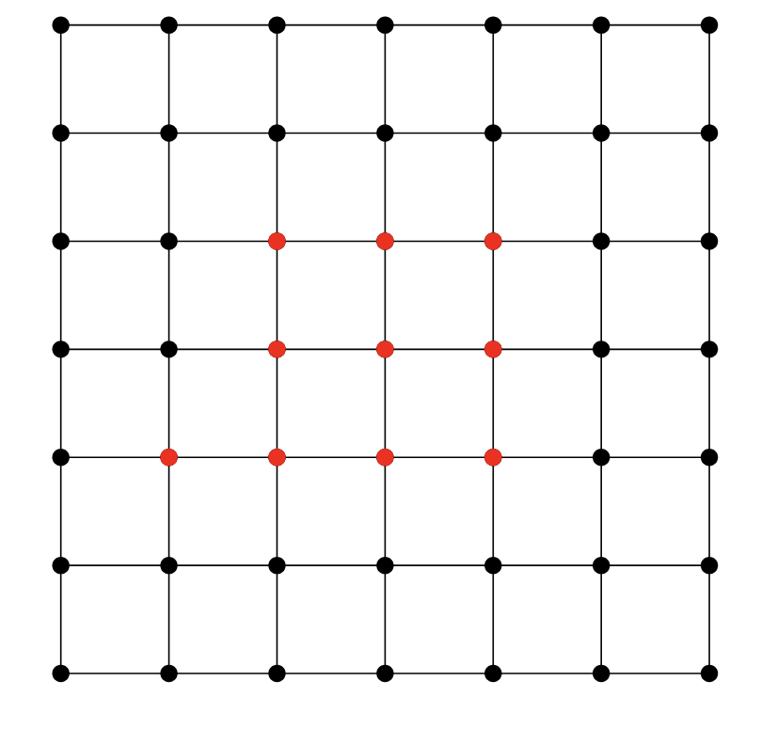
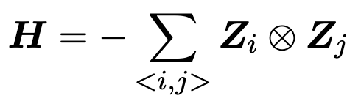
Classical and Quantum Gibbs States
Local Hamiltonians are an abstraction of how physical systems of particles interact.
The Ising Ferromagnet

Slide 5
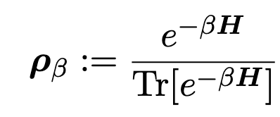
Classical and Quantum Gibbs States
Fixed a Hamiltonian H on n qubits, the associated Gibbs state at inverse-temperature $β=T^{−1}$ is
Gibbs states appear everywhere in physics, optimization and inference!

Slide 6
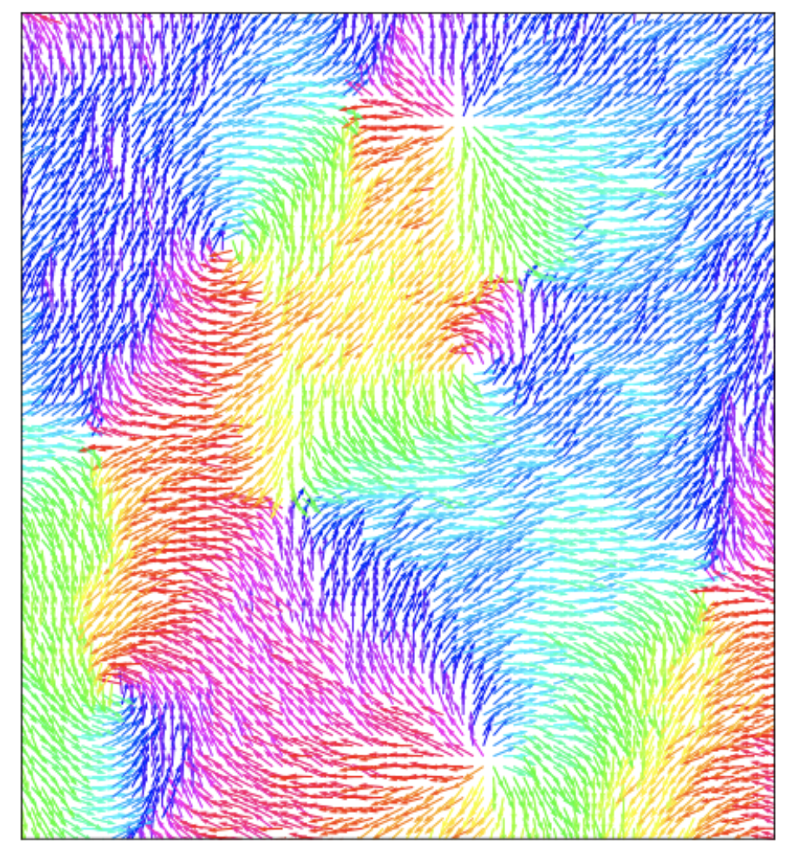
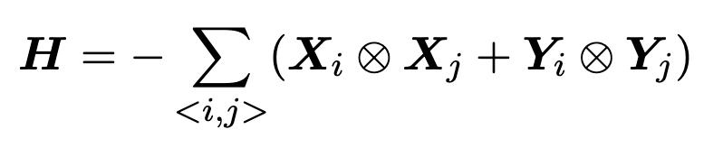
Classical and Quantum Gibbs States
Fixed a Hamiltonian H on n qubits, the associated Gibbs state at inverse-temperature $β$ is
Even without addressing how the system reaches equilibrium, studying Gibbs states has been remarkably explanatory, from magnetism [Isi25, Ons44] to superconductivity [BCS57, KT73]

Slide 7
Quantum systems, at high temperatures, are fundamentally classical

Slide 8
Quantum systems, at high temperatures, are fundamentally classical
The entanglement, and uniquely quantum correlations which could make simulation challenging,
entirely dissipate in this regime [YL23, BLMT24].
Bakshi et al. “High-Temperature Gibbs States are Unentangled and Efficiently Preparable.” (2024)

Slide 9

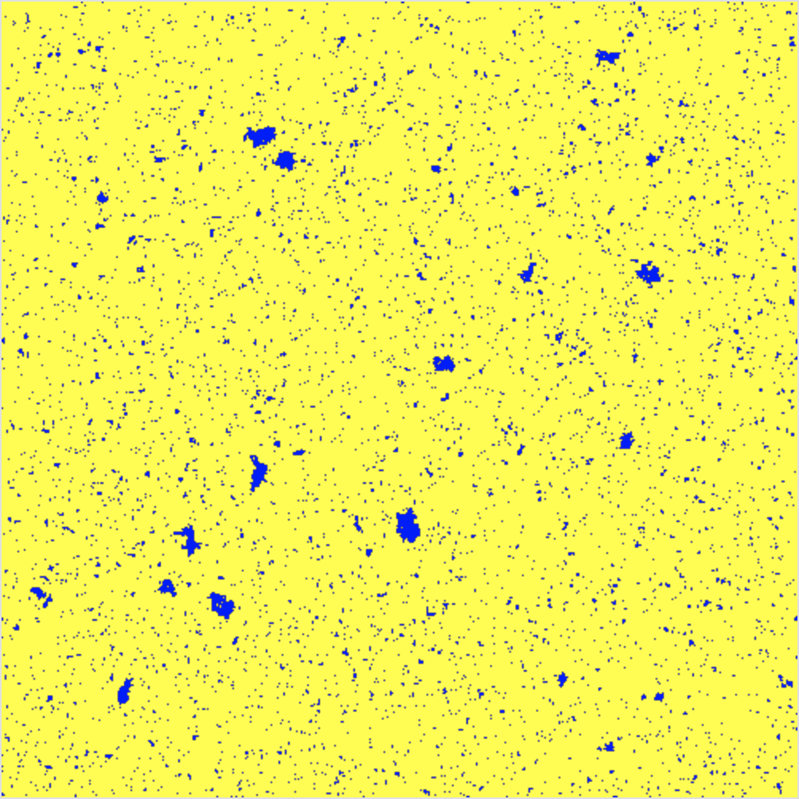


Quantum systems, at high temperatures, are fundamentally classical
The entanglement, and uniquely quantum correlations which could make simulation challenging,
entirely dissipate in this regime [YL23, BLMT24].
$$β$$
$$T$$
Bakshi et al. “High-Temperature Gibbs States are Unentangled and Efficiently Preparable.” (2024)

Slide 10
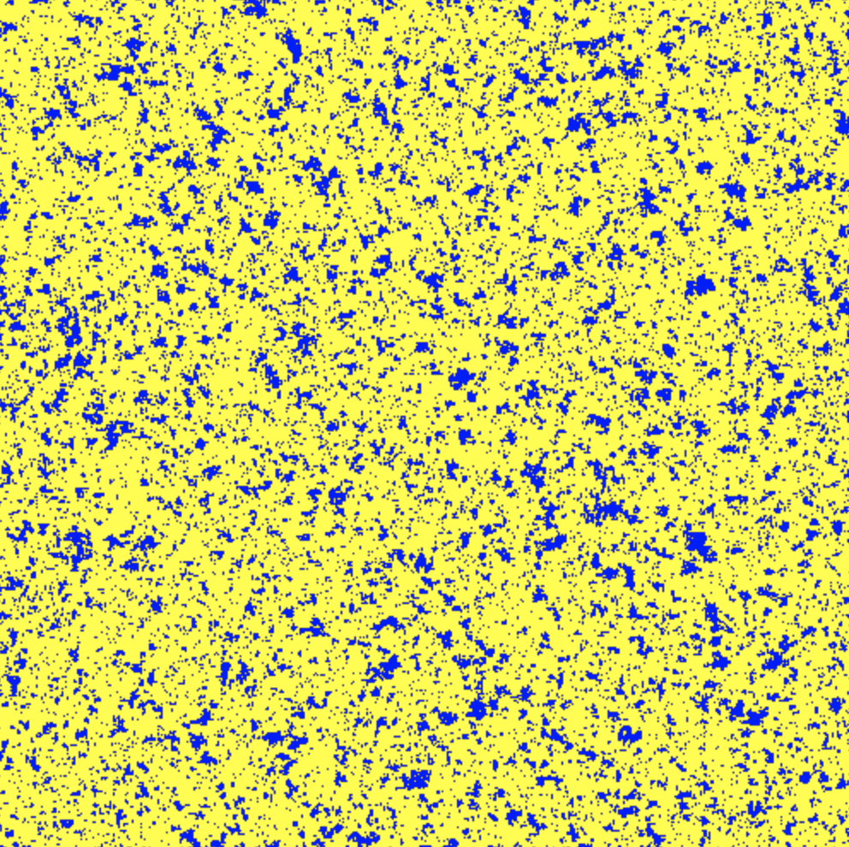
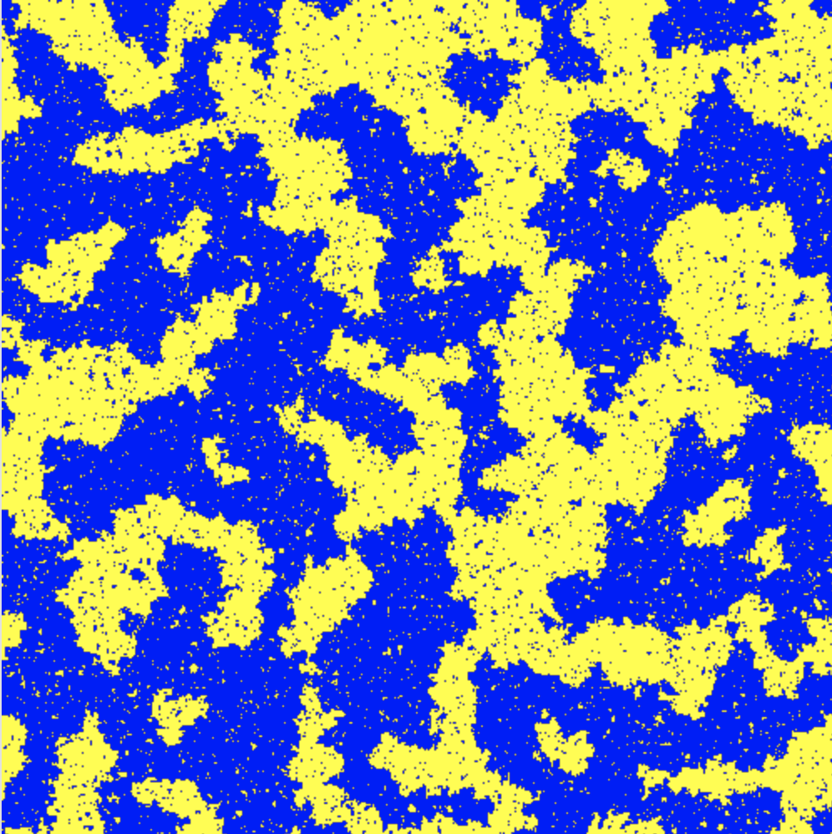
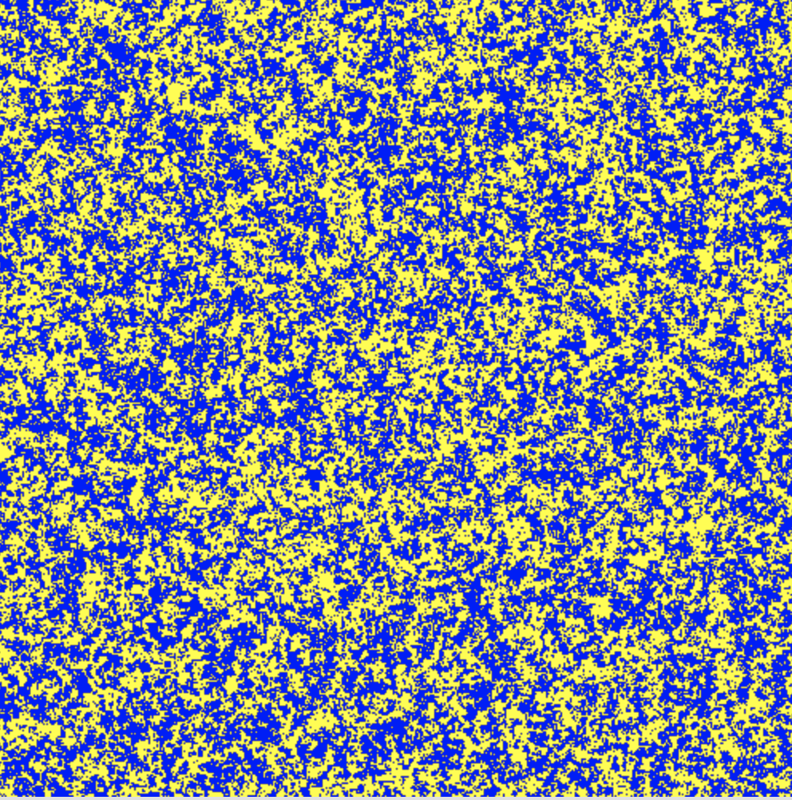
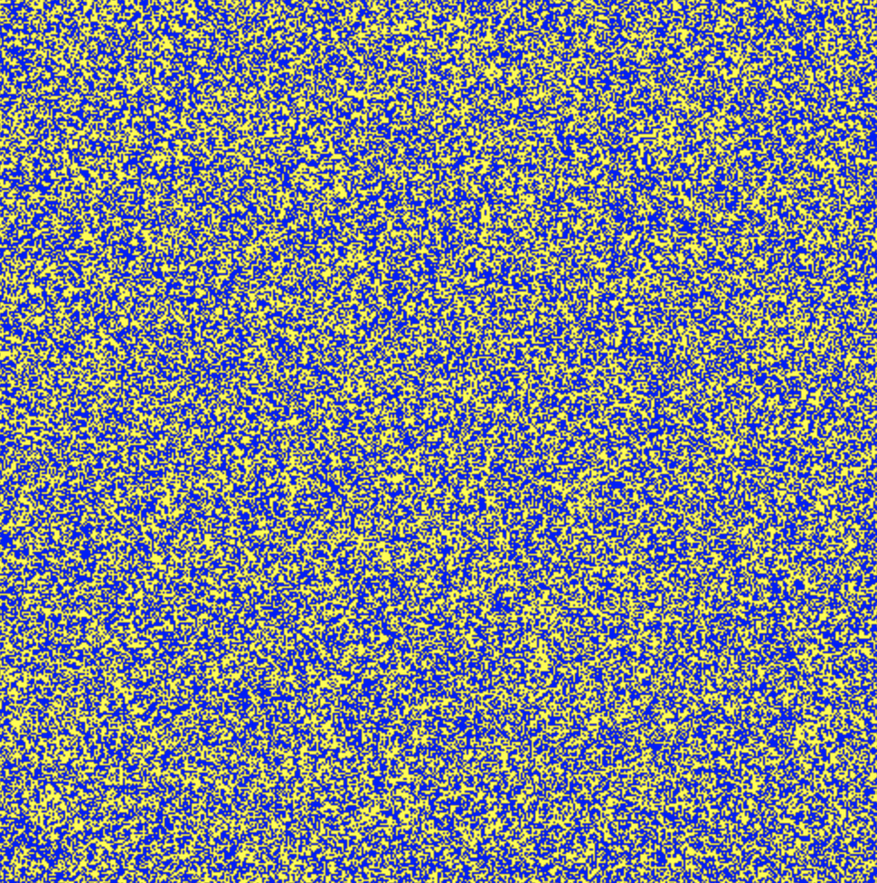
Quantum systems, at high temperatures, are fundamentally classical
The entanglement, and uniquely quantum correlations which could make simulation challenging,
entirely dissipate in this regime [YL23, BLMT24].
$$β$$
$$T$$
Bakshi et al. “High-Temperature Gibbs States are Unentangled and Efficiently Preparable.” (2024)

Slide 11
Quantum systems, at high temperatures, are fundamentally classical
The entanglement, and uniquely quantum correlations which could make simulation challenging,
entirely dissipate in this regime [YL23, BLMT24].
$$β$$
$$T$$
This places much of the meaningful quantum-algorithmic interest, in the low temperature regime.
Bakshi et al. “High-Temperature Gibbs States are Unentangled and Efficiently Preparable.” (2024)

Slide 12
There still lies challenges, and opportunities for quantum computers
The physics of cold and dense, strongly interacting matter can be computationally intractable to probe.

Slide 13
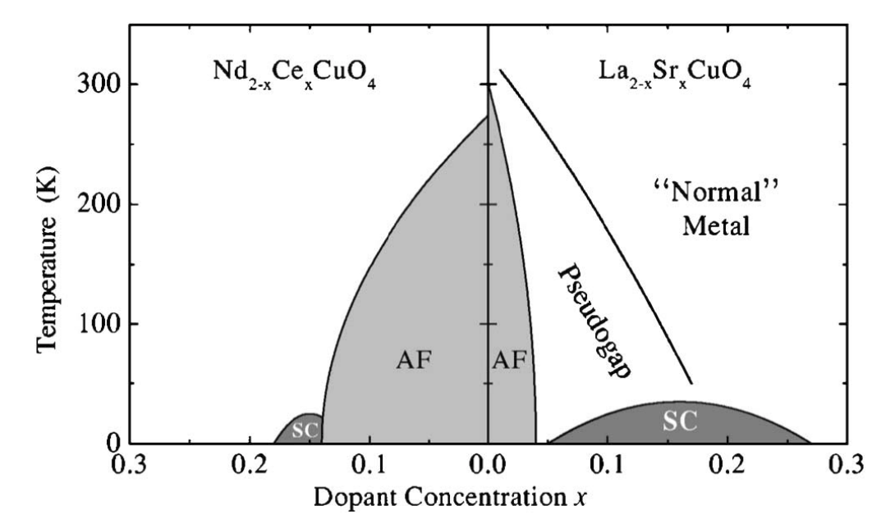
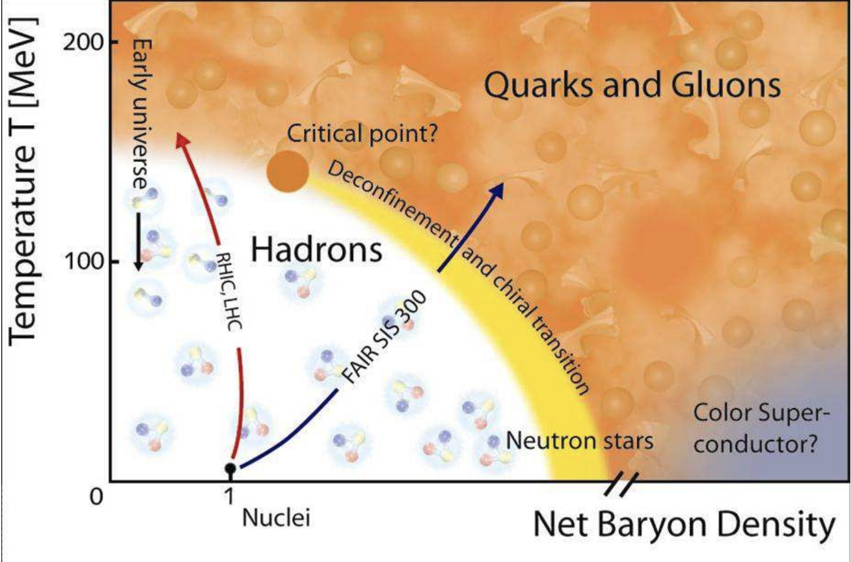
There still lies challenges, and opportunities for quantum computers
The physics of cold and dense, strongly interacting matter can be computationally intractable to probe.
Lee et al. “Doping a Mott insulator: Physics of high-temperature superconductivity” (2006)
Gert Aarts. “Introductory lectures on lattice QCD at nonzero baryon number” (2015)

Slide 14
There still lies challenges, and opportunities for quantum computers
The physics of cold and dense, strongly interacting matter can be computationally intractable to probe.
At least NP hard, by the hardness of approximate counting [Sly10, SS12]

Slide 15
Very brief outline for today
1. Local Hamiltonians and their thermal (Gibbs) states
2. (Quantum) Markov chain Monte Carlo algorithms for simulating thermal physics
3. Where, and why there are reasonable candidates for quantum speedups
4. What happens when these algorithms don’t converge quickly in the worst-case?

Slide 16
Quantum Markov chain Monte Carlo methods
The design and analysis of (recently proposed) quantum algorithms to simulate thermal physics [CKG23].

Slide 17
Quantum Markov chain Monte Carlo methods
The design and analysis of (recently proposed) quantum algorithms to simulate thermal physics [CKG23].
Akin to classical Markov Chain Monte Carlo methods, they are (quasi-)local, and detailed-balanced.
See also [Tem+11; RWW23; CKG23; Che+25a; DLL25; Gil+24; JI24]

Slide 18
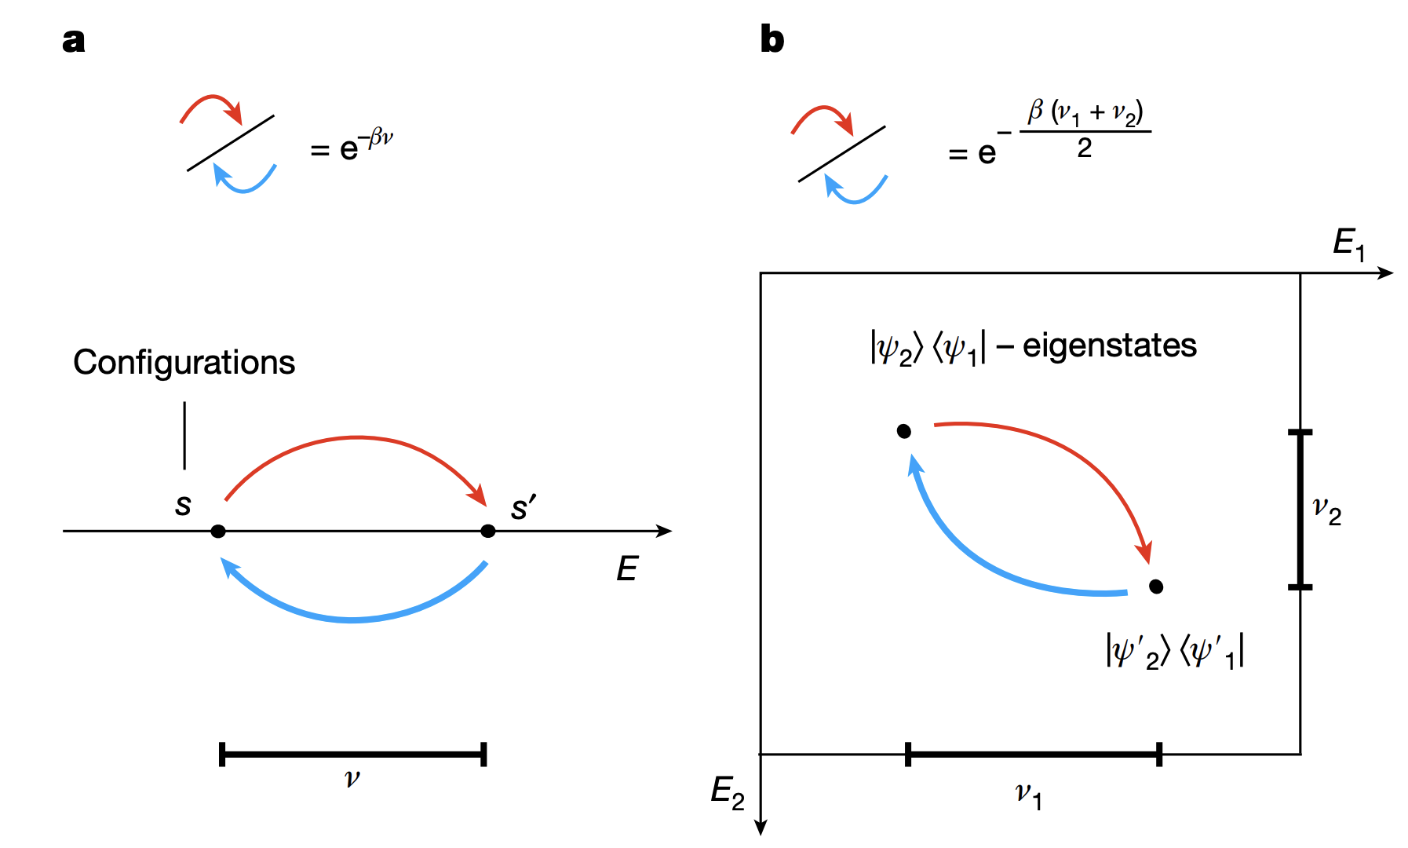
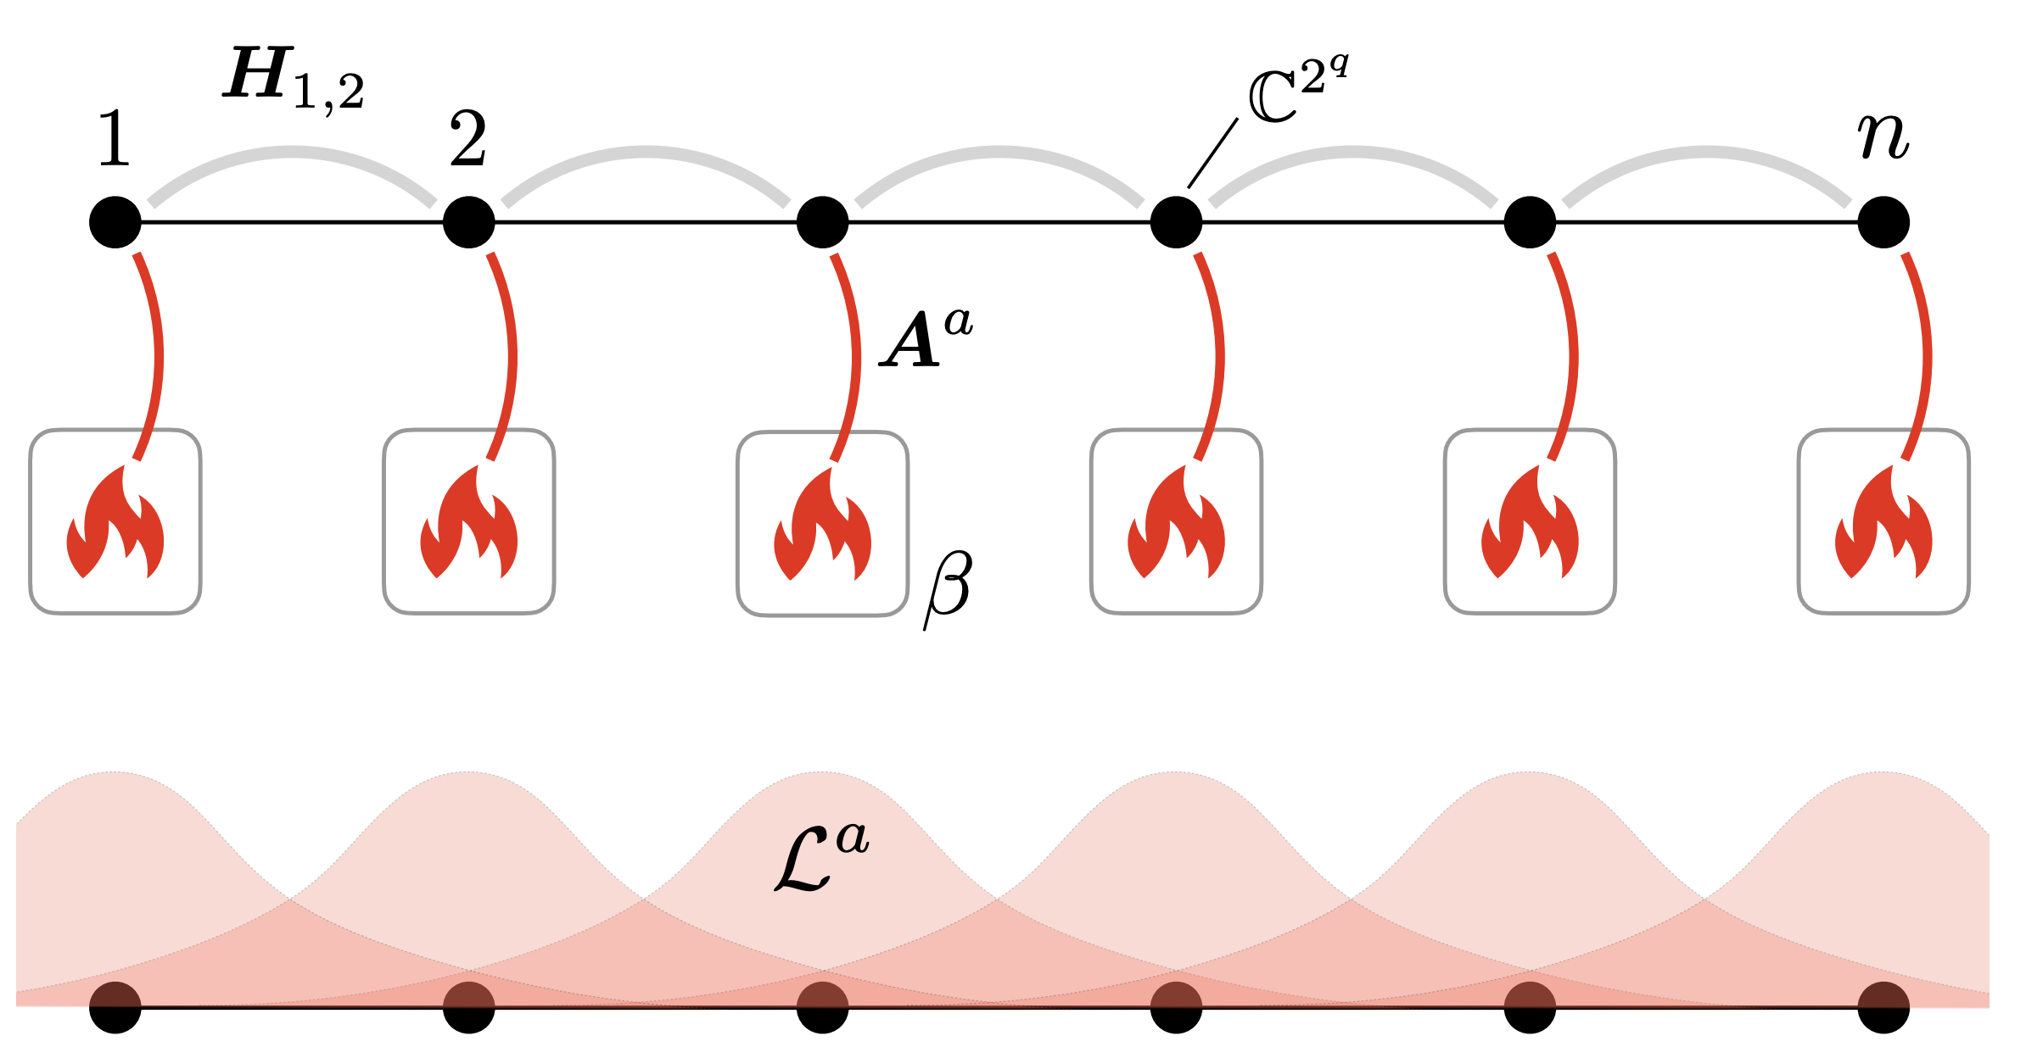
Quantum Markov chain Monte Carlo methods
The design and analysis of (recently proposed) quantum algorithms to simulate thermal physics [CKG23].
Akin to classical Markov Chain Monte Carlo methods, they are (quasi-)local, and detailed-balanced.

Slide 19



A quick classical example: Glauber dynamics
The algorithm. Pick a random bit, and flip it with some probability

Slide 20
A quick classical example: Glauber dynamics
The algorithm. Pick a random bit, and flip it with some probability
In this language, a self-correcting memory is nothing more than a Markov chain that does not converge quickly

Slide 21
Quantum Markov chain Monte Carlo methods
The design and analysis of (recently proposed) quantum algorithms to simulate thermal physics [CKG23].
Akin to classical Markov Chain Monte Carlo methods, they are (quasi-)local, and detailed-balanced.

Slide 22
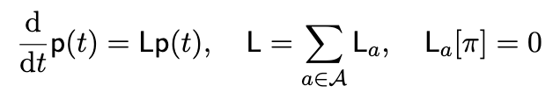
Quantum Markov chain Monte Carlo methods
The design and analysis of (recently proposed) quantum algorithms to simulate thermal physics [CKG23].
Akin to classical Markov Chain Monte Carlo methods, they are (quasi-)local, and detailed-balanced.
(Classical)

Slide 23
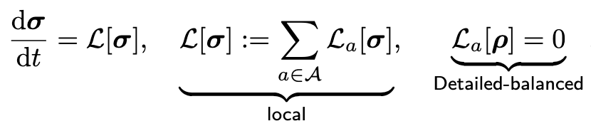
Quantum Markov chain Monte Carlo methods
The design and analysis of (recently proposed) quantum algorithms to simulate thermal physics [CKG23].
Akin to classical Markov Chain Monte Carlo methods, they are (quasi-)local, and detailed-balanced.
(Classical)
(Quantum)

Slide 24
Quantum Markov chain Monte Carlo methods
The dynamics is modeled as a continuous-time quantum Markov semigroup
Where the “updates” are time-evolved local operators:

Slide 25
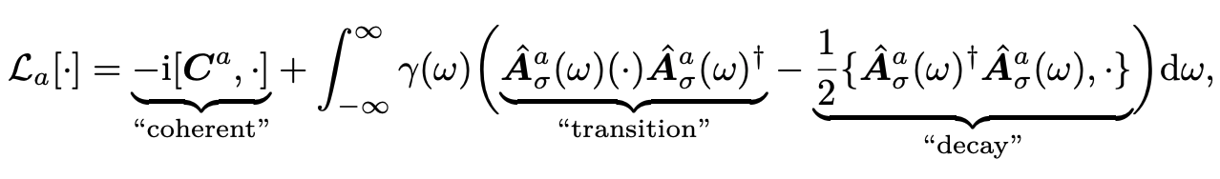

Quantum Markov chain Monte Carlo methods
The dynamics is modeled as a continuous-time quantum Markov semigroup
Where the “updates” are time-evolved local operators:
😱🫣

Slide 26


Quantum Markov chain Monte Carlo methods
The dynamics is modeled as a continuous-time quantum Markov semigroup
Goals sample from , and compute expectation values .
Question lies in the rate of convergence to the fixed point.

Slide 27
Quantum Markov chain Monte Carlo methods
The dynamics is modeled as a continuous-time quantum Markov semigroup
Goals sample from , and compute expectation values .
Question lies in the rate of convergence to the fixed point. Often quantified using spectral gaps.

Slide 28
Quantum Markov chain Monte Carlo methods
The dynamics is modeled as a continuous-time quantum Markov semigroup
Goals sample from , and compute expectation values .
Question lies in the rate of convergence to the fixed point. Often quantified using spectral gaps.
These algorithms are most efficient when the gap is constant, referred to as fast-mixing.

Slide 29
Quantum Markov chain Monte Carlo methods
The dynamics is modeled as a continuous-time quantum Markov semigroup
Goals sample from , and compute expectation values .
Question lies in the rate of convergence to the fixed point. Often quantified using spectral gaps.
[KB16; BCL+21; BCG+24; CRF21; KACR25; CGKR25; RFA25+26; BLMT25; TZ25; SMBB25+26; BT26 …]

Slide 30
Very brief outline for today
1. Local Hamiltonians and their thermal (Gibbs) states
2. (Quantum) Markov chain Monte Carlo algorithms for simulating thermal physics
3. Where, and why there are reasonable candidates for quantum speedups
4. What happens when these algorithms don’t converge quickly in the worst-case?

Slide 31
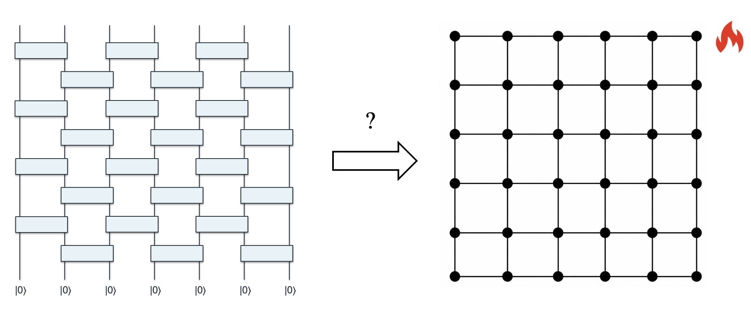
Where, and why these are candidates for quantum speedups
BQP completeness at finite temperatures?
Aharonov, Arad, Vidick. “The Quantum PCP Conjecture” (2013)
Anshu, Breuckmann, Nguyen. “Circuit-to-Hamiltonian from tensor networks and fault tolerance” (2023)

Slide 32
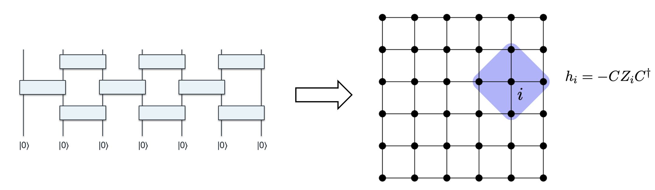
Where, and why these are candidates for quantum speedups
BQP completeness at finite temperatures?
As hard as random circuit sampling [BCL24]
B, Chen, Liu. “Quantum computational advantage with constant-temperature Gibbs sampling” (2024)
Rajakumar and Watson. “Gibbs Sampling gives Quantum Advantage at Constant Temperatures with O(1)-Local Hamiltonians” (2024)

Slide 34
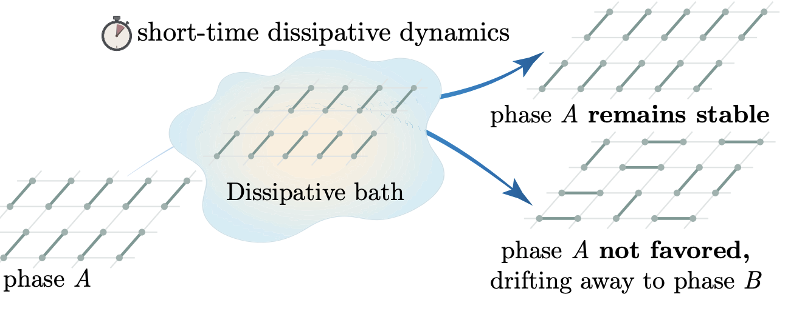
Where, and why these are candidates for quantum speedups
BQP completeness at finite temperatures?
As hard as random circuit sampling [BCL24]
Applications: dynamics + classifying phases
Li, Yang, Lin. “Dissipative phase decision without ground-state preparation” (2026)
Lin Lin. “Dissipative Preparation of Many-Body Quantum States: Towards Practical Quantum Advantage” (2025)

Slide 35
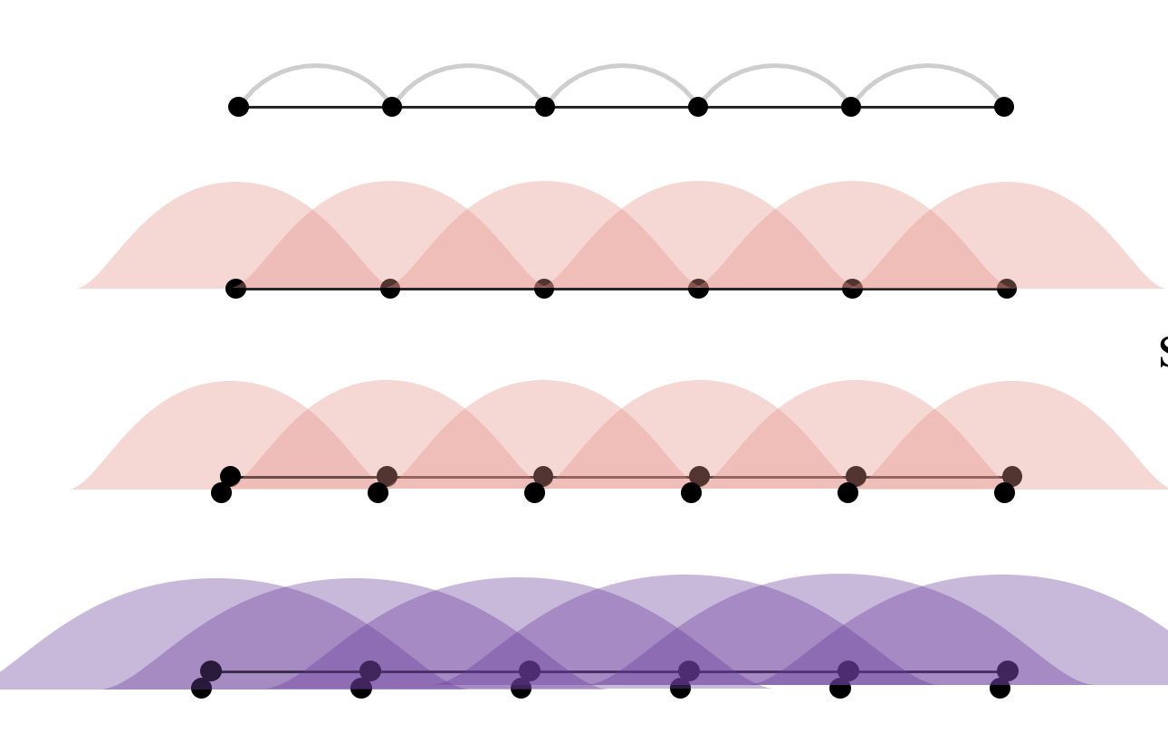
Where, and why these are candidates for quantum speedups
BQP completeness at finite temperatures?
As hard as random circuit sampling [BCL24]
Applications: dynamics + classifying phases
No-go’s: classical simulation in the fast-mixing regime
Chen, Kastoryano, and Gilyen. “An efficient and exact noncommutative quantum Gibbs sampler” (2023)
B and Chen. “Fast Mixing of Quantum Spin Chains at All Temperatures” (2025)
Notes:
Despite the complexity-theoretic evidence,
much like applications of quantum simulation to chemistry, condensed matter and nuclear physics, hard to find concrete, explicit instances of problems one could consider killer applications.
In part, this may be perhaps we’ve been searching in the wrong place

Slide 36
What if these algorithms don’t converge quickly in the worst-case?

Slide 37
Outline for today (part 2)
1. Metastable states as approximately stationary states
2. Studying metastability opens an uncountably rich set of (QEC inspired!) questions
3. A thermal area law for metastable states, via local decoders
4. Outlook and open problems

Slide 38
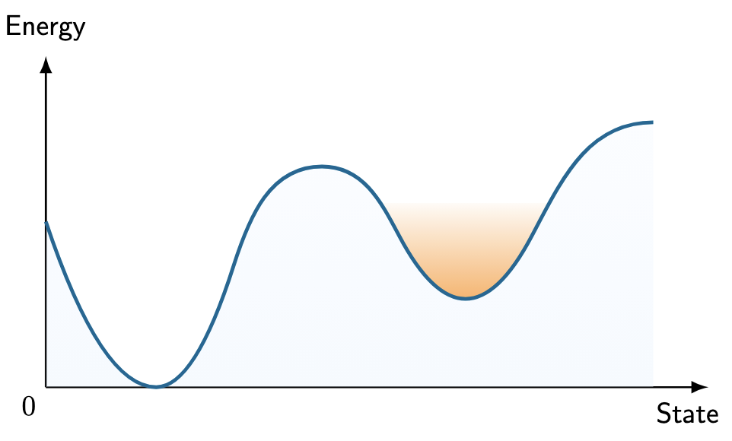
Slow-mixing, or metastable, Markov chains
Local Markov chains, in spin systems, suffer from exponential slowdowns at low temperatures.
Heuristically, this is due to the emergence of multiple metastable states, separated by energy barriers.

Slide 39

Slow-mixing, or metastable, Markov chains
Local Markov chains, in spin systems, suffer from exponential slowdowns at low temperatures.
Heuristically, this is due to the emergence of multiple metastable states, separated by energy barriers.
[High T]

Slide 40
Slow-mixing, or metastable, Markov chains
Local Markov chains, in spin systems, suffer from exponential slowdowns at low temperatures.
Heuristically, this is due to the emergence of multiple metastable states, separated by energy barriers.
[High T]
[Low T]

Slide 41
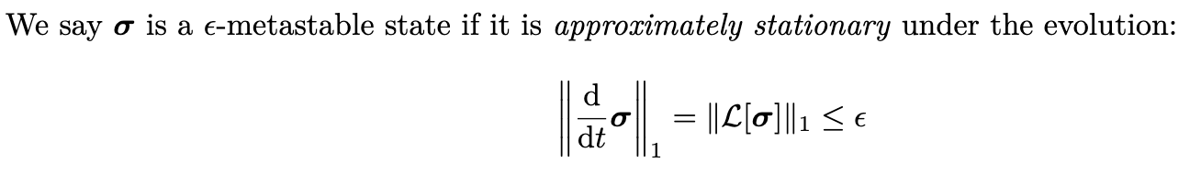
Metastable States as Approximately Stationary States

Slide 42
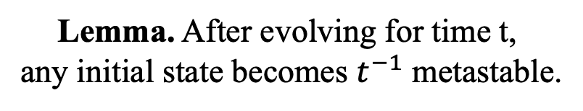
Metastable States as Approximately Stationary States
Lemma. After evolving for time t,
any initial state becomes $t^{−1}$ metastable.

Slide 43
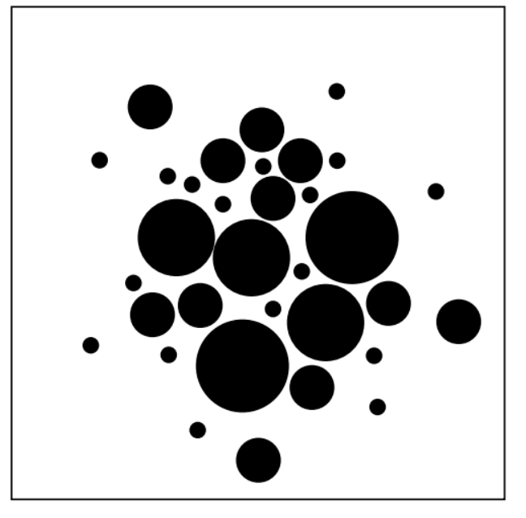
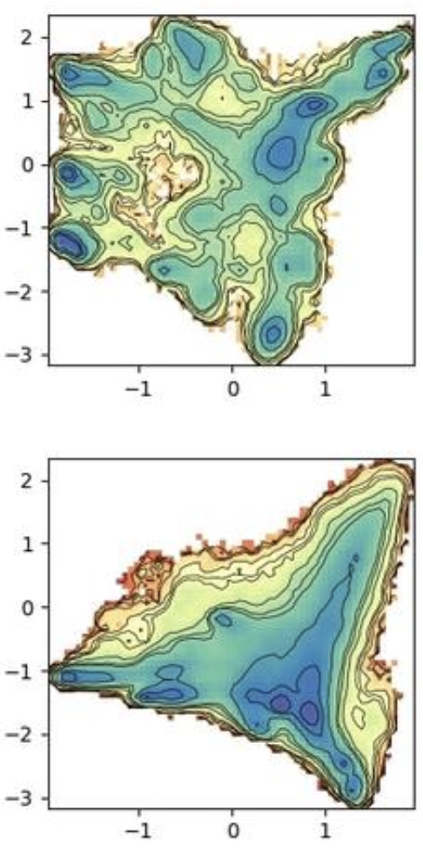
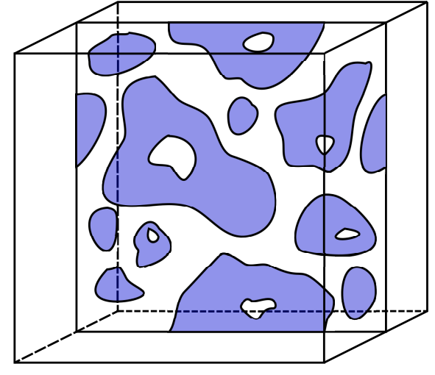
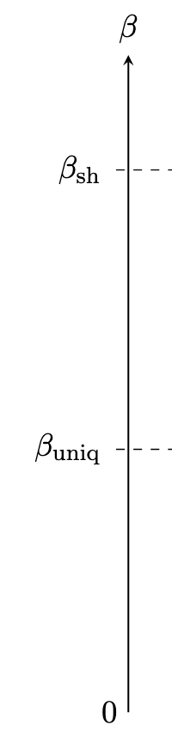

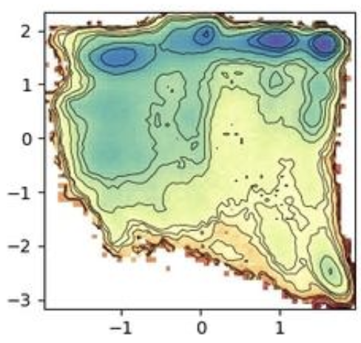
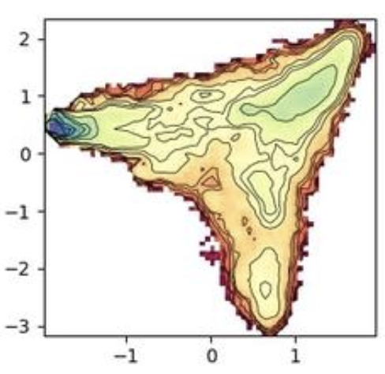

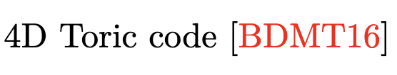
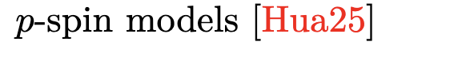
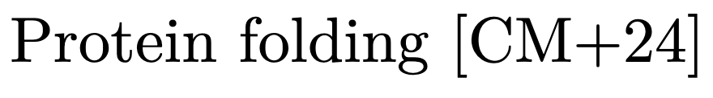
Some Canonical Examples of Metastable States

Slide 44
Outline for today (part 2)
1. Metastable states as approximately stationary states
2. Studying metastability opens an uncountably rich set of (QEC inspired!) questions
3. A thermal area law for metastable states, via local decoders
4. Outlook and open problems

Slide 45
Studying metastability opens an uncountably rich set of questions

Slide 46
Studying metastability opens an uncountably rich set of questions
Robustness to perturbations:
Markov properties + area laws
[BCV25]

Slide 47
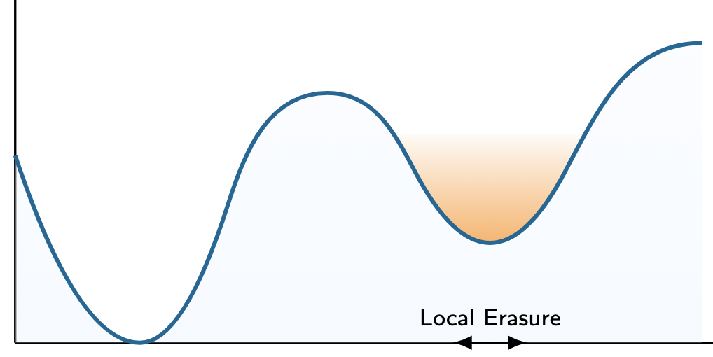
Studying metastability opens an uncountably rich set of questions
Robustness to perturbations:
Markov properties + area laws
[BCV25]

Slide 48
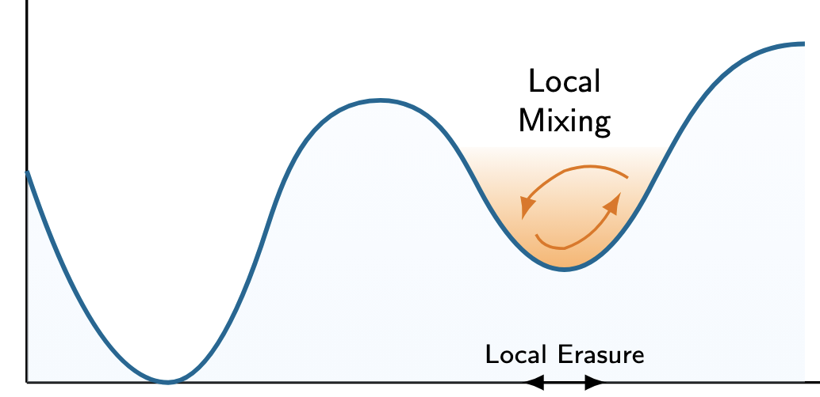
Studying metastability opens an uncountably rich set of questions
Robustness to perturbations:
Markov properties + area laws
[BCV25]

Slide 49
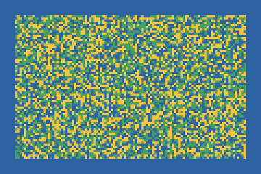
Studying metastability opens an uncountably rich set of questions
Robustness to perturbations:
Markov properties + area laws
[BCV25]

Slide 50
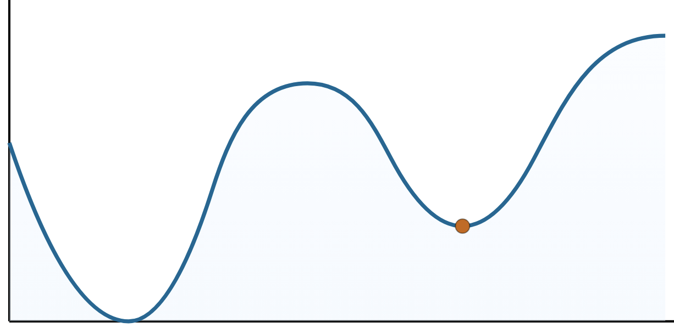
Studying metastability opens an uncountably rich set of questions
Robustness to perturbations:
Markov properties + area laws
[BCV25]
Mixing within a sector:
characterizations of phases
[BGL25]

Slide 51
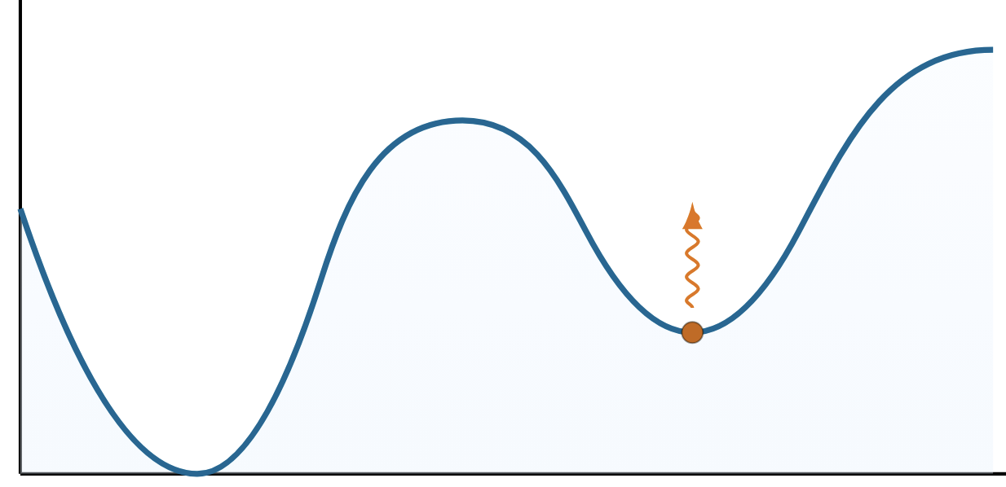
Studying metastability opens an uncountably rich set of questions
Robustness to perturbations:
Markov properties + area laws
[BCV25]
Mixing within a sector:
characterizations of phases
[BGL25]

Slide 52
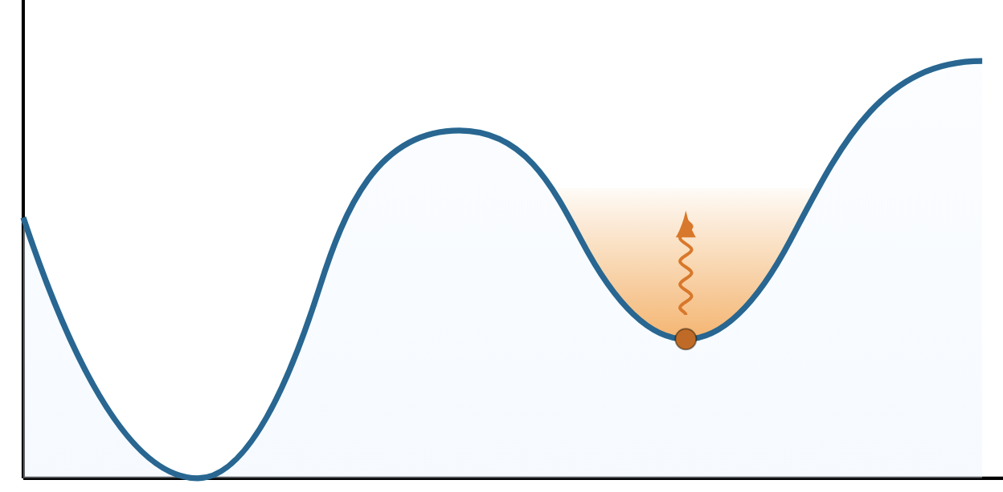
Studying metastability opens an uncountably rich set of questions
Robustness to perturbations:
Markov properties + area laws
[BCV25]
Mixing within a sector:
characterizations of phases
[BGL25]

Slide 53
Studying metastability opens an uncountably rich set of questions
Robustness to perturbations:
Markov properties + area laws
[BCV25]
Mixing within a sector:
characterizations of phases
[BGL25]

Slide 54
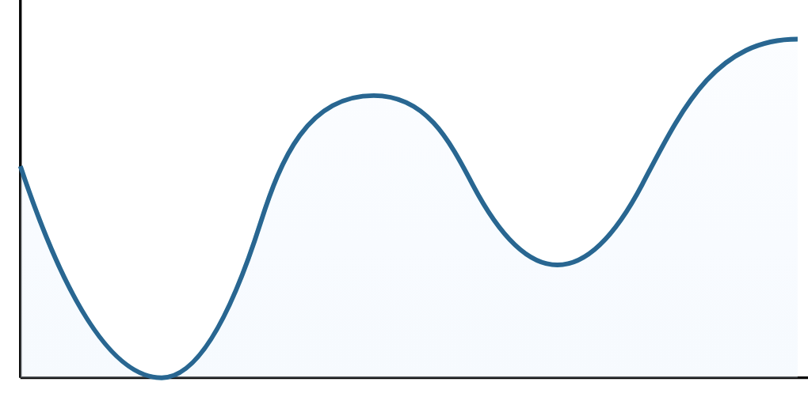
Studying metastability opens an uncountably rich set of questions
Robustness to perturbations:
Markov properties + area laws
[BCV25]
Mixing within a sector:
characterizations of phases
[BGL25]
Phase ordering after a quench:
fault-tolerant state preparation

Slide 55
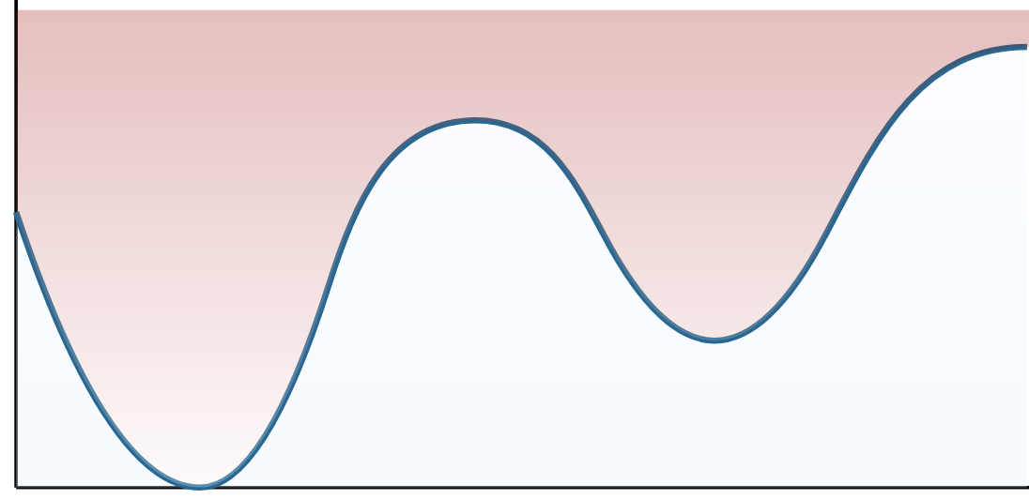
Studying metastability opens an uncountably rich set of questions
Robustness to perturbations:
Markov properties + area laws
[BCV25]
Mixing within a sector:
characterizations of phases
[BGL25]
Phase ordering after a quench:
fault-tolerant state preparation
[BL+26?]

Slide 56
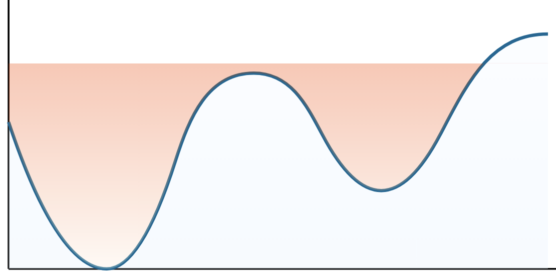
Studying metastability opens an uncountably rich set of questions
Robustness to perturbations:
Markov properties + area laws
[BCV25]
Mixing within a sector:
characterizations of phases
[BGL25]
Phase ordering after a quench:
fault-tolerant state preparation
[BL+26?]

Slide 57
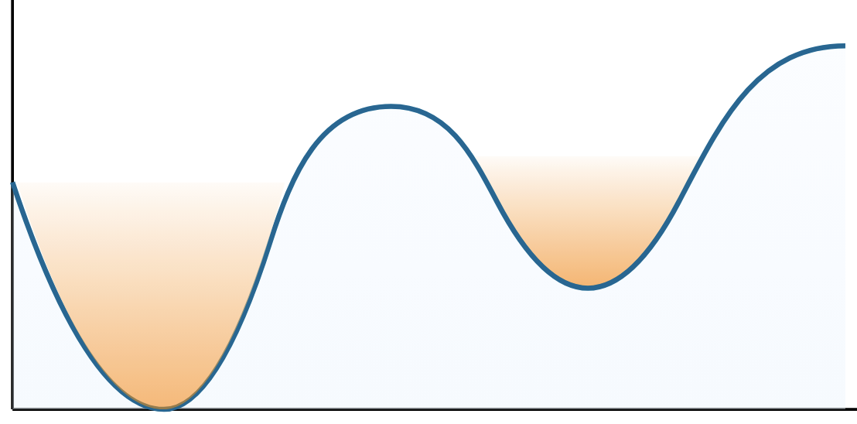
Studying metastability opens an uncountably rich set of questions
Robustness to perturbations:
Markov properties + area laws
[BCV25]
Mixing within a sector:
characterizations of phases
[BGL25]
Phase ordering after a quench:
fault-tolerant state preparation
[BL+26?]

Slide 58
Outline for today (part 2)
1. Metastable states as approximately stationary states
2. Studying metastability opens an uncountably rich set of (QEC inspired!) questions
3. A thermal area law for metastable states, via local decoders
4. Outlook and open problems

Slide 59
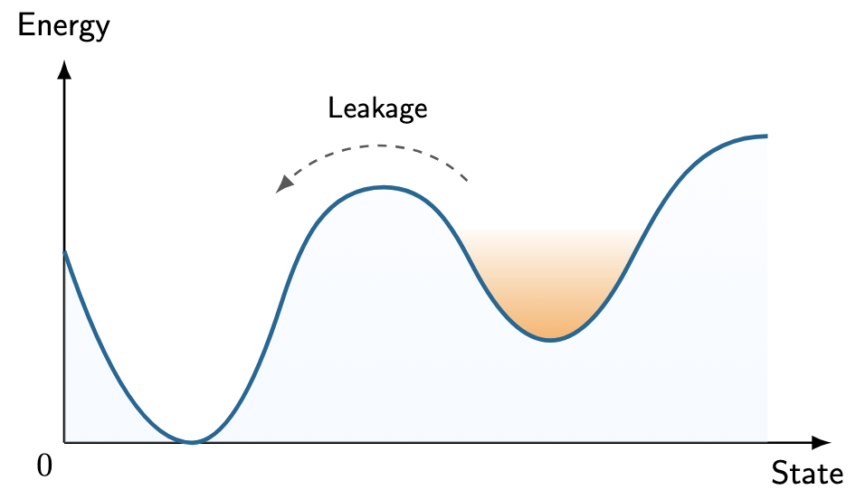
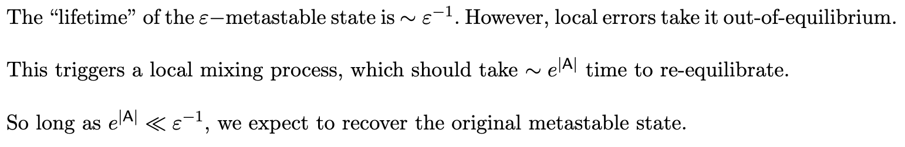
An interplay between two timescales

Slide 60
An interplay between two timescales

Slide 61
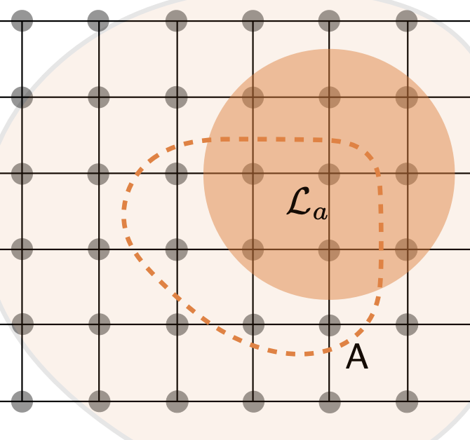
An interplay between two timescales

Slide 62
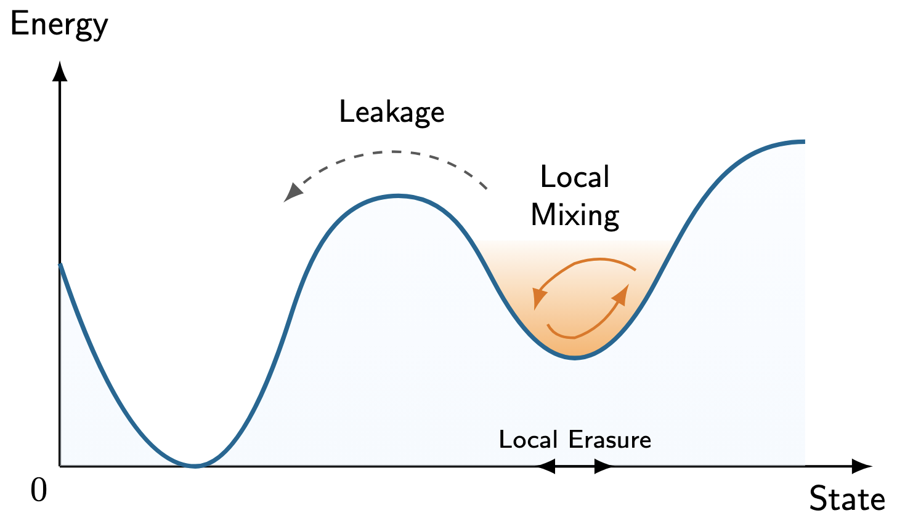
An interplay between two timescales

Slide 63
An interplay between two timescales

Slide 64
An interplay between two timescales

Slide 65

An interplay between two timescales

Slide 66
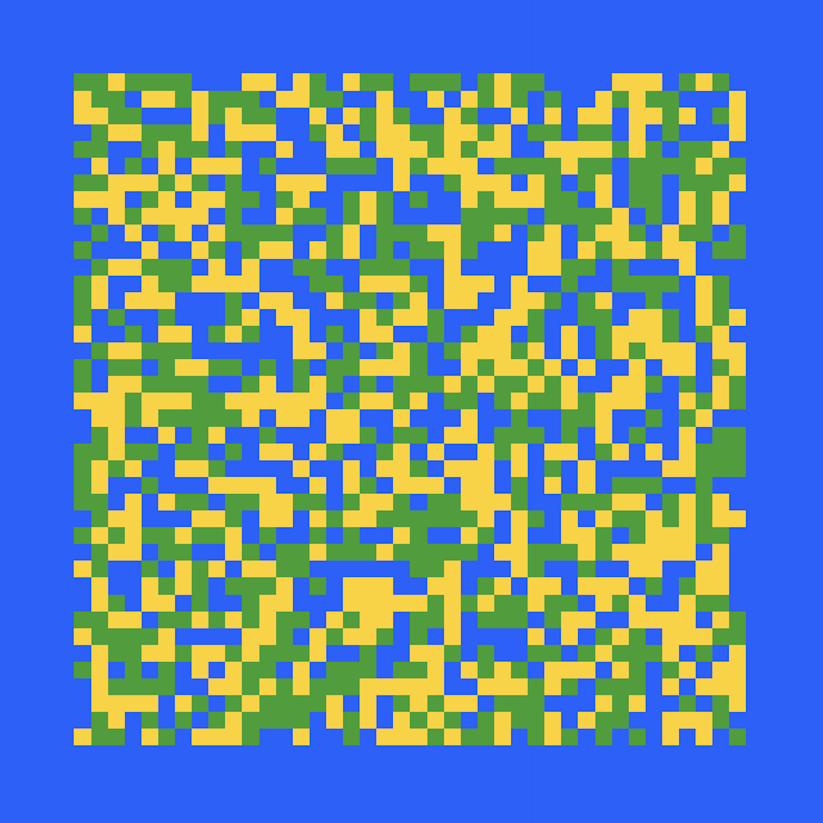
An interplay between two timescales

Slide 67

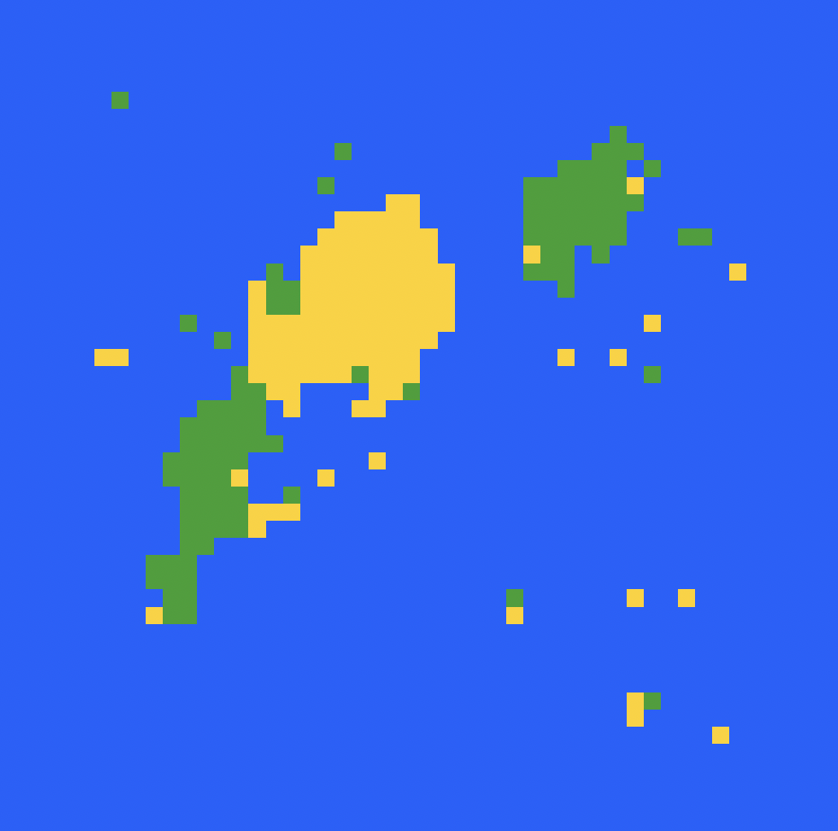
An interplay between two timescales

Slide 68
An interplay between two timescales

Slide 69
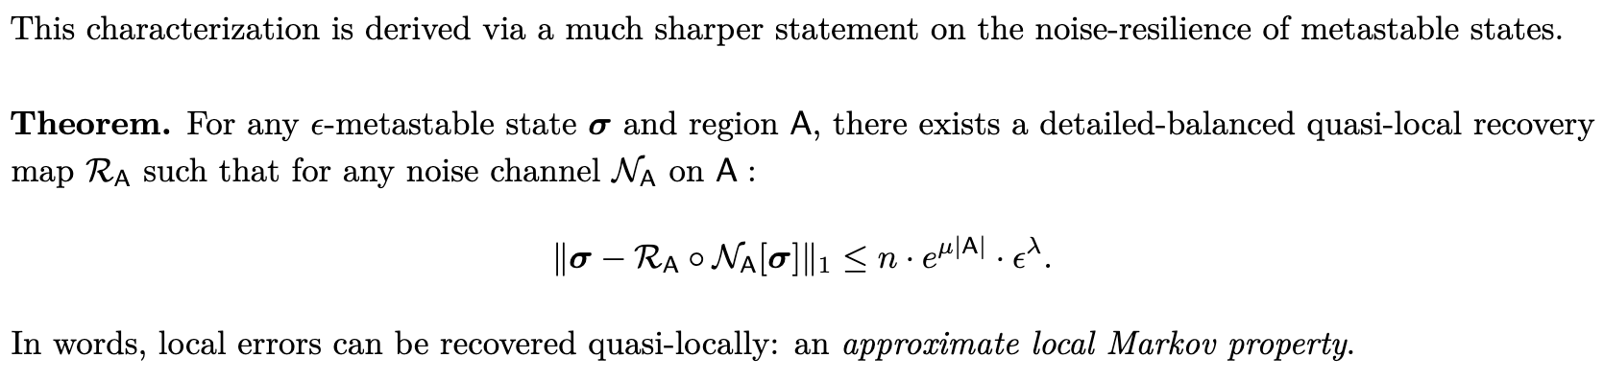

Metastable States satisfy a local Markov property

Slide 70
If these were classical systems …

Slide 71

If these were classical systems …
… this would be just some form of conditional independence

Slide 72

Metastable States satisfy a local Markov property
The pursuit of Markov properties in quantum Gibbs states is still
a very active research topic! [KK25, CR25, BLMT25]
Indeed, [CR25] is one of our central points of inspiration.

Slide 73


An Area Law for Metastable States

Slide 74
An Area Law for Metastable States

Slide 75



An Area Law for Metastable States

Slide 76
An Area Law for Metastable States

Slide 77
An Area Law for Metastable States

Slide 78
An Area Law for Metastable States

Slide 79
Outlook + a perspective on quantum thermal simulation
[CKG23] proposed a brand new quantum algorithm for quantum thermal simulation.

Slide 80
Outlook + a perspective on quantum thermal simulation
[CKG23] proposed a brand new quantum algorithm for quantum thermal simulation.
However, in the pursuit of meaningful applications lies a dilemma, in that
In the high temperature regime, often when these algorithms are efficient (gapped), they also come with classical simulation algorithms.
At low temperatures, there are worst-case complexity-theoretic barriers to state preparation.

Slide 81
Outlook + a perspective on quantum thermal simulation
[CKG23] proposed a brand new quantum algorithm for quantum thermal simulation.
However, in the pursuit of meaningful applications lies a dilemma, in that
In the high temperature regime, often when these algorithms are efficient (gapped), they also come with classical simulation algorithms.
At low temperatures, there are worst-case complexity-theoretic barriers to state preparation.
The thesis in this talk is that at low temperatures, the study of metastable states could be an alternative: there lies structure akin to Gibbs states, and admit efficient state-preparation.
Can one recover applications which require copies of low-temperature Gibbs states,
such as to optimization, learning, and classification-of-phases?

Slide 82
Two open questions

Slide 83

BPT bounds for non-commuting quantum memories
In seminal work, Bravyi, Poulin, and Terhal proved a bound on the rate and distance of 2D stabilizer codes.
The ability to locally correct from local errors,
implies a rate-distance tradeoff
Bravyi, Poulin, and Terhal. “Tradeoffs for reliable quantum information storage in 2D systems” (2009)
Dai and Li. “Locality vs Quantum Codes” (2024)

Slide 84
BPT bounds for non-commuting quantum memories
In seminal work, Bravyi, Poulin, and Terhal proved a bound on the rate and distance of 2D stabilizer codes.
The ability to locally correct from local errors,
implies a rate-distance tradeoff
Question. Consider quantum information stored in the degenerate ground space of a gapped, lattice Hamiltonian.
What are the limits to the (approximate) tolerance to erasures as a function of rate?
Flammia, Haah, Kastoryano, and Kim. “Limits on the storage of quantum information in a volume of space” (2017)

Slide 85
BPT bounds for non-commuting quantum memories
In seminal work, Bravyi, Poulin, and Terhal proved a bound on the rate and distance of 2D stabilizer codes.
The ability to locally correct from local errors,
implies a rate-distance tradeoff
Question. Consider quantum information stored in the degenerate ground space of a gapped, lattice Hamiltonian.
What are the limits to the (approximate) tolerance to erasures as a function of rate?
Beware! Very close connections to the area law conjecture.
Anshu, Arad, and Gosset. “An area law for 2D frustration-free spin systems” (2021)

Slide 86

Self-correcting logical state preparation
Question. Initialize the system in a product state. Then, run the thermal noise model (for e.g. the 4D toric code).
Does this prepare a logical state, up to a residual stochastic error?
Or, initialize the system from the maximally mixed state.
Does this converge efficiently to the Gibbs state?
Bombin et al. “Self-Correcting Quantum Computers” (2009)
Gheissari, Sly, Sohn “Rapid phase ordering for Ising and Potts dynamics on random regular graphs” (2025)

Slide 87
Self-correcting logical state preparation
Question. Initialize the system in a product state. Then, run the thermal noise model (for e.g. the 4D toric code).
Does this prepare a logical state, up to a residual stochastic error?
Or, initialize the system from the maximally mixed state.
Does this converge efficiently to the Gibbs state?
Faces NLTS-style circuit lower bounds.
The same “phase ordering” question for the Ising model
is a famous open problem
An “annealing” version of this was proposed by Bombin.
Bombin et al. “Self-Correcting Quantum Computers” (2009)
Gheissari, Sly, Sohn “Rapid phase ordering for Ising and Potts dynamics on random regular graphs” (2025)

Slide 88
Some more problems
1. Mixing times for disordered systems, e.g. the Sachdev-Ye-Kitaev model and spin glasses.
2. Rapid-mixing in non-commuting quantum systems.
3. Is every (non-commuting) metastable state either a classical or quantum memory?
4. Classical simulation algorithms, via separability, zero-freeness, connectivity of phases…
Are they all equivalent?
Recent progress in classical algorithms by [Zlo26, ZK26]
Only known on lattices at high T [RFA24, BLMT25]
More broadly, dynamical arguments seem like a versatile tool to prove new structure
See [Ber26] for a survey of this literature.

Slide 89
Thanks!

Slide 90

The correction to the Area Law is essentially tight

Slide 91
Markov properties in metastable classical spin systems

Slide 92

Markov properties in metastable classical spin systems

Slide 93

Markov properties in metastable classical spin systems

Slide 94

Markov properties in metastable classical spin systems

Slide 95

Markov properties in metastable classical spin systems

Slide 96
Markov properties in metastable classical spin systems

Slide 97
Markov properties in metastable classical spin systems

Slide 98
The key challenges in the quantum setting

Slide 99


The (Quantum Relative) Fisher Information

Slide 100

The (Quantum Relative) Fisher Information

Slide 101

The (Quantum Relative) Fisher Information

Slide 102
The (Quantum Relative) Fisher Information

Slide 103

The (Quantum Relative) Fisher Information
Classically, this condition already manifests some form of approximate detailed-balance.

Slide 104

Interlude: The Fisher information in other Markov chains

Slide 105
Interlude: The Fisher information in other Markov chains

Slide 106
Interlude: The Fisher information in other Markov chains

Slide 107
Interlude: The Fisher information in other Markov chains

Slide 108
Interlude: The Fisher information in other Markov chains

Slide 109


Local Markov Properties (in Gibbs states) [CR25]

Slide 110

Local Markov Properties (in Gibbs states) [CR25]
The time averaged dynamics

Slide 111
Local Markov Properties (in Gibbs states) [CR25]
The time averaged dynamics

Slide 112

Local Stationarity of the Dirichlet form

Slide 113

Local Stationarity of the Dirichlet form

Slide 114


Local Stationarity of the Dirichlet form

Slide 115
Local Stationarity of the Dirichlet form

Slide 116

Local Stationarity of the Dirichlet form

Slide 117
Local Stationarity of the Dirichlet form (in metastable states)

Slide 118

The Local Markov Property for Metastable states

