Slide 1


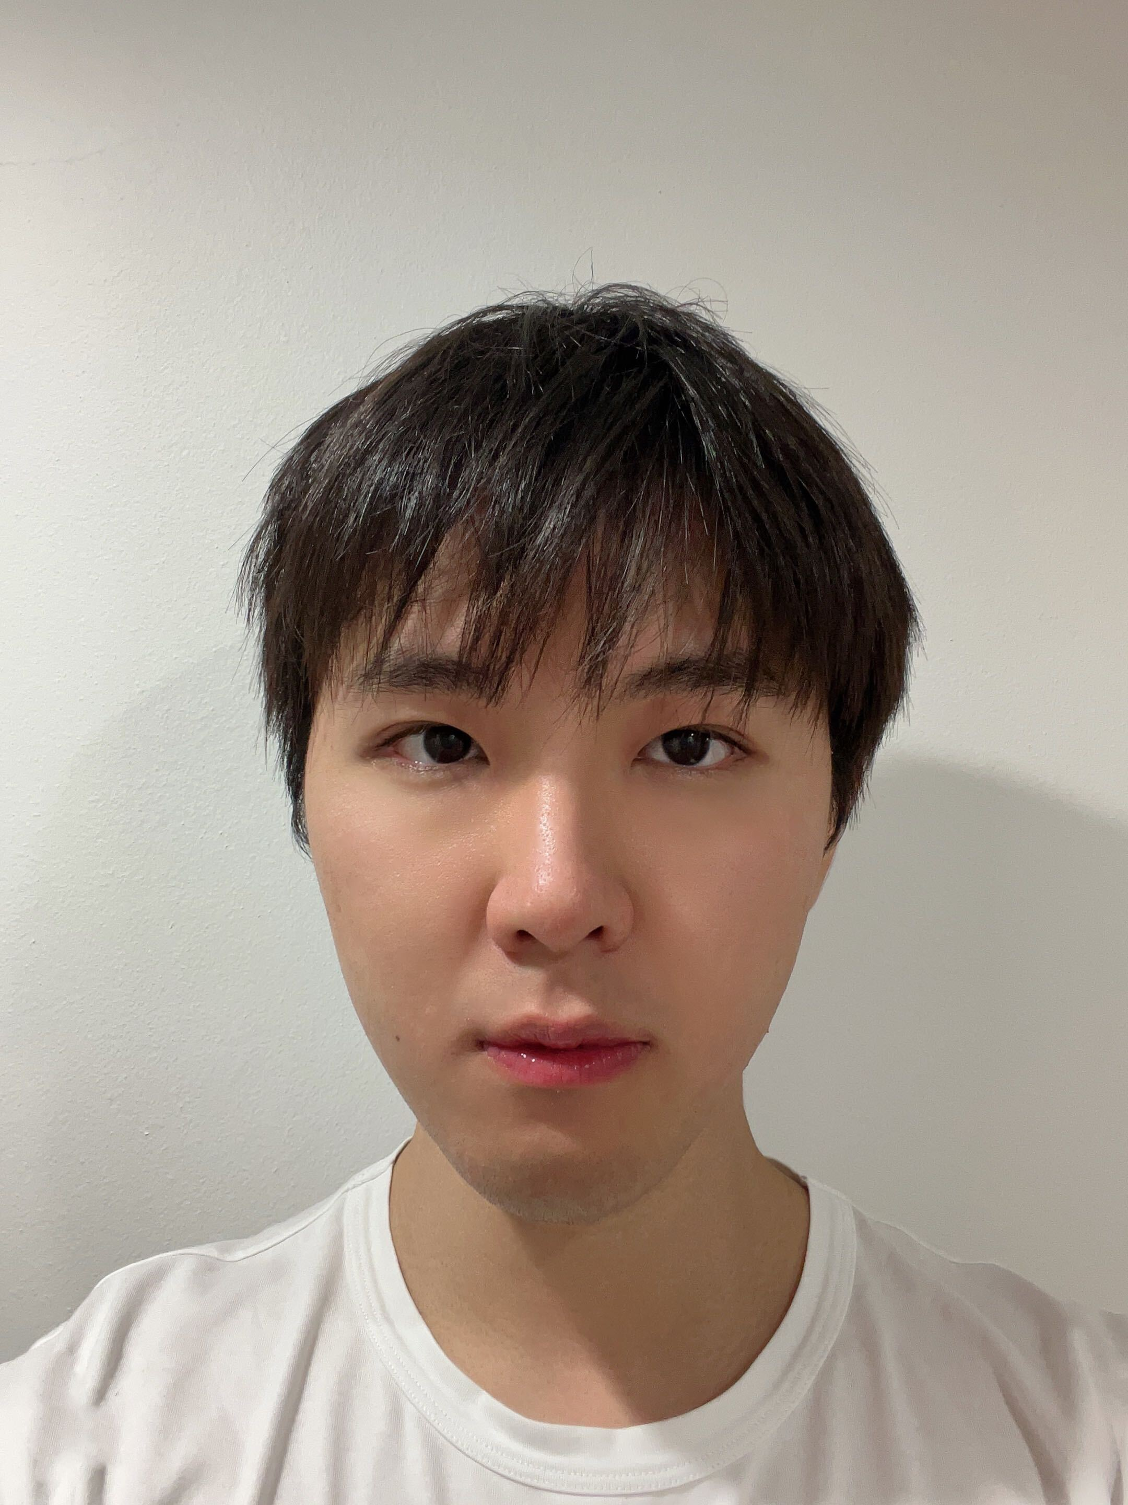


Duality constrains optimal thresholds in quantum error correction
Lucas H. English¹, Haoyuan Luo¹, YangMing Wang¹,
Basudha Srivastava², Stephen D. Bartlett¹, Dominic J. Williamson¹
¹School of Physics, University of Sydney, New South Wales 2006, Australia
²Quantinuum, Terrington House, Cambridge, CB2 1NL, UK
 | arXiv:2607.21160

Slide 2
Motivating questions
“Why do so many structured codes approximately saturate the Hashing bound?” – Christopher Chubb
“Does stat mech actually help solve practical problems?” – Nicholas Fazio

Slide 3
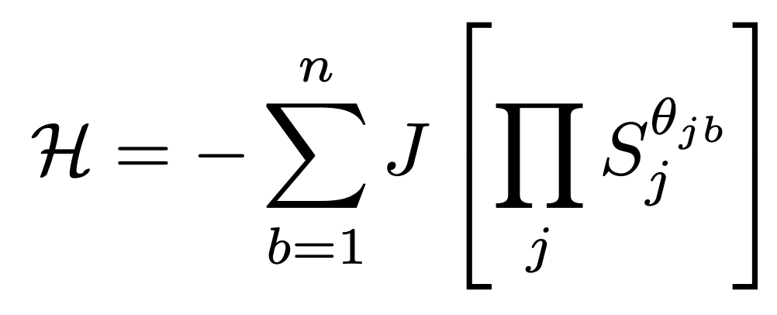
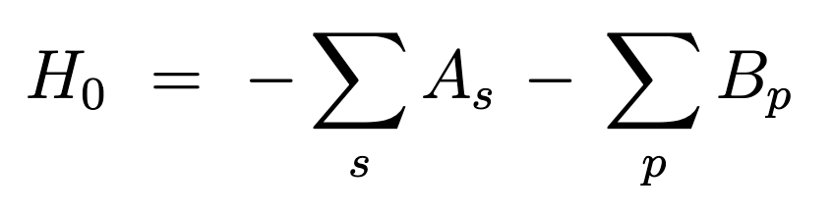
QEC Code
Quantum
Classical
 | arXiv:quant-ph/9707021

Slide 4
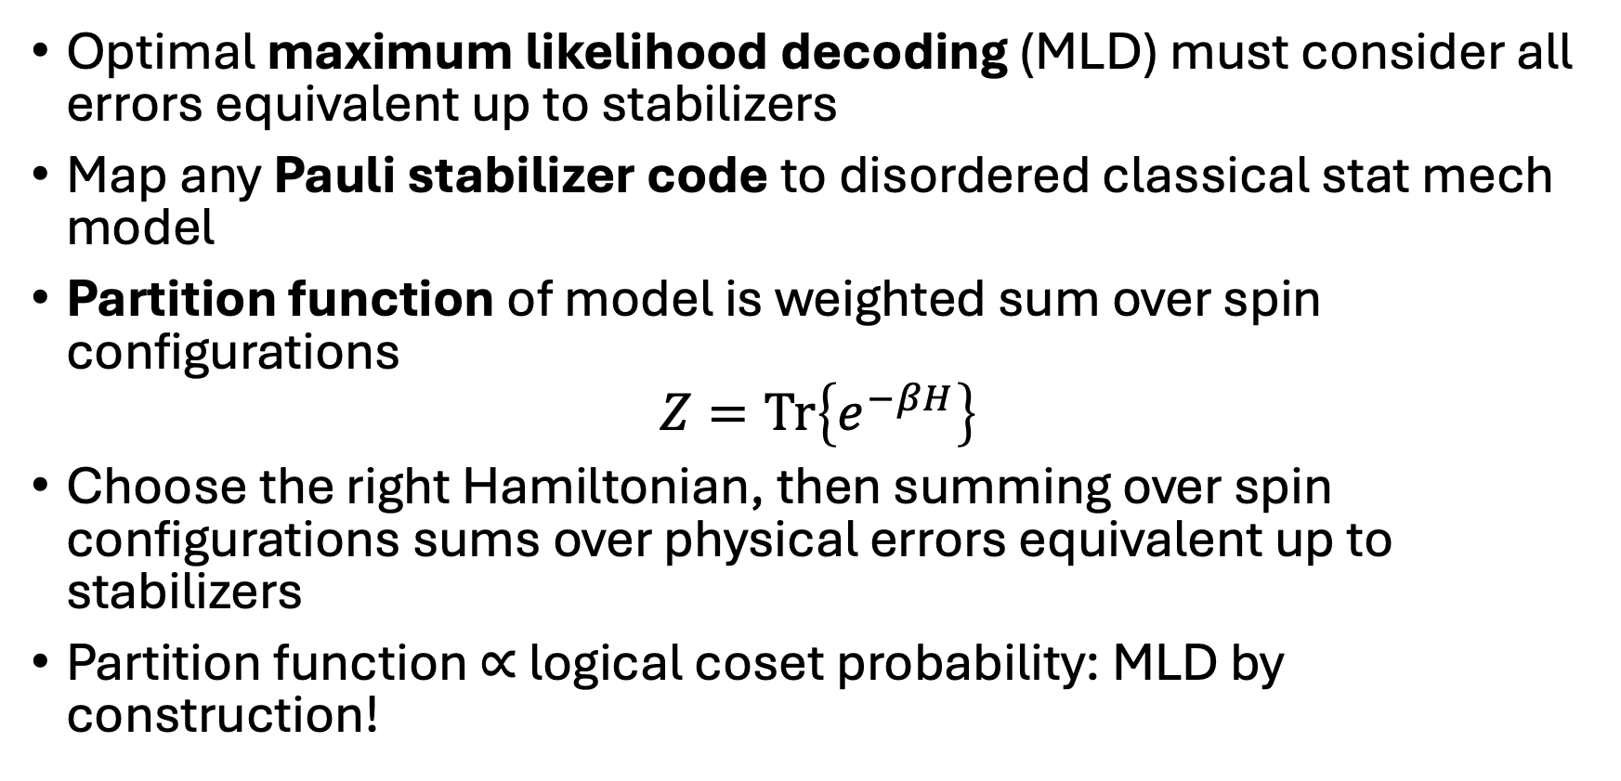
QEC – stat mech mapping
Optimal maximum likelihood decoding (MLD) must consider all errors equivalent up to stabilizers
Map any Pauli stabilizer code to disordered classical stat mech model
Partition function of model is weighted sum over spin configurations
$$Z=Tr\left\{e^{−βH}\right\}$$
Choose the right Hamiltonian, then summing over spin configurations sums over physical errors equivalent up to stabilizers
Partition function $∝$ logical coset probability: MLD by construction!

Slide 5
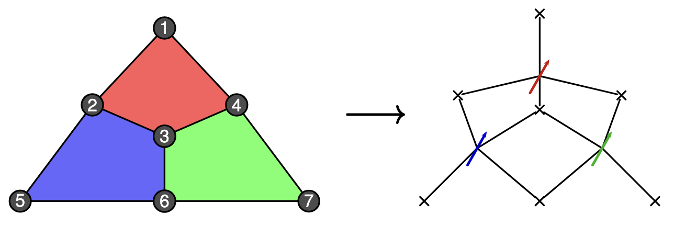

The prescription (on the Steane code)
Add classical Ising spin $S_{j}$ for each stabilizer generator ${\hat{S}}_{j}$
Add interaction term for each physical qubit $b$
Spins interact if they have support on the same qubit

Slide 6
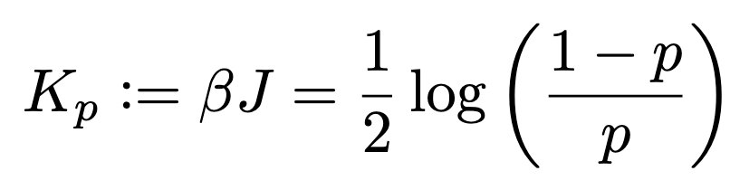
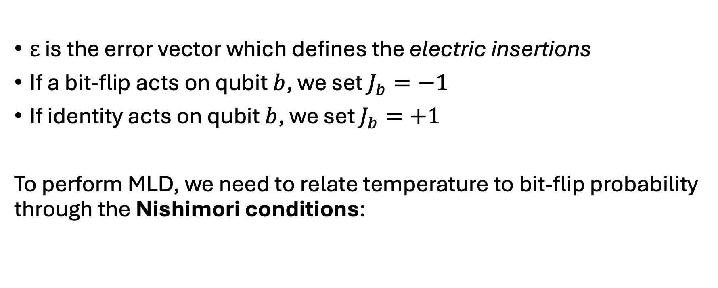
Steane code redux
$ε$ is the error vector which defines the electric insertions
If a bit-flip acts on qubit $b$, we set $J_{b}=−1$
If identity acts on qubit $b$, we set $J_{b}=+1$
To perform MLD, we need to relate temperature to bit-flip probability through the Nishimori conditions:

Slide 7
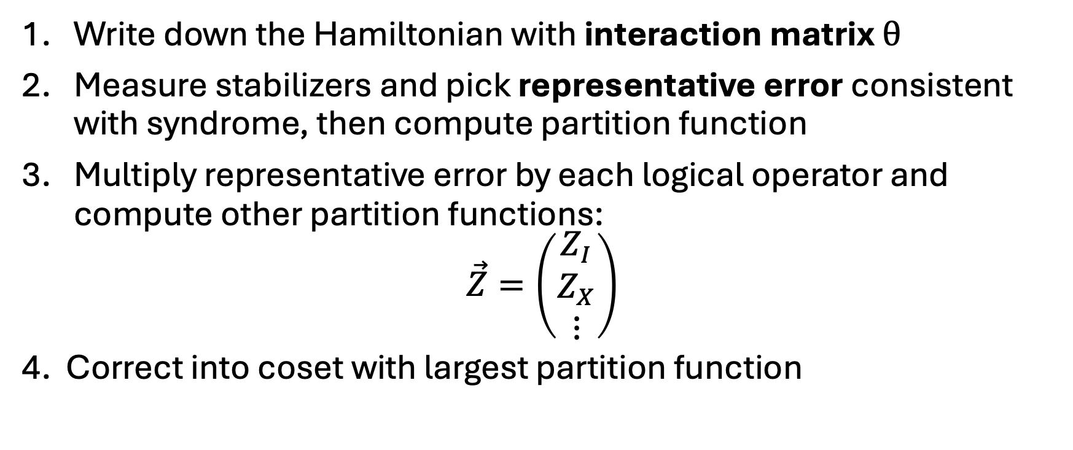
How to perform MLD
Write down the Hamiltonian with interaction matrix $θ$
Measure stabilizers and pick representative error consistent with syndrome, then compute partition function
Multiply representative error by each logical operator and compute other partition functions:
$$\vec{Z}=\left(\begin{matrix}Z_{I} \\ \begin{aligned}Z_{X} \\ ⋮\end{aligned}\end{matrix}\right)$$
4. Correct into coset with largest partition function

Slide 8
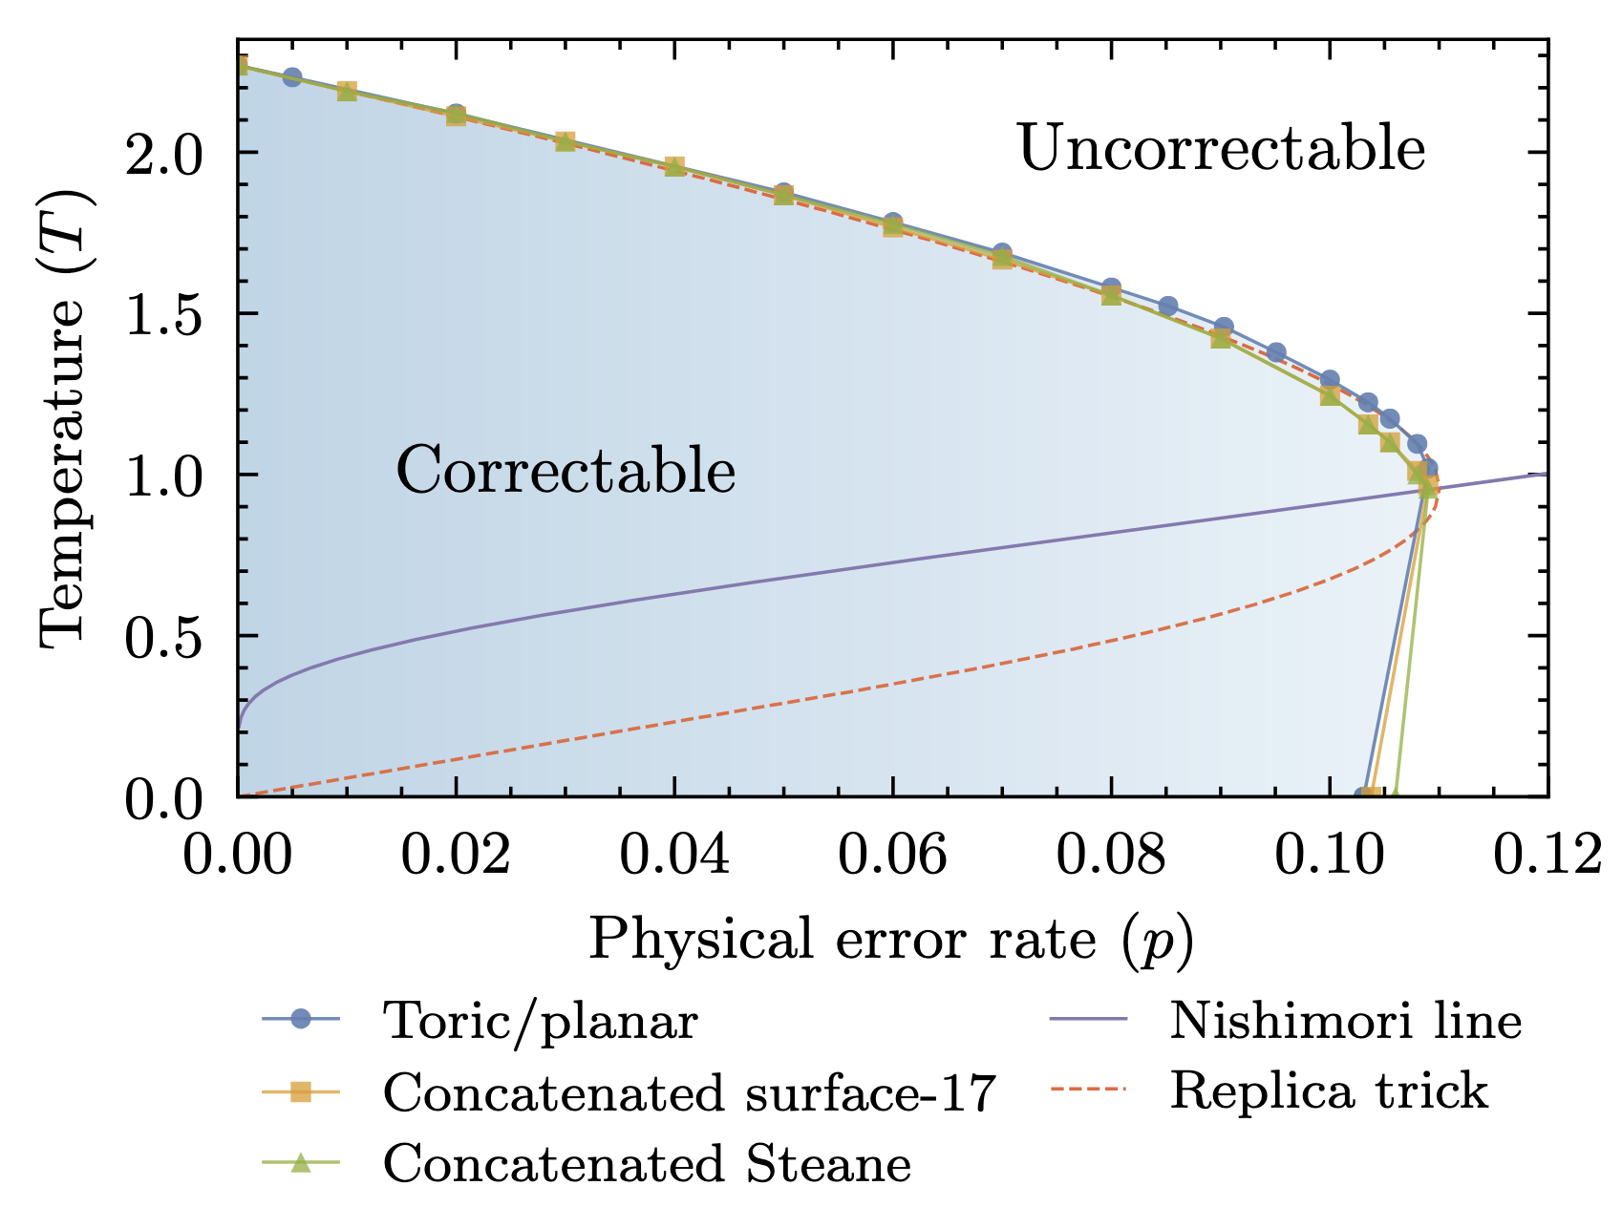
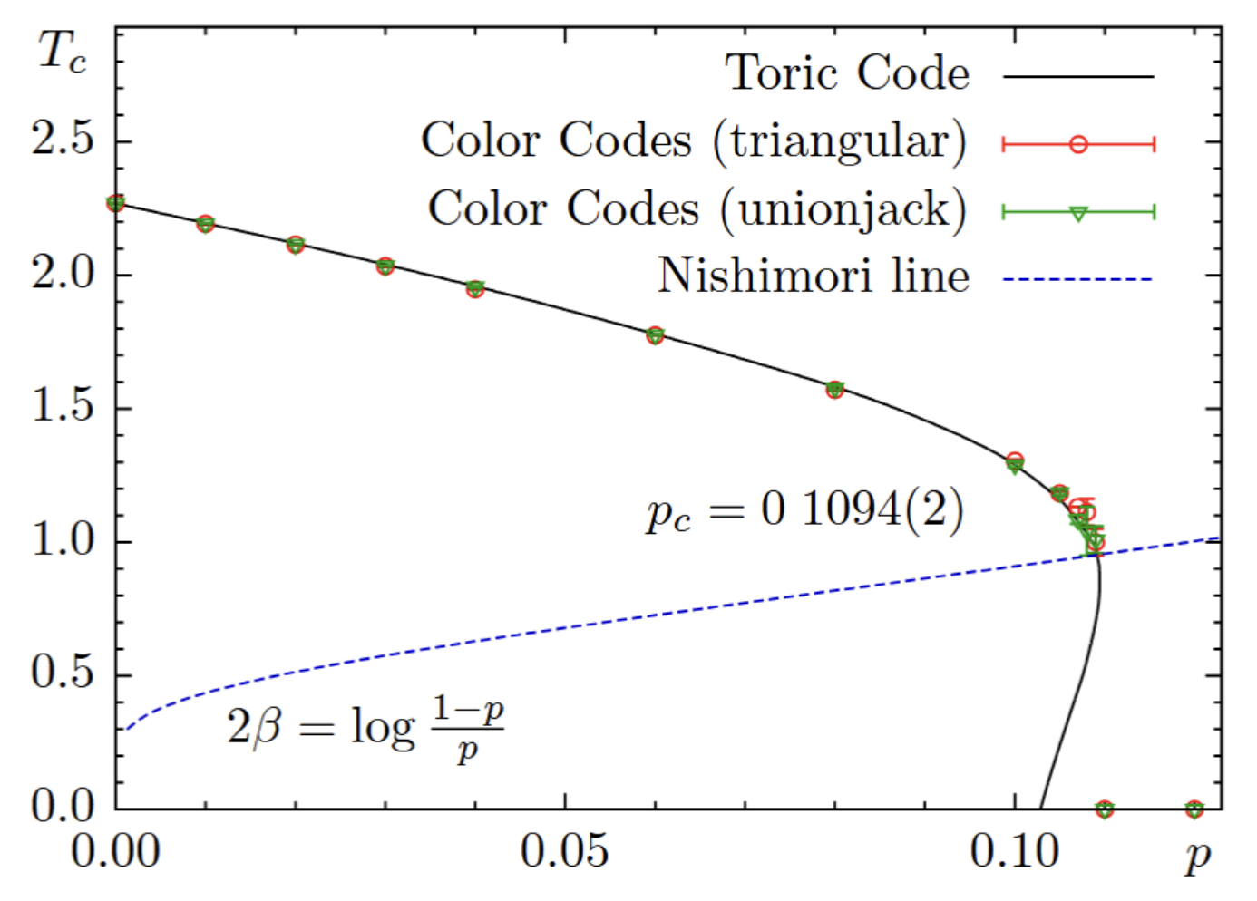
The puzzle
arXiv:1306.0540
“Remarkably, the phase boundaries for all three codes agree within error bars.”
 | arXiv:1202.1852

Slide 9
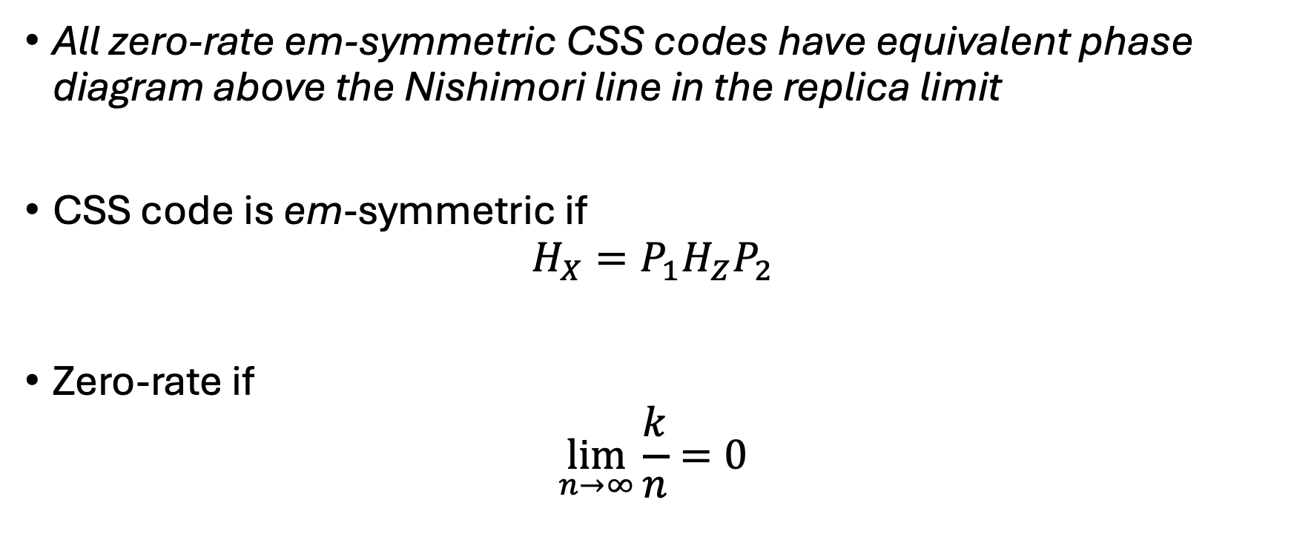
Proposition
All zero-rate em-symmetric CSS codes have equivalent phase diagram above the Nishimori line in the replica limit
CSS code is em-symmetric if
$$H_{X}=P_{1}H_{Z}P_{2}$$
Zero-rate if
$$\lim_{n→∞}\frac{k}{n}=0$$

Slide 10
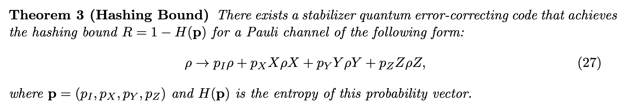

Corollary: optimal bit-flip code capacity threshold
With phase diagram constrained by replica trick prediction, we predict all codes should saturate the Hashing bound (approximately)
With independent bit-flip/phase-flip channel this gives:
$$p_{c}^{X}=p_{c}^{Z}≈0.11$$
https://www.dias.ie/wp-content/uploads/2012/06/lecture-6-wilde.pdf

Slide 11
Proof overview
Clean model: all em-symmetric codes are Kramers-Wannier self-dual if and only if the asymptotic rate is 0.
Disordered model: the principal Boltzmann factor construction constrains the phase diagram for all self-dual models.
All thresholds are (approximately) equal

Slide 12
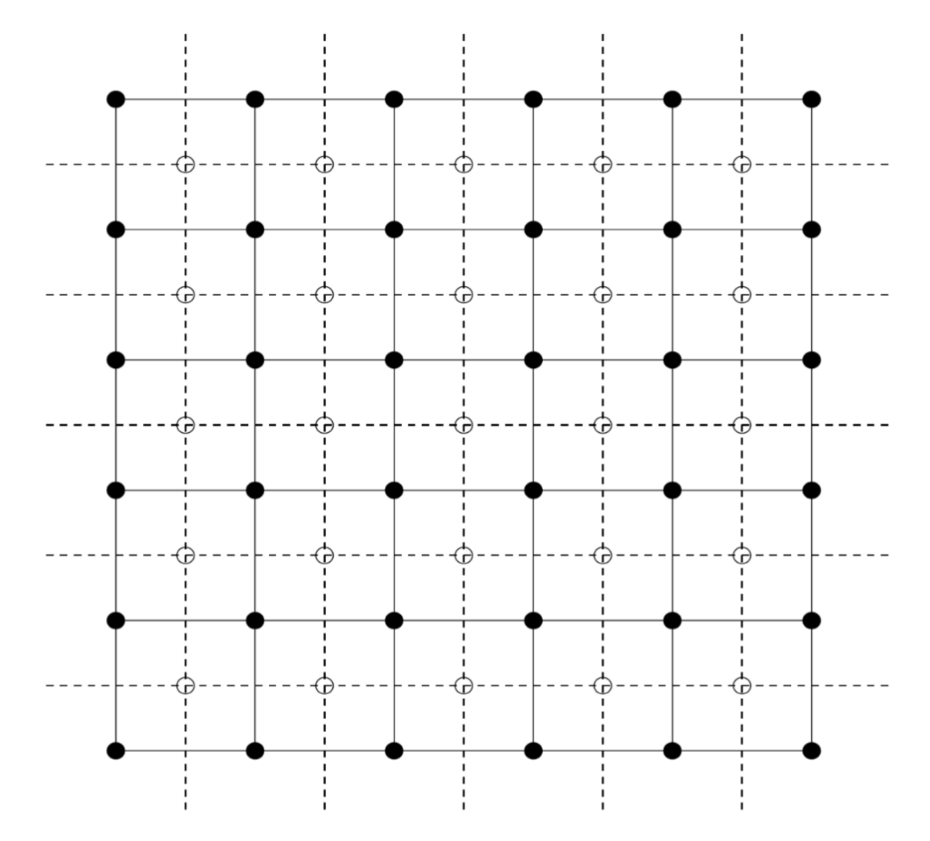
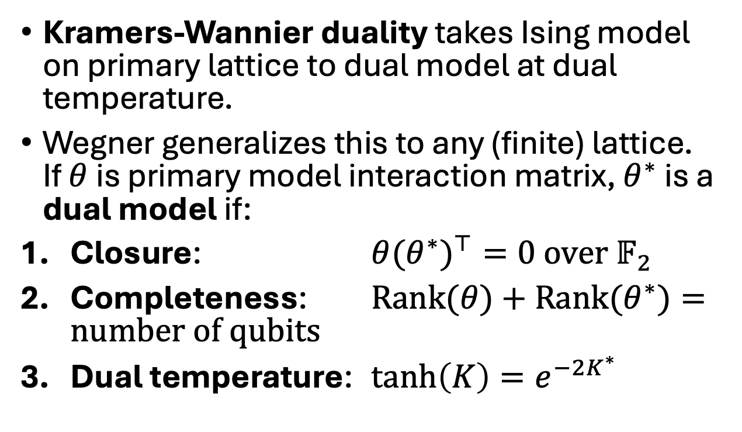
Generalized Kramers-Wannier duality
Kramers-Wannier duality takes Ising model on primary lattice to dual model at dual temperature.
Wegner generalizes this to any (finite) lattice. If $θ$ is primary model interaction matrix, $θ^{∗}$ is a dual model if:
Closure: $θ{{(θ}^{∗})}^{⊤}=0$ over $𝔽_{2}$
Completeness: $Rank(θ)+Rank{(θ}^{∗})=number of qubits$
Dual temperature: $tanh\left(K\right)=e^{−2K^{∗}}$

Slide 13
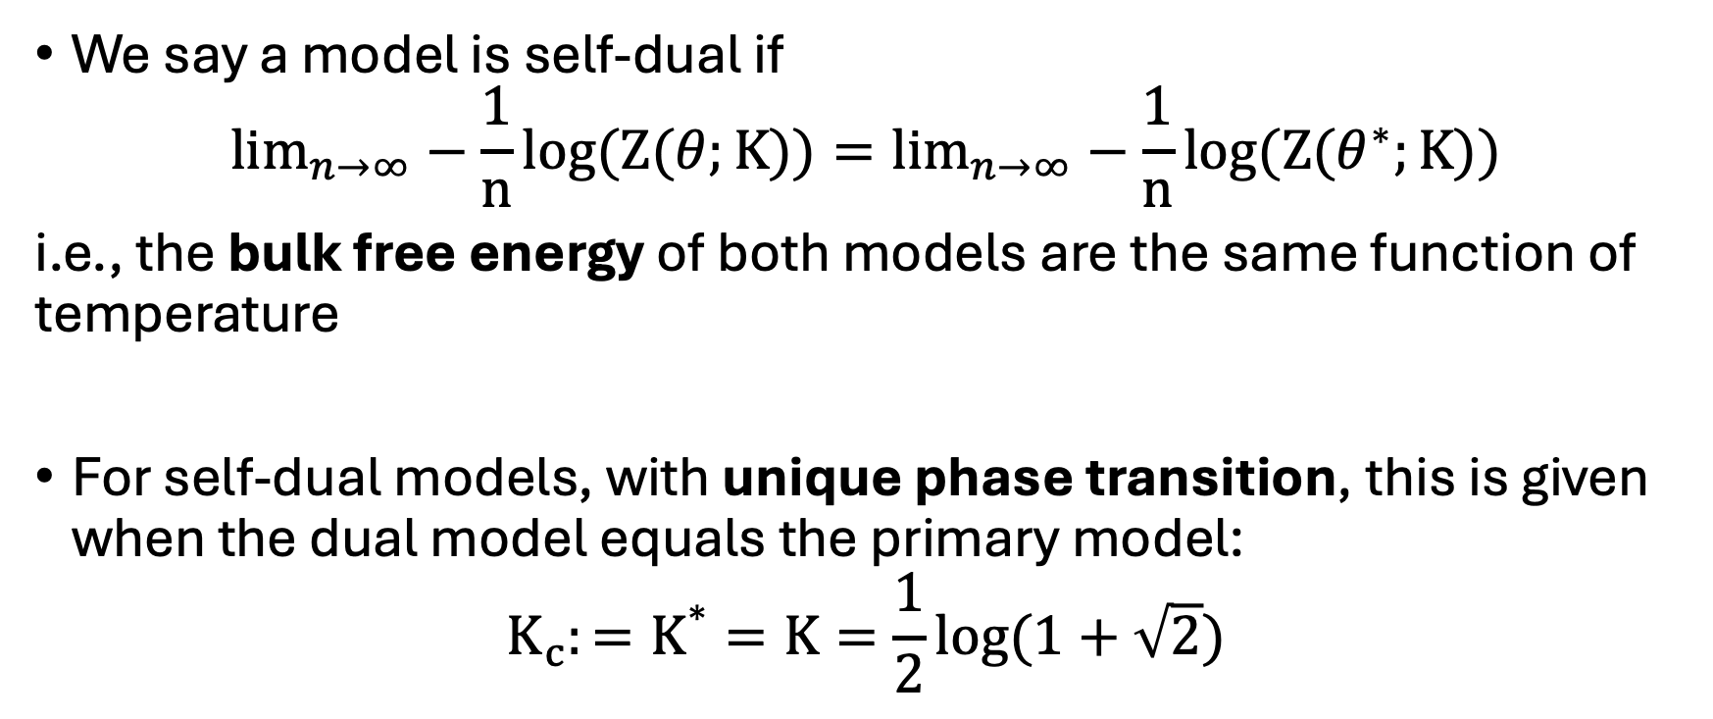
Generalized Kramers-Wannier self-duality
We say a model is self-dual if
$$\lim_{n→∞}−\frac{1}{n}log(Z(θ;K))=\lim_{n→∞}−\frac{1}{n}log(Z(θ^{∗};K))$$
i.e., the bulk free energy of both models are the same function of temperature
For self-dual models, with unique phase transition, this is given when the dual model equals the primary model:
$${K_{c}:=K}^{∗}=K=\frac{1}{2}log(1+\sqrt{2})$$

Slide 14
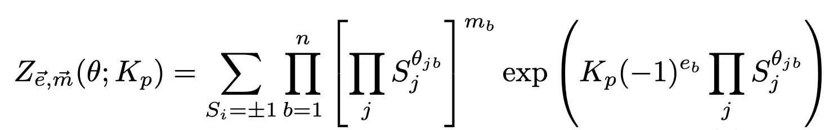
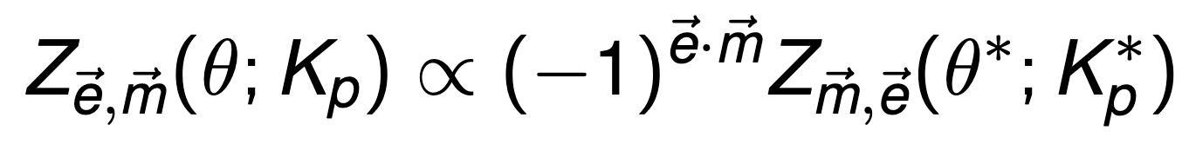

Electric and magnetic insertions
Define partition function with electric ($\vec{e}$) and magnetic ($\vec{m}$) charges:
Electric insertions: sign of coupling constant
Magnetic insertions: multispin correlation function
KW duality swaps e and m

Slide 15
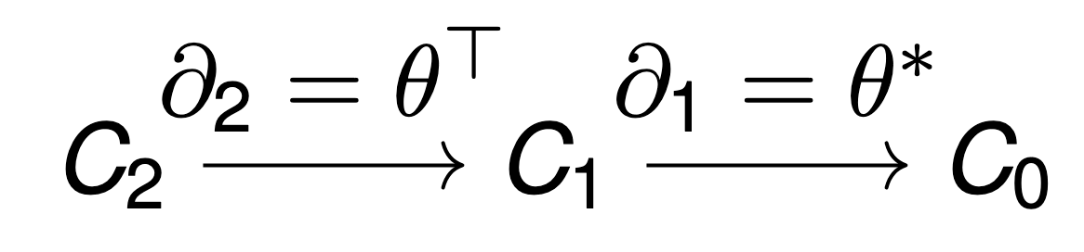
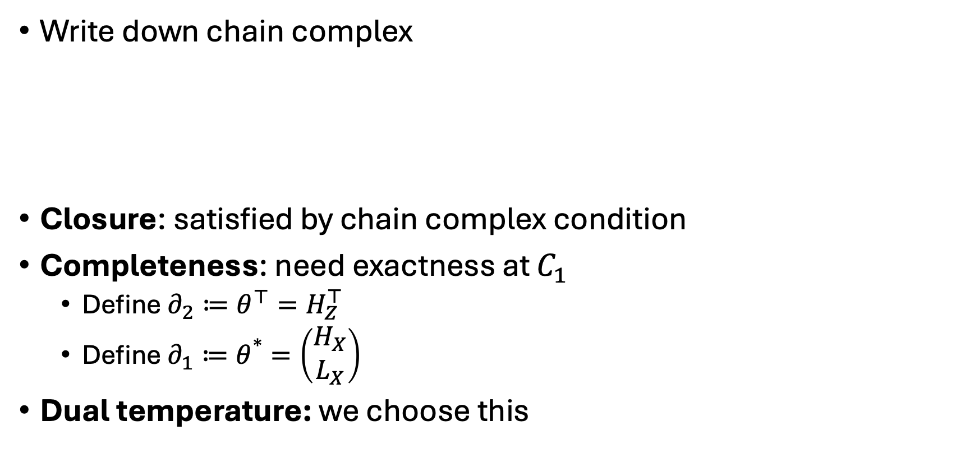
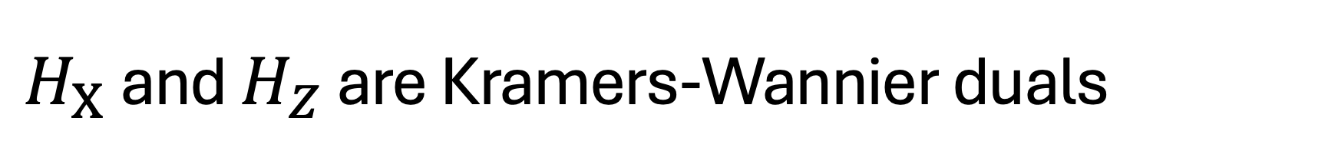
$H_{X}$ and $H_{Z}$ are Kramers-Wannier duals
Write down chain complex
Closure: satisfied by chain complex condition
Completeness: need exactness at $C_{1}$
  Define $∂_{2}≔θ^{⊤}=H_{Z}^{⊤}$
  Define $∂_{1}≔θ^{∗}=\left(\begin{matrix}H_{X} \\ L_{X}\end{matrix}\right)$
Dual temperature: we choose this

Slide 16
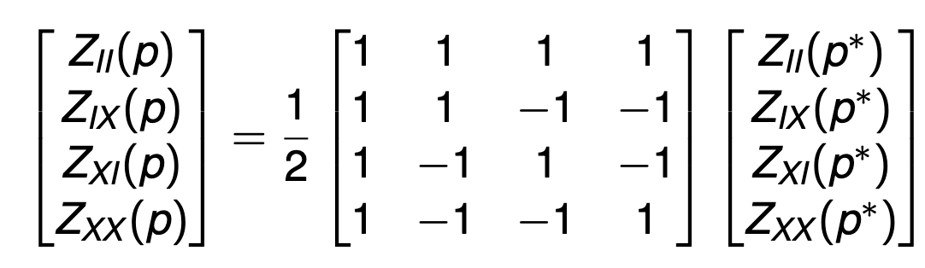

Mixing matrix of em-symmetric codes
Because of ${\left(−1\right)}^{\vec{e}⋅\vec{m}}$ swap, KW duality mixes coset vector with Hadamard matrix, e.g. fully postselected toric code:
 | arXiv:2512.10399

Slide 17
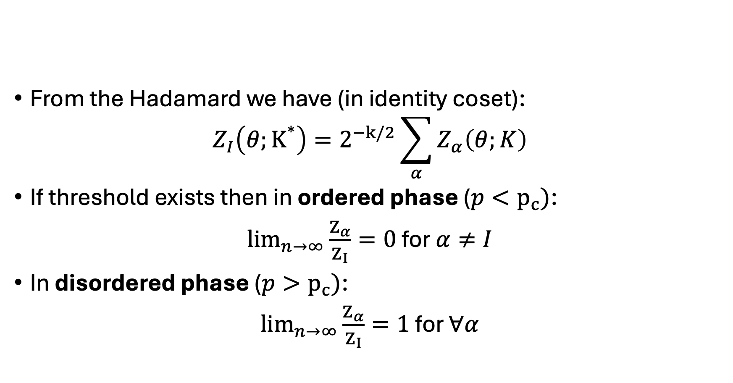
Mixing matrix and coset partition functions
From the Hadamard we have (in identity coset):
$$Z_{I}\left(θ;K^{∗}\right)=2^{−k/2}\sum_{α}{Z_{α}\left(θ;K\right)}$$
If threshold exists then in ordered phase ($p<p_{c})$:
$\lim_{n→∞}\frac{Z_{α}}{Z_{I}}=0$ for $α≠I$
In disordered phase ($p>p_{c})$:
$\lim_{n→∞}\frac{Z_{α}}{Z_{I}}=1$ for $∀α$
 | arXiv:1809.10704

Slide 18
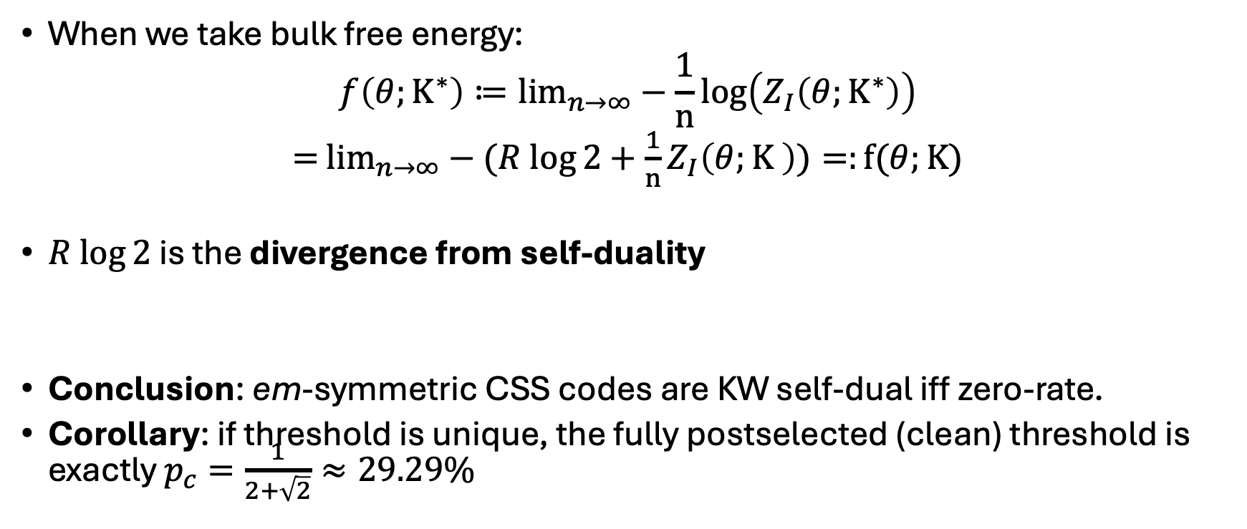
Self-duality if and only if zero-rate
When we take bulk free energy:
$$f\left(θ;K^{∗}\right)≔\lim_{n→∞}−\frac{1}{n}\log\left(Z_{I}\left(θ;K^{∗}\right)\right)$$
$=$ $\lim_{n→∞}−(R log⁡2+\frac{1}{n}Z_{I}\left(θ;K \right))=:f(θ;K)$
$R log⁡2$ is the divergence from self-duality
Conclusion: em-symmetric CSS codes are KW self-dual iff zero-rate.
Corollary: if threshold is unique, the fully postselected (clean) threshold is exactly $p_{c}=\frac{1}{2+\sqrt{2}}≈29.29\%$
 | arXiv:2410.07598

Slide 19
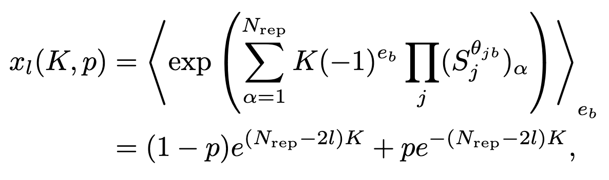
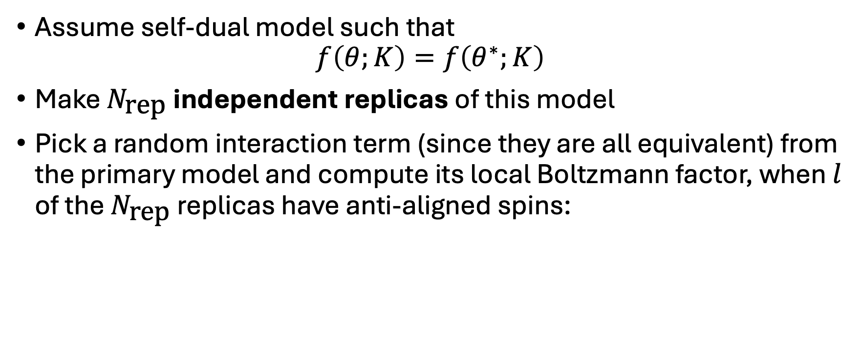
Principal Boltzmann factor construction
Assume self-dual model such that
$$f\left(θ;K\right)=f\left(θ^{∗};K\right)$$
Make $N_{\text{rep}}$ independent replicas of this model
Pick a random interaction term (since they are all equivalent) from the primary model and compute its local Boltzmann factor, when $l$ of the $N_{\text{rep}}$ replicas have anti-aligned spins:
arXiv:cond-mat/0111354

Slide 20
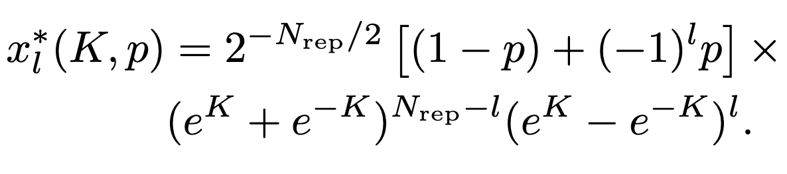
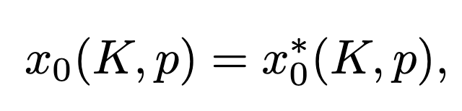
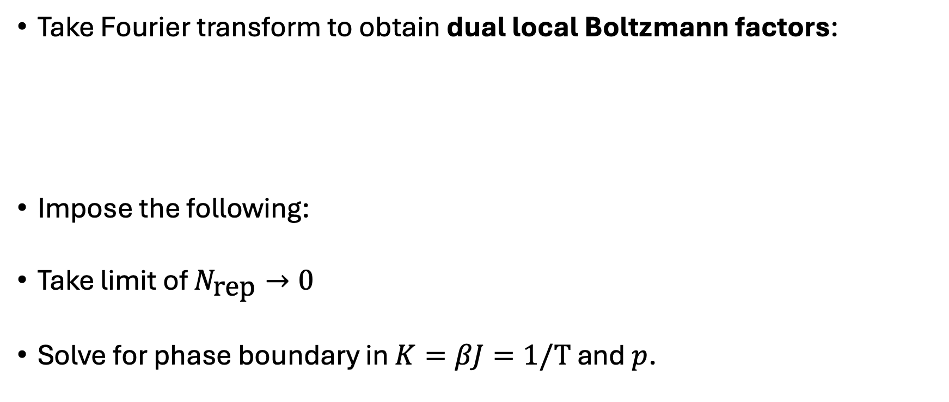
Principal Boltzmann factor construction cont.
Take Fourier transform to obtain dual local Boltzmann factors:
Impose the following:
Take limit of $N_{\text{rep}}→0$
Solve for phase boundary in $K=βJ=1/T$ and $p$.

Slide 21
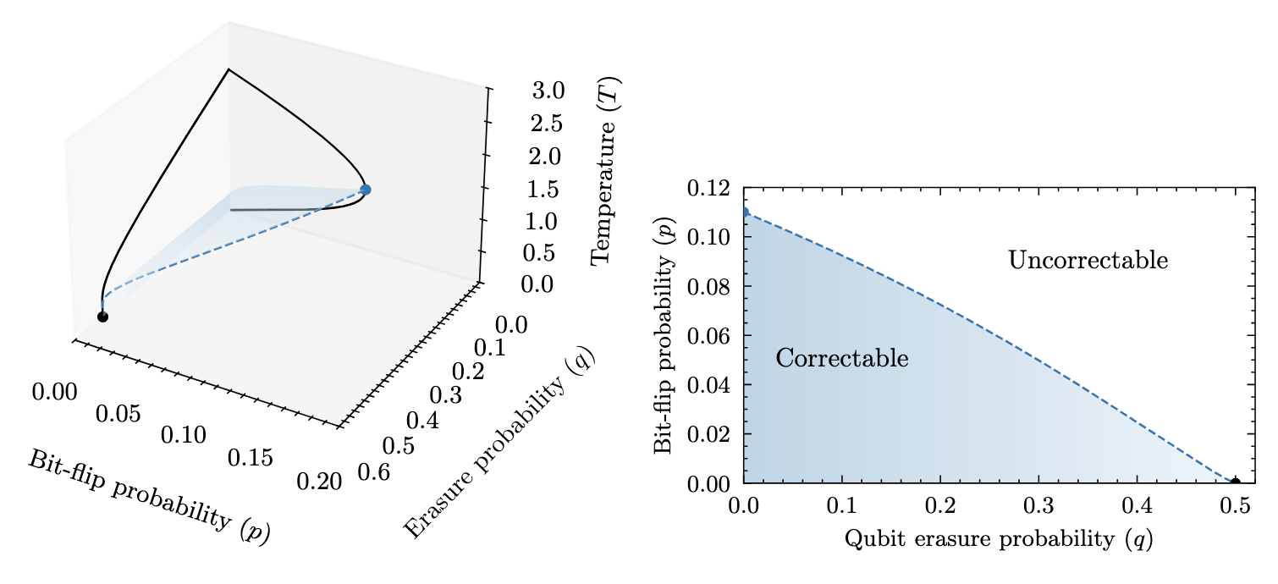
Pauli and erasure errors
We can extend this replica trick straightforwardly to include bond dilution (qubit erasures):

Slide 22
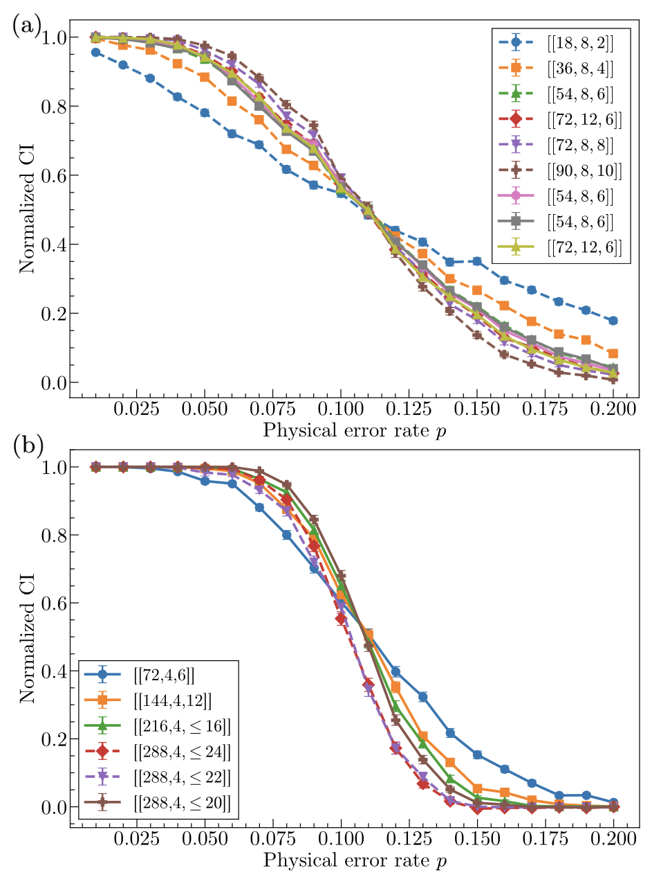
Where else can we apply this?
Other models are also self-dual and zero-rate so our results apply:
  Haah’s code
  3D toric code with bit-flips and measurement errors (phenomenological)
  4D (2,2) toric code
  BB codes
  Lifted product codes
 | arXiv:2607.28621

Slide 23
Other neat stuff in the paper
Concatenated quantum codes map to stat mech models on hierarchical lattices
Poulin’s efficient decoder can be rewritten as an exact real-space renormalization group flow
Overhead of topological and concatenated codes can be expressed as a tradeoff of distance scaling and multiplicity of minimum weight logicals
 | arXiv:quant-ph/0606126

Slide 24
Future work
Replica trick is uncontrolled approximation (why does it work at all?)
Counterexamples where replica trick doesn’t give good approximation
Extend result to non-zero rate codes (hyperbolic surface codes/asymptotically good qLDPC codes?)
Haah’s code

Slide 25
History
(1971) – Wegner generalizes the Kramers-Wannier duality
(2002) – the holy Bible is released by Dennis et al.
(2002) – Nishimori and Nemoto propose principal Boltzmann factor construction to estimate disordered phase diagrams
(2012) – phase diagram of color codes and topological codes mapped out by Bombin et al.
(2018) – Kovalev et al. map CSS codes onto generalized Ising models and apply Wegner duality
(2024) – Su, Yang and Jian propose em symmetry and show em-symmetric topological codes have constrained phase transitions
DOI:10.1063/1.1665530
arXiv:quant-ph/0110143
arXiv:cond-mat/0111354
 | arXiv:1202.1852
 | arXiv:1804.01950
 | arXiv:2401.17359

