Slide 1
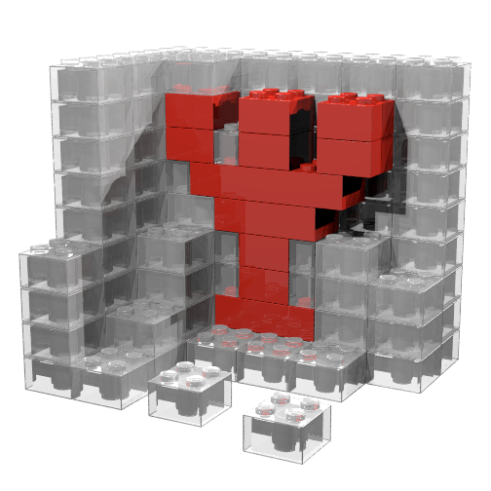

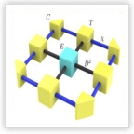
ENTANGLEMENT LEARNING FOR ANISOTROPIC XY AND XYZ MODELS
Physics of Quantum and Materials
Tymoteusz Tula
27.02.2026
Entanglement and topology in interacting quantum matter
Jorge Quintanilla, Gunnar Möller

Slide 2
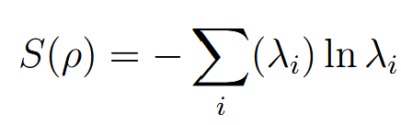
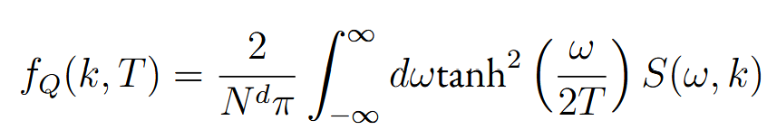

Motivation
General measure of entanglement for many-body state not accessible in experiment
  Entanglement spectrum
Some multipartite entanglement measures defined as a function of correlators in spin systems
  Concurrence
  Quantum Fisher Information
P. Hauke, M. Heyl, L. Tagliacozzo, and P. Zoller, “Measuring multipartite entanglement through dynamic susceptibilities,” Nature Physics, vol. 12, 2016

Slide 3
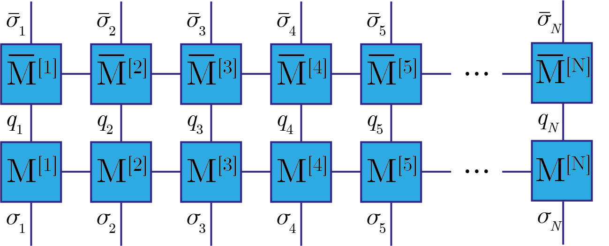
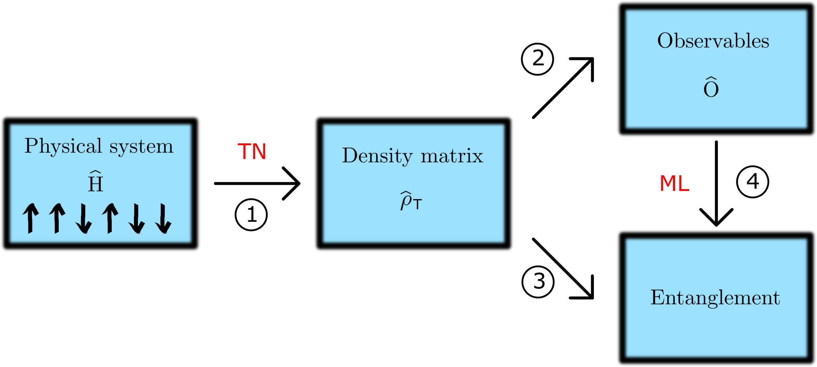
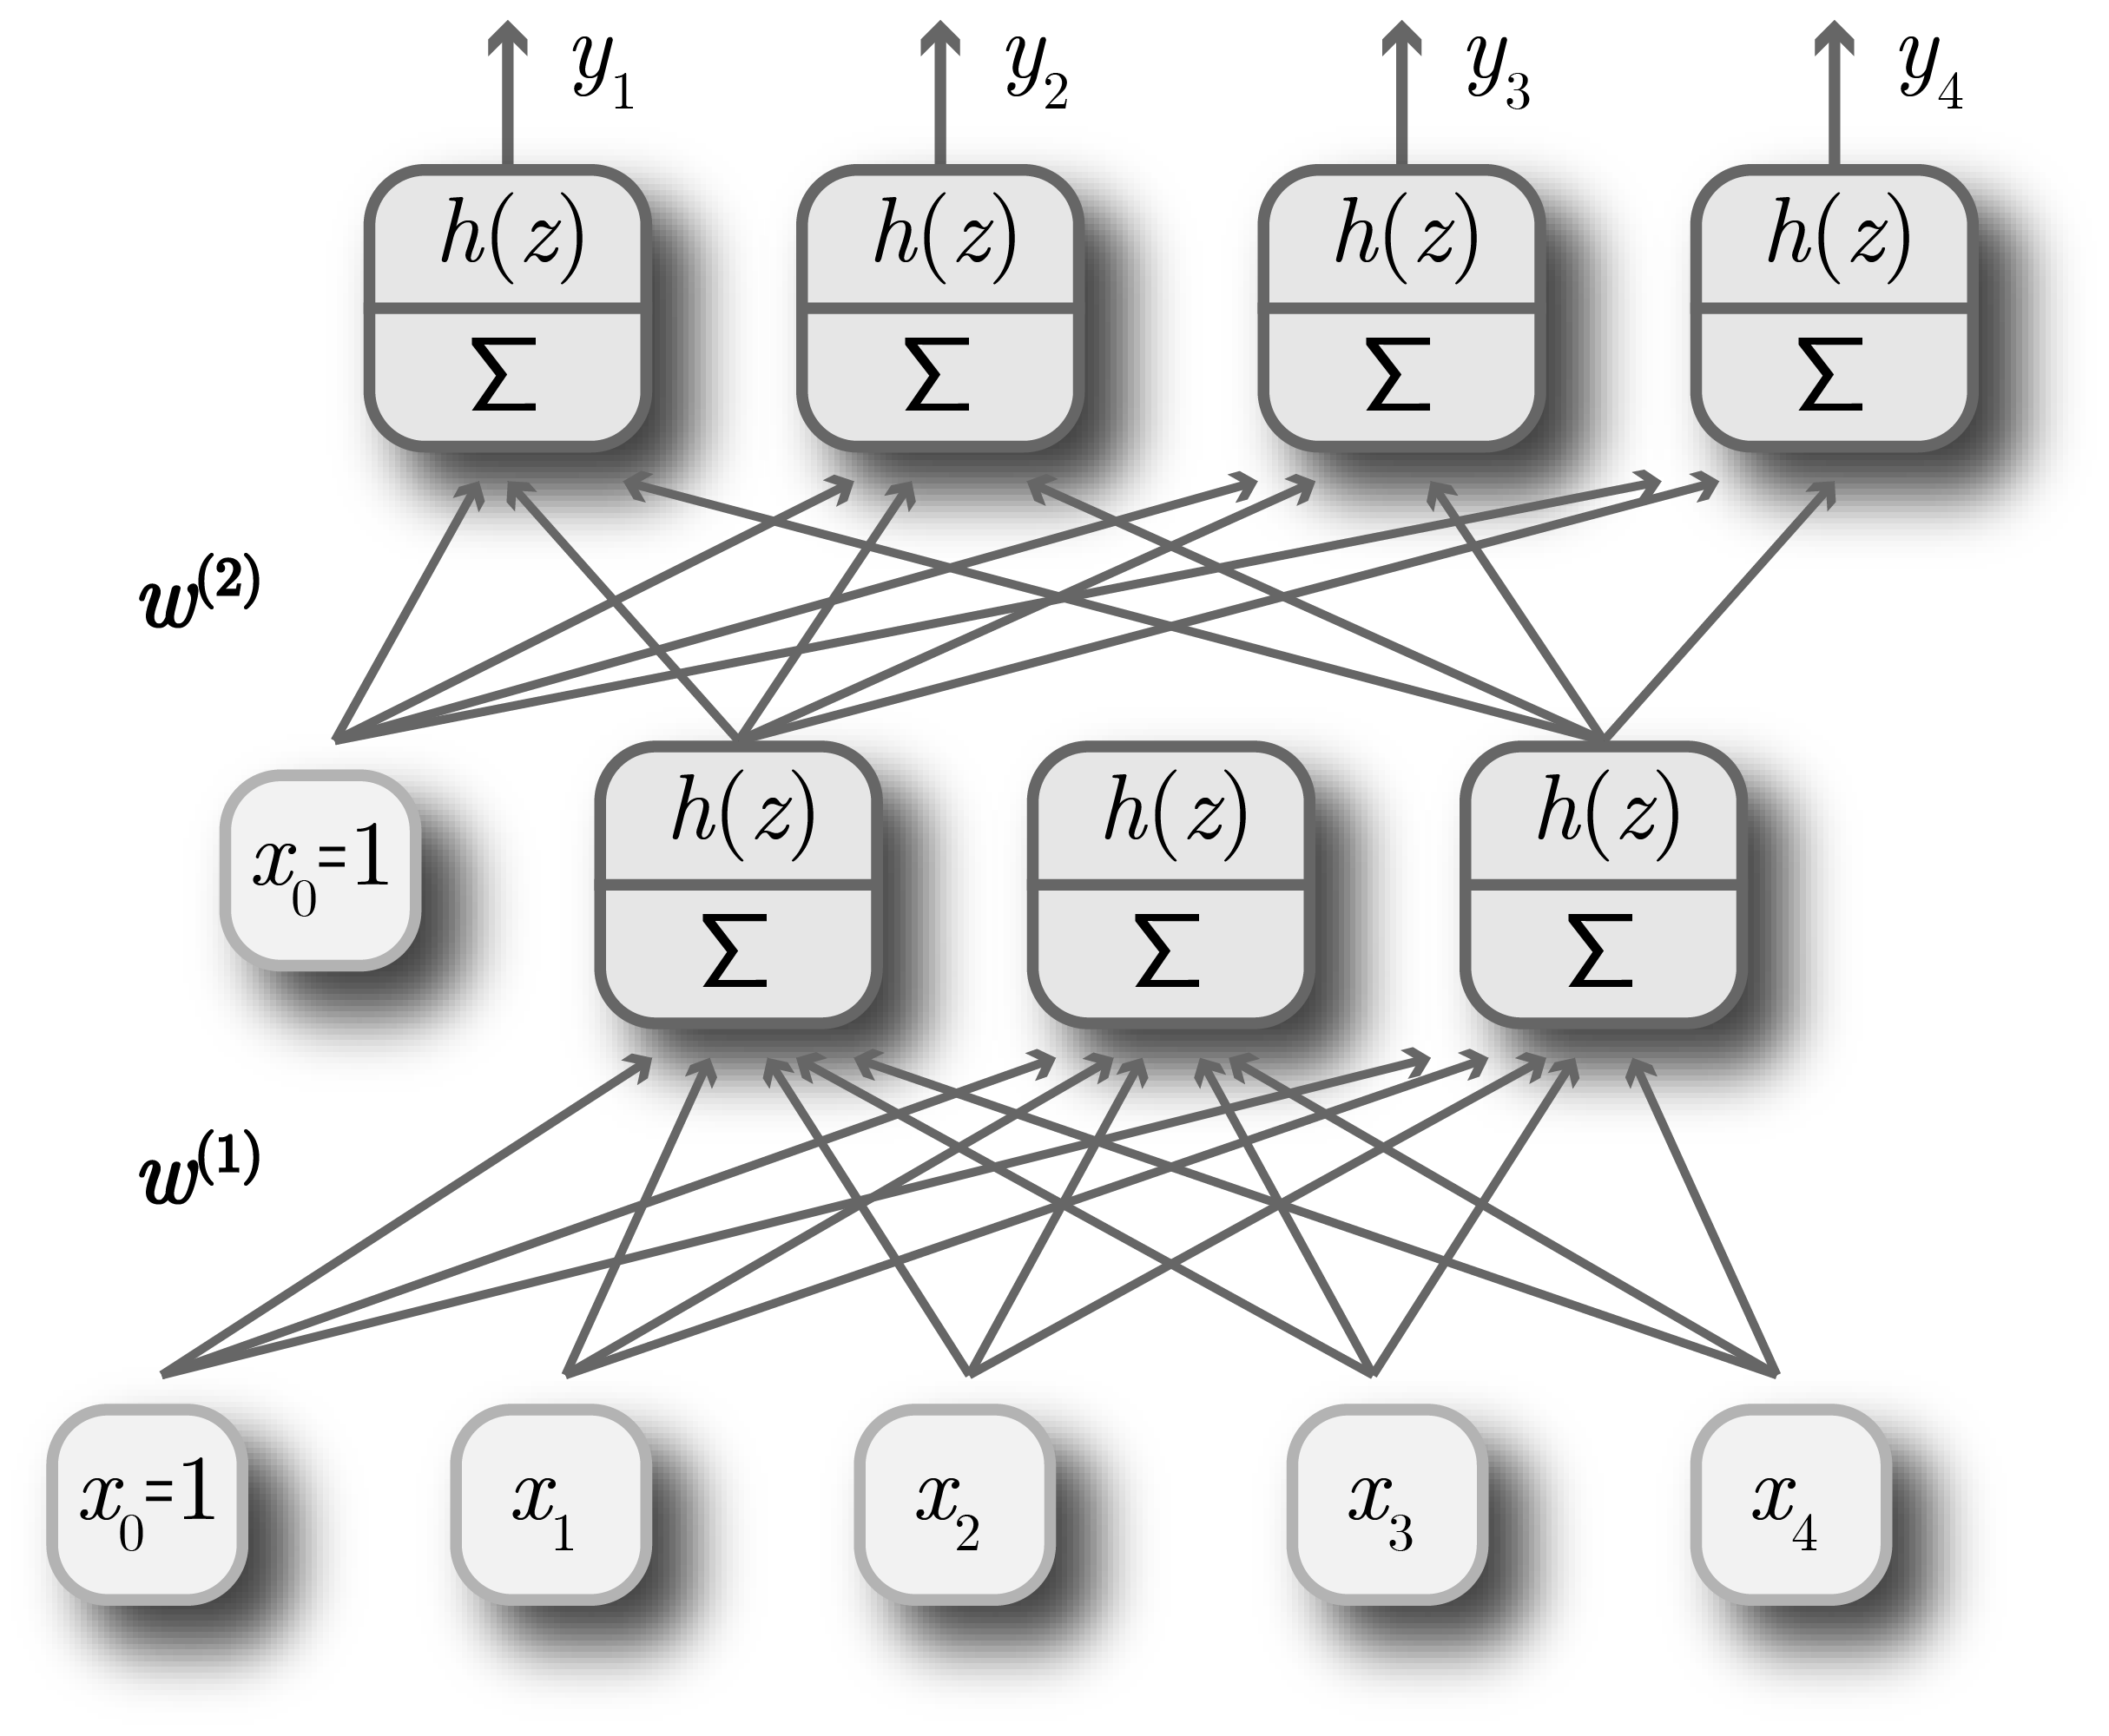
Motivation

Slide 4
Outline
Part 1- theoretical justification
  Connection from static spin correlators to Heisenberg-like Hamiltonians
  Theorem inspired by DFT formalism
  Fitness landscape of the integrated difference between scattering functions
Part 2 – results for entanglement learning
  Anisotropic XY and XYZ 1D spin chain models
  Purification MPS and Entanglement of Purification
  Results and future directions

Slide 5
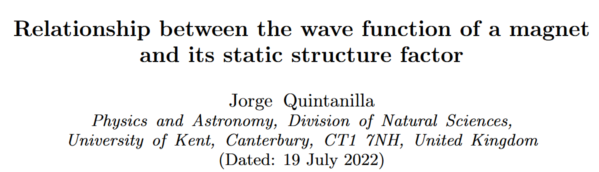
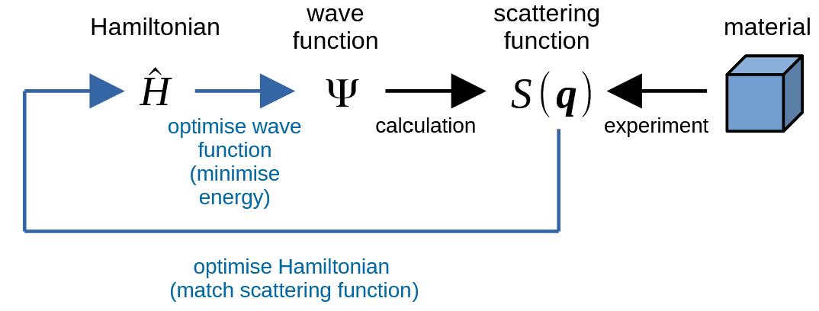
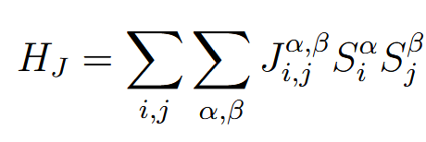
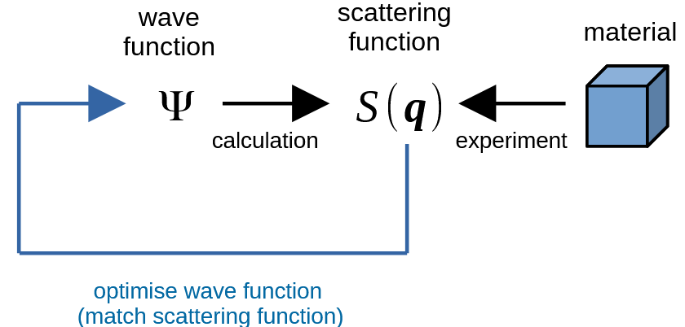
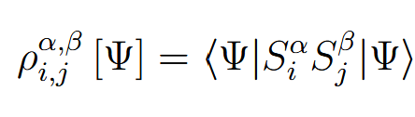
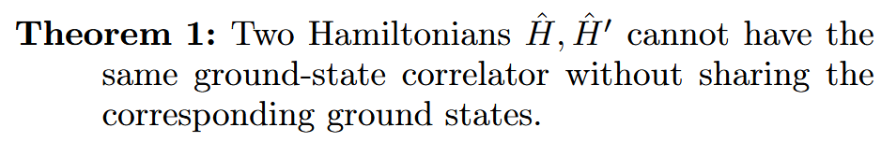
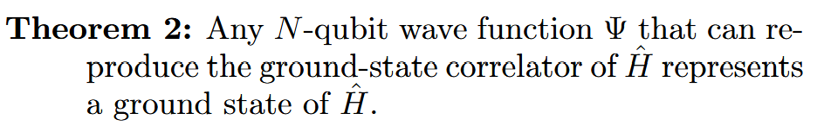
Relationship between Hamiltonian of the type
And spin static correlators:
P. Hohenberg and W. Kohn, “Inhomogeneous electron gas,” Physical Review, vol. 136, no. 3B, pp. B864–B871, 1964.
N. D. Mermin, “Thermal properties of the inhomogeneous electron gas,” Physical Review, vol. 137, no. 5A, pp. A1441–A1443, 1965.
T. K. Ng, “Generalized Hohenberg–Kohn theorem and effective Hamiltonian of a quantum system,” Physical Review B, vol. 44, no. 5, pp. 2407–2410, 1991.

Slide 6
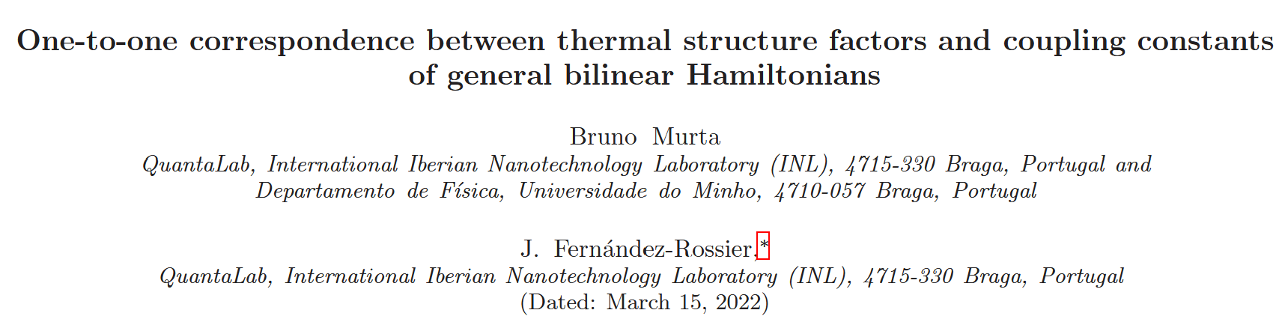
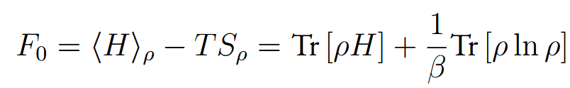
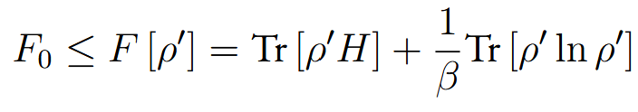
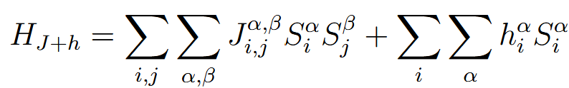
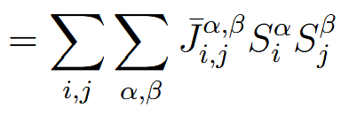

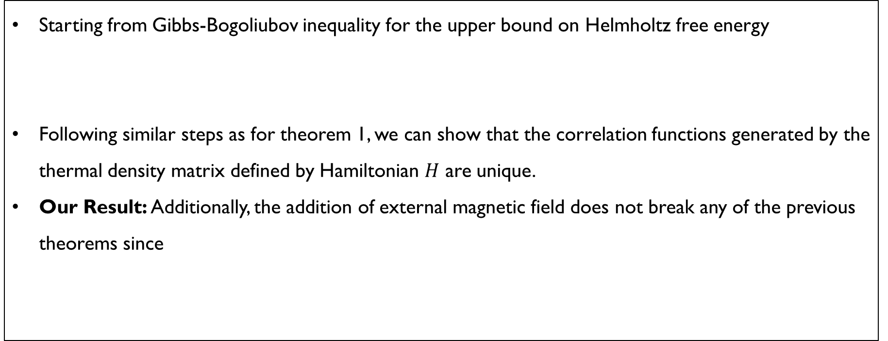
Starting from Gibbs-Bogoliubov inequality for the upper bound on Helmholtz free energy
Following similar steps as for theorem 1, we can show that the correlation functions generated by the thermal density matrix defined by Hamiltonian $H$ are unique.
Our Result: Additionally, the addition of external magnetic field does not break any of the previous theorems since
N. D. Mermin, “Thermal properties of the inhomogeneous electron gas,” Physical Review, vol. 137, no. 5A, pp. A1441–A1443, 1965.
T. Tula, J. Quintanilla, and G. Möller, “Fitness landscape for quantum state tomography from neutron scattering,” Physical Review B, vol. 112, no. 14, p. L140402, 2025.

Slide 7
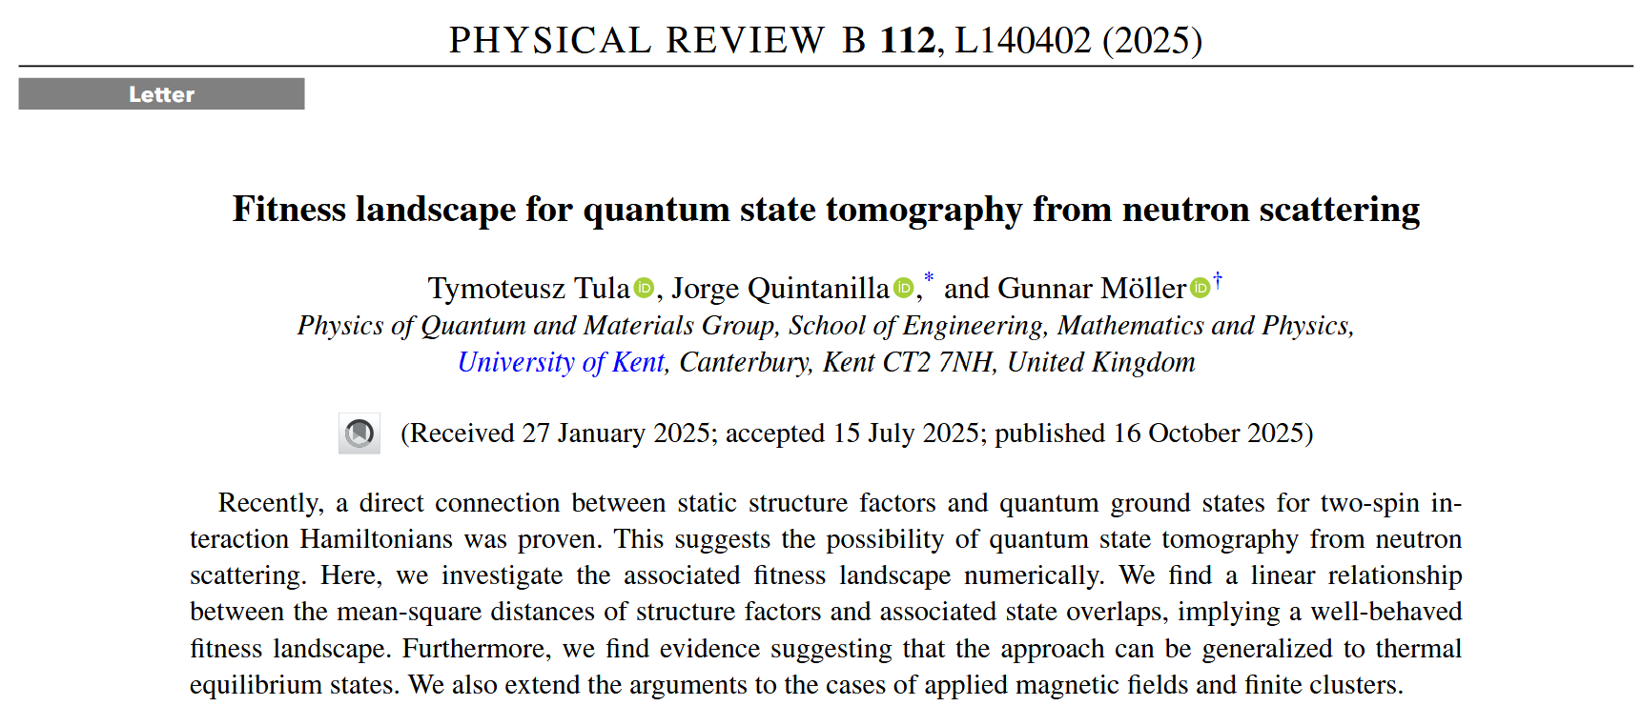
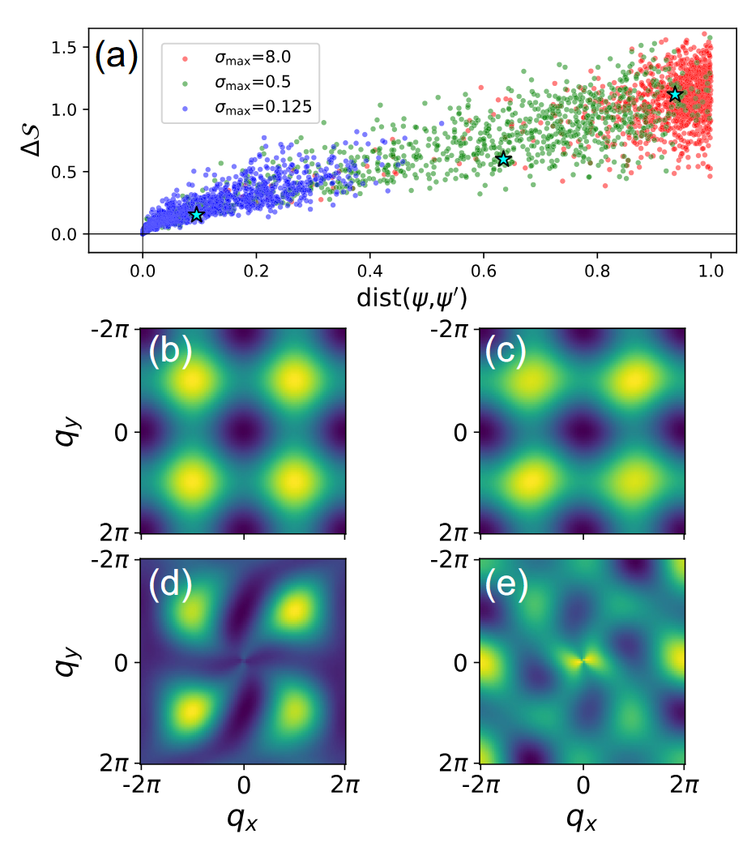
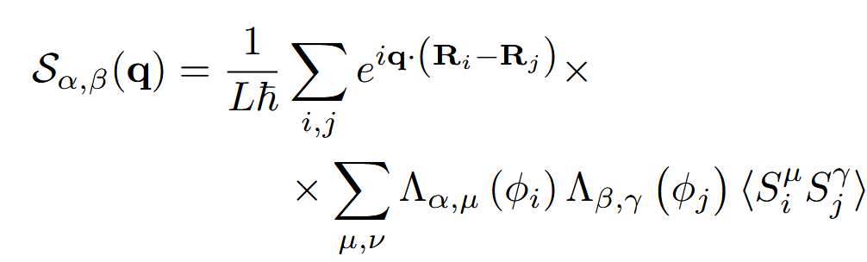
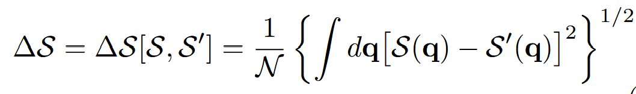
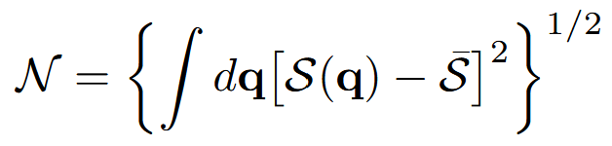
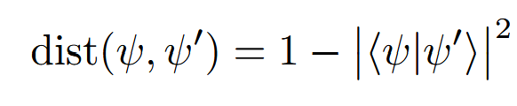
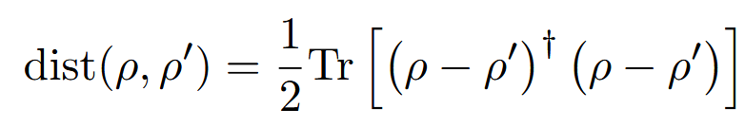
How well this connection looks in practice?
Integrated difference
Distance

Slide 8
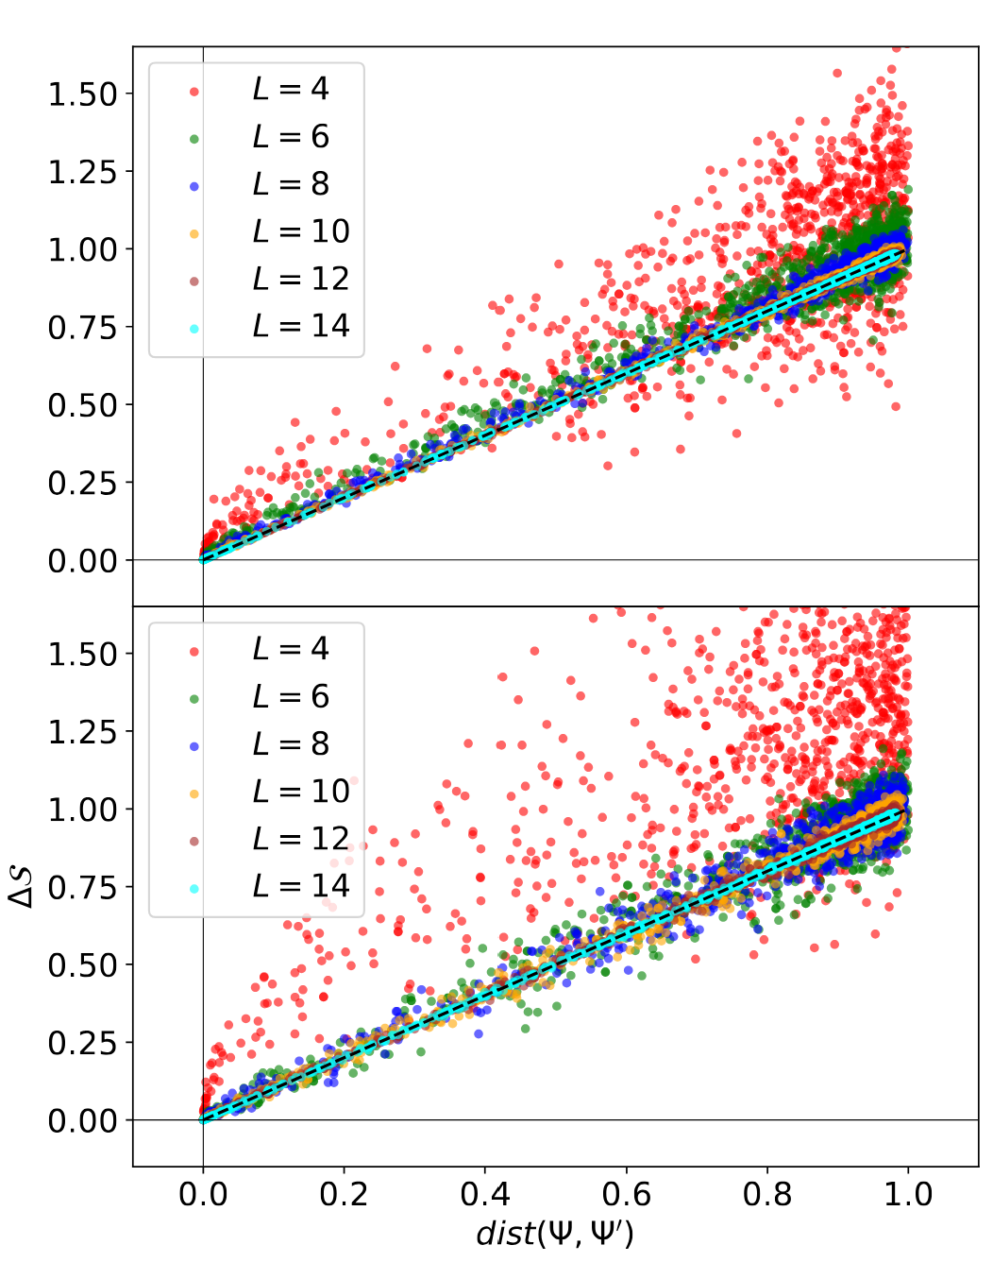
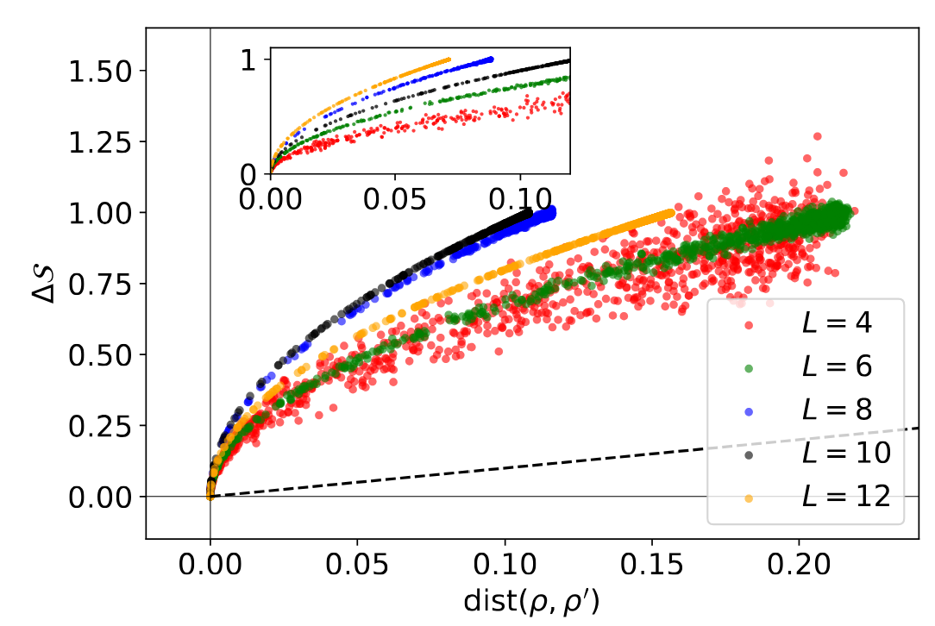
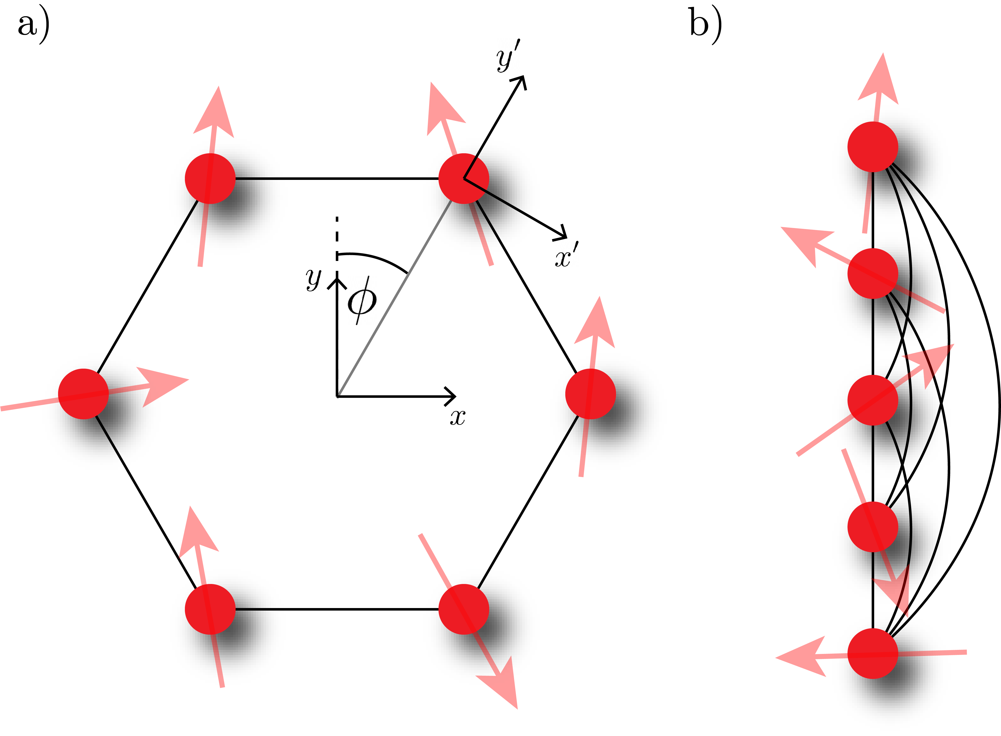
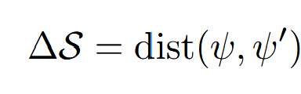
Ground state
Finite temperature state

Slide 9
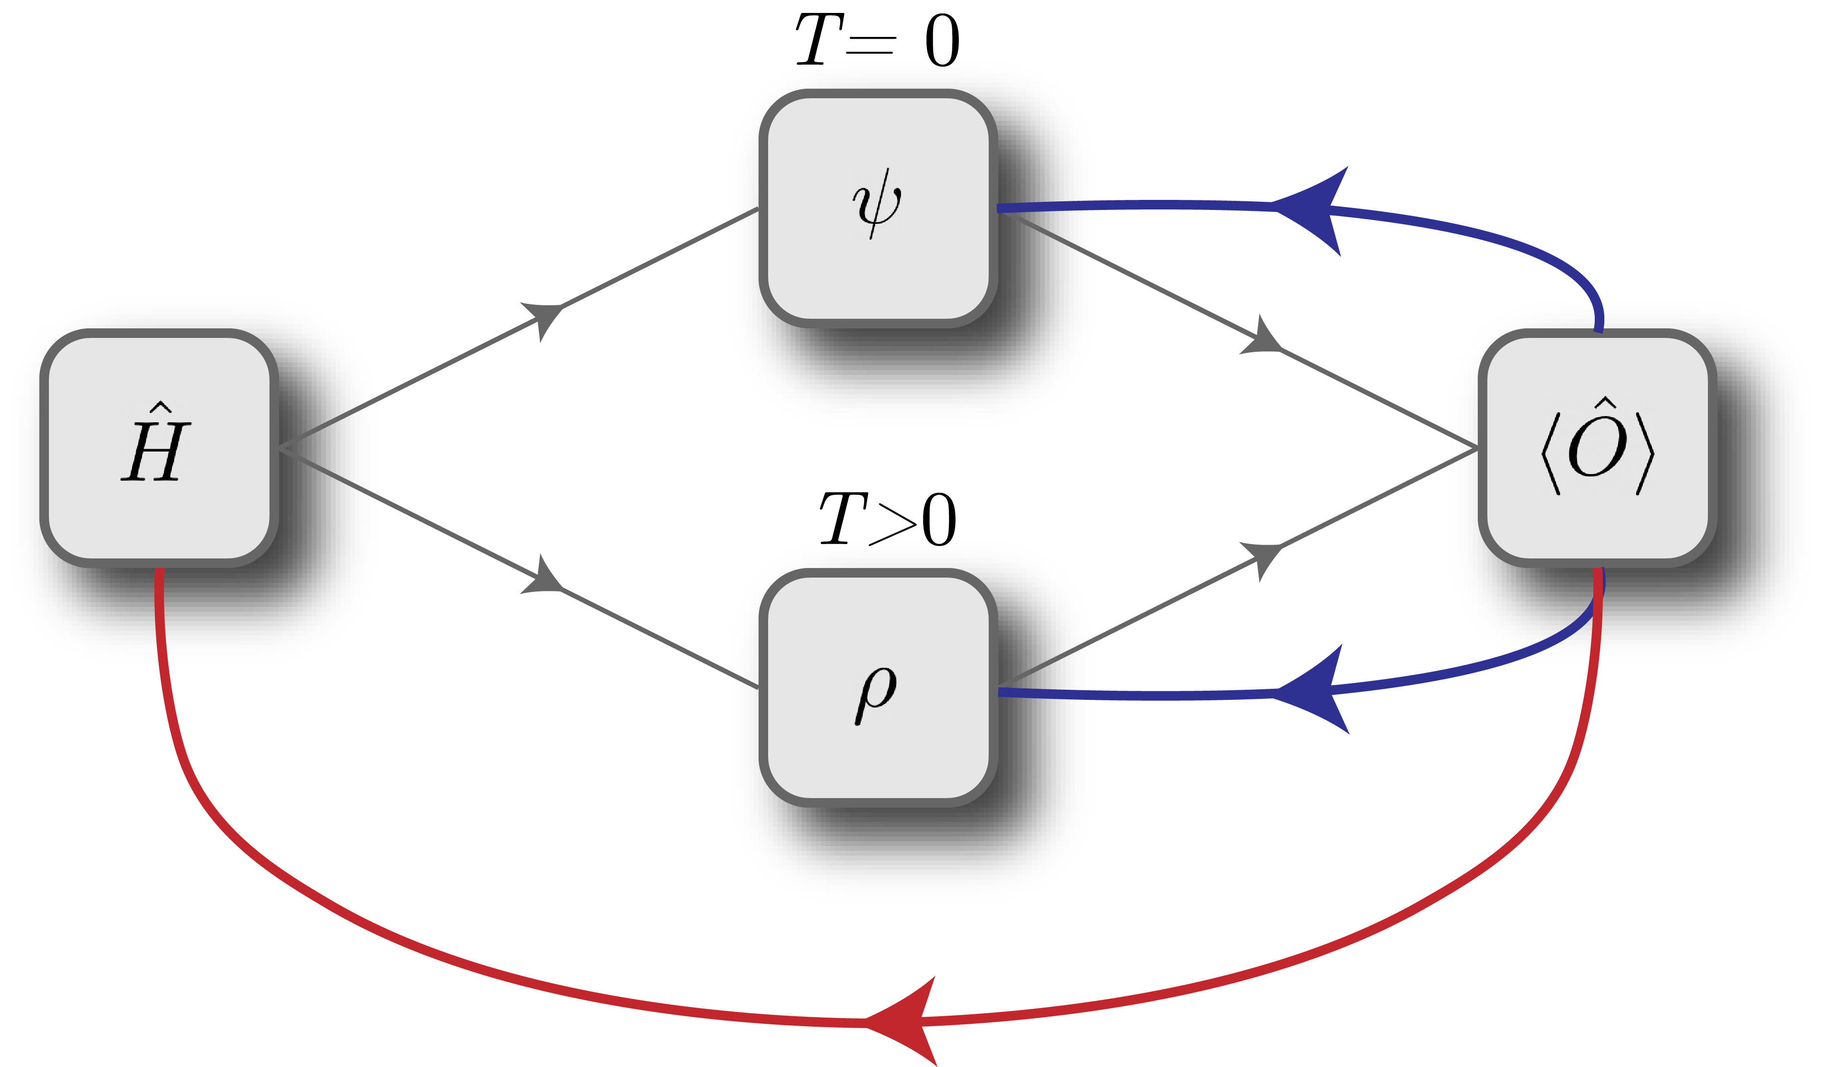
How these results connect to the entanglement learning
Entanglement measure

Slide 10
Outline
Part 1- theoretical justification
  Connection from static spin correlators to Heisenberg-like Hamiltonians
  Theorem inspired by DFT formalism
  Fitness landscape of the integrated difference between scattering functions
Part 2 – results for entanglement learning
  Anisotropic XY and XYZ 1D spin chain models
  Purification MPS and Entanglement of Purification
  Results and future directions

Slide 11
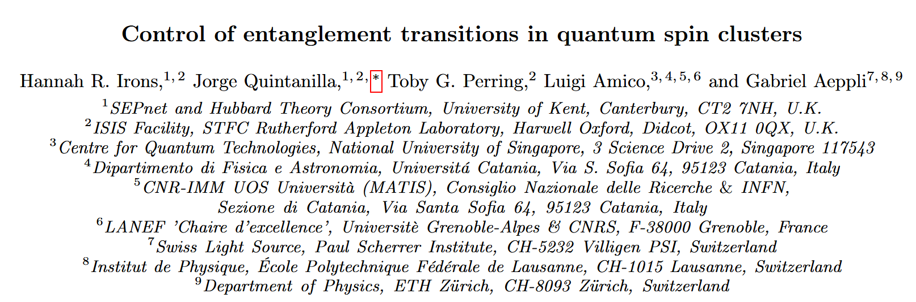
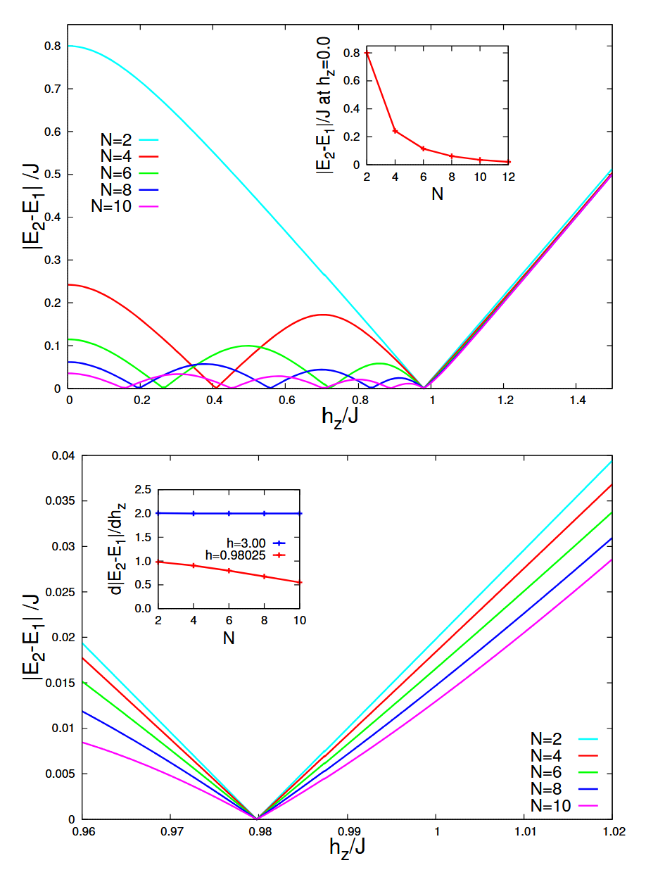
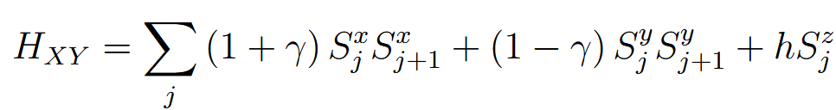

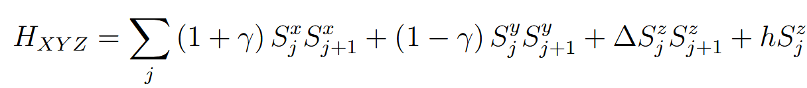

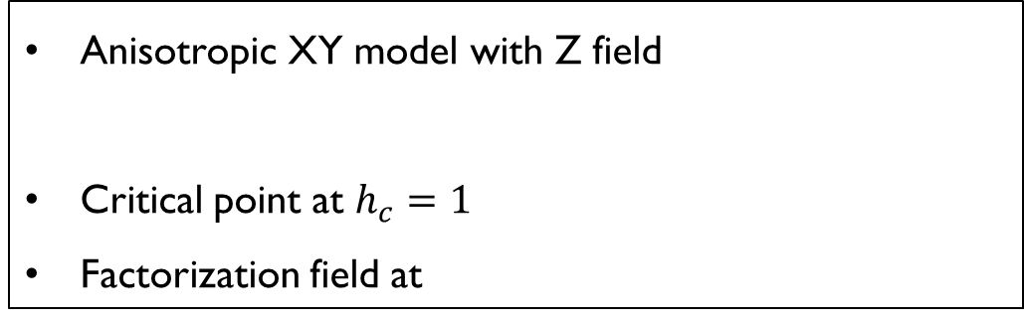
Anisotropic XY model with Z field
Critical point at $h_{c}=1$
Factorization field at
Anisotropic XYZ model with Z field
Critical point in general not known, but upper and lower bounds defined
Factorization field at
J. Kurmann, H. Thomas, and G. Müller, “Antiferromagnetic long-range order in the anisotropic quantum spin chain,” Physica A: Statistical Mechanics and its Applications, vol. 112, 1982.

Slide 12


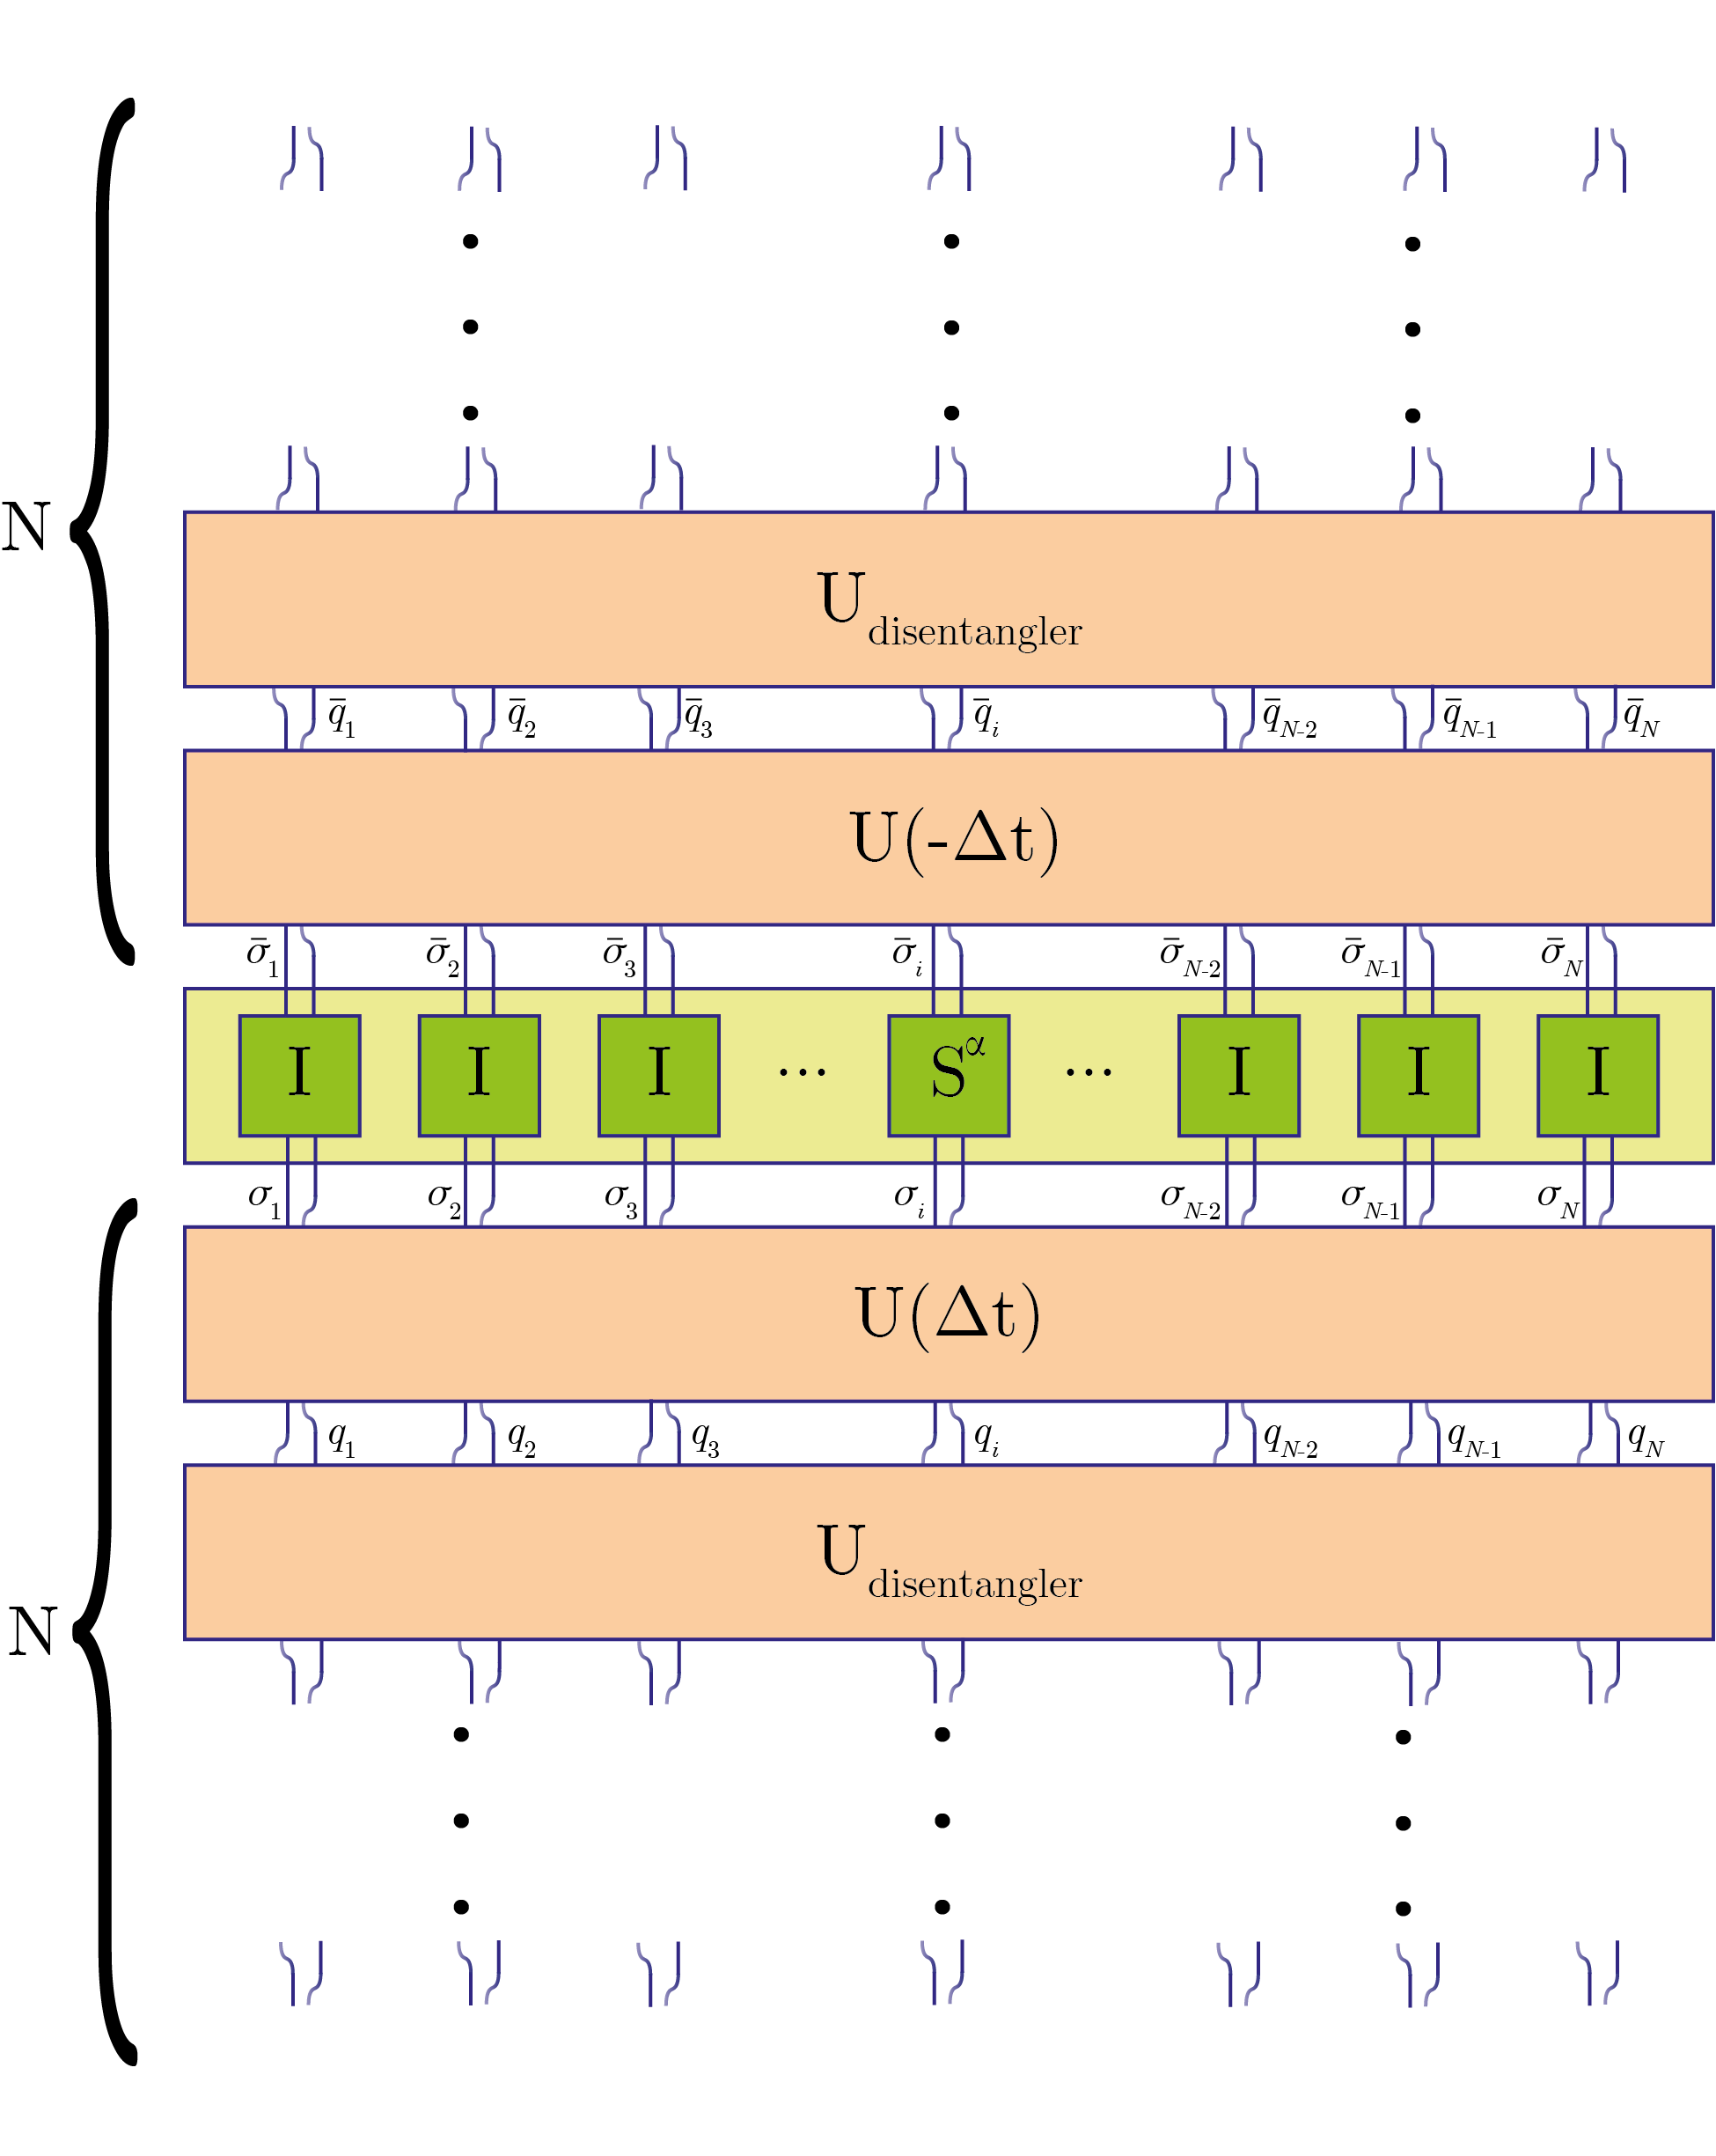
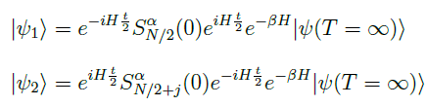
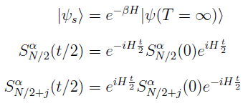
Purification MPS
Purification MPS
Calculating time-dependent observables
Calculating two-point correlations
In combined Heisenberg-Schrödinger picture
C. Karrasch, J. H. Bardarson, and J. E. Moore, “Reducing the numerical effort of finite-temperature density matrix renormalization group calculations,” New Journal of Physics, vol. 15, 2013.

Slide 13
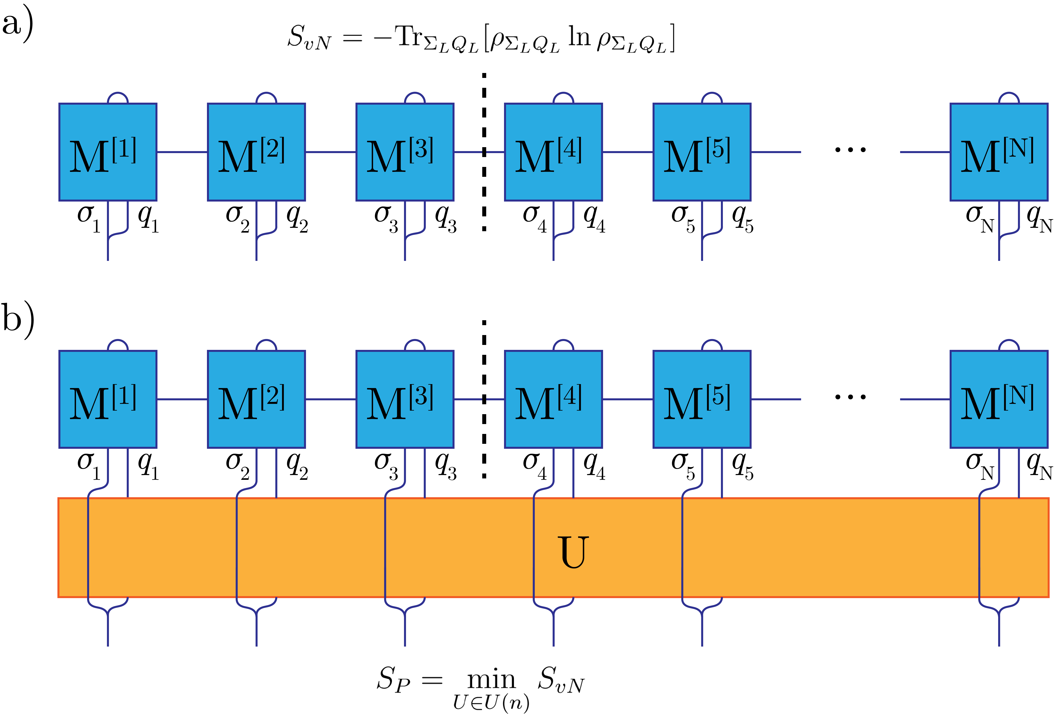
Entanglement of Purification
Satisfied criteria:
Vanishing on product states
Reduction to entanglement entropy on pure states
Non-negativity
Invariance under local Unitaries
Non-satisfied criteria:
Not monotonic under LOCC
Additivity
For mixed separable states, EoP can be non-zero
Vedral, Vlatko, and Martin B. Plenio. "Entanglement measures and purification procedures." Physical Review A 57.3 (1998): 1619.
J. Hauschild, E. Leviatan, J. H. Bardarson, E. Altman, M. P. Zaletel, and F. Pollmann, “Finding purifications with minimal entanglement,” Physical Review B, vol. 98, 2018.

Slide 14
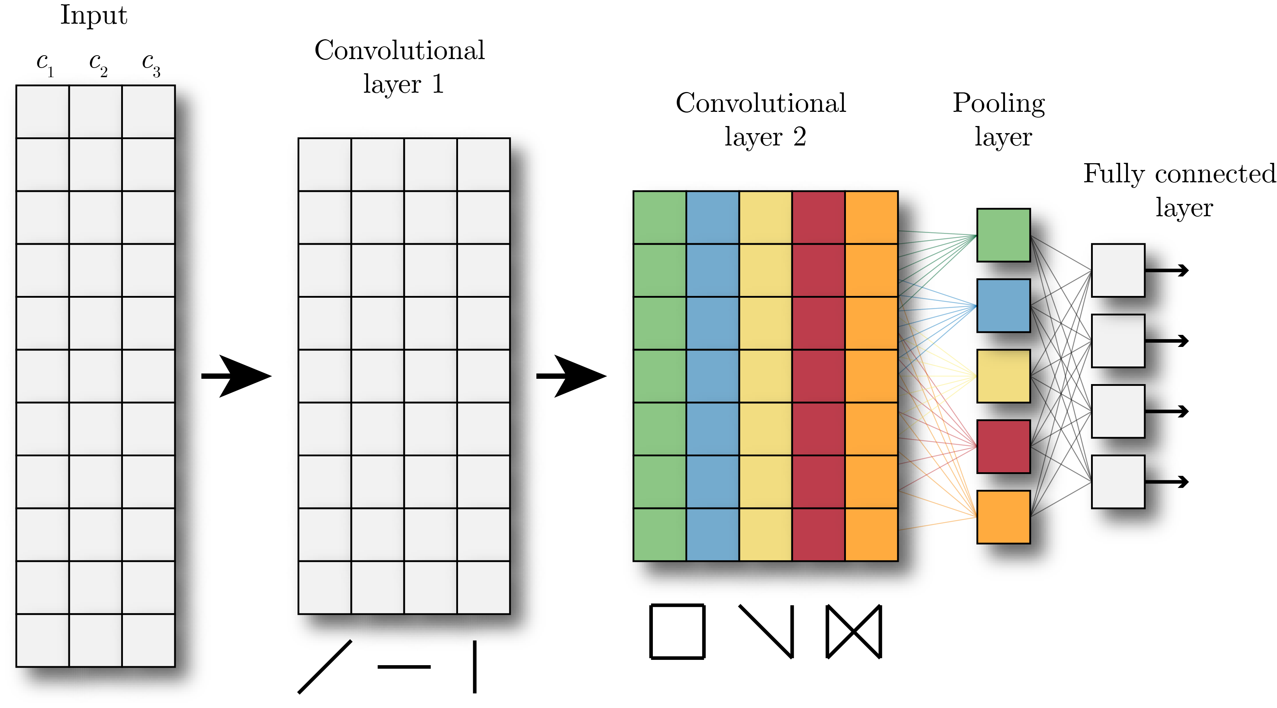
Convolutional Neural Networks
Entanglement of purification
Dynamical/Static spin-spin correlators/structure factors

Slide 15
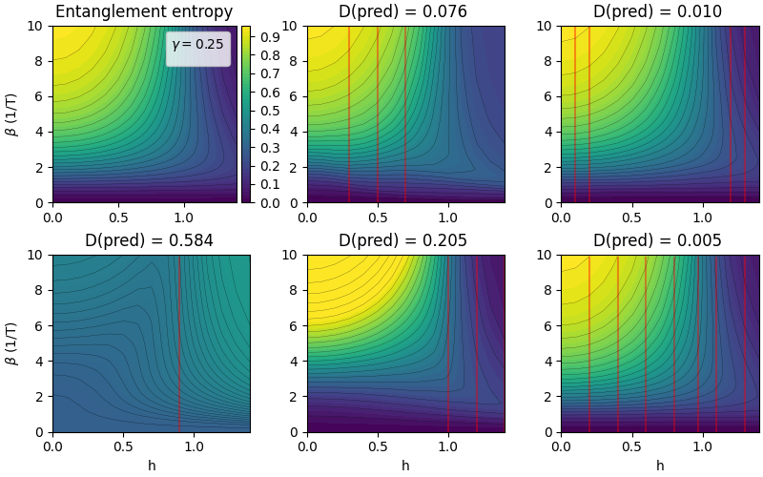
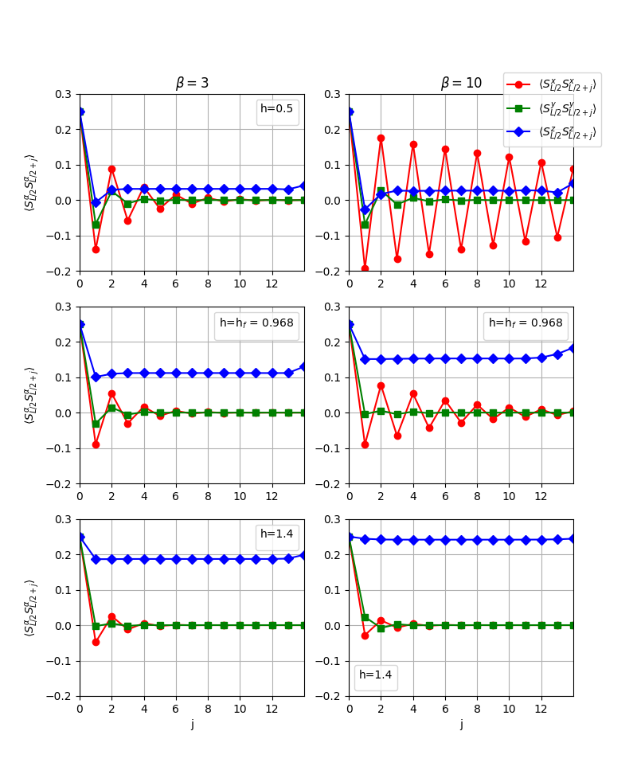
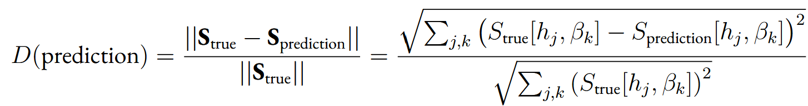
Learning on a Single Model – static correlators
Correlation functions
Dynamical/Static spin-spin correlators/structure factors
Entanglement of purification

Slide 16
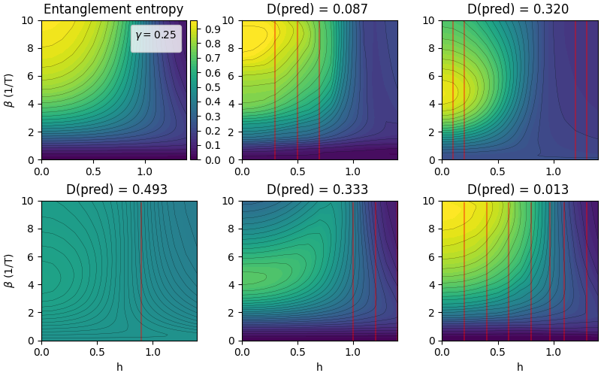
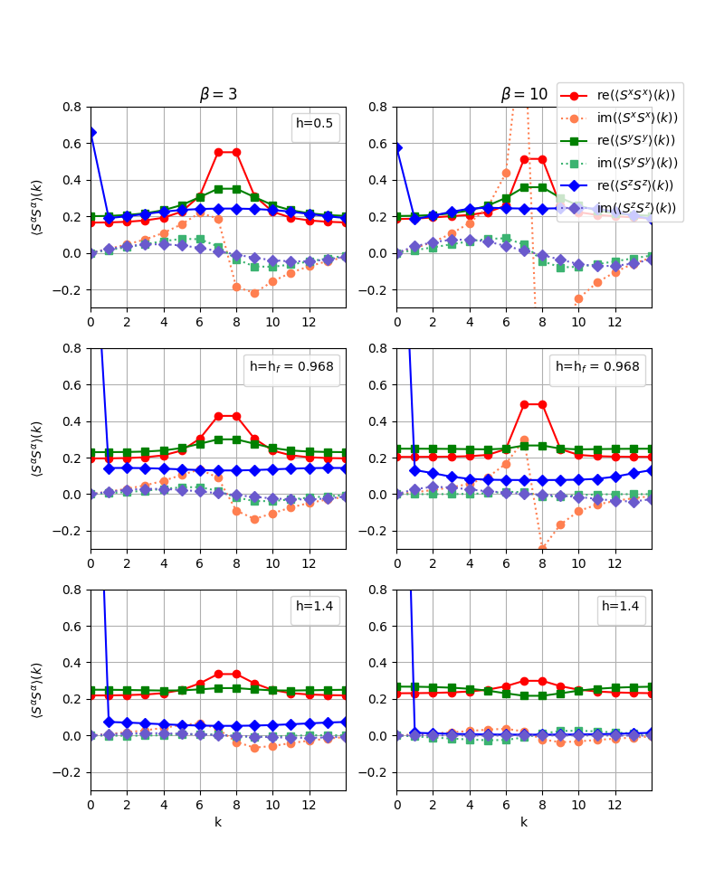
Learning on a Single Model – static Structure factors
Structure factors
Dynamical/Static spin-spin correlators/structure factors
Entanglement of purification

Slide 17
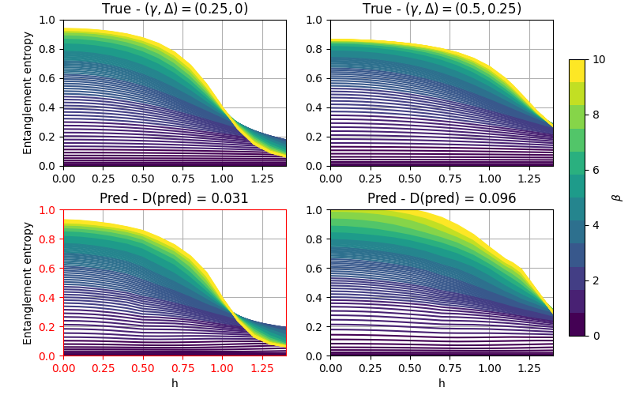
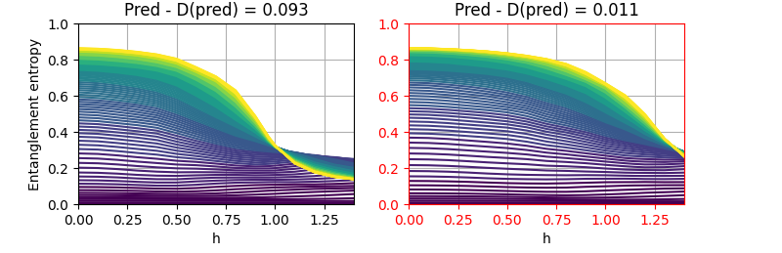
Learning Between models – static correlators
Correlation functions

Slide 18
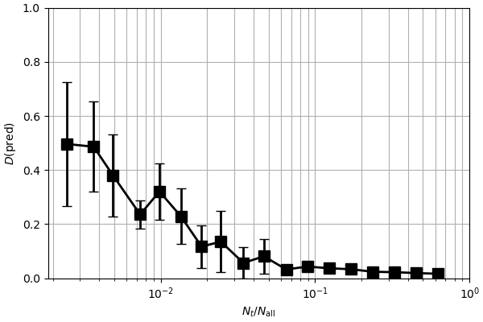

Learning with Dynamical Correlators
Correlation functions
Structure factors
Taking random samples from the entanglement landscape and treating them as training data

Slide 19
Summary and future directions
Numerical exploration of the fitness landscape of scattering functions
Entanglement learning possible for anisotropic XY and XYZ models, either within one model or between them
Future directions
  Applying Entanglement learning to different phases of 1D models
  Exploring different entanglement measures as a target function for entanglement learning (negativity, genuine multipartite entanglement)
  Possible application to experimental data

Slide 20






Sketch for the Proof of theorem 1
Assume that there are two different Hamiltonians $H$ and $H′$ that have different non-degenerate ground states $Ψ_{0}$, $Ψ_{0}^{′}$, but they generate the same static correlators
Then, using the fact that ground states minimizes energy of the corresponding Hamiltonians:
$$⇒$$
J. Quintanilla, “Relationship between the wave function of a magnet and its static structure factor,” Physical Review B, vol. 106, no. 10, p. 104435, 2022.

Slide 21






Sketch for the Proof of theorem 2
Assume that there exist a state $\tilde{Ψ}$ that is not a ground state of $H$ but has the same correlation function
Then, using the Rayleigh-Ritz variational principle
(<)
$$⇒$$
(=)
J. Quintanilla, “Relationship between the wave function of a magnet and its static structure factor,” Physical Review B, vol. 106, no. 10, p. 104435, 2022.

Slide 22







Genuine Multipartite entanglement
Measures whether the state is not-separable with ANY bipartition of the system
PPT mixture
If a state is outside PPT mixture, then it is “genuinely multipartite entangled”
State is outside PPT mixture = There exist a special entanglement witness for that state
Entanglement witness –
Parametrization
The large number of parameters contained in is reduced to optimizing over real numbers
Suitable for working with Tensor Networks!
Jungnitsch, B., Moroder, T., & Gühne, O. (2011). Taming multiparticle entanglement. Physical Review Letters, 106(19). https://doi.org/10.1103/PhysRevLett.106.190502

