Slide 1

Gauging the variational optimization of projected
entangled-pair states
arXiv:2508.10822
Wei Tang (Ghent University)
Joint work with Laurens Vanderstraeten and Jutho Haegeman
Feb 23, 2026 Benasque

Slide 2
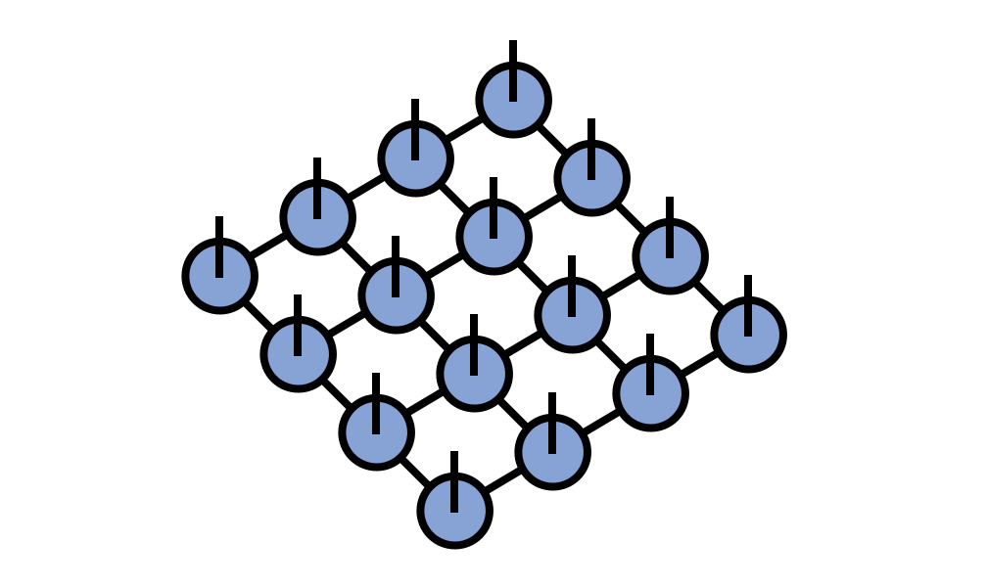

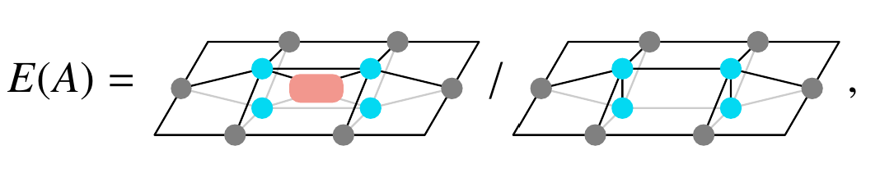
Variational optimization of iPEPS
Verstraete, Cirac, arXiv:cond-mat/0407066
Contraction
Optimization
Imaginary time evolution (simple update, full update…)
Gradient based methods (AD,...)
Approximate contraction schemes (CTMRG, VUMPS,…)
Accuracy controlled by environment bond dimension
The optimization can be unstable!

Slide 3
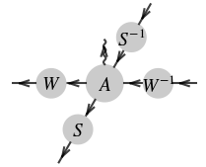
Variational optimization of iPEPS
Verstraete, Cirac, arXiv:cond-mat/0407066
Contraction
Approximate contraction schemes (CTMRG, VUMPS,…)
Accuracy controlled by environment bond dimension
Virtual gauge degrees of freedom

Slide 4
Virtual gauge degrees of freedom in iPEPS
Tensor network contraction schemes are …
  approximate (controlled by bond dim)
  based on entanglement structures of environment
Gauge transformations can …
  modify entanglement structure of env
Virtual gauge degrees of freedom
WT, Verstraete, Haegeman, Phys. Rev. B 111, 035107 (2025)

Slide 5
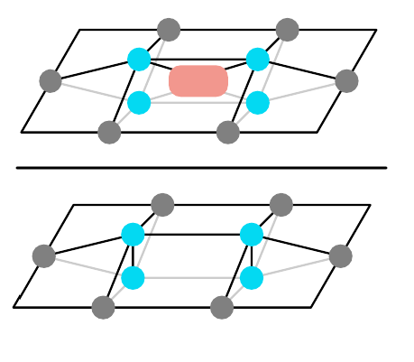



How do these gauge degrees of freedom affect the iPEPS optimization?
How to systematically exclude them from the optimization?

Slide 6
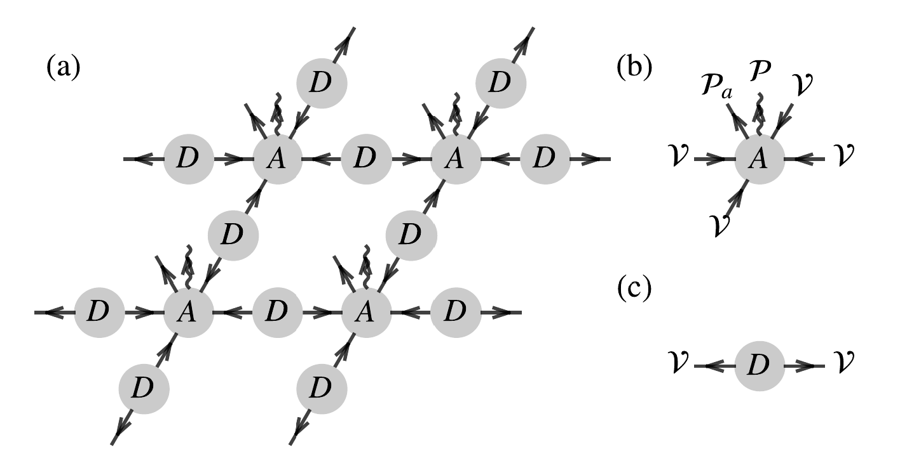
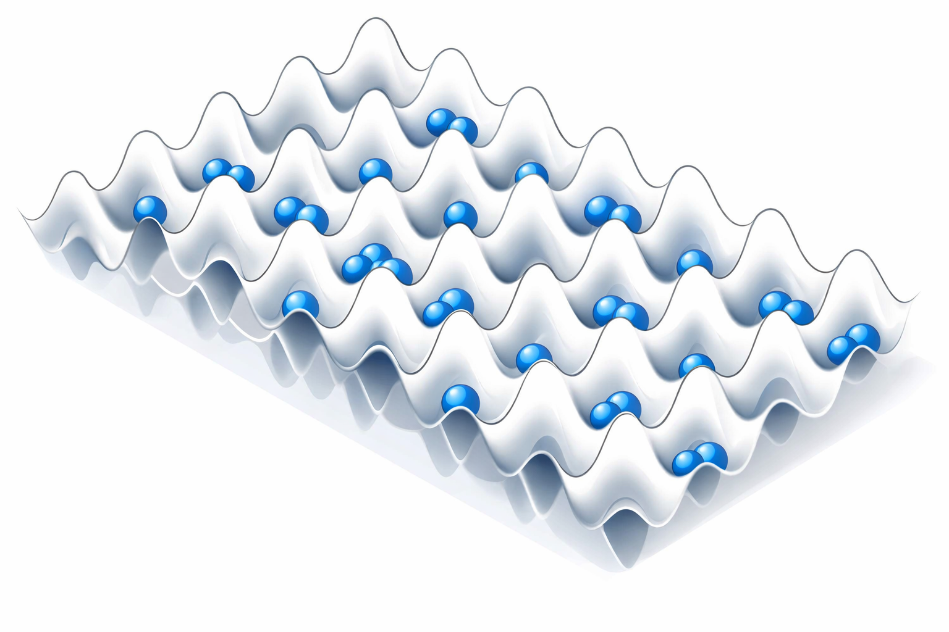
Example in Bose-Hubbard model
U = 30 (deep in the Mott insulator phase)
iPEPS with U(1) and C4v symmetry

Slide 7
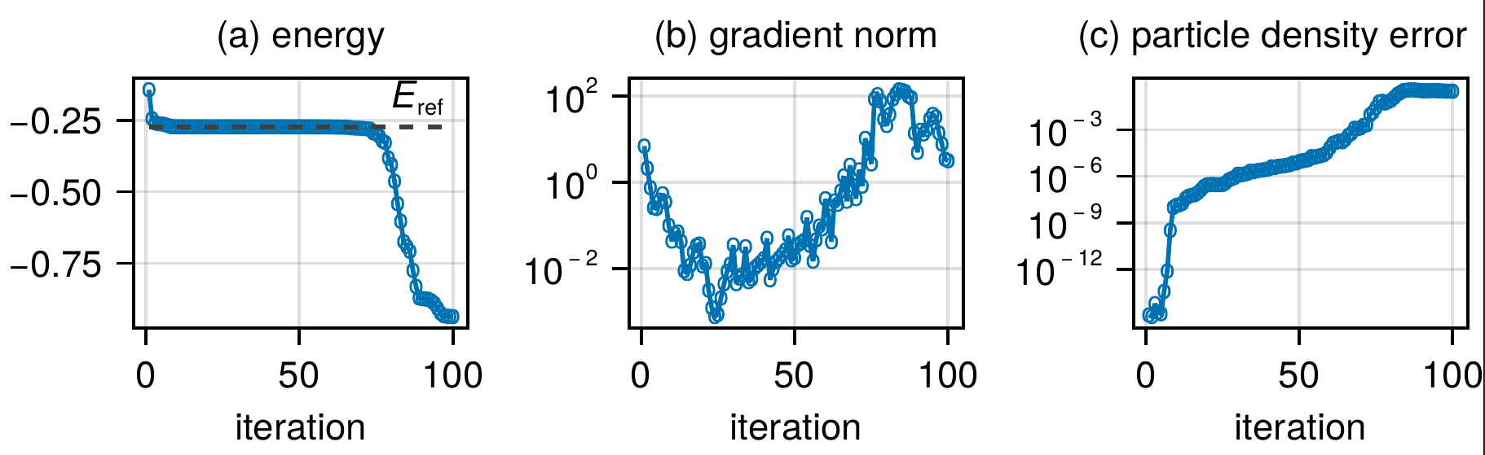
Example in Bose-Hubbard model
iPEPS with D = 4, environment bond dimension 𝜒 = 5
data obtained with VUMPS, all converged with convergence measure < 1e-9

Slide 8
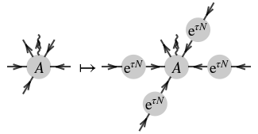

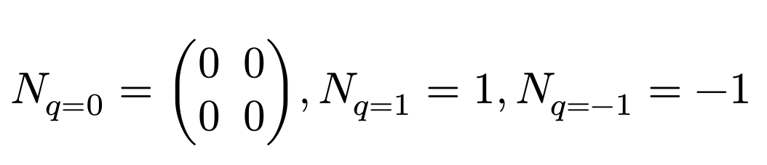
Gauge degrees of freedom
𝑁𝐷 + 𝐷𝑁 = 0
Example: virtual space -> 1 gauge degree of freedom

Slide 9
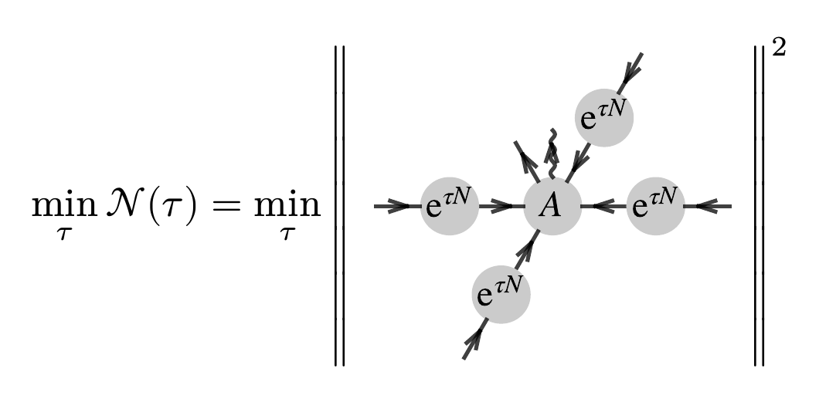
Gauge-fixing by minimal canonical form (MCF)
Minimal Canonical Form (MCF) Minimizing the 2-norm of local tensors
Acuaviva, Makam, Nieuwboer, Pérez-García, Sittner, Walter, Witteveen, in FOCS 2023, arXiv:2209.14358

Slide 10
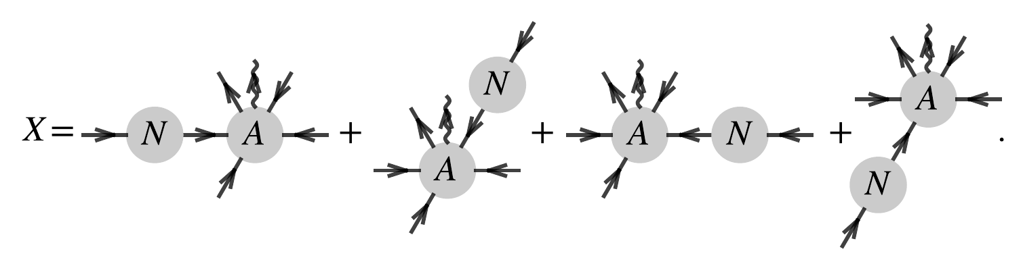

MCF gauge-fixing condition
quadratic function of A
Acuaviva, Makam, Nieuwboer, Pérez-García, Sittner, Walter, Witteveen, in FOCS 2023, arXiv:2209.14358

Slide 11
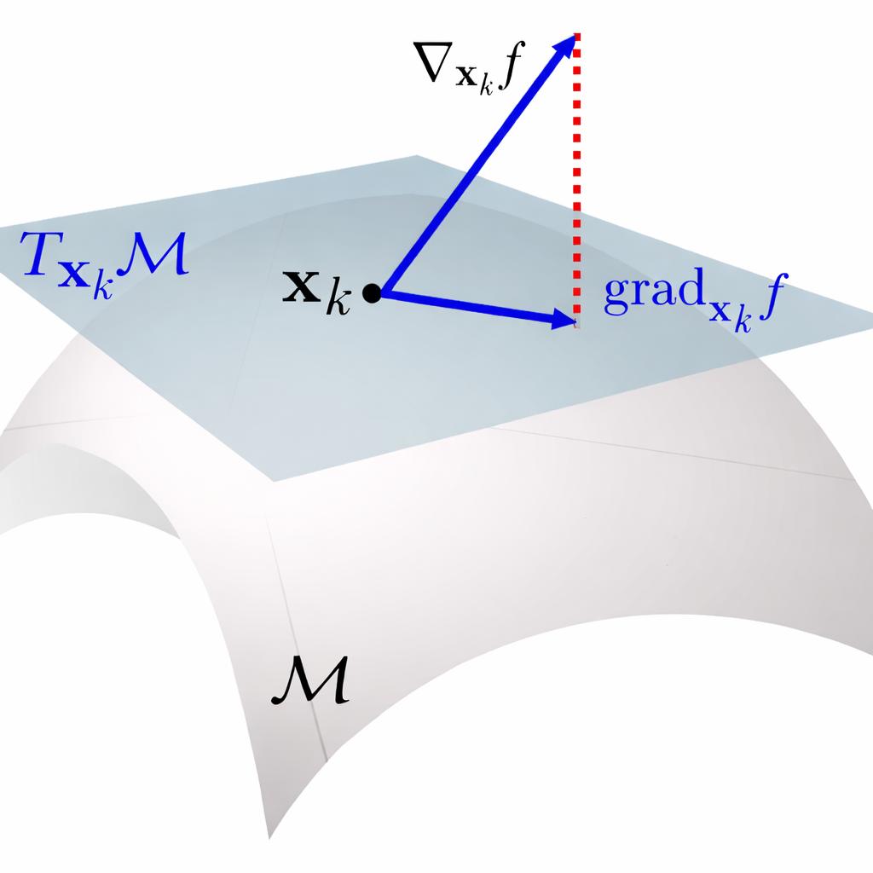
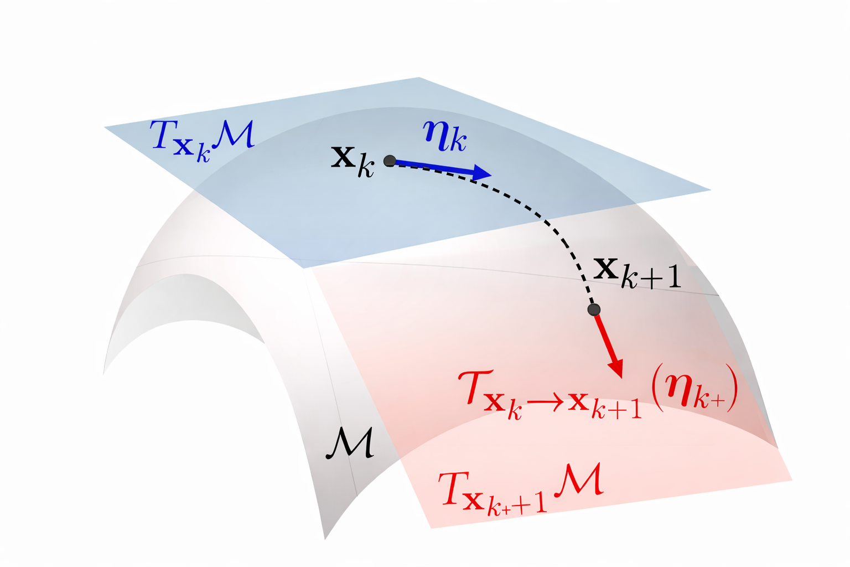

Manifold optimization
tangent-space projection
retraction + vector transport

Slide 12



Manifold optimization
tangent vector
gauge transformation directions
original derivative
tangent-space projection
number of equations = number of gauge degrees of freedom

Slide 13
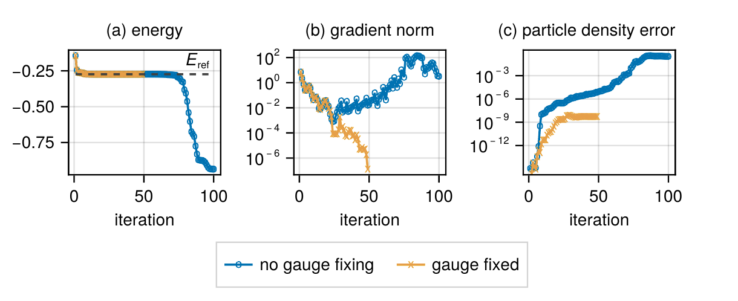
Example in Bose-Hubbard model
iPEPS with D = 4, environment bond dimension 𝜒 = 5
data obtained with VUMPS, all converged with convergence measure < 1e-9

Slide 14
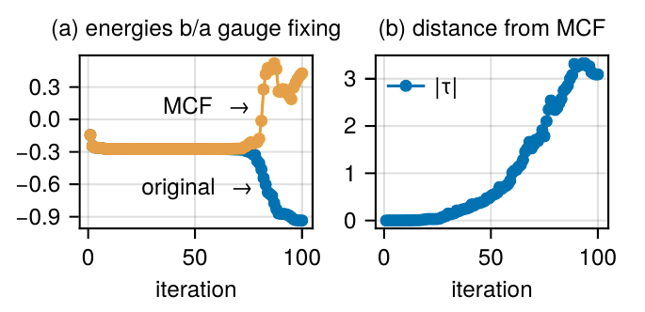
Comparison in more detail…
The states with artificially low energies are high-energy states
The optimization without gauge fixing drives the PEPS away from the MCF

Slide 15
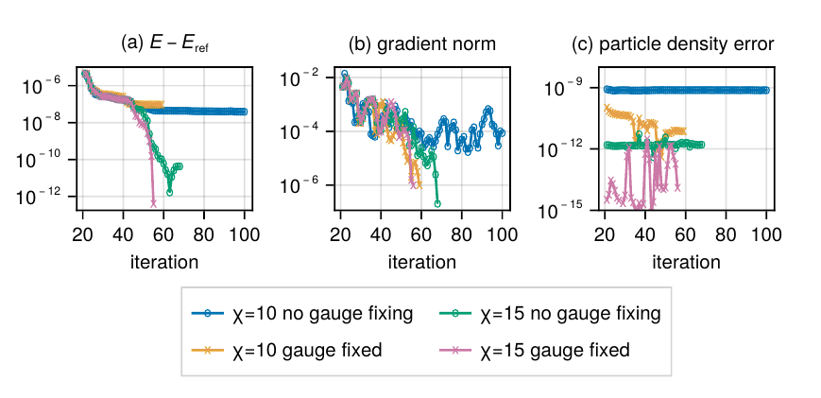
Results with larger environment bond dimensions
In practice, one may need very large 𝜒 to fully suppress the virtual gauge effects

Slide 16
Summary and outlook
gauge-fixing in the variational optimization of PEPS can help improve stability
Proposes a manifold optimization scheme for the MCF gauge-fixed iPEPS
Manifold optimization scheme in more general iPEPS ansatz?
Other gauge-fixing conditions
Gauge covariant contraction schemes for 2D tensor networks?
Thank you for your attention!

Slide 17
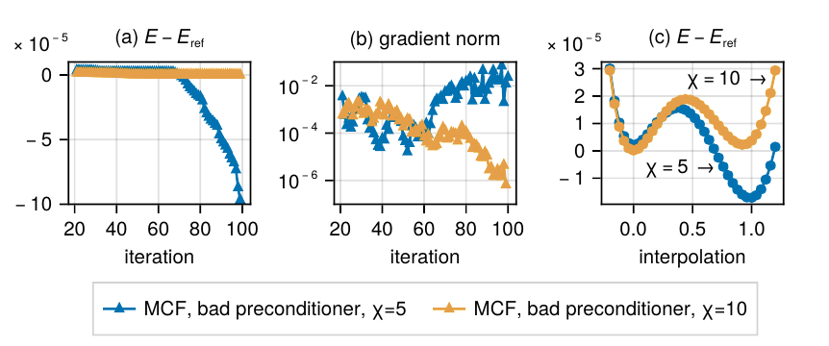
Does gauge fixing resolve all issues?

