Slide 1
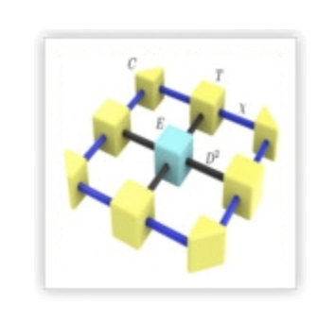

Wei Li
ITP
Spin Supersolid on a Triangular Lattice:
A Tensor Network Study of a Cobalt-based Quantum Magnet
Yuan Gao
Beihang U & Institute of Theoretical Physics
2026.02
Entanglement and topology in interacting quantum matter

Slide 2
Outline
1. Introduction of spin supersolid
2. Thermal tensor network
XTRG, tanTRG, stoMPS, …
3. Spin supersolid state in triangular lattice antiferromagnet Na₂BaCo(PO₄)₂
Model determination, phase diagram, magnetocaloric effect, …
4. Spin dynamics of spin supersolid state
Goldstone mode, pseudo-Goldstone mode, roton mode, …
5. Spin Seebeck effect of triangular lattice spin supersolid
Imaginary-time approximation for spin current, spin supercurrent, …

Slide 3
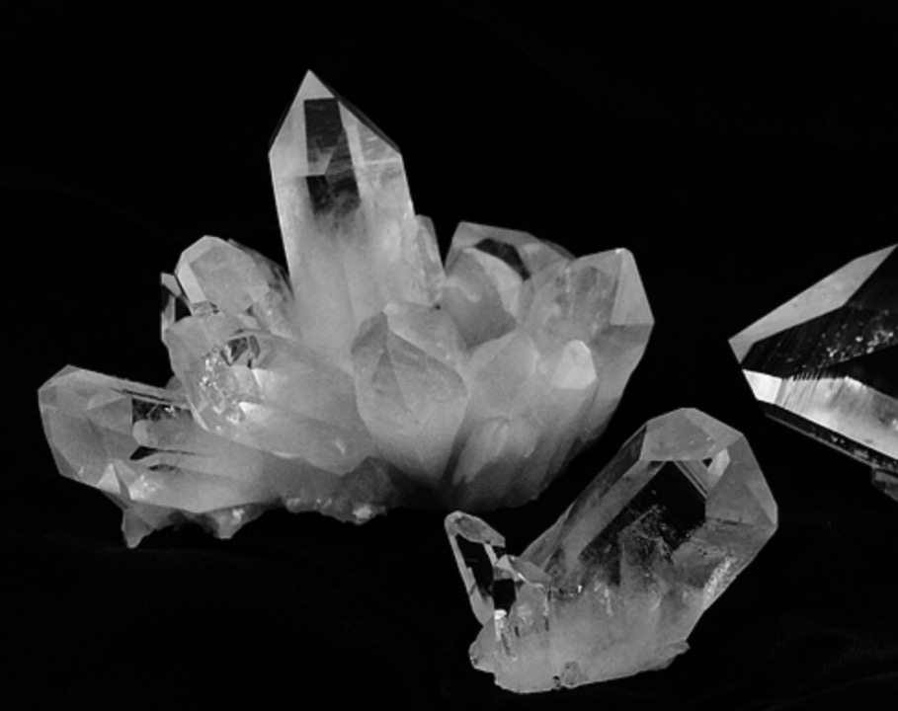
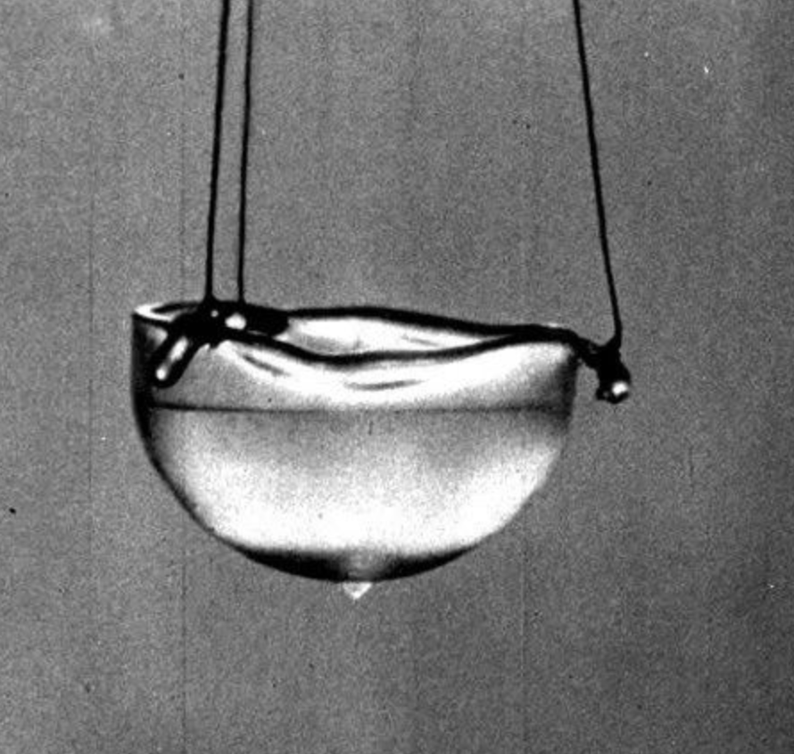
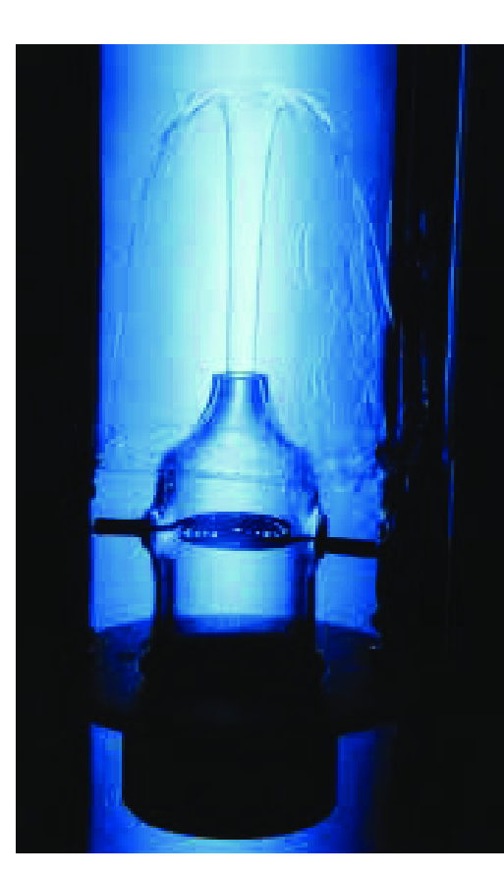
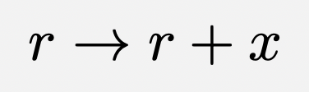
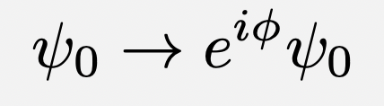
States of Matter: Solid, Superfluid, and More ...
Solid
Superfluid
Translation symmetry breaking
→ Crystal structure
U(1) Phase symmetry breaking
→ Superfluid order

Slide 4

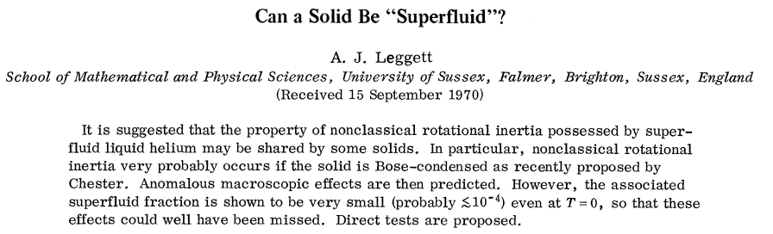
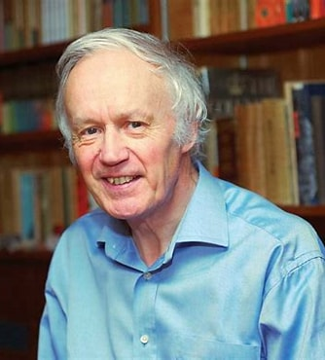
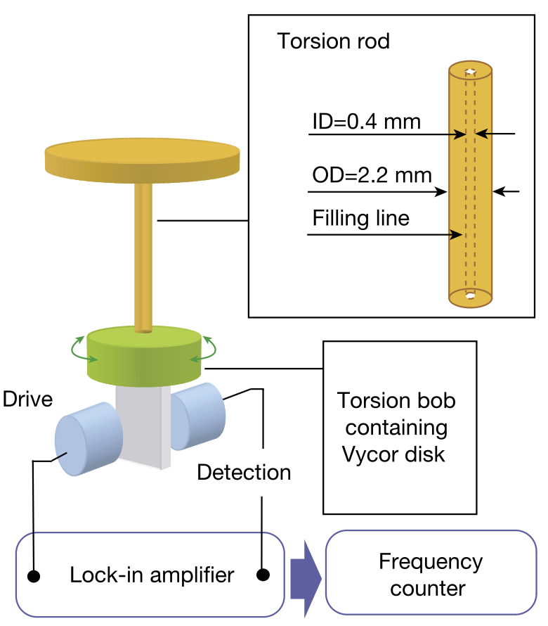
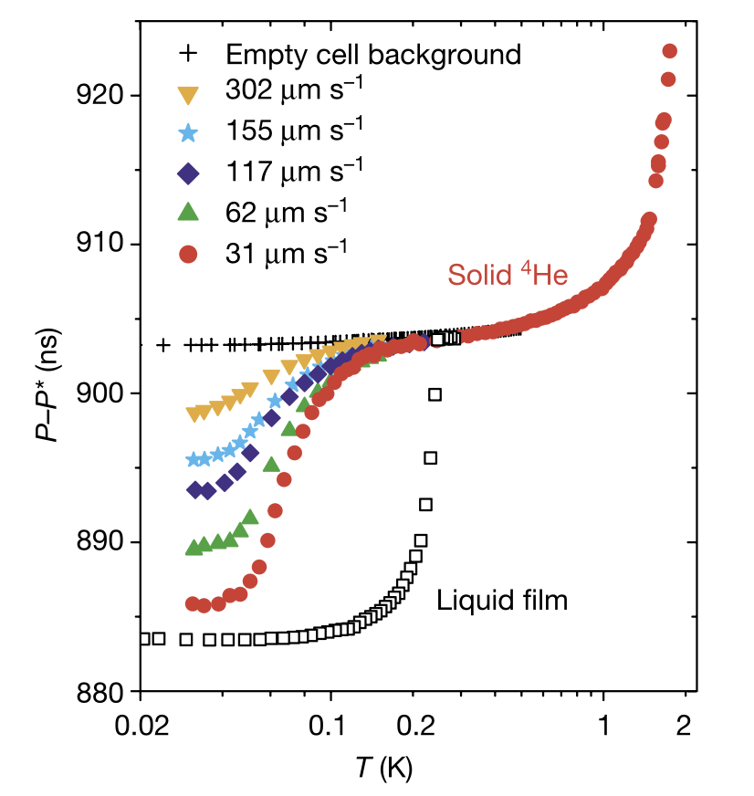
Can a Solid Be “Superfluid”?
2003 Nobel physics
PRL 25, 1543 (1970)
A. J. Leggett
Nonclassical rotational inertia (NCRI):
superfluid fraction
Kim et al., Nature 427, 225 (2004)

Slide 5
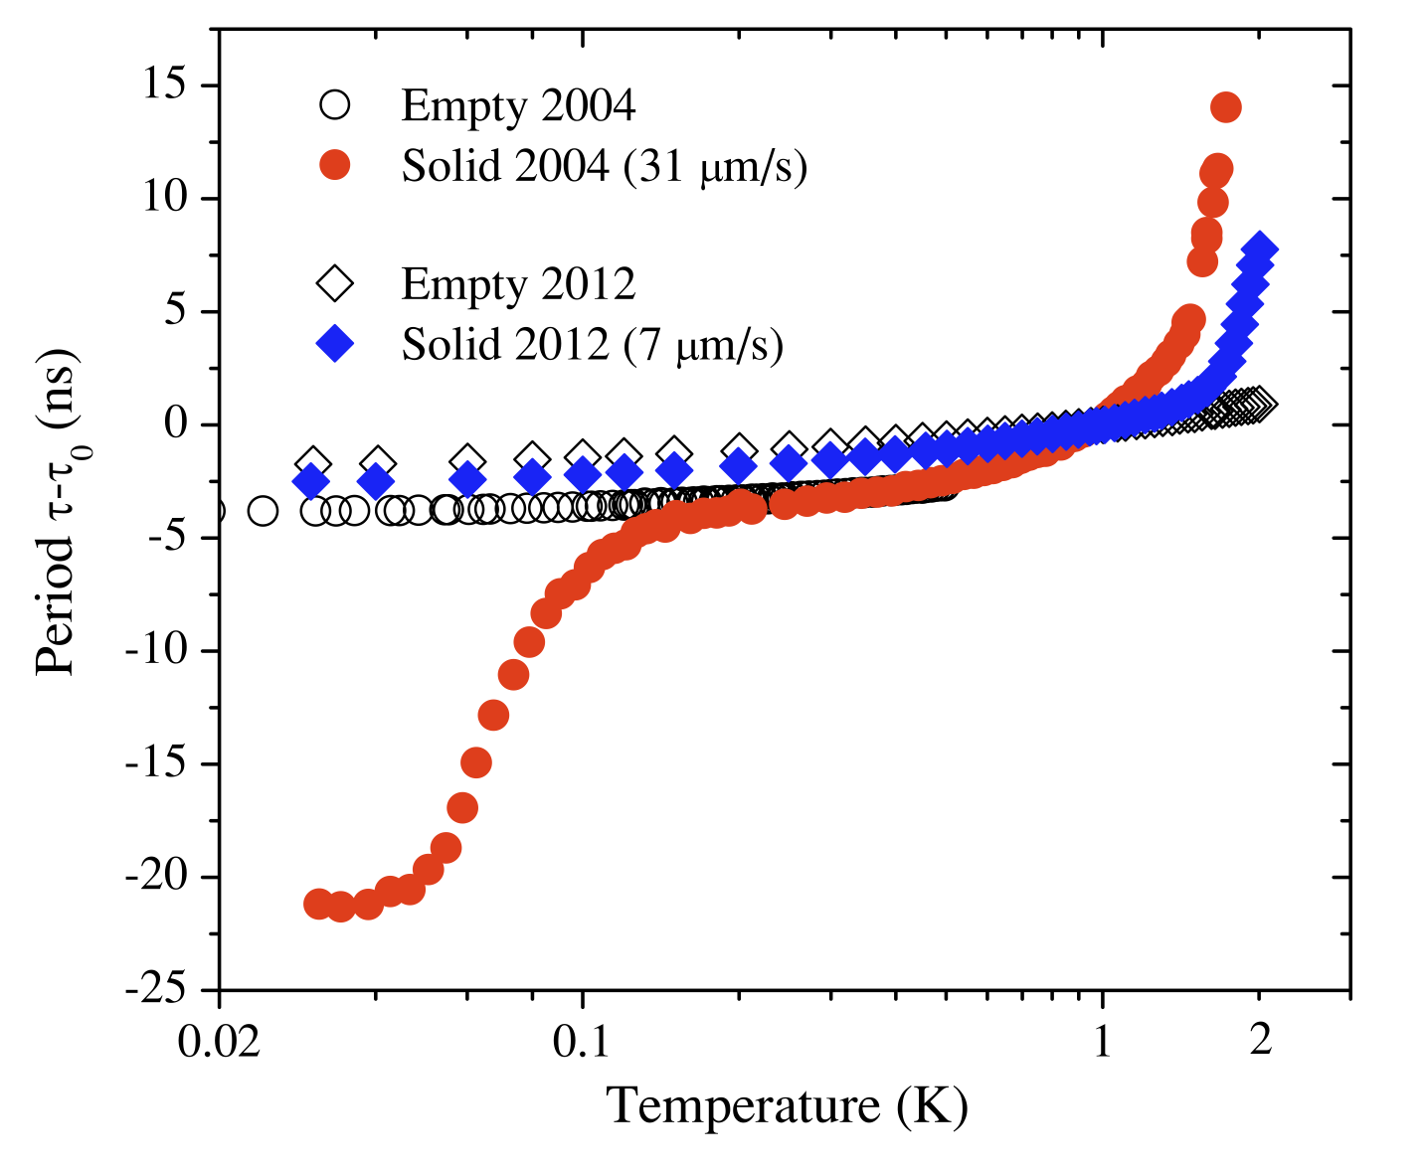
Can a Solid Be “Superfluid”?
2003 Nobel physics
PRL 25, 1543 (1970)
A. J. Leggett
Nonclassical rotational inertia (NCRI):
Absence of Supersolidity
PRL 109, 155301 (2012)
superfluid fraction

Slide 6
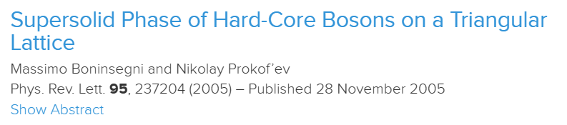
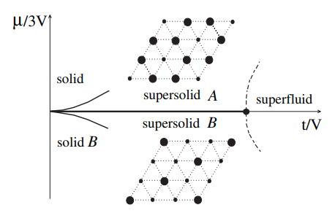
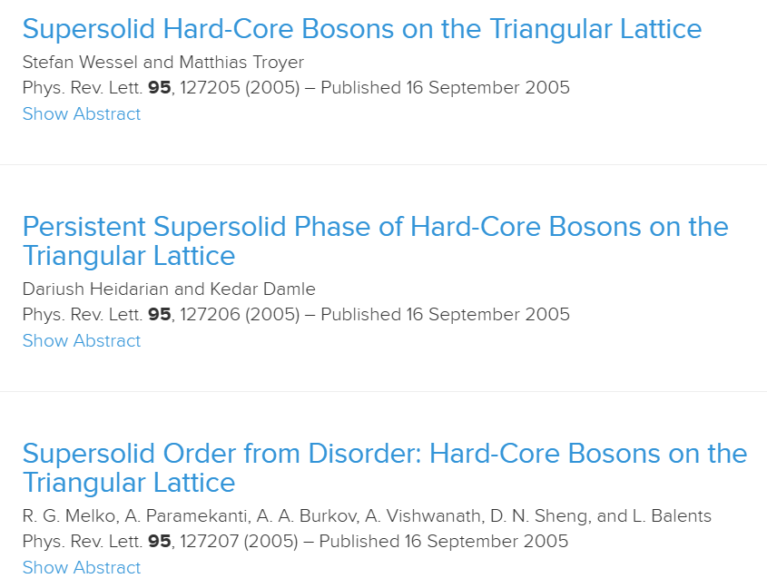
Supersolid Phase of Hard-Core Bosons
Hard-core boson model
PRL 95, 237204 (2005)
Solid order: lattice translation symmetry breaking
Superfluid order: U(1) gauge symmetry breaking

Slide 7
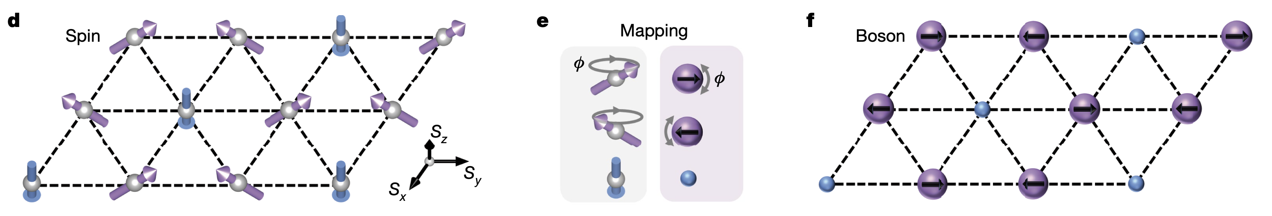
Spin Analog of Supersolid: Spin Supersolid
Hard-core boson to spin 1/2
Hard-core boson
Spin model
Spin realization of supersolid in hard-core boson——Spin supersolid

Slide 8
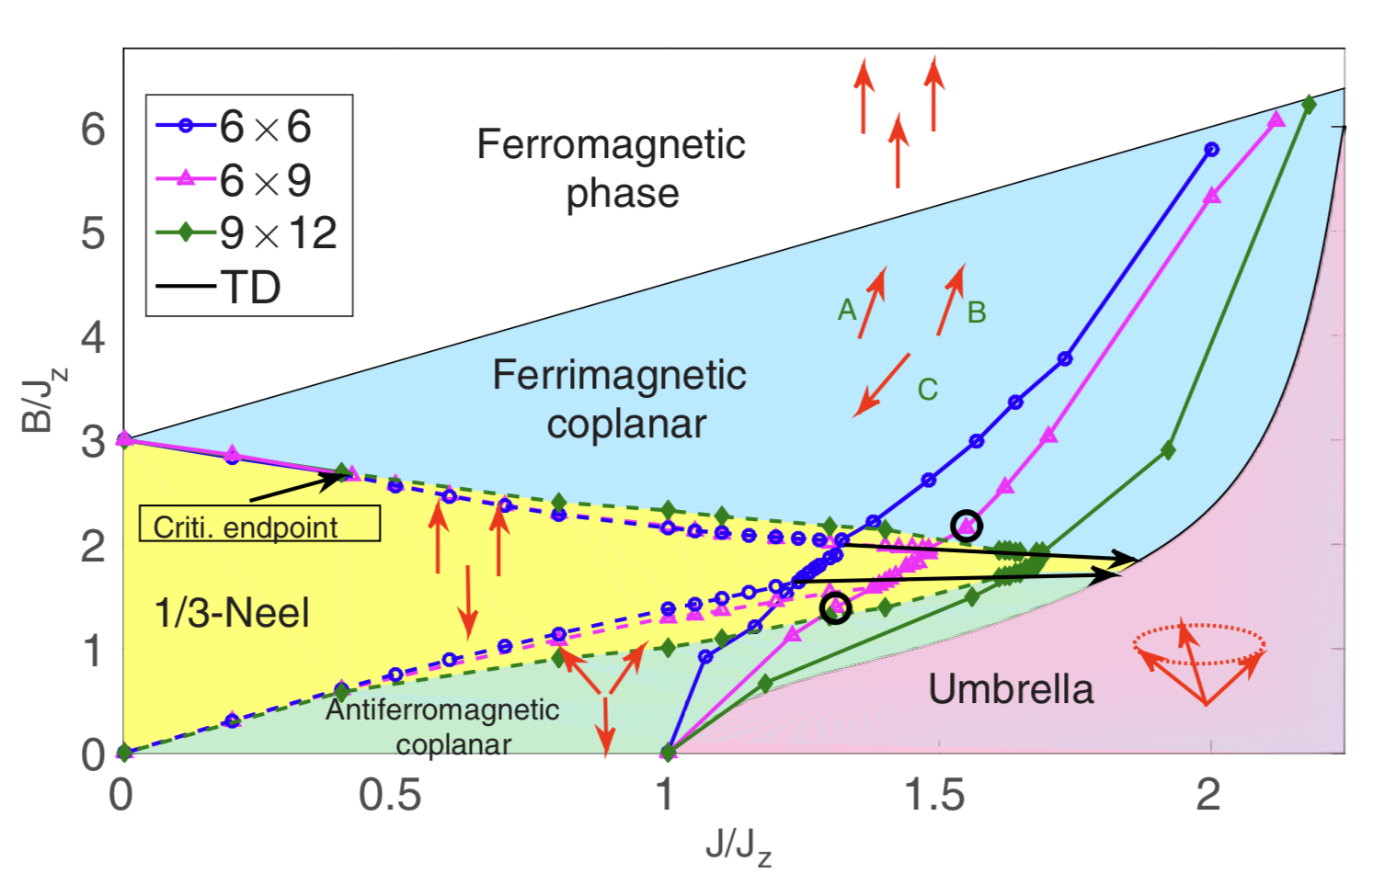
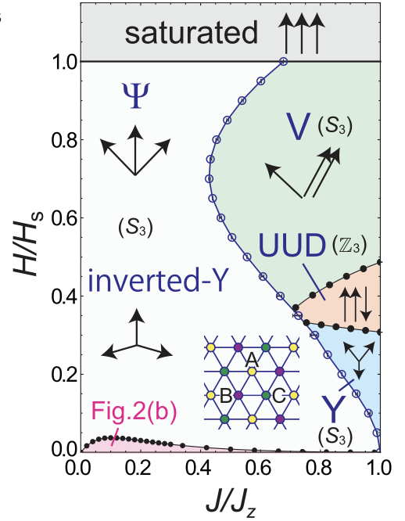
Exotic magnetic state in Triangular Lattice Antiferromagnet
Phase diagram of triangular lattice Heisenberg model under magnetic field
Supersolid V
Out-of-plane field
In-plane field
Supersolid Y
Sellmann et al., Phys. Rev. B 91, 081104 (2015)
Yamamoto et al., Phys. Rev. B 100, 140410(R) (2019)
The magnetic field induces a wealth of spin states

Slide 9
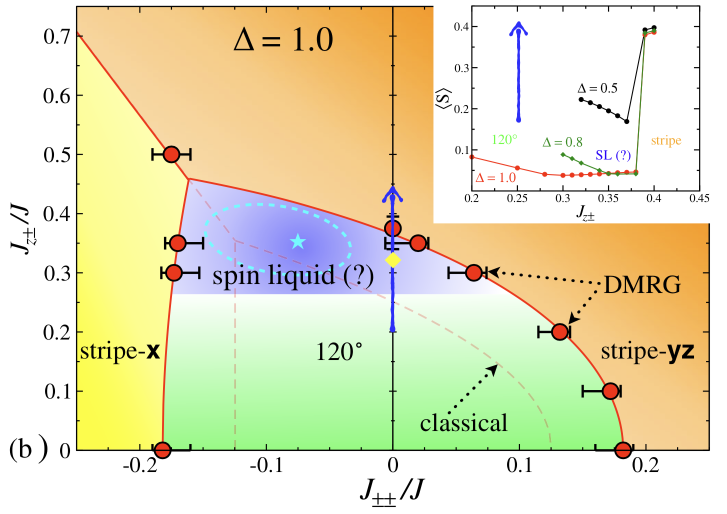
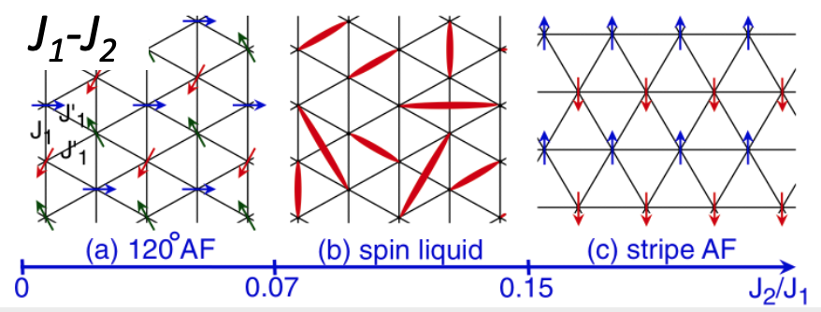
Exotic magnetic state in Triangular Lattice Antiferromagnet
Phase diagram of triangular lattice extended Heisenberg model
Bond-dependent interaction
Next-nearest neighbor interaction
Zhu et al., Phys. Rev. Lett. 120, 207203 (2018)
Hu et al., Phys. Rev. B 92, 140403(R) (2015)
Highly competition of magnetic order and quantum spin liquid

Slide 10
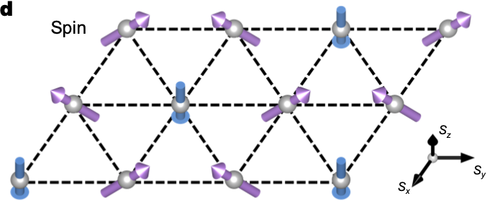
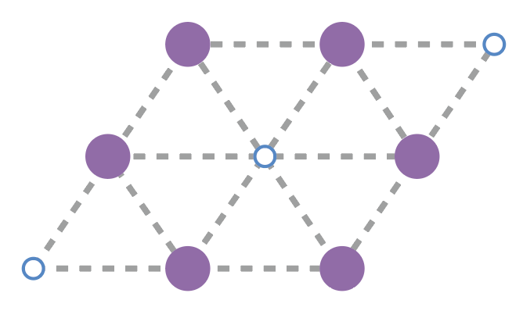
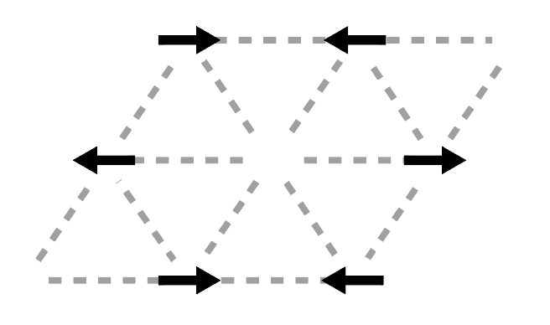
Triangular Lattice Spin Supersolid
Triangular lattice Heisenberg model with easy-axis anisotropic
Out-of-plane projection:
Solid order
In-plane projection:
Superfluid order
Supersolid ground state (Y state)
Is there a quantum magnetic material realization?

Slide 11
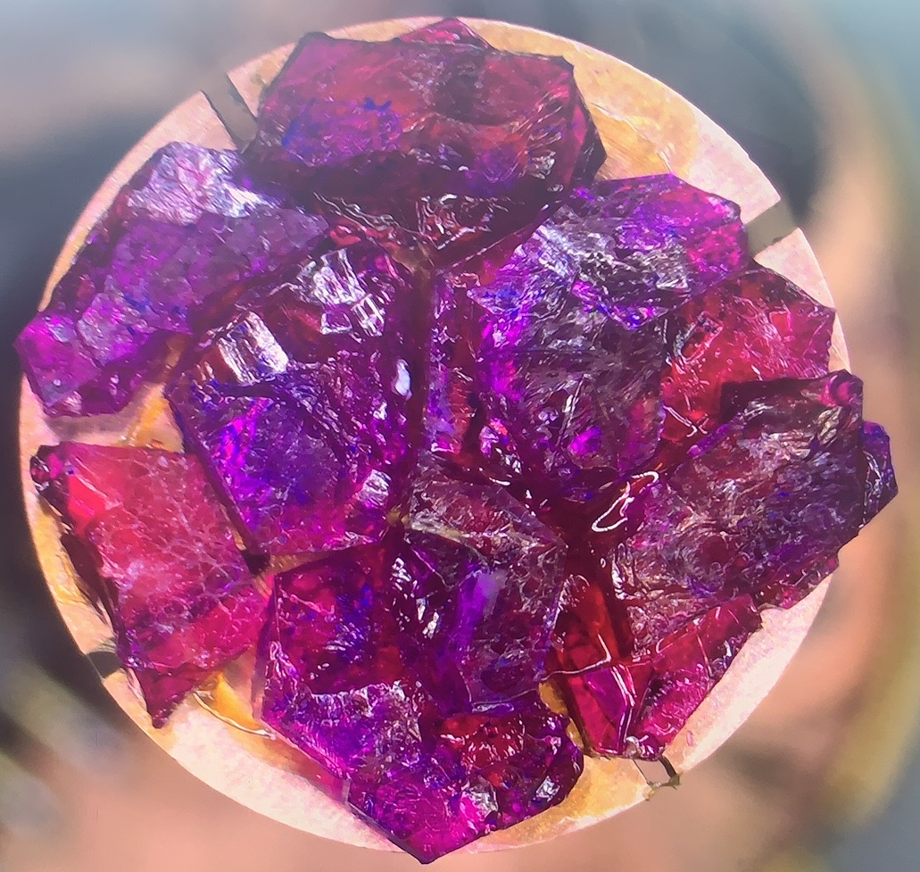
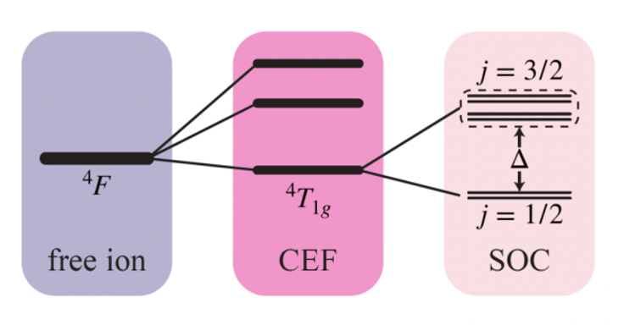
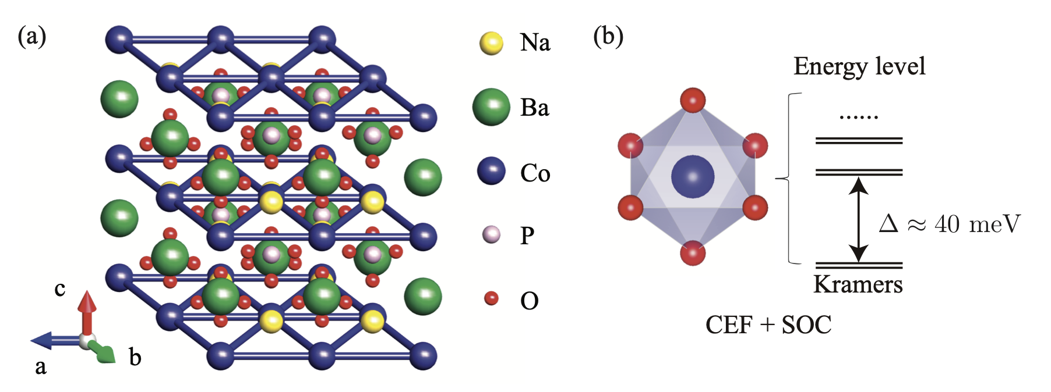
Triangular Lattice Antiferromagnet : Na₂BaCo(PO₄)₂
Lattice structure of Na₂BaCo(PO₄)₂
Building block: effective spin-1/2
Co²⁺ forms effective spin-1/2 under the crystal electric field and spin orbit coupling
Zhong et. al., PNAS 116, 14505 (2019)

Slide 12
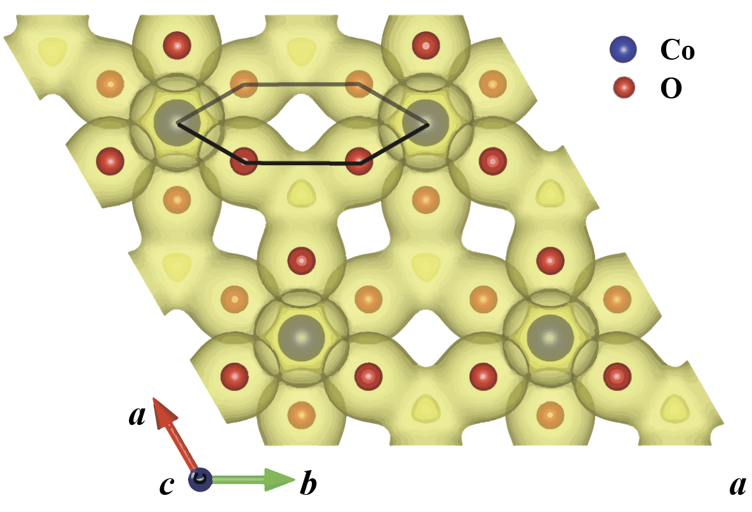
Triangular Lattice Antiferromagnet : Na₂BaCo(PO₄)₂
Intra-plane charge density landscape
Building block: effective spin-1/2
Co²⁺ forms effective spin-1/2 under the crystal electric field and spin orbit coupling
There exists super-super exchange interaction between Co²⁺ , forming a perfect triangular lattice structure
Gao, et al., npj Quantum Materials (2022)

Slide 13
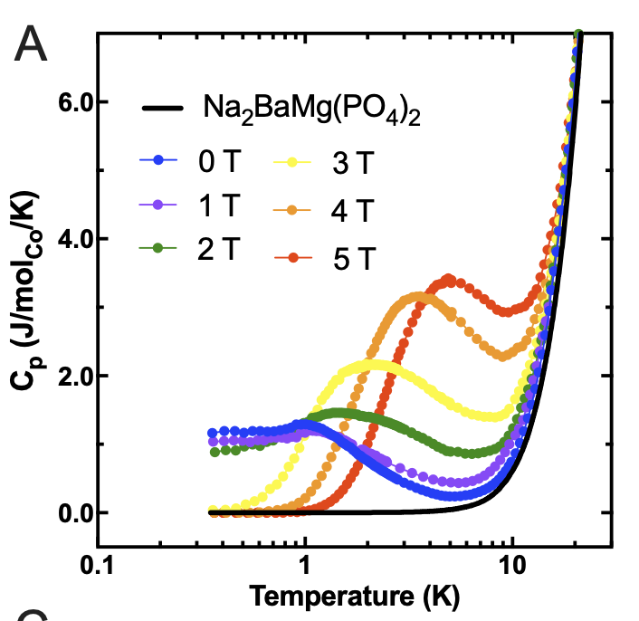
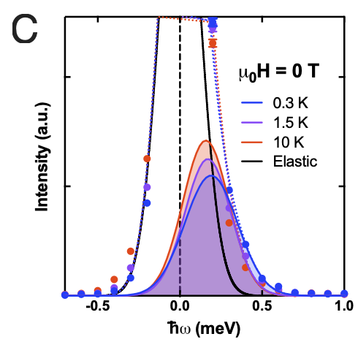
Experimental Result of Na₂BaCo(PO₄)₂
Specific heat measurement
Inelastic neutron scattering
No phase transition down to 300 mK
Strong spin fluctuations
Zhong et al., Proc. Natl. Acad. Sci. 116 (29) 14505-14510 (2019)

Slide 14
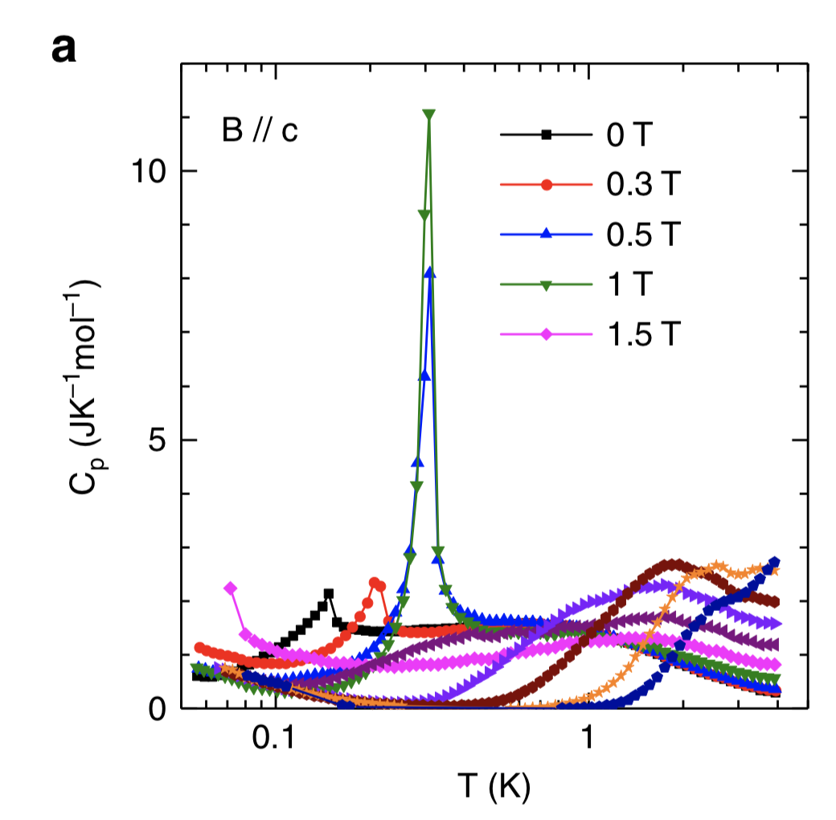
Experimental Result of Na₂BaCo(PO₄)₂
Specific heat measurement
Inelastic neutron scattering
Phase transition at 150 mK?
Strong spin fluctuations
Li, et al., Nature Commun. 11, 4216 (2020).

Slide 15
Experimental Result of Na₂BaCo(PO₄)₂
Specific heat measurement
Inelastic neutron scattering
Quantum spin liquid or magnetic order state?

Slide 16
Thermal tensor network

Slide 17
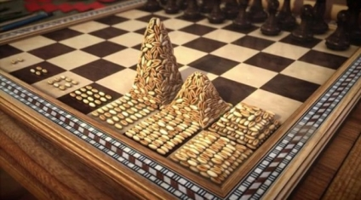
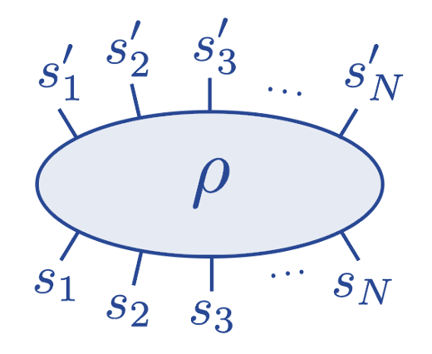
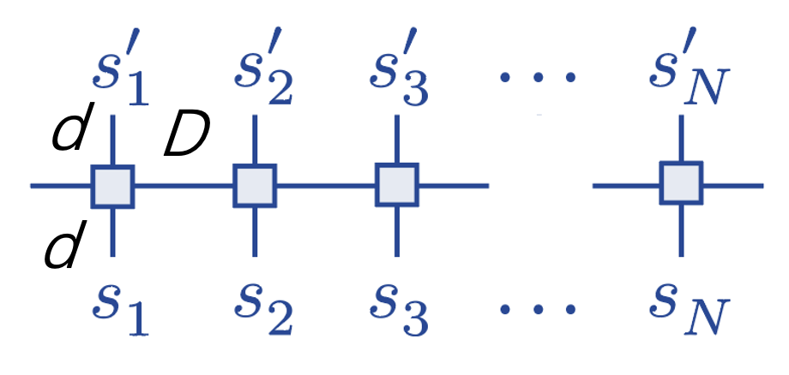
Tensor Network State
Exponential wall in many-body system
Thermal tensor network
Density matrix
Tensor network for quantum many-body system
Tensor network representation
Numerical renormalization group
Density matrix renormalization group
2D tensor network state: iPEPS
L
Density Matrix RG
S. White, 1992 PRL milestone
Matrix product operator
W

Slide 18
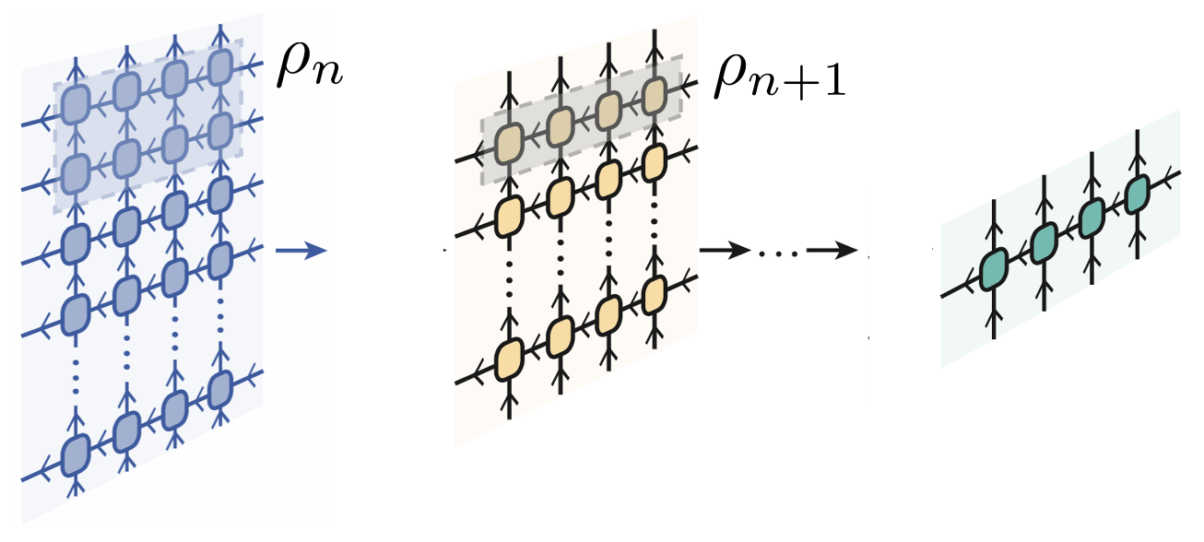
Thermal Tensor Network
Exponential tensor renormalization group (XTRG):
Chen, et al., PRX 8, 031082 (2018)

Slide 19
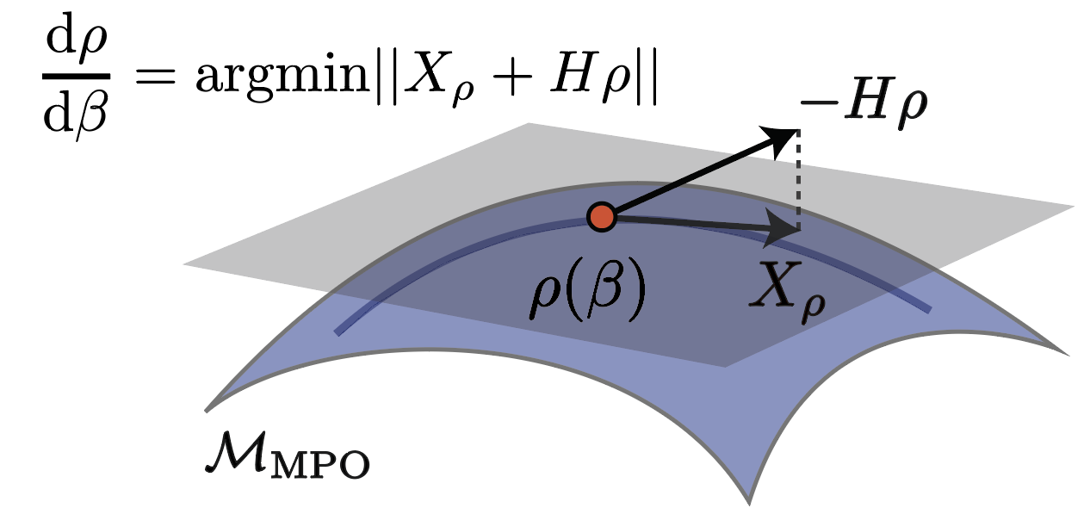
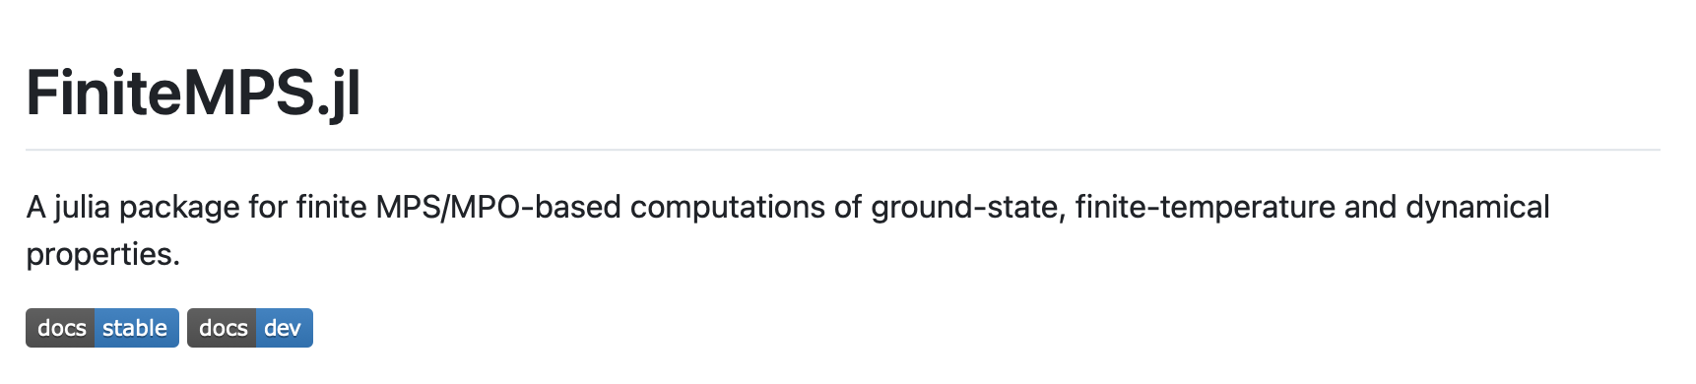
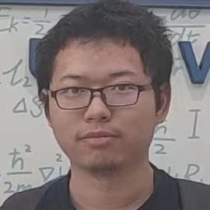
Thermal Tensor Network
Tangent space tensor renormalization group (tanTRG):
Imaginary-time evolution of the density matrix by time-dependent variational principle
Qiaoyi Li
ITP (on the market)
Haegeman, et al., PRL 107, 070601 (2011)
Li, et al., PRL 130, 226502 (2023)
https://github.com/ThermoTN/

Slide 20

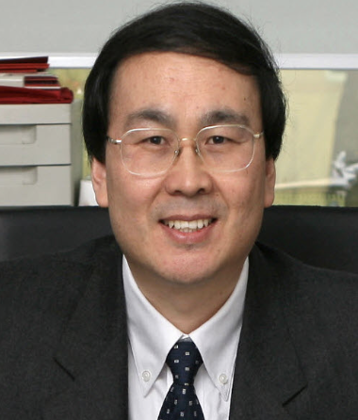
Yuan Wan
IOP
Wei Li
ITP
Gang Su
ITP
Spin supersolid state in triangular lattice antiferromagnet Na₂BaCo(PO₄)₂
Sizhuo Yu, Yuan Gao, Bin-Bin Chen, and Wei Li, Chinese Phys. Lett. 38 097502 (2021)
Yuan Gao, […], Yuan Wan, and Wei Li, npj Quantum Materials 7, 89 (2022)
Junsen Xiang, Chuandi Zhang, Yuan Gao, […], Wentao Jin, Wei Li, Peijie Sun, and Gang Su, Nature 625, 270 (2024)

Slide 21
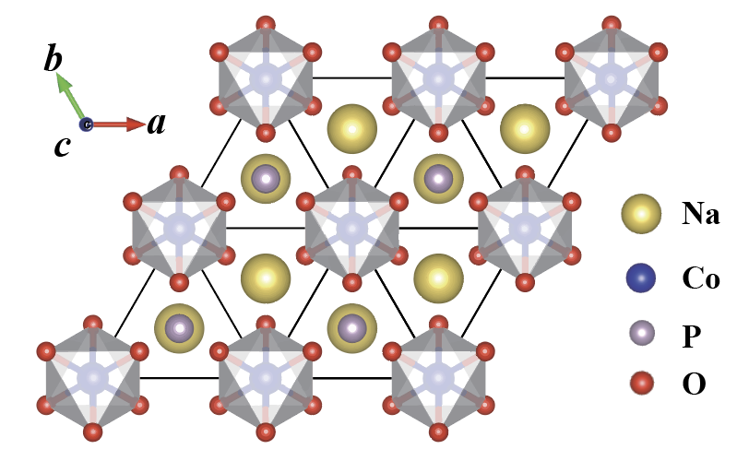
Model Determination: Symmetry Analysis
Site symmetry of Co:
3-fold rotation w.r.t c-axis
2-fold rotation w.r.t a-axis
Inversion
Site symmetry of Co-Co center: 2/m
2-fold rotation w.r.t a-axis
Inversion
Gao et. al., npj Quantum Materials 7, 89 (2022)

Slide 22
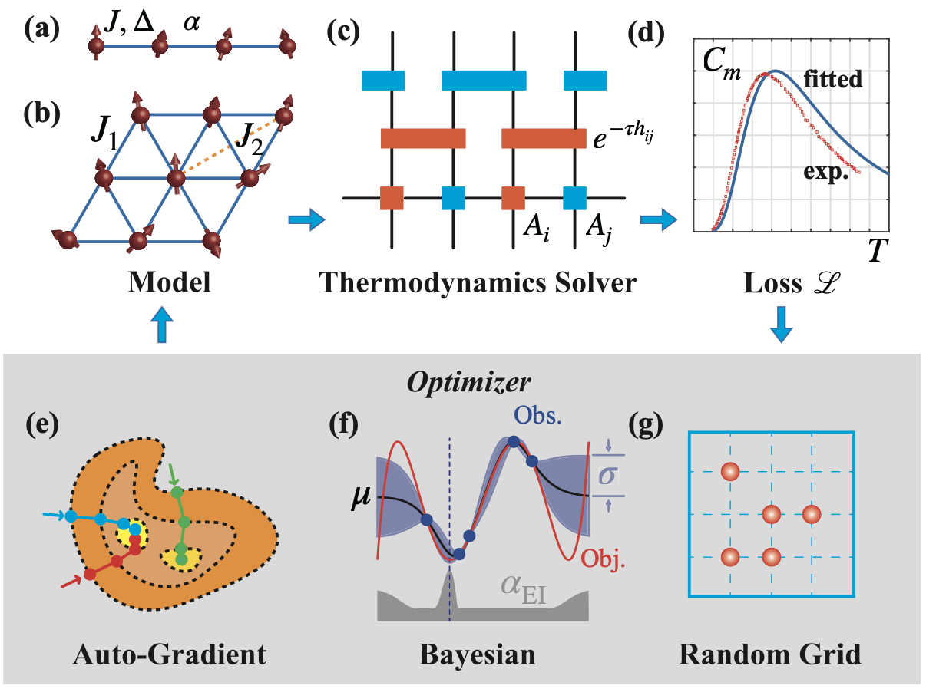
Model Determination: Bayesian Optimization
Automatic parameter research
Loss function
Parameter space
Yu et. al., Chinese Phys. Lett. 38 097502 (2021)

Slide 23
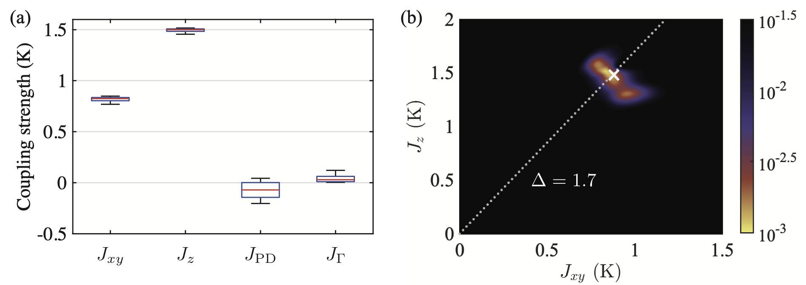
Effective Model of Na₂BaCo(PO₄)₂
The 20 best sets among 450 iterations
Landscape of loss function
Negligible off-diagonal terms
Single solution

Slide 24
Effective Model of Na₂BaCo(PO₄)₂
The 20 best sets among 450 iterations
Landscape of loss function

Slide 25
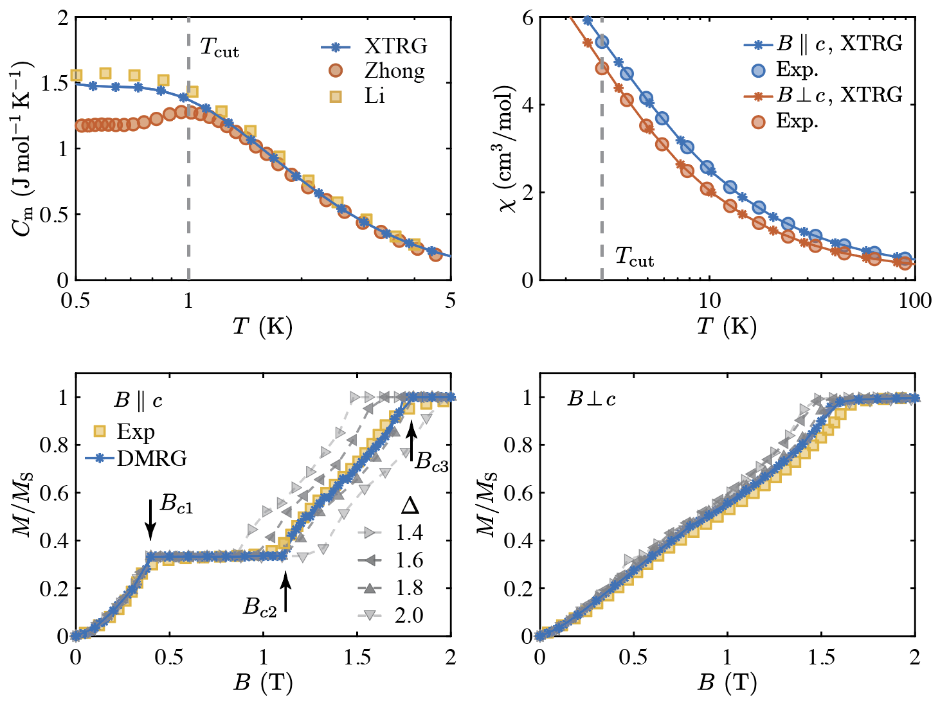
Effective Model of Na₂BaCo(PO₄)₂
Zero-field specific heat and magnetic susceptibility
Ground state magnetization

Slide 26

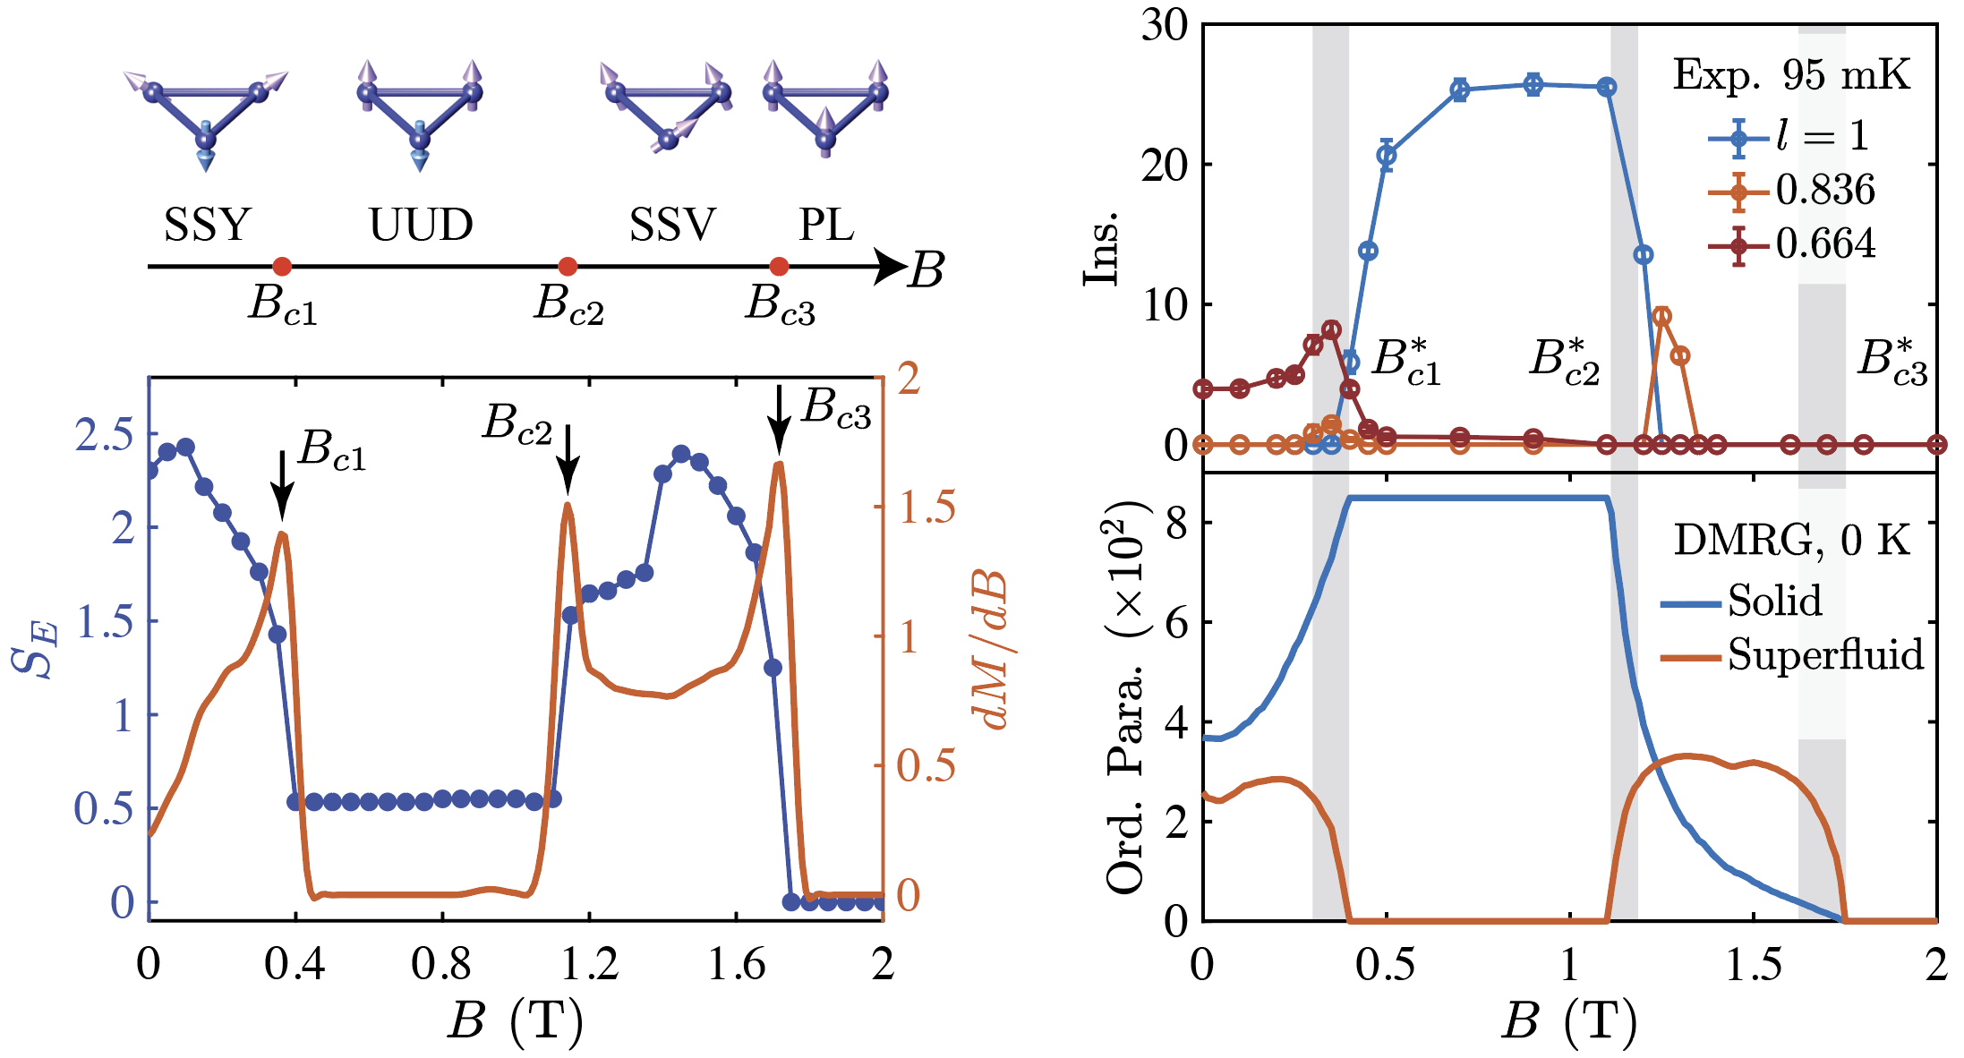
Ground-State Phase diagram
Out-of-plane magnetic field
Comparison with neutron diffraction
Wentao Jin
BUAA
Exp.
DMRG
Xiang et. al., Nature 625, 270 (2024)

Slide 27
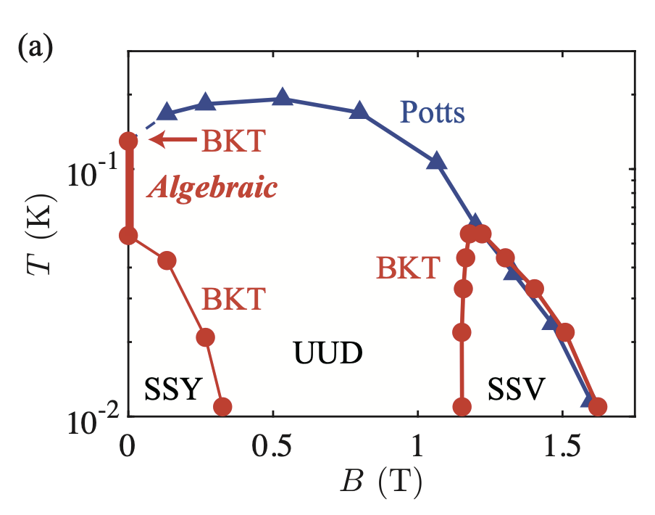
Finite-Temperature Phase Diagram
Classical Mento Carlo simulation
Zero Field
Out-of-plane: 6-fold degenerate ground state
2 BKT transitions with emergent U(1)
In-plane: U(1) symmetry breaking
BKT transition
High field
Potts + BKT or one phase transition?
Spin supersolid phase

Slide 28
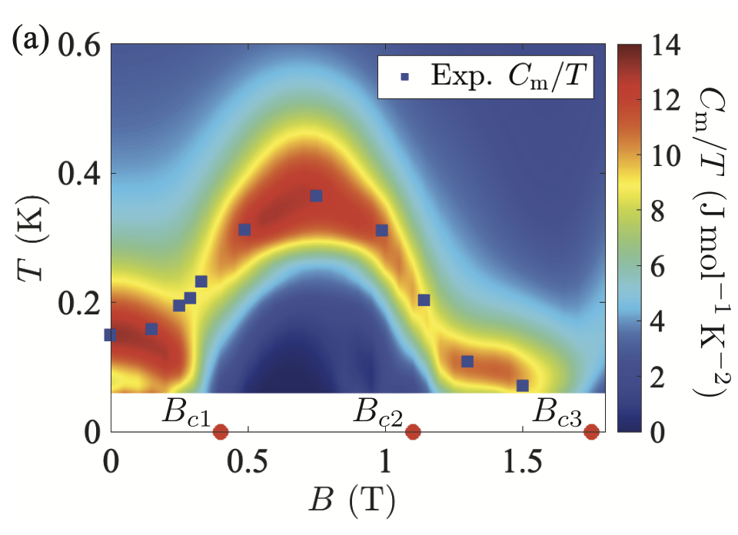
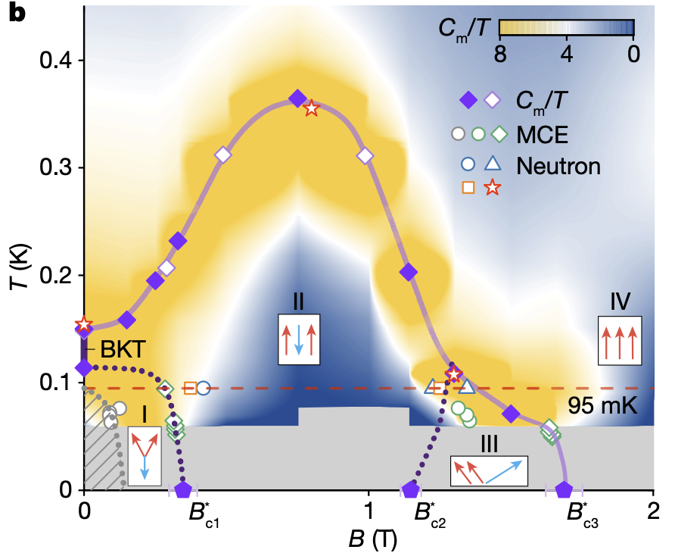
Finite-Temperature Phase Diagram
tanTRG result
Experiment
Excellent agreement between experimental and theoretical results!

Slide 29
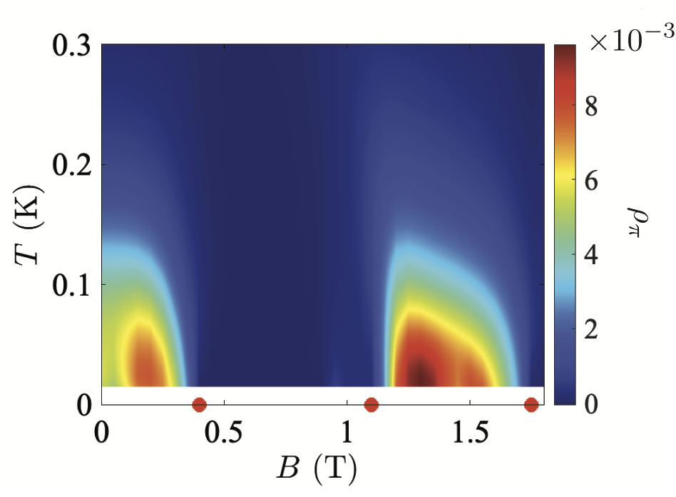
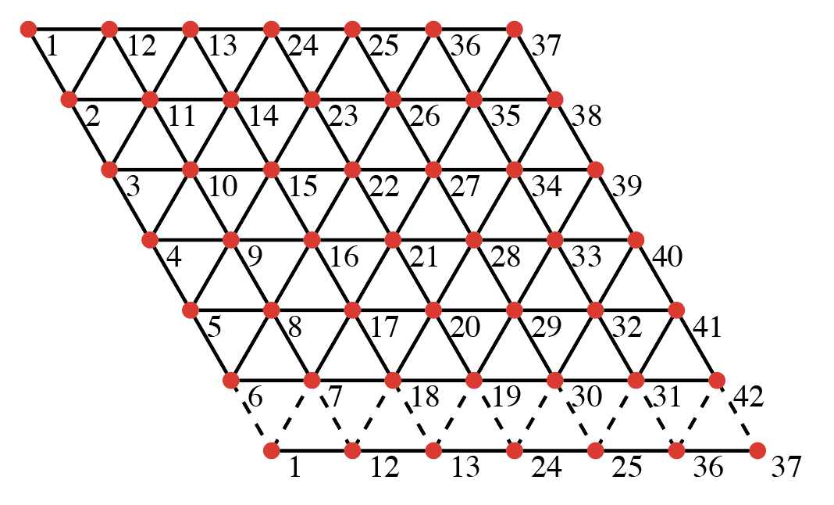
Finite-Temperature Phase Diagram
Spin stiffness
Huang et. al., arxiv:2509.03489 (2025)

Slide 30
Finite-Temperature Phase Diagram
Spin stiffness
Experiment
Huang et. al., arxiv:2509.03489 (2025)

Slide 31
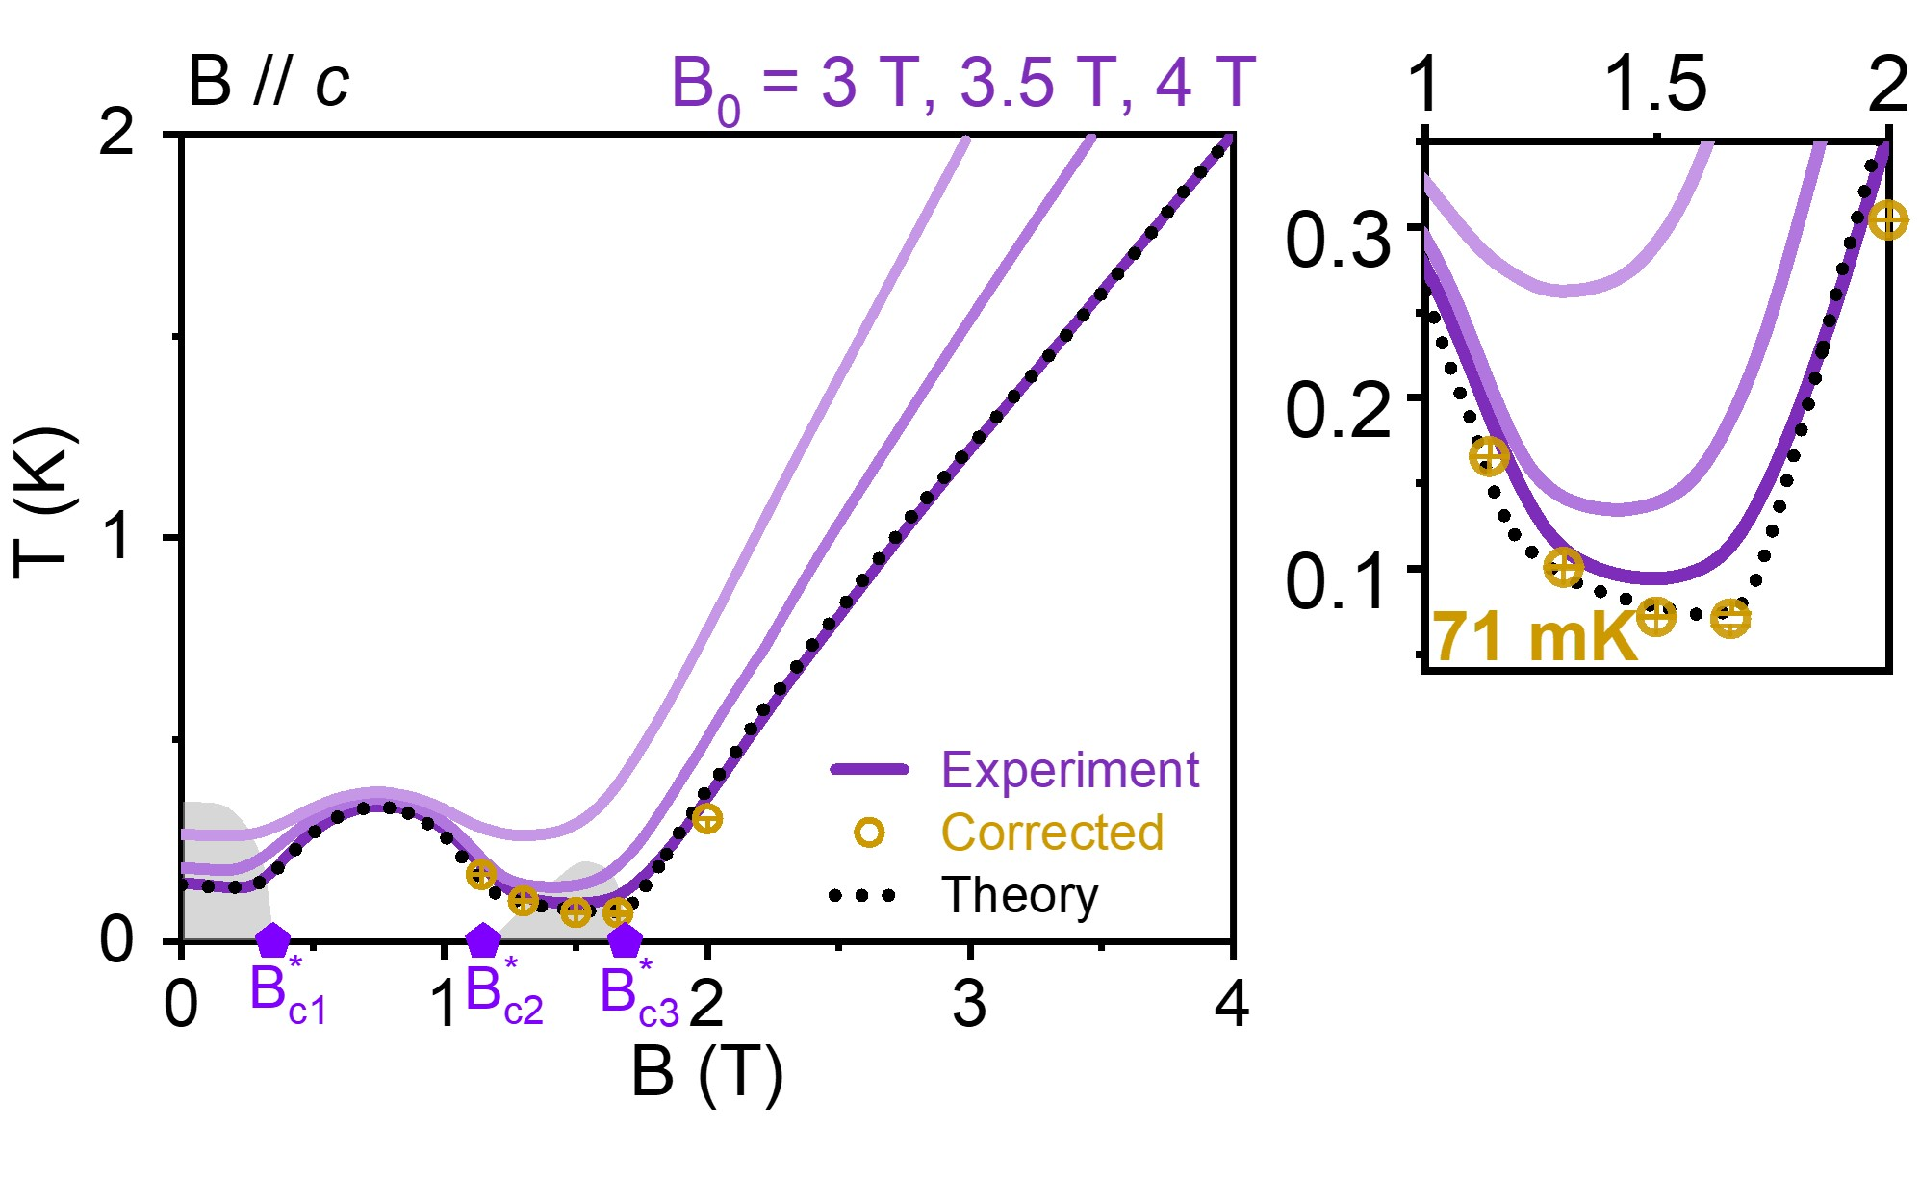
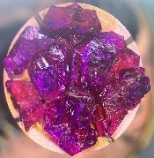
Giant Magnetocaloric Effect of Spin Supersolid
Adiabatic demagnetization curve
Junsen Xiang
IOP
Peijie Sun
IOP
Spin supersolid refrigeration achieves an extremely low temperature of 94 mK!
94 mK
Supersolid
The experimental measurements are highly consistent with theoretical calculations, providing further evidence for spin supersolid.
Xiang et. al., Nature 625, 270(2024)

Slide 32
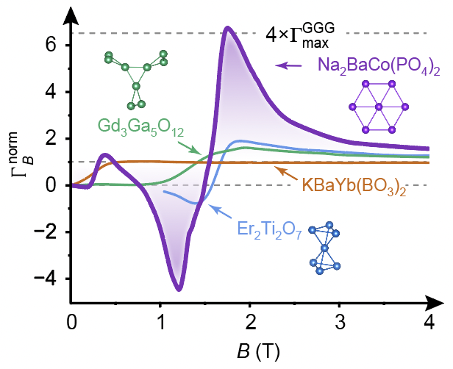

Giant Magnetocaloric Effect of Spin Supersolid
Differential characterization of the MCE
Grüneisen ratio
The peak value is 4 times more than that of general coolants
—— Giant MCE in spin supersolid
Xiang et. al., Nature 625, 270(2024)

Slide 33
Wentao Jin
BUAA
Spin dynamics of spin supersolid state
Yuan Gao, Chuandi Zhang, […], Wentao Jin, Gang Su, and Wei Li PRB 110, 214408 (2024)

Slide 34
Tensor Network Approach for Spin Dynamics
Real-time correlation function
DMRG

Slide 35
Tensor Network Approach for Spin Dynamics
Real-time correlation function
TDVP

Slide 36
Tensor Network Approach for Spin Dynamics
Real-time correlation function
Dynamical spin structure factor
Spectral function

Slide 37
Tensor Network Approach for Spin Dynamics
Real-time correlation function
Dynamical spin structure factor
Spectral function
In practice
Parzen window function

Slide 38


Comparison with Inelastic Neutron Scattering Result
Gapless Goldstone mode at K point
Microscopic evidence of spin supersolid state existence
Gao et al., PRB 110, 214408 (2024)

Slide 39

Spin Excitations of Spin SuperSolid
Spin resolved spectral function
In-plane spin dynamics
Out-of-plane spin dynamics

Slide 40
Goldstone Mode and Pseudo-Goldstone Mode
Goldstone mode
Pseudo-Goldstone mode
Spin superfluidity
Spin solidity

Slide 41



Origin of The Pseudo-Goldstone Mode
Classical energy of Y state
Linear spin-wave result
Net magnetization: accidental degenerate
Two Goldstone mode

Slide 42

Origin of The Pseudo-Goldstone Mode
Classical energy of Y state
Complex order parameter
Energy landscape of quantum spin supersolid
6-fold anisotropic Mexican-hat
Net magnetization: accidental degenerate
Quantum fluctuations break the accidental degenerate and induce the Pseudo-Goldstone modes.

Slide 43
Spin Excitations of Spin SuperSolid
Double magnon-roton excitations
Goldstone mode
Pseudo-Goldstone mode
Magnetic analog of phonon-roton dispersion in superfluid helium

Slide 44


Spin Supersolid in K₂Co(SeO₃)₂
Chen et al., arxiv:2402.15869 (2024)
Zhu et al., PRL 133, 186704 (2024)
Zhu et al., npj quantum materials 10, 74 (2025)
Observation of Goldstone mode, pseudo-Goldstone mode and roton mode

Slide 45


Spin Supersolid and Quantum Spin Liquid
Mean-field calculations
DMRG phase diagram
Jia et al., PRR 6, 033031 (2024)
Gallegos et al., PRL 134, 196702 (2025)

Slide 46


Sadamichi Maekawa
Riken
Spin Seebeck Effect of Triangular-lattice Spin Supersolid
What is the macroscopic quantum phenomenon for spin supersolid?
Yuan Gao, Yixuan Huang, Sadamichi Maekawa, and Wei Li, PRL 135, 236504 (2025)

Slide 47


Spin Seebeck Effect in a Magnetic Insulator

Slide 48



Linear-Response Theory of Spin Seebeck Effect
Experimental setup:
$T_{s}$: temperature of the magnet (spin)
$T_{m}$: temperature of the metal
$B$: magnetic field along $S^{z}$ direction
$$T=\frac{T_{s}+T_{m}}{2},δT=T_{s}−T_{m},β=1/T$$

Slide 49

Linear-Response Theory of Spin Seebeck Effect
Total Hamiltonian
weak coupling

Slide 50

Linear-Response Theory of Spin Seebeck Effect
Spin current (via non-equilibrium GF method)
How to calculate the normalized spin current ${\tilde{I}}_{S}$?
Spin-wave theory for ordered magnets, what about disordered spin systems?

Slide 51



Imaginary-time Approximation for Normalized Spin Current
Spin current ${⟨I}_{S}⟩=−A{\tilde{I}}_{S}δT$
Real-time spin dynamics:
$${\tilde{I}}_{S}=\int_{−∞}^{∞}{dω }Im[χ_{loc}^{−+}\left(ω\right)]∙k^{2}(βω)$$
$$χ_{loc}^{−+}\left(ω\right)=\frac{−i}{N}\sum_{j}{\int_{0}^{∞}{dt e^{iωt}⟨[S_{j}^{−}\left(t\right),S_{j}^{+}]⟩β}}$$
$$k\left(x≡βω\right)=\frac{x}{\sinh{x}/2}$$
$T_{s}$: temperature of the magnet (spin)
$T_{m}$: temperature of the metal
$T=\frac{T_{s}+T_{m}}{2},δT=T_{s}−T_{m},β=1/T$
$B$: magnetic field along $S^{z}$ direction
Imaginary time correlation:
$${\tilde{I}}_{2}=\frac{1}{N}\sum_{j}{β⟨O_{j}\left(\frac{β}{2}\right)⋅S_{j}^{+}⟩}$$
with $O_{j}=[H,S_{j}^{−}]$.

Slide 52




Imaginary-time Approximation for Normalized Spin Current
We assume $Im{[χ}_{loc}^{−+}\left(ω\right)]$ is analytical near $ω=0$, i.e.
$$Imχ_{loc}^{−+}\left(ω\right)=\sum_{n=1}{f_{n}∙\left(\frac{ω^{n}}{n!}\right)}$$
At low temperature, we have
Real-time formula
Imaginary-time formula
Compare these two formulas, we arrive at:

Slide 53



Thermal Tensor Network Approach
Imaginary-time correlation function:
Tensor-network simulations of the spin Seebeck effect

Slide 54


Benchmarks on Heisenberg spin chain

Slide 55




Experimental Observation of Spinon Spin Current
Sign reversal of spin current

Slide 56



Spin Current in 1D Heisenberg Spin Chain
Heisenberg spin-chain Hamiltonian
$$H=\sum_{i}{\frac{1}{2}\left(S_{i}^{−}S_{i+1}^{+}+S_{i}^{+}S_{i+1}^{−}\right)+S_{i}^{z}S_{i+1}^{z}}−B\sum_{i}{S_{i}^{z}}$$
Sign reversal: consistent with experimental result
Algebraic scaling of negative spinon spin current in Tomonaga-Luttinger liquid (TLL)
Universal scaling of spin current $T^{\frac{d}{z} }$ @ QCP

Slide 57





Benchmarks on 1D Heisenberg Spin Chain
Heisenberg spin-chain Hamiltonian
$$H=\sum_{i}{\frac{1}{2}\left(S_{i}^{−}S_{i+1}^{+}+S_{i}^{+}S_{i+1}^{−}\right)+S_{i}^{z}S_{i+1}^{z}}−B\sum_{i}{S_{i}^{z}}$$
Finite-temperature spin dynamics
ITA captures the sign reversal in spin current
Excellent agreement in low-T scaling behaviors between ${\tilde{I}}_{S}$ and ${\tilde{I}}_{2}$

Slide 58


Benchmarks on 1D Heisenberg Spin Chain
Heisenberg spin-chain Hamiltonian
$$H=\sum_{i}{\frac{1}{2}\left(S_{i}^{−}S_{i+1}^{+}+S_{i}^{+}S_{i+1}^{−}\right)+S_{i}^{z}S_{i+1}^{z}}−B\sum_{i}{S_{i}^{z}}$$
$$J \sim O(1000) K, TR/J \sim O(0.1)$$
ITA captures the sign reversal in spin current
Excellent agreement in low-T scaling behaviors between ${\tilde{I}}_{S}$ and ${\tilde{I}}_{2}$
Hirobe et al., Nature Phys 13, 30 (2017)

Slide 59


Spin Seebeck effect of Triangular Spin Supersolid

Slide 60



Spin current of Spin Supersolid State
Easy-axis XXZ Hamiltonian of Na₂BaCo(PO₄)₂
$$H=\sum_{⟨ij⟩}{\frac{J_{xy}}{2}\left(S_{i}^{−}S_{j}^{+}+S_{i}^{+}S_{j}^{−}\right)+J_{z}S_{i}^{z}S_{j}^{z}}−B\sum_{i}{S_{i}^{z}}$$
$$J_{xy}=0.88 K, J_{z}=1.48 K$$
Supersolid phase diagram
$0→B_{c1}:$ Supersolid Y (SSY)
$B_{c1}→B_{c2}:$ Up-up-down (UUD)
$B_{c2}→B_{c3}:$ Supersolid V (SSV)
$B_{c3}→∞:$ Polarized state (PL)
Sign reversal: detect the phase boundary of spin supersolid phases
W=6 cylinder

Slide 61


Linear spin wave theory for SSE
Quantum many-body calculation
Linear spin wave theory
Spin current behaviors in supersolid phase lies beyond LSWT!

Slide 62

Direction of Spin Current
Spin current
-dM/dT

Slide 63

SSE as a Probe of QCPs
Spin current with constant temperature
Spin current at constant magnetic field
Universal temperature scaling of spin current at QCPs
Identify QCPs from peaks and dips

Slide 64






Universal Scaling of SSE at QCPs
Spin current at U(1)-symmetric polarization quantum critical points
Spin current
At the polarization QCPs
Universal scaling of spin current

Slide 65


Spin Supercurrent in Spin Supersolid
Persistent spin current in spin supersolid state
Non-zero spin current survives even at the zero-temperature limit.

Slide 66



Spin Supercurrent in Spin Supersolid
Persistent spin current in spin supersolid state
Momentum resolved spin current
Goldstone-mode-mediated spin transport
Non-zero spin current survives even at the zero-temperature limit.

Slide 67

Spin Supercurrent in Spin Supersolid
Persistent spin current in spin supersolid state
Recall Leggett’s renowned proposal
non-classical rotational inertia
$${⟨I}_{S}⟩=−A {\tilde{I}}_{S} δT$$
Experimental probe
non-classical
normal
1. Rotate the solid in an annulus below the transition temperature and detect the effective moment of inertia.
2. Rotate the solid above the critical angular velocity and then bring the container to rest.
Two key predictions: (I) Sign Reversal (II) Persistent spin supercurrent

Slide 68

Summary
Thermal tensor network for quantum magnet
Effective model for Na₂BaCo(PO₄)₂: Nearly ideal easy-axis XXZ model with spin supersolid
Giant magnetocaloric effect: New pathway to sub-Kelvin cooling
Spin excitations of spin supersolid: Goldstone mode, pseudo-Goldstone mode, and roton mode
Spin Supercurrent: Macroscopic quantum transport phenomenon in spin supersolid

Slide 69

Thanks for your attention!

