Slide 1

Topological and trivial valence bond orders in higher-spin Kitaev models
Yuchi He
Entanglement and topology in interacting quantum matter
Benasque, Spain, Feb 18, 2026
Xing-Yu Zhang, Qi Yang, Philippe Corboz, Jutho Haegeman, Yuchi He arXiv:2511.07415

Slide 2
Outlines
PART I. Introduction and results
we find an unusual spontaneous valence bond solid with topological order.
PART II. New development of two-dimensional tensor networks
towards precise numerical studies of 2D strongly correlated electrons.

Slide 3
PART I. Introduction and results

Slide 4
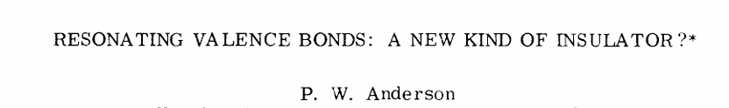
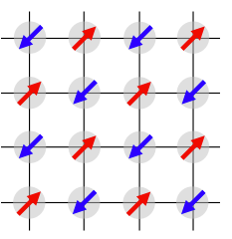
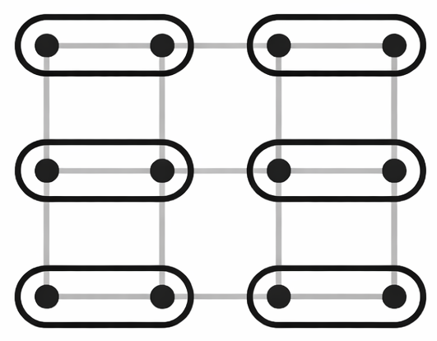
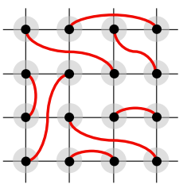
Early history of quantum frustrated magnetism
(1972)
Néel state
Valence Bond Solids
(VBS)
Spin Liquids
(SL)
SU(2)
No
Yes
Yes
Translation
No
No
Yes

Slide 5
More recent concepts for spin liquids
SL are no longer defined by the absence of magnetic and VBS.
Gapped: topological orders
Gapless: emergent gauge fields
Rethink the relations between VBS and SL
Example: 2D AKLT states are gapped and preserve all symmetries, but not a SL because no topological orders

Slide 6
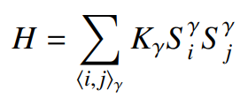
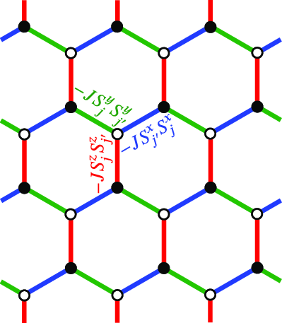
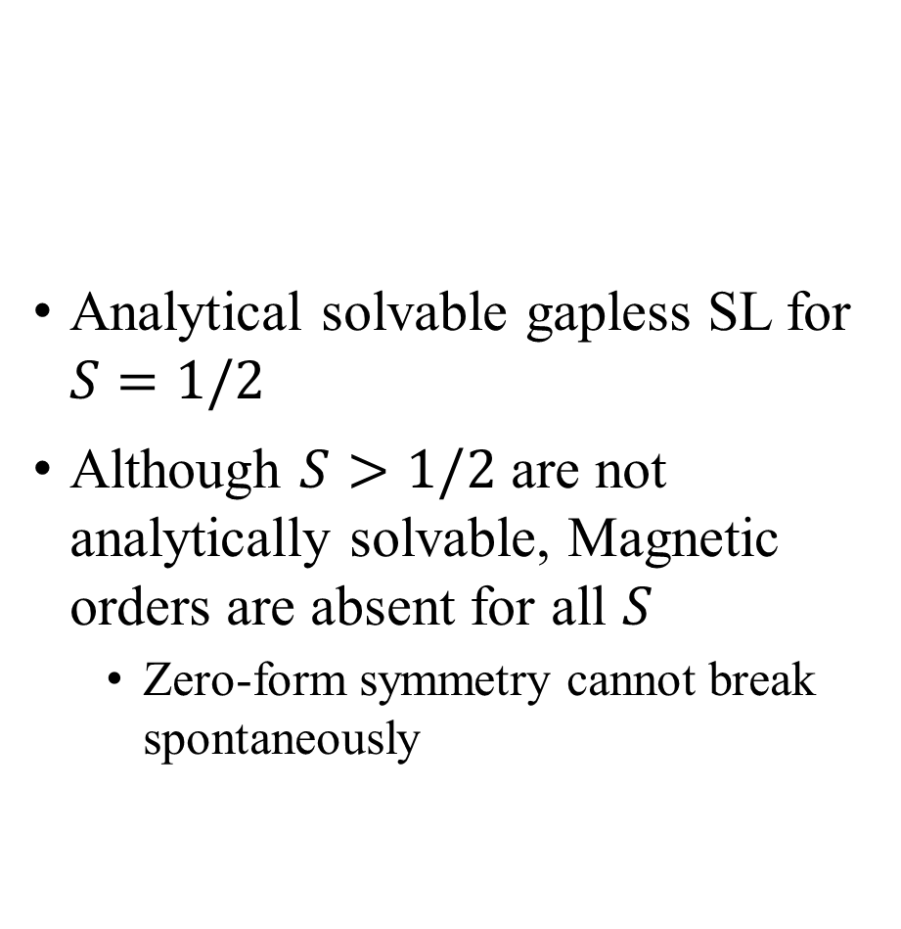
Kitaev honeycomb model
Analytical solvable gapless SL for $S=1/2$
Although $S>1/2$ are not analytically solvable, Magnetic orders are absent for all $S$
Zero-form symmetry cannot break spontaneously
Annals of Physics 321 (2006) A. Kitaev
Phys. Rev. D 12.3978 (1975)
S. Elitzur

Slide 7

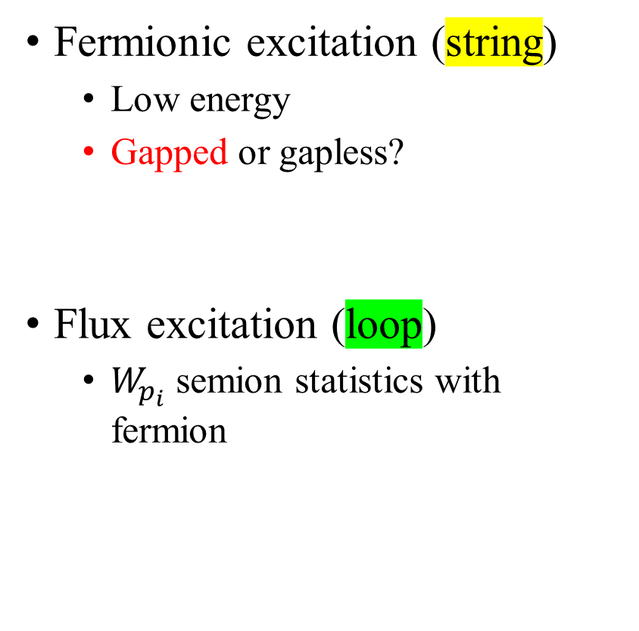
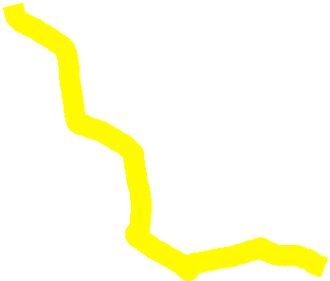
Fractionalization for half-integer-spin Kitaev models
Phys. Rev. B 78, 115116 (2008), G. Baskaran, D. Sen, and R. Shankar
Phys. Rev. Lett. 130, 156701 (2023), H. Ma
Fermionic excitation (string)
Low energy
Gapped or gapless?
Flux excitation (loop)
$W_{p_{i}}$ semion statistics with fermion
x
3
4
z
6
8
5
7

Slide 8

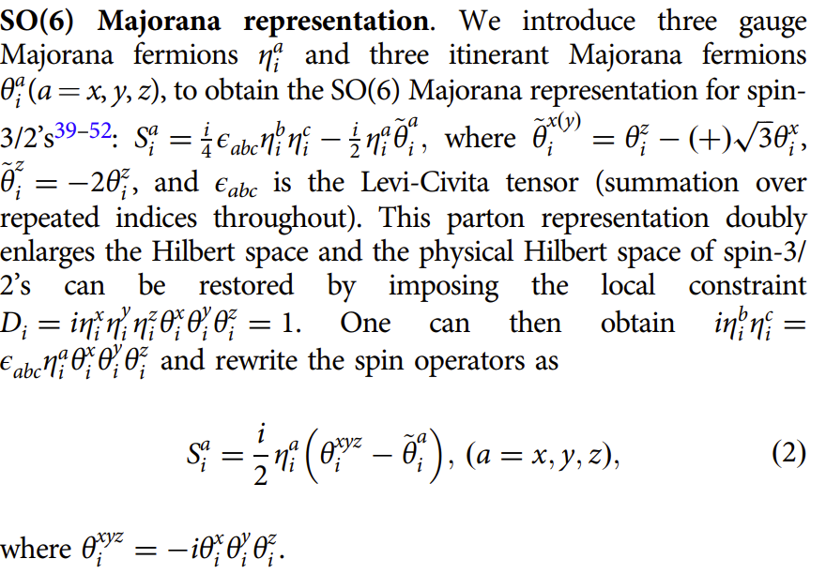
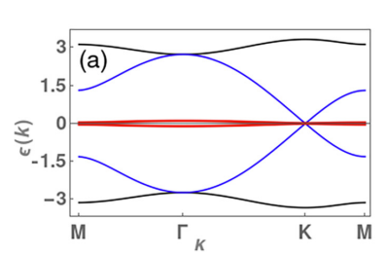

Spontaneously symmetry breaking?
Generalizing fermion-gauge basis transformation from spin-$\frac{1}{2}$ to spin-$\frac{3}{2}$
Mean-field theory approximation: Flat bond
Nature Communications 13:3813 (2022) H.-K. Jin, W. M. H. Natori, F. Pollmann and J. Knolle
Not quadratic! Cannot be solved exactly
Phys. Rev. B 108.075111 (2023) W. M. H. Natori, H.-K. Jin, and J. Knolle
Is there interaction-induced instability for the nearly flat band semimetal?

Slide 9
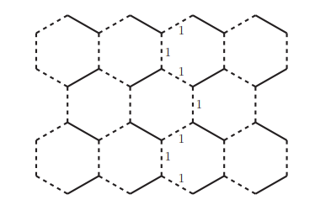
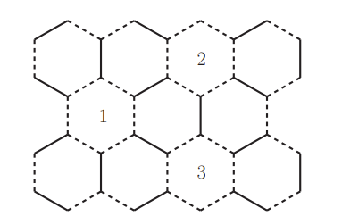
Kitaev model in the semiclassical limit
Phys. Rev. B 78, 115116 (2008), G. Baskaran, D. Sen, and R. Shankar
In the classical limit, there are extensive degeneracy
Any dimer (solid line) covering gives the energy minimum
Order from disorder
Spin-wave theory for self-avoiding walk shows the self-avoiding walk as close loop should have minimal length (6 bonds) to minimize the energy
Tripled unit cell

Slide 10
Recall of the known results and the questions
Known results
No magnetic orders in higher-spin Kitaev models
Fermionic and flux excitations are analytically constructed for half-integer spins
For large spin, the unit cell is tripled by dimer order.
Still, the models are not exactly solvable. Numerical calculation is needed to answer for any given higher spin:
VBS? Gap? Topological order?

Slide 11
The challenges for numerical methods
Main problem: finite-size effects or finite-precision effects
method | previous works (S=1) | results
exact diagonalization | A. Koga and H. Tomishige, J. Nasu Journal of the Physical Society of Japan 87.063703 (2018) | Do not see a clear gap convergence trend in 24 size, nor an obvious ground-state degeneracy.
DMRG | Xiao-Yu Dong and D.N. Sheng Phys. Rev. B.102.121102 (2020) | DMRG study for 4-width cylinder: Up to correlation length two, do not see its convergence.
simple update tensor network (iPEPS) | 1. H.-Y Lee, N. Kawashima, Y. B. Kim, Phys. Rev. R. 2.033318 (2020) 2. Y.-H. Chen, J. Genzor, Y.B. Kim, Y. Kao Phys. Rev. B 105.L060403 (2021) 3. S. Jahromi et. al. Communications Physics 7.1.319 (2024) | 1,2 claim gapped Z2 SL without symmetry-breaking 3 claims anisotropic VBS

Slide 12
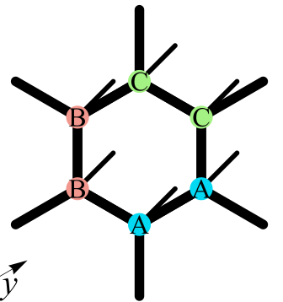
The challenges for numerical methods
The geometry should be
Compatible with tripled unit-cell structure
Does not support loop of weak bond with
length 6 cross periodic boundary
Infinite project entangled pair states (iPEPS)
Unit cell of iPEPS, A,B,C tensors are equivalent in our case, each with an index for local Hilbert space, and three contracts with nearby tensors.

Slide 13
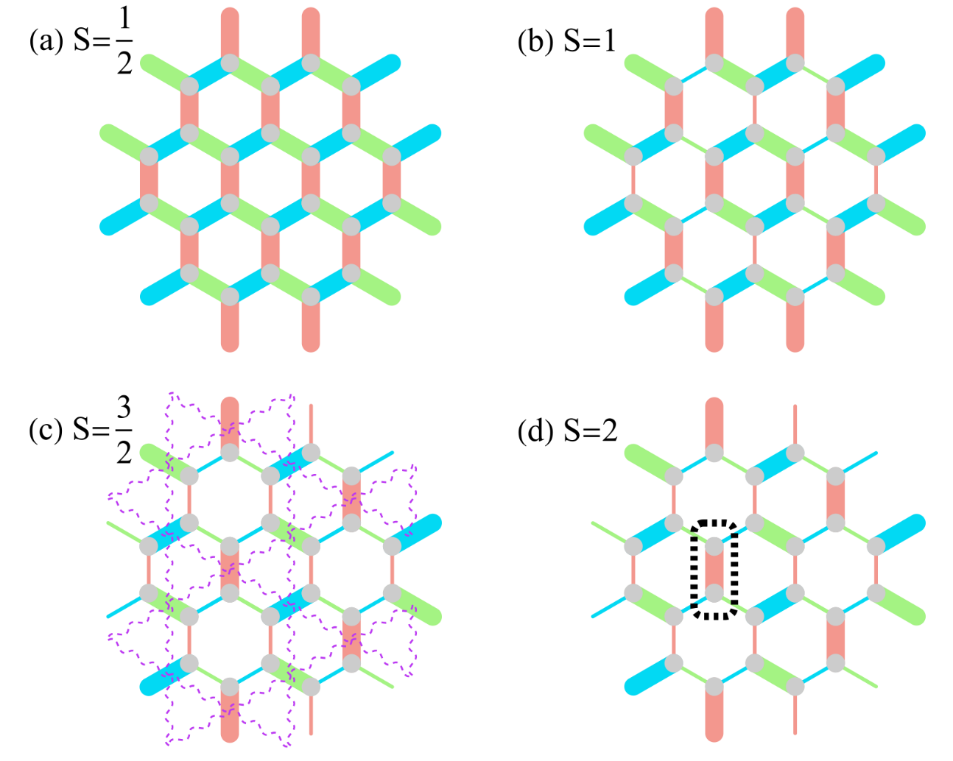
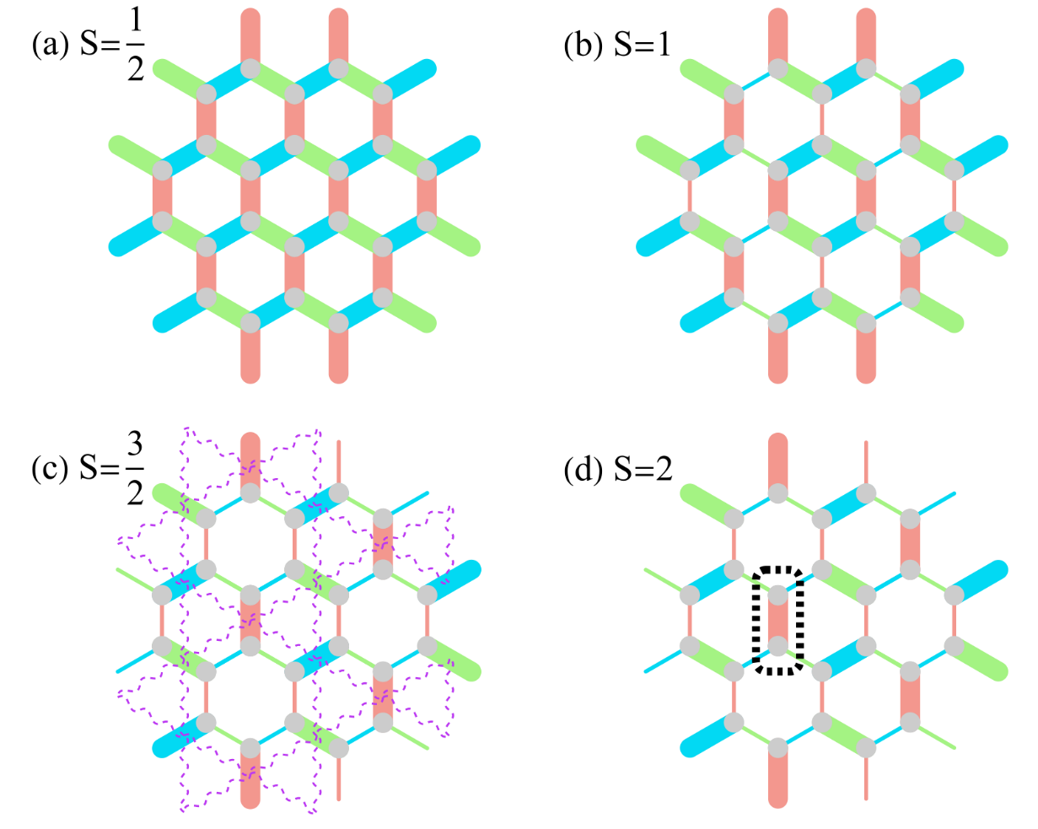
Our determination of quantum phases
uniform bond energy, gapless SL
plaquette order, no topological order
dimer order with topological order
dimer order, no topological order

Slide 14
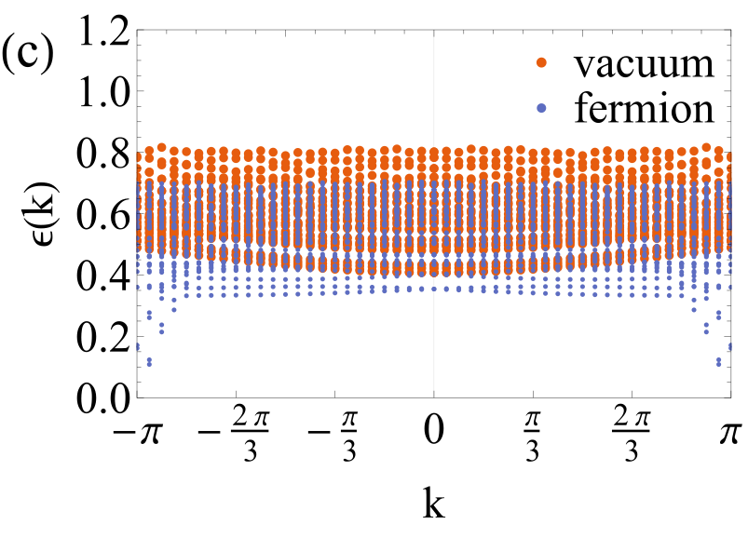
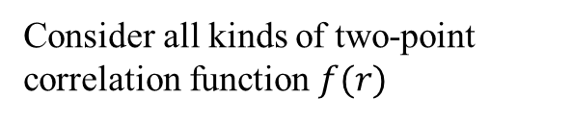
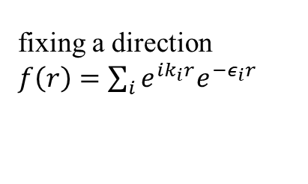
Correlation length spectrum for Spin-3/2
The system is gapped with Z2 topological order
String (fermion) correlation only exists as deconfined in spin-3/2 model
Consider all kinds of two-point correlation function $f(r)$
fixing a direction $f\left(r\right)=\sum_{i}{e^{ik_{i}r}e^{−ε_{i}r}}$

Slide 15
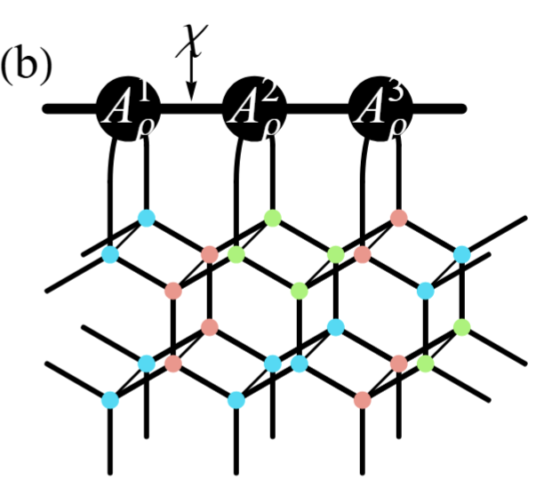
Contract the infinite tensor network with boundary MPS
Large-unit-cell variational uniform matrix product states (VUMPS)
Phys. Rev. B 97.045145 (2018)
V. Zauner-Stauber, L. Vanderstraeten, M.T. Fishman, and F. Verstraete, and J. Haegeman
Quantum 4, 328 (2020)
A. Nietner, B. Vanhecke, F. Verstraete, J. Eisert, and L. Vanderstraeten

Slide 16
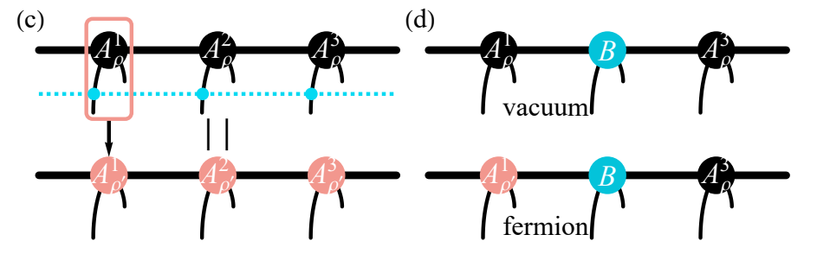
Detection of Z2 topological order from boundary MPS
Unrestricted PEPS optimization
For topological trivial state, no string, unique MPS
For topological non-trivial state, string, degenerated MPS
J. Haegeman, V. Zauner, N. Schuch & F. Verstraete, Nature Communications 6, 8284 (2015)
A . Francuz, J. Dziarmaga, G. Vidal, and L. Cincio
Phys. Rev. B 101, 041108 (2020)

Slide 17
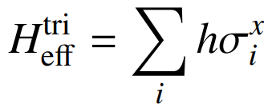
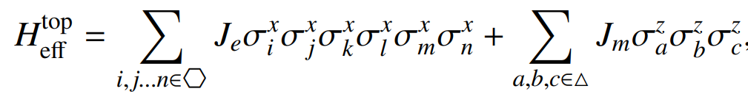
Topological non-trivial and trivial for different spin
Strong-bond effective theory
The effective variable has two states per bond.
Integer spin: topological trivial
Half-integer spin: topological non-trivial

Slide 18
Physics interpretation of the results
For half-integer spins, the spin bond order is translated into interaction-induced pseudo-fermion bond order, while the Z2 gauge structure is intact.
For spin 1, there might be a scenario of Z2 condensation from a parent theory with bosons interacting with a Z2 gauge field.

Slide 19
PART II. New development of two-dimensional tensor networks

Slide 20
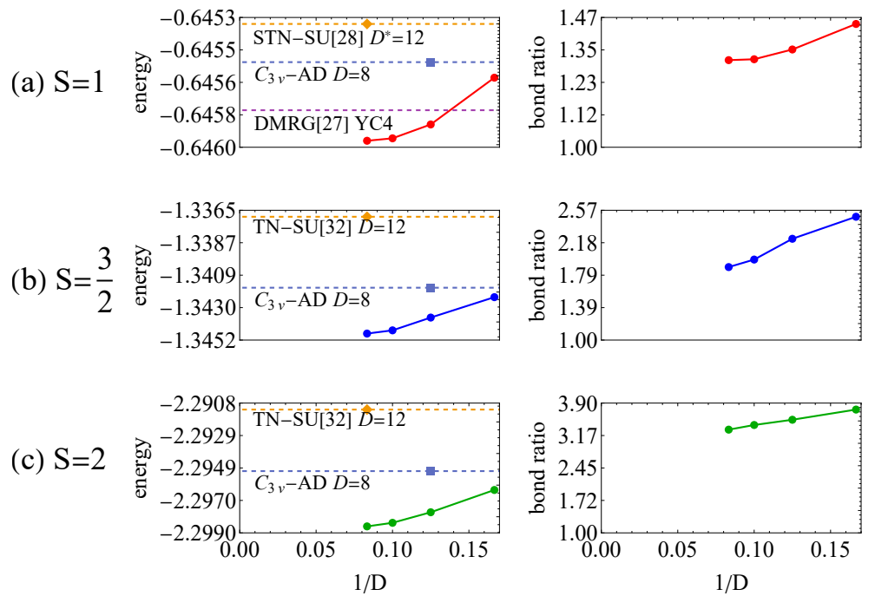
We systematically improve the methods
Variational energy advantage is gained by scaling up the bond dimension D

Slide 21
Gradient optimization of iPEPS
Gradient computation is complicated, but realized in Phys. Rev. B 94.035133 (2015) by P. Corboz
“Automatic differentiation”: Phys. Rev. X 9, 031041 (2019) by H.-J. Liao, J.-G. Liu, L. Wang, and Tao Xiang
Our methods and implementation, effectively, several orders of acceleration compared with Phys. Rev. X 9, 031041 (2019)
Faster contraction: A revised VUMPS method
Faster optimization: “Geometric” optimization

Slide 22
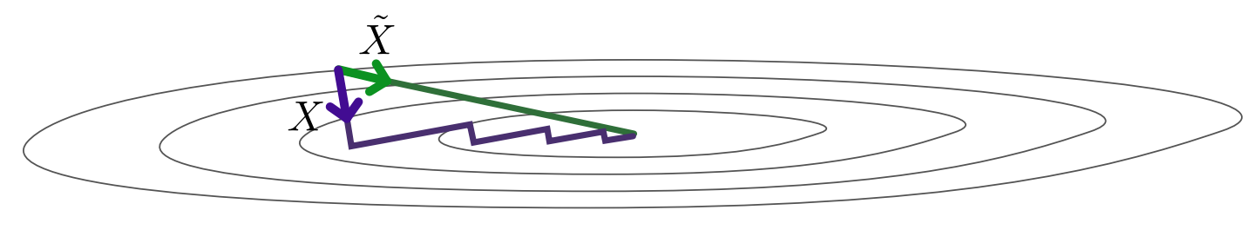
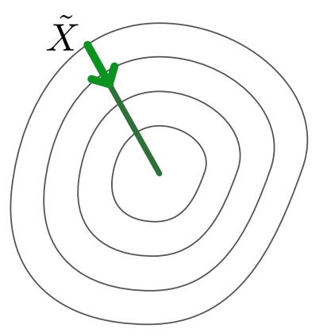
Conditioning optimization landscape
Precondition: decrease the optimization steps

Slide 23


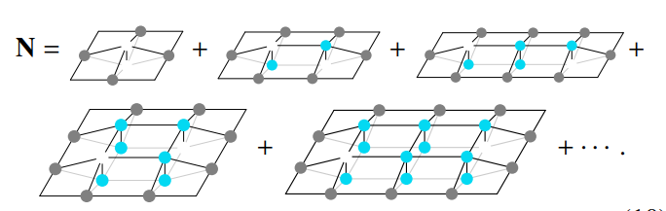

Metric in iPEPS
2511.09546 Xing-Yu Zhang, Qi Yang, Philippe Corboz, Jutho Haegeman and Wei Tang
Tangent space vector
Metric $N$ is defined using the overlap between the states represented by the tangent vectors
local

Slide 24
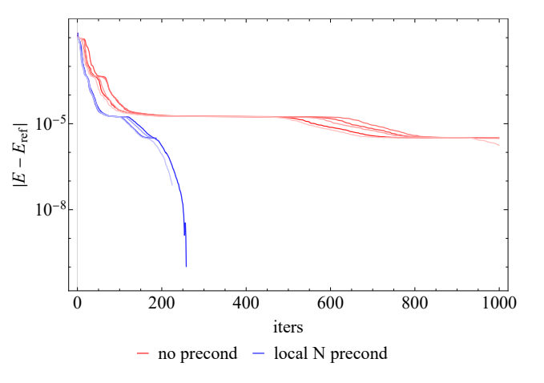
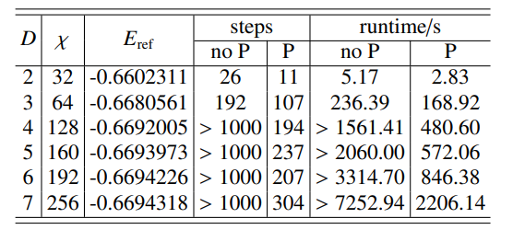
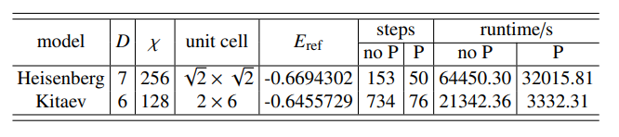


Different $D$ and unit cell
$$D=5$$

Slide 25
The precision benchmarks
In our Kitaev case, we benchmark Kitaev spin ½, get 7 significant digits for the energy per site of the exact solutions
The square lattice. The Heisenberg model is the golden standard for benchmarking with sign-problem-free Monte Carlo
 | Energy per site | Extrapolation | Computation time
SSE QMC, Sandvick 2011 | -0.6694421(5) | Yes, finite-size
Our unpublished result | -0.669438236 | No, bare data for D=9 | hour
Wait! Sandvick’s new
result arxiv 2601.20189
−0.669441857(7)
How far?

Slide 26
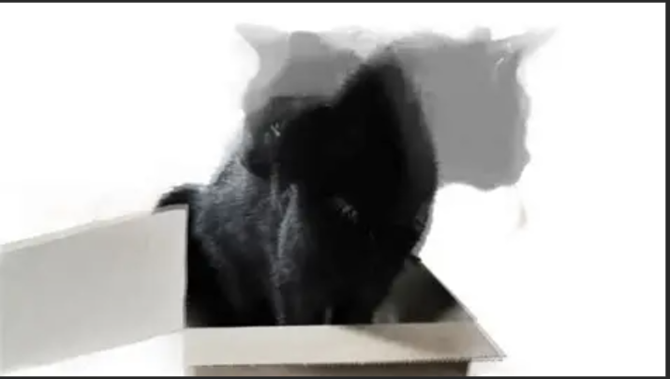
New Cross-validation: between “cat” and symmetry-breaking iPEPS calculations
Spontaneous symmetry breaking is characterized by degenerate states that break symmetry. These can form a superposition to restore the symmetry as a cat state.
We can forbid symmetry-breaking states by restricting PEPS and the environment!
Symmetries and CTMRG:
H.-Y. Lee, R. Kaneko, T. Okubo, and N. Kawashima Phys. Rev. Lett. 123, 087203 (2019)
I.V. Lukin and A. G. Sotnikov
Phys. Rev. B 107, 054424 (2023)
Q. Yang and P. Corboz
Phys. Rev. B 113, 085109 (2026)
M. Rispler, K. Duivenvoorden, and N. Schuch
PhysRevB.92.155133 (2015)
“exact cat PEPS”

Slide 27
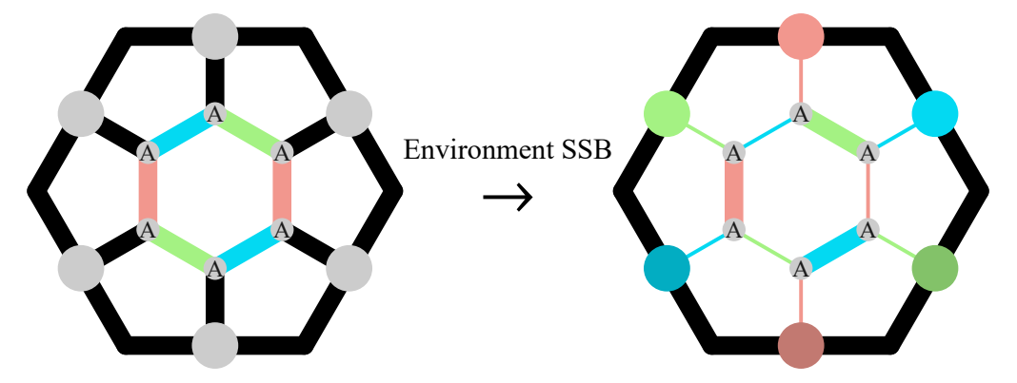
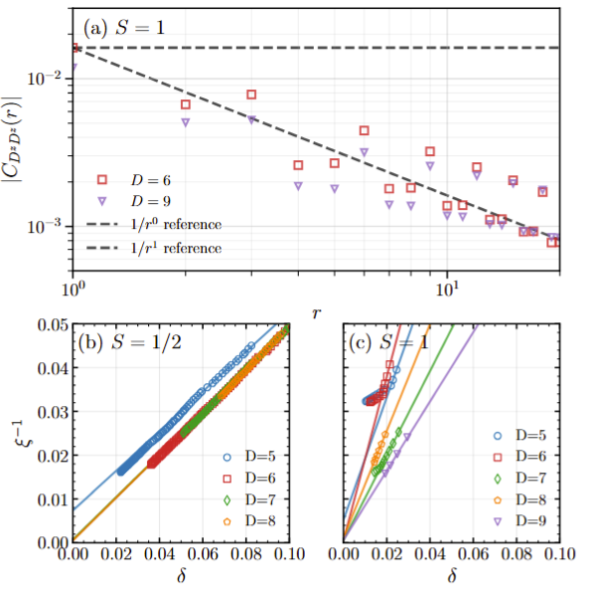
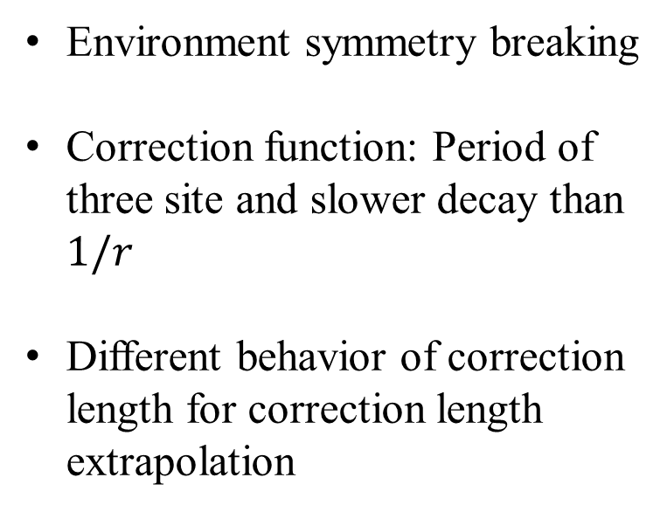
Cross validation between “cat” and symmetry-breaking iPEPS calculations
Environment symmetry breaking
Correction function: Period of three site and slower decay than $1/r$
Different behavior of correction length for correction length extrapolation

Slide 28
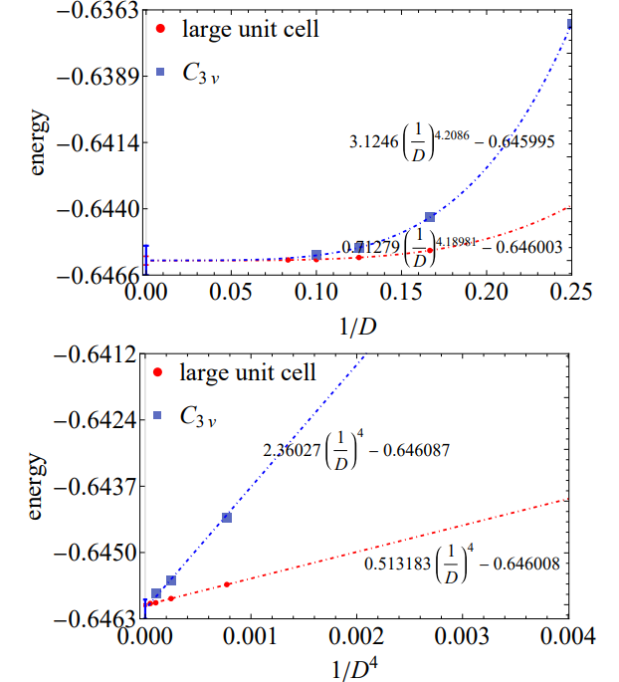
Agreement in energy extrapolation

Slide 29

Summary
Evolved variational iPEPS, determinate the phase for spin-1, 3/2, 2 Kitaev model. All of them have VBS order, and only S=3/2 has coexisting gapped Z2 topological order.

Slide 30





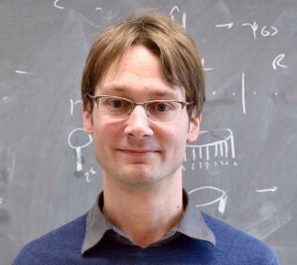
Collaboration
Xing-Yu Zhang
Qi Yang
Jutho Haegeman
Philippe Corboz

Slide 31
Thank you for your listening!

Slide 32
Appendix

Slide 33
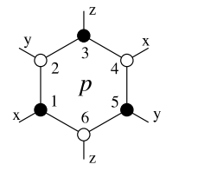


The absence of magnetic order
Extensive number of local conserved quantities, a.k.a. zero-form symmetry
Zero-form symmetry cannot break spontaneously
$$W_{p}=e^{iπ{(S}_{1}^{x}+S_{2}^{y}+S_{3}^{z}+S_{4}^{x}+S_{5}^{y}+S_{6}^{z})}$$
$$\left[W_{p},H\right]=0$$
Phys. Rev. D. 12.3978 (1975) S. Elitzur

Slide 34

The absence of magnetic order
We can construct global Z2 symmetries by multiplication of zero-form symmetries
Therefore, global Z2 symmetries cannot break, a.k.a., no magnetic order
Assume periodic boundary condition.
Multiply all the $W_{p}$ plaquette in odd row,
we obtain global Z2 symmetry for $π$ rotation around z direction.
Similar, we can obtain the other two for $π$ rotation
row 2i-1
row 2i
row 2i+1

Slide 35
String operator for low-energy fermionic excitation
1
y
x
Define string operator, for example
Any open string , e.g., highlighted, does not commute with the Hamiltonian due to endpoints. Endpoints as quasi particles obey fermionic mutual statistics
2
$$e^{iπ{(S}_{1}^{y}+S_{2}^{x}+S_{3}^{x}+S_{4}^{x}+S_{5}^{x}+S_{6}^{x}+S_{7}^{z}+S_{8}^{y})}$$
x
x
3
4
z
6
8
x
y
5
7
z

Slide 36
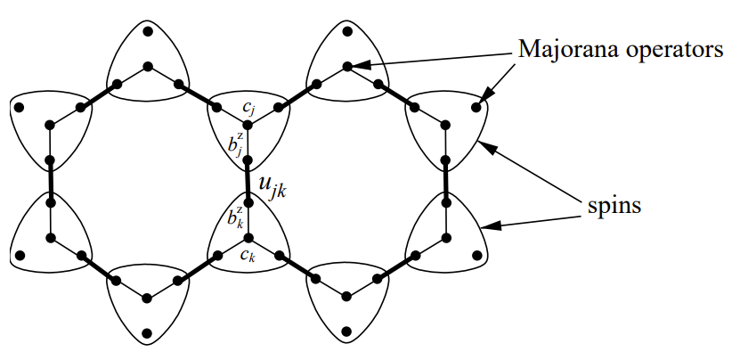
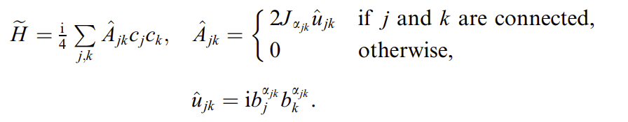
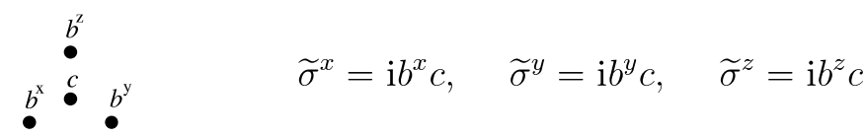
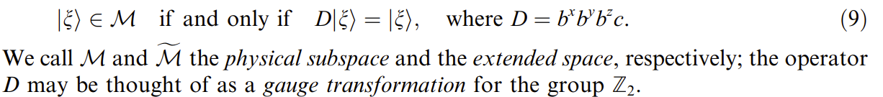
The fermion-gauge basis transformation for spin 1/2
Annals of Physics 321 (2006) A. Kitaev
In this basis, we can solve the model by solving a free Majorana fermion theory.

Slide 37
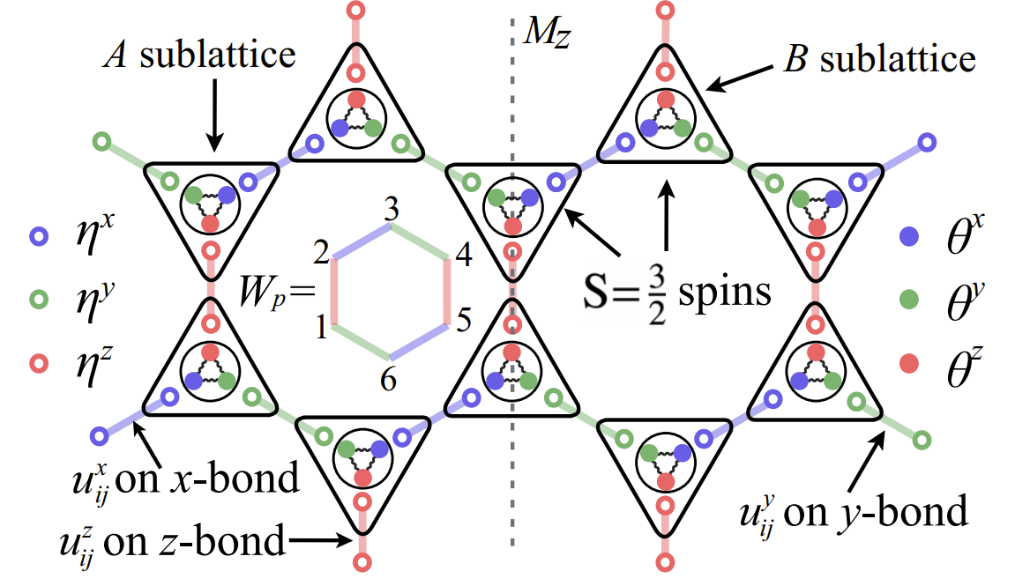
The fermion-gauge basis transformation for spin 3/2
Not quadratic! Cannot be solved exactly
Nature Communications 13:3813 (2022) H.-K. Jin, W. M. H. Natori, F. Pollmann and J. Knolle

Slide 38
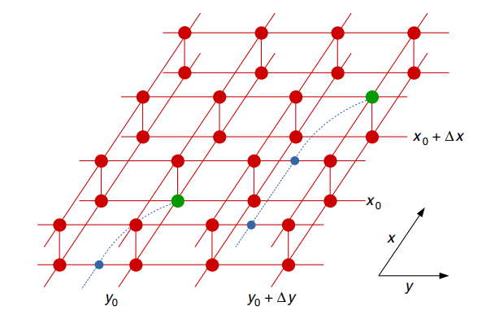
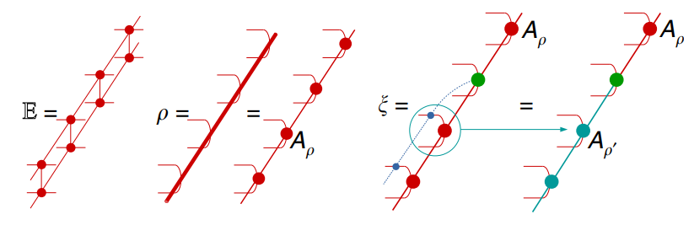
Detection of Z2 topological order from boundary MPS
J. Haegeman, V. Zauner, N. Schuch & F. Verstraete, Nature Communications 6, 8284 (2015)

