Slide 1

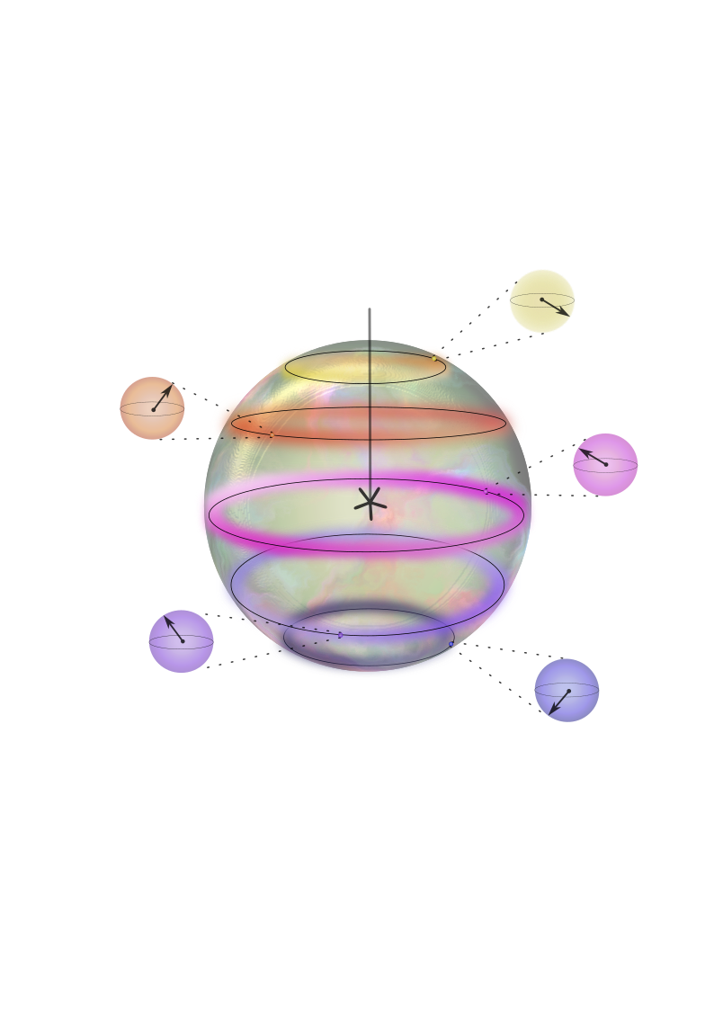

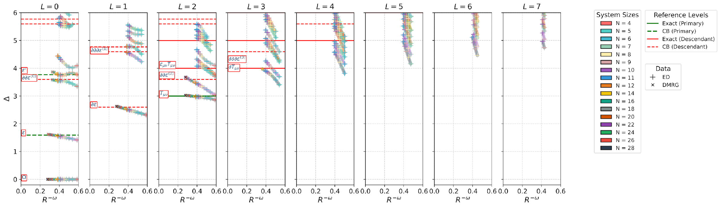

Conformal Data for the O(3) Wilson Fisher CFT
https://arxiv.org/abs/2510.09755
Arjun Dey
Dr. Loic Herviou
Prof. Dr. Christopher Mudry
Prof. Dr. Andreas Martin Läuchli Herzig
https://arxiv.org/abs/2510.09755

Slide 2
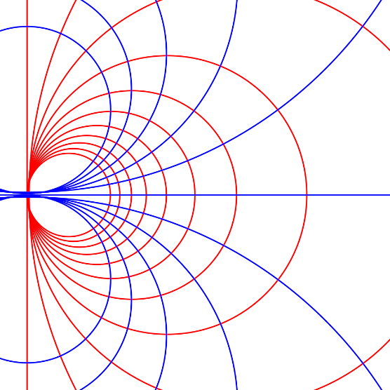
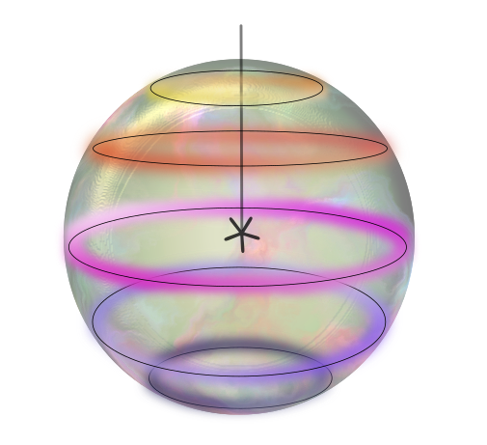
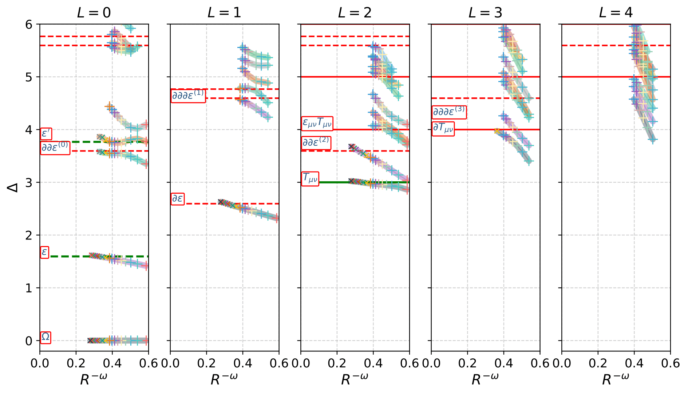
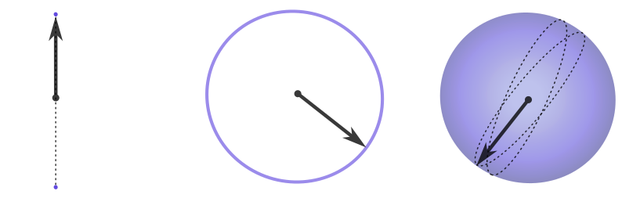
Conformal Field Theory (CFT)
Fuzzy sphere
Emergence of O(3) CFT
Quantum rotors
Rotors on FS

Slide 3
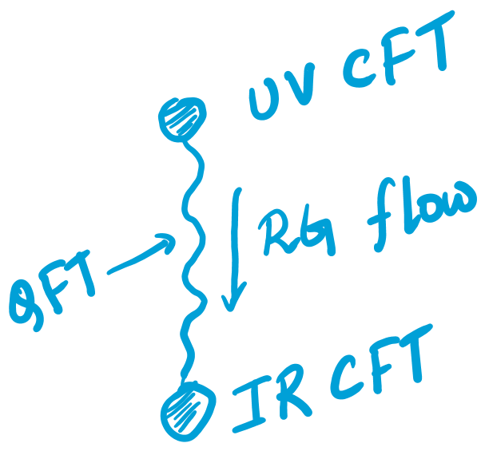
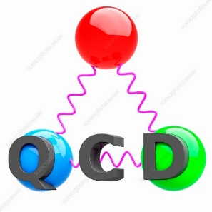

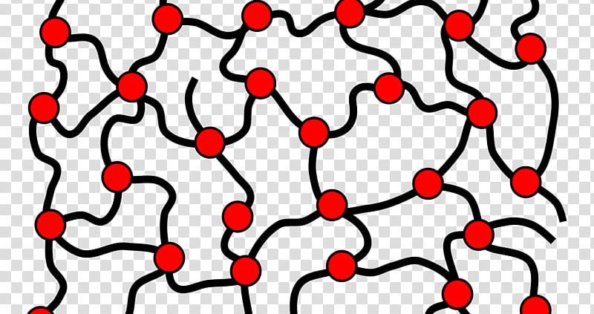
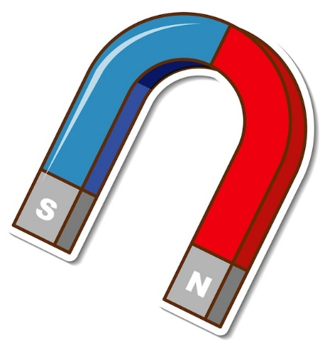

Conformal Field Theory (CFT)
Field theories with conformal symmetry
Appears in critical points (continuous phase transitions)
Universality classes

Slide 4
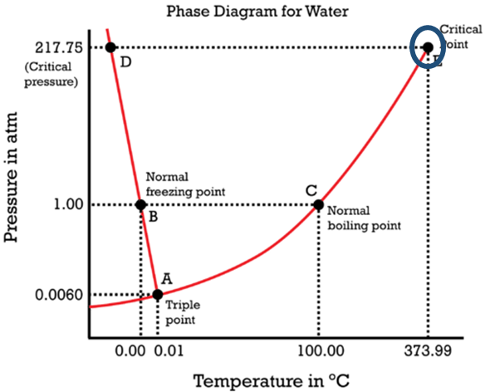


Ising CFT: $Z_{2}$
Critical point of water

Slide 5
Conformal Field Theory (CFT)

Slide 6
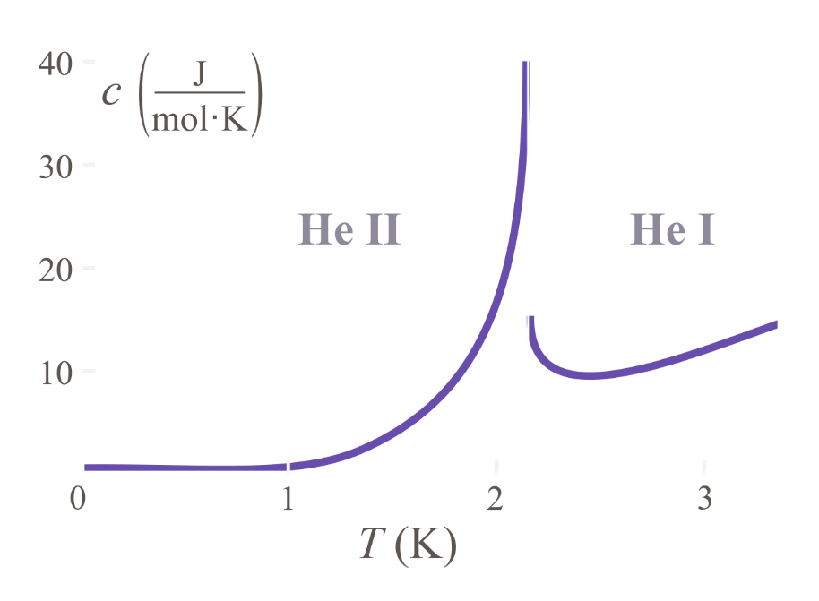


$$O\left(2\right)CFT$$
$λ$-point of ${}_{}^{4}{He}$

Slide 7
Conformal Field Theory (CFT)

Slide 8

$O(3)$ CFT
Isotropic magnet
Paramagnet

Slide 9
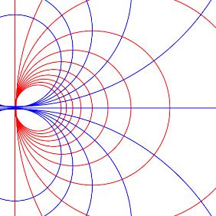
Conformal Symmetry
Translations
Rotation
Scaling
Special conformal transformation

Slide 10
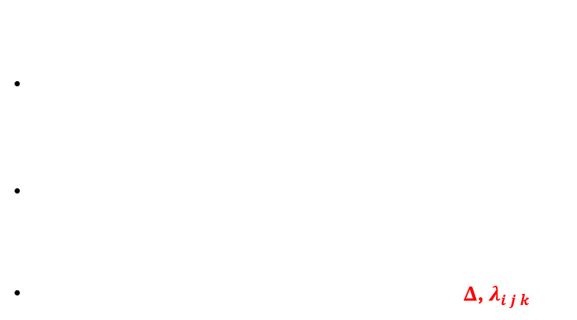
Conformal data
Two point correlation functions $〈φ_{1}\left(x\right)φ_{2}\left(y\right)〉∼ \frac{δ_{1,2}}{{\left|x−y\right|}^{2Δ_{2}}}$
$φ_{1}\left(x\right)φ_{2}\left(y\right)= \sum_{k}{\frac{λ_{1 2 k}}{{\left|x−y\right|}^{Δ_{1}+Δ_{2}−Δ_{k}}}} φ_{k}(\frac{x+y}{2})$
N-point correlation function is determined by $Δ$, $λ_{i j k}$

Slide 11
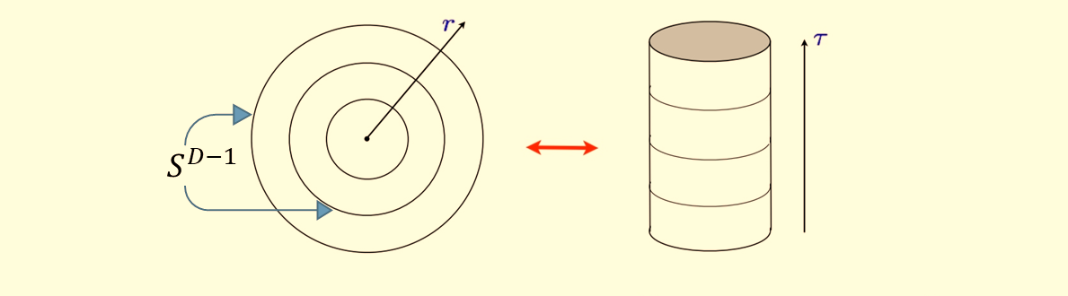
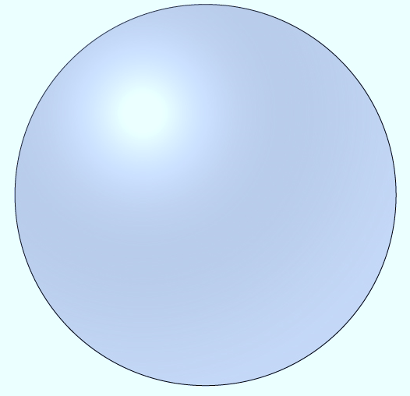
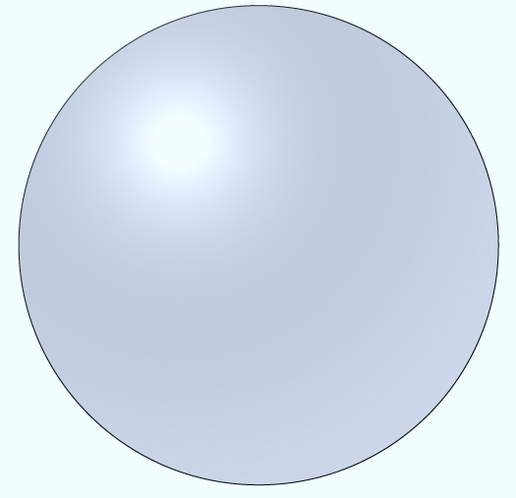
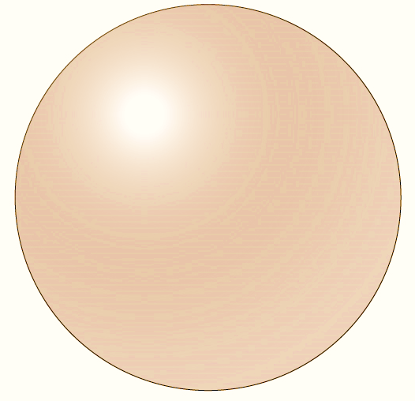
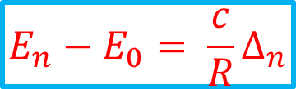

On sphere, $H=λ D$
$$E_{n}−E_{0}= \frac{c}{R}Δ_{n}$$
Conformal Data
State-Operator Correspondence

Slide 12
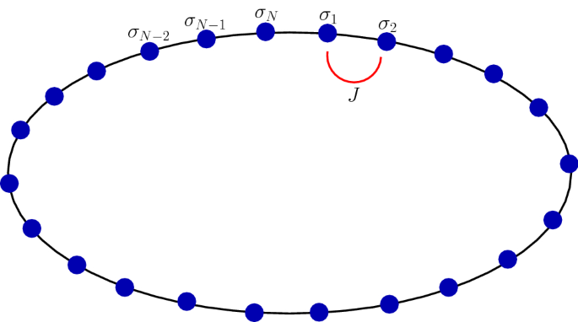
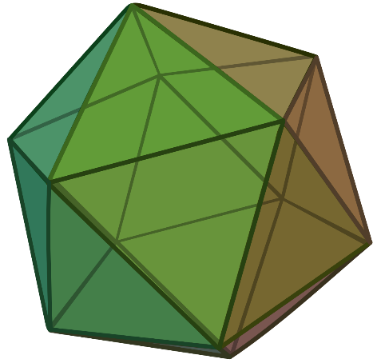


Conformal Data: Radial Quantization
Radial Quantization on $2D$ vs $3D$
$2D$:
$3D$:
A regular $2D$ lattice can not fit on $S^{2}$
Ref: On certain classes of exact solutions of two magnon states in the Heisenberg spin chain, M. S. Ramkarthik & Arijit Mandal
Ref: Lao, B.-X. & Rychkov, S. 3D Ising CFT and Exact Diagonalization on Icosahedron: The Power of Conformal Perturbation Theory. SciPost Phys. 15, 243 (2023).

Slide 13
Fuzzy Sphere
Notes:
Dirac Line from the monopole

Slide 14
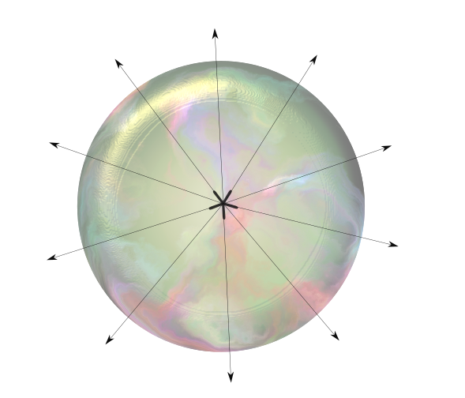
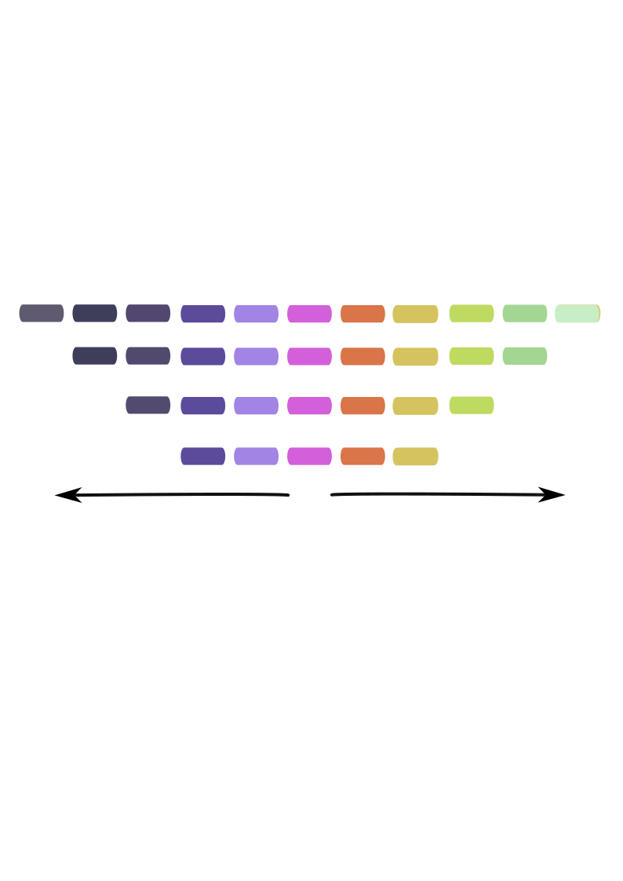
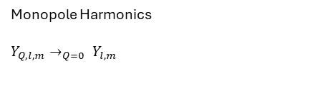
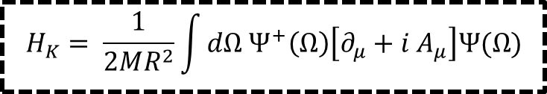
Quantum Hall on sphere
$$H_{K}= \frac{1}{2MR^{2}}\int{dΩ Ψ^{+}\left(Ω\right)\left[∂_{μ}+i A_{μ}\right]Ψ(Ω)}$$
$$m$$
Monopole Harmonics
$Y_{Q, l, m}→_{Q=0} Y_{l,m}$
Notes:
Dirac Line from the monopole

Slide 15


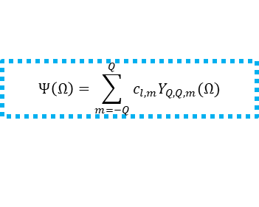
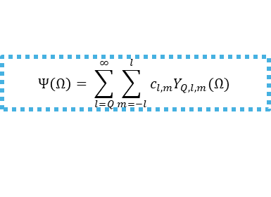

Lowest Landau level projection
$$H=H_{K}+UH_{int}$$
$$Ψ\left(Ω\right)= \sum_{l=Q}^{∞}{\sum_{m=−l}^{l}{c_{l,m}Y_{Q,l,m}(Ω)}}$$
Gap $≫U$
Lowest Landau level projection
$$m$$
At filling < 1, all electrons are in the LLL
$$Ψ\left(Ω\right)=\sum_{m=−Q}^{Q}{c_{l,m}Y_{Q,Q,m}(Ω)}$$
Introduces fuzziness $\left[θ, φ\right]≠0$
Notes:
Dirac Line from the monopole

Slide 16
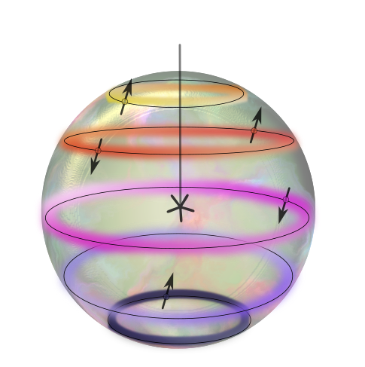



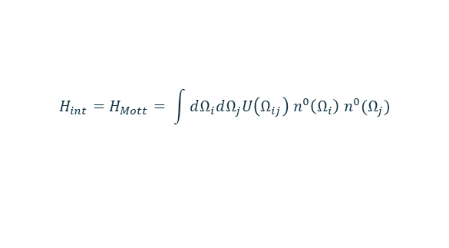


Effective spins on the fuzzy sphere
$$H=H_{K}+H_{int}$$
$$H_{int}=H_{Mott}= \int{dΩ_{i}dΩ_{j}U\left(Ω_{ij}\right) n^{0}\left(Ω_{i}\right) n^{0}(Ω_{j})}$$
$$n^{0}\left(Ω_{i}\right)=\left[Ψ_{↑}^{+}\left(Ω_{i}\right) Ψ_{↓}^{+}\left(Ω_{i}\right)\right] \left(\begin{matrix}1 & 0 \\ 0 & 1\end{matrix}\right)\left[\begin{matrix}Ψ_{↑}(Ω_{i}) \\ Ψ_{↓}(Ω_{i})\end{matrix}\right]$$
$$Two Flavors of electrons$$
$$Effective spin model$$

Slide 17
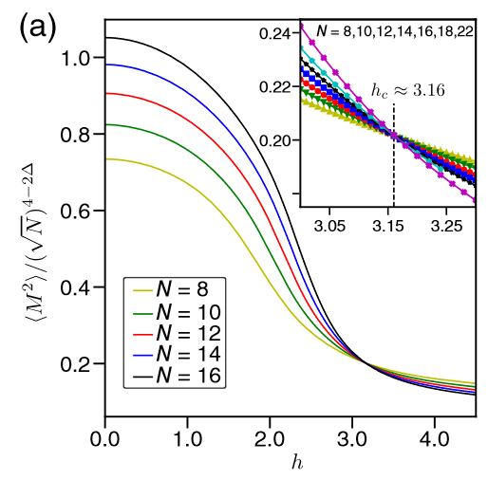




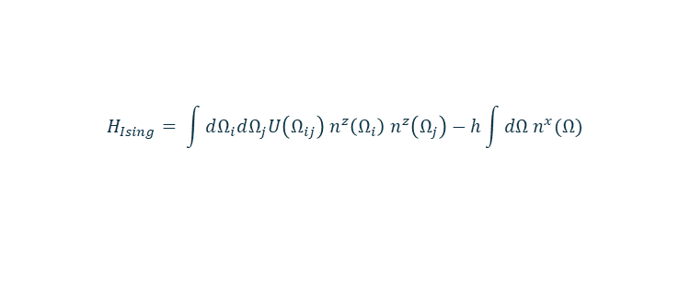
Ising model
$$H=H_{K}+H_{Mott}+H_{Ising}$$
$$0$$
$$H_{Ising}= \int{dΩ_{i}dΩ_{j}U\left(Ω_{ij}\right) n^{z}\left(Ω_{i}\right) n^{z}\left(Ω_{j}\right)−h\int{dΩ n^{x}(Ω)}}$$
$$n^{α}\left(Ω_{i}\right)=\left[Ψ_{↑}^{+}\left(Ω_{i}\right) Ψ_{↓}^{+}\left(Ω_{i}\right)\right] σ^{α}\left[\begin{matrix}Ψ_{↑}(Ω_{i}) \\ Ψ_{↓}(Ω_{i})\end{matrix}\right]$$
Ref: Zhu, W., Han, C., Huffman, E., Hofmann, J. S. & He, Y.-C. Uncovering Conformal Symmetry in the 3D Ising Transition: State-Operator Correspondence from a Quantum Fuzzy Sphere Regularization. Phys. Rev. X 13, 021009 (2023).

Slide 18
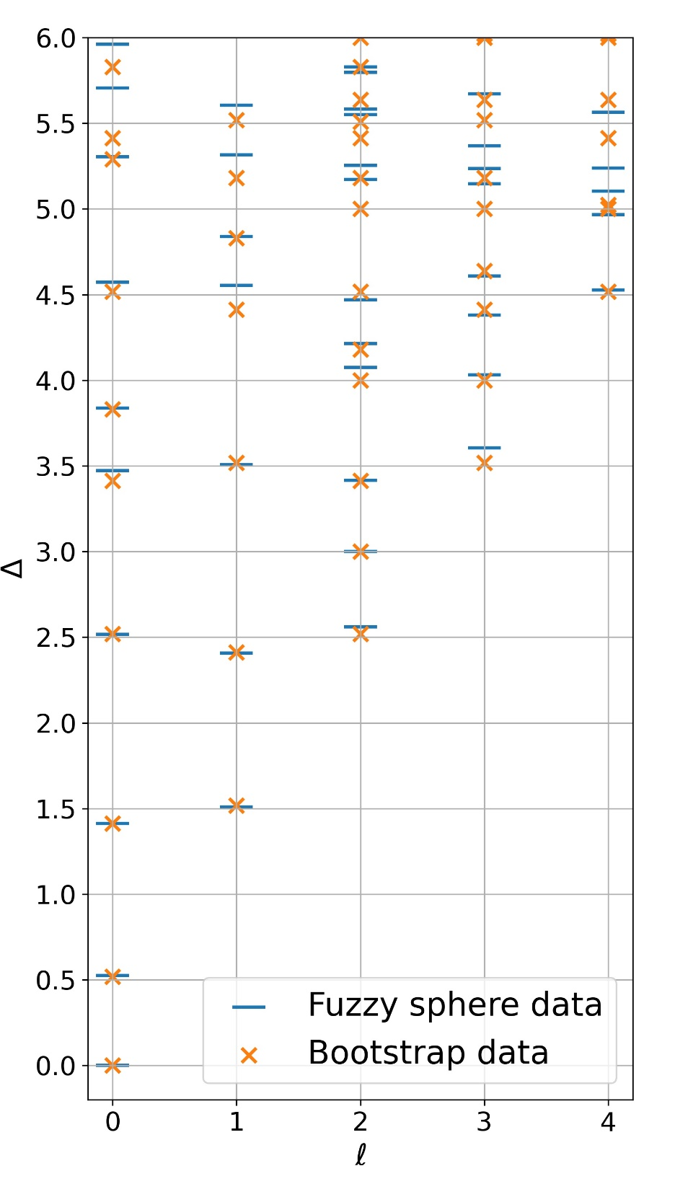
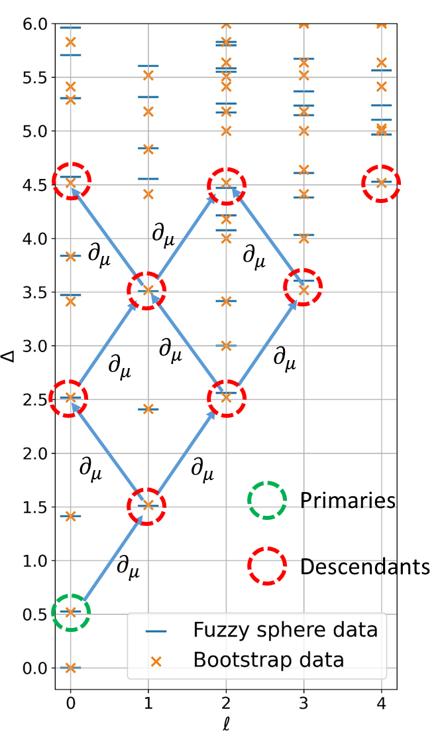
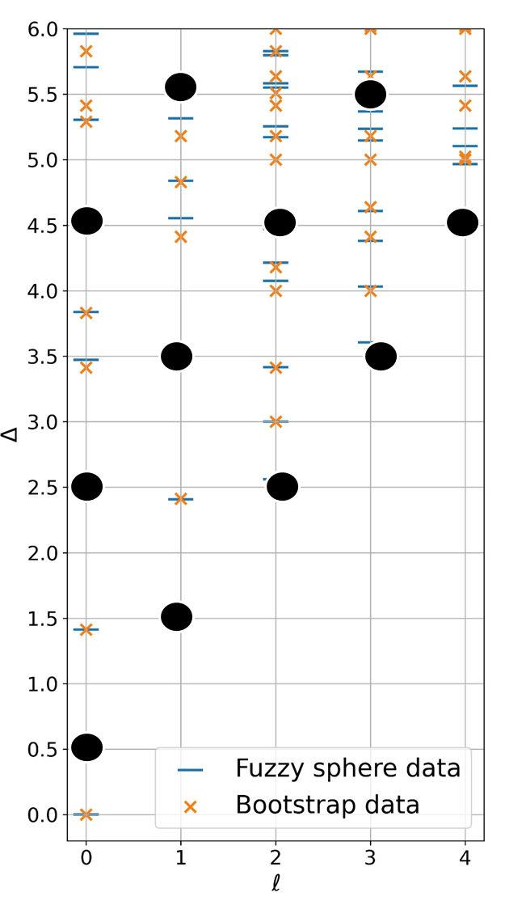
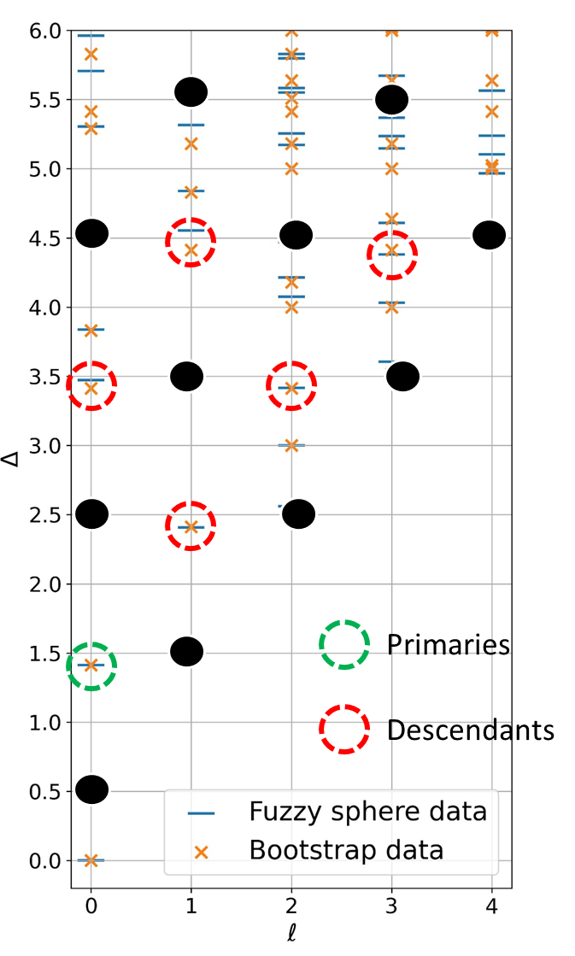

Ising CFT
Spectrum and CFT operators
$$E_{n} −E_{0}∼Δ_{n}$$
Extract conformal towers
Primaries: lowest energy state of a conformal tower
Descendants: generated from primaries by using translation operator
Data from:
Ref: Zhu, W., Han, C., Huffman, E., Hofmann, J. S. & He, Y.-C. Uncovering Conformal Symmetry in the 3D Ising Transition: State-Operator Correspondence from a Quantum Fuzzy Sphere Regularization. Phys. Rev. X 13, 021009 (2023).

Slide 19
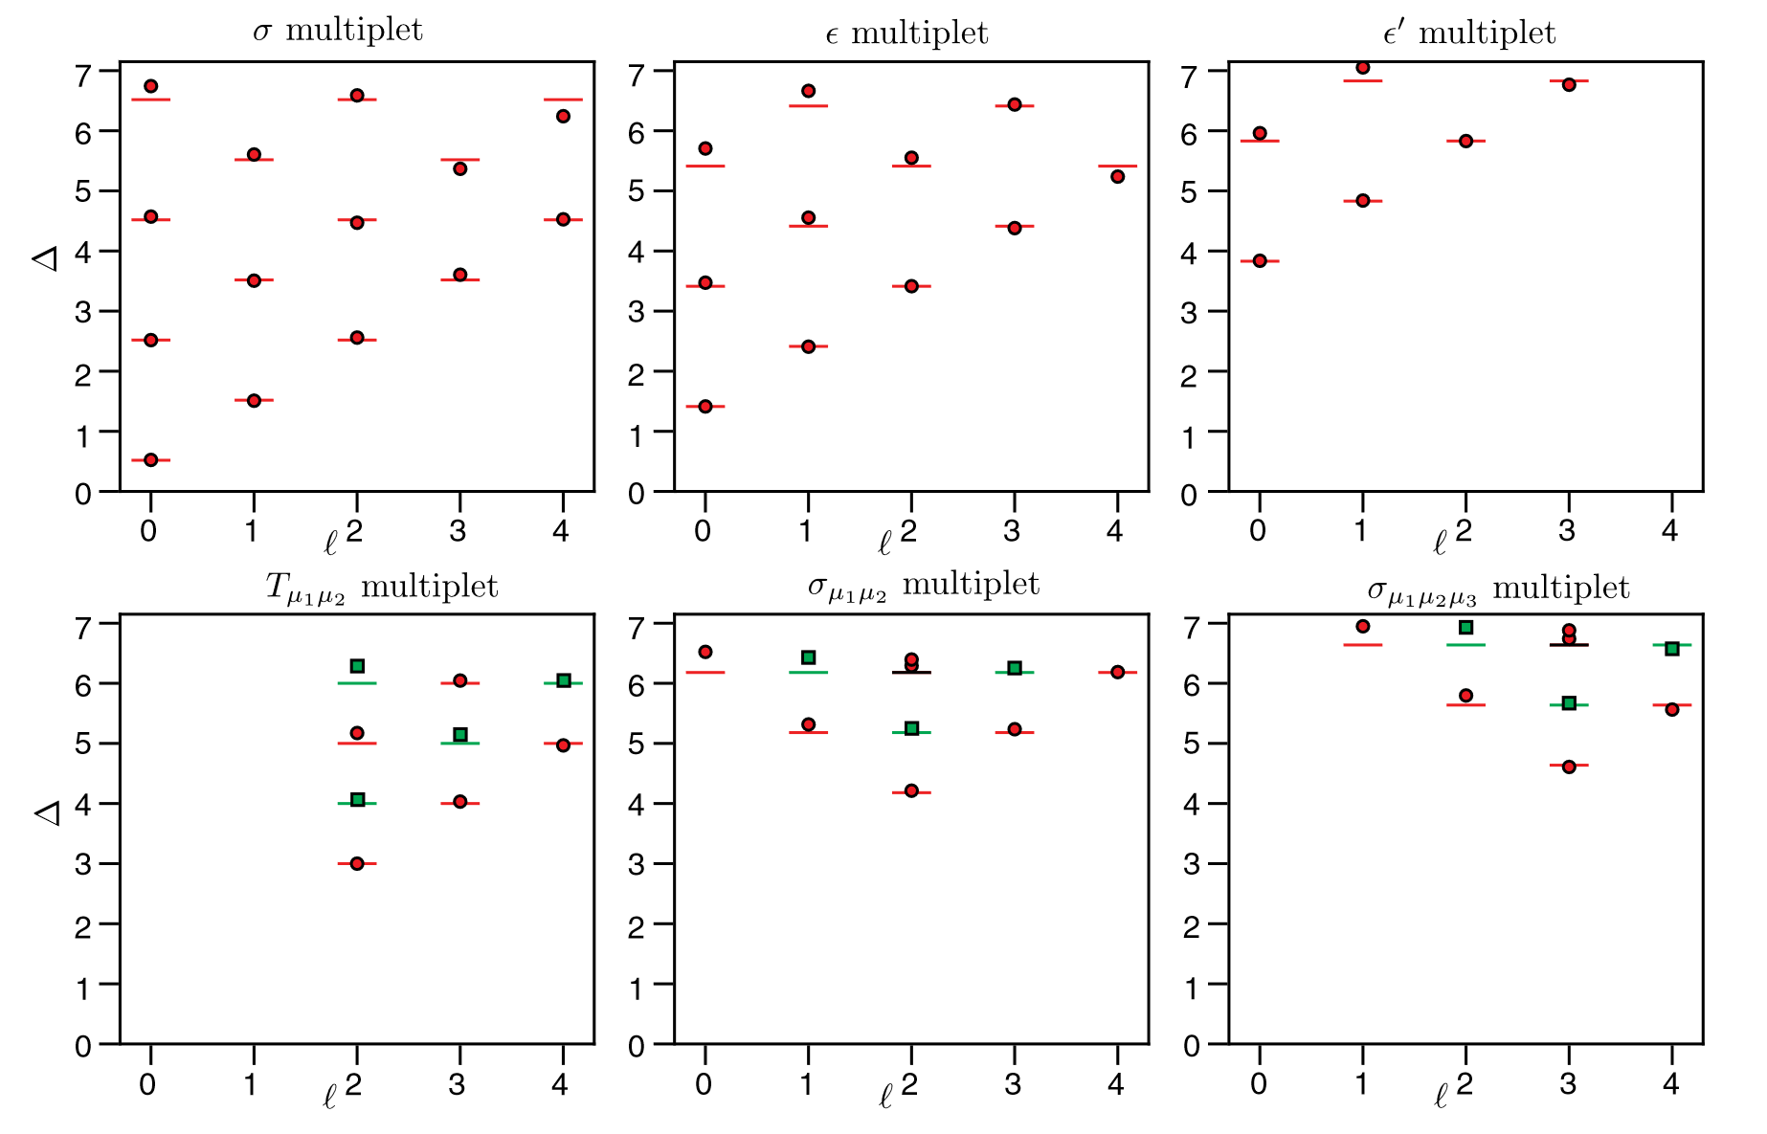


Ising CFT
Lowest landau level projection + Hubbard like interaction gives you effective 2+1D spin model on sphere
Spin-spin interactions can then simulate known spin models and their criticalities. e.g. Ising criticality
How to simulate other criticalities?
What about Wilson Fisher (O(N)) criticalities?
Ref: Zhu, W., Han, C., Huffman, E., Hofmann, J. S. & He, Y.-C. Uncovering Conformal Symmetry in the 3D Ising Transition: State-Operator Correspondence from a Quantum Fuzzy Sphere Regularization. Phys. Rev. X 13, 021009 (2023).

Slide 20
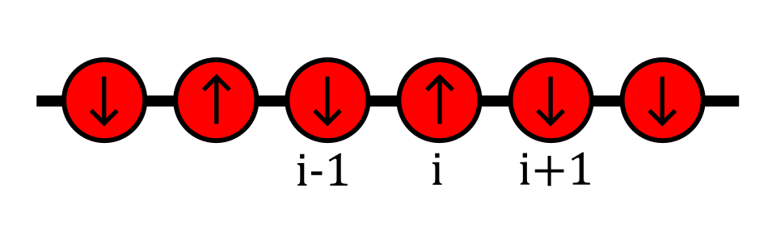
Quantum Rotor Model

Slide 21
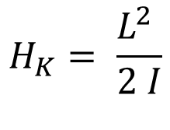
O(N) Rotors

Slide 22
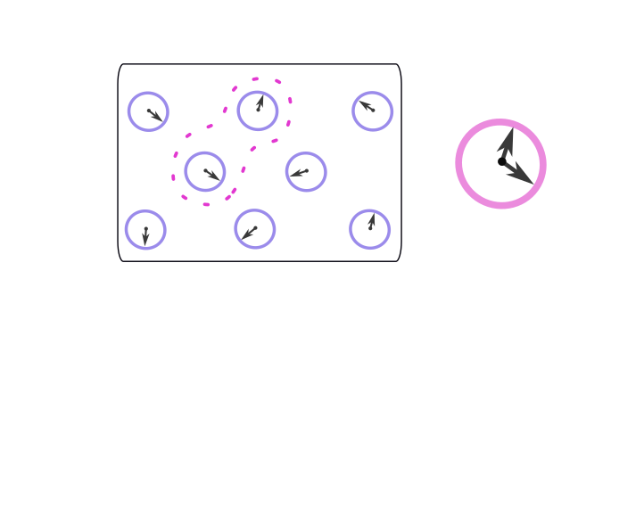






Quantum Rotor model
Paramagnetic
Ferromagnetic

Slide 23
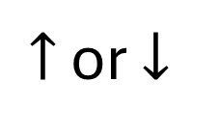



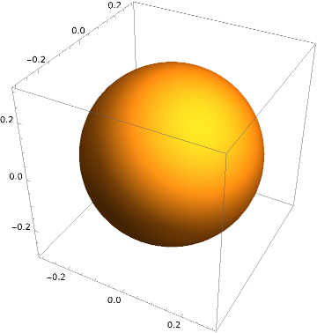
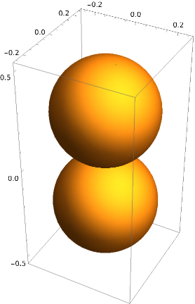


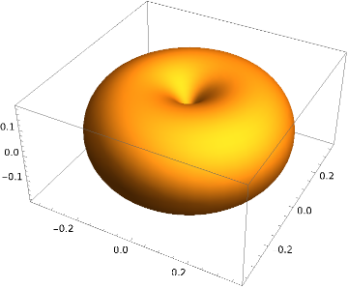

Rotors Hilbert space
Finite Hilbert space
Notes:
Z_2 rotor just maps to transverse field Ising model

Slide 24


Slide 25





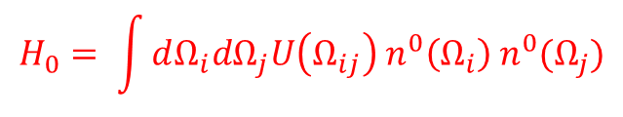

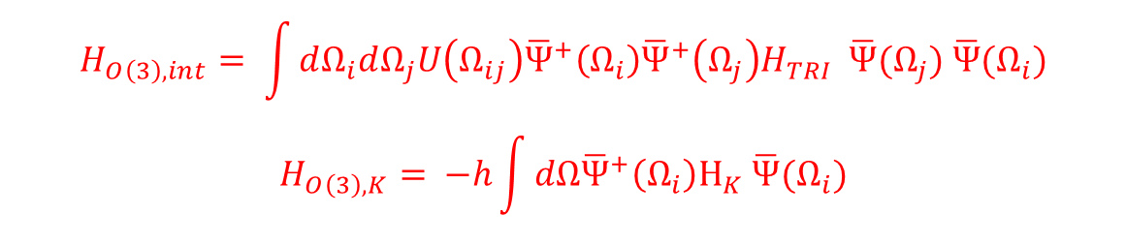
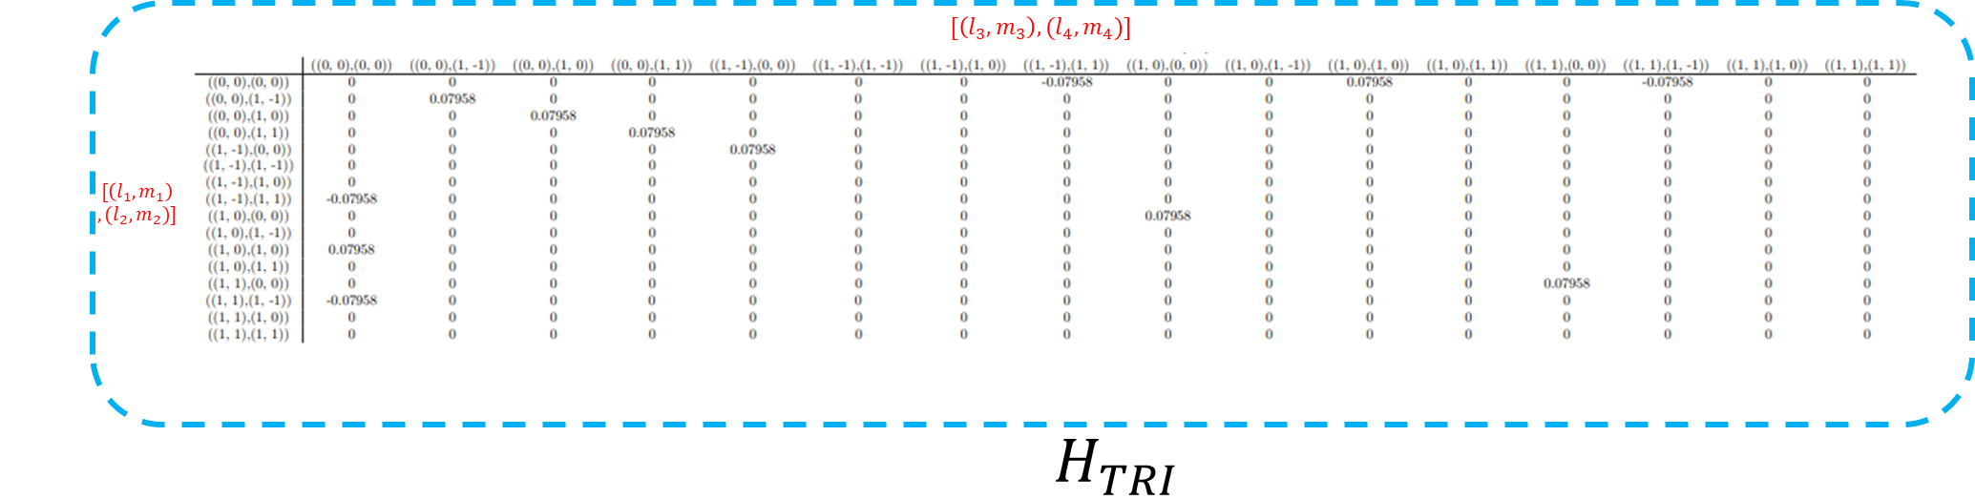

Model
4 flavors

Slide 26








Symmetries
# Electrons in (l=1) % 2

Slide 27
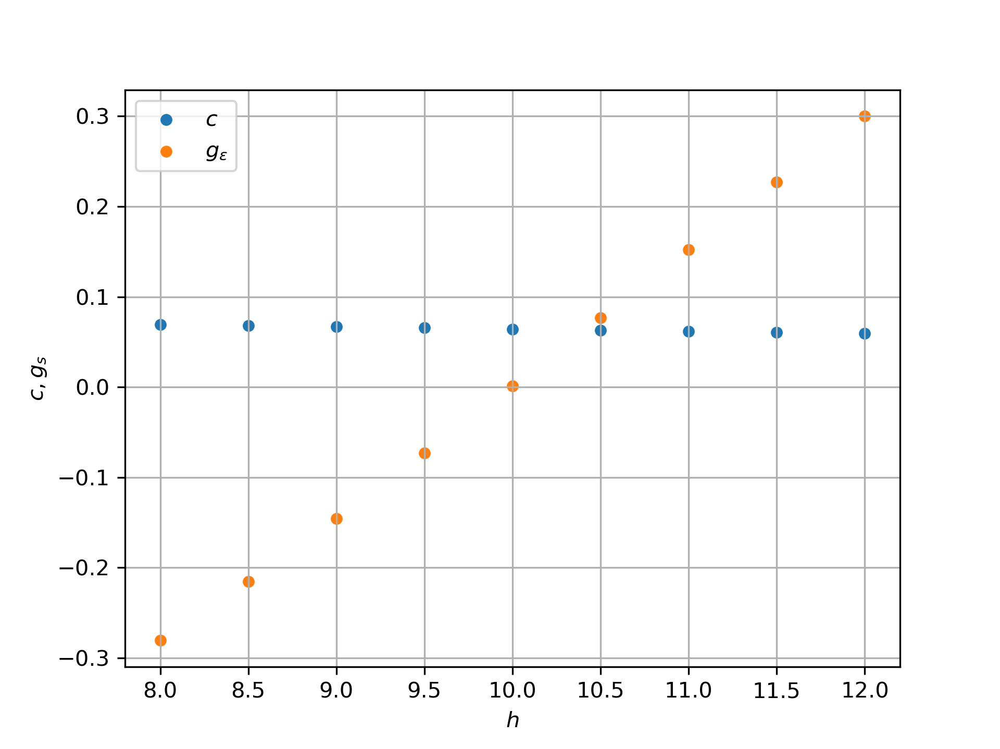
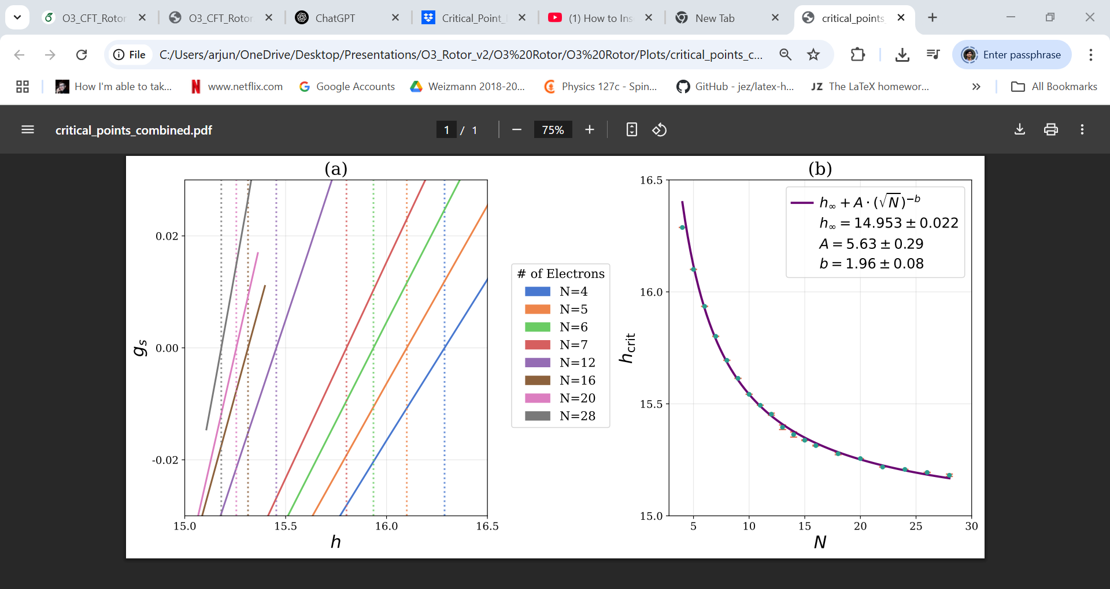


Determination of critical point
δH is coupling to a CFT operator
Symmetry constraints

Slide 28
Emergence of O(3) CFT

Slide 29

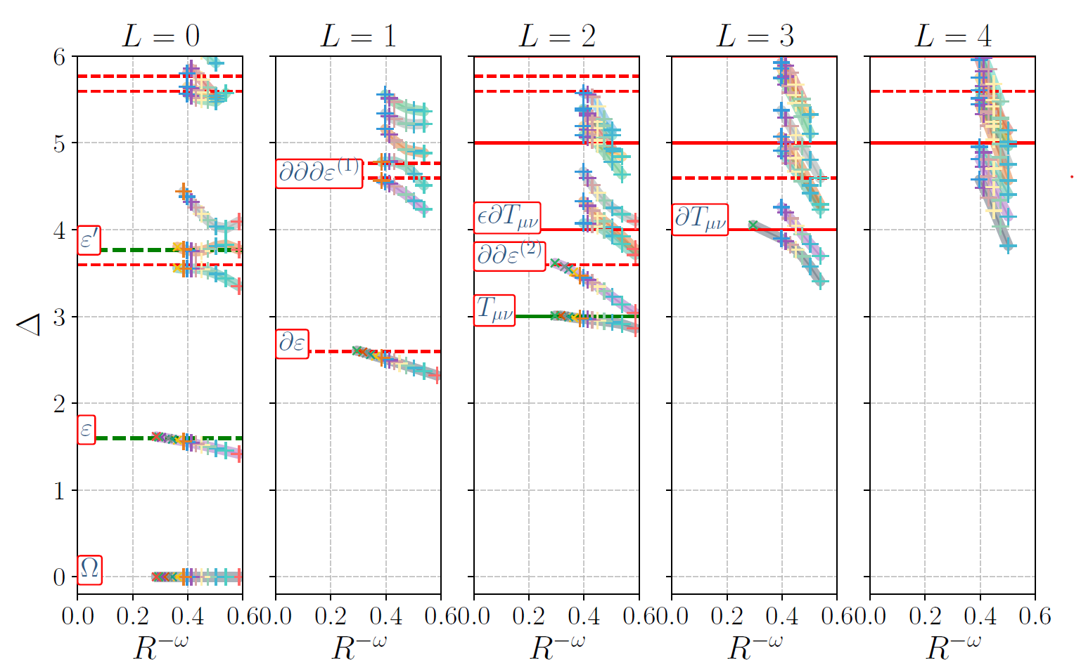
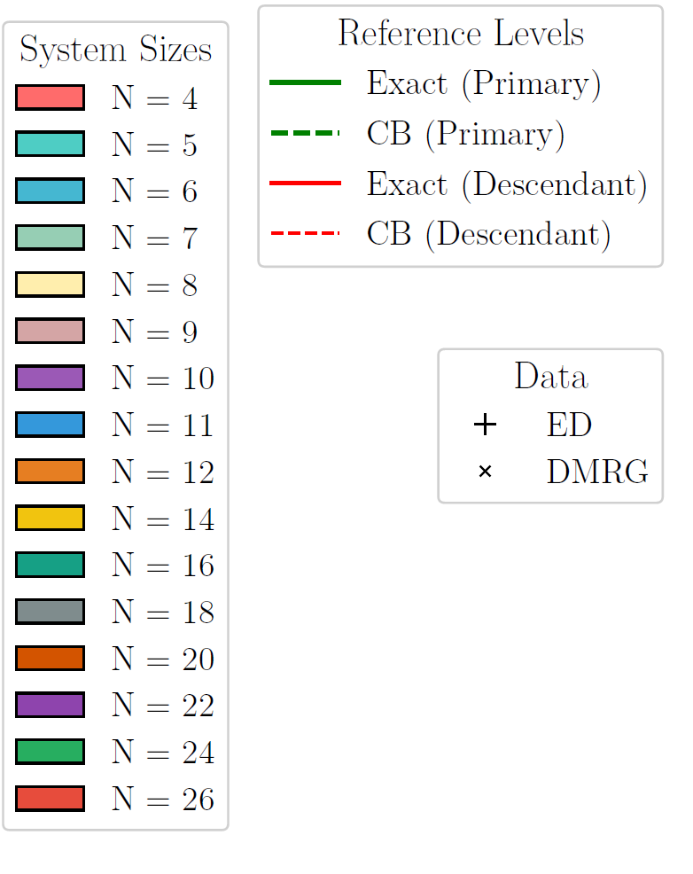

Slide 30



Slide 31



Slide 32



Operator product expansion coefficients
Truncated quantum rotors can be fuzzified to study O(N) models and their criticality
Conformal perturbation theory gives you access to the critical point. It also gives you access to OPE coefficients, and can explain finite size corrections at the critical point.
$$f_{nεn}= \frac{dδE_{n}}{dg_{ε}}{\left.​\right|}_{g_{ε}=0}$$

Slide 33


(# of electrons)

Slide 34

Verifying large charge expansion predictions
Ref: Gapped Goldstones at the cut-off scale: a non-relativistic EFT, Gabriele Cuomo et. al.

Slide 35


Dimerized Heisenberg antiferromagnets

Slide 36









$ε_{μ}$ in literature

Slide 37




More on $ε_{μ}$
Not relevant, no new universality class
For 18 electrons ~ 3.23
Five-loop epsilon expansion calculation shows ~3.44
The operator is in-fact is a cubic-interaction term

Slide 38

Conclusion and outlook
Scaling dimensions and OPEs for O(3) CFT
Model is generalizable to O(N) (results for O(2) available)
What happens to the operators in the presence of a boundary? $ε_{μ}$ operator should show interesting behaviour.
Non-diagonal OPEs?

Slide 39
Thank You

Slide 40



