Slide 1
SPECTRAL CASCADE FORMATION
IN A TWO-FLUID ANALOGUE COSMOLOGY SYSTEM
Analogue Gravity in 2026
Seán Gregory – University of Nottingham

Slide 2

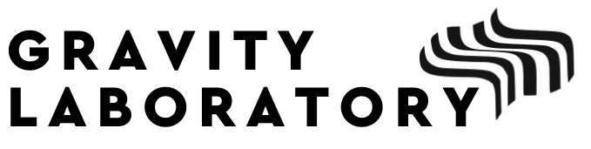


Contents
Most of this talk will be on the study of this paper:
[1] Gregory, S., Schiattarella, S., Barroso, V. S., Kaiser, D. I., Avgoustidis, A., & Weinfurtner, S. (2024). Tracing the nonlinear formation of an interfacial wave spectral cascade from one to few to many. arXiv preprint arXiv:2410.08842.
Spectral cascades
The shaker experiment
Cosmological analogue
Outlook
Find our paper here!
2
Notes:
The work of myself and my collaborators is to use the methodology of analogue gravity to study the creation and subsequent thermalisation of matter in the early universe. First, I’ll briefly cover our general research approach, followed by the cosmological theory to which we apply it. Then I’ll discuss our experimental setup, and the recent advances to what we can resolve. I’ll talk about our most recent findings in the areas of nonequilibrium physics and fluid dynamics, and then finally I’ll discuss in more depth the link between our experiment to cosmology and what we can hope to learn.

Slide 3

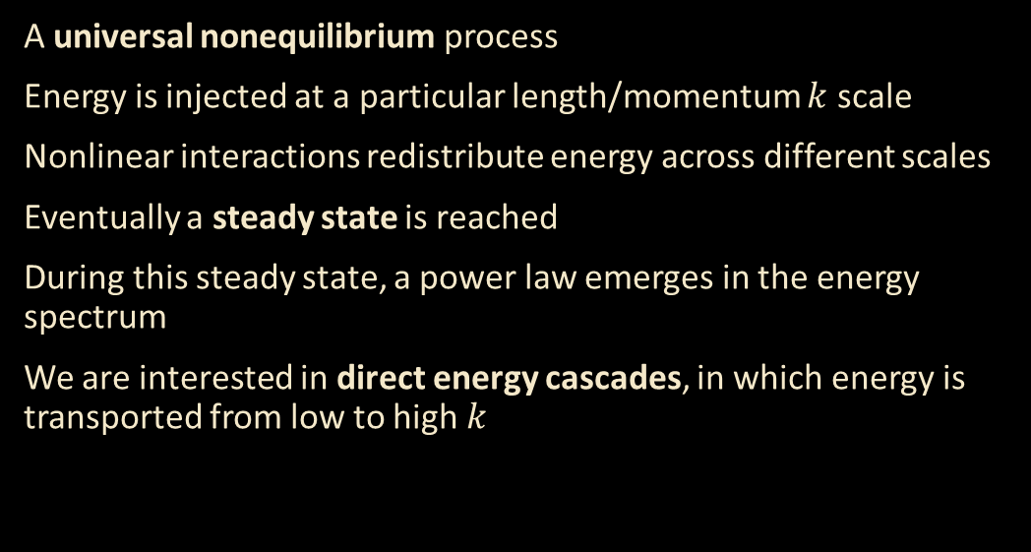
Cascades
Log(Spectrum)
Indirect cascade
A universal nonequilibrium process
Energy is injected at a particular length/momentum $k$ scale
Nonlinear interactions redistribute energy across different scales
Eventually a steady state is reached
During this steady state, a power law emerges in the energy spectrum
We are interested in direct energy cascades, in which energy is transported from low to high $k$
Direct cascade
Energy injection
Log($k)$

Slide 4
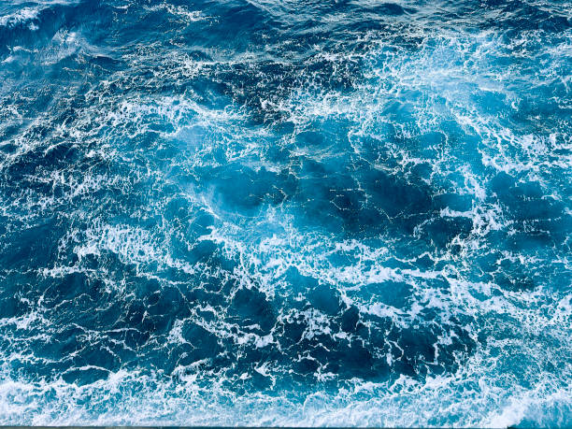
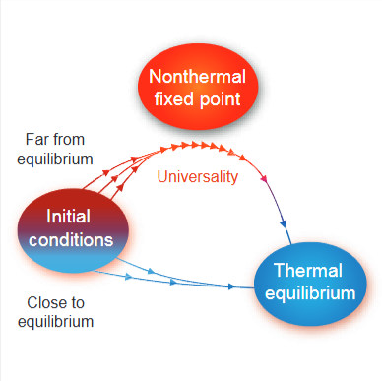
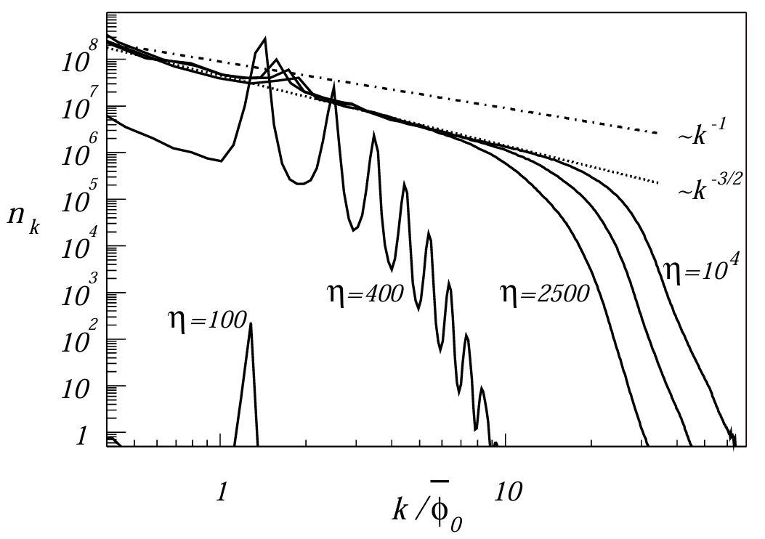
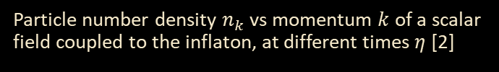
Universality
[1] J. Berges, Nonequilibrium Quantum Fields:From Cold Atoms to Cosmology
[2] Micha, R., & Tkachev, I. I. (2004). Turbulent thermalization. Physical Review D, 70(4), 043538.
Turbulence
Thermalisation of far-from-equilibrium quantum fields
Cosmological (p)reheating
Conserved quantities cascade to different length-scales. The underlying mechanism is:
vortex buildup/breakdown for hydrodynamic turbulence
Resonant wave interaction for wave turbulence
A field transitioning from a far-from-equilibrium initial state to a thermal state passes through a nonthermal fixed point at which a spectral cascade appear [1]
Particle number density $n_{k}$ vs momentum $k$ of a scalar field coupled to the inflaton, at different times $η$ [2]

Slide 5
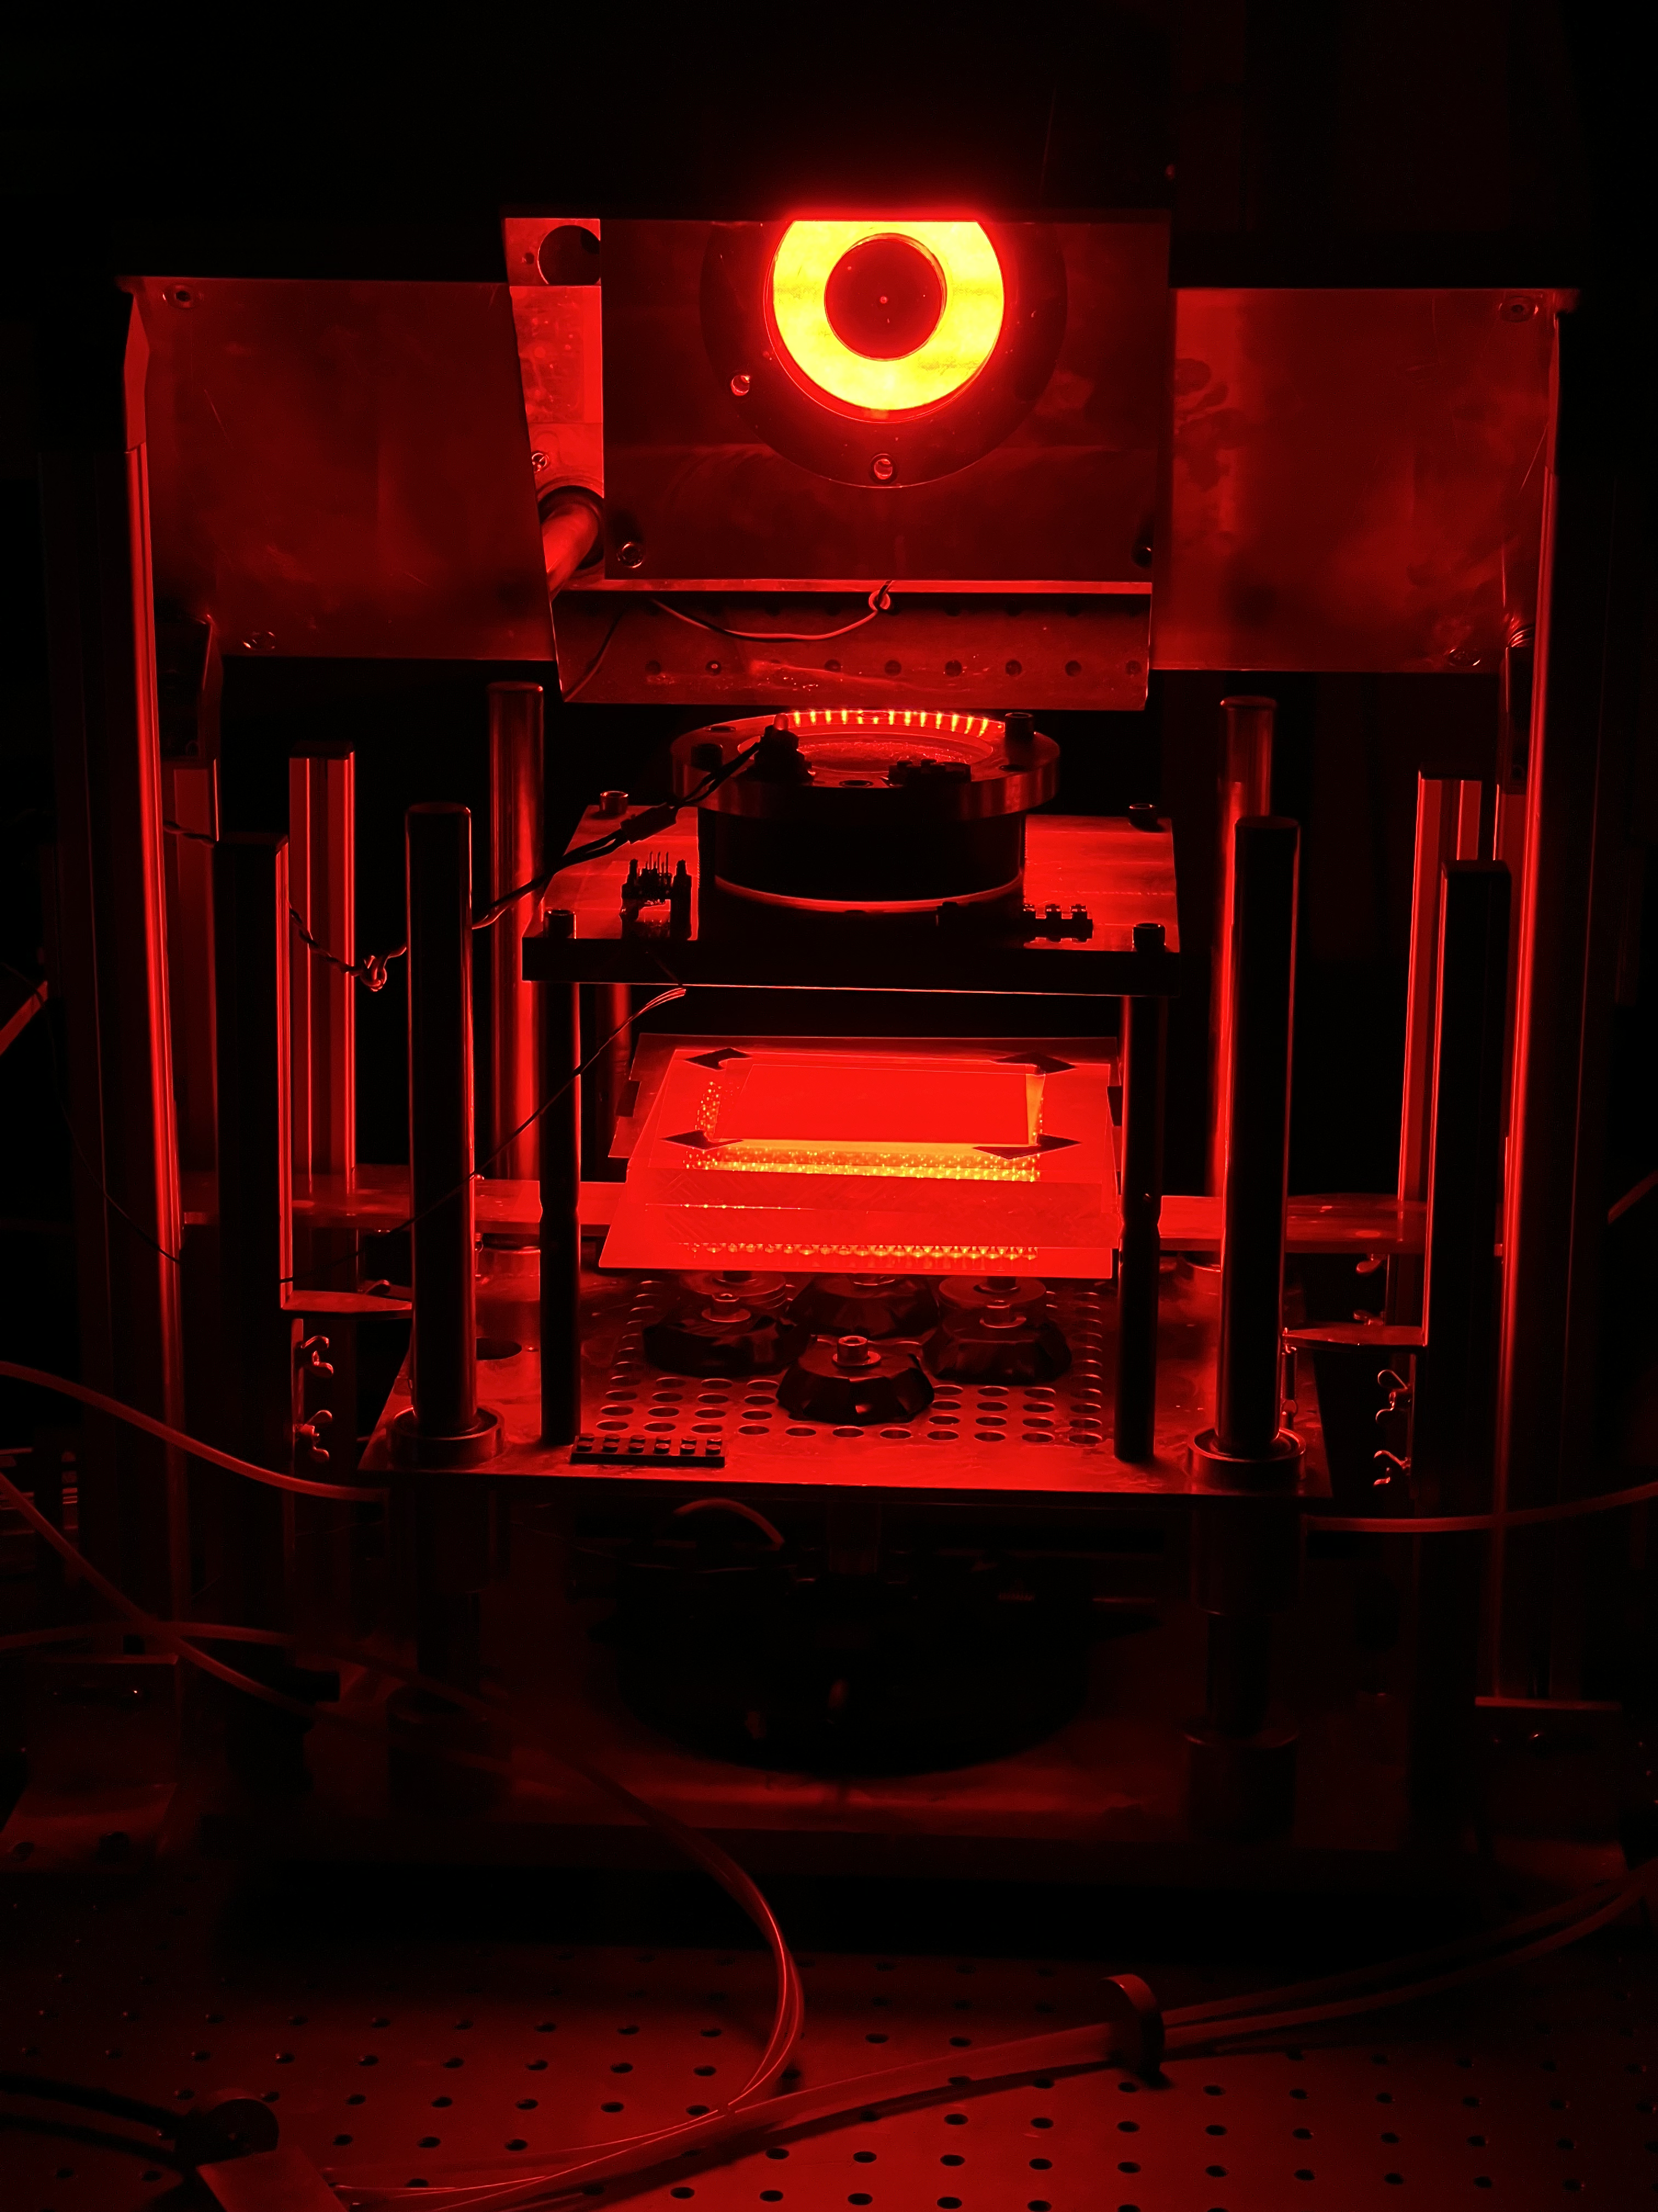
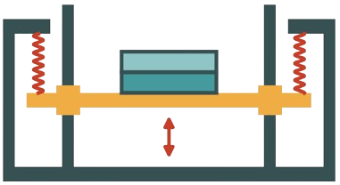
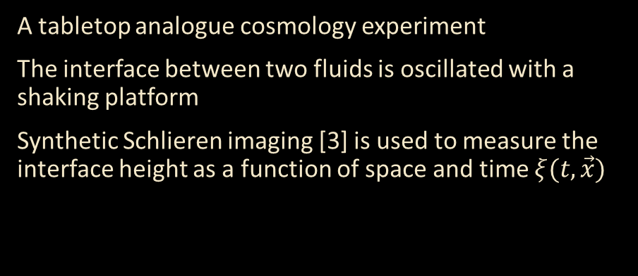
The Shaker Experiment
[3] Wildeman, S. (2018). Real-time quantitative Schlieren imaging by fast Fourier demodulation of a checkered backdrop. Experiments in Fluids, 59(6), 97.
A tabletop analogue cosmology experiment
The interface between two fluids is oscillated with a shaking platform
Synthetic Schlieren imaging [3] is used to measure the interface height as a function of space and time $ξ(t,\vec{x})$

Slide 6
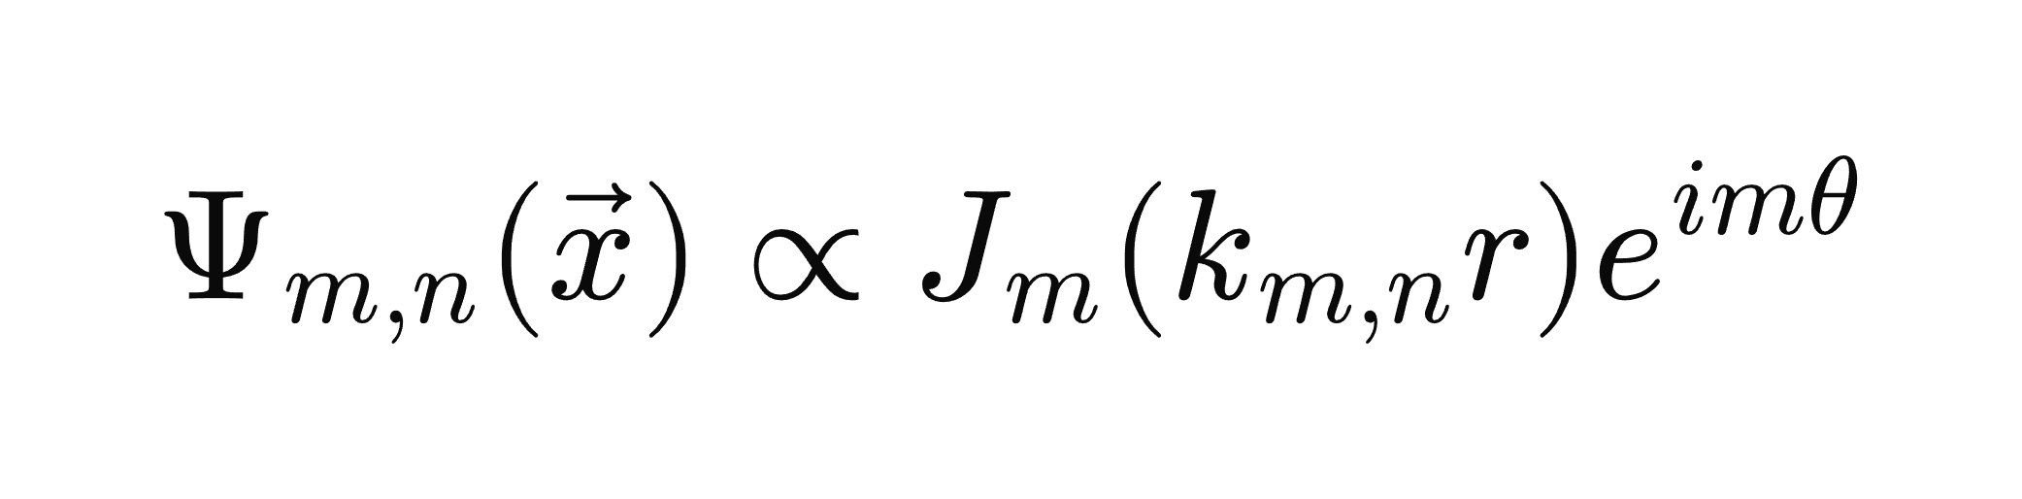
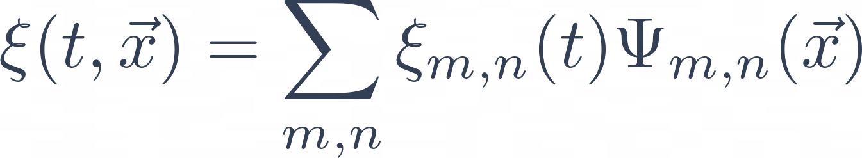
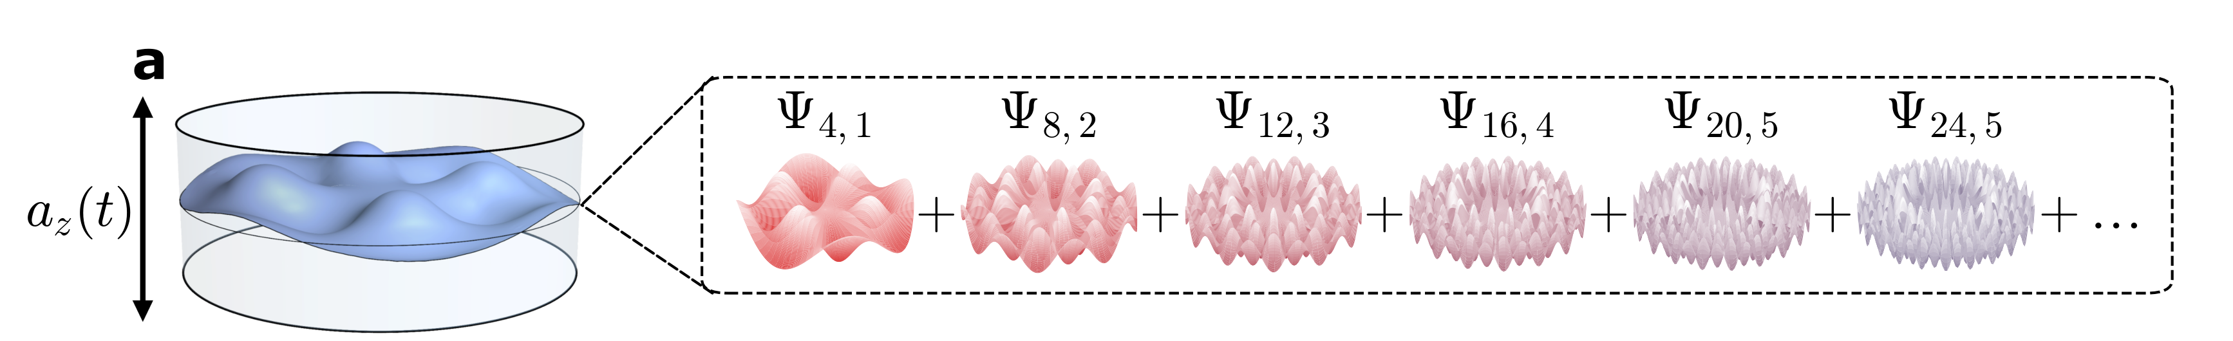
Mode Decomposition
Bessel function of 1st kind
Area of cylinder cross section
6

Slide 7
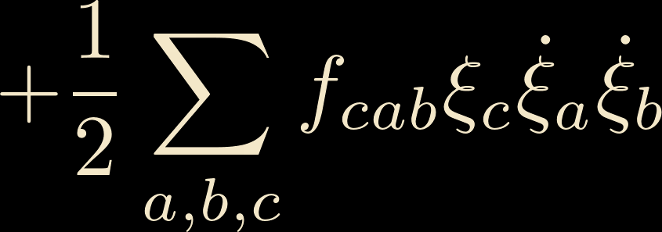
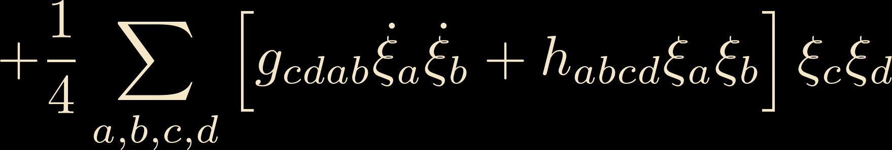
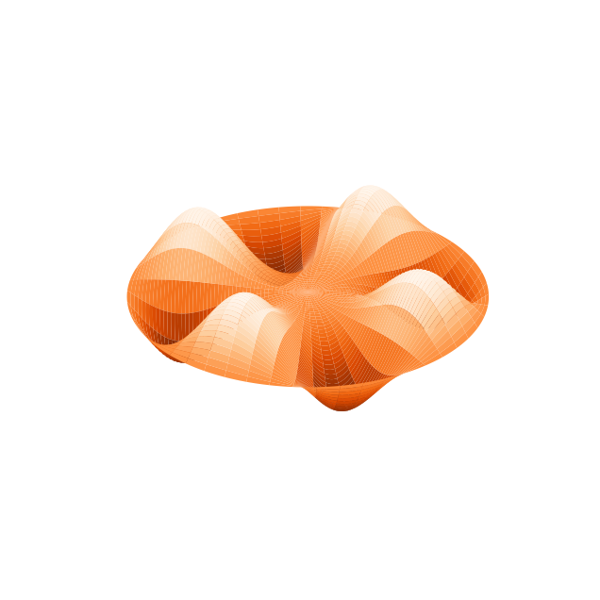
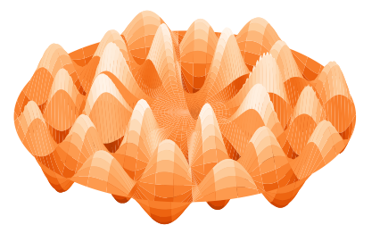


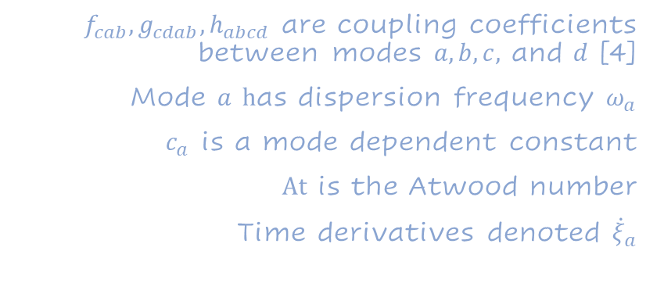

$f_{cab}, g_{cdab},h_{abcd}$ are coupling coefficients between modes $a, b, c,$ and $d$ [4]
Mode $a$ $h$as dispersion frequency $ω_{a}$
$c_{a}$ is a mode dependent constant
$At$ is the Atwood number
Time derivatives denoted ${\dot{ξ}}_{a}$
$$a$$
$$c$$
[4] Barroso, V. S., Bunney, C. R., & Weinfurtner, S. (2023, June). Non-linear effective field theory simulators in two-fluid interfaces. In Journal of Physics: Conference Series (Vol. 2531, No. 1, p. 012003). IOP Publishing.
$$b$$

Slide 8
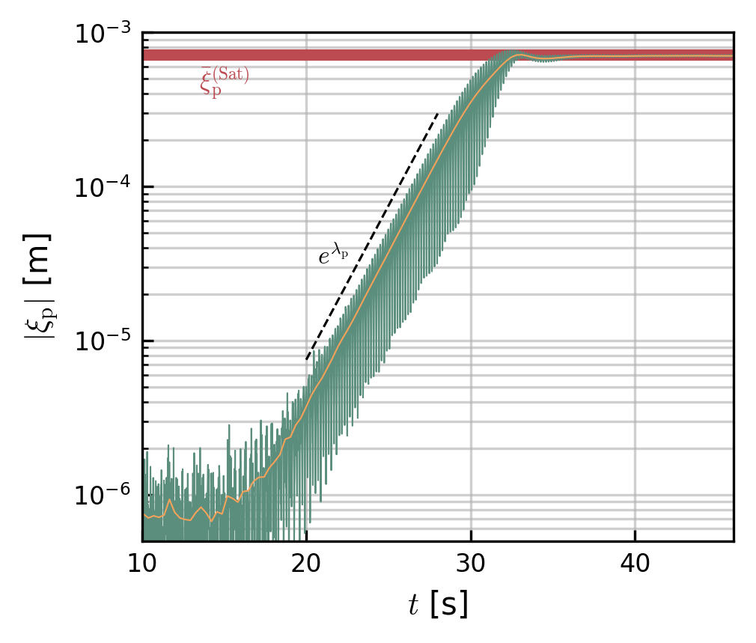
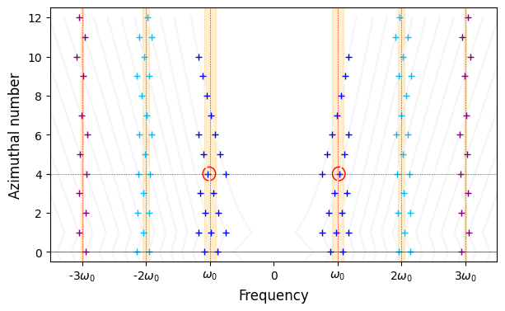

Linear
regime
The Floquet chart for our system informs us how to adjust the driving strength and frequency to excite a particular mode
One mode is excited via parametric resonance, its amplitude, $ξ_{p}(t)$, grows exponentially

Slide 9
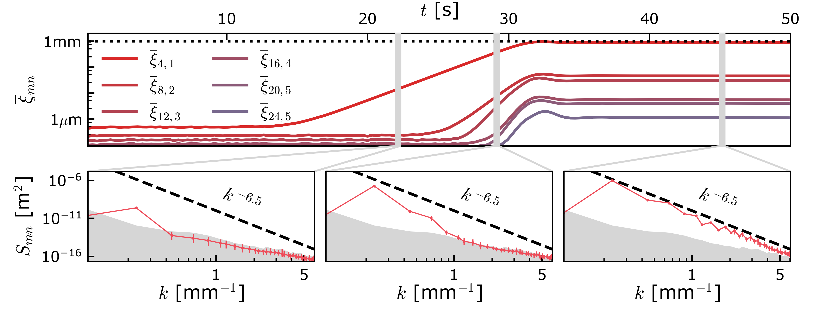
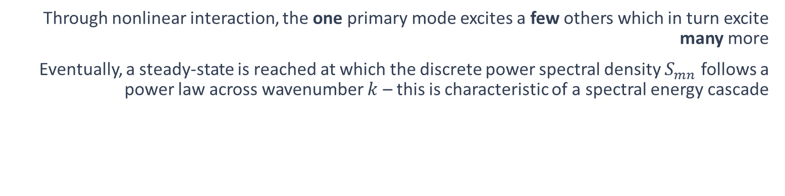
Nonlinear regime
Through nonlinear interaction, the one primary mode excites a few others which in turn excite many more
Eventually, a steady-state is reached at which the discrete power spectral density $S_{mn}$follows a power law across wavenumber $k$ – this is characteristic of a spectral energy cascade
Envelope amplitude of mode
Shaded region is detection noise

Slide 10
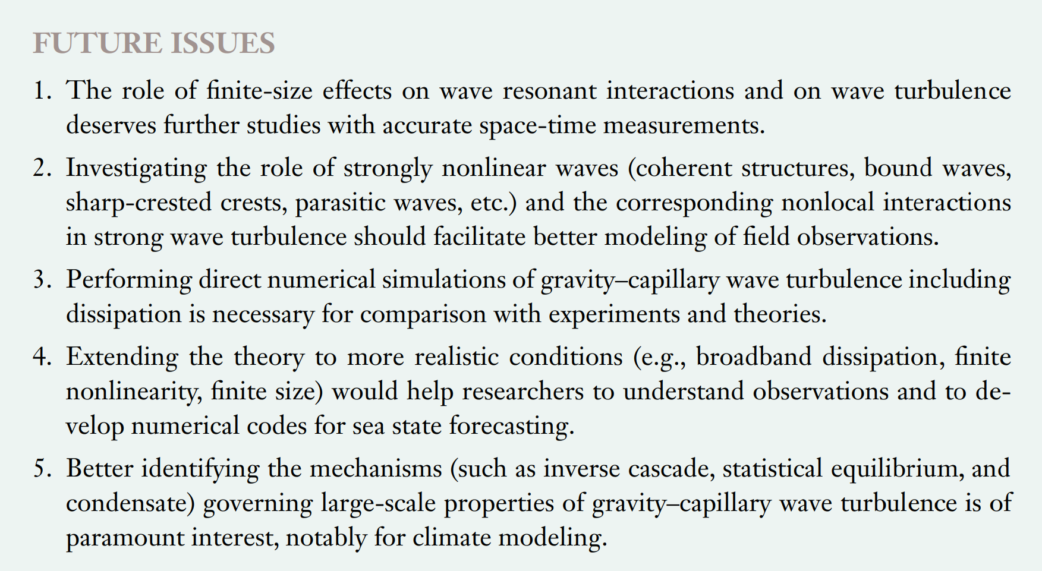
Findings in fluid mechanics
[5] Falcon, E., & Mordant, N. (2022). Experiments in surface gravity–capillary wave turbulence. Annual Review of Fluid Mechanics, 54(1), 1-25.
Current research outlooks in the field of weak wave turbulence, from [5]
Fluid interface spectral cascades are typically treated with the theory of weak wave turbulence (WWT)
strong forcing, nonlinearity and finite size are all conditions beyond the applicability of WWT, yet a spectral cascade emerges nonetheless
Correlation methods (see next talk by Silvia Schiattarella) have verified two assumptions of WWT:
Conservation of frequency
Only 3rd and 4th order wave-mixing is relevant

Slide 11
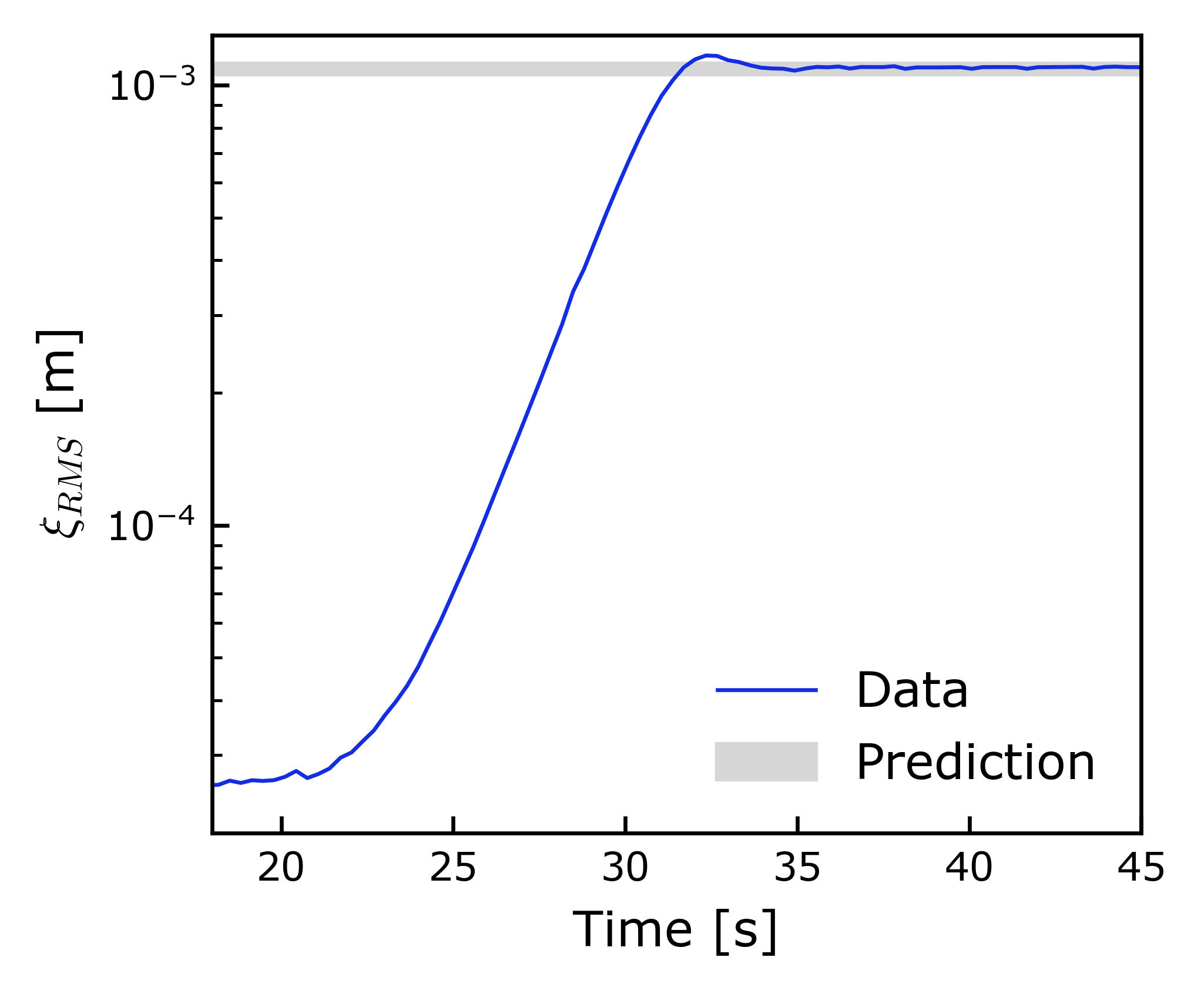
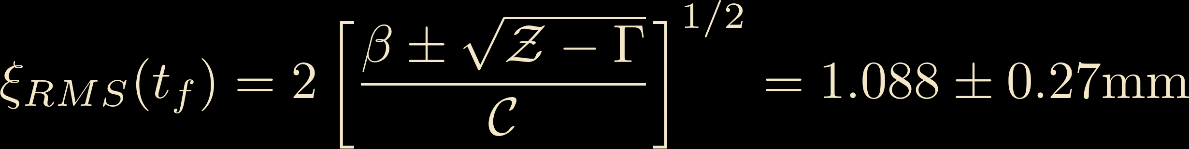
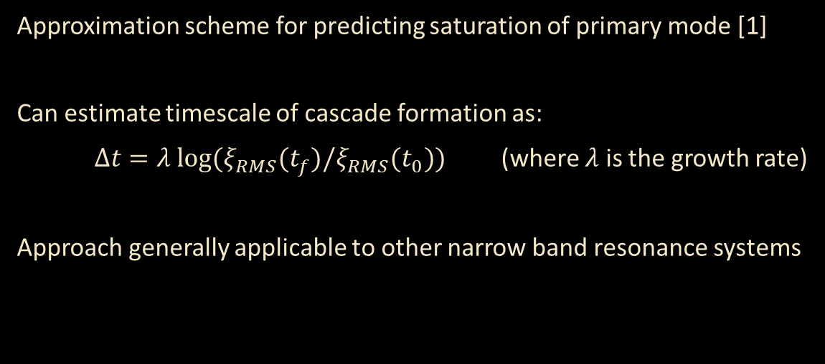
One mode reduced dynamics
[1] Gregory, S., Schiattarella, S., Barroso, V. S., Kaiser, D. I., Avgoustidis, A., & Weinfurtner, S. (2024). Tracing the nonlinear formation of an interfacial wave spectral cascade from one to few to many. arXiv preprint arXiv:2410.08842.
Approximation scheme for predicting saturation of primary mode [1]
Can estimate timescale of cascade formation as:
$Δt=λ log⁡(ξ_{RMS}(t_{f})/ξ_{RMS}(t_{0}))$ (where $λ$ is the growth rate)
Approach generally applicable to other narrow band resonance systems
Driving strength term
Frequency detuning
Damping term
Self-coupling

Slide 12
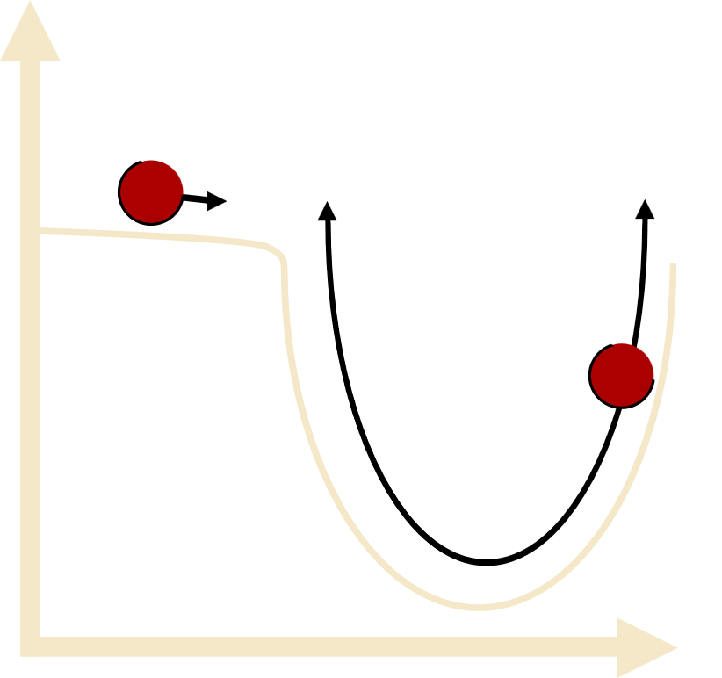
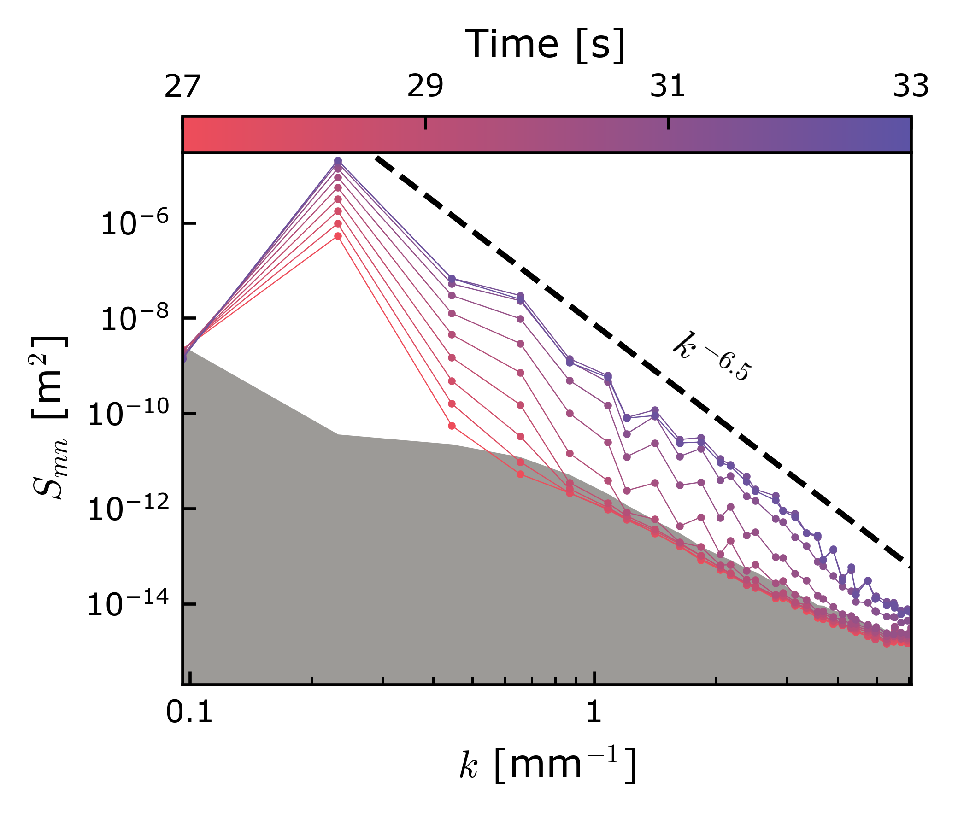

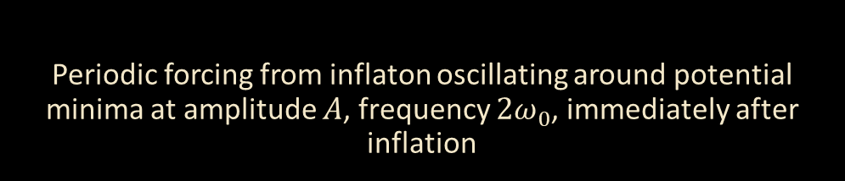

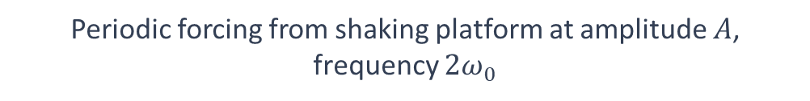
Analogue cosmology
[2] Micha, R., & Tkachev, I. I. (2004). Turbulent thermalization. Physical Review D, 70(4), 043538.
Fluid-fluid interface $ξ(t,\vec{x})$
(2+1) Scalar field in the early universe
Periodic forcing from inflaton oscillating around potential minima at amplitude 𝐴, frequency $2ω_{0}$, immediately after inflation
Periodic forcing from shaking platform at amplitude $A$, frequency $2ω_{0}$
Inflaton field
Inflaton Potential
Momentum distribution of particles $n_{k}$
Power spectral density of fluid interface $S_{mn}$
[2]

Slide 13
CONCLUSION
We use a parametrically excited two-fluid system as an analogue for cosmological preheating
We observe rich nonlinear dynamics responsible for the formation of a direct energy cascade [1]
The universality of cascade dynamics means that our analysis has relevance to many systems beyond our own
By mapping the field theory of the interface to models of cosmology, we can use our experiment as a simulation tool
[1] Gregory, S., Schiattarella, S., Barroso, V. S., Kaiser, D. I., Avgoustidis, A., & Weinfurtner, S. (2024). Tracing the nonlinear formation of an interfacial wave spectral cascade from one to few to many. arXiv preprint arXiv:2410.08842.
13

Slide 14
Thank You
Contact: sean.gregory@nottingham.ac.uk
Follow us on Instagram
@gravity_laboratory

Slide 15
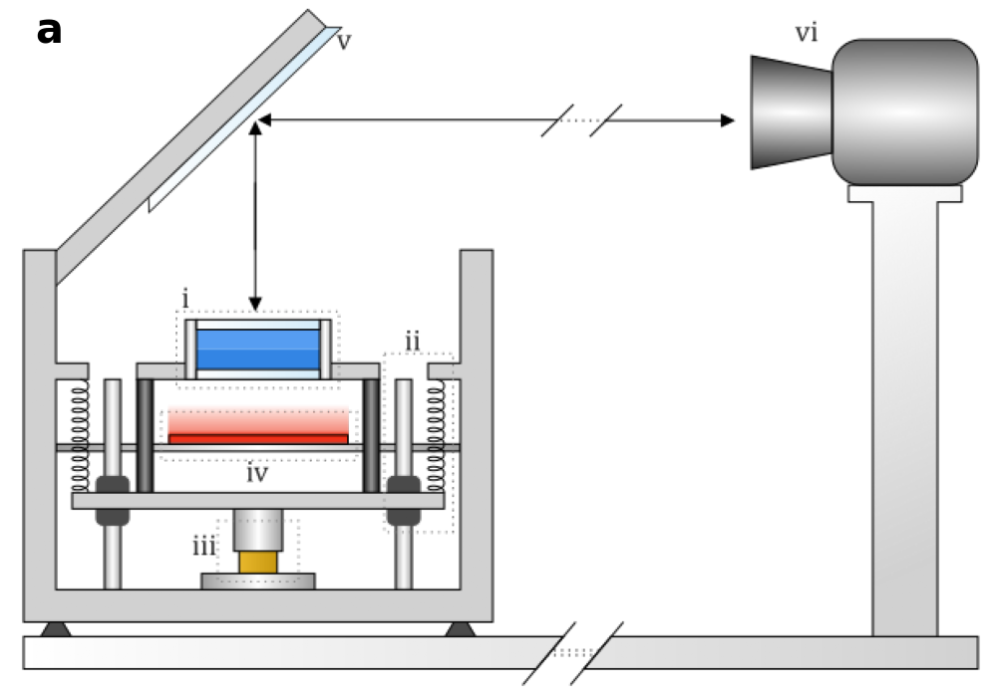
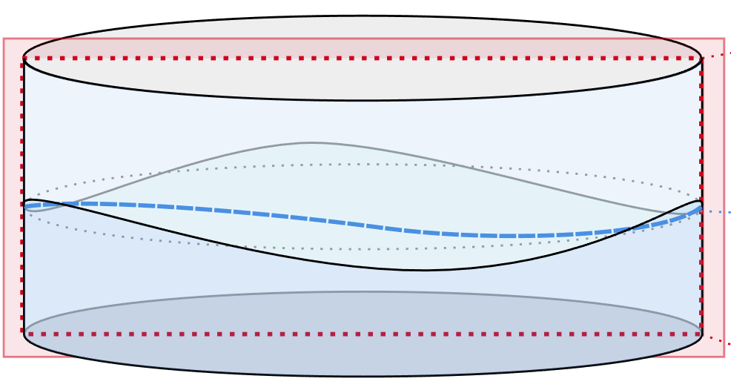

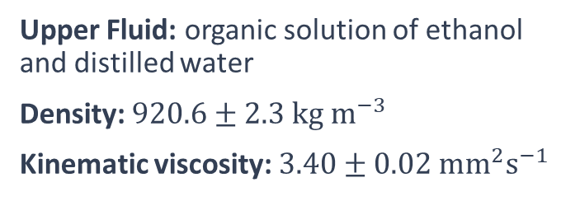
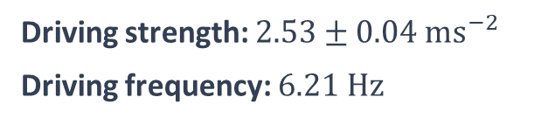

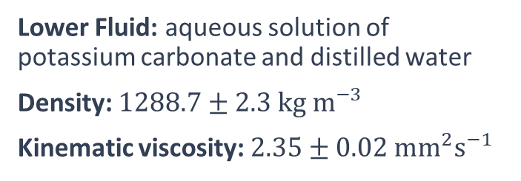
Bonus Slide: Experimental setup
Upper Fluid: organic solution of ethanol and distilled water
Density: $920.6±2.3 {kg m}^{−3}$
Kinematic viscosity: $3.40±0.02 {mm}^{2}s^{−1}$
Lower Fluid: aqueous solution of potassium carbonate and distilled water
Density: $1288.7±2.3 {kg m}^{−3}$
Kinematic viscosity: $2.35±0.02 {mm}^{2}s^{−1}$
Driving strength: $2.53±0.04 {ms}^{−2}$
Driving frequency: $6.21 Hz$
$$30mm$$
$$80mm$$
15

