Slide 1


The Gauge Principle in Density Functional Theory
G. Vignale
Institute for Intelligent Functional Materials (I-FIM), NUS
Time dependent Density-Functional Theory: Prospects and Applications, Benasque, Spain, 15th April 2025

Slide 2






The team
STEFANO PITTALIS
JACQUES DESMARAIS
ALESSANDRO ERBA
FLORIAN G. EICH

Slide 3
Gauge transformation in classical electromagnetism
The representation of the electric and magnetic field in terms of potentials is non-unique
The fields (hence all the physical effects) are unchanged under the gauge transformation

Slide 4
Gauge transformation in quantum mechanics
The representation of a quantum state by the wave function
is non unique. If the basis states of the representation are subjected to a unitary U(1) transformation
then
The physics is unchanged, but the Hamiltonian acquires additional scalar and vector potentials

Slide 5
Gauge transformations of density and current density
The density operator
is invariant under gauge transformation:
but the canonical current density and kinetic energy density operators are not.

Slide 6
Implications for DFT
The particle density is gauge invariant, but the wave function is not. Does this mean that the Hohenberg-Kohn theorem is wrong?
HK Theorem
n(r)
ψ(r)
No! The HK theorem requires a Hamiltonian of the form
only a local scalar potential is allowed!
which is not preserved by gauge transformations.
A gauge-invariant DFT must include vector potentials, and therefore current densities: in other words, it must be a CDFT!

Slide 7
Current density functional theory (Mark Rasolt and G.V 1987)
Motivations: electrons at high magnetic fields, quantum Hall effect, edge states, quantum dots.
Generalized HK Theorem
n(r), j_{p}(r)
ψ(r)
Gauge invariance requires:
Proposed solution
Gauge-invariant vorticity

Slide 8
Historical development (1990-2010)
Exchange-correlation functions of the vorticity (based on electron gas theory) were applied to several problems of interest:
Quantum dots
Edge states
Wigner crystal
Open shell atoms
Orbital magnetic moments
Chemical shifts and shielding tensors
These application met with limited success, failing to demonstrate the relevancy of the signature xc vector potential A_{xc}= δE_{xc}/δj_{p}.

Slide 9

Enter the spin: U(1)$×$SU(2) gauge invariance
(Mark Rasolt and G.V 1988, K. Bencheikh 2003)
The basic variables of Spin DFT are density n(r) and spin density m(r), with conjugate fields V(r) and B(r).
But the U(1)$×SU(2)$ transformation
2-component spinor wave function
U(1)
SU(2)
generates additional spin-dependent vector potentials, which couple to spin current densities.
Any fully gauge-invariant SDFT must be a SCDFT!

Slide 10
Potentials and densities in SCDFT
Mark Rasolt and G.V 1988, K. Bencheikh 2003, S. Rohra and A. Görling 2006
Spin-dependent vector potential/Spin-orbit coupling
Spin-current density
With these potentials the Hamiltonian takes the form
And the Kohn-Sham equation is
with xc potential

Slide 11

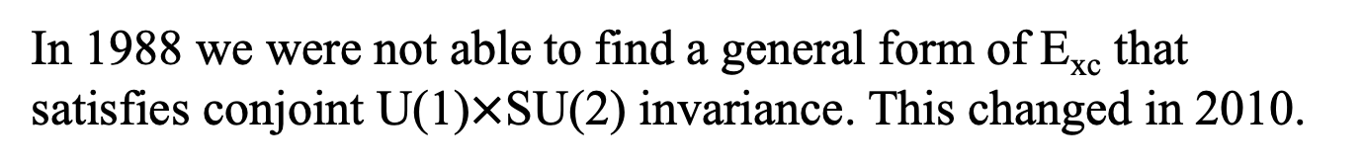
Gauge transformation of densities
where
and gauge invariance of the xc functional
In 1988 we were not able to find a general form of E_{xc} that satisfies conjoint U(1)$×$SU(2) invariance. This changed in 2010.

Slide 12
Why is SU(2) invariance so problematic?
Consider the simplest nonlocal functional of m(r)
This is not SU(2) invariant because m(r) and m(r') undergo different rotations at different points.
Even the semilocal functional
is not SU(2) invariant because the gradient connects fields at different points, which undergo different rotations.

Slide 13
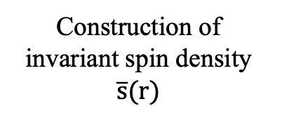

A formal attempt: the AVT functional
S. Abedinpour, G.V, I. V. Tokatly, PRB 81, 125123 (2010)
SU(2) velocity
Link operator
Construction of invariant spin density $\overline{s}(r)$
Invariant spin density
s(r)
Covariant Vorticity
L_{v}(r)
L$†$_{v}(r)
Invariant vorticity

Slide 14
Exchange-correlation hole
By the time AVT was proposed it was quite clear that the vorticity approach was not likely to work well in realistic systems.
But in the meanwhile currents and spin currents had started to emerge as building blocks in a physically grounded "exchange-correlation hole approach" which is manifestly gauge-invariant
exchange-correlation hole
Local Density Approximation (LDA):
exchange-correlation hole of the uniform electron gas at the local density

Slide 15
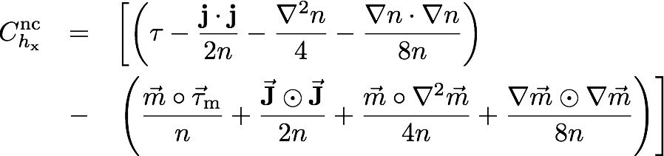





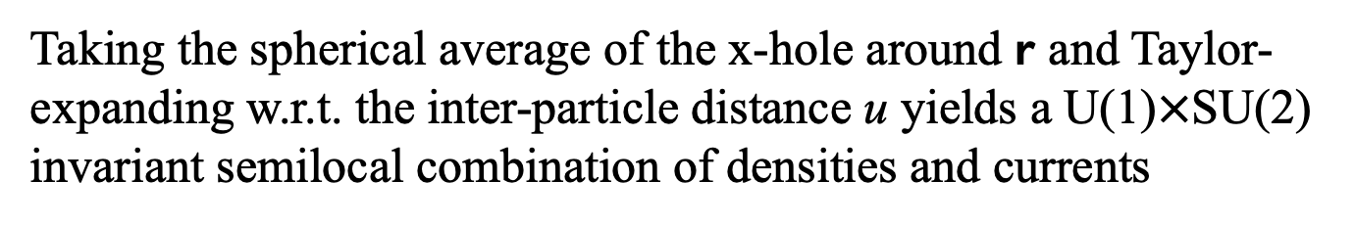

Short-range behavior of the exchange hole
S. Pittalis, G.V, F.G. Eich, PRB 96, 035141 (2017)
Taking the spherical average of the x-hole around r and Taylor-expanding w.r.t. the inter-particle distance u yields a U(1)$×$SU(2) invariant semilocal combination of densities and currents
$$+$$
$$−$$
$$−$$
$$−$$
Notice two new actors:
kinetic energy density
spin kinetic energy density

Slide 16
Meta-GGA and the iso-orbital indicator
The kinetic energy density is an essential ingredient of the meta-GGA family of approximations. The difference
Bosonic kinetic energy
is the excess kinetic energy induced by the Pauli exclusion principle. D(r) is non-negative and vanishes in a single orbital.
The iso-orbital indicator and and the electron localization function (ELF)
can be used to distinguish densities in different chemical environments:
Single-orbital density: α<<1
Metallic density: α ~1
Weak bonds: α >>1

Slide 17
Iso-orbital indicator and the SCAN

Slide 18

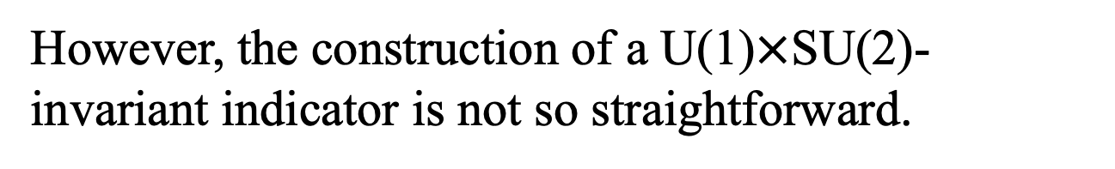
α is not gauge-invariant!
... and therefore SCAN is not gauge-invariant.
α can be easily made U(1)-invariant through the "minimal substitution"
(Becke, Dobson, Tao and Perdew...)
However, the construction of a U(1)$×$SU(2)-invariant indicator is not so straightforward.

Slide 19
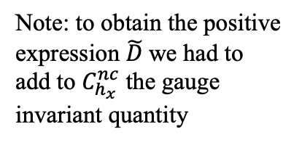



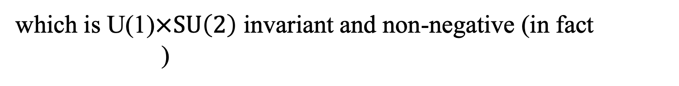

The gauge-invariant iso-orbital indicator
J. K. Desmarais, G.V., K. Bencheikh, A. Erba, S. Pittalis, PRL 133, 136401 (2024)
The Pauli kinetic energy D(r) is replaced by
which is U(1)$×SU\left(2\right)$ invariant and non-negative (in fact
)
Note: to obtain the positive expression $\tilde{D}$we had to add to $C_{h_{x}}^{nc}$ the gauge invariant quantity
$$+$$
$$−$$
$$−$$
$$−$$

Slide 20
Meta-GGA made magnetic I
The SCAN meta-GGA overestimates magnetic moments and magnetic energies of ferromagnetic metals
[Y. Fu and D. J. Singh, PRL 121, 207201 (2018)]
FSM energy for bcc Fe at the experimental lattice constant of 2.86 Å, on a per atom basis. The dashed lines are the energies of non-spin-polarized fcc Fe, at the optimized lattice parameter for the different functionals. The small dots indicate the minimum energy points.

Slide 21


Meta-GGA made magnetic II
J. K. Desmarais, A. Erba, G.V., S. Pittalis, PRL 134, 106402 (2025)
Implemented in
with
Use of U(1)$×$SU(2)-invariant α in mSCAN largely corrects the overestimation of magnetisms that is observed within SCAN

Slide 22
Meta-GGA made magnetic III
We attribute the improvement to the inclusion of the gradient of the magnetization, which is missing in ordinary SCAN.
By insisting on spin-separability of the exchange energy SCAN amplifies the well-known tendency of exchange to produce magnetic phases (e.g., the Bloch instability in the homogeneous electron gas).

Slide 23
Meta-GGA made magnetic IV
Non magnetic materials stay non-magnetic

Slide 24
Meta-GGA made magnetic V
mSCAN's performance is comparable to non-gauge-invariant SCAN's in antiferromagnetic Mott insulators. LDA and GGA incorrectly predict a metallic behavior for FeO and CoO.

Slide 25
Summary and additional results
The novel functional behaves differently from SCAN not only for magnetized states but also for open-shell states; therefore, atomization energies should be scrutinized with care. We have also pointed out that band gaps may be worsened. Therefore, superseding the SCAN functional in all respects will require further efforts.
Spin magnetization of the Chern magnet TbMn₆Sn₆ calculated at the experimental geometry
Dissociation of H₂

Slide 26
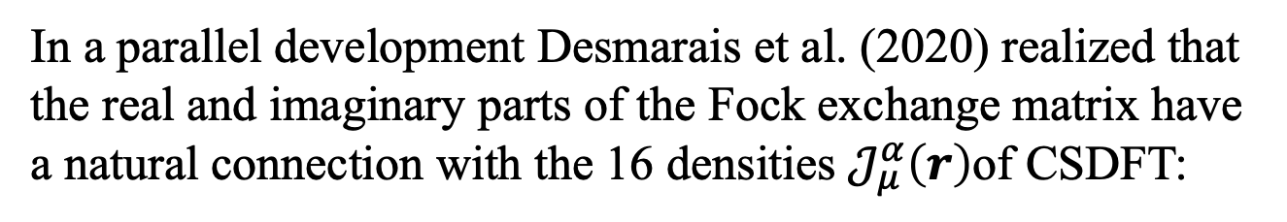
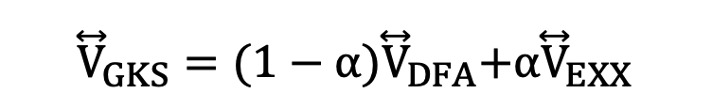
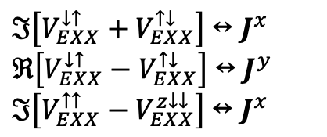
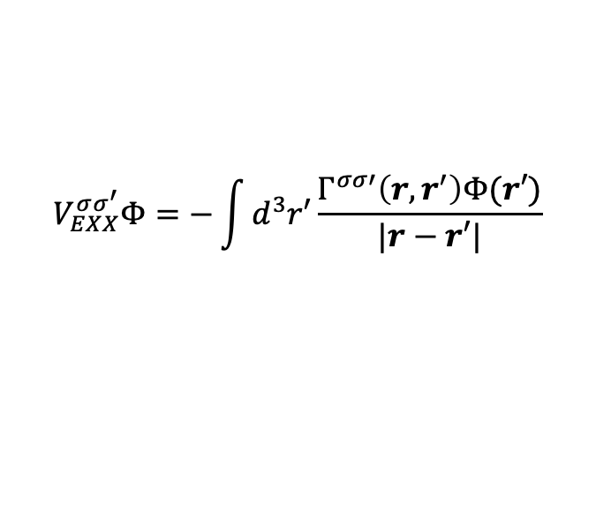
SCDFT from hybrid functionals
J. K. Desmarais, J-P. Flament., A. Erba, Phys. Rev. B 102, 235118 (2020)
In a parallel development Desmarais et al. (2020) realized that the real and imaginary parts of the Fock exchange matrix have a natural connection with the 16 densities $𝒥_{μ}^{α}\left(r\right)$of CSDFT:
$$V_{EXX}^{σσ^{′}}Φ=−\int{d^{3}r′\frac{Γ^{σσ′}\left(r,r^{′}\right)Φ(r′)}{|r−r′|}}$$
$$ℑ\left[V_{EXX}^{↓↑}+V_{EXX}^{↑↓}\right]↔J^{x}$$
$$ℜ\left[V_{EXX}^{↓↑}−V_{EXX}^{↑↓}\right]↔J^{y}$$
$$ℑ\left[V_{EXX}^{↑↑}−V_{EXX}^{z↓↓}\right]↔J^{x}$$
They used hybrid functionals of the form
${\overset{⃡}{V}}_{GKS}={(1−α)\overset{⃡}{V}}_{DFA}+{α\overset{⃡}{V}}_{EXX}$
where the spin-current blocks could be turned on or off to test their impact on calculated material properties.

Slide 27
Generalized Kohn-Sham approach
J. K. Desmarais, G. Ambrogio, G.V., A. Erba, S. Pittalis, PRM 8, 013802 (2024)
In this approach the xc potential is expressed as the sum of two parts: a functional of the spin-orbitals (typically a fraction of the exact exchange) and an explicit functional of local densities. The results are encouraging, but still time-consuming.

Slide 28
Gauge invariance should be considered a fundamental constraint on density functional approximations, on par with other exact constraints considered in the literature!

