Slide 1

Memory in Linear-Response TDDFT
f_{xc}
Neepa T. Maitra
Rutgers University at Newark

Slide 2


TDDFT for Linear Response
Unprecedented balance between accuracy and efficiency for electronic excitations
…. E.g. examples in Hardy’s lecture …
But with the usual approximations, it doesn’t always work!

Slide 3
Plan
Brief recall of linear response TDDFT for excitations and response
Cases where the usual approximations fail
Memory in linear response: double-excitations

Slide 4



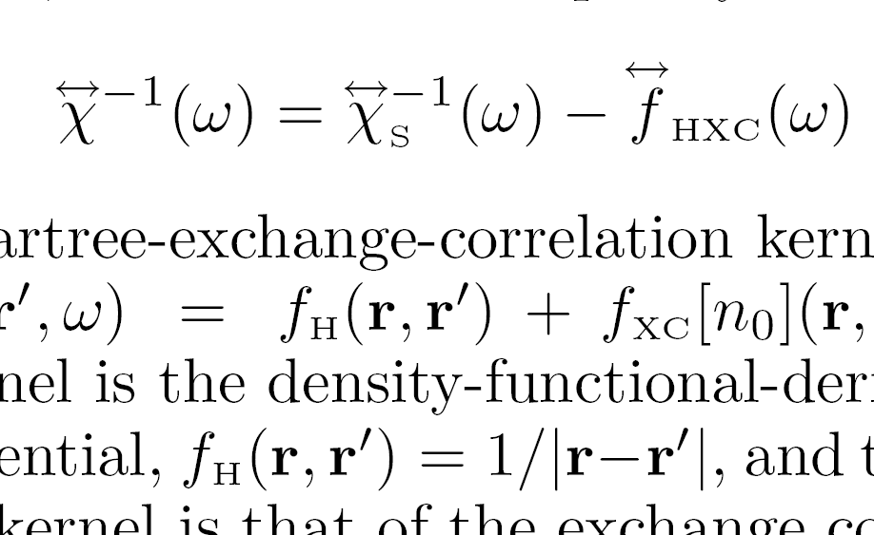
Quick recall of how we get excitations in TDDFT: Linear response
Petersilka, Gossmann & Gross, PRL 76, 1212 (1996)
Casida, in Recent Advances in Comput. Chem. 1,155, ed. Chong (1995)
Poles at true excitations
Poles at KS excitations
n₀
adiabatic approx: no ω-dep
Need (1) ground-state v_{S,0}[n₀](r), and its bare excitations
(2) XC kernel
~ δ(t-t’)
Yields exact spectra in principle; in practice, approxs needed in (1) and (2).
Notes:
Actually, poles of chi and zeros of chi_inverse etc.
Approxs – in particular, adiabatic, where memory dep negelected entirely, or, in freq domain, this fhxc is constant

Slide 5


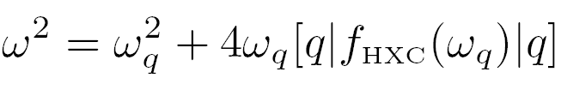

TDDFT linear response in matrix form (discrete spectra):
q =(i→ a) labels a single excitation of the KS system, with transition frequency ω_{q} = ε_{a} - ε_{i} , and
Eigenvalues → true frequencies of interacting system
Eigenvectors → oscillator strengths
Useful tool for analysis
Zoom in on a single KS excitation, q = i→ a
Well-separated single excitations: SMA
When shift from bare KS small: SPA

Slide 6
Where & why semilocal adiabatic approxs give poor excitations
i.e. semi-local in space and local in time
Rydberg states

Slide 7
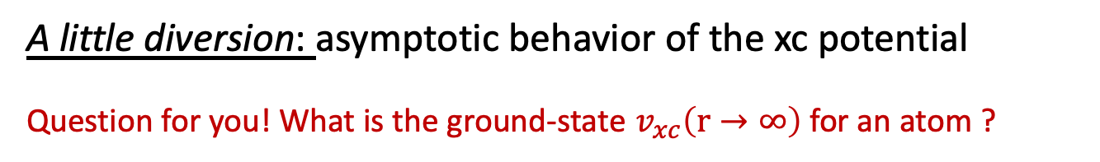
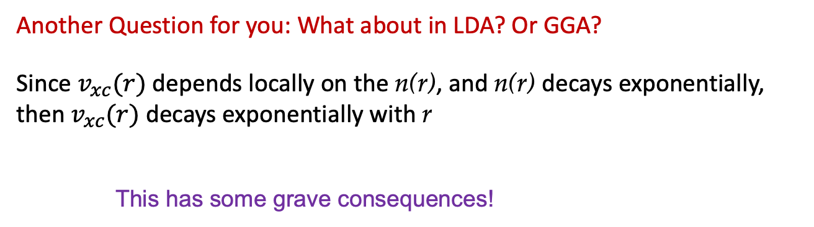
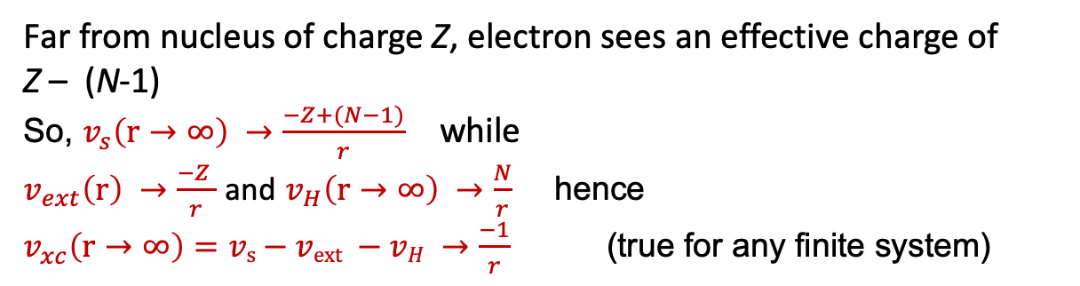
A little diversion: asymptotic behavior of the xc potential
Question for you! What is the ground-state $v_{xc}\left(r→∞\right)$for an atom ?
Far from nucleus of charge Z, electron sees an effective charge of
Z – (N-1)
So, $v_{s}\left(r→∞\right) →\frac{−Z+(N−1)}{r}$ while
$v_{ext}\left(r\right) →\frac{−Z }{r}$ and $v_{H}\left(r→∞\right) →\frac{N}{r}$ hence $v_{xc}\left(r→∞\right)=vs−vext −vH →\frac{−1}{r}$(true for any finite system)
Another Question for you: What about in LDA? Or GGA?
Since $v_{xc}(r)$ depends locally on the n(r), and n(r) decays exponentially, then $v_{xc}(r)$ decays exponentially with r
This has some grave consequences!
Notes:
Exact I for Ne atom ~ 0.79 H,while LDA gives ~0.44H

Slide 8
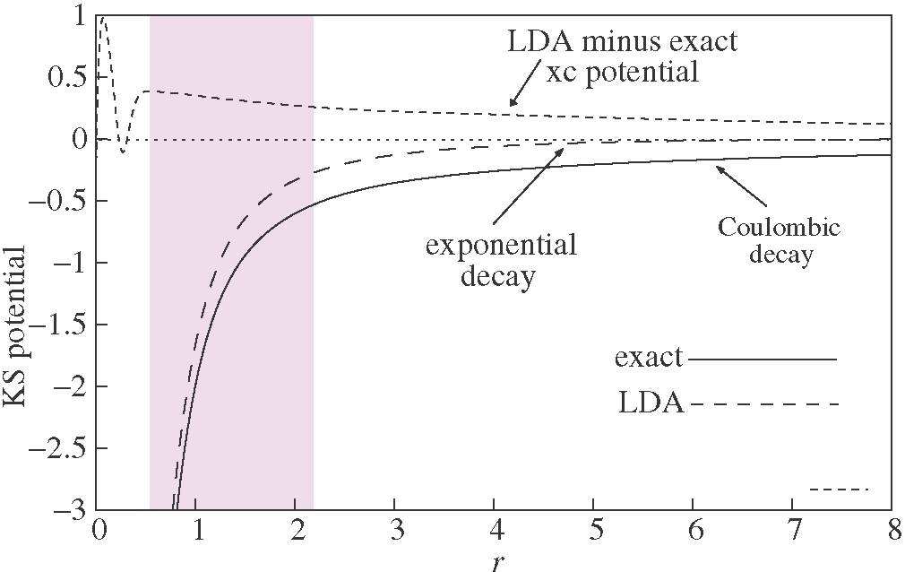
A little diversion: asymptotic behavior of the xc potential
Without -1/r tail, there’s no Rydberg series.
E.g. Ne atom
Not only that, but while
exact ε_{H} = -I (Koopman’s thm)
the LDA’s wrong decay pushes up the HOMO →
LDA ε_{H} underestimates -I
LDA ε_{H}
exact ε_{H}
This is one aspect that leads to underestimate of charge-transfer excitations.
Wasserman, Maitra, Burke, PRL 91, 263001 (2003)
Notes:
Exact I for Ne atom ~ 0.79 H,while LDA gives ~0.44H

Slide 9
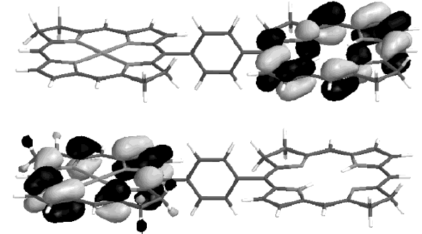
Eg. Zincbacteriochlorin-Bacteriochlorin complex (light-harvesting in plants and purple bacteria)
Semi-local TDDFT severely underestimates long-range CT energies
TDDFT predicts CT states energetically well below local fluorescing states. Predicts CT quenching of the fluorescence.
! Not observed !
TDDFT error ~ 1.4eV
Dreuw & Head-Gordon, JACS 126 4007, (2004).
Notes:
Should I put the energies??
I(ZnBC) = 5.57eV; A(BC) = -0.42eV;expect w_CT = 2.69eV
B3LYP TDDFT gives w = 1.33eV so error at least 1.36 eV

Slide 10
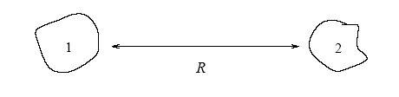
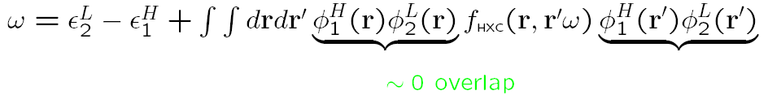

Why semilocal adiabatic approx’s fail for long-range charge transfer
First, we know what the exact energy for charge transfer at long range should be:
ionization energy of donor
e
electron affinity of acceptor
Now to analyse TDDFT, use single-pole approximation (SPA):
-A_{s,2}
-I₁
i.e. get just the bare KS orbital energy difference: missing xc contribution to acceptor’s electron affinity, A_{xc,2}, and -1/R
And we just saw, the usual ground-state approximations underestimate I
Tozer, JCP 119, 12697 (2003) ; Dreuw, J. Weisman, and M. Head-Gordon, JCP 119, 2943 (2003)
Several work-arounds proposed, e.g. range-separated hybrids: Baer et al, Annu. Rev. Phys. Chem. 61, 85 (2010)

Slide 11
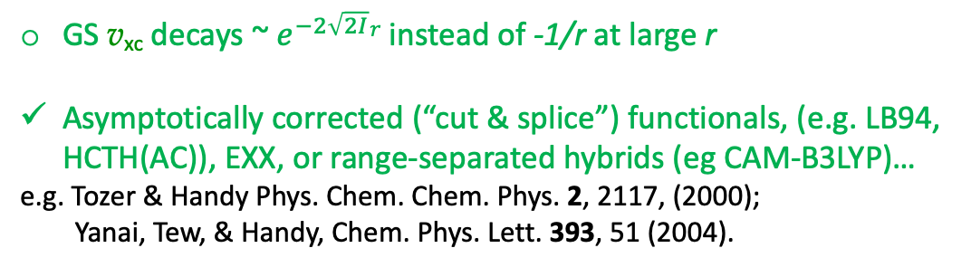
Where & why semilocal adiabatic approxs give poor excitations
i.e. semi-local in space and local in time
GS v_{xc} decays ~ $e^{−2\sqrt{2I}}r$ instead of -1/r at large r
Asymptotically corrected (“cut & splice”) functionals, (e.g. LB94, HCTH(AC)), EXX, or range-separated hybrids (eg CAM-B3LYP)…
e.g. Tozer & Handy Phys. Chem. Chem. Phys. 2, 2117, (2000);
Yanai, Tew, & Handy, Chem. Phys. Lett. 393, 51 (2004).
Rydberg states
Polarizabilities of long-chain molecules
Ground-state v_{xc} needs non-local density-dependence
EXX, SIC-LDA, TD current-DFT
e.g. van Gisbergen et al. Phys. Rev. Lett. 83, 694 (1999); van Faassen et al. Phys. Rev. Lett. 88, 186401 (2002).
Primary problem above is the ground-state v_{xc} ….not primarily the adiabatic approximation … what about cases where the problem is the f_{xc} ? We have…

Slide 12

Where the usual approxs give poor excitations, cont.
Optical response of solids
Need “ultra-long-ranged” kernel ~ 1/q² to produce excitons and to open the gap
Reviews: G. Onida, L. Reining, A. Rubio, Rev. Mod. Phys. 74, 601 (2002)
S. Botti, A. Schindlmayr, R. D. Sole, and L. Reining, Rep. Prog. Phys. 70, 357 (2007)
Y-M. Byun, J. Sun, C. A. Ullrich, Electron. Struct. 2 023002 (2020)
Carsten’s lecture
Long-range charge transfer
Double excitations
Too fast decay of GS v_{xc} → ε_{H} gives too small I, and exply-small donor-acceptor overlap → f_{xc} term ~ 0
Range-separated hybrids, and other approaches, for some cases. Some cases need frequency-dependence.
Reviews with many refs:
Maitra, J. Phys. Condens. Matt. 29, 423001 (2017)
Karolweski, Kronik, Kűmmel, JCP 138, 204115 (2013)
Adiabatic approx for f_{xc} fails.
Frequency-dependent kernel developed → “dressed TDDFT”
Maitra, Zhang, Cave, Burke, J. Chem. Phys. 120, 5932 (2004) Maitra, Ann. Rev. Chem. Phys. 73, 117 (2022)
Notes:
Hellgren & Gross, PRA 85, 022514 (2012): exact f_{xc} has a ω-dep. spatial step in f_{xc} whose size grows exponentially with separation (latter demonstrated with EXX)

Slide 13

Where the usual approxs give poor excitations, cont.
Conical intersections
Derivative Couplings
Both the GS v_{xc} is poor due to near-degeneracy – “static correlation” – and adiabatic f_{xc} fails.
e.g. Levine et al. Mol. Phys. 104, 1039 (2006); Tapavicza et al, J. Chem. Phys. 129., 124108 (2008)
Shane’s lecture!
Needed in coupled electron-ion dynamics using surface-hopping – need quadratic response to get excited-to-excited state couplings, but adiabatic quadratic response gives divergences.
e.g. Parker, Roy, Furche J. Chem. Phys. 145, 134105 (2016)
$$g_{xc, ijk}\left({t −t}_{i},{t−t}_{k}\right)= \frac{δ^{2}v_{xc}(r_{i},t)}{δn(r_{j}{,t}_{j})δn(r_{k}{,t}_{k})}$$
has linear ω-dependence to cure this
Notes:
Hellgren & Gross, PRA 85, 022514 (2012): exact f_{xc} has a ω-dep. spatial step in f_{xc} whose size grows exponentially with separation (latter demonstrated with EXX)

Slide 14
Plan
Brief recall of linear response TDDFT for excitations and response
Cases where the usual approximations fail
Memory in linear response: double-excitations

Slide 15
Types of Excitations
Non-interacting systems e.g. 4-electron atom
Eg. single excitations
Eg. double excitations
near-degenerate
Interacting systems: generally involve combinations of (KS) determinants that may have 1,2,3…electrons in excited orbitals.
single-, double-, triple- excitations

Slide 16

Double (Or Multiple) Excitations
How do these different types of excitations appear in the TDDFT response functions?
Consider:
χ – poles at true states that are mixtures of singles, doubles, and higher excitations
χ_{S} -- poles at single KS excitations only, since one-body operator can’t connect Slater determinants differing by more than one orbital.
χ has more poles than χ_{s}
? f_{xc} mixes KS single excitations together, but how does f_{xc} generate more poles to get states of multiple excitation character ?

Slide 17
Simplest model to get an idea of the structure of f_{xc}
Exactly solve for f_{xc} for one KS single (q) mixing with a nearby KS double (D)
Notes:
Add an eqn for Psi i.t.o Phi?

Slide 18
Invert and insert into Dyson-like eqn for kernel →dressed SPA (i.e. ω-dependent):
strongly non-adiabatic!
This kernel matrix element, by construction, yields the exact true ω’s when used in the Dressed SPA,

Slide 19
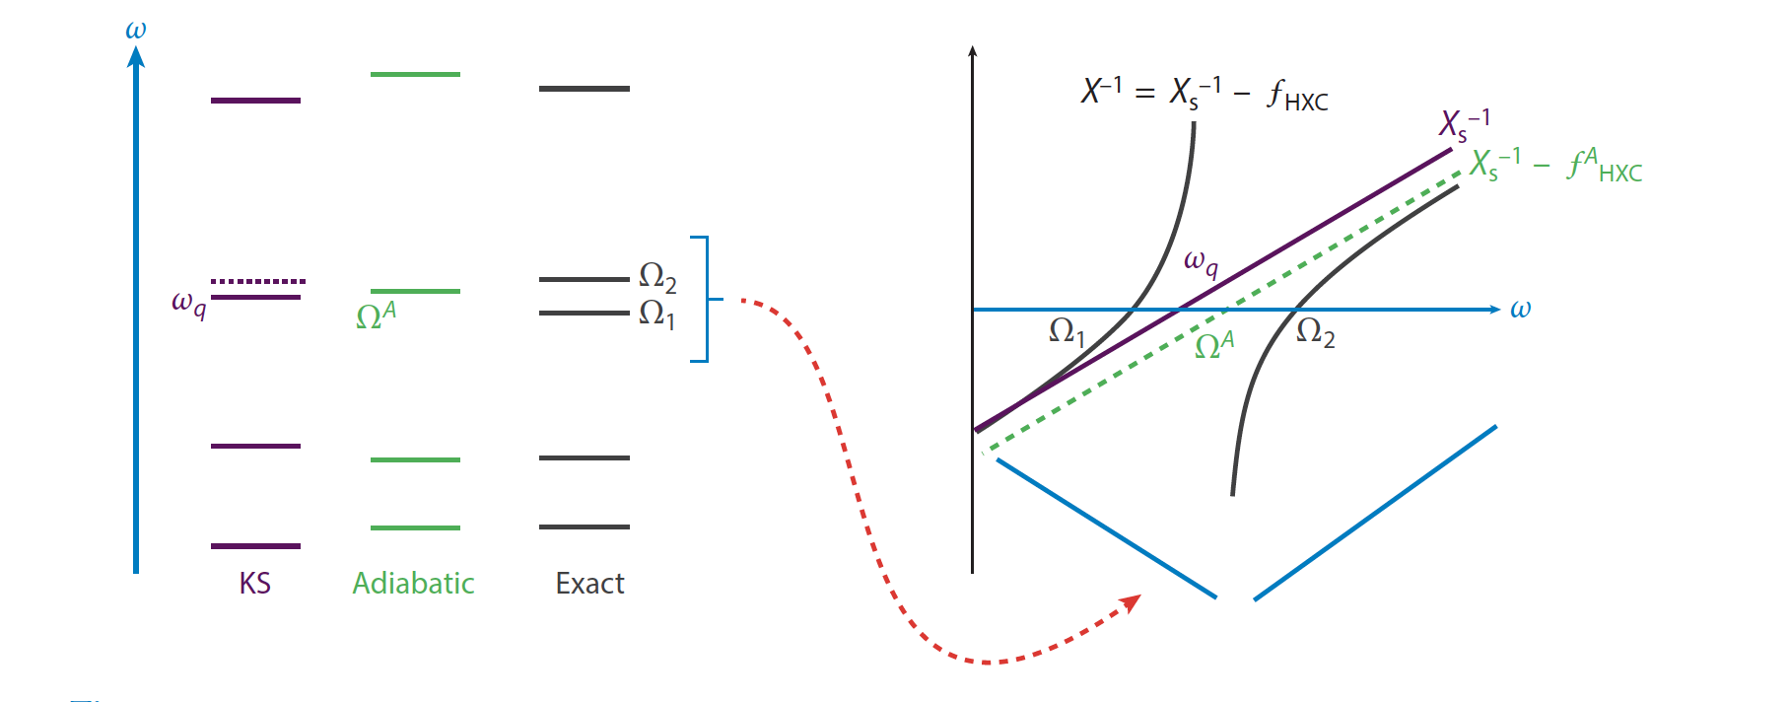
χ ⁻¹ = χ_{s}⁻¹ - f_{Hxc}

Slide 20
Practical Approximation for the Dressed Kernel
Diagonalize many-body H in KS subspace near the double-ex, and require reduction to adiabatic TDDFT in the limit of weak single-double coupling :
usual adiabatic matrix element
dynamical (non-adiabatic) correction
So: (i) scan KS orbital energies to see if a double lies near a single
apply this kernel just to that pair
apply usual ATDDFT to all other excitations
Maitra, Zhang, Cave, Burke, J. Chem. Phys. 120, 5932 (2004) Maitra, Ann. Rev. Chem. Phys. 73, 117 (2022)

Slide 21
Alternate Derivations
M.E. Casida, JCP 122, 054111 (2005)
M. Huix-Rotllant & M.E. Casida, in Density-Functional Methods for Excited States, ed. N. Ferre, M. Filatov, and M. Huix- Rotllant (Springer 2016)
-- from second-order polarization propagator (SOPPA) correction to ATDDFT
P. Romaniello, D. Sangalli, J. A. Berger, F. Sottile, L. G. Molinari, L. Reining, and G. Onida, JCP 130, 044108 (2009)
-- from Bethe-Salpeter equation with dynamically screened interaction W(ω)
O. Gritsenko & E.J. Baerends, PCCP 11, 4640, (2009).
-- use CEDA (Common Energy Denominator Approximation) to account for the effect of the other states on the inverse kernels and obtain spatial dependence of f_{xc}-kernel as well.
A note! Alternative DFT-based approach to double excitation energies: ensemble DFT
Pribram-Jones et al (2014), Fromager & Loos & co-workers (2020), Pittalis & Gould & co-workers (2021); Strubbe (2024) Kieron’s talk and David’s talk next week!

Slide 22
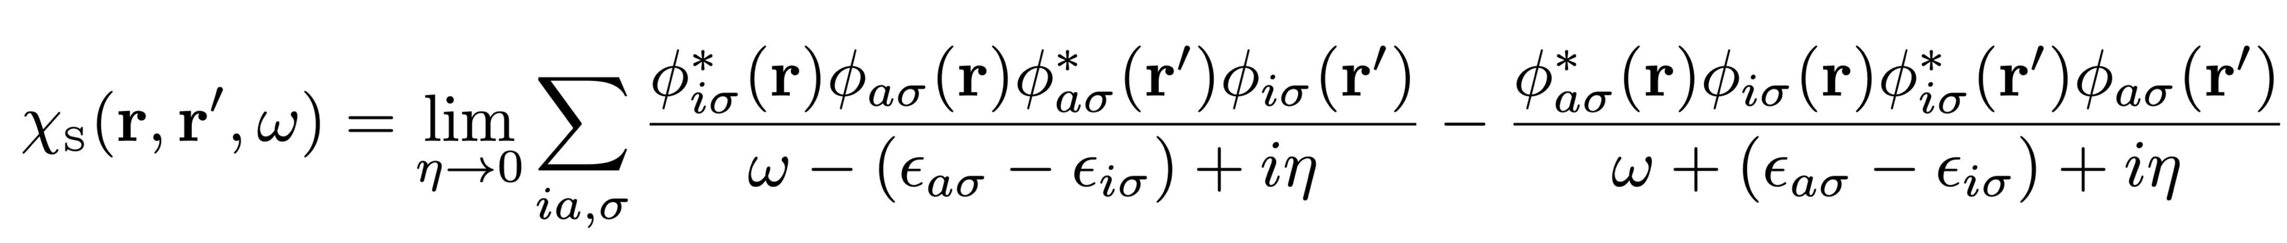
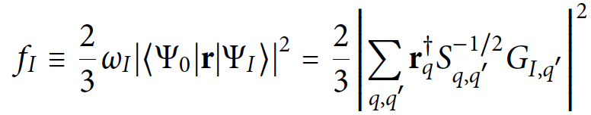
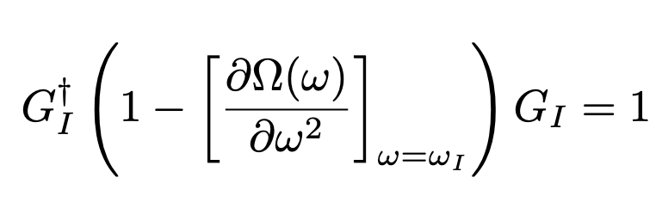
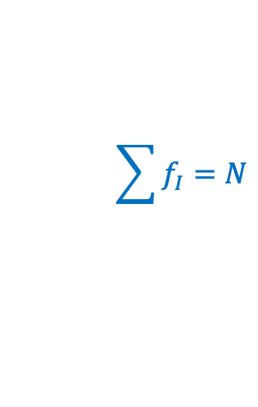
What about oscillator strengths?
SPA is the single-excitation version of Tamm-Dancoff approximation
SPA/TDA violate the oscillator-strength sum-rule (important for transition densities, couplings, spectral strengths )
$$\sum{f_{I}=N}$$
extract from eigenvectors of the TDDFT matrix eqn, normalized through
Casida, in Recent Advances in Comput. Chem. 1,155, ed. Chong (1995).
So DSPA will also violate the sum-rule→ problematic transition densities, non-adiabatic couplings etc to the double excitations.

Slide 23
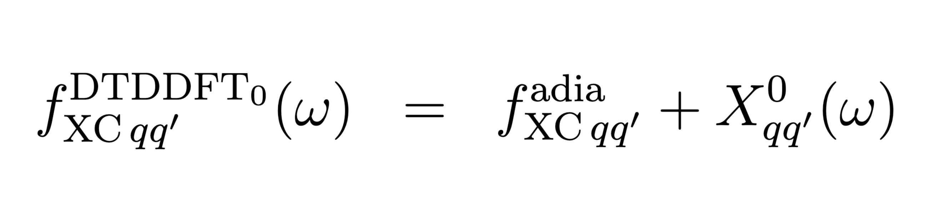
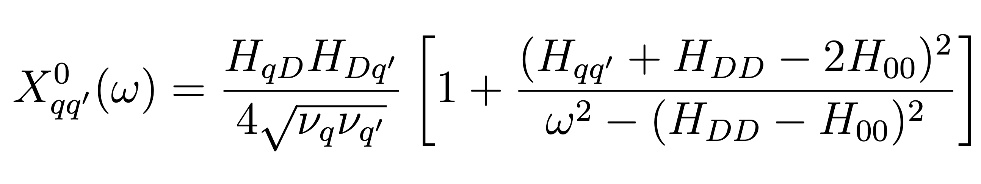
Dressed SMA/TDDFT → good oscillator strengths and energies
Instead derive frequency-dependent kernel within Small-Matrix Approximation (SMA) → DSMA
Can generalize to >1 single-excitation mixing with a double → DTDDFT:
Variations to reduce computation e.g. H_{DD} – H₀₀ → KS double ex freq...only need 2e integrals for H_{qD}
Dar & Maitra, J. Chem. Phys. 159, 211104 (2023); J. Phys. Chem. Lett. 16, 703 (2025)

Slide 24
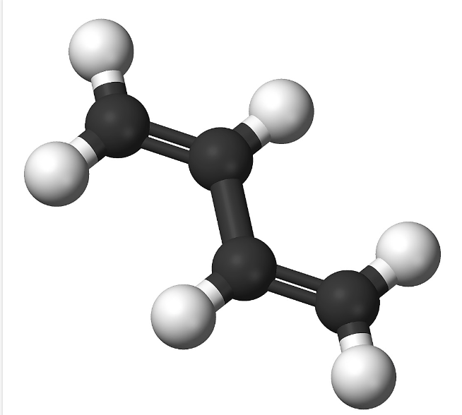
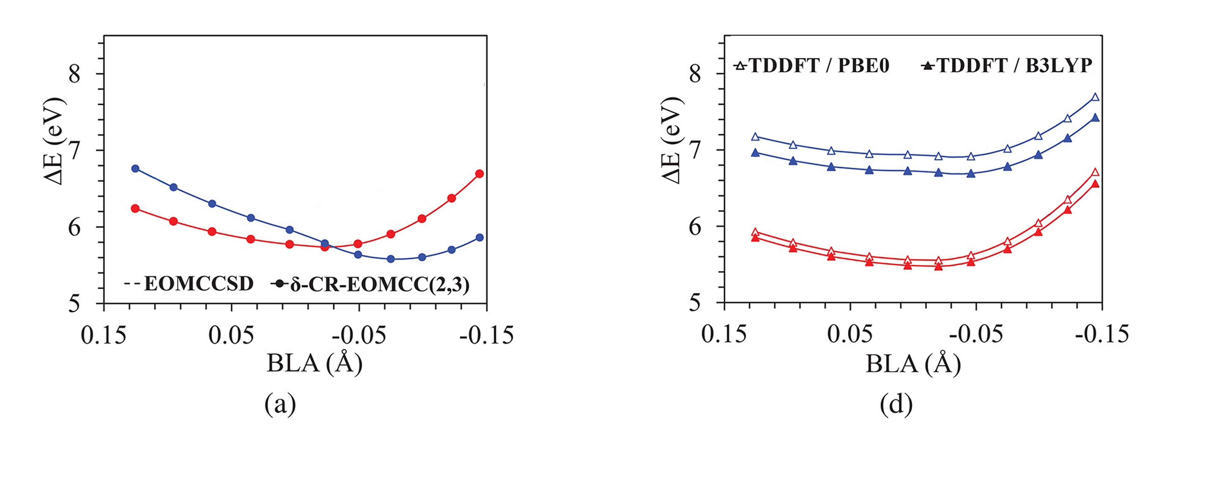
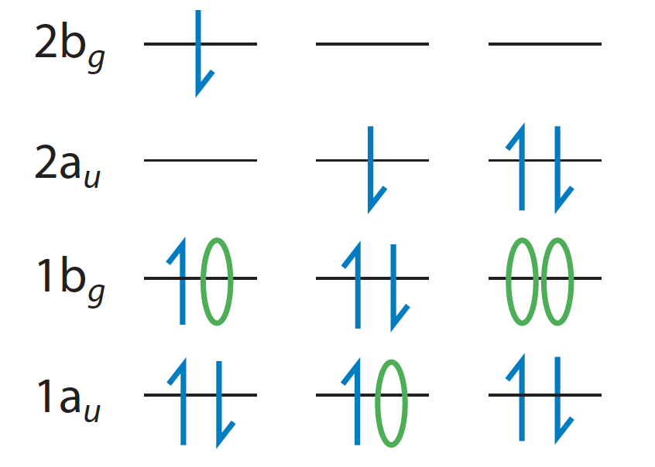




An Example:
Adiabatic TDDFT fails to capture curve-crossing in low-lying states of butadiene:
$2^{1}Ag$
$1^{1}Bu$
Park, W., Shen, J., Lee, S., Piecuch, P., Filatov, M., & Choi, C. H. J. Phys. Chem. Lett., 12, 9720 (2021).
$2^{1}Ag$ has significant double-excitation character

Slide 25
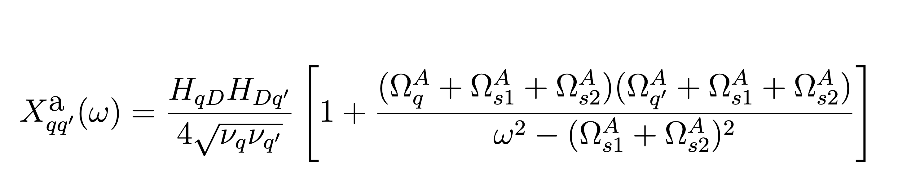
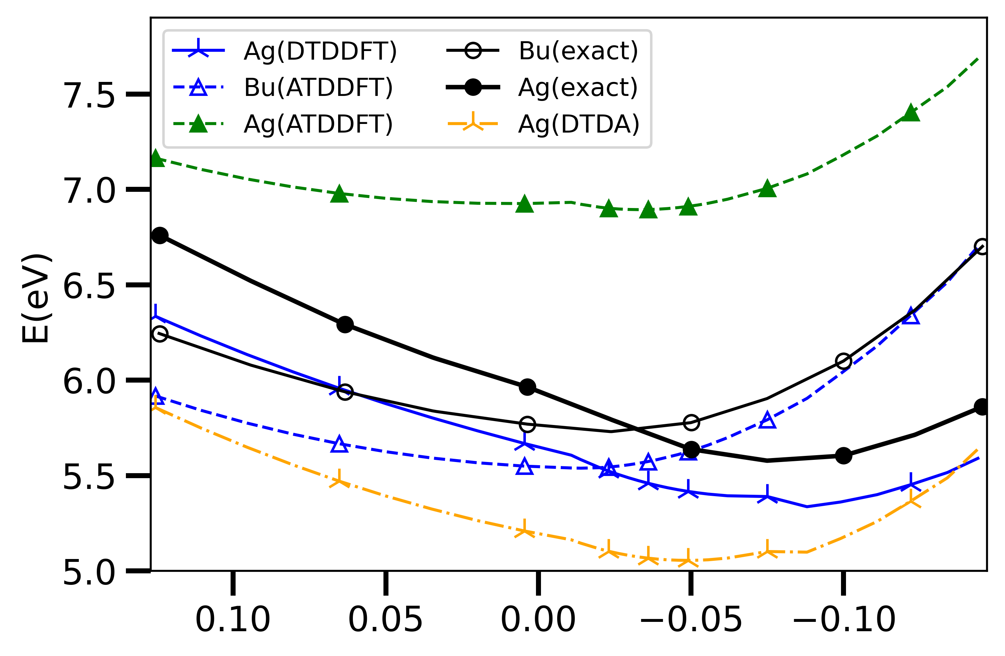
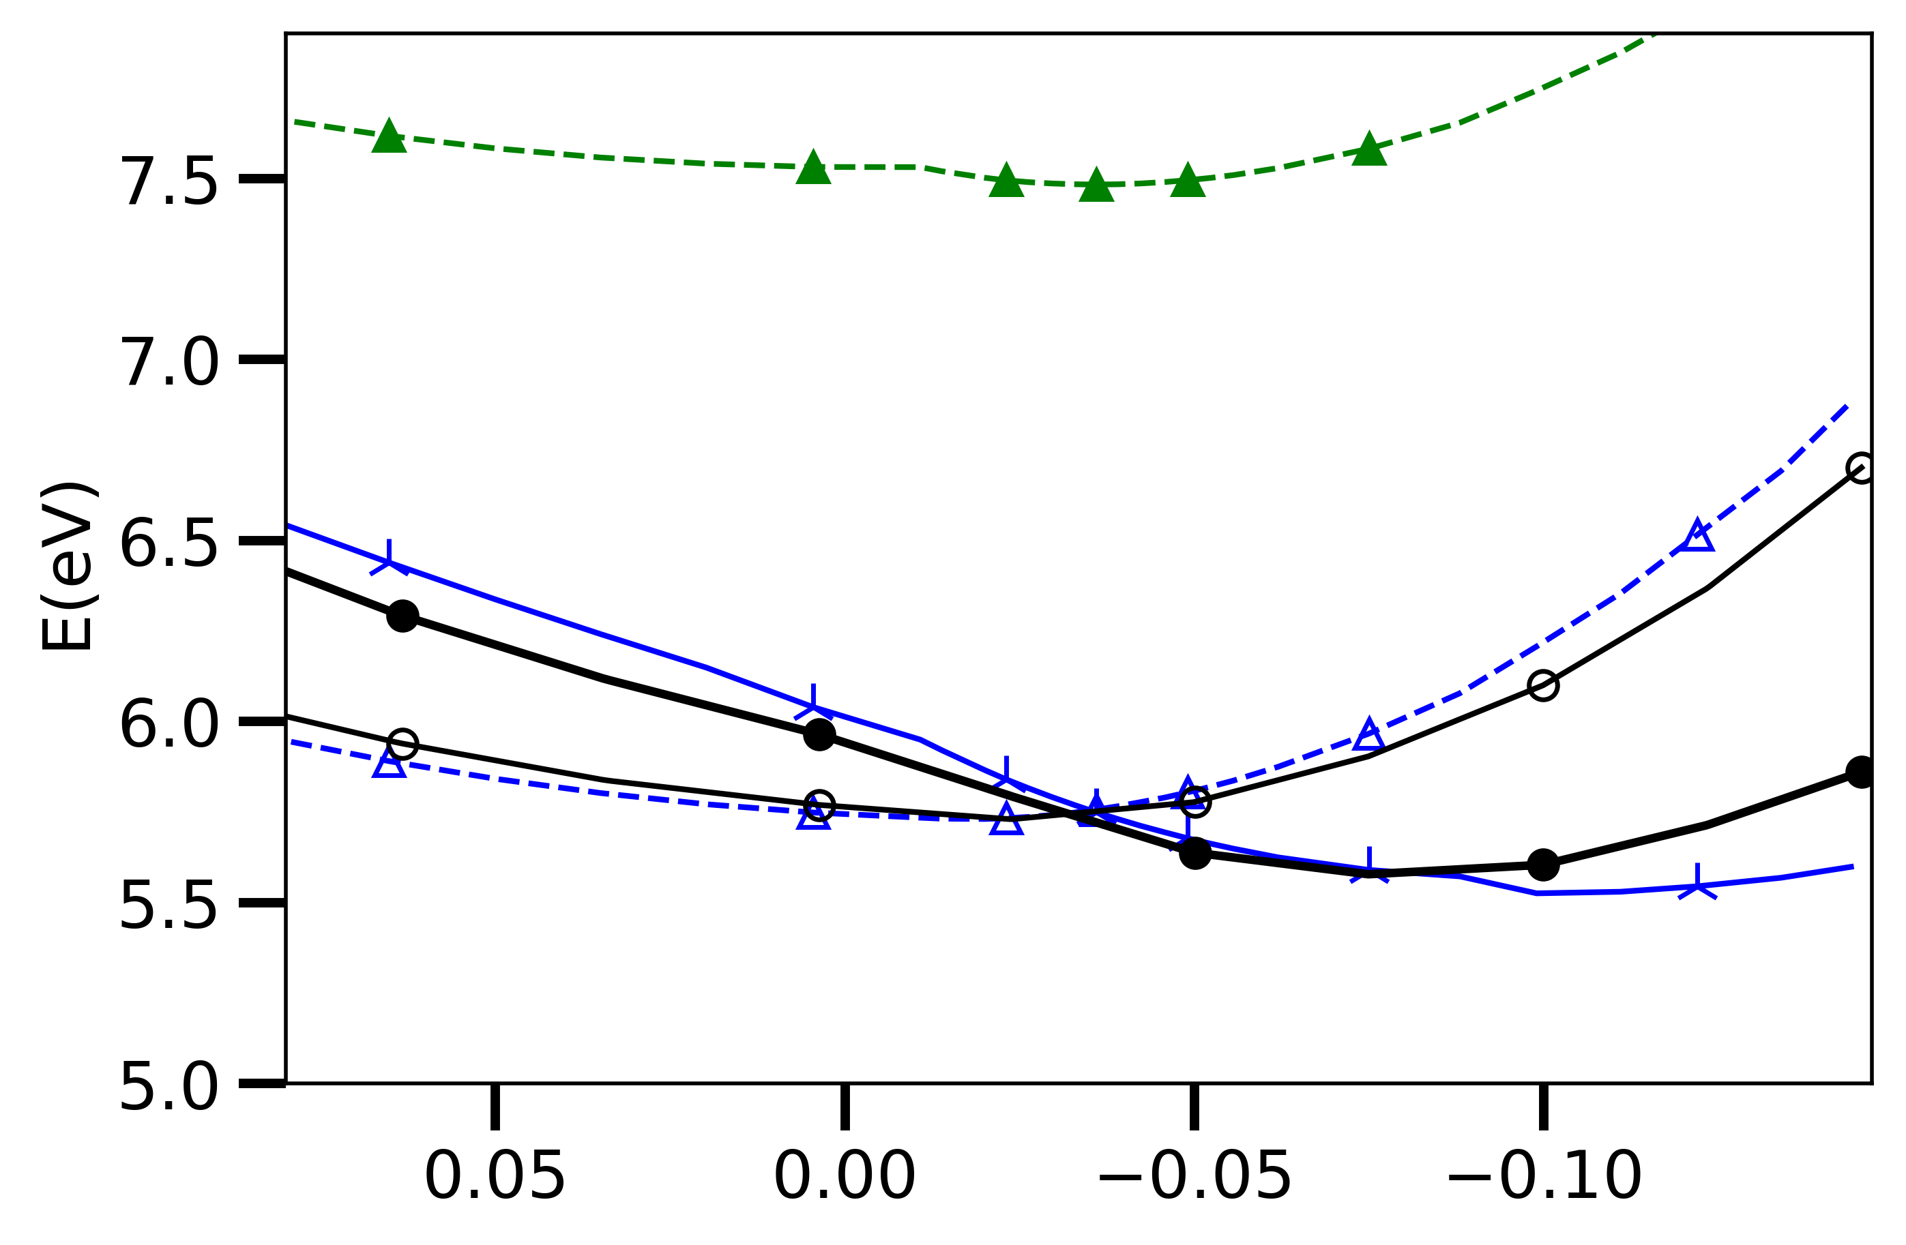
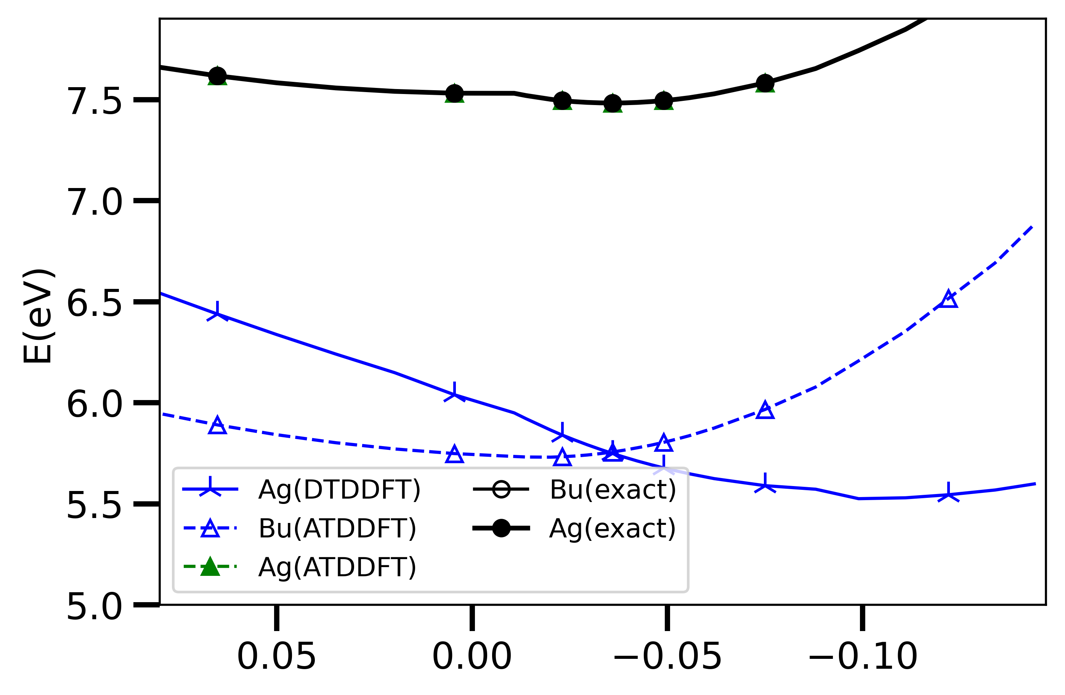
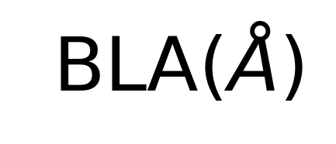
An Example:
Adiabatic TDDFT fails to capture curve-crossing in low-lying states of butadiene,
but DTDDFT does!
Caputring $1^{1}Bu$ and $2^{1}Ag$ Curve Crossing in Butadiene
adiabatic tddft energies
a
DTDDFT with PBE0
DTDDFT with CAM-B3LYP

Slide 26



That’s it for now about Memory in TDDFT!
Thanks so much for your attention!!!
Ask me any questions and I’ll try to answer them!
And always feel free to reach out in email: neepa.maitra@rutgers.edu

