Slide 1

Memory Dependence in
Real-Time TDDFT
Neepa T. Maitra
Rutgers University at Newark

Slide 2
Plan
Introduction to what is memory in TDDFT
-- the adiabatic approximation
Approximations including memory and some exact conditions
Some examples…and implications…
-- field-free superposition state dynamics
-- charge-transfer dynamics
-- electron-atom scattering
and where to especially beware the adiabatic approx

Slide 3
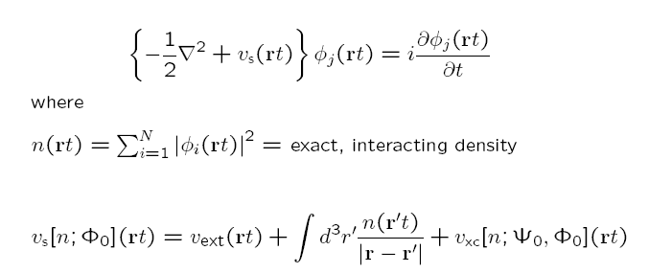
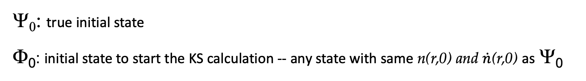
How did memory come in?
Ψ₀
Runge-Gross:
n v_{ext}
true system
1-1
Φ₀
n v_{s}
KS system
1-1
Hartree potential depends only on instantaneous density
Actually, v_{ext} [n,Ψ₀] (rt)
but v_{ext}(rt) is prescribed by problem at hand, so explicit functional dependence not needed
History: n(r t’<t) and initial states Ψ₀ and Φ₀ of true and KS systems
Ψ₀: true initial state
Φ₀: initial state to start the KS calculation -- any state with same n(r,0) and $\dot{n}$(r,0) as Ψ₀
usually choose Slater determinant but not necessary

Slide 4
Memory
Functional depends on history, n(r t’<t), and initial states Ψ₀ and Φ₀ of true and KS systems
Also, for a general observable: A[n; Φ₀]
Special, and common, case:
Ψ₀ = Ψ_{GS}
Φ₀ = Φ_{GS}
Then, by the Hohenberg-Kohn theorem, Ψ₀ = Ψ₀[n(0)] and Φ₀ = Φ₀ [n(0)]
-- no explicit initial-state-dependence → v_{xc}[n](r,t)
(still history-dependent)
e.g. linear response regime.

Slide 5
The Adiabatic Approximation
Almost all calculations today ignore memory, and use an
adiabatic approximation:
input instantaneous density into a ground-state approximation
Example:
Notes:
_{∴επσ xc}^{unif} (n) is the exchange-correlation energy per particle of a uniform electron gas of density n

Slide 6
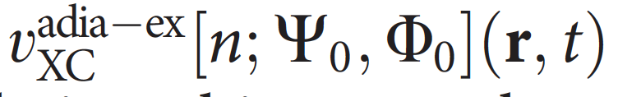
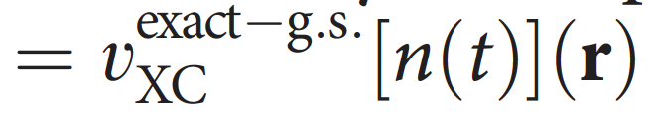
The Adiabatic Approximation
Almost all calculations today ignore memory, and use an
adiabatic approximation:
input instantaneous density into a ground-state approximation
Two sources of error:
Adiabatic approximation itself
Ground-state functional approximation
To disentangle, study “adiabatically-exact” potential (see examples soon!)

Slide 7
Plan
Introduction to what is memory in TDDFT
-- the adiabatic approximation
Approximations including memory and some exact conditions
Some examples…and implications…
-- field-free superposition state dynamics
-- charge-transfer dynamics
-- electron-atom scattering
and where to especially beware the adiabatic approx

Slide 8

Development of Memory-Dependent Functionals…
linear-response kernel of the uniform electron gas at finite frequency
Gross-Kohn (1985)
Phys. Rev. Lett. 55, 2850 (1985)
Non-adiabatic -- time-non-local although spatially local; “finite-frequency LDA”
Violates exact conditions: harmonic potential theorem, zero-force theorem

Slide 9

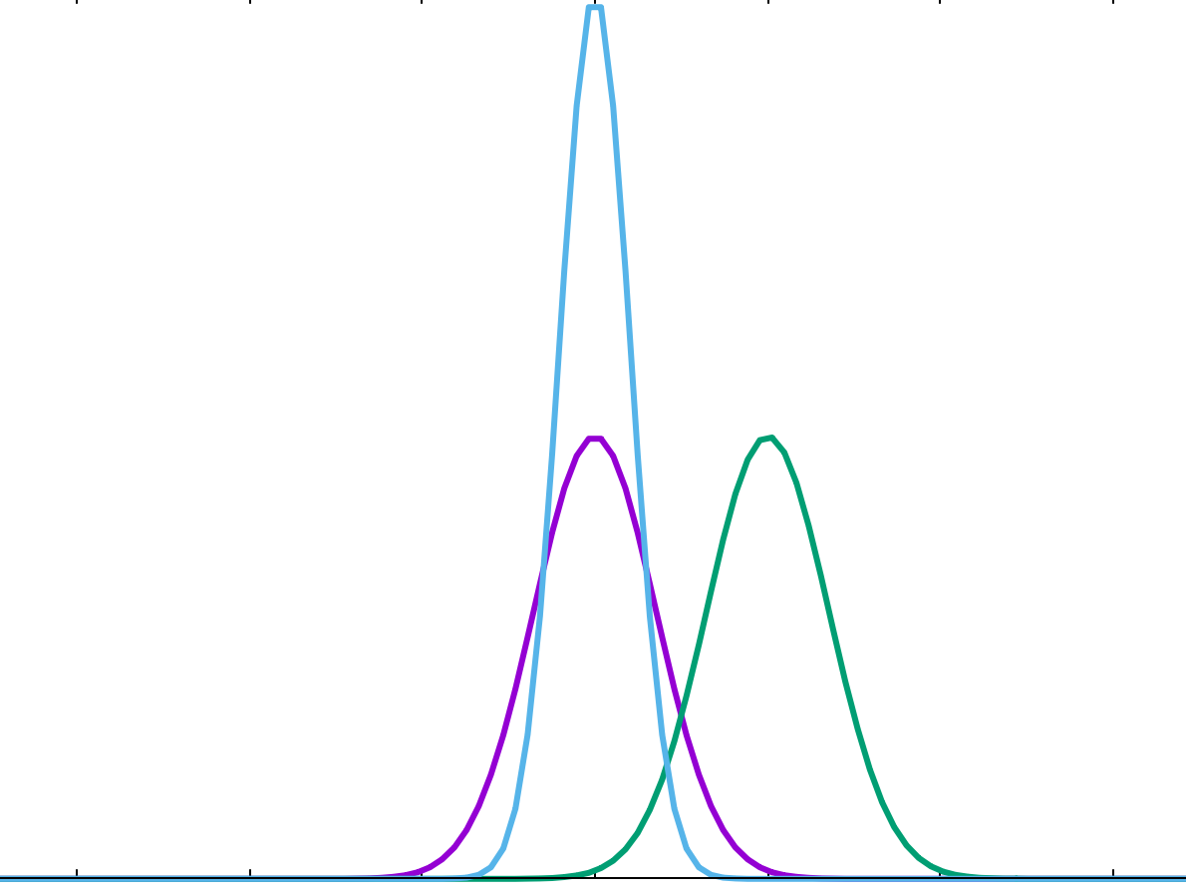
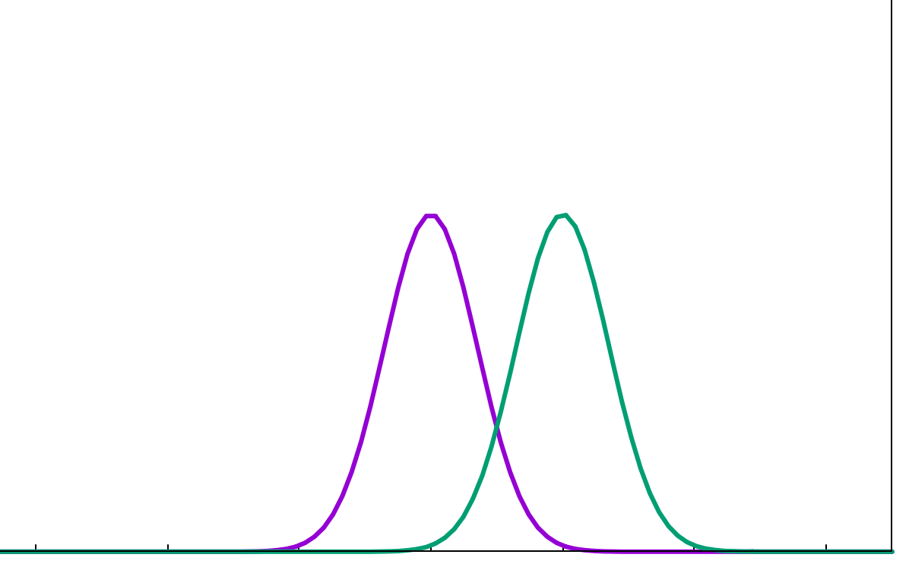
A couple of exact conditions in TDDFT:
(i) Harmonic Potential Theorem (Dobson (PRL 73, 2244, (1994); Vignale PRL 74, 3233, (1995))
N electrons in a harmonic well subject to a TD uniform electric field, E(t)
→ density rigidly sloshes back and forth following classical center of mass (CM)
n(r,t) = n_{GS}(r – r_{CM}(t))
→ v_{xc}(r,t) = v_{xc}^{GS}(r – r_{CM}(t))
Instead, GK finds an n-dependent shift in the frequency of the CM motion, and a damping of the oscillations.
One way to think about why is that when you only look only locally at the density at r, you can’t tell difference between sloshing motion and local compression/rarefaction:
t₂
‘breathing’
t₁
t₂
t₁
‘sloshing’
r
Notes:
Violation of HPT and GTI was shown to yield unphysical behavior in dynamics in sodium clusters – spurious low freq modes and instabilities (Kurzweil and Baer 2008; also showed how to impose thee constraints)

Slide 10
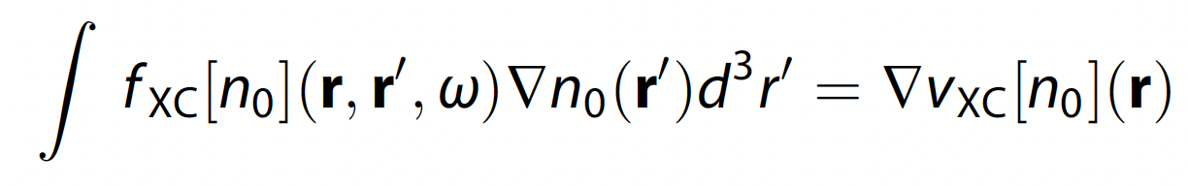

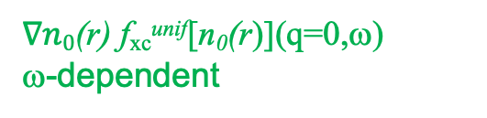

A couple of exact conditions in TDDFT:
(ii) Zero Force Theorem (Vignale PRL 74, 3233, (1995); Phys. Lett. A, 209, 206 (1995) )
xc field cannot exert a net force on itself
Can prove by: evaluate $\frac{d2}{dt2}$ <r> using Ψ(t) and then using Φ(t); then subtract… )
(exercise! Prove this !)
Linear response regime:
Using GK:
$∇n0$(r) f_{xc}^{unif}[n₀(r)](q=0,ω)
ω-dependent
ω-independent
The exact conditions imply time-non-locality → spatially non-local n-dependence, i.e. a local density approximation with memory does not exist.
even in limit of slowly-varying densities → “ultra-non-locality”
Chap. 24 by G. Vignale, in Fundamentals of TDDFT, (Springer 2012)

Slide 11
L. Lacombe and N. T. Maitra, Nonadiabatic approximations in TDDFT: Progress and prospects NPJ Comput. Mat. 9, 124 (2023)

Slide 12
… Development of Memory-Dependent Functionals
Vignale-Kohn (VK) (1996) – spatially local approx in terms of the current-density, j(r,t) → TD-current-density-FT Phys. Rev. Lett. 77, 2037 (1996); Vignale, Ullrich, Conti, , PRL 79, 4878 (1997)
Ψ₀
Based on map:
j A_{ext}
1-1
VK constructed from dynamical longitudinal and transverse current-density responses to slowly-varying perturbations of uniform electron liquid; involves Navier-Stokes-like eqn with complex viscosity coefficients.
Non-adiabatic, and satisfies harmonic potential theorem, zero-force theorems…
Similar concept was proposed by Dobson-Bünner-Gross (1997)
Phys. Rev. Lett. 79, 1905 (1997)
Spatially-local should be relative to where a fluid element at (r,t) was at earlier times t’, R’(t’|r,t) .
→apply Gross-Kohn in frame that moves along with local velocity of electron fluid: memory resides with the fluid element.
Agrees with VK in 1D.
R’,t’
r,t

Slide 13
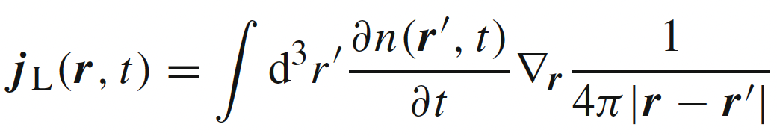
… A little more about Vignale-Kohn and TDCDFT…
Note that RG’s 1st step was j ←→ v_{ext}
Using A instead of v makes it easier to satisfy non-interacting representability: many currents of interacting systems in scalar potentials can only be reproduced by a non-interacting systems in vector potentials
Note that spatially local current j dependence → spatially ultra-nonlocal dependence on density n
E.g.
So even for static response (no memory), VK can help when spatial-non-locality important.
Some success for: correcting overestimate of LDA polarizabilities in long-chain polymers, dissipation in extended systems, spin-Coulomb drag, stopping power in metals….BUT problems for finite systems due to spurious damping

Slide 14
… Other Memory-Dependent Functionals
Lagrangian frame action functional
Y. Kurzweil & R. Baer (J. Chem. Phys. 121 8731 (2004).
Time-dependent deformation functional theory
I. V. Tokatly (Phys. Rev. B 71 (2005), Phys. Rev. B 75, 125105 (2007); Chap. 25 in Fundamentals of TDDFT (Springer, 2012)
Bootstrapping many-body perturbation theory
R. Van Leeuwen, Phys. Rev. Lett. 51, 1888 (1983); von Barth et al. Phys. Rev. B 72 235109 (2005)
Finite systems
Initial-state dependent
Orbital functionals v_{xc}[{φ_{i}(t)}]
H. Wijewardane and C. A. Ullrich, Phys. Rev. Lett. 100, 056404 (2008)
Approximations based on an exact decomposition of the xc potential
L. Lacombe and N. T. Maitra, J. Chem. Theory and Comput. 15, 1672 (2019).
Recent review of memory-dependent approximations:
L. Lacombe and N. T. Maitra, NPJ Comput. Mat. 9, 124 (2023)

Slide 15
Another exact condition: “Memory” condition
History and initial-state dependence are entangled
v_{xc} [n_{t’} ; Ψ₀ = Ψ(t’), Φ₀ = Φ(t’) ] (r,t) independent of t’ (for t >t’)
density n_{t’} defined only from t’ onward
n (t)
t’
t’
t’
t
Maitra, Burke, Woodward, PRL 89, 023002 (2002)
This is a very hard condition to satisfy for non-adiabatic functionals.
When finding exact xc potentials for a given model dynamics, this condition is useful to generalize your results! It says for any dynamics that reaches the instantaneous interacting and KS states Ψ(t), Φ(t), at some time t, the exact xc potential you might find in a given dynamics applies to all.

Slide 16
We will next look at some systems where we can find the exact TD xc potential, and compare with the adiabatic approximation.
To do this, we need a system for which we can find the exact interacting wavefunction from which we obtain the time-dependent density.
Then the question is what is the Kohn-Sham potential that reproduces this density evolution?

Slide 17
Plan
Introduction to what is memory in TDDFT
-- the adiabatic approximation
Approximations including memory and some exact conditions
Some examples…and implications…
-- field-free superposition state dynamics
-- charge-transfer dynamics
-- electron-atom scattering
and where to especially beware the adiabatic approx

Slide 18
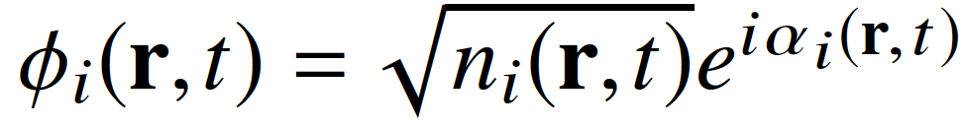
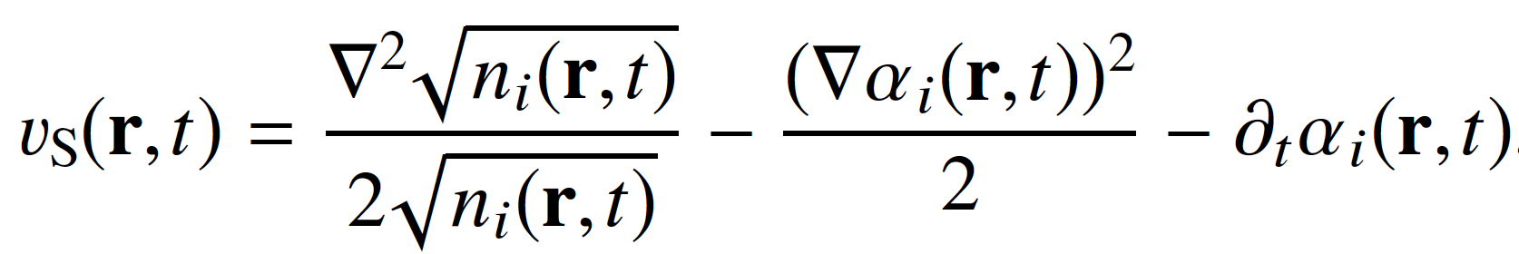
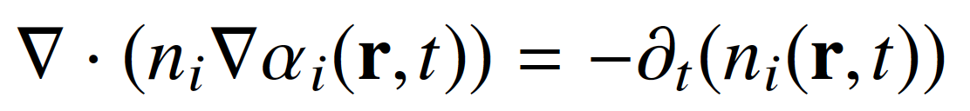
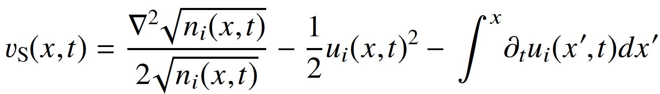
Finding the exact xc potential for a given known density-evolution
Generally, not so easy.
One can show:
into TDKS
orbital-density and orbital-phase of any one of the occupied orbitals
Exercise: show this!
where
In 1D, can express in terms of orbital-density and orbital-“velocity”, u_{i} = j_{i} /n_{i}
So, problem becomes finding the exact KS orbitals -- generally difficult, but possible, Nielsen, Ruggenthaler, van Leeuwen, Europhys. Lett. 101, 33001 (2013)
One easy case: 2 electrons spin-singlet in 1D, in a doubly-occupied KS orbital
n_{i}(x,t) → ½ n(x,t), the exact density, and u_{i}(x,t)→ j(x,t)/n(x,t), where j is the exact current-density

Slide 19
Expression directly for the exact exchange-correlation potential …
Those expressions are directly for v_{s}; to find v_{xc} we must subtract Hartree and v_{ext}
But there is also an expression directly for v_{xc}:
Equate equation of motion for $∂^{2}$n(r,t)/$∂t^{2}$ coming from interacting system,
with that of the KS system, and then subtract →
Exact expression for the TD exchange-correlation potential
TD one-body density-matrix: interacting, KS
TD exchange-correlation hole

Slide 20
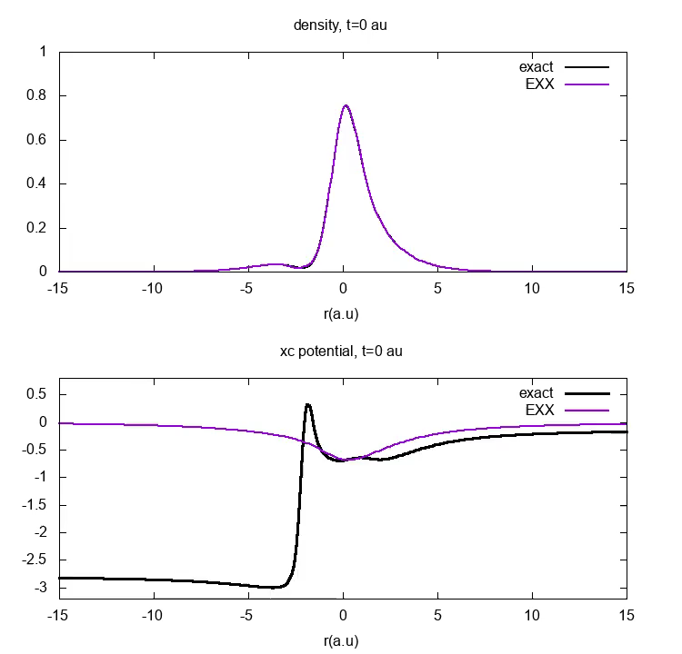

A simple example of memory-dependence:
Field-Free Evolution of Superposition State in 1D He
These large step and peak features cannot be captured by even the best adiabatic approximation, v_{xc}^{adia-ex} …

Slide 21
v_{xc}
Adiabatic approximations, even adiabatically-exact, lack the dynamical step and look really different

Slide 22
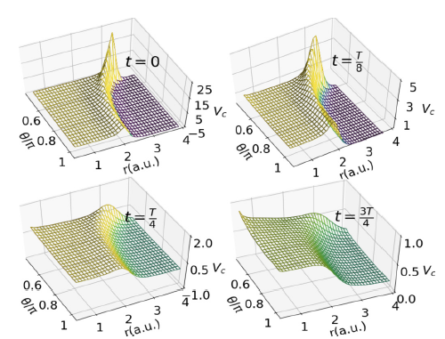



The large non-adiabatic features are not a consequence of 1D – they are equally present in real 3D systems,
e.g. 50:50 superposition state 1¹S₀ : 2¹P₁ in the He atom
D. Dar, L. Lacombe, J. Feist, N. T. Maitra, Phys. Rev. A. 104, 032821 (2021)

Slide 23
Non-adiabatic features in v_{c} appear generically in non-perturbative dynamics: resonantly-driven processes, charge-transfer dynamics, field-free evolution of non-stationary states, quasiparticle propagation in wires…
…but missing in all adiabatic approximations
E.g.
Elliott, Fuks, Rubio, Maitra, PRL 109, 266404 (2012)
Ramsden, Godby, PRL 109, 036402 (2012)
…
N. T. Maitra, Perspective in J. Chem. Phys. 144, 220901 (2016)
D. Dar, L. Lacombe, N. T. Maitra, Chem. Phys. Rev. 3, 031307 (2022)
What is the impact on dynamics?? Propagate with adiabatically-exact approximation to compare…

Slide 24
Another Example: Charge-transfer dynamics out of the ground-state
LiCN molecule
S. Ragunathan, M. Nest, J. Chem. Th. Comput. 7 2492 (2011).
J. I. Fuks, P. Elliott, A Rubio, N. T. Maitra J. Phys. Chem. Lett. 4, 735 (2013)
J.I. Fuks and Maitra, Phys. Rev. A. 89, 062502 (2014); Phys. Chem. Chem. Phys. 16, 14504 (2014)
EXX
ω = 0.5177
ω^{adia-ex} = 0.5187
Despite extremely accurate CT excitation energies, CT is not achieved by the adiabatically-exact approximation.

Slide 25
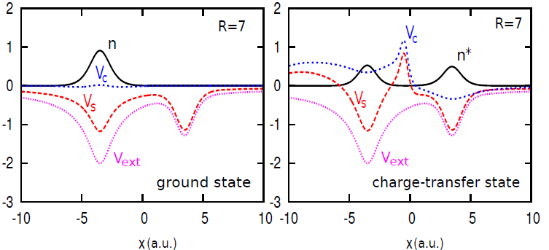
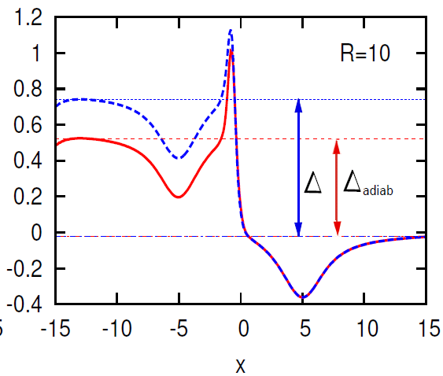
But charge-transfer out of the ground-state is challenging for KS, since a single KS orbital must always describe both the transferring electron and one that stays...
Step features build up in time – even v_{c}^{adia-ex} fails to correctly capture
v_{c}
adia-exact v_{c}
Correlation potential in the final CT state, as R→ ∞
N. T. Maitra, Topical Review on Charge Transfer in TDDFT, J. Phys. Cond. Matt. 29, 423001 (2017)

Slide 26
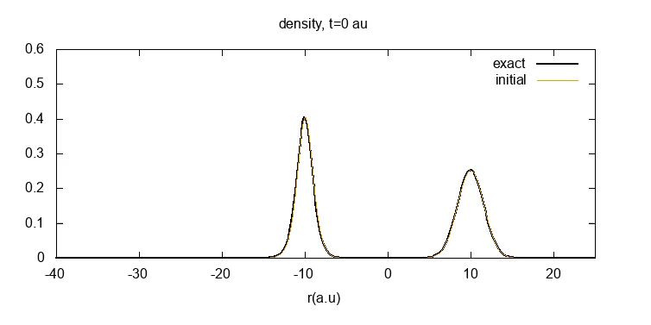

A final example: Time-Resolved e-H scattering
reflection
How do the TDDFT approximations do?
Choice of initial spin-singlet KS wavefunction:
Slater determinant (one orbital, doubly-occupied)
Two-orbital state: one for the electron in the atom, one for the incoming
t/fs
Y. Suzuki, L. Lacombe, K. Watanabe, N. T. Maitra, PRL 119, 263401 (2017)
L. Lacombe, Y. Suzuki, K. Watanabe, N. T. Maitra, Eur. Phys. J. B. 91, 96 (2018)

Slide 27
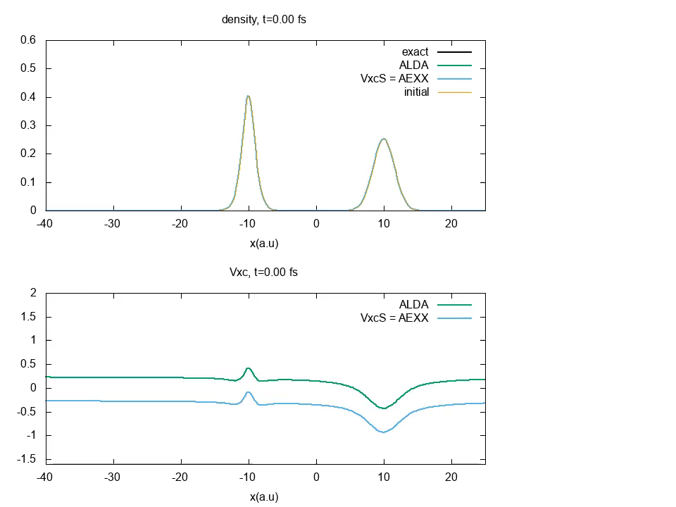
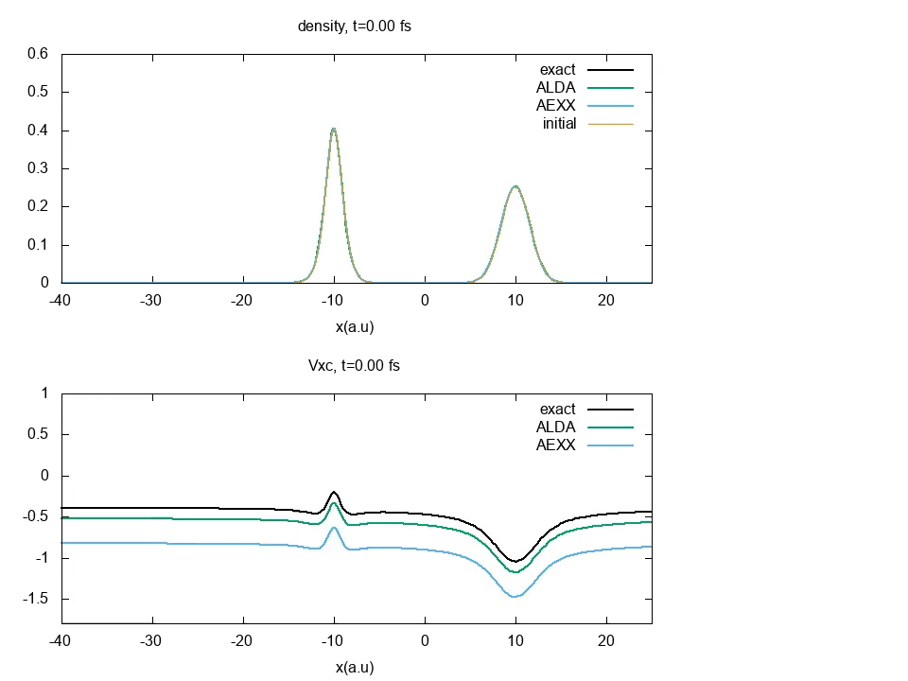
Time-Resolved e-H scattering
Choice (1) Slater determinant
Although ALDA and AEXX densities don’t show unphysical oscillations for choice (2), they overspread and ultimately fail to scatter – v_{xc} lacks crucial peak and valley structures.
Same trend for elastic case – here scattering coeffs extracted from linear response using AEXX are good but time-resolved calculation fails!
Choice (2) Two-orbital state
reflection
t/fs
Y. Suzuki, L. Lacombe, K. Watanabe, N. T. Maitra, PRL 119, 263401 (2017)
L. Lacombe, Y. Suzuki, K. Watanabe, N. T. Maitra, Eur. Phys. J. B. 91, 96 (2018)

Slide 28
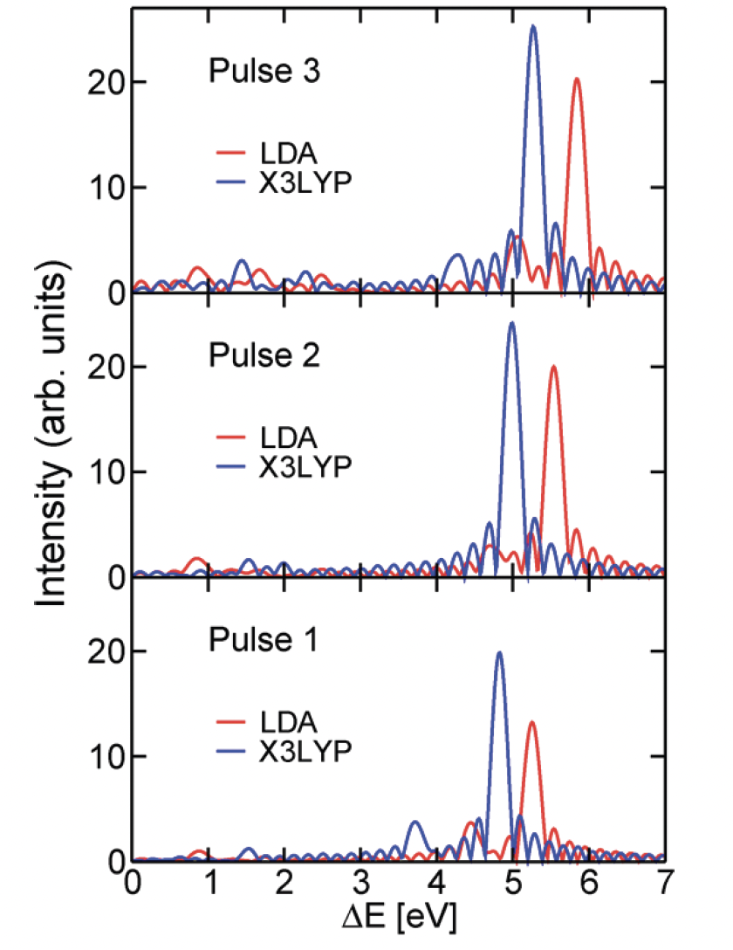

Key problem is that the TDKS eqn requires the xc functional on a fully non-equilibrium domain…
... but the adiabatic approximation uses xc effects as if the system was in the ground state!
This leads to errors, and even qualitative failures in some cases seen in e.g.
-- Resonantly driven dynamics (Rabi oscillations)
-- Pump-probe spectroscopy -- spurious peak shifting →
-- Charge-transfer dynamics out of the ground-state
-- Lack of relaxation/dissipation in extended systems
spectra of $Li_{2}C_{2}$
Raghunathan, S., & Nest, M. Journal of Chemical Theory and Computation, 8, 806 (2012).p

Slide 29
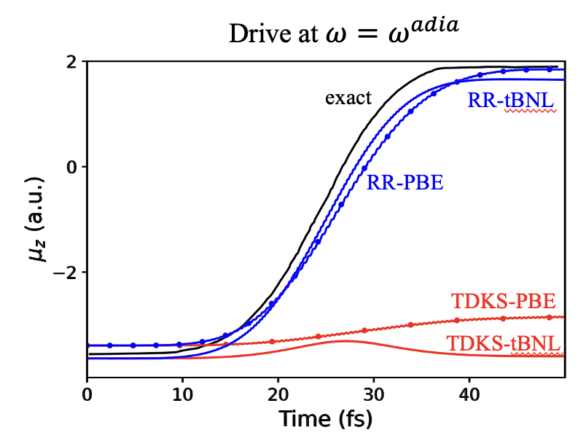
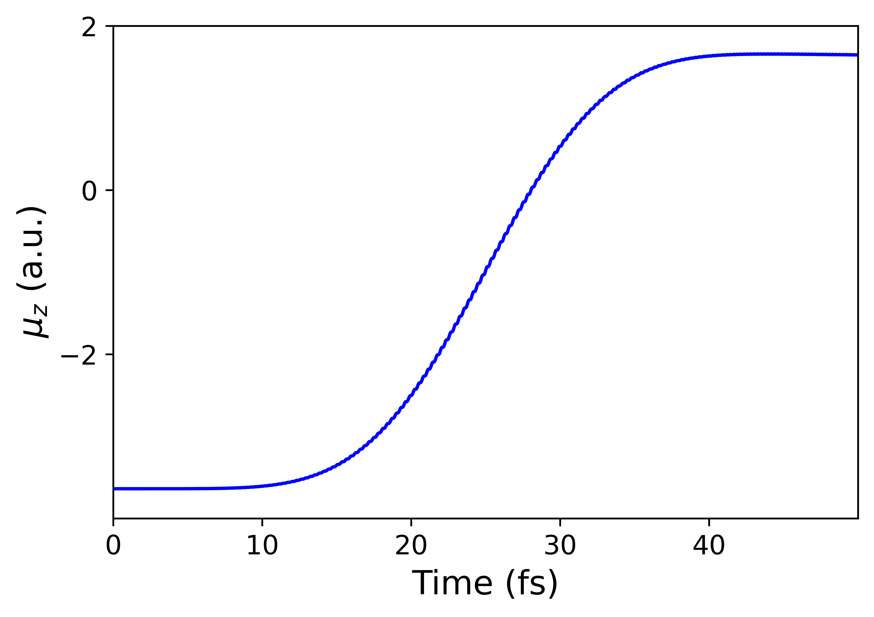
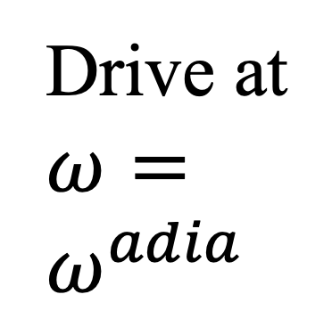
Key problem is that the TDKS eqn requires the xc functional on a fully non-equilibrium domain…
... but the adiabatic approximation uses xc effects as if the system was in the ground state!
Recent recasting of TDDFT such that only response properties are needed even to describe dynamics far from the ground-state!
RR-TDDFT resurrects Rabi oscillations ☺
Drive at $ω=ω^{adia}$
D. Dar, A. Baranova, N. T. Maitra
Phys. Rev. Lett. 133, 096401 (2024)

Slide 30
Short summary so far: memory in non-perturbative dynamics
The exact v_{xc} depends on memory: the history of the density, the initial state, and choice of KS initial state. Neglect of this → errors and some failures
Generically, dynamical steps and peaks appear in v_{c} that require non-adiabatic density-dependence
  -- impact on ensuing dynamics can be large, but not always
Approximations giving good response can give bad non-perturbative dynamics
-- functional evaluated in a very different domain.
With a judicious choice of Φ₀ the adiabatic approx can better approximate v_{xc}
!! But the adiabatic approximation has provided useful results and interpretation in many applications, especially for integrated observables… a better understanding of non-adiabatic effects is still needed
Response-reformulated TDDFT provides more reliable predictions than real-time TDKS propagation, as trustable as TDDFT for linear response – wait, how trustable is it there?! see next time!

