Slide 1

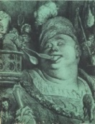














AvH
Feodor
Lynen
Advanced ERC Grant:
QUAGATUA
MSCA “QU-ATTO”
Doctoral Network
Advanced ERC Grant:
NOQIA
NExt level Quantum information processing for Science and Technology (NeQST)
Advanced ERC Grant:
OSYRIS
CERCA/Program
EU FET-Open OPTOlogic
MPG
MPI
Garching
Quantum-Cat
SGR 1341
FEDER/RIS3CAT
SGR 01452
Topological Quantum Matter @ ICFO-QOT
Symfonia
FNP
Polish Science Foundation
PN FIDEUA/STAMEENA
NCN
Narodowe Centrum Nauki
“Retos Colaboración” QUSPIN
European Union NextGenerationEU (PRTR)
Quantera MAQS
Quantera DYNAMITE

Slide 2


ICFO – Quantum Optics Theory (17 (6 females), 10 countries)
PhD ICFO (8)
Postdocs ICFO (7)
Dr. Przemysław Grzybowski (many-body, ML)
Dr. Reiko Yamada (composer)
Dr. Marcin Plodzień (many-body)
Dr. Lin Zhang (many body)
Dr. Sourav Bhattacharee (many-body)
Dr. Guillem Müller Rigat (many-body)
Dr. Javier Rivera-Dean (atto, QI)
Gabriel Fernández Fernández (ML, QI)
Arti Gaharwar (atto,QI)
Eloy Piñol (ML, statphys)
Pavel Popov (many-body)
Anubhav Kumar Srivastava (QI, many-body)
Philipp Stammer (atto)
Maria Recasens (many-body/exp)
Yuma Watanabe (many-body)
MSc ICFO (1)
Lidija Petrović)
PhD Politechnika Wroslawska-ICFO
Marlena Dziurawiec (many body)
Ex-members and collaborators: Aditi Sen De, Ujjwal Sen, Debraj Rakshit (HRI, Alahabad), Manab Bera (IIT), François Dubin (CNRS), G. John Lapeyre (IBM), Chiara Menotti (Trento), Jonas Larsson (Nordita), Philipp Hauke (Trento), Bruno Julia Díaz, Luca Tagliacozzo (UB), Anna Sanpera, Veronica Ahufinger, Alessio Celi (UAB), Tomek Sowiński, Mariusz Gada (IF PAN), Phillip Hauke (Trento), Omjyoti Dutta (GMV), Ralph Dum, Christian Trefzger (EC), Kuba Zakrzewski (UJ, Cracow), Boris Malomed (Haifa), Ulrich Ebling (Kyoto), Christine Muschik (UoT), Marek Kuś, Remigiusz Augusiak (CFT), Alexander Streltsov (UW), Ravindra Chhajlany, Przemek Grzybowski, Swapan Rana (ISI), Shi-Ju Ran (CNU), Irénée Frérot (Grenoble), Maria Maffei, Giulia de Rosi (UPC), Christos Charampoulos (IFICS), Angelo Piga (URiV), Zahra Khanian (TUM), Emilio Pisanty (KCL), Marcelo Ciappina (China-Technion), Titas Chanda, Emanuele Tirrito (SISSA), Luca Barbiero (Politecnica Torino), Alejandro Bermodez, Miguel Angel Martin-Delgado, German Sierra (Madrid), Albert Aloy (Vienna), Daniel González (Innsbruck), Luca Barbiero (Torino), Gorka Muñoz (Innsbruck), Simon Wall, Andy Maxwell (Aarhus), Tony Acín, Adrian Bachtold, Jens Biegert, Morgan Mitchell, Leticia Tarruell, Lluis Torner, Maria García-Parao (ICFO), Piotr Grochowski (Innsbruck), Jan Wehr (Tuscon). Paraskevas Tzallas, Theocharis Lamprou (FORTH), Anna Dawid (Leiden), Alexandre Dauphin (PASCAL), Sergi Julià Farré (PASCAL), Valenting Kasper (Sherbrook); Allan Johnson (Madrid), Tobias Grass (Donistia), Tymoteusz Salamon (QT), Dr. Utso Bhattacharya (ETH), Mohit Lal Bera (UPV), Joana Fraxanet Morales (IBM),Borja Requena (Axiomatic-AI), Aikaterini Gratsea (ML-industry), Themistoklis Mavrogordatos (QO), Alexis Chacón Salazar (Panama), Grzegi¡orz Rajchel-Mieldodź (QI), Maciej Maska (Politechnika Wroclawska), Bárbara Andrade (DITP), Andrea Tononi (UPC)
Notes:
3

Slide 3
Outline – Topological Quantum Matter at ICFO-QOT
1. Atto-Physics
1.1 Introduction to attophysics
1.2 Generation of Schrödinger cat states
1.3 Toward cat states with geometrical, or topological phase
2. Quantum Thermometry
2.1 Individual quantum probes for optimal thermometry
2.2 Topological quantum thermometry
3. Quantum Engines with Anyons
3.1 Pauli engines and motivation
3.2 Our proposal
3.3 Results
3. Topological Bogoliubov Quasiparticles
3.1 Bose-Einstein Condensate in a flat band system
3.2 Non-zero and high Chern numbers, chirality
3.3 Anomalous fluctuations of BEC in optical lattices
4. Haldane Superfluid: Is it real?
4.1 Platforms for many body phenomena
4.2.Challenges of numerical methods
4.3 Haldane Superfluid in the two-leg ladder extended Bose-
Hubbard model
4.4 Does Haldane Superfluid exist?

Slide 4
1. Atto-Physics

Slide 5
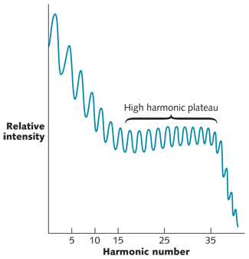
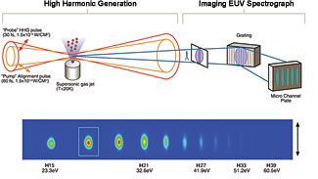
1.1 Introduction to attophysics
Matter in intense laser fields
High Harmonics Generation (HHG)

Slide 6
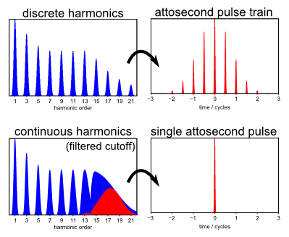
1.1 Introduction to attophysics
Conventional atto-physics
High Harmonics Generation (HHG)

Slide 7
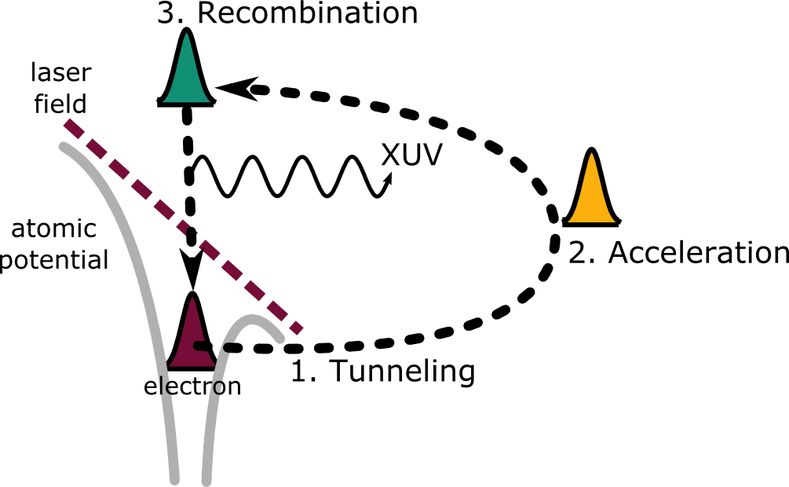
1.1 Introduction to attophysics
Attosecond physics
Three step model
Dynamics of short-pulse excitation, ionization and harmonic conversion, KC Kulander, KJ Schafer, JL Krause - Super-intense laser-atom physics, 1993 - Springer
Plasma perspective on strong field multiphoton ionization, P.B Corkum, Physical Review Letters 71 (13), 1994
Theory of high-harmonic generation by low-frequency laser fields, M Lewenstein, P Balcou, MY Ivanov, A l’Huillier, PB Corkum Physical Review A 49 (3), 2117

Slide 8
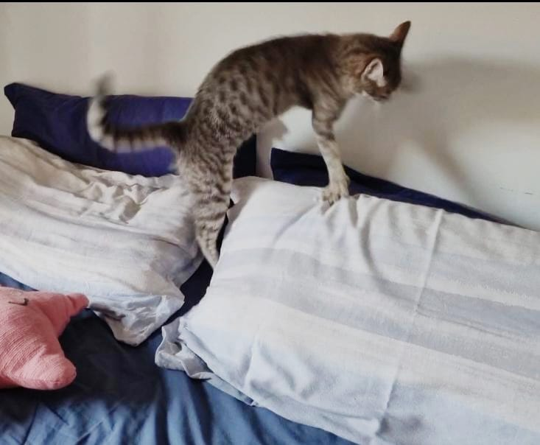
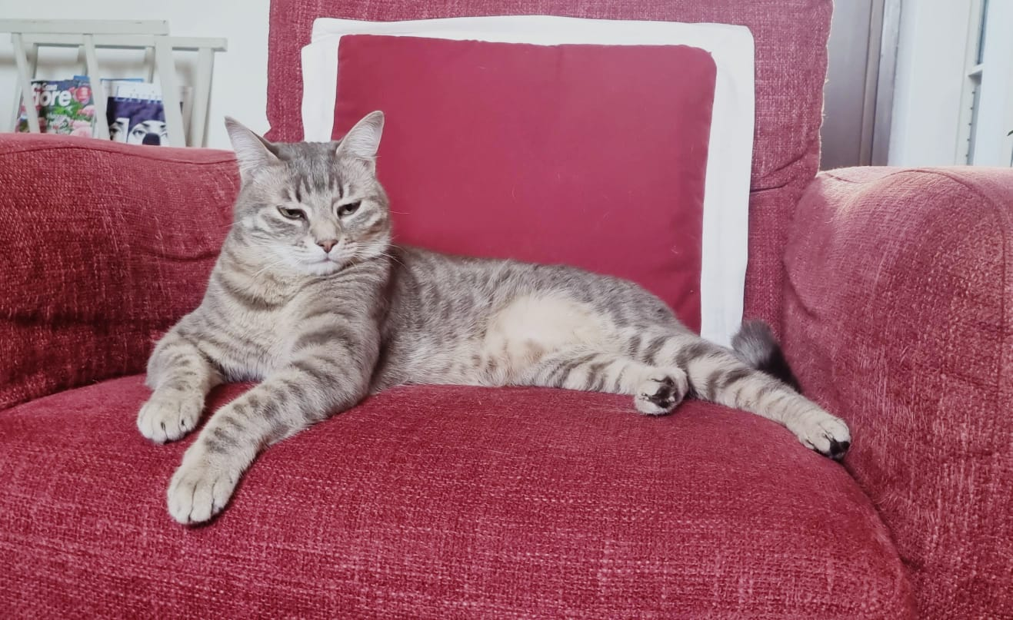
Modified Schrödinger Cat
A cat alive
A cat VERY MUCH alive

Slide 9
1.2 Generation of Schödinger cat states
Attosecond physics and QED

Slide 10

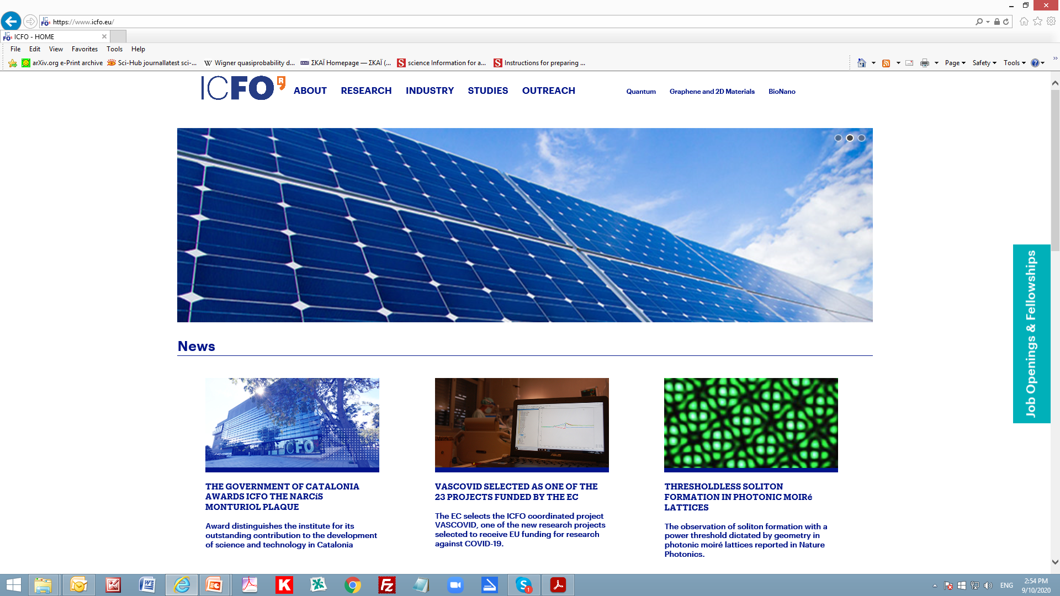
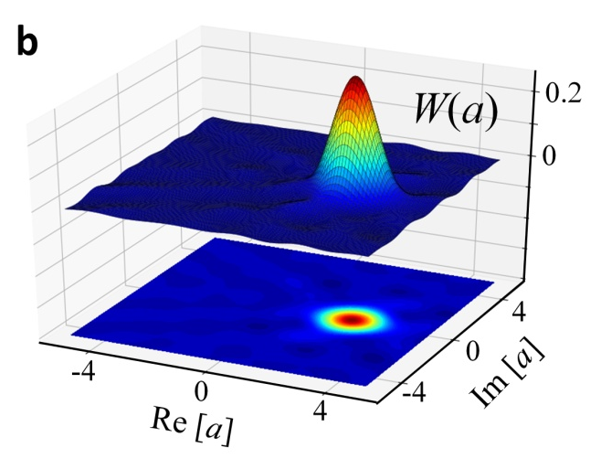
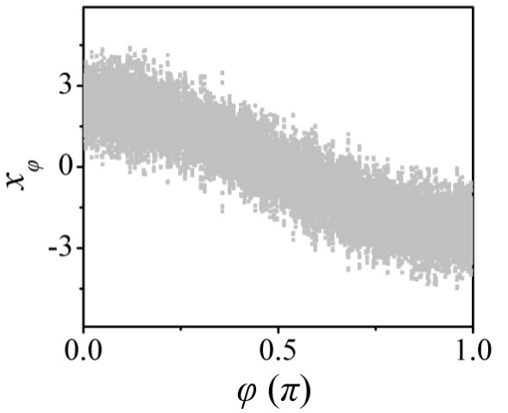
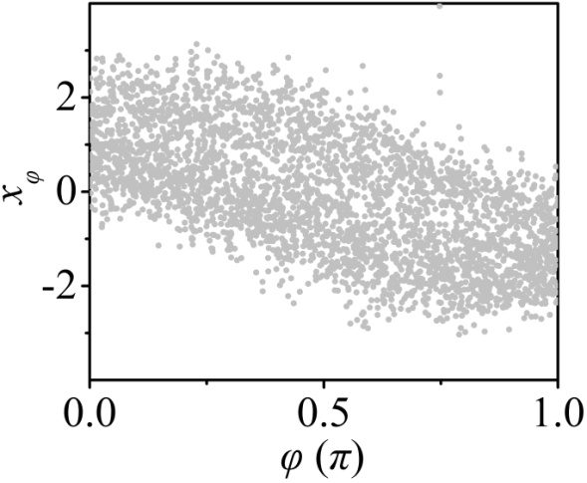
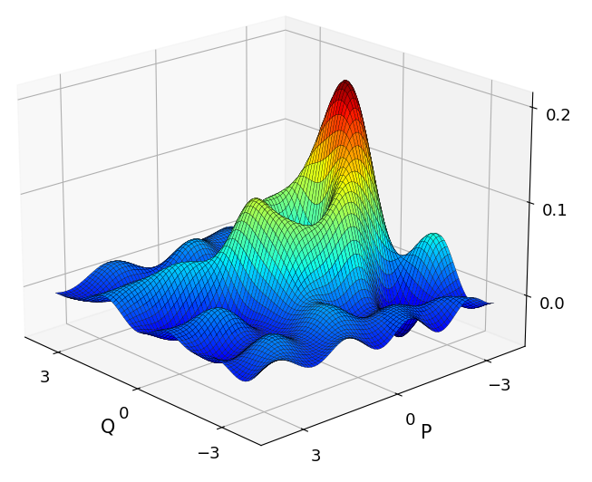
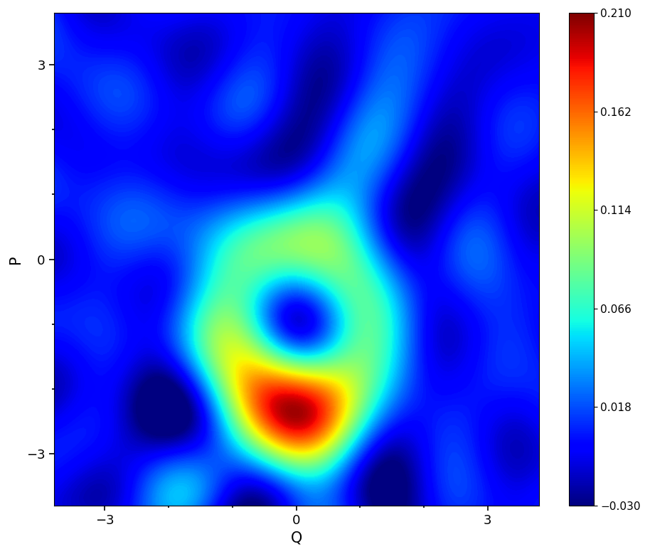
1.2 Generation of Schödinger cat states
Quantum state characterization
Xenon gas jet OFF
coherent state
Xenon gas jet ON
“cat” state
W(a)
Im[a]
Re[a]
Im[a]
Re[a]
M. Lewenstein et. al., arXiv/2008.10221 (2020), Nature Phys.17, 1104{1108 (2021).

Slide 11
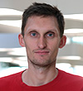

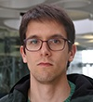
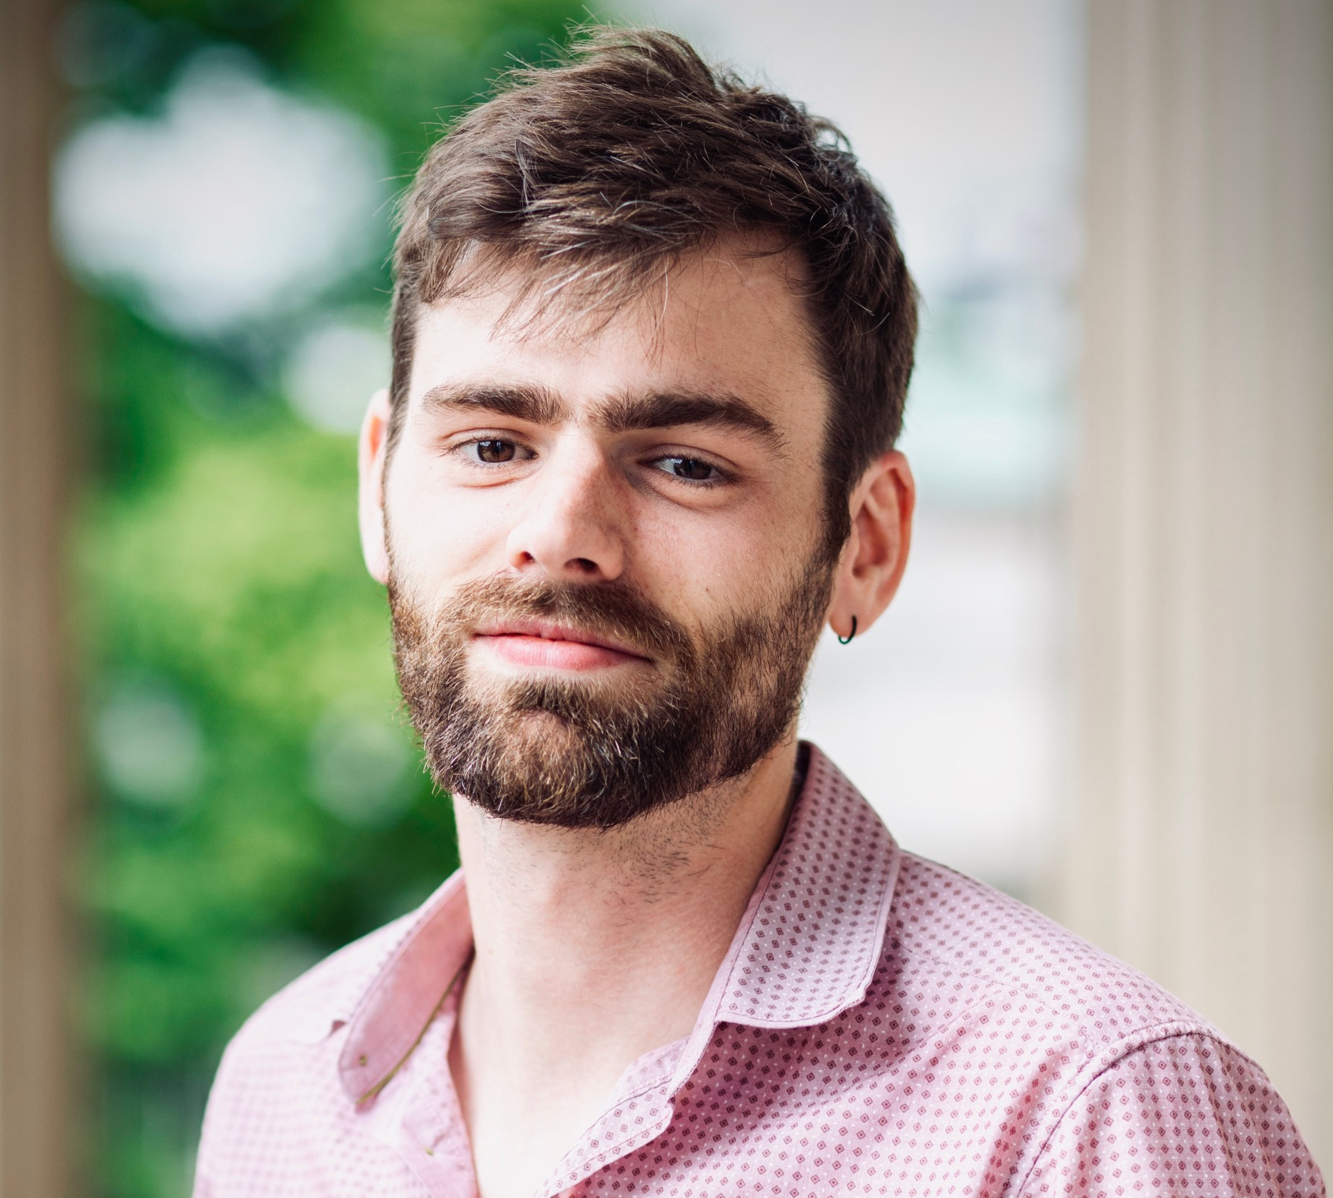
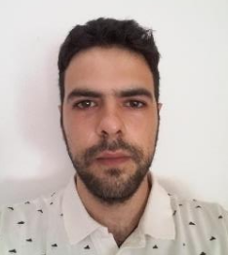

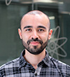

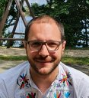
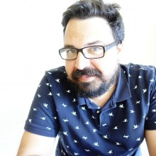
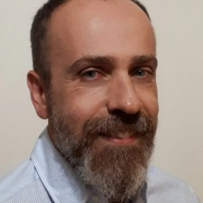
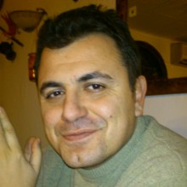
Quantum nature of EM radiation in strongly laser driven atoms
ICFO + UCL + Guangdong Technion
+ Aarhus
M. Lewenstein
J. Rivera-Dean
M. F. Ciappina
E. Pisanty,
Ph. Stammer
A. Maxwell
A. Ordóñez
Attosecond Science and Technology group
Th. Lamprou
N. Papadakis
E. Skantzakis
I. Liontos
P. Tzallas

Slide 12
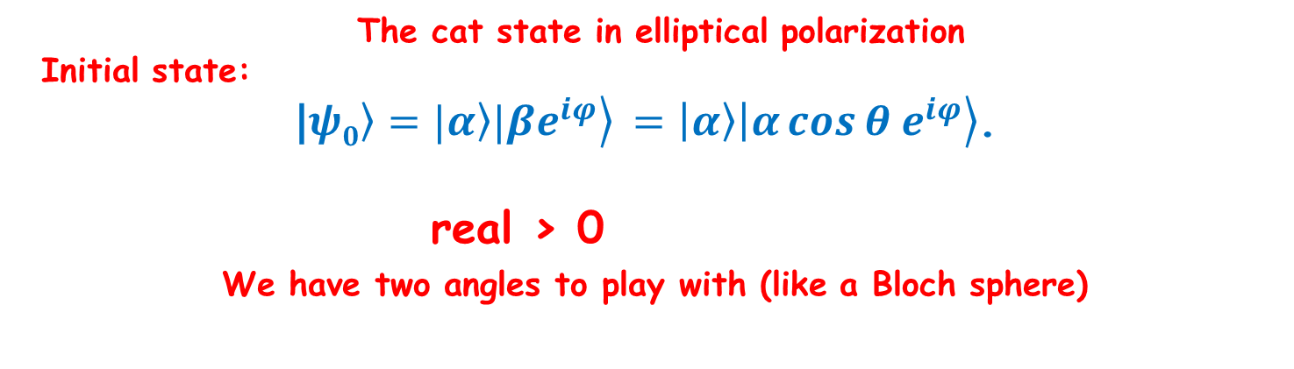
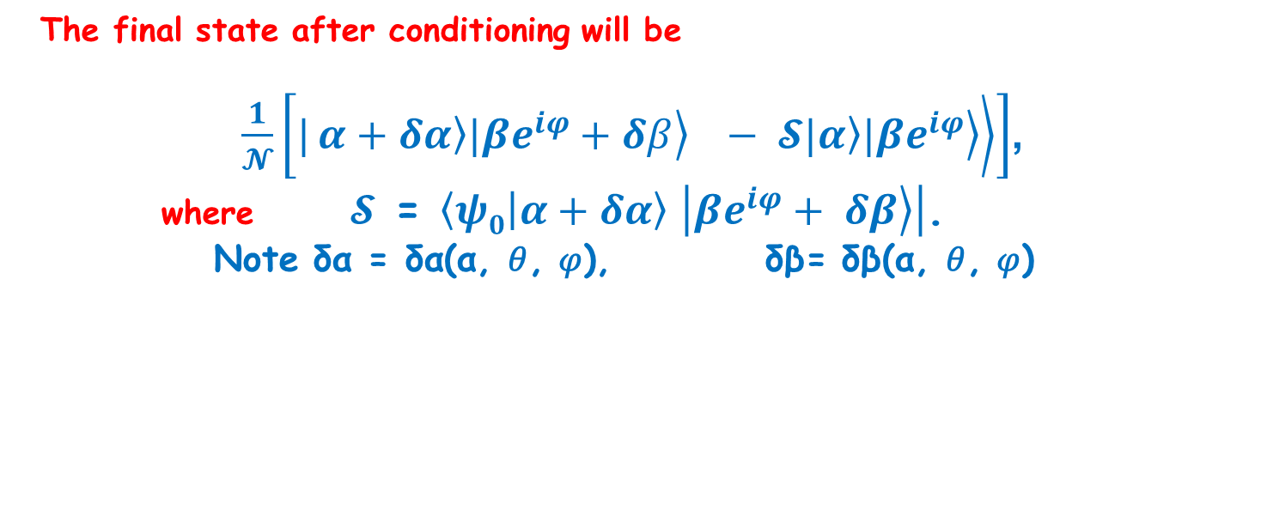

1.3 Toward generation and characterization topological Schrödinger cat states
The cat state in elliptical polarization
Initial state:
|$\left.ψ0\right\rangle =|\left.α\right\rangle |\left.βe^{iφ}\right\rangle$ $=\left|\left.α\right\rangle \right|\left.α\cos{θ e^{iφ}}\right\rangle$.
real > 0
We have two angles to play with (like a Bloch sphere)
Quantum state characterization
After interactions:
$|\left.α\right\rangle$ $=\left|\left.α+δα\right\rangle \right|$,
$|\left.βe^{iφ}\right\rangle$ $=\left|\left.βe^{iφ}+ δβ\right\rangle \right|$,
The final state after conditioning will be
$\frac{1}{𝓝}\left[|\left.\left.α+δα\right\rangle |\left.βe^{iφ}+δβ\right\rangle − 𝓢|\left.α\right\rangle |\left.βe^{iφ}\right\rangle \right\rangle \right]$,
where $𝓢$ = $\left\langle ψ0 | α+δα\right\rangle$ $\left|\left.βe^{iφ}+ δβ\right\rangle \right|$.
Note δα = δα(α, 𝜃, 𝜑), δβ= δβ(α, 𝜃, 𝜑)

Slide 13
1.3 Toward generation and characterization topological Schrödinger cat states
Quantum state characterization

Slide 14
1.3 Toward generation and characterization topological Schrödinger cat states
Quantum state characterization

Slide 15
1.3 Toward generation and characterization topological Schrödinger cat states
Quantum state characterization

Slide 16
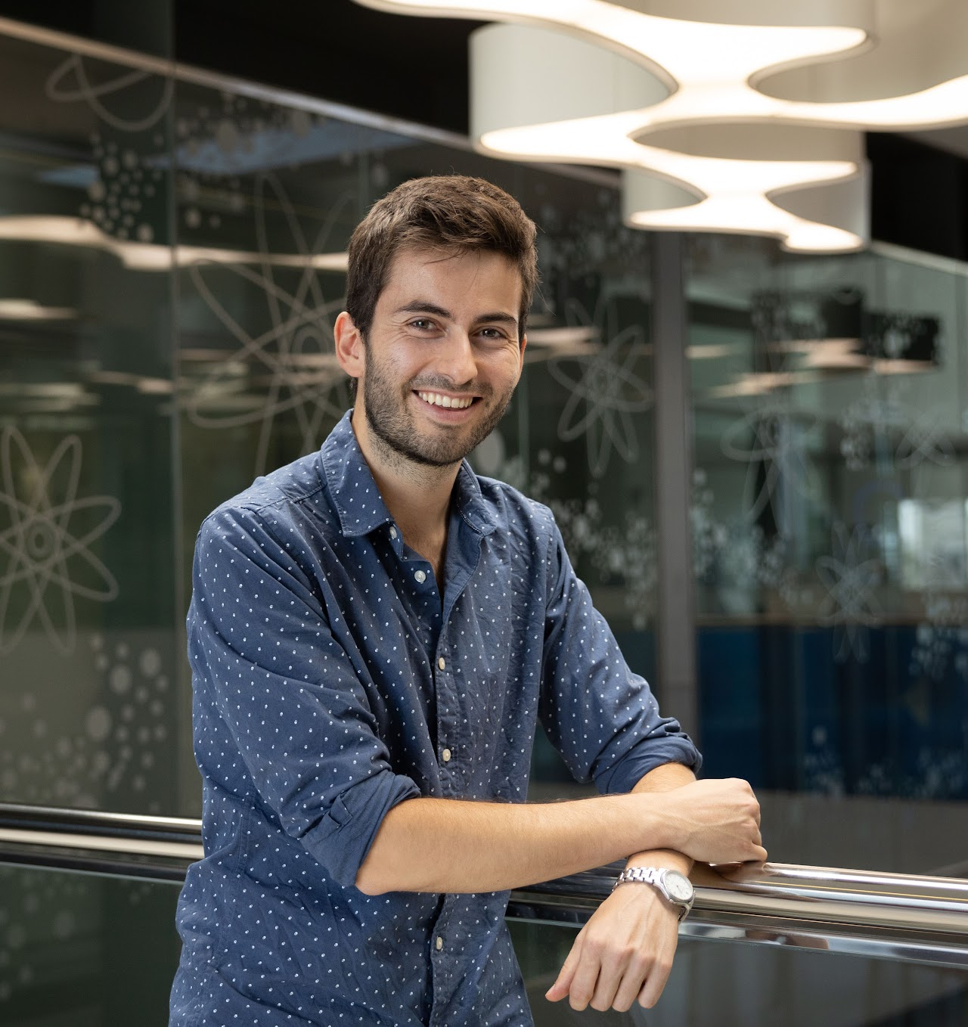
Attosecond physics, ultracold atoms and BEC

Slide 17
Attosecond physics, ultracold atoms and BEC

Slide 18
2. Quantum Thermometry

Slide 19
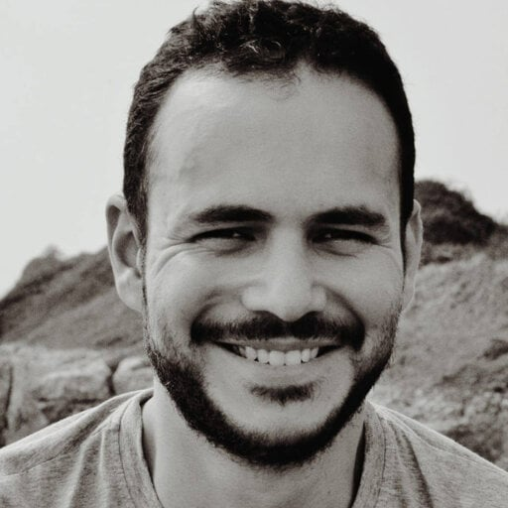
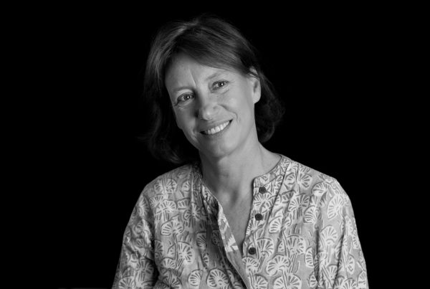
2.1. Optimal Quantum Thermometry
Luis A. Correa
Anna Sanpera

Slide 20
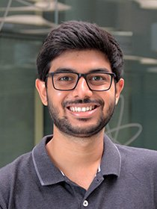
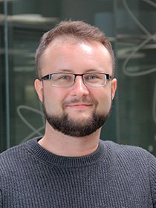
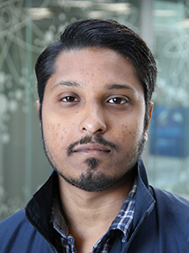
2.2 Topological Quantum Thermometry
Anubhav
Srivastava
Marcin
Płodzień
Utso
Bhattacharya

Slide 21
2.2 Topological Quantum Thermometry

Slide 22
3. Topological Bogoliubov Quasiparticles

Slide 23
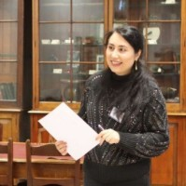
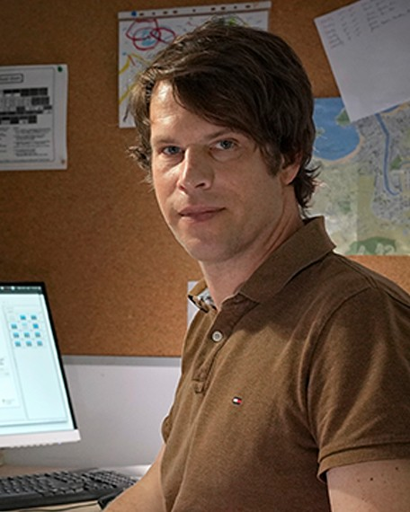
3.1. Bose-Einstein Condensate in a Flat Band System
Zahra Jalali-mola
Tobias Grass

Slide 24
3.1. Bose-Einstein Condensate in a Flat Band System
Zahra Jalali-mola
Tobias Grass

Slide 25
3.2 Non-zero and high Chern numbers, chirality

Slide 26
3.2 Anomalous fluctuations of BEC in optical lattices

Slide 27
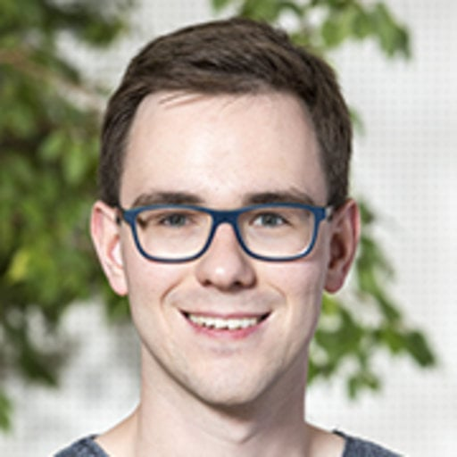

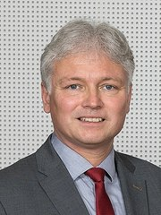
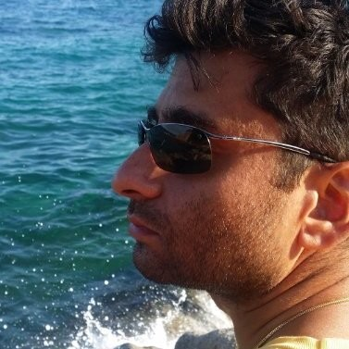
3.2 Anomalous fluctuations of BEC in optical lattices
Niklas Käming
Christof Weitenberg
Klaus Sengstock
Ravindra Chhajlany

Slide 28
3.2 Anomalous fluctuations of BEC in optical lattices

Slide 29
4. Haldane superfluid?
Yuma Watanabe, Ravindra W. Chhajlany, Maciej Lewenstein, Tobias Graß, Utso Bhattacharya
arXiv:2508.00377

Slide 32
Jian-Ping Lv and Z.D. Wang

Slide 34
Conclusions
Conclusions?
Enjoy physics and beyond!!!

