Slide 1


Tensor Network Approaches for Simulations of Larger Superconducting Circuits
Christian Hensel, Andrés N. Cáliz, Pau Torrente, María Hita-Pérez, Arnau Riera

Slide 2
Introduction
Notes:
hello

Slide 3
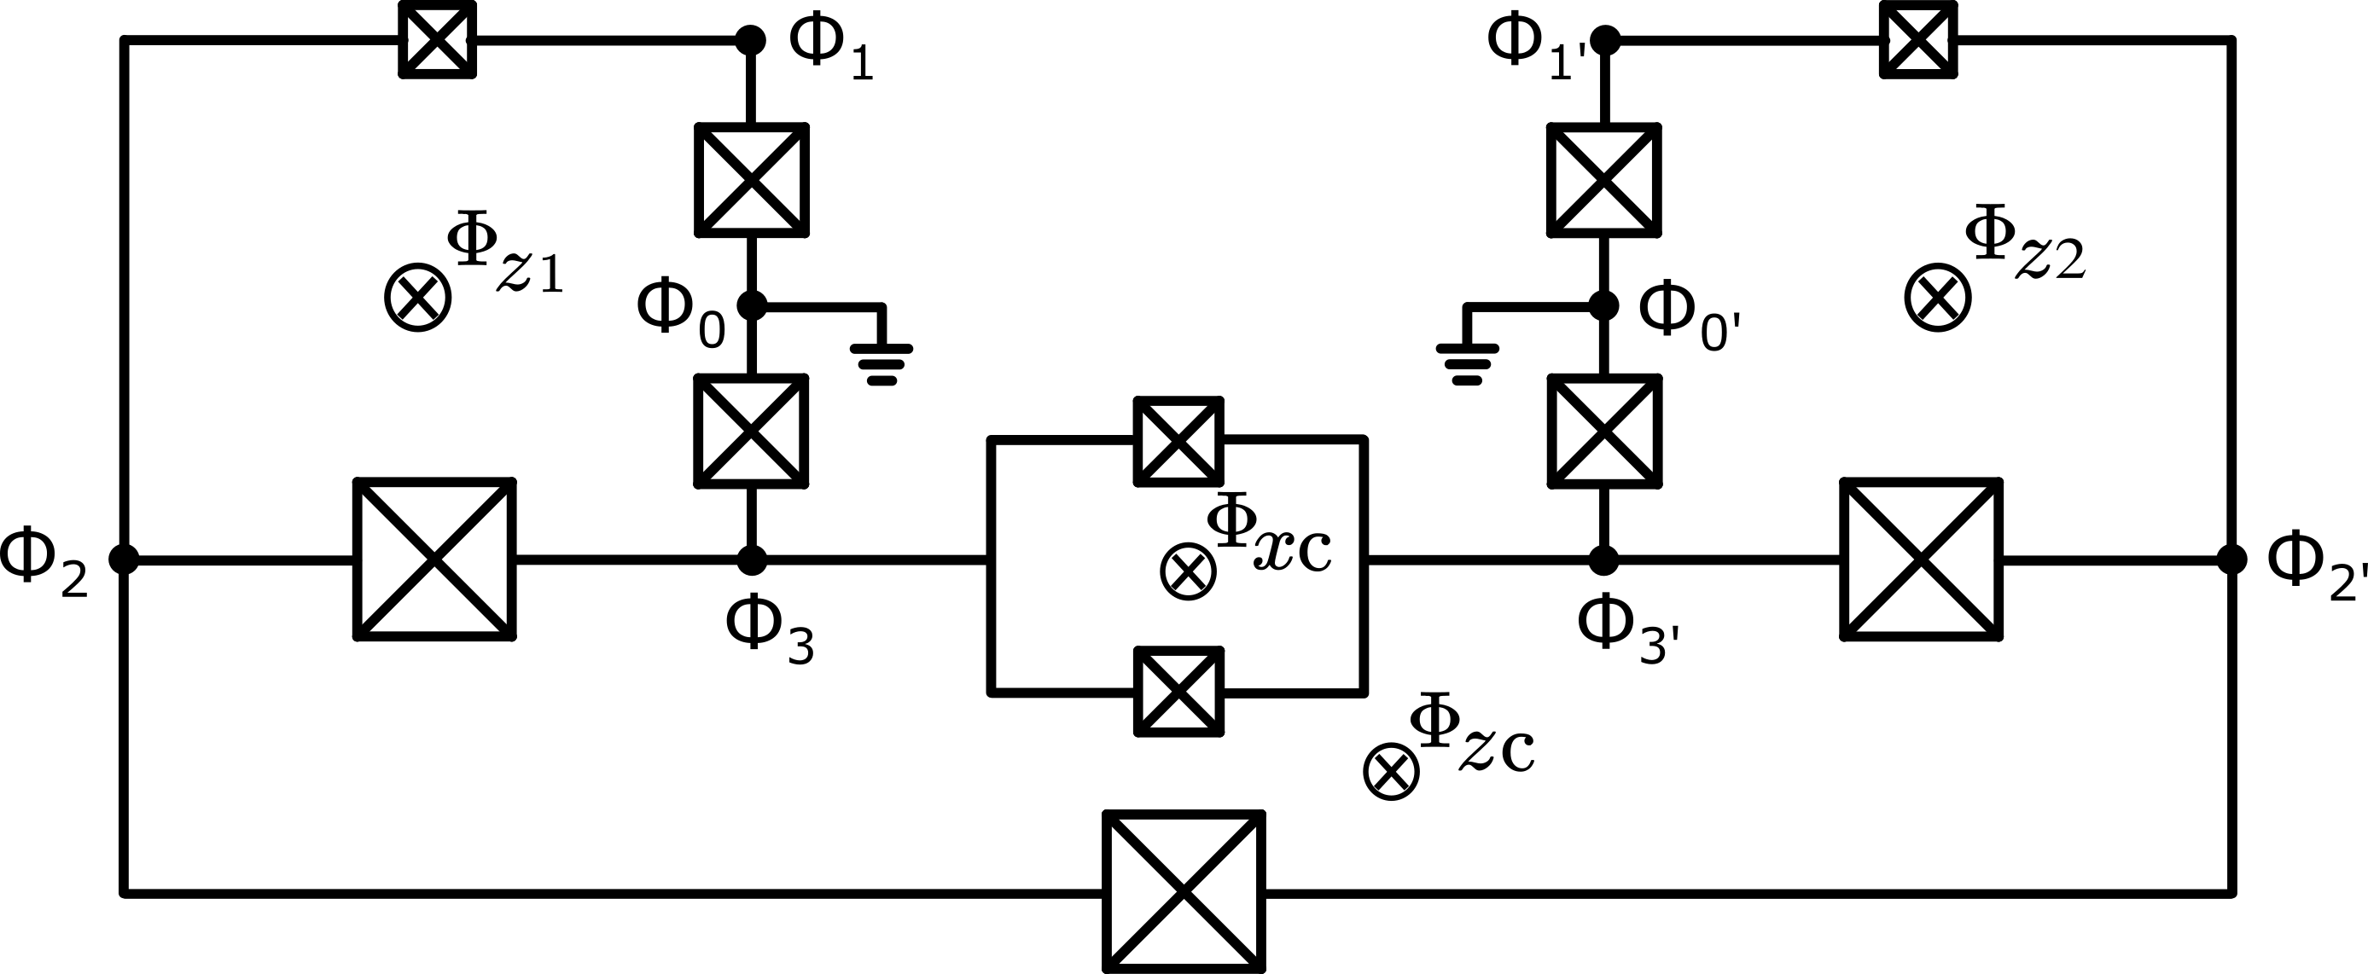

Problem: Simulation of a “larger” circuit
persistent current qubit: A
persistent current qubit: B
tuneable coupler
Circuit from Andrea’s Poster
explore strong coupling regime (e.g. for non-stoquastic effects)
Notes:
Explain
2 qubits, 1 coupler
Galvanically coupled
Inductivelly coupled
extra large Josephson Junctions as linear inductances
Tune x and z loops

Slide 4
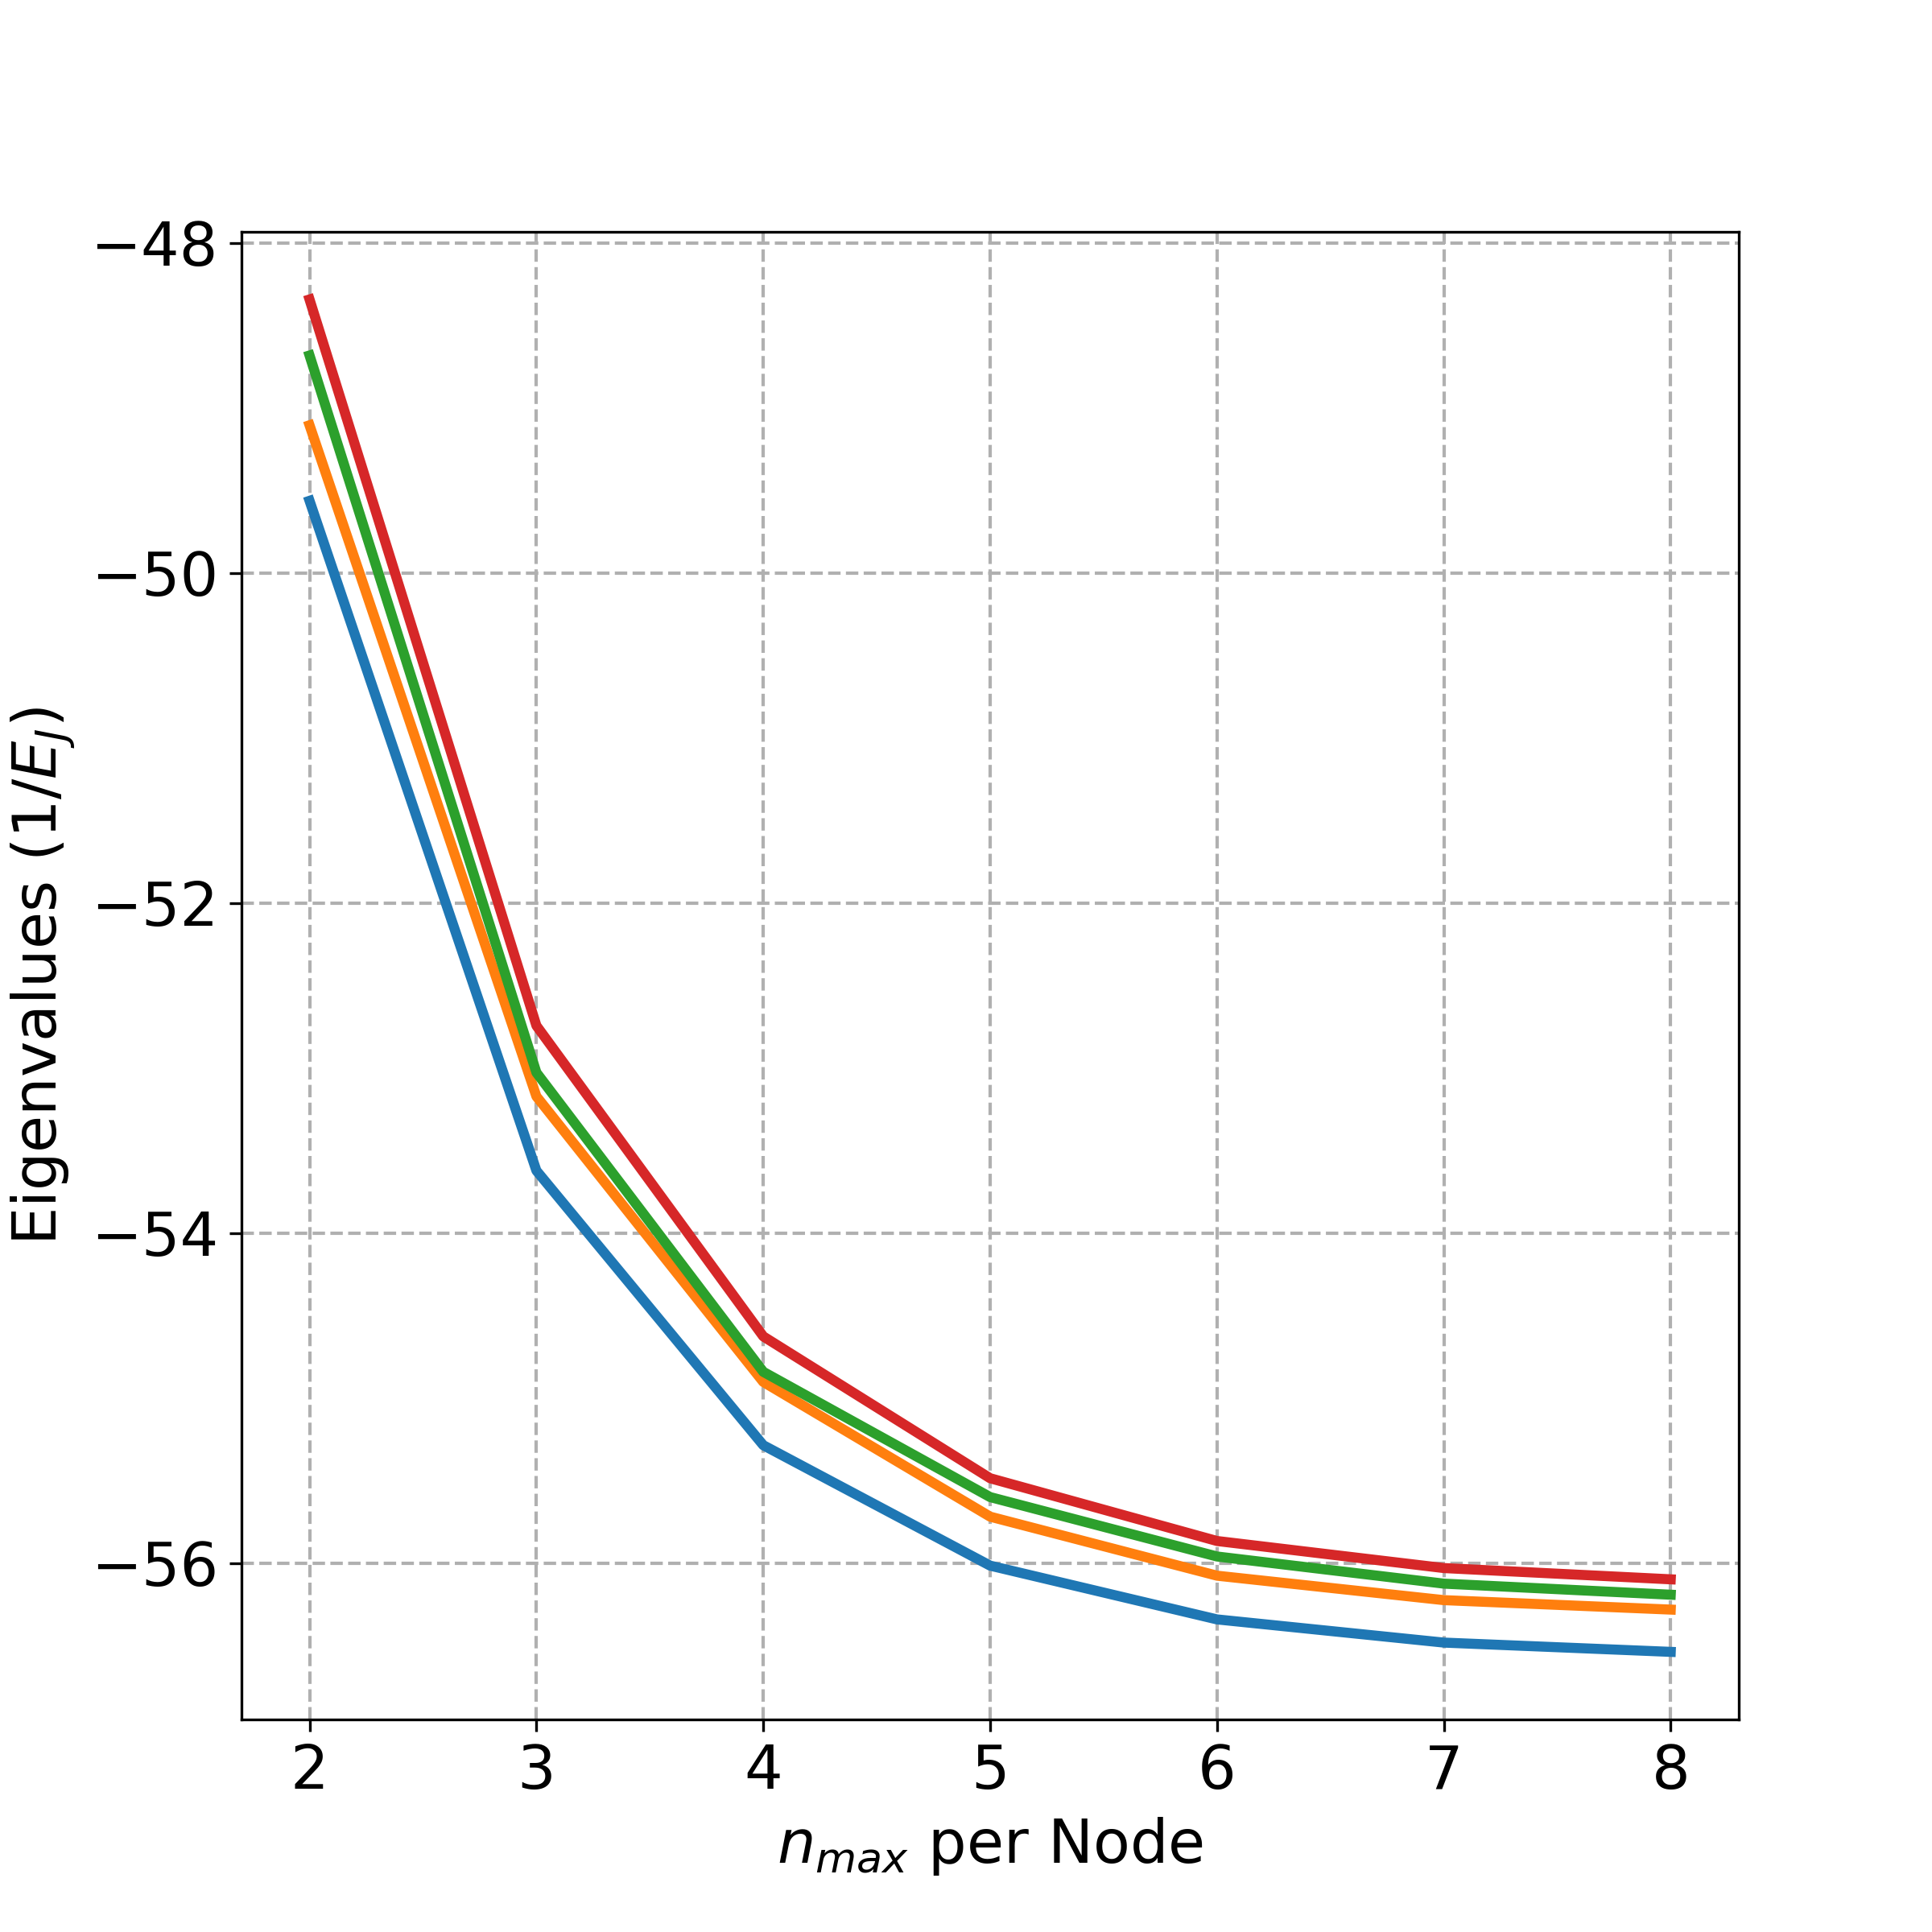
Problem: Simulation of a “larger” circuit
matrix representation must converge on a suitable basis (here charges per node)
But it does not converge
Notes:
Walk through plot
The representable number of charges per node has to be sufficient to capture the dynamics of the problem which means the matrix representation has to converge on a suitable basis (here charges per node)

Slide 5
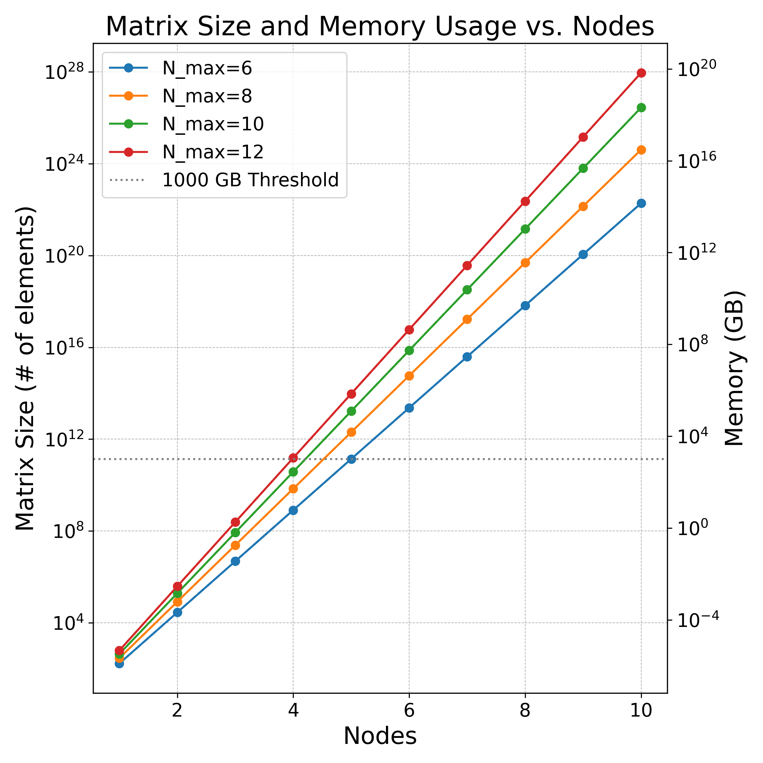
Bottleneck in exact diagonalisation
Our example run with 1 TB of RAM
orange star: maximum sparse matrix size reached
General
Exponential scaling
Limitation already for modest circuits
Notes:
Walk through plot

Slide 6
Discarded approximations
Born-Oppenheimer
only linear interaction of subsystems
need assumptions of the interaction mechanisms
typical inductive interaction but not capacitance interaction
Hierarchical diagonalisation [1]
Hamiltonians of the subsystems can get very large when capturing more coupling mechanisms
Do not capture strong coupling and all coupling terms.
[1] Kerman, Andrew J. “Efficient Numerical Simulation of Complex Josephson Quantum Circuits.” 2020 http://arxiv.org/abs/2010.14929.

Slide 7
Goal
Explore tensor networks techniques aiming to accurately simulate superconducting circuits of two qubits and beyond, considering strong coupling and revealing all coupling terms.

Slide 8
Method
Notes:
hello

Slide 9
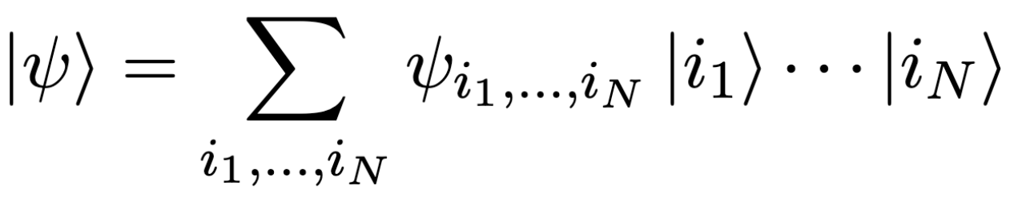
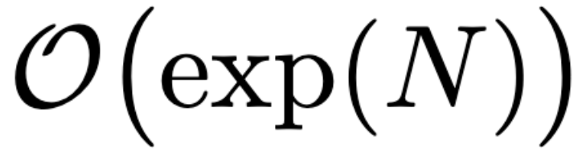
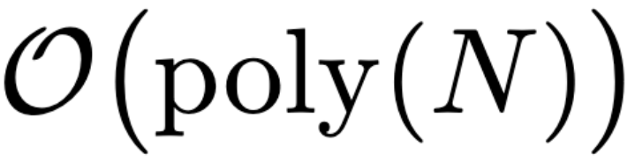
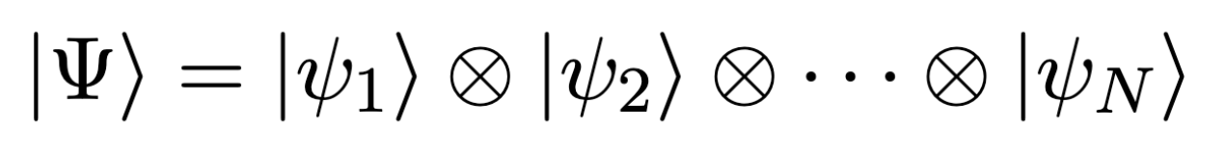
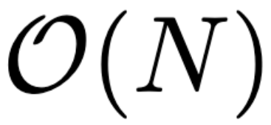
Why are we using Tensor Networks?
Generic entangled state
Specified by parameters
Tensor Networks: Product of simple objects
Some (very well tuneable) entanglement but still efficient
Product state (or unentangled state)
[4]

Slide 10
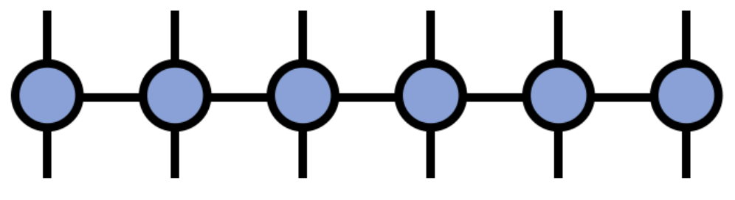
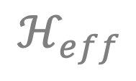

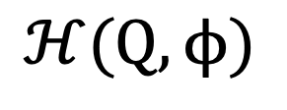
Workflow
$$ℋ(Q,ϕ)$$
Lumped Element Hamiltonian
MPO for each term in the Hamiltonian: OpSum in ITensors
Matrix Product Operator (MPO)
Density matrix renormalization group algorithm (DMRG)
Eigenvalues
Schrieffer Wolf Transformation (in tensor network framework)
$$ℋ_{eff}$$
Effective Hamiltonian
Work in Progress
Expansion in Pauli coefficients
$$J_{μν}$$
Coupling terms
[2] Di Paolo et al “Efficient Modeling of Superconducting Quantum Circuits with Tensor Networks.” 2021
[4] Tensors.Net, https://www.tensors.net/intro. Accessed 15 May 2025.

Slide 11
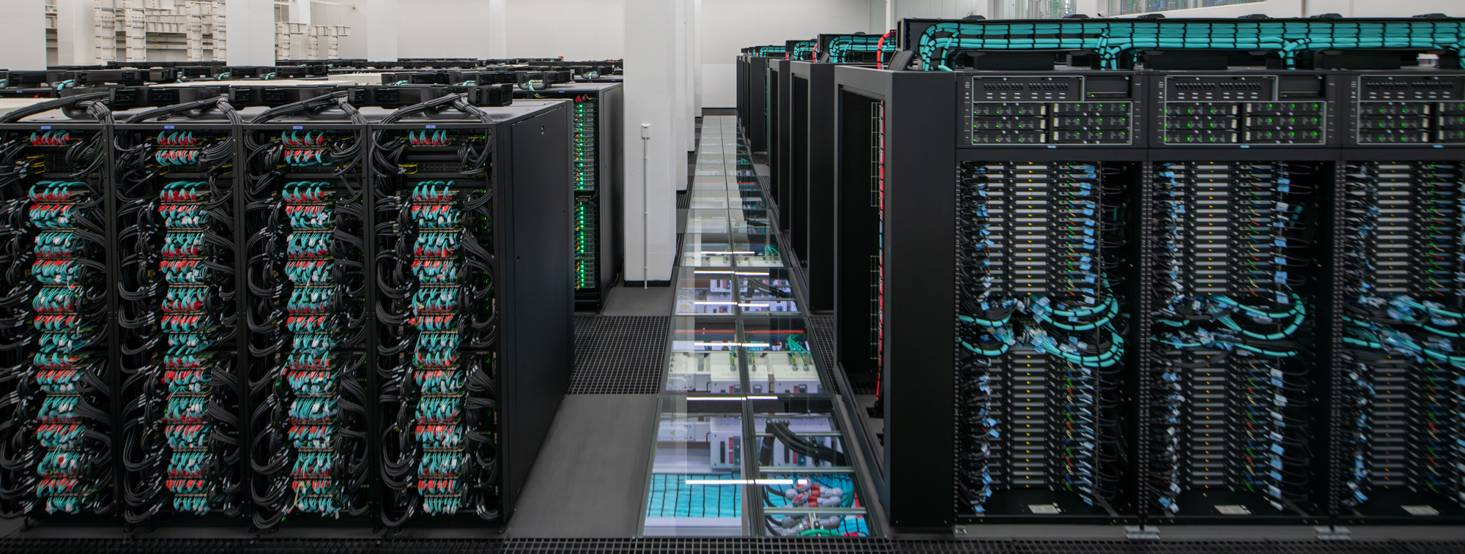
High Performance Computing
in Julia using ITensors library [3]
executing on CPUs, with GPU support
deployment multiple nodes on the Mare Nostrum 5 supercomputer for large-scale parallel simulations
[3] "The ITensor Software Library for Tensor Network Calculations", Fishman et al. 2022

Slide 12
Preliminary Results
Notes:
hello

Slide 13
Single persistent current qubit
Spectra of TN exactly and exact diagonalisation match exactly
Notes:
Walk through plot

Slide 14
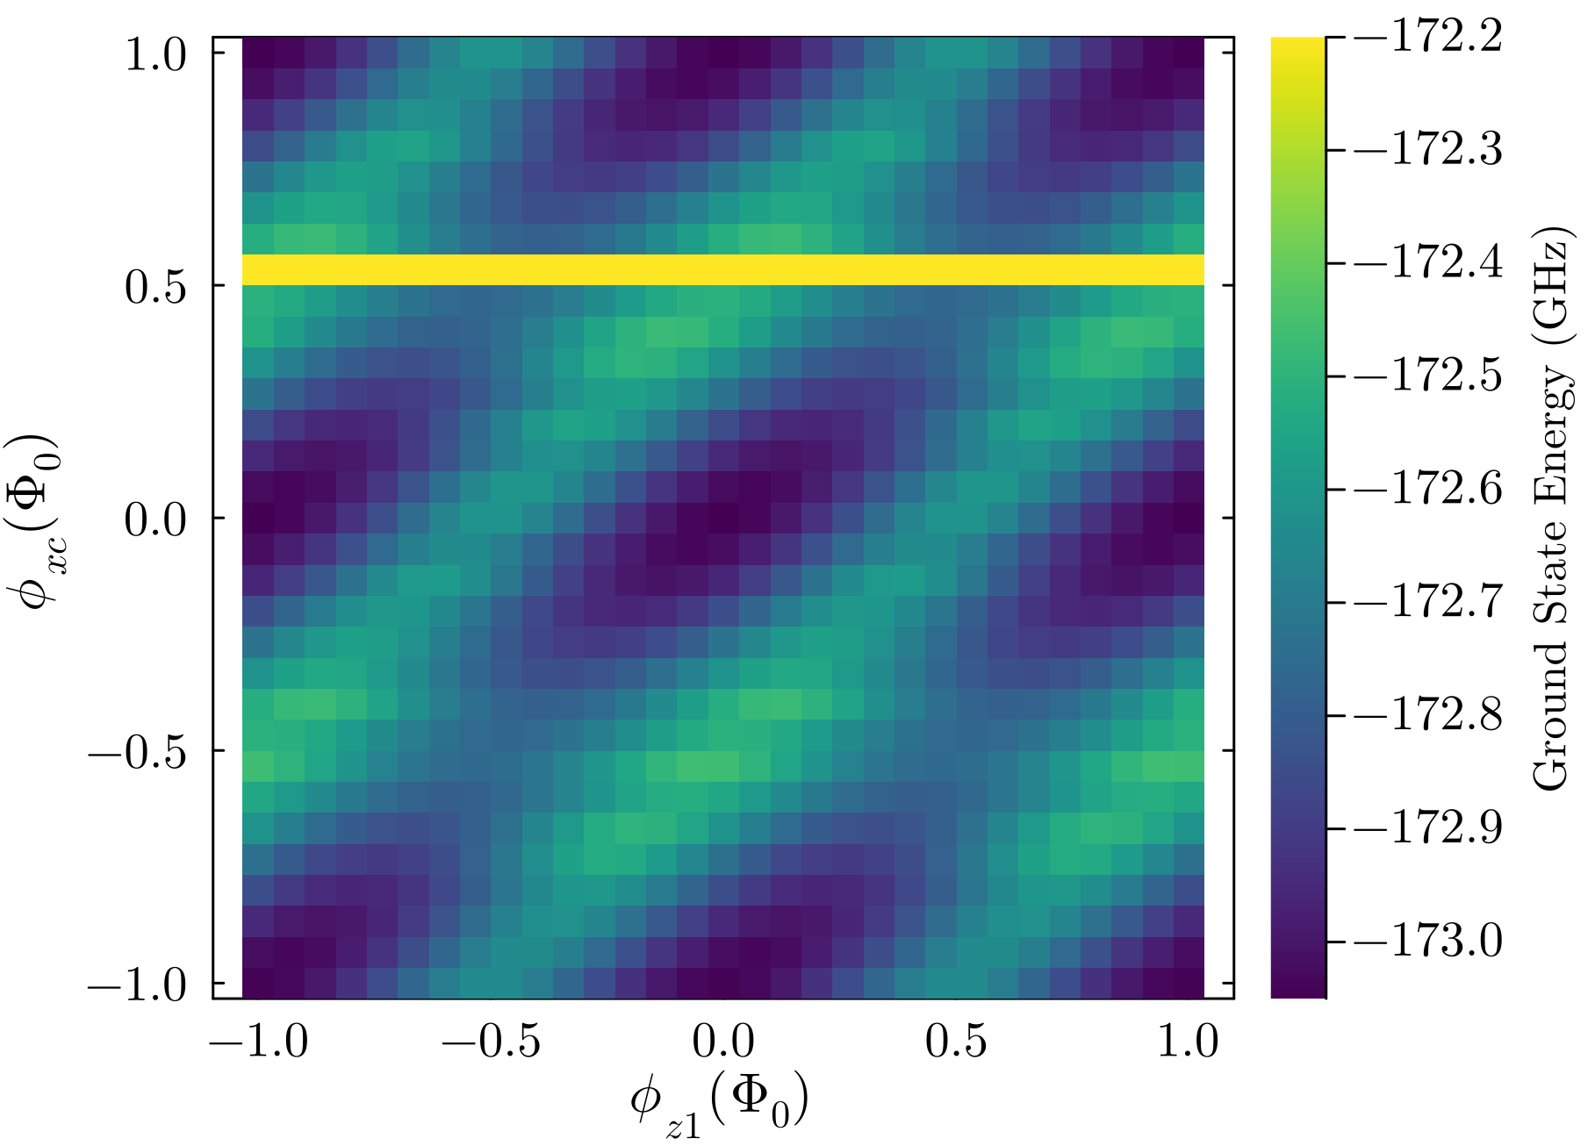
Two tuneable coupled persistent current qubits
Whole System Energy: SWT was not ready
Periodic Structure
Tilt Effect from crosstalk
Discontinuities: yellow line from a local minimum
Approx. 30 s per datapoint
Notes:
Walk through plot
Axis and external fluxes
Potential generates periodic structure
Notes:
(11*60)/(31*31) = 0,7 min per datapoint (calculating 2 eigenvalues and entaglement)

Slide 15
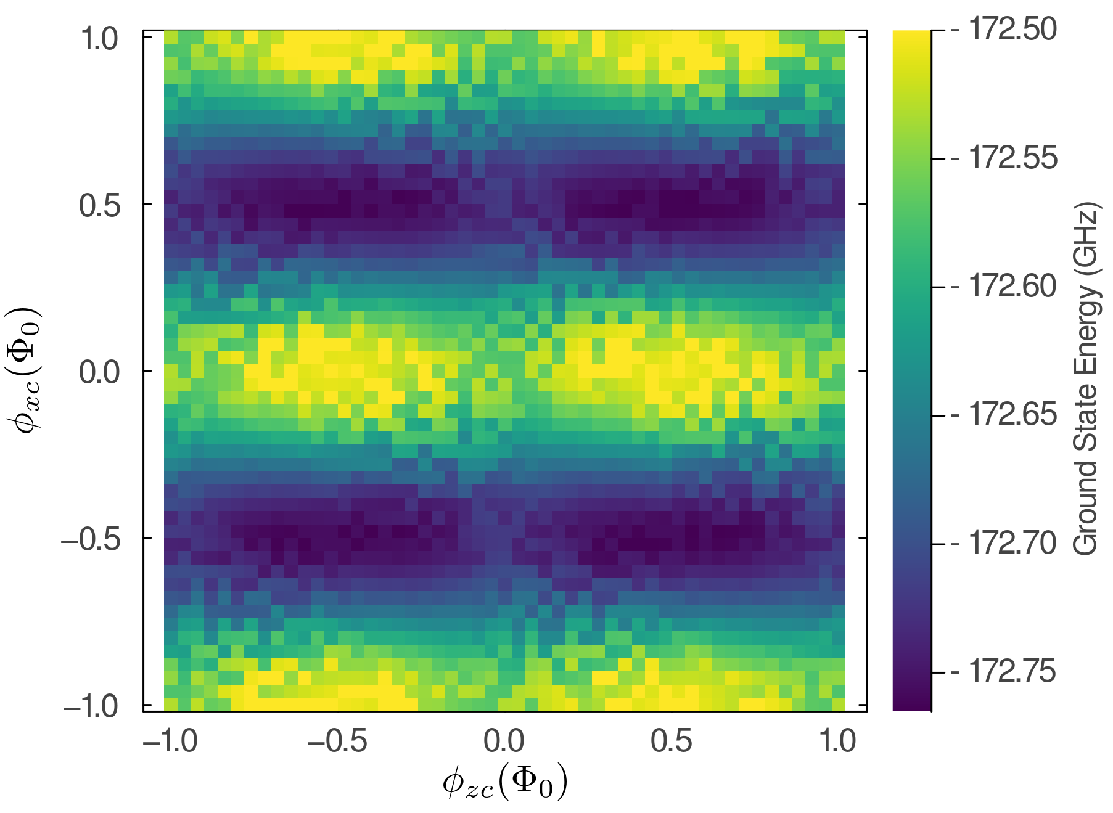
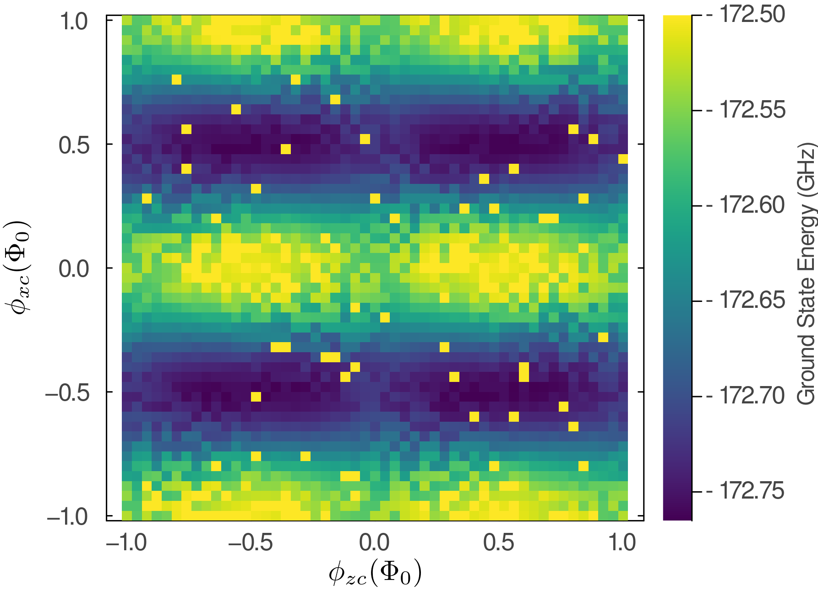
Two tuneable coupled persistent current qubits
Whole System Energy
Periodic Structure
wavefront propagation for increased parallelism.
Discarded many outliers
Notes:
Walk through plot
Axis and external fluxes
Potential generates periodic structure
3. Outliers: These local minima are not fully avoidable as DMRG is a variational method.
4. Periodic “Fireball” Structure: Visible in both axes, even clearer in slice plots
Notes:
(43*60)/(51*51) = 1 min per datapoint (also calculating higher eigenvalues and entaglement)

Slide 16
Outlook and Conclusion
Notes:
hello

Slide 17
Outlook
Refining to match with experimental results
Aid cross talk simulations (Andrea’s poster)
Schrieffer–Wolff transformation in the TN framework — likely reveal coupling terms that approximate methods miss [5]
Machine-learning strategies to mitigate local minima
Computational: improve efficiency and conclusive benchmark
Harnessing tensor network perspective (e.g. study entanglement, fine tune bond dimensions)
[5] Hita-Pérez et al “Three-Josephson Junctions Flux Qubit Couplings.” 2021

Slide 18
Conclusion
Scalable Framework: Designed, implemented, and are currently validating a methodology to break through computational bottlenecks in larger, strongly coupled circuits.
Preliminary Proof of Concept: Our method surpass the computational limits of exact diagonalization.

Slide 19
Acknowledgment and References
The authors thankfully acknowledges RES resources provided by Barcelona Supercomputing Center in Mare Nostrum 5 to FI-2025-1-0043.
Kerman, Andrew J. “Efficient Numerical Simulation of Complex Josephson Quantum Circuits.” 2020 http://arxiv.org/abs/2010.14929.
Di Paolo, Agustin, Thomas E. Baker, Alexandre Foley, David Sénéchal, and Alexandre Blais. “Efficient Modeling of Superconducting Quantum Circuits with Tensor Networks.” 2021 https://doi.org/10.1038/s41534-020-00352-4.
"The ITensor Software Library for Tensor Network Calculations", Matthew Fishman, Steven R. White, E. Miles Stoudenmire, 2022
Tensors.Net, https://www.tensors.net/intro. Accessed 15 May 2025.
Hita-Pérez, María, Gabriel Jaumà, Manuel Pino, and Juan José García-Ripoll. “Three-Josephson Junctions Flux Qubit Couplings.” 2021, https://doi.org/10.1063/5.0069530.

Slide 20

chris.hensel@qilimanjaro.tech
23/05/2025
www.qilimanjaro.tech
Copyright © 2025 Qilimanjaro

Slide 21
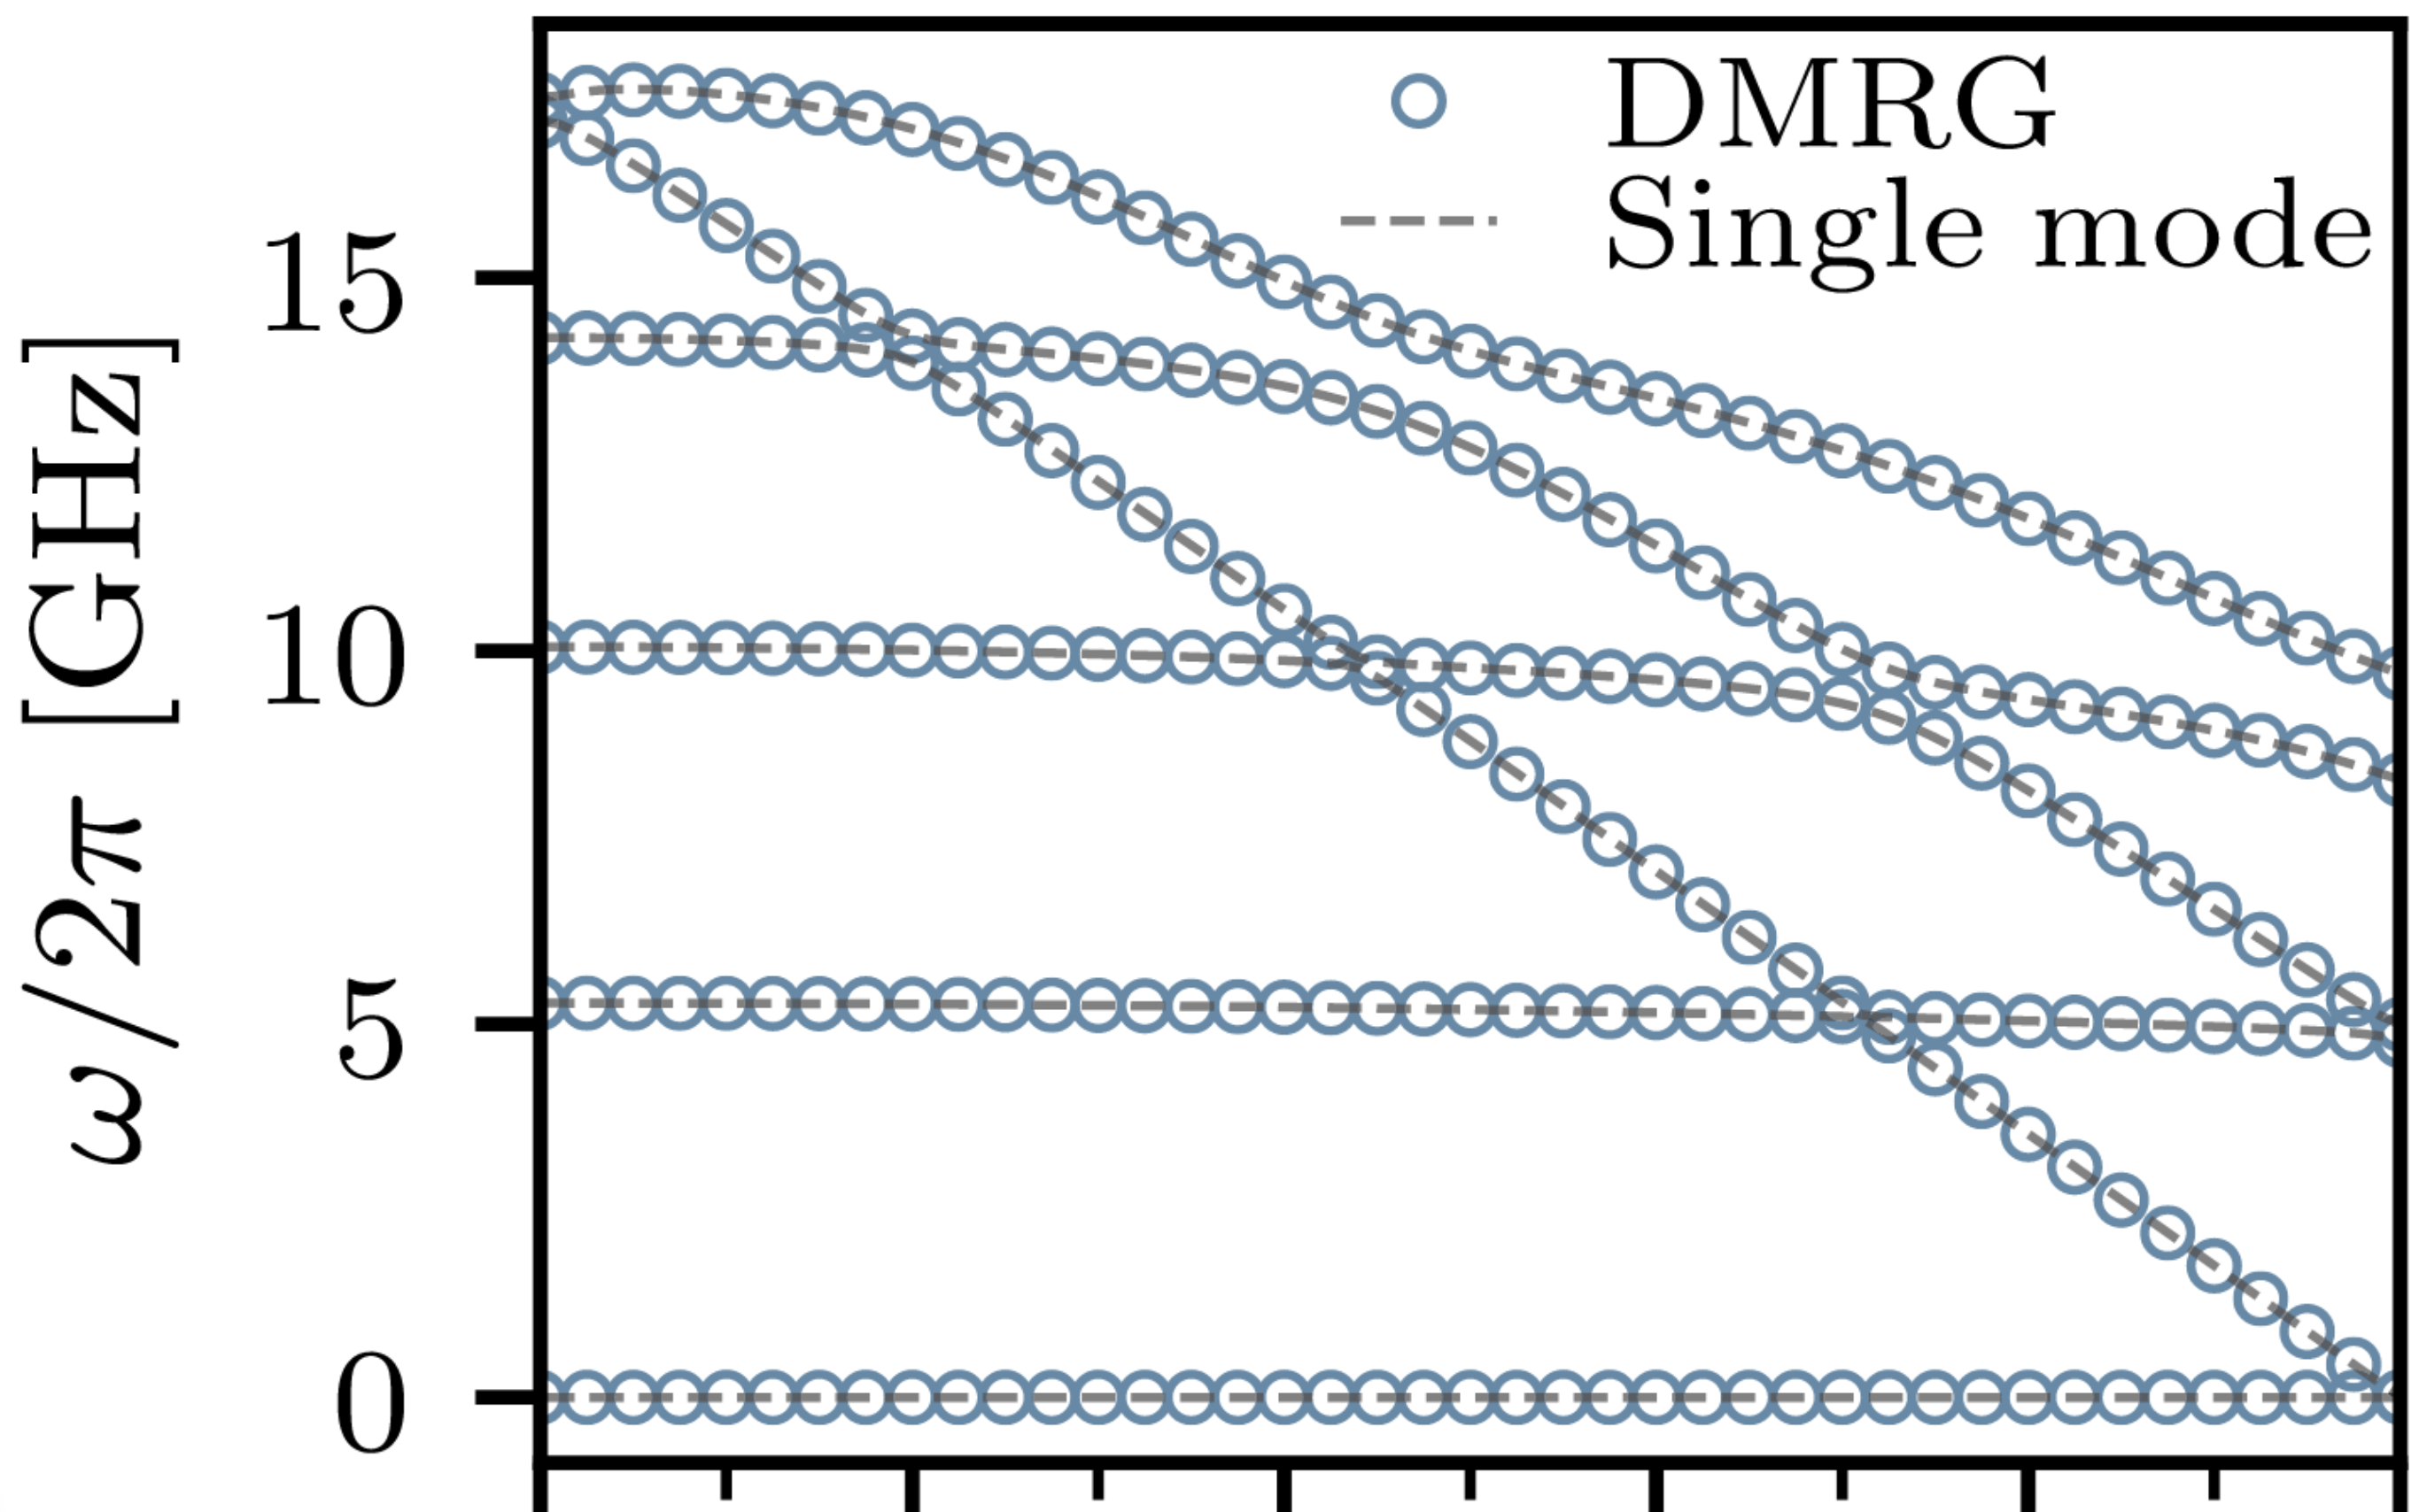
Previous Work
“Efficient Modeling of Superconducting Quantum Circuits with Tensor Networks.” Di Paolo et al. 2011 [2]
Applied to Fluxonia

Slide 22
Possible harnessing the tensor network perspective
insight from the many body perspective on coupled superconducting circuits
e.g. entanglement
Easily tune computational cost vs accuracy of the model (via bond dimension)

Slide 23
Outline
Introduction
- Studied circuit
- Computational bottleneck
- Limitations of the approximations
2. Method
- Why are we using Tensor Networks?
- Workflow
3. Preliminary results
- Single persistent current qubit
- Two tuneable coupled persistent qubit
4. Outlook and Conclusion

Slide 24
Hamiltonian of the full circuit

Slide 25
MPO construction with OpSum

Slide 26
DMRG

Slide 27
Schrieffer Wolf Transformation

Slide 28
Expansion in Pauli coefficients

Slide 29
All FQ3JJcoupledx results
All results from the demo

