Slide 1







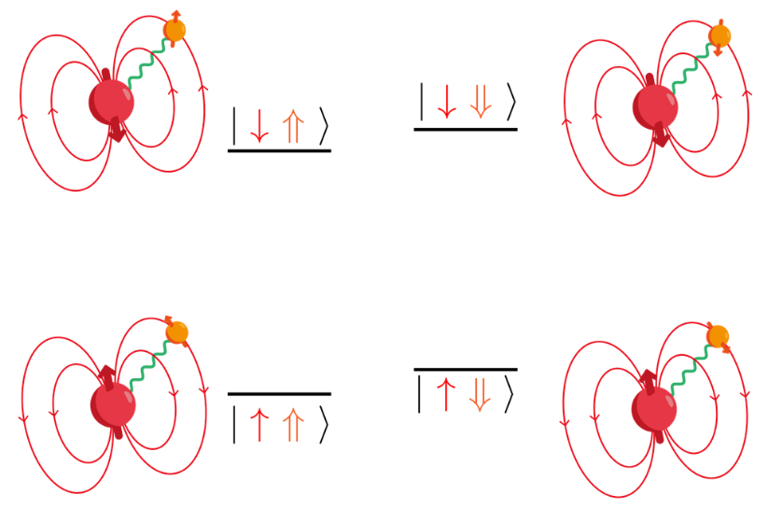
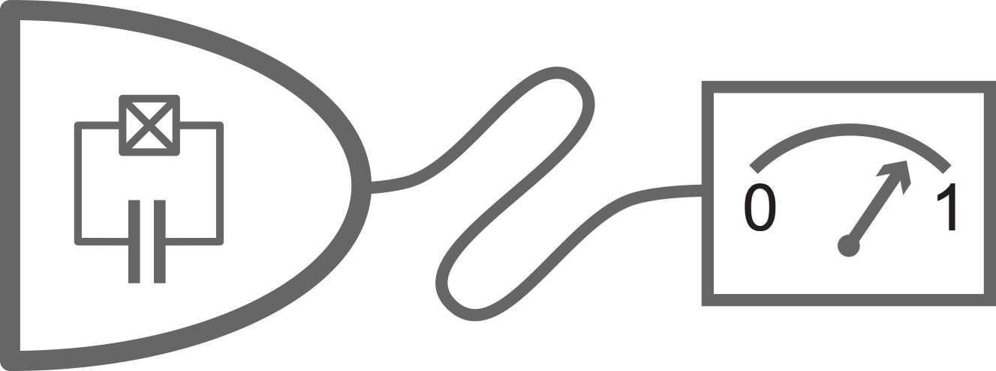
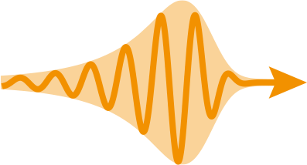
click
Superconducting Parallel-Plate Resonators
for Single-Spin Detection
A. Pscherer, Patrick Abgrall, J. O’Sullivan, E. Flurin, P. Bertet
Quantronics group, SPEC, CEA, Université Paris-Saclay
Notes:
It’s my pleasure to present the latest results of our Quantronics group at CEA Saclay. As the title says, we use single Er ions to sense and control individual nuclear spins, but as you have to infer from the session name, we do it with all-microwave control.

Slide 2
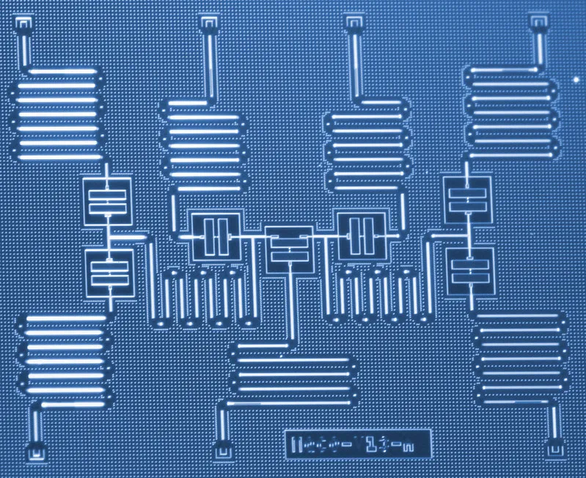
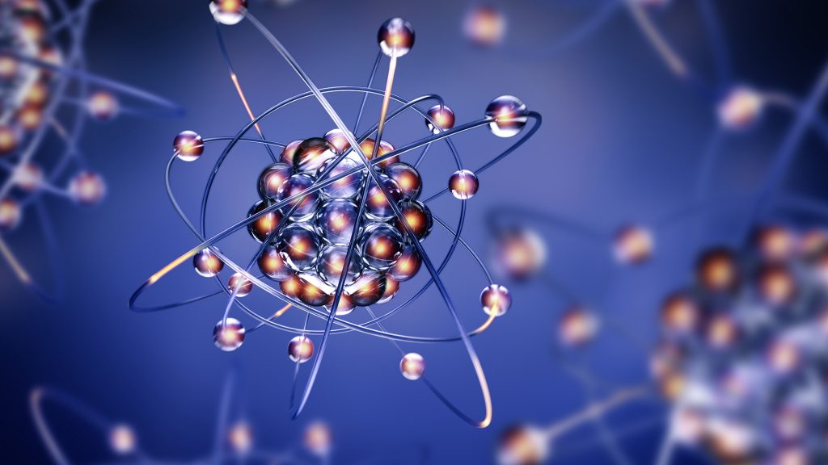
Hybrid spin–microwave systems
Microwave circuits
  high level of control
    resonance frequency
    coupling strength
  exploring the limits of scalability
  but: limited coherence time
Natural atoms
  long coherence time
  small size
  but: not designed as you like
Notes:
Anyone working in quantum information science can hardly miss all the progress in superconducting qubit circuits. This field could evolve so quickly, because it is possible to design the artificial atoms in whatever way you want, giving them the right resonance frequencies and coupling strengths to each other. However, here the challenge is in reaching long coherence times.
On the other hand natural atoms are much smaller and can achieve very long coherence times, in particular the nuclear spin degree of freedom.
Our system tries to use the advantages of both worlds by using superconducting microwave circuits to control single Er ions, which in turn control single nuclear spins.

Slide 3
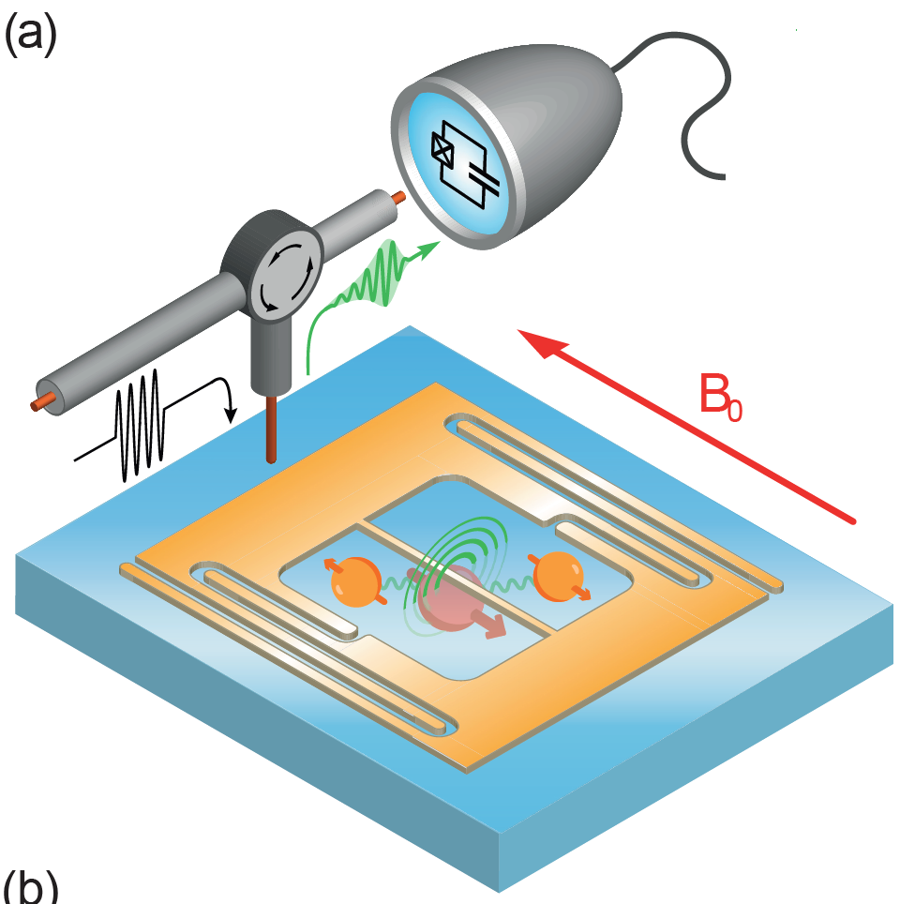
Experimental setup overview
SMPD
Resonance fluorescence
Microwave pulse in
Er³⁺ ion with nearby nuclear spins
Superconducting
resonator
CaWO₄ crystal
Notes:
This is a sketch of our base experimental scheme: We send a microwave pulse into a super conducting resonator on top of an Er-doped calcium tungstate crystal. The resonator consists of an interdigitated-fingers capacitor and a nanowire inductor. The nanowire concentrates the magnetic field of the resonator mode in a very small volume and thereby drives magnetic dipole transitions of the Er electron spin. The resonance fluorescence is emitted into the same resonator and sent to a single microwave photon detector, which was recently developed in our group.

Slide 4
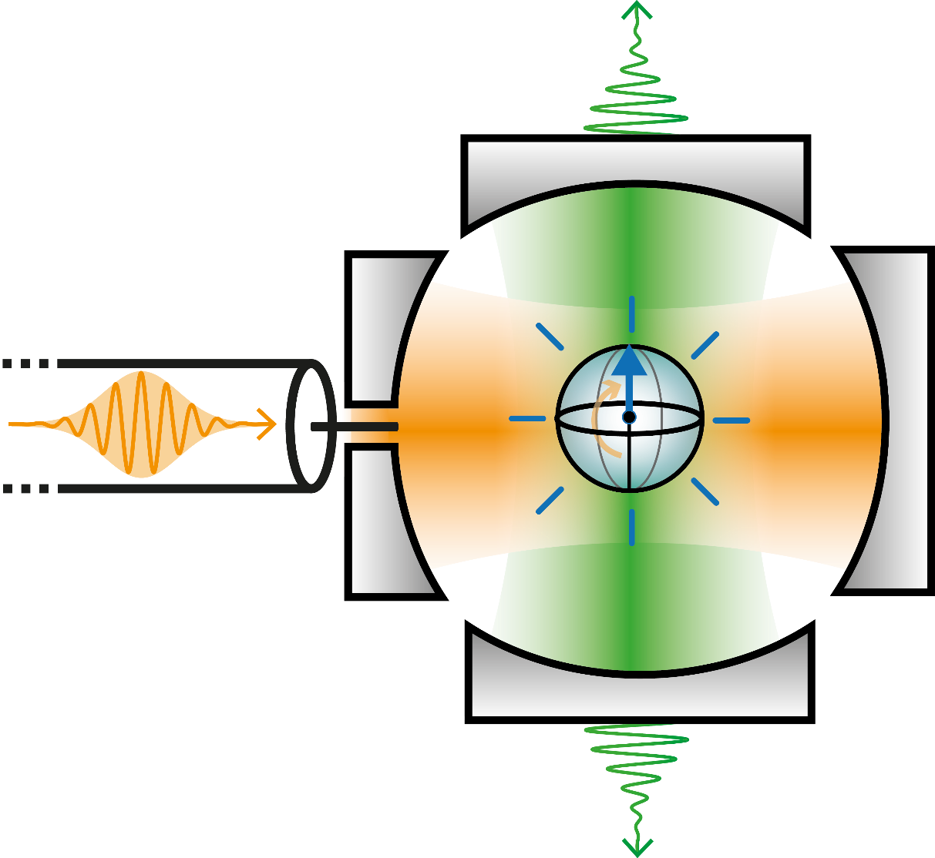
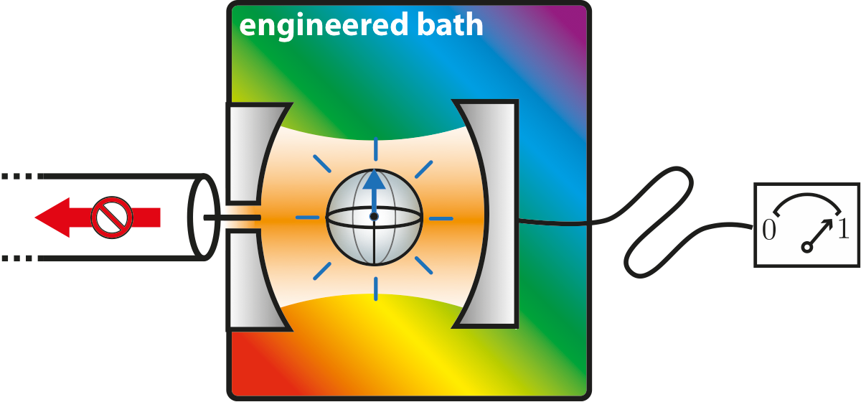
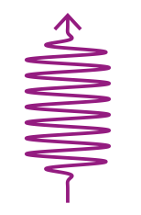





SMPD principle
$$ω_{b}$$
$$ω_{q}$$
$$ω_{a}$$
$$ω_{a}+ω_{p}=ω_{q}+ω_{b}$$
$$ω_{p}$$
K. Inomata et al. Nature com (2016)
J.-C. Besse et al. Phys. Rev. X (2018)
Kono, S, et al. Nature Physics 14.6 (2018)
Opremcak, A., et al., Science 361.6408 (2018)
R. Lescanne et al., PRX (2020)
Notes:
Now that we have this 4 wave mixing process, we can engineer the dissipation of the additional output cavity so that the photons inside are fastly dissipated in the environnement. The absence of phtons in the green cavity damps the second term in the hamiltonian. SO the effective evolution of the system is now non-unitary and irresversible. We managed to trap the incoming photon in a qubit excitation.
And to complete the detection, we just have to measure the state of the qubit. this state will give us information on the arrival or not of a photon.

Slide 5
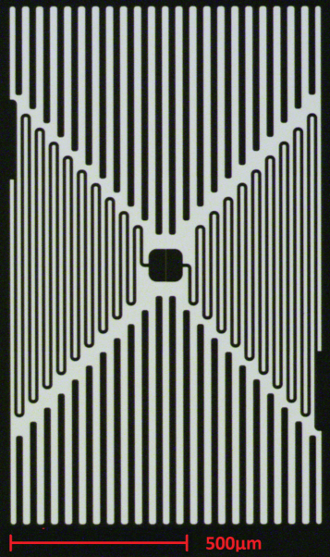
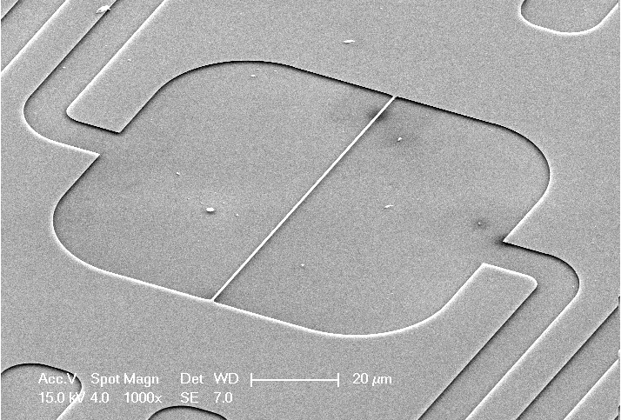
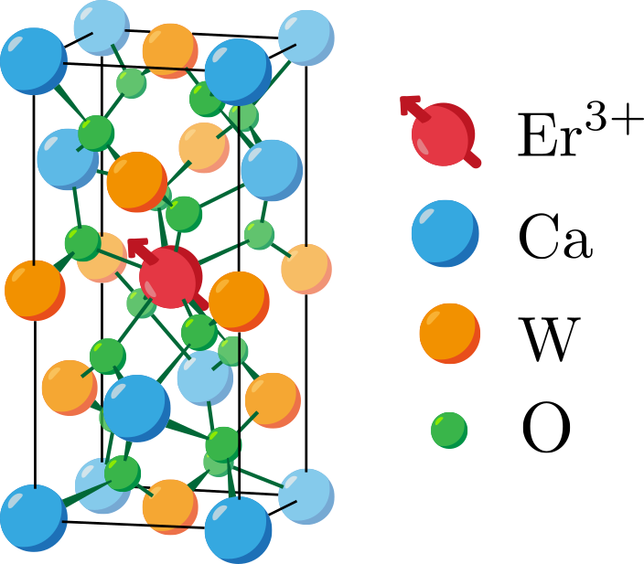
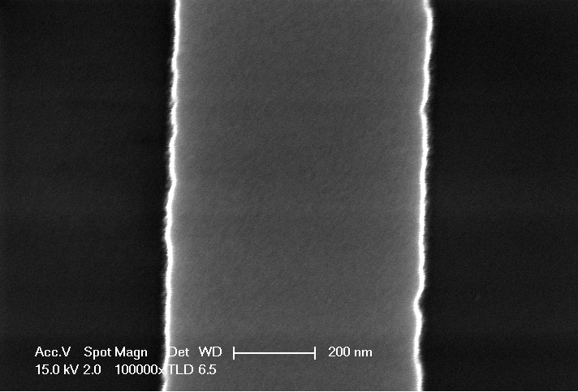
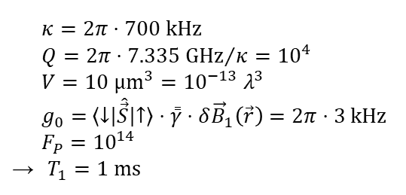


Nanowire resonator on CaWO₄
Free space:
$T_{1}={10}^{11} s$
$≈{10}^{4}$ PhD durations
$κ=2π⋅700 kHz$
$Q={2π⋅7.335 GHz}/κ={10}^{4}$
$V=10 {µm}^{3}={10}^{−13} λ^{3}$
$g_{0}=$ $\left\langle \left.↓\right|\right.\hat{\vec{S}}\left.\left|↑\right.\right\rangle ⋅\overset{̿}{γ}⋅δ{\vec{B}}_{1}\left(\vec{r}\right)=2π⋅3 kHz$
$F_{P}={10}^{14}$
$T_{1}=1 ms$
100μm
600nm
Notes:
Here is how the Purcell factor is achieved: The crystal is black, and the bright structures are a 50 nm thick superconducting film of niobium. Most of the area is taken up by the capacitor of this LC-resonator. If you look closer, you will find that the only connection between the two halves is through this thin nanowire. So, all the current is funneled through this narrow inductor. The Er electron spins in the near-field of this inductor couple to it magnetically as you can see in this coupling strength map.
The linewidth of the resonator is 700 kHz, which corresponds to a Q factor of 10^4, not extraordinarily high when aiming for a high Purcell factor. The important quantity is the extremely small mode volume on the order of 10 µm³, which is 13 orders of magnitude smaller than a cubic wavelength. The coupling of a typical nearby spin is on the order of 3kHz, which means a Purcell factor of 10^14, reducing the radiative lifetime down to 1ms.

Slide 6



Single Er³⁺ spins
Narrow reproducible peaks
$${\left(\begin{matrix} & & \\ & & \end{matrix}\right)}^{N}$$
$$〈C〉$$
2ms
$$B_{0} (mT)$$
Z. Wang et al., Nature (2023)
Notes:
As I mentioned, the scheme is to send a microwave pulse into the resonator and then integrate the resonance fluorescence. If we repeat this often enough and sweep the magnetic field strength we see narrow reproducible peaks standing out of the shot noise and dark counts. This has been published in Nature last year, if you want to know more.

Slide 7
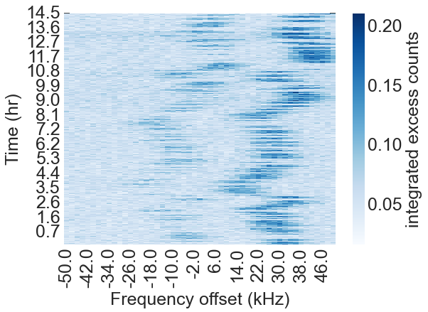
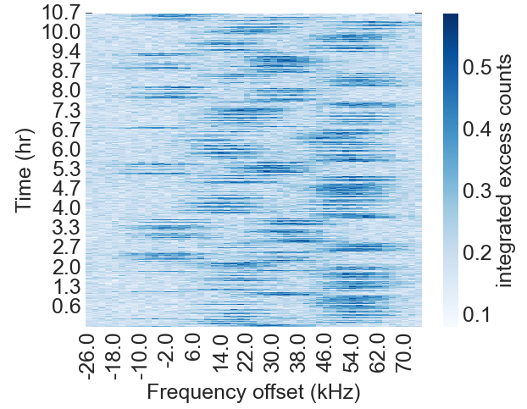
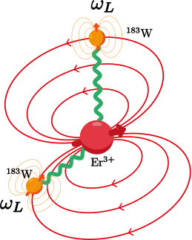






Two selected Er³⁺ ions
Chantal: one ¹⁸³W
Edith : two ¹⁸³W
14
10
$$|↑_{S}↓_{I}〉$$
$$|↑_{S}↑_{I}〉$$
Time (hrs)
Time (hrs)
7
5
0
0
$$|↓_{S}↓_{I}〉$$
-50
0
50
-50
0
50
Frequency, $ω−ω_{0}$ (kHz)
Frequency, $ω−ω_{0}$ (kHz)
$$|↓_{S}↑_{I}〉$$
Long-lived qubit
J. Travesedo, J. O’Sullivan et al., Sci. Adv. (2025)
Notes:
Lately, after some optimization, we performed high-resolution spectroscopy on the sample and found that many ions jump between different resonance frequencies over time. This is because nearby nuclear spins change their state. Here is a selection of one Er ion coupled to 1 such strongly influential nuclear spin, we call it Chantal, and another Er ions with 2 such nuclear spins nearby, we call it Edith. In the following part of the talk, I will elaborate on our efforts on using the nuclear spins as long-lived qubit registers.

Slide 8
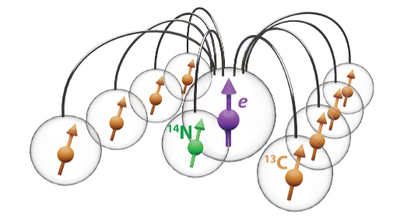

Perspectives (1): Quantum Computing
NV centers
10-¹³C-nuclear-spin register
J. O’Sullivan, J. Travesedo et al.,
arXiv 2410.10432
Nuclear state readout
Nuclear state initialization
Coherent single spin gates
Long coherence time
2-qubit gates
C. E. Bradley, Phys. Rev. X (2019)
Notes:
The plan for scaling up is to use several Er ions with their nuclear spin registers on the same resonator. These can be interconnected by spin-spin interactions between the Er ions, either mediated by their near-field in densely doped samples or through the resonator mode, once we increased the coupling. In fact, increasing the coupling strength and decreasing the resonator losses are among the current efforts to improve the system.

Slide 9
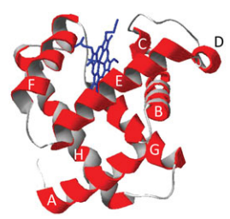
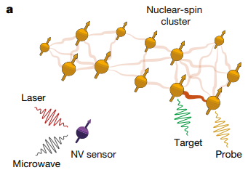
Perspectives (2): Single-spin ESR spectroscopy
Single-electron spin addressing enables
atomic-scale imaging of surrounding nuclear spins
Up to 50 nuclear spins in diamond (¹³C atoms) using a NV center single-spin sensor !
Fe³⁺
Metmyoglobin
protein
Taminiau group
Abobeih et al., Nature (2019)
Van de Stolpe et al., arxiv (2023)
Notes:
Another completely different perspective for this system is to use it to resolve the locations of nuclear spins around the Er ion, or actually any paramagnetic center. The feasibility of this has been shown with NV centers in diamond. The advantage of our system over NV centers is that our system does not require an optical transition, but only the unpaired spin. And that is pretty much the definition of the paramagnetic center.

Slide 10
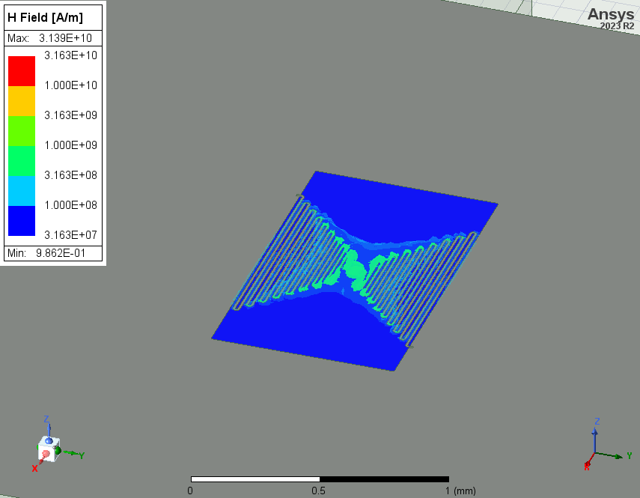
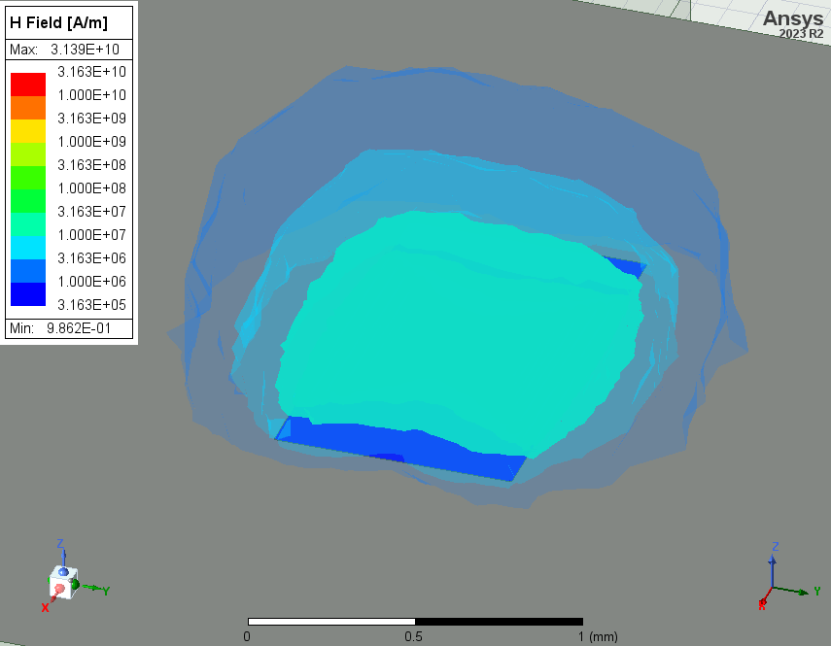
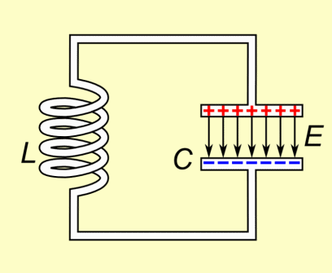
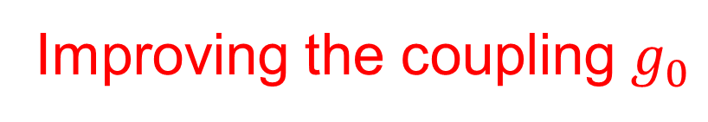
Improving the coupling $g_{0}$
$$g_{0}= \left\langle \left.↓\right|\right.\hat{\vec{S}}\left.\left|↑\right.\right\rangle ⋅\overset{̿}{γ}⋅{\vec{B}}_{zpf}\left(\vec{r}\right) \sim I_{zpf}$$
Energy of the ZPFs $\frac{1}{2}ℏω_{r}$
half of it is inductive energy $\frac{1}{4}ℏω_{r}=\frac{1}{2}L{I_{zpf}}^{2}$
$$⇒ I_{zpf}=\sqrt{\frac{ℏω_{r}}{2L}}$$
$$L=300 pH$$
$$I_{zpf}=91 nA$$

Slide 11
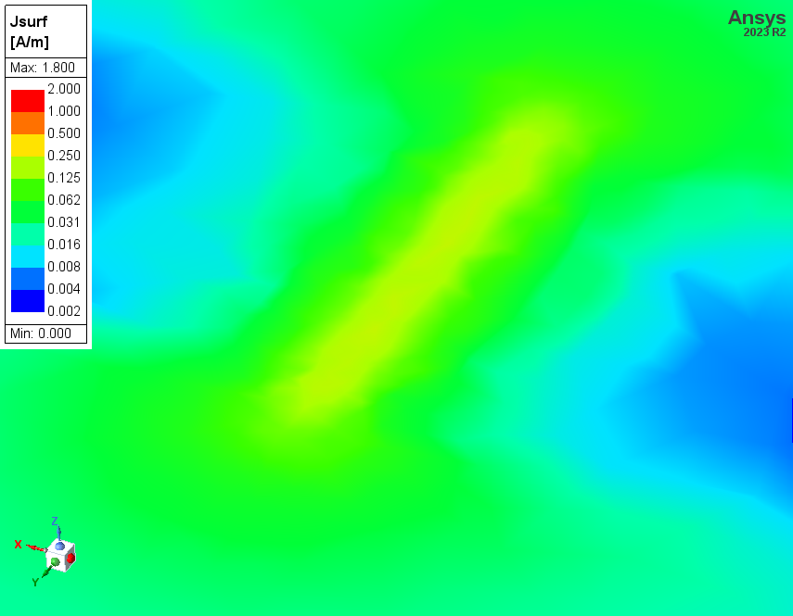
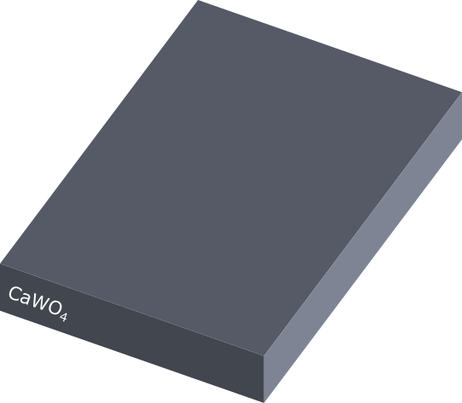
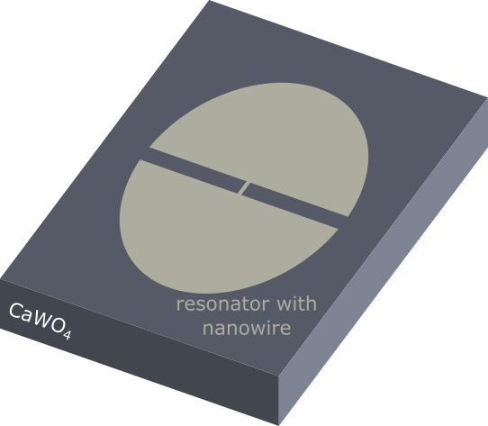
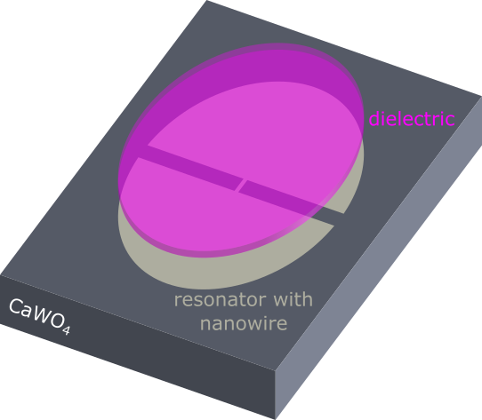
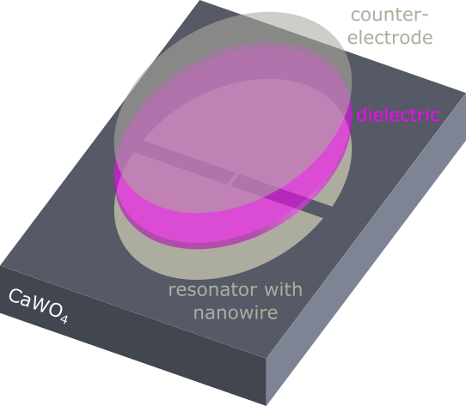
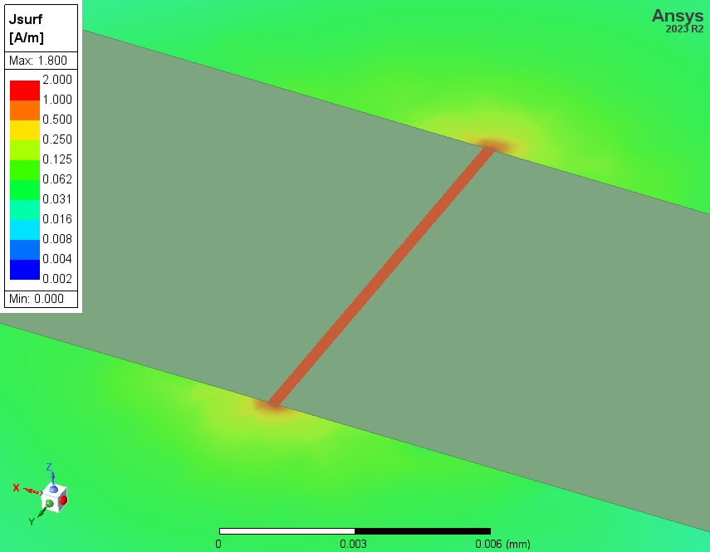
Parallel plate resonator design
counter-
electrode
nanowire

Slide 12
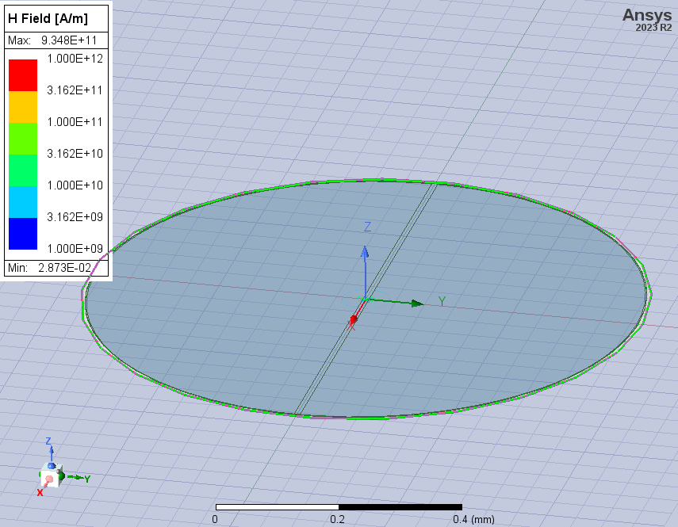
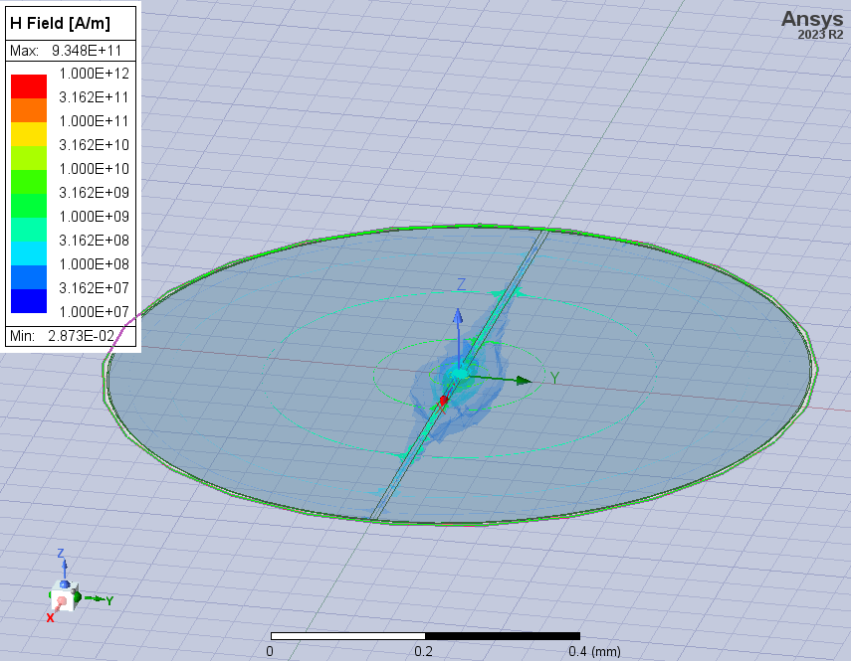
Parallel plate resonator design
$$L=300 pH$$
$$L=13 pH$$
$$I_{zpf}=91 nA$$
$$I_{zpf}=430 nA$$
$5×$ higher $g_{0}$
$25×$ higher $F_{P}$
together with
$4×$ decrease of $κ$
$→100×$ increase of $F_{P}$

Slide 13
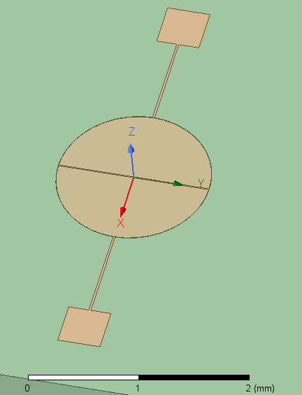
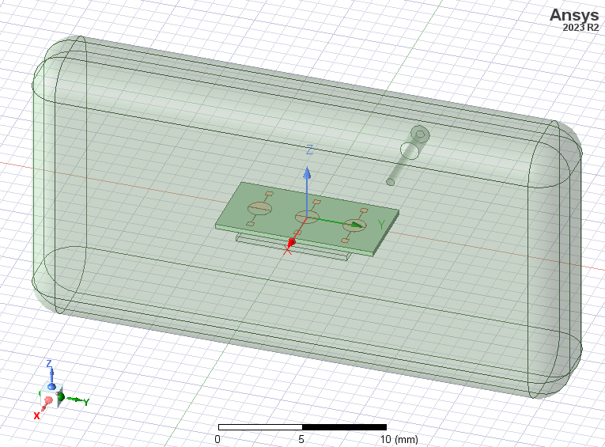
Antenna-coupled resonators

Slide 14
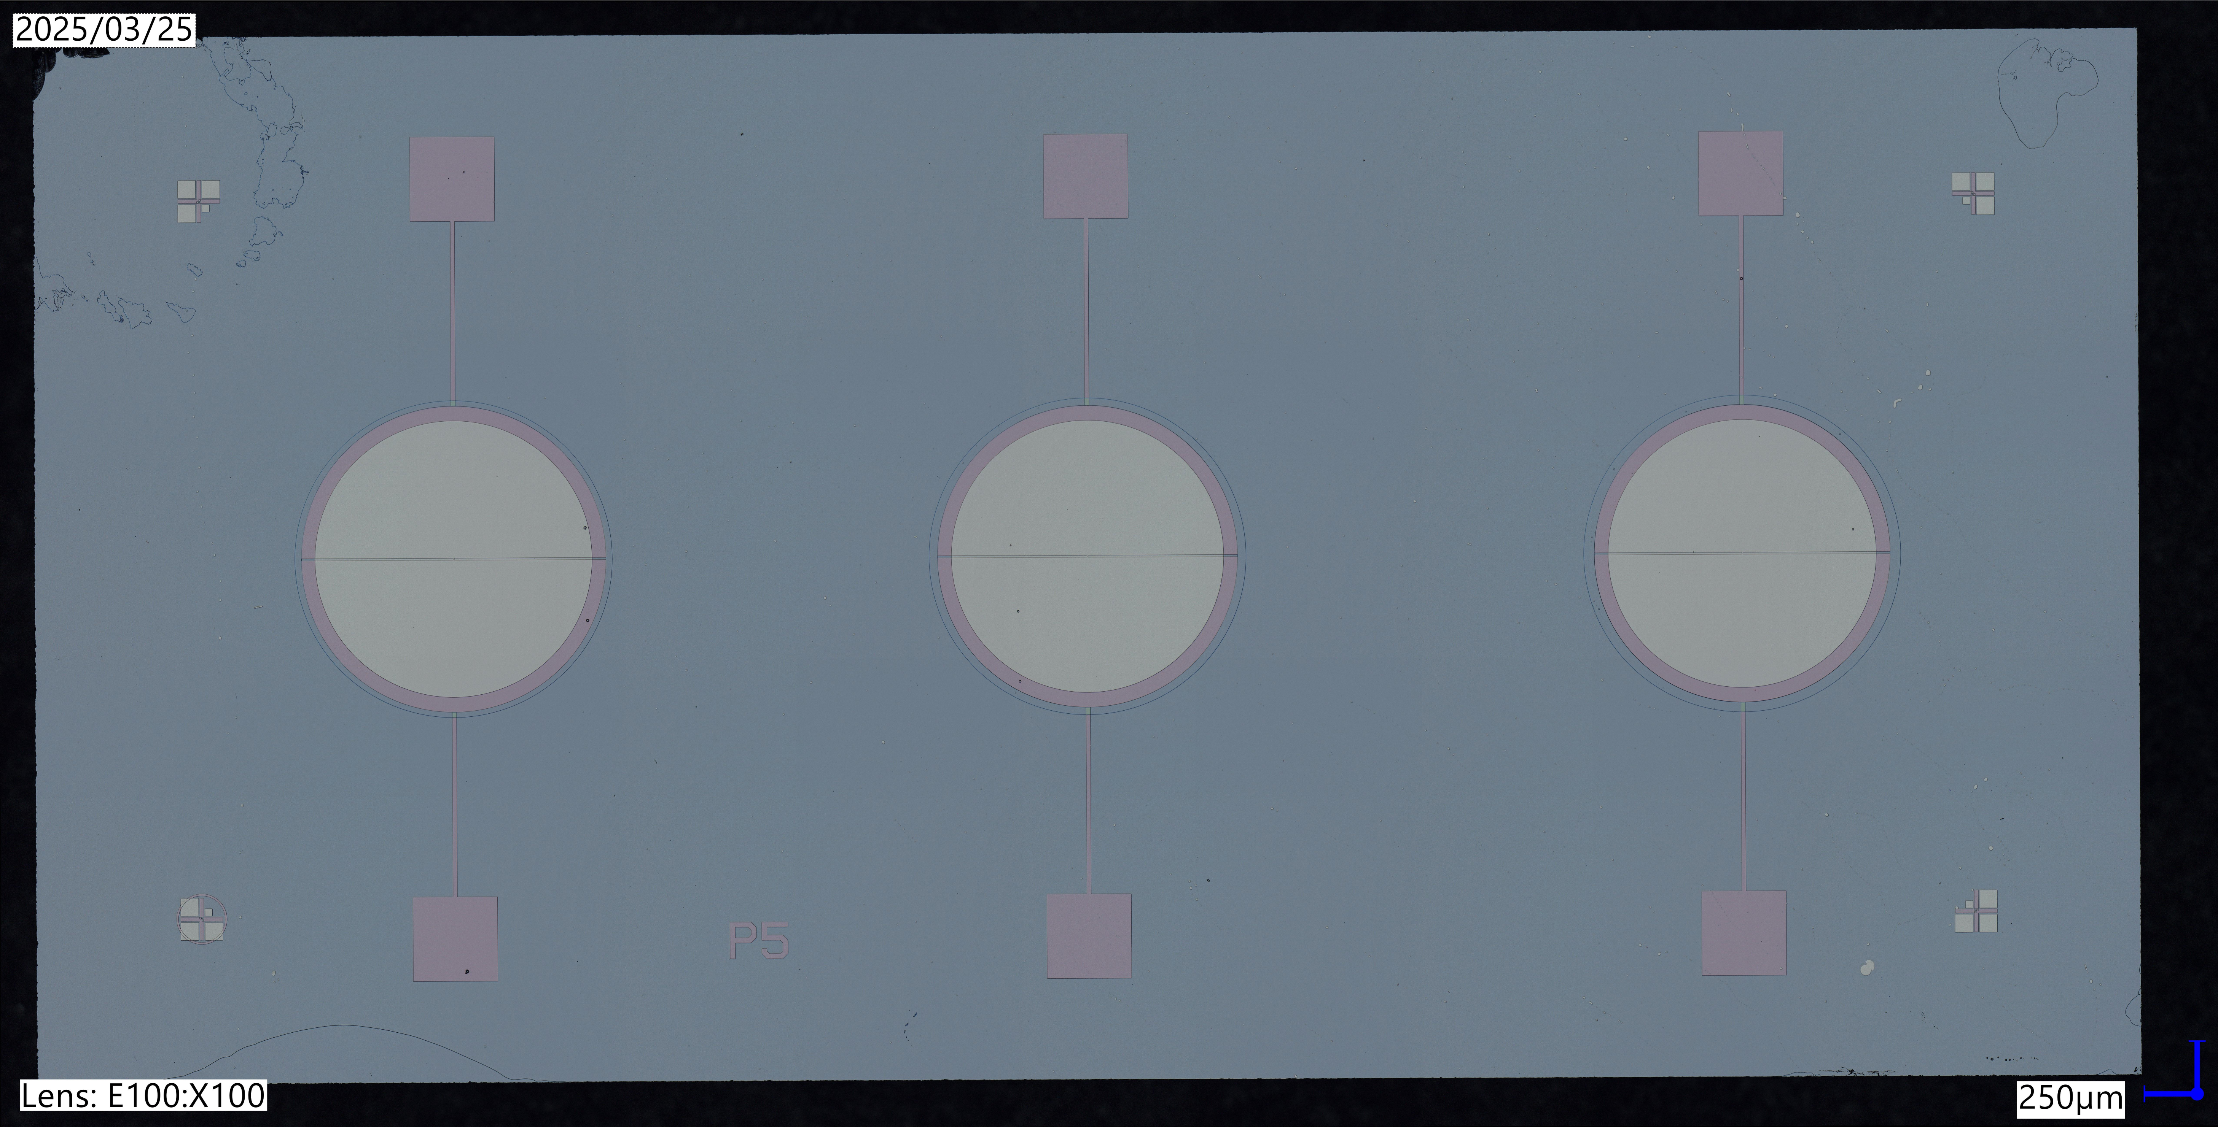
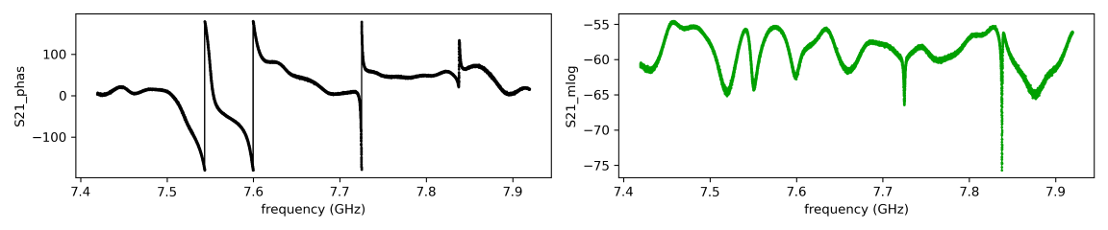
Antenna-coupled resonators

Slide 15
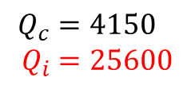
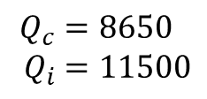
Antenna-coupled resonators
Overcoupled resonances, hybrid modes of resonator + 3D cavity
$$Q_{c}=4150 \\ Q_{i}=25600$$
$$Q_{c}=8650 \\ Q_{i}=11500$$

Slide 16
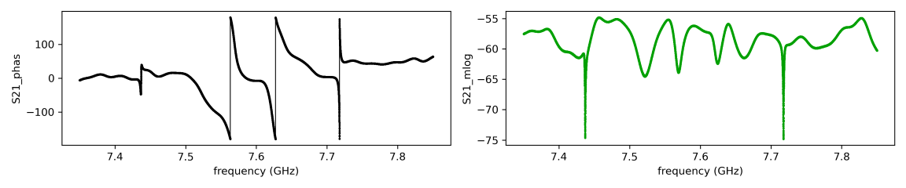
Antenna-coupled resonators in magnetic field
0 mT:
500 mT:

Slide 17
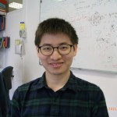

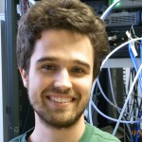


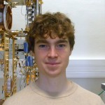
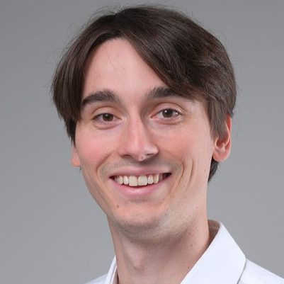

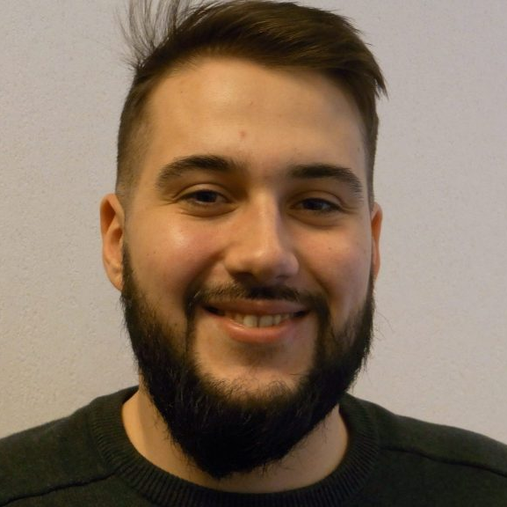
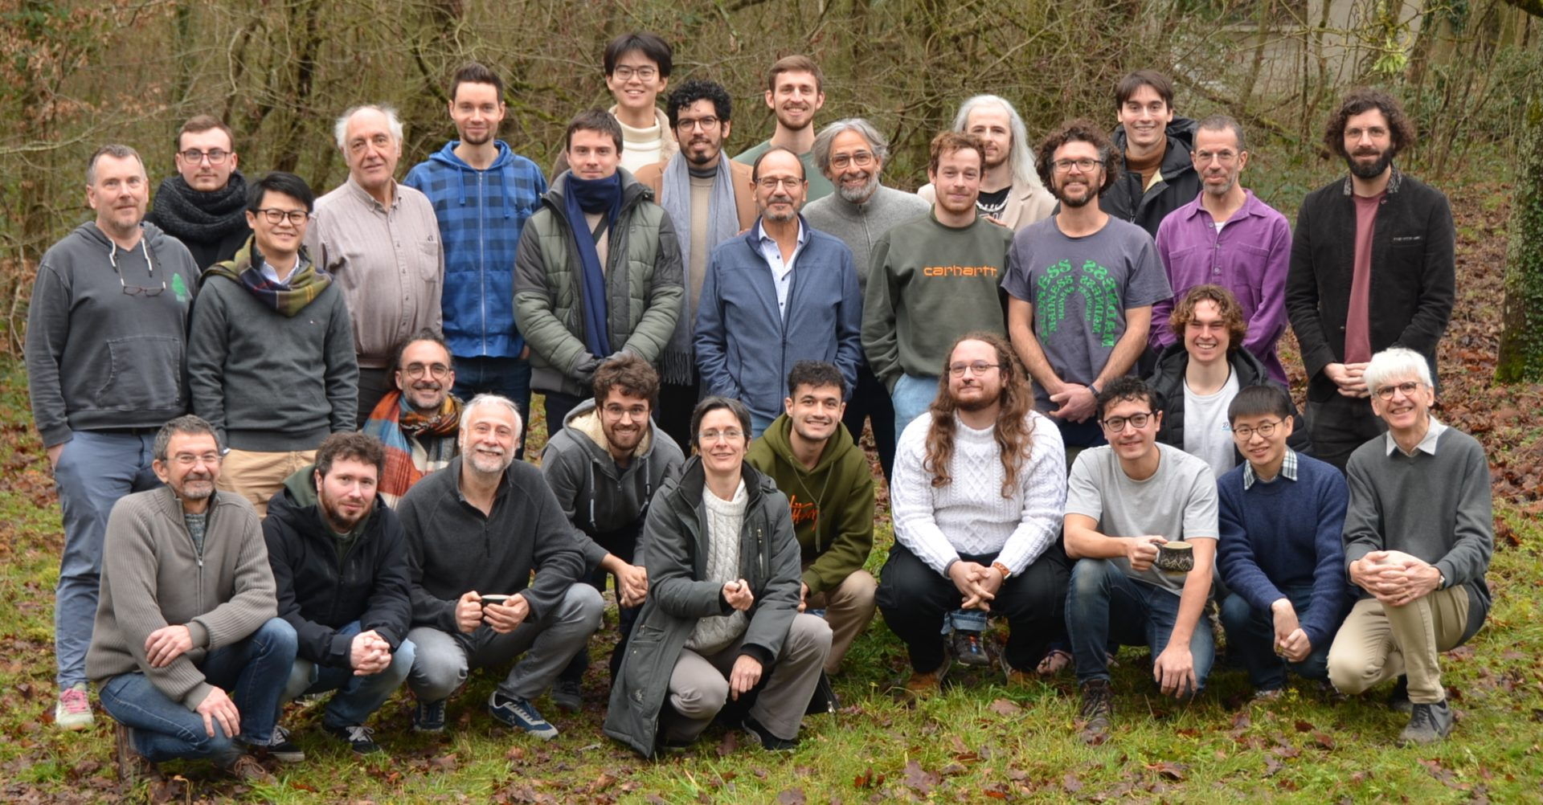
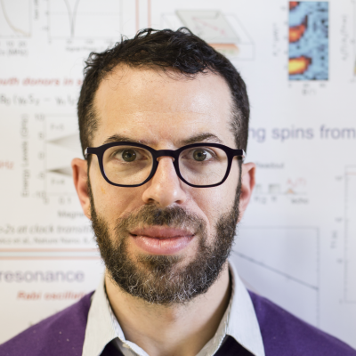
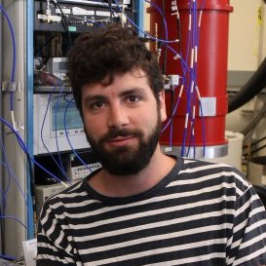
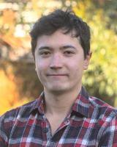
The spin team
Former members
Ongoing collaborations
Y. Kubo
C. Grezes
A. Bienfait
P. Campagne-Ibarcq
V. Ranjan
B. Albanese
M. Le Dantec
M. Rancic
L. Balembois
Y. Wen
E. Billaud
P. Jamonneau
M. Stern
X. Zhou
S. Probst
J. Barbosa Dasilva
R. Heeres
E. Albertinale
B. Yavkin
R. Liu (HongKong)
P. Goldner (Chimie ParisTech)
T. Chanelière (Néel)
S. Bertaina (U. Marseille)
QUAX (INFN, Padova)
G. Jeschke (ETH Z)
Zhiren
Wang
Louis
Pallegoix
Jaime
Travesedo
Xianjing
Zhou
Many thanks to W. Olliver and MIT/Lincoln Labs
for providing us with a JTWPA
Will
Huang
Dominik
Haegi
Nicolas
Thill
Alexandre
May
Leo
Sutevski
Patrice Bertet
Emmanuel Flurin
James O’Sullivan

Slide 19
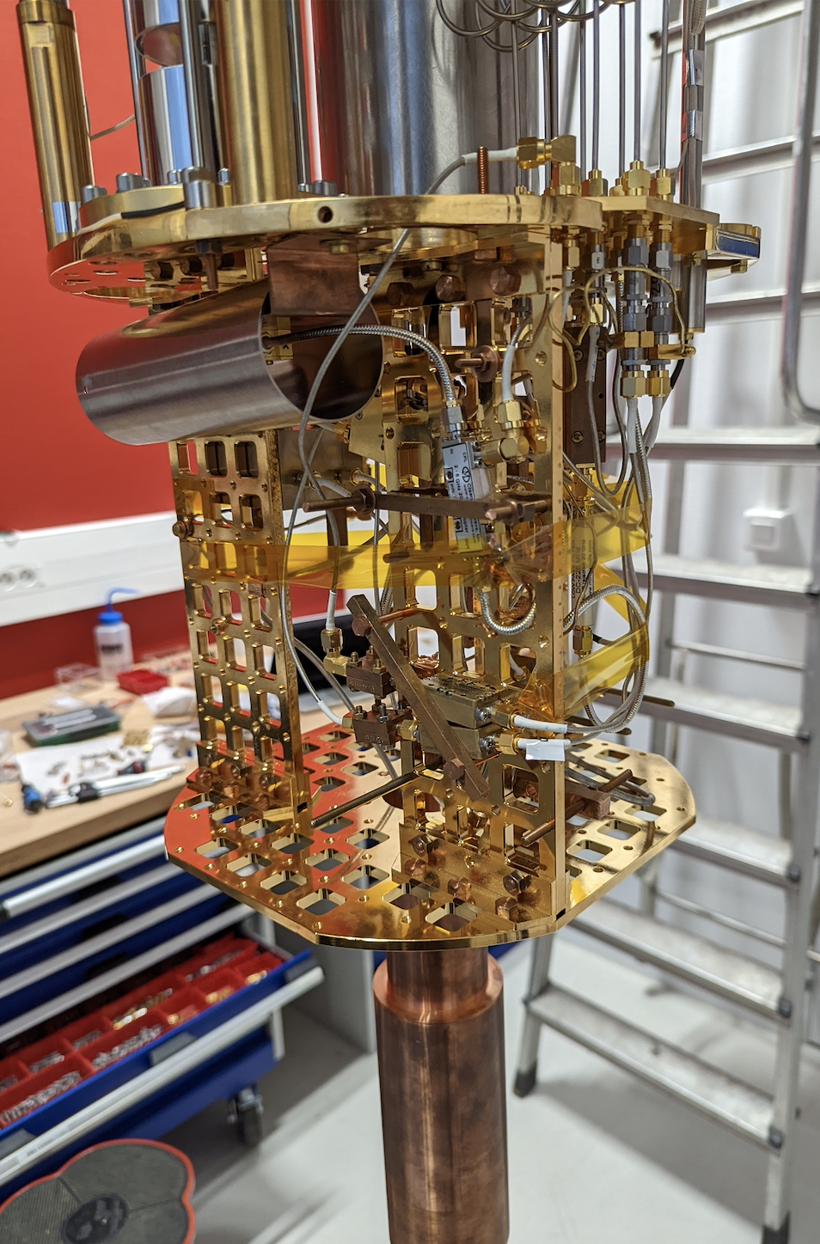





Experiment
10mK
SMPD
MIT JTWPA
1T/1T/1T
vector magnet
$\frac{ω_{0}}{2π}=7.3352$GHz
$$κ={\left(0.5μs\right)}^{−1}$$
Notes:
In the cryostat, the sample is inside a 3D copper cavity, which suppresses all frequencies below the resonator frequency. The signal is guided in and out of the cavity by a small antenna sticking into the 3D cavity. The 3D cavity is then mounted on the bottom of the dilution refrigerator inside a 1T vector magnet. The rest of the setup is for signal routing and the single photon detector, which I will not talk about, in favor of focusing on more recent results. But feel free to ask me afterwards.

Slide 20




SMPD principle
One-way
$$ω_{b}$$
Animation instead of explanation
$$ω_{q}$$
$$ω_{a}$$
Transmon qubit
K. Inomata et al. Nature com (2016)
J.-C. Besse et al. Phys. Rev. X (2018)
Kono, S, et al. Nature Physics 14.6 (2018)
Opremcak, A., et al., Science 361.6408 (2018)
R. Lescanne et al., PRX (2020)
Notes:
In recent years many proposals for microwave photon detectors have been developped. our solution is based on this work.
the idea will be to convert the incoming photon of frequency omega a into an excitation of a transmon type qubit of frequency omega q. To achieve this, we couple the qubit with 2 cavity one at the photon frequency omega a and an other at the frequency omega b.

Slide 21




SMPD principle
$$ω_{b}$$
$$ω_{q}$$
$$ω_{a}$$
$$ω_{a}+ω_{p}=ω_{q}+ω_{b}$$
$$ω_{p}$$
$$\hat{H}=g_{4}⋅(ξ \hat{a}{\hat{σ}}^{+}{\hat{b}}^{+}+ξ^{∗} {\hat{a}}^{+}\hat{σ}\hat{b})$$
21
Notes:
Now by pumping the qubit with another tone at frequency omega p, we can activate a 4 wave mixing process when this energy condition is satisfied. The conversion is lead by this Hamiltonian
The first term discribe the combination of a pump photon with an incoming photon to generate an excitation of the qubit and a photon in the additional output mode.
the second term corresponds to the reversible process

Slide 22

SMPD principle
$$ω_{b}$$
$$ω_{q}$$
$$ω_{a}$$
$$ω_{a}+ω_{p}=ω_{q}+ω_{b}$$
$$ω_{p}$$
$$\hat{H}=g_{4}⋅(ξ \hat{a}{\hat{σ}}^{+}{\hat{b}}^{+}+ξ^{∗} {\hat{a}}^{+}\hat{σ}\hat{b})$$
Notes:
Now that we have this 4 wave mixing process, we can engineer the dissipation of the additional output cavity so that the photons inside are fastly dissipated in the environnement. The absence of phtons in the green cavity damps the second term in the hamiltonian. SO the effective evolution of the system is now non-unitary and irresversible. We managed to trap the incoming photon in a qubit excitation.
And to complete the detection, we just have to measure the state of the qubit. this state will give us information on the arrival or not of a photon.

Slide 23




Wirebonded resonators
directly coupled $Q_{c}=600$
Coupled through nearest-neighbor interaction
$$Q_{c}=30000 \\ Q_{i}=11400$$
Target frequency 7.5 GHz (assuming 500 nm a-Si).
Andrew measured 465 nm a-Si.
The rest of the frequency offset probably comes from our uncertainty in the kinetic inductance.

Slide 24



Wirebonded resonators
directly coupled $Q_{c}=600$
$Q_{c}$ from impedance mismatch between 50 Ω and resonator
$$Z≈0.06 Ω$$

Slide 25




Cascaded single-photon detector

Slide 26


Spin system : Er³⁺:CaWO₄
Calcium tungstate
$S_{4}$ symmetry site
Notes:
Let’s have a look at the individual components, starting with the crystal. In calcium tungstate the Er ions replace a Ca ion in a S4 symmetry site.

Slide 27

Spin system : Er³⁺:CaWO₄
Notes:
There are 11 f-orbital electrons in Er3+. The energy levels are split due to Coulomb interaction and spin-orbit interaction. The famous 1.5µm transition which is so interesting for telecom applications is between the lowest two states in this manifold.

Slide 28


Er : CaWO₄
Spin system : Er³⁺:CaWO₄
0.57 THz
Stark effect from host crystal
Notes:
The crystal field splits the levels further into 8 Kramers levels, which are each doubly degenerate.

Slide 29




Spin system : Er³⁺:CaWO₄
Free-space radiative lifetime $T_{1,rad}≈{10}^{11} s$
(${10}^{3}$ PhD durations)
→ Need high Purcell factor
a
b
c
$$\frac{γ}{2π}=\frac{1}{2π}\left(\begin{matrix}\begin{aligned}117.3 \\ 0\end{aligned} & \begin{aligned}0 \\ 117.3\end{aligned} \\ 0 & 0\end{matrix} \begin{aligned}0 \\ 0 \\ 17.45\end{aligned}\right)GHz/T$$
$$H_{Zeeman}=−S⋅γ⋅B$$
0.57 THz
Stark effect from host crystal
Notes:
This degeneracy is lifted by applying a magnetic field. This forms our two-level system.
Practically however, non of these effects is isolated and there is a strong hybridization of quantum numbers. For this reason, the gyromagnetic ratio gamma, is not scalar, but a tensor, with components along the a- and b-crystal axes which are 4 times higher than that of a free electron. This increases the coupling between the electron spin and resonator mode. This is the reason why we chose this system.
However, even with this high gyromagnetic tensor, the free-space radiative lifetime of the electron spin in 10^11 s, or 10^3 PhD durations. Hence, we need a high Purcell factor to even work with single Er electron spins.

Slide 30

Low-power spectroscopy : angular dependence
Direct measurement of
individual spin gyromagnetic tensor
$$γ≠γ_{0}$$
Ppm accuracy possible
thanks to kHz linewidth

Slide 31

Nearest-neighbors ¹⁸³W in the CaWO4 matrix
Tungsten has a 0.14 abundance of ¹⁸³W,
with nuclear spin $I=1/2$
Notes:
In the calcium tungstate unit cell there are 10 tungsten ions, of which most have no nuclear spin, but isotope 183 has nuclear spin ½. It has a natural abundance of 14%.

Slide 32


Nearest-neighbors ¹⁸³W in the CaWO4 matrix
$$B_{0}$$
Tungsten has a 0.14 abundance of ¹⁸³W,
with nuclear spin $I=1/2$
Nearest-neighbor can be of two different types
of 4 equivalent W atoms if $B_{0}$//c, as observed
Type 1
Type 2
Notes:
With the external magnetic field which sets the spin quantization axis along the c-crystallographic direction, there are effectively 2 different sites in which tungsten can be positioned relative to the Er.

Slide 33






Hyperfine coupling of a spin-1/2 electron to a spin-1/2 nucleus
$$μ_{I}$$
Hyperfine interaction $H_{dd}+H_{F}$
Dipole-dipole $H_{dd}=\frac{μ_{0}}{4πr^{3}}\left[μ_{S}⋅μ_{I}−3\frac{(μ_{S}⋅r)(μ_{I}⋅r)}{r^{2}}\right]$
Fermi-contact $H_{F}=a_{iso}S⋅I$
$$r$$
$$μ_{S}$$
$$B_{0}$$
Secular approximation and frame rotation
$\hat{H}=ω_{S}{\hat{S}}_{z}$ + $ω_{I}{\hat{I}}_{z}$ + $A {\hat{S}}_{z}∙{\hat{I}}_{z}$ + $B {\hat{S}}_{z}∙{\hat{I}}_{x}$
Isotropic HF
Anisotropic HF
Notes:
The interaction between the Er electron spin and the nuclear spins is of magnetic dipole-dipole type, plus additionally the Fermi-contact interaction.
With the secular approximation, we can reduce it to a S_z I_z interaction of strength A and a S_z I_x interaction of strength B. The first one s responsible for a shift in the energy levels, while the second one allows the electron and nuclear spins to drive each other.

Slide 34


















« Standard model » of ESR Spectroscopy:
allowed and forbidden transitions
$\hat{H}(t)=ω_{S}{\hat{S}}_{z}$ + $ω_{I}{\hat{I}}_{z}$ + $A {\hat{S}}_{z}∙{\hat{I}}_{z}$ + $B {\hat{S}}_{z}∙{\hat{I}}_{x}+ω_{R}{(S}_{+}e^{−iωt}+S_{−}e^{iωt})$
In the limit where $A,B≪{|ω}_{I}|$, and for $A>0$
Red-sideband
(forbidden)
Two allowed
transitions
Blue-sideband
(forbidden)
$$|↑_{S}↓_{I}〉$$
$${|ω}_{I}|−A/2$$
$$|↑_{S}↑_{I}〉$$
$$A$$
$$ω_{S}−A/2$$
$${|ω}_{I}|$$
$${|ω}_{I}|$$
$$ω_{S}+A/2$$
$$ω_{S}$$
Frequency, $ω$
$$ω_{S}−|ω_{I}|$$
$$ω_{S}+{|ω}_{I}|$$
Allowed transition amplitude $ω_{R}$
$$|↓_{S}↓_{I}〉$$
|$ω_{I}|+A/2$
$$|↓_{S}↑_{I}〉$$
Forbidden transition amplitude ${ ω}_{R}\frac{B}{2ω_{I}}$
Notes:
Here is the energy level scheme of a single electron spin coupled to a single nuclear spin. The electron spin transition frequencies are shifted by + or – A/2 depending on the nuclear spin. Additionally to the pure electron spin transitions, there is a red and a blue sideband, which alter both the electron and the nuclear spin. Their frequencies are still somewhat within the resonator linewidth.

Slide 35




« Standard model » of ESR Spectroscopy: Cross-Relaxation
$\hat{H}(t)=ω_{S}{\hat{S}}_{z}$ + $ω_{I}{\hat{I}}_{z}$ + $A {\hat{S}}_{z}∙{\hat{I}}_{z}$ + $B {\hat{S}}_{z}∙{\hat{I}}_{x}$
In the limit where $A,B≪{|ω}_{I}|$, and for $A>0$
Red-sideband
(forbidden)
Two allowed
transitions
Blue-sideband
(forbidden)
$$|↑_{S}↓_{I}〉$$
$${|ω}_{I}|−A/2$$
$$|↑_{S}↑_{I}〉$$
$$A$$
$$ω_{S}−A/2$$
$${|ω}_{I}|$$
$${|ω}_{I}|$$
$$Γ_{R}$$
$$Γ_{x}$$
$$ω_{S}$$
Frequency, $ω$
$$\frac{Γ_{x}}{Γ_{R}}={\left(\frac{B}{2ω_{I}}\right)}^{2}\frac{1}{1+{\left({2ω_{I}}/κ\right)}^{2}}$$
$$|↓_{S}↓_{I}〉$$
|$ω_{I}|+A/2$
$$|↓_{S}↑_{I}〉$$
Notes:
The pure electron spin transitions are almost cyclic. The probability for cross-relaxation is given by the B parameter (that’s the one quantifying the mutual driving between electron and nuclear spin) and the detuning from the resonator.

Slide 36
Wishlist
Nuclear state readout
Nuclear state initialization
Coherent single spin gates
Long coherence time
2-qubit gates
Notes:
These are the characteristics of our system.
What we need for a scalable platform: Being able to read out the state of the qubit, that is the nuclear spin. Initialize it in a known state. The ability to coherently manipulate it, so that we can bring it into superposition states. The coherence time should be much longer than the gate duration. And lastly, 2-qubit gates to spread entanglement throughout the qubit register.

Slide 37
















Nuclear spin Single-Shot Read-Out
Nuclear Spin
Read-Out
$$N_{RO}=120$$
$$t_{s}=400 ms$$
$$×N_{RO}$$
$$C$$
$$C$$
$$|↓_{I}〉$$
$$|↑_{I}〉$$
$${|ω}_{I}|−A/2$$
$$|↑_{S}↓_{I}〉$$
$$|↑_{S}↑_{I}〉$$
$$δC=C−C$$
Cross-relaxation
$$F_{max}=0.92$$
$$|↓_{S}↓_{I}〉$$
$$N_{RO}=123$$
$$|↓_{S}↑_{I}〉$$
|$ω_{I}|+A/2$
Notes:
As you can imagine from the slide with the quantum jumps, we can figure out the state of the nuclear spin by evaluating the resonance frequency of the electron spin. But scanning the whole spectrum is inefficient, therefore we just send pulses at the resonance frequencies the electron spin can have. The sequence looks like this: Excitation pulse at the high frequency, collect fluorescence. Excitation pulse at the low frequency, collect fluorescence. Repeat this N_Readout times until enough statistics is collected to overcome shot noise and dark counts.
Here is how the fidelity evolves with the number of readout cycles. Fidelity in this context means the probability to correctly identify the nuclear spin state. For a low number of readout cycles, it is limited by the shot noise. It then reaches a maximum.

Slide 38
Nuclear spin Single-Shot Read-Out
Nuclear Spin
Read-Out
$$N_{RO}=120$$
$$t_{s}=400 ms$$
$$×N_{RO}$$
$$C$$
$$C$$
$$|↓_{I}〉$$
$$|↑_{I}〉$$
$${|ω}_{I}|−A/2$$
$$|↑_{S}↓_{I}〉$$
$$|↑_{S}↑_{I}〉$$
$$δC=C−C$$
Cross-
relaxation
Cross-relaxation
Cross-relaxation
$$F_{max}=0.92$$
$$|↓_{S}↓_{I}〉$$
$$N_{RO}=123$$
$$|↓_{S}↑_{I}〉$$
|$ω_{I}|+A/2$
Notes:
The reason why it doesn’t improve indefinitely is that every time the electron is excited, there is a small chance that the coupled system cross-relaxes, thereby flipping the nuclear spin. For this particular nuclear spin (Chantal) the maximum fidelity of 92% is reached with 123 Readout cycles.

Slide 39
Wishlist
Nuclear state readout
Nuclear state initialization
Coherent single spin gates
Long coherence time
2-qubit gates
Notes:
Ok, readout works. But how about initializing the spin in a desired state?

Slide 40





Nuclear spin State Preparation
Nuclear Spin
Prep $|↓_{S}↓_{I}〉$
$$×N_{prep}$$
Nucl
Prep
Nucl
RO
$$T_{1}$$
$$|↑_{S}↓_{I}〉$$
$$|↑_{S}↑_{I}〉$$
$$P(↓_{I})$$
$$|↓_{S}↓_{I}〉$$
$$|↓_{S}↑_{I}〉$$
Notes:
If, let’s say, the nuclear spin is initially in spin down, but we want it to be spin up, we can drive the system along the blue sideband. An ideal pi-pulse drives the system into the |electron spin up, nuclear spin down> state, from which it likely decays into the |electron spin down, nuclear spin down> state. However, if the first pulse didn’t succeed, we just continue sending more pulses. This doesn’t hurt the fidelity, because if the spin is already in the right state, it isn’t resonant with the blue sideband anymore. So we effectively pump the system incoherently into the desired state.
In this graph you can see how just a few pulses suffice to bring the system into the desired state. It’s not 100%, because we have a finite preparation and readout fidelity.
What limits the preparation fidelity?

Slide 41
Wishlist
Nuclear state readout
Nuclear state initialization
Coherent single spin gates
Long coherence time
2-qubit gates
Notes:
Alright, readout and incoherent state preparation is there. How can we perform coherent gates?

Slide 42








Red-sideband coherent dynamics
Nucl
Prep
$$T_{P}$$
Nucl
RO
$$P(↑_{I})$$
$$|↑_{S}↓_{I}〉$$
$$|↑_{S}↑_{I}〉$$
By comparing the Rabi frequencies
of the Forbidden- and Allowed- Transitions, we get
$$|↓_{S}↓_{I}〉$$
$A/{2π}=40.5$ kHz
$B/{2π}=92.7$kHz
$$|↓_{S}↑_{I}〉$$
Notes:
If we don’t mind the electron spin to change as well, we can simply drive Rabi oscillations on the red and blue sidebands, which also allows us to gain spectroscopic information about the system. However, because of the relatively short lifetime of the electron spin, we prefer to use the electron spin just as bus to manipulate the nuclear spin. This type of transition, with the electron spin decaying very quickly would not lead to a coherent superposition of nuclear spin states.

Slide 43





Nuclear Rabi
MW input
resonator
$$|↑_{S}↓_{I}〉$$
$$|↑_{S}↑_{I}〉$$
Direct driving at $ω_{I}$? Impossible in our setup
$$|↓_{S}↓_{I}〉$$
$$|↓_{S}↑_{I}〉$$
Notes:
It would be very convenient to drive the nuclear spins directly at ~1MHz frequencies. However, the 3D cavity around our resonator suppresses these low frequencies. That’s what it is designed for – to eliminate noise. Therefore, in our current setup, we cannot drive these transitions directly. However, one of the improvements we’re working on at the moment is to couple the Purcell resonator via a Bragg mirror instead of an antenna. This allows low frequencies to pass through the waveguide, while the resonance frequency of the resonator is reflected and therefore the mode volume remains small.

Slide 44

Nuclear Rabi
$$|↑_{S}↓_{I}〉$$
$$|↑_{S}↑_{I}〉$$
Direct driving at $ω_{I}$ ? Impossible in our setup
Sequential driving Sideband-Allowed ?
Suffers from electron spin decoherence
Loss of contrast when several pulses
$$|↓_{S}↓_{I}〉$$
$$|↓_{S}↑_{I}〉$$
Notes:
Alternatively, we could use a pulse sequence of first applying a pi-pulse along the sideband and then coherently de-exciting the electron spin. While these gates are fast, they have fundamentally limited coherence, because during the time the electron spin is excited, it can incoherently decay.

Slide 45









Nuclear spin spectroscopy by stimulated Raman driving
$$Δ$$
$$Δ$$
$$|↑_{S}↓_{I}〉$$
$$|↑_{S}↑_{I}〉$$
$$Δ$$
$$Ω_{R1}$$
$$Ω_{R2}$$
$$|↓_{S}↓_{I}〉$$
$$|↓_{S}↑_{I}〉$$
Notes:
Instead, we drive a Raman-like transition from one ground state to the other. The detuning from a real state Delta minimizes the population of the excited state and therefore ensures the coherence of the gate.

Slide 46


Nuclear spin spectroscopy by stimulated Raman driving
$$Δ$$
$$Δ$$
Effective nuclear spin
drive frequency
$$Ω_{R}≈\frac{Ω_{R1}Ω_{R2}}{2Δ}$$
$$|↑_{S}↓_{I}〉$$
$$|↑_{S}↑_{I}〉$$
$$Δ$$
$$Ω_{R1}$$
$$Ω_{R2}$$
$$|↓_{S}↓_{I}〉$$
$$|↓_{S}↑_{I}〉$$
$$Ω_{R}$$
Notes:
Effectively, this is like driving a direct nuclear spin transition with an effective Rabi frequency proportional to the product of the individual Rabi frequencies.

Slide 47






Nuclear spin spectroscopy by stimulated Raman driving : Chantal
$$δ$$
$\frac{Δ}{2π}=400$kHz
RO
$$|↓_{S}↓_{I}〉$$
$$Δ$$
$$Δ$$
$$|↑_{S}↓_{I}〉$$
$$|↑_{S}↑_{I}〉$$
$$Δ$$
$$Ω_{R1}$$
$$Ω_{R2}$$
Frequency difference $δ/2π$(kHz)
$$|↓_{S}↓_{I}〉$$
Direct driving of nuclear spin, no electronic decoherence
Works for all nuclear spins with non-zero $B$
Direct measurement of ${|ω}_{I}|+A$
$$δ$$
$$|↓_{S}↑_{I}〉$$
Notes:
As we sweep the detuning between the two drives (little delta), we find a narrow resonance at omega_I + A. This works for all nuclear spins with non-zero B, which means in all systems where the electron spin and nuclear spin can drive each other via S_z I_x interaction.

Slide 48



Nuclear spin spectroscopy by stimulated Raman driving : Edith
$$|↓_{1}↓_{2}〉$$
$\frac{Δ}{2π}=350$kHz
RO
Spin 1
Spin 2
Notes:
The single nuclear spin coherent gate can also discriminate between the two nuclear spins coupled to Edith (the Er ion with 2 nuclear spins).
Here, we prepare the system in the |nuclear spin 1 down, nuclear spin 2 down> state, then apply a Raman pulse at a given detuning between the two drives and then read out the state of the combined two nulcei (by probing at 4 different frequencies). If we sweep the detuning little delta, we find two resonances, in which either nuclear spin 1 or nuclear spin 2 is flipped.

Slide 49









Stimulated Raman driving of two independent nuclear spins
Spin 1
$\frac{Δ}{2π}=350$kHz
Spin 2
$$|↓_{1}↓_{2}〉$$
$$δ_{1}$$
RO
$$|↓_{1}↓_{2}〉$$
$$δ_{2}$$
RO
Dt
Dt
Raman Pulse duration $Dt$ (ms)
Raman Pulse duration $Dt$ (ms)
Notes:
In the time-domain, we can see coherent Rabi oscillations for each of the spins. Here, the contrast is limited by various infidelities:
The initialization
The gate fideility, which in turn suffers from the residual spectral diffusion
The readout fidelity

Slide 50


Stimulated Raman driving of two independent nuclear spins
Spin 1
$\frac{Δ}{2π}=350$kHz
Spin 2
$$|↓_{1}↓_{2}〉$$
$$δ_{1}$$
RO
$$|↓_{1}↓_{2}〉$$
$$δ_{2}$$
RO
Dt
Dt
$${A_{1}}/{2π=35}kHz$$
$${B_{1}}/{2π=70.5}kHz$$
$${A_{2}}/{2π=21}kHz$$
$${B_{2}}/{2π=14.3}kHz$$
Raman Pulse duration $Dt$ (ms)
Raman Pulse duration $Dt$ (ms)
Notes:
As you can see, the duration of a Rabi cycle differs between the ions. That is because they have different B parameters, meaning that their coupling to the electron spin is faster or slower. But overall, we are happy to be able to drive a pi-pulse within 2 or 6ms, respectively.

Slide 51
Wishlist
Nuclear state readout
Nuclear state initialization
Coherent single spin gates
Long coherence time
2-qubit gates
Notes:
Although this is quite a long gate duration, we have to compare it to the coherence time, in order to assess how many operations can be performed before decoherence.

Slide 52












Nuclear spin coherence time measured by stimulated Raman driving
$$|↓_{1}↓_{2}〉$$
$$π/2_{x}$$
$$π/2_{δωτ}$$
RO
$$τ$$
$$P_{↓↓}$$
$$P_{↓↓}$$
Spin 1, $T_{2}^{∗}=0.8$s
Spin 2, $T_{2}^{∗}=0.9$s
Ramsey delay, $τ$ (ms)
Ramsey delay, $τ$ (ms)
Notes:
We can measure the coherence time with a Ramsey experiment. We initialize the system in the |nuclear spin 1 down, nuclear spin 2 down> state, apply a pi/2 pulse, let the super position evolve over a time tau and then apply another pi/2 pulse, before reading out the resulting state. The decay time of the envelope tells us the T2* time, which is on the order of 1s.

Slide 53








Nuclear spin coherence time measured by stimulated Raman driving
$$|↓_{1}↓_{2}〉$$
$$π/2_{x}$$
$$π_{y}$$
$$π/2_{δωτ}$$
RO
$$τ$$
$$τ$$
$$P_{↓↓}$$
Also limited by electron
spin thermal excitation
Spin 1 $T_{2}=2.6$s
Notes:
If we apply just a single rephasing pi pulse in between, we find a T2 coherence time of 2.6s. Even though the pulses don’t give rise to a high excited state amplitude of the electron spin, there is additionally thermal excitation, which limits the achievable coherence times.

Slide 54
Wishlist
Nuclear state readout
Nuclear state initialization
Coherent single spin gates
Long coherence time
2-qubit gates
Notes:
Lastly, I will show you the basic idea of the 2-qubit gate, in this case a controlled-NOT gate, where nuclear spin 1 controls if nuclear spin 2 gets flipped.

Slide 55












2-qubit gate
enabled by differential AC Zeeman shift
$$|↑_{S}↓_{I1}↓_{I2}〉$$
$$|↑_{S}↑_{I1}↓_{I2}〉$$
$$|↑_{S}↓_{I1}↑_{I2}〉$$
$$Δ−A_{1}$$
$$|↑_{S}↑_{I1}↑_{I2}〉$$
$$Δ$$
$$Ω_{R1}$$
$$Ω_{R2}$$
$$Ω_{R1}$$
$$Ω_{R2}$$
$$δ$$
$$|↓_{S}↓_{I1}↓_{I2}〉$$
$$|↓_{S}↑_{I1}↓_{I2}〉$$
$$δ$$
$$|↓_{S}↓_{I1}↑_{I2}〉$$
$$|↓_{S}↑_{I1}↑_{I2}〉$$
Notes:
Here are all 8 energy levels associated with the electron spin and the two nuclear spins. Imagine, we drive a Raman transition which is right for one of the spins (in this case spin 1), we need the same detuning (little delta) no matter if spin 2 is up or down. There is only a difference in the effective Rabi frequency, because the detuning to a real level is different. In principle this could be used for a gate, for example by choosing a driving strength such that one transition completes a 2pi-pulse while the other undergoes only a pi-pulse. But this is not very flexible. Instead, we use an effect I haven’t mentioned yet: the AC Zeeman shift.
The AC Zeeman shift for the two halves are different, because the detuning of the Raman drives from the real energy levels is different. So, it’s a difference of the AC Zeeman shifts of a second-order process; therefore it is small, but resolvable thanks to the long coherence time of the nuclei.

Slide 56




2-qubit gate
enabled by differential AC Zeeman shift
$|↓_{1}↓_{2}〉$ or $|↑_{1}↓_{2}〉$
$\frac{Δ}{2π}=110$kHz
RO
244 Hz
Notes:
Here is the corresponding experiment: We prepare nuclear spin 2 in the down state and nuclear spin 1 either in the up or down state. Then, for a given Raman driving strength, we sweep the detuning between the two tones (little delta) and find that the population of the initial state depletes at slightly different frequencies. In fact, the splitting in this experiment is only 244 Hz, but this is enough to resolve the resonances clearly. So if, we drive the system at the lower of these two frequencies, the second spin flips only when spin 1 is down. And if we drive the system at the higher frequency, spin 2 flips only when spin 1 is up. This CNOT gate takes about 6 ms.

Slide 57

Material tests
3 resonators on a Si chip + dielectric film
Material | Source | $\tan{δ}$
a-Ge | Neyco, 5N purity, evaporated | $$4⋅{10}^{−4}$$
a-Ge | UniversityWafer, >7N purity, evaporated | $$7⋅{10}^{−4}$$
a-Si:H | Polytechnique, PECVD | no resonances visible
a-Si:H | PTA Grenoble, PECVD | $$3⋅{10}^{−4}$$
a-Si:H | JPL, PECVD | $$4⋅{10}^{−5}$$

Slide 58

Parallel plate resonator on Si membrane
Material | Source | $\tan{δ}$
Si membrane | Silson | $$5⋅{10}^{−5}$$ possibly down to $6⋅{10}^{−6}$

Slide 59



Si membranes
4 multi frame arrays for 2680€
  2 µm thick float zone Si device layer
  2.5 x 2.5 mm membranes
  5 x 5 mm frame
  4 x 4 frames per array

Slide 60




Goals: Dispersive spin readout
$$χ=\frac{{g_{0}}^{2}}{Δ}$$
$$Δφ=2\tan^{−1}\left(\frac{2χ}{κ}\right)$$
$$SNR=\sqrt{2\overline{n}κτ_{m}}\frac{4χ}{κ}$$
$$\overline{n}<n_{crit}={\left(\frac{Δ}{2g_{0}}\right)}^{2}$$
 | $${g_{0}}/{2π}$$ | $$κ/{2π}$$ | $$Δ/{2π}$$ | $$n_{crit}$$ | $$T_{1}$$ | $$χ/{2π}$$ | $$Δφ$$ | $$\overline{n}$$ | $$τ_{m}$$ | $$P_{TWPA}$$ | $$SNR$$ | $$F$$
Case 1 | 10 kHz | 200 kHz | 400 kHz | 400 | 1.35 ms | 250 Hz | 0.14° | $$\frac{n_{crit}}{2}$$ | $${T_{1}}/4$$ | $$−119 dBm$$ | 2 | 85%
Case 2 | 50 kHz | 75 kHz | 1366 kHz | 186.6 | 1.59 ms | 1.83 kHz | 2.8° |  | $${T_{1}}/{100}$$ | $$−127 dBm$$ | 3.643 | 99%
Notes:
Single-shot non-destructive readout

