Slide 1
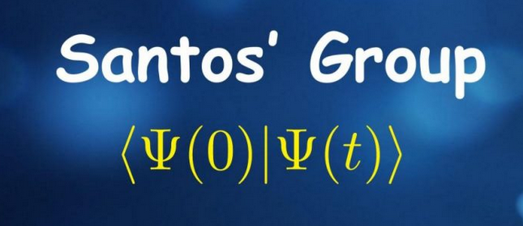



Quantum phase transitions in multi-photon KPO: toward protected superconducting qubits
M.A.P. Reynoso², Edson M. Signor¹, J.K. Riveira³, A.D. Ribeiro⁴, F. Pérez-Bernal³ and Lea F. Santos¹
¹Department of Physics, University of Connecticut, Storrs, Connecticut, USA
²Departamento de Física, Universidad Rey Juan Carlos, Madrid, Spain
³Departamento de Física, Universidad de Huelva, Huelva, Spain
⁴Departamento de Física, Universidade Federal do Paraná, Curitiba, Brazil
Notes:
Present. Title. Systematic analysis of multi-photon KPO. Molecules dynamics, quantum sensing, quantum computing. Knowledge of QPT to Tunneling protection.

Slide 2
Tunneling protection
$$\hat{H}=−Δ{\hat{a}}^{†}\hat{a}+K{\hat{a}}^{†}{\hat{a}}^{†}\hat{a}\hat{a}−ε_{2}\left({{\hat{a}}^{†}}^{2}+{\hat{a}}^{2}\right)$$
Notes:
Well-know Kerr-cat qubits from KPO. Detuning = 0. Cat states inside the DW with decreasing expotential crossing due to tunneling. Important to cancel tunneling to preserve the cat state/qubit.
Once we make detuning != 0, new pathways to tunnel are created. However,It has been showed that suitably choosing Delta, tunnelling is suppressed. Found for even integer numbers. Confirm by WKB theory, they saw that level crossings leads to the suppress.
Our goal in this work, it is to extent this analysis for multi-photons drive. In the work, we explore all cases, but for qubits 2,3,4 are the ones with currently applications.
Goal: Connect quickly to superconducting qubits and motivate generalization.
🔹 Superconducting qubits need robust quantum encodings:
Traditional qubits are fragile — new ideas use bosonic modes for protection.
🔹 Kerr Parametric Oscillators (KPOs) are crucial:
Adding squeezing drives (2-photon processes) creates cat states.
Recent advances like the Δ-Kerr-cat qubit (Venkatraman 2024) use interference effects to suppress tunneling and decoherence.
🔹 Our question:
What if we explore more general driving?
Beyond squeezing → multi-photon drives (μ = 1, 2, 3, 4).
Can we discover new symmetries, degeneracies, protection schemes?

Slide 3
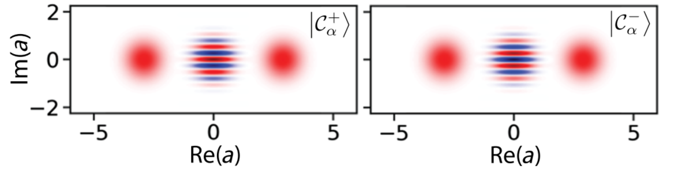
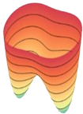

Tunneling protection
Puri et al., NPJ Quantum, 2017
Grimm et al., Nature, 2020
Frattini et al., PRX, 2024
Carlos-Chavez et al., NPJ Quantum, 2023
$$\hat{H}=−Δ{\hat{a}}^{†}\hat{a}+K{\hat{a}}^{†}{\hat{a}}^{†}\hat{a}\hat{a}−ε_{2}\left({{\hat{a}}^{†}}^{2}+{\hat{a}}^{2}\right)$$
$$Δ=0$$
Notes:
Well-know Kerr-cat qubits from KPO. Detuning = 0. Cat states inside the DW with decreasing expotential crossing due to tunneling. Important to cancel tunneling to preserve the cat state/qubit.
Once we make detuning != 0, new pathways to tunnel are created. However,It has been showed that suitably choosing Delta, tunnelling is suppressed. Found for even integer numbers. Confirm by WKB theory, they saw that level crossings leads to the suppress.
Our goal in this work, it is to extent this analysis for multi-photons drive. In the work, we explore all cases, but for qubits 2,3,4 are the ones with currently applications.
Goal: Connect quickly to superconducting qubits and motivate generalization.
🔹 Superconducting qubits need robust quantum encodings:
Traditional qubits are fragile — new ideas use bosonic modes for protection.
🔹 Kerr Parametric Oscillators (KPOs) are crucial:
Adding squeezing drives (2-photon processes) creates cat states.
Recent advances like the Δ-Kerr-cat qubit (Venkatraman 2024) use interference effects to suppress tunneling and decoherence.
🔹 Our question:
What if we explore more general driving?
Beyond squeezing → multi-photon drives (μ = 1, 2, 3, 4).
Can we discover new symmetries, degeneracies, protection schemes?

Slide 4

Tunneling protection
Puri et al., NPJ Quantum, 2017
Grimm et al., Nature, 2020
Frattini et al., PRX, 2024
Carlos-Chavez et al., NPJ Quantum, 2023
$$\hat{H}=−Δ{\hat{a}}^{†}\hat{a}+K{\hat{a}}^{†}{\hat{a}}^{†}\hat{a}\hat{a}−ε_{2}\left({{\hat{a}}^{†}}^{2}+{\hat{a}}^{2}\right)$$
$$Δ=0$$
$$Δ≠0$$
Δ-Kerr-cat qubit
Venkatraman et al., PNAS, 2024
Marthaler et al., PRA, 2007
Notes:
Well-know Kerr-cat qubits from KPO. Detuning = 0. Cat states inside the DW with decreasing expotential crossing due to tunneling. Important to cancel tunneling to preserve the cat state/qubit.
Once we make detuning != 0, new pathways to tunnel are created. However,It has been showed that suitably choosing Delta, tunnelling is suppressed. Found for even integer numbers. Confirm by WKB theory, they saw that level crossings leads to the suppress.
Our goal in this work, it is to extent this analysis for multi-photons drive. In the work, we explore all cases, but for qubits 2,3,4 are the ones with currently applications.
Goal: Connect quickly to superconducting qubits and motivate generalization.
🔹 Superconducting qubits need robust quantum encodings:
Traditional qubits are fragile — new ideas use bosonic modes for protection.
🔹 Kerr Parametric Oscillators (KPOs) are crucial:
Adding squeezing drives (2-photon processes) creates cat states.
Recent advances like the Δ-Kerr-cat qubit (Venkatraman 2024) use interference effects to suppress tunneling and decoherence.
🔹 Our question:
What if we explore more general driving?
Beyond squeezing → multi-photon drives (μ = 1, 2, 3, 4).
Can we discover new symmetries, degeneracies, protection schemes?

Slide 5
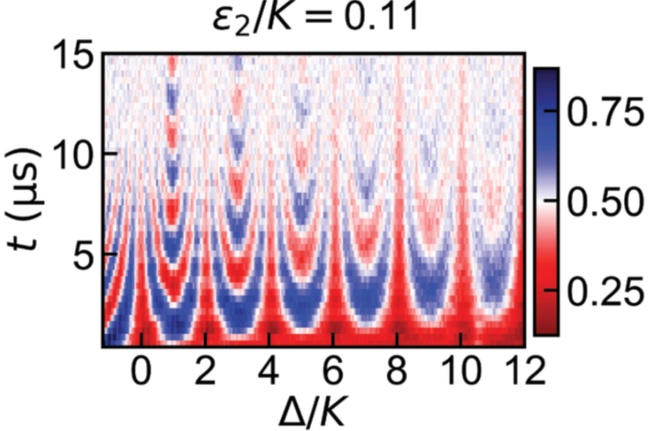
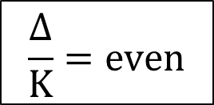
Tunneling protection
Puri et al., NPJ Quantum, 2017
Grimm et al., Nature, 2020
Frattini et al., PRX, 2024
Carlos-Chavez et al., NPJ Quantum, 2023
$$\hat{H}=−Δ{\hat{a}}^{†}\hat{a}+K{\hat{a}}^{†}{\hat{a}}^{†}\hat{a}\hat{a}−ε_{2}\left({{\hat{a}}^{†}}^{2}+{\hat{a}}^{2}\right)$$
$$Δ=0$$
$$Δ≠0$$
Δ-Kerr-cat qubit
$$\frac{Δ}{K}=even$$
Venkatraman et al., PNAS, 2024
Marthaler et al., PRA, 2007
Notes:
Well-know Kerr-cat qubits from KPO. Detuning = 0. Cat states inside the DW with decreasing expotential crossing due to tunneling. Important to cancel tunneling to preserve the cat state/qubit.
Once we make detuning != 0, new pathways to tunnel are created. Transition probability (Rabi oscillations).However, It has been showed that suitably choosing Delta, tunnelling is suppressed. Found for even integer numbers. Confirm by WKB theory, they saw that level crossings leads to the suppress.
Our goal in this work, it is to extent this analysis for multi-photons drive. In the work, we explore all cases, but for qubits 2,3,4 are the ones with currently applications.
Goal: Connect quickly to superconducting qubits and motivate generalization.
🔹 Superconducting qubits need robust quantum encodings:
Traditional qubits are fragile — new ideas use bosonic modes for protection.
🔹 Kerr Parametric Oscillators (KPOs) are crucial:
Adding squeezing drives (2-photon processes) creates cat states.
Recent advances like the Δ-Kerr-cat qubit (Venkatraman 2024) use interference effects to suppress tunneling and decoherence.
🔹 Our question:
What if we explore more general driving?
Beyond squeezing → multi-photon drives (μ = 1, 2, 3, 4).
Can we discover new symmetries, degeneracies, protection schemes?

Slide 6
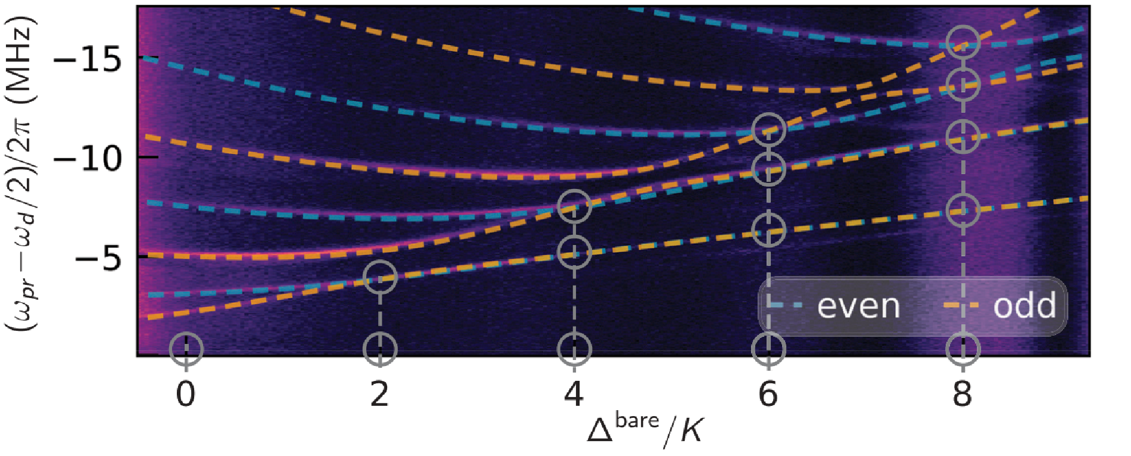
Tunneling protection
Puri et al., NPJ Quantum, 2017
Grimm et al., Nature, 2020
Frattini et al., PRX, 2024
Carlos-Chavez et al., NPJ Quantum, 2023
$$\hat{H}=−Δ{\hat{a}}^{†}\hat{a}+K{\hat{a}}^{†}{\hat{a}}^{†}\hat{a}\hat{a}−ε_{2}\left({{\hat{a}}^{†}}^{2}+{\hat{a}}^{2}\right)$$
$$Δ=0$$
$$Δ≠0$$
Δ-Kerr-cat qubit
$$\frac{Δ}{K}=even$$
Venkatraman et al., PNAS, 2024
Marthaler et al., PRA, 2007
Notes:
Well-know Kerr-cat qubits from KPO. Detuning = 0. Cat states inside the DW with decreasing expotential crossing due to tunneling. Important to cancel tunneling to preserve the cat state/qubit.
Once we make detuning != 0, new pathways to tunnel are created. Transition probability (Rabi oscillations).However, It has been showed that suitably choosing Delta, tunnelling is suppressed. Found for even integer numbers. Confirm by WKB theory, they saw that level crossings leads to the suppress.
Our goal in this work, it is to extent this analysis for multi-photons drive. In the work, we explore all cases, but for qubits 2,3,4 are the ones with currently applications.
Goal: Connect quickly to superconducting qubits and motivate generalization.
🔹 Superconducting qubits need robust quantum encodings:
Traditional qubits are fragile — new ideas use bosonic modes for protection.
🔹 Kerr Parametric Oscillators (KPOs) are crucial:
Adding squeezing drives (2-photon processes) creates cat states.
Recent advances like the Δ-Kerr-cat qubit (Venkatraman 2024) use interference effects to suppress tunneling and decoherence.
🔹 Our question:
What if we explore more general driving?
Beyond squeezing → multi-photon drives (μ = 1, 2, 3, 4).
Can we discover new symmetries, degeneracies, protection schemes?

Slide 7
Tunneling protection
Puri et al., NPJ Quantum, 2017
Grimm et al., Nature, 2020
Frattini et al., PRX, 2024
Carlos-Chavez et al., NPJ Quantum, 2023
$$\hat{H}=−Δ{\hat{a}}^{†}\hat{a}+K{\hat{a}}^{†}{\hat{a}}^{†}\hat{a}\hat{a}−ε_{2}\left({{\hat{a}}^{†}}^{2}+{\hat{a}}^{2}\right)$$
$$Δ=0$$
$$Δ≠0$$
Δ-Kerr-cat qubit
$$\frac{Δ}{K}=even$$
Venkatraman et al., PNAS, 2024
Marthaler et al., PRA, 2007
Our goal:
$$\hat{H}=−Δ{\hat{a}}^{†}\hat{a}+K{\hat{a}}^{†}{\hat{a}}^{†}\hat{a}\hat{a}−ε_{μ}\left({{\hat{a}}^{†}}^{μ}+{\hat{a}}^{μ}\right), μ=1,2,3,4$$
Notes:
Well-know Kerr-cat qubits from KPO. Detuning = 0. Cat states inside the DW with decreasing expotential crossing due to tunneling. Important to cancel tunneling to preserve the cat state/qubit.
Once we make detuning != 0, new pathways to tunnel are created. Transition probability (Rabi oscillations).However, It has been showed that suitably choosing Delta, tunnelling is suppressed. Found for even integer numbers. Confirm by WKB theory, they saw that level crossings leads to the suppress.
Our goal in this work, it is to extent this analysis for multi-photons drive. In the work, we explore all cases, but for qubits 2,3,4 are the ones with currently applications.
Goal: Connect quickly to superconducting qubits and motivate generalization.
🔹 Superconducting qubits need robust quantum encodings:
Traditional qubits are fragile — new ideas use bosonic modes for protection.
🔹 Kerr Parametric Oscillators (KPOs) are crucial:
Adding squeezing drives (2-photon processes) creates cat states.
Recent advances like the Δ-Kerr-cat qubit (Venkatraman 2024) use interference effects to suppress tunneling and decoherence.
🔹 Our question:
What if we explore more general driving?
Beyond squeezing → multi-photon drives (μ = 1, 2, 3, 4).
Can we discover new symmetries, degeneracies, protection schemes?

Slide 8

2-photon drive: Energy levels
Prado et al., PRA, 2023
Venkatraman et al., PNAS,2024
Iachello, et al., JPA, 2023
Number Parity Symmetry
${\hat{S}}_{2}=e^{−i2π\hat{n}/2}={\left(−1\right)}^{\hat{n}}=\hat{P}$
$$\hat{H}=−Δ{\hat{a}}^{†}\hat{a}+K{\hat{a}}^{†}{\hat{a}}^{†}\hat{a}\hat{a}−ε_{2}\left({{\hat{a}}^{†}}^{2}+{\hat{a}}^{2}\right)$$
Notes:
To understand the tunneling cancellation, lets analyze more carefully the 2photon drive case. The basic knowledge is when degenerate energies suppress tunnelling.
When they happen? For that, we evoke Wigner-von Neumann theorem. Degeneracy means real crossings. Real crossing can only be possible from different symmetries. Otherwise we have avoided crossings which enables tunneling. Because <L|H|R> ~ dE.
Symmetry sectors dictated by Parity for 2 photons. Then we can plot the energy levels (blue is even). In DW trivial degeneracy, especially for deep wells. Shallow in real cases. Real crossings happening at even numbers and avoided at odd numbers. This only happens below ESQPTs. Above the local maximum no crossings. The local maximum gives the oportuniti for duality and possible crossings. We have the same thing for 3 and 4
KPO Hamiltonian basics:
Key idea:
μ = 2 → squeezing, Δ-Kerr-cat qubit (Venkatraman).
μ = 1, 3, 4 → new symmetry sectors (Zμ\mathbb{Z}_\muZμ​ rotational symmetries).
Phase space:
μ controls the number of wells (1, 2, 3, 4 "petals" in phase space).

Slide 9
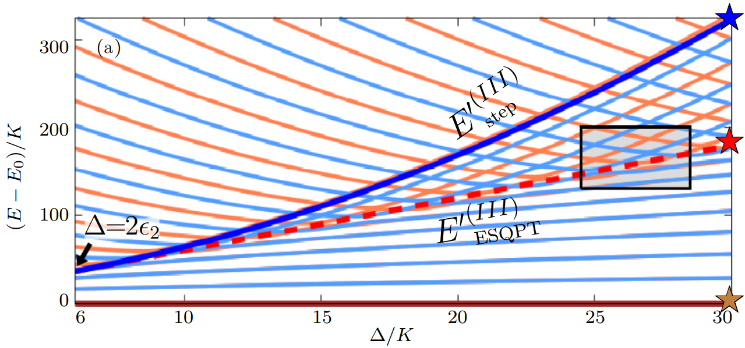
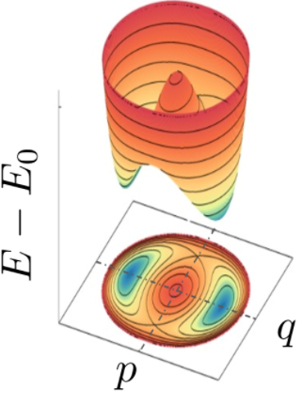
2-photon drive: Energy levels
Prado et al., PRA, 2023
Venkatraman et al., PNAS,2024
Iachello, et al., JPA, 2023
Number Parity Symmetry
${\hat{S}}_{2}=e^{−i2π\hat{n}/2}={\left(−1\right)}^{\hat{n}}=\hat{P}$
$$\hat{H}=−Δ{\hat{a}}^{†}\hat{a}+K{\hat{a}}^{†}{\hat{a}}^{†}\hat{a}\hat{a}−ε_{2}\left({{\hat{a}}^{†}}^{2}+{\hat{a}}^{2}\right)$$
Notes:
To understand the tunneling cancellation, lets analyze more carefully the 2photon drive case. The basic knowledge is when degenerate energies suppress tunnelling.
First let unsdertands the energy levels. Below First ESQPT, saddle poit, L and R. Above, No L and R. Local max due to detuning. New interaction between the states. Crossings.
When they happen? For that, we evoke Wigner-von Neumann theorem. Degeneracy means real crossings. Real crossing can only be possible from different symmetries. Otherwise we have avoided crossings which enables tunneling. Because <L|H|R> ~ dE.
Symmetry sectors dictated by Parity for 2 photons. Then we can plot the energy levels (blue is even). In DW trivial degeneracy, especially for deep wells. Shallow in real cases. Real crossings happening at even numbers and avoided at odd numbers. This only happens below ESQPTs. Above the local maximum no crossings. The local maximum gives the oportuniti for duality and possible crossings. We have the same thing for 3 and 4
KPO Hamiltonian basics:
Key idea:
μ = 2 → squeezing, Δ-Kerr-cat qubit (Venkatraman).
μ = 1, 3, 4 → new symmetry sectors (Zμ\mathbb{Z}_\muZμ​ rotational symmetries).
Phase space:
μ controls the number of wells (1, 2, 3, 4 "petals" in phase space).

Slide 10
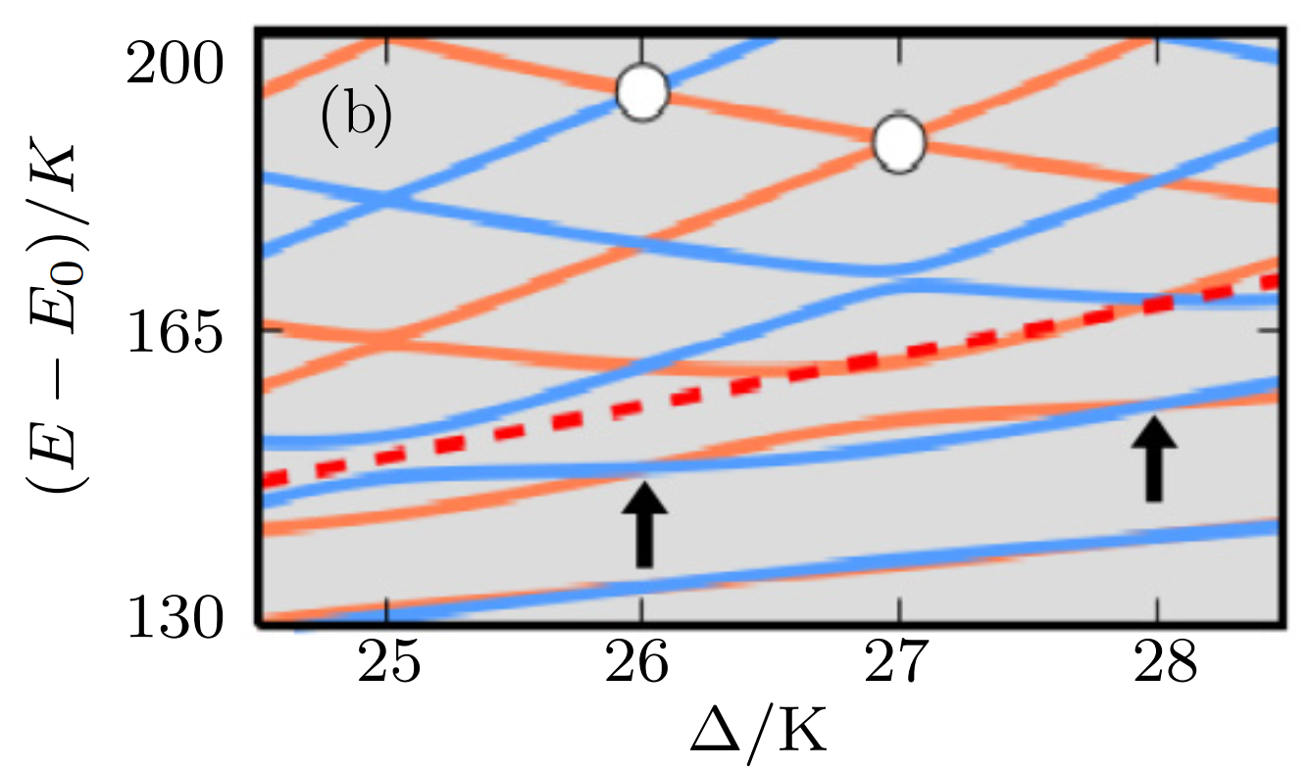
2-photon drive: Energy levels
Prado et al., PRA, 2023
Venkatraman et al., PNAS,2024
Iachello, et al., JPA, 2023
Number Parity Symmetry
${\hat{S}}_{2}=e^{−i2π\hat{n}/2}={\left(−1\right)}^{\hat{n}}=\hat{P}$
$$\hat{H}=−Δ{\hat{a}}^{†}\hat{a}+K{\hat{a}}^{†}{\hat{a}}^{†}\hat{a}\hat{a}−ε_{2}\left({{\hat{a}}^{†}}^{2}+{\hat{a}}^{2}\right)$$
Notes:
To understand the tunneling cancellation, lets analyze more carefully the 2photon drive case. The basic knowledge is when degenerate energies suppress tunnelling.
When they happen? For that, we evoke Wigner-von Neumann theorem. Degeneracy means real crossings. Real crossing can only be possible from different symmetries. Otherwise we have avoided crossings which enables tunneling. Because <L|H|R> ~ dE.
Symmetry sectors dictated by Parity for 2 photons. Then we can plot the energy levels (blue is even). In DW trivial degeneracy, especially for deep wells. Shallow in real cases. Real crossings happening at even numbers and avoided at odd numbers. This only happens below ESQPTs. Above the local maximum no crossings. The local maximum gives the oportuniti for duality and possible crossings. We have the same thing for 3 and 4
KPO Hamiltonian basics:
Key idea:
μ = 2 → squeezing, Δ-Kerr-cat qubit (Venkatraman).
μ = 1, 3, 4 → new symmetry sectors (Zμ\mathbb{Z}_\muZμ​ rotational symmetries).
Phase space:
μ controls the number of wells (1, 2, 3, 4 "petals" in phase space).

Slide 11
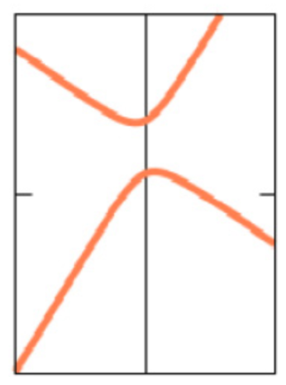
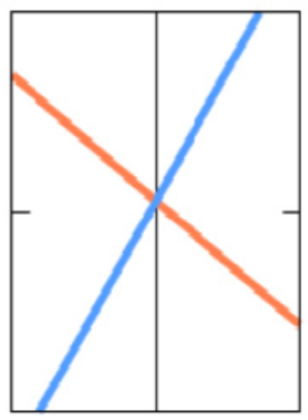


2-photon drive: Energy levels
Prado et al., PRA, 2023
Venkatraman et al., PNAS,2024
Iachello, et al., JPA, 2023
Number Parity Symmetry
${\hat{S}}_{2}=e^{−i2π\hat{n}/2}={\left(−1\right)}^{\hat{n}}=\hat{P}$
$$\hat{H}=−Δ{\hat{a}}^{†}\hat{a}+K{\hat{a}}^{†}{\hat{a}}^{†}\hat{a}\hat{a}−ε_{2}\left({{\hat{a}}^{†}}^{2}+{\hat{a}}^{2}\right)$$
Wigner-von Neumann theorem
Real crossings: $≠$ symmetries
Avoided crossings: $=$ symmetries
Notes:
To understand the tunneling cancellation, lets analyze more carefully the 2photon drive case. The basic knowledge is when degenerate energies suppress tunnelling.
When they happen? For that, we evoke Wigner-von Neumann theorem. Degeneracy means real crossings. Real crossing can only be possible from different symmetries. Otherwise we have avoided crossings which enables tunneling. Because <L|H|R> ~ dE.
Symmetry sectors dictated by Parity for 2 photons. Then we can plot the energy levels (blue is even). In DW trivial degeneracy, especially for deep wells. Shallow in real cases. Real crossings happening at even numbers and avoided at odd numbers. This only happens below ESQPTs. Above the local maximum no crossings. The local maximum gives the oportuniti for duality and possible crossings. We have the same thing for 3 and 4
KPO Hamiltonian basics:
Key idea:
μ = 2 → squeezing, Δ-Kerr-cat qubit (Venkatraman).
μ = 1, 3, 4 → new symmetry sectors (Zμ\mathbb{Z}_\muZμ​ rotational symmetries).
Phase space:
μ controls the number of wells (1, 2, 3, 4 "petals" in phase space).

Slide 12
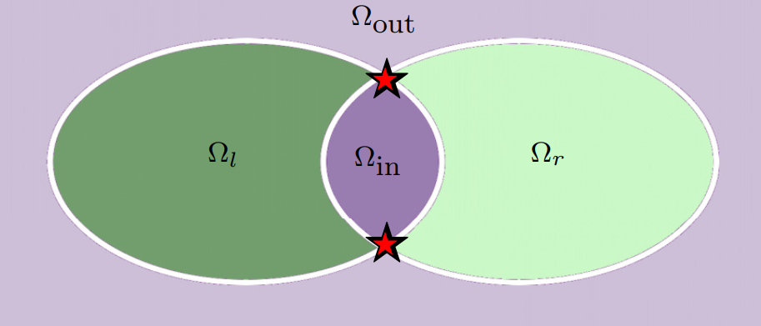
2-photon drive: Tunneling
Prado et al., PRA, 2023
Notes:
The tunneling suppression or enhancement is felt in the regions between ESQPTs (local maximum and saddle point). Therefore, we focus the amount of tuneling from OUT to IN. However, the same can be done for R and L, with the same conclusions.
To quantify the tunneling, we prepare a coherent state in the region OUTSIDE very close to saddle point (having the same energy as local maximum ) and calculate its Husimi function and its volume in the quantum phase space (Monte Carlo integration). Therefore, the effective tunneling will be measure by the difference of the amount of Husimi in the beginning with the amount after a certain time in the phase space. Any increase of loss means tunneling.
Following the blue ribbon, we have the avoided crossings for the same symmetry sectors, leading to an enhancement of tunneling (Husimi is lost to IN). Now, real crossings cancel the tunelling and protect the states.

Slide 13
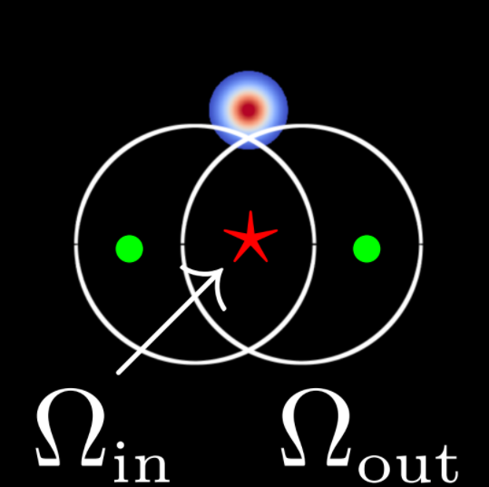
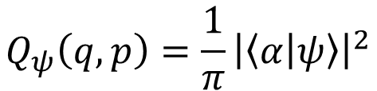
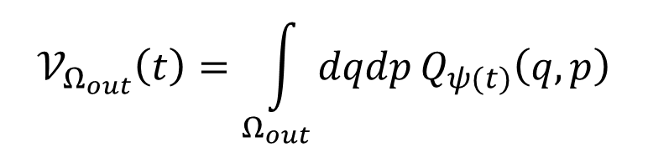
2-photon drive: Tunneling
$$Q_{ψ}\left(q,p\right)=\frac{1}{π}{\left|\left\langle α | ψ\right\rangle \right|}^{2}$$
$$𝒱_{Ω_{out}}\left(t\right)=\int_{Ω_{out}}^{ }{dqdp}Q_{ψ(t)}\left(q,p\right)$$
$$Τ_{Ω_{out}}\left(t, t_{0}\right)=𝒱_{Ω_{out}}\left(t\right) −𝒱_{Ω_{out}}\left(t_{0}\right)$$
Prado et al., PRA, 2023
Notes:
The tunneling suppression or enhancement is felt in the regions between ESQPTs (local maximum and saddle point). Therefore, we focus the amount of tuneling from OUT to IN. However, the same can be done for R and L, with the same conclusions.
To quantify the tunneling, we prepare a coherent state in the region OUTSIDE very close to saddle point (having the same energy as local maximum ) and calculate its Husimi function and its volume in the quantum phase space (Monte Carlo integration). Therefore, the effective tunneling will be measure by the difference of the amount of Husimi in the beginning with the amount after a certain time in the phase space. Any increase of loss means tunneling.
Following the blue ribbon, we have the avoided crossings for the same symmetry sectors, leading to an enhancement of tunneling (Husimi is lost to IN). Now, real crossings cancel the tunelling and protect the states.

Slide 14
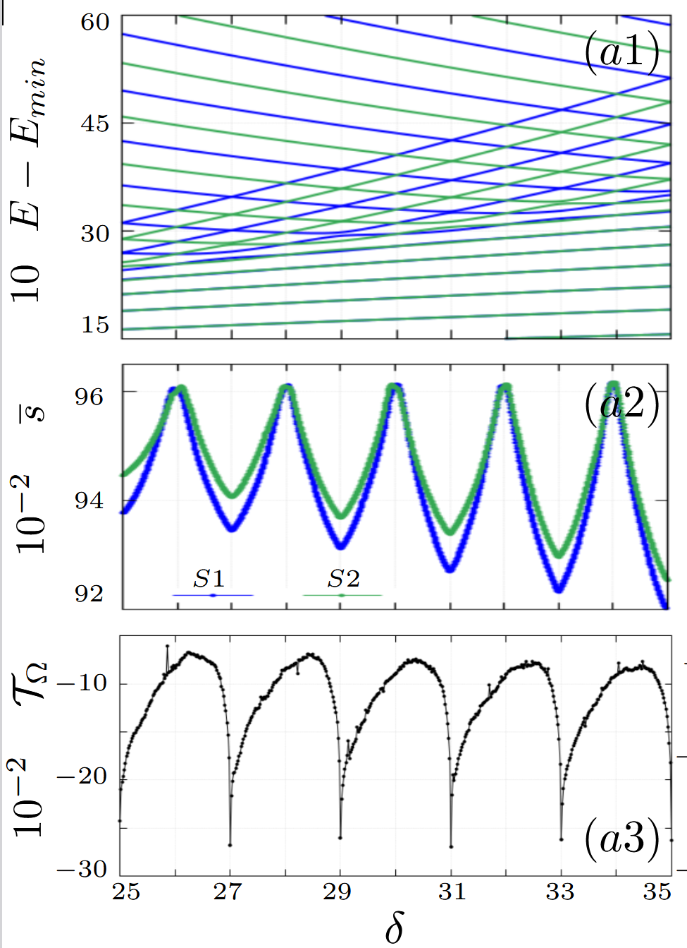

2-photon drive: Tunneling
$$ε_{2}=5$$
$$Q_{ψ}\left(q,p\right)=\frac{1}{π}{\left|\left\langle α | ψ\right\rangle \right|}^{2}$$
$$𝒱_{Ω_{out}}\left(t\right)=\int_{Ω_{out}}^{ }{dqdp}Q_{ψ(t)}\left(q,p\right)$$
$$Τ_{Ω_{out}}\left(t, t_{0}\right)=𝒱_{Ω_{out}}\left(t\right) −𝒱_{Ω_{out}}\left(t_{0}\right)$$
odd
even
Prado et al., PRA, 2023
Notes:
The tunneling suppression or enhancement is felt in the regions between ESQPTs (local maximum and saddle point). Therefore, we focus the amount of tuneling from OUT to IN. However, the same can be done for R and L, with the same conclusions.
To quantify the tunneling, we prepare a coherent state in the region OUTSIDE very close to saddle point (having the same energy as local maximum ) and calculate its Husimi function and its volume in the quantum phase space (Monte Carlo integration). Therefore, the effective tunneling will be measure by the difference of the amount of Husimi in the beginning with the amount after a certain time in the phase space. Any increase of loss means tunneling.
Following the blue ribbon, we have the avoided crossings for the same symmetry sectors, leading to an enhancement of tunneling (Husimi is lost to IN). Now, real crossings cancel the tunelling and protect the states.

Slide 15
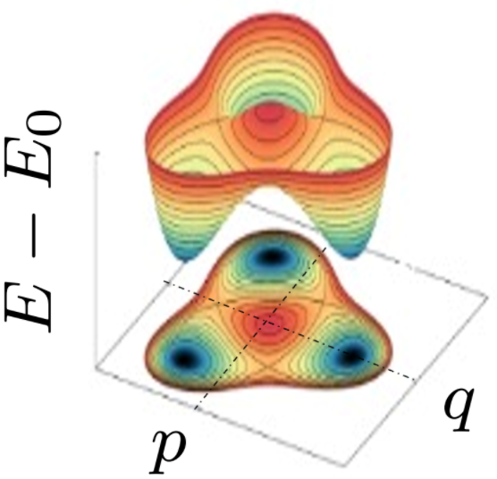
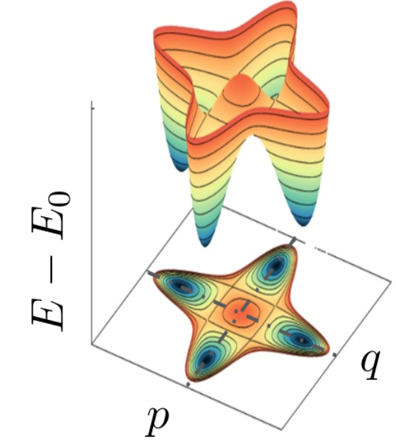
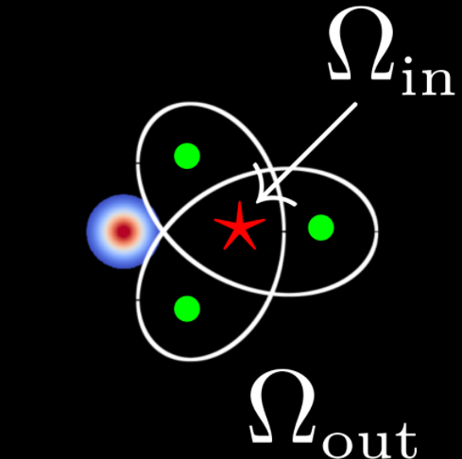
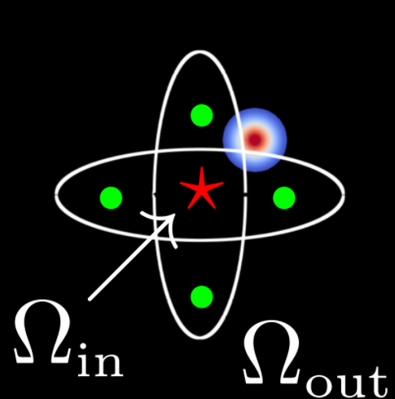


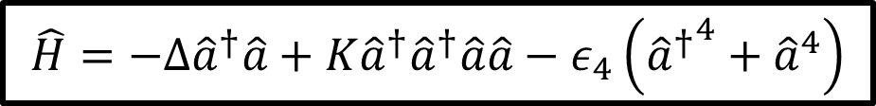
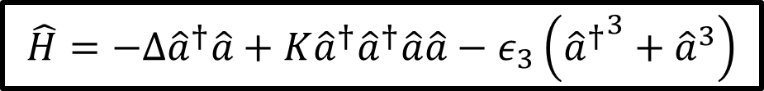
Multi-photon drive
$$\hat{H}=−Δ{\hat{a}}^{†}\hat{a}+K{\hat{a}}^{†}{\hat{a}}^{†}\hat{a}\hat{a}−ε_{3}\left({{\hat{a}}^{†}}^{3}+{\hat{a}}^{3}\right)$$
$$\hat{H}=−Δ{\hat{a}}^{†}\hat{a}+K{\hat{a}}^{†}{\hat{a}}^{†}\hat{a}\hat{a}−ε_{4}\left({{\hat{a}}^{†}}^{4}+{\hat{a}}^{4}\right)$$
$${\hat{S}}_{3}=e^{−i2π\hat{n}/3}$$
$${\hat{S}}_{4}=e^{−i2π\hat{n}/4}$$
Notes:
Since we understand how it works for 2 photon drive, we can apply the same analysis for 3 and 4 and obtain the Delta protected states. The important change for 3 and 4 photon drive is the symmetry. Instead of parity, creating 3 or 4 symmetry sectors based on each case. The symmetry is associated with Z_3 and Z_4 discrete rotations in phase space. However the same idea is applied, due to the detuning a local maximum (ESQPT) is formed in the middle of the wells, and tunneling suppression can be study by the same procedure. Prepare a coherent state outside and see how much is lost to the local maximum.
Expand same characterization to mu= 3 and 4
Analyze KPOs for μ = 1, 2, 3, 4.
Classical limit: identify critical points (ground-state QPTs and ESQPTs).
Floquet quasienergies: study level crossings and tunneling.
Main results:
New spectral structures: real vs avoided crossings depend on symmetry.
Effective control of tunneling via interference.
Possibility to engineer robust qubit manifolds by choosing μ and parameters carefully.

Slide 16
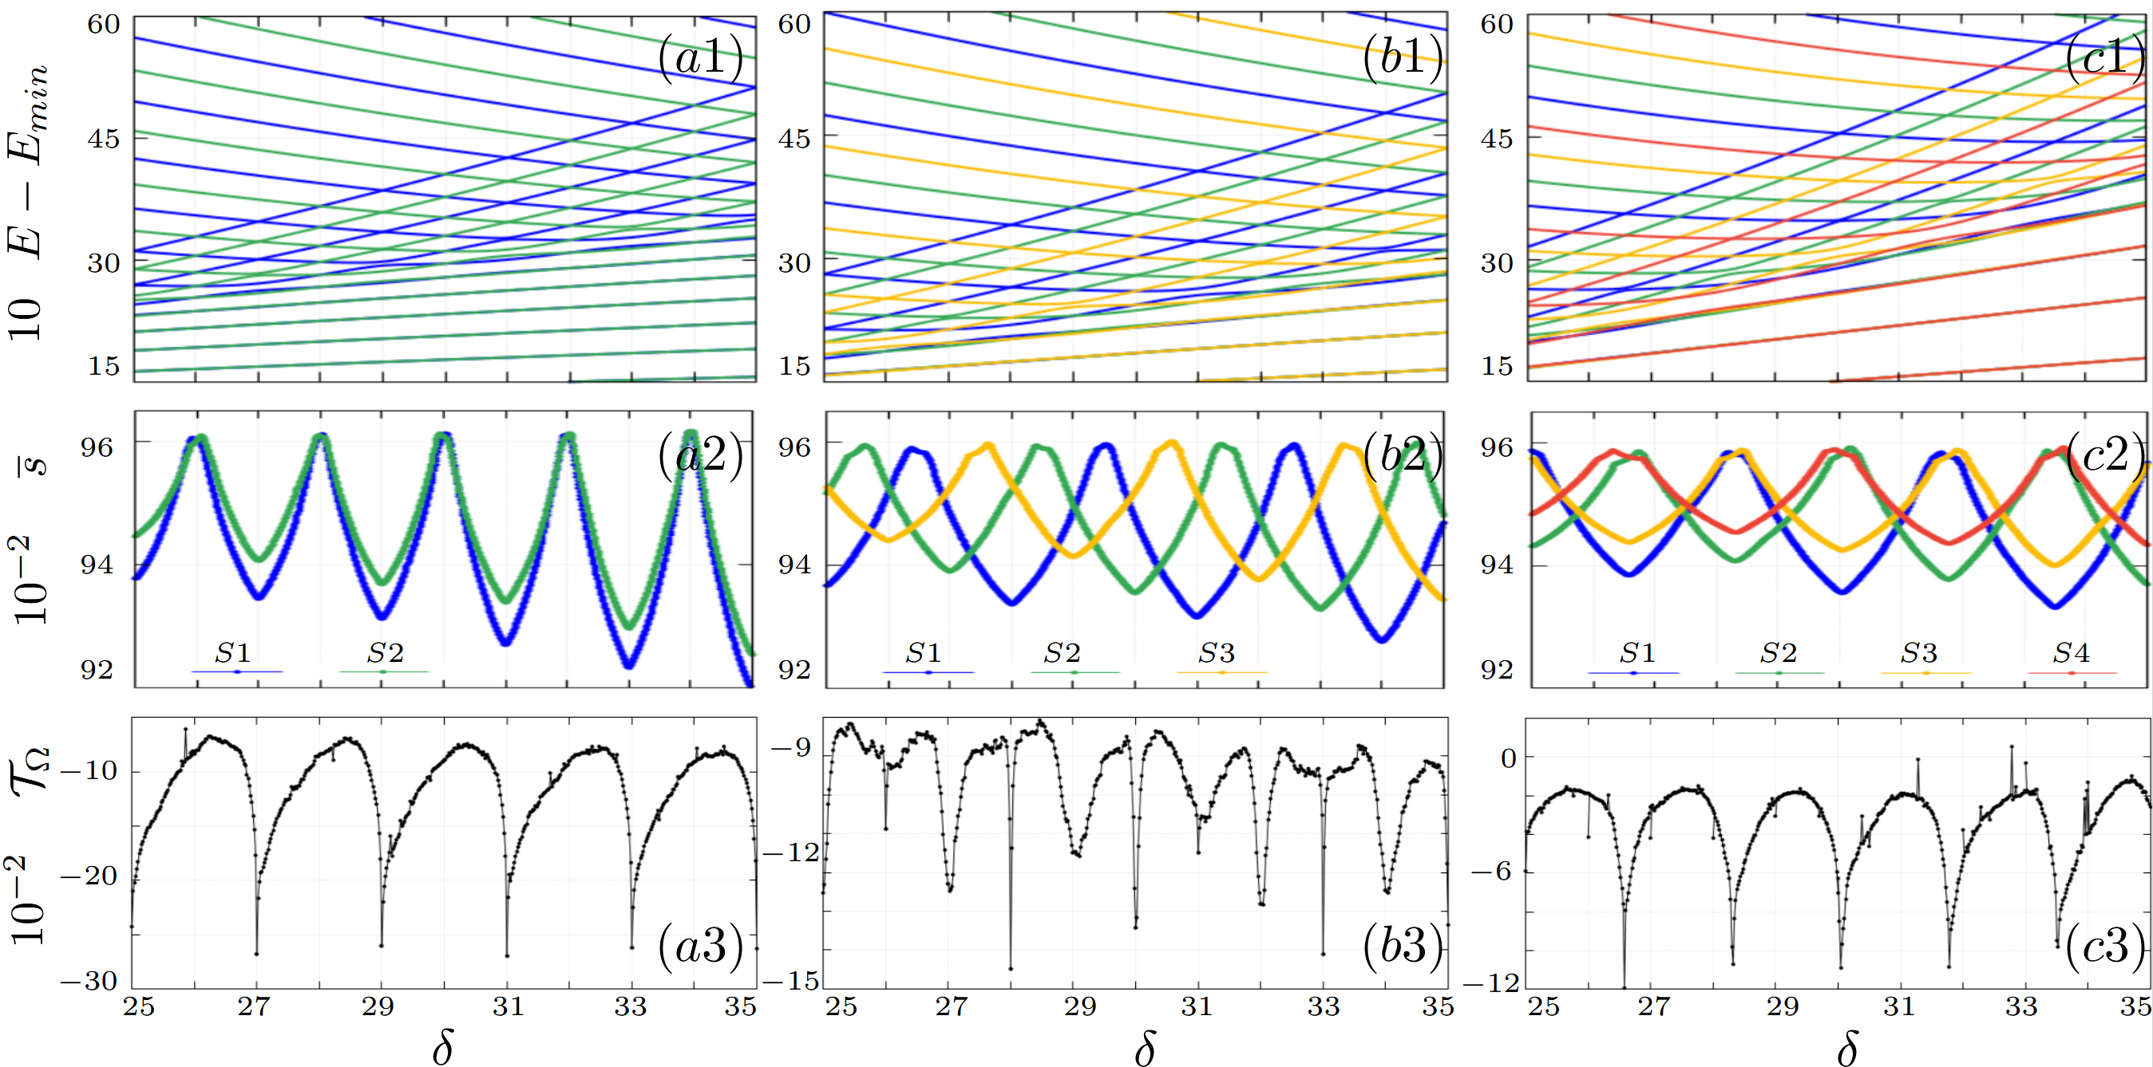


Multi-photon drive: Tunneling
$$ε_{3}=1$$
$$ε_{4}=0.25$$
Notes:
Starting by 3-photon drive. Above the max, we see the split energies from different symmetries. Below the ESQPT tunneling takes place and the interplay between the crossings are important. Unfortunately, the game is highly non-trivial. Take one of the highest tunneling, we see clearly an avoided crossings from the green but a real crossing for the other two symmetries. And that seems to be the trend. For the suppression, it is something in between, we saw that whenever you have a real crossing from one, you have a avoided to the other (favoring tunneling). The best the system can get is some5ying in between.
Now for the 4-photon drive, instead of 3 we have 4 symmetry sectors. Now, real and avoided crossing is appear in pairs. The battle between avoided and real, tunneling prevails. We have the dips into the inside space due to tunneling. The suppression again come from something in between. No trend was found.

Slide 17

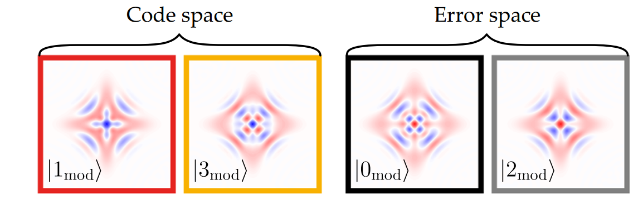
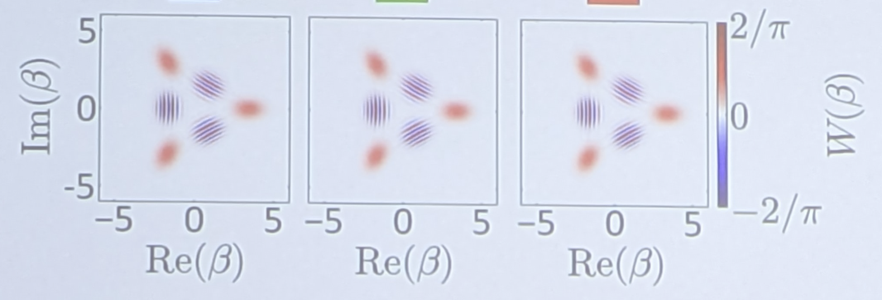
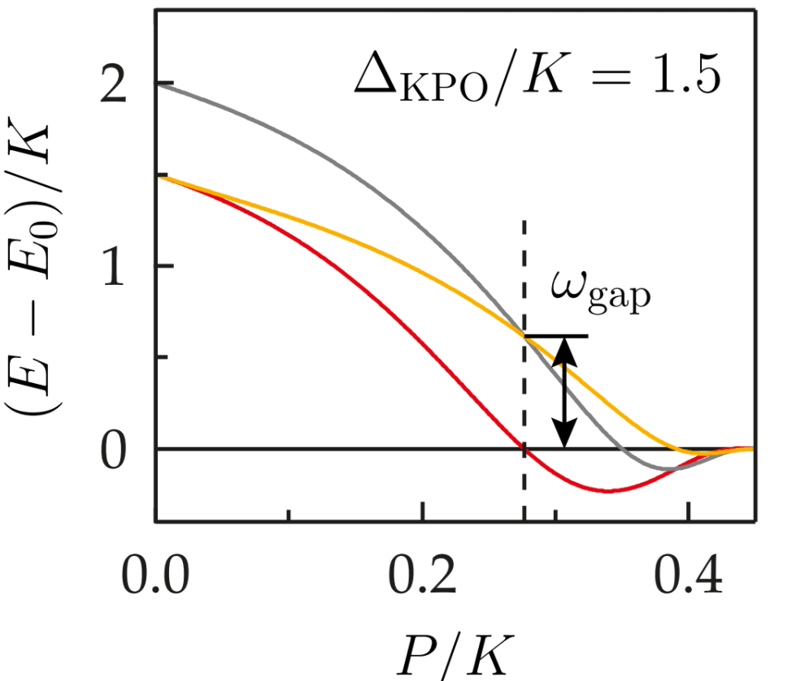
Superconducting Qubits
Kwon et al., NPJ Quantum
Dr. Alexander Grimm
Autonomous quantum error correction
Image curtesy of Alessandro Bruno. PSI group
Qutrits
Notes:
How this becomes useful in regards of qubits
For 4 photon, It has already been realized 4-legged cat states. In fact, the degenerancy by pairs has been used to autonomous quantum error correction. For 4 photon drive we have the 4 degenerated GS, but parity is still a symmetry where for even lays the blocks 0 and 2 and odd 1 and 3. So any degenerancy must be between even and odd. For this case, they engineering states from odd parity as thei logical qubits and the correspondent degenerate state as ancilla for corrections. The gap between the logical odd states becomes an additional protection that I was achieved by detuning. Photon-drive resistant, since 1 goes 0 and 3 goes 2.
Otherwise, for 3-photon drive we haven’t found any experiment done in regards to qubits. However, we have been in contact to a member of Dr. Alexandre Grimm group in Swisterland, where they are working exactly on the 3 photon case to build qutrits. Same resistance to one-photon loss was observed getting exciment in this avenue. However, we already predict that canceling the tunneling effective as for 2 photon drive will be a caveat.
Extending the Δ-Kerr-cat idea:
Not limited to 2-photon squeezing.
Can explore 3-photon, 4-photon driven architectures.
More control over phase space topology and protection:
Symmetry-protected subspaces.
Tunable tunneling barriers via driving.

Slide 18
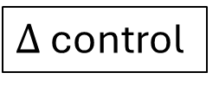
Conclusion
Systematic analysis of Tunneling for multi-photon driven KPOs.
4-photon drive AQER 3-photon drive Qutrit
Future: Expand to dissipative KPO and KPOs!!
Suppression Real crossings Enhancement Avoided crossings
$Δ$ control
arXiv:2504.15347v1
Notes:
To conclude, we cover a systematic analysis to describe tunneling for multi-photon driven KPOs. From Wigner-von Neuman theorem, we could relate tunneling suppression to real crossings in the energy levels and tunnling enhancement for avoided crossings. All was possible by controlling the detuning. The same has been applied to engineering qubits with autonomous quantum error correction and can be possibly used to engineer qutrit with 3-photon drive. From now, we want to bring dissipation that we have not considered already and characterize coupled KPOs.
We extend Δ-Kerr-cat ideas to multi-photon driven KPOs.
Symmetry and tunneling control are crucial tools for future qubit designs.
Opens new directions in quantum error protection and Floquet-engineered quantum systems

Slide 19


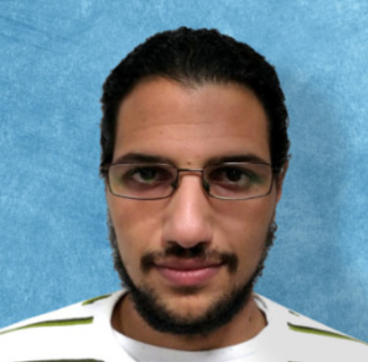
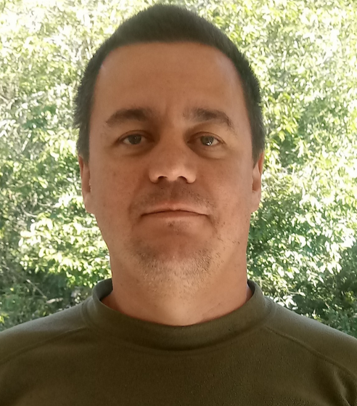
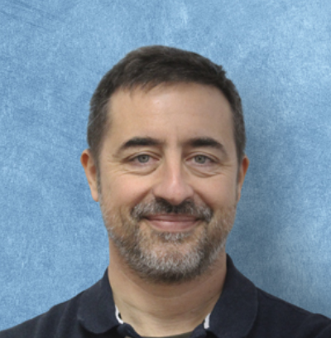
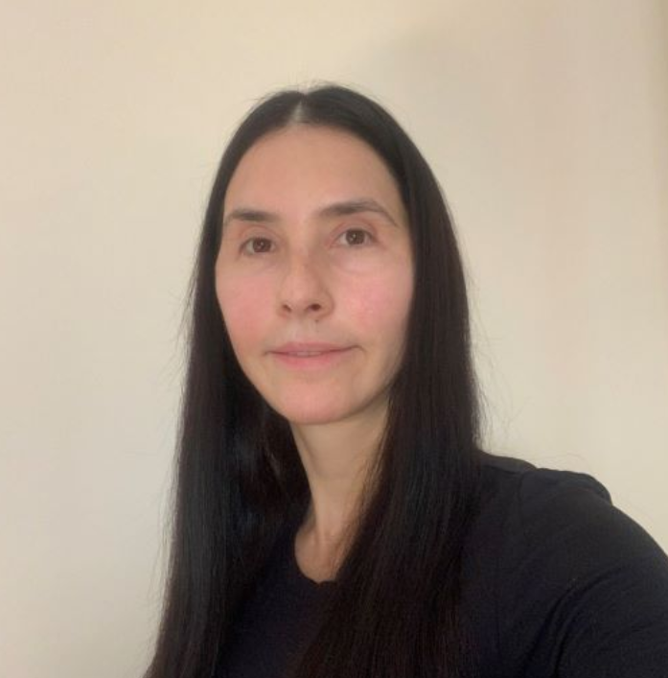



Thank you!!
Miguel A.P. Reynoso
Edson M. Signor
Jamil K. Riveira
Alexandre D. Ribeiro
Francisco P. Bernal
Lea F. dos Santos

Slide 20
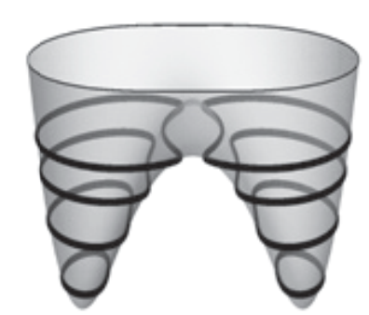

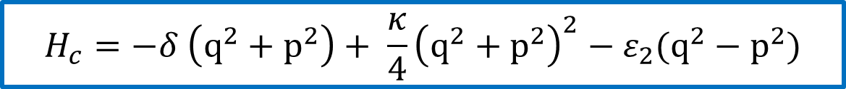
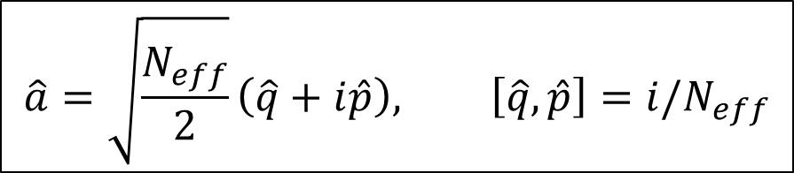


Semiclassical analysis - Metapotential
Dimensionless quadratures:
$N_{eff}→ ∞ \left[\hat{q},\hat{p}\right]= 0=iℏ\left\{q,p\right\}$
${\hat{H}}_{eff}=−Δ{\hat{a}}^{†}\hat{a}+K{\hat{a}}^{†}{\hat{a}}^{†}\hat{a}\hat{a}−ε_{2}\left({{\hat{a}}^{†}}^{2}+{\hat{a}}^{2}\right)$
$$\hat{a}=\sqrt{\frac{N_{eff}}{2}}\left(\hat{q}+i\hat{p}\right), \left[\hat{q},\hat{p}\right]=i/N_{eff}$$
$${κ=KN_{eff}^{2} \atop \begin{aligned}δ=ΔN_{eff} \\ ε_{2}=ε_{2}N_{eff}\end{aligned}}$$
$$H_{c}=−δ \left(q^{2}+p^{2}\right)+ \frac{κ}{4}{\left(q^{2}+p^{2}\right)}^{2}−ε_{2}(q^{2}−p^{2})$$
Notes:
Divide by K to have 2 parameters dependency. Depend on the ratio. Neff plays the role of how many levels we have inside the potential. As we increase Neff we increase the parameters. In actual experiments, just make these parameters really big.

Slide 21
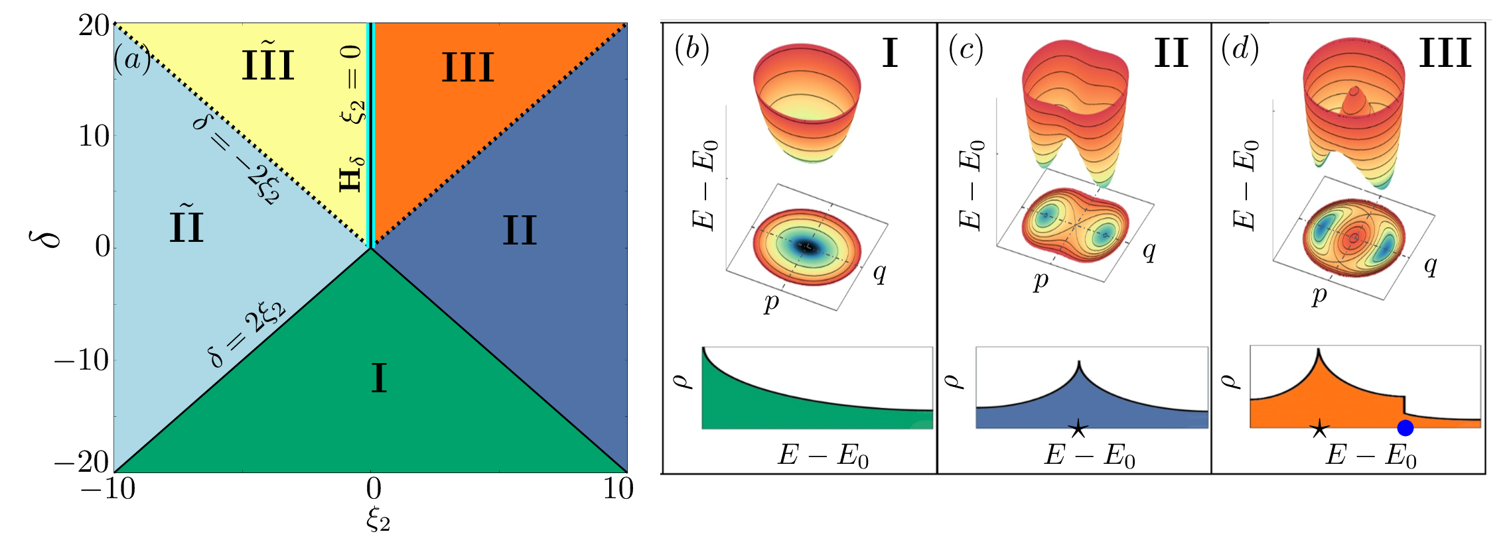
Semiclassical analysis - Metapotential
$$H_{c}=−δ \left(q^{2}+p^{2}\right)+ \frac{1}{4}{\left(q^{2}+p^{2}\right)}^{2}−ε_{2}\left(q^{2}−p^{2}\right), κ=1$$
arXiv:2504.15347v1
Notes:
Energy surface, called metapotential diff from potential is not K +P. Now if the metapotential, we can have a framework of the Quantum system. We can see the diff formats of the matapotential with those parameters. They want that we focus on is the dowuble well.

Slide 22
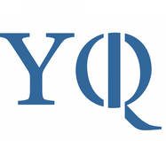
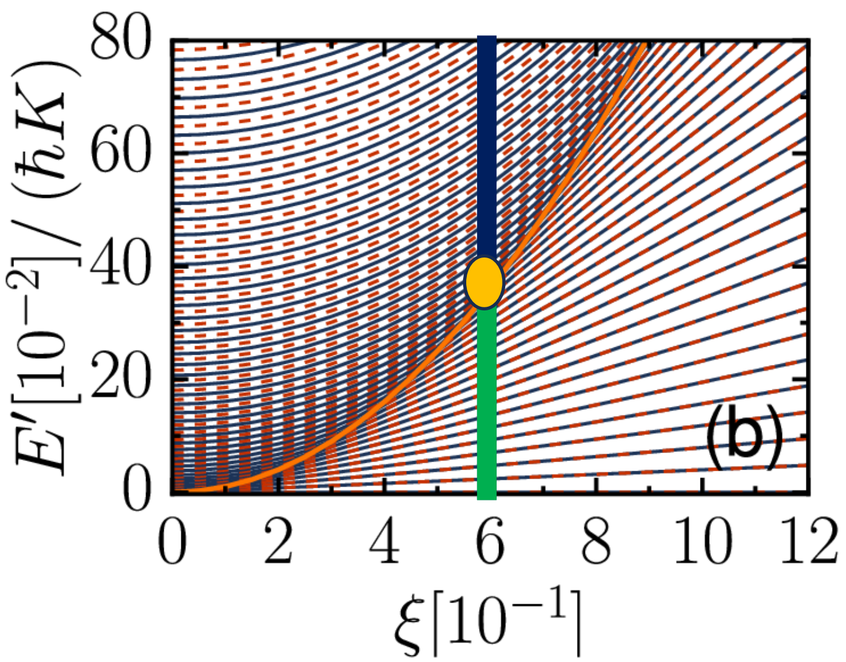
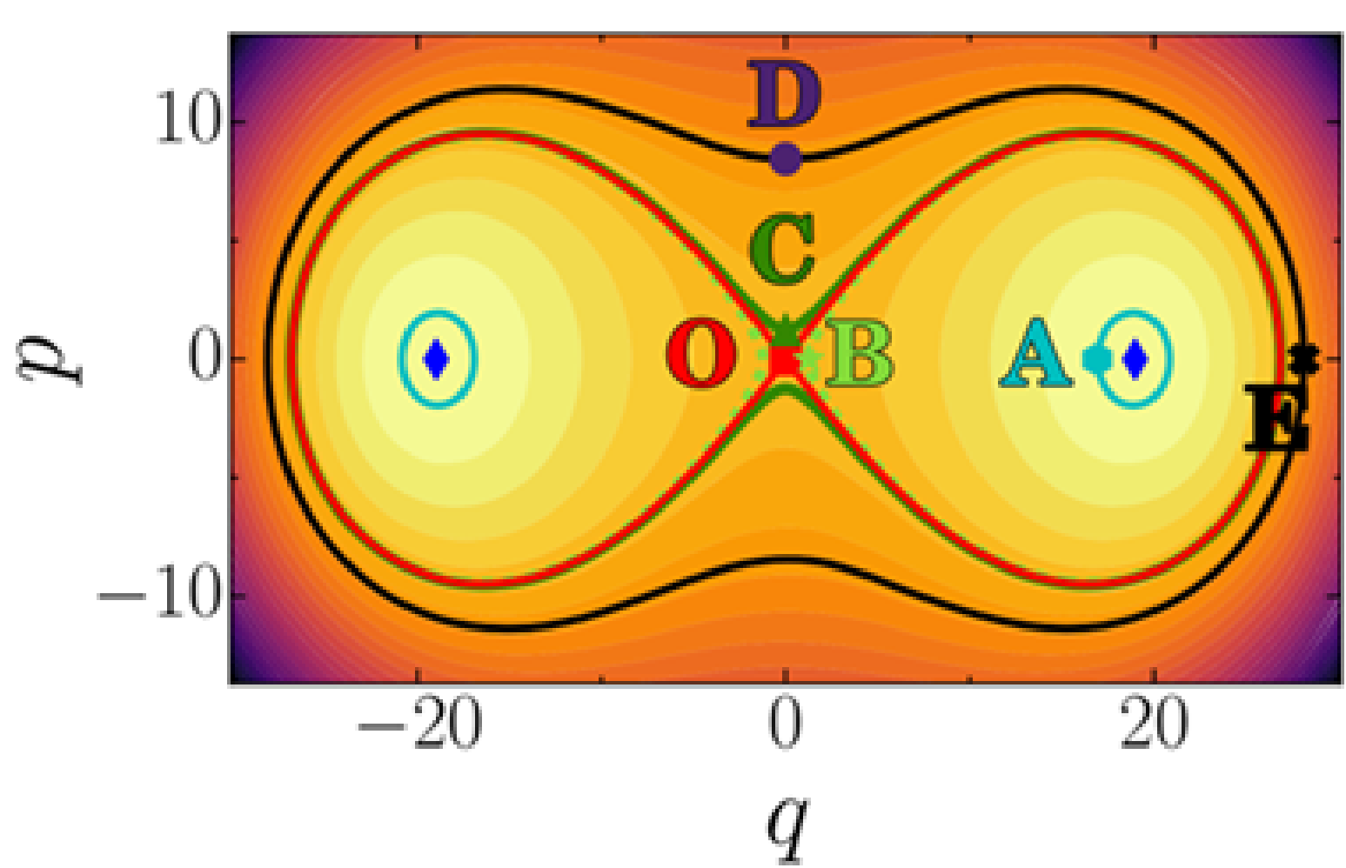
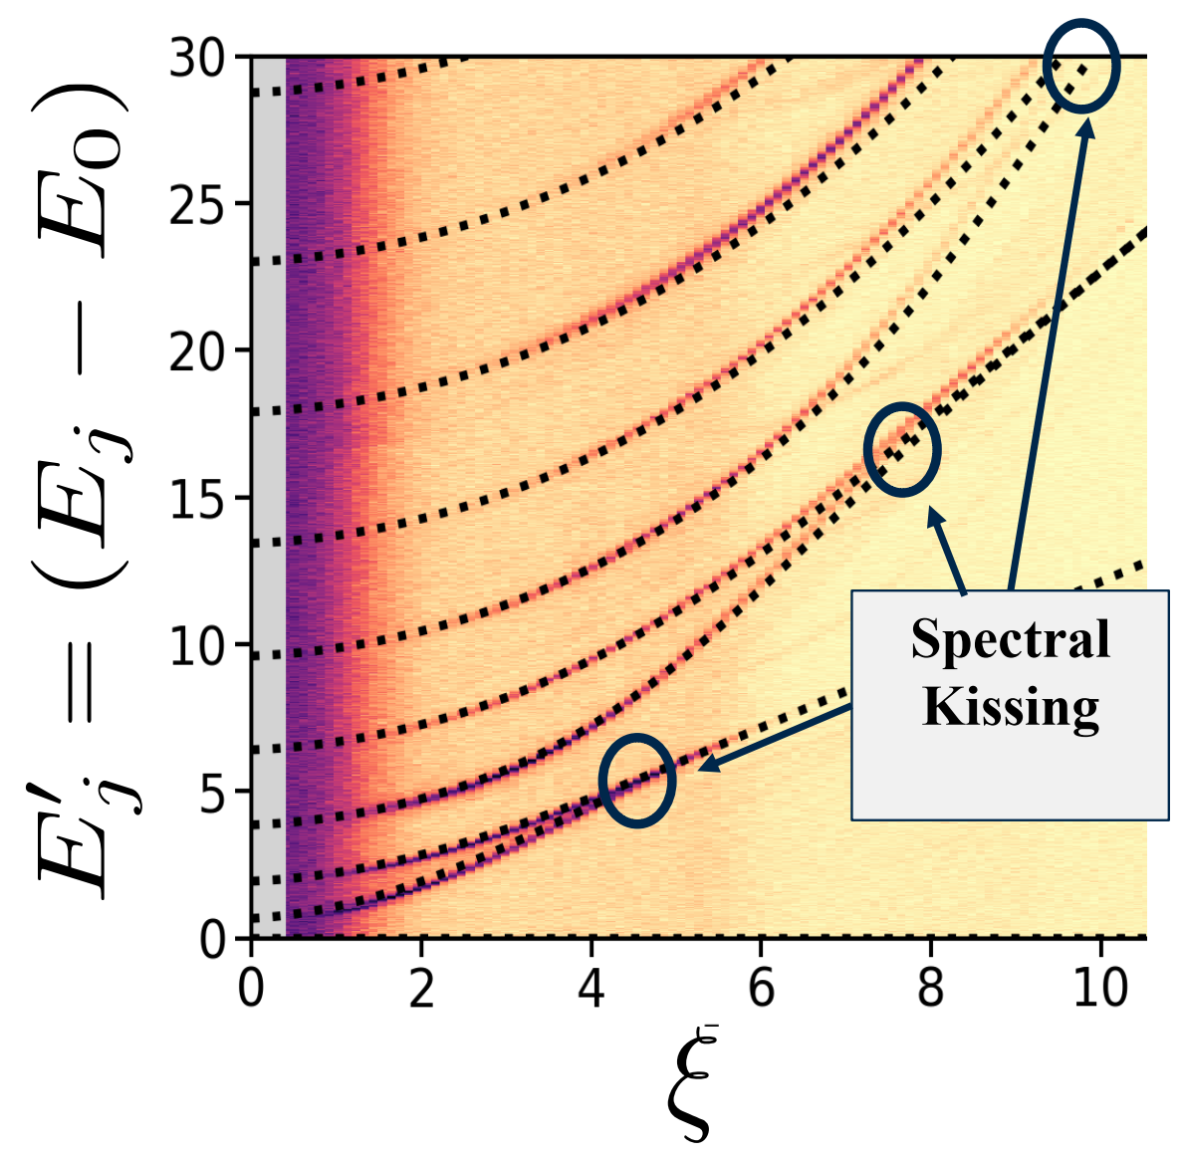
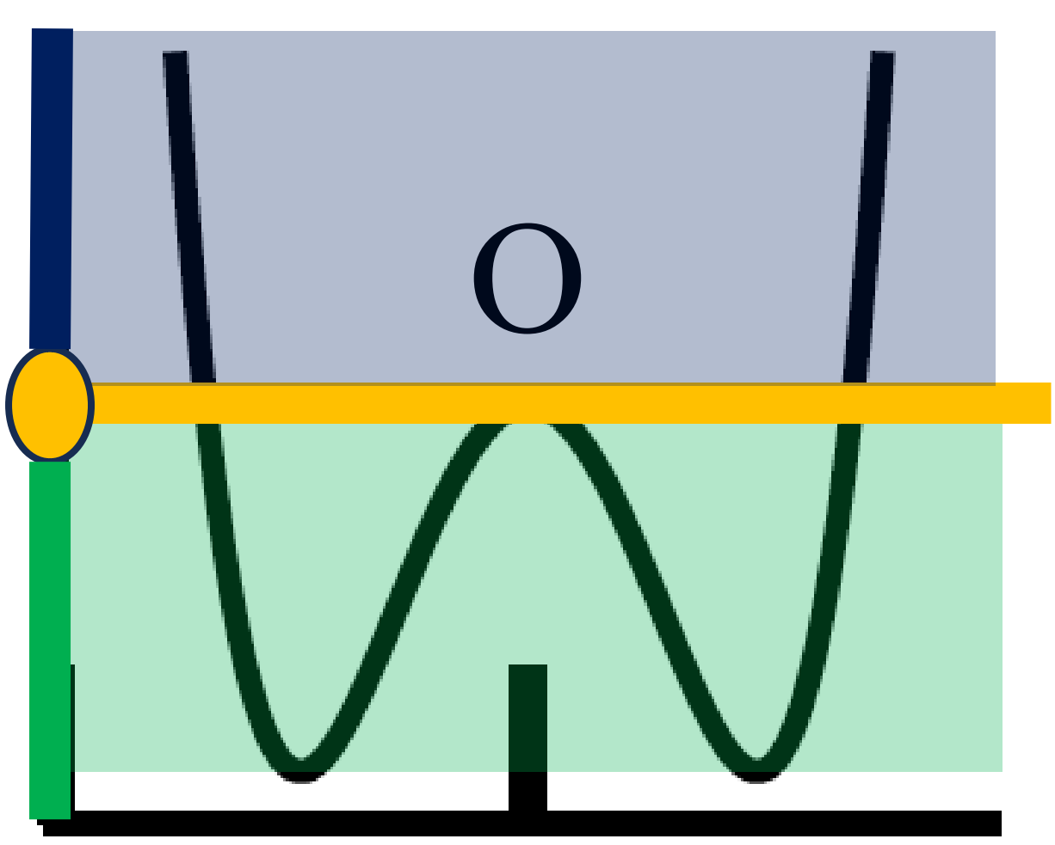
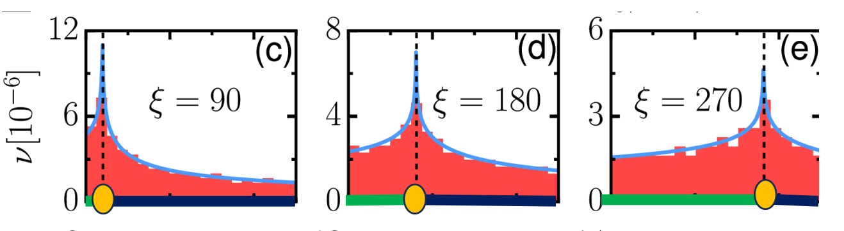
Semiclassical analysis – ESQPT
Energy surface
QuLab
Notes:
Following the vertical line. Multiple energy levels, The ESQPT critical energy value marks the boundary between two regions with different dominating symmetries. Why tunneling is good. Protection. Simone works LMG model (spin model). Where they also had this leminiscate. Expotential grow in one direction. Time-reversal protocol to instead of spread, squeeze it. Why does energy concentrate physically?

Slide 23

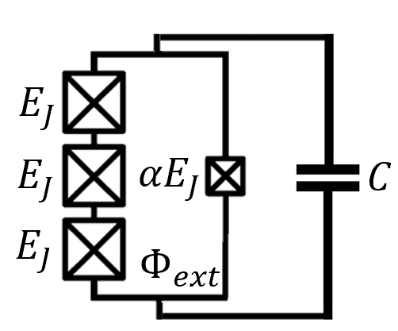
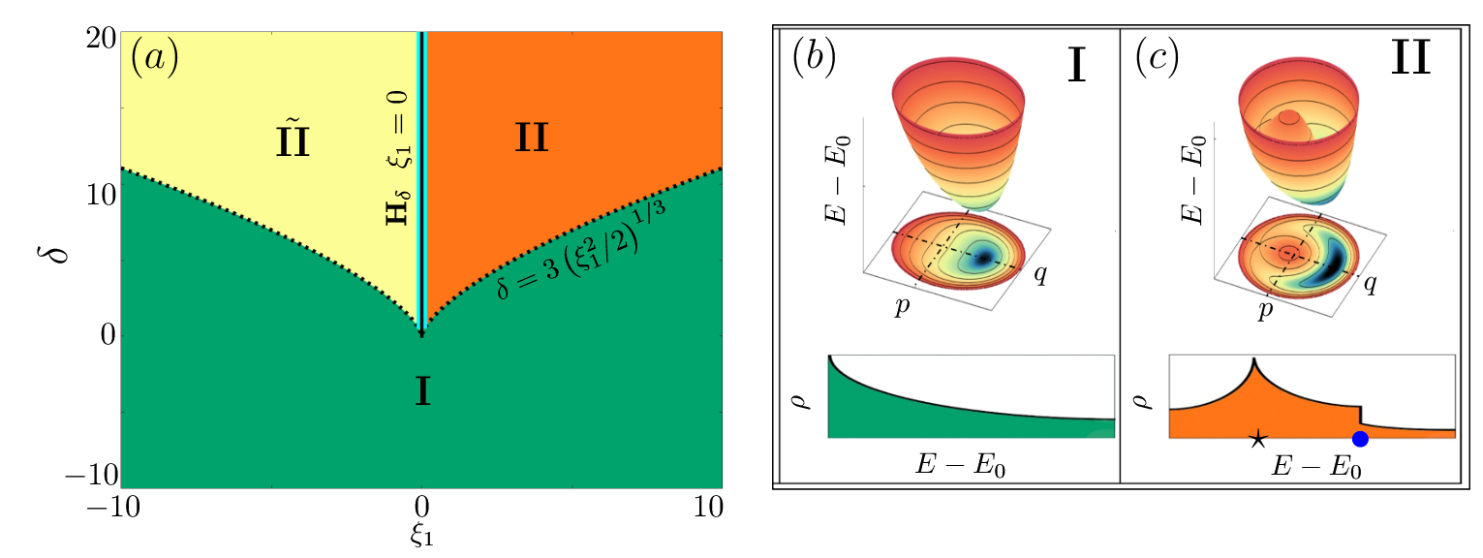
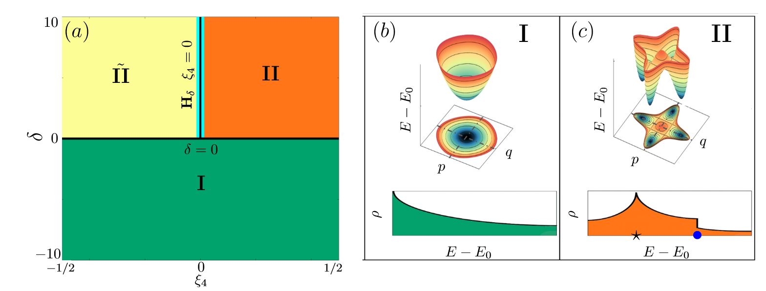
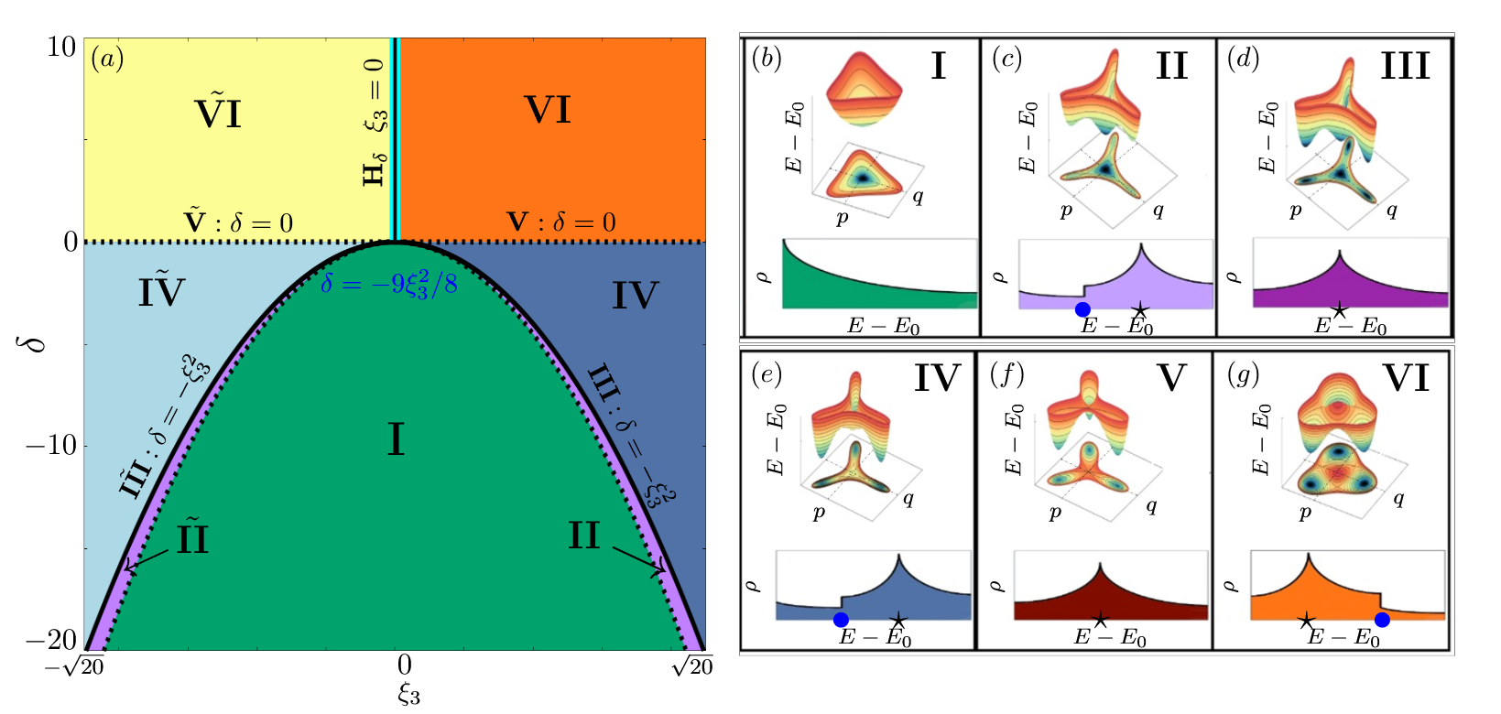




Semiclassical analysis – QPT & ESQPT
$$ω_{d}≈μω_{a}$$
$${\hat{H}}_{eff}=−Δ{\hat{a}}^{†}\hat{a}+K{\hat{a}}^{†}{\hat{a}}^{†}\hat{a}\hat{a}−ε_{μ}\left({{\hat{a}}^{†}}^{μ}+{\hat{a}}^{μ}\right), μ=1,2,3,4$$
$$μ=1$$
$$μ=4$$
$$μ=3$$
arXiv:2504.15347v1
Notes:
Anallogy. All kinds of Phase transitions. 2 types of ESQPT. Tunneling. What we did and put on arvix las month, is doing this same analysis not just for 2 photons drive. Drive mu. We characterized all the possible transition for each case as QPT and ESQPT. Give examples. Untable and stable points appear from bifuractions.
QPTs: GS change. QPT and EQPT high QFI, High precision. Very sensitive in the parameter. QFI is fidelity susceptibility. Mention tunneling.

