Slide 1
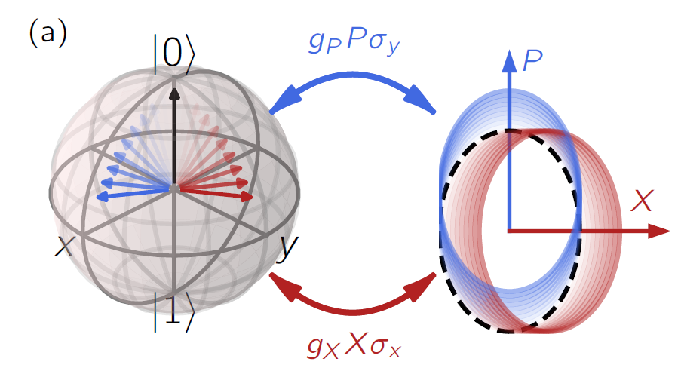


Mixed coupling for qubit readout with suppressed residual shot-noise dephasing
Jinlun Hu
Antonio L. Manesco
André Melo
Taryn V. Stefanski
Valla Fatemi
Christian K. Andersen

Slide 2

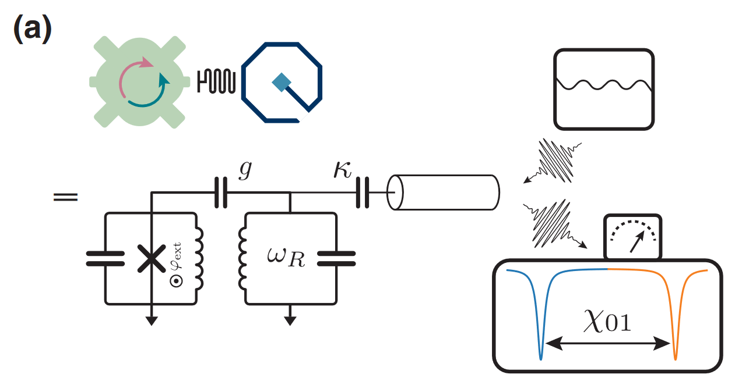


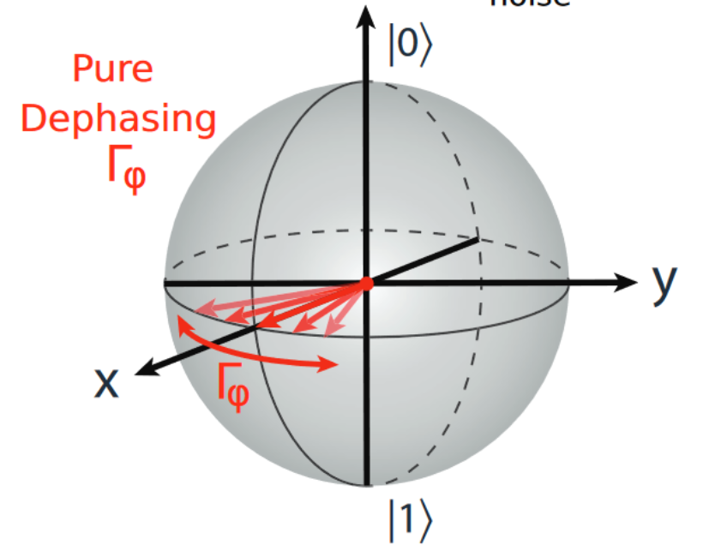
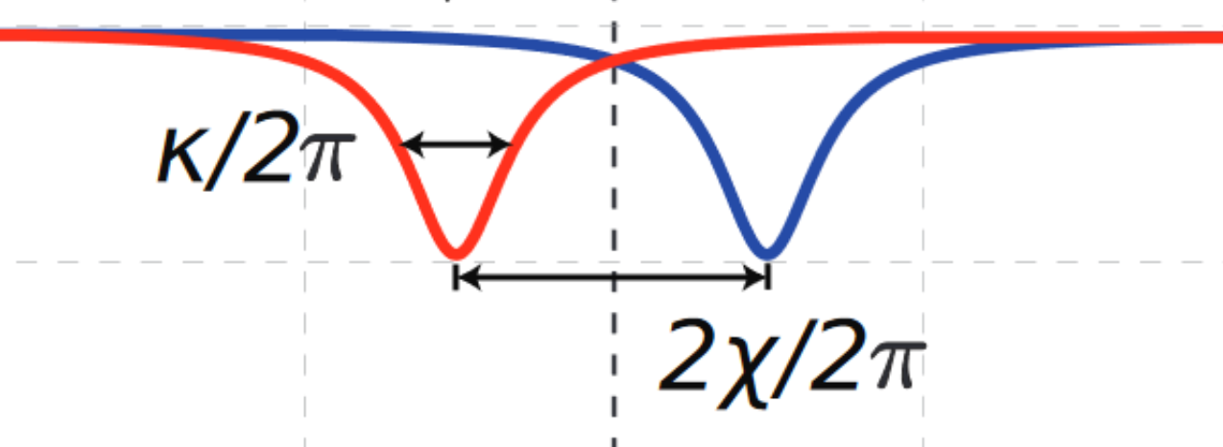

The trade-off in dispersive readout
arXiv: 2503.13411
Dispersive readout
Photon shot noise
Nguyen et al. “Blueprint for a high-performance fluxonium quantum processor.” PRX Quantum 3.3 (2022).
Krantz et al. “A quantum engineer's guide to superconducting qubits.” Appl. Phys. Rev. 6.2 (2019).
Notes:
- Dispersive Hamiltonian

Slide 3
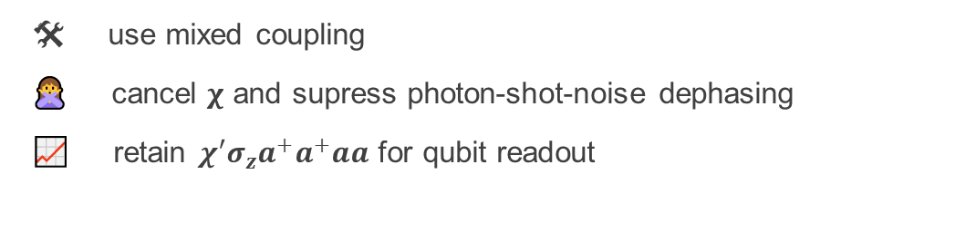
Our work
arXiv: 2503.13411
At the circuit Hamiltonian level
🛠 use mixed coupling
🙅 cancel $χ$ and supress photon-shot-noise dephasing
📈 retain $χ′σ_{z}a^{+}a^{+}aa$ for qubit readout
Notes:
It acts as a tunable coupler that automatically reduces the effective linewidth 𝜅eff of the readout resonator with the application of a readout pulse.

Slide 4
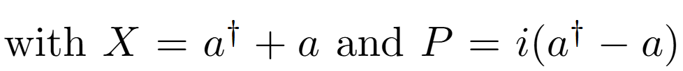
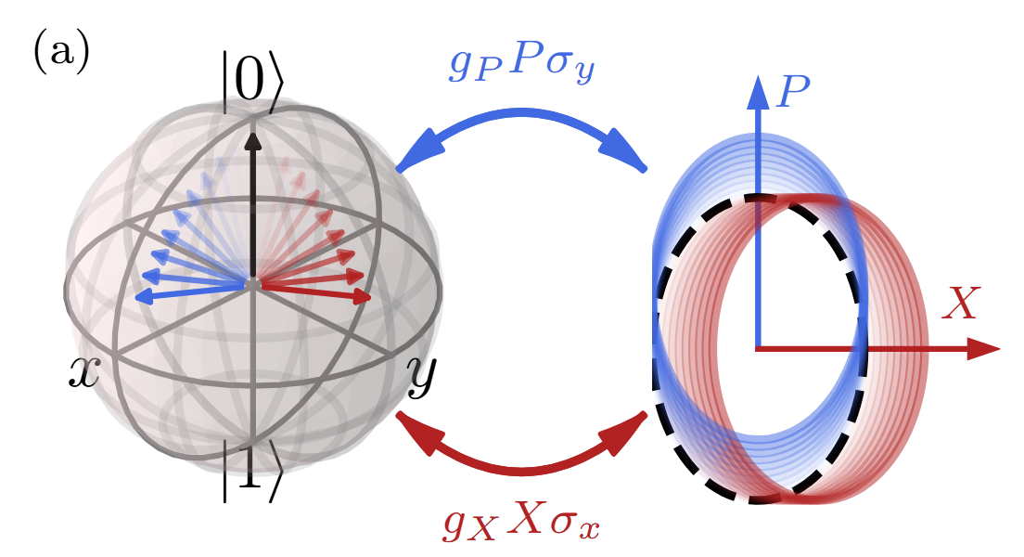
The mixed coupling scheme
arXiv: 2503.13411
Dipole coupling for dispersive readout
where and
Under dispersive limit + apply RWA:
$$χ$$
Mixed coupling
Notes:
It acts as a tunable coupler that automatically reduces the effective linewidth 𝜅eff of the readout resonator with the application of a readout pulse.

Slide 5
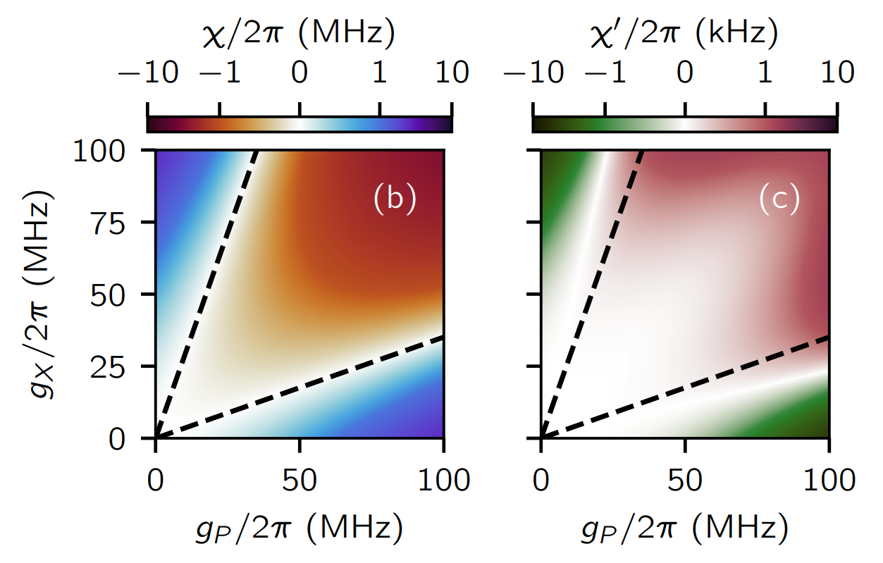
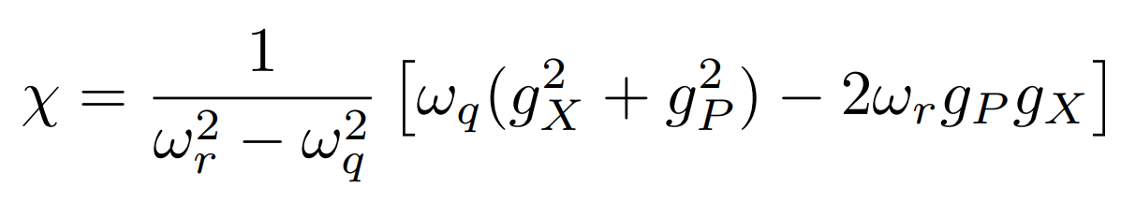
Higher-order Kerr shift with zero dispersive shift
arXiv: 2503.13411
Can be made 0!
Can engineer $χ=0$ with finite $χ$’!
Notes:
It acts as a tunable coupler that automatically reduces the effective linewidth 𝜅eff of the readout resonator with the application of a readout pulse.

Slide 6
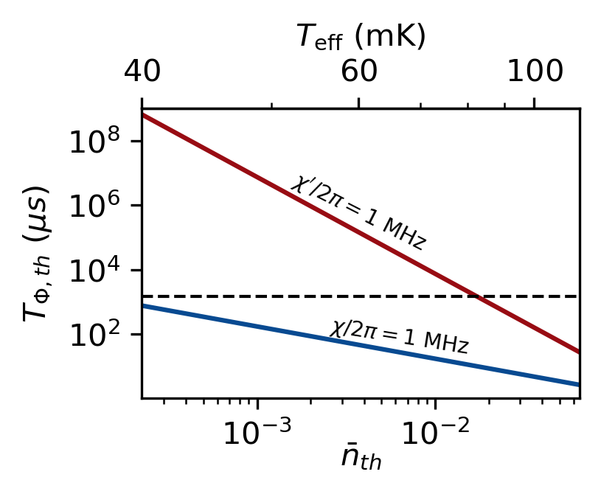
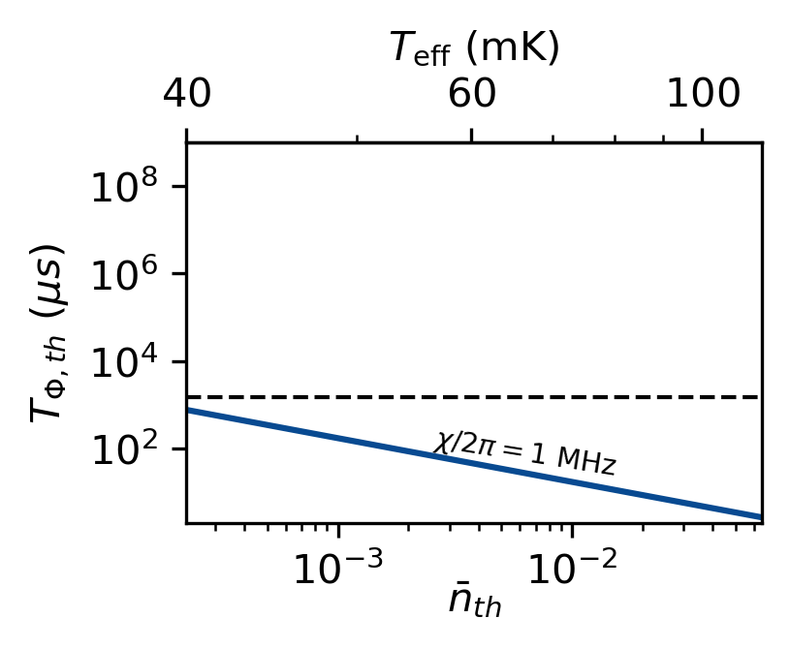



Suppressing photon shot noise
arXiv: 2503.13411
$$\frac{ω_{r}}{2π}=7 GHz$$
$$\frac{κ}{2π}=3 MHz$$
Somoroff, Aaron, et al. "Millisecond coherence in a superconducting qubit." PRL 130.26 (2023): 267001.

Slide 7
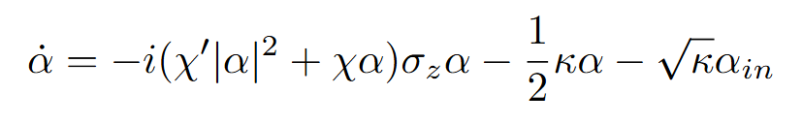
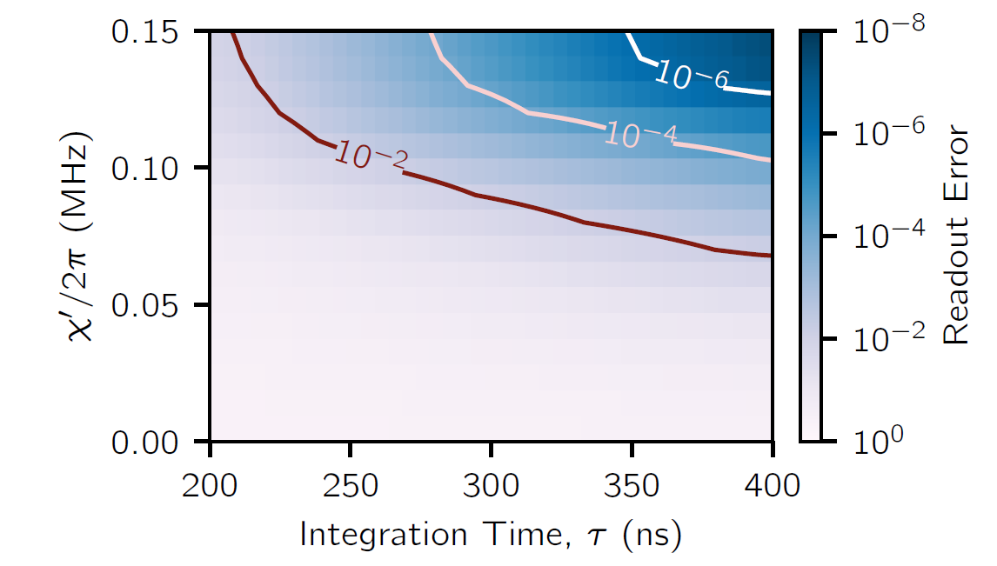
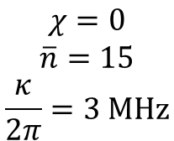
Nonlinear readout
arXiv: 2503.13411
$$χ=0$$
$$\overline{n}=15$$
$$\frac{κ}{2π}=3 MHz$$
Andersen, C. K., et al. "Quantum vs. classical switching in driven Kerr resonators." PR. Applied. 13.4. (2020): 044017.
Stefanski, T. V., & Andersen, C. K. (2024). Flux-pulse-assisted readout of a fluxonium qubit. PR.Applied, 22(1), 014079.

Slide 8
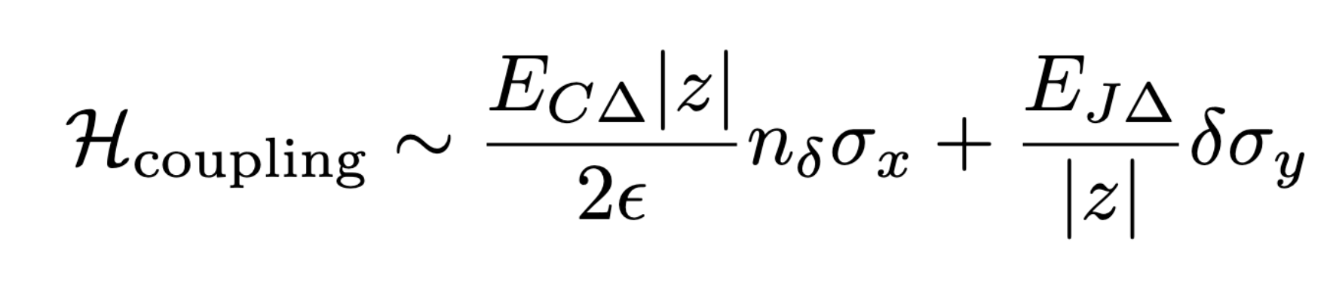
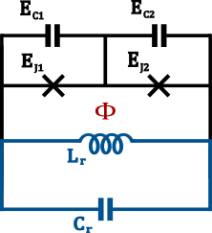
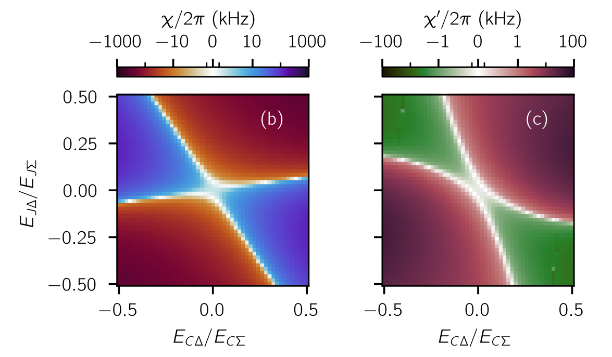
Engineering mixed coupling in a circuit
arXiv: 2503.13411
Island mode
Resonator mode
Notes:
Split Cooper pair box in parallel with resonator give combination of capacitive and inductive couplings
Imbalance in capacitors (inductors) controls mixing:

Slide 9
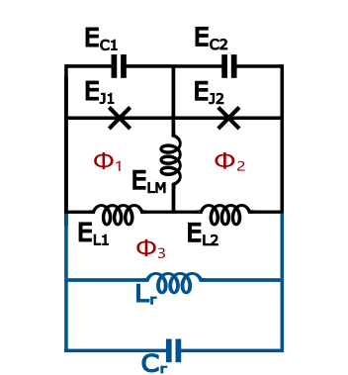
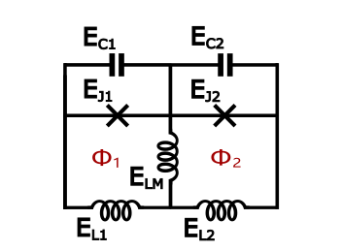
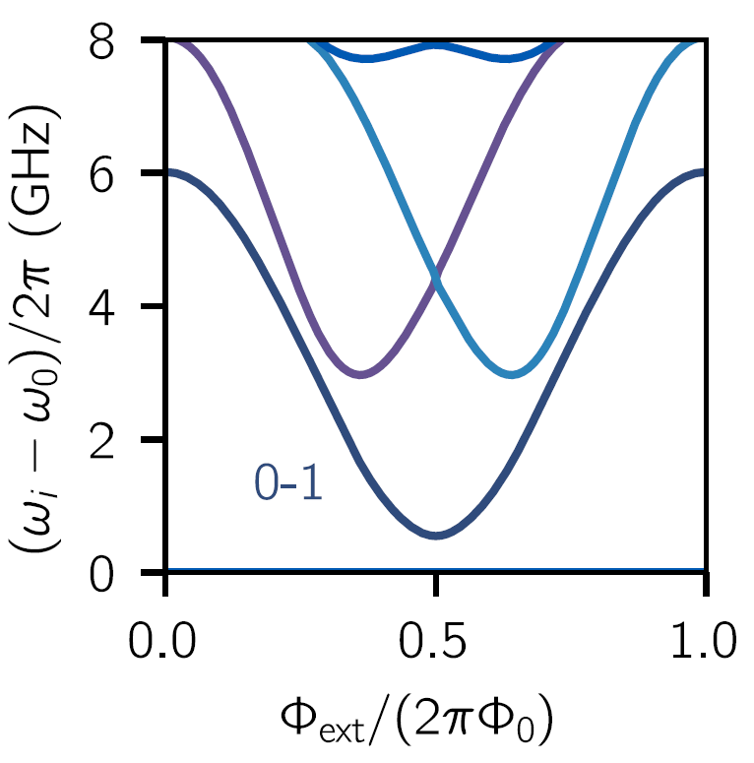

Implementation - fluxonium molecule
arXiv: 2503.13411
Better coherence
Beyond the two-level approximation
Fluxonium molecule
Galvanic connection
Readout resonator
Kou, A., et al. "Fluxonium-based artificial molecule with a tunable magnetic moment." Physical Review X 7.3 (2017): 031037.

Slide 10
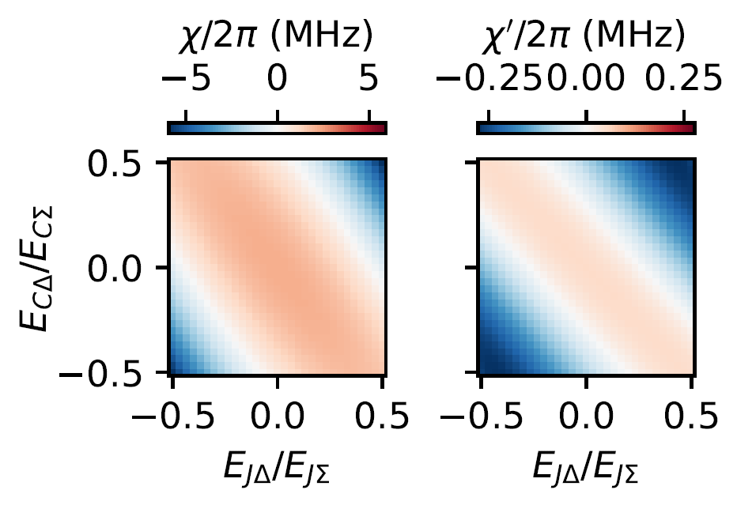
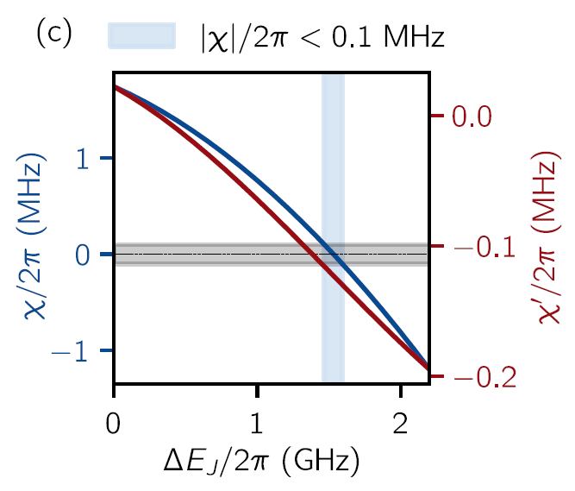



Suppression of 𝛘
arXiv: 2503.13411
Full circuit Hamiltonian + numerical diagonaliztion
Notes:
explain axis label

Slide 11
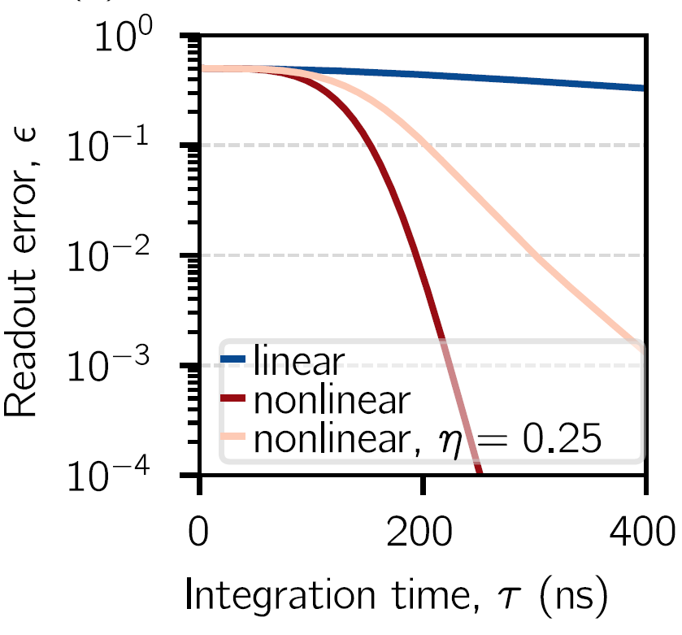
Readout simulation result
arXiv: 2503.13411
Notes:
spend more time on the readout plot, go one by one, and specify all params

Slide 12


Summary & Outlook
arXiv: 2503.13411
Mixed coupling
Fluxonium molecule implementation
Experiments
Other circuits with less flux loops
Suppressed shot-noise dephasing
High-fidelity readout

Slide 13










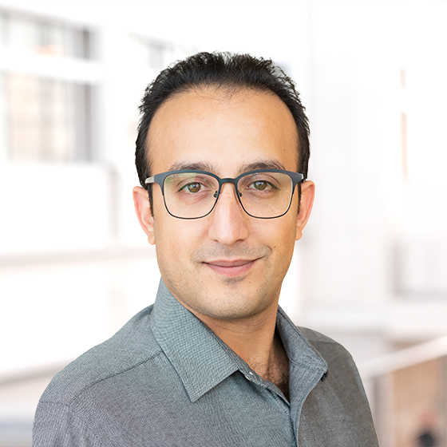
Acknowledgement
Rohan Acharya
Collaborators:
We acknowledge funding from:
•Dutch Research Council (NWO)
•Top consortia for Knowledge and Innovation (TKI)
from the Dutch Ministry of Economic Affair
•EIC Pathfinder Challenge
Antonio Manesco
André Melo
Valla Fatemi

Slide 14
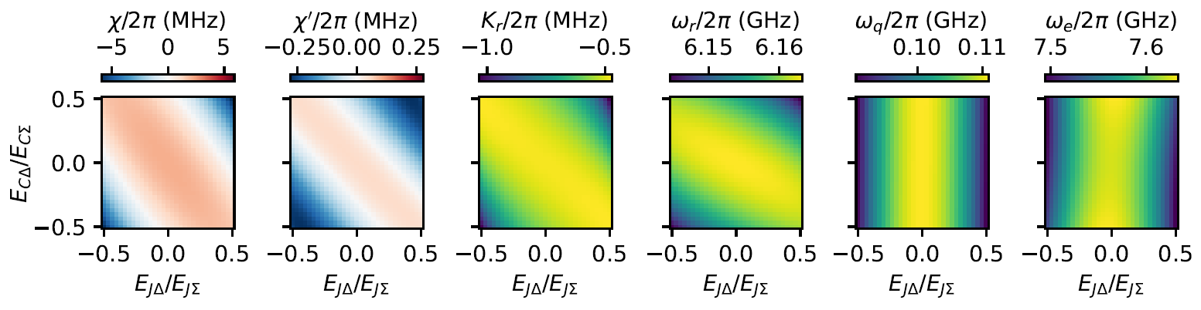
Additional slides

Slide 15
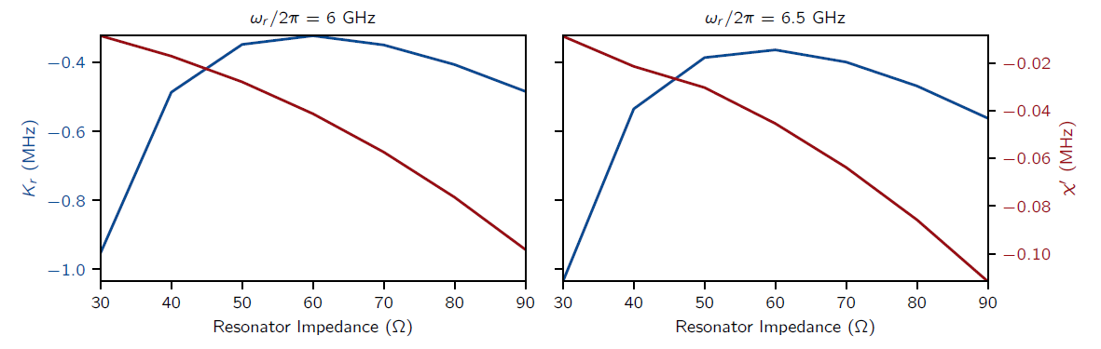
Additional slides

Slide 16
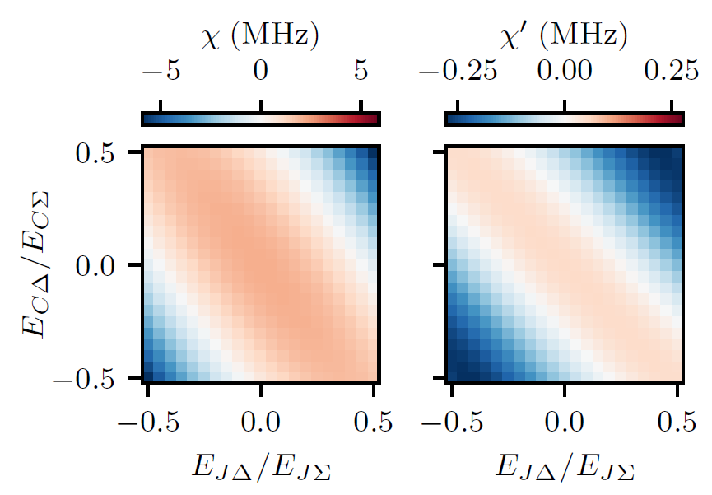
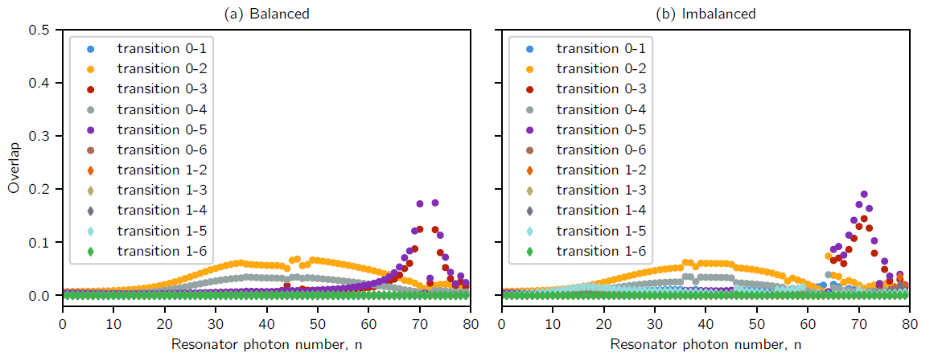
Additional slides

Slide 17
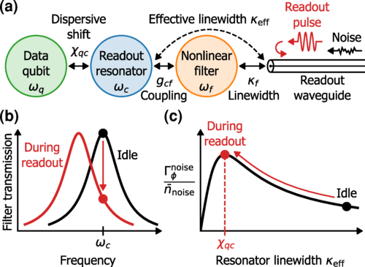
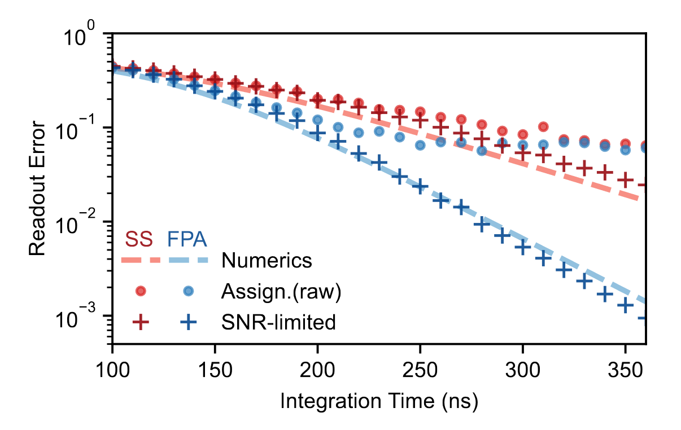
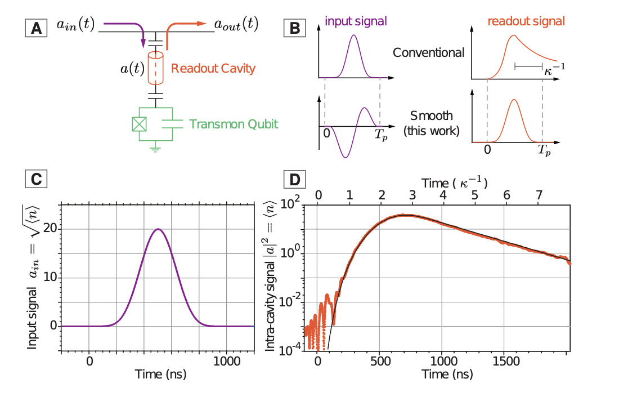
Ways to mitigate shot-noise dephasing
arXiv: 2503.13411
Engineering qubit environment/control:
non-linear Purcell filters flux-pulse-assisted readout pulse shaping
Sunada, Y. et al. "Photon-Noise-Tolerant Dispersive Readout of a Superconducting Qubit Using a
Nonlinear Purcell Filter”
Stefanski, Taryn V., et al. "Improved fluxonium readout through dynamic flux pulsing."
Jerger, M. et al. "Dispersive Qubit Readout with Intrinsic Resonator Reset”
Notes:
It acts as a tunable coupler that automatically reduces the effective linewidth 𝜅eff of the readout resonator with the application of a readout pulse.

