Slide 1




Two-mode squeezing generation in a flux tunable Josephson Traveling Wave Parametric Amplifier (JTWPA)
ISITA CHATTERJEE
University of Naples Federico II, Naples, Italy

Slide 2
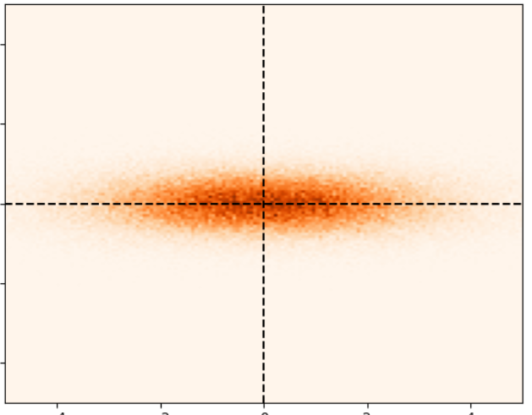


MOTIVATION: Why Two-mode Squeezing in TWPA ?
Ans: Quantum enhanced detection in the microwave regime
-Improvement in dark matter detection
Xiran Bai et al. Phys. Rev. Lett. 134, 151006, 2025
K.M. Backes et al. Nature 590, 238–242, 2021
-Quantum communication/sensing protocols
Mateo Casariego et al Quantum Sci. Technol. 8 023001, 2023
Example of vacuum squeezing
Outline :
Device (Flux tunable Jhosephson TWPA)
Our goal: 3-wave mixing two mode squeezing
Experimental setup and preliminary results
Conclusion and Perspective
$$ΔXΔP=\frac{ℏ}{2}$$
$$ΔP<ΔX$$
P
X

Slide 3
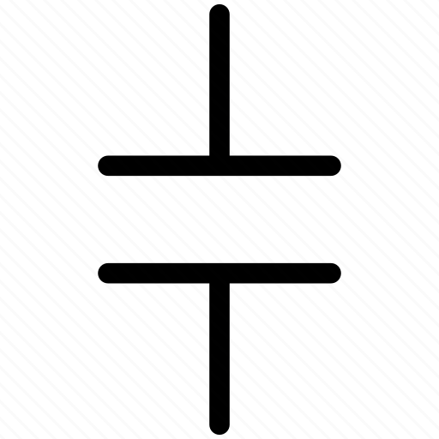


Josephson Traveling Wave Parametric Amplifier (JTWPA)
$$a≪λ$$
50 Ω
50 Ω
J. Aumentado et al. IEEE Microwave Magazine, 21, 2020
Josephson Junction
Ground Capacitance

Slide 4
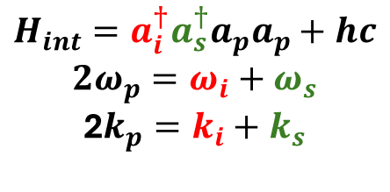
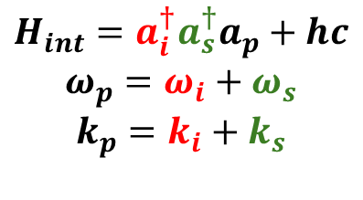
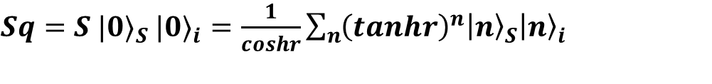





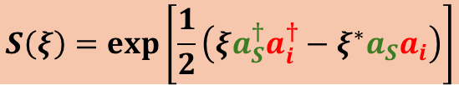
Josephson Traveling Wave Parametric Amplifier (JTWPA)
Non-linear medium
(TWPA)
Two-mode squeezing
Pump
Pump
$$(a_{p})$$
$$S\left(ξ\right)=\exp\left[\frac{1}{2}\left(ξa_{S}^{†}a_{i}^{†}−ξ^{∗}a_{S}a_{i}\right)\right]$$
Signal
Signal
$$(a_{s})$$
Squeezing parameter $ξ$ =$r e^{(iφ)}$
Idler
$$(a_{i})$$
$$G_{TWPA}=cosh^{2}(r)$$
3-wave mixing (3WM)
4-wave mixing (4WM)
$$H_{int}={a_{i}^{†}a_{s}^{†}a}_{p}+hc$$
$$ω_{p}=ω_{i}+ω_{s}$$
$$k_{p}=k_{i}+k_{s}$$
$$H_{int}={a_{i}^{†}a_{s}^{†}a}_{p}a_{p}+hc$$
$${2ω}_{p}=ω_{i}+ω_{s}$$
2$k_{p}=k_{i}+k_{s}$
$Sq=S {|0⟩}_{S}$ ${|0⟩}_{i}=\frac{1}{coshr}\sum_{n}{{\left(tanhr\right)}^{n}{\left|n\right\rangle }_{S}{\left|n\right\rangle }_{i} }$
Energy conservation

Slide 5
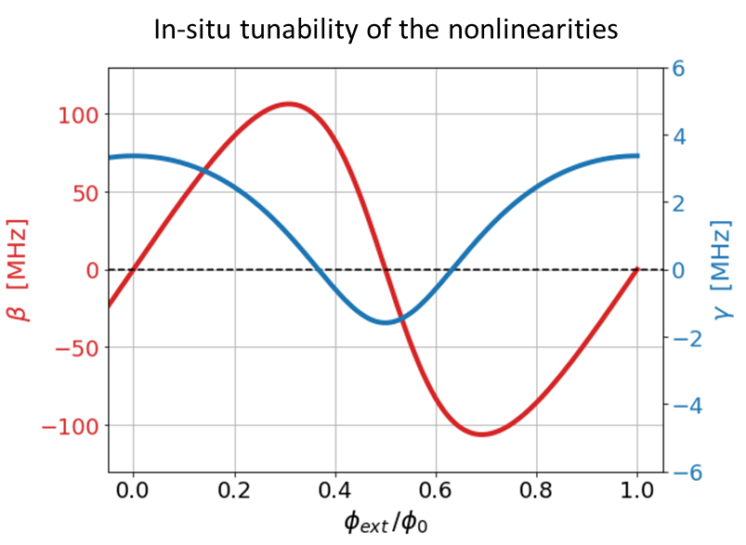
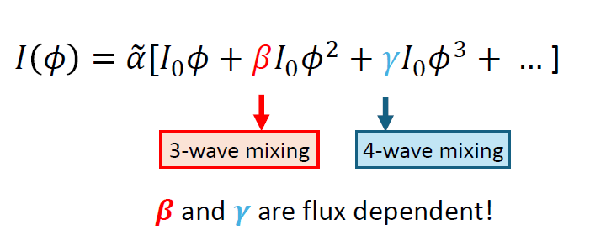

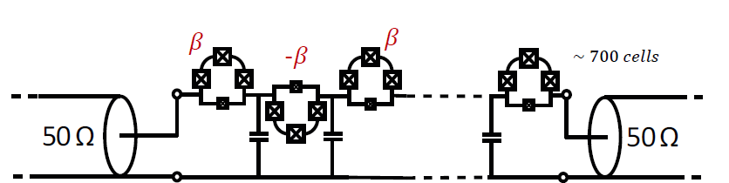


Flux-Tunable JTWPA
SNAIL
$$Φ_{ext}$$
Frattini et al. Physical Review Applied, 10, 054020 (2018)
Arpit Ranadive thesis , Université Grenoble Alpes [2022]
Fabricated in
N. Roch’s Lab
Ranadive et al. Nat Commun 13, 1737 (2022)
(4-wave mixing amplifier demostration)
Esposito et al. PRL,128, 153603 (2022)
(4-wave mixing squeezer demostartion)

Slide 6
3WM two mode squeezing in SNAIL TWPA ?
Residual 3-wave mixing
Ranadive et al. Nature Communication 13, 1737 (2022)
Esposito et al. Physical Review Letters,128, 153603 (2022)
Levochkina et al. Superconductor Science and Technology, 37, 115021 (2024)

Slide 7
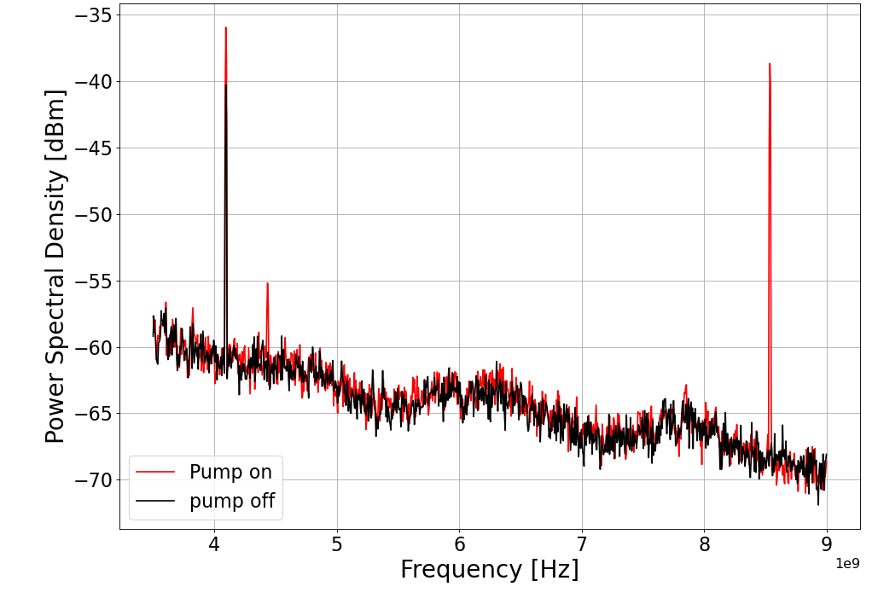
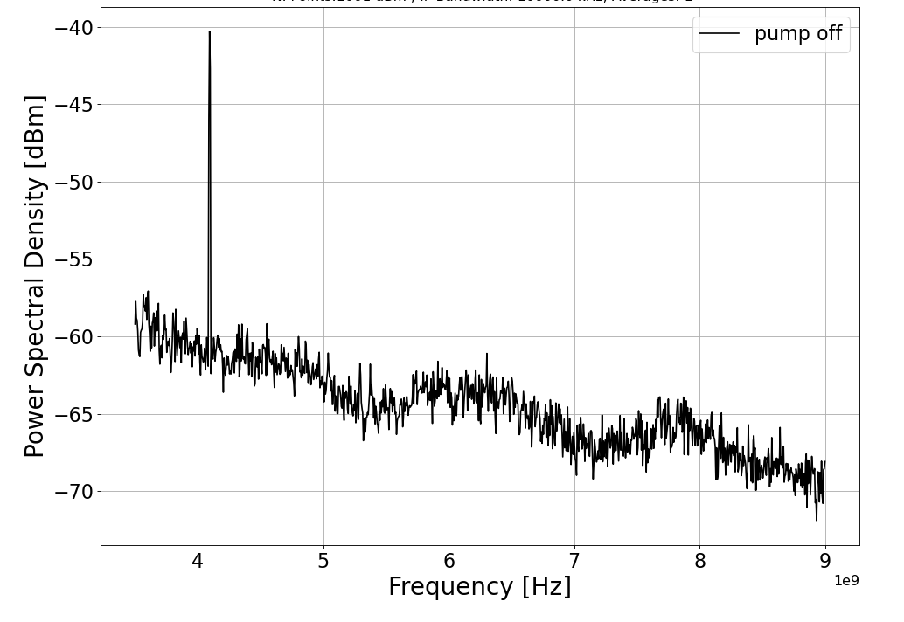
3WM Parametric Idler generation
signal
Pump
Pump/2
Pump
signal
idler
idler
f
Frequency [GHz]

Slide 8
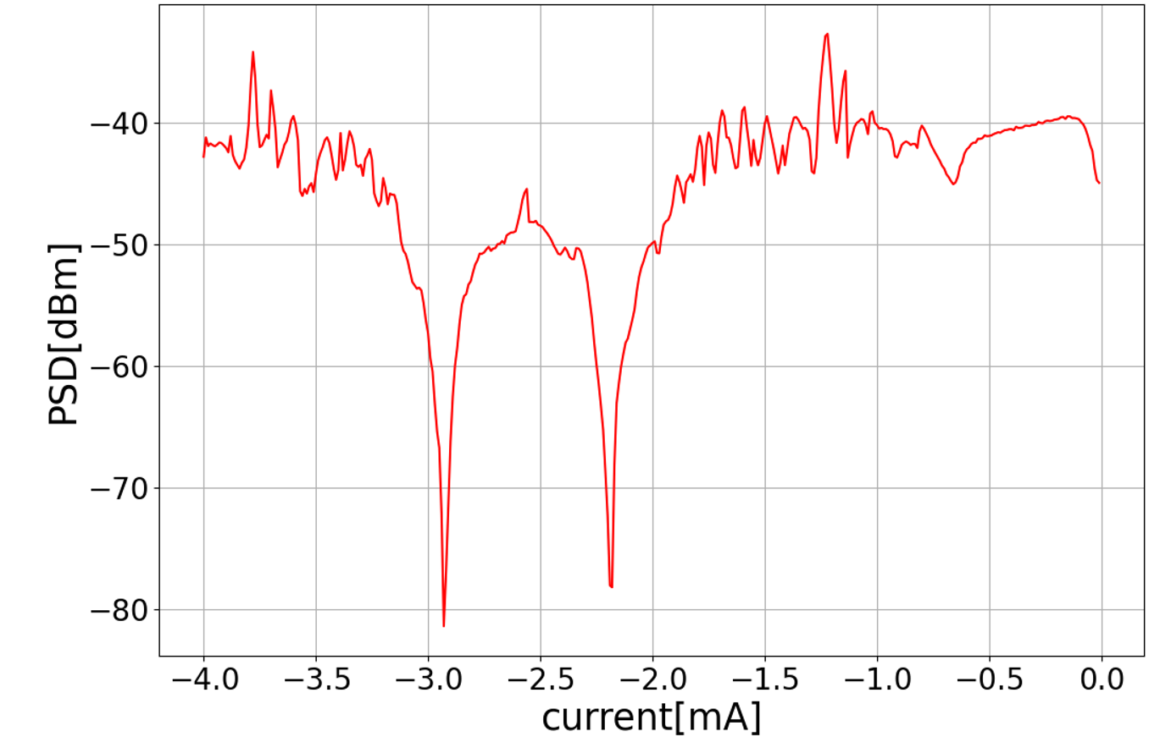
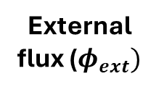
3WM Parametric Idler generation (Flux dependence)
Pump
4WM
idler
signal
f
External flux ($φ_{ext})$

Slide 9
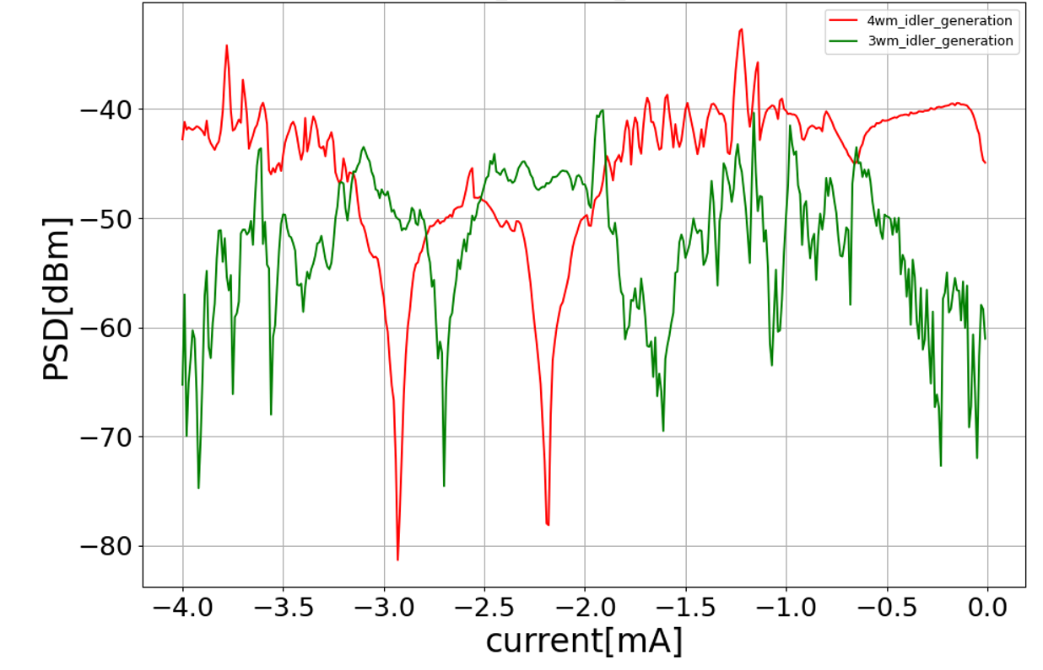
3WM Parametric Idler generation (Flux dependence)
Flux sweet spot
4WM idler generation
3WM idler generation
Pump/2
Pump
3WM idler
signal
f
External flux ($φ_{ext})$

Slide 10
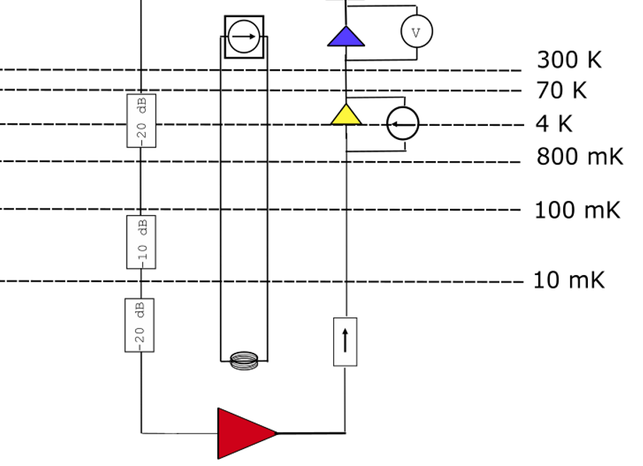
Experimental setup
Cryostat in Napoli Lab
Acquisition
Pump
Generator
G_sys
TWPA

Slide 11
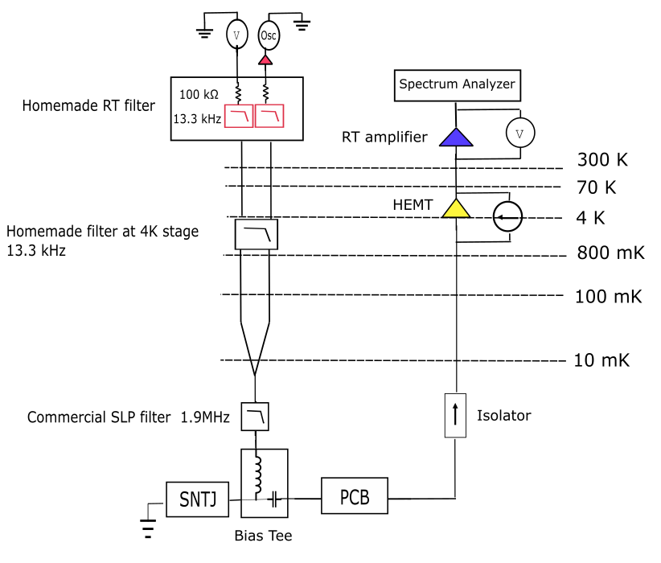
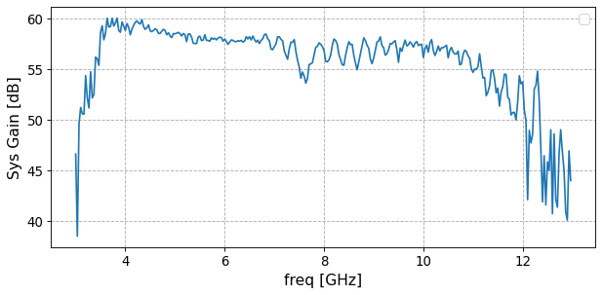

Experimental setup: System gain calibration
G_sys

Slide 12
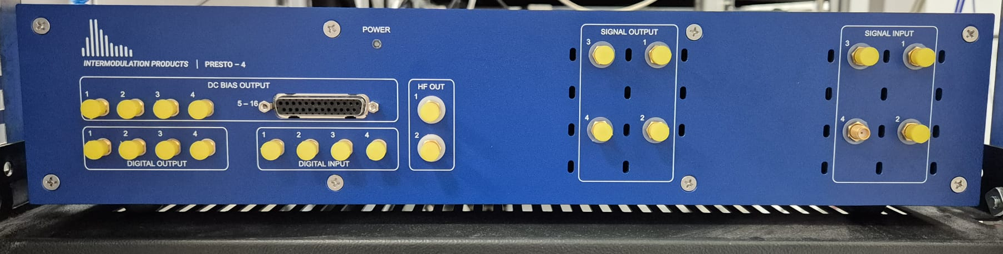



3WM two-mode squeezing experiment: Preliminary results
$$τ=10 us$$
${∼10}^{6}$ pulses
Acquisition
Pump
Generator
(off)
signal
TWPA
idler
PUMP OFF
Intermodulation Product
$$R=({\hat{x}}_{S},{\hat{p}}_{S},{\hat{x}}_{i},{\hat{p}}_{i})$$
signal
idler
f

Slide 13

3WM two-mode squeezing experiment: Preliminary results
$$τ=10 us$$
${∼10}^{6}$ pulses
Acquisition
signal
Pump Generator (On)
TWPA
idler
PUMP ON
Intermodulation Product
$$R=({\hat{x}}_{S},{\hat{p}}_{S},{\hat{x}}_{i},{\hat{p}}_{i})$$
Pump/2
Pump
signal
idler
f
$$Δ$$

Slide 14
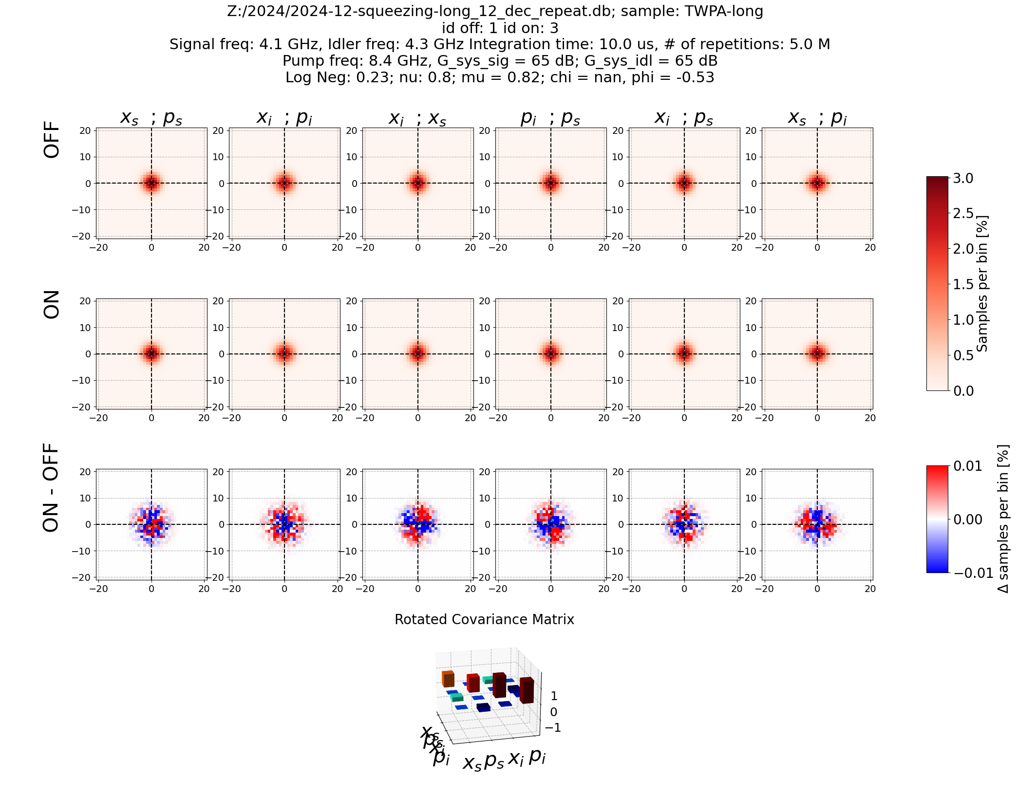
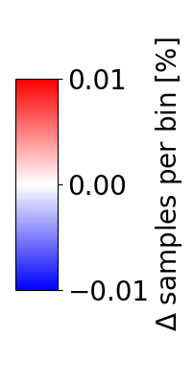







3WM two-mode squeezing experiment: Preliminary results
$$τ=10 us$$
${∼10}^{6}$ pulses
Acquisition
signal
Pump Generator (On)
TWPA
idler
PUMP ON
Intermodulation Product
$$R=({\hat{x}}_{S},{\hat{p}}_{S},{\hat{x}}_{i},{\hat{p}}_{i})$$
(PUMP ON) – (PUMP OFF)
$$(X_{S};P_{s})$$
$$(X_{i};P_{i})$$
$$(X_{i};X_{S})$$
$$(P_{i};P_{S})$$
$$(X_{i};P_{S})$$
$$(X_{S};P_{i})$$
No. Of measurements = $5×{10}^{6}$

Slide 15
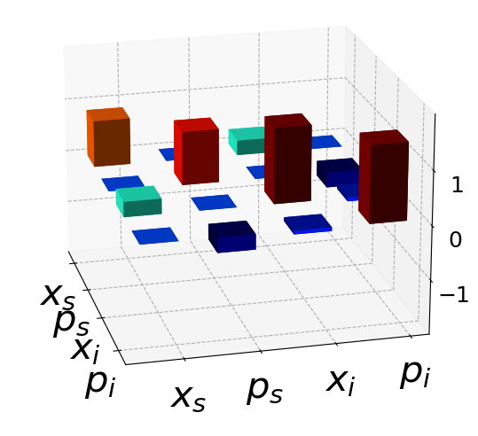
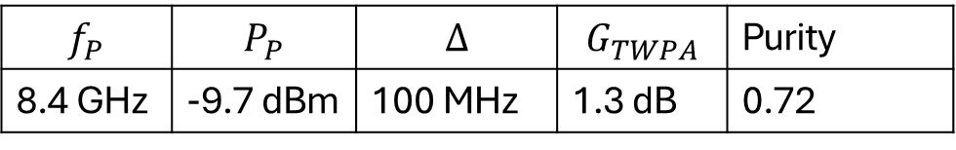



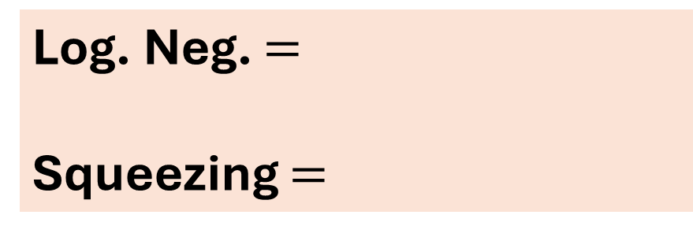

3WM two-mode squeezing experiment: Preliminary results
$$σ=σ^{meas,on}−σ^{meas,off}+1_{4}$$
Two- mode Covariance Matrix,
$σ_{jk}^{meas}=4[\frac{1}{2}\left\langle R_{j}R_{k}+R_{k}R_{j}\right\rangle −\left\langle R_{j}\right\rangle$ $\left\langle R_{k}\right\rangle ]$
Log. Neg. $=$
Squeezing $=$
$$0.23±0.05$$
$$0.643±0.13$$
$$f_{P}$$ | $$P_{P}$$ | $$Δ$$ | $$G_{TWPA}$$ | Purity
8.4 GHz | -9.7 dBm | 100 MHz | 1.3 dB | 0.72

Slide 16

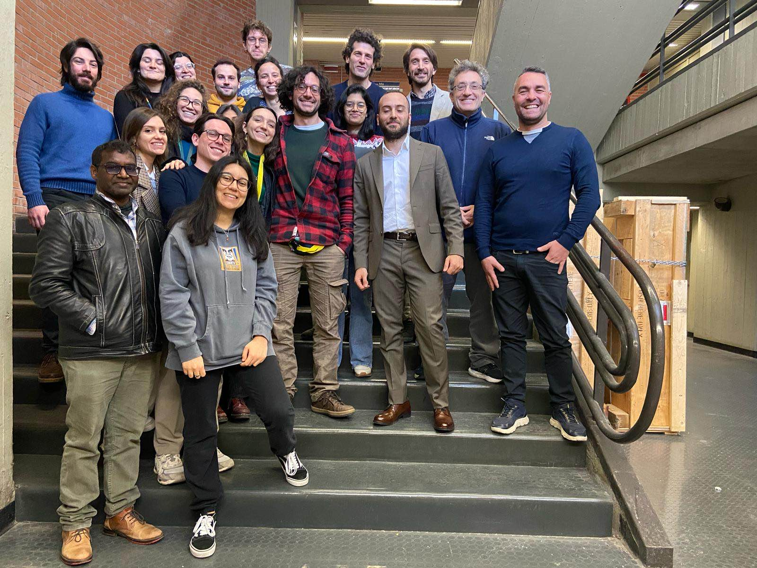
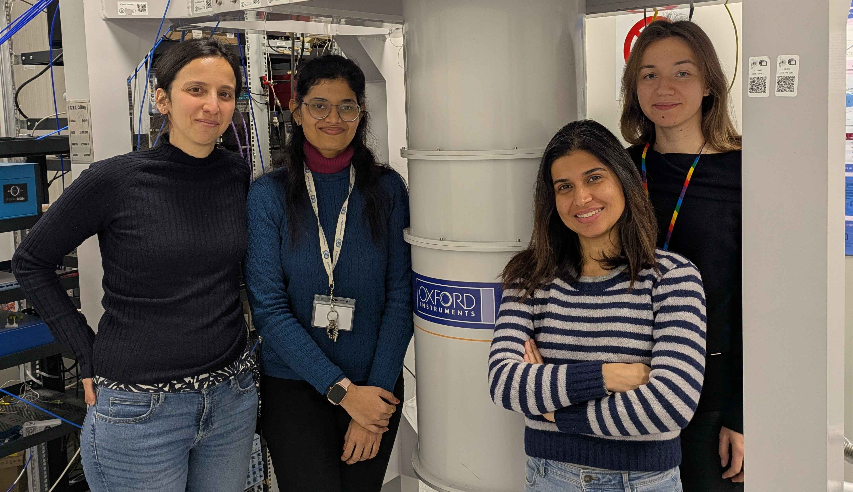


Conclusion
Preliminary evidence of 3WM two mode squeezing in a SNAIL JTWPA
PERSPECTIVE
Measure phase sensitive gain at 3WM regime
Extend the approach to multimode squeezing
AKNOLEDGEMENT
A. Levochkina (former PhD + Postdoc)
A. Orsi (Master sudent)
M. Esposito (PI)
I. Chatterjee (PhD)
P. Darvehi (Postdoc)
Microwave Photonics team

Slide 17
Thank you for your attention !

Slide 18
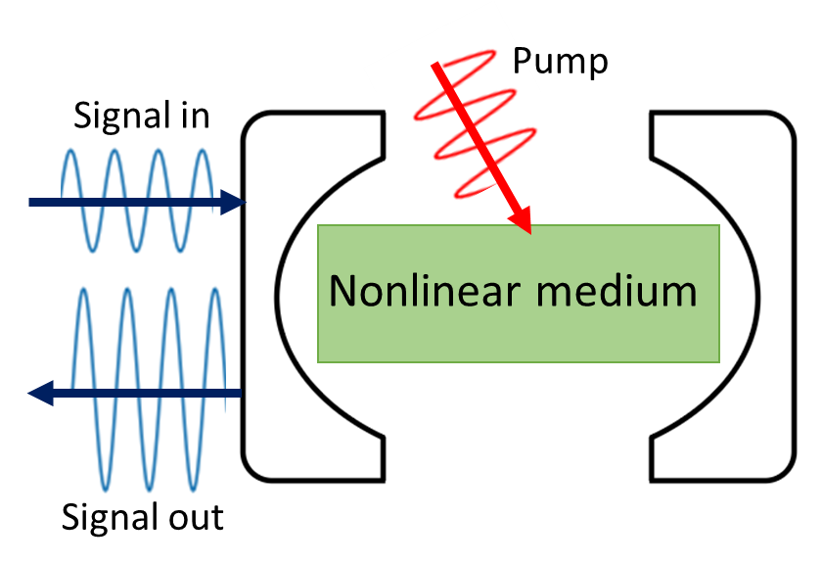
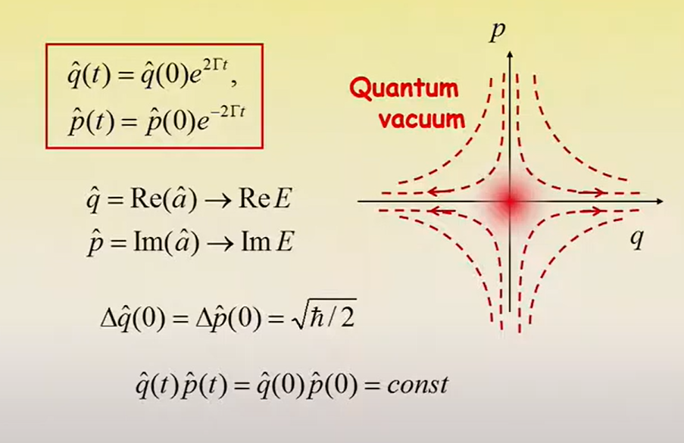
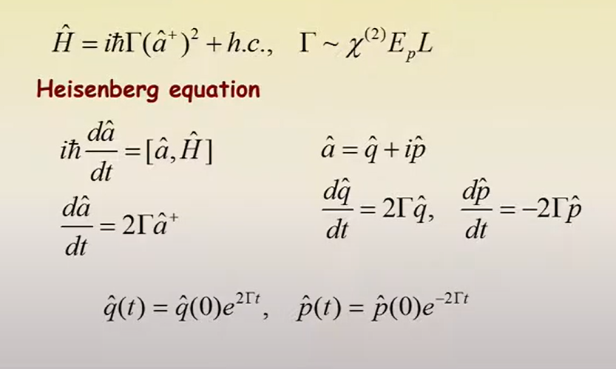
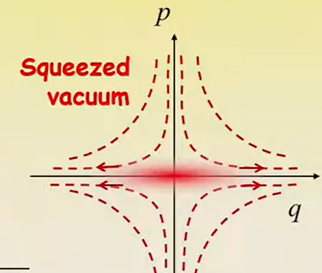
How is it generated?

Slide 19
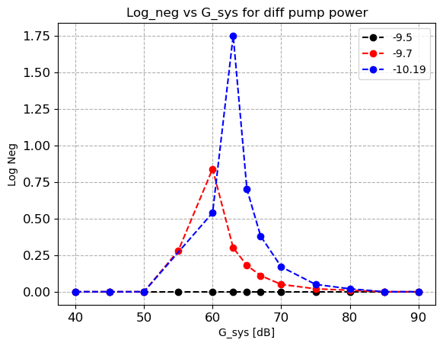
Gain error estimation

Slide 20
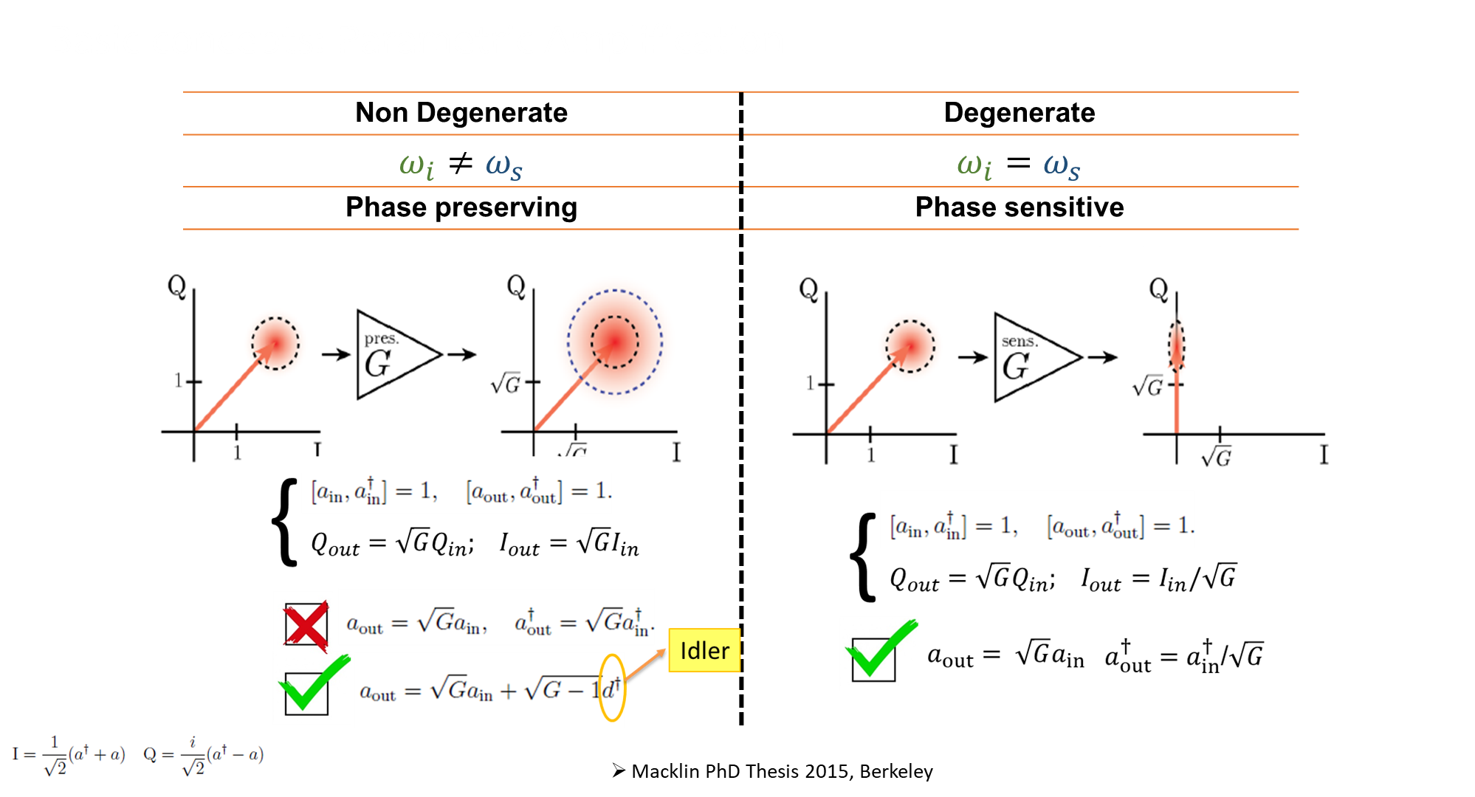

Slide 21
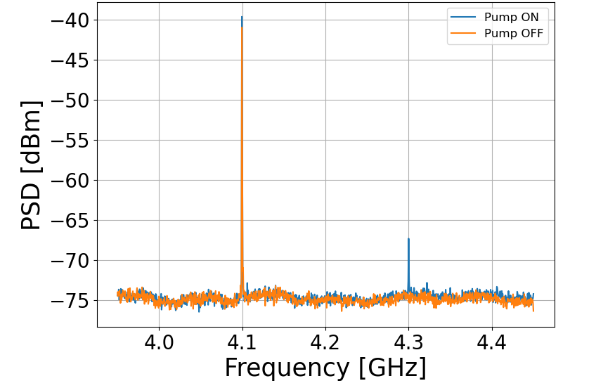

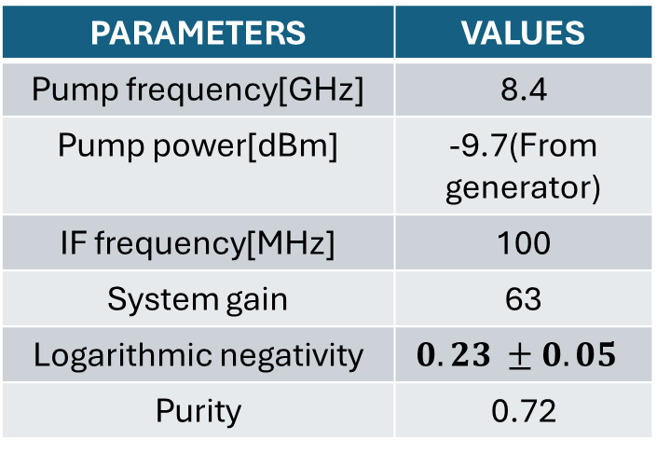


TWPA GAIN at 3WM regime
$$f_{signal}$$
Pump at 8.4 GHz
Pump power = -9.7 dBm
Current = 1.17 mA
$$f_{Pump/2}$$
PARAMETERS | VALUES
Pump frequency[GHz] | 8.4
Pump power[dBm] | -9.7(From generator)
IF frequency[MHz] | 100
System gain | 63
Logarithmic negativity | $$0.23 ±0.05$$
Purity | 0.72
$$f_{idler}$$

Slide 22







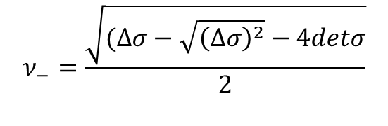

Mathematical concept
Covariance Matrix
$$=\left[\begin{matrix}A & C \\ C & B\end{matrix}\right]$$
$$, R=(\hat{x_{S},}\hat{p_{S},}\hat{x_{i},}\hat{p_{i}})$$
$$ν_{−}=\frac{\sqrt{(Δσ−\sqrt{{\left(Δσ\right)}^{2}}−4detσ}}{2}$$
Simplectic eigen value,
$$Δσ=\det{A+\det{B−2 detC}}$$
Logarithmic Negativity,
$E_{N}=Max\left[−ln\left(ν_{−}\right),0\right]>0$
Purity,
$$μ=\frac{1}{\sqrt{detσ}}$$
Collective quadrature,
${\hat{x}}_{+}={\hat{x}}_{S}$+ ${\hat{x}}_{i} ,$
${\hat{p}}_{+}={\hat{p}}_{S}$+ ${\hat{p}}_{i}$
Squeezing, ${ Sq}_{\left\langle x_{+}^{2}\right\rangle }=10 log_{10}\left(\frac{\left\langle x_{+}^{2}\right\rangle }{0.5}\right) ≠0$ ( showing correlation)

Slide 23
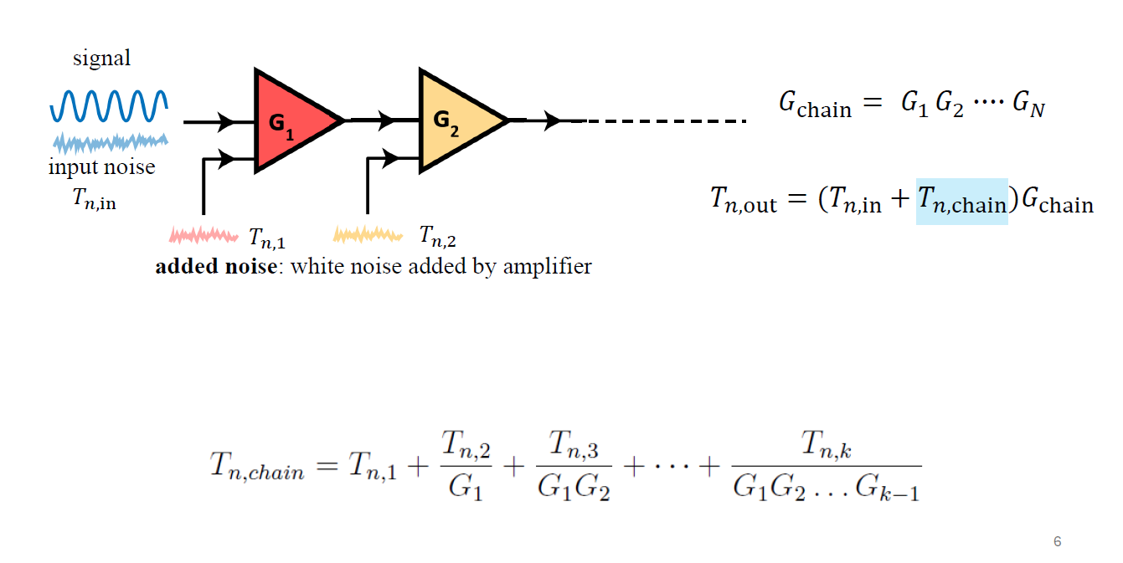
Quantum Noise Limited Amplification

Slide 24
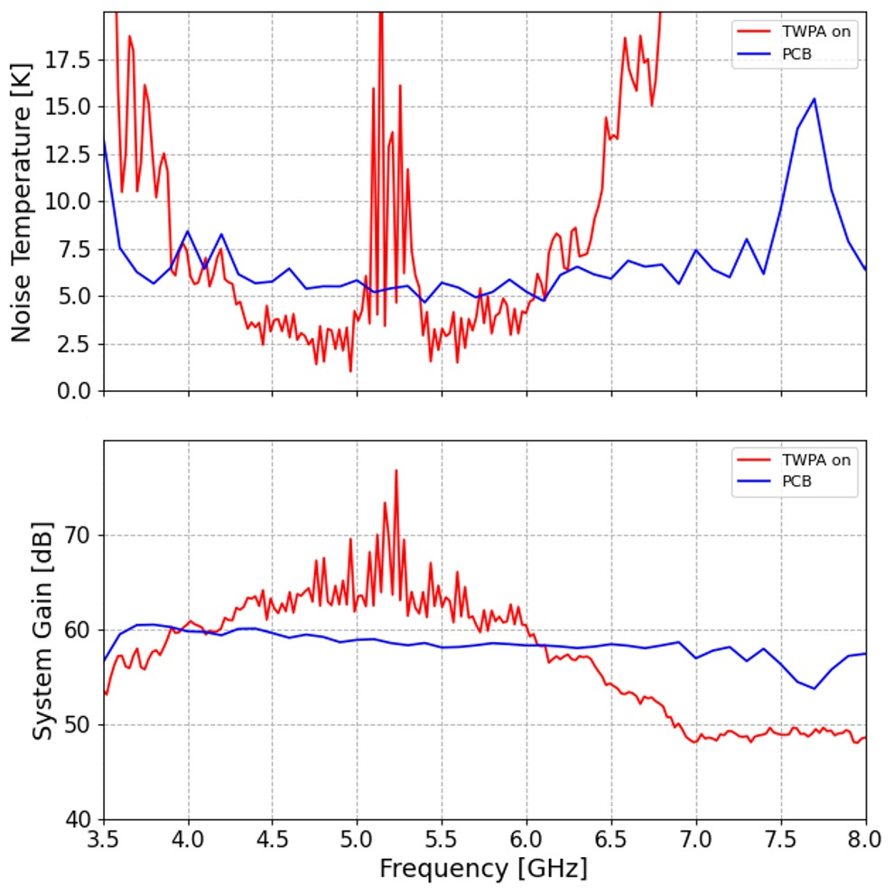
Quantum Noise Limited Amplification:Experimental results

Slide 25
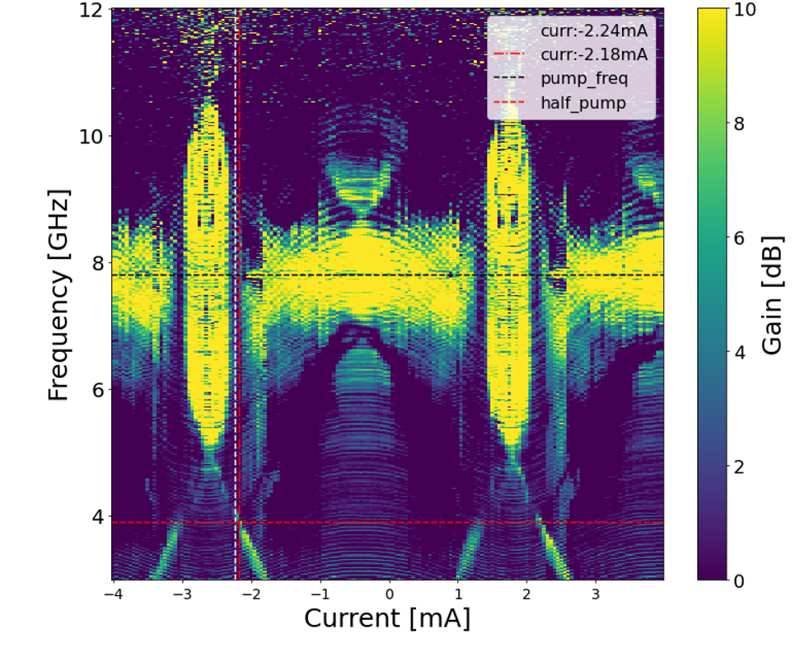
Quantum Noise Limited Amplification:Experimental results

Slide 26
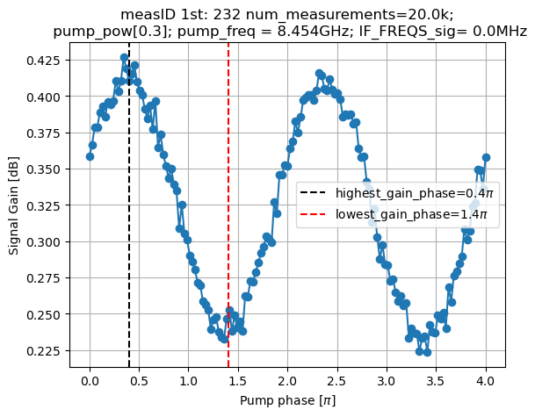
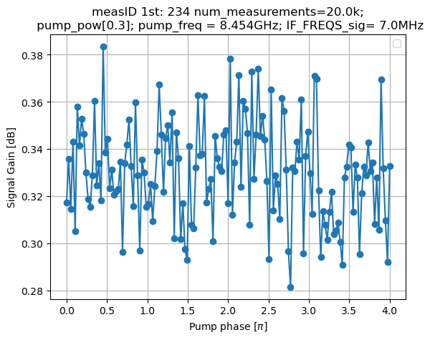
Phase sensative gain

Slide 27
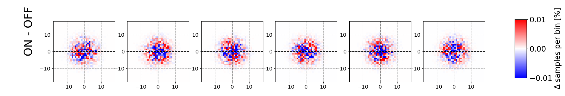
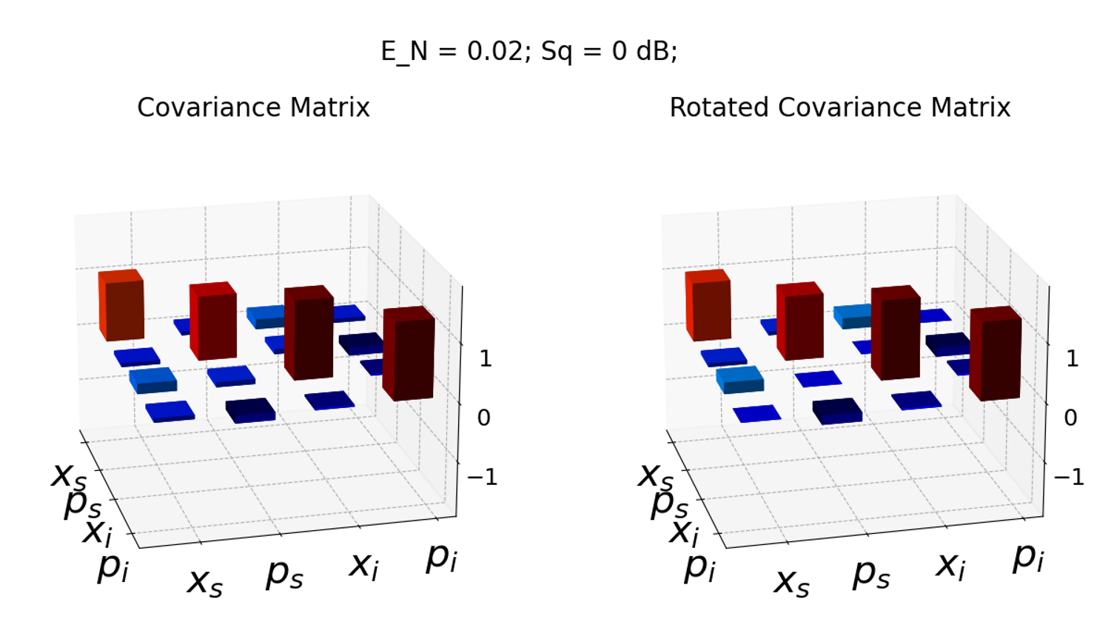
Non_zero 4WM

Slide 28
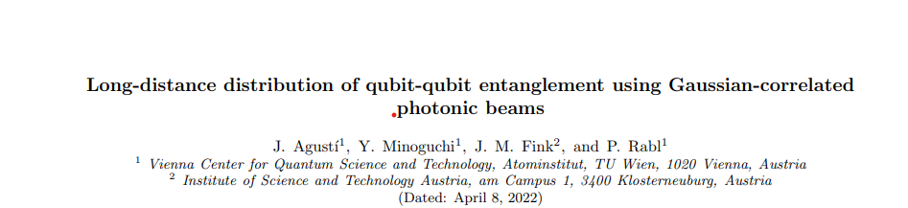
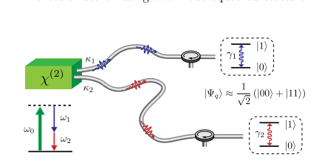

Slide 29
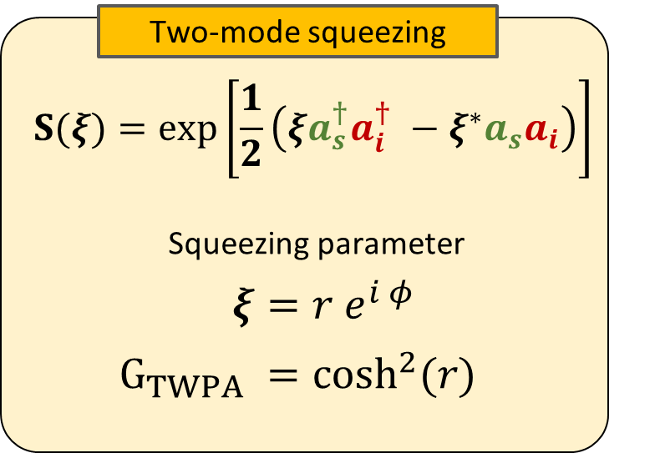
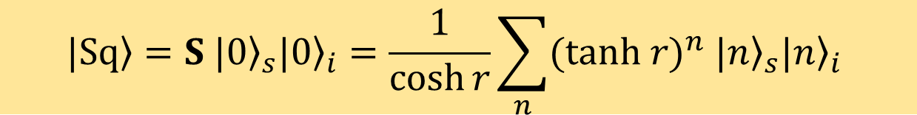
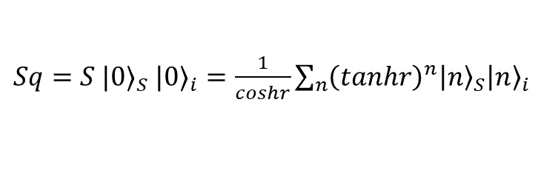



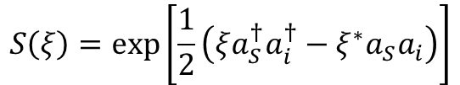
$Sq=S {|0⟩}_{S}$ ${|0⟩}_{i}=\frac{1}{coshr}\sum_{n}{{\left(tanhr\right)}^{n}{\left|n\right\rangle }_{S}{\left|n\right\rangle }_{i} }$
$$ΔXΔP=\frac{ℏ}{2}$$
Two-mode squeezing
$$S\left(ξ\right)=\exp\left[\frac{1}{2}\left(ξa_{S}^{†}a_{i}^{†}−ξ^{∗}a_{S}a_{i}\right)\right]$$
Squeezing parameter,$ξ$ =$r e^{(iφ)}$
$$G_{TWPA}=cosh^{2}(r)$$

