Slide 1







Low crosstalk modular flip-chip architecture for coupled superconducting qubits
Paul Kugler
Ihssen & Geisert et al, Appl. Phys. Lett. 126, 134003 (2025)

Slide 2
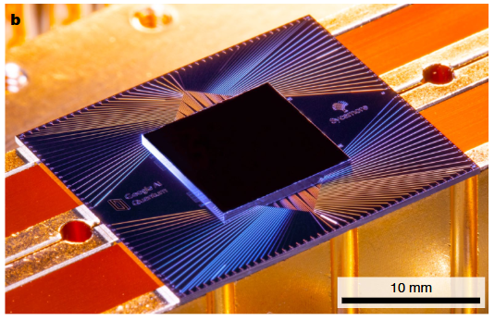
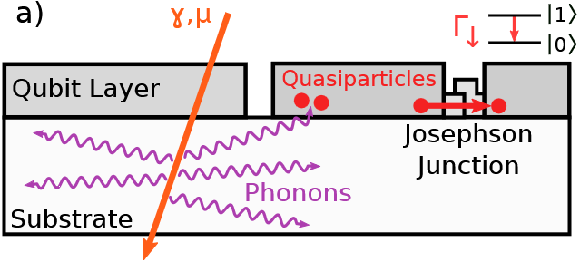
Superconducting quantum processors are amazing …
Quantum supremacy [1]
Error correction [2]
Involved fabrication technique
Modularity?
Crosstalk
Correlated errors ! [3,4,5]
[1] Arute & Arya & Babbush et al., Nature, 2019
[2] Google Quantum AI and Collaborators, Nature, 2024
[3] McEwen et al., Nature Physics, 2021
[4] Cardani & Valenti et al., Nature Comm., 2021
[5] C. D. Wilen et al, Nature, 2021

Slide 3
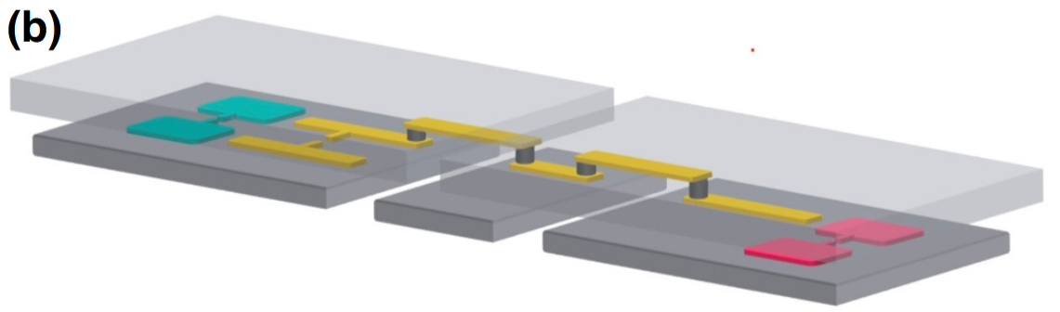
… and diverse
Chiplet
q1
coupler
q3
Field & Chen et al, Phys. Rev. Applied, 2024
Yost et al, npj Quantum Information, 2020

Slide 4
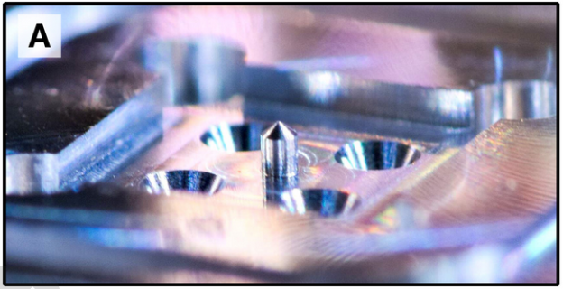
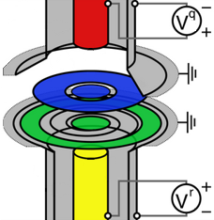
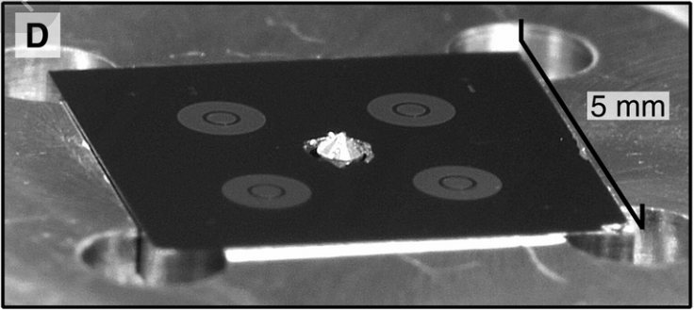
… and diverse
Chiplet
Cavity based
5 mm
5 mm
Spring et al, Science Advances, 2022

Slide 5
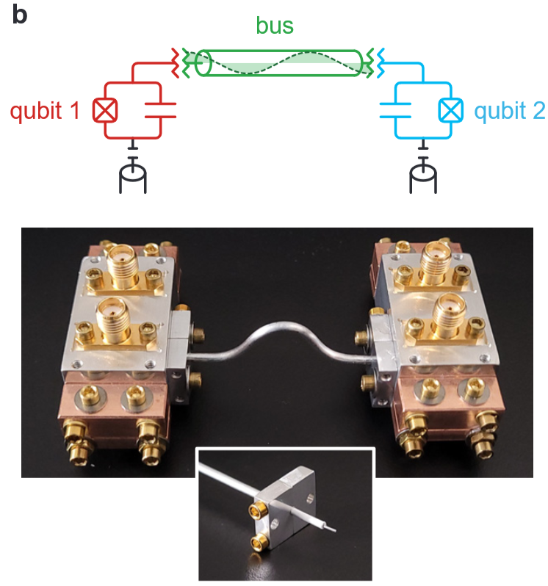
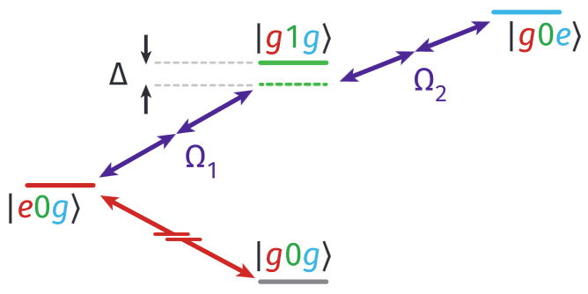
… and diverse
bus
Chiplet
Cavity based
“Lego-Like”
q1
q2
16 mm
Mollenhauer & Irfan, & Cao, & Mandal et al,
Arxiv 2407.16743 (2024)

Slide 6
Our plan..
Chiplet
Cavity based
“Lego-Like”
Low crosstalk modular flip-chip architecture
for coupled superconducting qubits

Slide 7
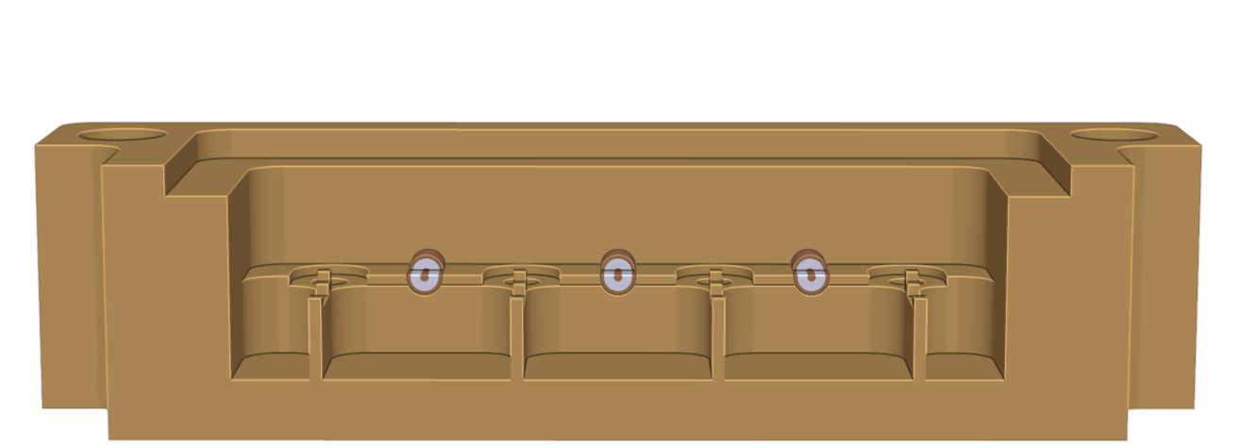
The modular architecture
copper sample holder
coaxial port
1 cm
individual enclosure

Slide 8
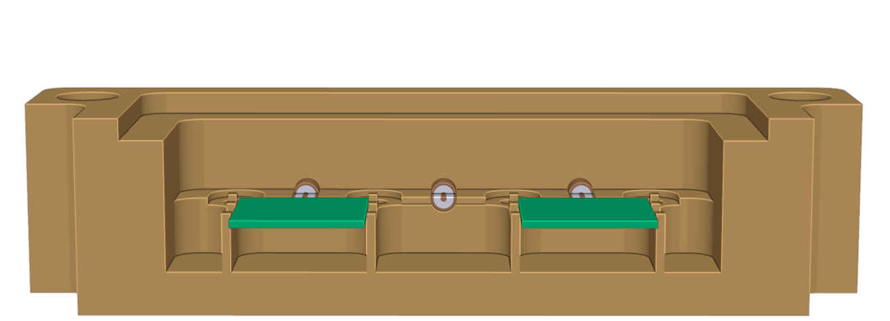
The modular architecture
copper sample holder
coaxial port
1 cm
individual enclosure
control chip

Slide 9
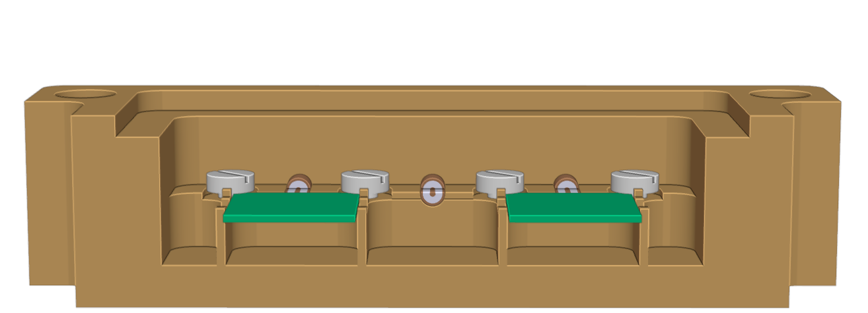
The modular architecture
copper sample holder
coaxial port
1 cm
individual enclosure
control chip

Slide 10
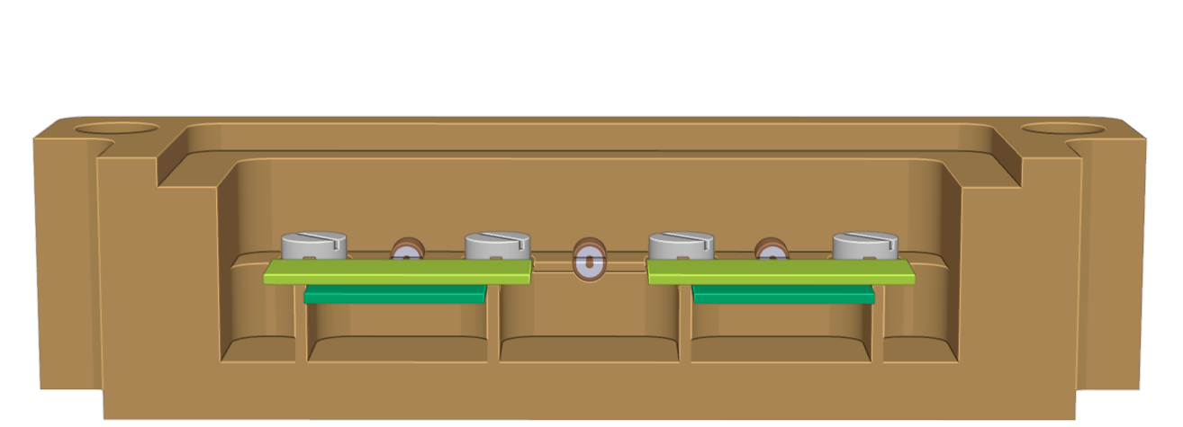
The modular architecture
copper sample holder
coaxial port
1 cm
individual enclosure
control chip
qubit chip

Slide 11
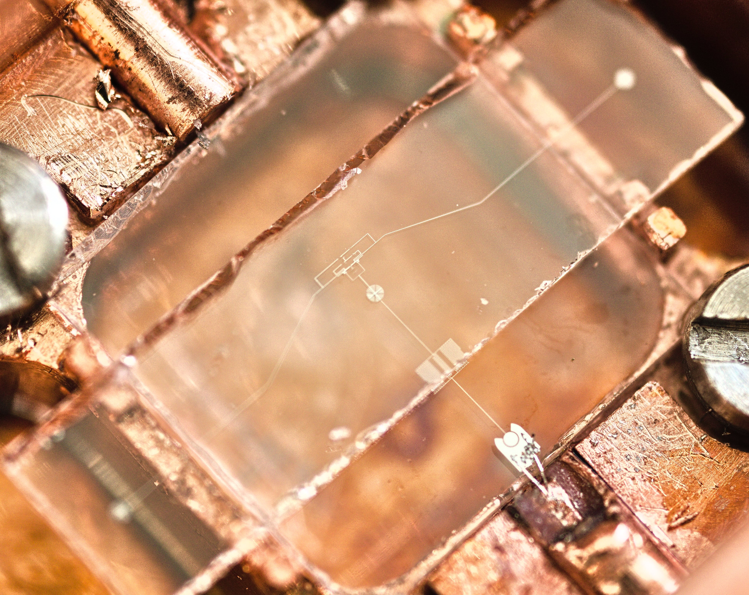
The modular architecture
coaxial port
2 mm
1 cm
control chip
qubit chip

Slide 12
The modular architecture
coaxial port
2 mm
1 cm
inductivley coupled qubit-resonator circuit
S. Geisert & S. Ihssen et al, APL, 2024
capacitive extenders
Al + grAl
2 mm

Slide 13
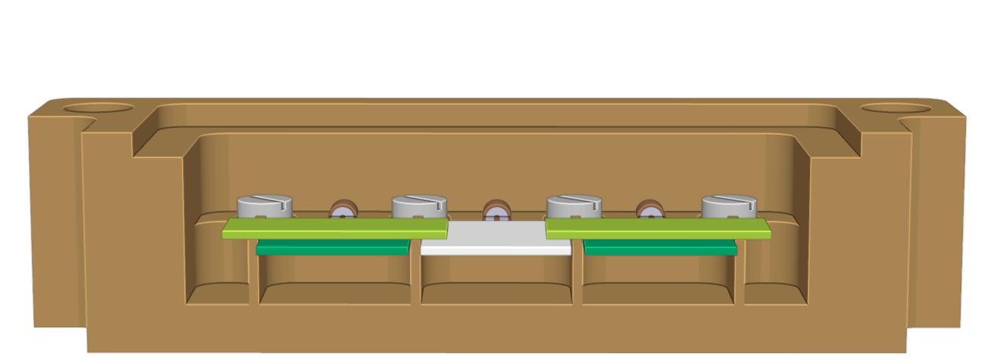
The modular architecture
copper sample holder
coaxial port
1 cm
individual enclosure
coupler chip
control chip
qubit chip

Slide 14
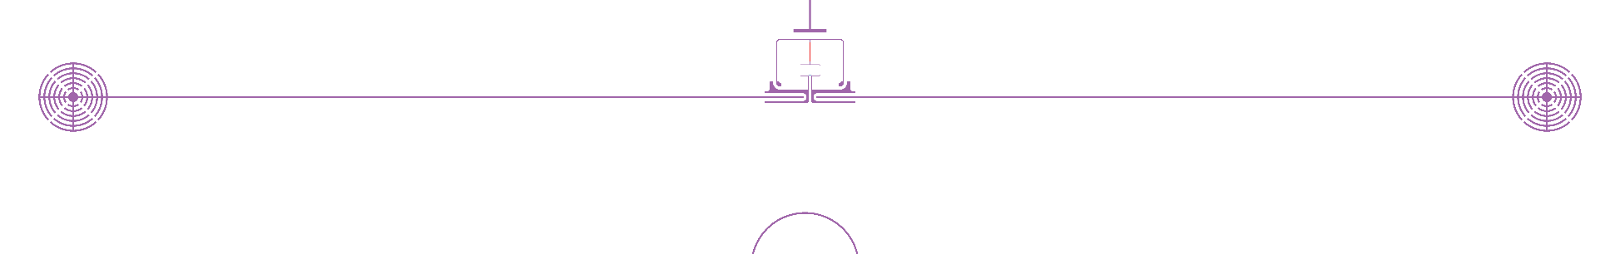
The modular architecture
copper sample holder
coaxial port
1 cm
inductivley coupled qubit-resonator circuit
S. Geisert & S. Ihssen et al, APL, 2024
capacitive extenders
1 mm
Al + grAl
2 mm
FBL

Slide 15
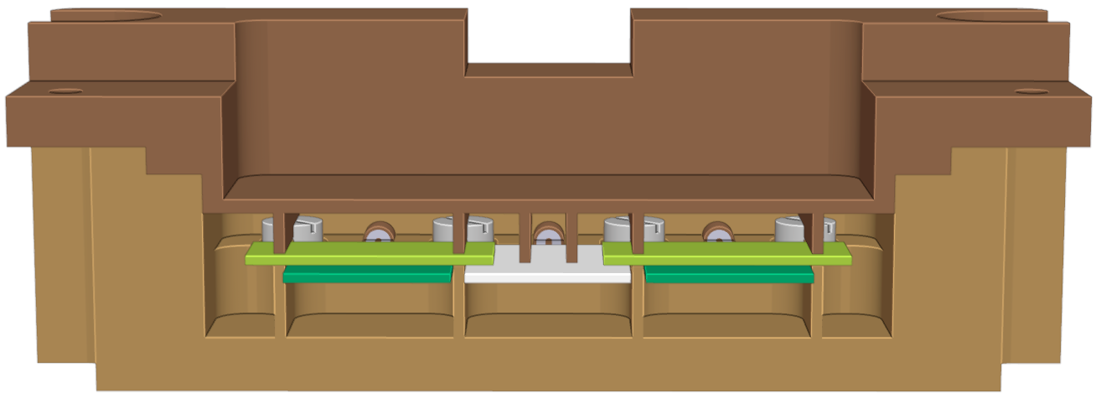
The modular architecture
copper sample holder
coaxial port
1 cm
individual enclosure
coupler chip
control chip
qubit chip

Slide 16
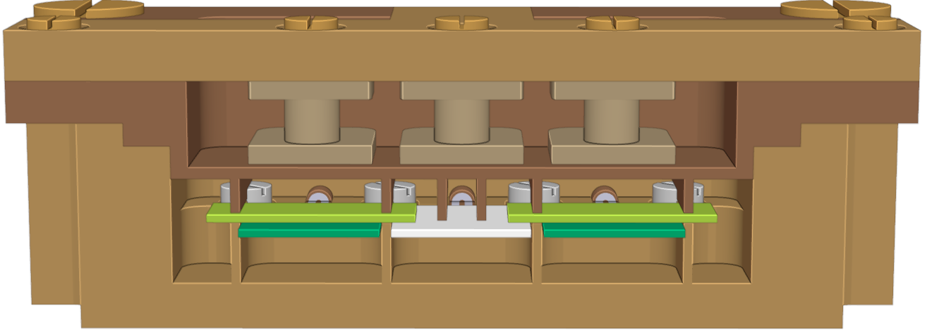
The modular architecture
copper sample holder
static bias coil
coaxial port
1 cm
individual enclosure
coupler chip
control chip
qubit chip

Slide 17
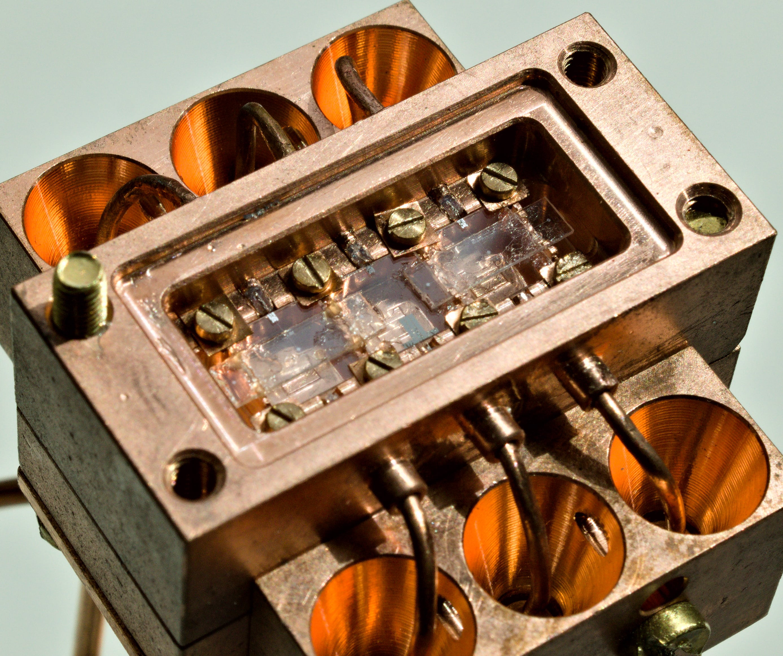
The modular architecture
10 mm

Slide 18
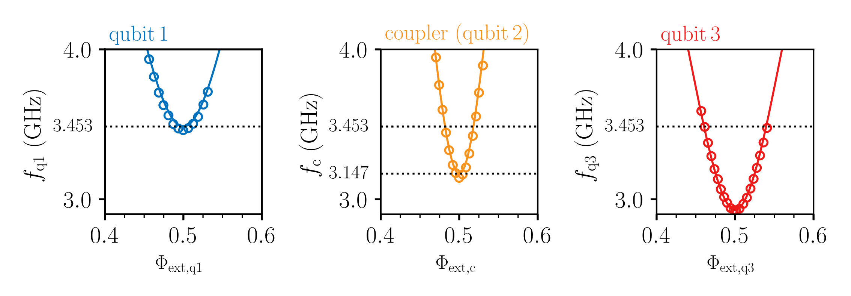
Devices
bp
bp on
bp
measurement
fit

Slide 19
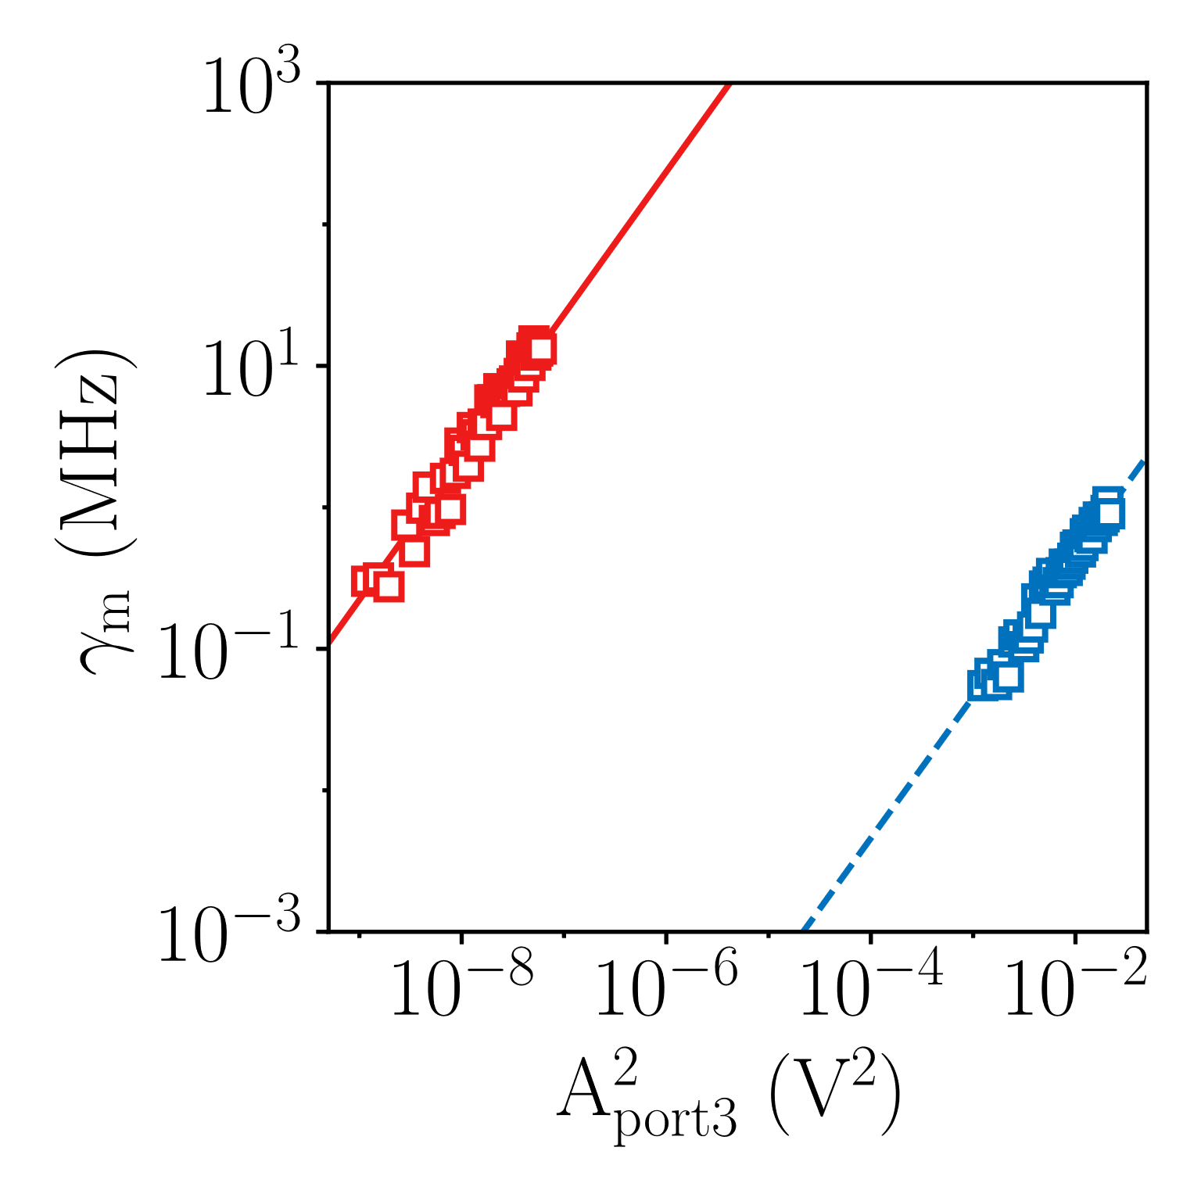
Isolation between enclosures
f_{r1} = 6.508 GHz
f_{r3} = 5.226 GHz
q3
64 dB
r₁
r₃
1 cm
q1
port 1
port 3
Methodology as in Gambetta et al, Phys. Rev. A, 2006

Slide 20
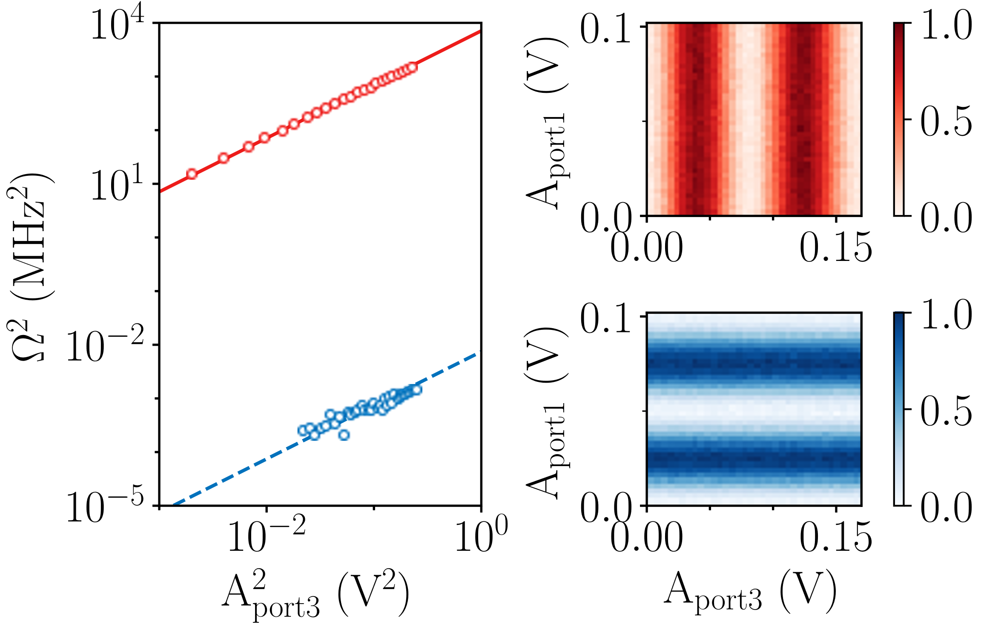
Qubit to qubit isolation
q1
q2
q3
3.453 GHz
3.147 GHz
q3
60 dB
q₁
q₃
1 cm
q1
port 1
port 3
Methodology as in Kosen et al., PRX Quantum 5, 2024

Slide 21
Qubit to qubit isolation
q1
q2
q3
3.453 GHz
3.147 GHz
q3 inversion
q3
60 dB
q₁
q₃
1 cm
q1 inversion
q1
port 1
port 3

Slide 22
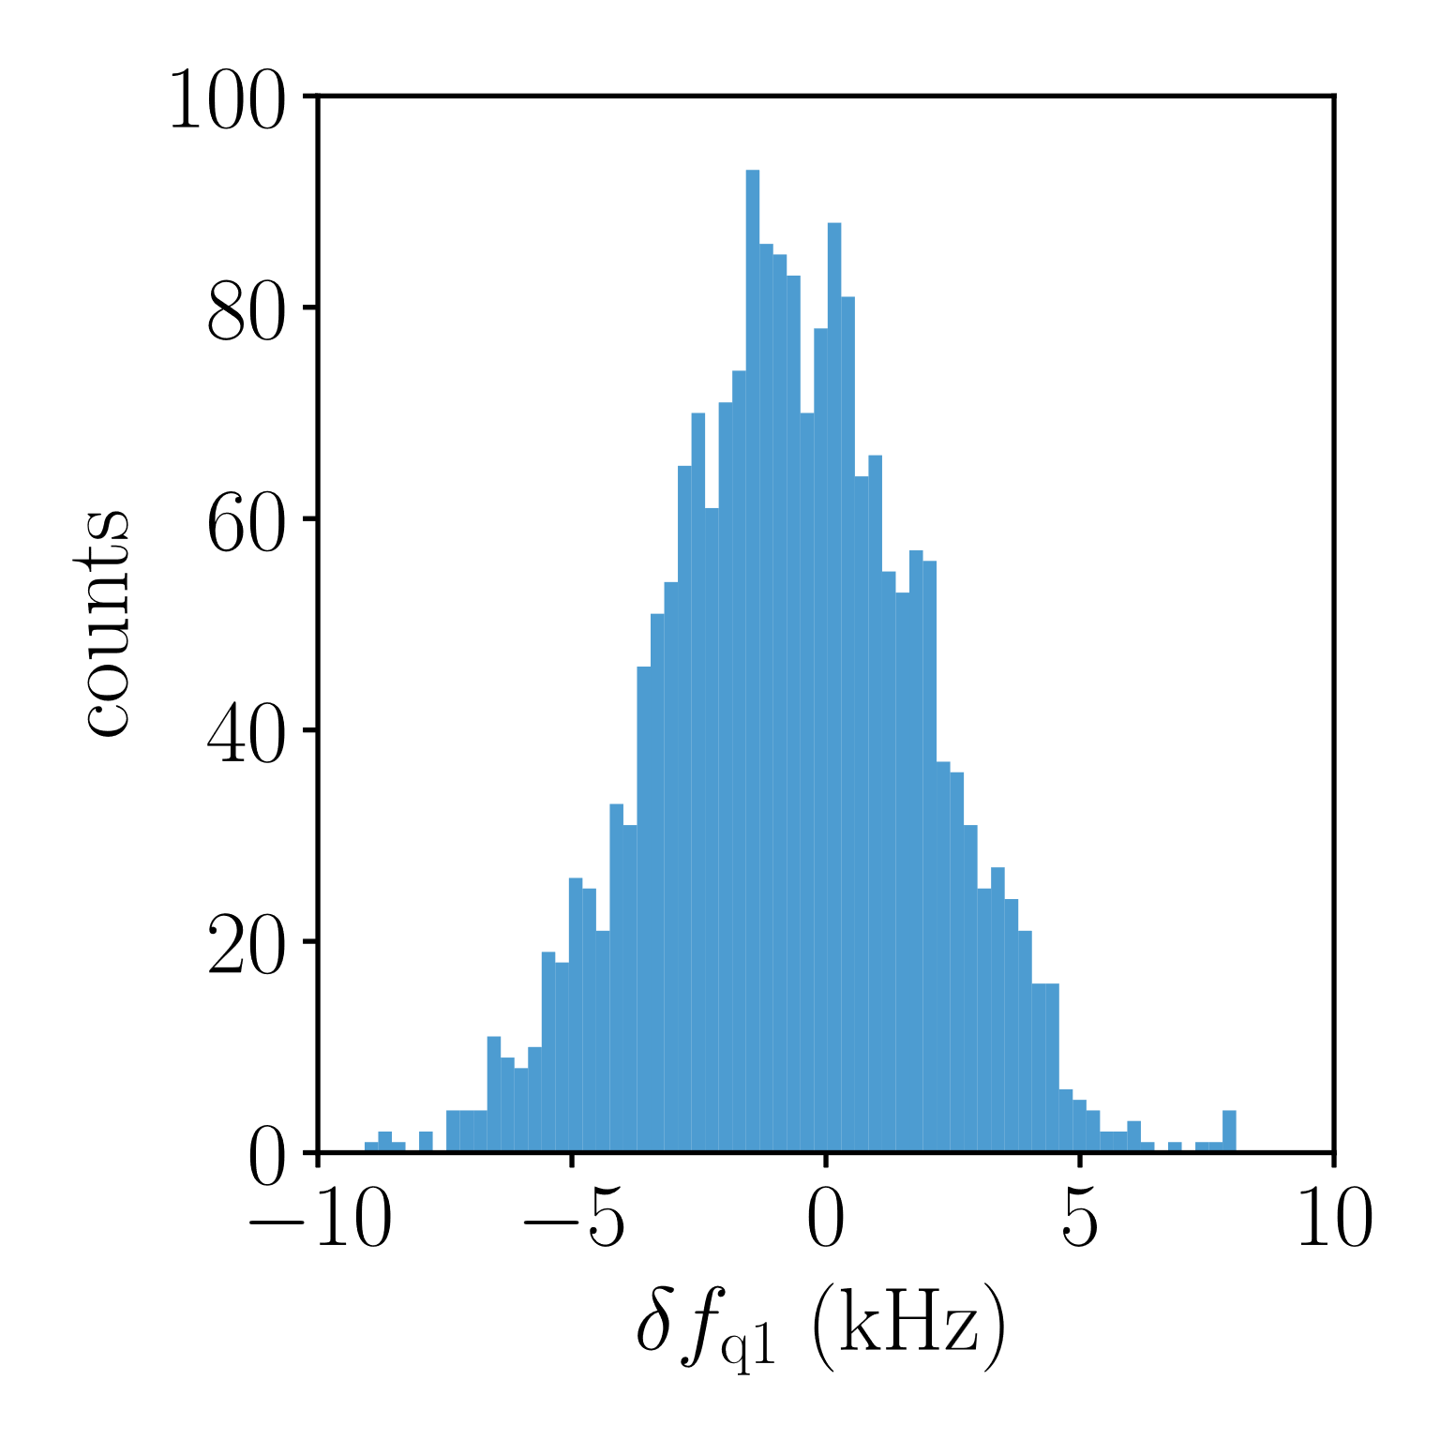
zz-crosstalk between qubits
q1
q2
q3
3.453 GHz
3.147 GHz
q₁
q₃
1 cm
port 1
port 3
π/no-π

Slide 23
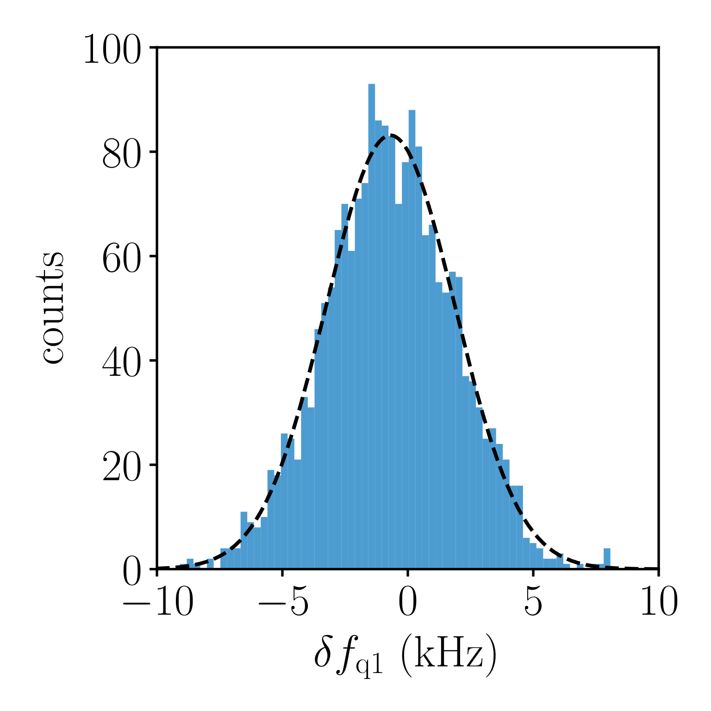

zz-crosstalk between qubits
q1
q2
q3
3.453 GHz
3.147 GHz
$$\overline{δf_{q}}=−690 Hz$$
q₁
q₃
1 cm
port 1
port 3
π/no-π

Slide 24
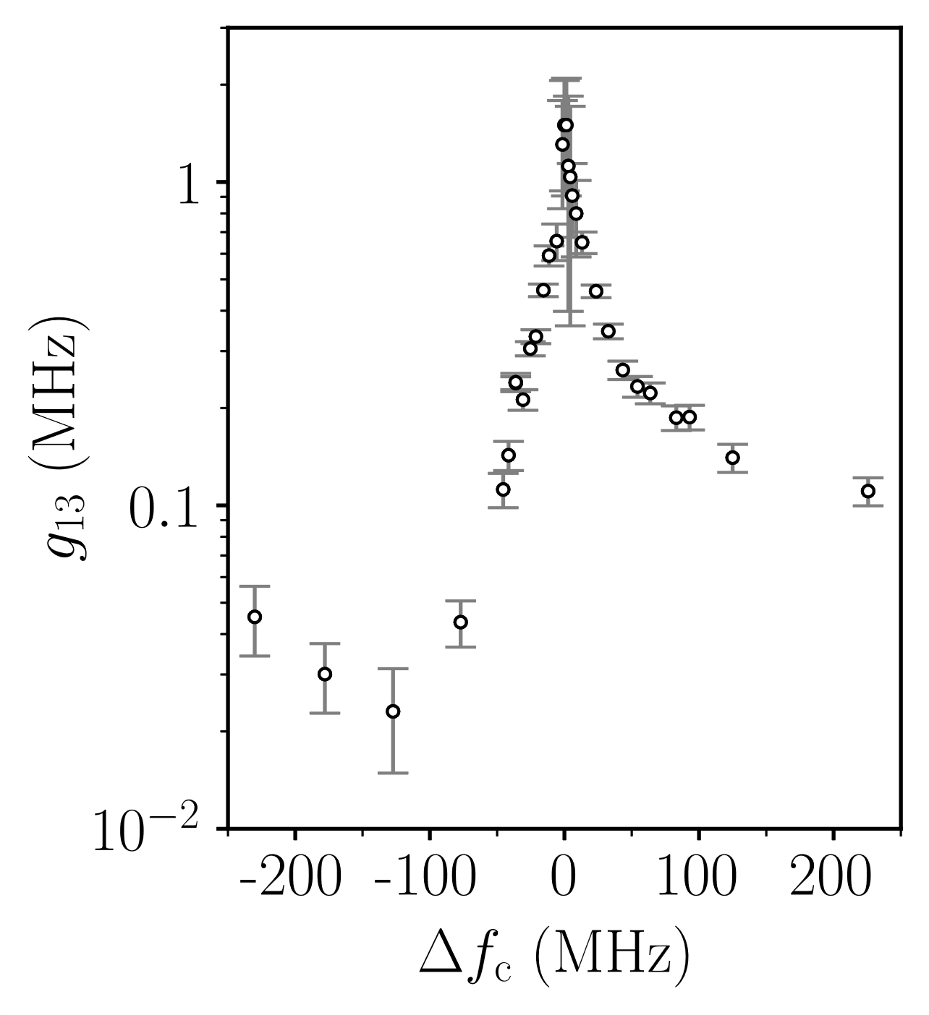
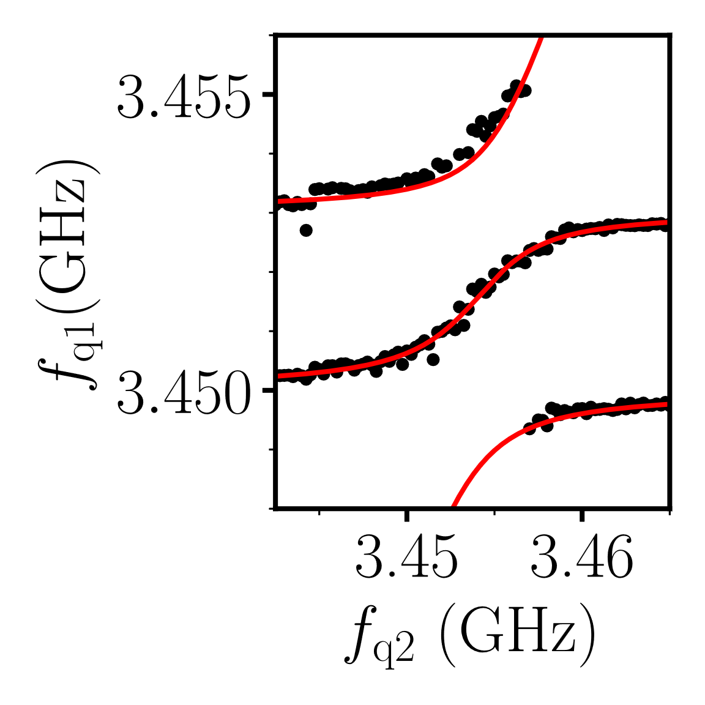

Coupling between the qubits vs. Coupler detuning
q1
q2
q3
3.453 GHz
∆f_{c}
3.147 GHz
q₁
q₃
1 cm
port 1
port 3
$g_{13}=1.5$MHz

Slide 25
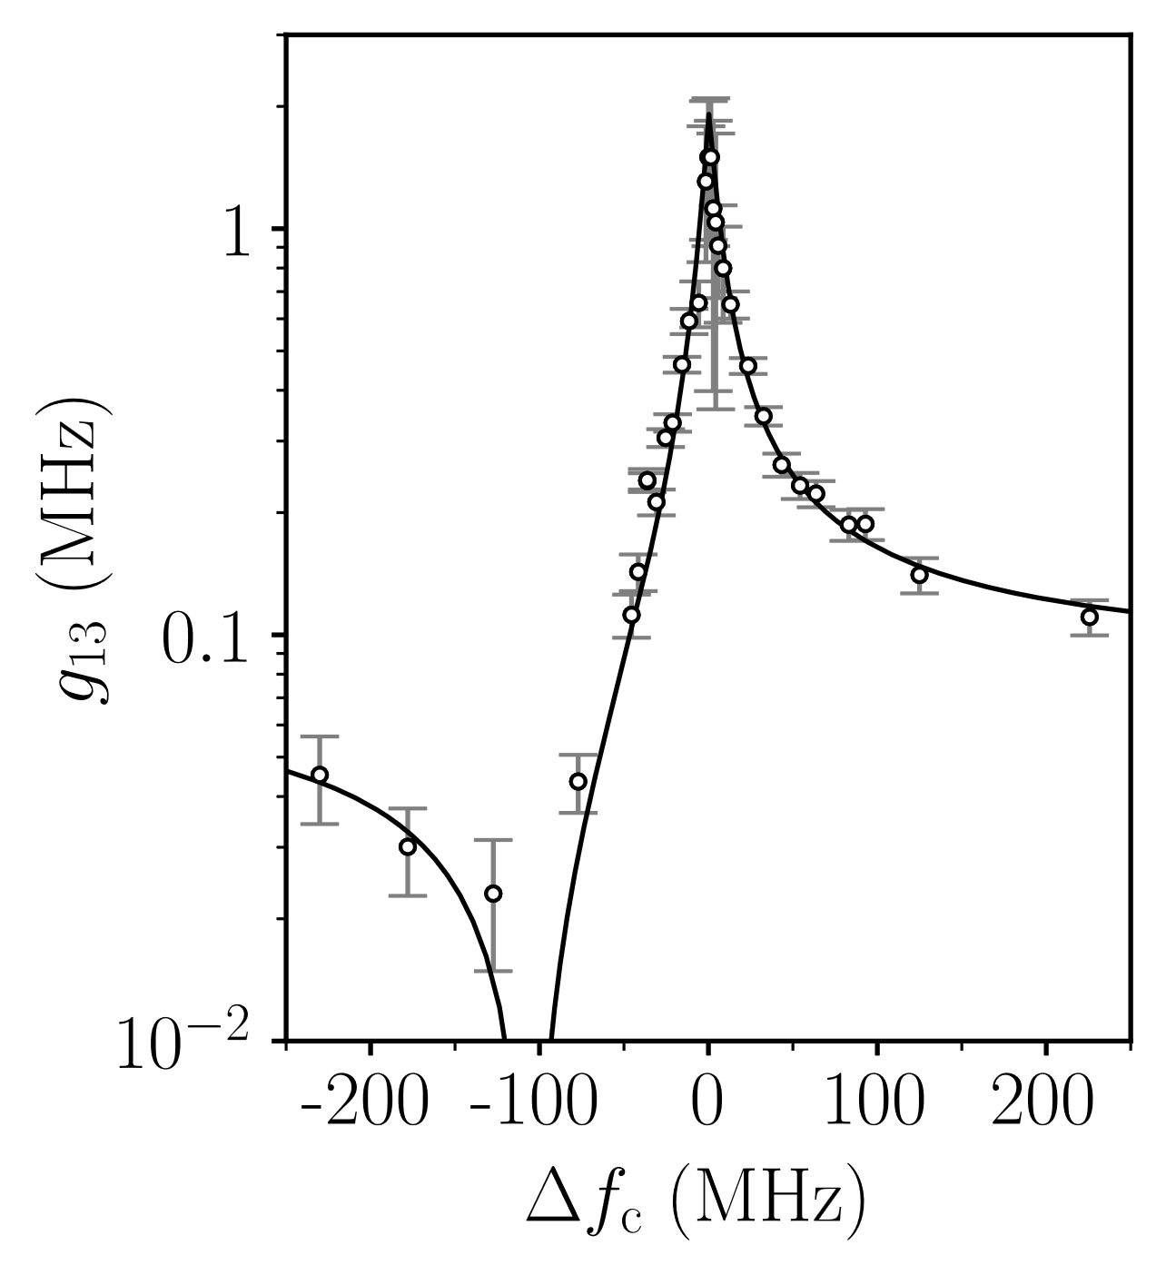
Coupling between the qubits vs. Coupler detuning
q1
q2
q3
3.453 GHz
∆f_{c}
3.147 GHz
q₁
q₃
1 cm
port 1
port 3
$g_{13}=1.5$MHz
Theory by G. Jauma & M. Pino & J.J. Garcia-Ripoll

Slide 26
Summary
Individual enclosures for qubits
Low microwave crosstalk ( < -60dB )
Flux tunable coupler
10 mm

Slide 27
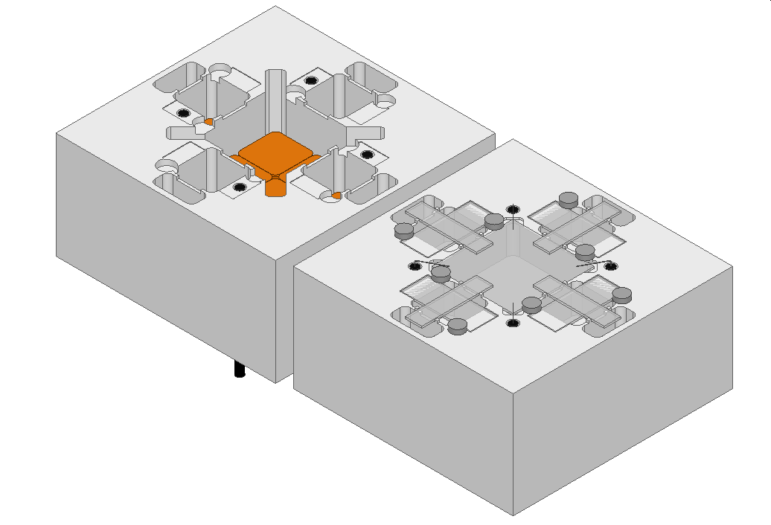
Summary & Outlook
Individual enclosures for qubits
Low microwave crosstalk ( < -60dB )
Flux tunable coupler
Two-qubit gates
Scalable in two dimensions
top
bottom
37 mm
10 mm
feedthroughs

Slide 28
Thank you for you attention !

Slide 29

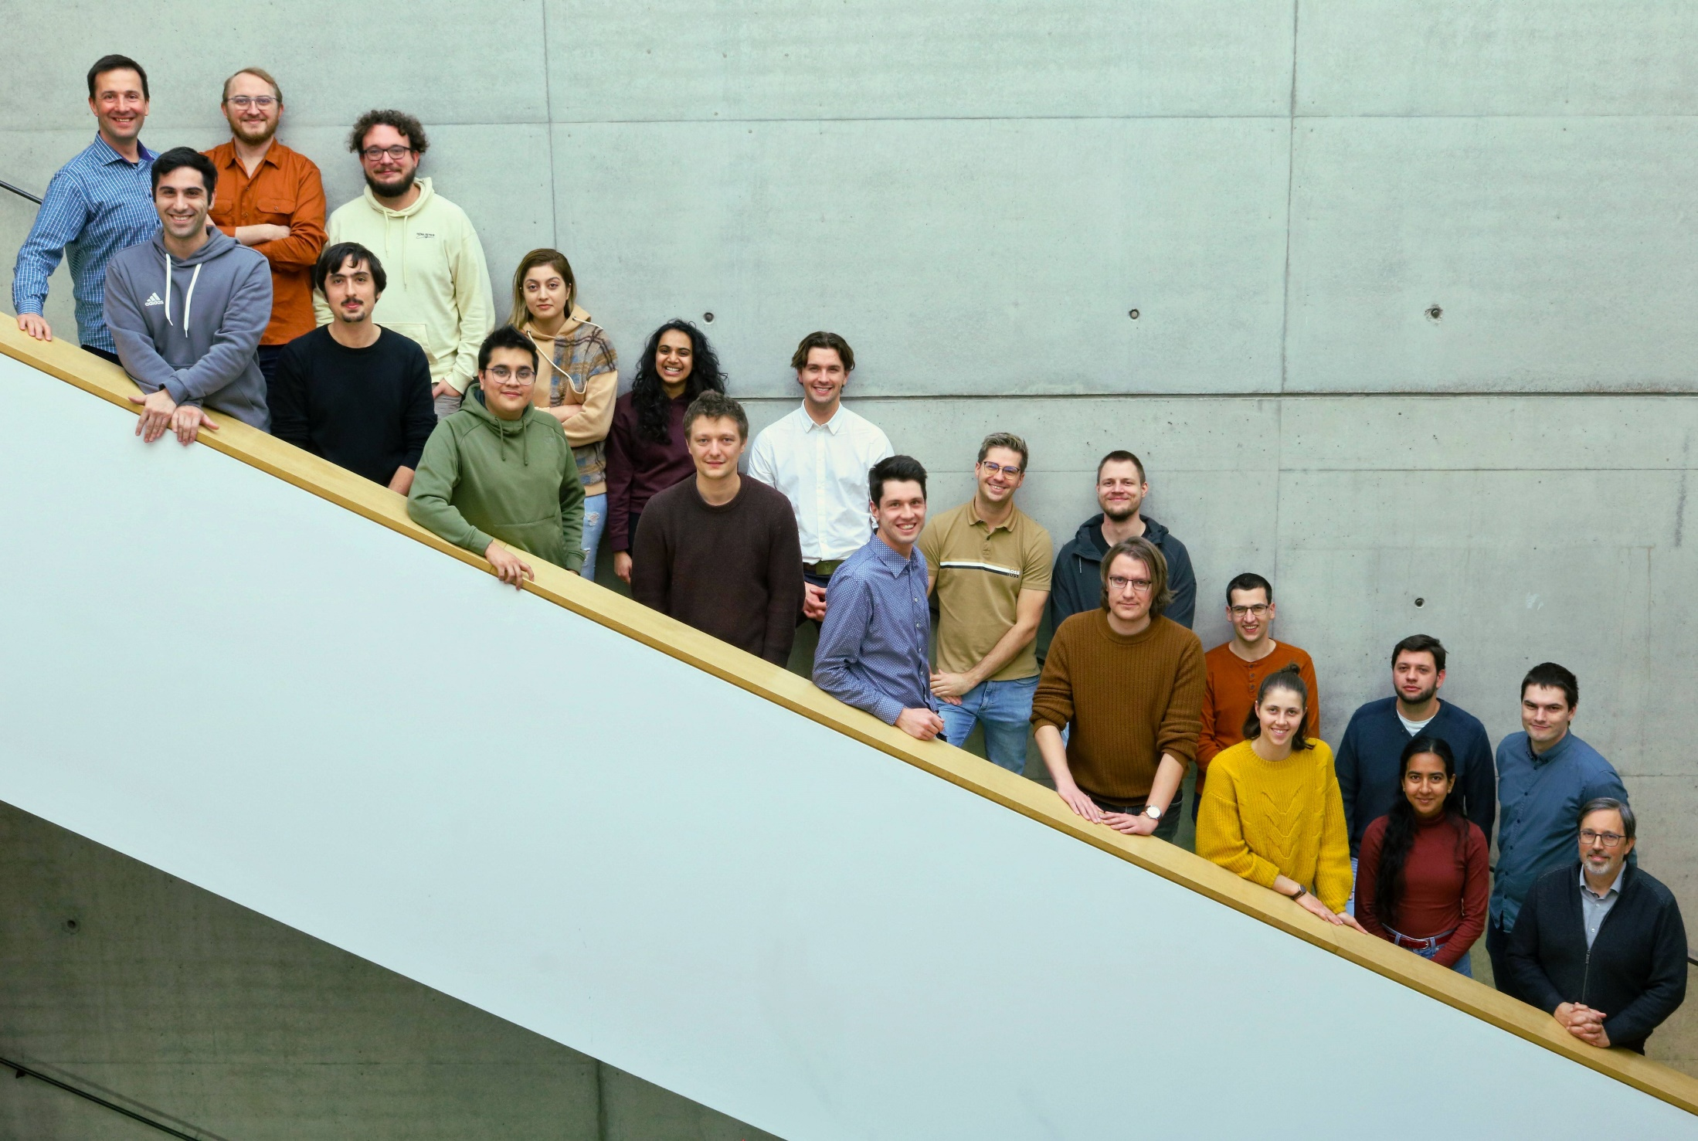

Black Forest Quantum Group
Ioan
Mathieu
Soroush
Nico G.
Denis
Mahya
Nico Z.
Ameya
Martin
Mitchell
Patrick
Simon I.
Paul
Simon II.
Philipp
Naomi
Janic
Ritika
Sören
Thomas

Slide 30
Isolation between enclosures
f_{r1} = 6.508 GHz
f_{r3} = 5.226 GHz
r₁
r₃
1 cm
port 1
port 3

Slide 31
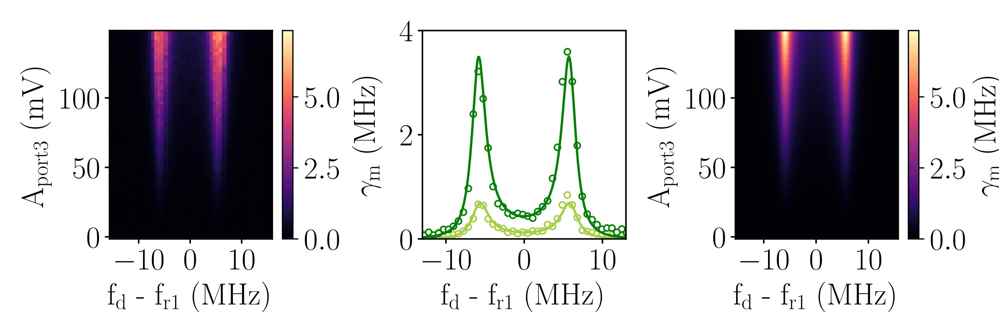

Isolation between enclosures
f_{r1} = 6.508 GHz
f_{r3} = 5.226 GHz
r₁
r₃
1 cm
port 1
port 3
$$χ$$
$$χ$$
Methodology as in Gambetta et al, Phys. Rev. A, 2006

Slide 32

Isolation between enclosures
f_{r1} = 6.508 GHz
f_{r3} = 5.226 GHz
r₁
r₃
1 cm
port 1
port 3
$$χ$$
[1]
$$χ$$
Methodology as in Gambetta et al, Phys. Rev. A, 2006

Slide 33

Isolation between enclosures
f_{r1} = 6.508 GHz
f_{r3} = 5.226 GHz
$$γ_{m}(χ,κ,f_{d},f_{r},A)$$
r₁
r₃
q3
1 cm
64 dB
port 1
port 3
$$χ$$
[1]
q1
$$χ$$
Methodology as in Gambetta et al, Phys. Rev. A, 2006

