Slide 1
Quantum detector tomography of a nanophotonic-amplifier-based single photon detector
Elina Sendonaris
esendona@caltech.edu
Quantum Nanophotonics 2025
24/3/25

Slide 2
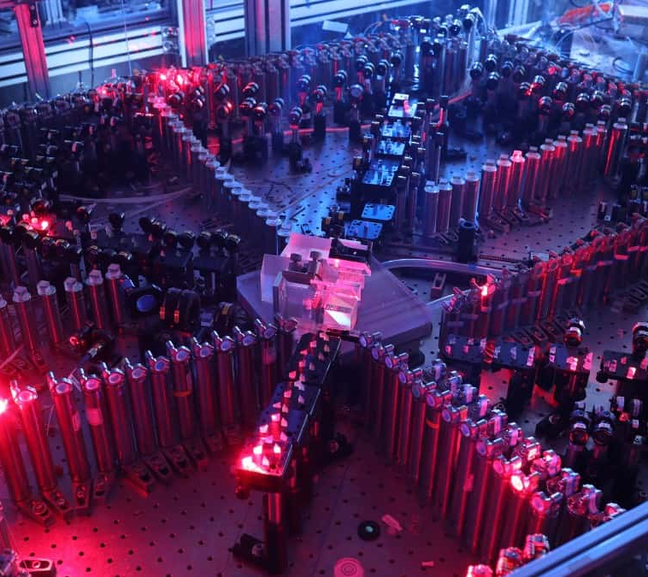
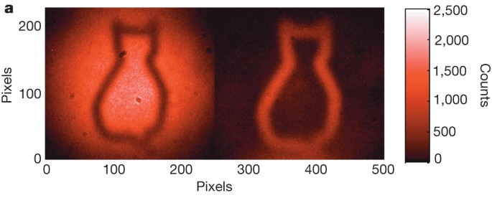
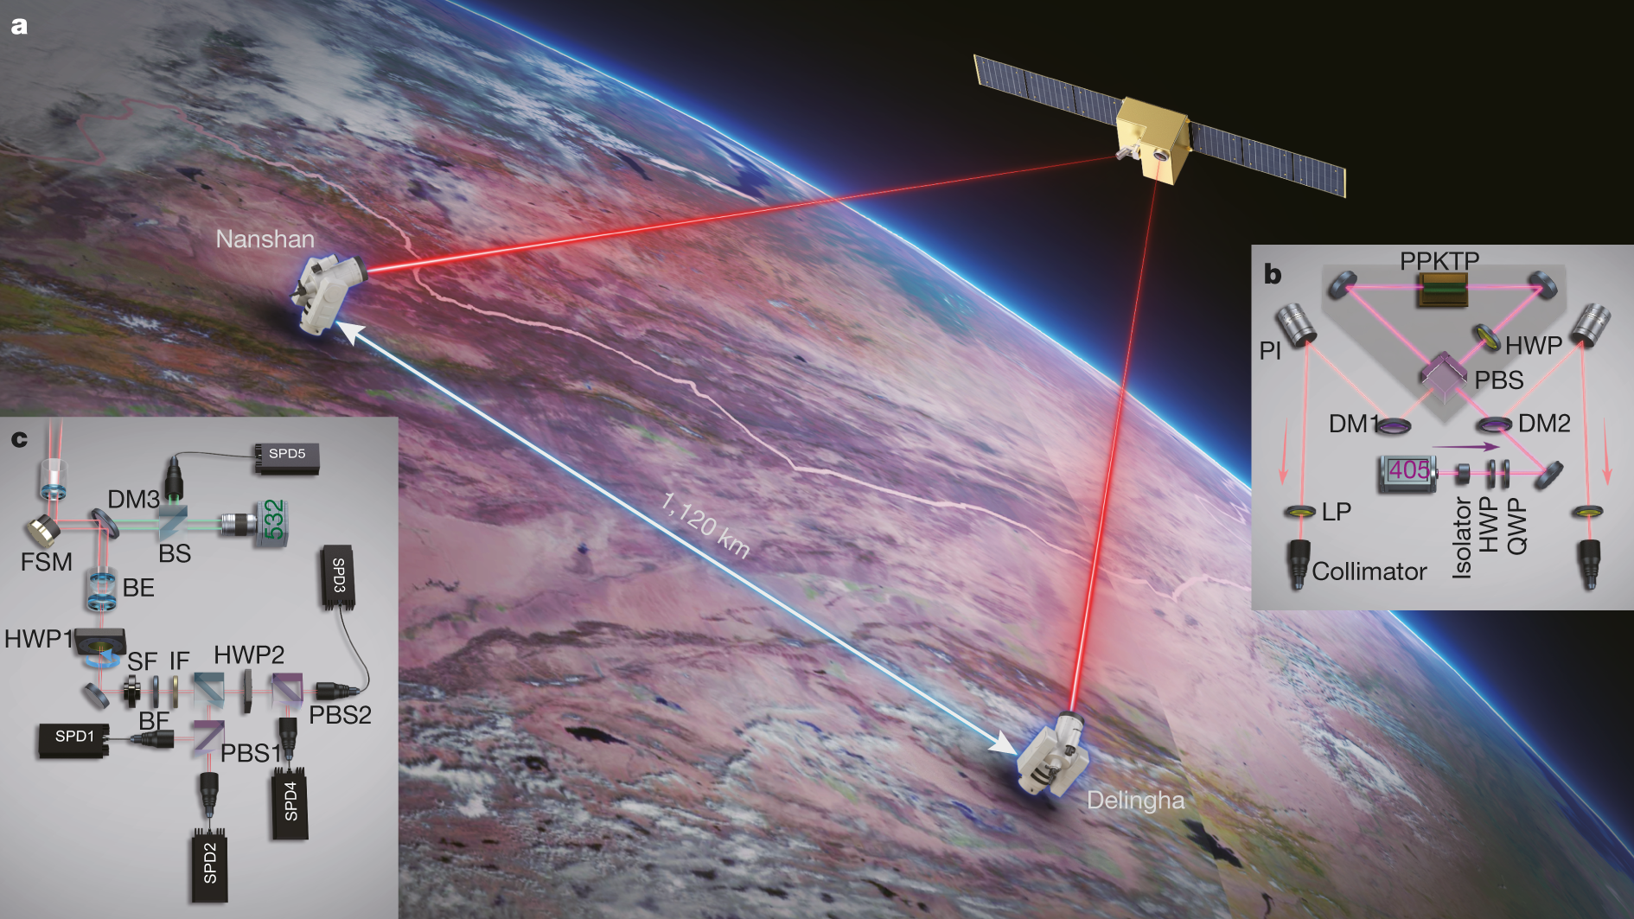
Quantum photonics
Quantum information processing
Quantum communication
Quantum imaging
and sensing
G. Lemos, et al., Nature 512 (409–412) (2014)
J. Yin, et al, Nature 582 (501-503) (2020)
H.-S. Zhong, et al., Science 370 6523 (2020)
Challenges: scalability, nonlinearity

Slide 3
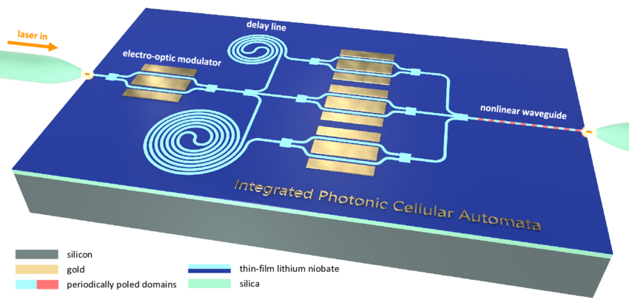
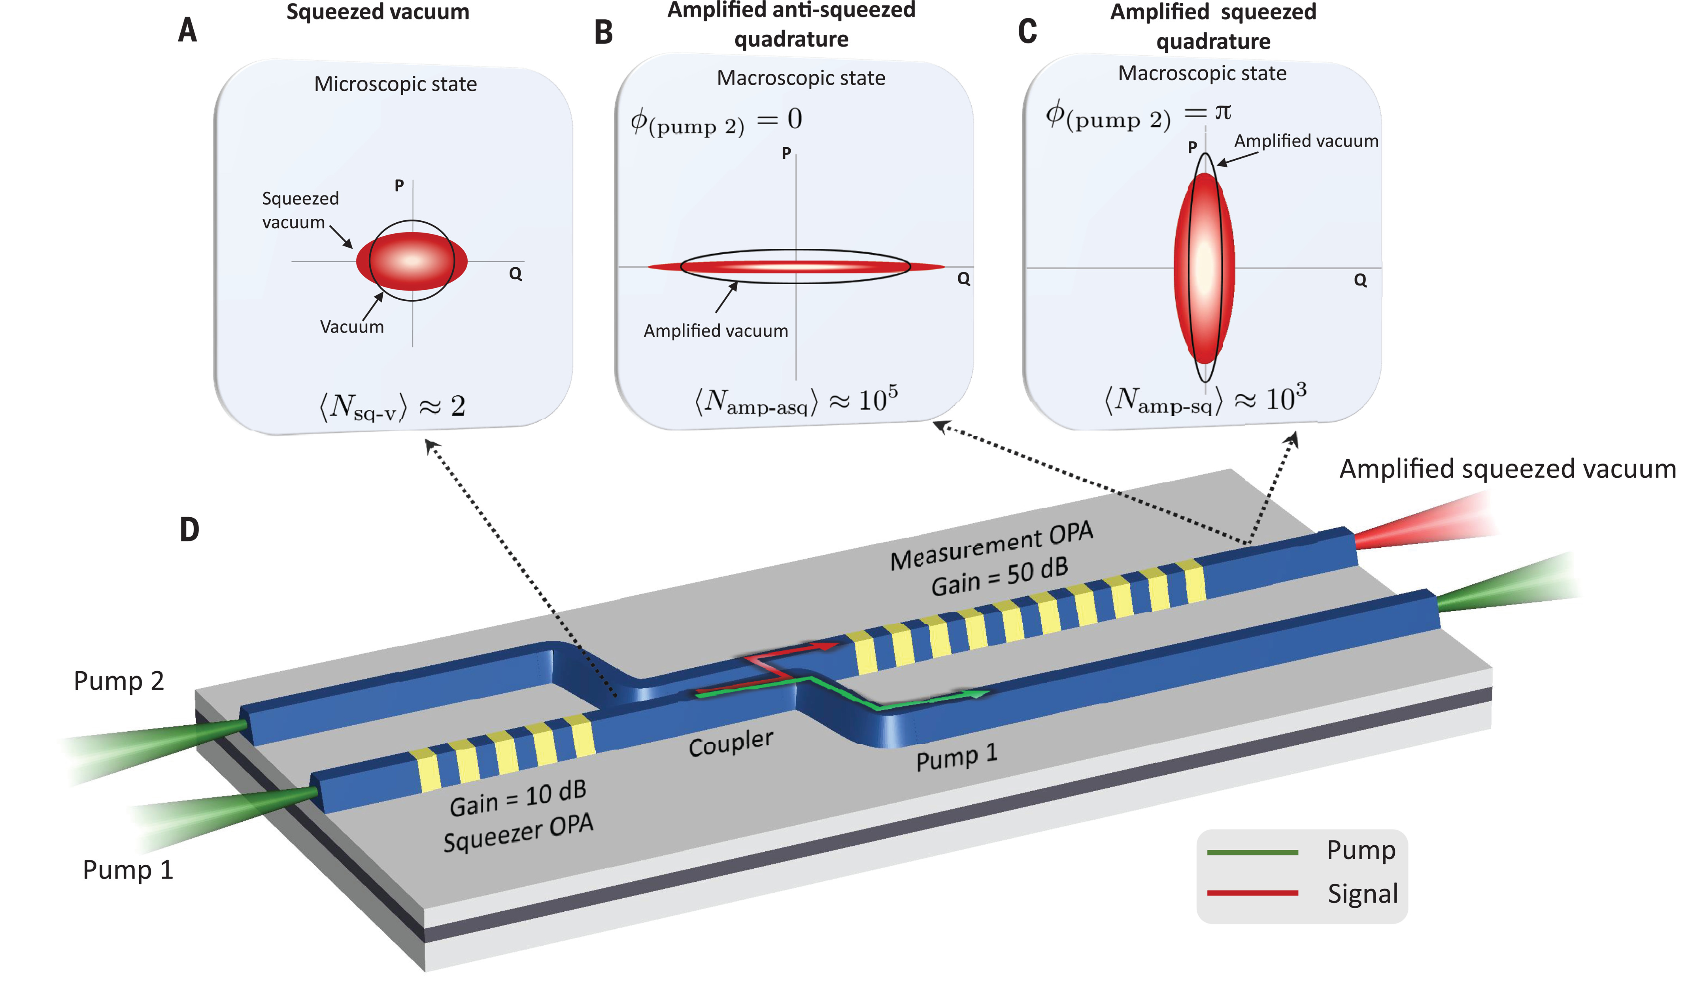
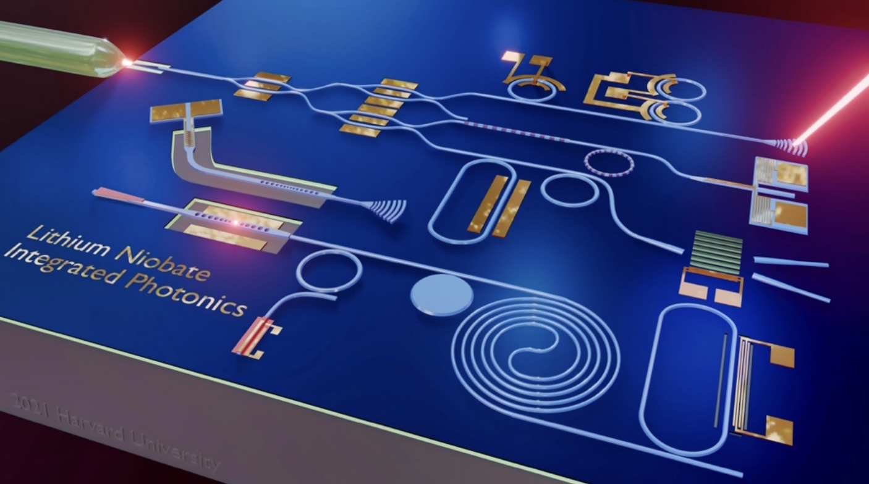
Lithium niobate integrated quantum photonics
Benefits:
Strong χ⁽²⁾ optical nonlinearity
Wealth of linear and nonlinear components
Scalability
G. H. Y. Li, et al., Light: Science & Applications 12 (2023)
D. Zhu, et al., Optica, 13 2 (2021)
R. Nehra, et al., Science, 2022 37 (2022)

Slide 4
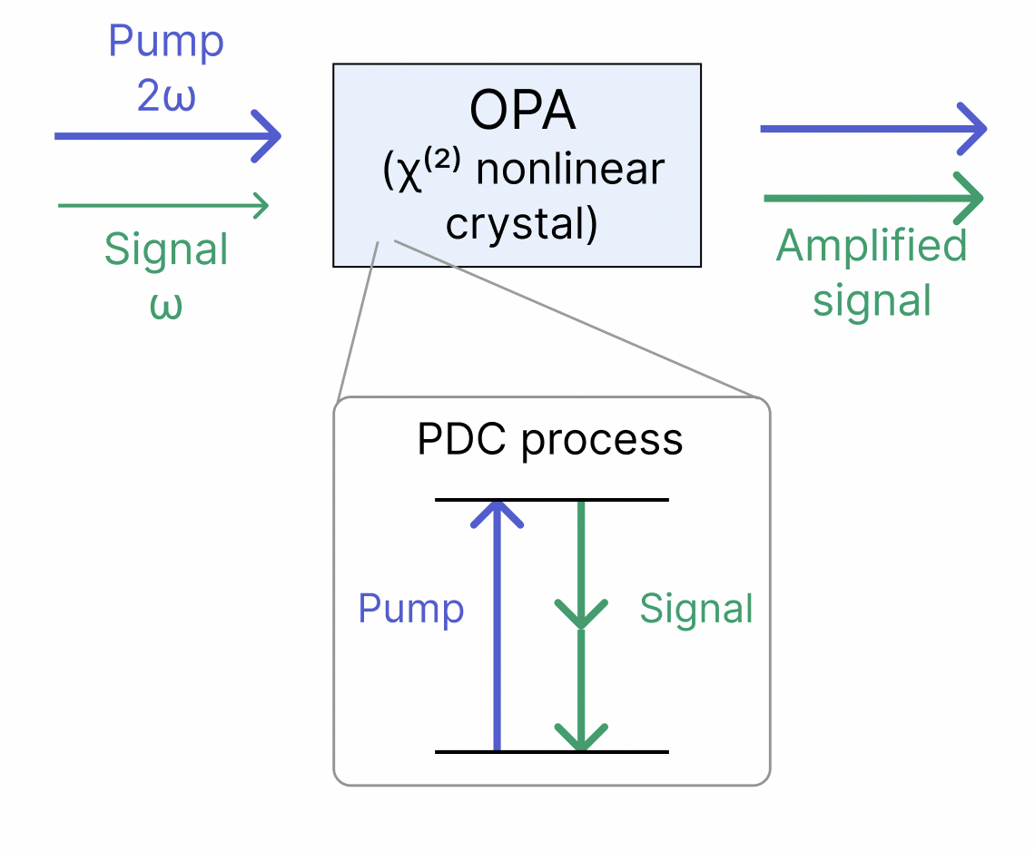
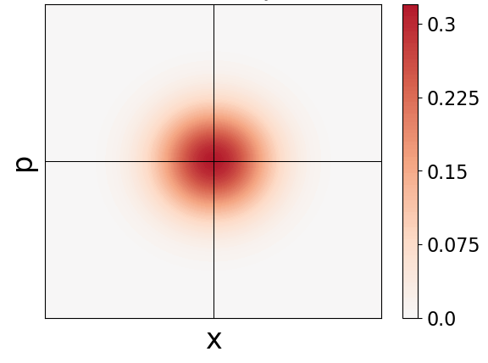
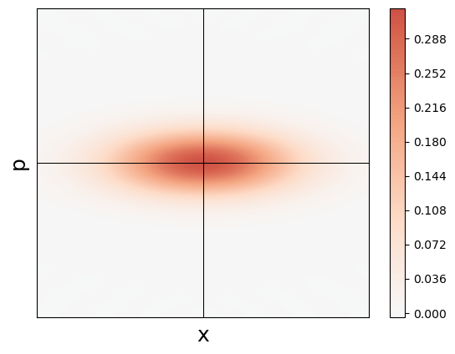
Optical parametric amplifiers (OPAs)
Degenerate OPA
Quadrature squeezing
Squeezed vacuum
Vacuum

Slide 5
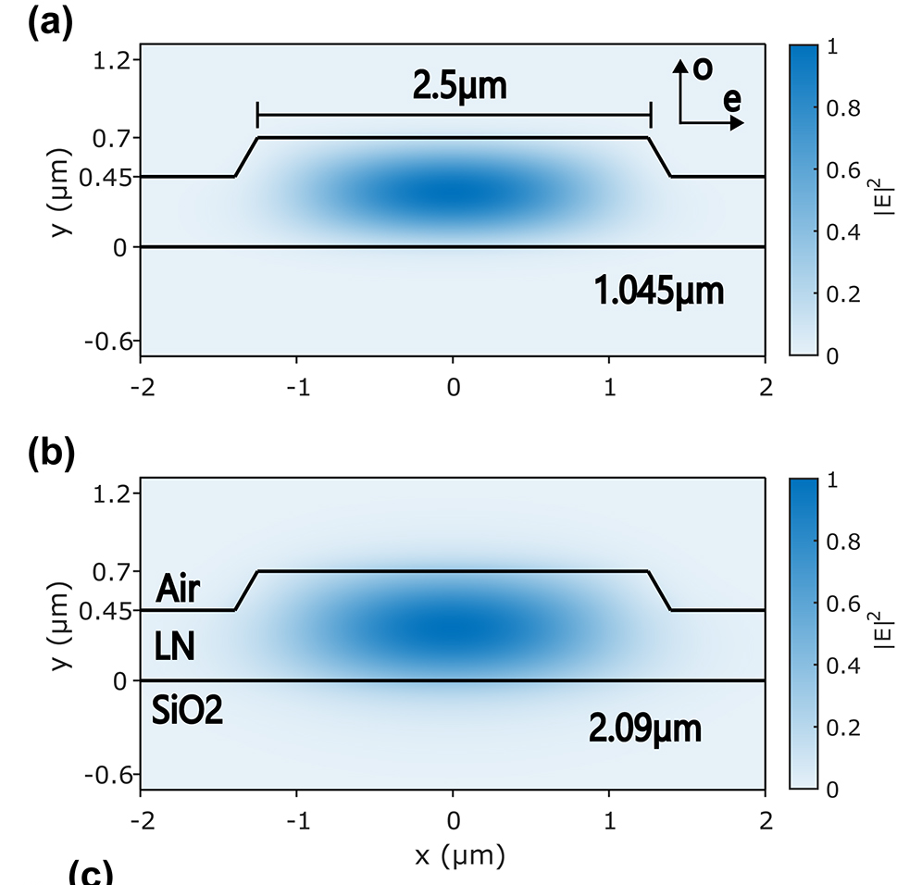
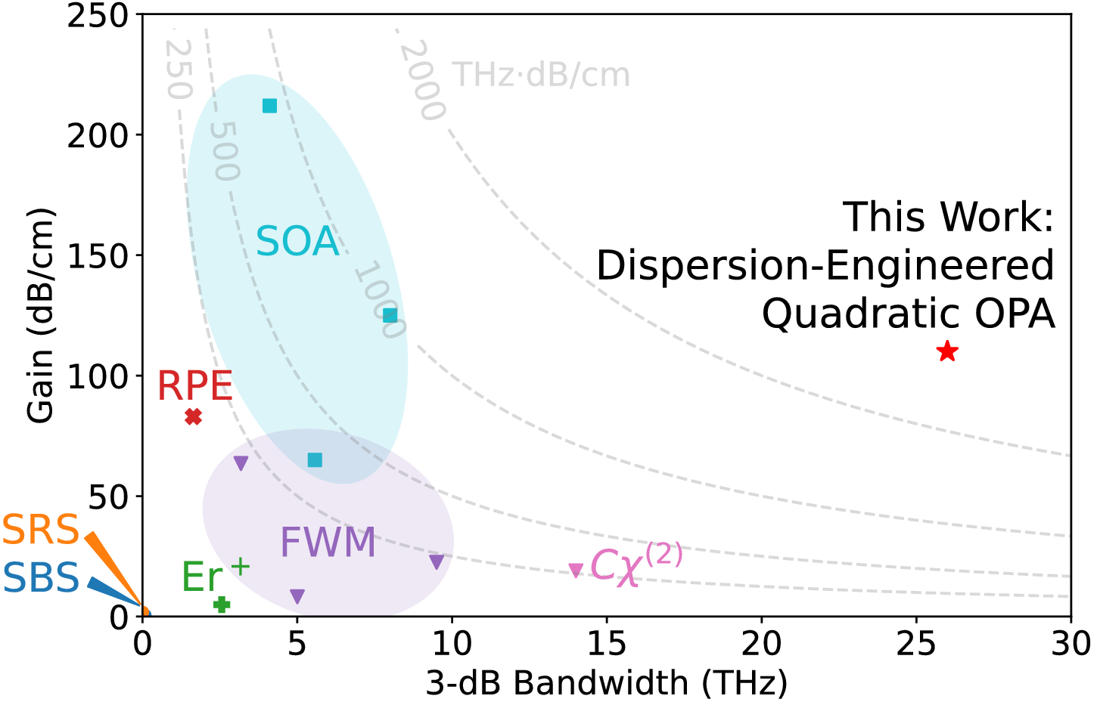
Integrated thin-film lithium niobate OPAs
High spatial mode confinement
Dispersion engineering for ultrashort pulse operation and high gain
L. Ledezma et al., Optica 9 3 (2022)
J. Willliams et al., Nanophotonics 13 (2024)

Slide 6
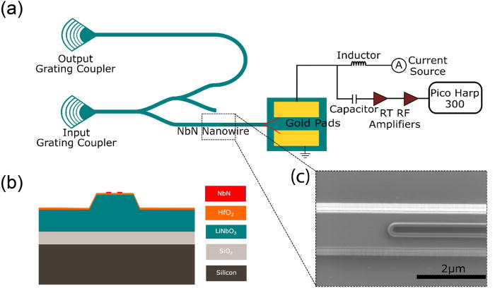
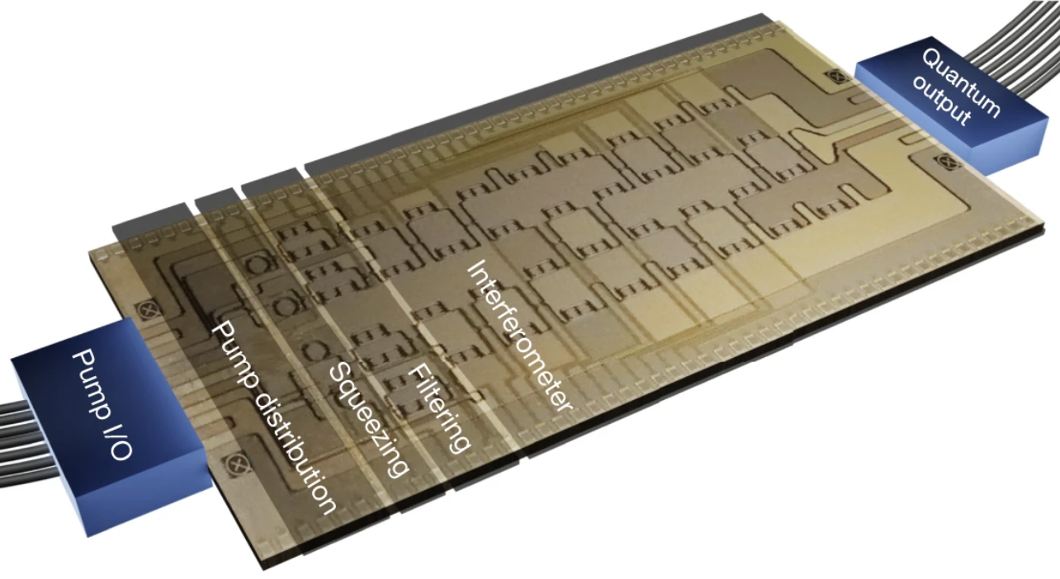
Photon detection in nanophotonics
Necessary for quantum communication and computation
Outcouple from chip to detector
Integrate a superconducting detector on-chip
J. M. Arrazola, et al., Nature 591 54-60 (2021)
A. Sayem, et al., Applied Phys. Lett., 116 151102 (2020)
Issues: High outcoupling loss
Entire chip must be in cryostat
Speed limited by reset time of physical process

Slide 7
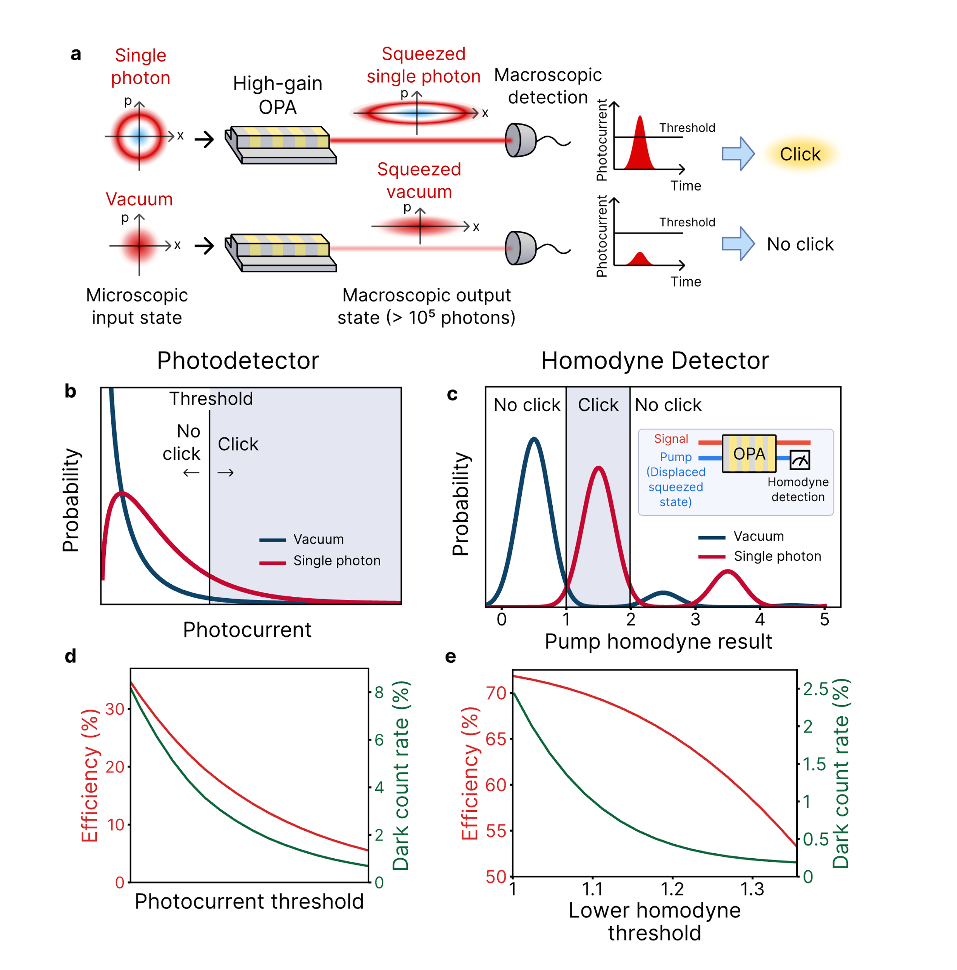
Photon detection using an optical parametric amplifier
OPA detector: OPA + macroscopic detector
OPA amplifies signal to macroscopic levels
Thresholding to identify a photon (click detector)

Slide 8
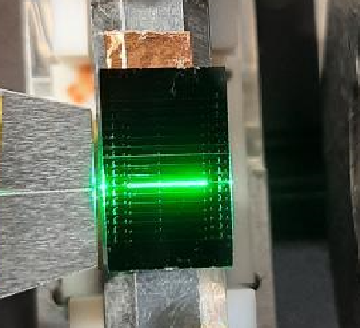
Why integrated OPAs for photon detection?
Ultrafast (THz)
Room-temperature
Wide wavelength range
High gain
Resistant to out-coupling loss
Integrated

Slide 9
Photon detection using an optical parametric amplifier – photodetector
Photodetector
Gaussian operation
OPA in linear regime
Not sufficient for universal quantum computation

Slide 10

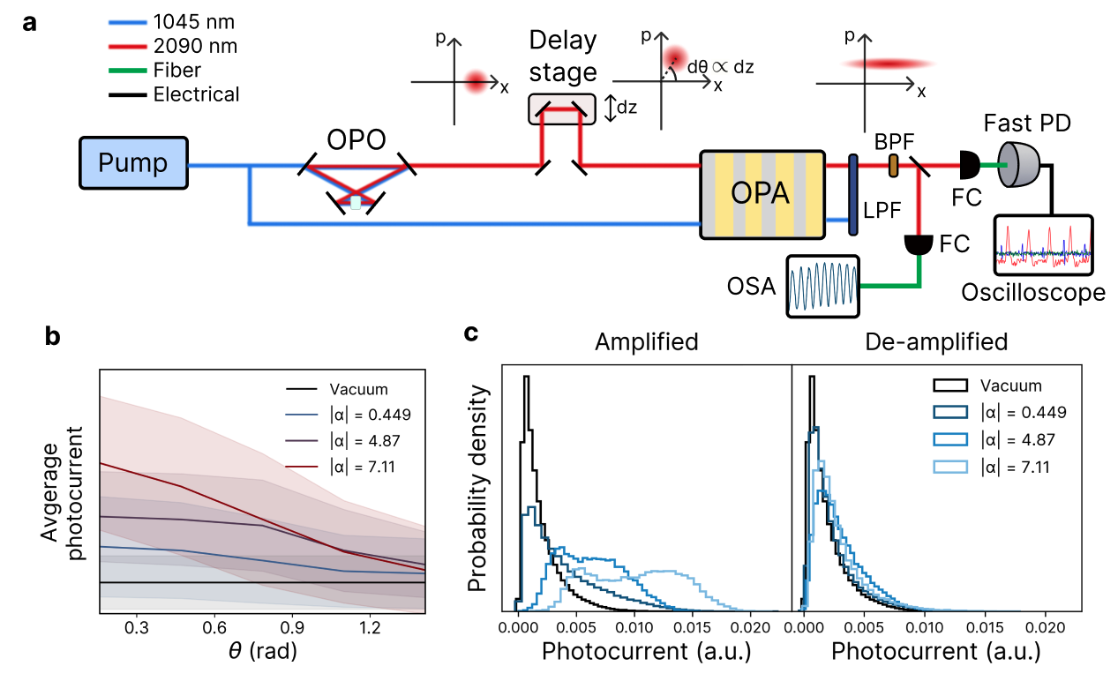
Quantum detector tomography
Obtain POVM through inversion of:
Measurement results
Integrated periodically-poled lithium niobate OPA
18 GHz fast photodetector
100 fs pump pulses
Probe state
POVM

Slide 11
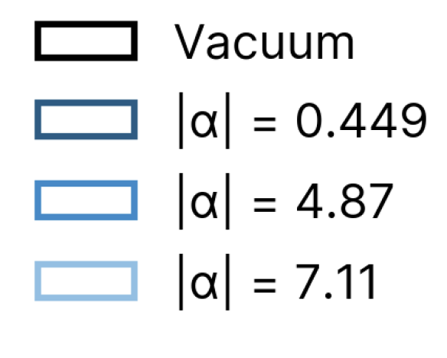
OPAD performance
Want:
High photon detection efficiency
Low dark count rate

Slide 12
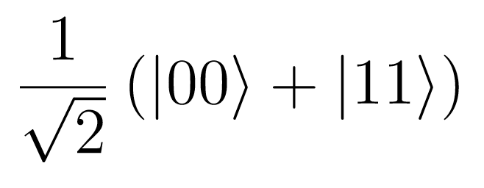
OPAD discrete variable performance
Start with a Bell state in the Fock basis
High fidelity of other mode with single photon conditioned on click
Non-Gaussianity remains

Slide 13
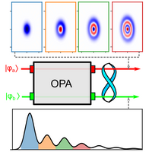
Photon detection using an optical parametric amplifier – pump homodyne
QND measurement using homodyne on depleted pump:
Large nonlinearity-to-loss ratio (g/κ) leads to pump-signal entanglement
Homodyne measurement of pump projects signal onto squeezed Fock basis
R. Yanagimoto et al., PRX Quantum 4, 010333 (2023)

Slide 14
Photon detection using an optical parametric amplifier – pump homodyne
Pump Homodyne Detection
QND measurement using homodyne on depleted pump:
R. Yanagimoto et al., PRX Quantum 4, 010333 (2023)

Slide 15
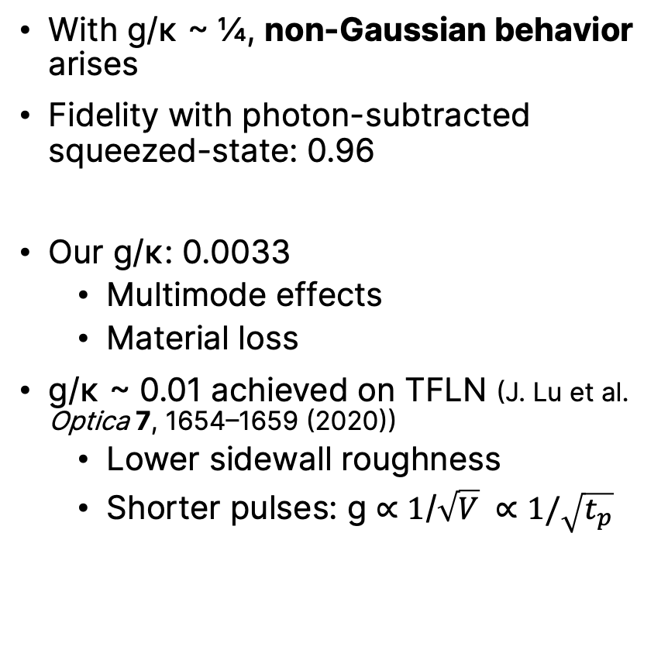
Schrodinger’s cat through pump homodyne OPAD
With g/κ ~ ¼, non-Gaussian behavior arises
Fidelity with photon-subtracted squeezed-state: 0.96
Our g/κ: 0.0033
  Multimode effects
  Material loss
g/κ ~ 0.01 achieved on TFLN (J. Lu et al. Optica 7, 1654–1659 (2020))
  Lower sidewall roughness
  Shorter pulses: g ∝ 1/$\sqrt{V} ∝1/\sqrt{t_{p}}$

Slide 16
Recap of completed work
Designed and implemented OPA-based single-photon detection system
Integrated, room-temperature, ultrafast operation, no non-Gaussianity
26.5% efficiency for 2.2% dark count rate
Next steps:
Non-Gaussian operation with higher g/κ and pump homodyne
Email: esendona@caltech.edu
E. Sendonaris* and J. Williams* et al., arXiv:2410.18397 (2024)

Slide 17
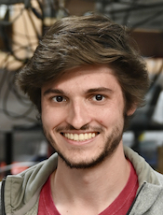
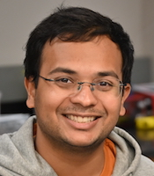


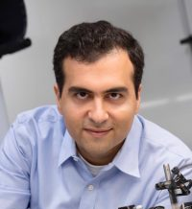
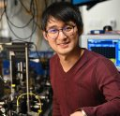
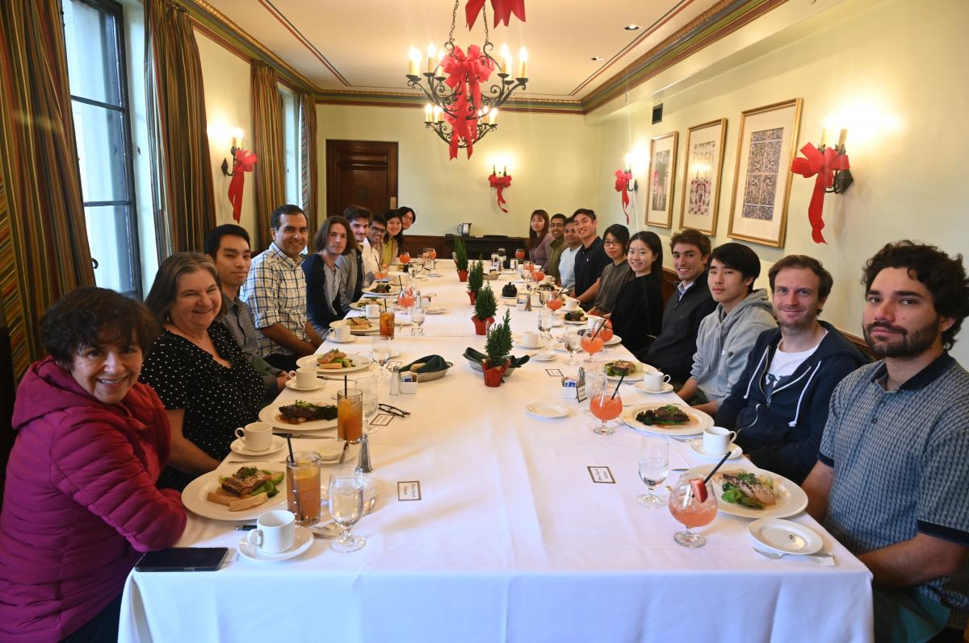




Thank you!
Thank you to everyone in the Nonlinear Photonics Lab, especially James Williams, Thomas Zacharias, Robert Gray, Ryoto Sekine, Luis Ledezma, and Alireza Marandi

Slide 19
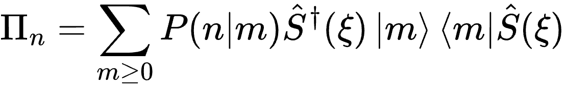
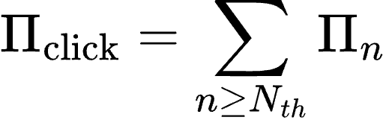
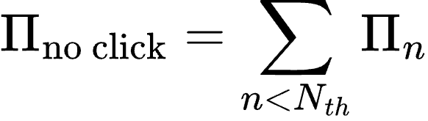
Reconstructed POVM
Theoretical POVM:
Fidelity between theoretical and experimental POVMs of 0.72
E. Sendonaris* and J. Williams* et al., arXiv:2410.18397 (2024)

