Slide 1
Restricting Fat Pleasure: Fatphobia in the Representation of Sexuality in Bridgerton Season 3
Rebeca Maseda García University of Alaska Anchorage rmasedagarcia@alaska.edu
Elisabet Marco Arocas Universitat de València, elisabet.marco@uv.es
Emma Gómez Nicolau Universitat Jaume I, enicolau@uji.es
This Photo by Unknown Author is licensed under CC BY

Slide 2
FAT WOMEN IN SERIALIZED FICTION
Growing inclusion but featuring a fat protagonist alone is insufficient to dismantle entrenched prejudices
Too often fatness becomes the central trait around which all narrative developments revolve (Risch, 2002; Amador Navarro, 2022)
Most are inactive or passive, they tend to have fewer interactions with friends or partners, and are less likely to go on dates, or have sex (Greenberg et al., 2003)
Rarely positioned as objects of romantic desire. Romantic pairings are often deemed implausible by mainstream standards (Mobley, 2014; Hutter, 2023)

Slide 3
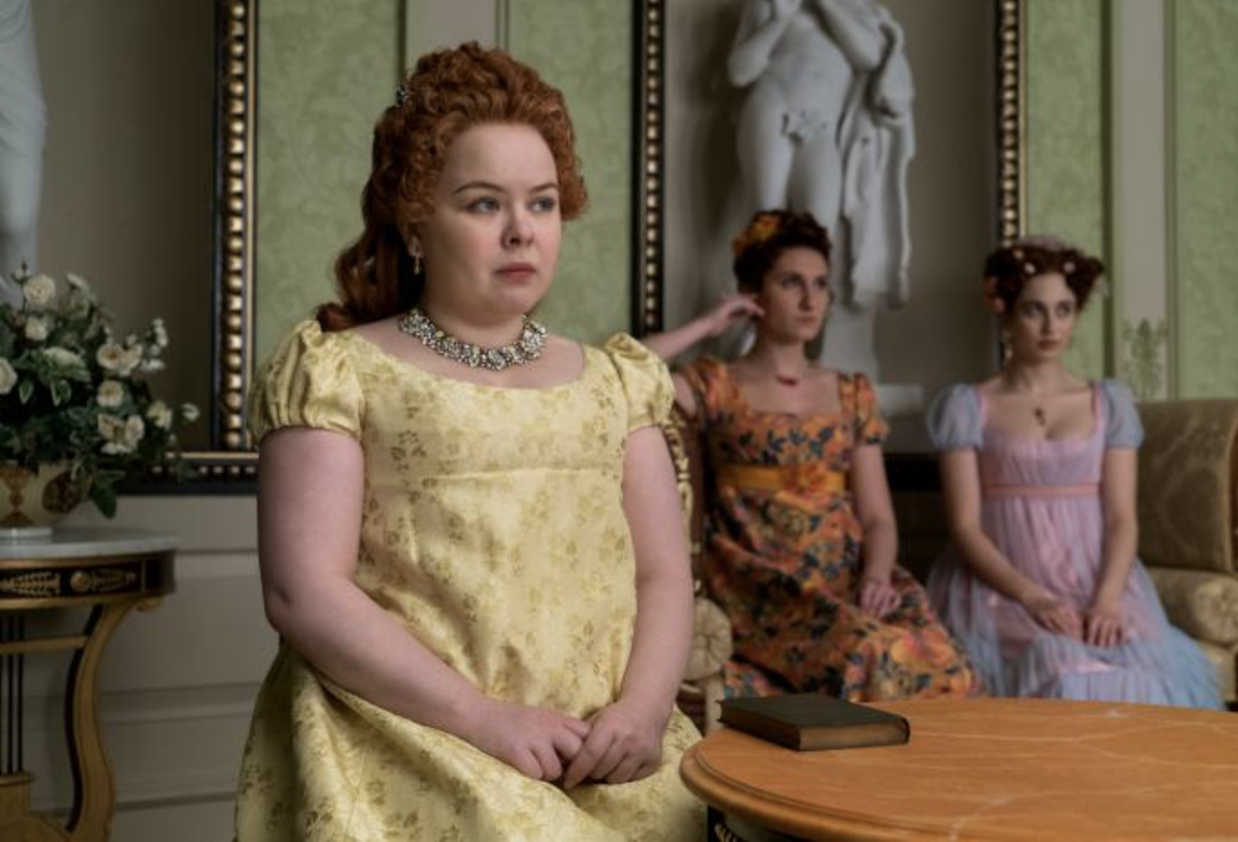
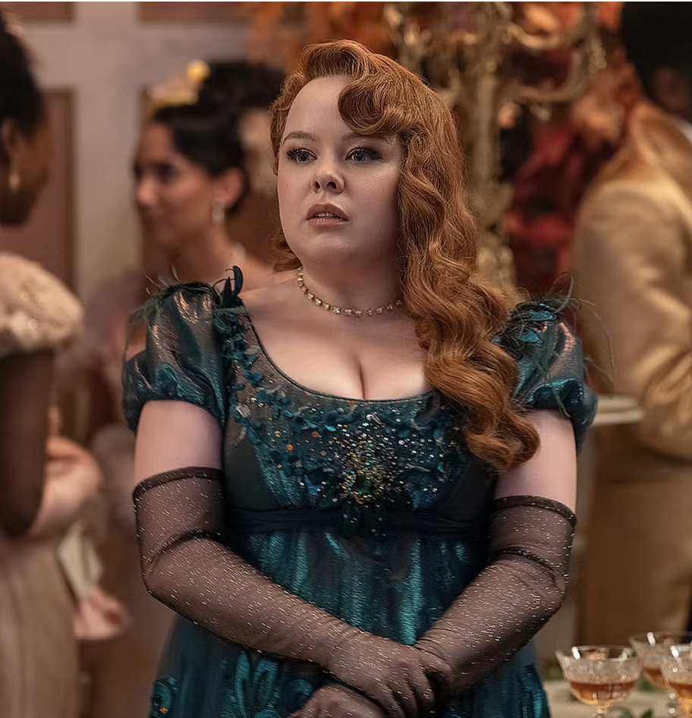
Penelope Featherington (Nicola Coughlan) in the U.S. television series Bridgerton (created by Chris Van Dusen and Shonda Rhimes, based on Julia Quinn's book series, Netflix, 2020–2024)
Challenges many stereotypes:
Protagonist of Season 3,
Portrayed as intelligent, desirable, and emotionally and psychologically complex.
Her weight is not the focus of her struggles or achievements, nor does she lose weight to find love (but she conducts a makeover).
However, we point out that the show continues to reflect elements of fatphobia, particularly in its portrayal of sexuality.

Slide 4
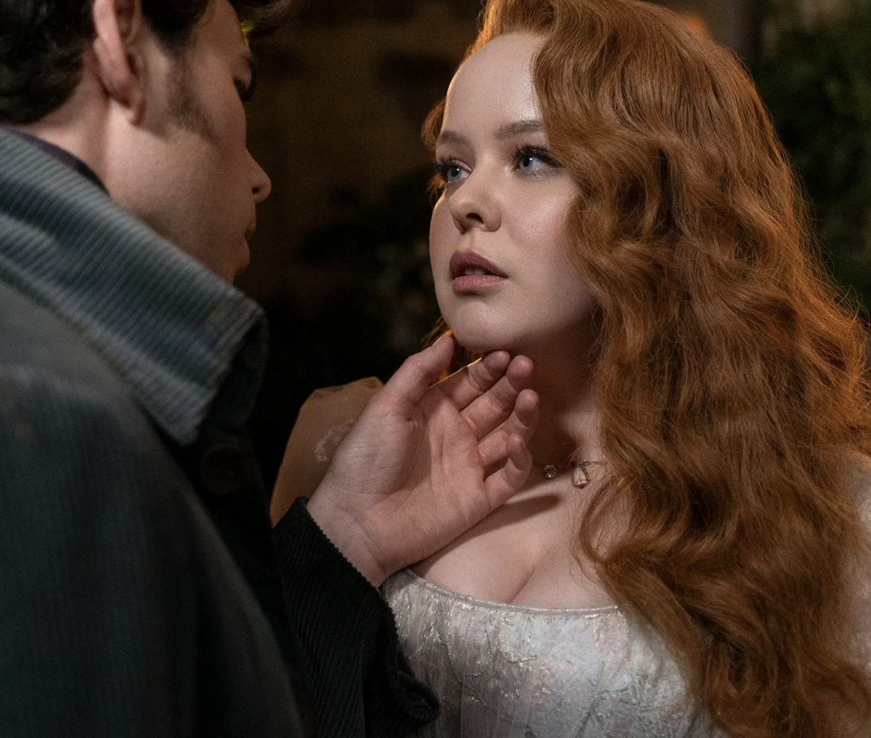
Series grounded in eroticism and desire (especially female).
In each season there is a leading couple who experience love, desire and sex.
The sexual narrative shifts noticeably in Season 3.
To explore these dynamics, we analyzed the portrayal of sexuality and love across the three seasons.
The methodology combines a quantitative and qualitative approach to audiovisual analysis.

Slide 5
QUANTITATIVE
We calculated screen time devoted to sexuality by identifying and timing all relevant scenes across different seasons.
Each episode was watched closely, with the start and end times of scenes related to sexuality recorded and used to determine total duration.
These scenes were then coded as either SEX or DESIRE, based on specific criteria.
Note: To ensure inter-coder reliability, we applied double coding

Slide 6
Sex (Code: SEX)
Applied to explicit representations of sexual acts, including masturbation, physical sexual contact (e.g., touching of genitals, breasts), or consensual sexual practices involving one or more characters.
Desire (Code: DESIRE)
Applied when there is sexual or erotic attraction, longing, or tension that is not acted upon through explicit sexual behavior. It includes emotional, psychological, or symbolic expressions of desire, either between characters or internal to a single character.

Slide 7
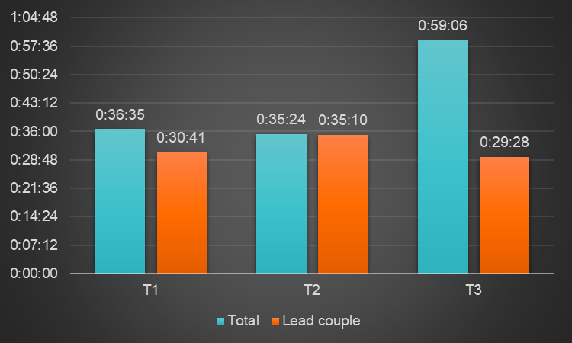
RESULTS. GRAPH 1: Time Distribution of Sexuality in Bridgerton. Minutes and seconds.
Increase of time dedicated to sexuality in Season 3, although lead couple time decreases.
Other erotic storylines with other characters compensate this decline.

Slide 8
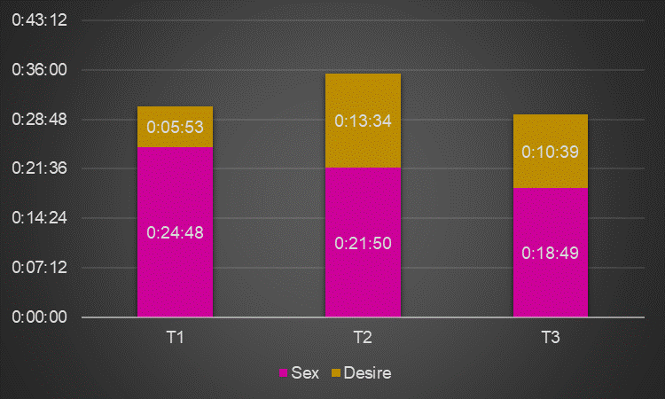
GRAPH 2: Time Distribution of Sexuality in Bridgerton. Minutes and seconds.
Sex screen time decreases across seasons, but in Season 2 has to do with the plot (substantial time dedicated to desire).
Specially decreases in Season 3 when a fat body is involved.

Slide 9
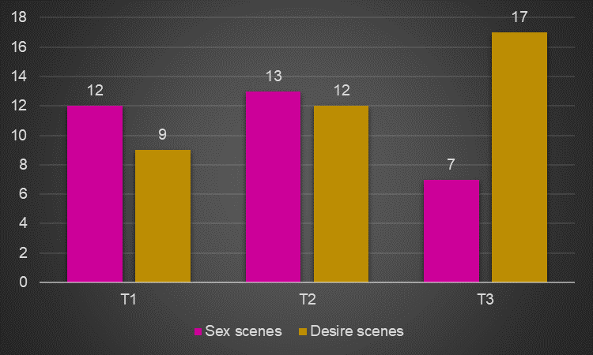
GRAPH 3: Time Distribution of Sexuality in Bridgerton. Number of scenes.
Desire scenes in Season 3 increase notably.
Sex scenes in Season 3 decline dramatically.
Reduction of complexity and diversity of sexual expression.

Slide 10
QUALITATIVE
We carried out a comparative qualitative analysis of sex and desire scenes focusing on how bodies and sexual relationships are represented.
From a feminist film perspective, the analysis considers aspects such as the sexual practices depicted, the visual treatment of bodies and the settings in which the action unfolds, identifying significant variations in the portrayal of eroticism across seasons.

Slide 11
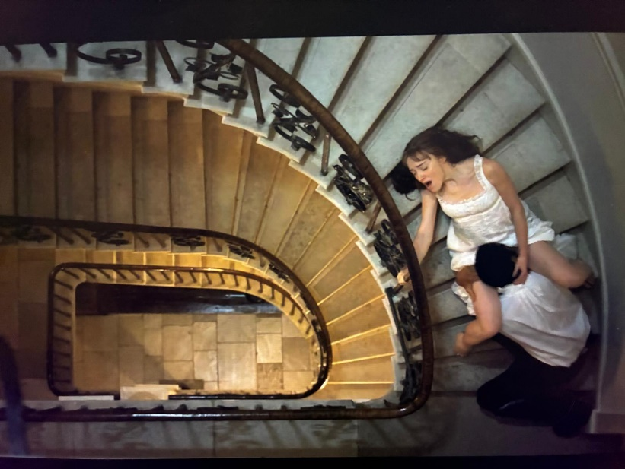
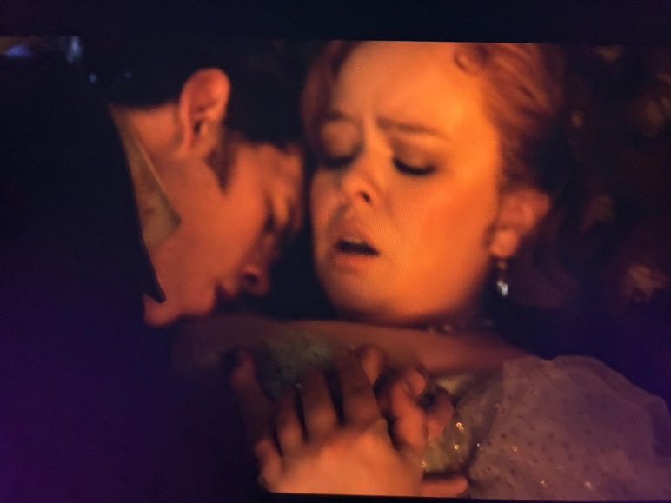
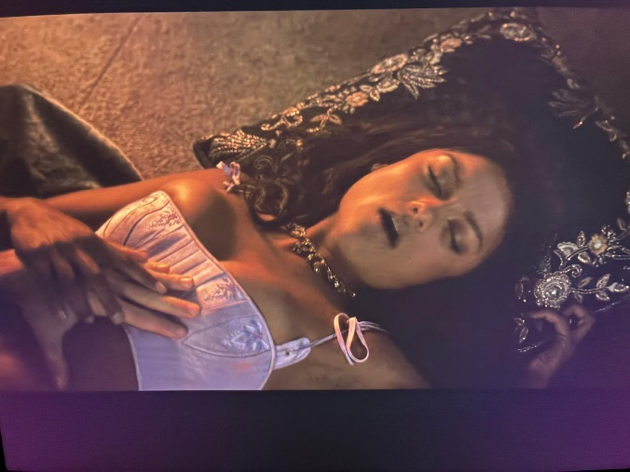
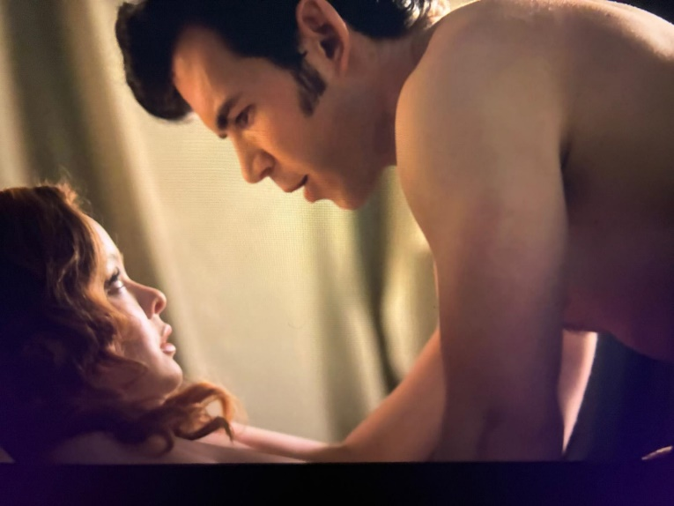
From Variety to Restraint
Sex in Season 3 is much more limited in terms of variety of sexual practices
The female character’ sexual expression is more passive and dependent on the male partner's initiative.
They reinforce a more conservative gender dynamic.
It is worth highlighting that in Season 3, sex is clearly framed around explicit consent and care.

Slide 12
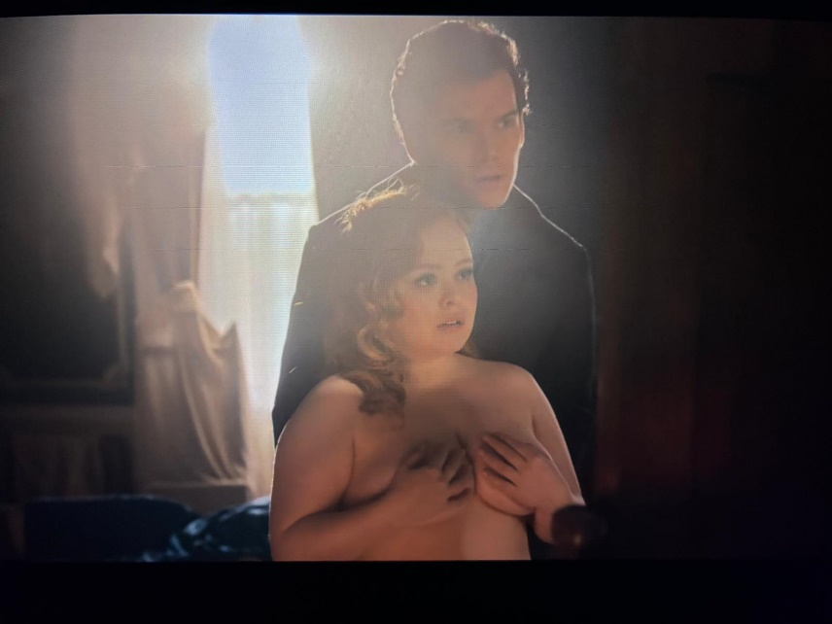
Bodies in Contrast
Male bodies fully displayed, female bodies partially hidden. Focus is placed on female pleasure, not the ‘male gaze’
In seasons 1 and 2, presented naturally and confidently during sexual scenes. In 3, the only two coital scenes are slower and centered on Penelope’s inexperience.
The camera briefly shows her breasts but avoids her stomach; she remains largely motionless, contrasting with the explicit, dynamic scenes of earlier seasons.

Slide 13
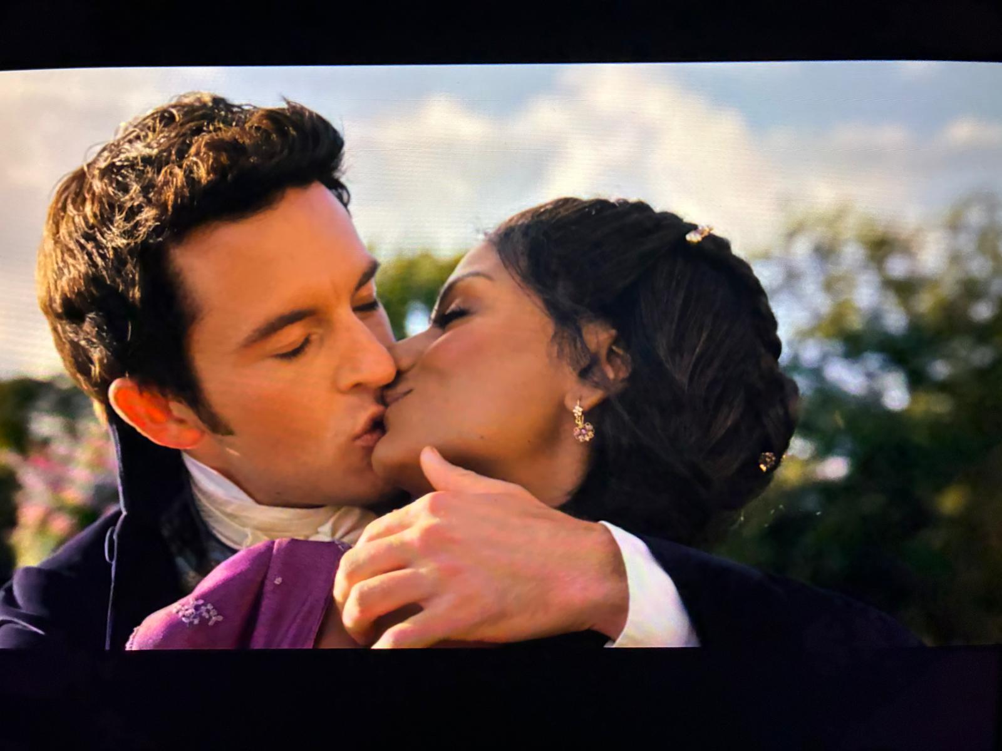
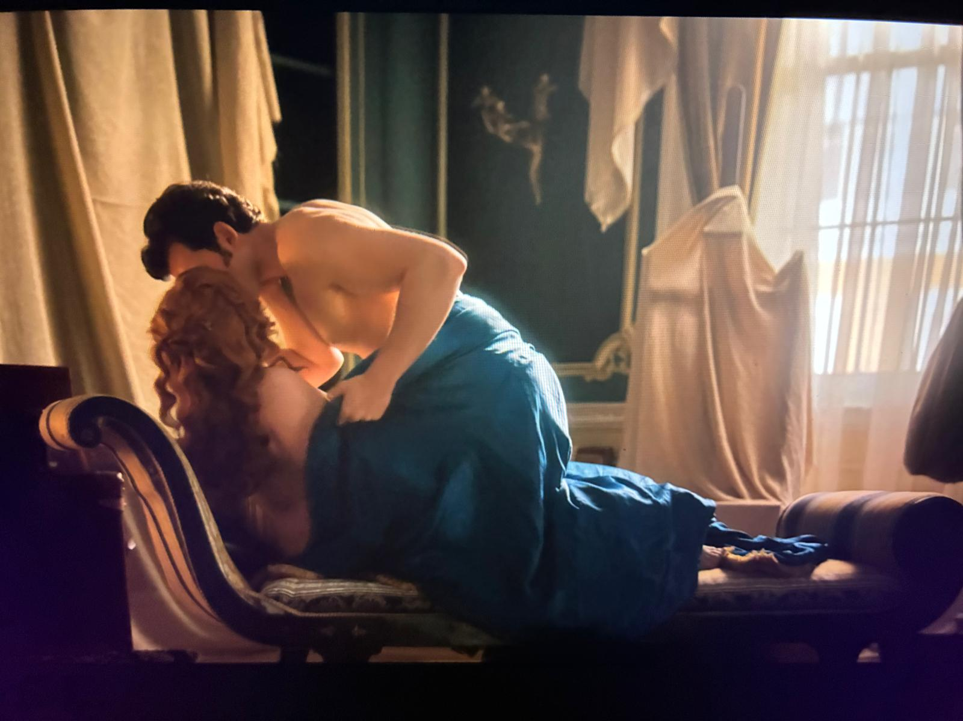
The Geography of Desire
In Seasons 1 and 2, sex occurs well beyond the confines of the marital bed (in the open).
Sex scenes between Pen and Colin take place exclusively in private settings.
Desire is concealed in the presence of a fat body—a shift that signals broader cultural dynamics around normative embodiment and the spatial regulation of sexual visibility.

Slide 14
CONCLUSIONS
The representation of Penelope challenges fatphobic portrayals in meaningful ways (personality, narrative arc, relationships with others and the position of power she occupies).
However, the realm of desire and sexuality continues to uphold significant taboos. While she is granted romantic fulfillment and sexual legitimacy, her sexual expression is still shaped by constraints—spatial, visual, and behavioral—that reflect broader cultural discomfort with fat bodies.
Bridgerton remains hesitant when it comes to showing how fat bodies love, desire, and are desired, which reveals the persistent structural tension between inclusion and control in the representation of non-normative sexualities on screen.

Slide 15
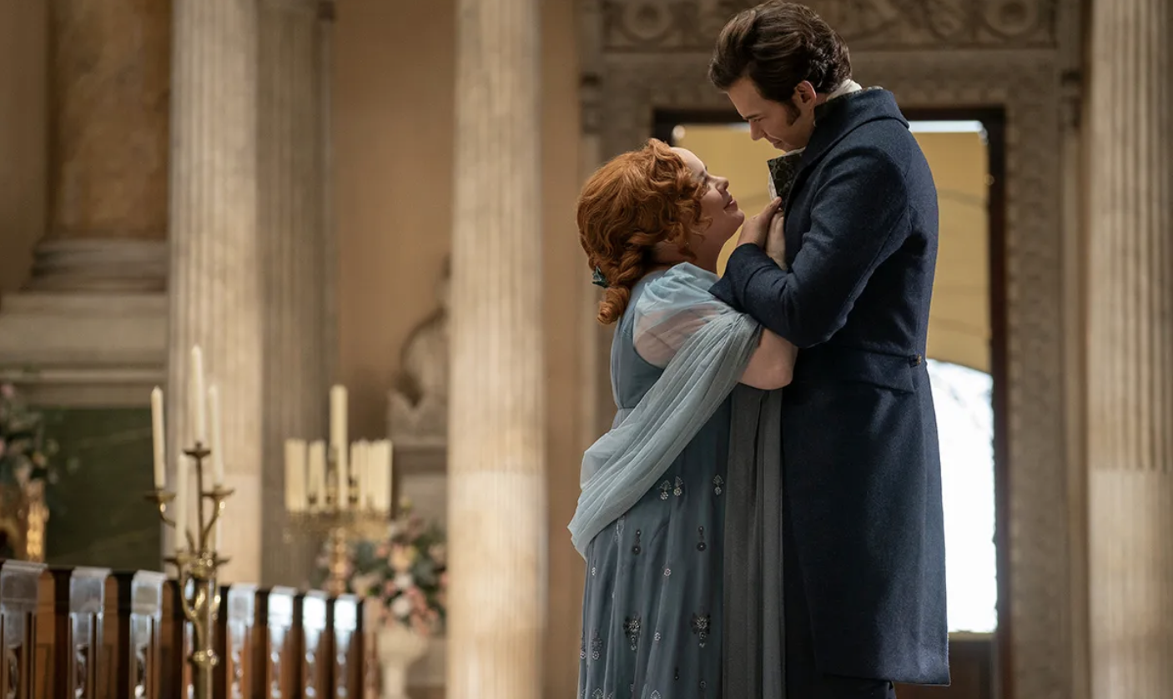
Thank you!
Questions?

