Slide 1
"Nie Xiaoqian:"
A New Female Ghost
= A New Woman?
Presenter: Xiangning Hong (Tiffany)
School of Communication, Hong Kong Baptist University, Hong Kong, China
Department of Communication, Beijing Normal Hong Kong Baptist University, Zhuhai, China

Slide 2
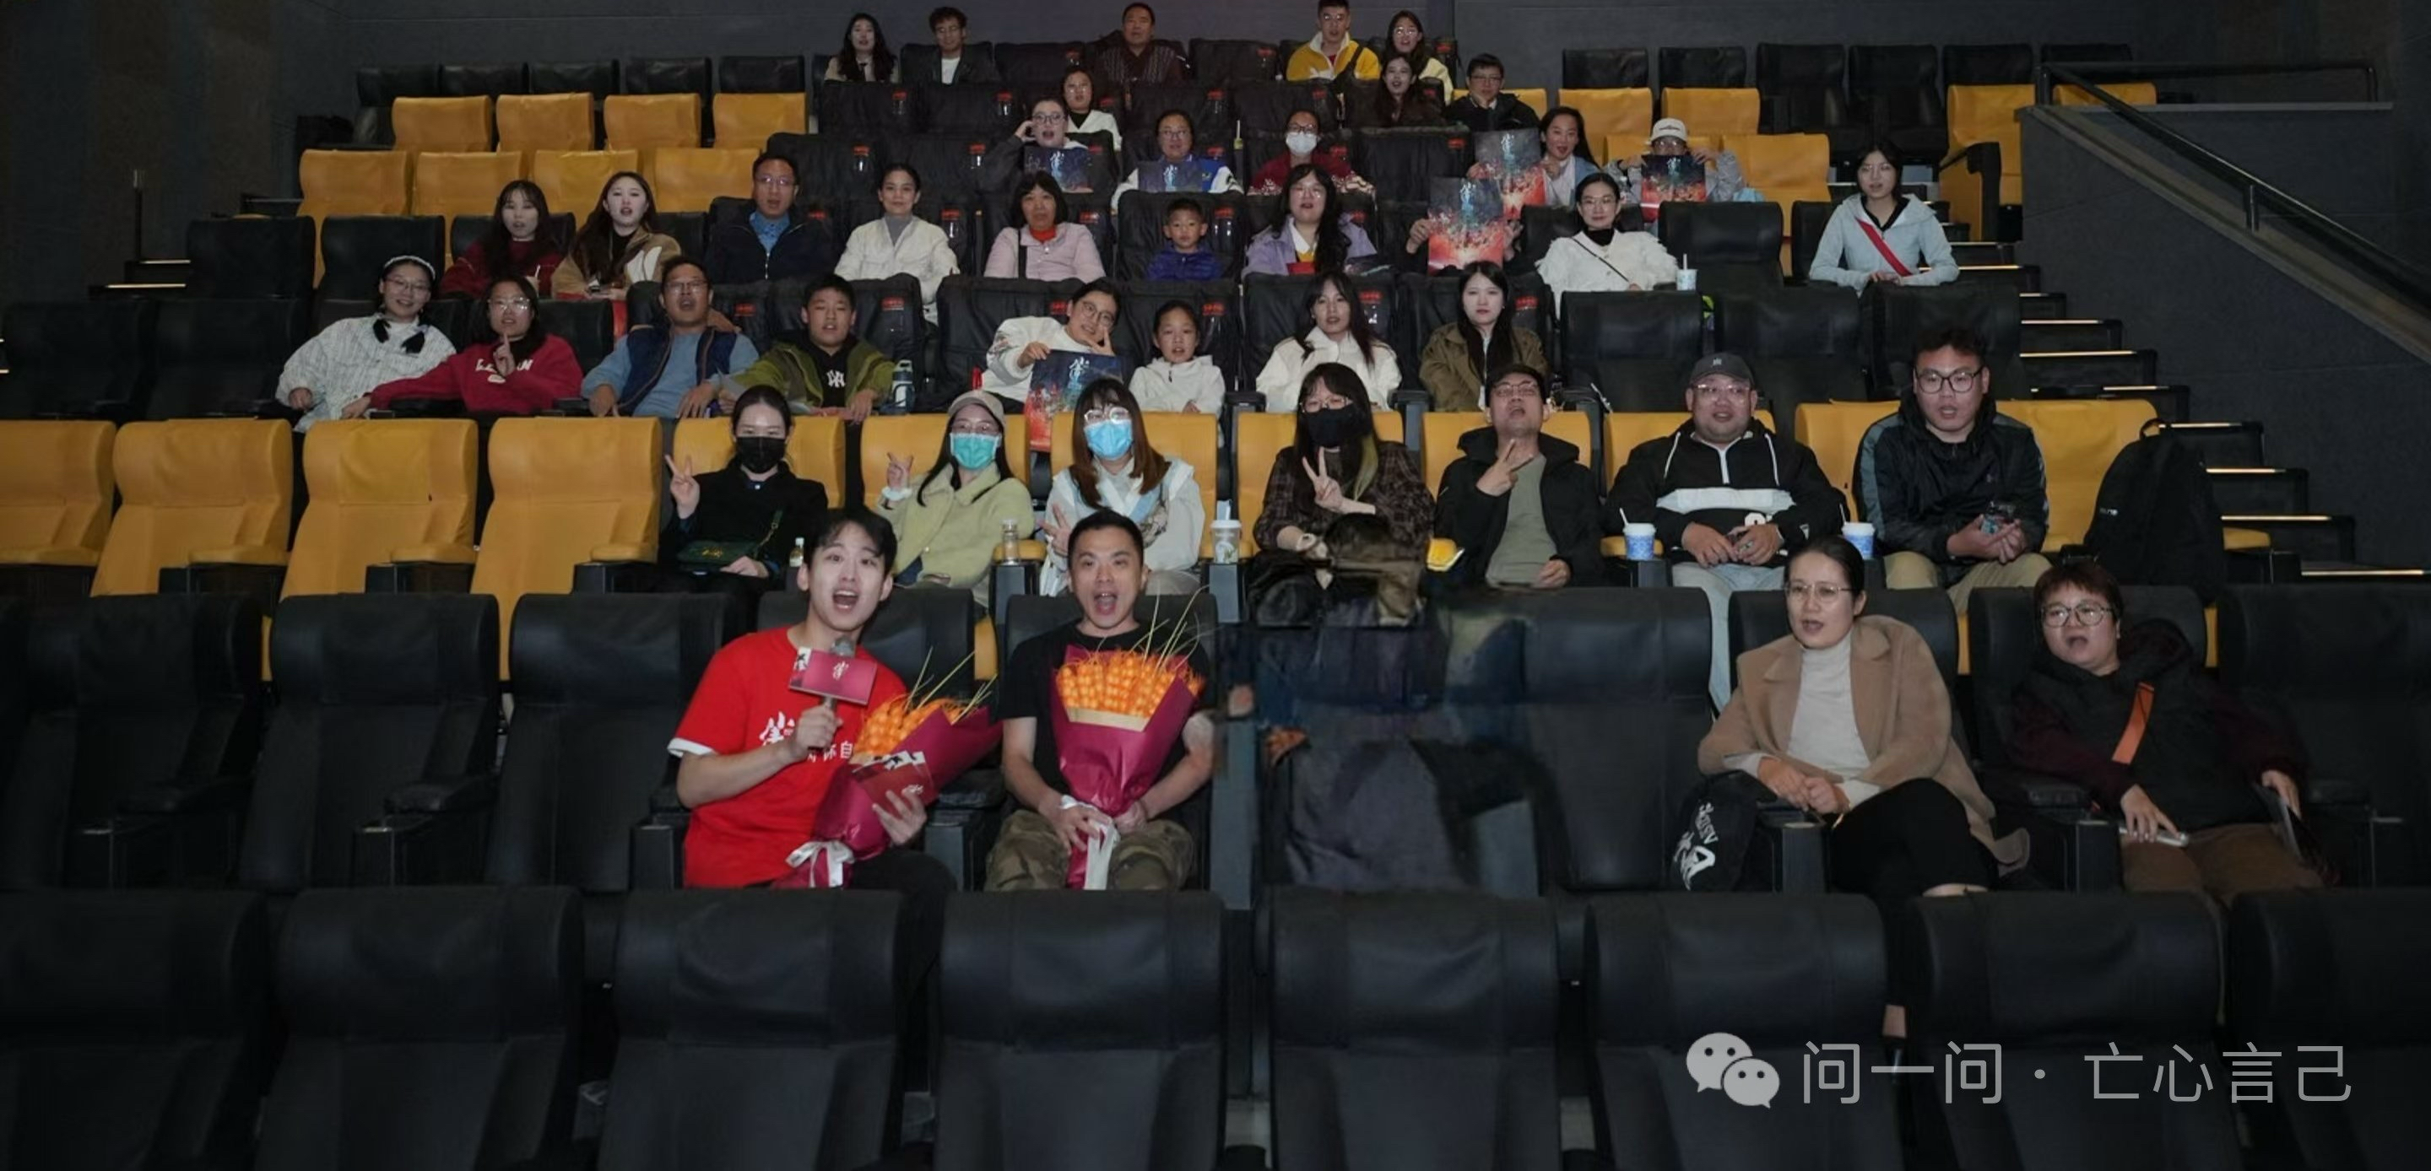
Research Method
Semi-structured
Interview
Director
- Mao Qichao
"In real life, many of the women around me are exceptional. They embody beauty, kindness, and strength, while also possessing a lively and charming side. They remain calm and composed in challenging situations, with admirable poise and wisdom. These women around me are the ones who represent the image of Xiao Qian in my mind."
Screenwriter
- Cheng Zi
"I would be proud of Xiaoqian if she were my daughter."

Slide 3
Research Method
 | Pseudonym | Age | Gender | Province | Viewing Motivation | Occupation | Date
1 | Mei Xiayu | 22 | Female | Shandong | Exposure to polarized online discourse | Senior undergraduate student | April 4th2025
2 | Chuan | 29 |  | Guangdong | Recommendation from friends | E-commerce operations
3 | Ball | 28 |  | Anhui | Interest in the male protagonist's voice actor | Technicalspecialist
4 | Mango | 30 |  | Jiangsu | Longstanding appreciation for the original story of Nie Xiaoqian | Accountant
5 | Lemon | 26 |  | Zhejiang | Appreciation of beautiful and outstanding women as protagonists | Phd student
Figure. Focus Group Participant Overview

Slide 4
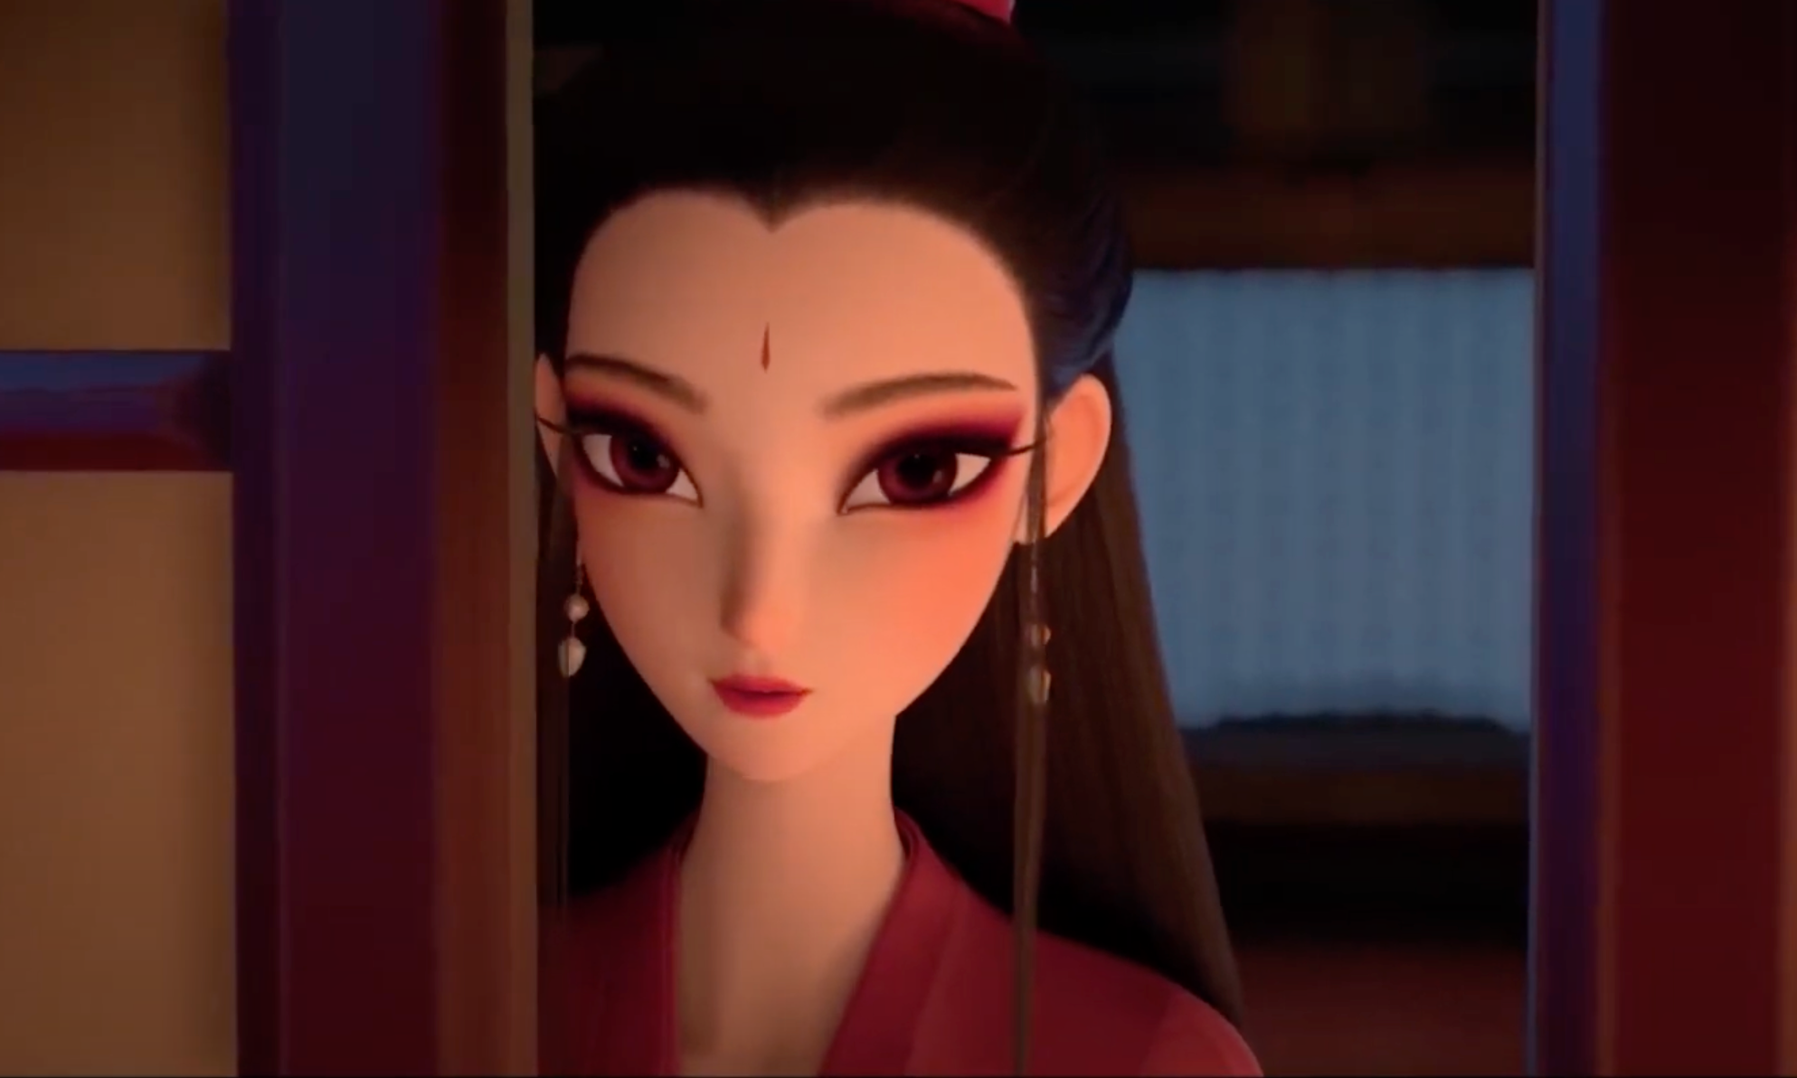
Analysis and Finding
Xiaoqian in
Nie Xiaoqian (2019)
White snake in
White Snake (2019)
KOL Face (网红脸）
under the male gaze in Chinese Conext

Slide 5
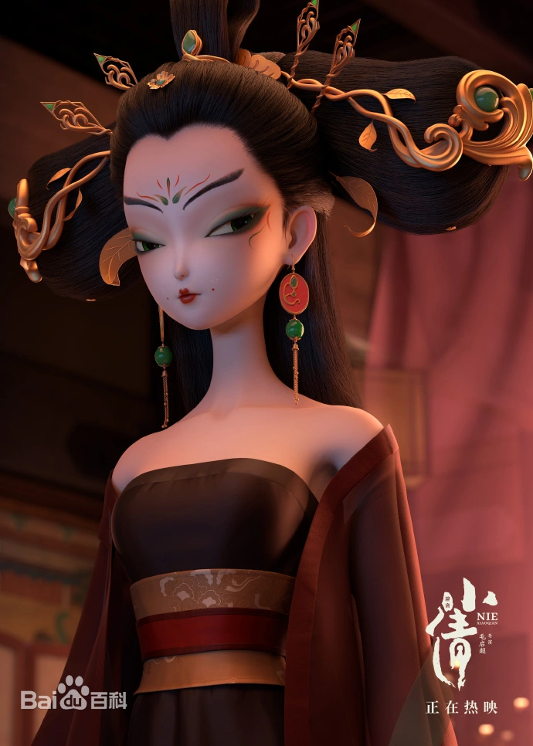
Analysis and Finding
Granny as an aged guardian
in Nie Xiaoqian (2024)
Granny as an youthful enchantress
in Nie Xiaoqian (2024)
Evil Queen
in Snow White

Slide 6
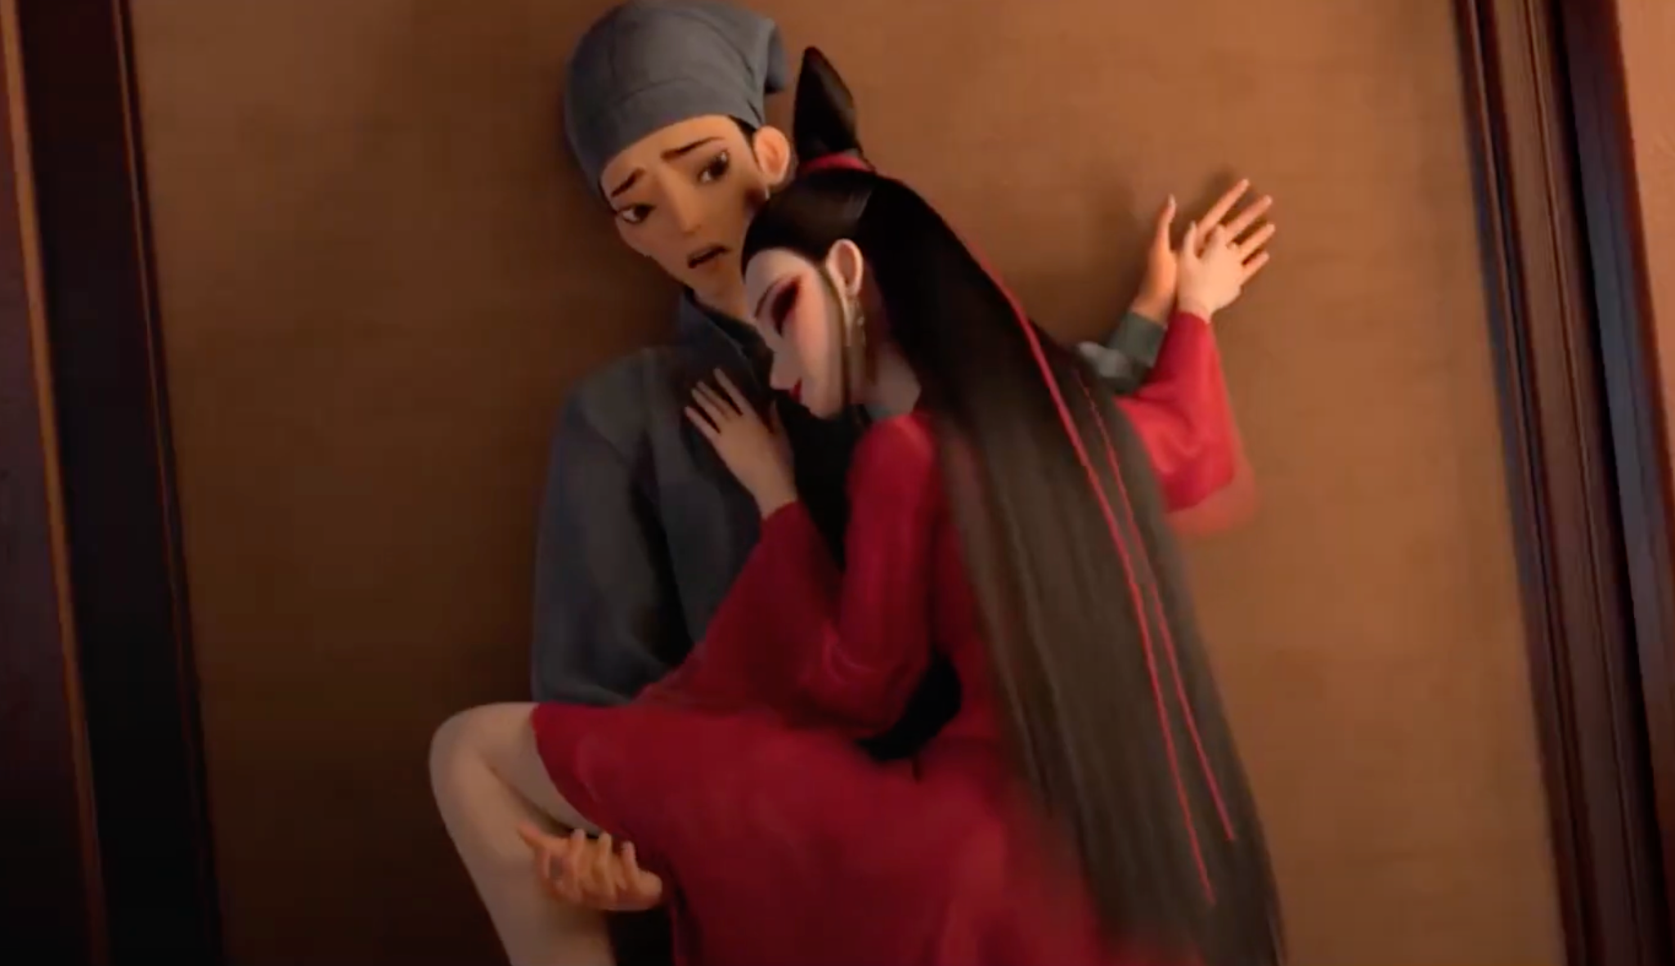
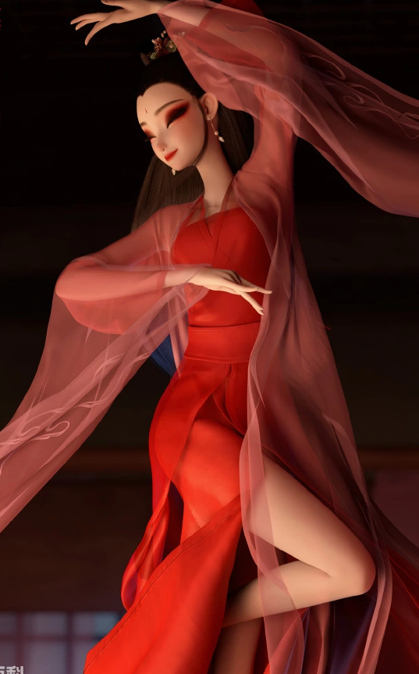
Analysis and Finding
Figure. Xiaoqian hugged Ning Sheng to seduce him
Figure. Xiaoqian wrapped her bare thighs around Ning Sheng
Figure. Xiaoqian lies on the ground in a seductive pose

Slide 7
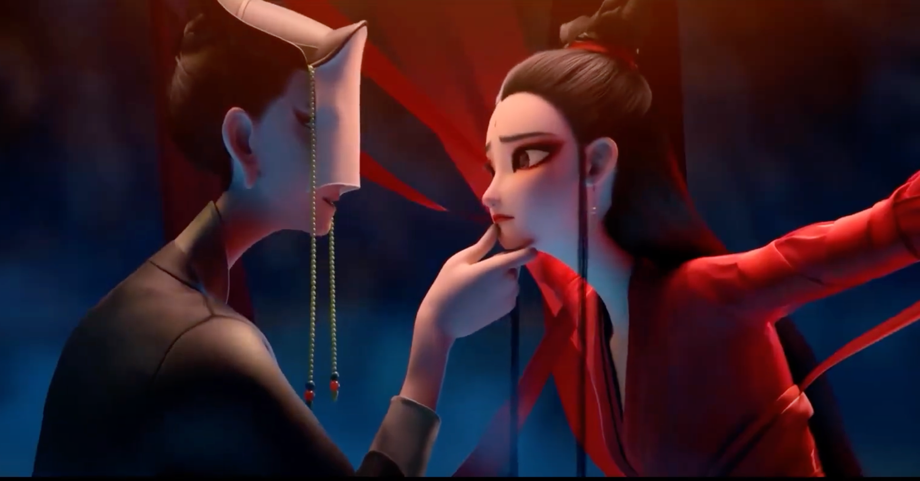
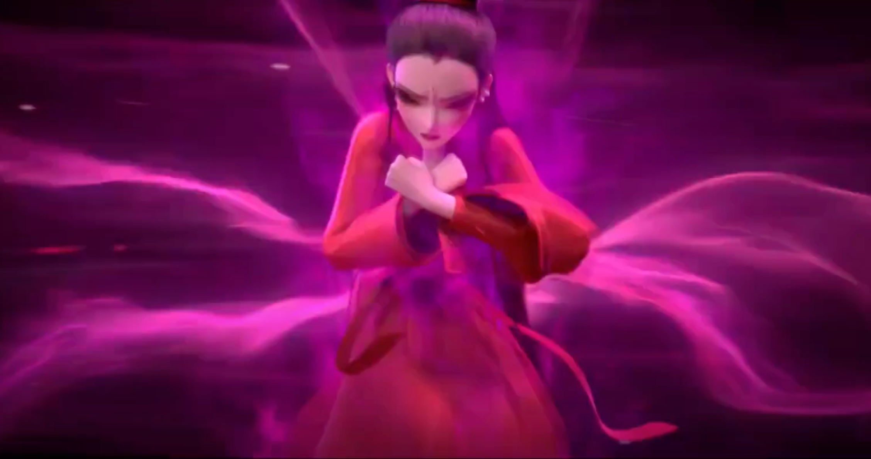
Analysis and Finding
Figure. The Judge of the Underworld threatens Xiaoqian
Figure. Xiaoqian is breaking the spectral red ribbons from the underworld judge

Slide 8
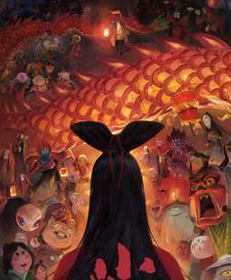
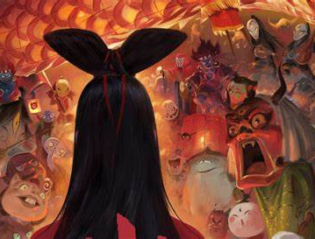
Conclusion
Is she
really new?
The answer, perhaps, is not in the radical sense advocated by Euro-American edcfeminism. However, through her contradictions: her acts of strength coupled with sacrifice, moments of voice intertwined with silence, and processes of becoming alongside unbecoming.

Slide 9
THANKS！
Email:
24483478@life.hkbu.edu.hk

