Slide 1
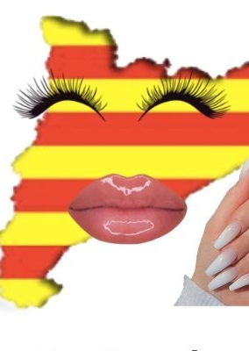
“Cuntalunya Triomfant”: Reimagining the Catalan Nation in Global Times through a New Feminine Star System
Celia Martínez Sáez
Marie Sklodowska-Curie Postdoctoral Fellow

Slide 3
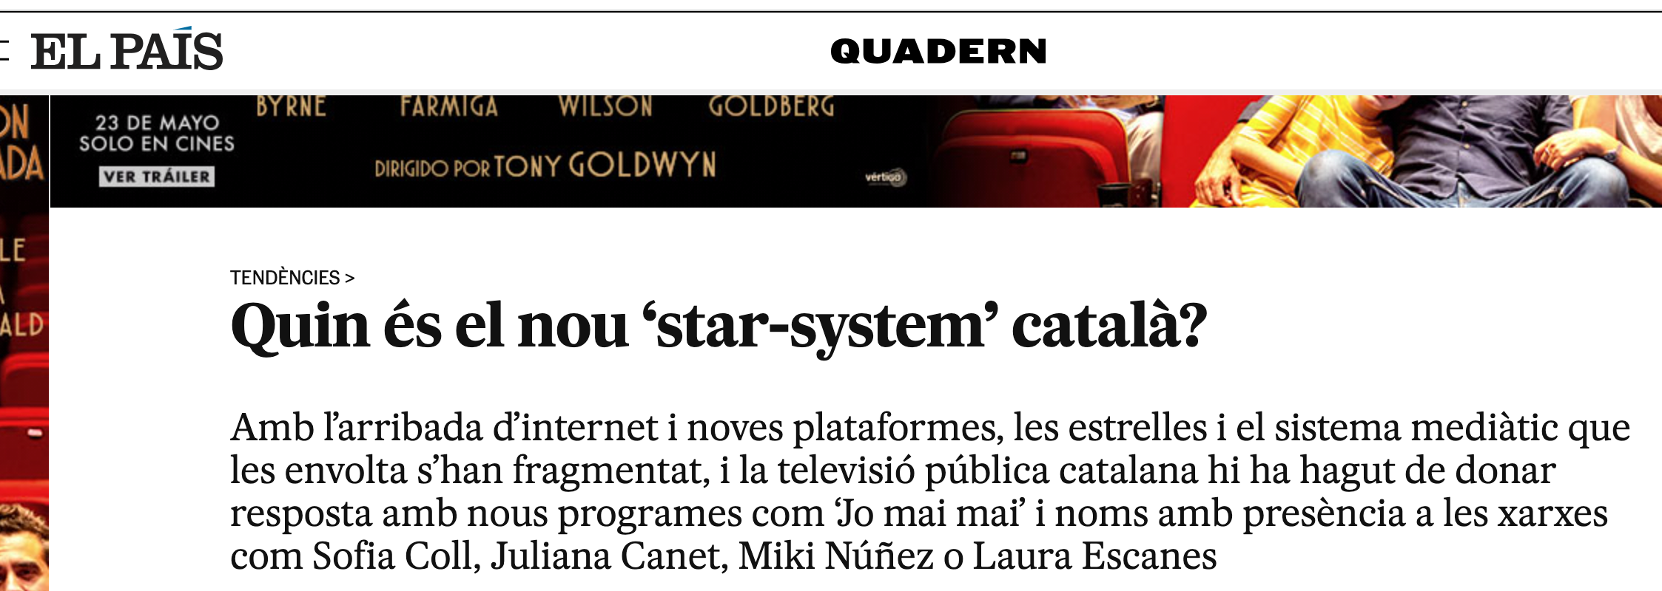

Slide 4
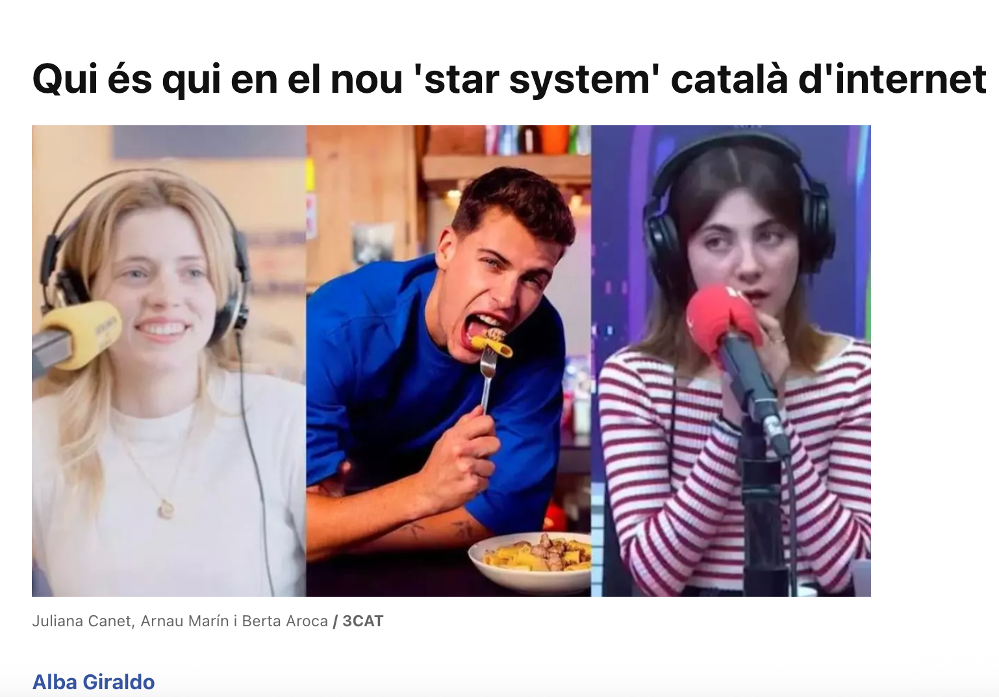

Slide 5
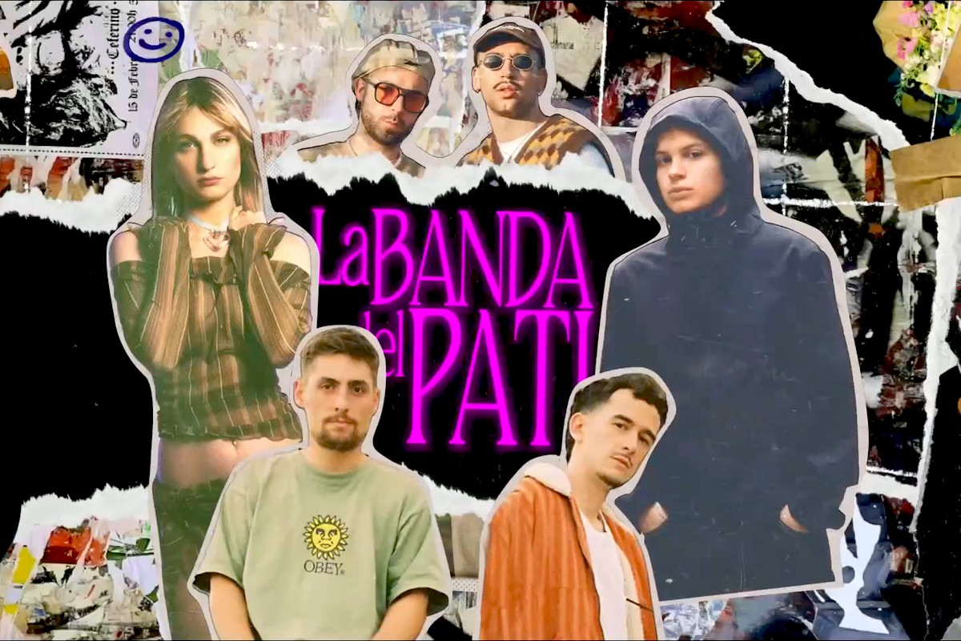

Slide 6
If a celebrity is understood as a “cultural symbol and conduit for ideas about gender, values, and national identity” (Gundle 263), what do these stars signify in terms of gender, sexuality, and national constructions in the context of globalization and the post-procés moment?

Slide 7
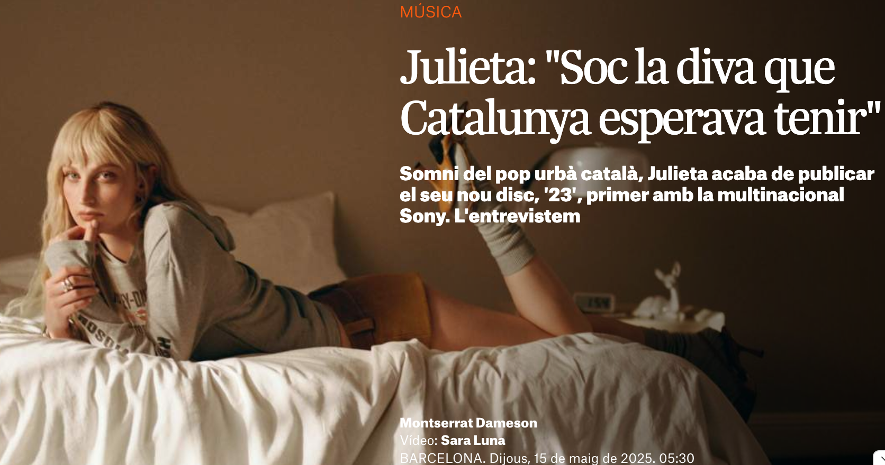
Case study: julieta

Slide 8
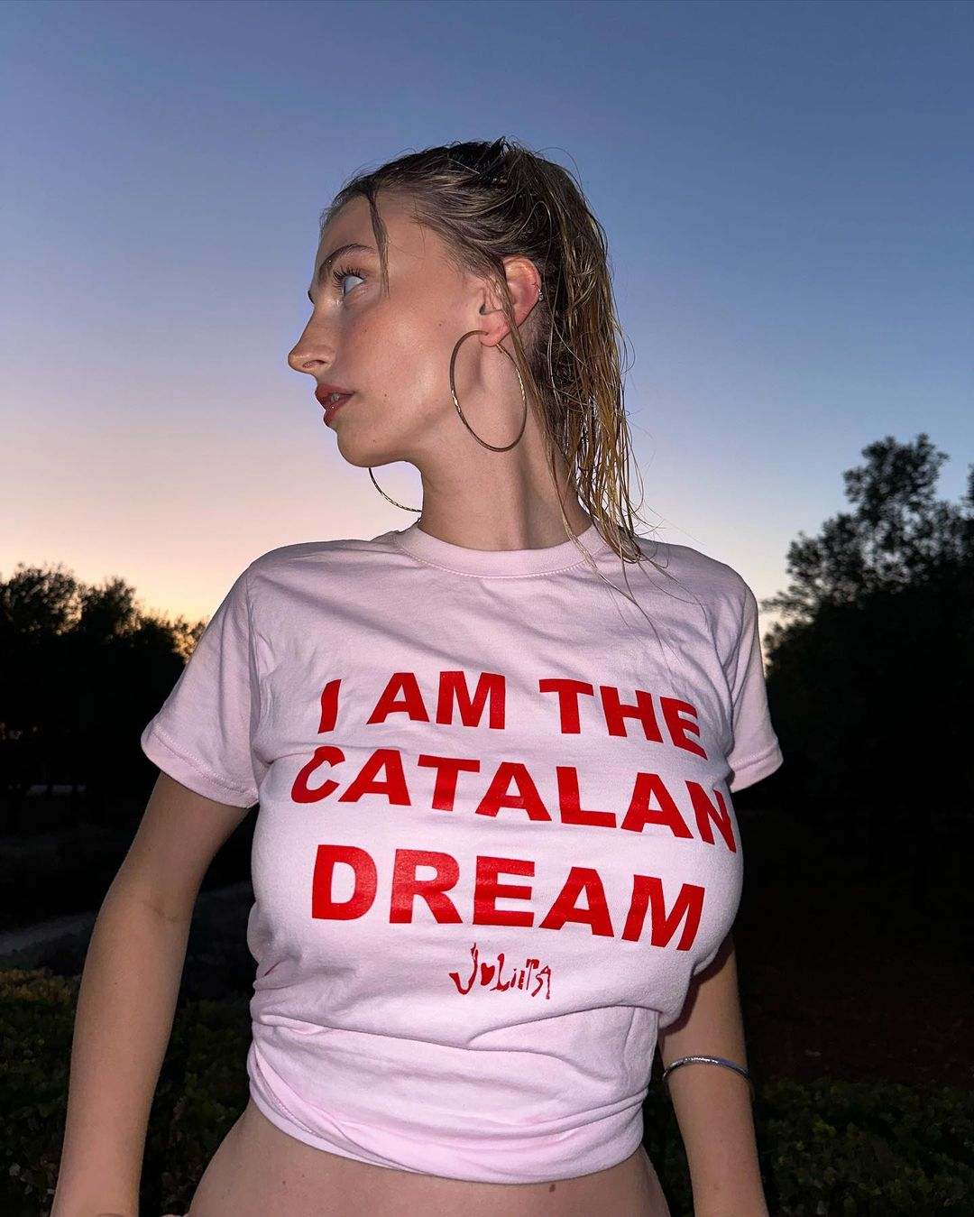
Julieta’s star text
Hegemonic femininity
Neoliberal discourse of the “Catalan Dream”
Historical symbolism of the pop diva and its queer dimension

Slide 9
Political potential of the diva
Brett Farmer asserts that female star adoration in queer contexts has been a cornerstone of gay cultural production.
Ann Cvetkovich emphasizes structures of feelings as sites for political and cultural knowledge. Feelings as archives for people who have been excluded from traditional histories.
The diva disrupts the categorical binarism of male/female, self/other, subject/object, image/reality or identification/desire (Farmer 250).

Slide 10
Cuntalunya
Term used on social media as a response to the “Catalan Dream” to reimagine Catalan identity as produced by the Catalan celebrity movement from a queer and feminist perspective.

Slide 17
Cuntalunya
Micropolitical expression.
A liminal identity that disrupts traditional nationalism, institutional mainstream feminism, digital/analogical spaces, non-binary fem space.

Slide 18
Conclusions
The emergence of a new star system in urban music represents a site of convergence for an ambiguous framework that, on the one hand, aligns with the top-down nation-building mechanisms promoted by Catalan media institutions, while, on the other hand, it evolves into a bottom-up movement originated in social media, that proposes the queering of this star system.
Looking at star studies in Catalan culture can open a critical line rarely explored by academia that has a lot of potential: stateless national celebrity systems (like Catalonia’s) can be a platform where meanings of gender and nation are negotiated, contested, reimagined, and spectacularized.

Slide 19
THANK YOU! Celia.martinez@upf.edu

