Slide 1
Center vortex geometry through the deconfinement phase transition in pure gauge theory
Jackson Mickley
In collaboration with
Derek Leinweber, Waseem Kamleh
Phys. Rev. D 110, 034516 (2024), arXiv:2405.10670 [hep-lat]
Confinement and symmetry from vacuum to QCD phase diagram
Benasque Science Center, 9-15 February 2025

Slide 2
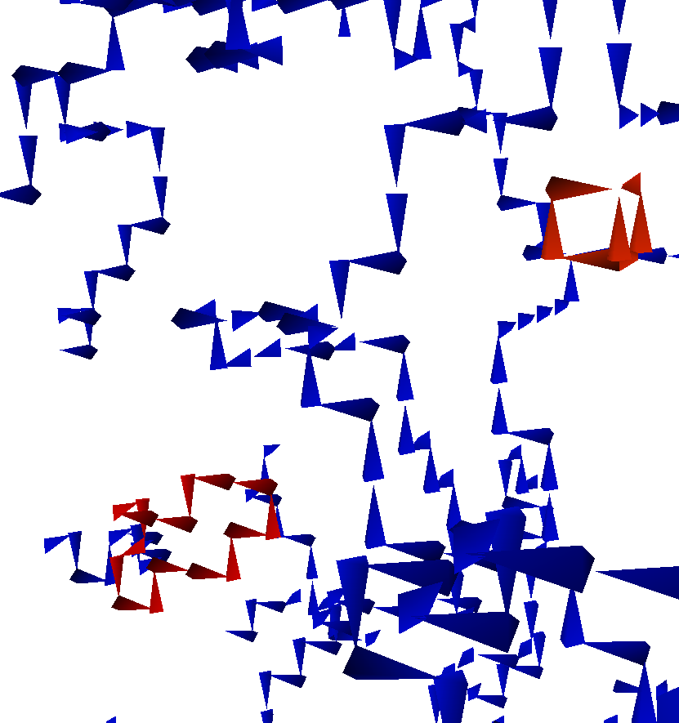
Overview
Introduction to center vortices
Identification on the lattice
Vortex structures at zero temperature
How are center vortices related to confinement?
Evolution through the deconfinement phase transition
Alignment with the temporal dimension
Quantified by temporal correlation measure
Relation to secondary clusters
Collection of vortex statistics
Vortex density, branching point densities, vortex chain lengths all sensitive to the phase transition

Slide 3
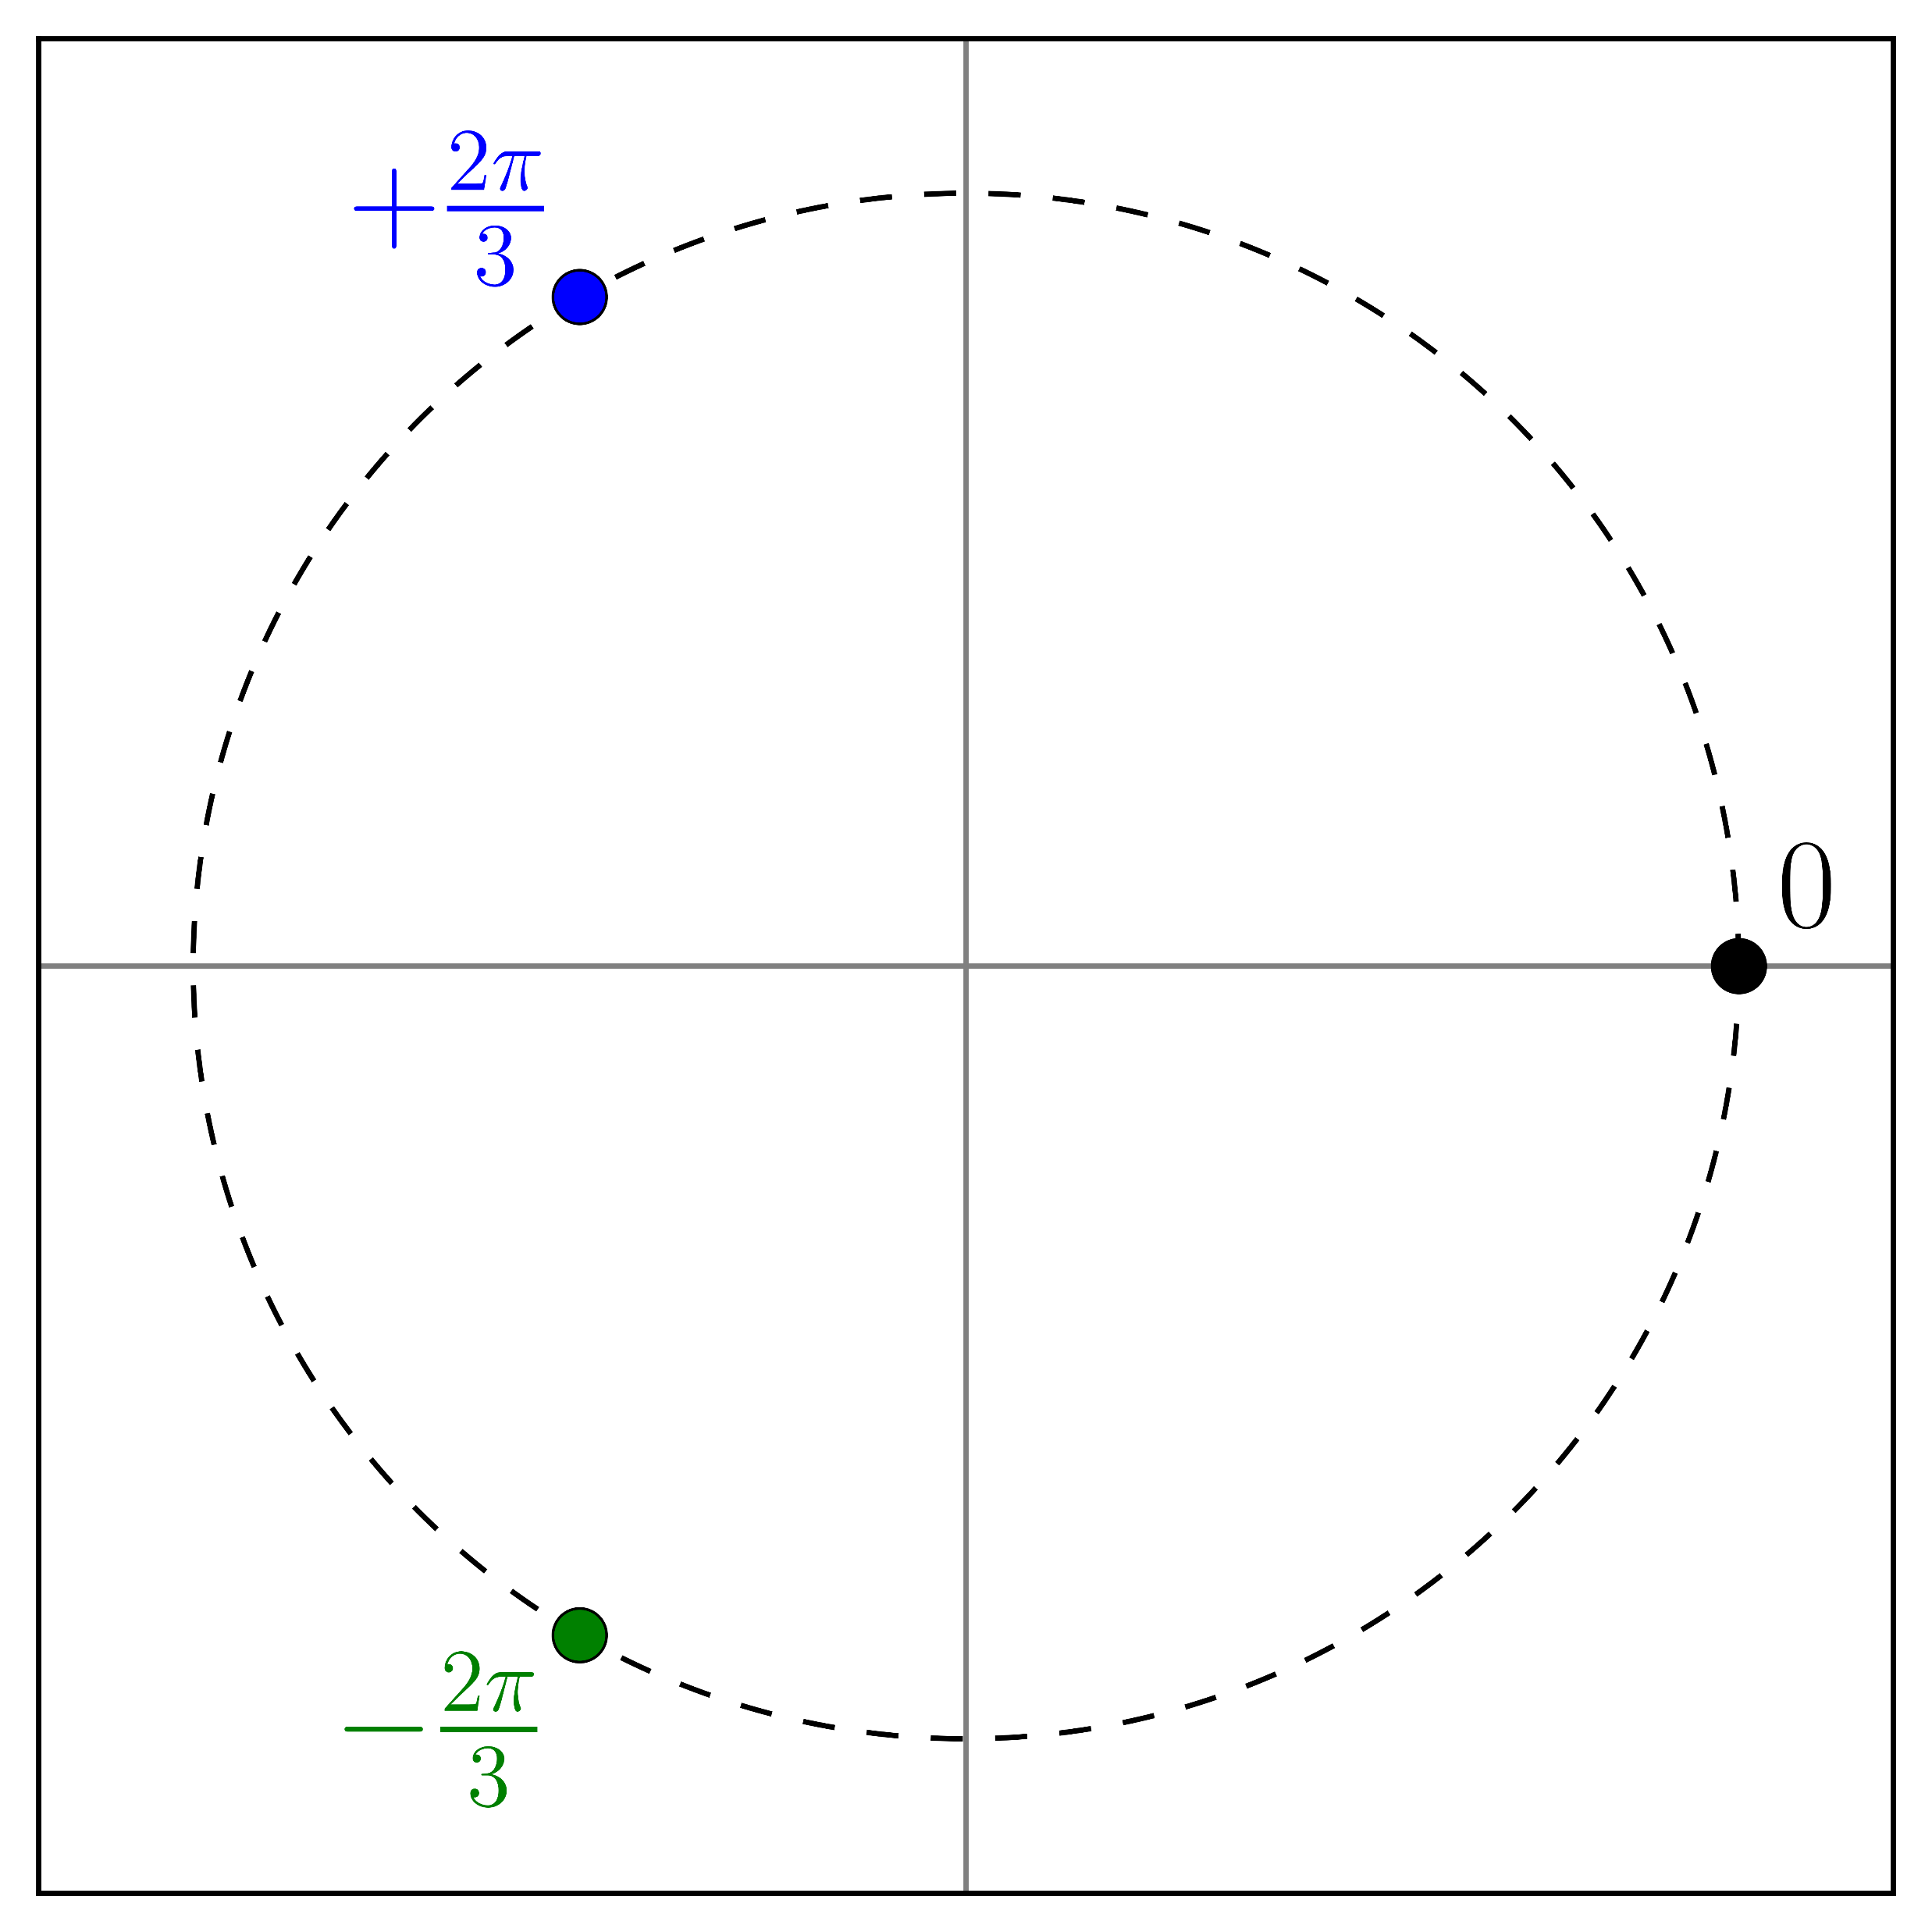
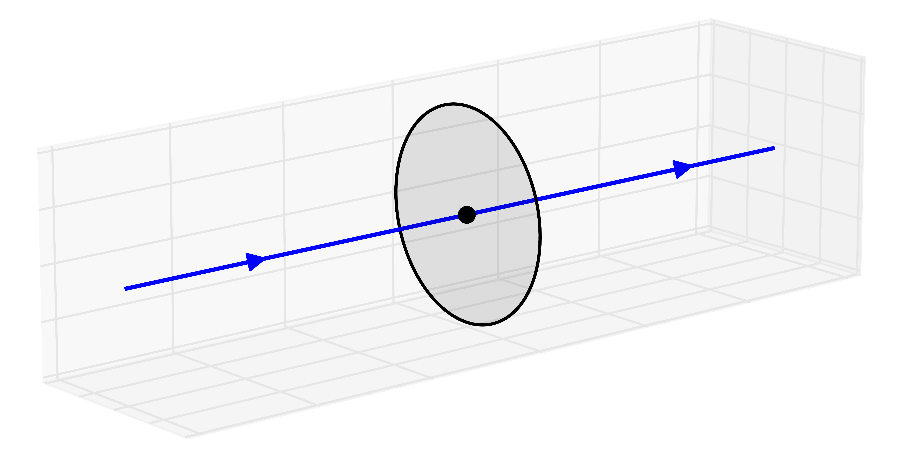
What are center vortices?
Center vortices are surface-like topological defects that exist in the QCD vacuum
Possess some finite thickness
Form tube-like structures in three-dimensional slices of the four-dimensional spacetime
Form the conserved flow of center charge, quantized by the center of
Any Wilson loop that encircles a vortex picks up a factor of

Slide 4
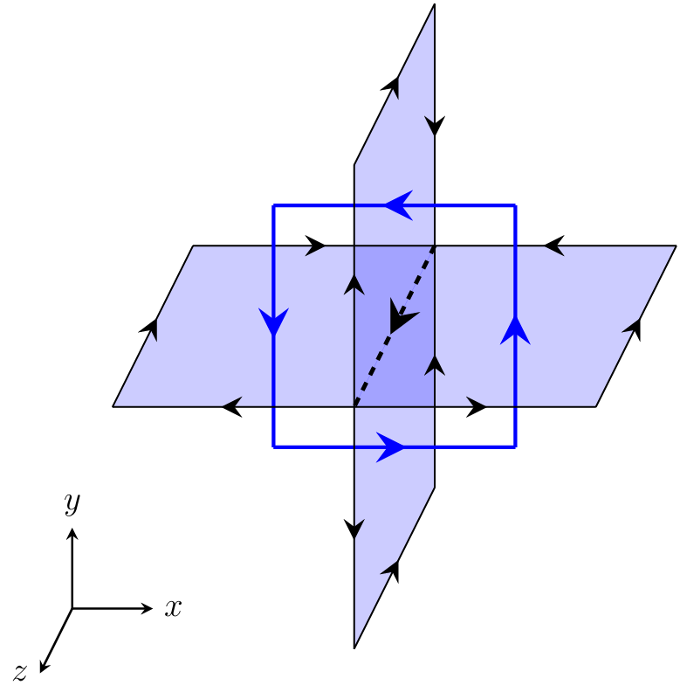
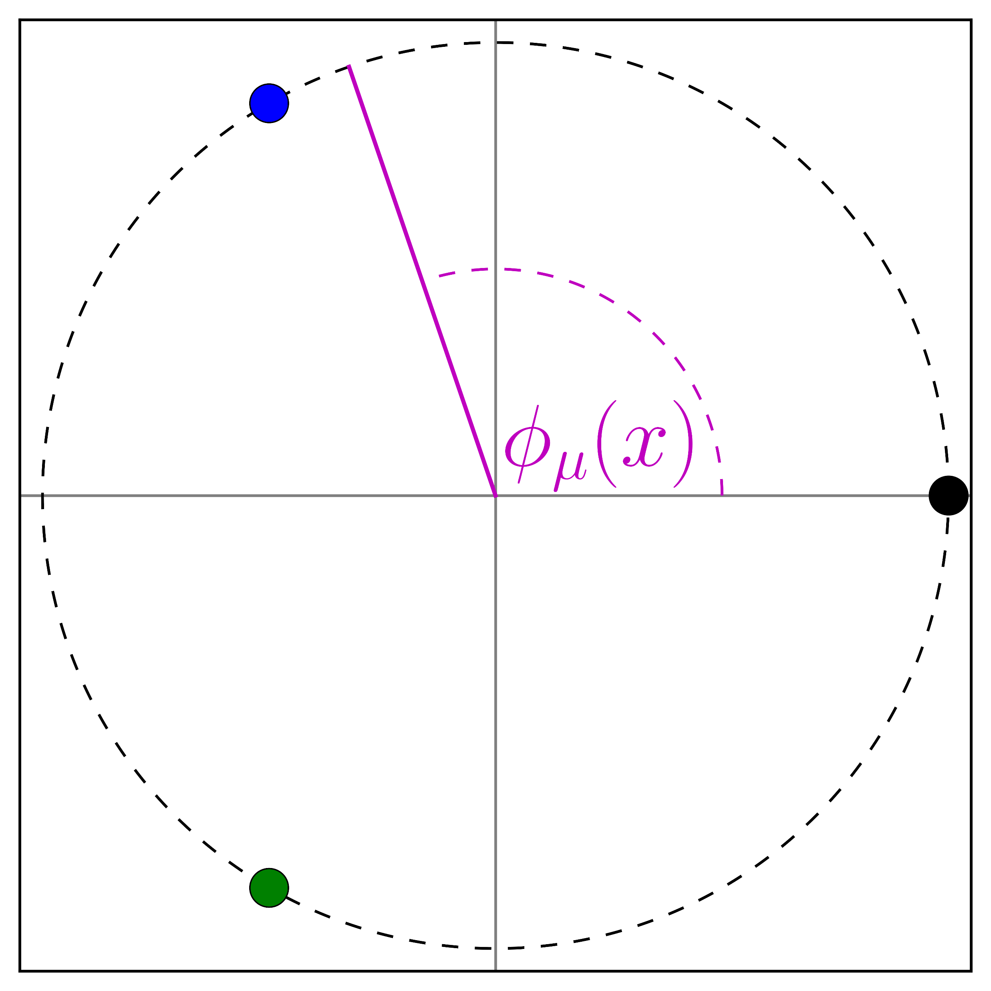
Identification on the lattice
A center vortex can be created by multiplying a single link by a center phase
Decompose gauge field as
Seek to gauge away the vortex-removed part
Find the gauge transformation to bring each link as close as possible to an element of
Maxmize the functional
Known as ‘Maximal Center Gauge’ (MCG)
Project links onto nearest element
defined by

Slide 5
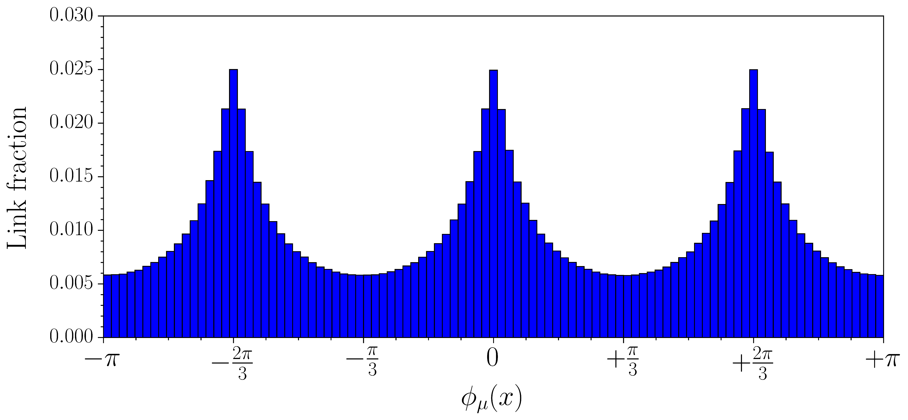
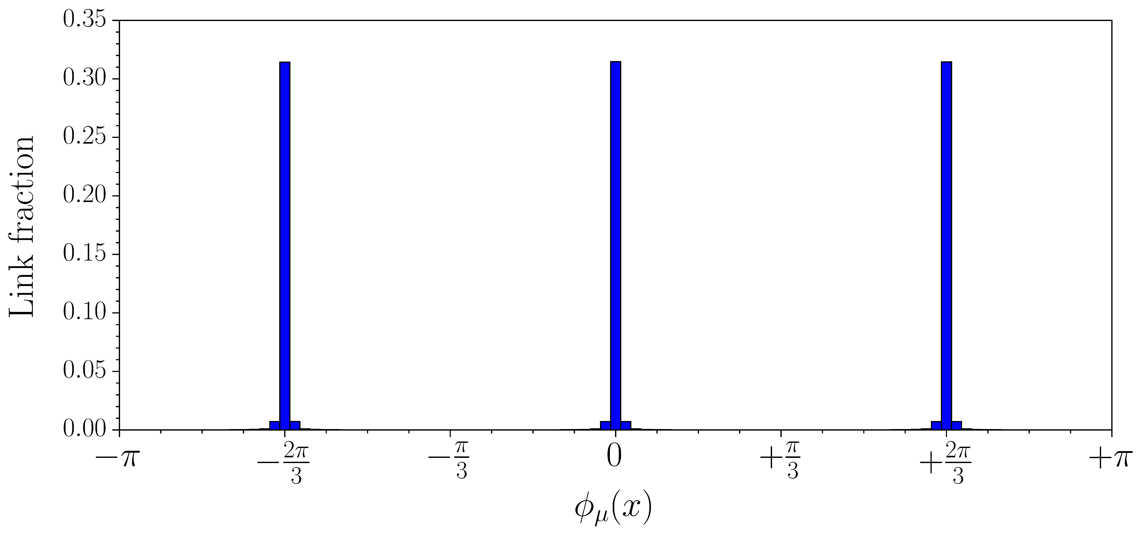
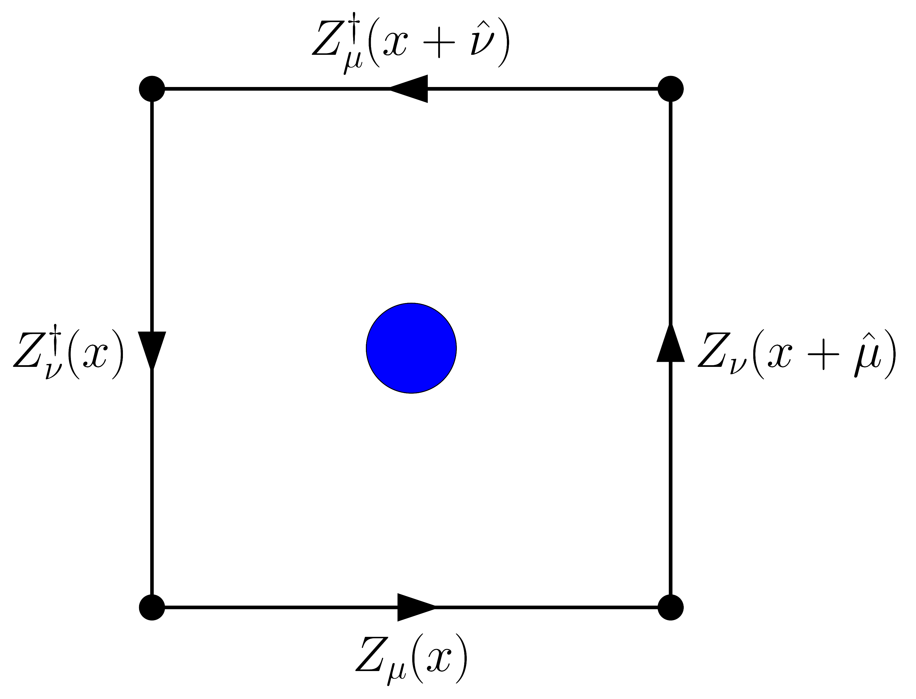
Identification on the lattice
Distribution of link phases before/after MCG
Vortices identified by nontrivial plaquettes in center-projected field
is the ‘center charge’ of the vortex
These vortices are infinitely thin
Represent the ‘axis of rotation’ or ‘guiding center’ of the physical vortex

Slide 6
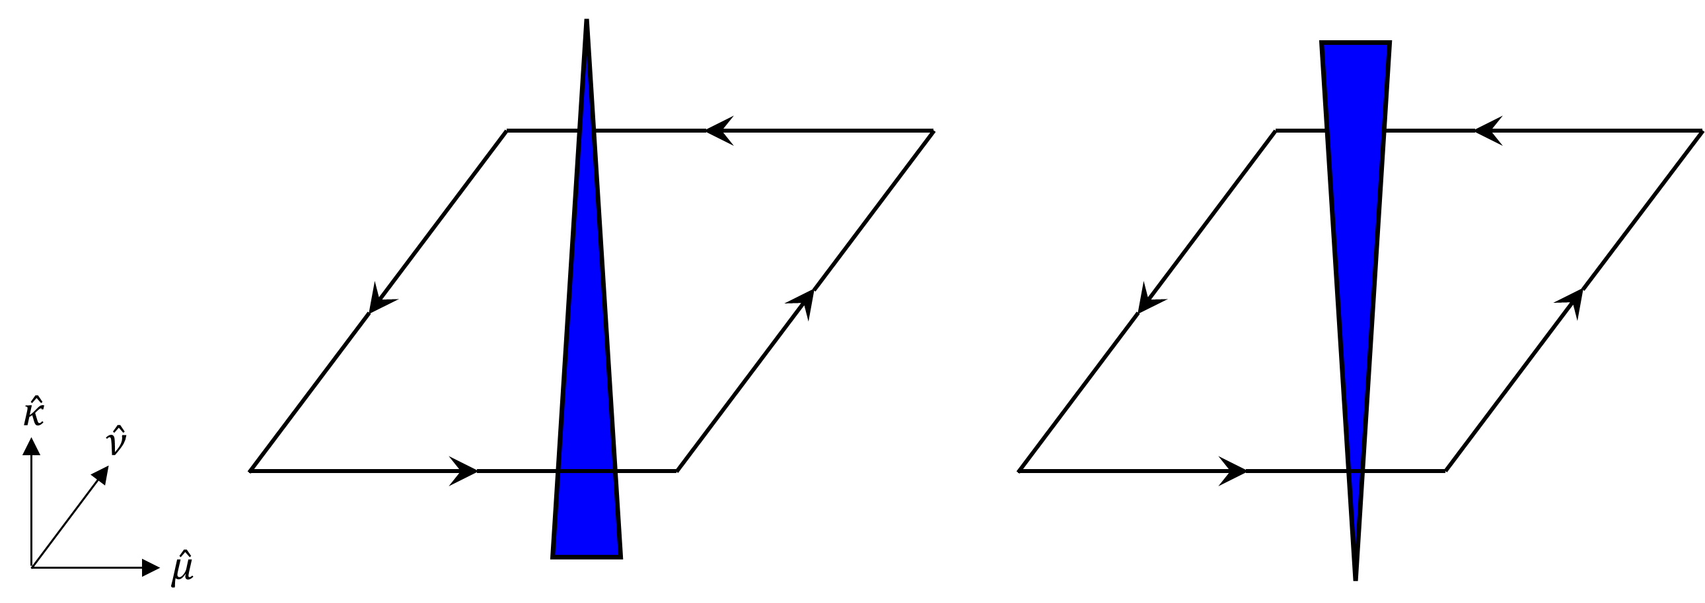
Visualizing center vortex structure
Visualize vortex structure in three-dimensional slices of the lattice
Hold one coordinate fixed, show the remaining three
2D vortex sheet reduced to 1D vortex line
Animate by varying slice coordinate
Visualizations exclusively show the flow of center charge
direction determined by right-hand rule
rendered in opposite direction

Slide 7
Center vortex structure: pure gauge

Slide 8
Center vortex structure: finer lattice

Slide 9
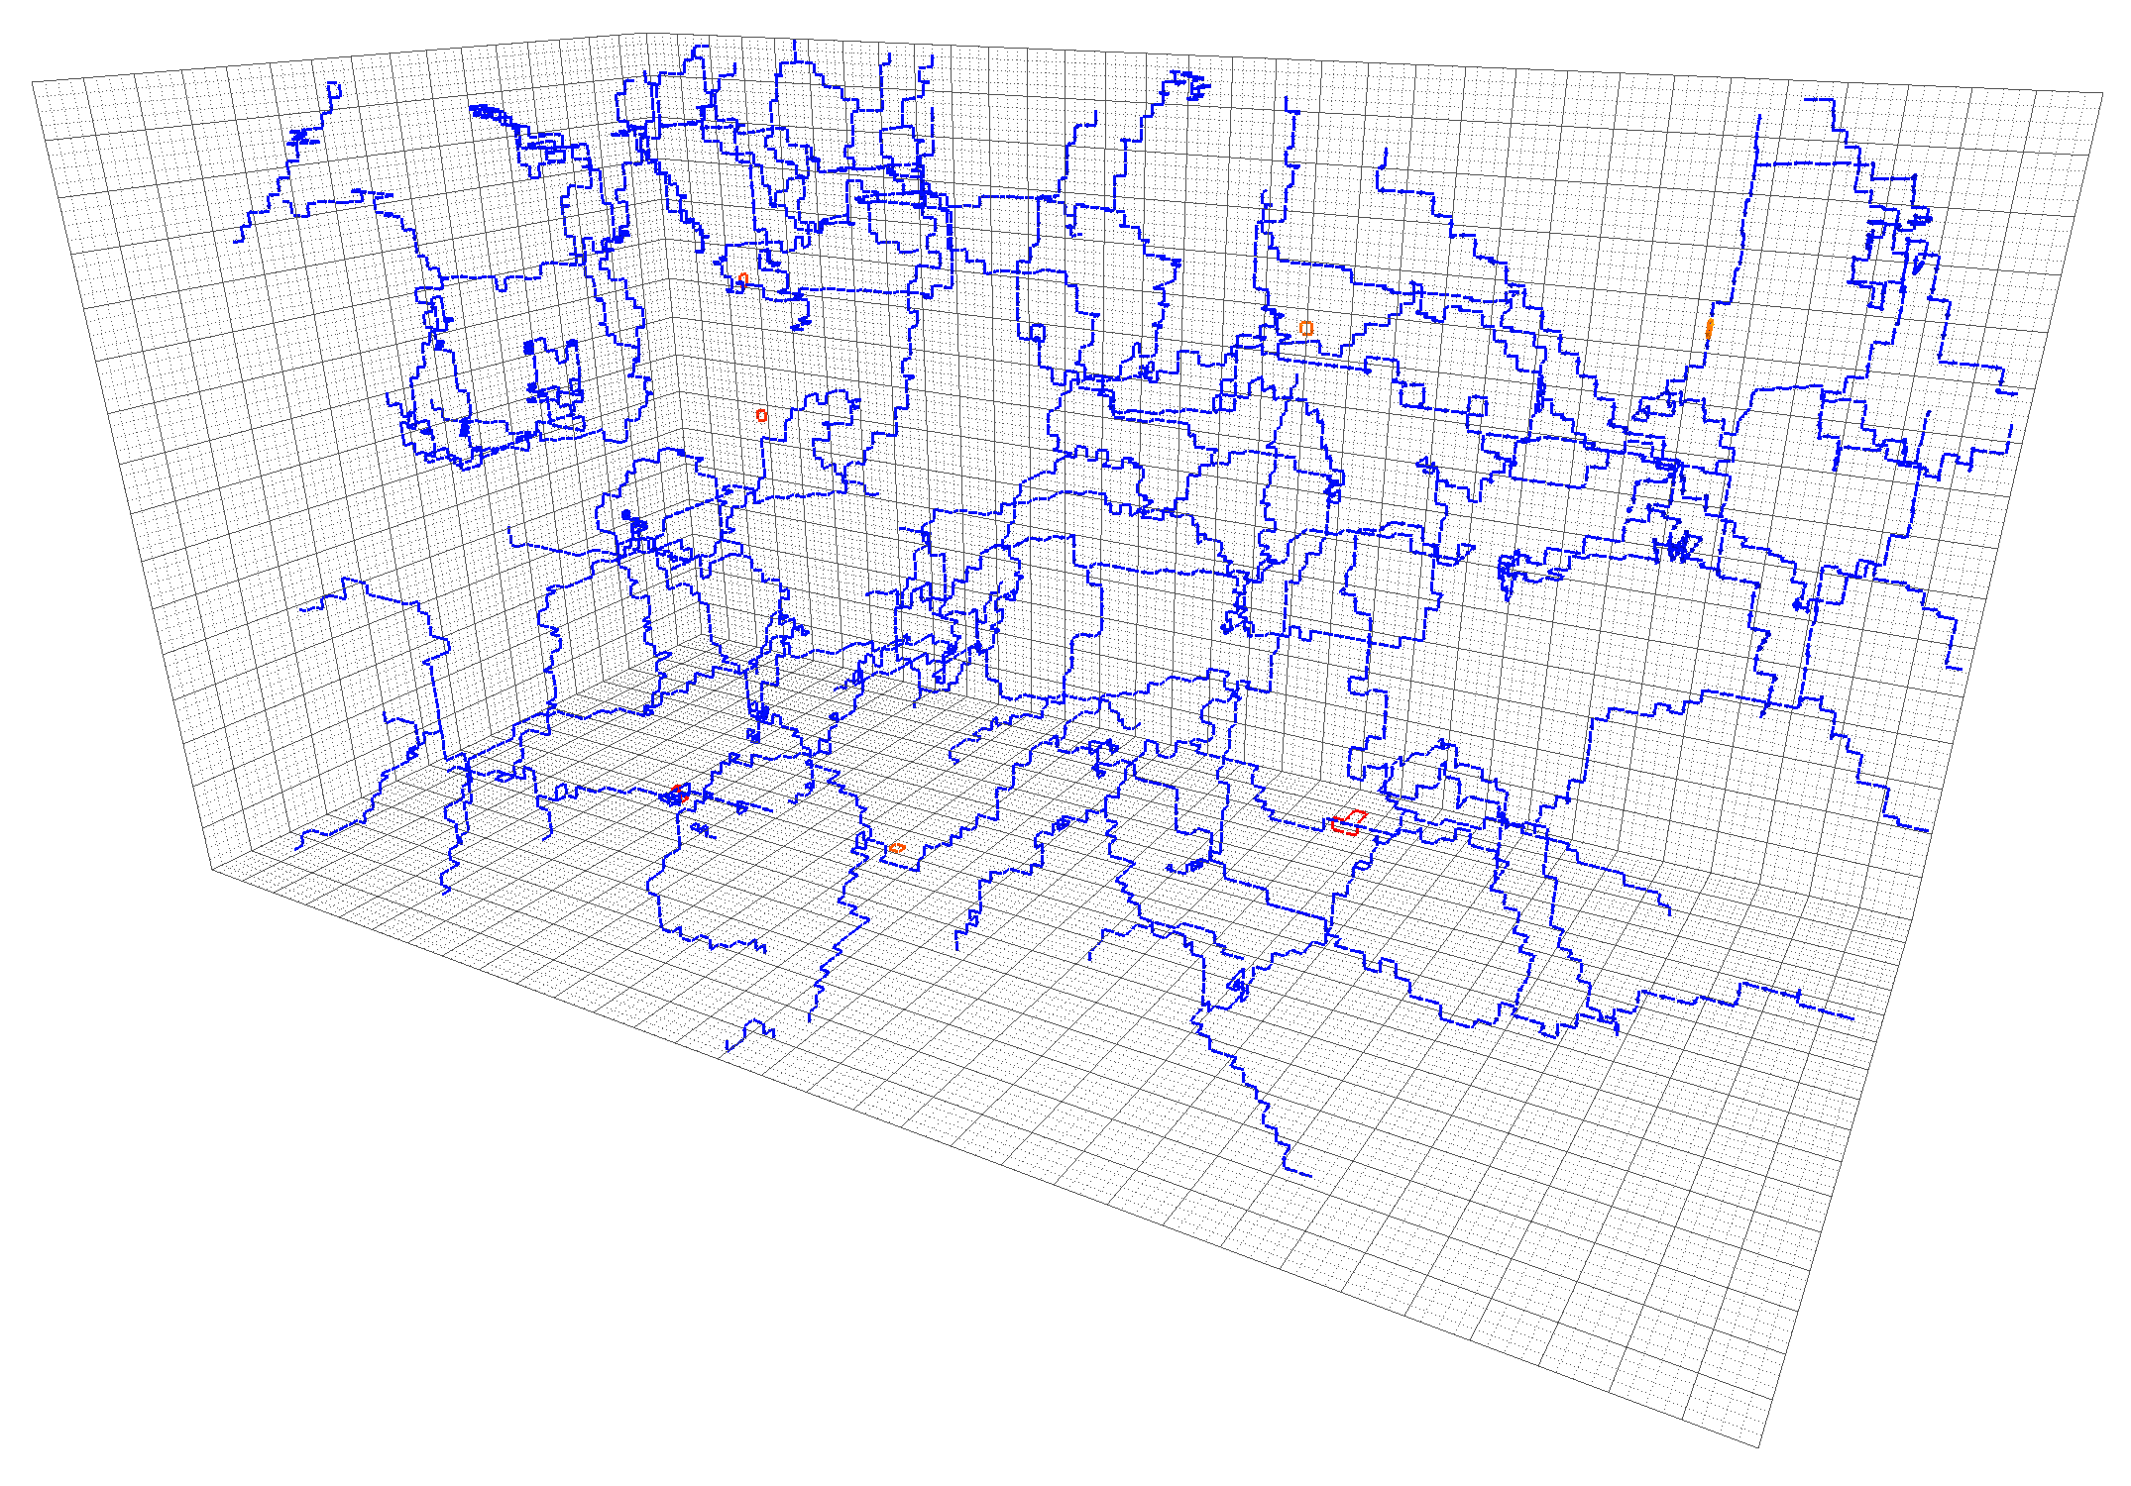
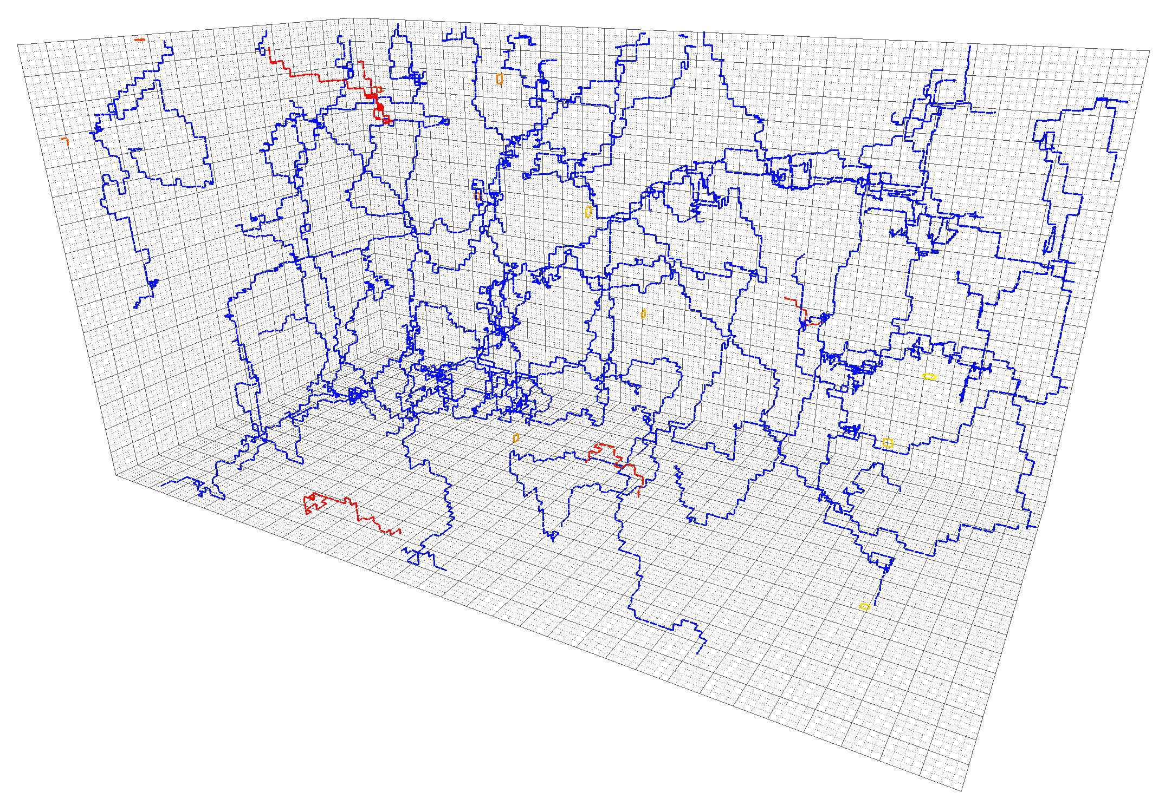
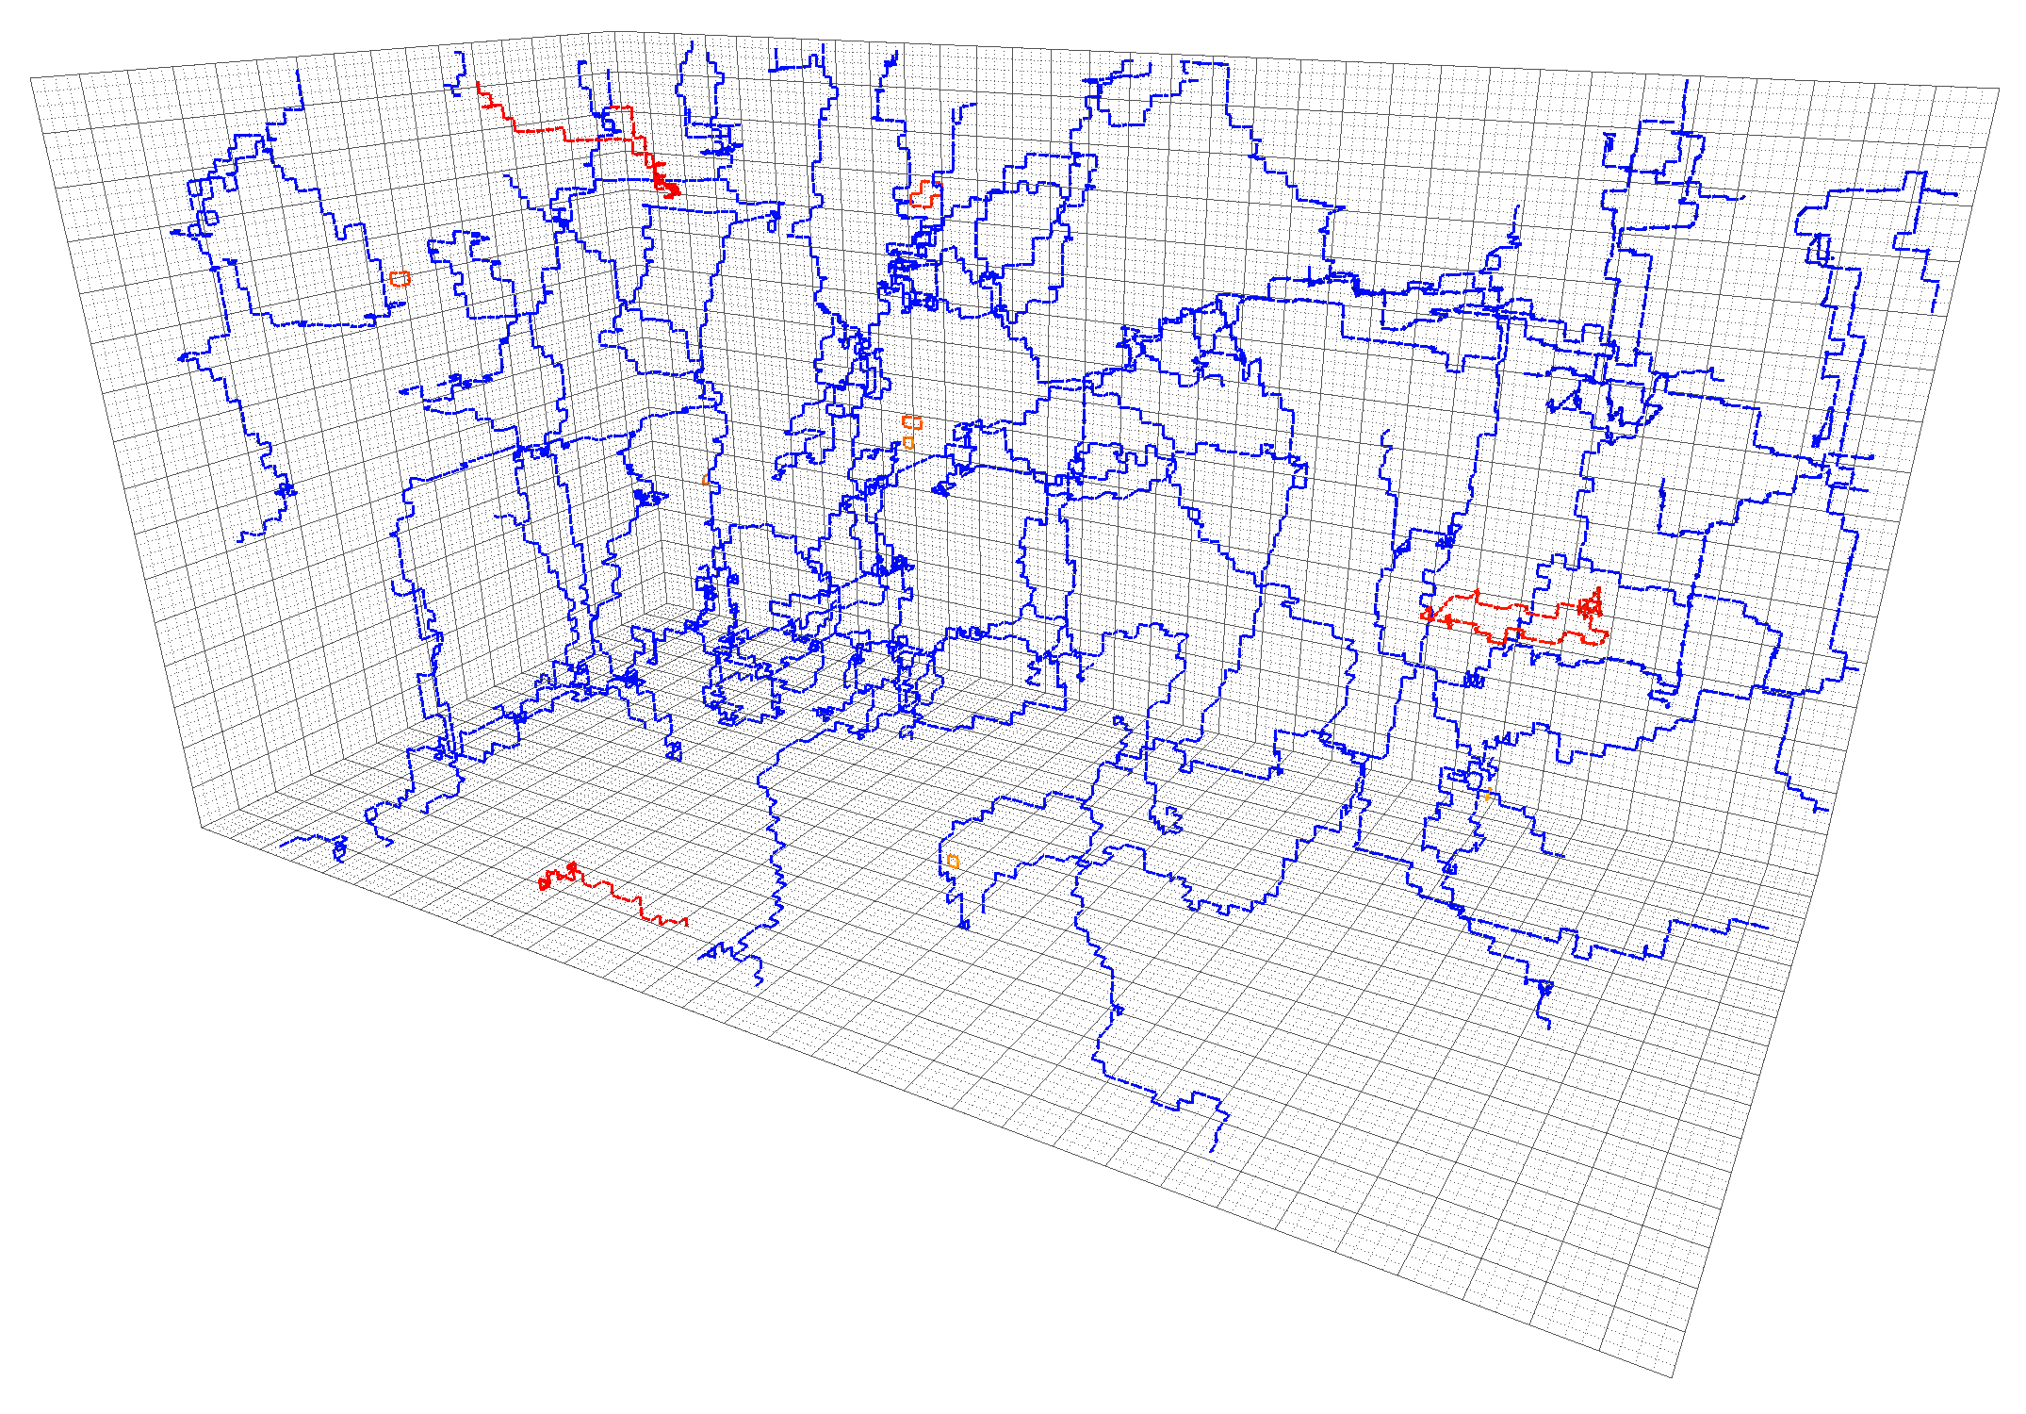
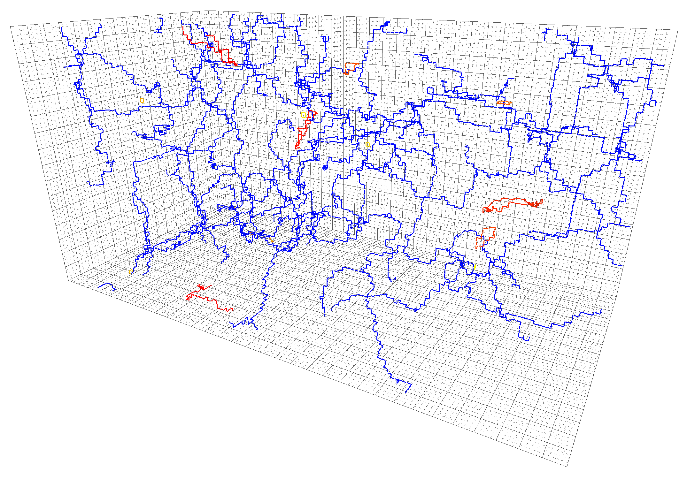
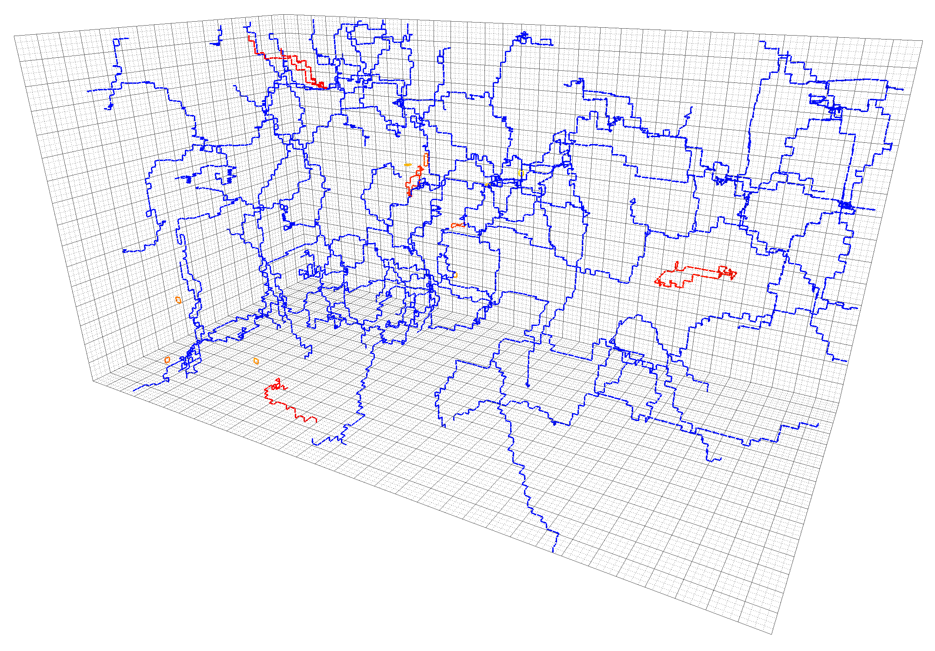
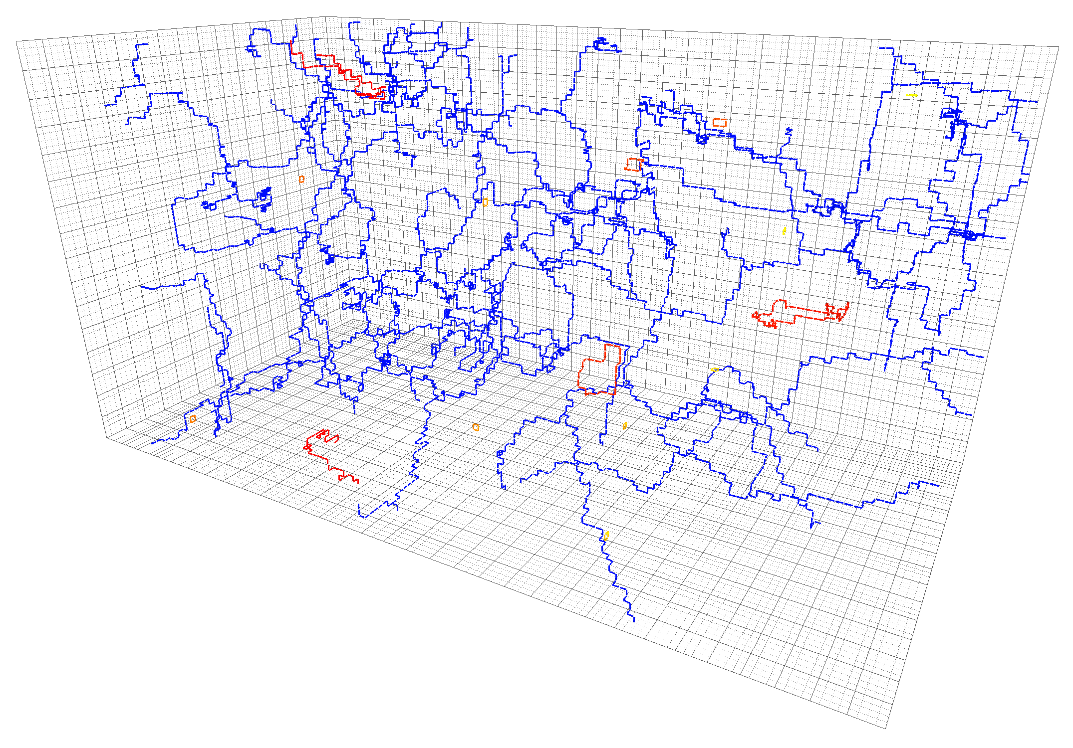
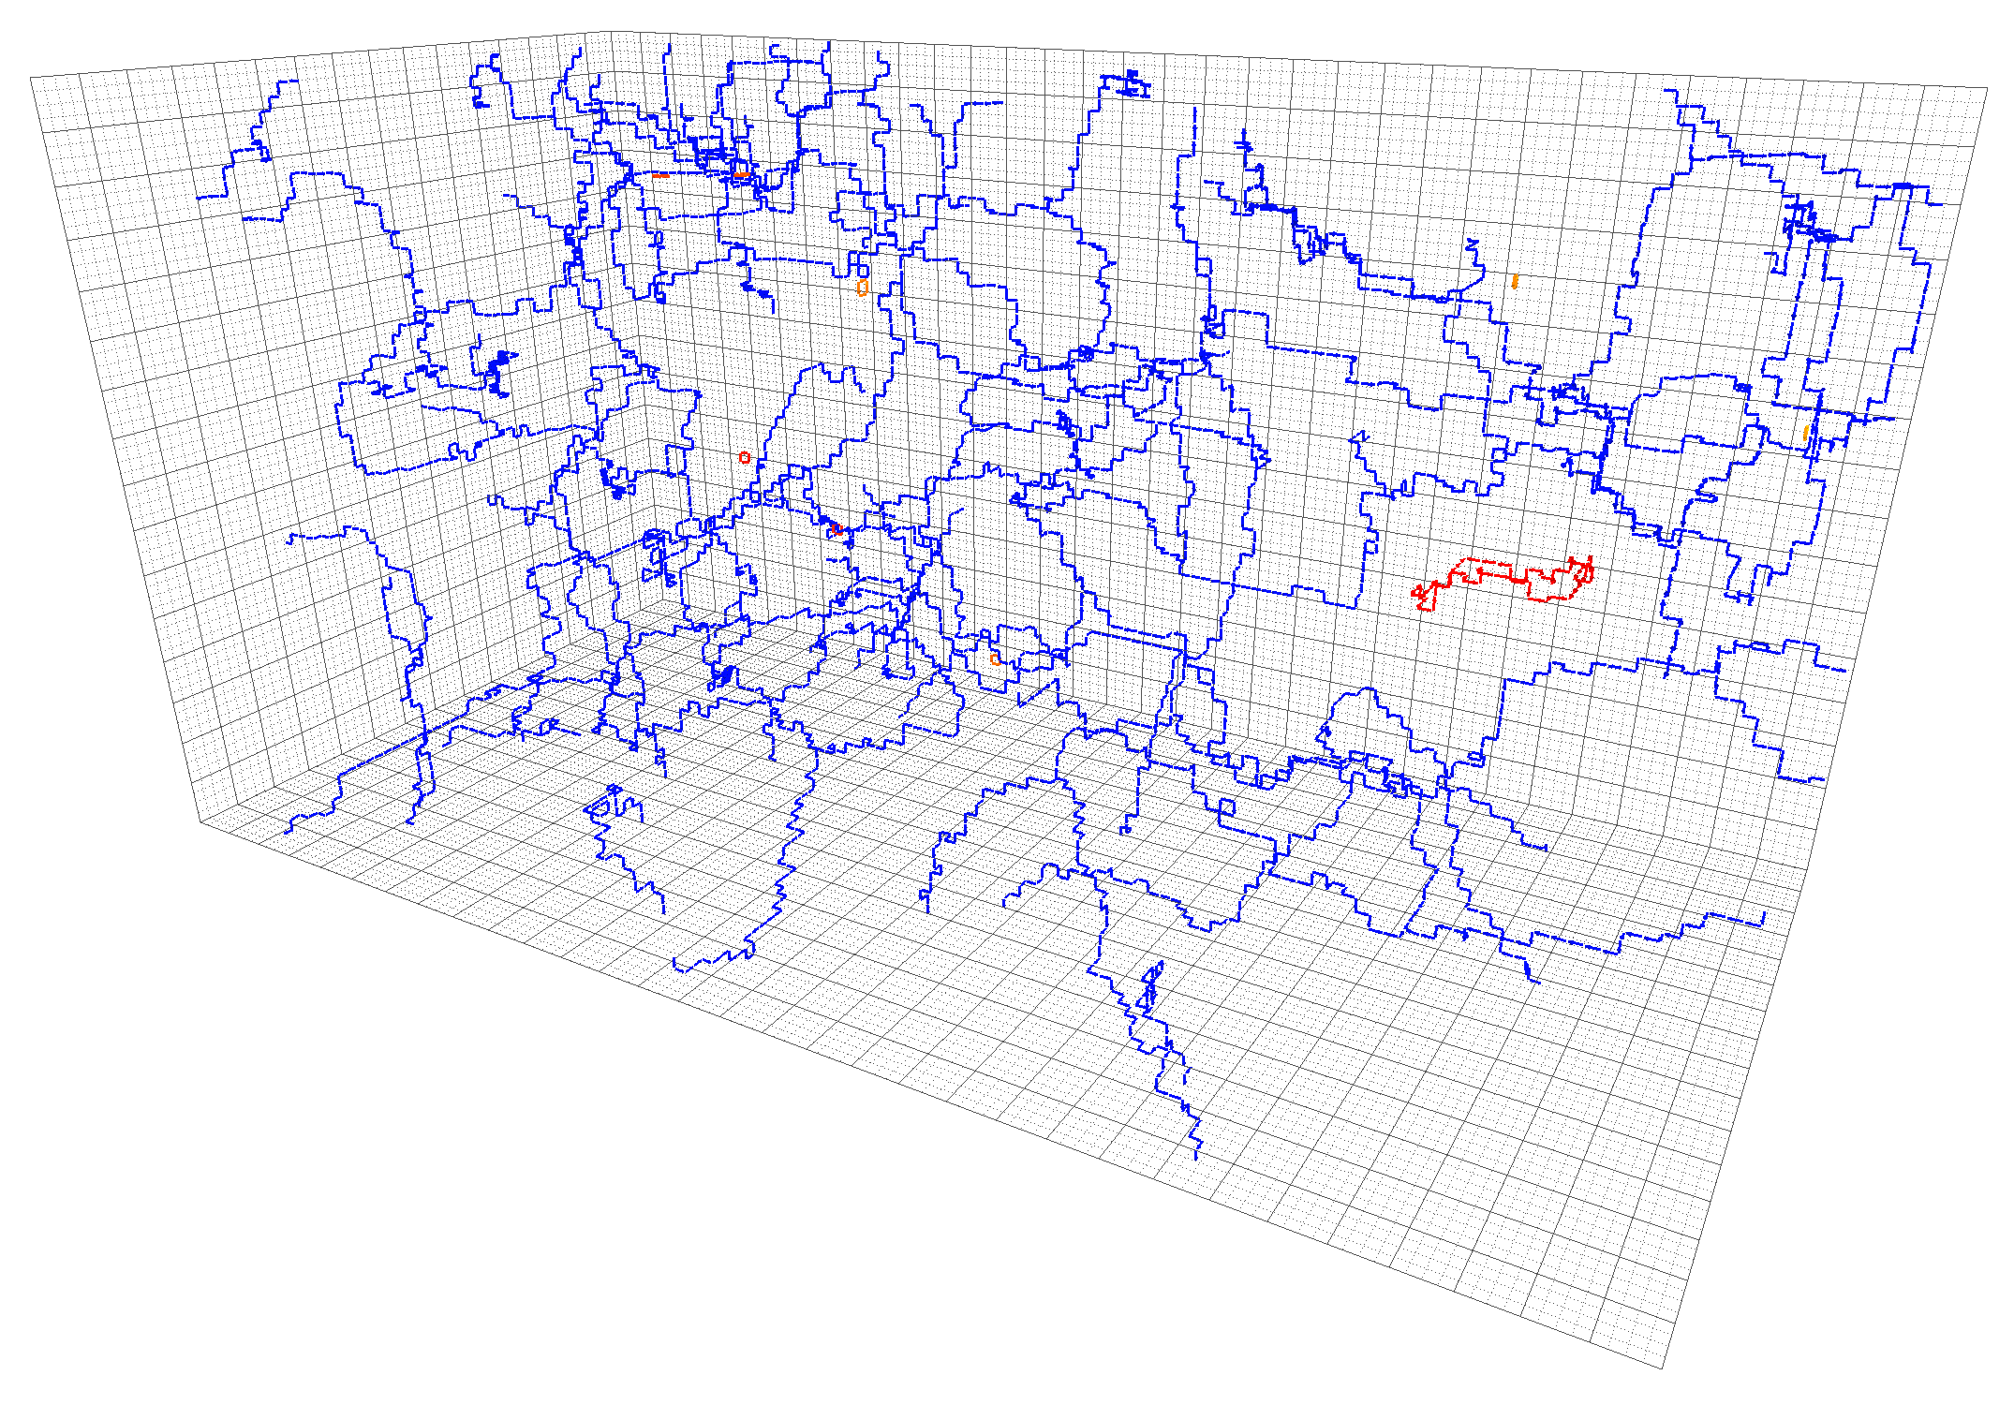
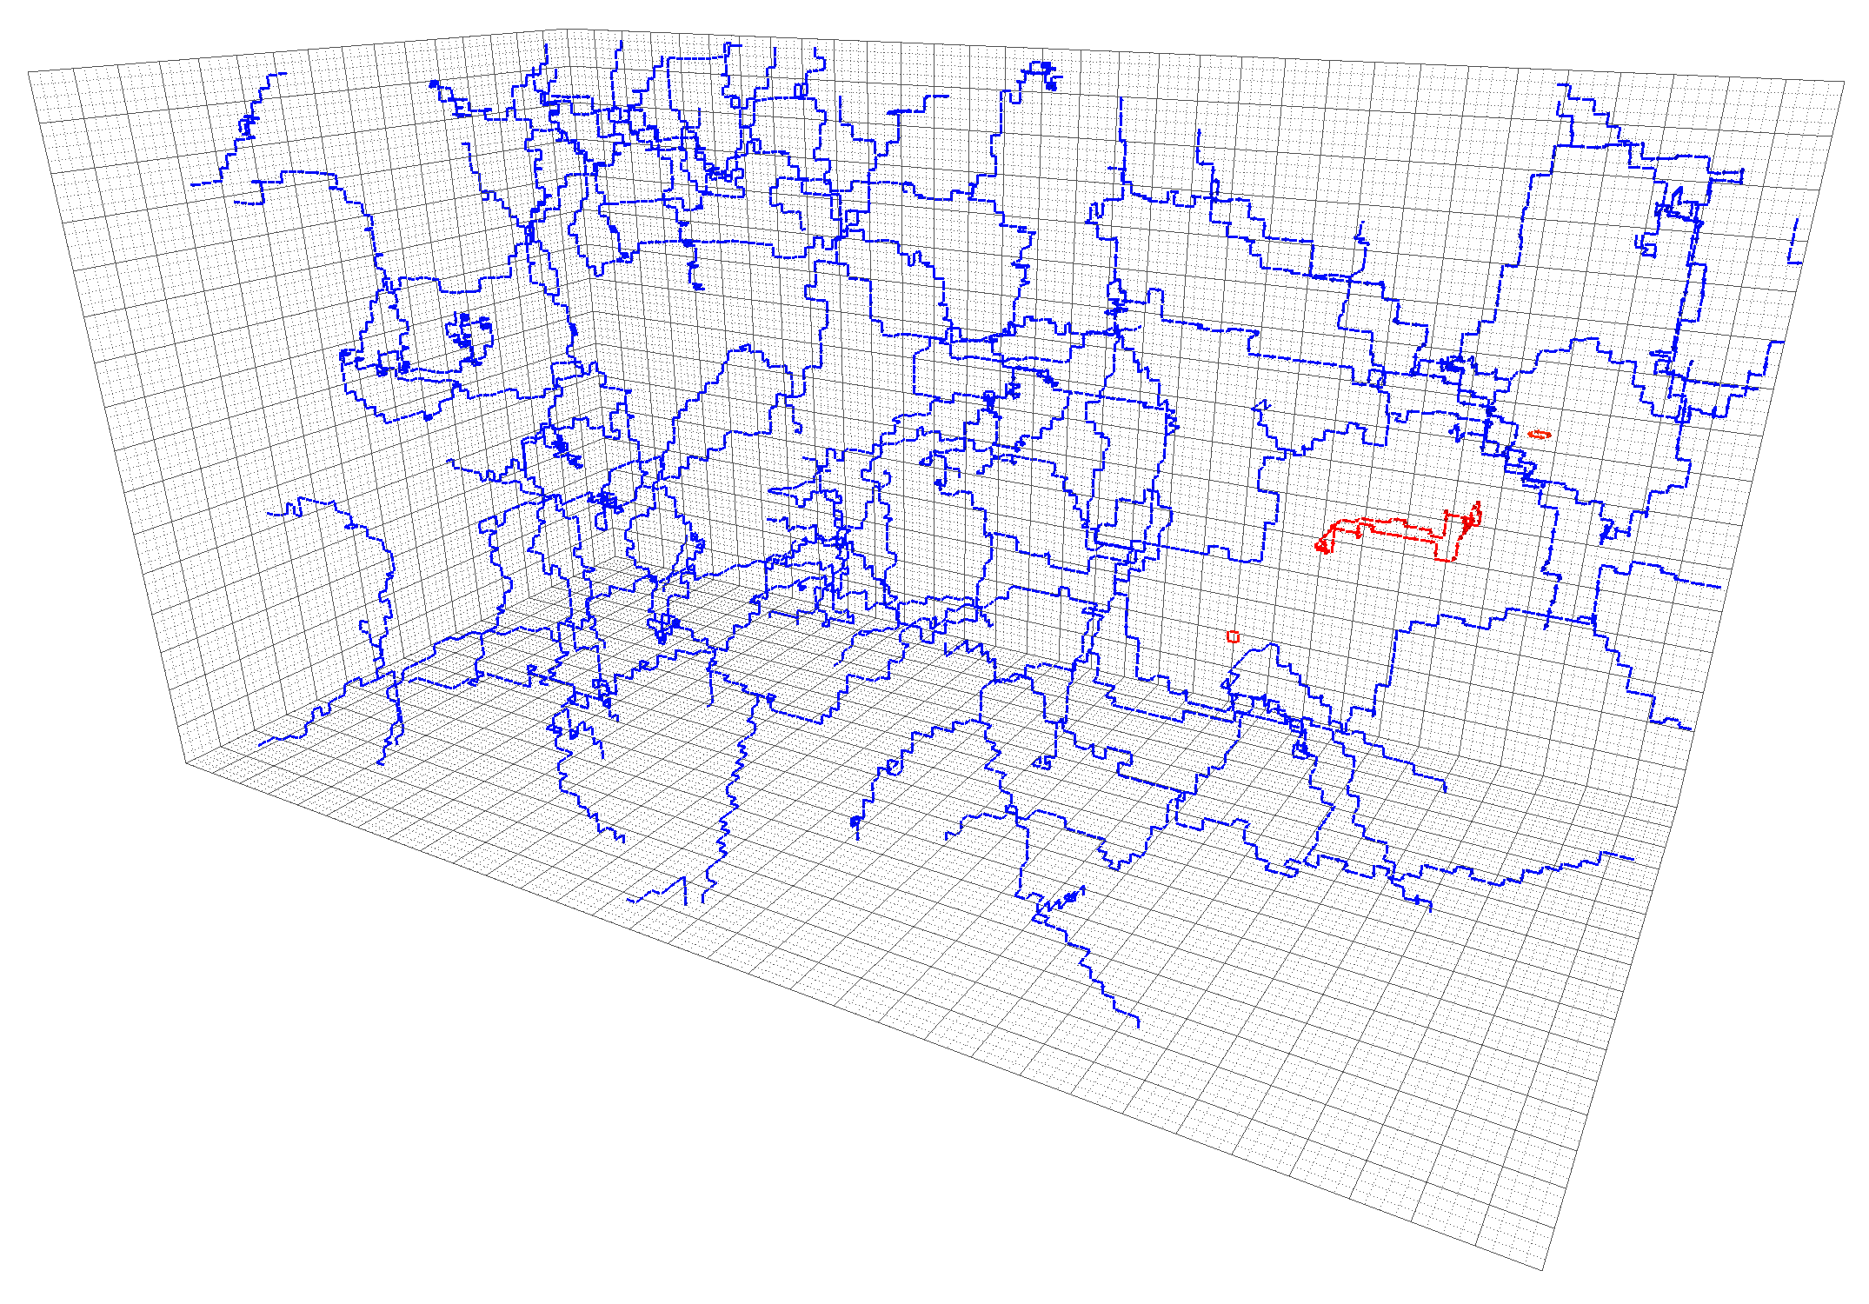
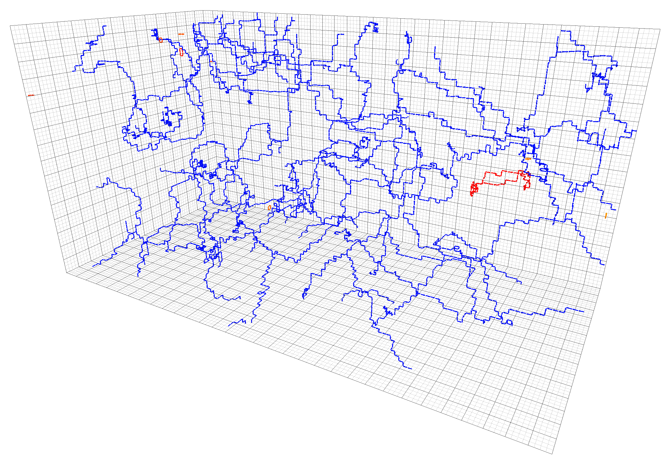
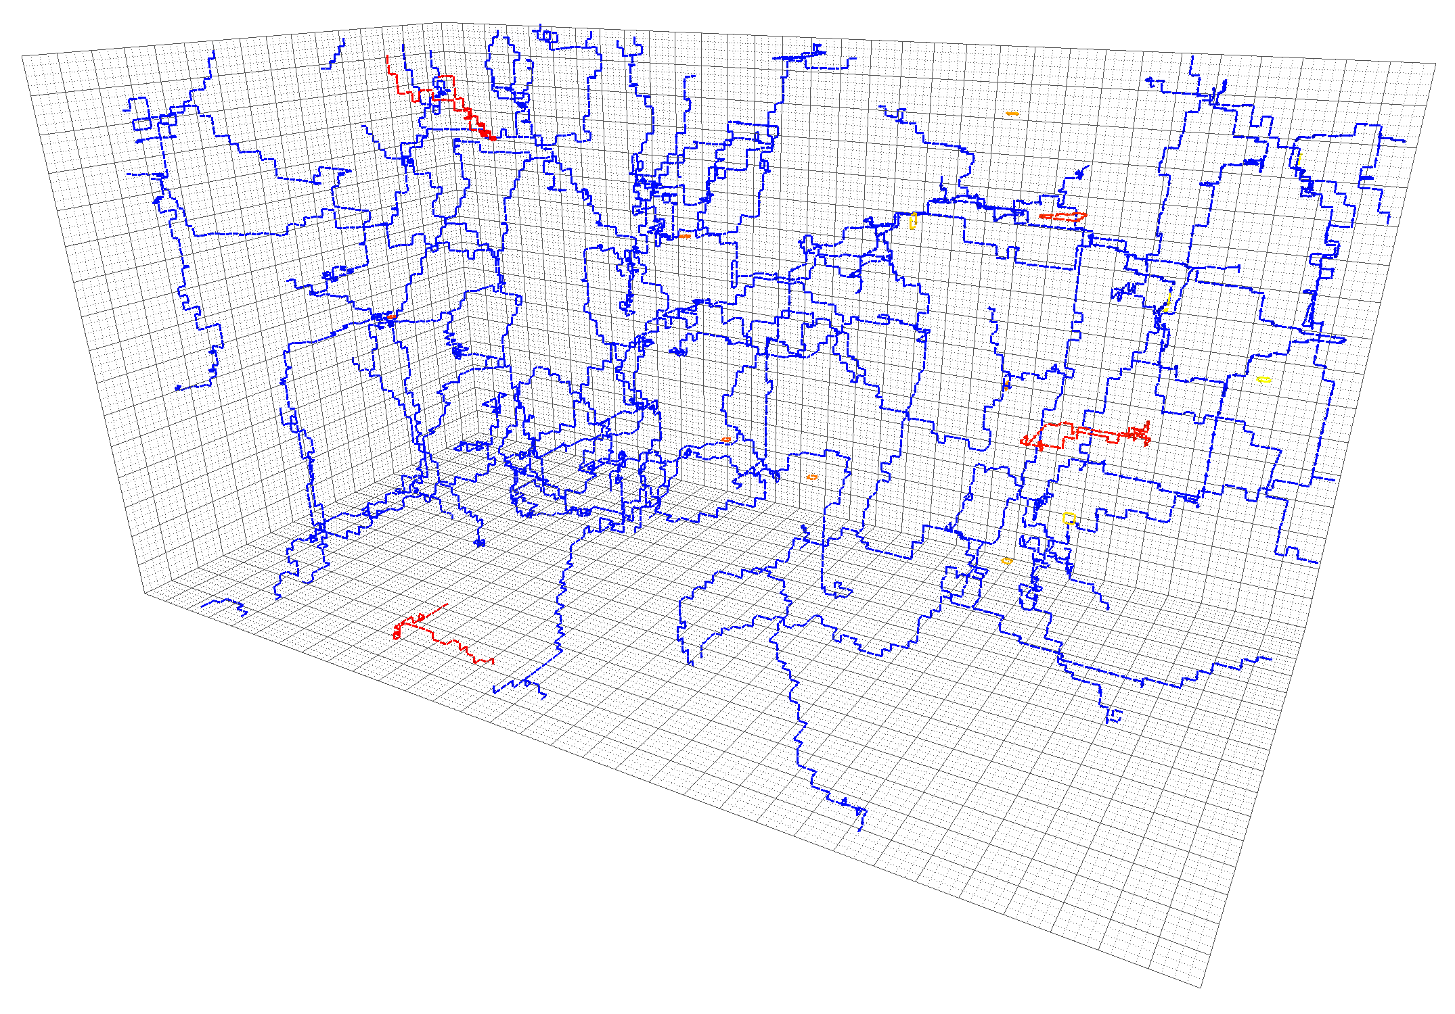
Not-so-secondary clusters

Slide 10
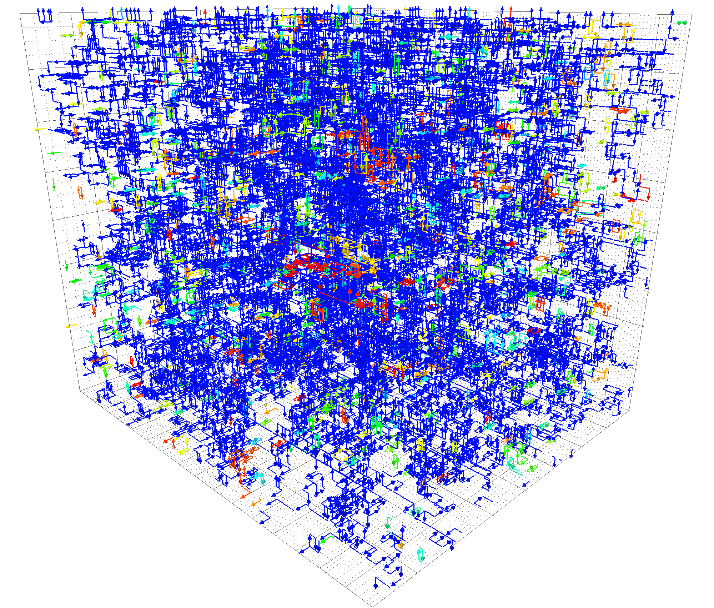
Center vortex structure: dynamical fermions

Slide 11
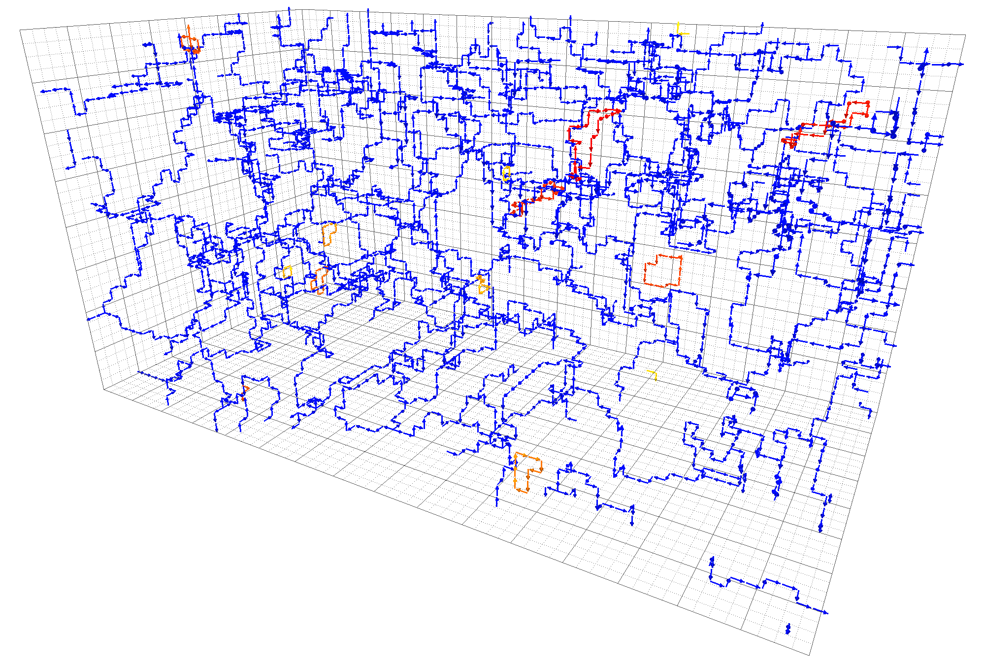
Center vortices and confinement
Center vortices percolate spacetime
Generates an area law for large loops
i.e.
Space-time loops give access to static quark-antiquark potential
For large
Area law gives linear potential
Vortex percolation implies confinement!
No percolation means loss of confinement
Trivial expectation value for large loops
i.e. no area law

Slide 12
Lattice details
Temperature given by (inverse) period of temporal dimension
Critical temperature at which confinement is lost
Ensembles are
Iwasaki renormalization-group-improved action
Fixed lattice spacing
100 configurations for each

Slide 13
Center vortex structure:
Temporal (fixed- ) slices
Visualising
Spatial (fixed- ) slices
Visualising

Slide 14
Center vortex structure:
Temporal (fixed- ) slices
Visualizing
Spatial (fixed- ) slices
Visualizing

Slide 15
Cylinders..?
Temporal (fixed- ) slice
Spatial (fixed- ) slice
Vortex sheet aligns with temporal dimension above

Slide 16
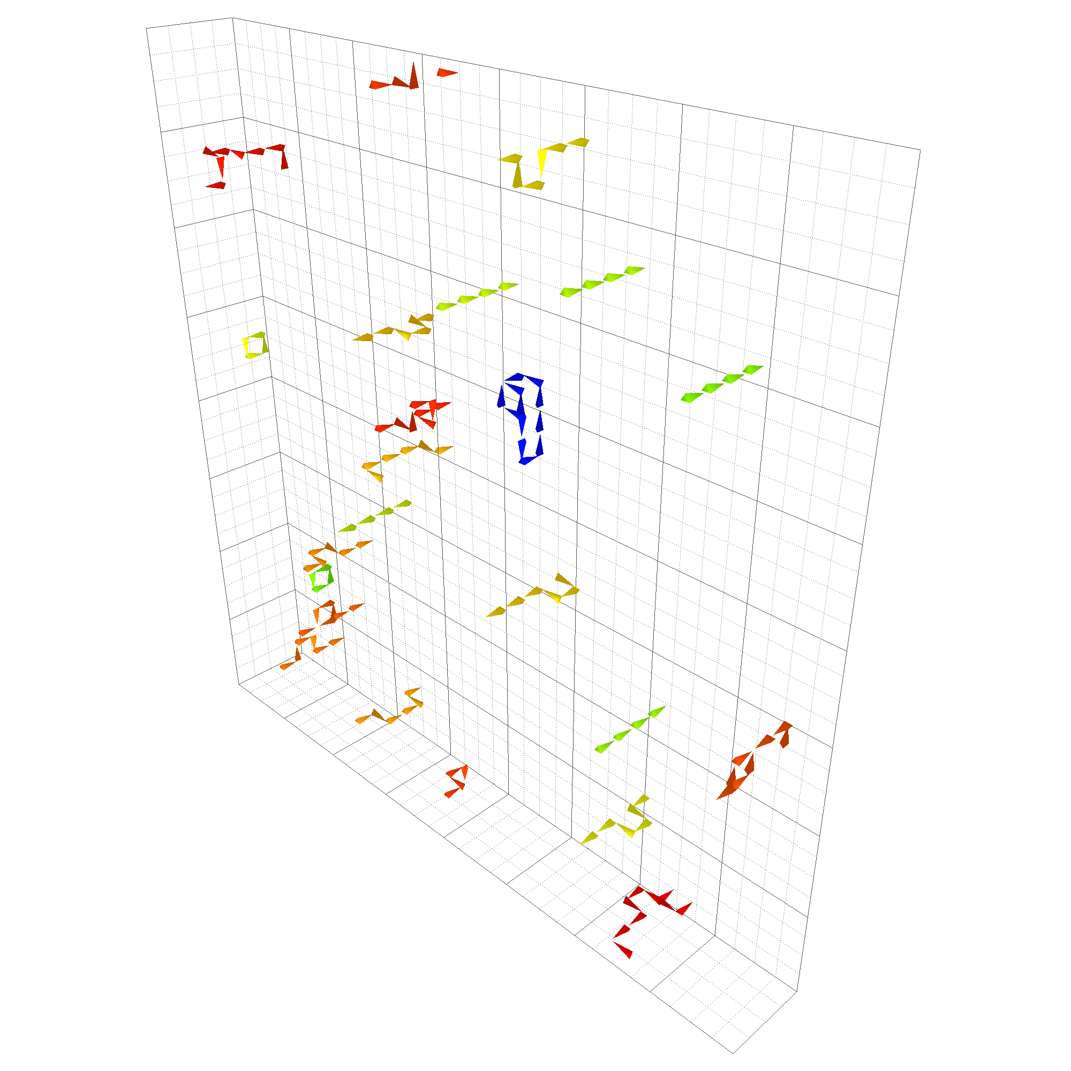
Deconfinement from center vortices
2D vortex sheet aligns with temporal dimension above
Percolation reduced from full four dimensions to three-dimensional submanifold
Vortex structure frozen in temporal slices
Still observe percolation in the three spatial dimensions
Lines predominantly parallel to temporal axis in spatial slices
Closed under periodic boundary conditions
Results specifically in an absence of vortices piercing space-time loops
Loss of confinement!

Slide 17
Quantifying alignment
Suppose a plaquette in temporal slice is pierced by a vortex
Is this plaquette still pierced in the same direction in temporal slice ?
Slice
Slice
Define indicator function
Equals only when and are both or both
Define correlation measure
Separation restricted to

Slide 18
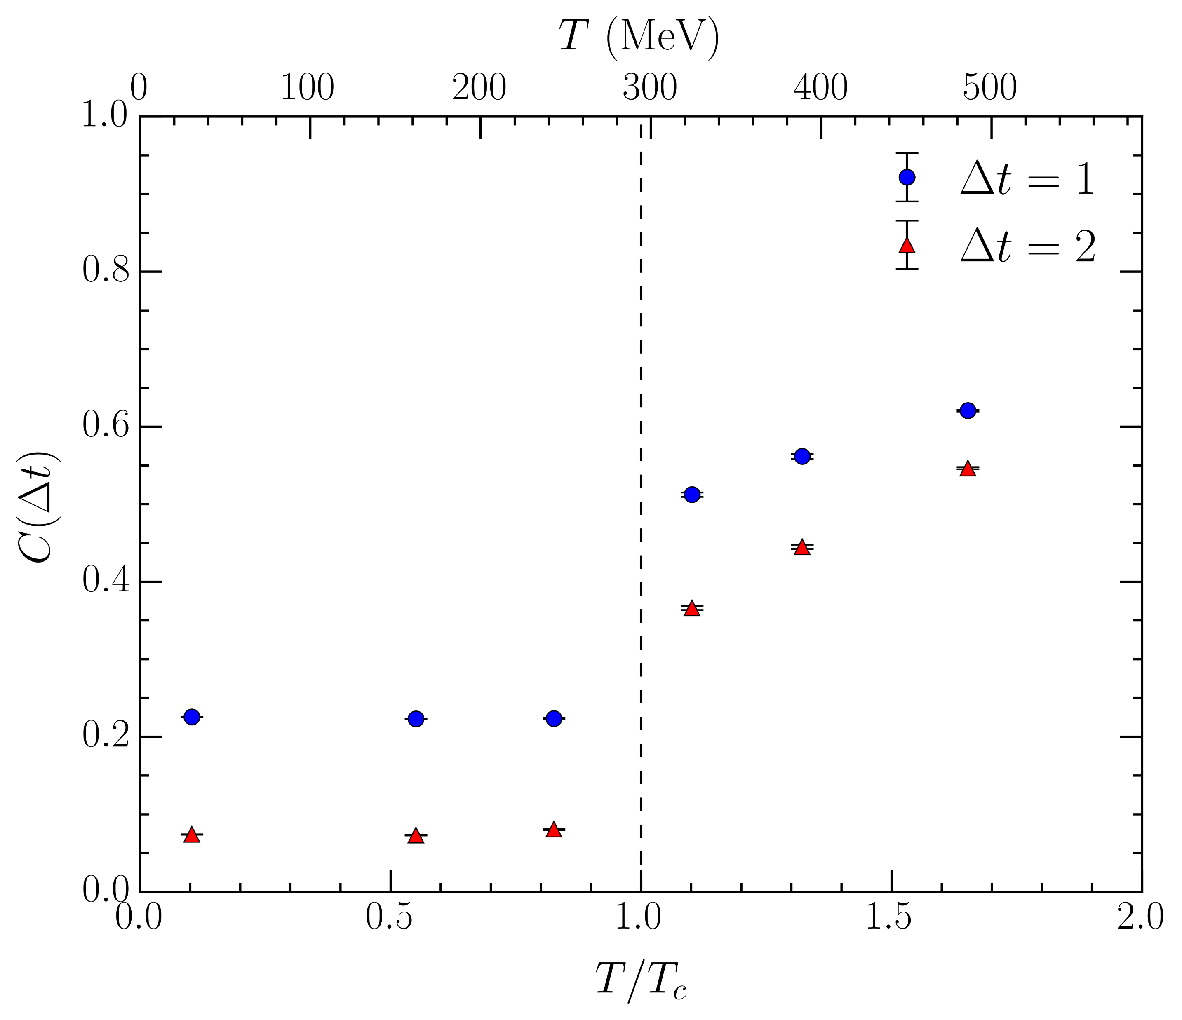
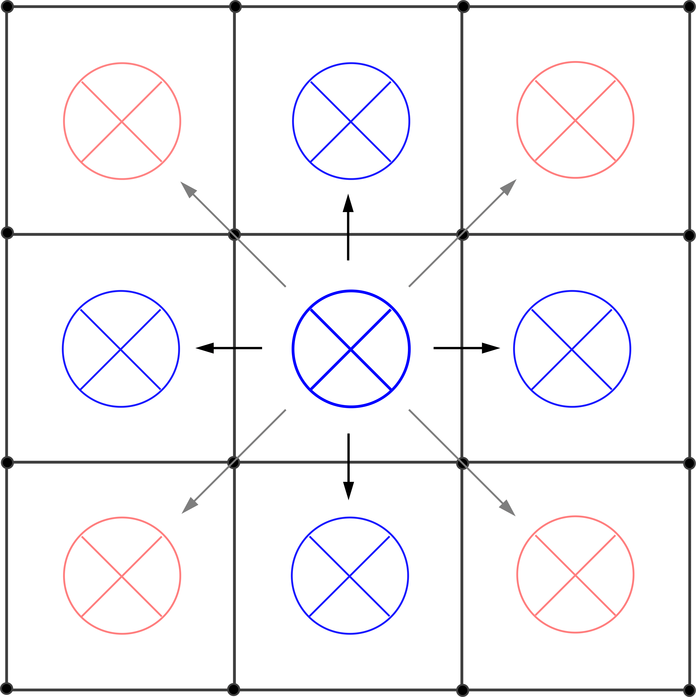
Temporal correlation
Significant increase as we cross
Growth above indicates the alignment becomes stronger at high temperatures
and become closer
Nonzero value below
Random chance vortex is invariant

Slide 19
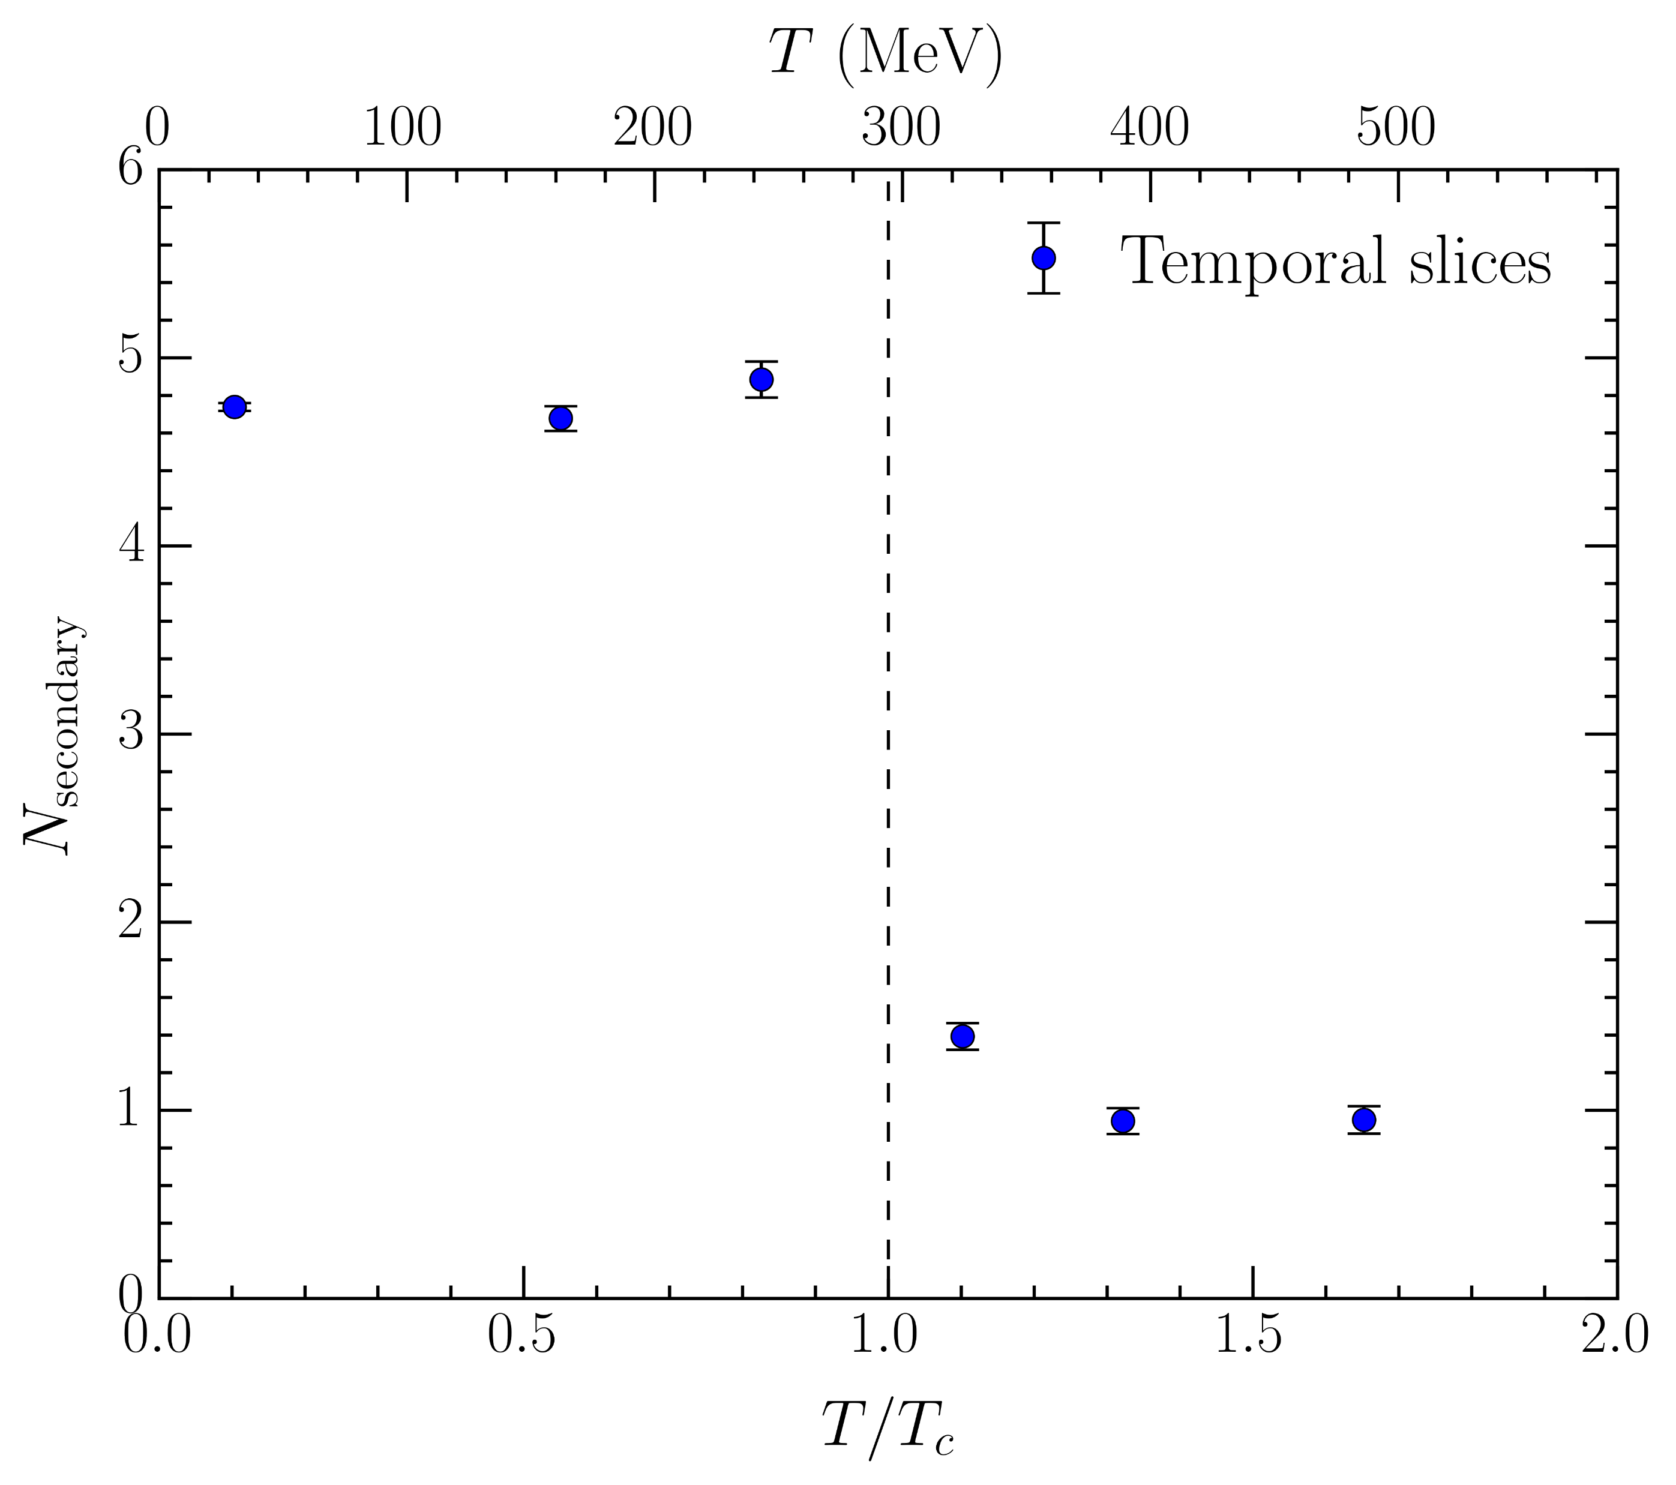
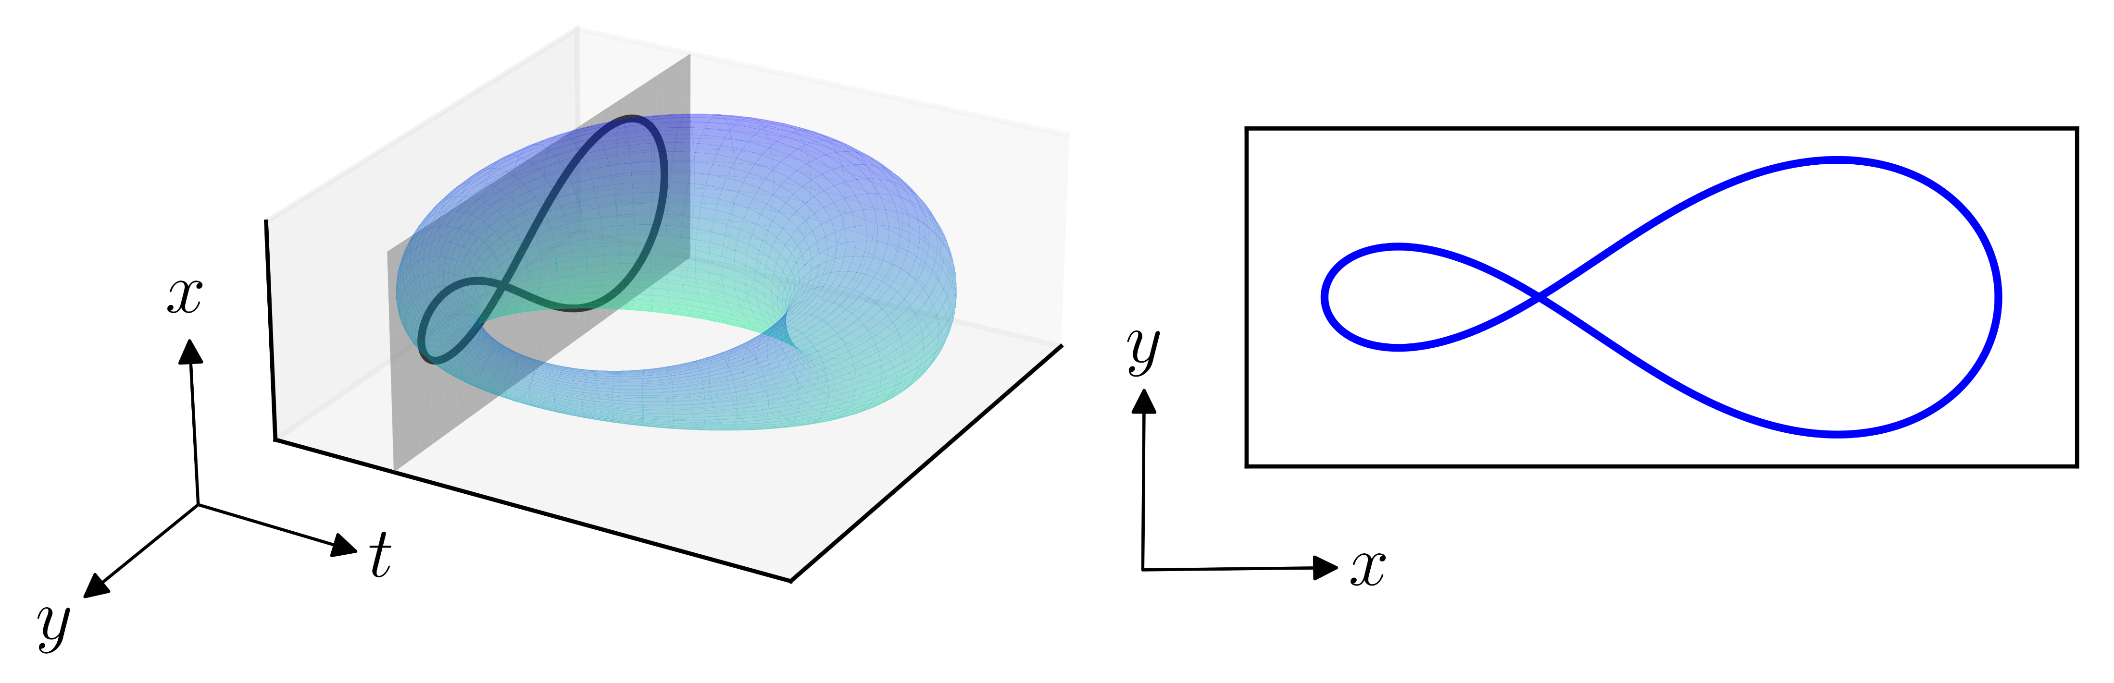
Secondary clusters
Small loops disconnected from percolating cluster in three-dimensional slices
Well defined in temporal slices for all
is average number of secondary clusters per temporal slice
Pronounced drop through
Down to secondary cluster per slice!
Connected to alignment of vortex sheet
Temporal (fixed- ) slice

Slide 20
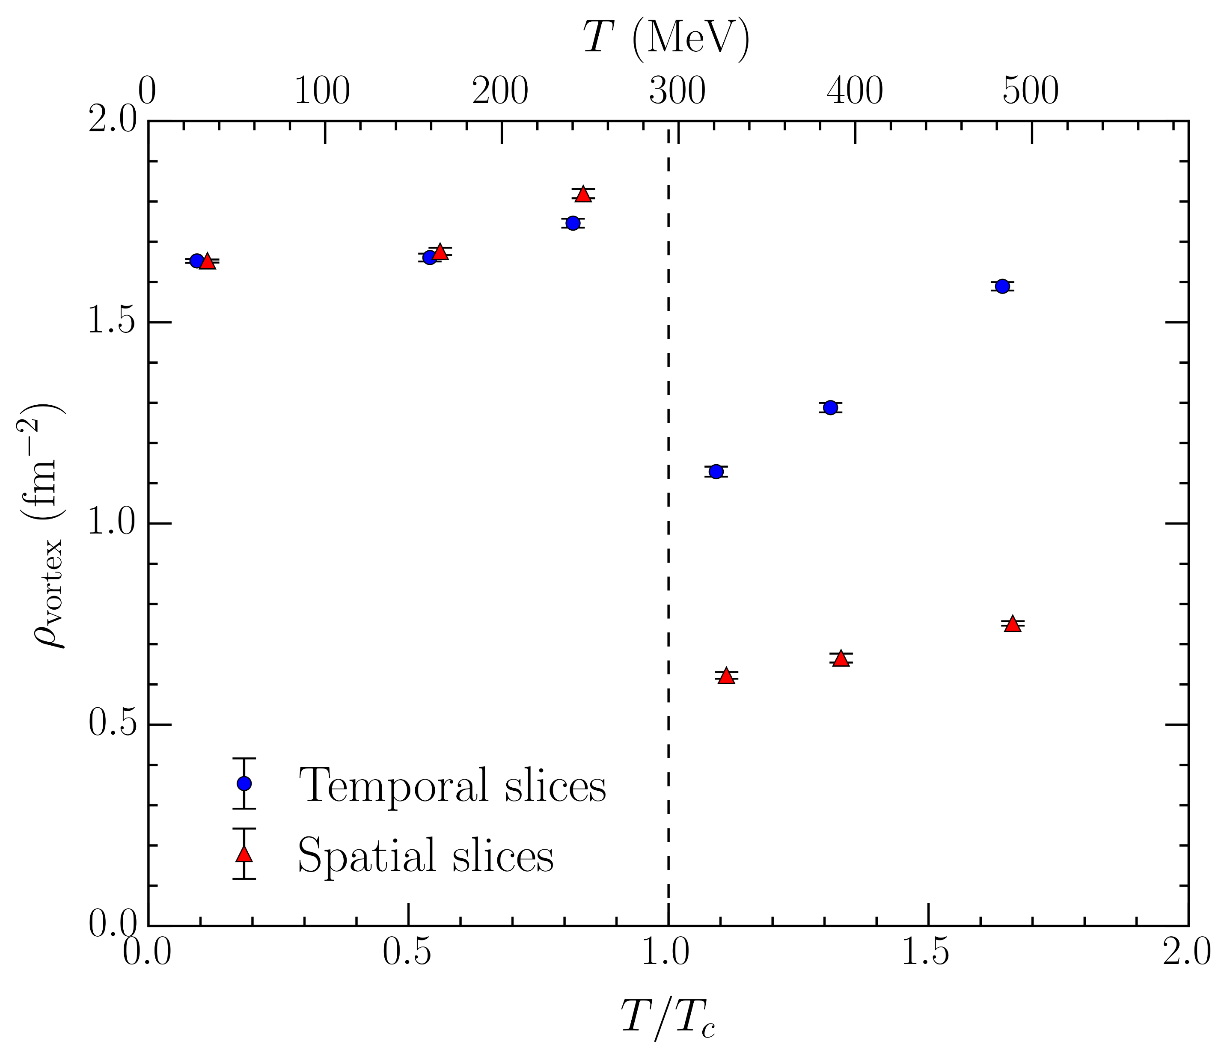
Vortex density
Number of vortices per unit area
plaquettes in 3D slices
Spatial (fixed- ) slices
Visualizing
Substantial drop in vortex density – matches loss of percolating cluster
Temporal (fixed- ) slices
Visualizing
Also see a decrease through !
Continued increase at high temperatures
Consider space-space and space-time plaquettes separately?

Slide 21
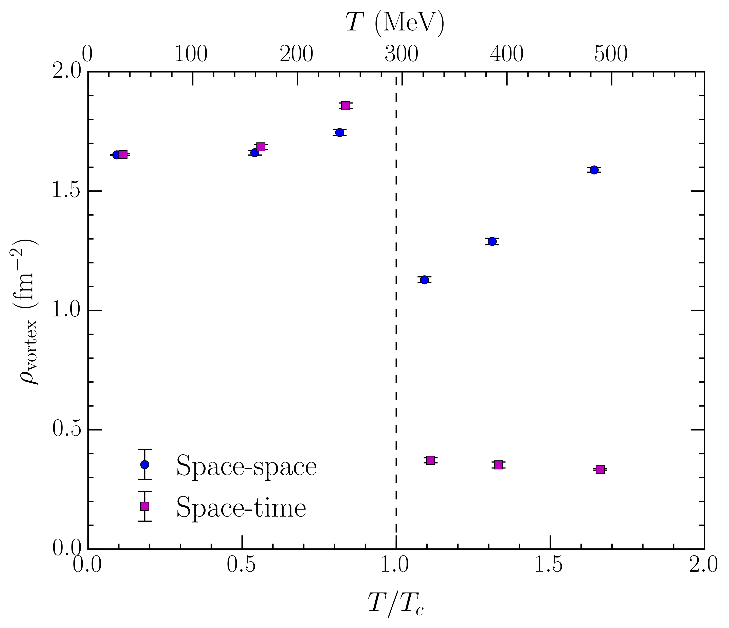
Vortex density: space-space/space-time
Total proportions of space-space and space-time plaquettes pierced
Space-space density is equivalent to temporal slices density
Space-time density
Even larger drop through – matches temporal alignment
Soft decrease above
Larger space-time density as is approached from below
Vortex sheet prepares to align with temporal dimension
Lots of small “wiggles” – more space-time plaquettes pierced

Slide 22
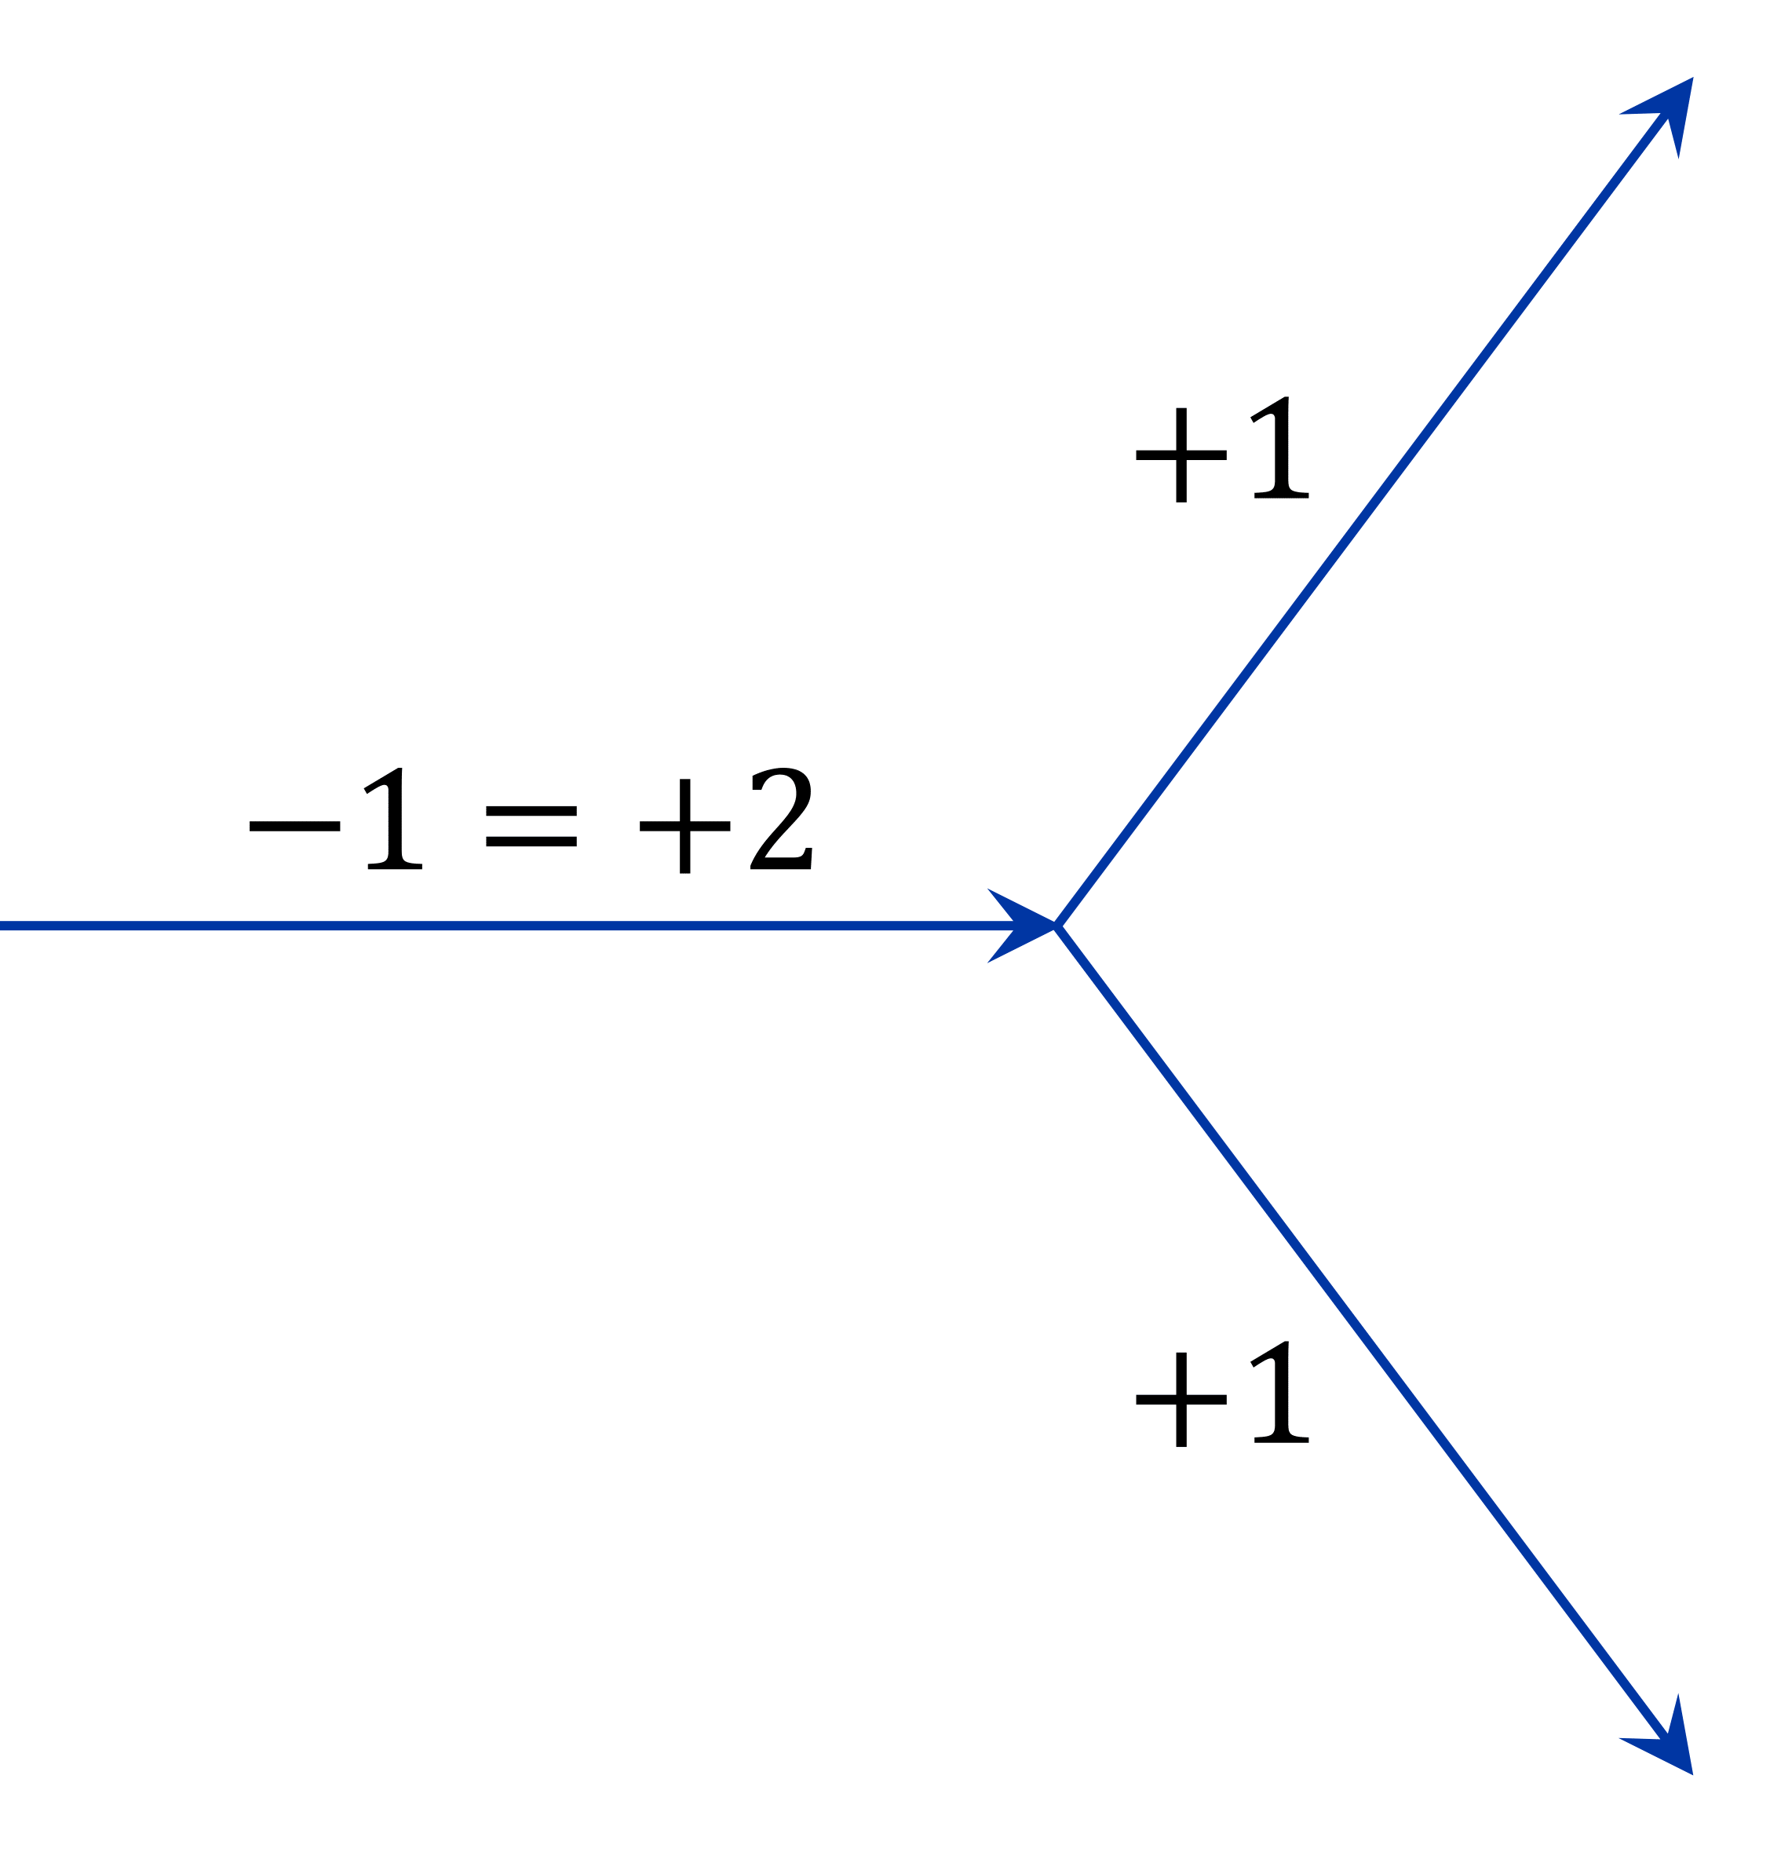
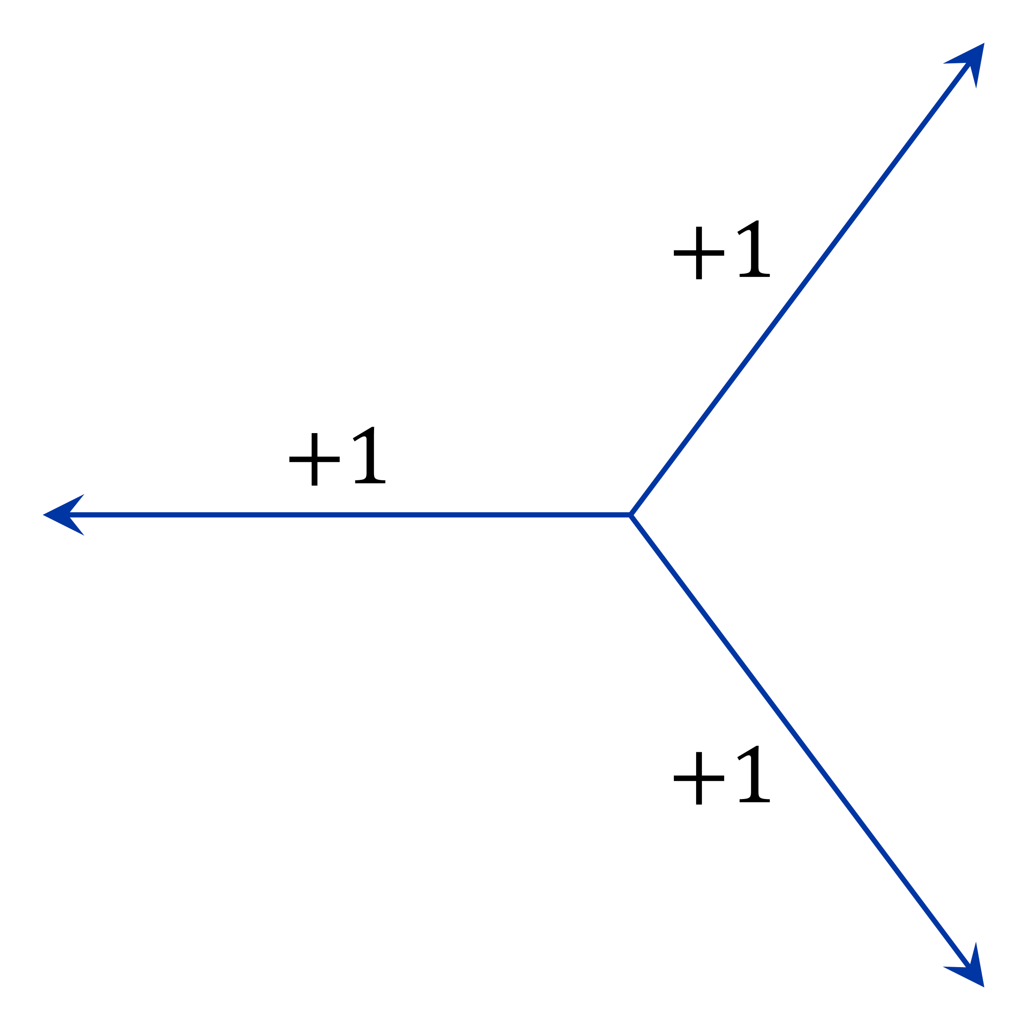
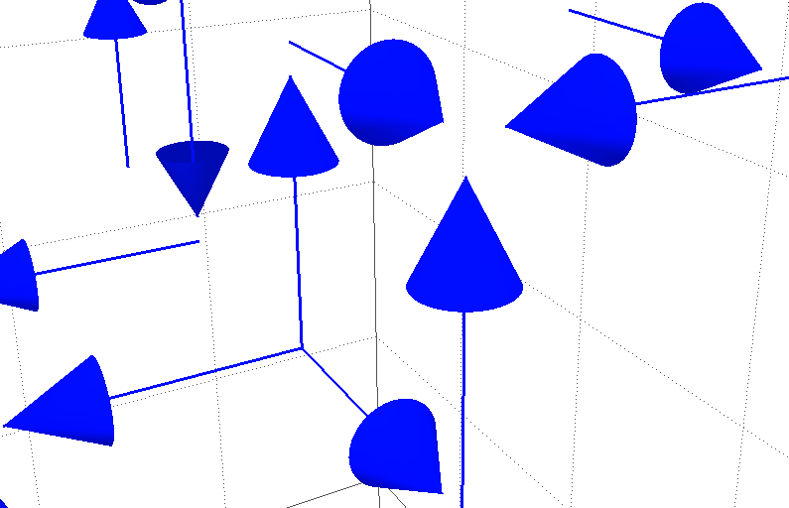
Branching points
Center charge only conserved modulo in
An vortex can branch into two vortices
New feature of compared to
Can also be viewed as monopoles
Three vortices emerging from/converging to a point
This is how they appear in the visualizations
Precise terminology
Three emerging monopole
Three converging anti-monopole

Slide 23
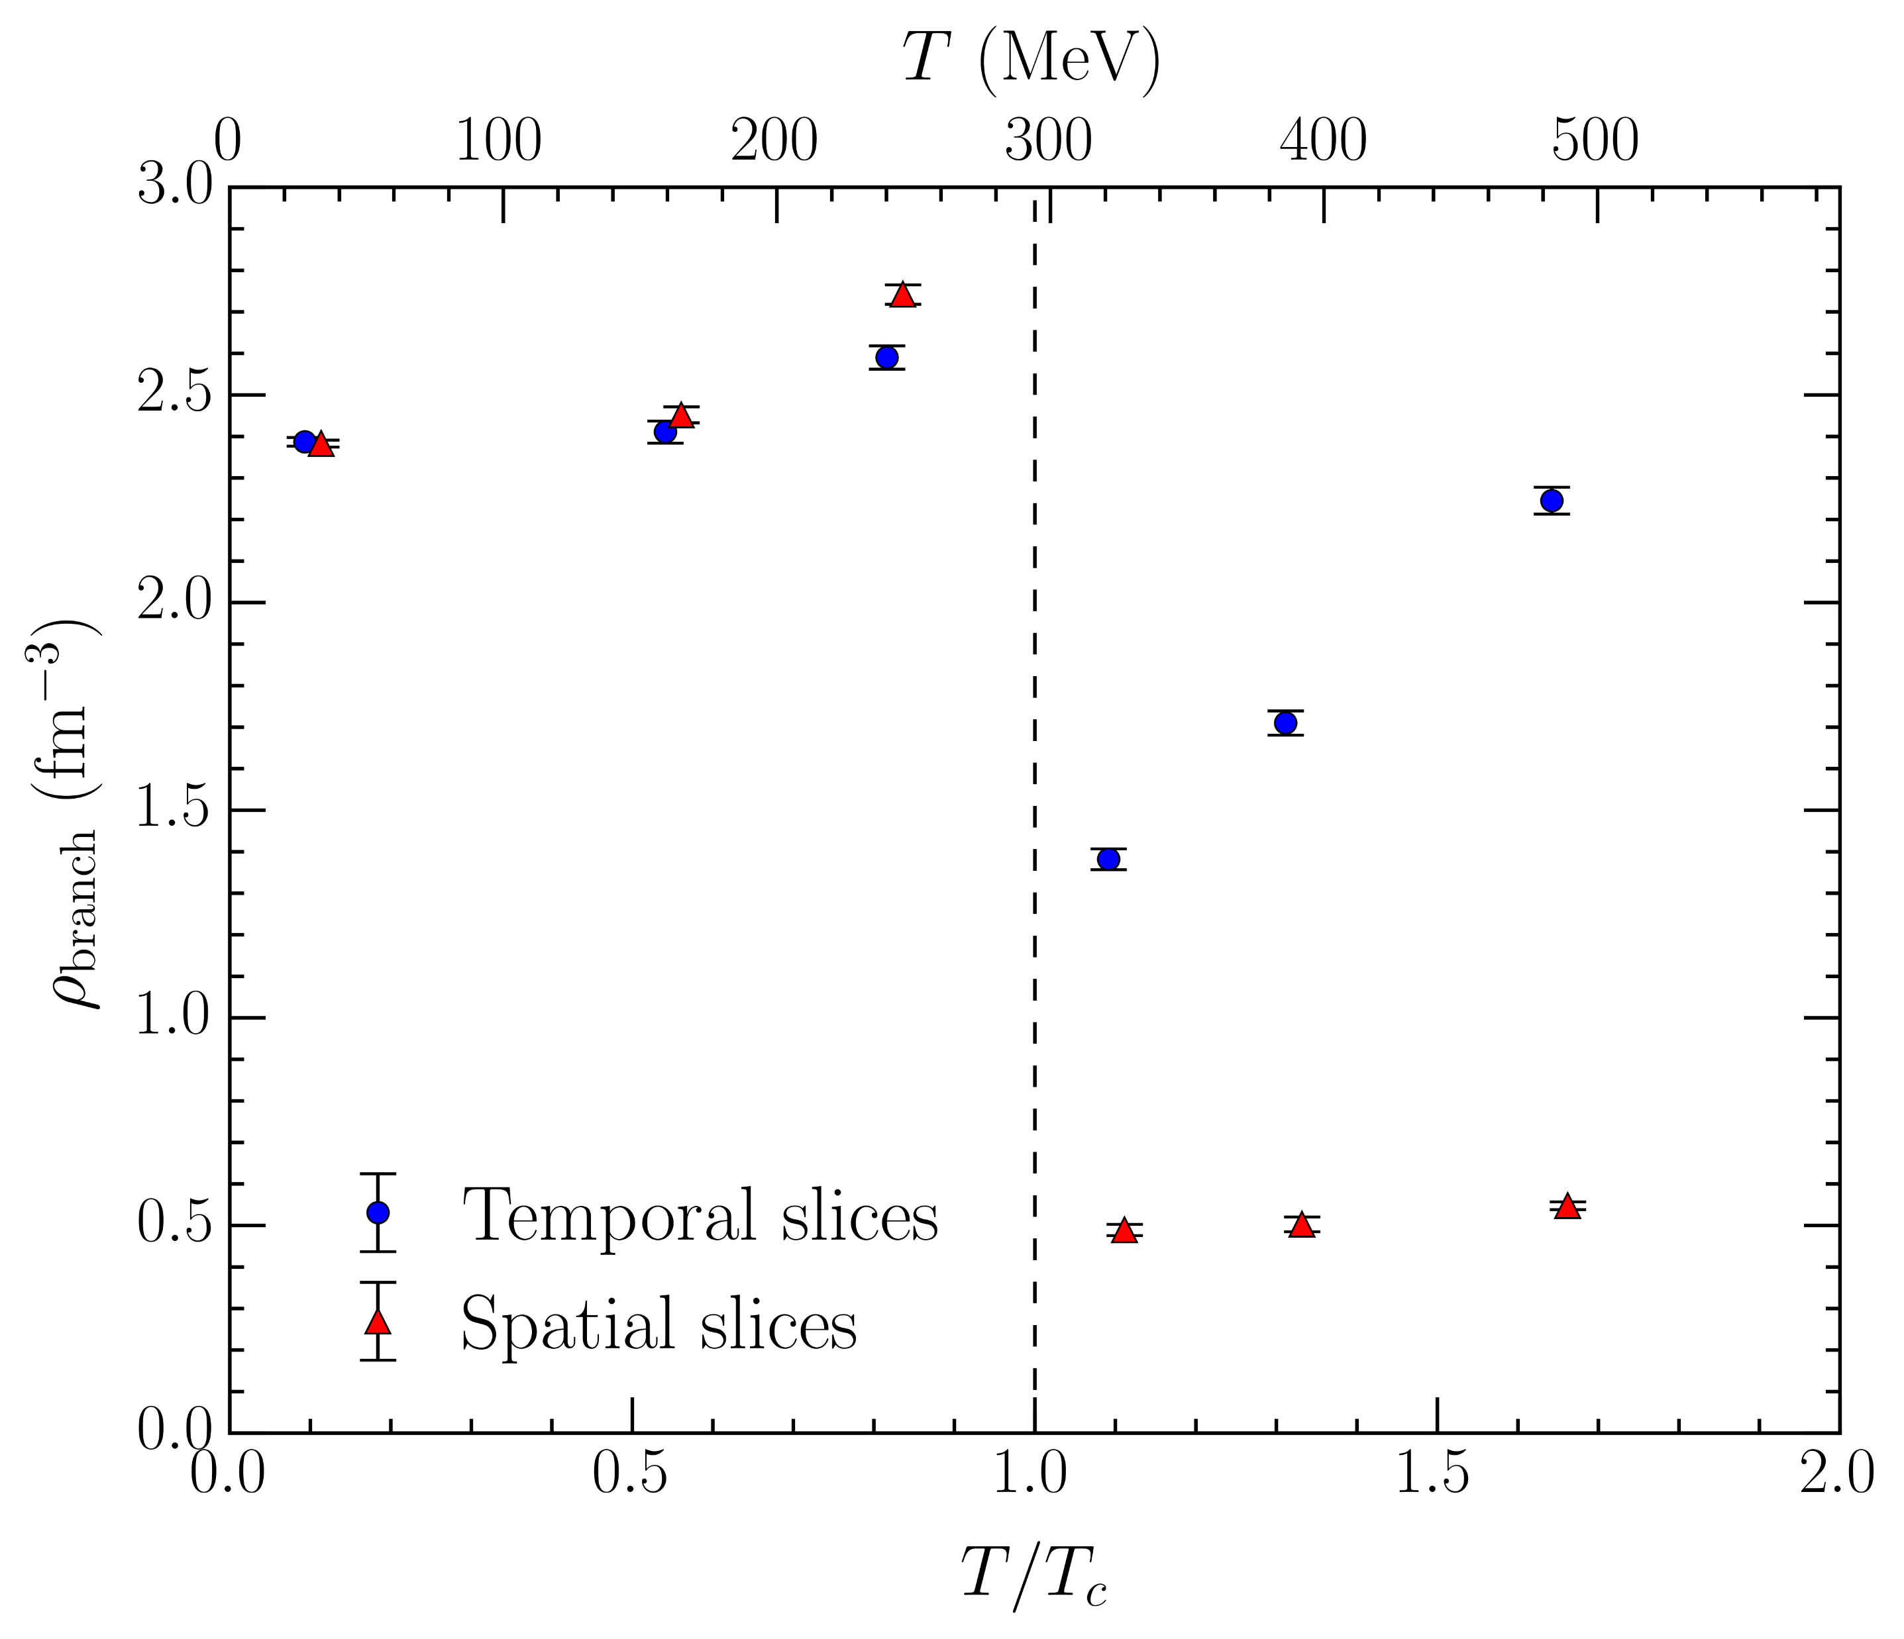
Branching point density
Number of branching points per unit volume
Spatial (fixed- ) slices
Visualizing
Significant drop through
Branching points necessarily pierce space-time plaquettes – suppressed
Temporal (fixed- ) slices
Visualizing
Same qualitative behavior as vortex density – more vortices, more branching chances
What about the number of branching points relative to the number of vortices?

Slide 24
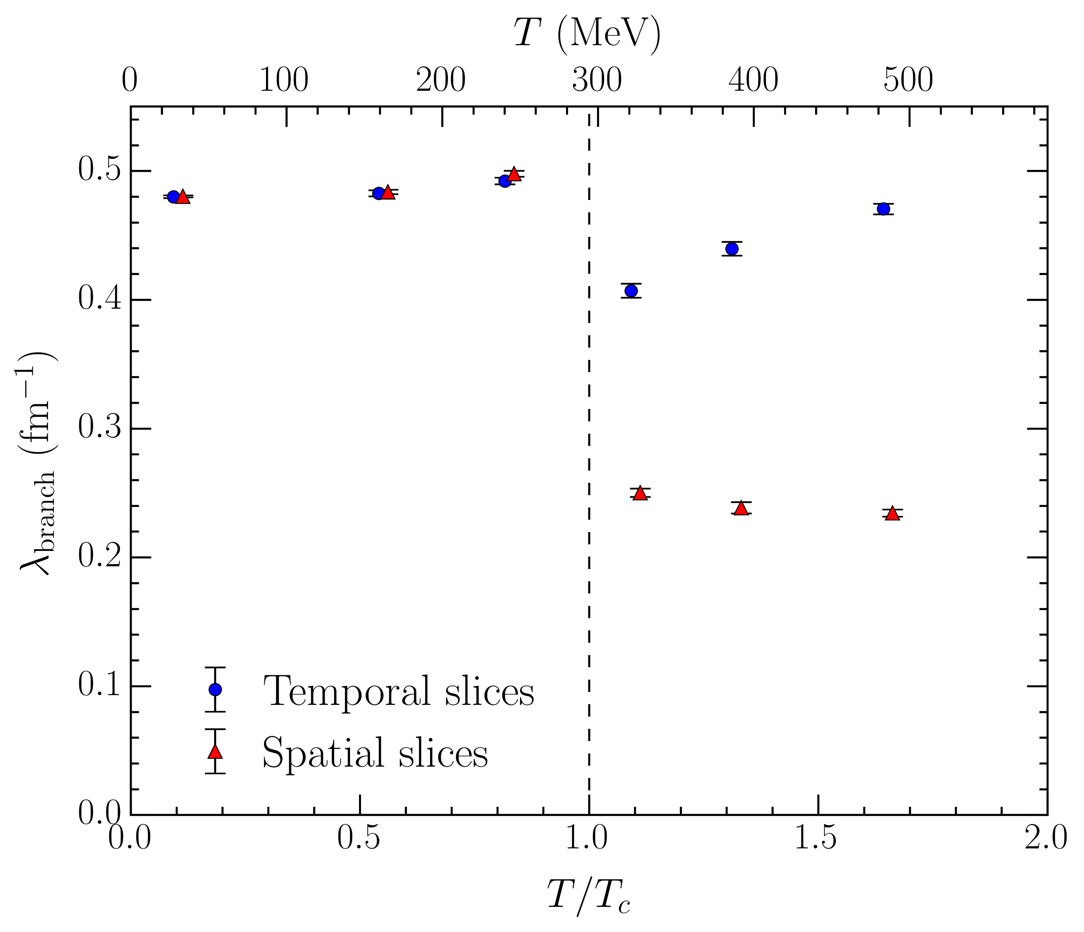
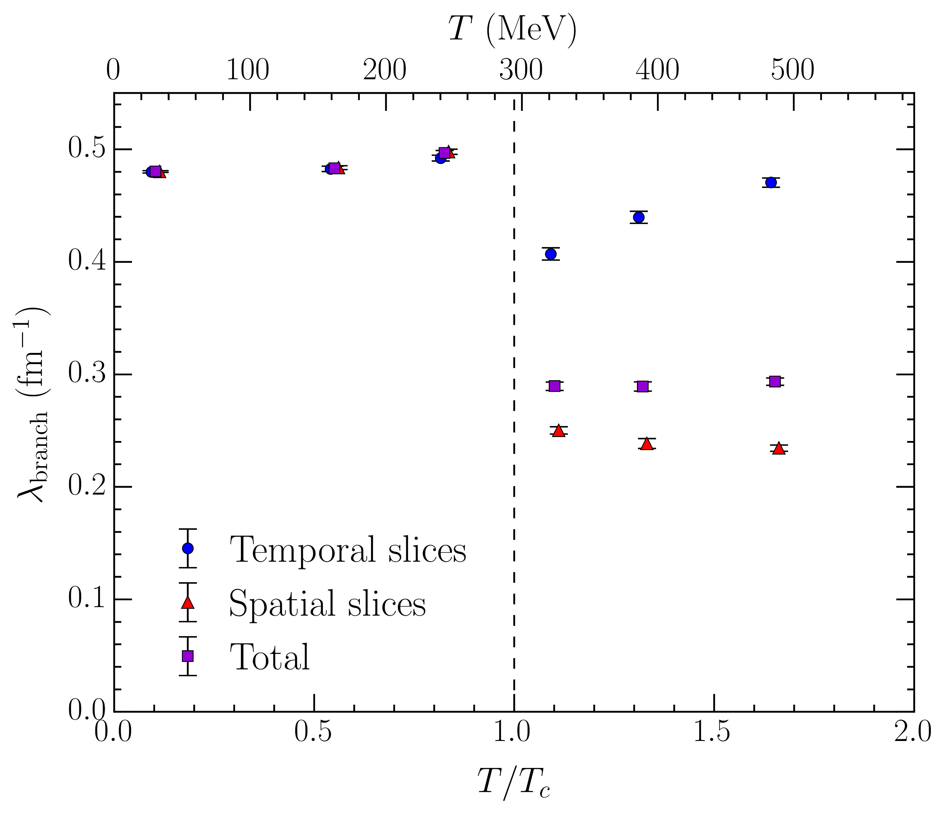
Linear branching point density
Number of branching points per unit length
Naive estimate of probability for vortex chain to branch
Spatial slices
Continued decline above , in accord with growing alignment
Temporal slices
Familiar qualitative behavior, but subdued
Second factor driving the evolution in the volume branching point density
Total average constant above
Reduction in spatial slices compensated by a proportionate increase in temporal slices

Slide 25
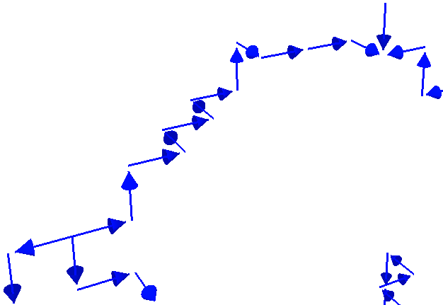
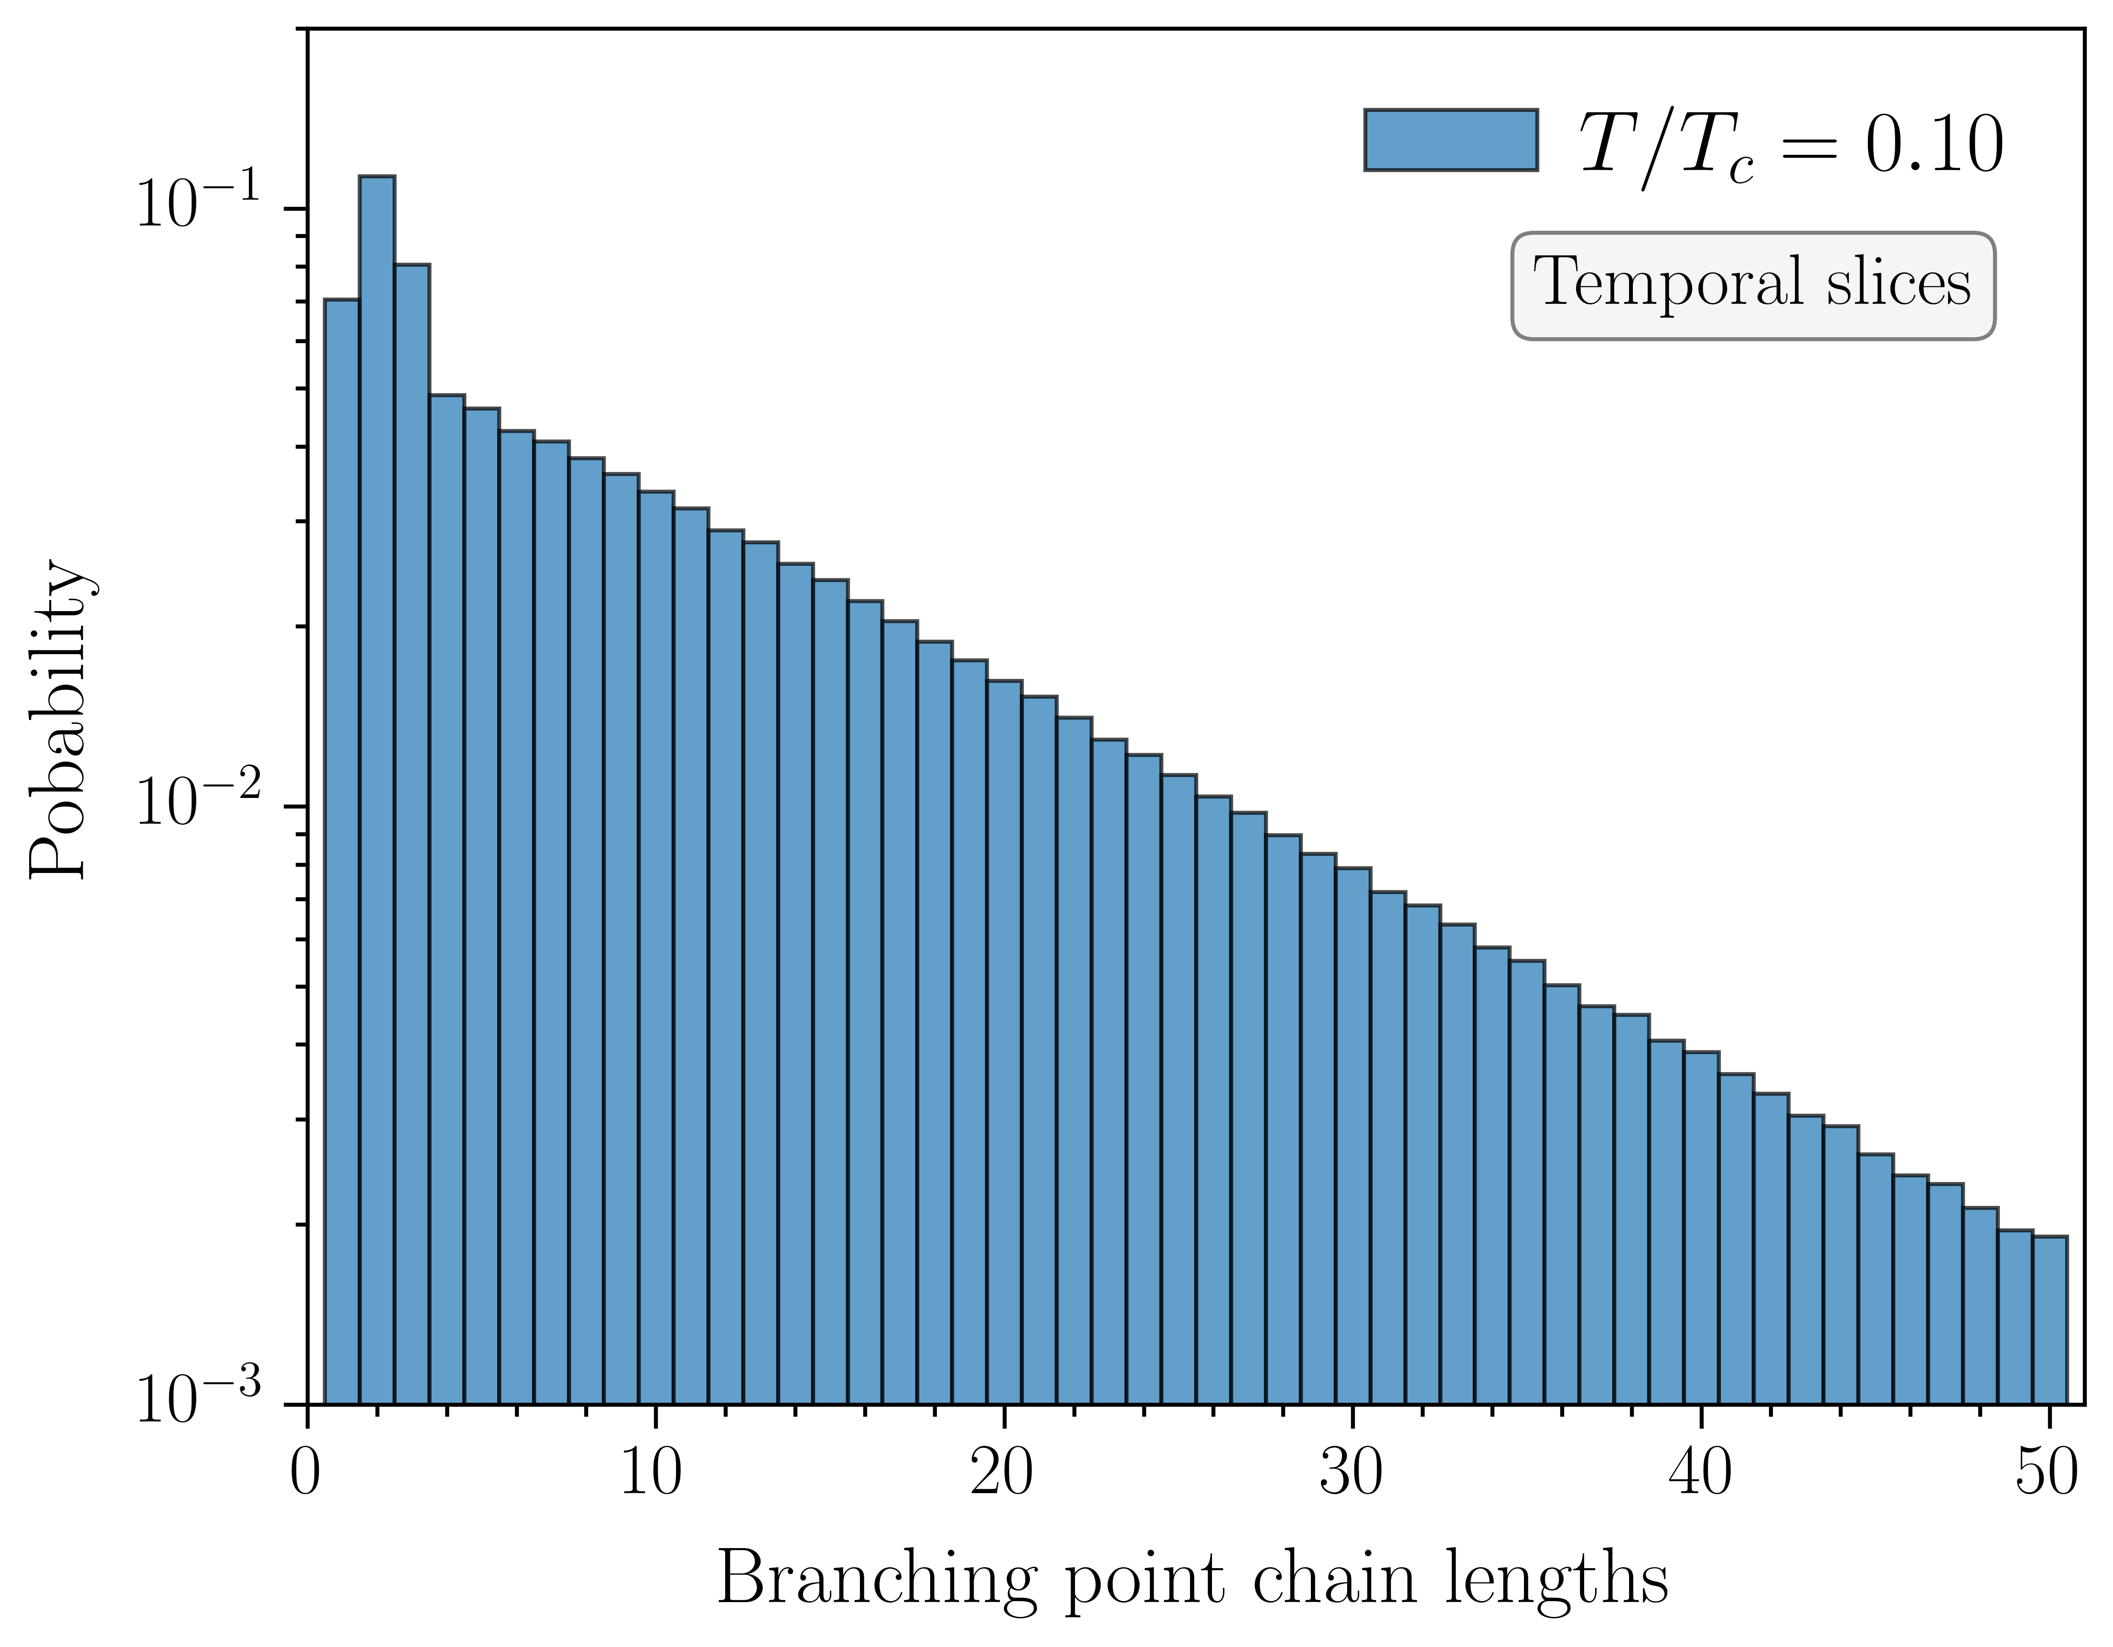
Vortex chain lengths
Analyze intrinsic distribution of branching points
Every monopole must terminate at an anti-monopole
Allows the calculation of vortex chain lengths between branching points
$$11$$
$$12$$
$$9$$
$$10$$
$$8$$
$$7$$
$$6$$
$$5$$
Histogram of the chain lengths
Logarithmic scale
Normalized to unit probability
$$4$$
$$3$$
$$2$$
Predominantly linear!
Chain lengths exponentially distributed
Breaks down at short distances due to branching point clustering
$$1$$
Does this change at high temperatures?

Slide 26
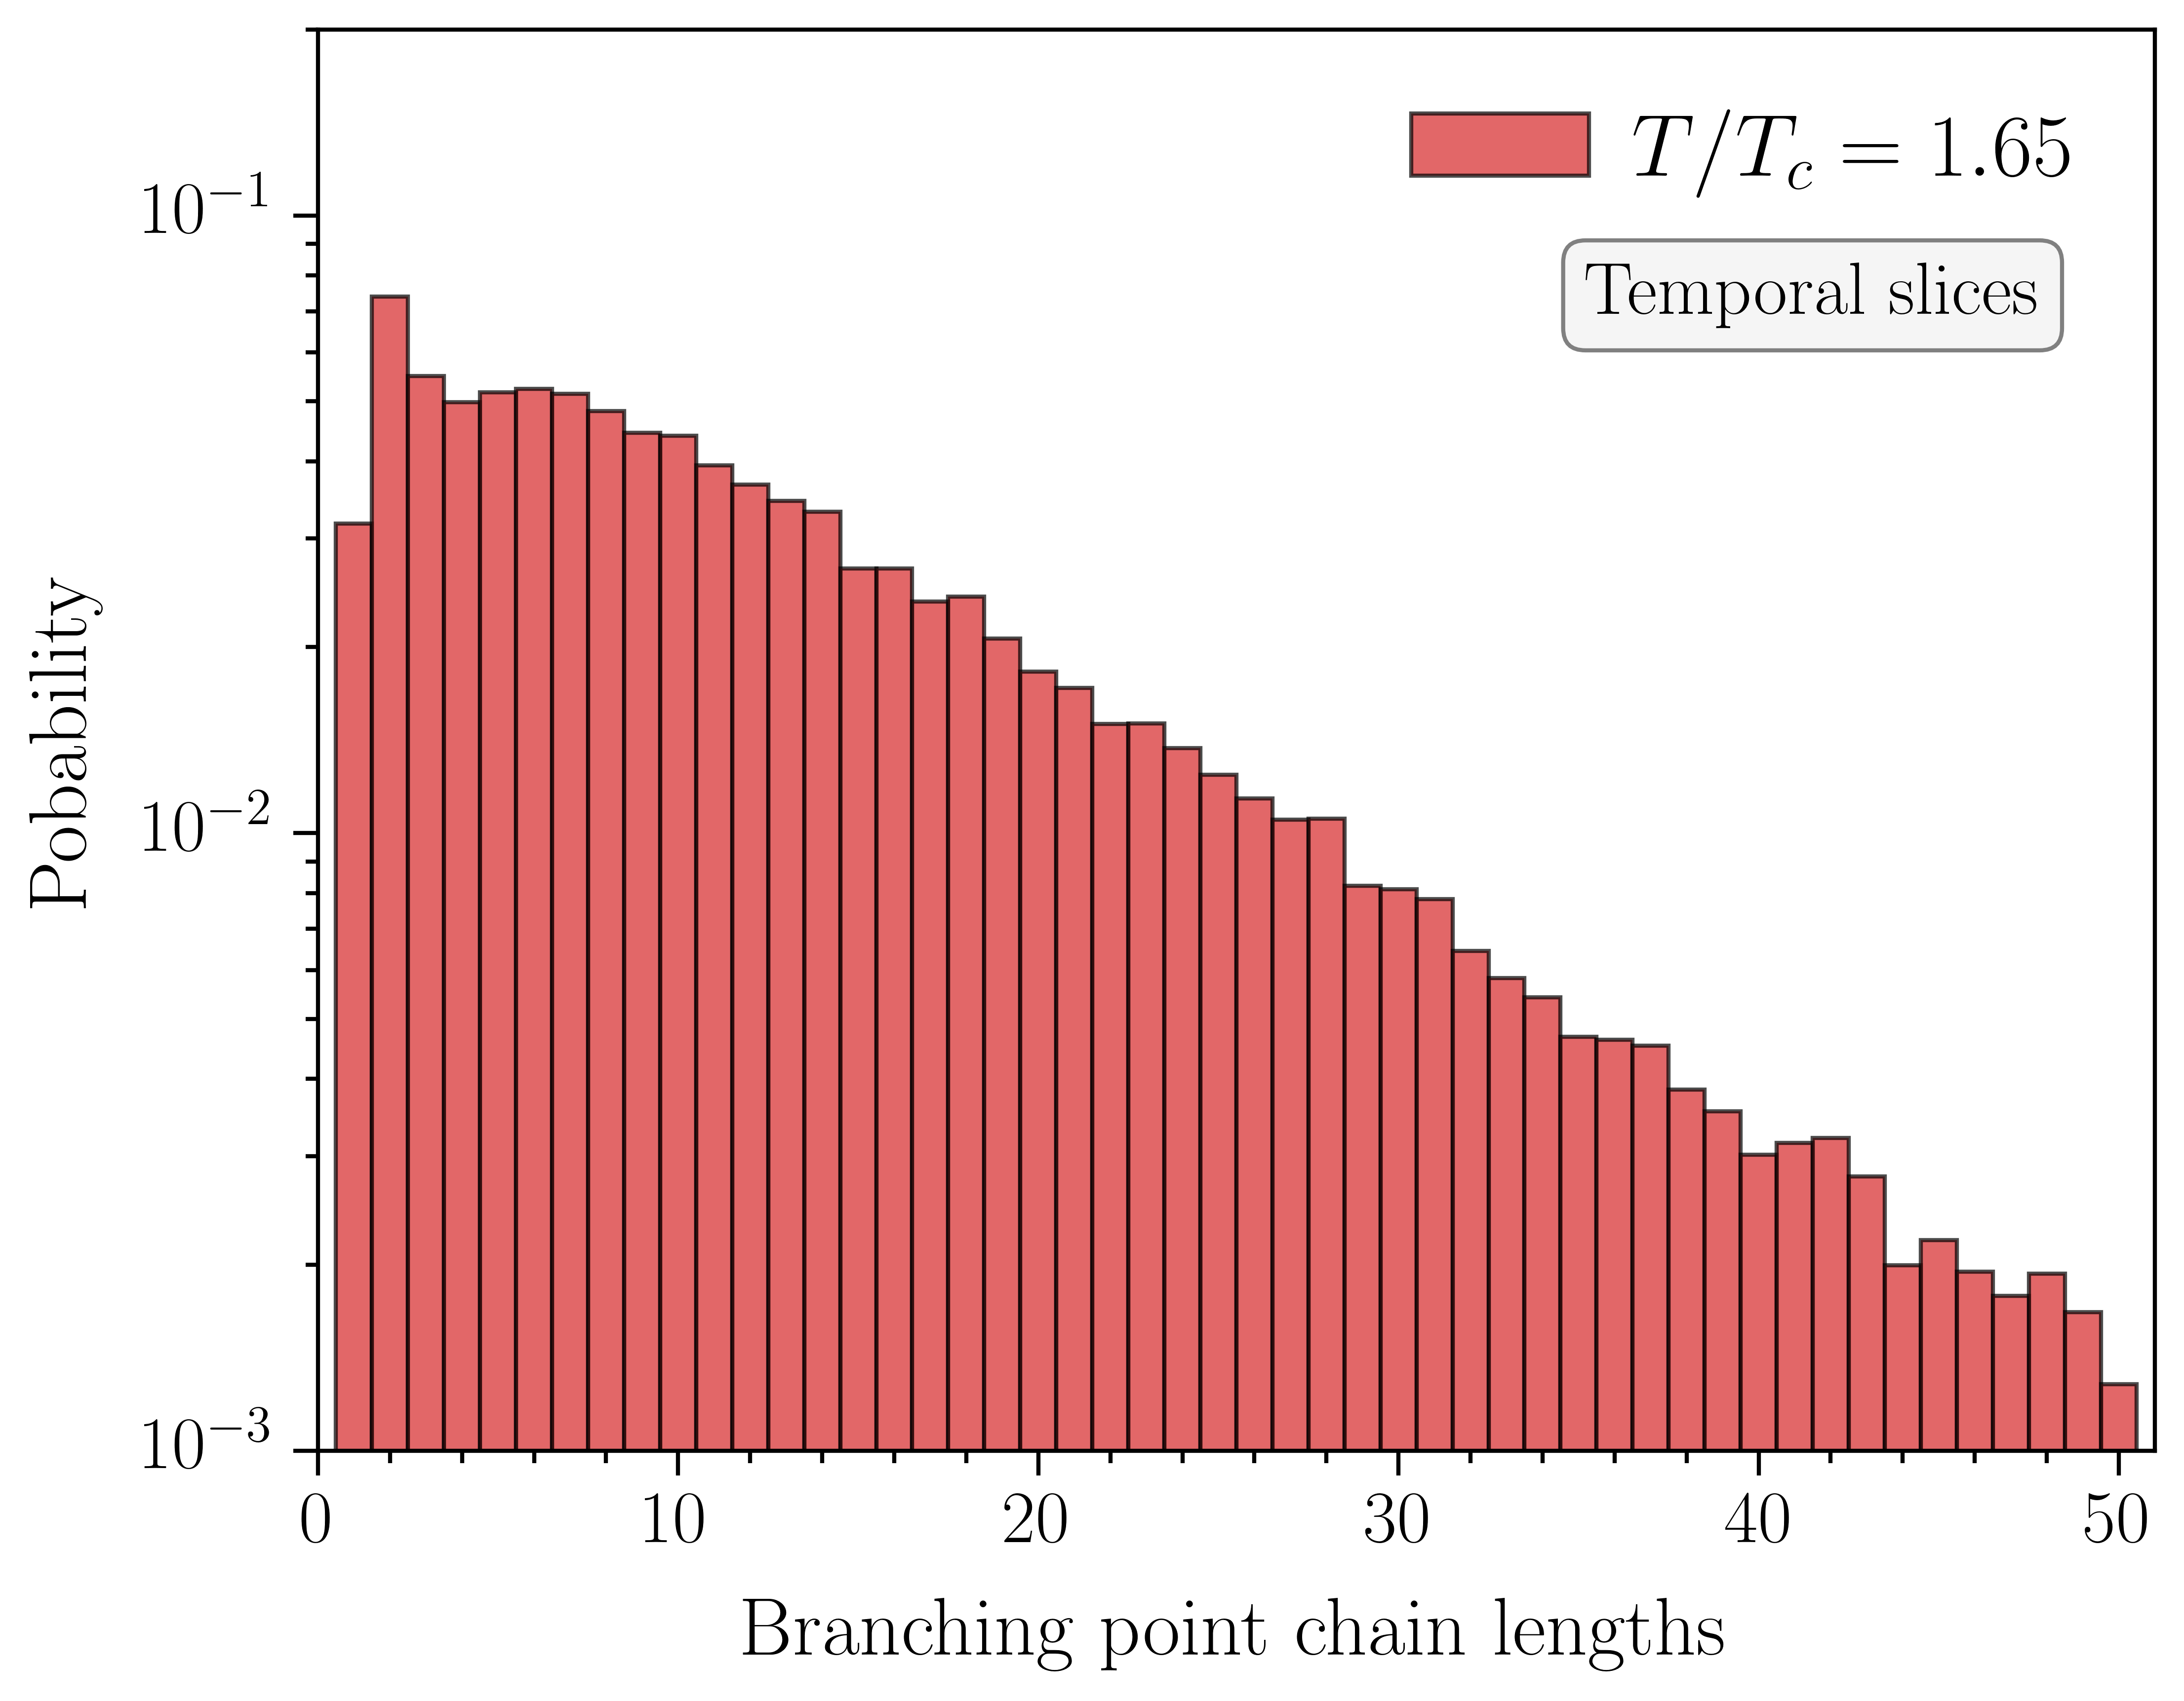
Vortex chain lengths:
Only consider temporal slices
Percolating cluster at all temperatures
Branching points no longer cluster at short distances!
Reduced probability for branching points to occur near each other
Suggests the clustering at low temperatures is a physical effect
Steeper histogram slope
Probability to branch enhanced at long distances
Internal rearrangement of branching points within the percolating cluster

Slide 27
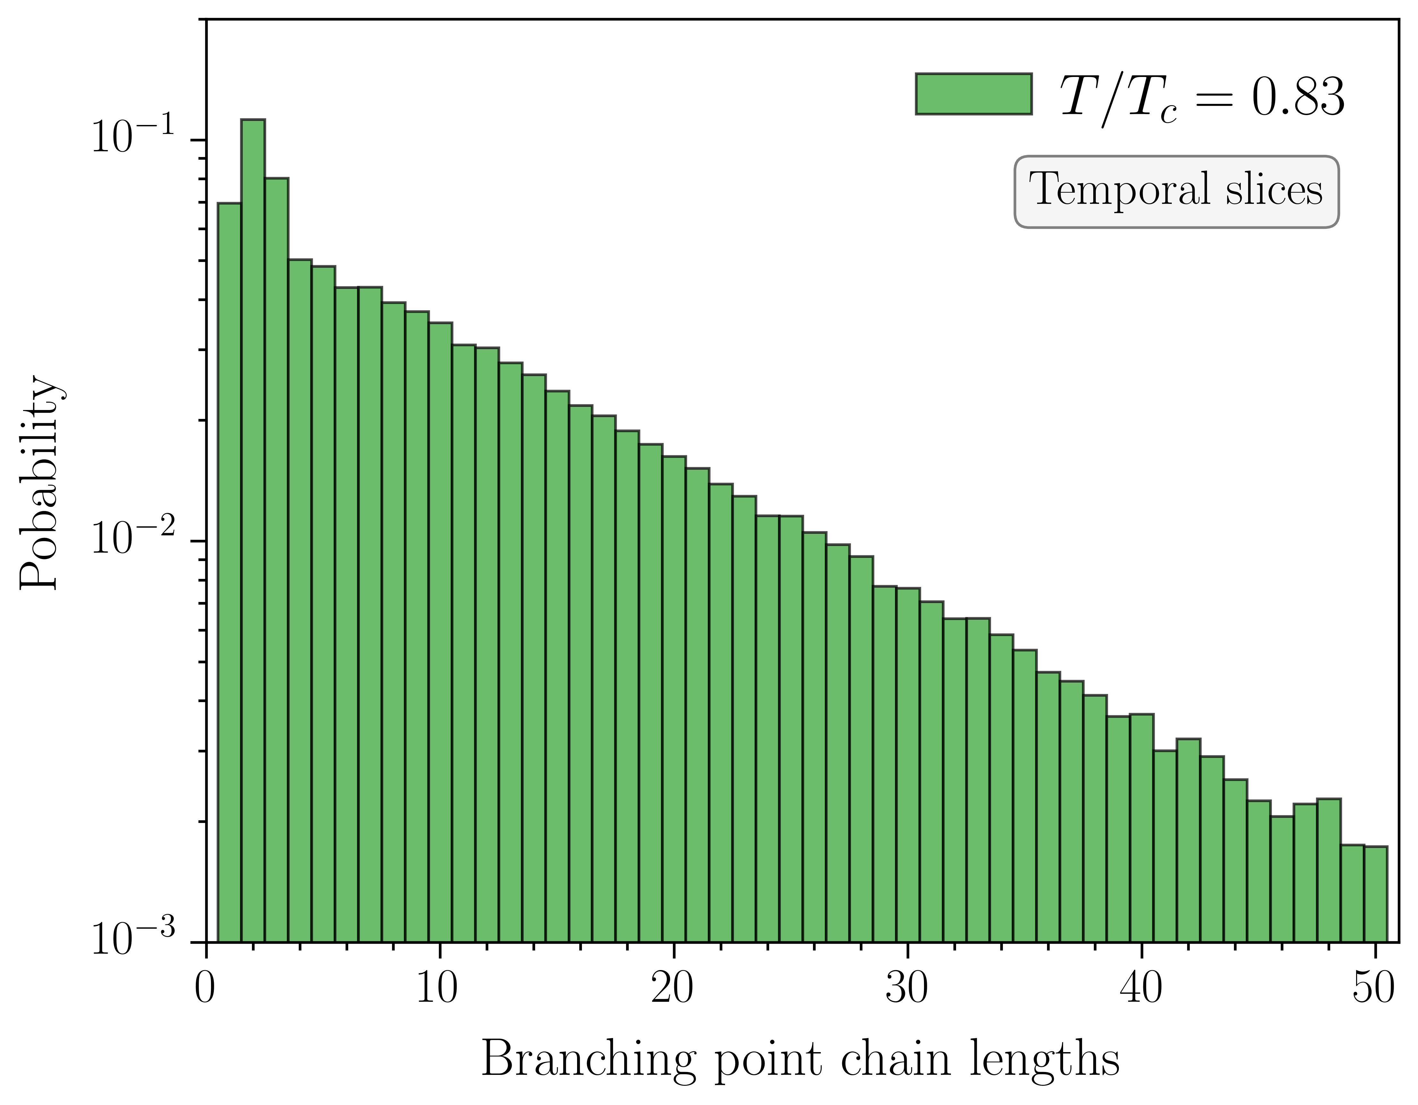
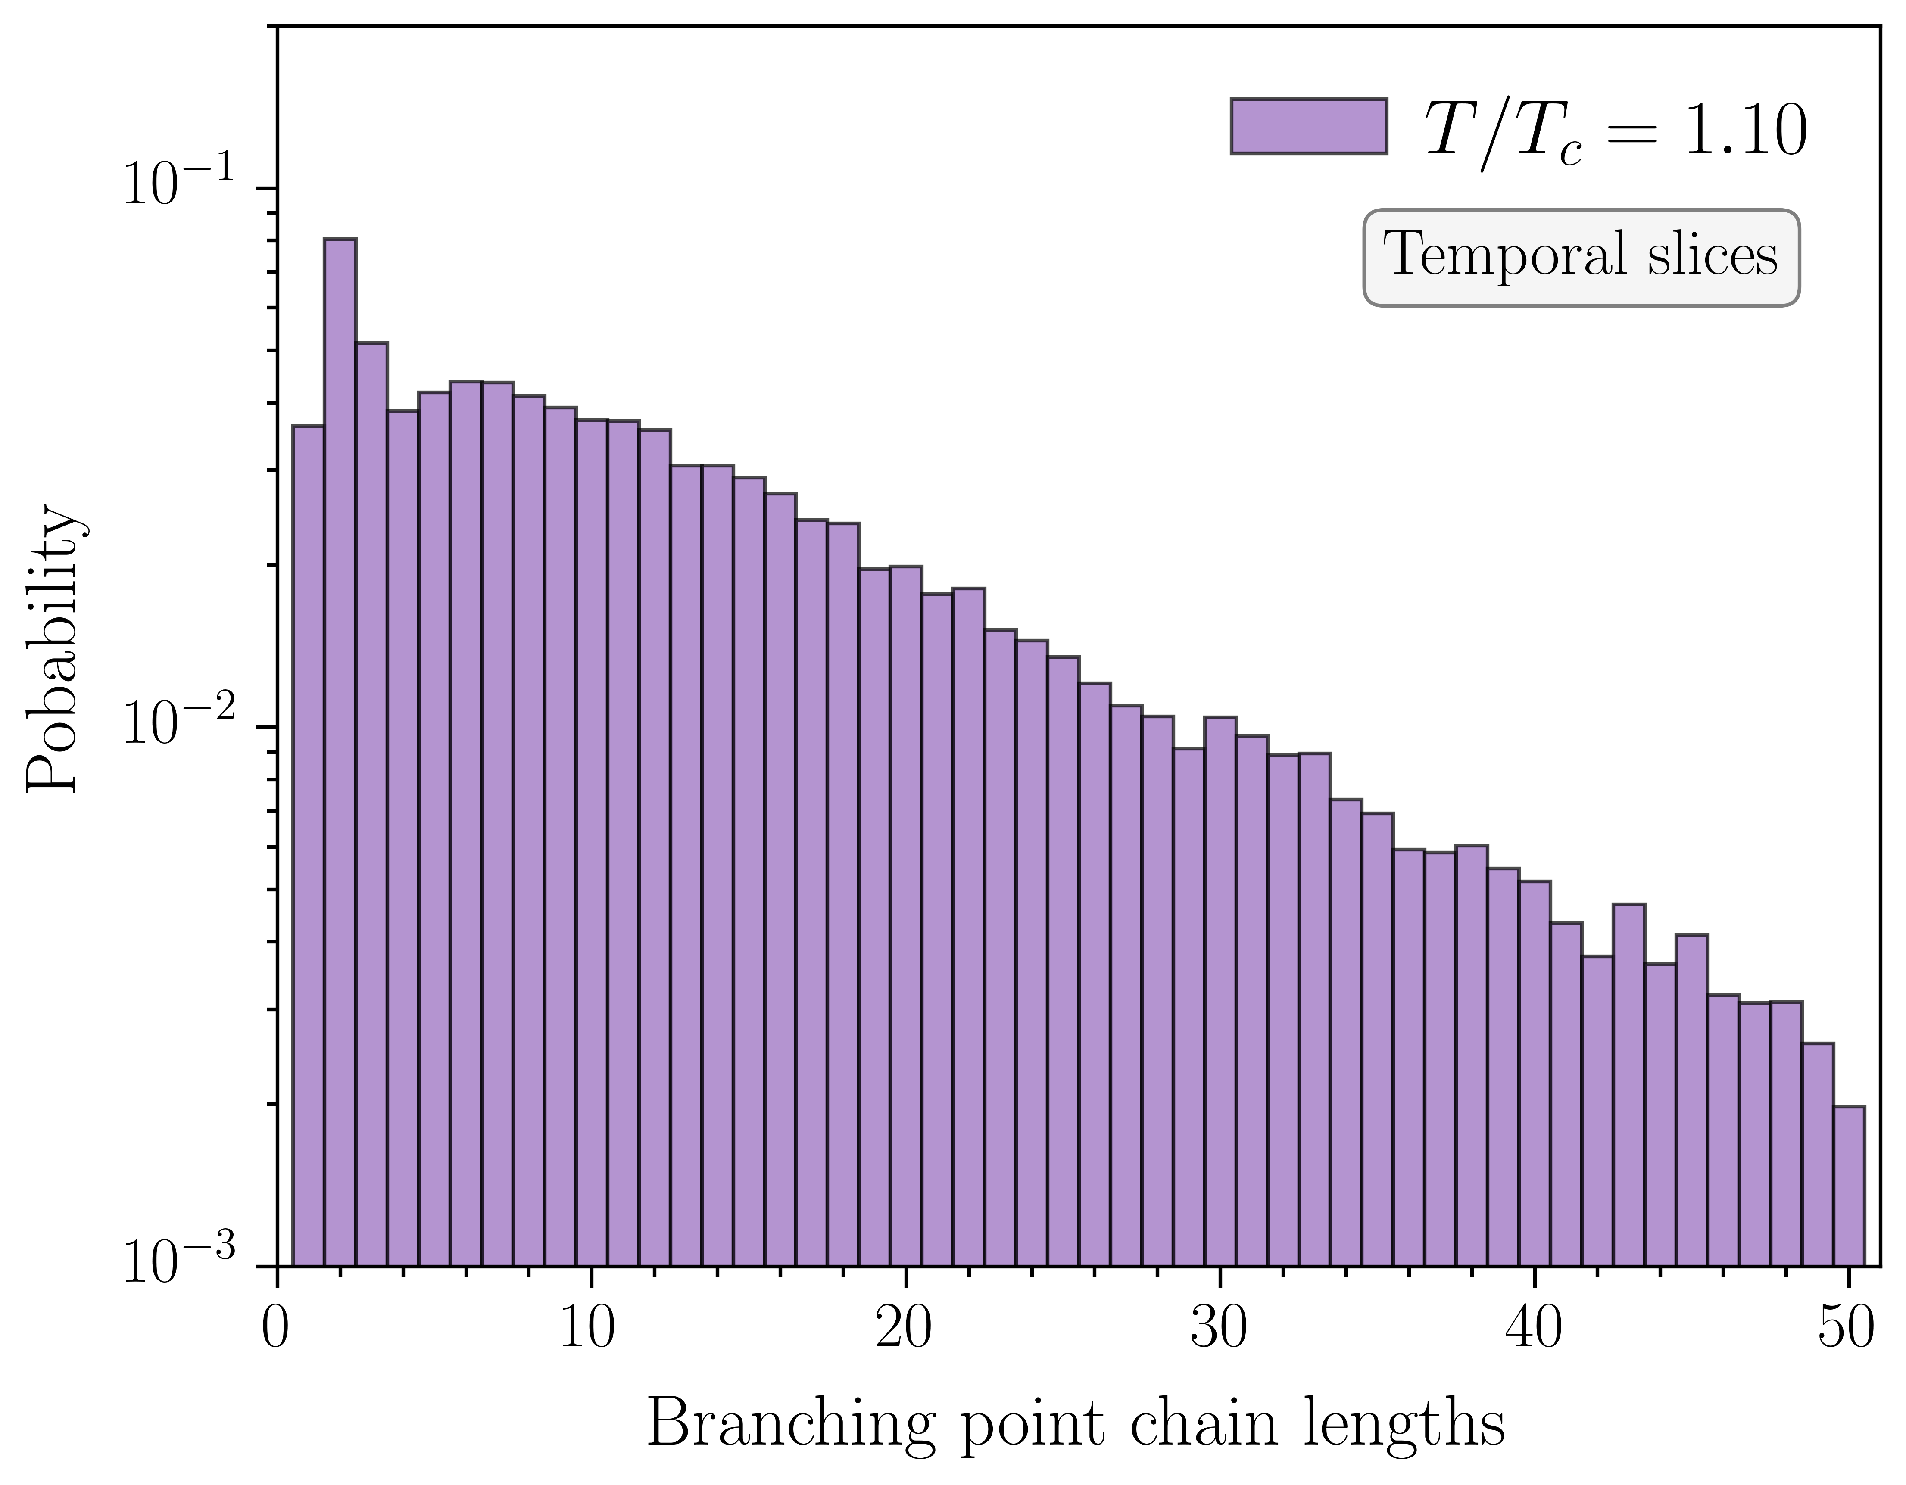
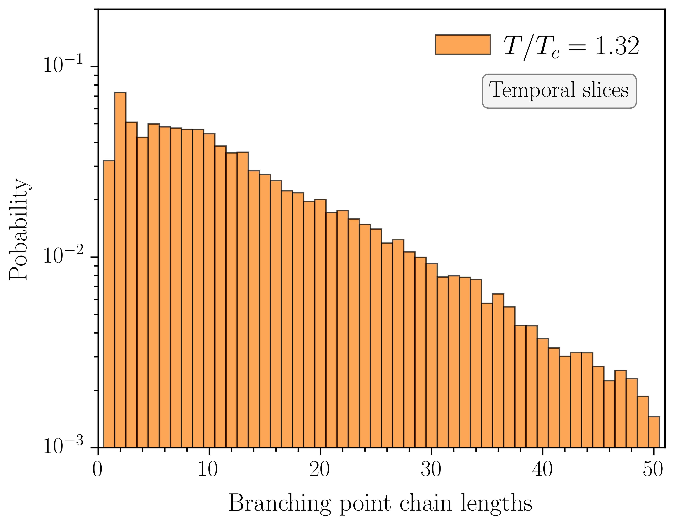
Vortex chain lengths: temperature evolution

Slide 28
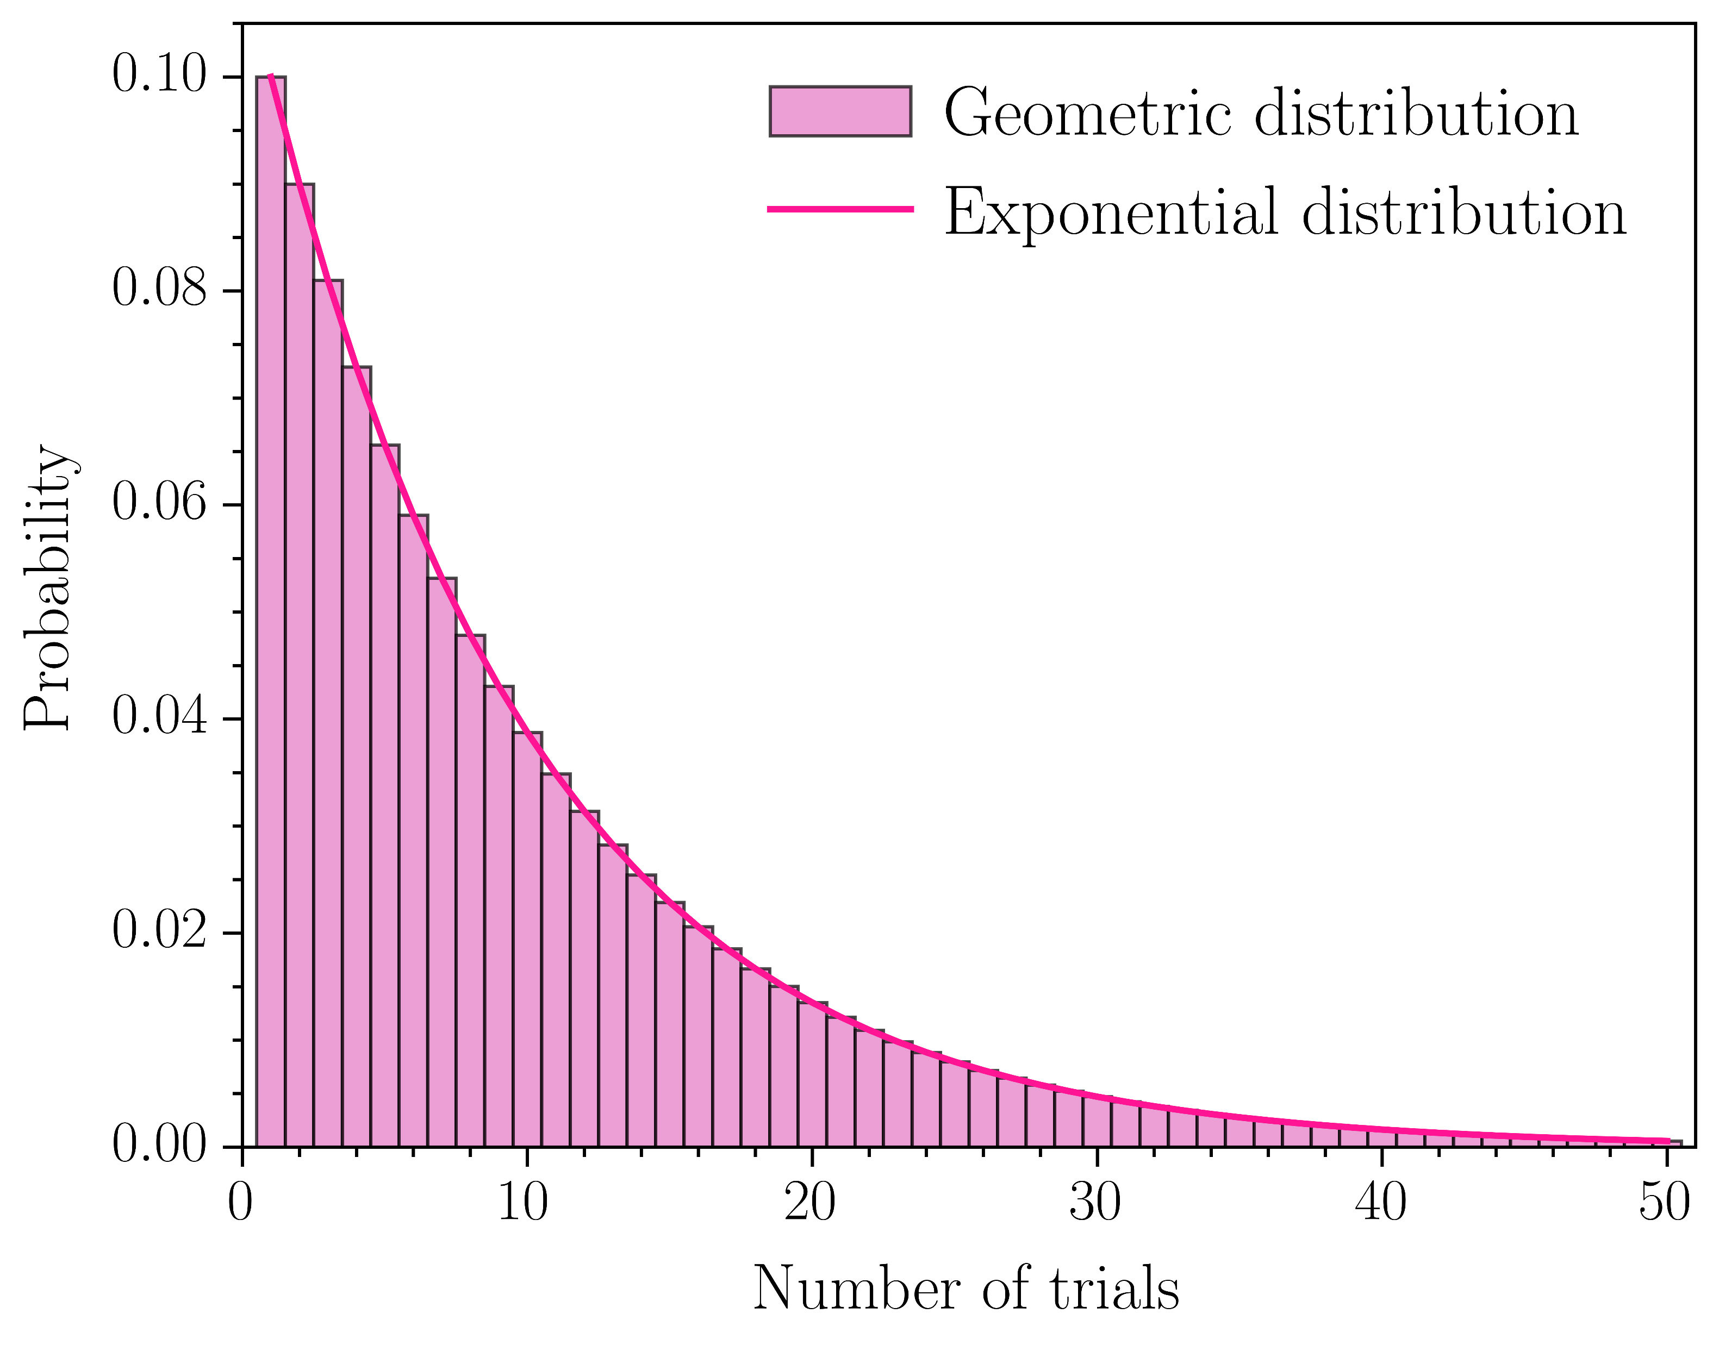
Branching probability
Exponential distribution implies constant branching probability
Model chain lengths by
Constant ratio:
Consider sequence of independent trials with fixed probability of success
Probability of first success after trials given by
Similarly:
Probability of success is
Perform exponential fits to chain lengths
“Success” branching point
Chain length of success after trials

Slide 29
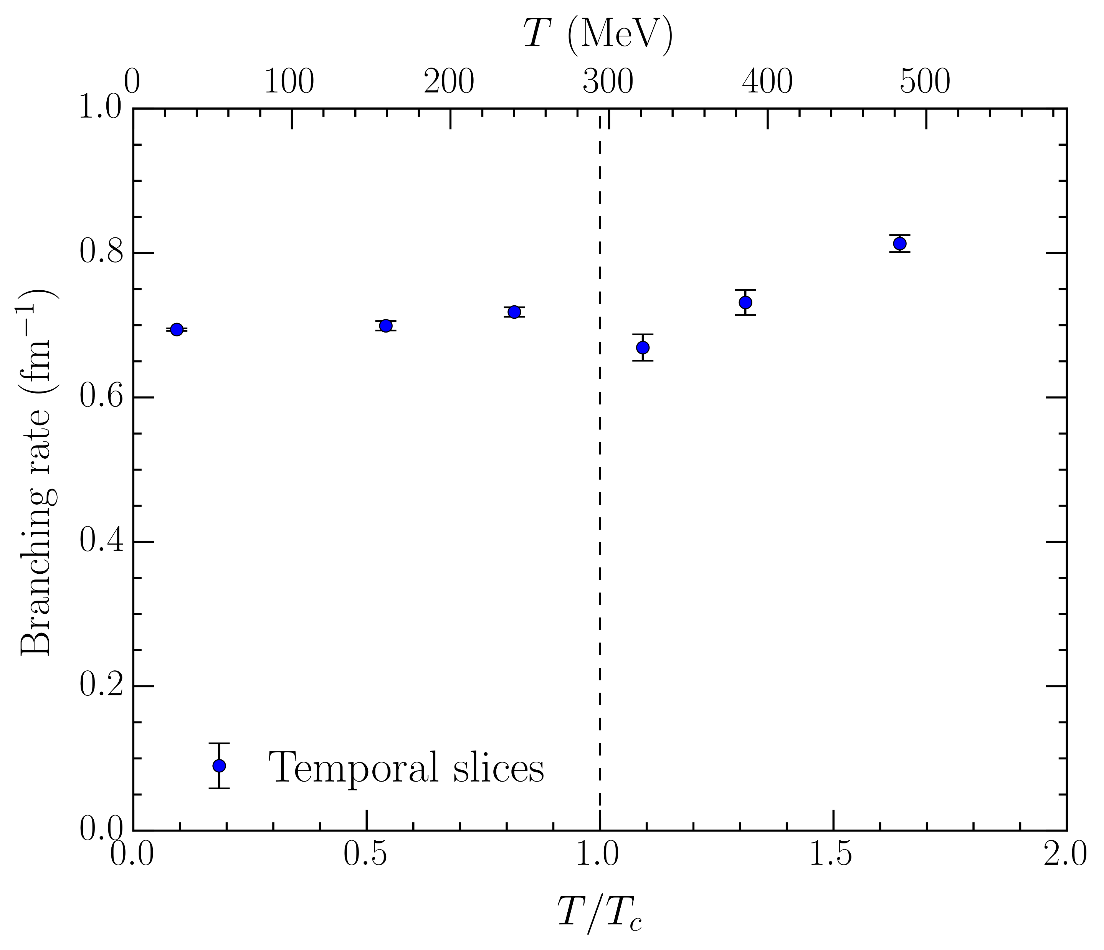
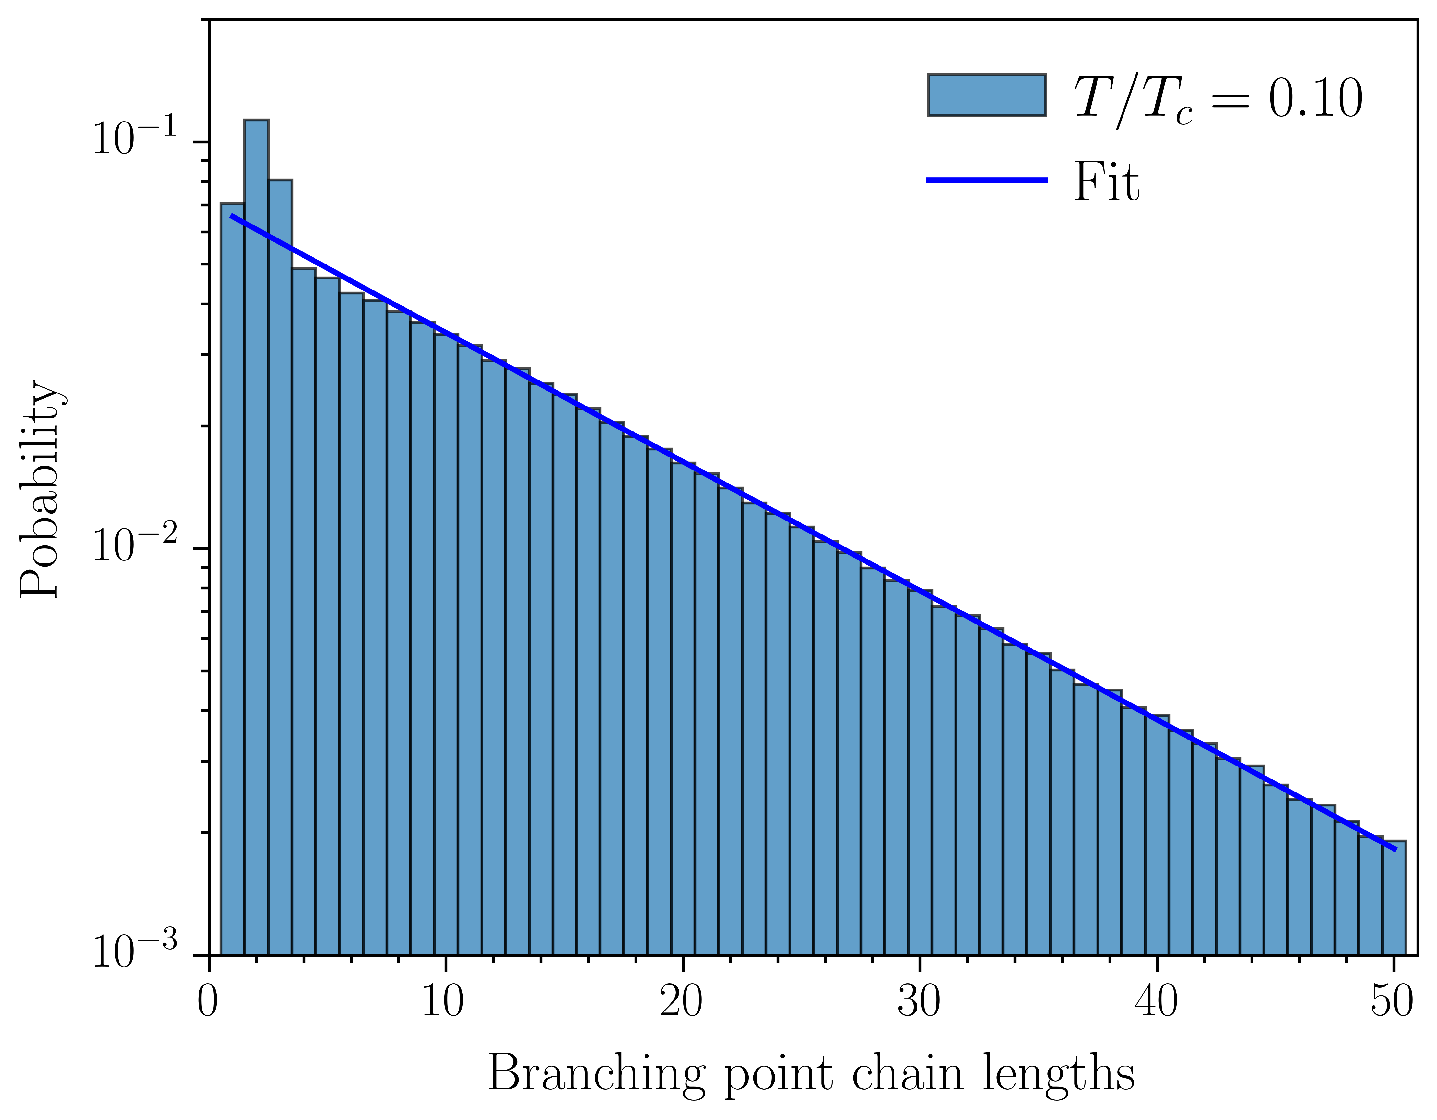
Branching rate
Perform fits for chain lengths
i.e. ignore short-distance behavior
Accurately captures long-distance behavior
Convert branching probability to physical branching rate
Divide by lattice spacing: rate
Gives a probability per unit length
Look at temperature evolution
Same qualitative trends, including a small decrease through
Branching rate at high temperatures exceeds low temperatures!
Long-distance branching enhanced at high temperatures

Slide 30
Conclusion
Below , center vortices percolate all four spacetime dimensions
Gives rise to confinement through area law for space-time Wilson loops
Above , center vortex sheet aligns with the temporal dimension
Results specifically in an absence of space-time areas pierced above
Three-dimensional spatial percolating cluster frozen in temporal slices
Quantified by a correlation measure – discontinuous jump at the phase transition
Secondary clusters suppressed in 3D slices
Vortex and branching point densities all sensitive to the phase transition
Sudden decrease at , more pronounced in spatial slices
Rapid increase above in temporal slices – growing disorder at very high
Internal rearrangement of branching point geometry through
Clustering radius lost above the phase transition
Long-distance branching probability enhanced at high temperatures

Slide 31
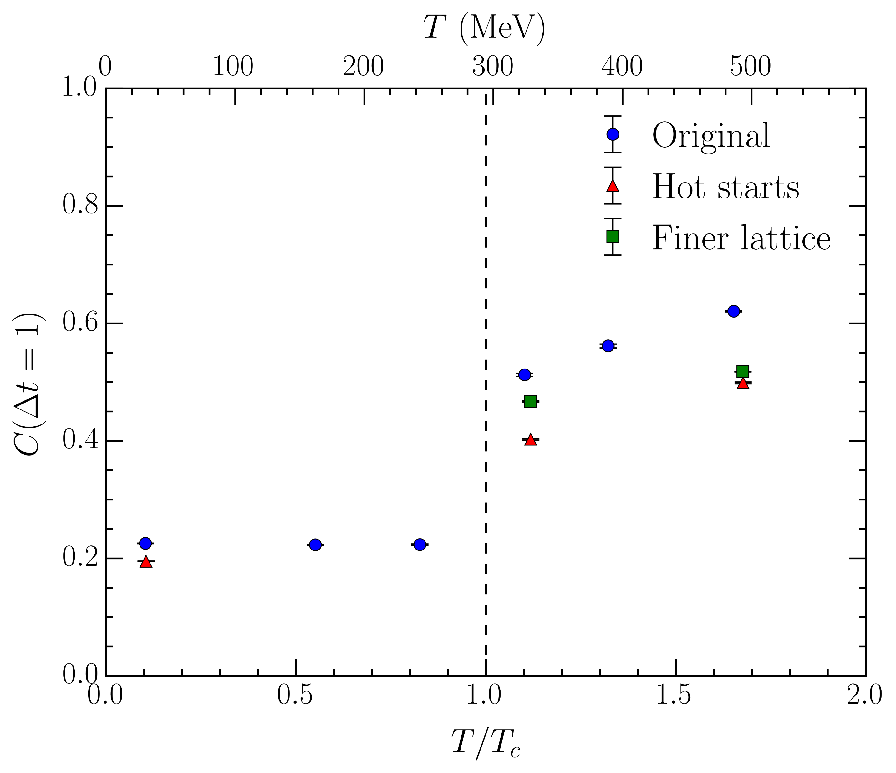
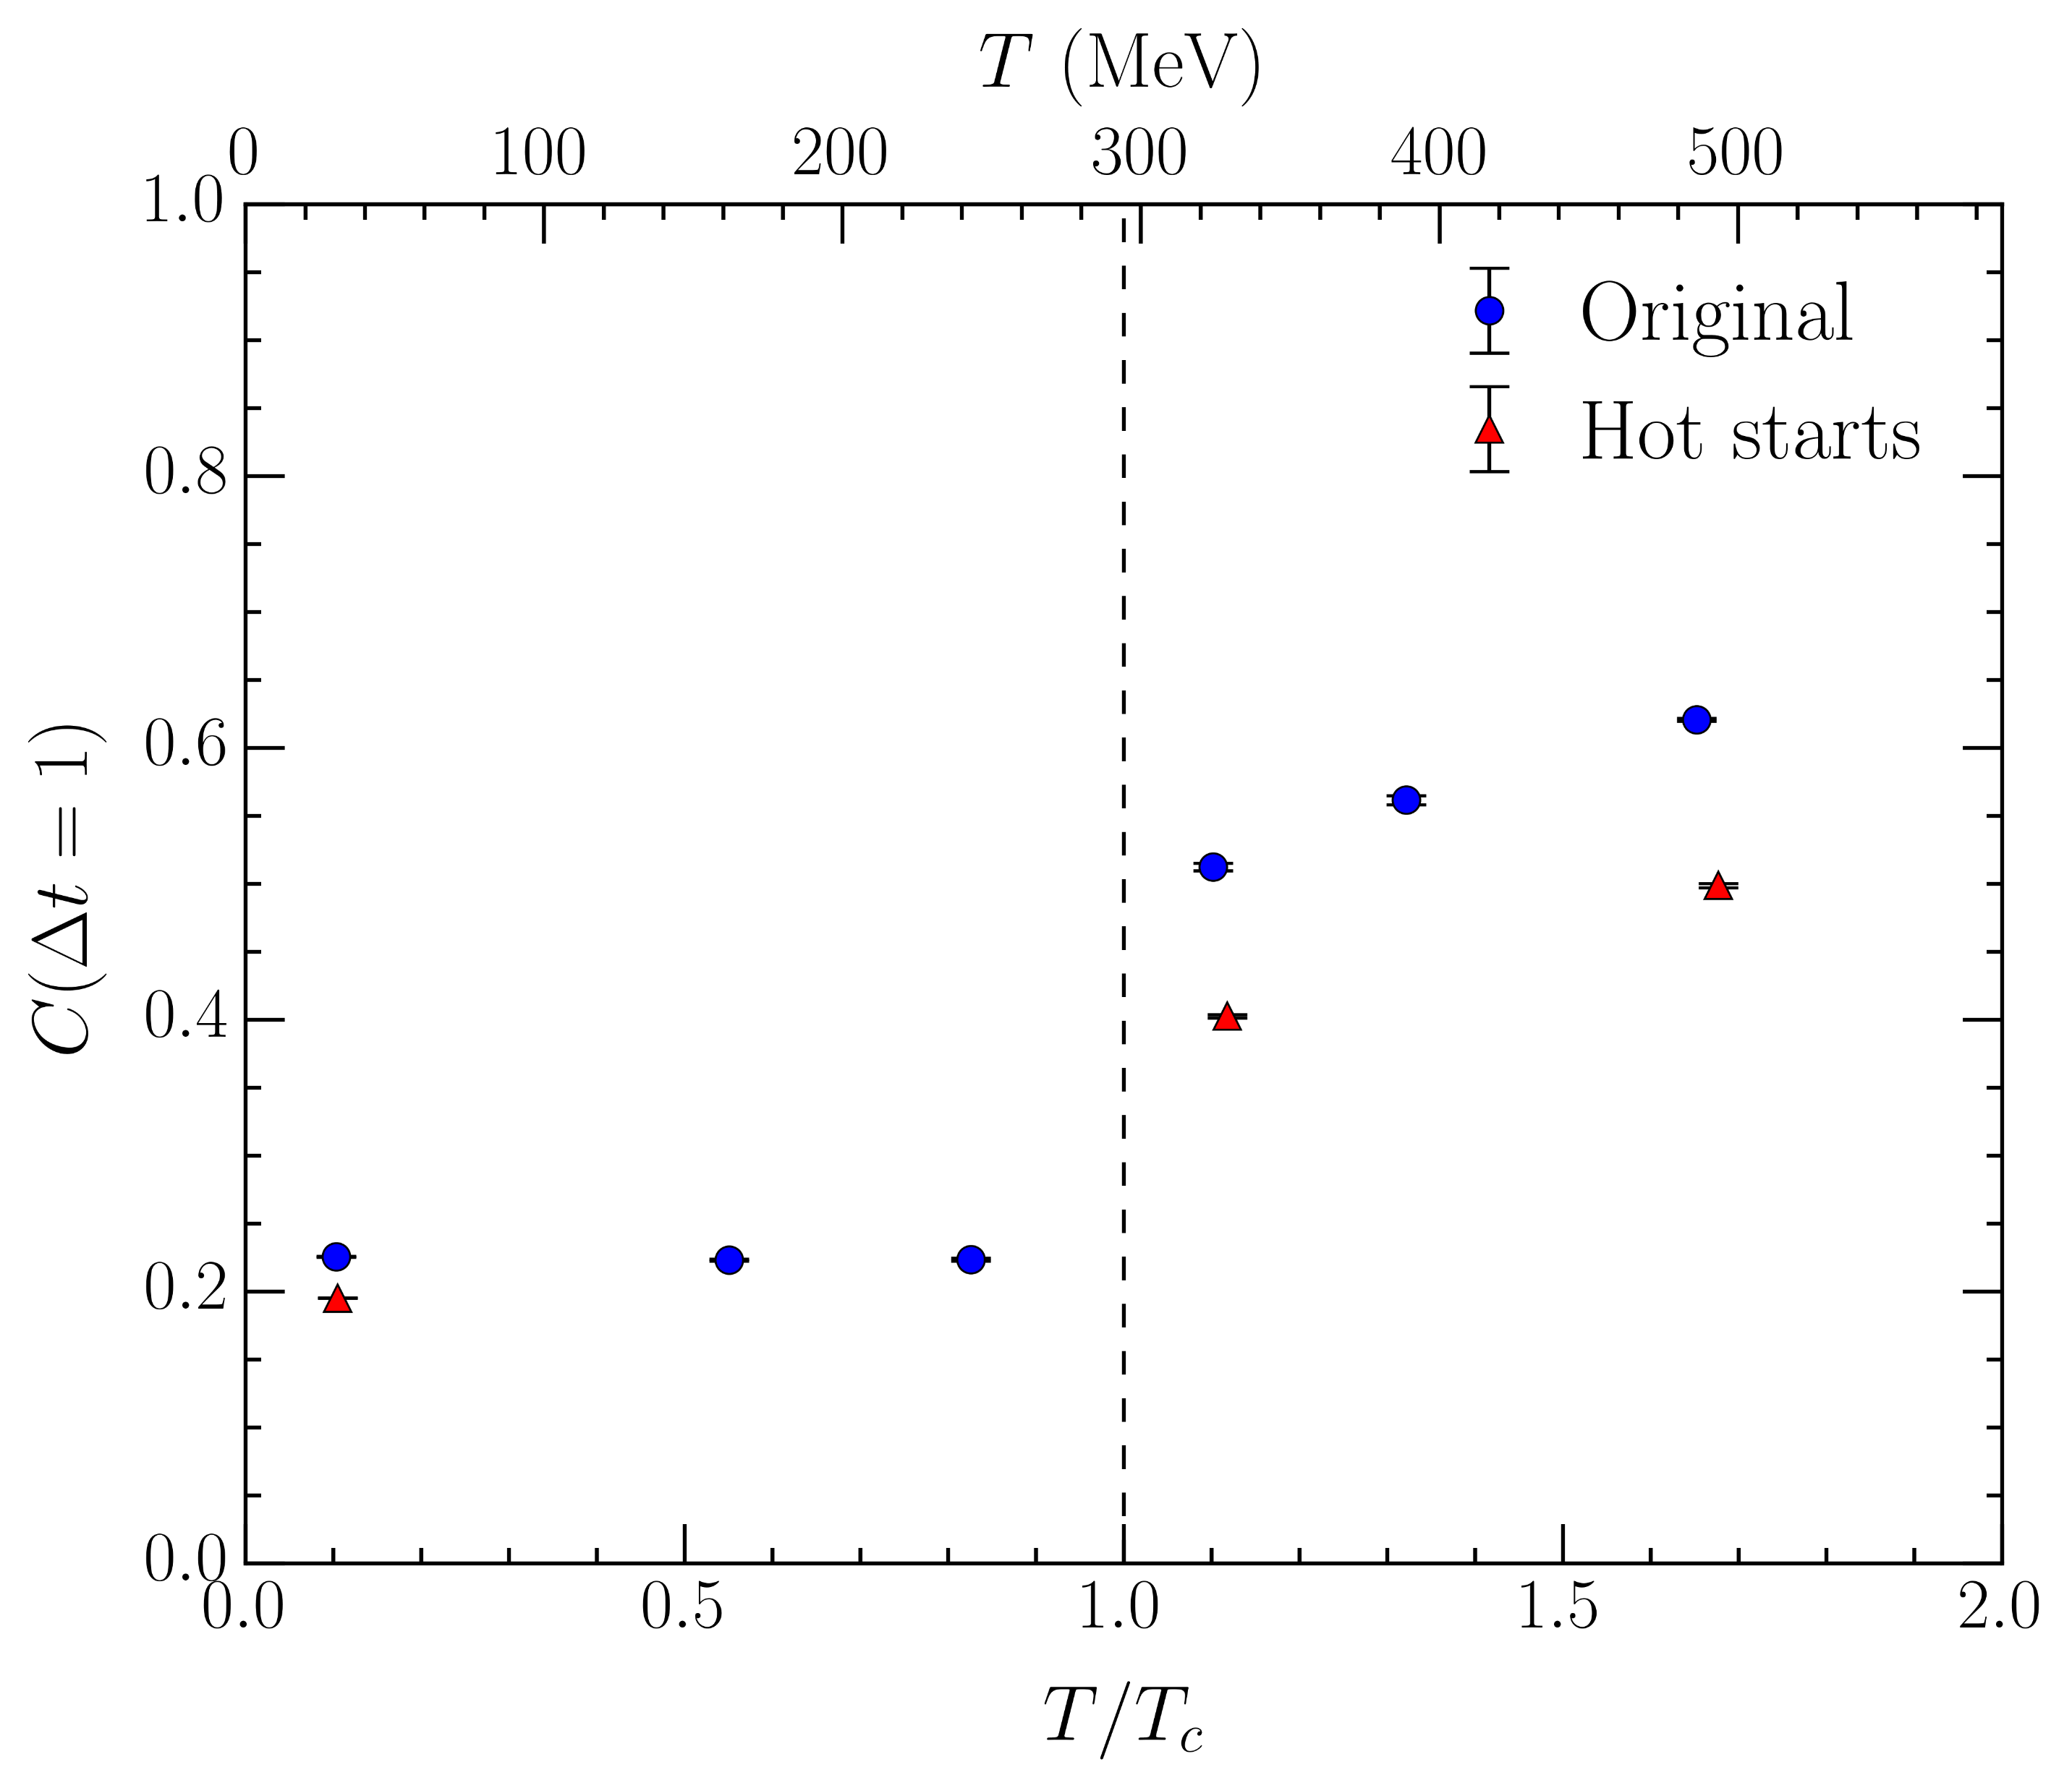
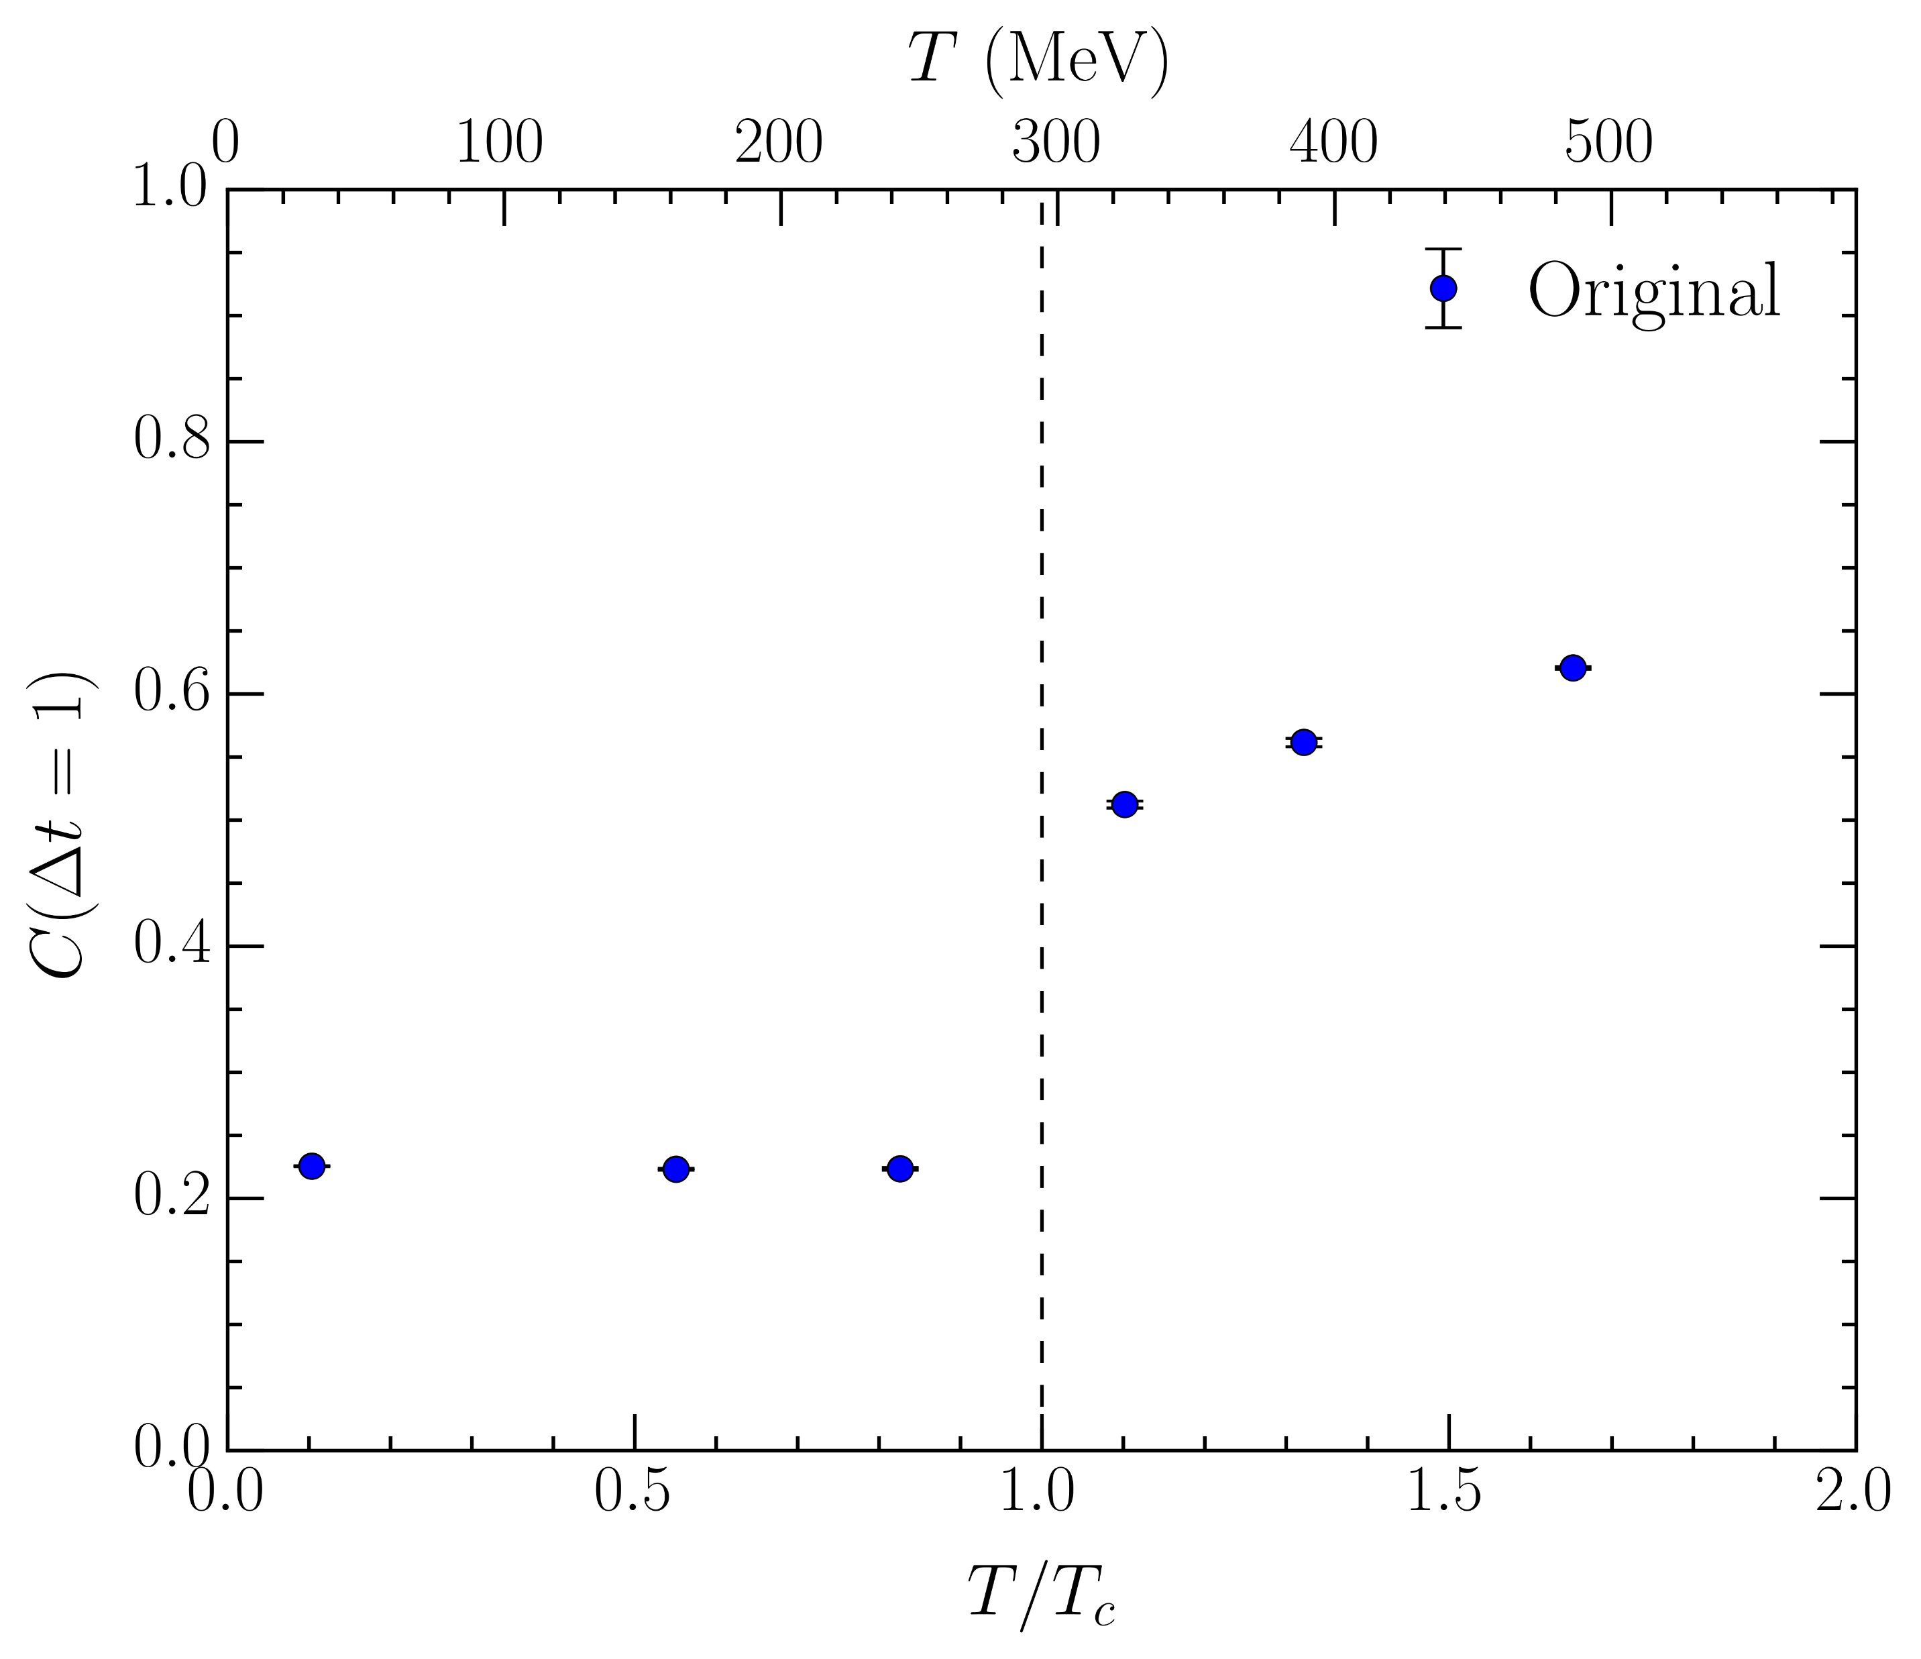
Algorithmic concerns?
Could the alignment be an algorithmic effect?
Ergodicity of Markov chain
Lattice-spacing dependence
Ergodicity: thermalize 100 independent hot starts
Utilize Wilson action
still increases through
Correlation is slightly smaller, but alignment persists
Continuum limit: halve the lattice spacing ( )
Double the lattice volume ( )
Correlation is even larger!

Slide 32
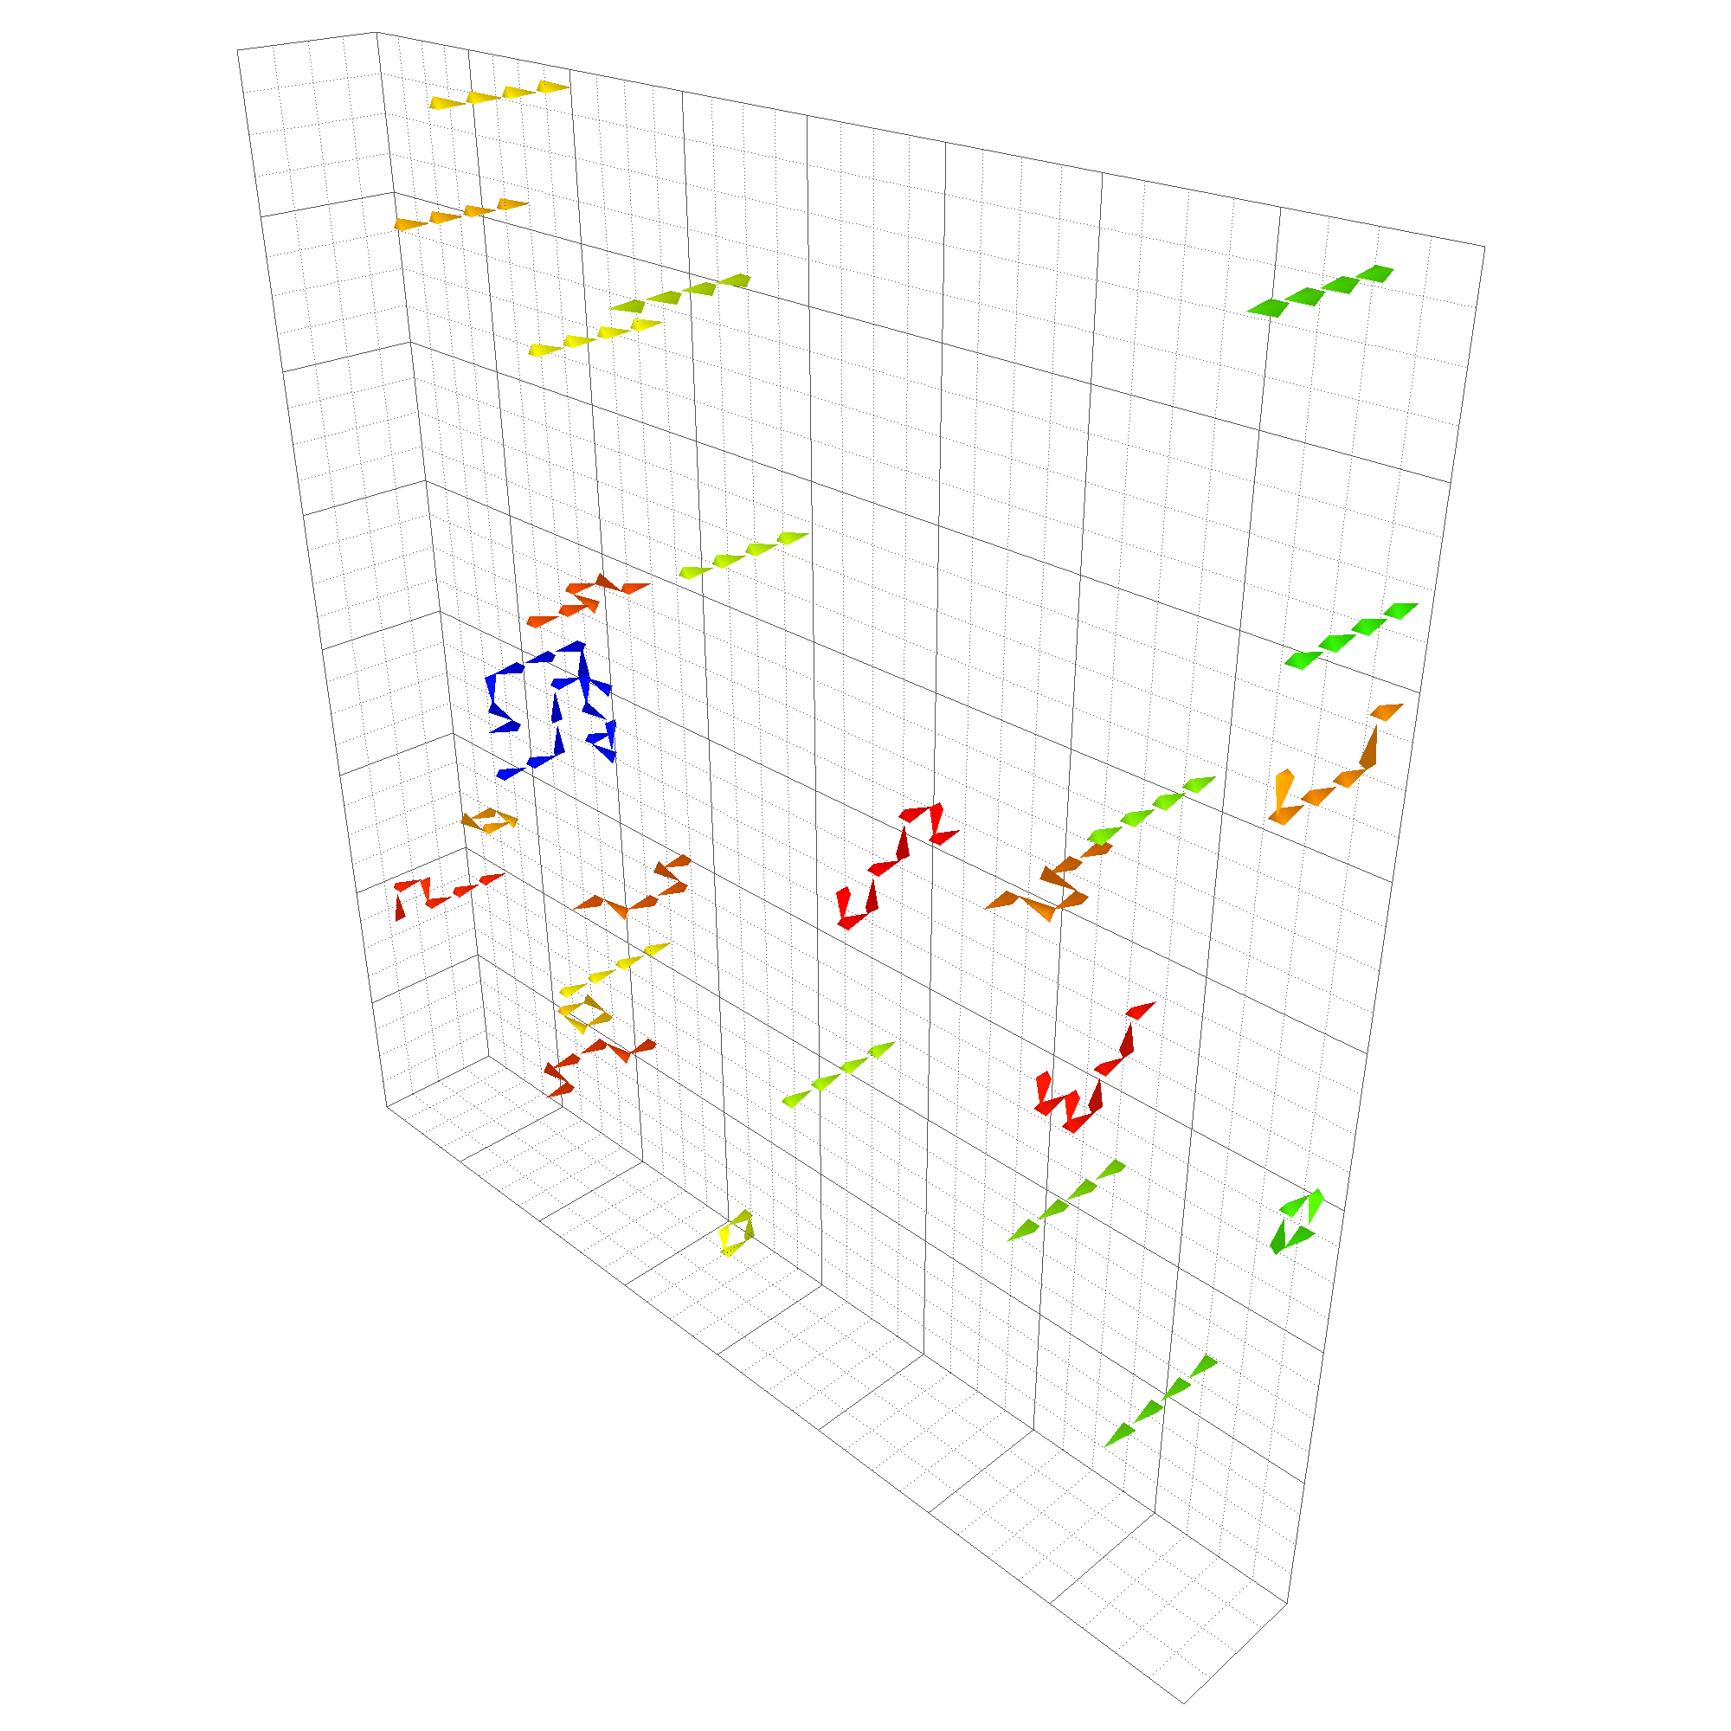
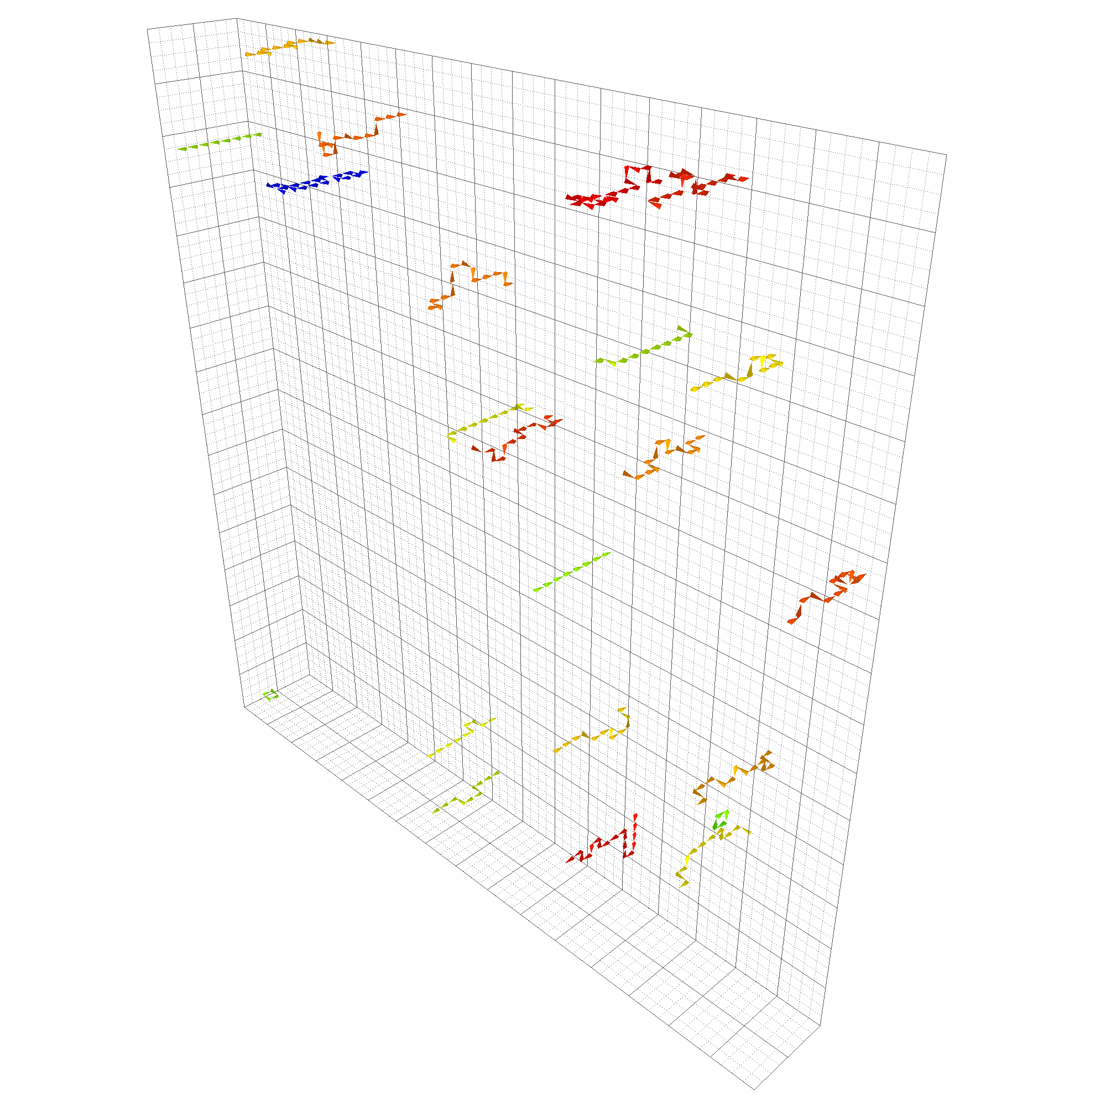
Algorithmic concerns?
Hot start using Wilson action
Finer lattice, fixed physical volume

Slide 33
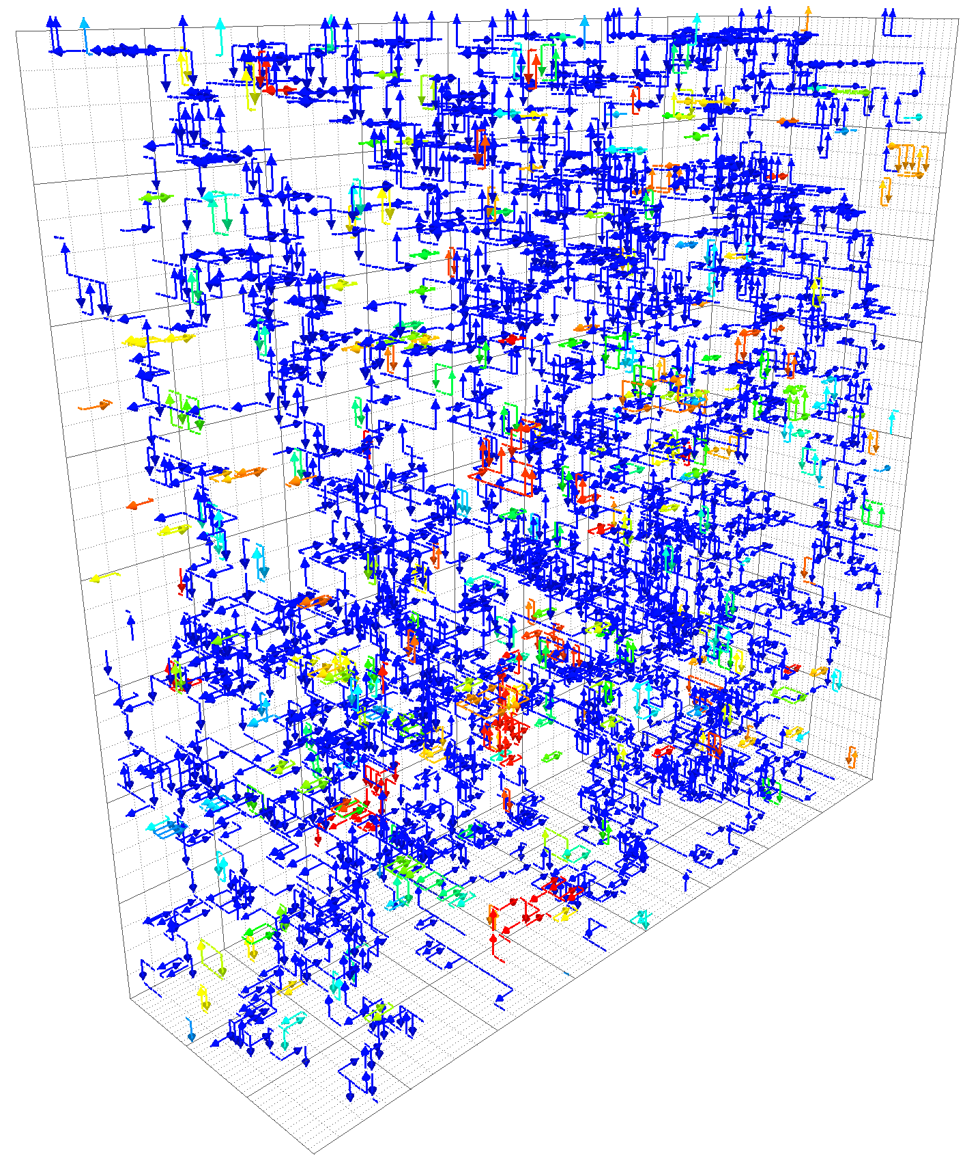
Full QCD:
Spatial (fixed- ) slices
Visualising

Slide 34
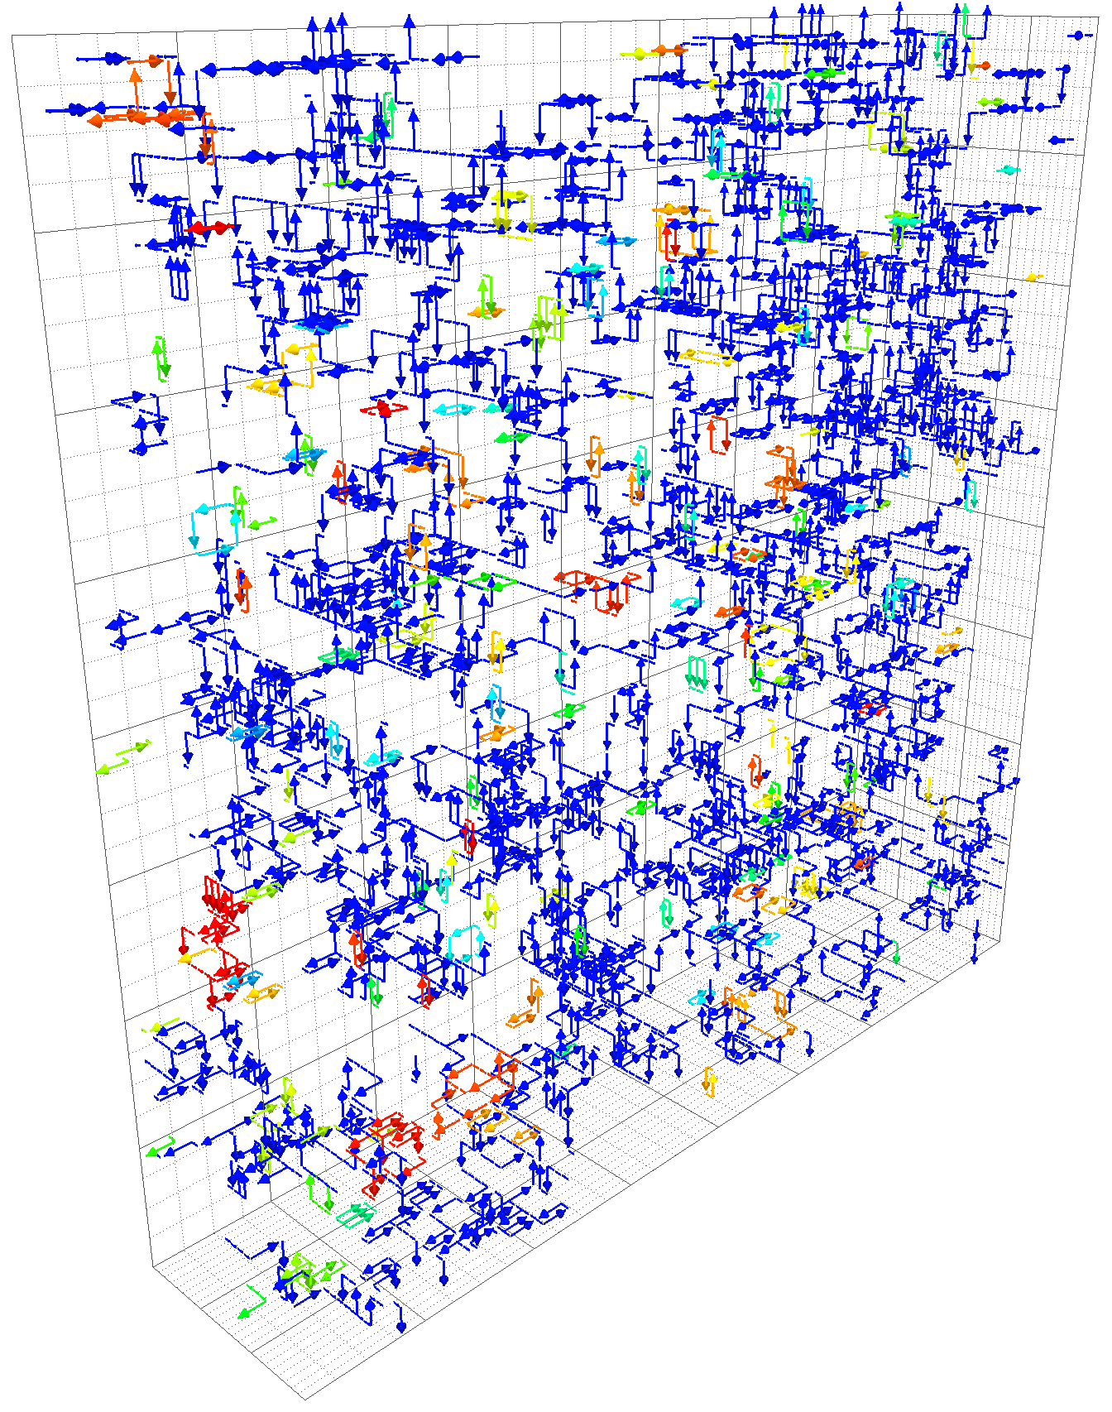
Full QCD:
Spatial (fixed- ) slices
Visualising

Slide 35
Full QCD:
Spatial (fixed- ) slices
Visualising

Slide 36
Full QCD:
Spatial (fixed- ) slices
Visualising

