Slide 1
Future insights into Metal ion-RNA interaction prediction and analysis
Dina Hussein

Slide 2
Riboswitch:
5’ UTR
3’ UTR
Ni-Co Riboswitch
czcD gene
Transcriptional riboswitch
CzcD gene
CzcD heavy metal ion transporter proteins
M
M
M
M
M

Slide 3
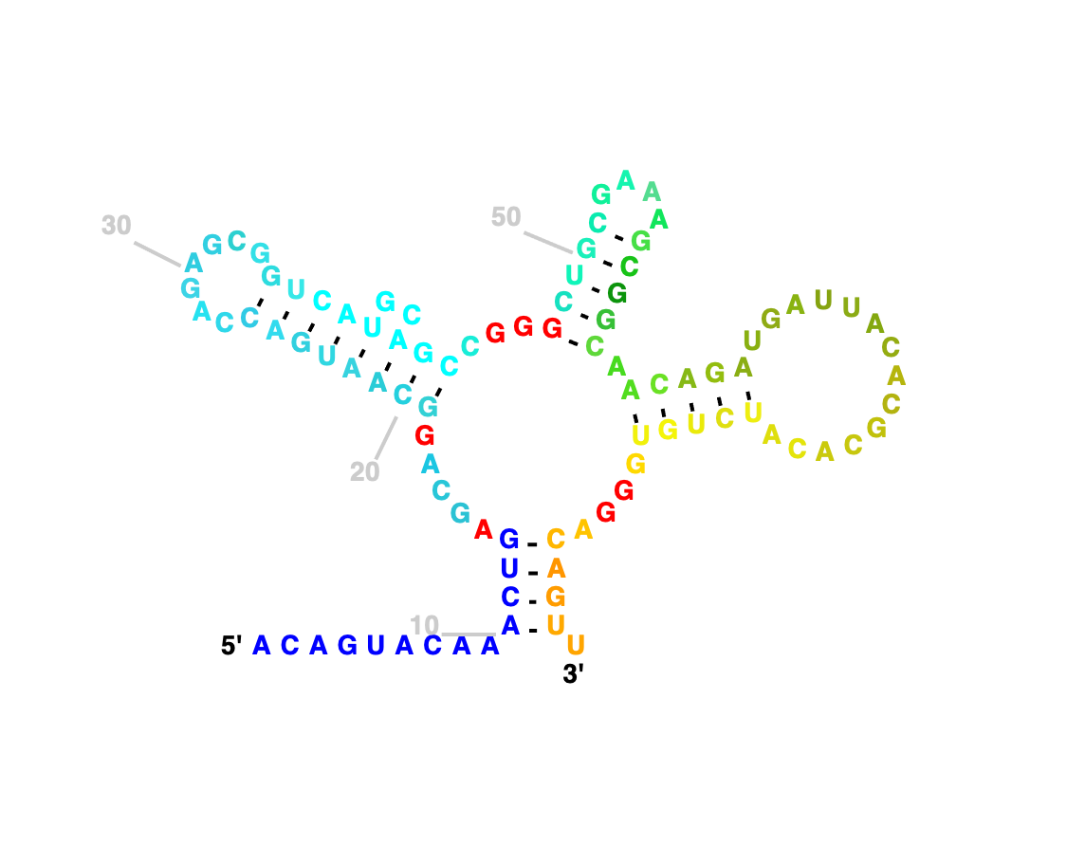
2D-3D structure of Ni-Co aptamer
P3
P2
P4
P1
The secondary structure of E. bacterium Ni-Co riboswitch
The 3D structure of Ni-Co riboswitch PDB: [4RUM]

Slide 4
Sm-FRET on Ni-Co Riboswitch from E. bacterium
P2
P3
P4
P4
P1
P3
P3
P4
Lei sung and Nesbitt, J.Phys.Chem.B (2020)

Slide 5
Sequence Alignment of Ni-Co Riboswitch Constructs (E. bacterium and L. monocytogenes)

Slide 6
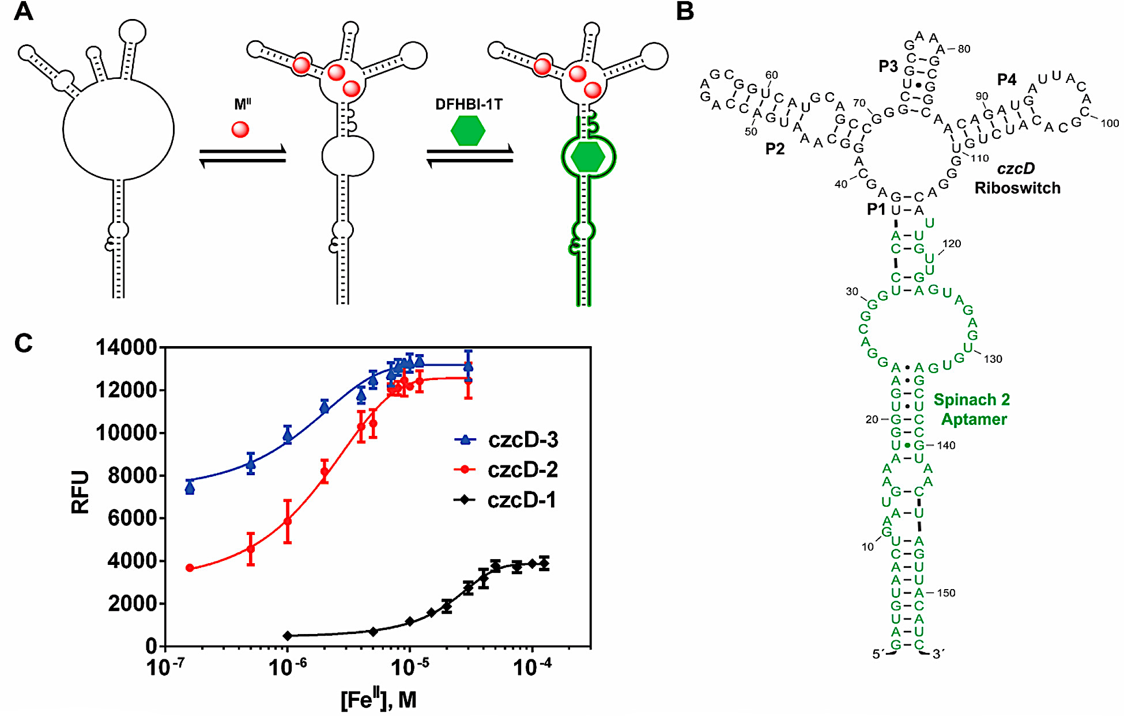
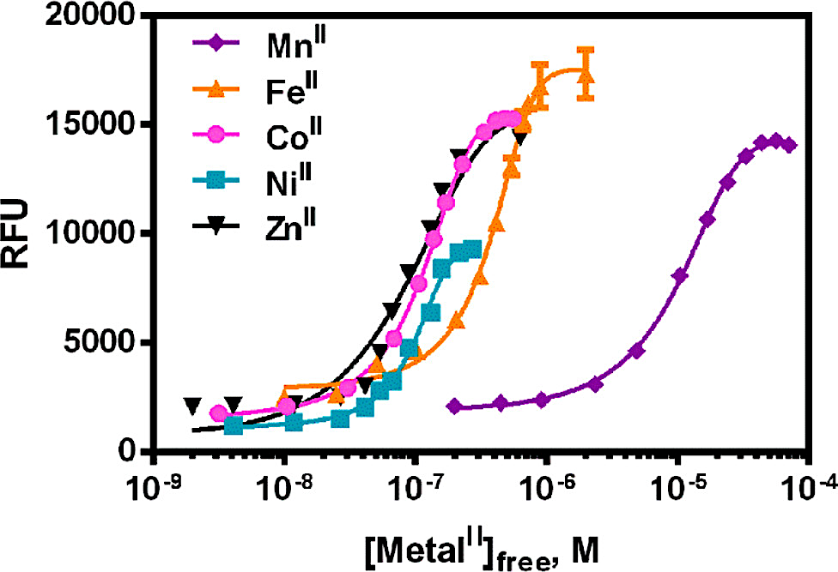
Ni- Co riboswitch: binding specifically to first-row transition metal ions
Xu and Jr. ACS. Bio&MED.Chem. (2022)

Slide 7
In Vivo?
1-To study conformational changes of E.bacterium Ni-Co aptamer and probe the tertiary interactions because of binding to different metal ions.
Ni²⁺
Fe²⁺
✓
2-To study conformational changes of L.monocytogenes Ni-Co aptamer and probe the tertiary interactions because of binding to different metal ions.
Ni²⁺
Fe²⁺
✓
✓

Slide 8
Motivation:
L. monocytogenes : Pathogenic bacteria – possibility of anti-bacterial drug
Development of methods for current structural techniques such as Cryo-EM and X-ray crystallography (Fe²⁺ - anaerobic conditions )
-Differentiate between these metal ions?
Prediction tools

Slide 9
SmFRET on Ni-Co Riboswitch from E. bacterium
P2
P3
P4
P4
P1
P3
P3
P4
Lei sung and Nesbitt, J.Phys.Chem.B (2020)

Slide 10
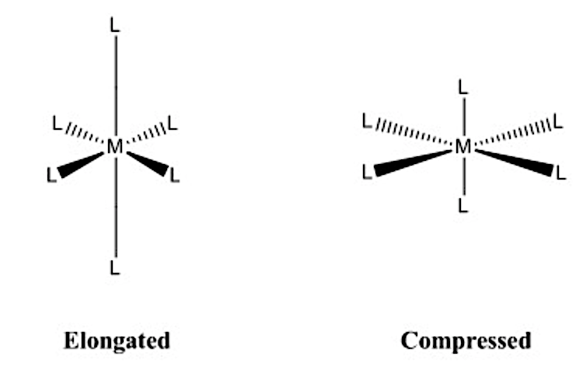
Q: Do we have force field model for metal ions for CHARMM or GROMACS?
Q: How to incorporate transition metal ions in molecular dynamics?

Slide 11
Thank you!

