Slide 1

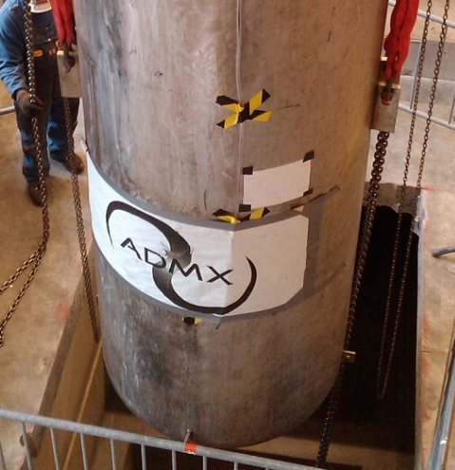
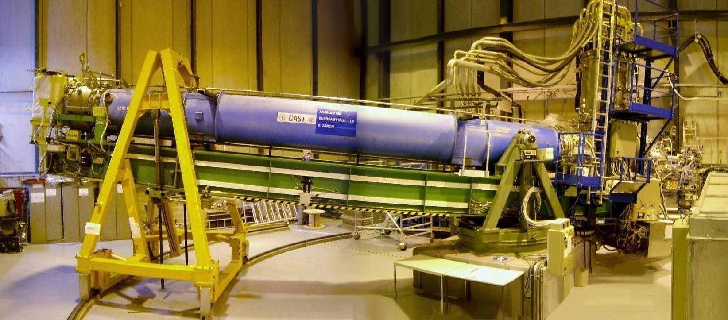
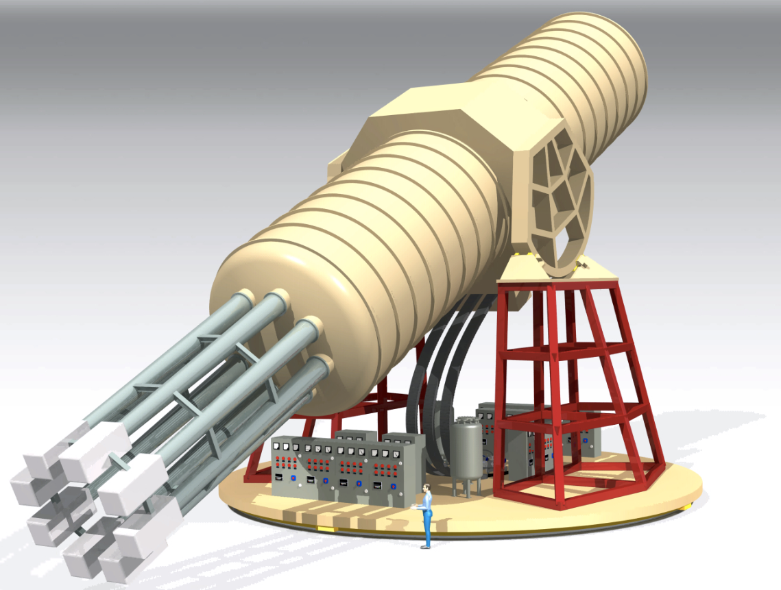
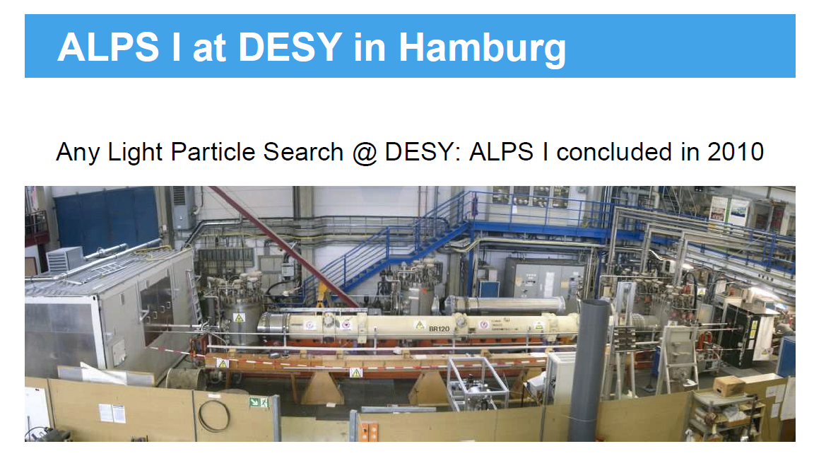
Recent progress on axion searches
Igor G. Irastorza
LI - International Meeting on Fundamental Physics
Benasque Science Center, Sep 09 - Sep 14, 2024

Slide 2
Why axions?
Most compelling solution to the Strong CP problem of the SM
Axion-like particles (ALPs) predicted by many extensions of the SM (e.g. string theory)
Axions, like WIMPs, may solve the DM problem for free. (i.e. not ad hoc solution to DM)
Astrophysical hints for axion/ALPs?
  Transparency of the Universe to UHE gammas
  Stellar anomalous cooling → g_{aγ} ~ few 10⁻¹¹ GeV⁻¹ / m_{a} ~few meV ?
Relevant axion/ALP parameter space at reach of current and near-future experiments
Rapidly increasing experimental efforts devoted to axions

Slide 3
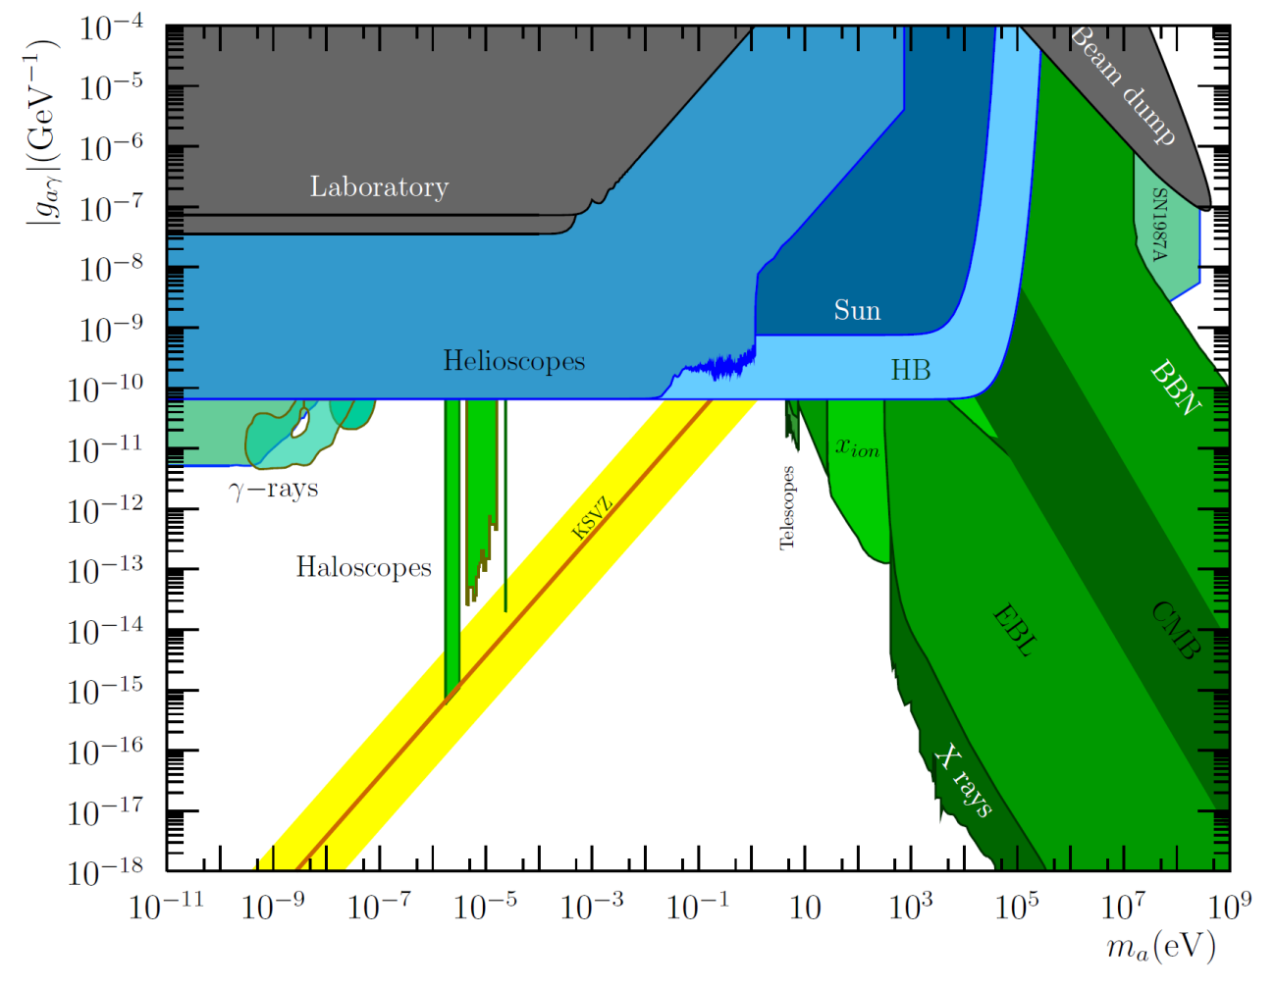
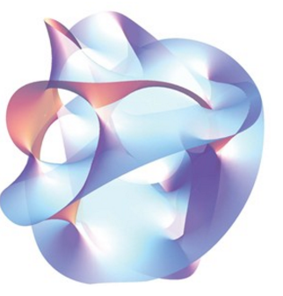
Beyond axions
Many extensions of SM predict axion-like particles
  Higher scale symmetry breaking
Generic ALPs parameter space →
Weakly Interacting Sub-eV Particles
(WISPs)
Hidden Photons
(HPs)
Axion Like particles
(ALPs)
AXIONS
Stringy ALPs
Arion
Majoron
Familon
Millicharged Particles
String theory predicts a plenitude of ALPs
Chameleons

Slide 4
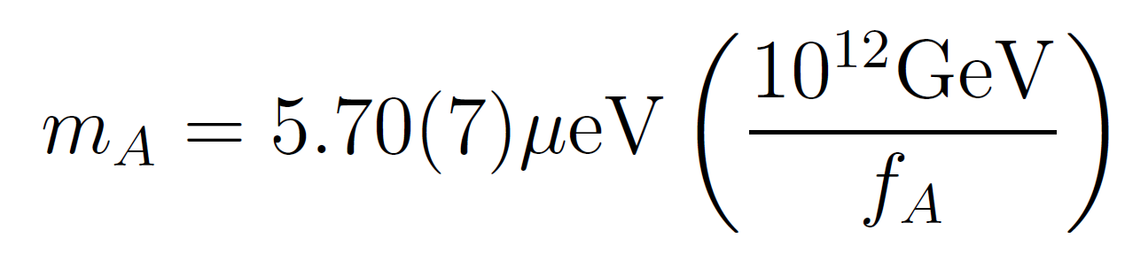
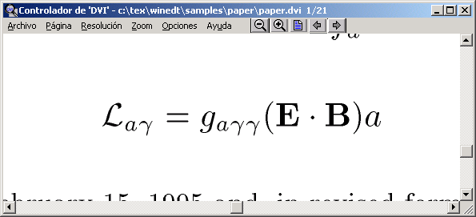
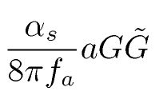
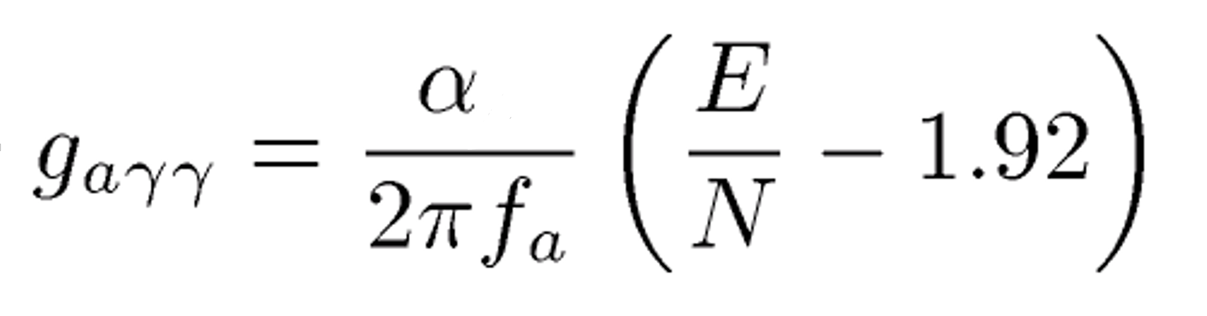
Axion phenomenology
Some phenomenology depends on the “axion model”, e.g.
  KSVZ axions are “hadronic axions” (no coupling with leptons at tree level)
  DFSZ axions couple to electrons
Gluon coupling
generic
Mass
generic
Photon coupling
generic but value
model dependent
Fermion couplings
Electron coupling
Nucleon coupling
…
Model dependent
×

Slide 5
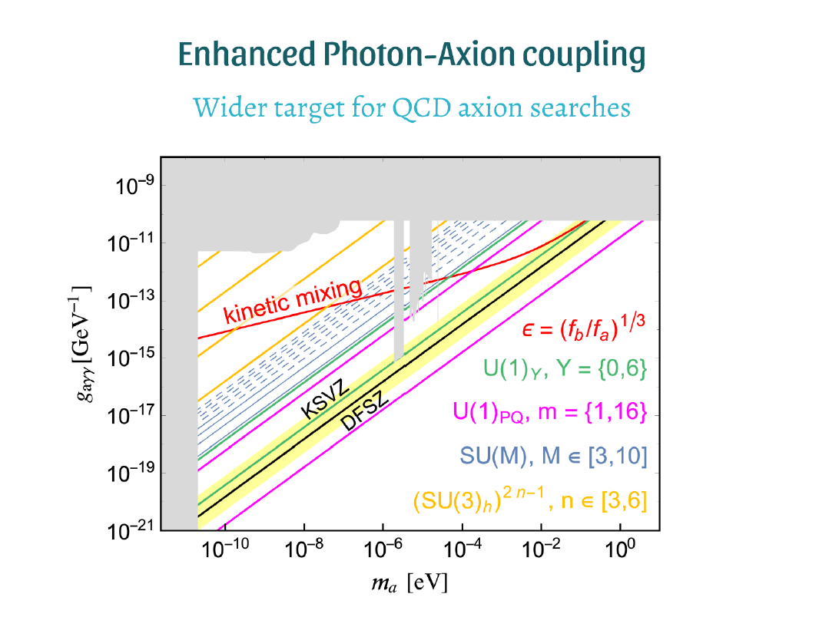
Axion models
Conventional QCD axion models lie on the “yellow band”
  KSVZ, DSFZ benchmarks
Outside the band typically ALPs
BUT a lot of “model building” activity in recent years, leading to QCD axion models outside the conventional band…
  Normally populating higher g_{aγ}.
  Very interesting for experiments!
P. Agrawal, ESPP 2019 Granada

Slide 6
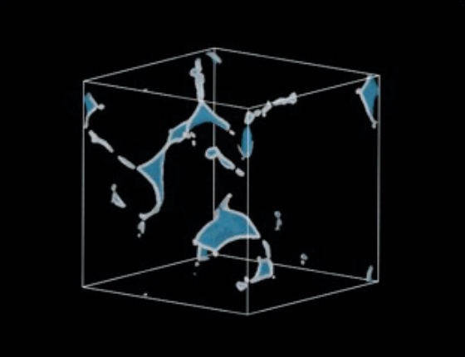
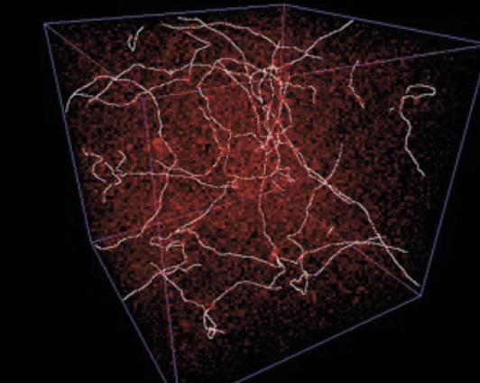
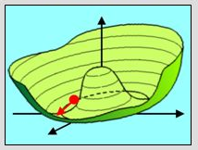
Axions as cold dark matter
Axion realignment…
(AR)
… AND decay of topological defects.
(TD)
PQ before or after inflation?
Only well-known AR
BUT, initial misalignment angle unknown…
Large range of masses possible, even very low ones (→ anthopically finetuned?)
TD contributes, potentially dominating…
Not initial AR uncertainty
BUT TD computation very complex
Still large range of masses possible
ALP as inflaton AND dark matter?
eV
→ Right axion DM density is possible for a wide range range of masses

Slide 7
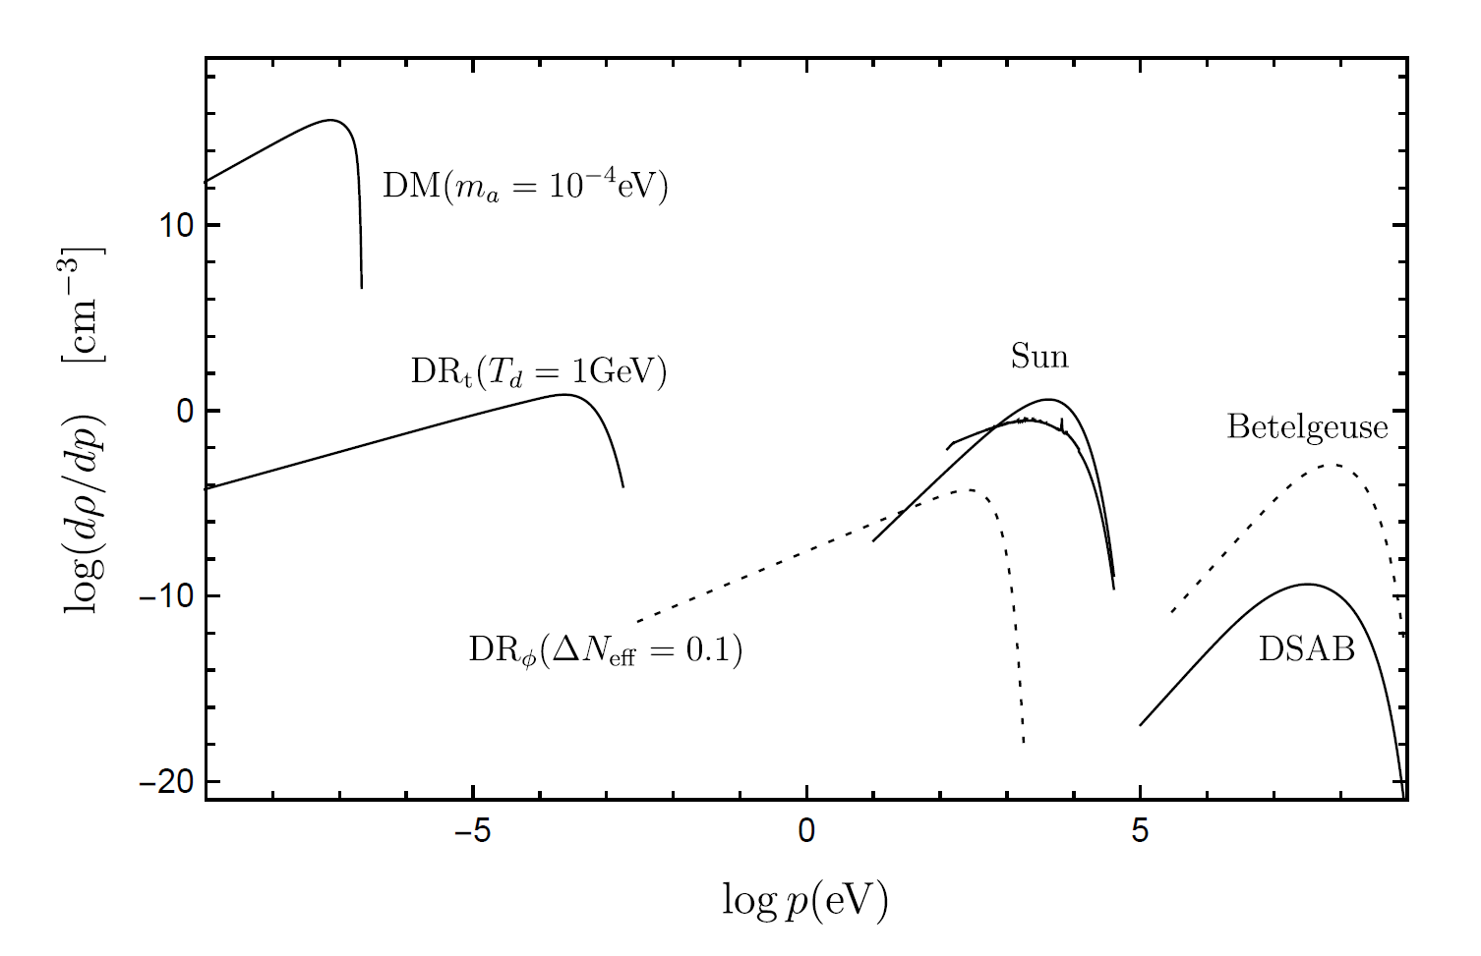
Sources of axions
Natural sources
Laboratory sources
Photon-ALP conversion in strong magnetic fields (axion-photon coupling)
ALP fields from macroscopic bodies (fermionic couplings)
Dark matter
Dark radiation
Stellar
IGI, J. Redondo, 1801.08127

Slide 8

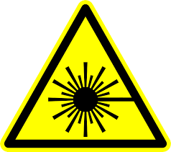

Detection of axions
Source | Experiments | Model & Cosmology dependency | Technology
Relic axions | ADMX, HAYSTAC, CAPP, MADMAX, BRASS, ORGAN, RADES, QUAX, CASPEr, SHAFT, ABRA, DM-Radio, … | High | New ideas emerging, Active R&D going on,…
Lab axions | ALPS, JURA, OSQAR, PVLAS, ARIADNE,… | Very low | Ready for large scale experiment
Solar axions | SUMICO, CAST, (Baby)IAXO | Low | Ready for large scale experiment
Large complementarity among categories

Slide 9


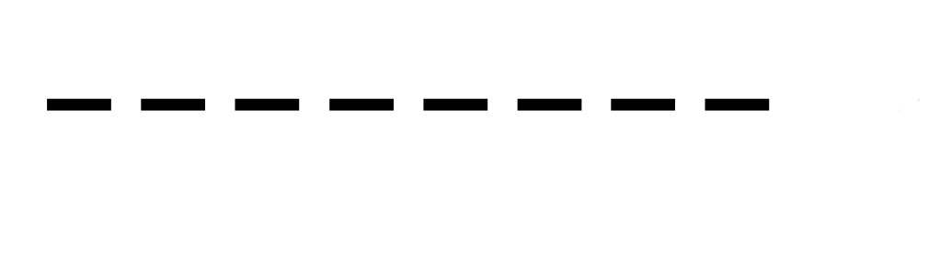

Laboratory axions
γ
a
γ
Photon source
Photon detector
WALL

Slide 10
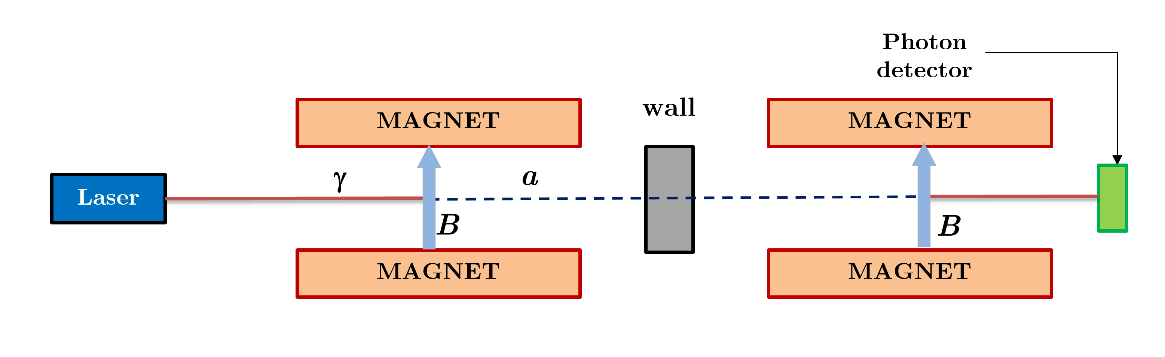
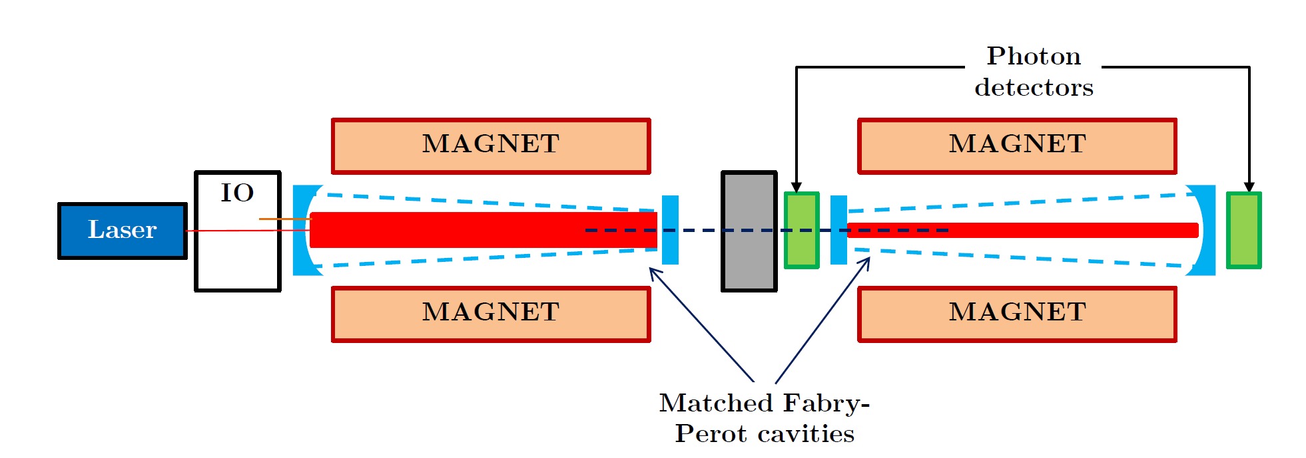
Light-shining-through-wall (LSW)
Standard configuration →
Enhanced “resonant”
configuration (future) →

Slide 11
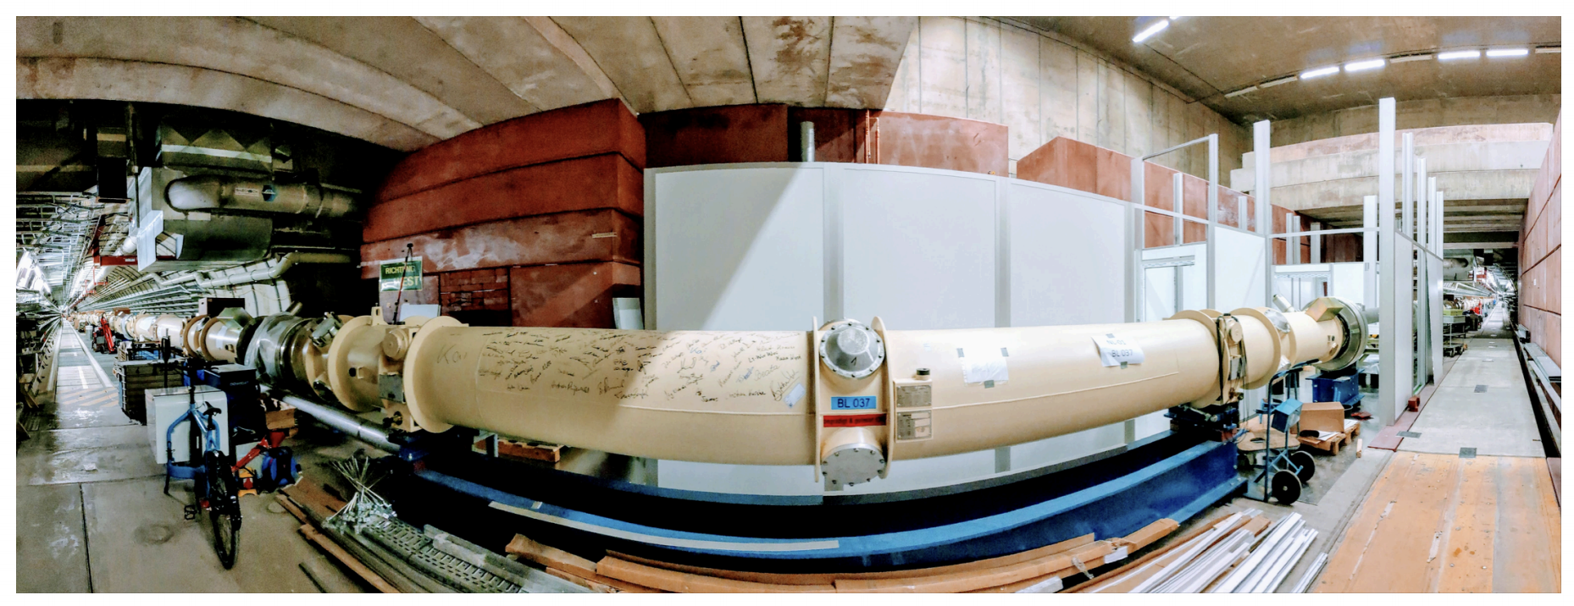
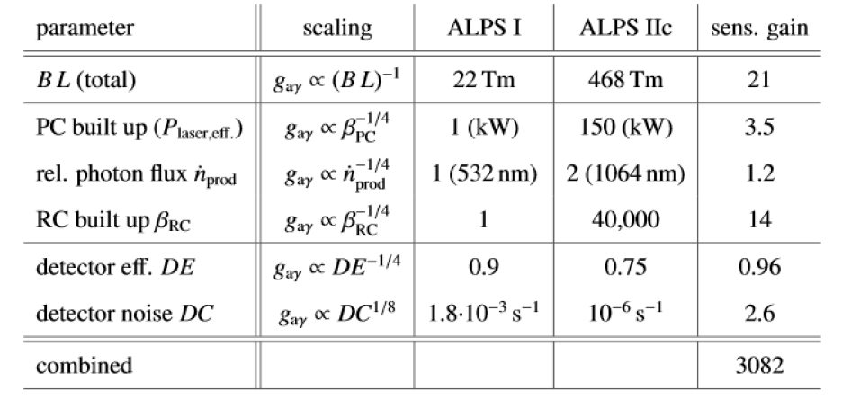
From ALPS-I to ALPS-II experiments
ALPS-II entered data taking phase this year at DESY!!
(resonant, 12+12 magnets,…)
3000x better sensitivity than ALPS-I expected

Slide 12
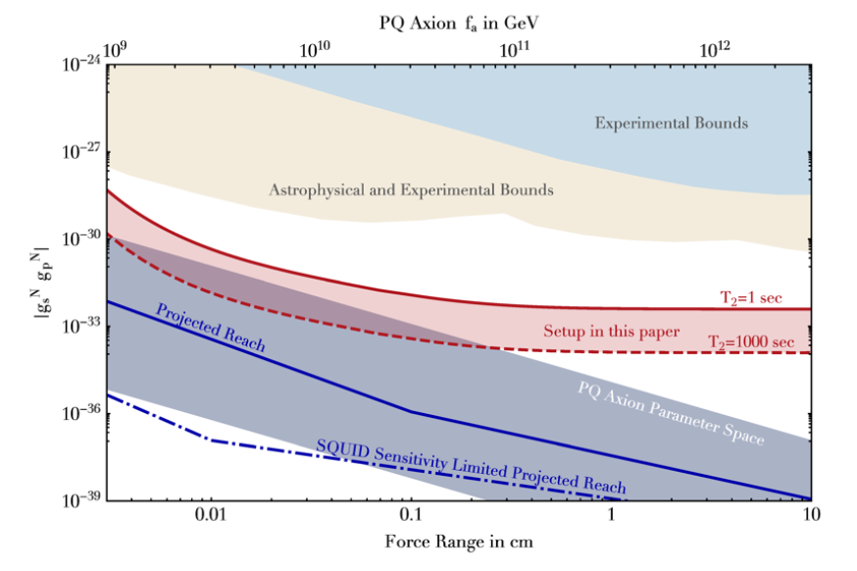
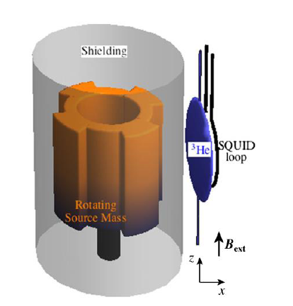
Other purely laboratory searches
Other LSW experiments active in the past, some at different photon energies:
OSQAR@CERN, CROWS@CERN, GammeV & REAP @ Fermilab, US, BMV @ Toulouse,…
Possible future extrapolation: JURA (& also STAX with MW)
Laser polarization experiments (sensitive to VMB): PVLAS @ Ferrara, … Future (project): VMB@CERN
Short-range axion-mediated macroscopic forces: ARIADNE
  NMR techniques
  Sensitive to (products of) fermion couplings
  Good prospects for sub-meV axion
NMR sample
Arvanitaki, Geraci
Phys. Rev. Lett. 113, 161801 (2014)
Rotating source
mass
Rotating source

Slide 13
Axion-mediated macroscopic forces
Axions could be detected as short-range deviation of gravity…
(but traditionally though without enough sensitivity to QCD axions)
Recently proposed: ARIADNE experiment
Short-range force by NMR technique
Sensitive to (products of) fermion couplings
Good prospects for sub-meV axion
(assuming CP-violating effects not far from current bound on θ)
Arvanitaki, Geraci
Phys. Rev. Lett. 113, 161801 (2014)
NMR sample
Rotating source
mass
Rotating source

Slide 14
Solar axions
a
γ
Photon detector
Axions from the Sun

Slide 15
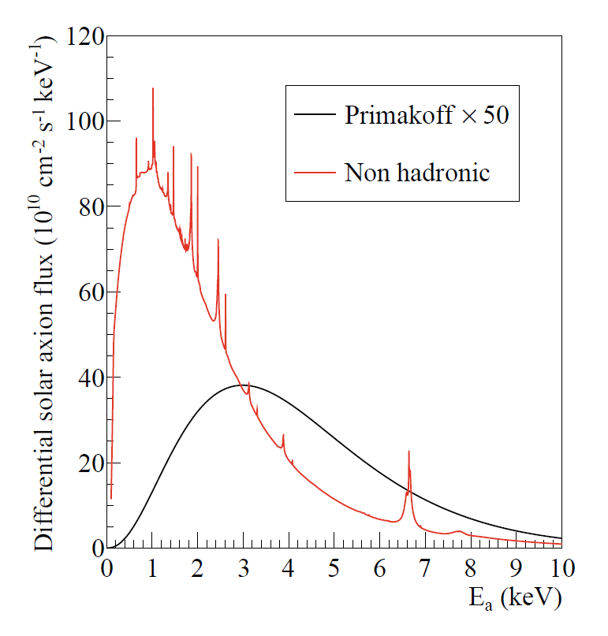
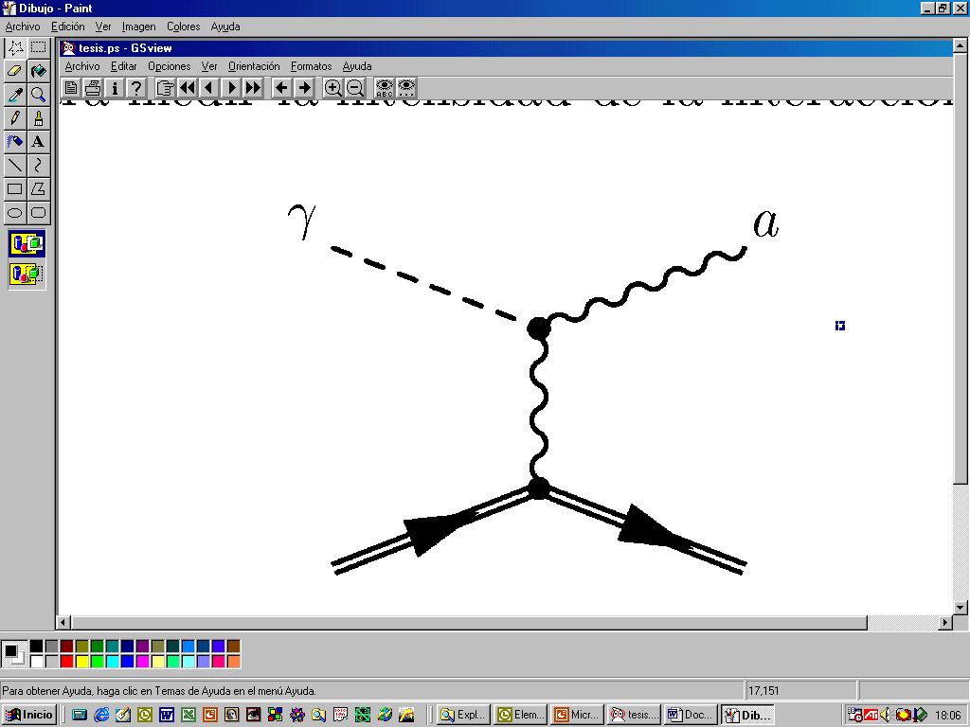
Solar Axions
Standard Primakoff spectrum
Robust prediction from axion models. Conversion of solar plasma fotons into axion (only axion-photon coupling involed)
van Bibber PRD 39 (89)
CAST JCAP 04(2007)010
Non-hadronic “ABC” Solar axion flux at Earth
(only if axion couples to electron)
Redondo, JCAP 1312 008
IMFP2024 - Benasque

Slide 16
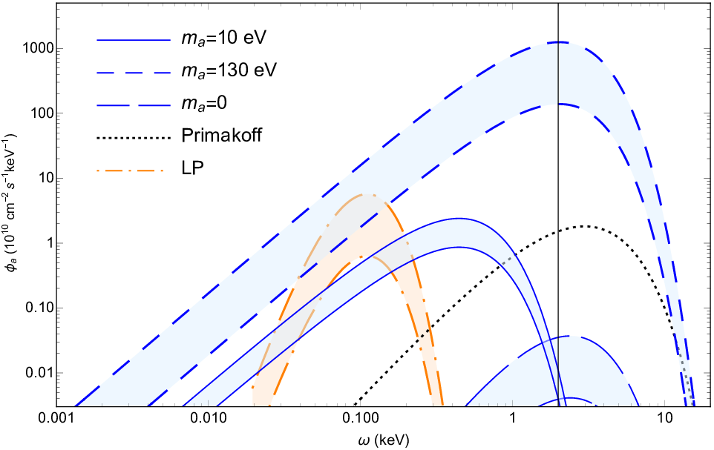
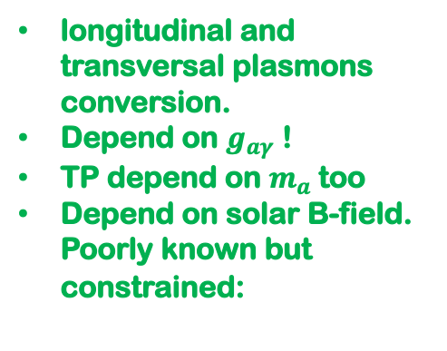
…and more solar axions
Via axion-nucleon couplings: monochromatic lines from nuclear transitions:
  E.g. 14.4 keV axions emitted in the M1 transition of Fe-57 nuclei, MeV axions from 7Li and D(p;γ)³He nuclear transitions or Tm-169.
More recently proposed: photons interacting with macroscopic solar B-fields.
axions
See recent study Di Luzio et al, EPJC 82, 2111.06407 [hep-ph]
longitudinal and transversal plasmons conversion.
Depend on $g_{aγ}$ !
TP depend on $m_{a}$too
Depend on solar B-field. Poorly known but constrained:
See e.g. Caputo et al 2005.00078, Guarini et al. 2010.06601

Slide 17
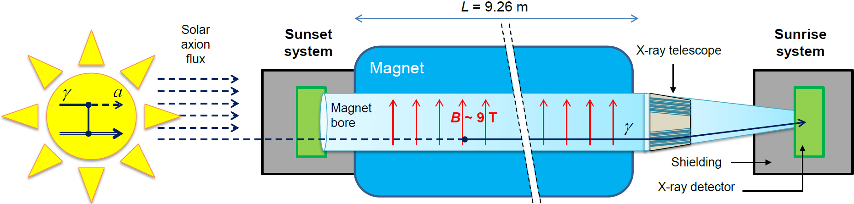
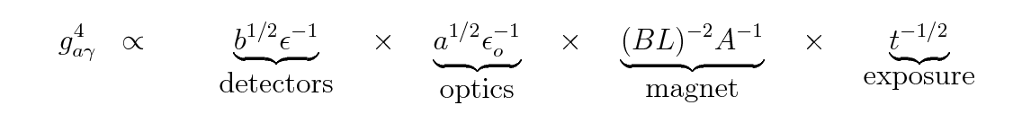
Axion helioscopes
Axion helioscope concept
P. Sikivie, 1983
+ K. van Bibber, G. Raffelt, et al. (1989)
(use of buffer gas)
Pioneer implementations of helioscope concept:
  Brookhaven (just few hours of data) [Lazarus et at. PRL 69 (92)]
  TOKYO Helioscope (SUMICO): 2.3 m long 4 T magnet
Current state-of-the-art: CERN Axion Solar Telescope (CAST)
X-ray Focussing &
low-background
Later innovations by CAST

Slide 18
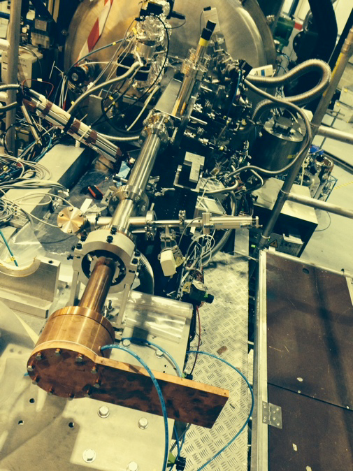
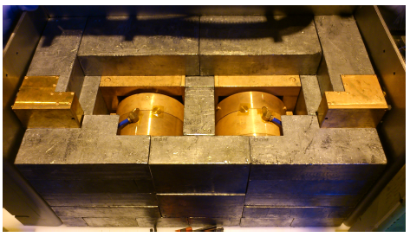
CAST experiment @ CERN
Decommissioned LHC test magnet (L=10m, B=9 T)
Moving platform ±8°V ±40°H (to allow up to 50 days / year of alignment)
4 magnet bores to look for X rays
3 X rays detector prototypes used.
X ray Focusing System to increase signal/noise ratio.
CAST: last solar axion configuration
Moving platform ±8°V ±40°H
LHC test magnet
2 low background Micromegas
1 Micromegas + XRT
1 Ingrid + XRT

Slide 19
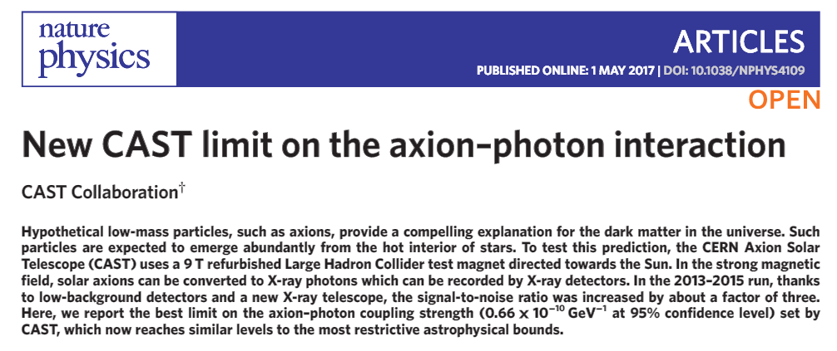
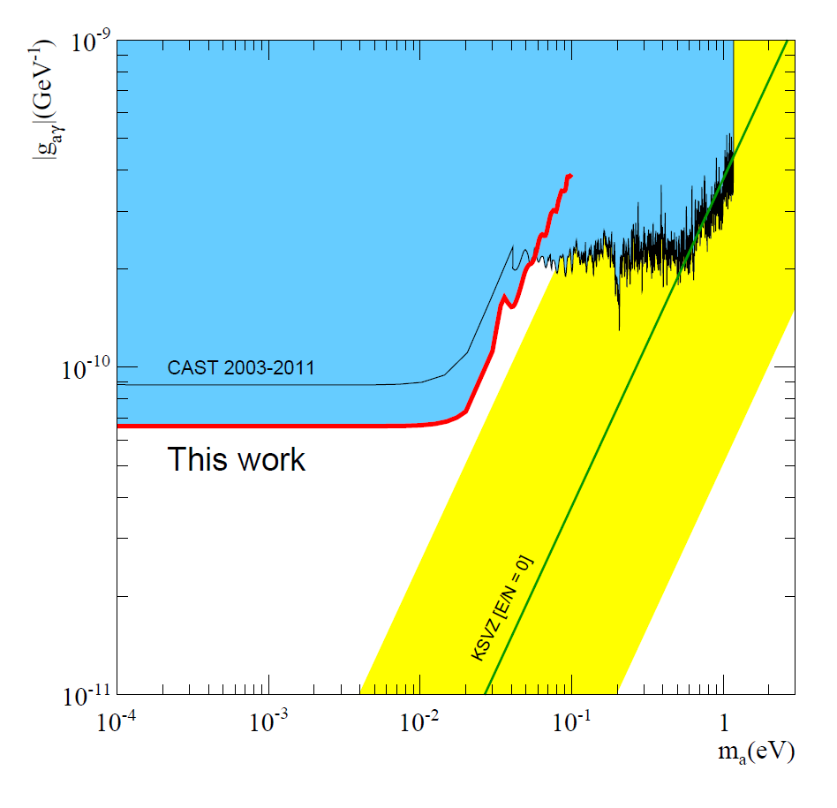

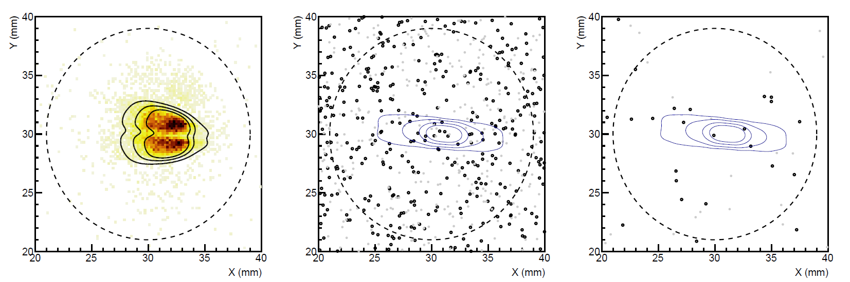
Latest CAST limit (2017)
Enabled by the
IAXO pathfinder system
Detector: JCAP12 (2015)
Physics: Nature Physics 13 (2017) 584-590
5 mm
X-ray optics specifically built for axions
Calibration data
“axion” data
Low background Micromegas
  Best SNR of any previous detector
  290 tracking hour acquired (6.5 months operation)
  3 counts observed in RoI (1 expected)

Slide 20
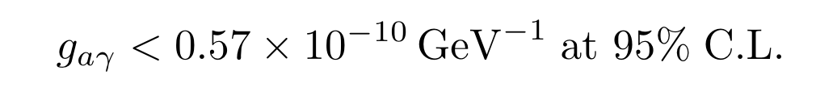
Latest CAST limit
Enabled by the
IAXO pathfinder system
Detector: JCAP12 (2015)
Physics: Nature Physics 13 (2017) 584-590
Updated: 2406.16840
Updated limit (2024)
5 mm
X-ray optics specifically built for axions
Calibration data
“axion” data
Low background Micromegas
  Best SNR of any previous detector
  290 tracking hour acquired (6.5 months operation)
  3 counts observed in RoI (1 expected)
  Statistic doubled later on: new results 2024: 0 counts in RoI (1 expected)

Slide 21
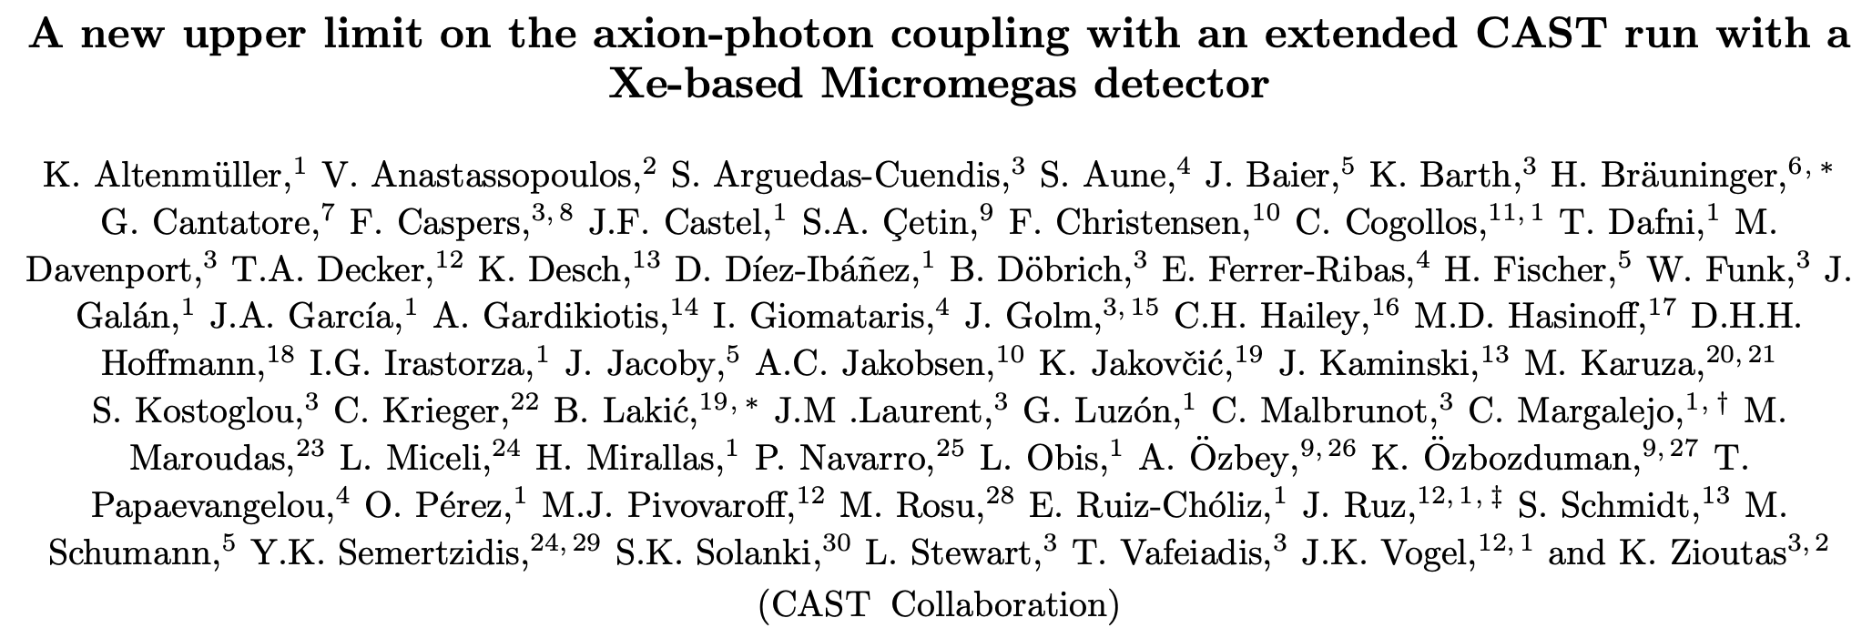
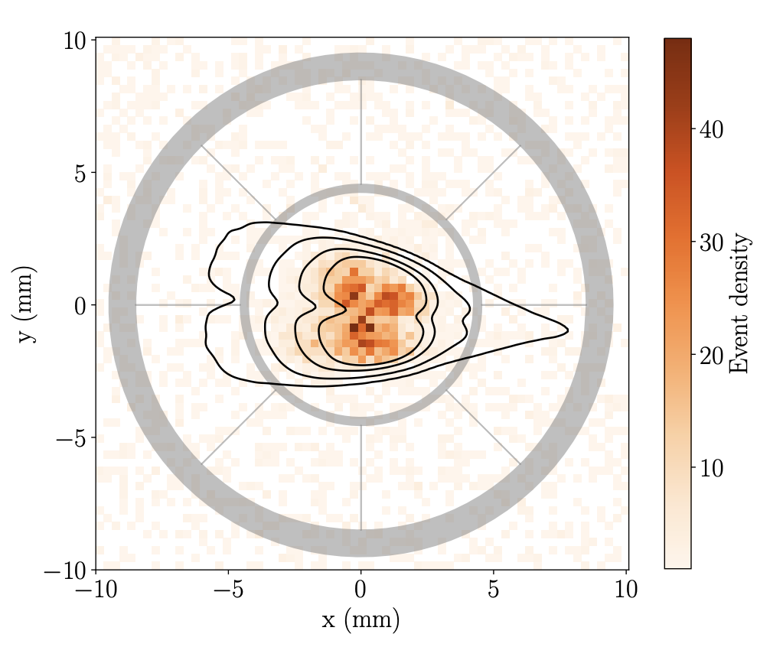
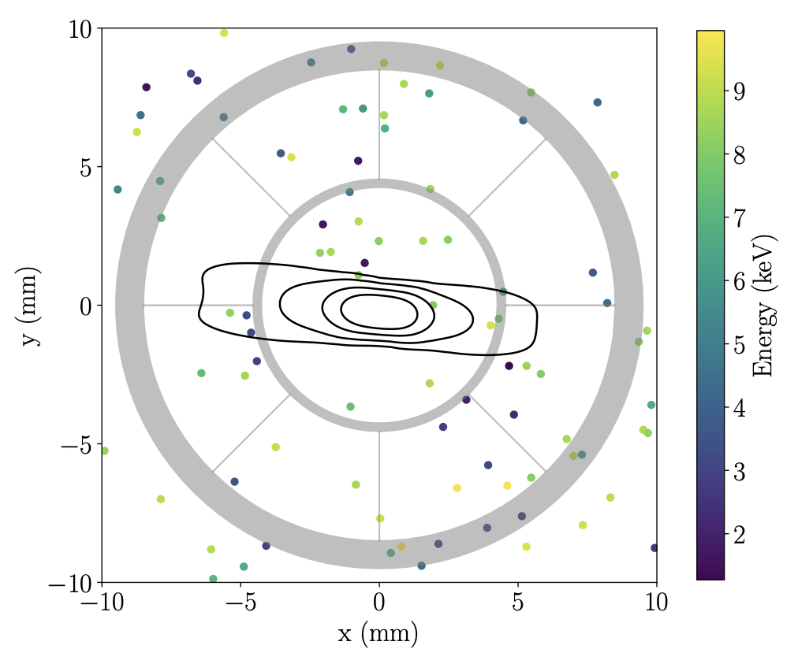
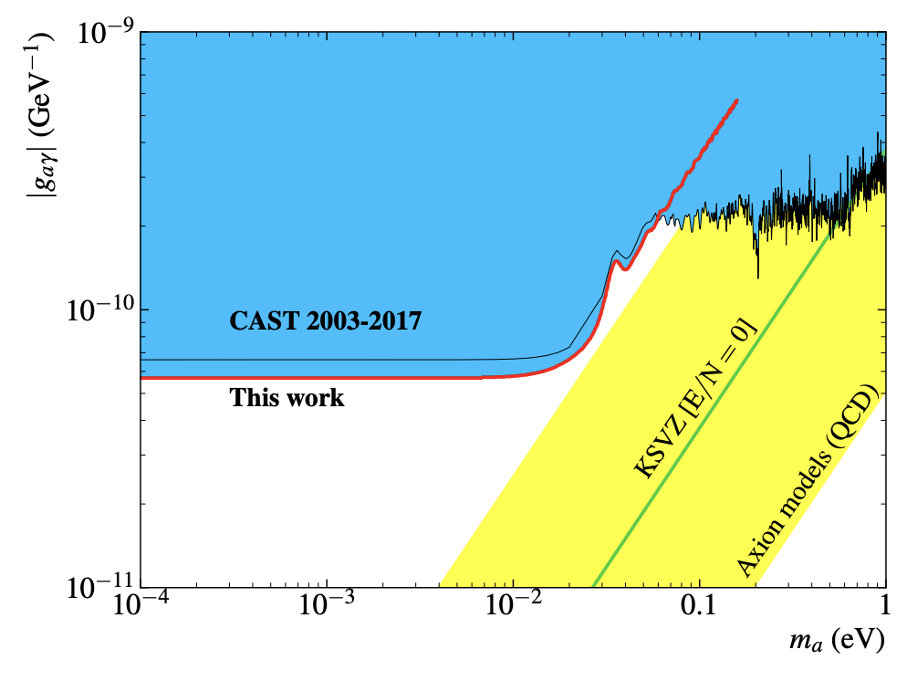
Latest CAST limit (2024)
Under review by PRL
preprint: 2406.16840
Updated limit (2024)
X-ray optics specifically built for axions
  Doubles statistics of 2017 result
  No counts seen in RoI
  Best limit on g / CAST legacy
  Use of Xe to increase efficiency, improve background
Low background Micromegas

Slide 22
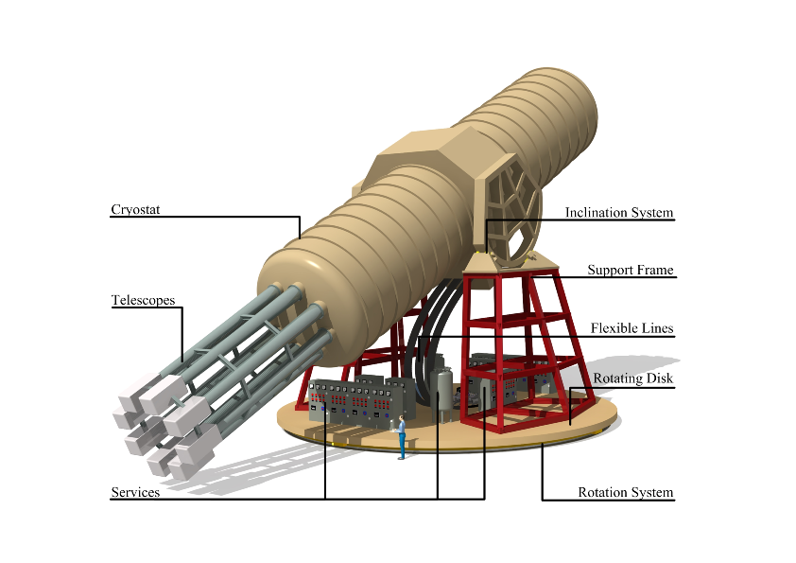
IAXO – Conceptual Design
Large toroidal 8-coil magnet L = ~20 m
8 bores: 600 mm diameter each
8 x-ray telescopes + 8 detection systems
Rotating platform with services
>10⁴ x CAST SNR
IAXO CDR: JINST 9 (2014) T05002 (arXiv:1401.3233)

Slide 23
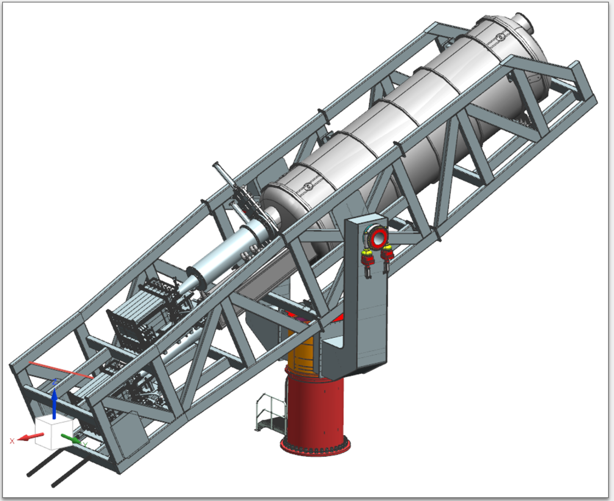

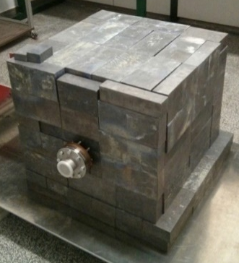
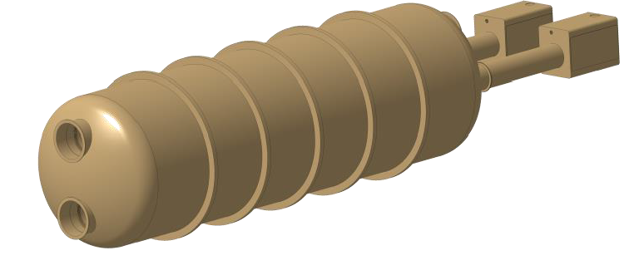
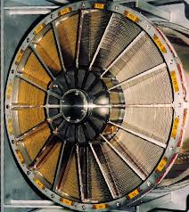

BabyIAXO
Intermediate experimental stage before IAXO:
  Prototype of final IAXO system
  Relevant physics
Approved by DESY in 2019.
Rely on CERN magnet SC expertise & experience with CAST
Collaborations with ESA & NASA (x-ray optics)
Magnet delayed, expected for 2028
~100x CAST SNR

Slide 24
Helioscopes & astrophysics
IAXO+: enhanced scenario with x10 (x4) higher FOM (MFOM) with respect to LoI
… as well as a large fraction of the axion & ALP models invoked in the “stellar cooling anomaly”
But for this the g_{ae} is particularly interesting (see backup slides)
IAXO will fully explore ALP models invoked to solve the “transparency hint”
MFOM = Magnet FOM

Slide 25
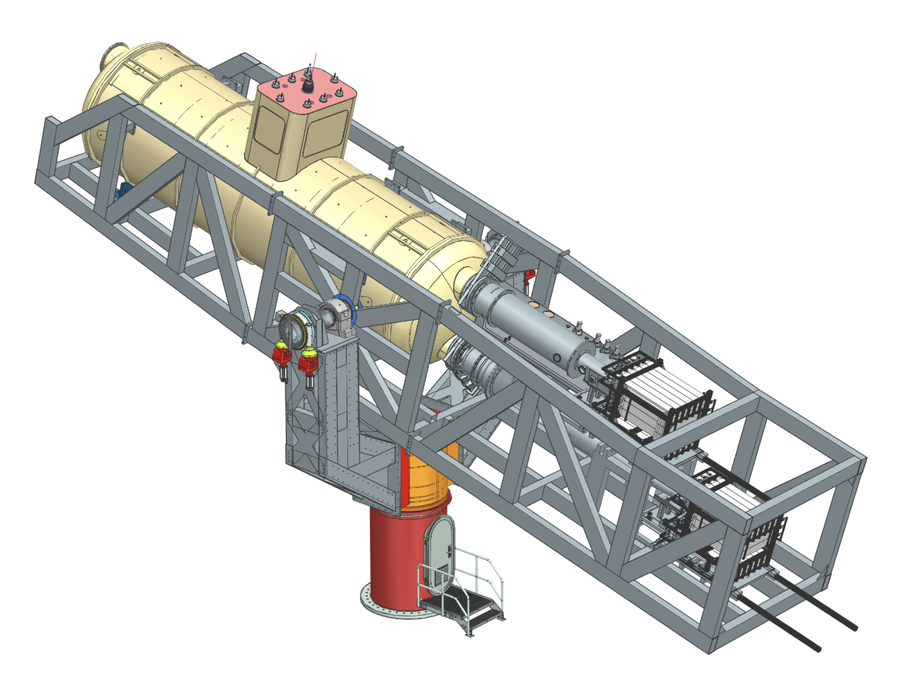
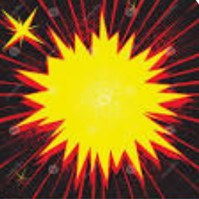
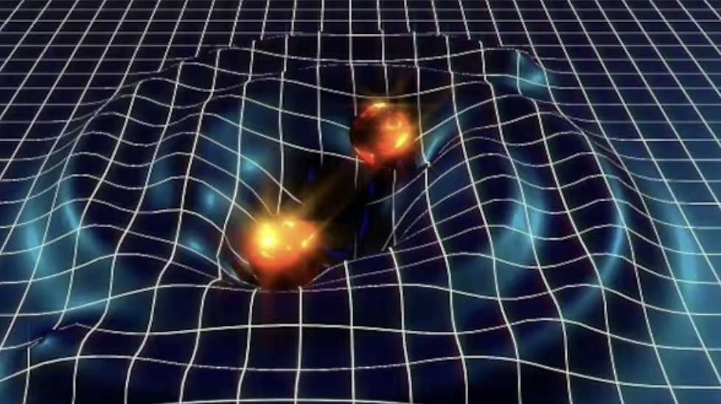
Beyond baseline
BabyIAXO as a generic axion(-like) facility
Axions from SN:
O(100MeV) energies
Requires large HE γ-ray detector
Dark Matter axions:
Axion haloscope setup (RF cavities) inside BabyIAXO bores
Other axion DM sensors (pick-up coils or emitting surfaces)
Synergies with quantum sensors
Extra cryogenics needed?
Other (non-Primakoff) solar axion production mechanisms:
“ABC” axions (~1 keV)
12 keV or HE axions from nuclear transitions
LE axions from plasmon conversion
…
Other WISPs: hidden (dark) photons, chameleons, …
post-Discovery “precision” physics:
Signal polarization
Axion mass determination (spectral distortions)
Multi-coupling determination → QCD axion model
Solar physics (B & T of solar core)
And also high-frequency Gravitational Waves!!

Slide 26
Dark matter axions
a
γ
Photon detector
Axions from DM halo

Slide 27
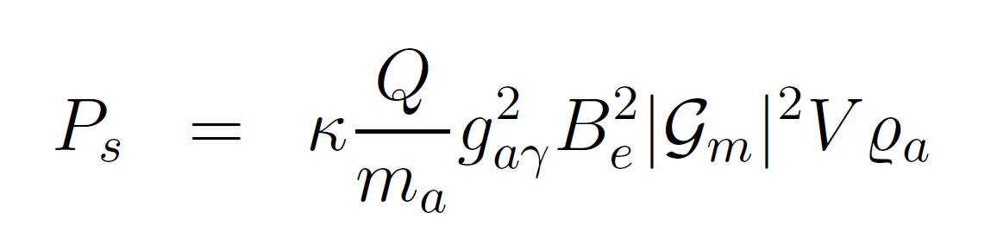
Detecting DM axions: “haloscopes”
Primakoff conversion of DM axions into microwave photons inside cavity
Assumption: DM is mostly axions
Resonant cavities (Sikivie,1983)
  Primakoff conversion inside a “tunable” resonant cavity
  Energy of photon = m_{a}c²+O(β²)
Axion DM field
Non-relativistic
Frequency ← axion mass
B₀
If cavity tuned to the axion frequency, conversion is “boosted” by resonant factor
(Q quality factor)
Cavity dimensions smaller than de Broglie wavelength of axions

Slide 28
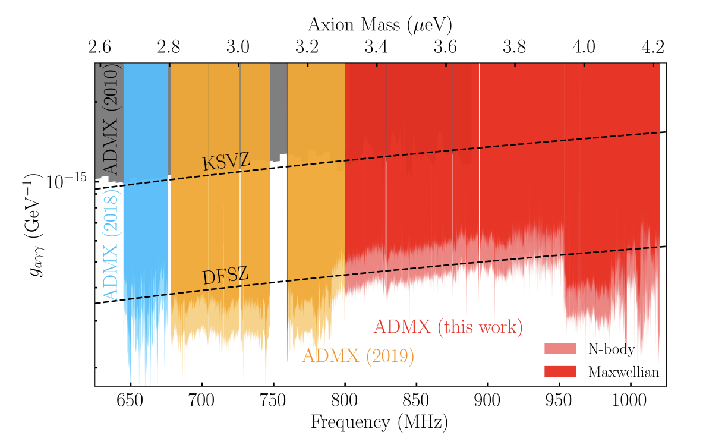
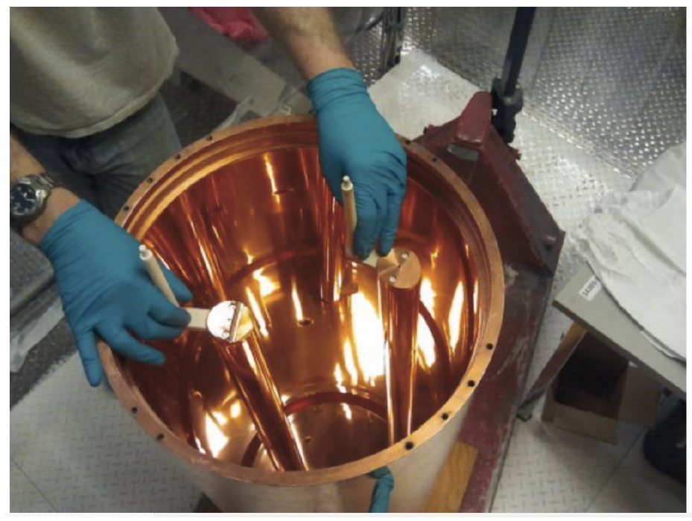


ADMX
Leading haloscope
  Many years of R&D
  First results >10 years ago.
Sensitivity to few μeV proven
Now producing new results:
  First data down to DFSZ coupling (2.7 to 3.3 μeV)…
Current program will surely cover 1-10 μeV with high sensitivity (i.e. reaching even pessimistic coupling).
What about higher masses?

Slide 29





Higher-m_{a} haloscopes
Problematic:
higher m_{a} → lower V → lower sensitivity
R&D to go to:
  Higher B magnets
  Larger instrumented volumes
  Lower noise sensors
  Higher Q cavities
Very active R&D in many groups!
More powerful magnets
Multicell structures:
  Phase-matched
  Filter-like
  Dielectric loading
  Photonic bandgap
  …
SC deposited cavities
RADES project
in CAST
CAST-CAPP project
In the CAST magnet
QUAX at LNL
“Pizza cavity”
at CAPP
→ 2008.10141

Slide 30



Higher-m_{a} haloscopes
HAYSTAC
HAYSTAC @ Yale: started as ADMX test bed for new ideas.
  First results released in 2018 (1803.03690)
  Very recent: first result with squeeze states (2008.01853)
CAPP: recently created “Center for Axion and Precision Physics” at South Korea
  Several physics results released CAPP-PACE & CAPP18T, CAPP12T, and CAPPMAX (2024)
  Also multicell setup (pizza cavity)
  + a lot of R&D lines
ADMX-Sidecar (small demonstrator) + ADMX-EFR
Many other projects exploring new cavity designs:
  QUAX @ LNL: SC coated cavity. Also setups sensitivity to g_{ae} coupling
  RADES & CAST-CAPP @ CERN
  Also ORGAN in Australia
  TASEH in Taiwan
  And others!
ADMX-Sidecar
CAPP-PACE
CAPP projected
5-y plan

Slide 31

Higher-m_{a} haloscopes
Problematic:
higher m_{a} → lower V → lower sensitivity
R&D to go to:
  Higher B magnets
  Larger instrumented volumes
  Lower noise sensors
  Higher Q cavities
Squeezed state to reduce noise beyond quantum limit
Quantum information technologies for axion search
First experimental application HAYSTAC 2008.01853:
  factor x2 effective faster scan rate
  17.14-17.28 μeV scanned down to 1.38 x g_{aγ}^{KSVZ}

Slide 32




RADES
Exploratory project emerged at a later stage of CAST: use of “helioscope” magnets for “haloscope” searches
Creation and build-up “axion haloscope” community in Europe
Strong boost by ERC-StG (B. Dobrich) in 2018
Very interesting results so far:
Now ultra-cryogenic setup being built at MPP-Munich
→ DarkQuantum ERC-SyG starting 2024
Physics result at single f point (34.7 meV) in the CAST magnet
Inner HTS coatings to improve Q factor
New geometry concepts to scale in V but keeping high resonant f
JCAP 05 (2018) 040
JHEP 07 (2020) 084
IEEE Trans. Appl. Supercond. 32 (2022) 45
JHEP 21 (2020) 075

Slide 33





Going for lower $T_{sys}$
SQUID amplifier from ADMX collaboration
Leading haloscopes use cryogenics to cool down well below $T_{phys}≪1 \text{K}$.
But $T_{sys}{=T}_{phys}+T_{sen}$ (contribution from the sensor technology). New technologies with lower $T_{sen}$ are also needed. Quantum technology needed to profit from $T_{phys}$ at reach by dilution refrigerators (SQUID, JPA,…)
But Standard Quantum Limit (SQL): when $T_{phys}$ approaches $\sim hν$, irreducible noise from vacuum fluctuations

Slide 34


Beyond the SQL: HAYSTAC
  Quantum information technologies for axion searches
Squeezed photon state: one quadrature has lower variance, and the complementary one has higher-than-normal variance (to respect Heisenberg principle)
If the cavity vacuum is prepared in a squeezed state, the axion signal can be read with a noise that is effectively lower than the SQL in an amount dependent of the degree of squeezing. Concept studied in Malnou et. al 2018
First experimental application HAYSTAC at Yale (Backes et al 2021). Factor x2 effective faster scan rate obtained

Slide 35




Beyond the SQL: photon counting
Counting photons (versus phase preserving readout): SQL is evaded as phase uncertainty is maximal…
But, how to implement photon counters at these energies? → quantum technologies Several promising ideas. Some examples:
QUAX+Saclay group: 2403.02321 (x20)
Dixit et al (PRL 126)
RADES / DarkQuantum ERC-SyG project
DarkQuantum

Slide 36


DarkQuantum: quantum-enhancing RADES
Main “rationale”:
Built on RADES plans, high-frequency and low-frequency (BabyIAXO)
Add “quantum” ingredient. Establish link with key experts and bring them to the axion field.
A number of secondary exploratory line with great potential:
  HTS for increasing Q
  Low radioactive techniques / underground
  Machine learning
  Magnonics for tuning
Very novel synergies: remain open for new ideas…
3rd RADES Coll. Meeting & DarkQuantum KICKOFF Meeting
last may @ MPP-Munich
DQ
LF
DQ
HF

Slide 37





Beyond haloscopes…
Dish antennas & dielectric haloscopes
Horns et al. JCAP 1304 (2013) 016
Jaeckel , Redondo JCAP 1311 (2013)
Dish antennas:
No resonance, but large area possible…
Realistic sensitivity limited, but boost possible with dielectric multilayer
Even newer ideas:
  DM-induced atomic transitions (AXIOMA)
  dielectric haloscope at visible λ (PRD98 (2018))
  plasmas haloscopes… (arXiv:1904.11872)
BRASS @ Hamburg
(*) Also BREAD Project @ US
Variation: solenoidal geometry
MADMAX dielectric haloscope
Similar high-m_{a} structures: ORPHEUS and
Electric-Tiger in US

Slide 38




Magnetized dish antenna
DM field + B field + boundary condition in the dish → photon emission normal to surface
No resonance (loss a factor Q) BUT may be compensated with very large areas ?
Horns et al. JCAP 1304 (2013) 016
Jaeckel , Redondo JCAP 1311 (2013)
Resonance versus area
Implementation
In the BRASS Project at Hamburg
Also BREAD Project @ US
Variation: solenoidal geometry
Proposal at LSC: CADEx
Hybrid – resonator + horn antenna

Slide 39


Dielectric haloscopes
Effect of dish antenna “boosted” by the addition of many dielectric disks
Some “mild” resonance
  Concept between a haloscope and a dish antenna
  It needs tuning! (challenging)
Relevant sensitivity in the 10⁻⁴ eV ballpark for a ~m³ 10T experiment (80 disks)
Similar high-m resonant structure:
ORPHEUS: multi-wires
  LAMPOST: dielectric haloscope at visible wavelengths (PRD98 (2018))
  ALPHA: plasma haloscope (metamaterial)… (arXiv:1904.11872)
MADMAX dielectric haloscope

Slide 40



Lower m_{a} haloscopes
Large V haloscopes are technologically simpler, but expensive → huge magnet needed.
Use of existing magnets could be an effective strategy
KLASH proposal: use of 50 m³, 0.6T, KLOE magnet at LNF
Future IAXO helioscope (see later) will offer B²V > ~100 T²m³
Also
GraHal in Grenoble
ADMX plans for lower masses
See recent workshop on low-mass haloscopes https://indico.cern.ch/event/1115163/
  Also, recent work pointing to opportunities to detect gravitational waves with these experiments

Slide 41


Pick-up coil & resonant circuit
DM-induced oscillating B in the center of a toroidal magnet
Resonance is achieved externally with a circuit (no cavity)
Both wideband search and resonance search possible
ABRACADABRA @ MIT
DM-Radio @ Stanford
Also
ADMX-SLIC
SHAFT @ Boston
BASE @CERN
ABRA-10cm
SHAFT
DM-Radio m3 program
CAST
ABRA: arXiv:1810.12257
SHAFT:arXiv:2003.03348

Slide 42


Slide 43


Haloscopes -
+ projections
Pre-inflation models
Post-inflation models
$$N_{DW}>1$$
$$N_{DW}=1$$
Finetunned$θ_{i}$
Summary of current status and future prospects…
A diverse experimental landscape has emerged with potential to cover a substantial fraction of parameter space
Caution: many of these prospects still rely on a prior succesful R&D phase
Caution: Green areas rely on axion as DM hypothesis…

Slide 44




Haloscopes - current results
Pre-inflation models
Post-inflation models
$$N_{DW}=1$$
$$N_{DW}>1$$
$$N_{DW}=1$$
Finetunned$θ_{i}$

Slide 45

Overall picture ( for )
Helioscopes (IAXO) will probe ALP models motivated by astrophysics
Helioscopes (IAXO) will probe meV – eV QCD axion models
… and most of the region hinted by stellar cooling
Haloscopes will soon probe 1-10 μeV QCD axions
Promising new haloscopes R&D to substantially expand explorable mass range
In overall, a large fraction of the ALP parameter space may be explored in the future

Slide 46
Conclusions
Experimental search for axions → attracting new interest
Increasing efforts: experimental (& phenomenology/theory)
  Singular combination of technologies: magnets, RF, x-ray astro, low noise, …
Consolidation of classical detection lines: ADMX, CAST, ALPS,…
  ADMX and CAST have firstly probed interesting (small) fraction of par space.
  Helioscopes: next gen IAXO clear step ahead
  Haloscopes: ADMX, CAPP + vigorous multiple R&D approach
New ideas to tackle new regions + connection with quamtum tech
  Dielectric haloscopes (MADMAX), “DM-radios”, NMR, DarkQuantum,…
Large fraction of parameter space at reach of near-future experiments
  chances of discovery!
  Good times for axions… stay tuned

Slide 47
Backup slides

Slide 48


Best $m_{A}$for axion DM?
Distribution of our “confidence” on where the DM axion is:
  Assumptions: DM is all axions, QCD axions, standard models,…
Bayesian analysis from Hoof et al. 1810.07192

Slide 49

Axion/ALP searches motivation
“Focuses of interest” in the ALP parameter space
Theory
Astrophysics
Cosmology

Slide 50

Cosmological axions: axion realignment
  When T > T_{QCD}
  <a_{phys}> is arbitrary
  When T ~ T_{QCD}
  <a_{phys}> → 0
  When T ~ T_{QCD}
  <a_{phys}> → 0
V
V
a
a
As the Universe cools down below T_{QCD}, space is filled with low energy axion field fluctuations → act as cold dark matter
Their density depends on the initial value of <a_{phys}> (“misalignment angle”) which:
Unique (but unknown) for all visible Universe in pre-inflation models
Effectively averaged away in post-inflation models

Slide 51
Cosmological axions: topological defects
  When T ~ T_{QCD}
  <a_{phys}> → 0
Axion strings
Domain walls
But inflation may “wipe out” topological defects… Did inflation happen before or after the creation of defects (PQ transition) ?
pre-inflation or post-inflation scenarios
Computation of axion DM density from defect decay is complicated (→ big uncertainty)

Slide 52





Astrophysical hints for axions
Gama ray telescopes like MAGIC or HESS observe HE photons from very distant sources…
ALP:

Slide 53




Astrophysical hints for axions
Most stellar systems seem to cool down faster than expected.
Presence of axions/ALPs offer a good joint explanation (M. Giannotti et al. JCAP 1710 (2017) 010, arXiv:1708.02111)
Red Giants
White dwarfs
g_{aγ}
g_{ae}
Neutron star
CAS A

Slide 54


Astrophysical hints for axions
g_{aγ}
g_{ae}

Slide 55

IAXO & stellar cooling hints
IAXO can detect “ABC” solar axions (i.e. non-hadronic, g_{ae}-mediated)
Boost in sensitivity for models featuring g_{ae}- coupling.
Will probe QCD axion models invoked to solve all stellar cooling anomalies

Slide 56

Axion detection strategies
Most detection strategies rely on the axion-photon conversion

Slide 57


Polarization experiments
PVLAS experiment: study QED vacuum birrefringence (standard effect), but also sensitivty to ALPs:
Dichroism:
Production of real particles
Ellipticity:
Production of massive virtual particles

Slide 58
Summary of current status and future prospects…
A diverse experimental landscape has emerged with potential to cover a substantial fraction of parameter space
Caution: many of these prospects still rely on a prior succesful R&D phase
Caution: Green areas rely on axion as DM hypothesis…
From arXiv:1801.08127

Slide 59



Buffer gas for higher masses
Coherence condition (qL << 1) is recovered for a narrow mass range around m_{γ}
axions
Transverse magnetic field (B)
Buffer gas
L
X ray
detector
X ray
N_{e}: number of electrons/cm³
r: gas density (g/cm³)

Slide 60


IAXO technologies – magnet
IAXO magnet
Superconducting “detector” magnet.
Toriodal geometry (8 coils)
Based on ATLAS toroid technical solutions.
CERN+CEA expertise
8 bores / 20 m long / 60 cm Ø per bore
Baseline developed at:
IAXO Letter of Intent: CERN-SPSC-2013-022
IAXO Conceptual Design: JINST 9 (2014) T05002 (arXiv:1401.3233)

Slide 61


IAXO x-ray optics
X-rays are focused by means of grazing angle reflection (usually 2)
Many techniques developed in the x-ray astronomy field. But usually costly due to exquisite imaging requirements
ABRIXAS spare telescope, in use in one of the 4 bores of CAST
(pioneer use of x-ray optics in axion research)
Focal length

Slide 62




IAXO low background MM detectors
History of background improvement of Micromegas detectors at CAST
Goal background level for IAXO:
  10⁻⁷ – 10⁻⁸ c keV⁻¹ cm⁻² s⁻¹
Already demonstrated:
~8×10⁻⁷ c keV⁻¹ cm⁻² s⁻¹
  (in CAST 2014 result)
  10⁻⁷ c keV⁻¹ cm⁻² s⁻¹
  (underground at LSC)
IAXO goals
Nominal values at CAST
Active program of development.
IAXO-D0 test-platform to explore background sources and improve levels

Slide 63





Additional detector technologies for IAXO
Ingrid detectors (U. Bonn):
Micromegas on top of a CMOS chip (Timepix)
Very low threshold (tens of eV)
Tested in CAST
MMC detectors (U. Heidelberg):
Extremely low threshold and energy resolution (~eV scale)
Low background capabilities under study
Typical X-ray event
Single e- visible
Also:
Transition Edge Sensors (TES)
Si- detetors

Slide 64

IAXO & axion cosmology
Axion post-inflation mass window overlaps with astro window
  Uncertainty in topological defect decay is large (Gorghetto et al 2018)
  NDW>1 models (Saikawa, Ringwald 2016)
Also:
  If axions only subdominant DM component, axion mass moves to higher values.
  ”ALP miracle” (ALP inflation + DM) models @ 0.01 to 1 eV
  EDGES anomaly interpretation with DM axions at 0.01-1 eV range
IAXO will probe interesting DM axion & ALP models

Slide 65



Post-discovery physics
A positive signal in BabyIAXO will be seen >100x stronger in IAXO
With sufficient statistics and precision detectors IAXO can determine axion model parameters:
  Axion mass: “Weighing” the solar axion” [Dafni et al. arXiv:1811.09278]
  Axion couplings: “Distinguishing axion models with IAXO” [Jaeckel et al. arXiv:1811.09278]
IAXO collaboration is developing high-precision (”post-discovery”) detectors (e.g. MMCs or TES)

Slide 66

Detecting DM axions: “haloscopes”
Data taking proceeds by scanning small (1/Q) mass steps and taking limited data a each step
Figure of merit:
(proportional to “time needed to scan a given mass range”)

Slide 67


CULTASK @ CAPP
CAPP: recently created “Center for Axion and Precision Physics” at South Korea
Main goal to “build a large axion DM experiment in Korea”
Many R&D lines ongoing:
  Ultrahigh field superconducting magnets
  Superconducting films to get high G cavities
  Low noise sensors (SQUIDs)
  New cavity designs & multi-cavity phase locking schemes

Slide 68


Directional effects
DM directionality would be a powerful signature to confirm a putative signal
Long aspect-ratio cavities should show a directional dependence if L > ldeBroglie
Dish antennas: small parallel component proportional to axion momentum
  pixelised detector at the focal point could image velocity distribution
An “axion astronomy” era would follow a discovery

Slide 69
Magnetized dish antenna
DM field + B field + boundary condition in the dish → photon emission normal to surface
No resonance (loss a factor Q) BUT may be compensated with very large areas ?
Directionality
Resonance versus area
Possible implementation
(BRASS Project at Hamburg)

Slide 70
Dielectric haloscopes
Effect of dish antenna “boosted” by the addition of many dielectric disks
Some “mild” resonance
  Concept between a haloscope and a dish antenna
  It needs tuning! (challenging)
Relevant sensitivity in the 10⁻⁴ eV ballpark for a ~m³ 10T experiment (80 disks)
Similar high-m_{a} structures: ORPHEUS and
Electric-Tiger in US
MADMAX dielectric haloscope

Slide 71



DM-induced atomic transitions
DM can induce atomic excitations equal to m_{a}.
Sensitive to axion-electron and axion-nucleon coupling
Zeeman effect → create atomic transitions tunable to m_{a}
Detection of excitation via pump laser
AXIOMA → recent project aiming at an implementaiton
Relevant sensitivity for m_{a} ~ 10⁻⁴ eV
seems possible for kg-sized samples
P. Sikivie PRL 113(14)

