Slide 1
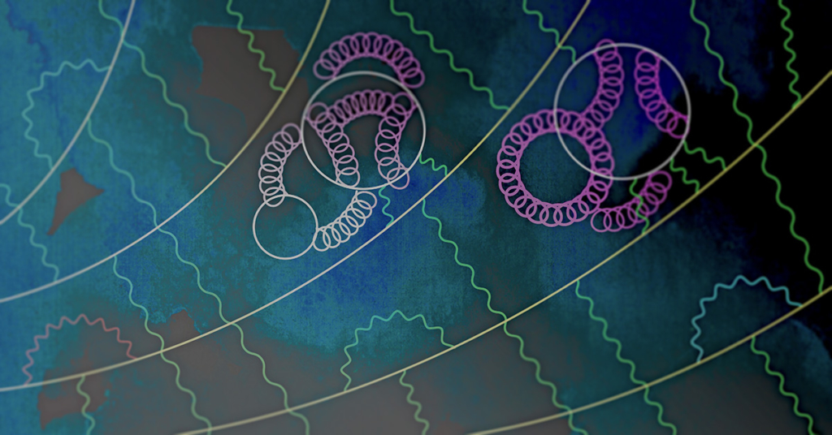
Recent advances for the muon anomalous magnetic moment from lattice QCD
Tom Blum (UConn/RBRC)
First LatticeNet
workshop on challenges in lattice field theory
Centro de Ciencias de Benasque Pedro Pascual
September 15, 2022
Anomalous moment for the muon, Cern Courier May/June 2021
Credit: Mark Rayner/CERN

Slide 2
Outline
Hadronic Vacuum Polarization Contribution
  intermediate window
  short distance window
  isospin symmetry breaking corrections
  long distance window
  total contribution
Hadronic Light by Light Scattering Contribution
Summary/Outlook

Slide 3
Hadronic vacuum polarization contribution from Lattice QCD
Calculate C(t) on 4d
Euclidean space-time lattice
RBC/UKQCD 2018
Notes:
Euclidean space time lattice for HVP, quarks props: large sparse matrix, gluons: MC integration of gauge fields

Slide 4
Outline
Hadronic Vacuum Polarization Contribution
  intermediate window
  short distance window
  isospin symmetry breaking corrections
  long distance window
  total contribution
Hadronic Light by Light Scattering Contribution
Summary/Outlook

Slide 5
(slide: C. Lehner, muon g-2 TI 5th Plenary Workshop, Edinburgh 2022)

Slide 6
RBC/UKQCD 2018
Fig.: G. Colangelo, PWA12/ATHOS7 2021
Fig.: RBC/UKQCD 2018

Slide 7
From Aubin et al. talk at the 2019 Muon g-2 TI workshop in Seattle

Slide 8
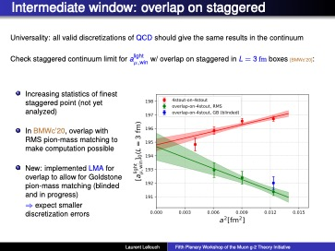
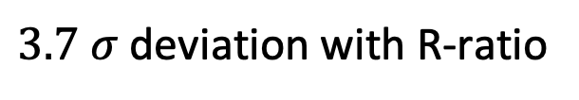
BMWc (talk by L. Lellouch)
$3.7 σ$ deviation with R-ratio
blinded

Slide 9
ABGP (talk by T. Blum)
SRHO model
NLO SChPT
NNLO SChPT
R-ratio
R-ratio
Compatible with BMW; NNLO SChPT no good
SRHO model and NLO SChPT about the same
but different values in continuum limit
Need smaller lattice spacing
Issue: no reliable calc. of corrections!
𝑎_{𝜇}^{𝑊1,lqc} = 206.8(2.2) × 10⁻¹⁰

Slide 10
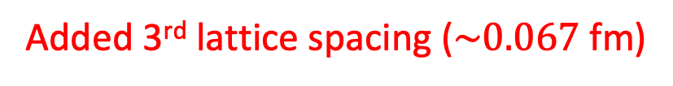
RBC/UKQCD (talk by C. Lehner)
Added 3rd lattice spacing ($\sim 0.067$ fm)

Slide 11
RBC/UKQCD (talk by C. Lehner)
8 different combinations of
currents, Z factors, weighting functions
fit simultaneously to common continuum limit

Slide 12
RBC/UKQCD (talk by C. Lehner)

Slide 13
Mainz (talk by S. Kuberski)
(see Simon’s talk tomorrow)

Slide 14
ETMc (talk by G. Gagliardi)

Slide 15
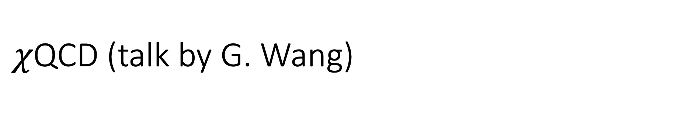
$χ$QCD (talk by G. Wang)

Slide 16
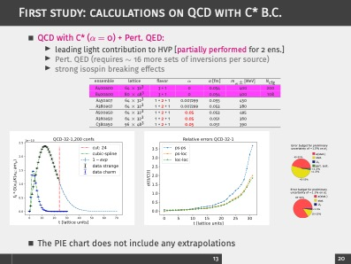
RC* (talk by J. Komijani)

Slide 17
Fermilab-HPQCD-MILC
(talk by S. Gottlieb this afternoon)

Slide 18
Summary of Intermediate Window Results
(figure: C. Lehner, g-2 TI WS, Edinburgh 2022)
Colangelo et al. shifted by -29.10 for strange, etc. from RBC/UKQCD 2018
A discrepancy between lattice and R-ratio of size 5-7 x 10⁻¹⁰
(about ½ of total between BMW and R-ratio)

Slide 19
Outline
Hadronic Vacuum Polarization Contribution
  intermediate window
  short distance window
  isospin symmetry breaking corrections
  long distance window
  total contribution
Hadronic Light by Light Scattering Contribution
Summary/Outlook

Slide 20
RBC/UKQCD (talk by C. Lehner)

Slide 21
ETMc (talk by G. Gagliardi)
+ s, c, b, IB, disconnected
Light quark, connected

Slide 22
Outline
Hadronic Vacuum Polarization Contribution
  intermediate window
  short distance window
  isospin symmetry breaking corrections
  long distance window
  total contribution
Hadronic Light by Light Scattering Contribution
Summary/Outlook

Slide 23
Isospin-breaking contributions

Slide 24
RBC/UKQCD (talk by M. Bruno)
$\sim +7 σ$discrepancy with e⁺e⁻ R-ratio determination

Slide 25
Outline
Hadronic Vacuum Polarization Contribution
  intermediate window
  isospin symmetry breaking corrections
  short distance window
  long distance window
  total contribution
Hadronic Light by Light Scattering Contribution
Summary/Outlook

Slide 26
Long distance contribution: Low Mode Average
(LMA: Neff et al., Giusti et al., Degrand and Schaefer)
Degenerate light quark contribution (u+d)
(see Simon’s talk tomorrow)
ABGP 19
m_{π} =133 MeV
m_{π} =129 MeV
(figure: S. Kuberski, g-2 TI 2022, Edinburgh and talk tomorrow)
RBC/UKQCD 18, ABGP 19, 22, BMWc 20, FHM, Mainz, …
(C(t) averaged over all EM current source-sink pairs)

Slide 27
Long Distance Contribution: spectral reconstruction
Mainz, RBC/UKQCD 2019 (see Simon’s talk tomorrow)
m_{π}=129 MeV
(figure: S. Paul, Lattice 2022)

Slide 28
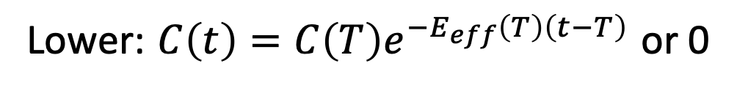
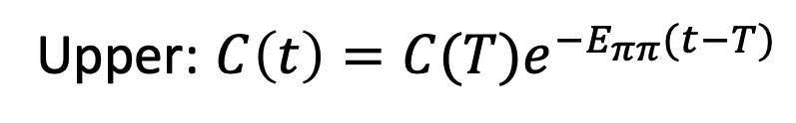
Long Distance Contribution: bounding method
Impose strict upper and lower bounds on C(t) for t > T:
Upper: $C\left(t\right)=C(T)e^{−E_{ππ}(t−T)}$
Lower: $C\left(t\right)=C\left(T\right)e^{−E_{eff}\left(T\right)\left(t−T\right)}$ or 0
Original method: RBC/UKQCD, BMWc
Mainz-19, RBC/UKQCD: Improved method
using long distance correlator reconstruction
T
T
(figure: A. Meyer, RBC/UKCD)
t/a
t/a
LMA + spectral reconstruction + bounding method = sub-percent statistical errors on total

Slide 29
Outline
Hadronic Vacuum Polarization Contribution
  intermediate window
  isospin symmetry breaking corrections
  short distance window
  long distance window
  total contribution
Hadronic Light by Light Scattering Contribution
Summary/Outlook

Slide 30
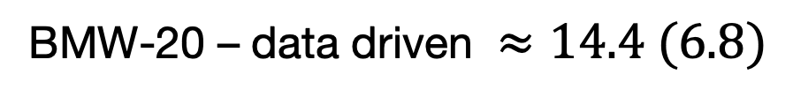
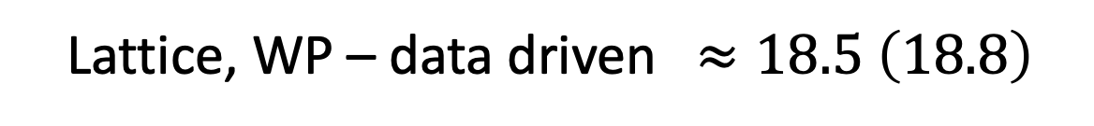
a_{μ}-HVP Summary (TI WP 2020+)
(0.75%)
HVP (BMW-20): a_{μ} = 707.5 (5.5) x 10⁻¹⁰
(2.6%)
HVP (Lattice, WP): a_{μ} = 711.6 (18.4) x 10⁻¹⁰
(0.58%)
HVP (data driven): a_{μ} = 693.1 (4.0) x 10⁻¹⁰
Lattice, WP – data driven $≈18.5 \left(18.8\right)$
BMW-20 – data driven $≈14.4 (6.8)$
30

Slide 31
Disconnected contributions
Improving, but can be further cleaned up

Slide 32
ABGP (talk by T. Blum)

Slide 33
ABGP (talk by T. Blum)

Slide 34
Total HVP Contribution Summary

Slide 35
Outline
Hadronic Vacuum Polarization Contribution
  intermediate window
  isospin symmetry breaking corrections
  short distance window
  long distance window
  total contribution
Hadronic Light by Light Scattering Contribution
Summary/Outlook

Slide 36
(T. Blum, g-2 TI WS 2022, Edinburgh)

Slide 37
(T. Blum, g-2 TI WS 2022, Edinburgh)

Slide 38

RBC/UKQCD: QED_{L}
Blum, et al. PRL 124 (2020)
Editor’s Suggestion
$$a_{μ}^{HLBL}=7.87±3.06±1.77×{10}^{−10}$$
RBC: first lattice calculation with all errors controlled.
1 G core-hours on ALCF’s Mira (BG/Q).
1st HLbL calculation was done on USQCD resources (Blum, et al., PRL 114 (2015))
Crucial for Standard Model Comparison
Included in Muon g-2 Theory Initiative average
  92(19)x 10⁻¹¹ (phenomenology)
  90(17)x 10⁻¹¹ (phenomenology+lattice)
Unlikely to explain discrepancy with experiment
Notes:
Consistency between lattice and pheno for both hvp and hlbl crucial for discovery of new physics

Slide 39

RBC-UKQCD QED$∞$(talk by T. Blum)

Slide 40

Mainz QED$∞$ (talk by A. G$\acute{e}$rardin)
Notes:
Consistency between lattice and pheno for both hvp and hlbl crucial for discovery of new physics

Slide 41

Mainz QED$∞$ (talk by A. G$\acute{e}$rardin)
Notes:
Consistency between lattice and pheno for both hvp and hlbl crucial for discovery of new physics

Slide 42

RBC-UKQCD QED$∞$(talk by T. Blum)
(T. Blum (RBC), g-2 TI WS 2022, Edinburgh)

Slide 43
Hadronic Light-by-Light Summary

Slide 44
Outline
Hadronic Vacuum Polarization Contribution
  intermediate window
  isospin symmetry breaking corrections
  short distance window
  long distance window
  total contribution
Hadronic Light by Light Scattering Contribution
Summary/Outlook

Slide 45
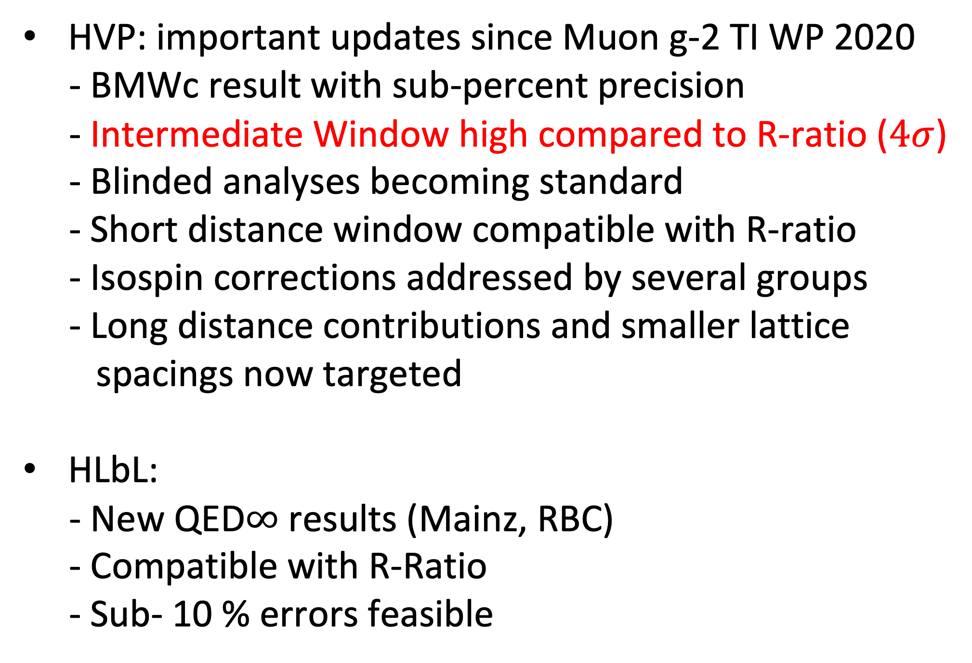
Summary/Outlook
HVP: important updates since Muon g-2 TI WP 2020
- BMWc result with sub-percent precision
- Intermediate Window high compared to R-ratio ($4σ$)
- Blinded analyses becoming standard
                - Short distance window compatible with R-ratio
                - Isospin corrections addressed by several groups
                - Long distance contributions and smaller lattice
                spacings now targeted
            HLbL:
            - New QED$∞$ results (Mainz, RBC)
            - Compatible with R-Ratio
            - Sub- 10 % errors feasible

Slide 46
Acknowledgements
Work partially supported by US Department of Energy (DOE)
Computations done on
  ALCF at Argonne (MIRA) and OLCF at Oakridge under ALCC (US DOE)
  Bridges2 at PSC, Expanse at SDSC, and Stampede2 at TACC under XSEDE (US NSF)
  USQCD KNL cluster at JLAB (US DOE)

