Slide 1
Beyond the adiabatic approximation

Slide 2
Hamiltonian for the complete system of N_{e} electrons with coordinates and N_{n} nuclei with coordinates
with
Time-dependent Schrödinger equation

Slide 3
Standard approach to deal with the full e-n problem
1st step: Solve the electronic-structure problem with clamped nuclei
for each fixed nuclear configuration
J=1
J=0

Slide 4
2nd step: Adiabatic approximation

Slide 5
“Variationally best” adiabatic approximation
Berry connection

Slide 6
Where does the adiabatic approximation come from?
What is neglected?
Expand full electron-nuclear wave function in complete set of BO
States (Born-Huang expansion) to get formally exact representation:
and insert expansion in the full Schrödinger equation → standard non-adiabatic coupling terms from T_{n} acting on

Slide 7
Plug Born-Huang expansion in full TDSE:
NAC-1
NAC-2

Slide 8
Plug Born-Huang expansion in full TDSE:
NAC-1
Setting NACs ≡0 is the adiabatic approximation.
NAC-2

Slide 9
Plug Born-Huang expansion in full TDSE:
NAC-1
Setting NACs ≡0 is the adiabatic approximation.
Setting only the off-diagonal NACs ≡0 corresponds to the variationally best adiabatic approximation.
NAC-2

Slide 10
Good approximation for vibrational spectroscopy
Essentially all calculations of vibrational spectra make two approximations:
Adiabatic approximation
Harmonic approximation

Slide 11
Vibrational spectra are usually very well described within
the adiabatic approach, but not always! (Hammes-Schiffer)
Similar situation, but TD:
Zewail experiments

Slide 12
Na⁺+ I⁻
Na + I
Two BO potential energy surfaces of equal importance

Slide 13
Na⁺+ I⁻
Na + I
Nuclear
Density:

Slide 14
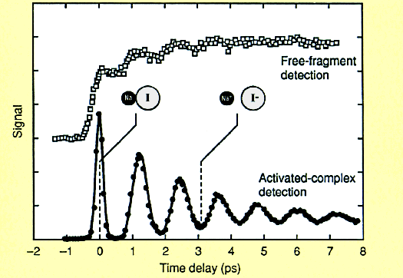
Na⁺+ I⁻
Na + I
emitted neutral Na atoms
Nuclear
Density:

Slide 15
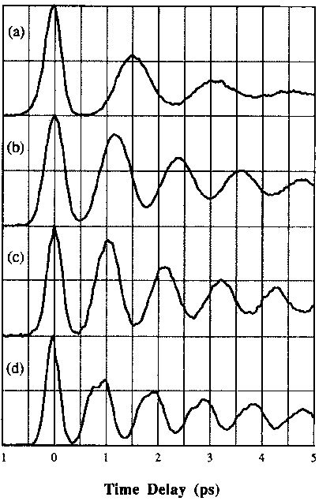
Effect of tuning pump wavelength (exciting to different points on excited surface)
λ_{pump}/nm
300
311
321
Different periods indicative of anharmonic potential
339
T.S. Rose, M.J. Rosker, A. Zewail, JCP 91, 7415 (1989)

Slide 16
Dramatic failure of the adiabatic approximation: Calculation of electronic flux density associated with nuclear motion
Adiabatic approximation (dynamics on a single BO-PES)
with non-degenerate, real-valued BO state
Time-dependent electronic (N-body, or one-body) density:
very close to true TD density
completely wrong!! Dramatic failure of adiabatic approximation

Slide 17
When the adiabatic approximation fails one has
to go back to the Born-Huang expansion.
When only two (or few) surfaces are important
(like in Zewail experiment) that’s feasible.
Problem: Born-Huang expansion not feasible
for larger molecules or solids

Slide 18
The exact factorization

Slide 19
The exact factorization
“Exactification”
of the adiabatic approximation

Slide 20
electrons and nuclei
Fully QM
electrons and nuclei
Full problem
electrons
nuclei

Slide 21
Theorem I
The exact solution of
can be written in the form
where
for any fixed .
A. Abedi, N.T. Maitra, E.K.U.G., PRL 105, 123002 (2010), JCP 137, 22A530 (2012).
Static case:
N. Gidopoulos, E.K.U.G. arXiv 0502433, Phil. Trans. R. Soc. A372, 20130059 (2014).

Slide 22
Theorem II
satisfy the equations
A. Abedi, N.T. Maitra, E.K.U.G., PRL 105, 123002 (2010), JCP 137, 22A530 (2012).
Static case:
N. Gidopoulos, E.K.U.G. arXiv 0502433, Phil. Trans. R. Soc. A372, 20130059 (2014).

Slide 23
Theorem II
satisfy the equations
A. Abedi, N.T. Maitra, E.K.U.G., PRL 105, 123002 (2010), JCP 137, 22A530 (2012).
Static case:
N. Gidopoulos, E.K.U.G. arXiv 0502433, Phil. Trans. R. Soc. A372, 20130059 (2014).

Slide 24
Properties of the exact electronic EoM:
Non-linear equation in $φ_{R}\left(rt\right)$ because of $A[φ]$
Non-adiabatic terms are not operators in the electronic Hilbert space
in BO-basis: non-Hermitian matrix, still the time-propagation conserves norm
Electronic EoM depends on $χ\left(Rt\right)$
Properties of the exact nuclear EoM:
Standard TDSE
Scalar potential is N_{n}-body interaction
Vector potential is N_{n}-body operator, i.e. 3D vector field depending on

Slide 25
Theorem III:
The TDSE for the nuclear factor yields both the exact nuclear
N-body probability density and the exact nuclear N-body
current density from:

Slide 26
Analogously:
true momentum of nuclear subsystem
true angular momentum of
nuclear subsystem
can be calculated from the nuclear wave function alone as:

Slide 27
Theorem IV: Subsystem Ehrenfest equations:
Lorentz-like force
with
electric-like field
Berry curvature
Lorentz-like force, but with internuclear Berry curvature
with

Slide 28
in the subsystem Ehrenfest equations
in the classical limit of the nuclear TDSE
in the mixed-quantum-classical algorithm
These forces appear:
Chen Li, R. Requist, EKU Gross, PRL 128, 113001 (2022)
F. Agostini, A. Abedi, EKU Gross, JCP 141, 214101 (2014)
A. Abedi, F. Agostini, EKU Gross, EPL 106, 33001 (2014)
S.K. Min, F. Agostini, E.K.U. Gross, Phys. Rev. Lett. 115, 073001 (2015)
F. Agostini, S.K. Min, I. Tavernelli, E.K.U. Gross, JPCL 8, 3048 (2017)
Note:
These forces are the “right” classical forces. There
are no other choices!
These forces appear in any two-component system
(not just for electrons and nuclei)

Slide 29
Are the Lorentz-like forces important?
For a neutral atom moving in a constant external magnetic field,
the magnetic field associated with the Berry connection cancels
the external magnetic field exactly (making the atom move on a
straight line).
The internuclear Lorentz force, D, plays an important role in
the energy transfer from electrons to nuclei in the
“atomic water wheel”
central region C
left lead L
right lead R
-- atomic waterwheels (Dundas, McEniry, Todorov,
Nature nanotechnology 4, 99 (2009))

Slide 30
On the exact level, the electronic and nuclear EoMs following from
the factorization are equivalent to the full TDSE.
Crucial advantage:
Nuclei and electrons satisfy separate equations
Useful starting point to make approximations
Which approximations?
Perturbation theory for non-adiabatic terms in electronic EoM
Mixed quantum-classical approach (for large-amplitude nuclear
motion)
Density-functionalization of the electronic EoM of the factorization

Slide 31
Theorem II
satisfy the equations
A. Abedi, N.T. Maitra, E.K.U.G., PRL 105, 123002 (2010), JCP 137, 22A530 (2012).
Static case:
N. Gidopoulos, E.K.U.G. arXiv 0502433, Phil. Trans. R. Soc. A372, 20130059 (2014).

Slide 32
Theorem II
satisfy the equations
μ⁴
μ⁴
μ⁴
Important: There is a small parameter:
(equations are in atomic units, and nuclear masses in multiples of )

Slide 33
Use electronic EoM of exact factorization and treat the non-adiabatic terms in 1st-order perturbation theory to determine the electronic flux density
μ⁴
μ⁴
A. Schild, F. Agostini, EKUG., J. Phys. Chem. A 120, 3316 (2016)
A. Scherrer, F Agostini, D. Sebastiani, EKUG., R. Vuilleumier,
JCP 143, 074106 (2015) , and PRX 7, 031035 (2017).

Slide 34
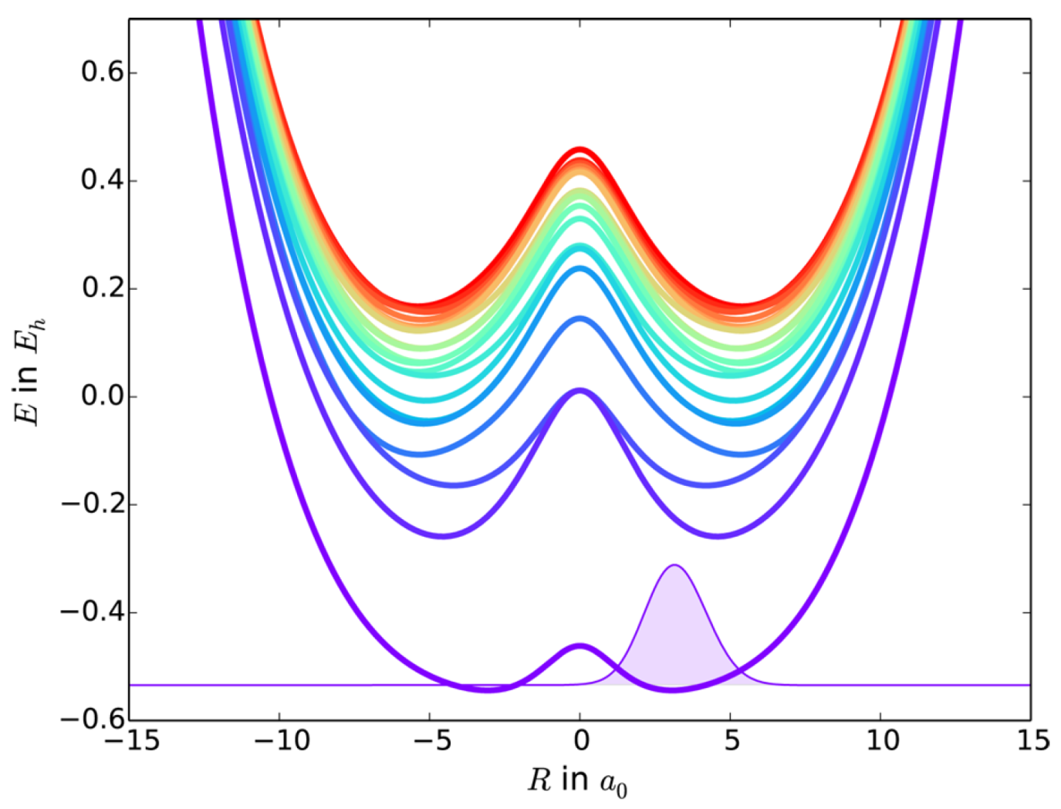
Model Study:
One electron in 2D (x,y), one nucleus in 1D (R), and another very heavy
nucleus clamped at the origin, all interacting with soft Coulomb potentials
Lowest 20 Born−Oppenheimer potential energy surfaces and
initial BO wave function.

Slide 35
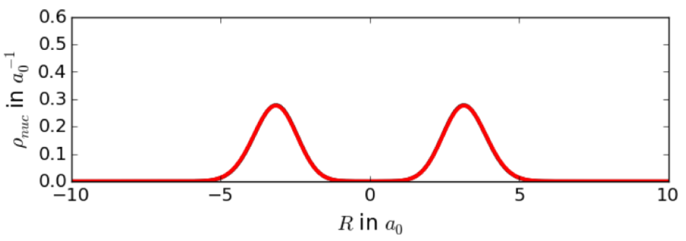
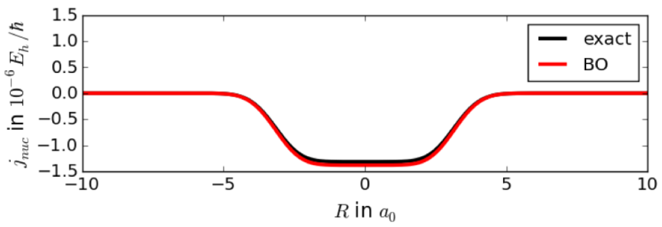
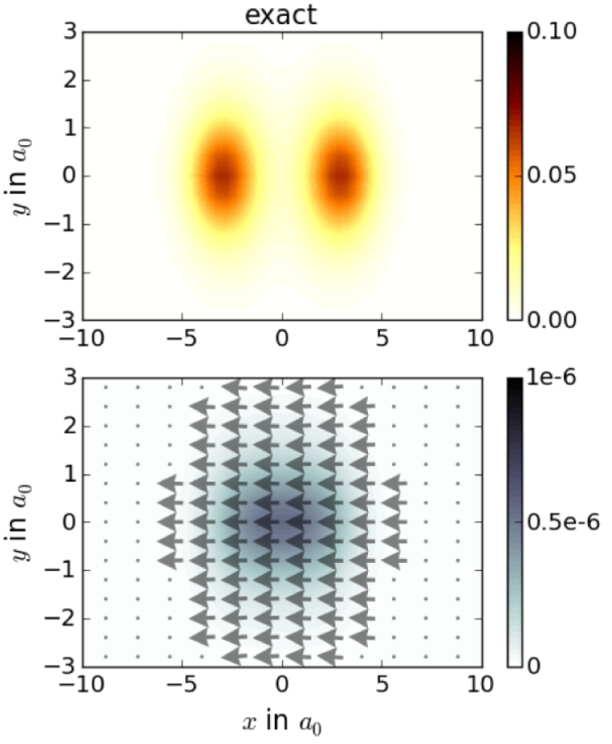
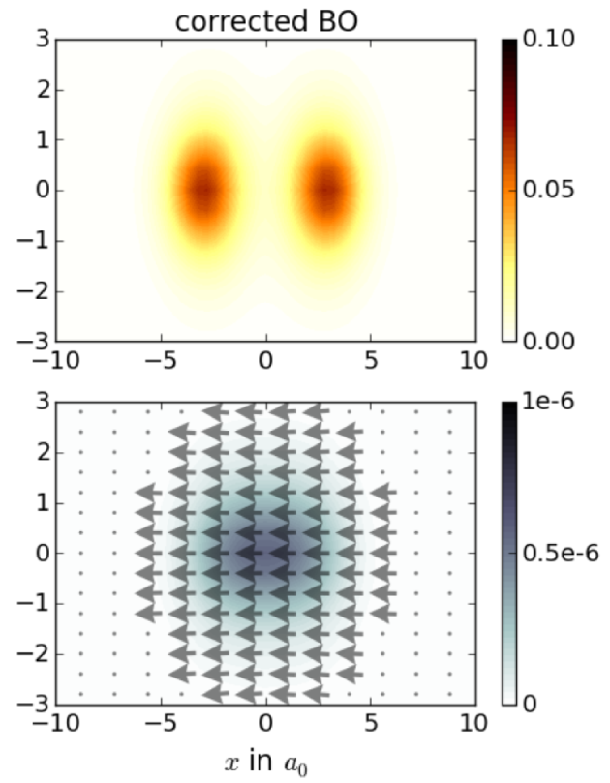

Slide 36
Vibrational circular dichroism
Absorption difference between lefthanded and righthanded
circularly polarized light:
with harmonic vibrational frequencies ω_{k} and refractive index n(ω) and
Rotational strength:

Slide 37
Electronic contributions to the electric current and to the magnetic
dipole moment vanish identically in the adiabatic approximation.
Employ the exact factorization:
and evaluate Φ_{R} within first-order PT, employing DFT-PT

Slide 38
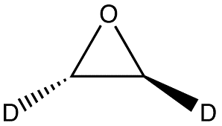
Normal modes, dipole and rotational strengths, for (S)-d₂-oxirane.
 | D_{MFP} | D_{NVP} |  | R_{MFP} |  | R_{NVP}
ῦ(cm⁻¹) | (10⁻⁴⁴ esu² cm²) |  |  | (10⁻⁴⁴ esu² cm²)
647.50 | 0.55 | 0.85 |  | −0.35 | −0.45
733.42 | 123.35 | 124.88 |  | 8.73 | 10.54
769.76 | 53.44 | 51.77 |  | 3.17 | 3.29
856.38 | 145.31 | 145.55 |  | 4.31 | 2.70
894.67 | 9.78 | 10.24 |  | −3.37 | −3.89
936.33 | 39.73 | 39.24 |  | −19.14 | −20.26
1088.21 | 3.79 | 4.44 |  | 6.95 | 8.34
1093.95 | 1.41 | 1.71 |  | −3.98 | −4.97
1210.44 | 26.26 | 26.09 |  | 9.56 | 10.45
1326.86 | 0.34 | 0.37 |  | −0.91 | −0.76
1377.38 | 11.65 | 10.78 |  | −7.50 | −8.17
2235.16 | 49.17 | 50.88 |  | −22.60 | −22.90
2244.19 | 12.63 | 12.81 |  | 16.80 | 16.78
3047.68 | 11.43 | 11.66 |  | −32.80 | −32.59
3054.15 | 58.64 | 60.16 |  | 46.63 | 47.04
A. Scherrer, F Agostini, D. Sebastiani, EKUG., R. Vuilleumier, JCP 143, 074106 (2015)

Slide 39
Coupled-Trajectory Mixed Quantum-Classical Algorithm
Treat the nuclear motion with classical trajectories, but retain
the quantum treatment of the electronic degrees of freedom.
S.K. Min, F. Agostini, E.K.U. Gross, Phys. Rev. Lett. 115, 073001 (2015)
F. Agostini, S.K. Min, I. Tavernelli, E.K.U. Gross, JPCL 8, 3048 (2017)

Slide 40
Electronic EoM
Nuclear EoM
Represent χ(R,t) by swarm of classical trajectories (method
of charactristics). Classical forces are unique. No need for
Tully surface hopping and decoherence corrections.

Slide 41
Electronic EoM
Represent Φ(r|R(t)) along the nuclear trajectories by Born-Huang expansion and plug into EoM. Ultimately needed are
vertical excitation energies and NAC’s along the trajectories, calculated with linear-response TDDFT.
Nuclear EoM
Represent χ(R,t) by swarm of classical trajectories (method
of charactristics). Classical forces are unique. No need for
Tully surface hopping and decoherence corrections.

Slide 42
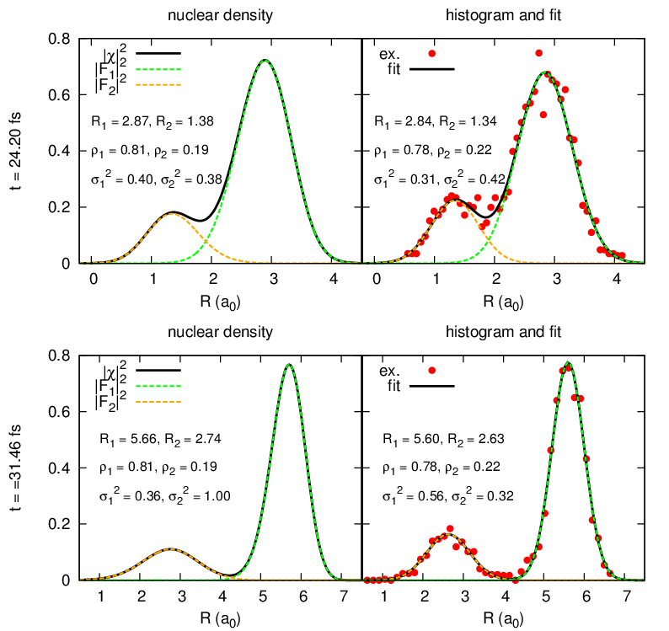
Propagation of classical nuclei on exact TDPES (for Chin-Metiu model)

Slide 43
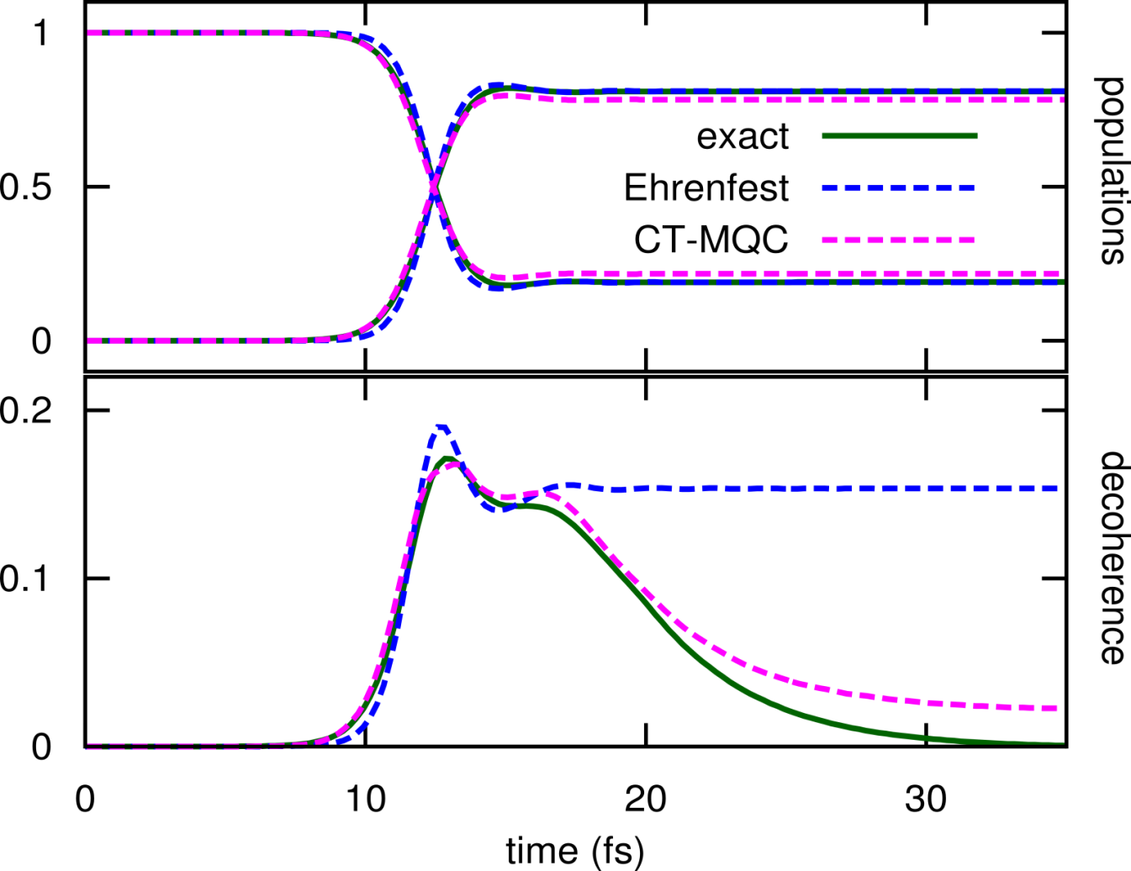
Measure of decoherence:
Quantum:
Trajectories
$$\int{d\underline{\underline{R}}{\left|C_{1}\left(\underline{\underline{R}},t\right)\right|}^{2}{\left|C_{2}\left(\underline{\underline{R}},t\right)\right|}^{2}{\left|χ\left(\underline{\underline{R}},t\right)\right|}^{2}}$$
$$N_{traj}^{−1}\sum_{I}{{\left|C_{1}^{\left(I\right)}\left(t\right)\right|}^{2}{\left|C_{2}^{\left(I\right)}(t)\right|}^{2}}$$

Slide 44
Photo-induced ring opening in Oxirane

Slide 45
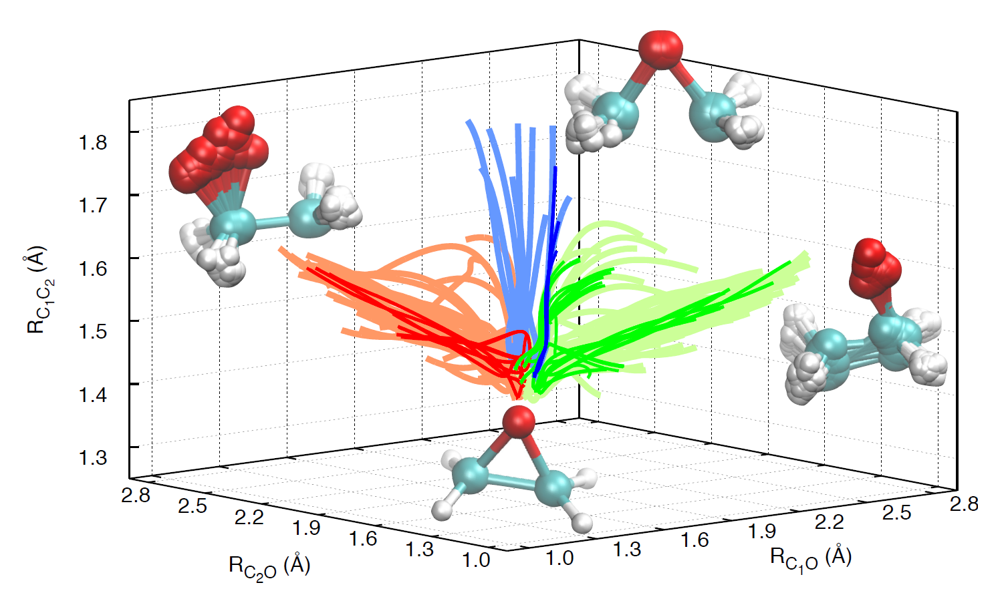
Identification of the three groups of trajectories that, starting from the initial geometries, yield right-open (red) or left-open (green) ring structures and CC-extended bond geometry (blue).
Result: Probability of ring-opening by oxygen motion is about 4 times larger than the C-C-bond stretch. Light colors identify CT-MQC trajectories and darker colors corr-FSSH trajectories.
F. Agostini, S.K. Min, I. Tavernelli, E.K.U. Gross, J.Phys.Chem. Lett. 8, 3048 (2017)

Slide 46
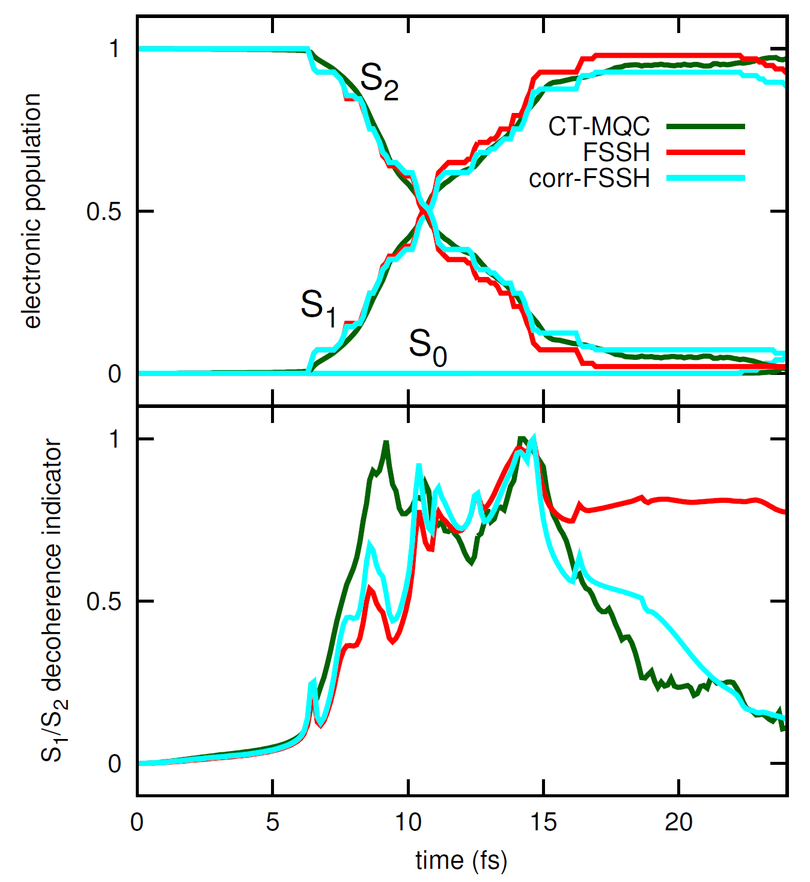
Upper panel: electronic populations of S0, S1 and S2 as functions of time. Lower panel: indicator of decoherence for the element S1=S2. Three sets of results are compared, based on the CT-MQC algorithm (dark-green lines), FSSH (red lines) and corr-FSSH (cyan lines).
F. Agostini, S.K. Min, I. Tavernelli, E.K.U. Gross, J.Phys.Chem. Lett. 8, 3048 (2017)

Slide 47
Upper panel: electronic populations of S0, S1 and S2 as functions of time. Lower panel: indicator of decoherence for the element S1=S2. Three sets of results are compared, based on the CT-MQC algorithm (dark-green lines), FSSH (red lines) and corr-FSSH (cyan lines).
Algorithm implemented
in CPMD
F. Agostini, S.K. Min, I. Tavernelli, E.K.U. Gross, J.Phys.Chem. Lett. 8, 3048 (2017)

Slide 48
DFT of the combined system of electrons and phonons,
based on the exact factorization
R Requist, EKU Gross, Phys. Rev. Lett. 117, 193001 (2016).
Chen Li, R Requist, EKU Gross, JCP 148, 084110 (2018).
R Requist, C Proetto, EKU Gross, Phys. Rev. B 99, 165136 (2019)

Slide 49
Basic densities
Electrons: n(r|R) conditional probability of finding an electron
at r, given the nuclei are at R.
follows directly from the exact electronic
conditional wave function Φ(r , r₂, … |R)
Nuclei: Γ(R₁, R₂, …. ) = |χ(R₁, R₂, …. )|² nuclear N-body
density as it follows from exact factorization

Slide 50
Electronic Kohn-Sham equation:
is a functional of n(r|R): need approximations

Slide 51
Nuclear “Kohn-Sham” equation:
identical with the nuclear equation from the exact factorization
In practice: Expand all functions w.r.t. their R-dependence
around equilibrium positions exact phonons

Slide 52
Take expansion to 2nd order in the displacements
Makc transformation to collective coordinates
(and analogously for the conjugate momenta)

Slide 54
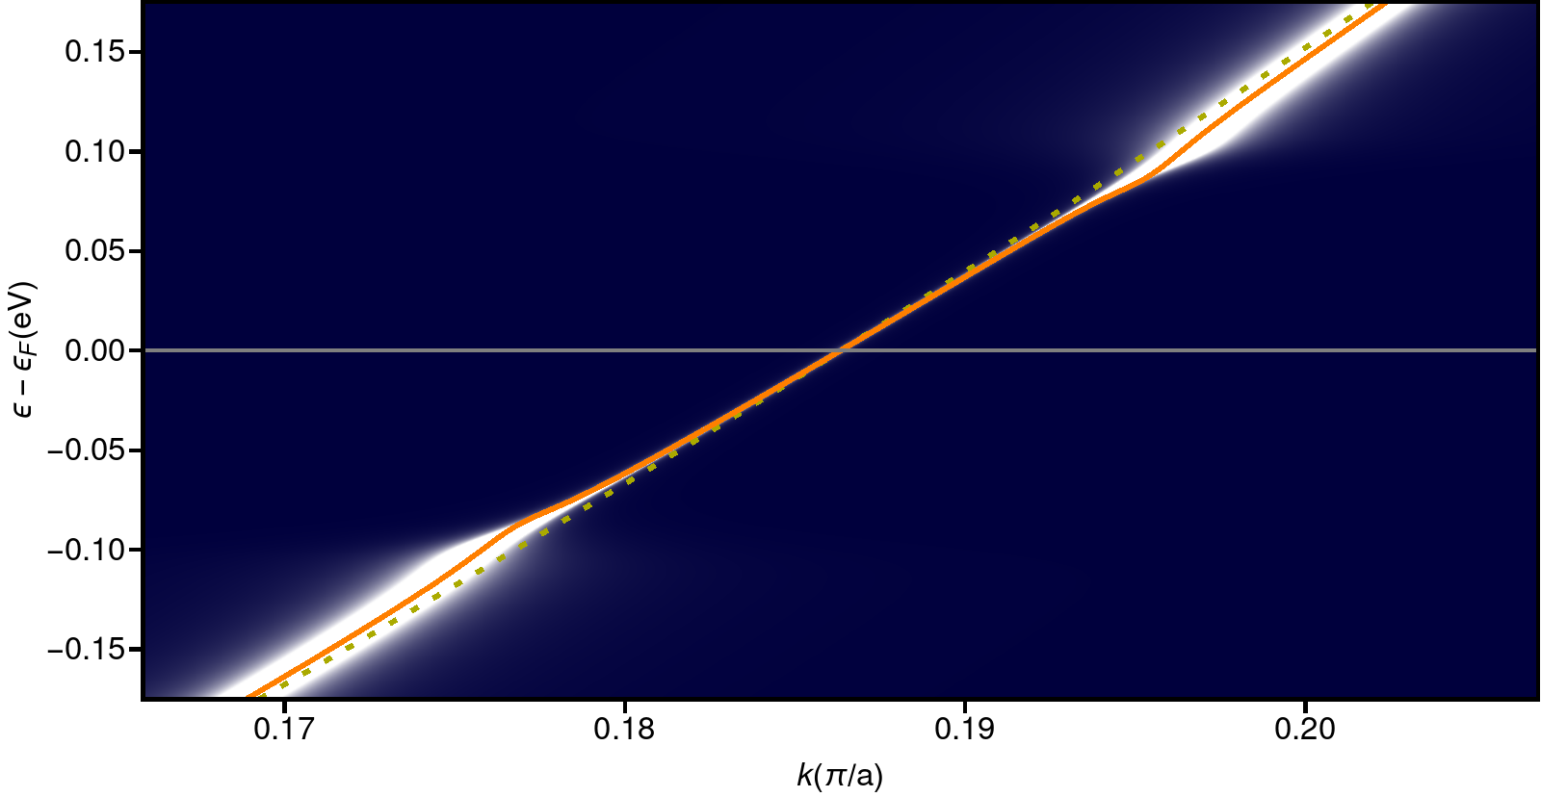
The Kohn-Sham band structure (orange) in exact factorization-based
DFT captures the phonon-induced wiggle in the electronic spectral function

Slide 55
Take-home messages
Exact factorization useful to settle conceptual issues
identify uniquely the correct forces on the nuclei,
especially Lorentz force involving internuclear Berry curvature
Exact factorization useful to develop practical algorithms
Starting from the right Schrödinger equation for the nuclei (the one
that comes from the exact factorization), the resulting mixed quantum-
classical algorithm correctly describes wave packet splitting and
decoherence: No need for surface hopping nor decoherence corrections.
Treating the non-adiabatic terms in the exact electronic EoM
by 1st-order perturbation theory provides an accurate and
numerically efficient way to calculate electronic
flux densities and vibrational circular dichroism.
(TD)DFT for the combined system of electrons and phonons

