Slide 1
DFT and TDDFT: The basics
E.K.U. Gross
Fritz Haber Center for Molecular Dynamics

Slide 2
Hamiltonian for the complete system of N_{e} electrons with coordinates and N_{n} nuclei with coordinates
with

Slide 3
Hamiltonian for the complete system of N_{e} electrons with coordinates and N_{n} nuclei with coordinates
with
Stationary Schrödinger equation

Slide 4
Hamiltonian for the complete system of N_{e} electrons with coordinates and N_{n} nuclei with coordinates
with
Time-dependent Schrödinger equation

Slide 5
Born-Oppenheimer problem:
Neglect nuclear kinetic energy in full Hamiltonian
To be solved for each fixed nuclear configuration
J=1
J=0

Slide 6
Adiabatic approximation for the complete molecular wave function:
find best χ^{BO} by minimizing <Ψ^{BO} | H | Ψ^{BO} > w.r.t. χ^{BO}

Slide 7
Nuclear equation
Berry connection
is a geometric phase
reflecting topological features of the molecule
expansion of PES to second order around equilibrium
positions yields phonon spectrum

Slide 8
Lectures I+II+III: Focus on the electronic-structure problem, for static
and time-dependent systems, but with clamped nuclei
(i.e. Born-Oppenheimer approximation):
with fixed nuclear coordinates

Slide 9
Lectures I+II+III: Focus on the electronic-structure problem, for static
and time-dependent systems, but with clamped nuclei
(i.e. Born-Oppenheimer approximation):
with fixed nuclear coordinates
This is still an exponentially hard problem!
Lecture I: Ground-state DFT, basic concepts
Lecture II: Approximate xc functionals
Lecture III: Time-dependent DFT, linear response and beyond
Lecture IV: Electron-nuclear coupling beyond Born-Oppenheimer

Slide 10
Why don’t we just solve the many-particle SE?
Example: Aluminium atom (13 electrons)
depends on 39 coordinates
rough table of the wavefunction
10 entries per coordinate: ⇒ 10³⁹ entries
1 byte per entry: ⇒ 10³⁹ bytes
10¹² bytes per SSD: ⇒ 10²⁷ SSDs
20 g per SSD: ⇒ 2×10²⁸ g SSDs
For Ti atom the required mass of SSDs exceeds mass
of the universe

Slide 11
Two fundamentally different classes of ab-initio approaches:
Wave function approaches
-- Configuration interaction
(also stochastic CI)
-- Tensor networks
“Functional Theories”

Slide 12
Two fundamentally different classes of ab-initio approaches:
Wave function approaches
-- Configuration interaction
(also stochastic CI)
-- Tensor networks
“Functional Theories”
Write total energy as functional
of a simpler quantity and minimize

Slide 13
Motivation
“Functional Theories”
MBPT
RDMFT
DFT

Slide 14
Motivation
“Functional Theories”
MBPT
RDMFT
DFT
Functional:
Φ_{xc}[G]
or Σ_{xc}[G]
Functional:
E_{xc}[γ]
Functional:
E_{xc}[ρ]
or v_{xc}[ρ]

Slide 15
Motivation
“Functional Theories”
MBPT
RDMFT
DFT
Functional:
Φ_{xc}[G]
or Σ_{xc}[G]
easy (e.g. GW)
Functional:
E_{xc}[γ]
difficult
Functional:
E_{xc}[ρ]
or v_{xc}[ρ]
very difficult

Slide 16
Motivation
“Functional Theories”
MBPT
RDMFT
DFT
Functional:
Φ_{xc}[G]
or Σ_{xc}[G]
easy (e.g. GW)
numerically
heavy
Functional:
E_{xc}[γ]
difficult
moderate
Functional:
E_{xc}[ρ]
or v_{xc}[ρ]
very difficult
light

Slide 17
Each of these functional theories comes in two
versions:
a ground-state (or equilibrium) version
a time-dependent (or non-equilibrium) version

Slide 18
ESSENCE OF DENSITY-FUNTIONAL THEORY
Every observable quantity of a quantum system can be calculated from the density of the system ALONE
The density of particles interacting with each other can be calculated as the density of an auxiliary system of non-interacting particles

Slide 19
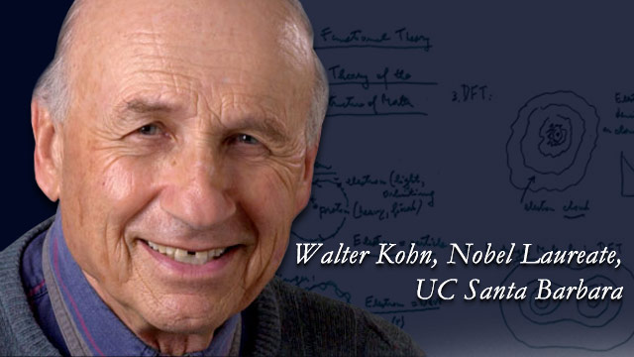
ESSENCE OF DENSITY-FUNTIONAL THEORY
Every observable quantity of a quantum system can be calculated from the density of the system ALONE
The density of particles interacting with each other can be calculated as the density of an auxiliary system of non-interacting particles
Hohenberg-Kohn theorem (1964)
Kohn-Sham theorem (1965)
(for the ground state)

Slide 20
HOHENBERG-KOHN THEOREM
v(r) ρ(r)
one-to-one correspondence between external potentials v(r) and ground-state densities ρ(r). Consequence: Many-body WF is uniquely determined by the density, Ψ = Ψ[ρ], and hence all expectation values w.r.t. Ψ[ρ] are functionals of ρ(r).
Variational principle
Given a particular system characterized by the external potential v₀(r). There exists a functional, E_{HK} [ρ], such that the solution of the Euler-Lagrange equation
yields the exact ground-state energy E₀ and ground-state density ρ₀(r) of this system
E_{HK}[ρ] = < Ψ[ρ]|T+V_{ee}+V₀| Ψ[ρ]> = F[ρ] + ρ(r) v₀(r) d³r
F[ρ] is UNIVERSAL. In practice, F[ρ] needs to be approximated
1—1

Slide 21
compare ground-state densities ρ(r) resulting from different external potentials v(r).
ρ(r)
v(r)
QUESTION: Are the ground-state densities coming from different potentials always different?

Slide 22
G
A
Ã
ρ (r)
v(r)
Ψ (r₁…r_{N})
single-particle
potentials having
nondegenerate ground state
ground-state
densities
ground-state
wavefunctions
Hohenberg-Kohn-Theorem (1964)
G: v(r) → ρ (r) is invertible

Slide 23
Proof
Step 1: Invertibility of map A
Solve many-body Schrödinger equation for the external potential:
This is manifestly the inverse map: A given Ψ uniquely yields the external potential.

Slide 24
Step 2: Invertibility of map Ã
Given: two (nondegenerate) ground states Ψ, Ψ’ satisfying
with
to be shown:
Ψ
Ψ’
ρ = ρ’
cannot happen

Slide 25
Use Rayleigh-Ritz principle:
Proof by reductio ad absurdum:
Assumption ρ = ρ’. Add the two inequalities ⇒ E + E’ < E + E’

Slide 26
Consequence
Every quantum mechanical observable is completely determined by the ground state density.
Proof:
Hermitian operator
e.g. excitation spectrum: E_{i}[ρ]

Slide 27
What is a FUNCTIONAL?
E[ρ]
functional
ρ(r)
R
set of functions
set of real numbers
Generalization:
functional depending parametrically on
or on

Slide 28
QUESTION:
How to calculate ground state density of a given system (characterized by the external potential ) without recourse to the Schrödinger Equation?
Theorem:
There exists a density functional E_{HK}[ρ] with properties
i) E_{HK}[ρ] > E_{o} for ρ ≠ ρ_{o}
ii) E_{HK}[ρ_{o}] = E_{o}
where E_{o} = exact ground state energy of the system
Thus, Euler equation
yields exact ground state density ρ_{o}.

Slide 29
proof:
formal construction of E_{HK}[ρ] :
for arbitrary ground state density
define:
> E_{o} for ρ ≠ ρ_{o}
= E_{o} for ρ = ρ_{o}
q.e.d.
E_{HK}[ρ] =
d³r ρ(r) v_{o}(r)
+
F[ρ] is universal

Slide 30
An Example: Explicit algorithm to construct the HK map
v_{s} ρ for non-interacting particles
(– + v_{s}(r) ) ϕ_{i} = ∈_{i} ϕ_{i} Σ ϕ_{i}* ·
Σ ϕ_{i}*(– )ϕ_{i} + v_{s}(r)ρ(r) = Σ ∈_{i}⏐ϕ_{i}(r)⏐²
h² ∇ ²
2m
i
N
N
h² ∇ ²
2m
i = 1
i = 1
1
ρ(r)
N
⇒ v_{s}(r) = · Σ (∈_{i}⏐ϕ_{i}(r)⏐²– ϕ_{i}* (- ) ϕ_{i})
h² ∇ ²
2m
i = 1
Iterative procedure
ρ₀(r) given (e.g. from experiment)
Start with an initial guess for v_{s}(r) (e.g. LDA potential)
solve
h² ∇ ²
2m
(– + v_{s}(r) ) ϕ_{i} = ∈_{i} ϕ_{i}
1
ρ₀( r)
N
h² ∇ ²
2m
v_{s}^{new}(r) = · Σ (∈_{i}⏐ϕ_{i}(r)⏐²– ϕ_{i}* (- ) ϕ_{i})
i = 1
solve SE with v_{s}^{new} and iterate, keeping ρ₀(r) fixed
ϕ_{i}[ρ]
Consequence: The orbitals are functionals of the density:

Slide 31
KOHN-SHAM EQUATIONS
E_{HK}[ρ] = T_{S}[ρ] + ρ(r) v₀(r) d³r + E_{H}[ρ] + Ε_{xc}[ρ]
where
is the kinetic energy functional of non-interacting particles
Rewrite HK functional:
yields the Kohn-Sham equations:
The orbitals from these equations yield the true density of the interacting system
Walter Kohn: “The KS equations are an
exactification of the Hartree mean-field equation”
E_{xc}[ρ] is a universal functional of the density which, in practice, needs
to be approximated.

Slide 32
The functional E_{xc}[ρ] is universal:
Curse or blessing?

Slide 33
The functional E_{xc}[ρ] is universal:
Curse or blessing?
Only ONE functional needs to
be approximated

Slide 34
The functional E_{xc}[ρ] is universal:
Curse or blessing?
Only ONE functional needs to
be approximated
Functional can be systematically improved, i.e. results will
improve -on average- for all systems. Systematic improvement
for a single given system is not possible.

Slide 35
EXTENSIONS
Relativistic KS equations:
A_{s}(r)
v_{s}(r)
A_{s}(r) =
v_{s}(r) =
v_{nuc}(r)
KS orbitals are Dirac spinors

Slide 36
EXTENSIONS
Finite temperature KS equations:
f_{T}(ε _{j})
Fermi-Dirac distribution

Slide 37
Approximations for the exchange-correlation functional

Slide 38
Local density approximation (LDA)
Result: lattice constants and bonding distances much too large (20%-50%)
LDA (Kohn and Sham, 1965)
xc energy per particle of a uniform electron gas of density ρ
(known from quantum Monte-Carlo and many-body theory)
Result: decent lattice constants, phonons, surface energies of metals

Slide 39
Quantity | Typical deviation (from expt)
Atomic & molecular ground state energies |  | < 0.5 %
Molecular equilibrium distances |  | < 5 %
Band structure of metals, Fermi surfaces |  | few %
Lattice constants |  | < 2 %

Slide 40
Quantity | Typical deviation (from expt)
Atomic & molecular ground state energies |  | < 0.5 %
Molecular equilibrium distances |  | < 5 %
Band structure of metals, Fermi surfaces |  | few %
Lattice constants |  | < 2 %
Systematic error of LDA: Molecular atomisation energies too large and bond lengths
and lattice constants too small

Slide 41
One would expect the LDA to be good only for weakly
inhomogeneous systems, i.e., systems whose density satisfies:
and
Why is the LDA good also for strongly inhomogeneous systems?
Answer: Satisfaction of many exact constraints (features of exact xc fctl)
coupling-constant-averaged xc hole density
Important constraints:
are satisfied in LDA

Slide 42
Generalized Gradient Approximations (GGA)
Langreth, Mehl (1983), Becke (1986), Perdew, Wang (1988)
PBE: Perdew, Burke, Ernzerhof (1996)
Construction principle: Satisfaction of exact constraints
(important lesson from LDA and from gradient expansion of E_{xc} )
Results: GGAs reduce the LDA error in the atomisation energy
significantly (but not completely) while LDA bond lengths are
over-corrected (i.e. are in GGA too large compared with expt)

Slide 43
Detailed study of molecules (atomization energies)
B. G. Johnson, P. M. W. Gill, J. A. Pople, J. Chem. Phys. 97, 7847 (1992)
32 molecules (all neutral diatomics from first-row atoms only and H₂ )
Atomization energies (kcal/mol) from:
mean deviation from experiment 0.1 1.0 -85.8
mean absolute deviation 4.4 5.6 85.8
for comparison: MP2
-22.4
22.4

Slide 44
LIMITATIONS OF LDA/GGA
Not free from spurious self-interactions: KS potential decays more rapidly than r⁻¹ for finite systems
Consequences: – no Rydberg series
– negative atomic ions not bound
– ionization potentials (if calculated from highest occupied orbital energy) too small
Dispersion forces cannot be described
W_{int} (R) e^{-R} (rather than R⁻⁶)
band gaps too small: G
E_{gap} (LDA/GGA) ≈ 0.5 E_{gap}(expt)
Energy-structure dilemma of GGAs
atomisation energies too large
bond lengths too large
(no GGA known that gets both correct!!)
Wrong ground state for strongly correlated solids, e.g. CoO, La₂CuO₄ predicted as metals

Slide 45
Meta Generalized Gradient Approximations (MGGA)
Result: Solves energy-structure dilemma of GGAs

Slide 46
Jacob’s ladder of xc functionals (John Perdew)
heaven
(exact functional)
RPA-like
occupied & unoccupied KS orbitals + energies
hybrid
occupied orbitals (e.g. fraction of EXX)
MGGA
GGA
LDA
earth
(Hartree )

Slide 47
DFT description of quantum phases:
Magnetism and
Superconductivity

Slide 48
MAGNETIC SYSTEMS
Quantity of interest: Spin magnetization density m(r)
In principle, Hohenberg-Kohn theorem guarantees that m(r) is a
functional of the density: m(r) = m[ρ](r). In practice, good
approximations for the functional m[ρ] are not known.
Include m(r) as basic variable in the formalism, in addition
to the density ρ(r).

Slide 49
Start from fully interacting Hamiltonian with Zeeman term:
HK theorem
total energy:
universal

Slide 50
KS scheme
For simplicity:
,
v_{xc}(r)
B_{xc}(r)
v_{xc}[ρ,m] = δE_{xc}[ρ,m]/δ ρ
B_{xc}[ρ,m] = δE_{xc}[ρ,m]/δ m
ρ (r) = ρ₊ (r) + ρ₋ (r) ,
m (r) = ρ₊ (r) - ρ₋ (r) ,
ρ± = Σ⏐ϕ ^{j}± ⏐²
B ⎯→ 0 limit
These equations do not reduce to the original KS equations for B → 0 if, in this limit, the system has a finite m(r).

Slide 51
Construction of a novel xc functional
for non-collinear magnetism
Enforce property of the exact xc functional:
K. Capelle, E.K.U. Gross, PRL 78, 1872 (1997)
This condition is violated by all standard functionals (LDA, GGAs,…), i.e.
the approximate xc magnetic field is produced by magnetic monopoles
By virtue of Helmholtz’ theorem, any vector field can be
decomposed as:
Enforce exact property by subtracting source term!

Slide 52
Explicit construction:
S. Sharma, E.K.U. Gross, A. Sanna, K. Dewhurst, JCTC14, 1247 (2018)
Scaling factor, s, only depends on underlying functional (GGA/LSDA), nothing else. (s = 1.14 for GGAs)

Slide 53
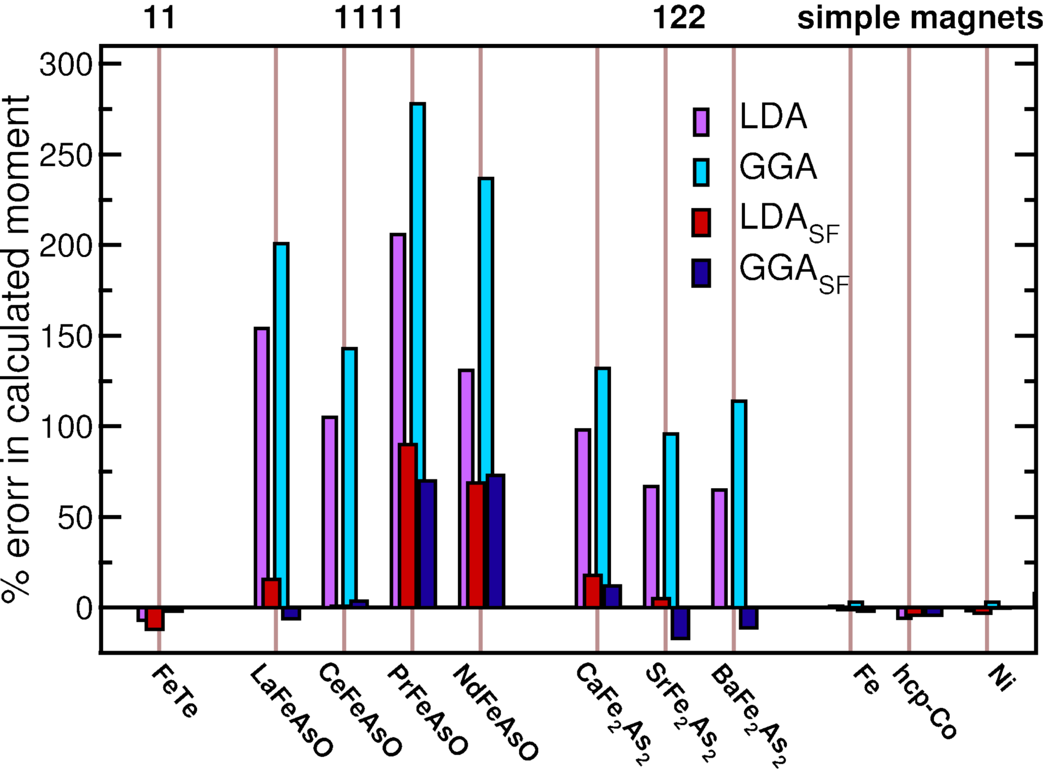

Slide 54
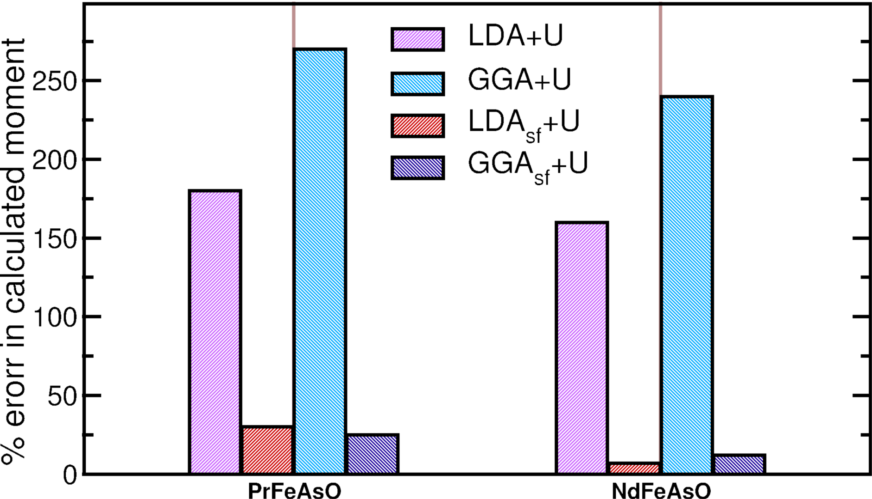

Slide 55
DENSITY-FUNTIONAL THEORY OF THE SUPERCONDUCTING STATE
BASIC IDEA:
Include order parameter, χ , characterising
superconductivity as additional “density”
L.N. Oliveira, E.K.U.G., W. Kohn, PRL 60, 2430 (1988)
Include N-body density, Γ, of the nuclei as additional “density”
T. Kreibich, E.K.U.G., PRL 86, 2984 (2001)

Slide 56
General (model-independent) characterization of superconductors:
Off-diagonal long-range order of the 2-body density matrix:
order parameter of the N-S phase transition

Slide 57
Hamiltonian

Slide 58
ANALOGY
S
Δ
N
F
B
P
χ
m
x
x
“proximity effect”

Slide 59
Hamiltonian
3 densities:
electron density
order parameter
diagonal of nuclear N_{n}-body density matrix

Slide 60
Hohenberg-Kohn theorem for superconductors
1-1
[v(r),Δ(r,r’),W(R)] ←⎯→ [ρ(r),χ(r,r’),Γ(R)]
Densities in thermal equilibrium
at finite temperature

Slide 61
Electronic KS equation
v_{s}[ρ,χ,Γ](r)
Δ_{s}[ρ,χ,Γ](r,r’)
Δ_{s}*[ρ,χ,Γ](r,r’)
v_{s}[ρ,χ,Γ](r)
Nuclear KS equation
W_{s}[ρ,χ,Γ](R)
3 KS potentials:
v_{s} Δ_{s} W_{s}
No approximation yet!
“Exactification” of BdG mean-field eqs.
KS theorem:
There exist functionals v_{s}[ρ,χ,Γ], Δ_{s}[ρ,χ,Γ], W_{s}[ρ,χ,Γ], such that the above equations reproduce the exact densities of the interacting system

Slide 62
Electronic KS equation
v_{s}[ρ,χ,Γ](r)
Δ_{s}[ρ,χ,Γ](r,r’)
Δ_{s}*[ρ,χ,Γ](r,r’)
v_{s}[ρ,χ,Γ](r)
Nuclear KS equation
W_{s}[ρ,χ,Γ](R)
Solved in harmonic approximation
3 KS potentials:
v_{s} Δ_{s} W_{s}
No approximation yet!
“Exactification” of BdG mean-field eqs.
KS theorem:
There exist functionals v_{s}[ρ,χ,Γ], Δ_{s}[ρ,χ,Γ], W_{s}[ρ,χ,Γ], such that the above equations reproduce the exact densities of the interacting system

Slide 63
CONSTRUCTION OF APPROXIMATE F_{xc} :
develop diagrammatic many-body perturbation theory on the basis of the H_{o}-propagators:
G_{s} normal electron propagator (in superconducting state)
F_{s}
F_{s}*
D_{s} phonon propagator
anomalous electron propagators
Immediate consequence:
F_{xc} = F_{xc} + F_{xc}
^{ph}
^{el}
all others diagrams
all diagrams containing D_{s}

Slide 64
Phononic contributions
First order in phonon propagator:
Input to
F_{xc}
^{ph}
: Full k,k’
resolved Eliashberg function
Calculated with Quantum Espresso code

Slide 65
Phononic contributions
First order in phonon propagator:
dominant diagrams
(Migdal’s theorem)
Input to
F_{xc}
^{ph}
: Full k,k’
resolved Eliashberg function
Calculated with Quantum Espresso code

Slide 66
Purely electronic contributions
[ ]
F
ee
ρ
,
χ
=
+
F
GGA
[
ρ
]
xc
xc
RPA-screened electron-electron interaction
Crucial point: NO ADJUSTABLE PARAMETERS

Slide 67
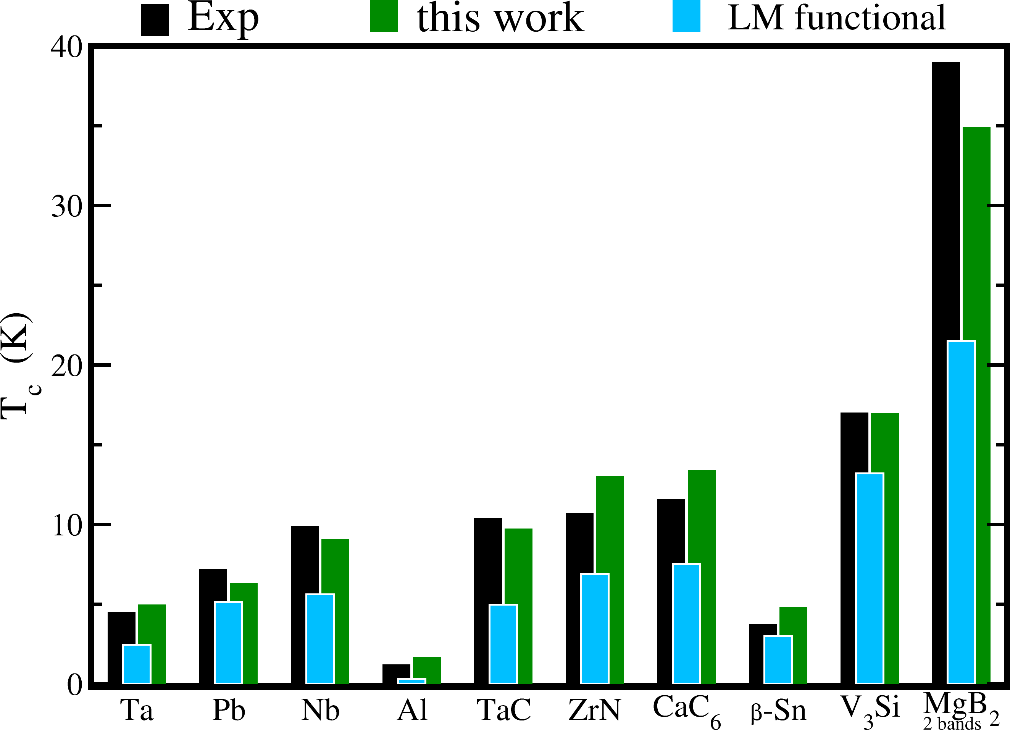
Full Green fctn
KS Green fctn
A Sanna, C Pellegrini, EKU Gross, Phys. Rev. Lett. 125, 057001 (2020).

Slide 68
Isotope effect:
The deviations from BCS value α=0.5 are correctly described

Slide 69
Jump of specific heat at T_{c}

Slide 70
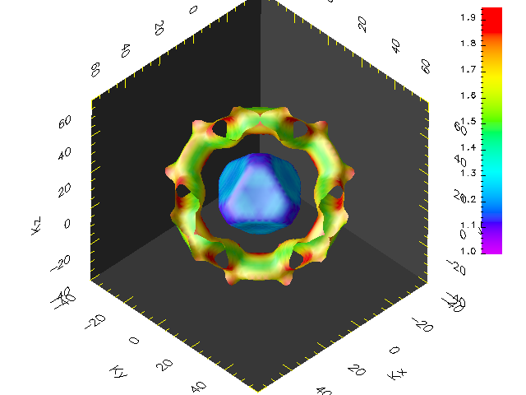
Pb: Gap on the Fermi surface

Slide 71
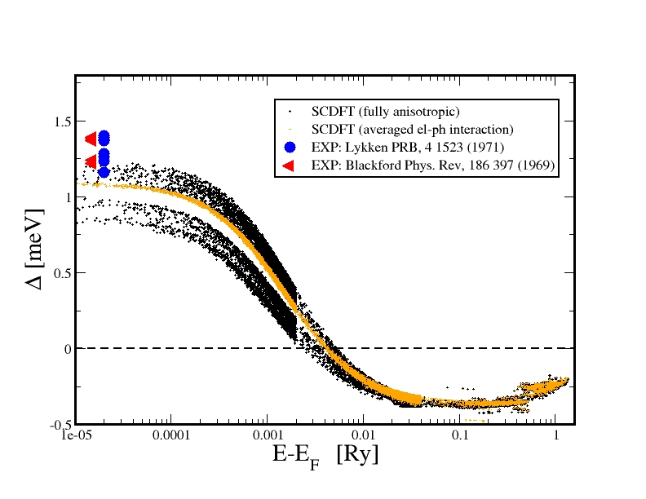
Pb ( Gap at T = 0.01 K)
Prediction:
Two-band superconductivity in Pb from ab initio calculations,
A. Floris, A. Sanna, S. Massidda, E.K.U.G., Phys. Rev. B 75, 054508 (2007).
Experimental confirmation
Experimental Demonstration of a Two-Band Superconducting State for Lead Using
Scanning Tunneling Spectroscopy, M. Ruby, B. W. Heinrich, J.I. Pascual, K. J. Franke,
Phys. Rev. Lett. 114, 157001 (2015).

Slide 72
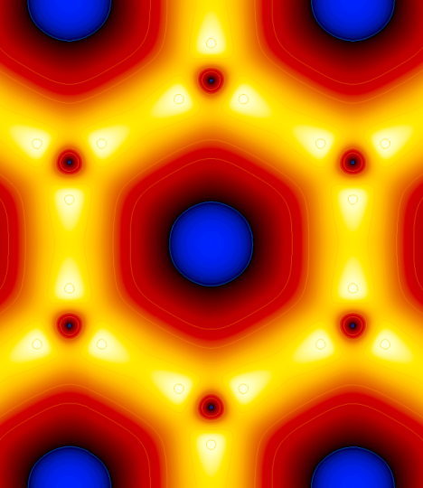
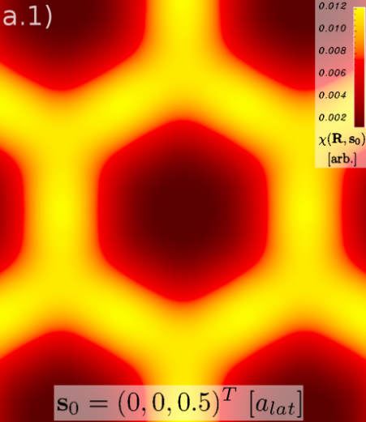
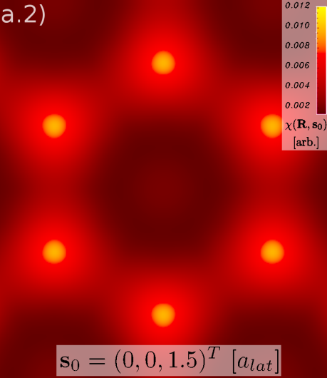
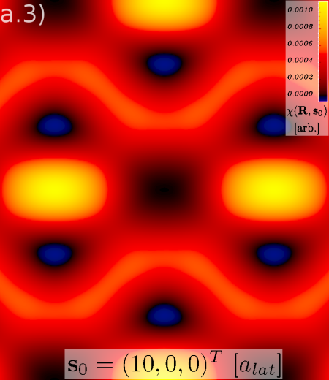
Ab-initio calculation of SC order parameter χ(r,r’) for MgB₂
χ(R,s) as function of R
for fixed s.
χ(r,r’) ≡ χ(R,s)
R = (r+r’)/2
s = r-r’
s = 0
s = (0,0, 0.5)
s = (0,0, 1.5)
s = (10,0,0)
A. Linscheid, A. Sanna, E. K. U. Gross, Phys. Rev. Lett. 115, 097002 (2015).

Slide 73
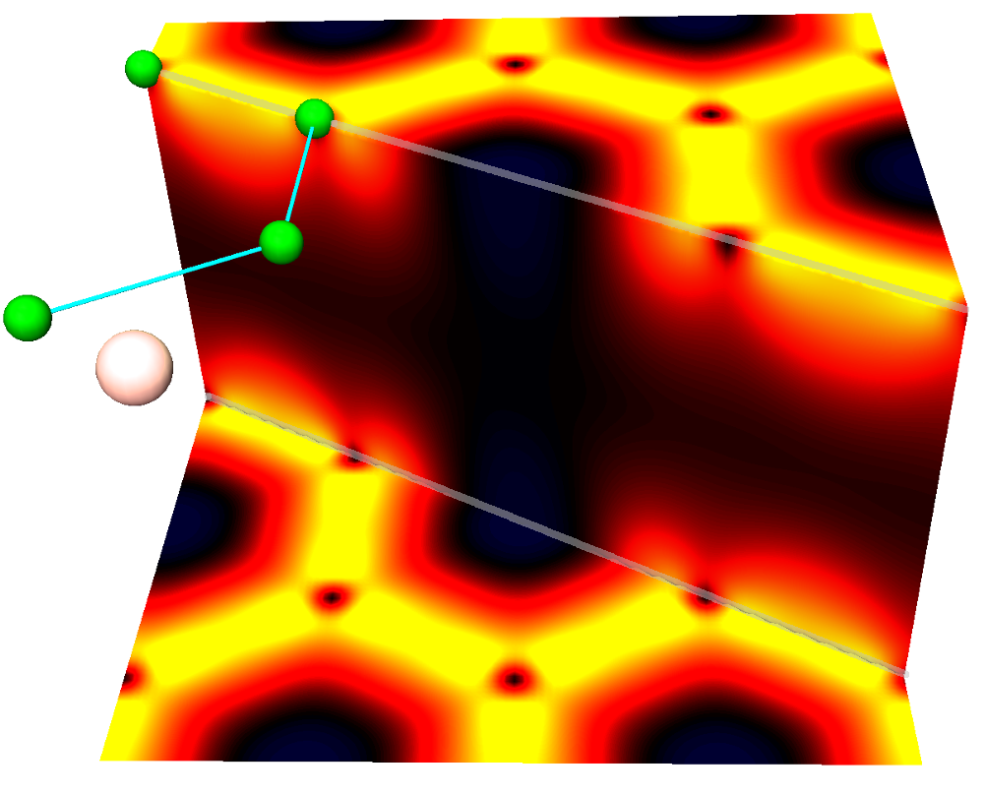
χ(R, s=0) as function of R
MgB₂
The superconducting order parameter “lives” in the chemical bonds!

Slide 74
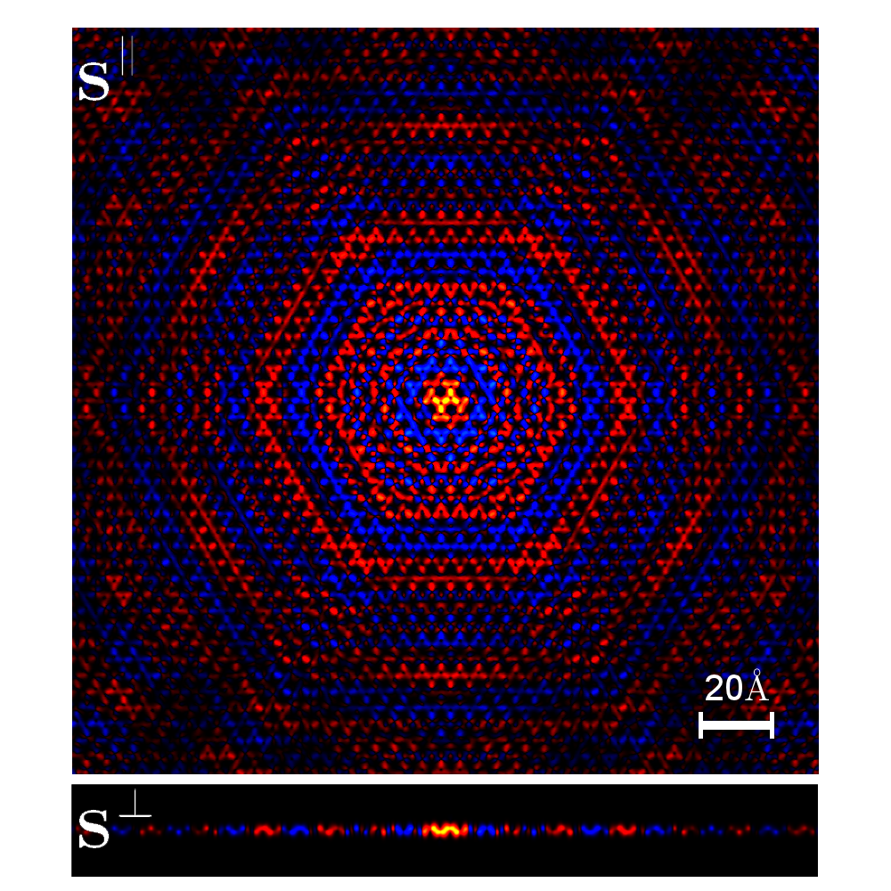
χ(R₀,s) as function of s (R₀ fixed at middle of C-C σ bond)
C₂H₂

Slide 75
Pb monolayer on Si
χ(R, s=0)

Slide 76
Pb monolayer on Si
χ(R, s=0)
superconducting
metallic band of Si

