Slide 1








LHC Physics
(Higgs II)
Mario Martínez
TAE, Benasque, September 2022

Slide 2

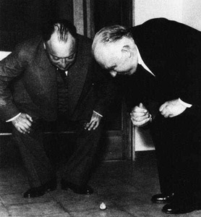
Outline for Part II
Other (Bronze) Channels
Detailed study on Couplings
Higgs width
Invisibly decaying Higgs
Higgs and Vacuum Stability
Hierarchy Problem & SUSY
Search for other Higgs (few examples)
What to expect in the future ?
Disclaimer: completely unbalanced
set of results from CMS and ATLAS
and no fanatic collection of latest results

Slide 3
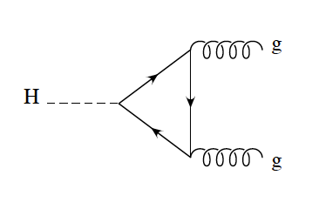
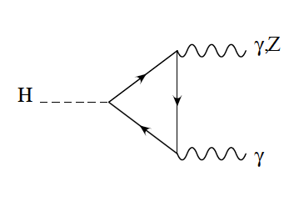
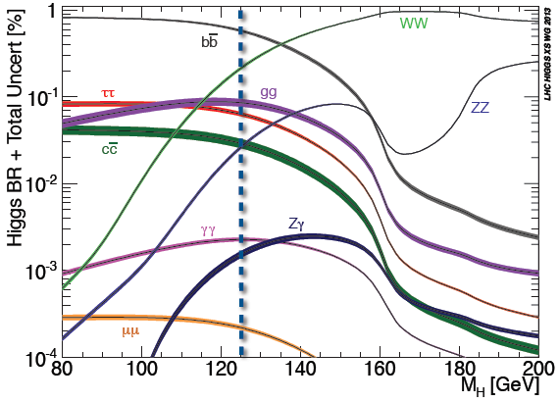
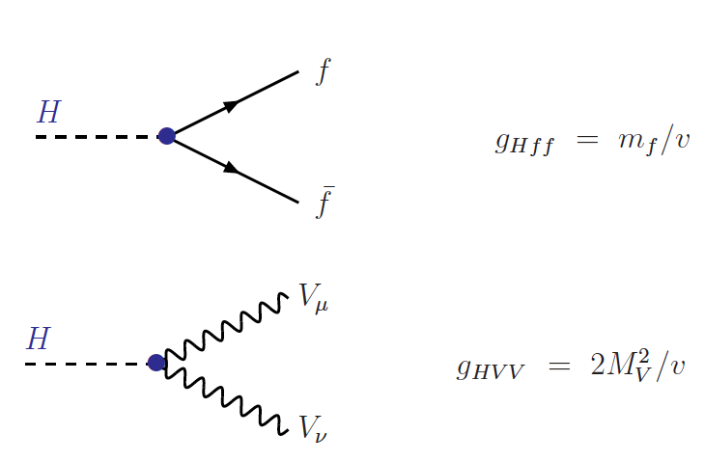
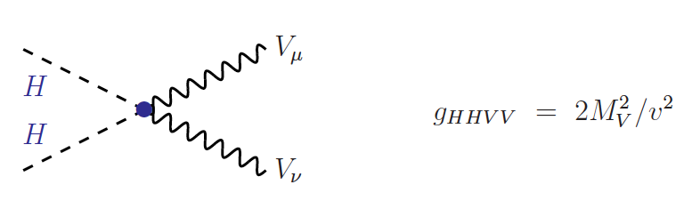
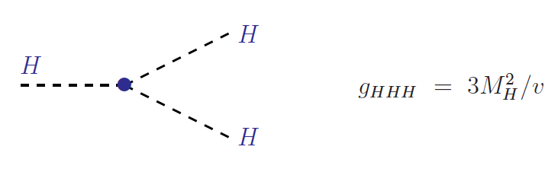
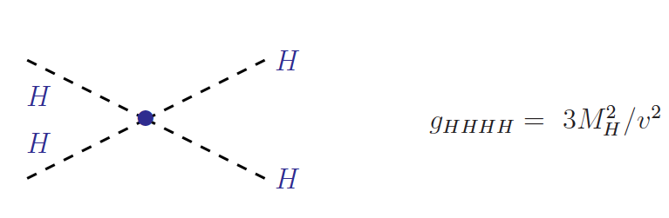
Higgs Couplings to SM
and via
loops..
Couplings proportional to masses of particles
→ This determines the phenomenology

Slide 4
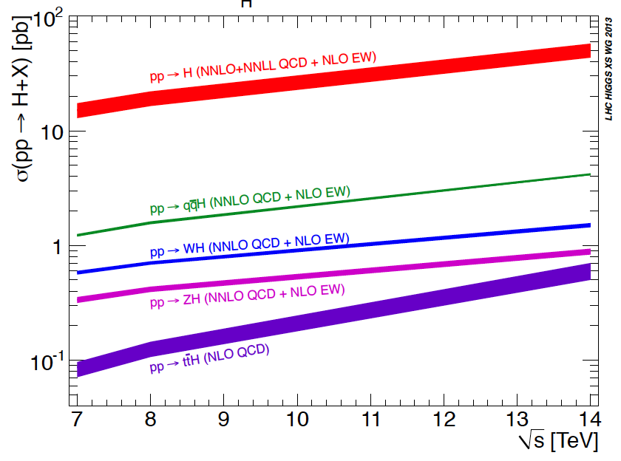
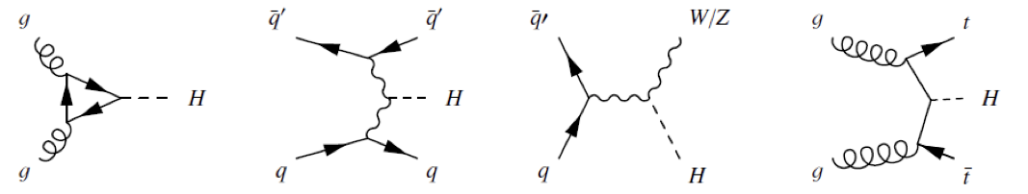
Higgs Production (LHC)
For a Higgs of 125 GeV
Decreasing cross section

Slide 5
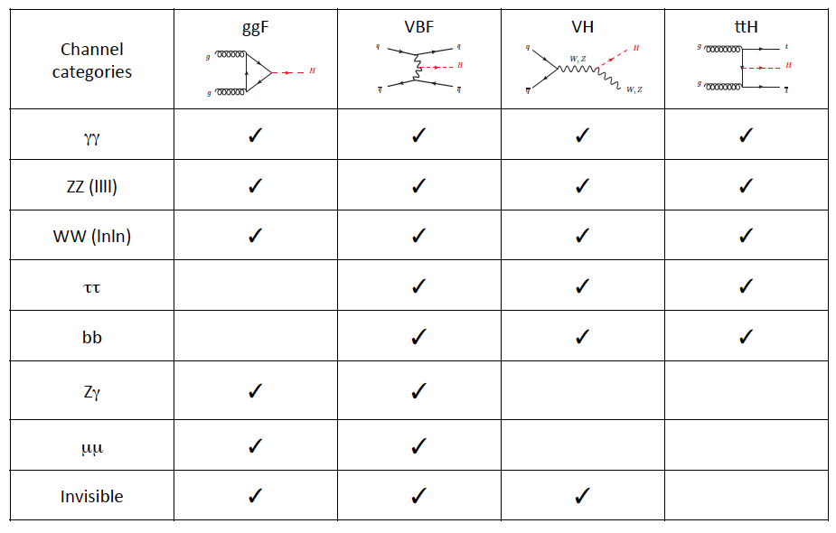
Higgs Program in a Glance
OK
OK
Rare Decays

Slide 6
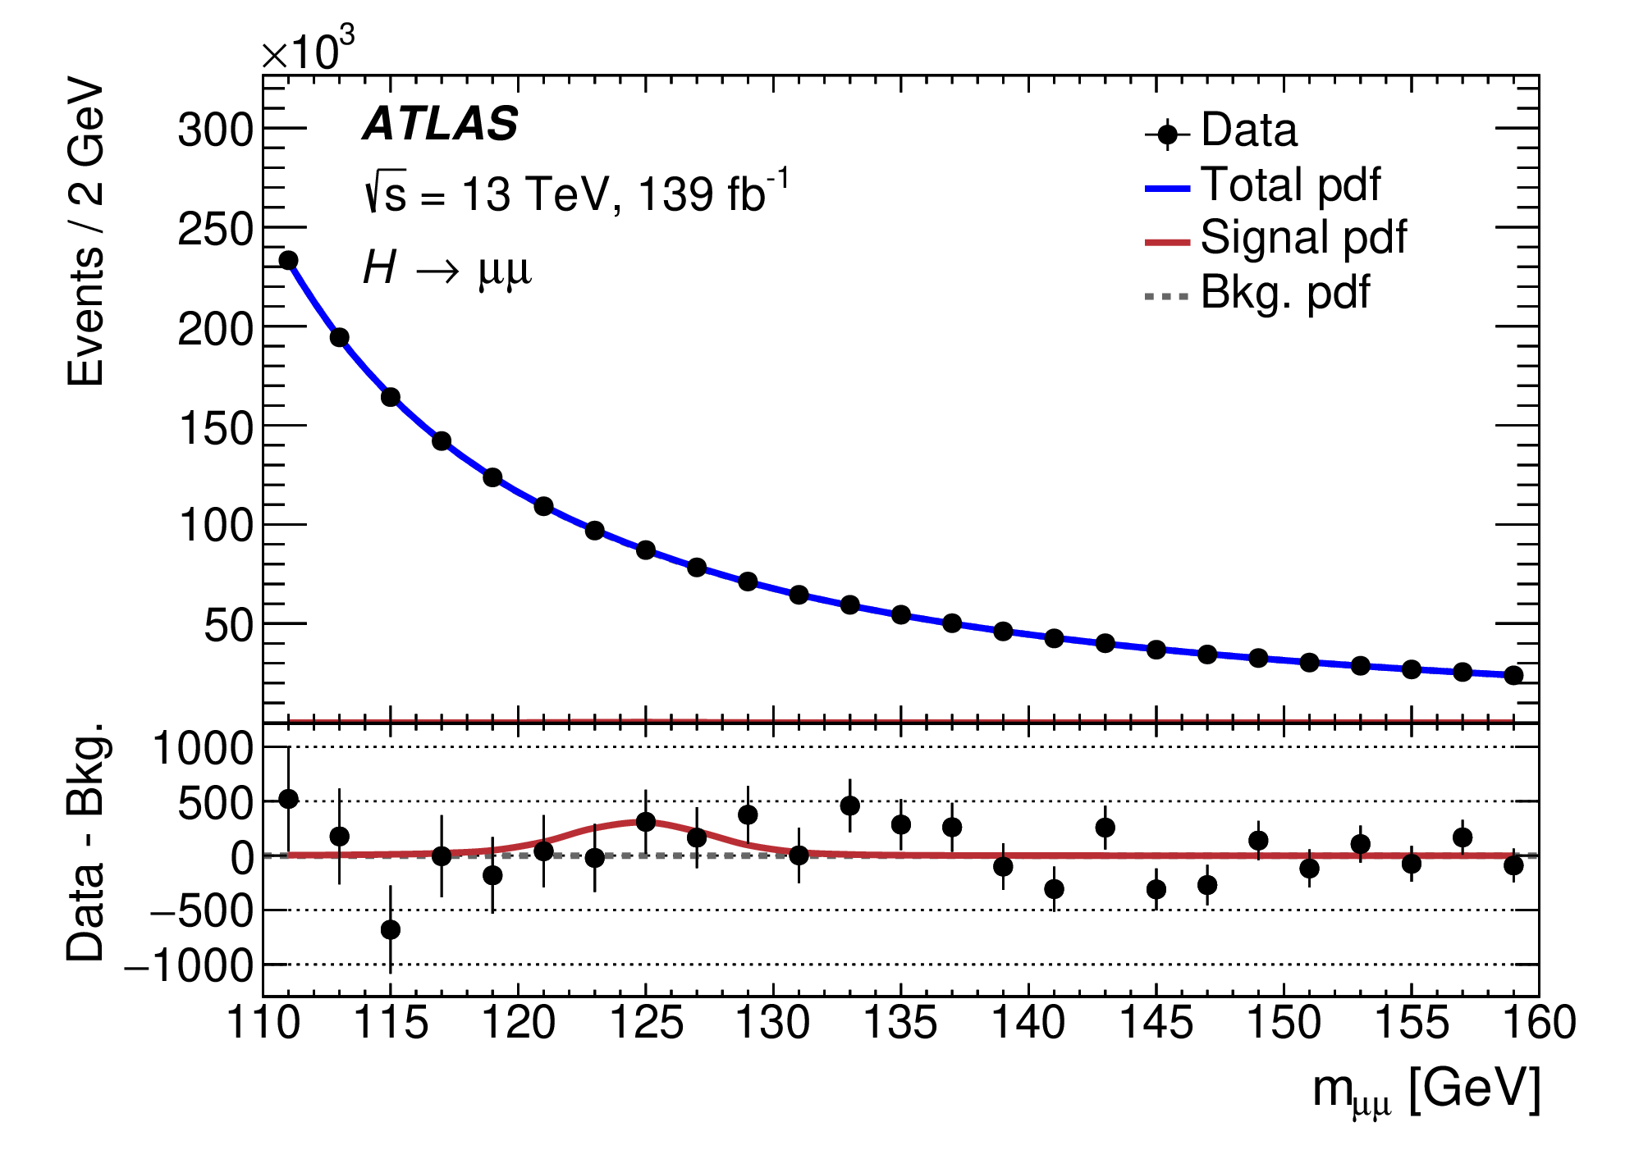
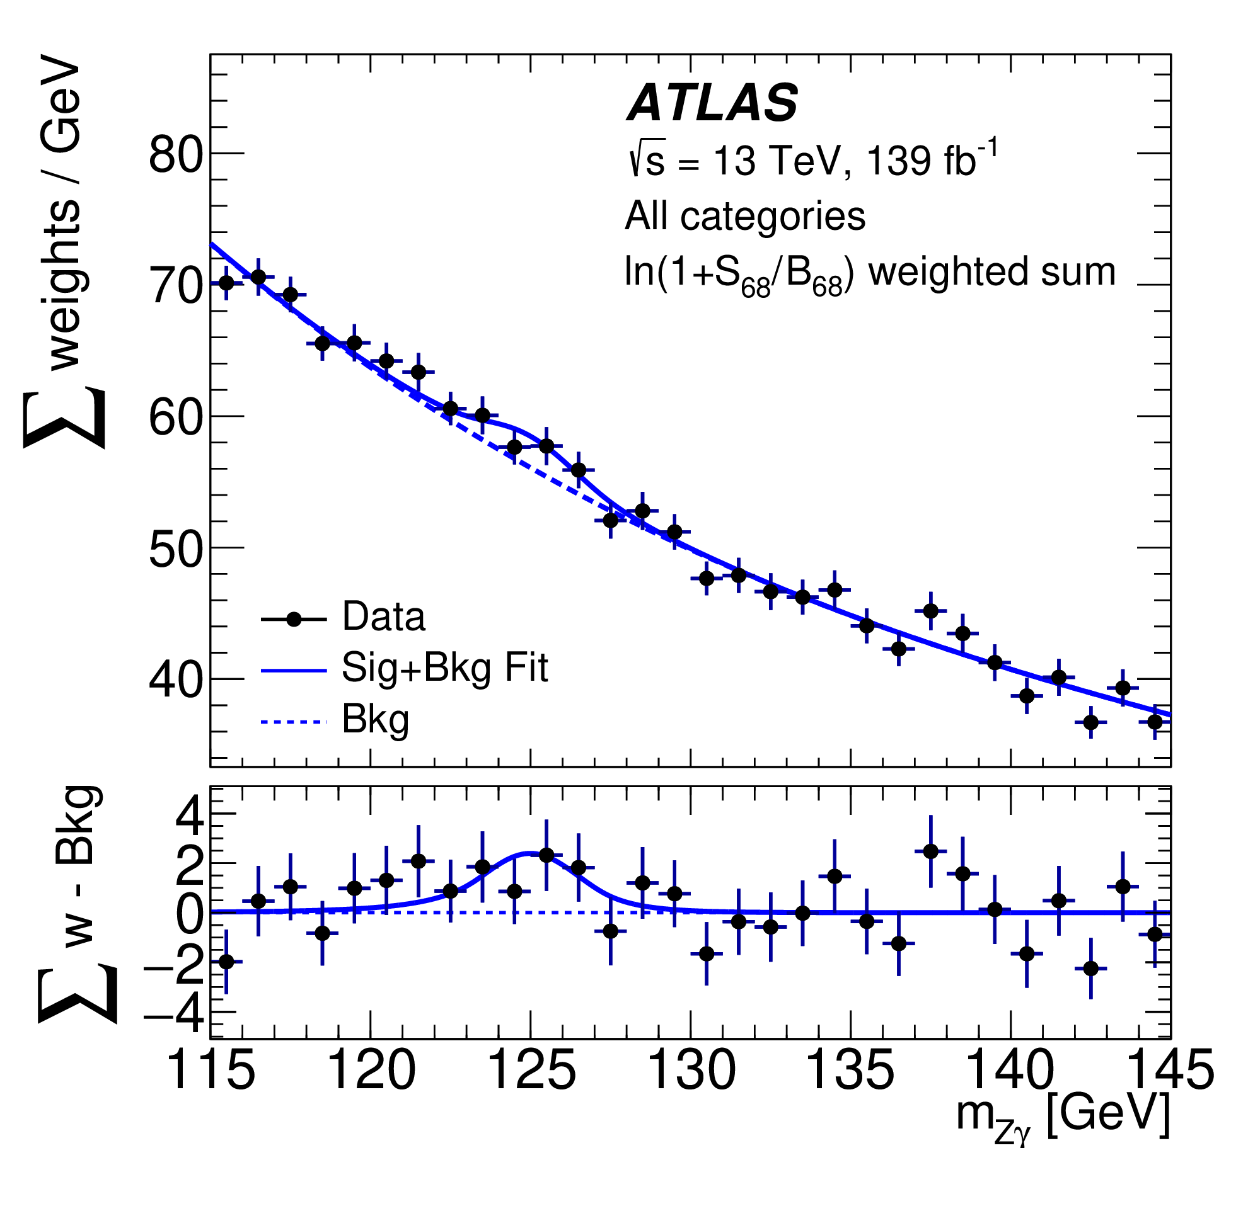
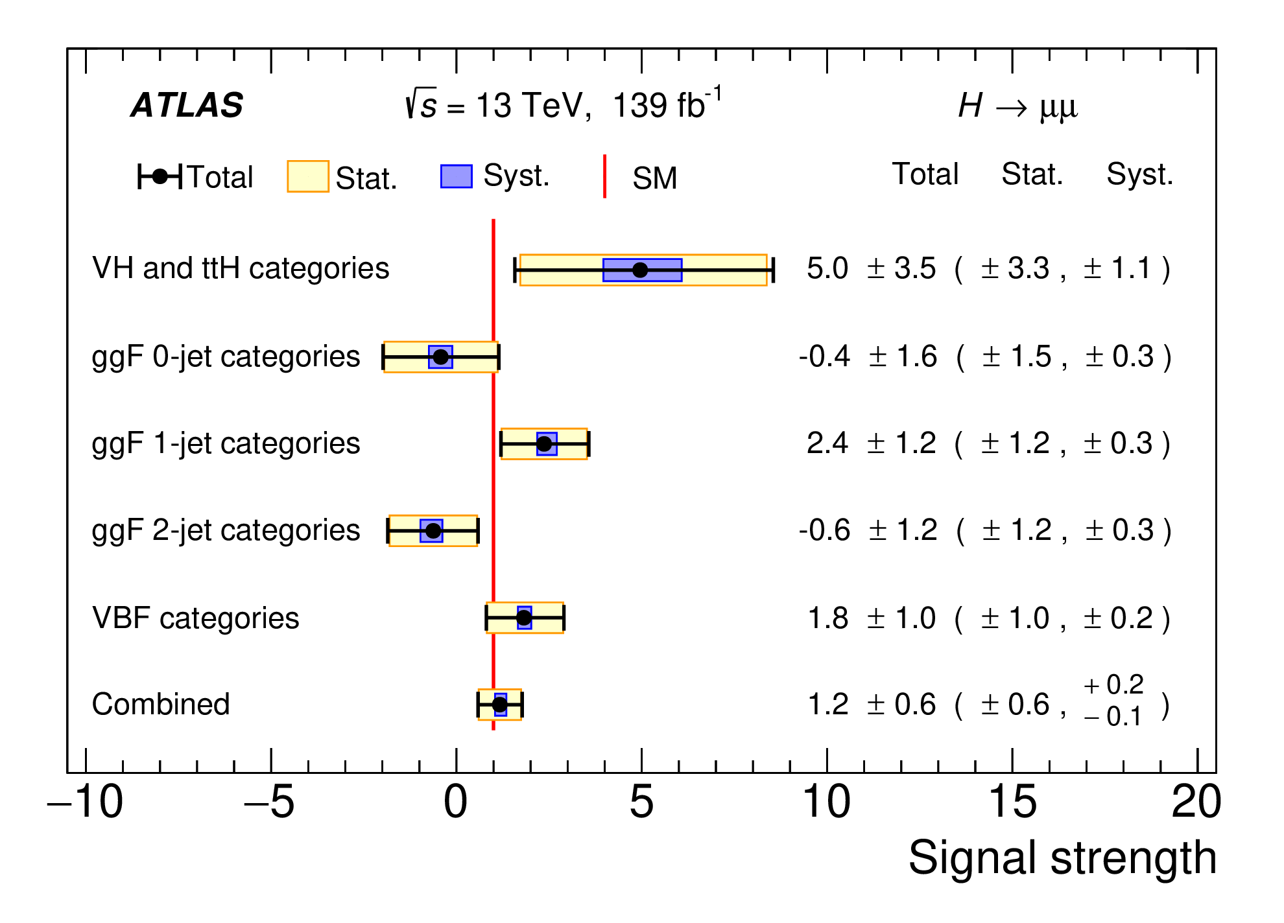
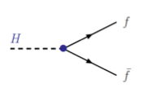
Rare Decays
μ⁺
μ⁻
Data still consistent with no Higgs
in this channel --- time will tell

Slide 7
Global Understanding
OK
OK

Slide 8





Detailed Study of Couplings
Taking some assumptions

Slide 9
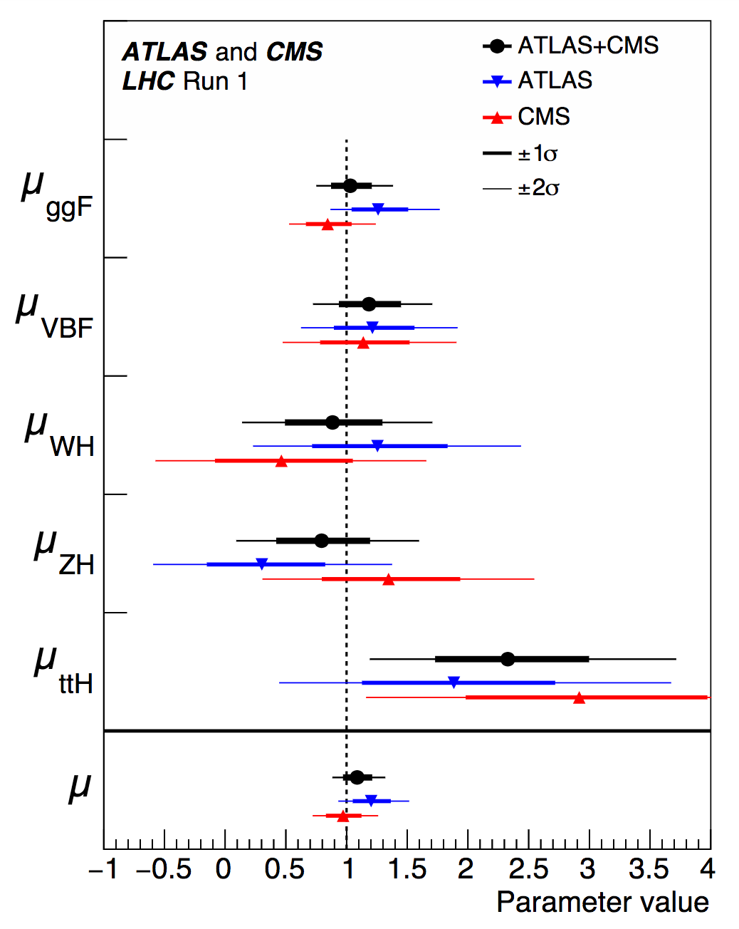
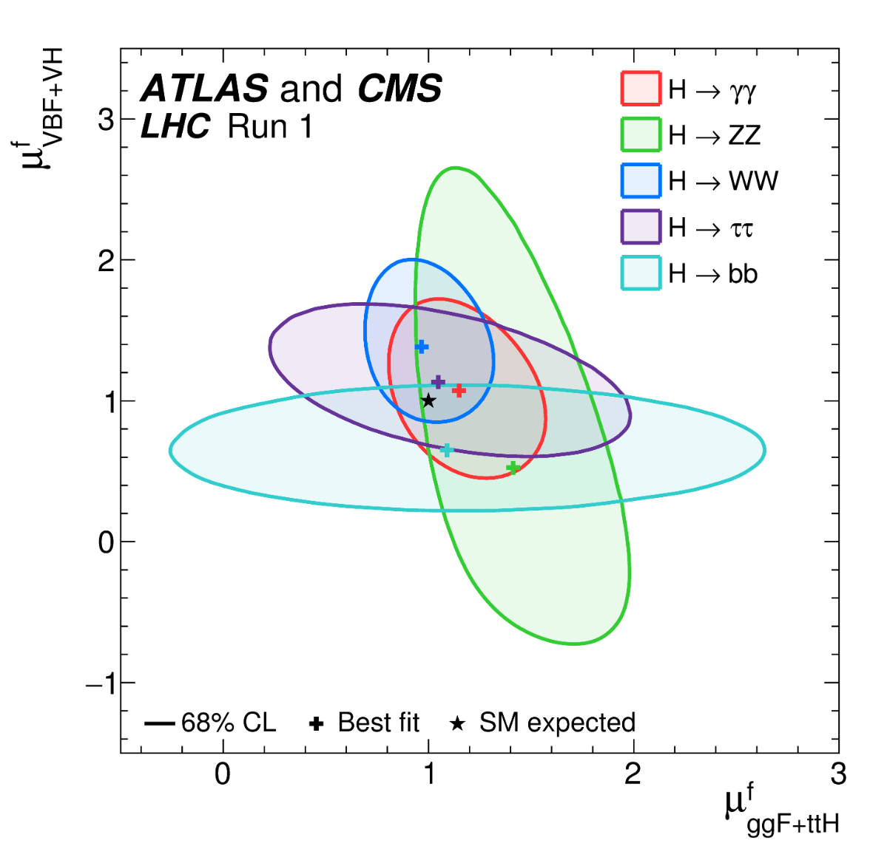
Higgs Couplings
PDG 2016
Run I:
Within the uncertainty of the data
all looks consistent with a SM Higgs

Slide 10
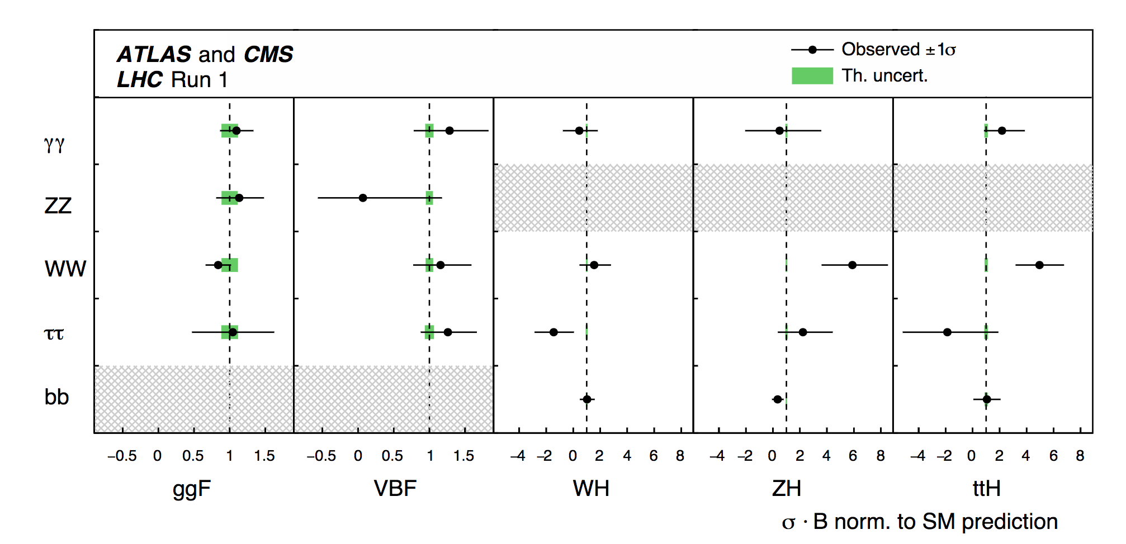
ATLAS & CMS
PDG 2016

Slide 11
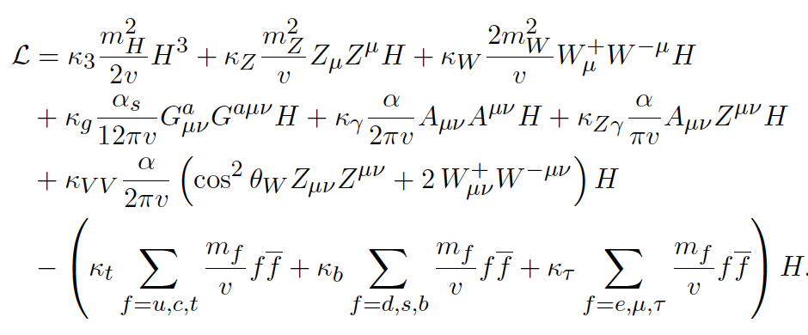

Using EFT Lagrangian in Global Fit
Global EFT analysis using scale factors κ_{k} that modify SM couplings
One can build the relationships between different
scale factors according to the different processes…

Slide 12
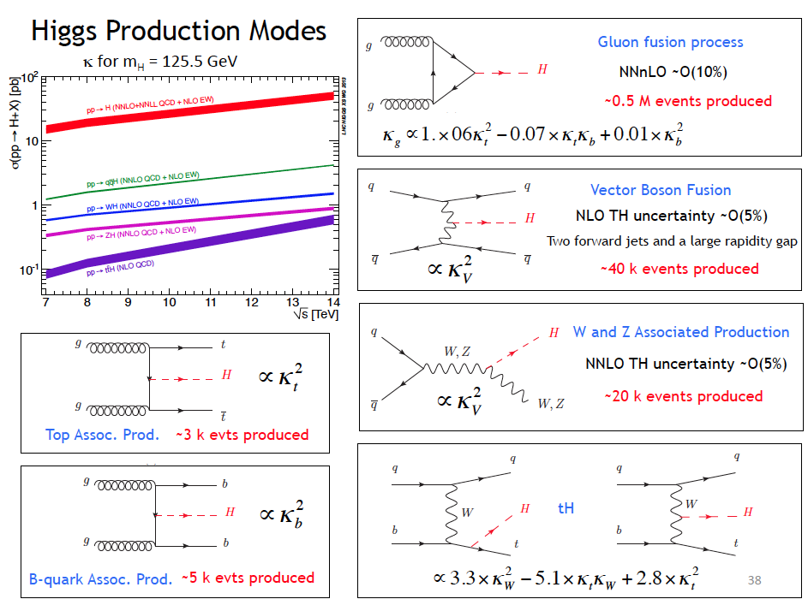

Slide 13
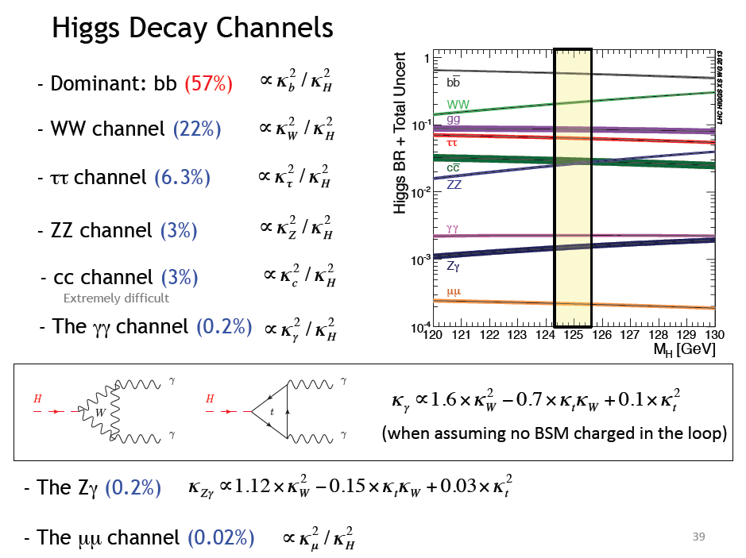

Slide 14
Relative Couplings to fermions/bosons
As in PDG (Aug 2014)
Best fit consistent with SM
That would imply new physics
and compromise vacuum stability

Slide 15
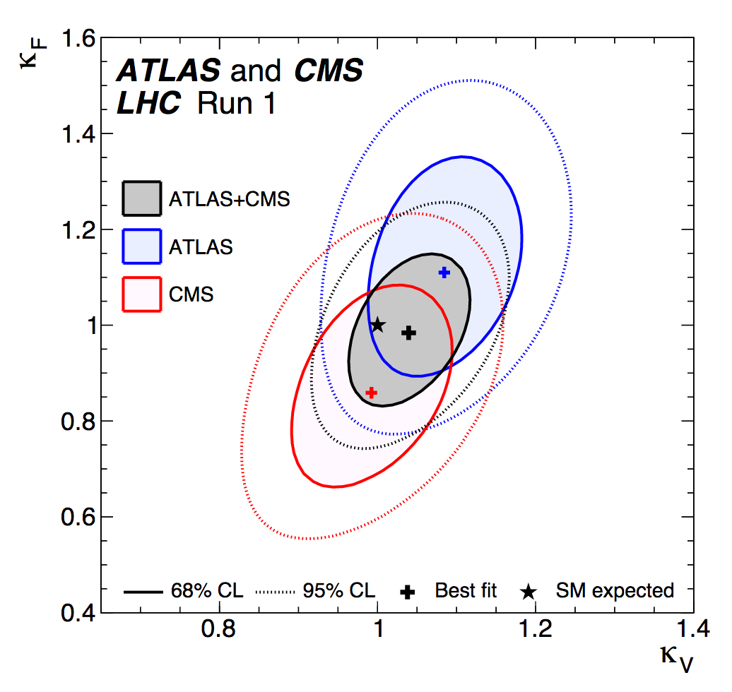
Relative Couplings to fermions/bosons
As in PDG (Aug 2016)

Slide 16
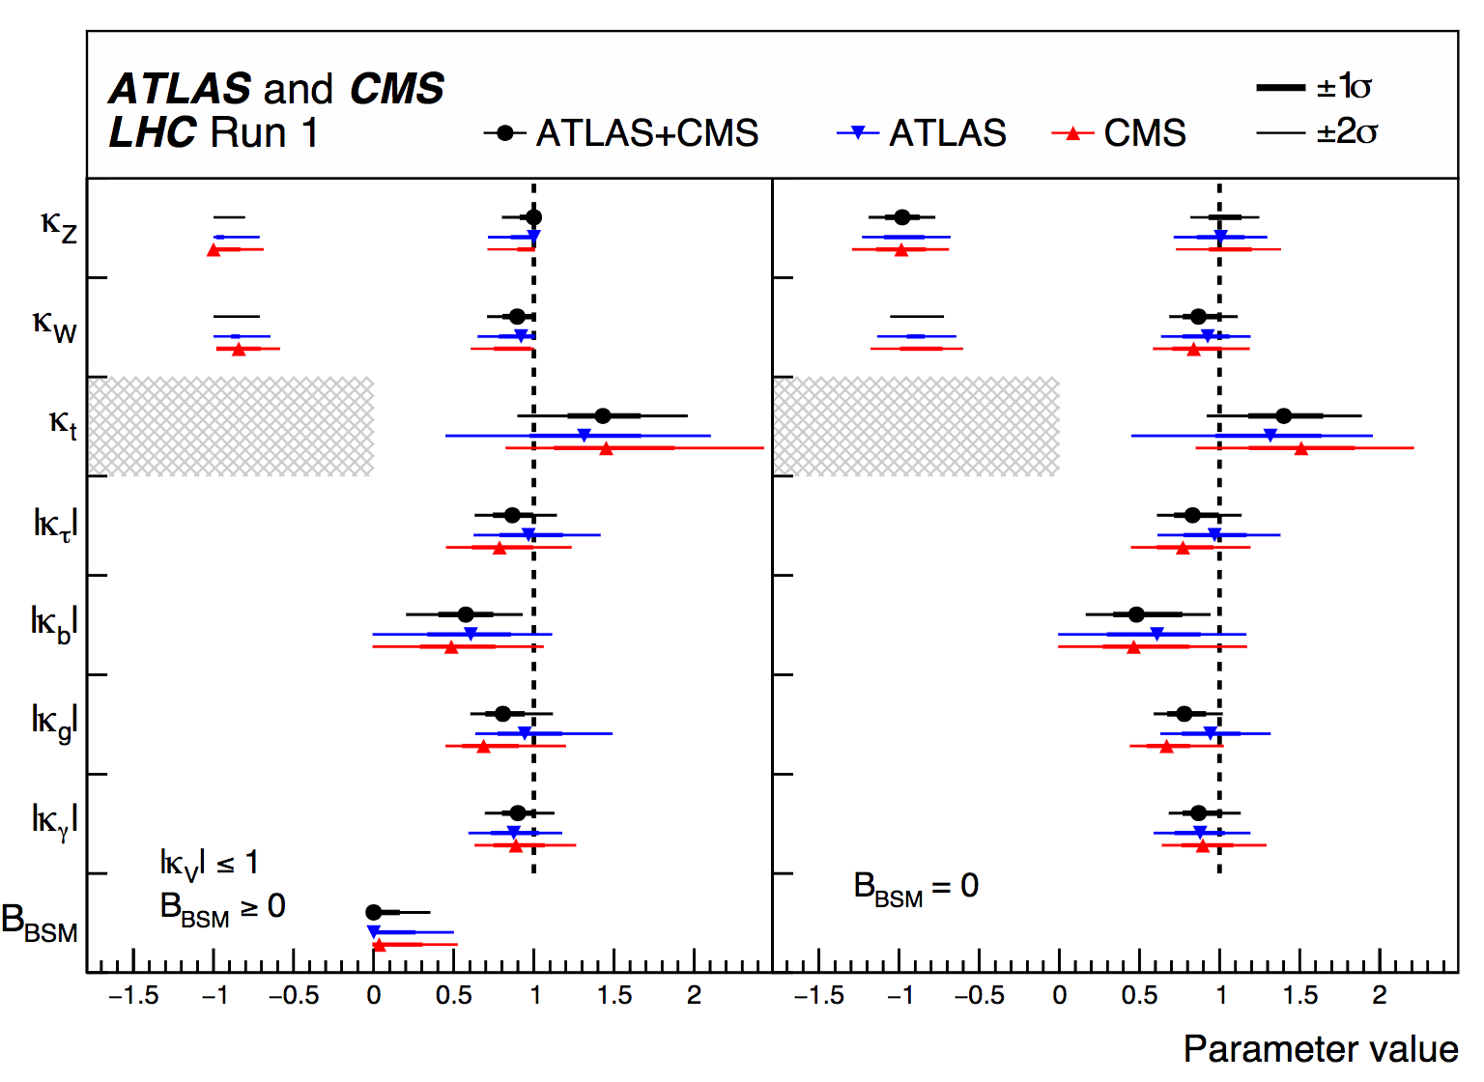
So close to 1…
As in PDG (Aug 2016)

Slide 17
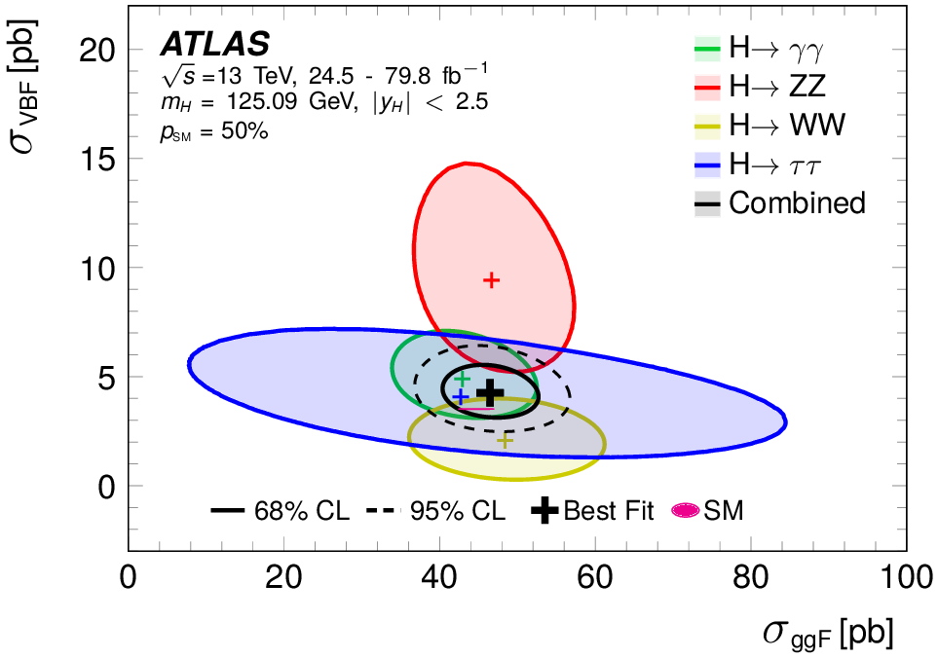
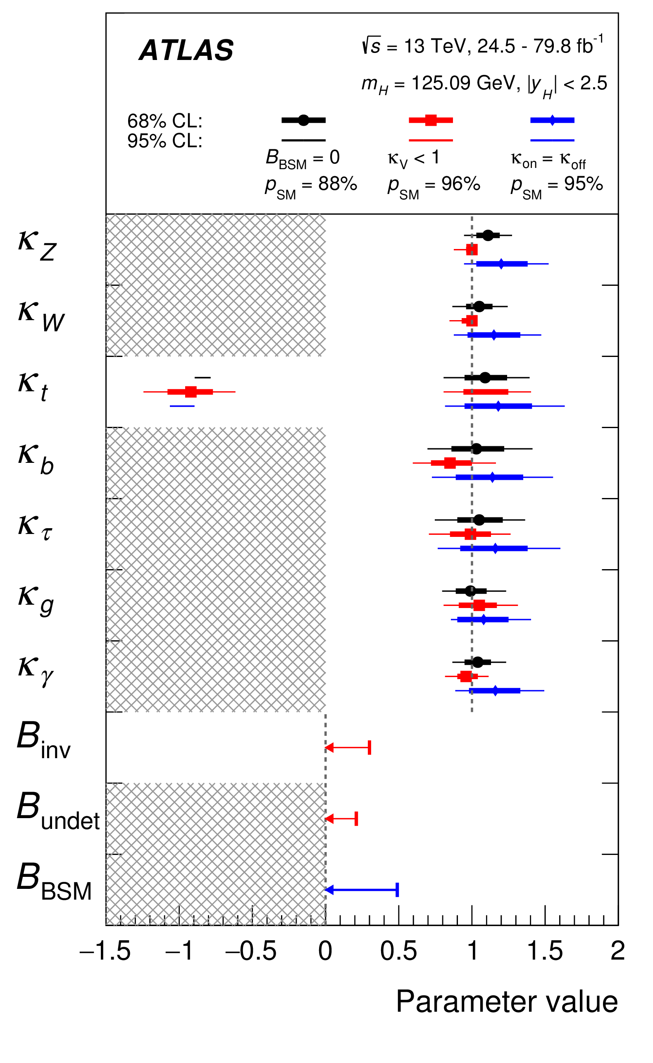
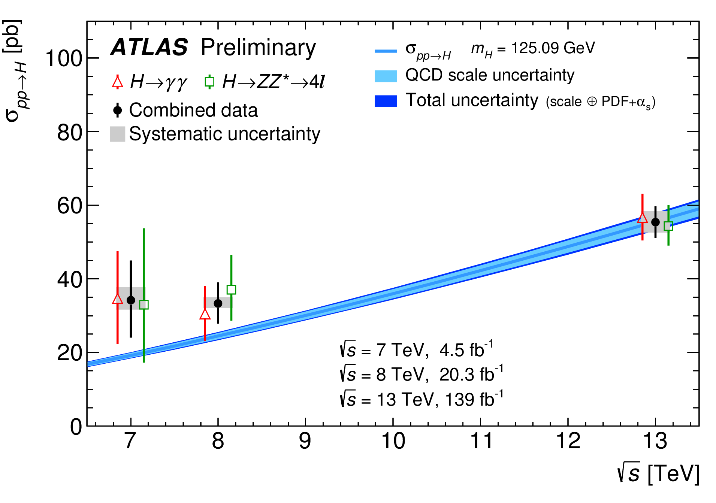
So SM like…
HIGG-2018-57
Using Run II data

Slide 18
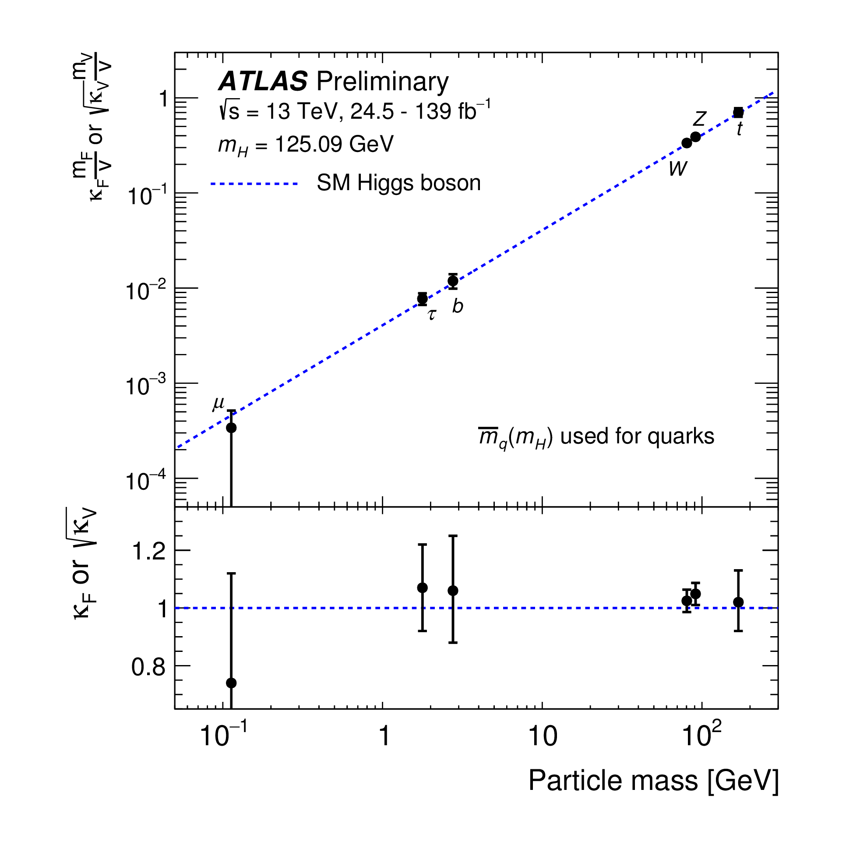

Higgs Couplings vs mass
If it looks like a duck, swims like a duck, and quacks like a duck…

Slide 19

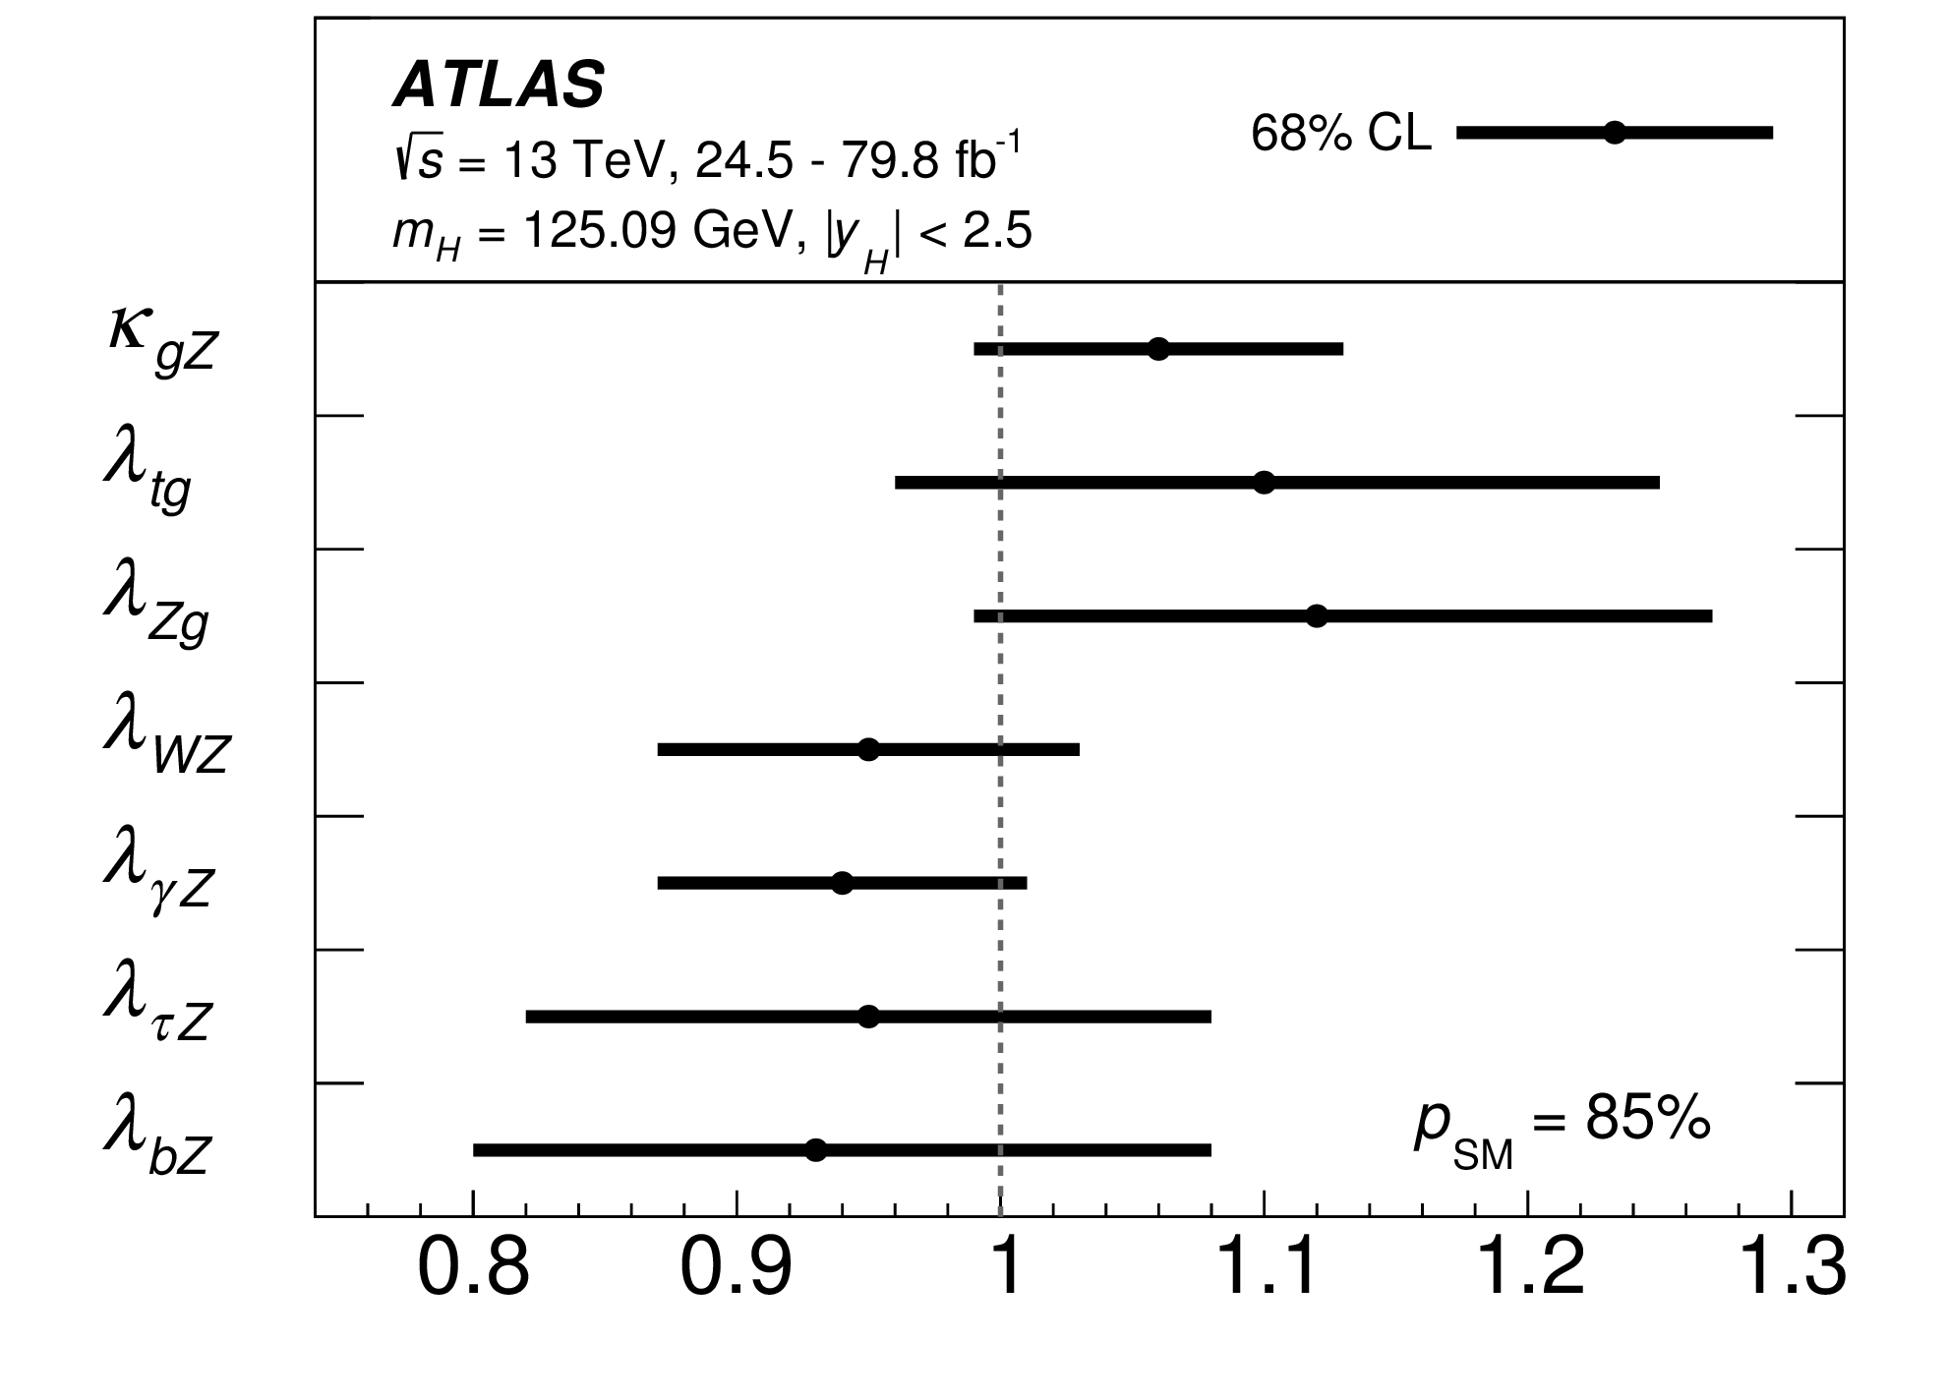
Custodial Symmetry (W/Z ratio))
68% CL
Consistent with SM ρ = 1

Slide 20
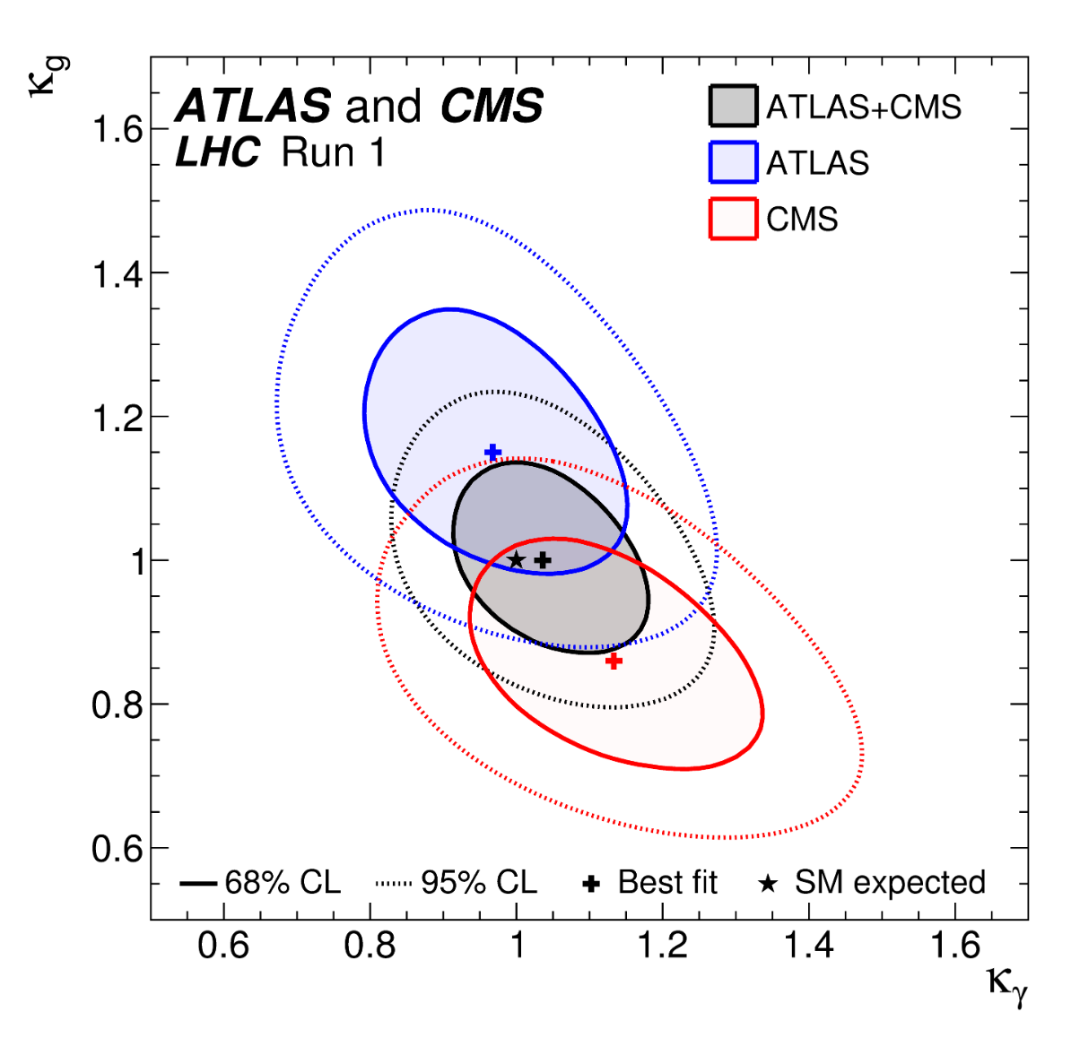
New Physics in Loops ?
Does not look like..

Slide 21
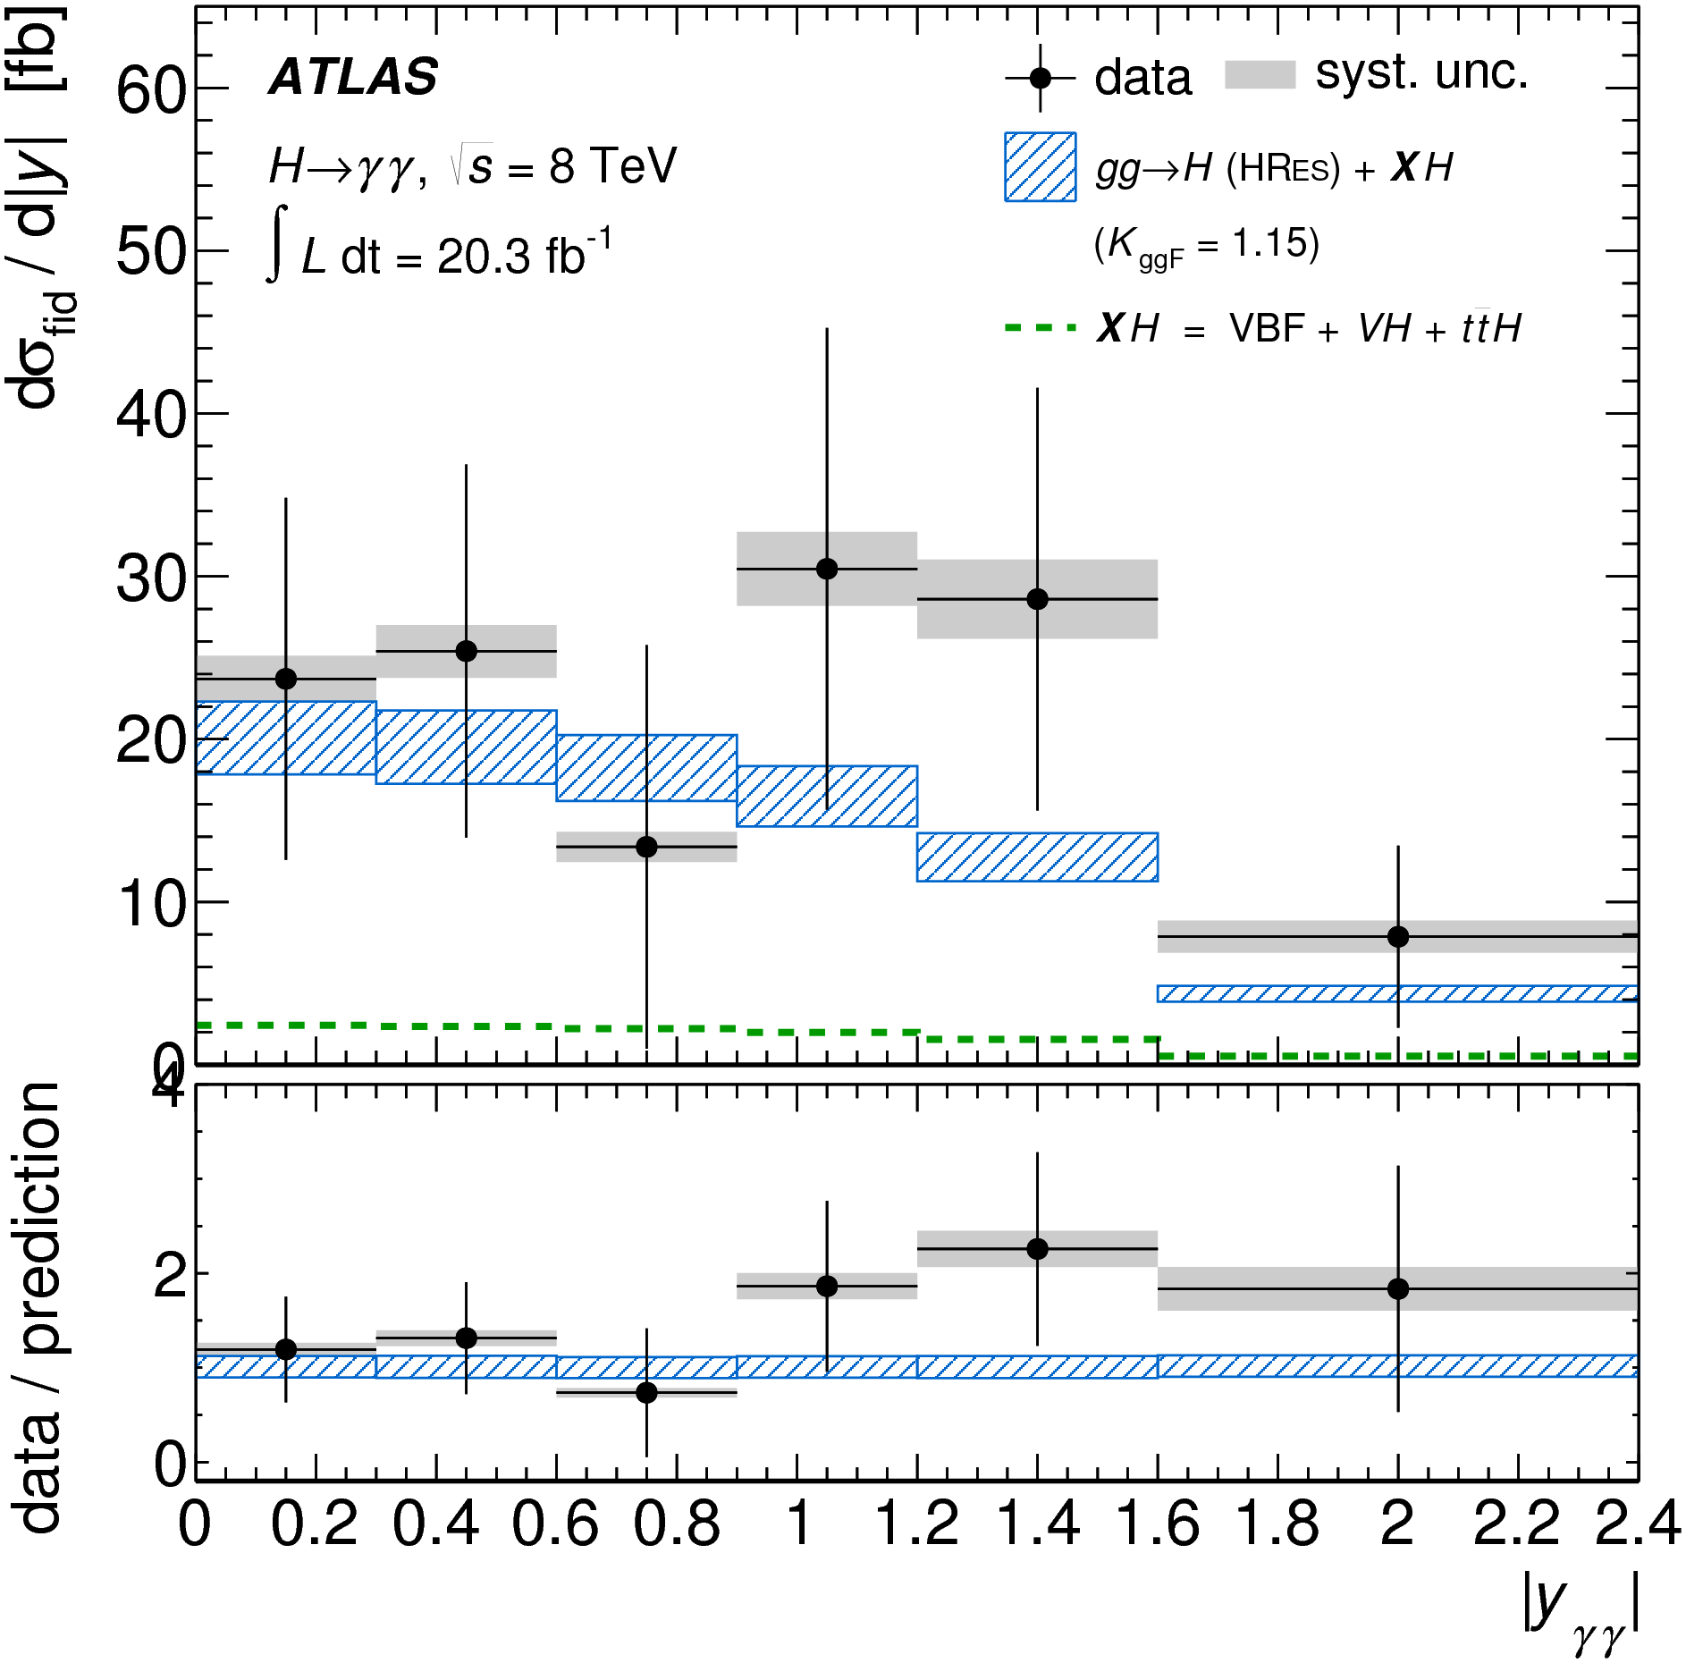
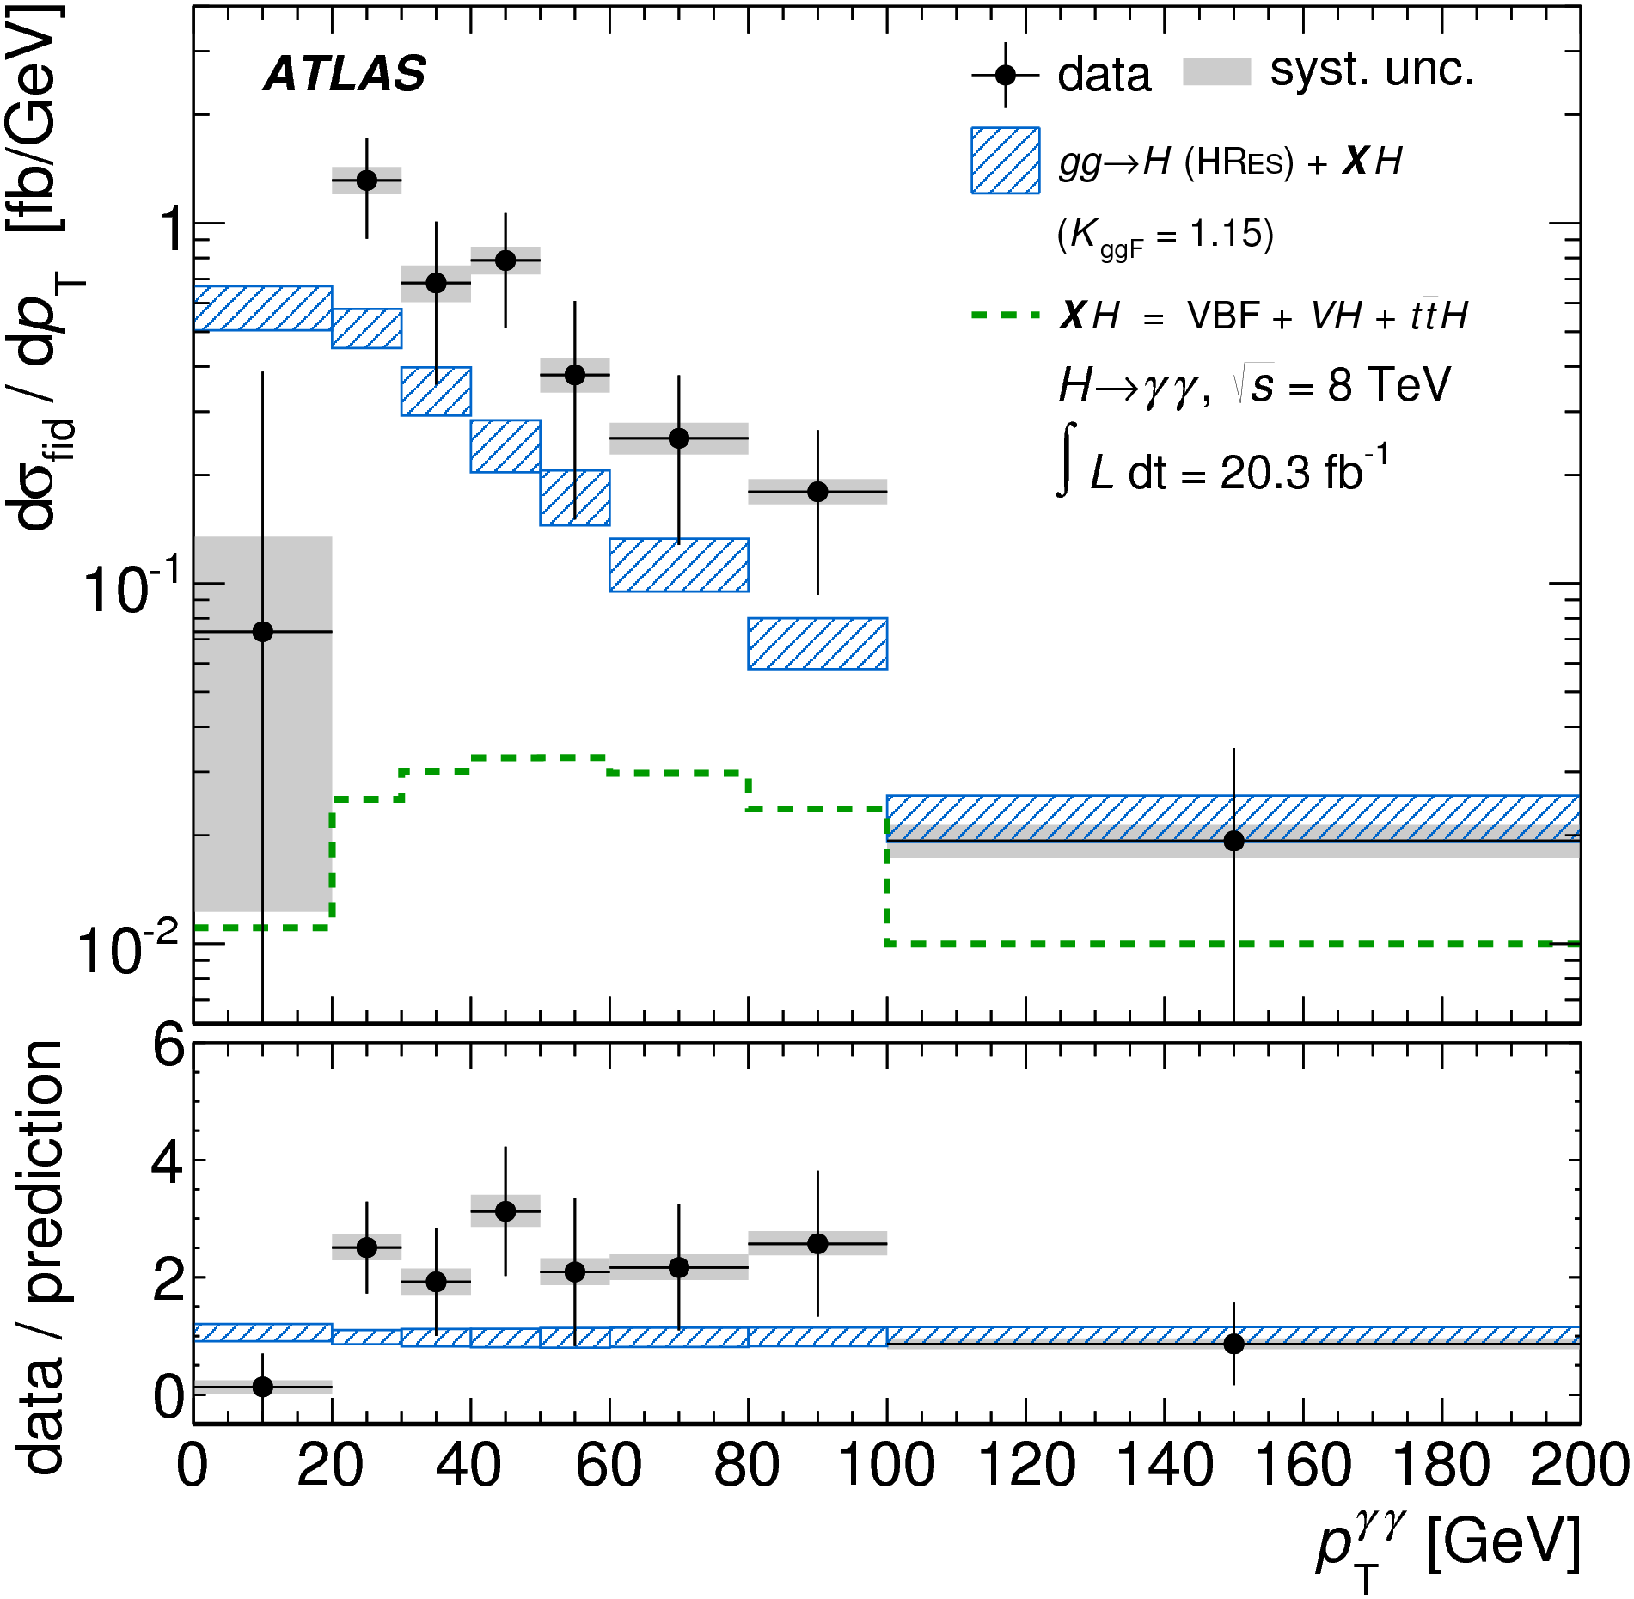
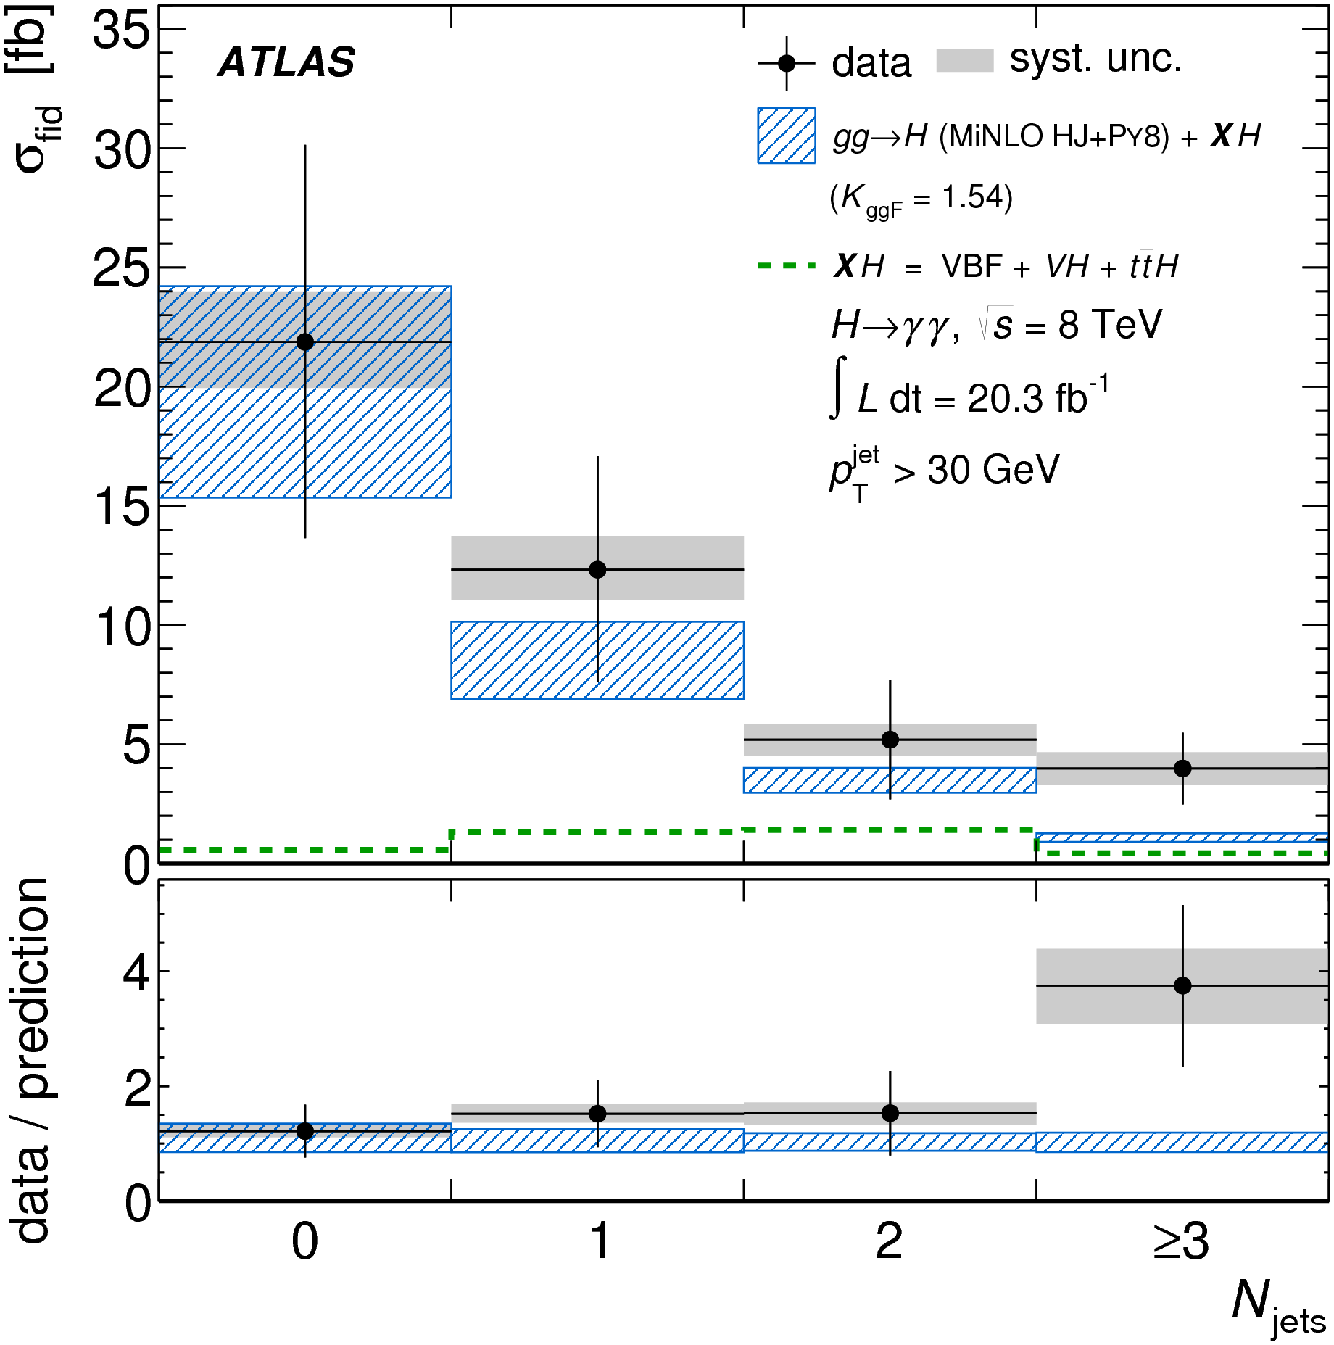
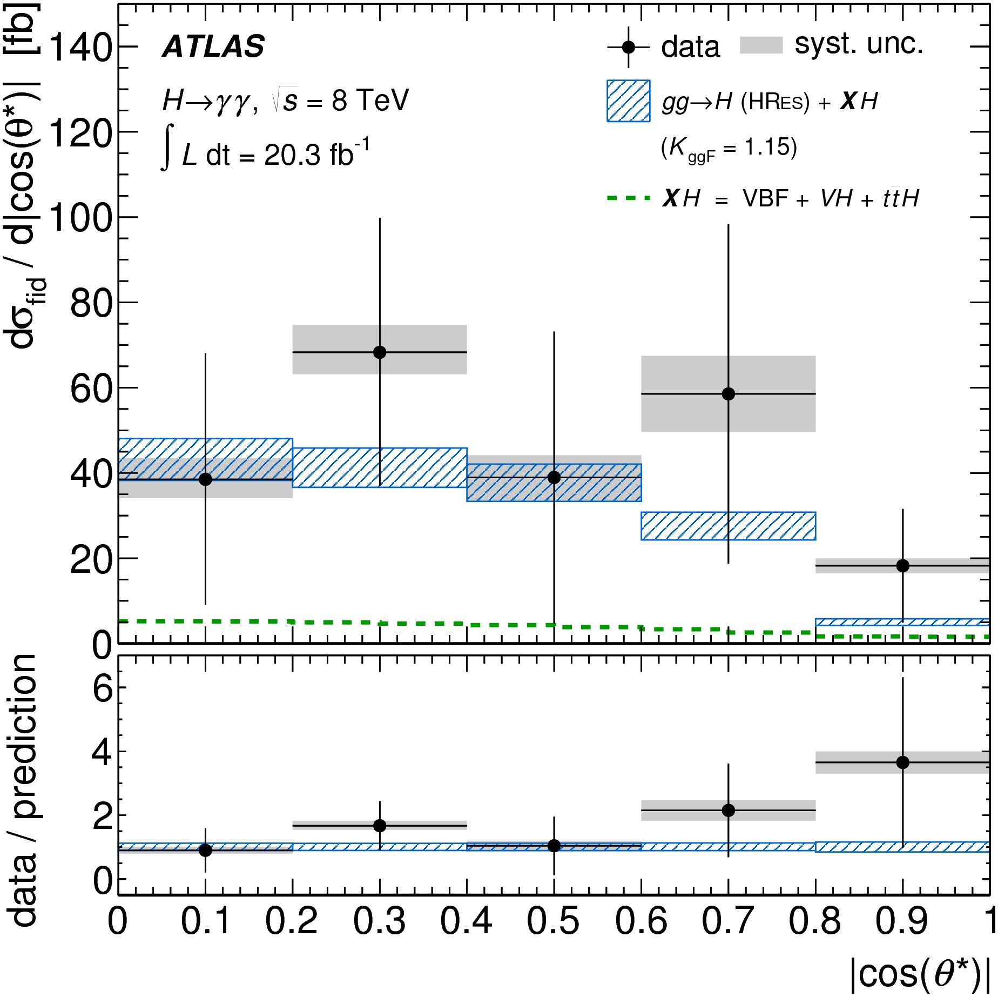
Going differential…
Some excess at low p_{T}^{γγ} and large Y_{γγ}

Slide 22
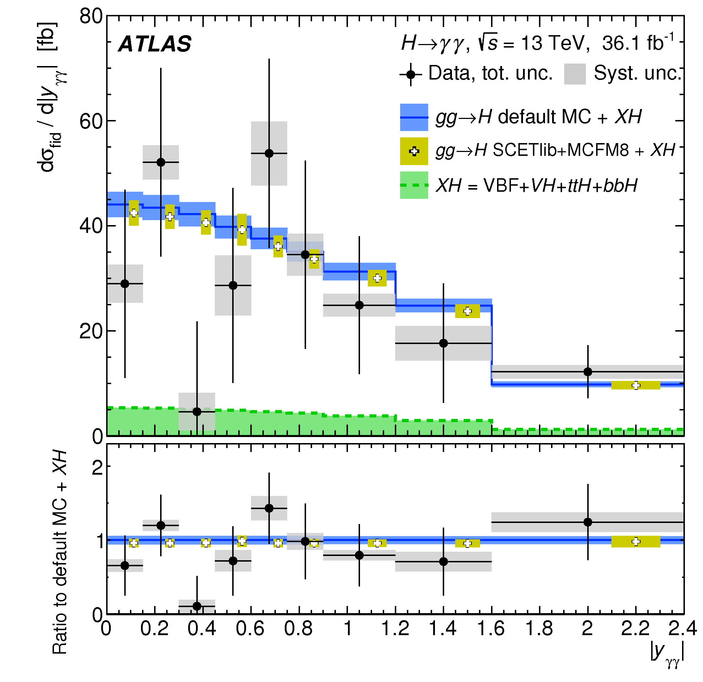
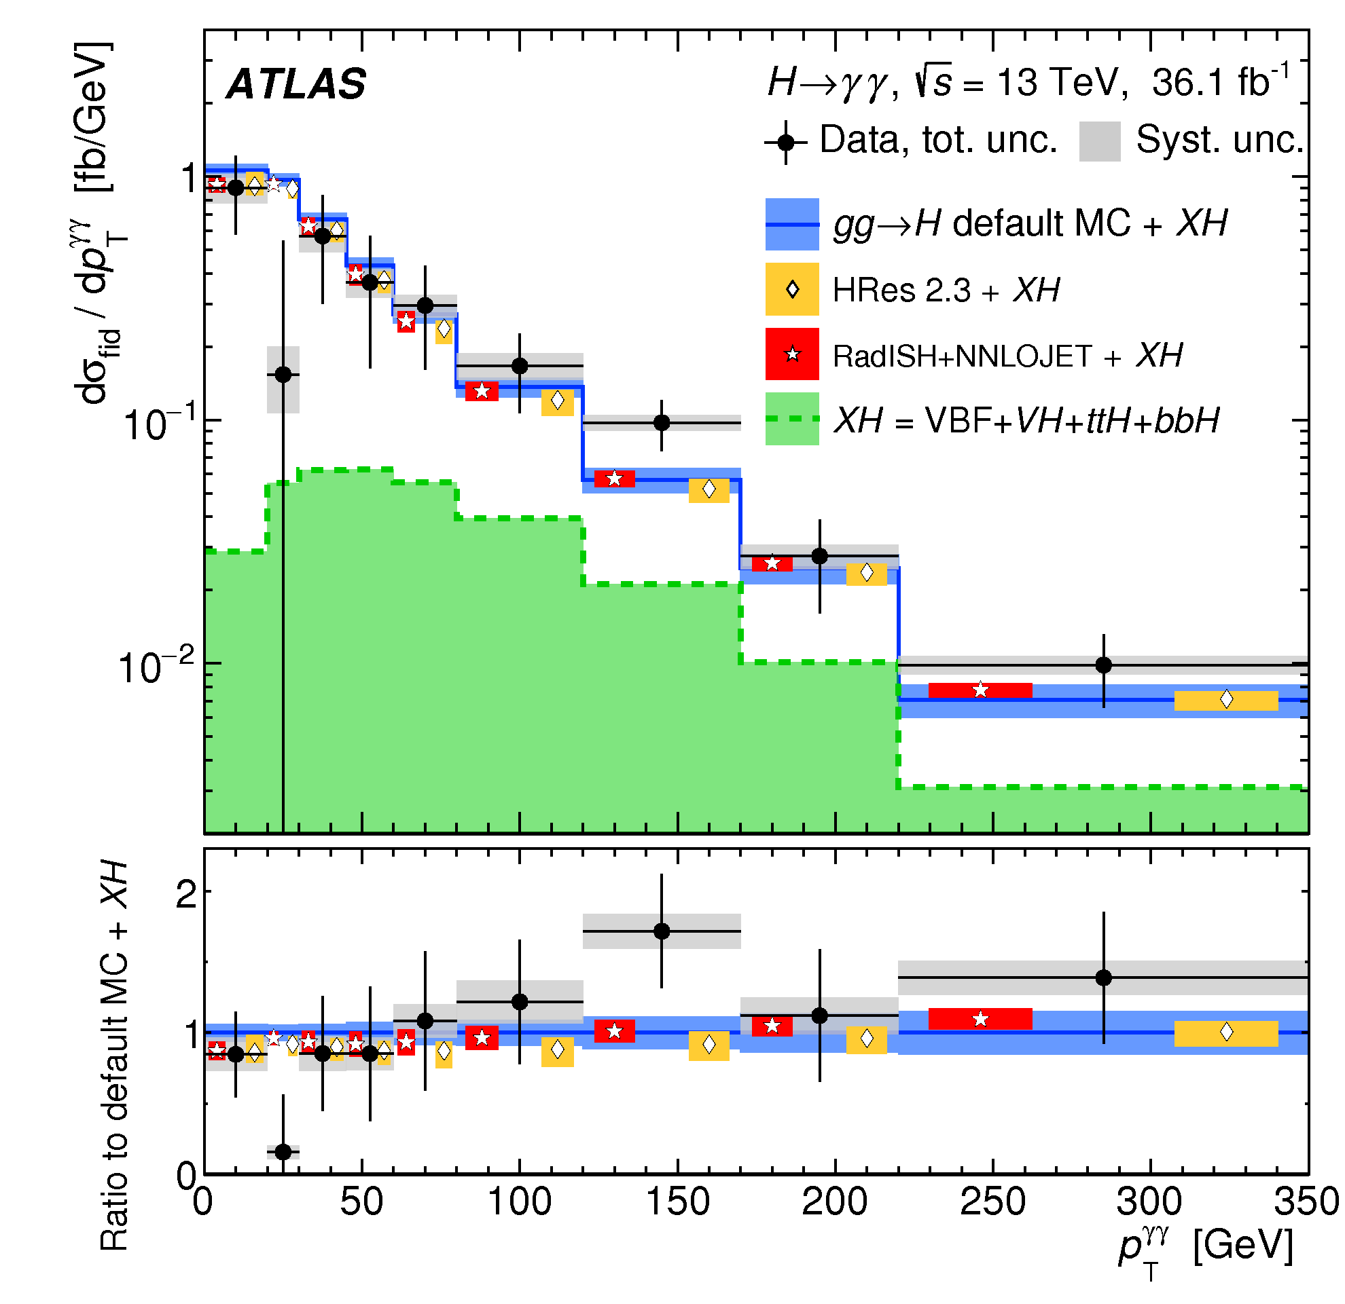
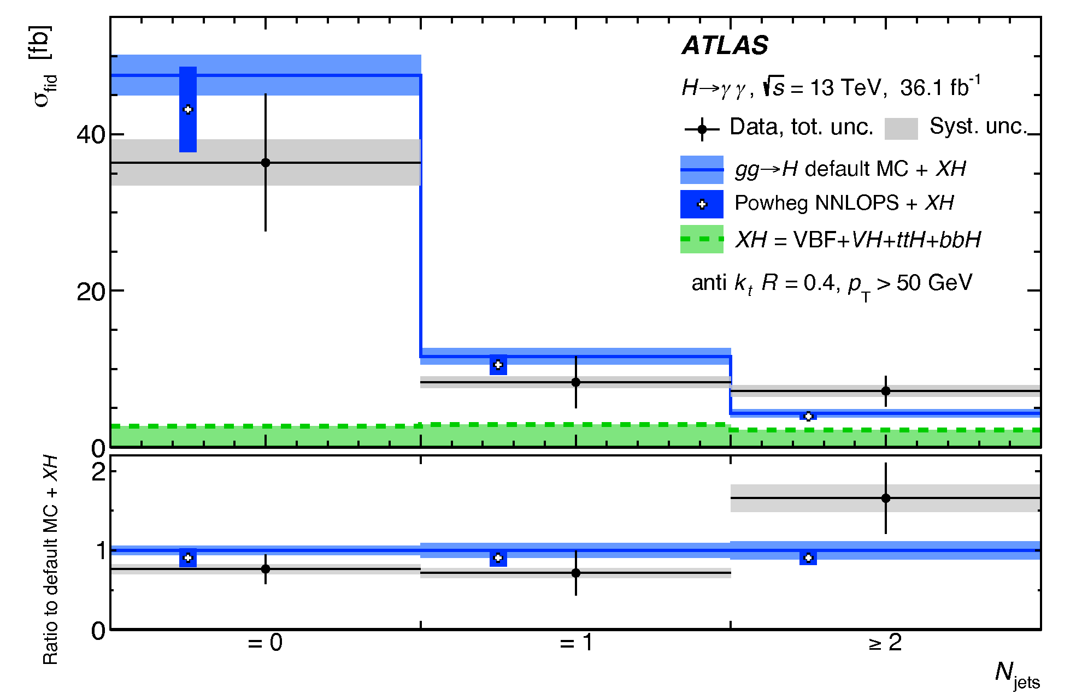
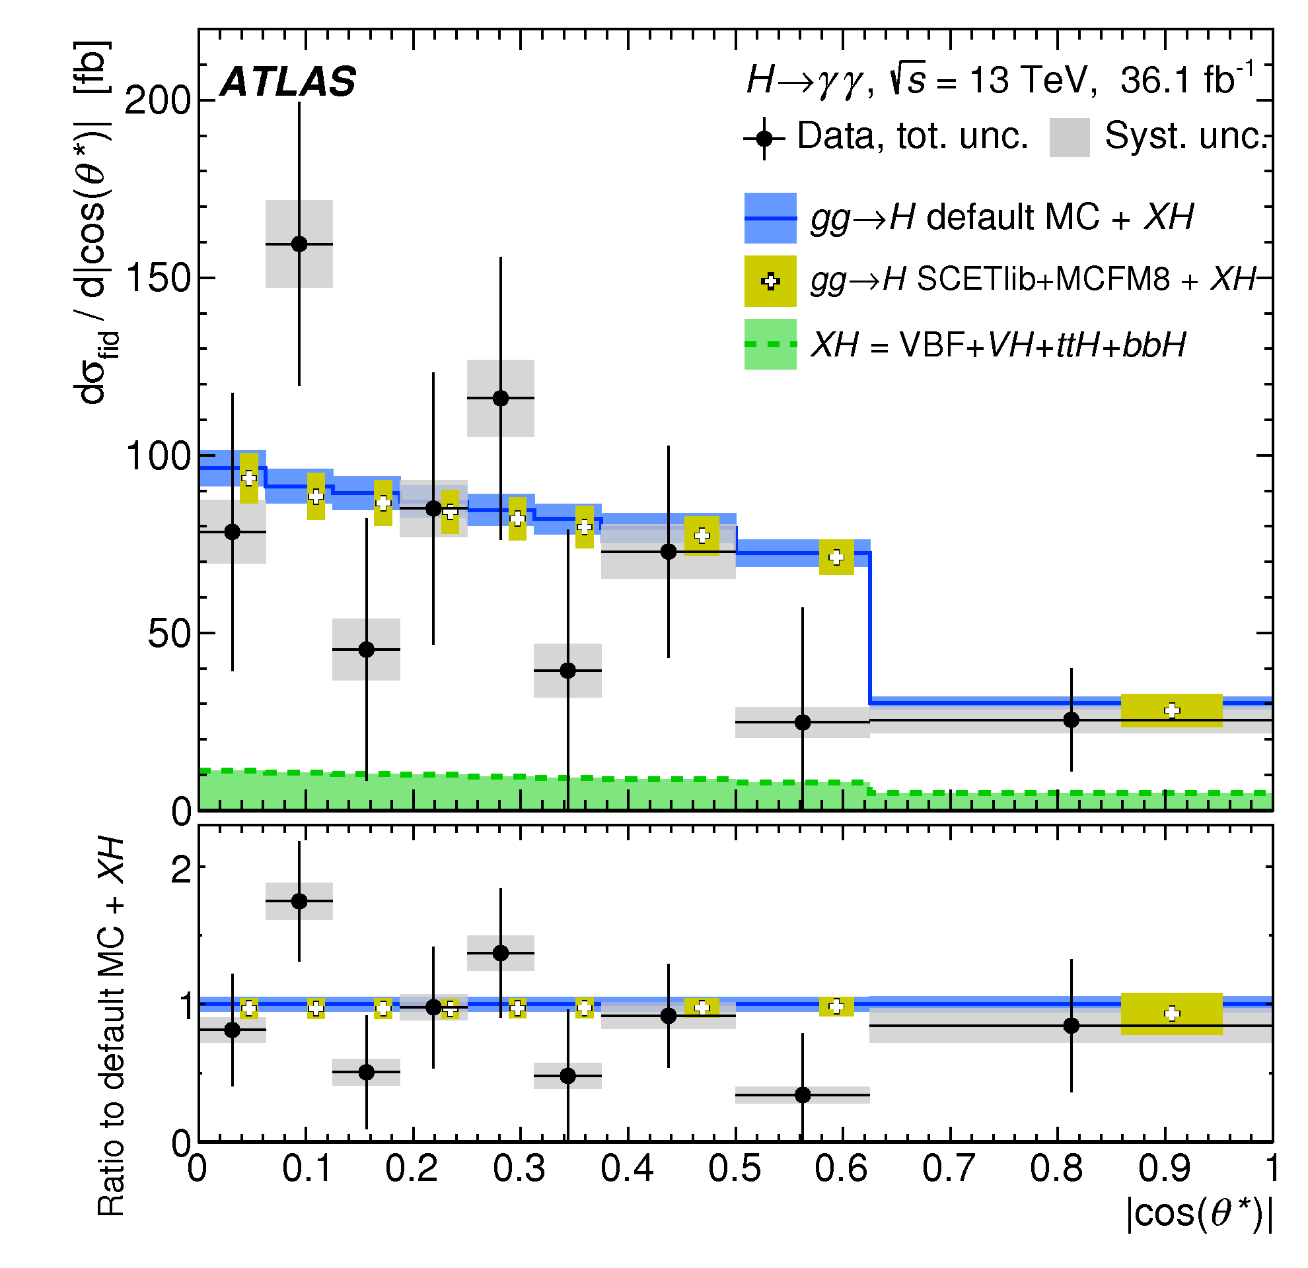
Going differential…
arXiv:1802.04146
Better agreement in 13 TeV data
(much more data will be needed…..)

Slide 23
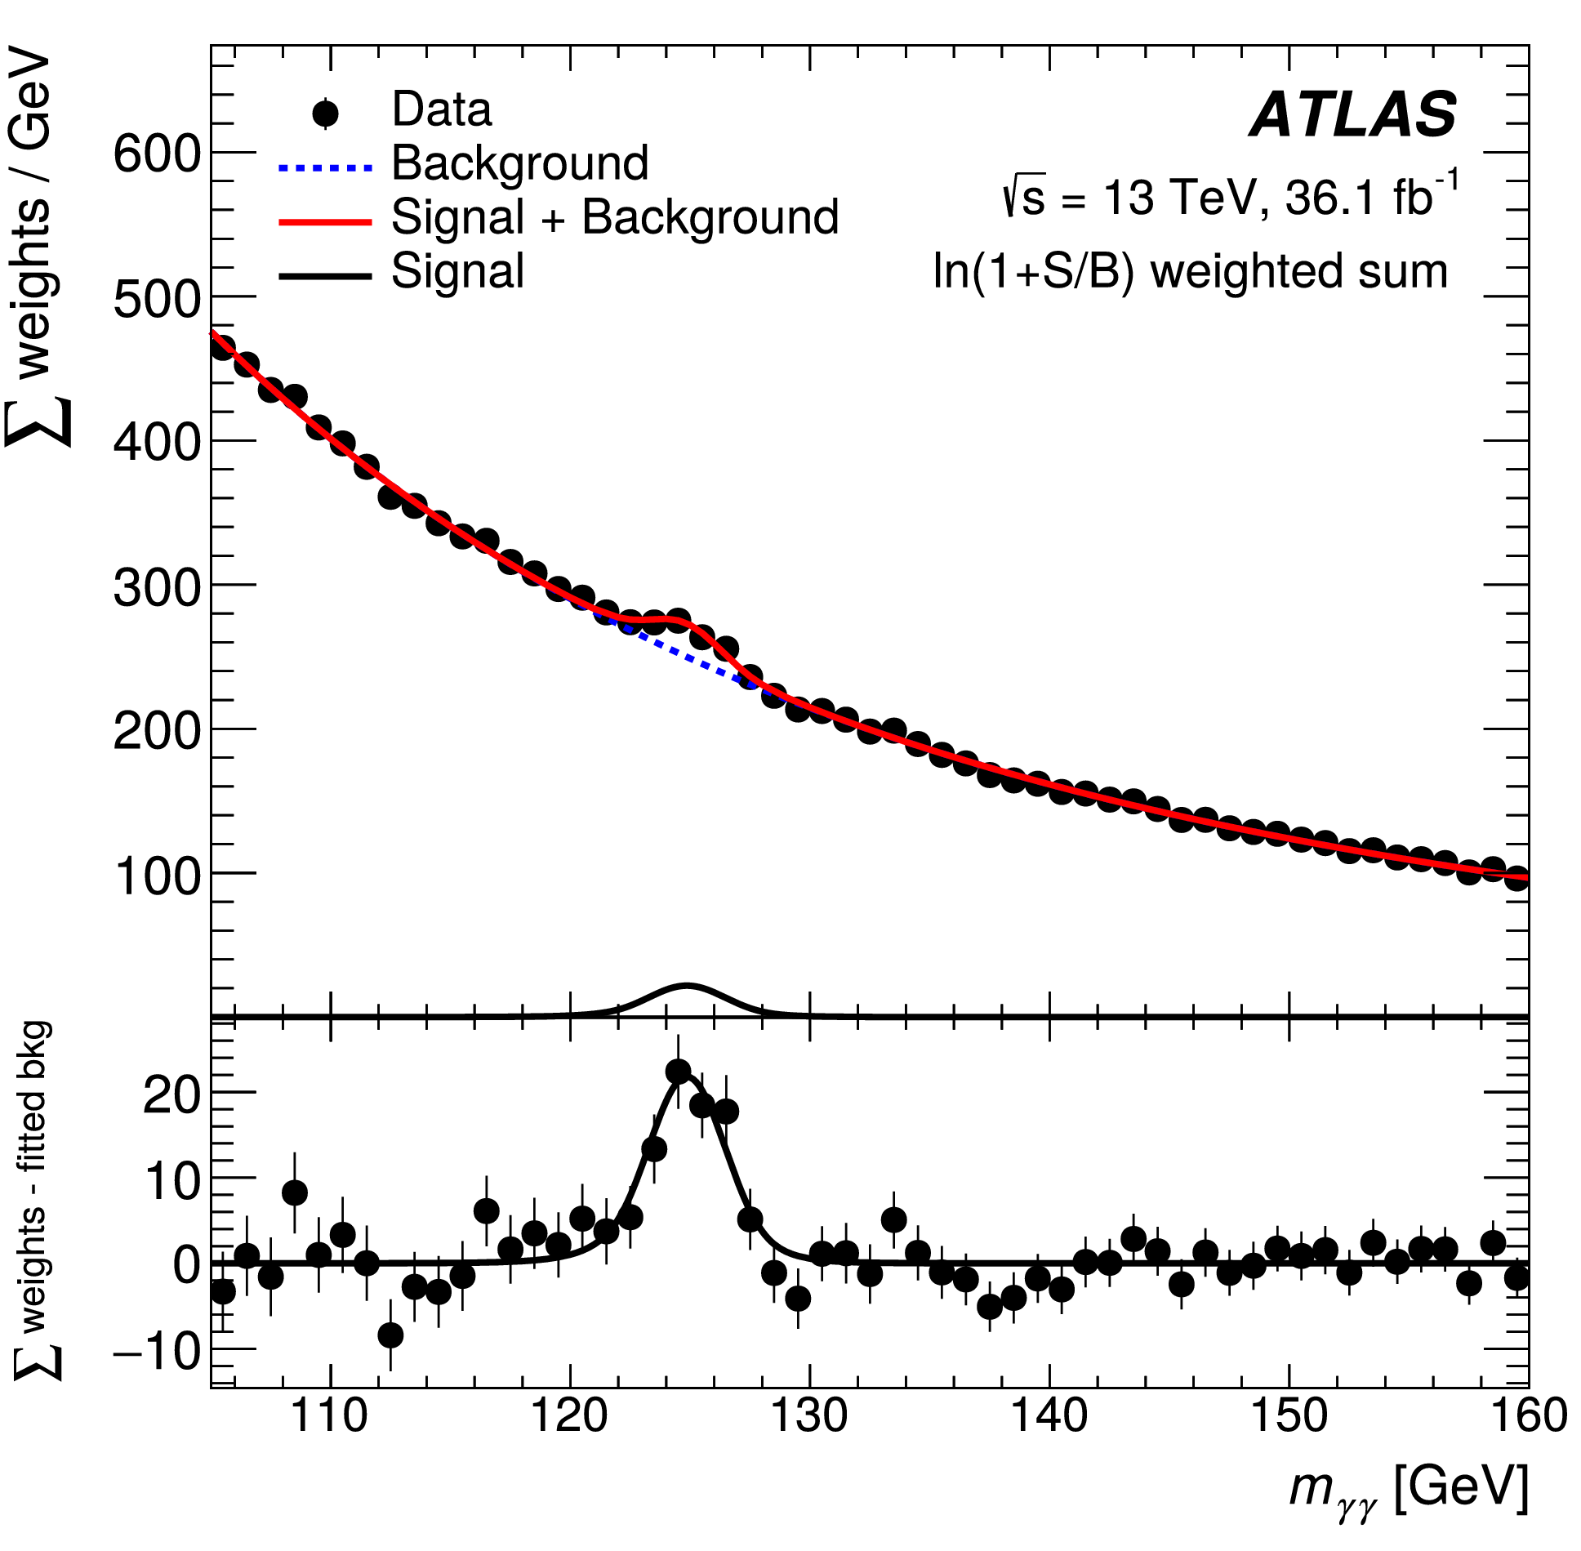
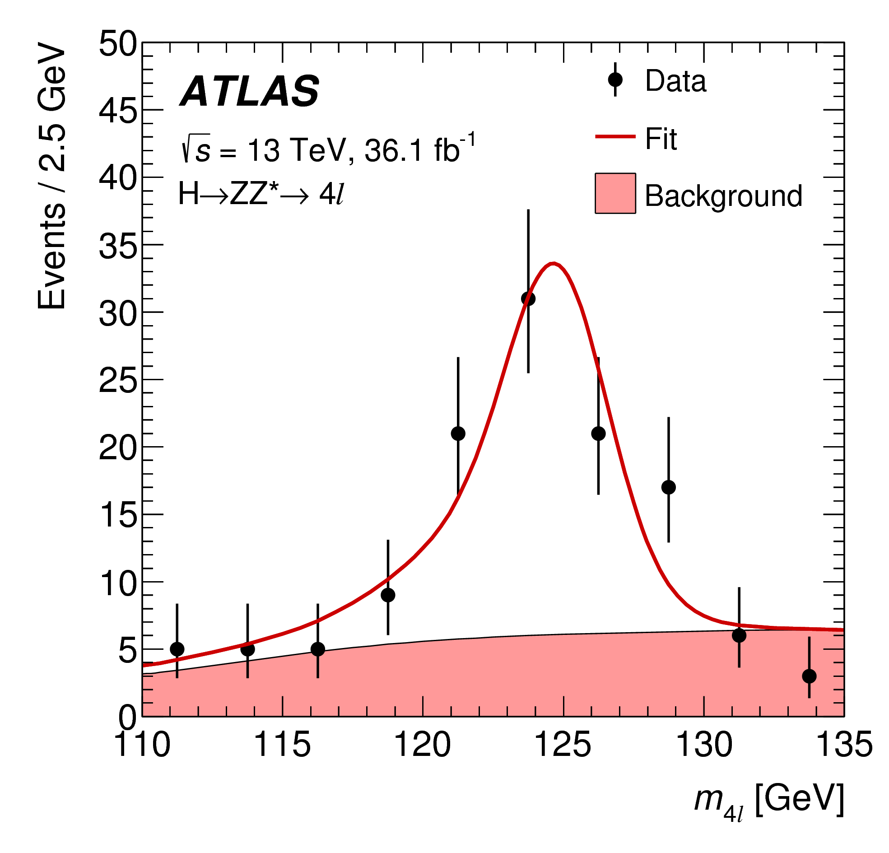
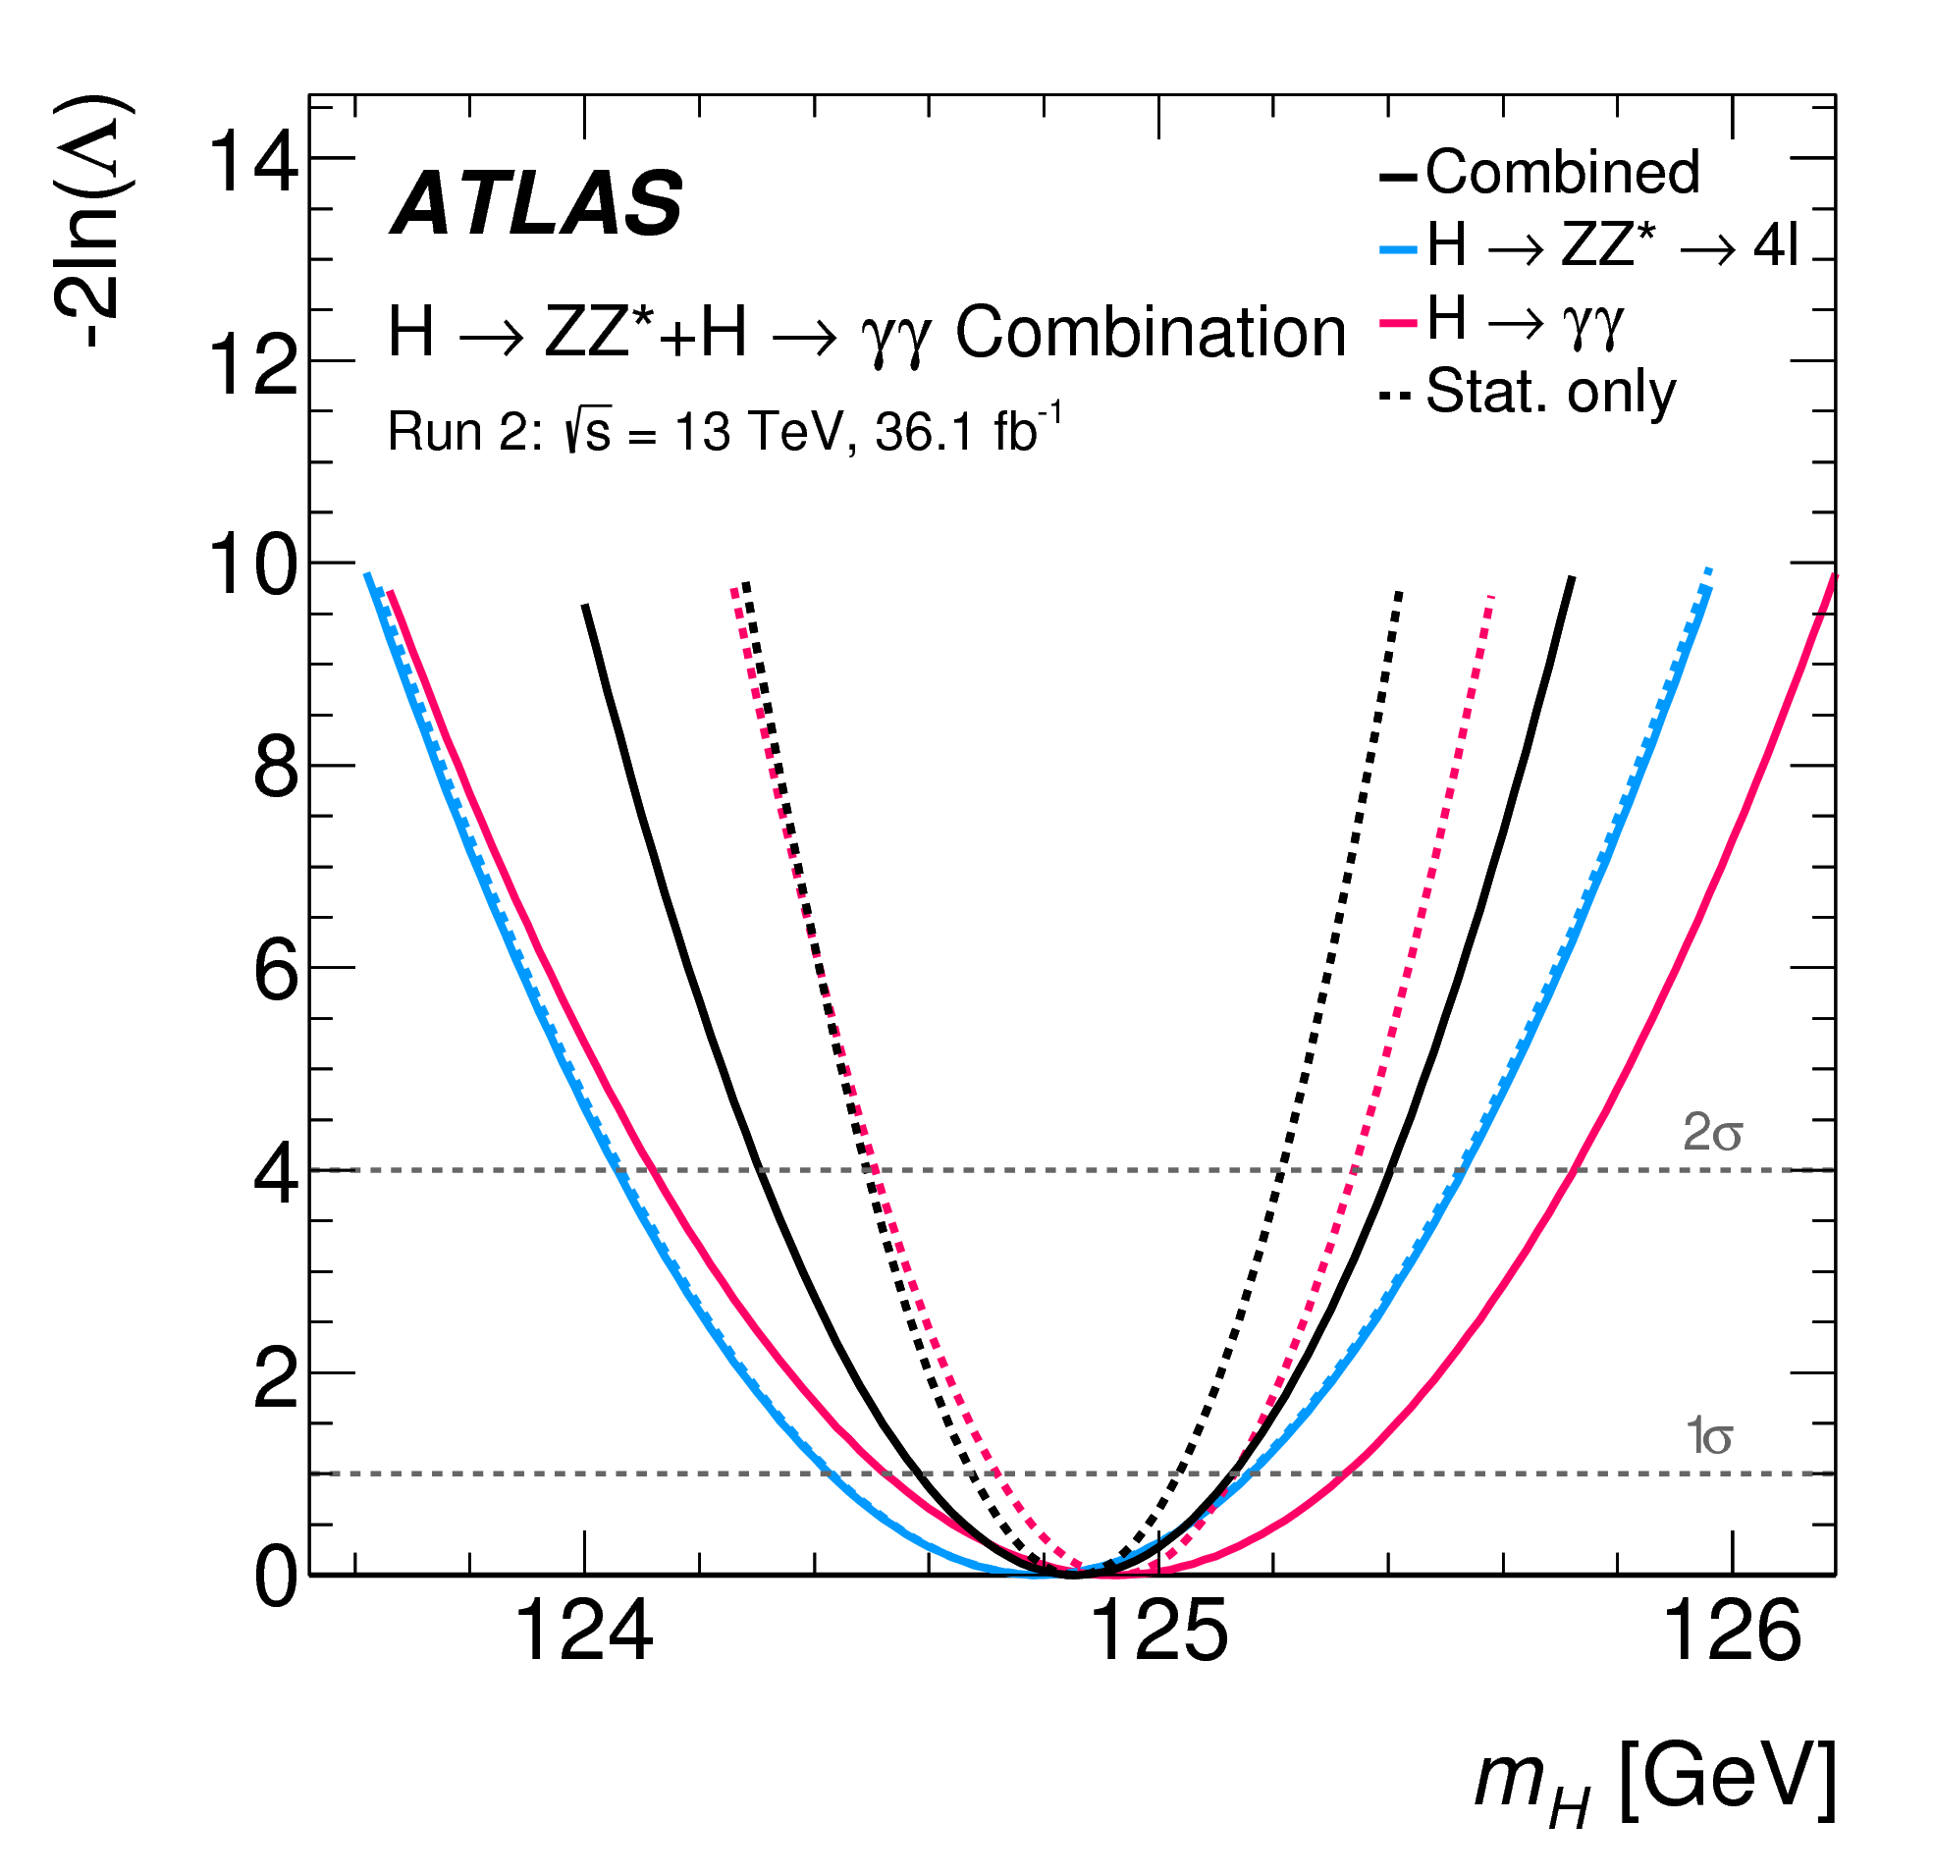
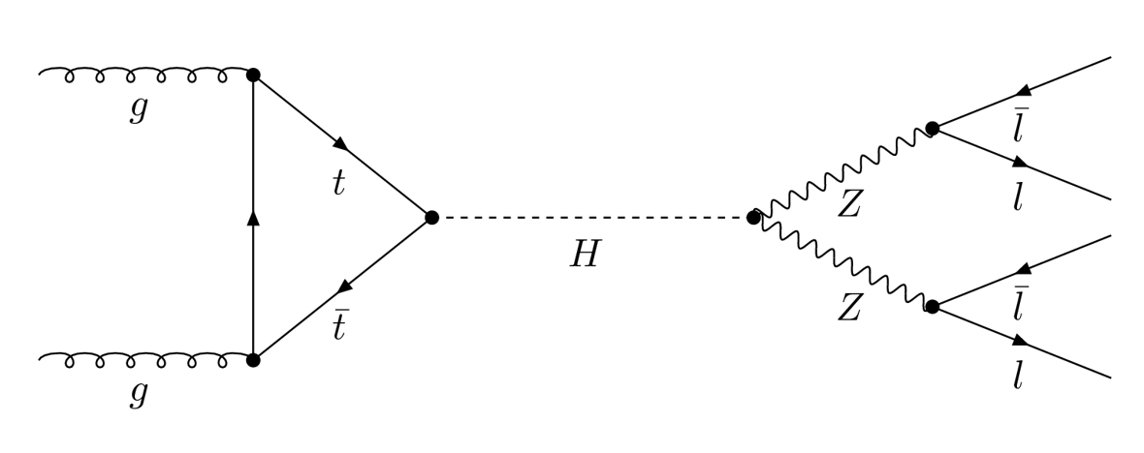
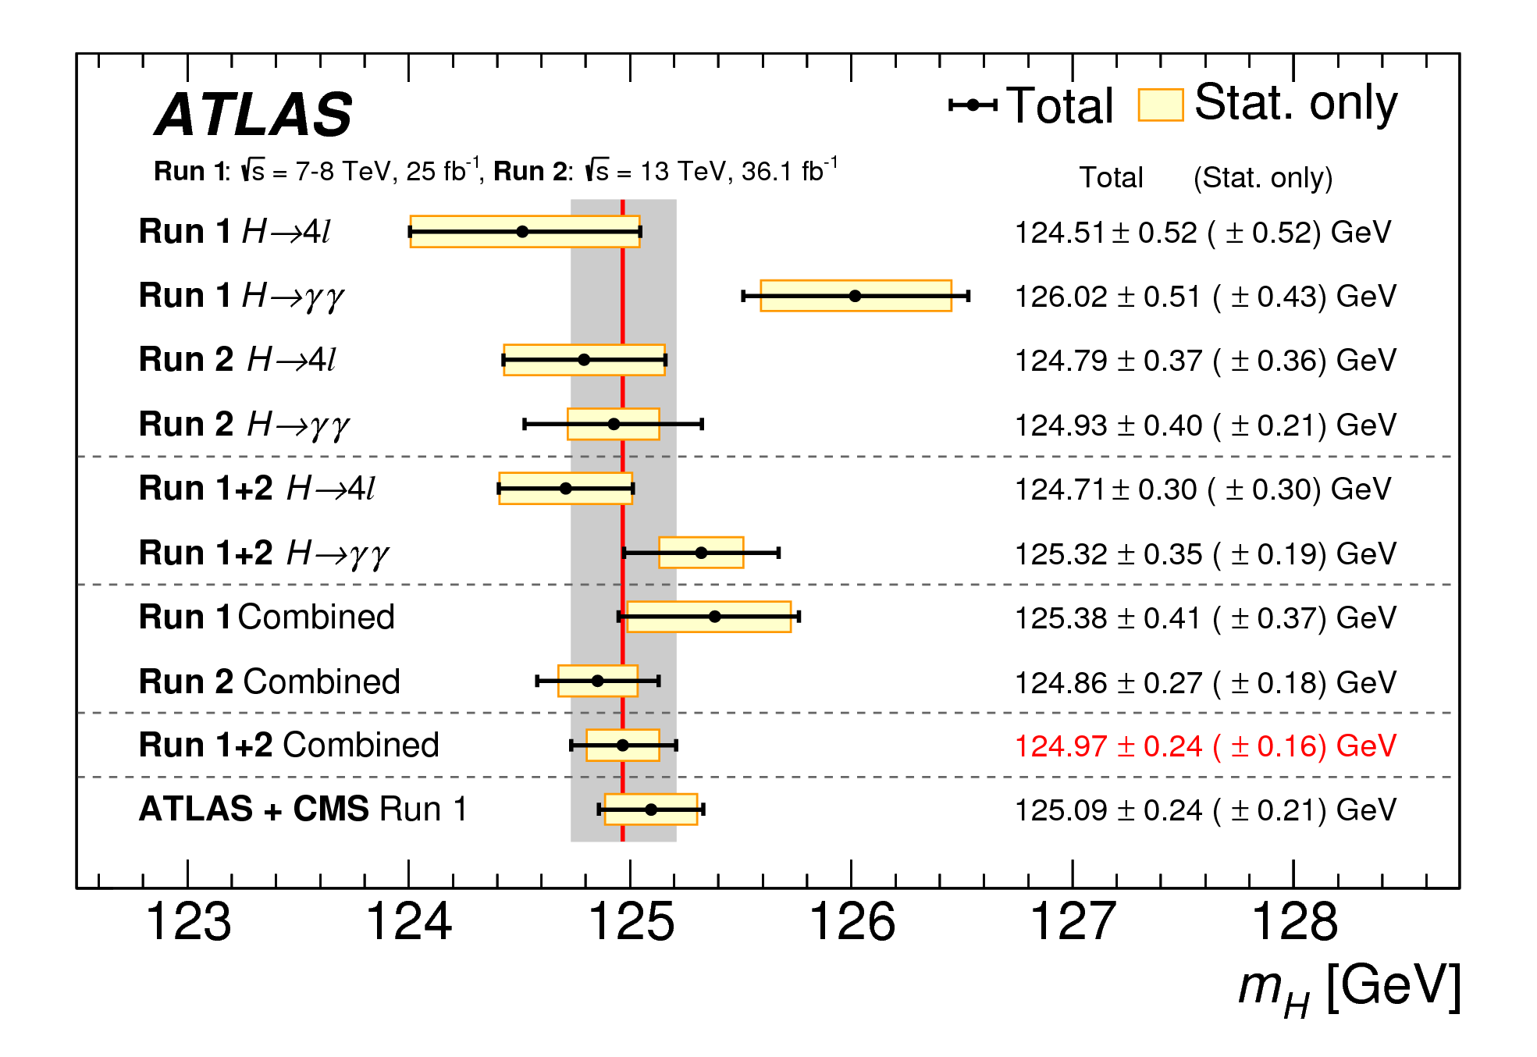
Higgs Mass
0.2% precision in mass

Slide 24
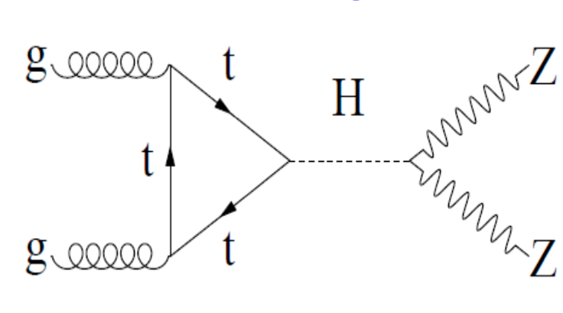
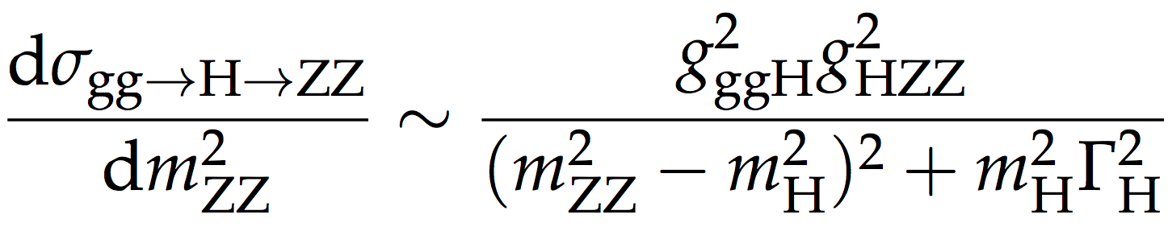
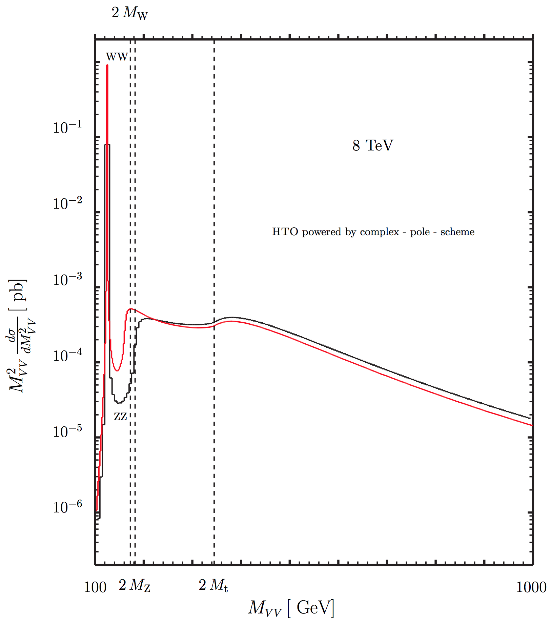
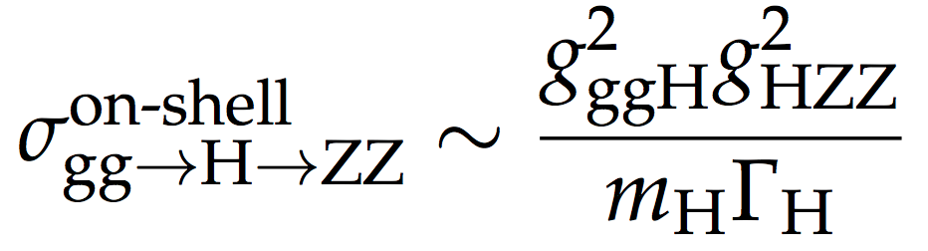
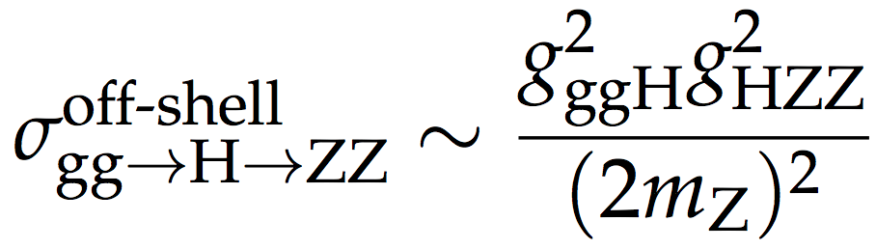
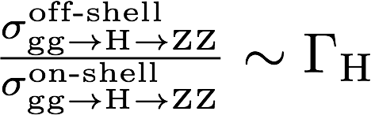
Higgs width
Sensitive to small contributions

Slide 25
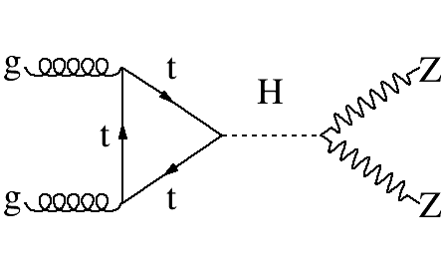
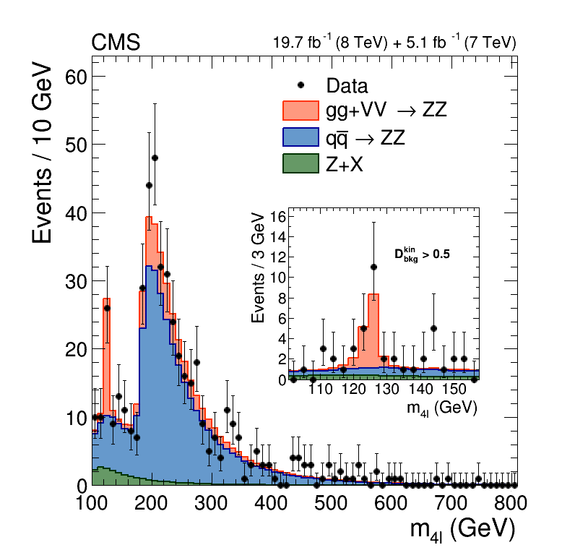





Off-Shell Higgs

Slide 26


Higgs width results
arXiv:1808.01191
Combination of on-shell and off-shell
Γ_{Η} < 14. 4 MeV @ 95% CL

Slide 27

Invisibly decaying Higgs

Slide 28


Remember Z width..
Higgs is too narrow to do this

Slide 29





Invisible Higgs
(Run I)
BR (invisible) < 75% @ 95% CL

Slide 30



Invisible Higgs
BR (invisible) < 69% @ 95% CL

Slide 31



Evidence for Dark Matter
The rotation of the stars around the
center of the galaxies is not consistent
with the amount of mass observed
(L/M ratio)_{SUN}
Gravitational Lensing
Spherical dark matter halo
Large distortion of the imagines of distant
galaxies due to gravitation lensing
→ indication of DM in galaxy clusters
Collisions of clusters of galaxies
Considered the ultimate
demonstration of the presence of Dark
Matter since this does not involve
Newton’s Law

Slide 32




Higgs Portal
The limits on invisibly decaying Higgs
can be re-interpreted in the context of
SM – DM interactions via light Higgs
mediators
Note the LHC results
provide unique access to
light DM range ( < 10 GeV)

Slide 33




Higgs Portal
Assuming different kind of DM – Higgs Interactions

Slide 34


The BEH Mechanism

Slide 35





Higgs mass and Vacuum Stability
If too large it becomes
non-perturbative
If too negative destabilizes
the EWK vacuum

Slide 36



Higgs vs Vacuum Stability
What this really means ?
Large dependence on top and Higgs masses
Assumes no BSM physics enters in the RGE
This really means that the SM is consistent
all the way to the Planck scale..
Do not worry .. Lifetime probably larger than
the age of the Universe.

Slide 37


Hierarchy Problem
From EWK to Planck scale ?
f
H
Already a serious problem at 5 TeV scale
(cancellation among top, gauge and Higgs loops)
This kind of conspiracy has name in Physics…
SuperSymmetry ?
(taken from C. Quigg, hep-ph/0704.2232)

Slide 38















SUSY? … LESSON 3

Slide 39


SuperSymmetry in 30"
Fermion/Boson symmetry
Double Spectra of Particles
Exact cancellation between
fermion & boson loops for Higgs
~
G
G
..will mix to form mass eigenstates..
Higgs sector with 2 doublets
..SUSY must be broken….. model-dependent phenomenology

Slide 40
Hard to believe in SUSY if the Higgs sector stays with just h₀
…Looking for extra Higgs particles ….

Slide 41




MSSM Higgs
MSSM Higgs production cross section
boosted compared to SM at large tanβ
σ(φ) ∼ 2σ(Α)

Slide 42



MSSM Neutral Higgs

Slide 43






MSSM Neutral Higgs

Slide 44



MSSM Higgs
h → bb

Slide 45




H⁺ → cs
Expressed in terms of limits on BR in top decays

Slide 46





H⁺ → τ ν
Limits on top BR and
SUSY MSSM parameters
lepton + jets
Tau-ID + jets

Slide 47





X → HH (→ bbbb)
3-b control region
Very difficult analysis
(huge QCD and ttbar)

Slide 48




X → HH (γγ bb)
arXiv:1807.04873

Slide 49
LHC BEYOND RUN I+II
HL-LHC

Slide 50

LHC Plan
Producción
174M Higgs

Slide 51





Higgs signal strength
10 – 20 % accuracy after long time

Slide 52




Higgs Couplings
5-10% accuracy on couplings

Slide 53




LHC-HL prospects
ATL-PHYS-PUB-2014-019
ATL-PHYS-PUB-2014-016
Higgs couplings (assuming SM Γ_{H})
2-5% in most cases
10% for rare processes (H→ μμ, ttH → ttγγ)
may measure Higgs self couplings to 30% ?

Slide 54







Higgs width
Bounding the Higgs Boson Width
Through Interferometry
200 MeV

Slide 55



Higgs Portal to DM

Slide 56
End Part II

