Slide 1








LHC Physics
(Higgs I)
Mario Martínez
TAE, Benasque, September 2022

Slide 2
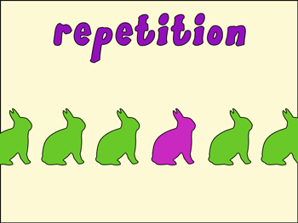
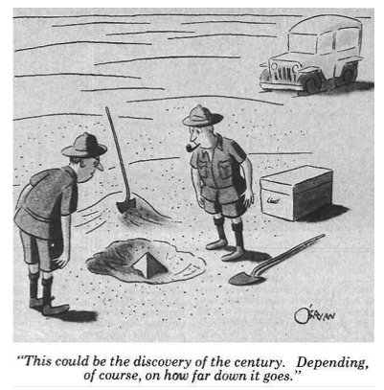
Outline for Part I
Mass vs BEH Mechanism
The BEH Mechanism
Higgs boson production and decays
Pre-LHC Higgs Searches at Colliders
Building Blocks for a Discovery
Higgs Discovery (Golden Channels)
Higgs J^{PC}
Other (Silver) Channels
Disclaimer: completely unbalanced
set of results from CMS and ATLAS
No attempt to have the latest results anywhere

Slide 3

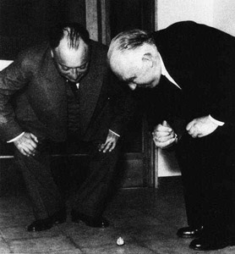
Part II
Other (Silver) Channels
Detailed study on Couplings
Higgs width
Invisibly decaying Higgs
Higgs and Vacuum Stability
Hierarchy Problem & SUSY
Search for other Higgs
What to expect in the future ?

Slide 4
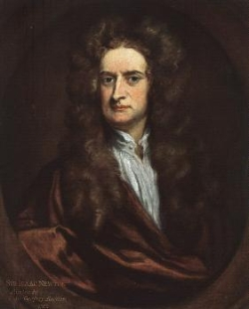
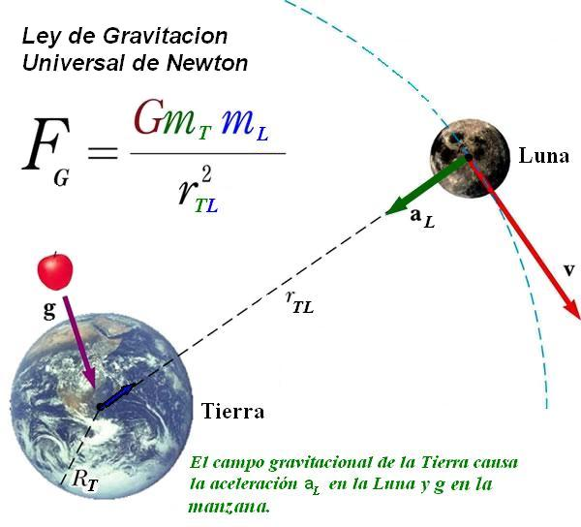
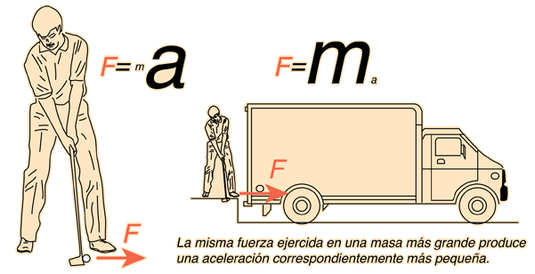
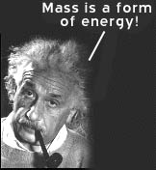
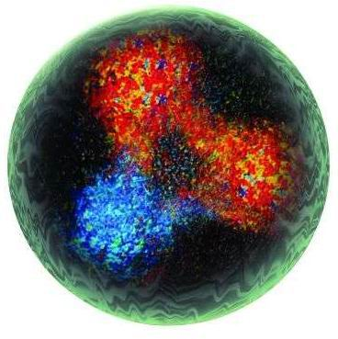
Mass
F = M a
I. Newton
Protón
(uud)
E = M c²
Mass as a
form of energy
Only 2% of the proton mass is
due to quarks…most of it is
QCD confinement energy
A. Einstein

Slide 5
Lesson 0
Do not go around saying:
“The Higgs mechanism explains the origin of the mass in the Universe…”
It is simply incorrect…

Slide 6
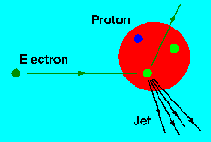
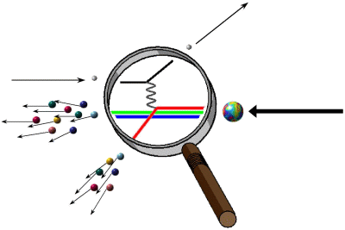
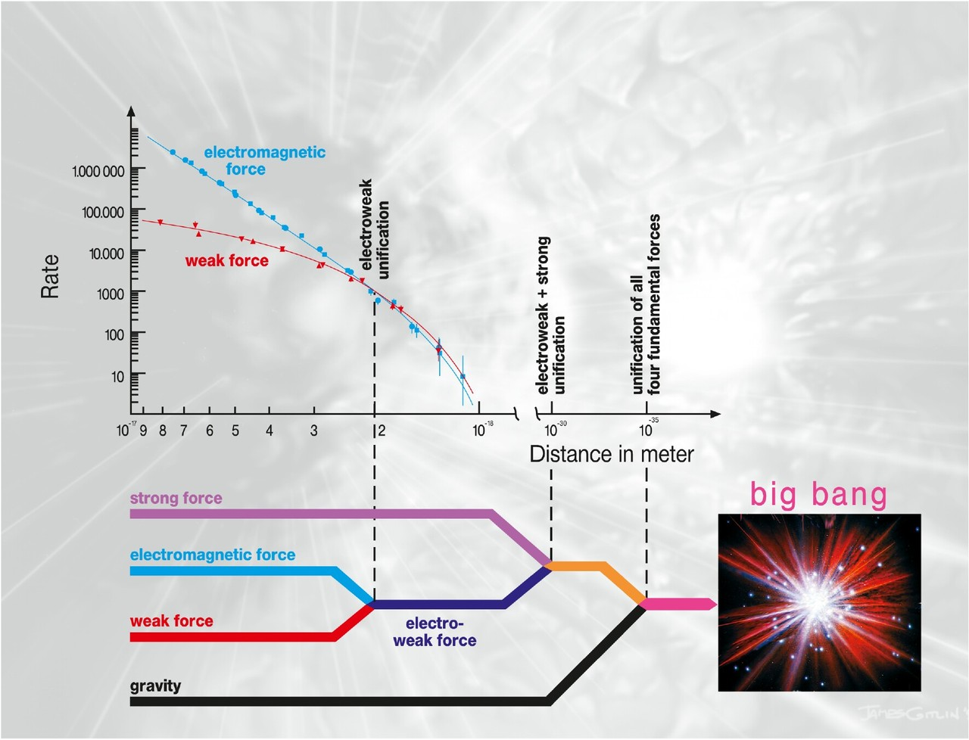


EWK Symmetry Breaking
BHE mechanism makes the small range and
weak interaction (massive Ws and Z )
Same time allows for fermion masses

Slide 7

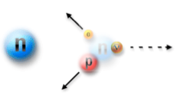
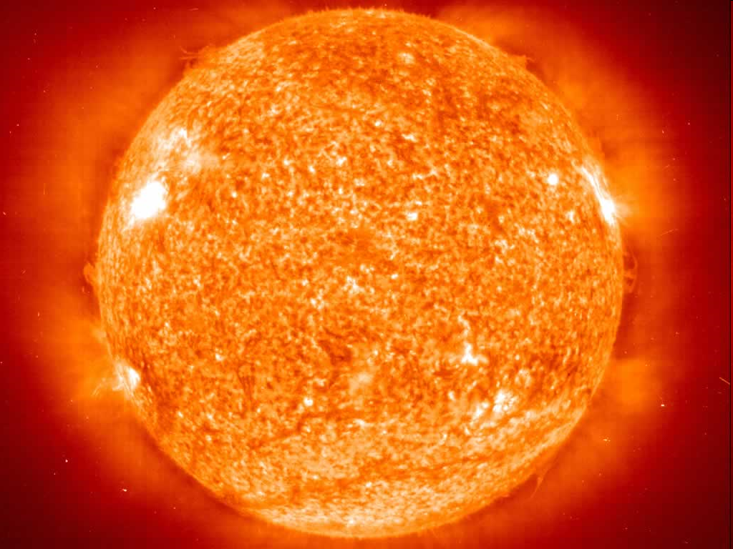
A world without mass ?
Without giving masses to fermions
it would be impossible to form stables atoms
Light W ? → Faster reactions and a Cold Universe

Slide 8
How to include the mass ?
These terms are not allowed by gauge invariance

Slide 9
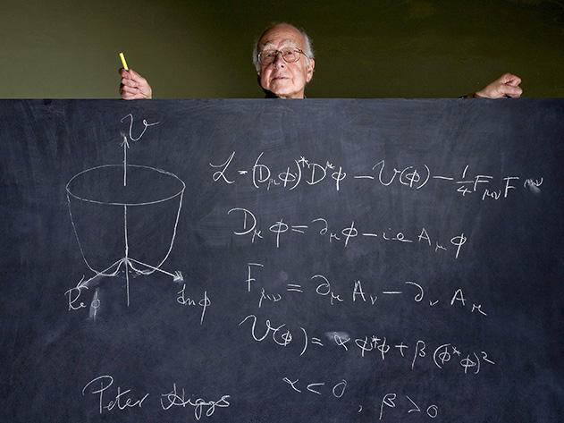
Higgs Mechanism

Slide 10
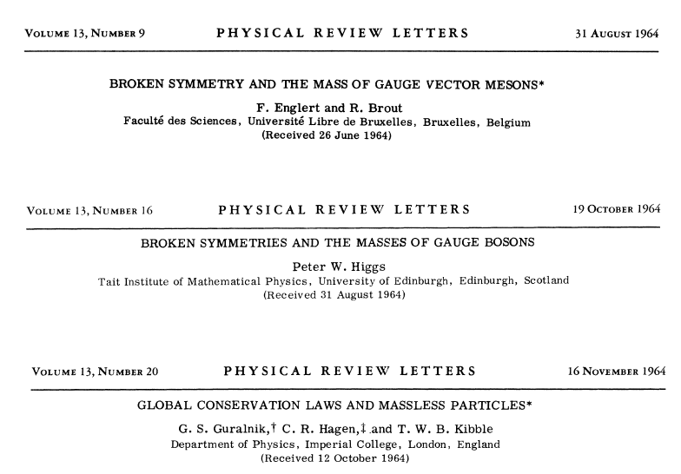
1964….

Slide 11
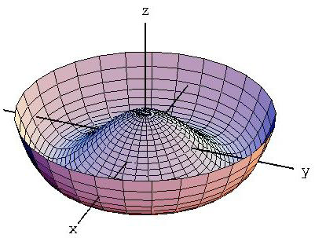
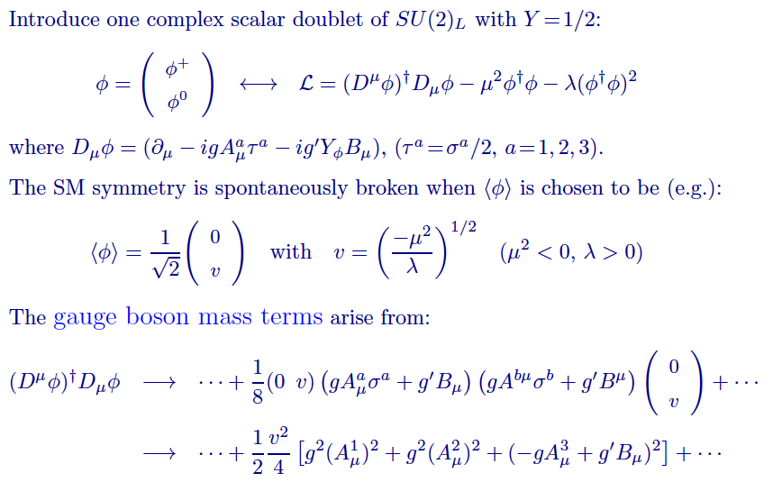
The BEH Mechanism

Slide 12
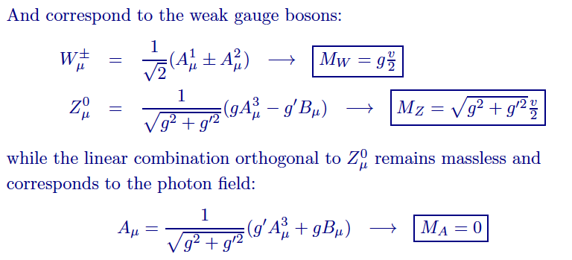
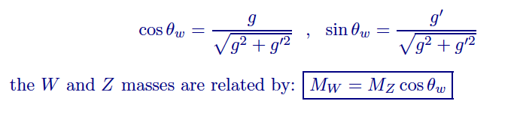
The BEH Mechanism

Slide 13
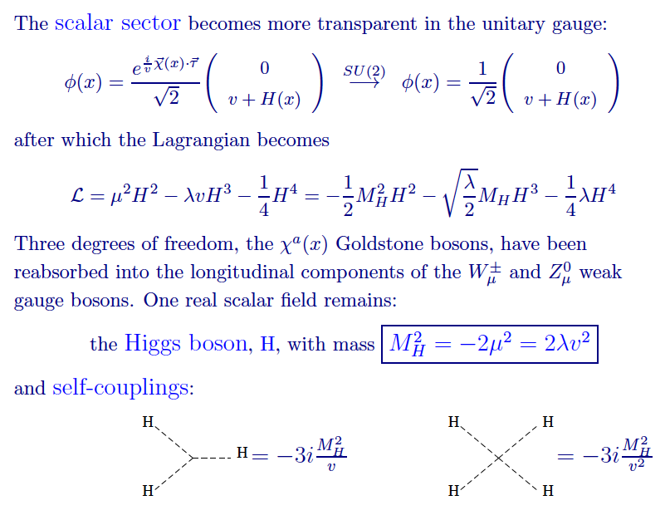
The BEH Mechanism

Slide 14
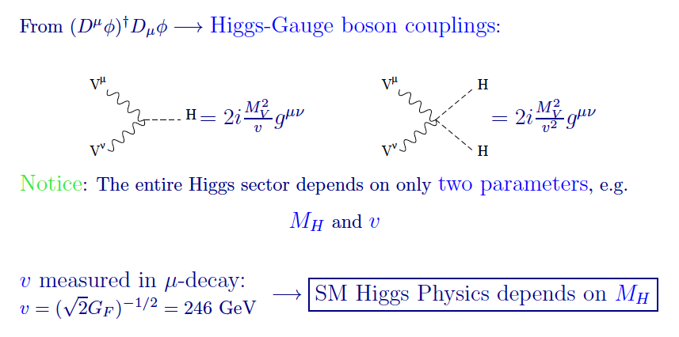
The BEH Mechanism

Slide 15
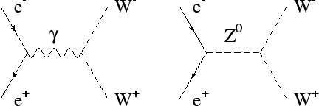
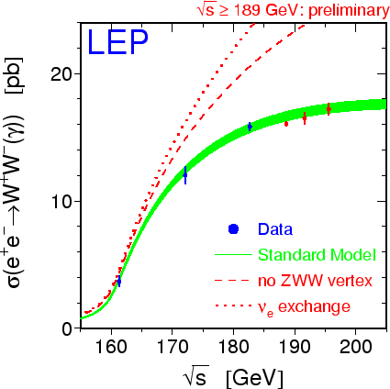
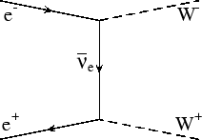
Consistency of Gauge Interactions
This illustrates the consistency
of the Gauge Interactions

Slide 16
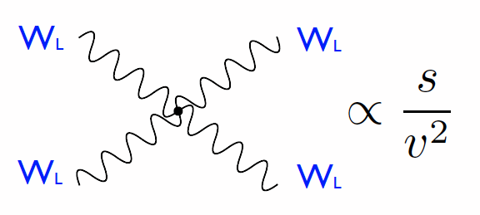
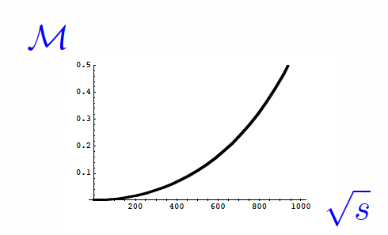
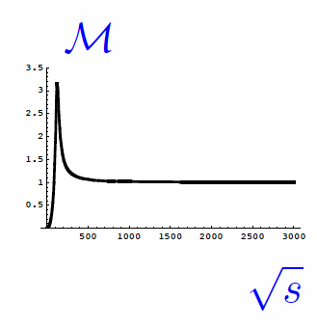
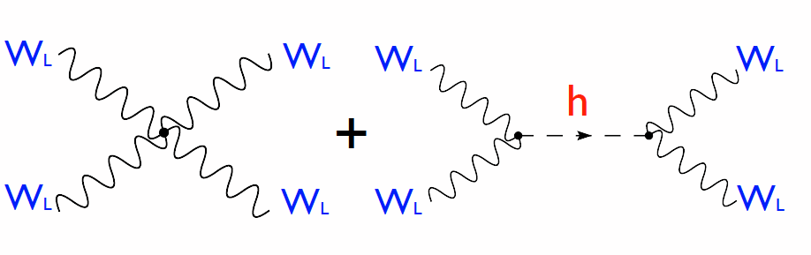
W_{L}⁺W_{L}⁻ → W_{L}⁺W_{L}⁻ scattering
To restore unitarity one needs to postulate
a Higgs boson with mass below 800 GeV
Otherwise new physics should come
at the TeV scale to rescue us

Slide 17
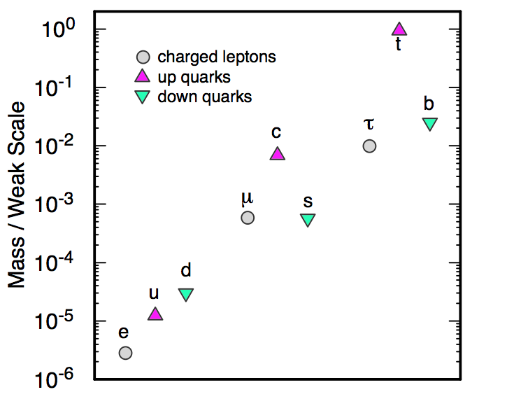
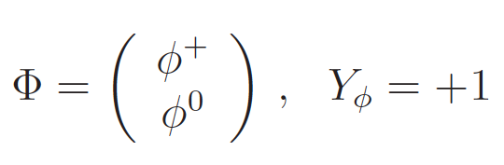
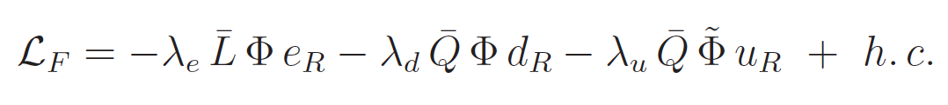
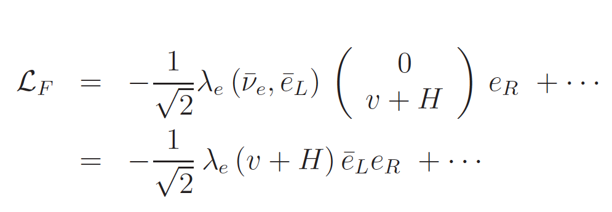
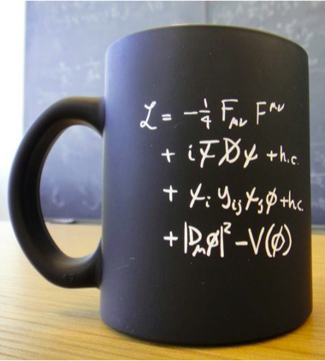
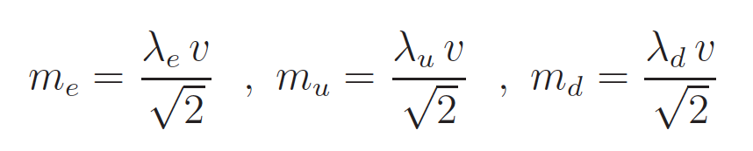
Fermion Masses
Most of the free parameters
in the SM model come from here

Slide 18
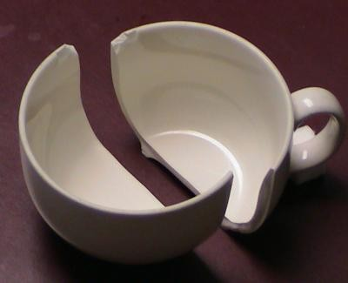
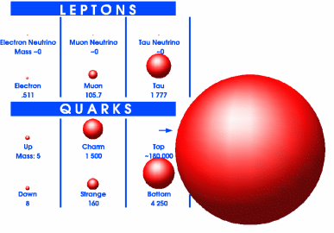
Why such a mass hierarchy ?

Slide 19
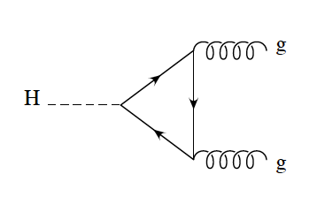
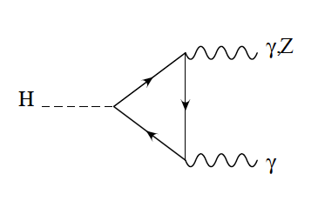
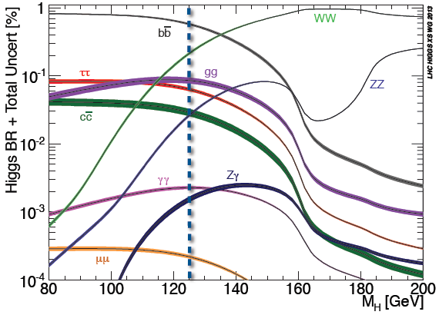
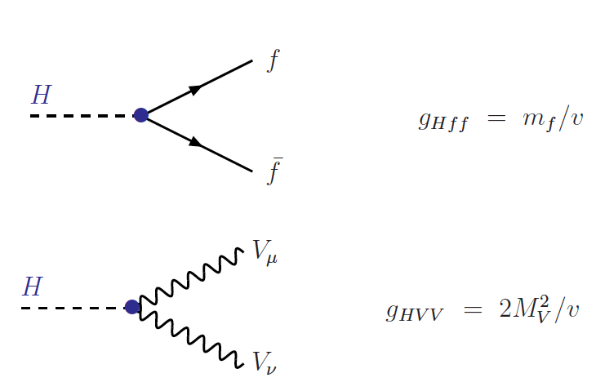
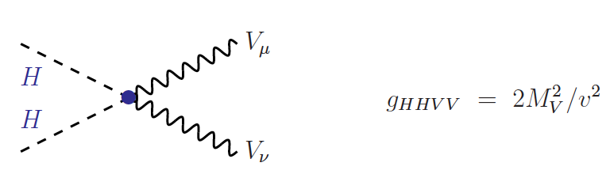
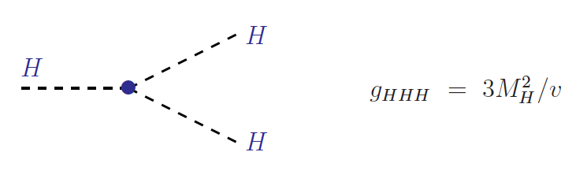
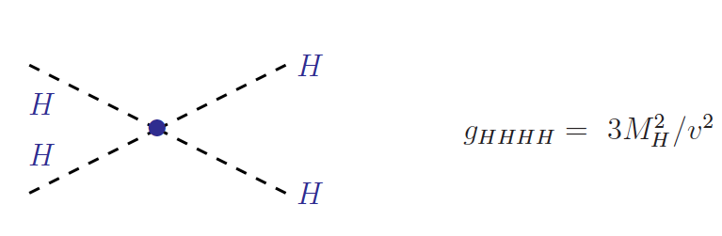
Higgs Couplings to SM
and via
loops..
Couplings proportional to masses of particles
→ This determines the phenomenology

Slide 20
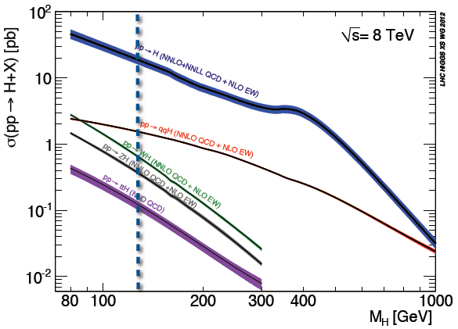
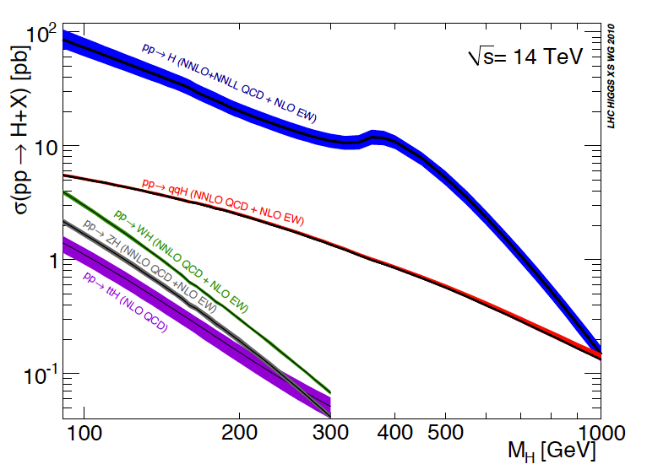
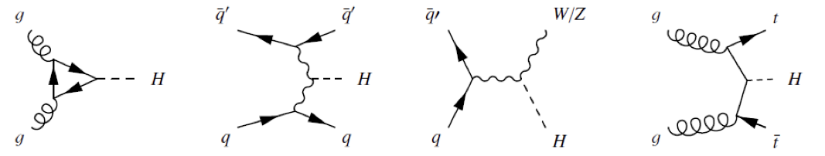
Higgs Production (LHC)
Decreasing cross section

Slide 21
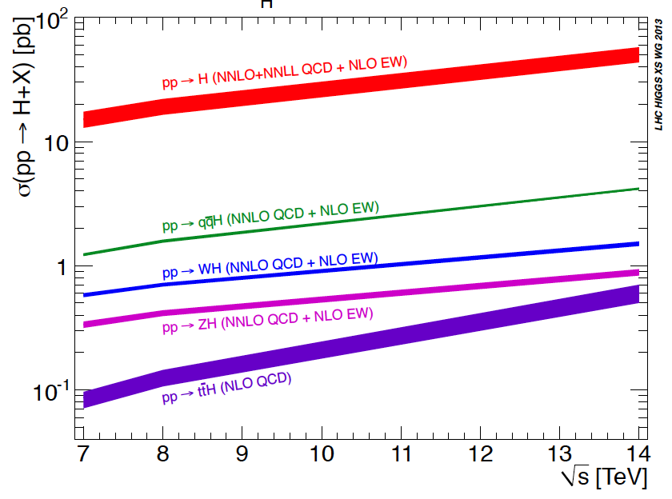
Higgs Production (LHC)
For a Higgs of 125 GeV
Decreasing cross section

Slide 22
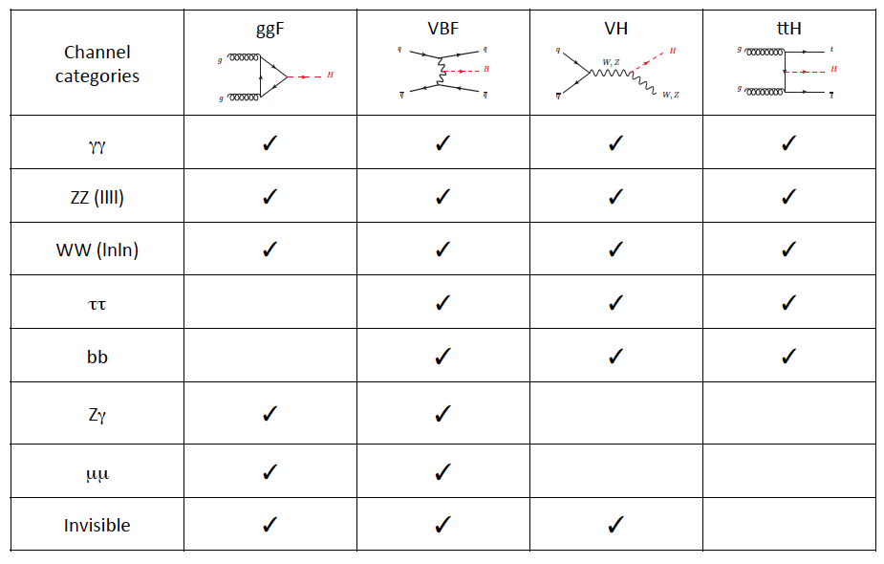
Higgs Program in a Glance
X
X

Slide 23
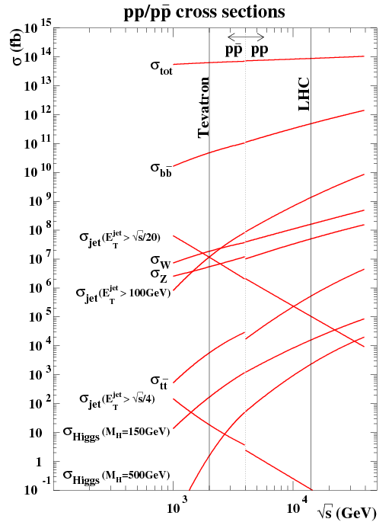
Beat the background
The discovery channels are subject of
signal rate, mass resolution,
and the capacity to beat the
background
For example the a priori
good channel for Higgs production
gg → H, H → b (anti)b
gets killed by the huge underneath
(non-resonant) QCD-driven process
gg → b (anti)b

Slide 24

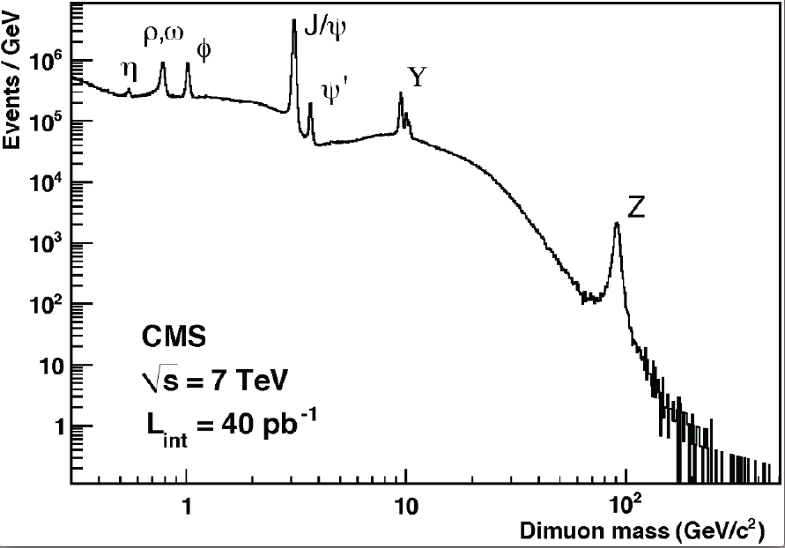
Want a Nobel?...find a resonance

Slide 25








The Golden Channels
Irreducible background from di-photons
….and background from γ+jets and jet-jet
with jets faking photon signals….
A resonance out of a huge non-resonant background
Key: good photon energy/momentum reconstruction

Slide 26






The Golden Channels
Background dominated by
Diboson (ZZ*) w/wo resolved Zs
with contributions from
other processes (Z+jets) and top
production with jets faking leptons
Very clean and high-resolution channel
(few events piling up in a given mass will be
enough to claim discovery)

Slide 27
Pre-LHC Higgs Results
Electroweak Fits
Tevatron Searches
Searches at LEP

Slide 28




Absolute limits on Higgs from LEP
LEP : e+ e- collider @ CERN : up to 210 GeV
Hot days at CERN … by now we know it was nothing..
Excludes @ 95 % CL
M_{h} < 114 GeV

Slide 29

A hard decision was taken to stop LEP and allow for the LHC
program to start .. Quite the right decision.. we know now

Slide 30


Tevatron
Chicago
↓
Booster
CDF
DØ
Tevatron
p-bar source
Main Injector
(new)

Slide 31





Electroweak Fits
(indirect Higgs Mass constrains)
H
Δr ~ln (m_{H})
Δr ~ m_{top}²
..as presented in
Lepton Photon 2007

Slide 32



Tevatron in July 2010
H → bb ?? (limited resolution)
If goes below 1 you exclude the SM Higgs for a given mass

Slide 33

CERN (Geneva) LHC across the France-Switzerland border
Approved in 1994
27 Km
1232 high-tech superconducting dipole magnets
(at 1.8 K…the coldest (and coolest) place in the universe)
proton – proton 7-8 TeV in Run I (2010 – 2012)
(13 TeV in Run II) (2015 -- )

Slide 34





LHC construction

Slide 35


LHC Construction

Slide 36





ATLAS
LHC will run for 15 years..
A total of 6 10¹⁵ collisions

Slide 37

CMS

Slide 38

ATLAS

Slide 39



Slide 40


ATLAS
(relevant to photon ID)

Slide 41

H → γγ

Slide 42

H → ZZ* → 4l

Slide 43


LHC Performance (2010-)
Spectacular LHC performance
(rapid increase of data samples)
LHC ended pp run at 7+8 TeV (28 fb⁻¹)
A total integrated luminosity for physics of 150 fb⁻¹ at 13 TeV
Taking data now again for Run III since April..
… rapid increase of pile-up conditions

Slide 44


Multiple Interactions
Up to 60 interactions / crossing
(requires enormous efforts to
understand the reconstruction
of the physics objects…)
Z → μμ events with
20 interactions on top

Slide 45






Building Blocks
Z → ee , J/Psi → ee …..
eeγ and μμγ
Photons
Electrons

Slide 46





Building Blocks
Detector Material
EM absolute scale

Slide 47





Building Blocks
Alignment
of trackers
and muon
chambers
Using well-known peaks
Z
J/Psi
Y

Slide 48







Building Blocks
Missing E_{T} vs PILEUP
TAU ID vs PILEUP
B-JET TAGGING EFFICIENCY
JET ENERGY SCALE UNCERTAINTY

Slide 49
SM Physics
Selected results on
jets, photons, W/Z+jets,Top quark, Dibosons….
Just to illustrate the Glory of the SM
(processes relevant for searches later on…)

Slide 50



Jet Production
PRD86(2012)014022
anti-K_{T} jets with R=0.4, 0.6
Jet p_{T} > 20 GeV, |Y| < 4.4
ATLAS-CONF-2012-021
Inclusive jet and dijet production measured
in a wide range of jet p_{T} , rapidity
and dijet mass.
Well described by NLO pQCD predictions

Slide 51






Inclusive photons
Phys. Lett. B706 (2011) 150-167
Phys. Rev. D83 (2011) 052005
ATLAS-CONF-2013-022
(cross section for isolated photons)
Isolation distribution used to extract
the background contributions
Good agreement with NLO pQCD predictions
(at very low E_{T}^{γ} predictions are affected by the
limited knowledge of the fragmentation contributions)

Slide 52





γ+jet
CERN-PH-EP-2012-009
jet
Measured cross sections with
η^{γ} y^{jet} >0 & η^{γ} y^{jet} < 0
Fair agreement with NLO pQCD
except at very low E_{T}^{γ} (< 45 GeV)
difficult region where
photon purity decreases and
non-pQCD corrections are sizable
Jet p_{T} > 20 GeV
photon E_{T} > 25 GeV
γ
photon purity
non-pQCD

Slide 53



W+jets
Phys. Rev. D85 (2012) 092002
Very good description of the different
Jet p_{T} distributions by NLO pQCD and
LO ME + PS (ALPGEN)
Non trivial test of the ME - PS implementation
& matching procedures built inside the MCs
→ Input to future MC tunes

Slide 54


Z+jets
JHEP07(2013)032
γ/Z
γ/Z
Z (→ νν)+jets irreducible background
In searches for SUSY, LED, etc….
Z (→ ll)+jets fundamental SM measurement…
→ Very clean samples with no missing E_{T}
(e and μ channels combined)
Data well described by NLO pQCD and
ME + PS (ALPGEN/SHERPA) predictions

Slide 55






Top
Cross section
Top mass
Simultaneous fit to top mass and JES

Slide 56

SM Cross Section Summary
As by July 2014
Top production
Dibosons

Slide 57

SM Cross Section Summary
As by July 2021
W/Z+jets
Dibosons

Slide 58
Towards the discovery
Notes on statistics
The discovery channels

Slide 59

Notes on Statistical Significance
?

Slide 60




Likelihood ratio
Nuisance
parameters

Slide 61



Only background ?
Test of “null” hypothesis of no signal
If a real signal appears … p₀ → 0
(once p₀ < 2.87 x 10⁻⁷ → Discovery)

Slide 62

CL_{s}
(do not exclude your signal…)
In the case of very small
signals (limited sensitivity)
the use of p_{s} to exclude signals
can lead to false exclusions if the
data fluctuates down….
In these cases it is better to use
CLs … which is conservative in the
exclusion
If CLs < 0.05 → excluded at 95% CL
EXCLUDED

Slide 63


Building up the peaks..

Slide 64



The Announcement
(4th July 2012)

Slide 65


Slide 66

Exciting times....
2011-2012

Slide 67
Higgs !!
As in Moriond 2013
A mass peak in the vicinity of 125 GeV

Slide 68
Higgs !!
A mass peak in the vicinity of 125 GeV

Slide 69

Higgs Discovery

Slide 70



EPS 2013 High Energy and Particle Physics Prize is awarded to…
"The ATLAS and CMS collaborations, for the discovery of a Higgs boson, as predicted
by the Brout-Englert-Higgs mechanism
and to
Michel Della Negra, Peter Jenni, and Tejinder Virdee, for their pioneering and
outstanding leadership rôles in the making of the ATLAS and CMS experiments”
…..it was announced during the LHCP Conference in Barcelona, May 17th 2013…

Slide 71

8th Oct. 2013

Slide 72



“…acuerda por unanimidad conceder el
Premio Príncipe de Asturias de Investigación Científica y Técnica 2013
de forma conjunta a los físicos Peter Higgs (Reino Unido) y
François Englert (Bélgica) y a la institución internacional CERN,
el Laboratorio Europeo de Física de Partículas, por la predicción
teórica y detección experimental del Bosón de Higgs.”
Oviedo, 29 de Mayo de 2013

Slide 73

Higgs at the PDG

Slide 74

Higgs at the PDG (as by 2016)

Slide 75


EWK fits vs Higgs
m_{H} = 94 ⁺²⁵₋₂₂ GeV
Δr ~ m_{top}²
Δr ~ln (m_{H})
Very remarkable agreement
(within 1.3 σ) between direct
m_{H} measurement and the indirect
determination via EWK fits

Slide 76



EWK fits vs Higgs
Indirect determination of M_{W} using
measured Higgs mass as input leads to
M_{W} (indirect) = 80.359 +- 0.011 GeV
→ Better than direct measurement
(World Average : 15 MeV)
Room for improvement in M_{W} measurement
(sensitive via loops to presence of new physics)

Slide 77
γ
γ
0⁺⁺ , 0⁻⁺, 2⁺⁺ , 2⁻⁺ ….

Slide 78




Higgs Spin/Parity
Phys. Lett. B 726 (2013), pp. 120
J^{P} = 1⁺ and 1⁻ rejected at 99.7% CL
J^{P} ⁼ 2⁺ rejected at 99.9% CL
→ Evidence for J^{P} = 0⁺

Slide 79





Higgs Spin/Parity
(J^{P} = 0⁺ vs 0⁻)
Phys. Lett. B 726 (2013), pp. 120
Data agree with 0⁺ hypothesis
0⁻ solution excluded at 97.8 % CL

Slide 80
Other (Silver) Channels
H → W⁺W⁻
H → ττ
WH and ZH (H → bb)
ttH

Slide 81
Higgs Program in a Glance
difficult
very difficult
Rare Decays
Lesson II

Slide 82



H → W⁺W⁻ → llvv
Limited mass resolution due to
the presence of neutrinos

Slide 83



H → ττ
Analysis in mutiple channels with
+0/1/2-jets in the final state
2-jet channels optimized for VBF and VH
Considering lepton-lepton,
lepton-hadron and hadron-hadron
tau decay channels
First indication of the Higgs
couplings to fermions…

Slide 84


VH → bb
From Fermilab
Observation at the
3 sigma level

Slide 85



VH → bb
Intense use of
Neural Nets to
separate signal
from background
Run I results:
At the level of what is expected from the SM

Slide 86



VH → bb
Sept 2021
Run II @ 13 TeV (80 fb⁻¹) in 2018
Observation of H→bb¯ decays and VH production

Slide 87





ttH
Observation in Run II
in H → gamma-gamma

Slide 88
ttH
Run II@ 13TeV (80 fb⁻¹)
Observation of ttH production (5.8 sigmas)

Slide 89
Part II
Other (Silver) Channels
Detailed study on Couplings
Higgs width
Invisibly decaying Higgs
Higgs and Vacuum Stability
Hierarchy Problem & SUSY
Search for other Higgs
What to expect in the future ?

Slide 90
End Part I

Slide 91
Higgs Mechanism
(Abelian Case)
To understand the mechanism

Slide 92


Slide 93


Slide 94


Slide 95


