Slide 1
Theoretical ab-initio study of graphene vacancies and pyridinic defects for gas separation
N. N. Lathiotakis, Z. G. Fthenakis, and I. D. Petsalakis
Theoretical and Physical Chemistry Institute, National Hellenic Research Foundation,
Vass. Constantinou 48, 11635 Athens, Greece

Slide 2
1ML Graphene as membrane
Graphene based membranes for gas separation is one of its promising applications
Experimentally most attempts concern GO and many ML graphene.
1-2 ML graphene-based membranes with pores (0.3-0.5 nm) were synthesized (Koenig et al, Nature Nanotech. 7, 728 (2012)):
Molecular sieving (H₂, CO₂ vs N₂, CH₄)

Slide 3
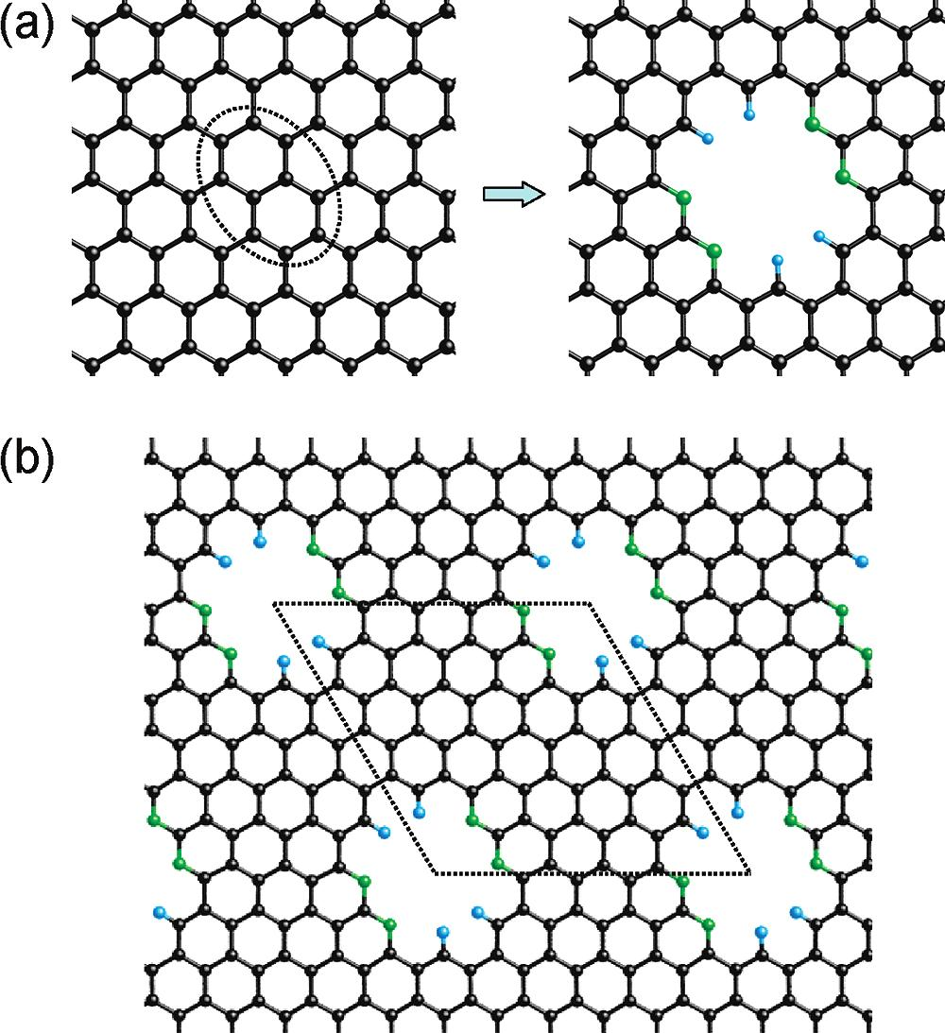
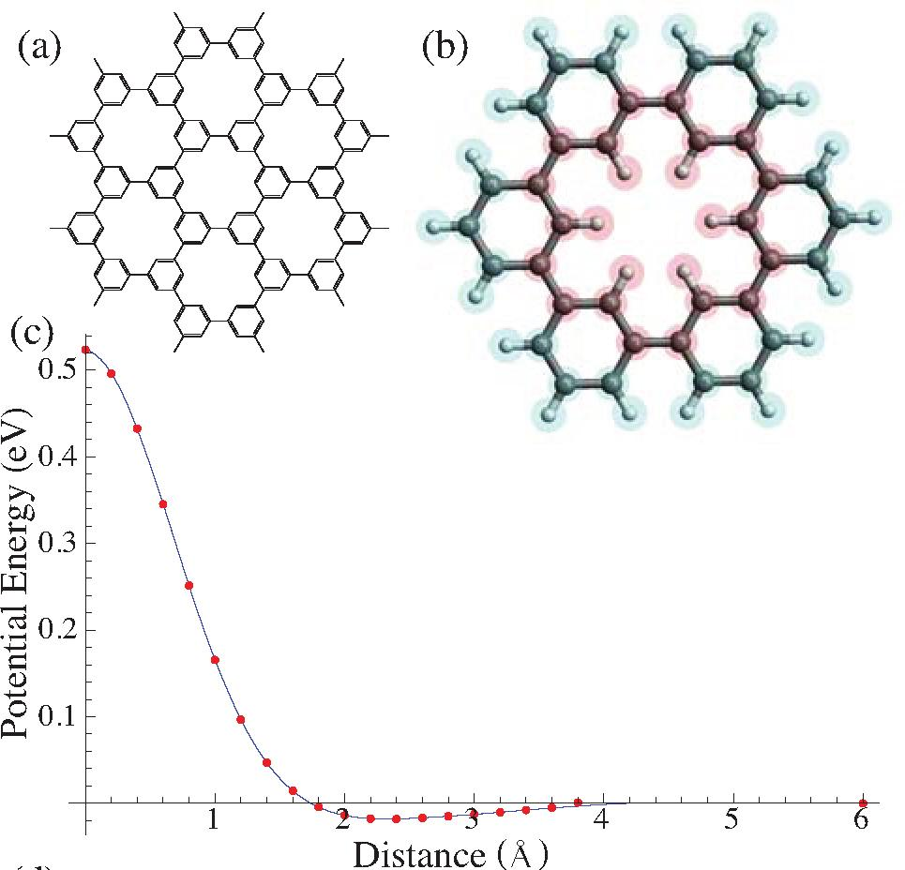
1ML Graphene as membrane (theory)
Jiang et al, Nanolett (2009) 0.3nm pores:
Schrier, JPCL (2010):
(porous graphene)
Promising results for gas separation

Slide 4
Energy barriers
Energy barrier is the key quantity for molecule permeation
Ideally:
Transition State calculation
Plot the energy along the “reaction coordinate”
Energy barrier is the height of the minimal energy path
Such calculations are not straightforward for many atom systems.
Our strategy: To bring the molecule slowly at fixed distance allowing its atoms and pore atoms to rearrange.

Slide 5
He permeation through polygons

Slide 6
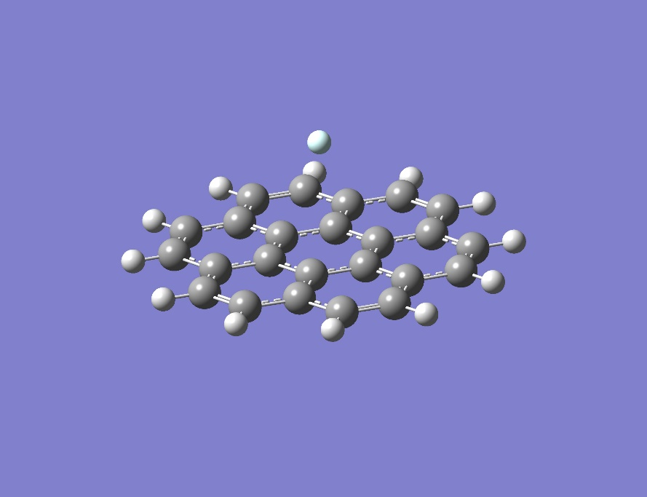
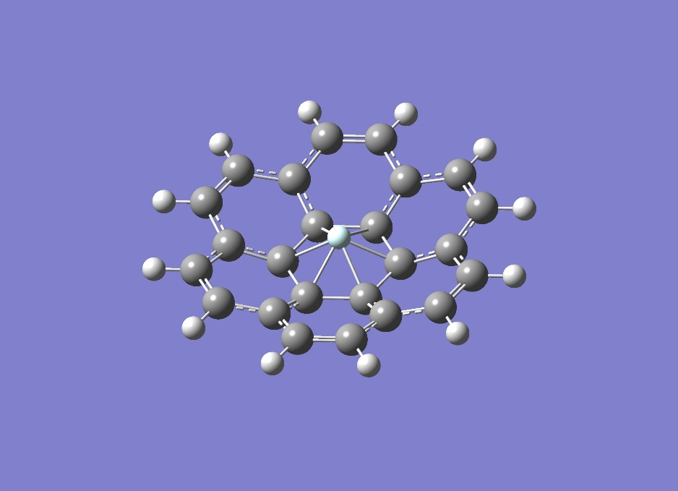
Graphene: The barrier for a He atom
A high accuracy benchmark calculation: Coronene model flake, MP2 / cc-PVTZ (Gaussian 16)
Frame (H, edge C), He are fixed at each distance d.
All the rest C atoms are allowed to move.
Find the equilibrium geometry at each d.
The surface is repelled, and a “bowl” is formed.
He can move to “negative” distances without
d=3 Å d=0.05 Å

Slide 7
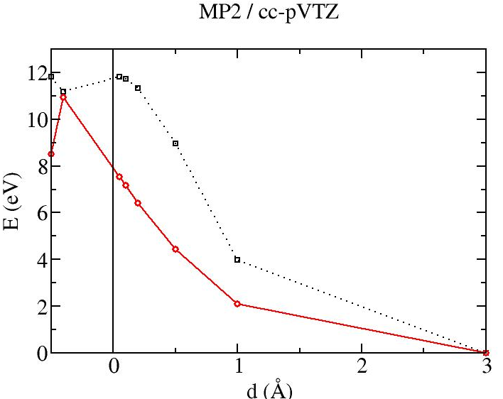
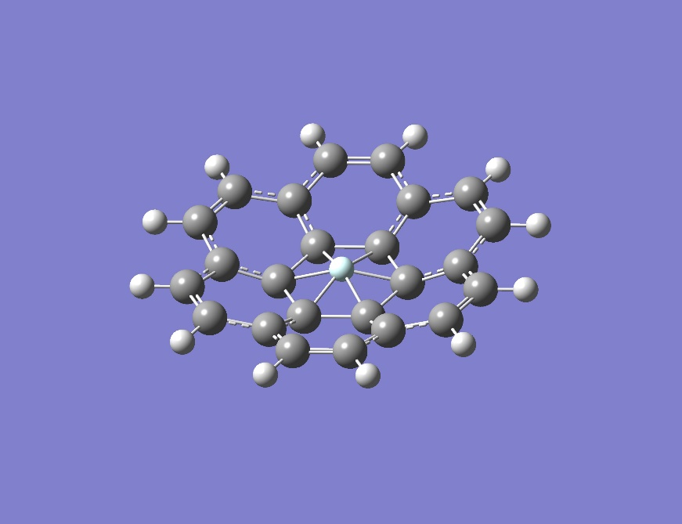
Graphene: The barrier for a He atom
The energy barrier is the point that the hexagon moves to the other side of He
The last point found before crossing is d=-0.4 Å.
Energy barrier: 10.92 eV (Other theoretical 9.0-18.77 eV, JAP 93, 193107)
Hexagon C-C bond elongated (1.55 Å, 9.1%)

Slide 8
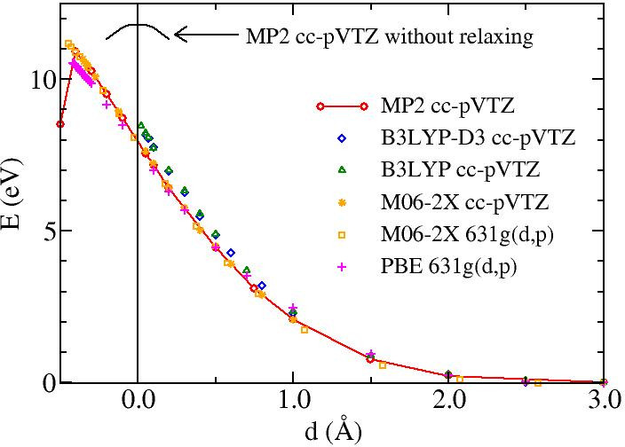
Graphene: The barrier for a He atom
MP2 is an accurate model but demanding. What about DFT?
DFT functionals are reasonably accurate
M06-2X meta-GGA functional is very accurate
Dispersion forces correction is very small.

Slide 9
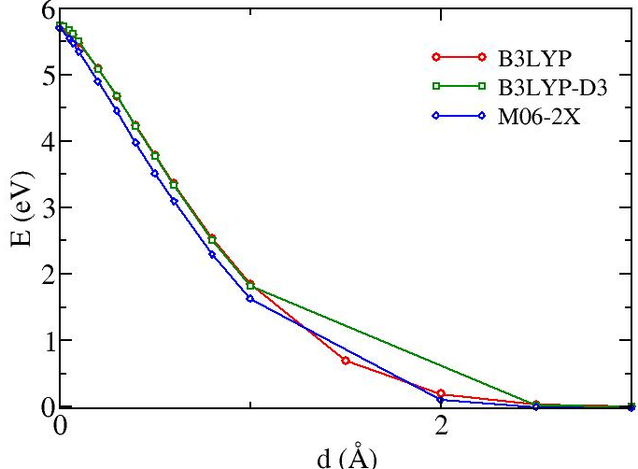
He permeance through heptagon
Distortion of the surface is much less pronounced
Barrier:
B3LYP | 5.71 eV
B3LYP-D3 | 5.75 eV
M06-2X | 5.70 eV
d=0.02 Å

Slide 10
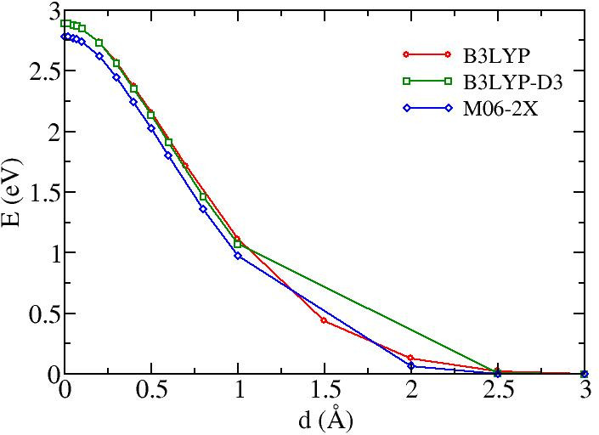
He permeance through octagon
Distortion of the surface is much less pronounced
Barrier:
B3LYP | 2.89 eV
B3LYP-D3 | 2.89 eV
M06-2X | 2.78 eV
d=0.02 Å

Slide 11
Conclusions so far
DFT approximations can be very accurate for the problem at hand (M06-2X).
Dispersion corrections are not very significant, strong covalent nature of interactions due to the large degree of deformation.
The barriers for “ordered” grain boundaries where different polygons than hexagons exist are impermeable.

Slide 12
Pyridinic pores

Slide 13
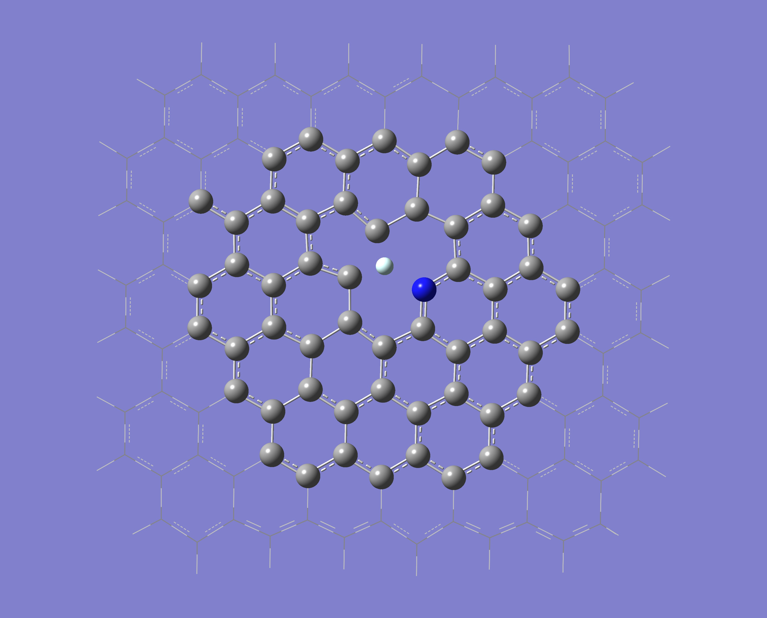
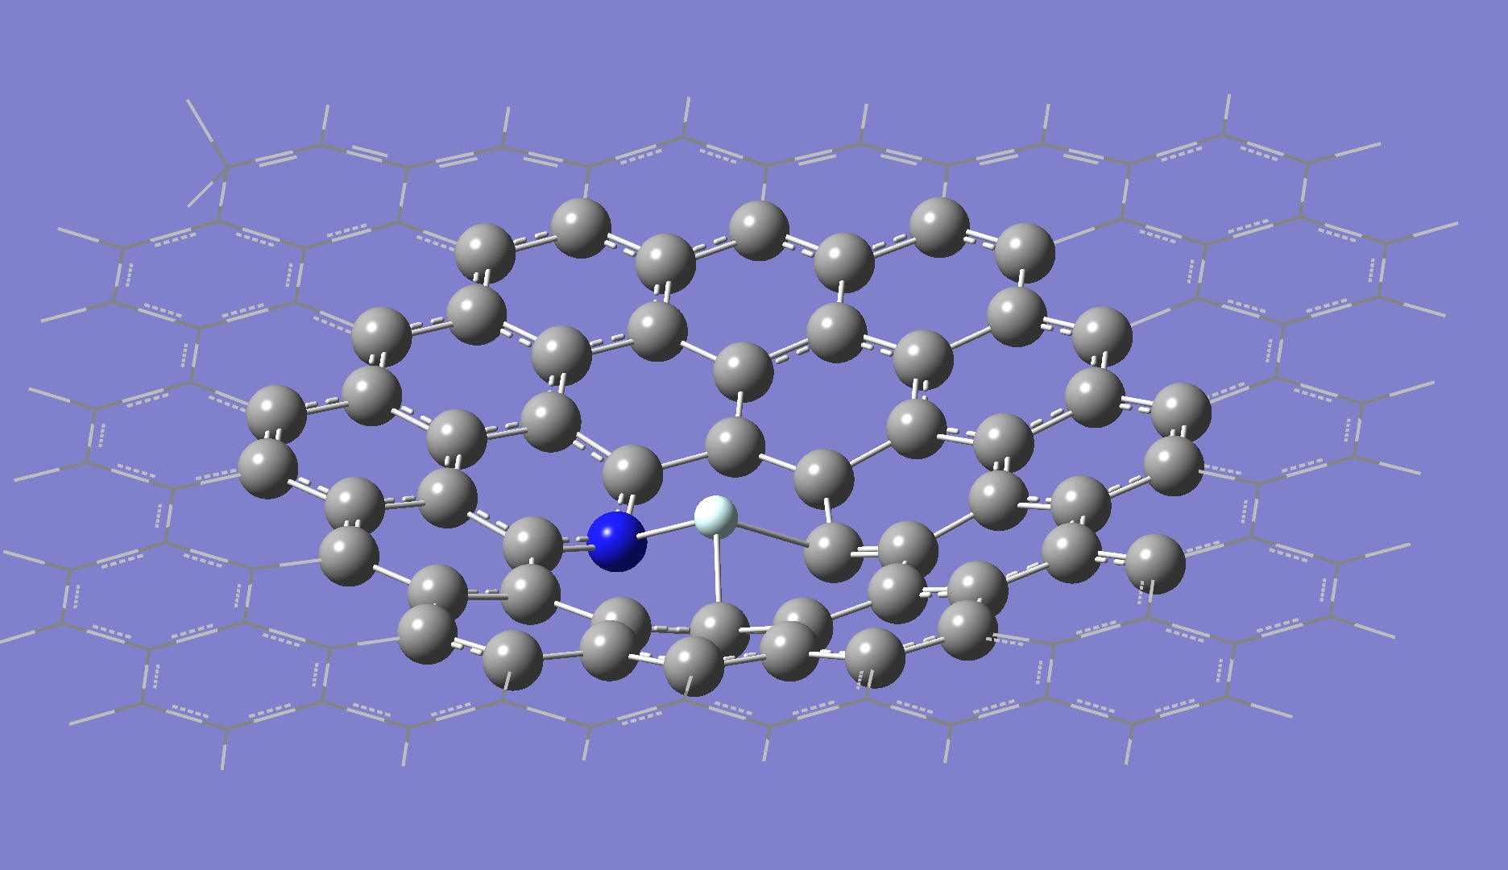
Systems with pyridinic defects
Several pyridinic pores 1-6 N atoms (1-6 C vacancies)
Study of the energy barriers
Method: Oniom method, Gaussian 16,
M06-2X functional , 6-31g(d,p) (Zhao&Truhlar, Theor. Chem. Acc. 120 215)
B3LYP functional, 3-21g
1N-He (1 C vacancy)
Barrier: ~ 4.7 eV
Top view, d=5.0 Å
D=-0.5 Å

Slide 14
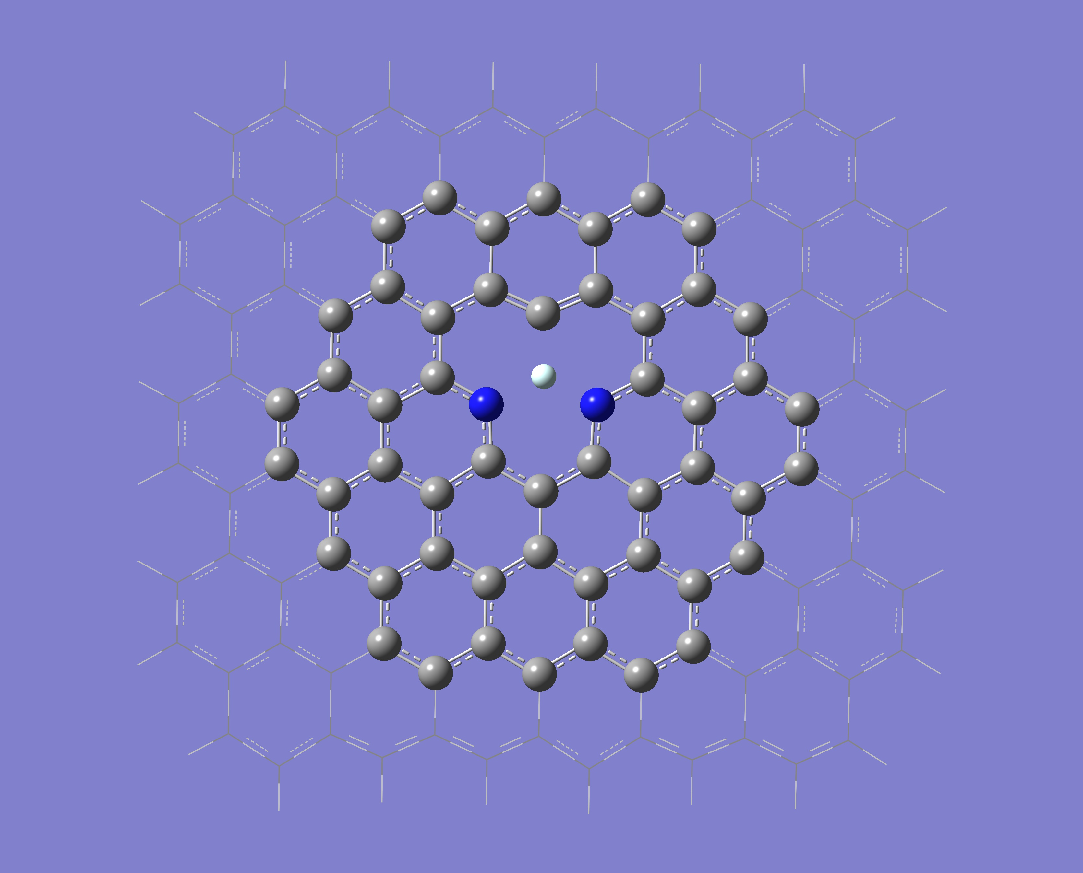
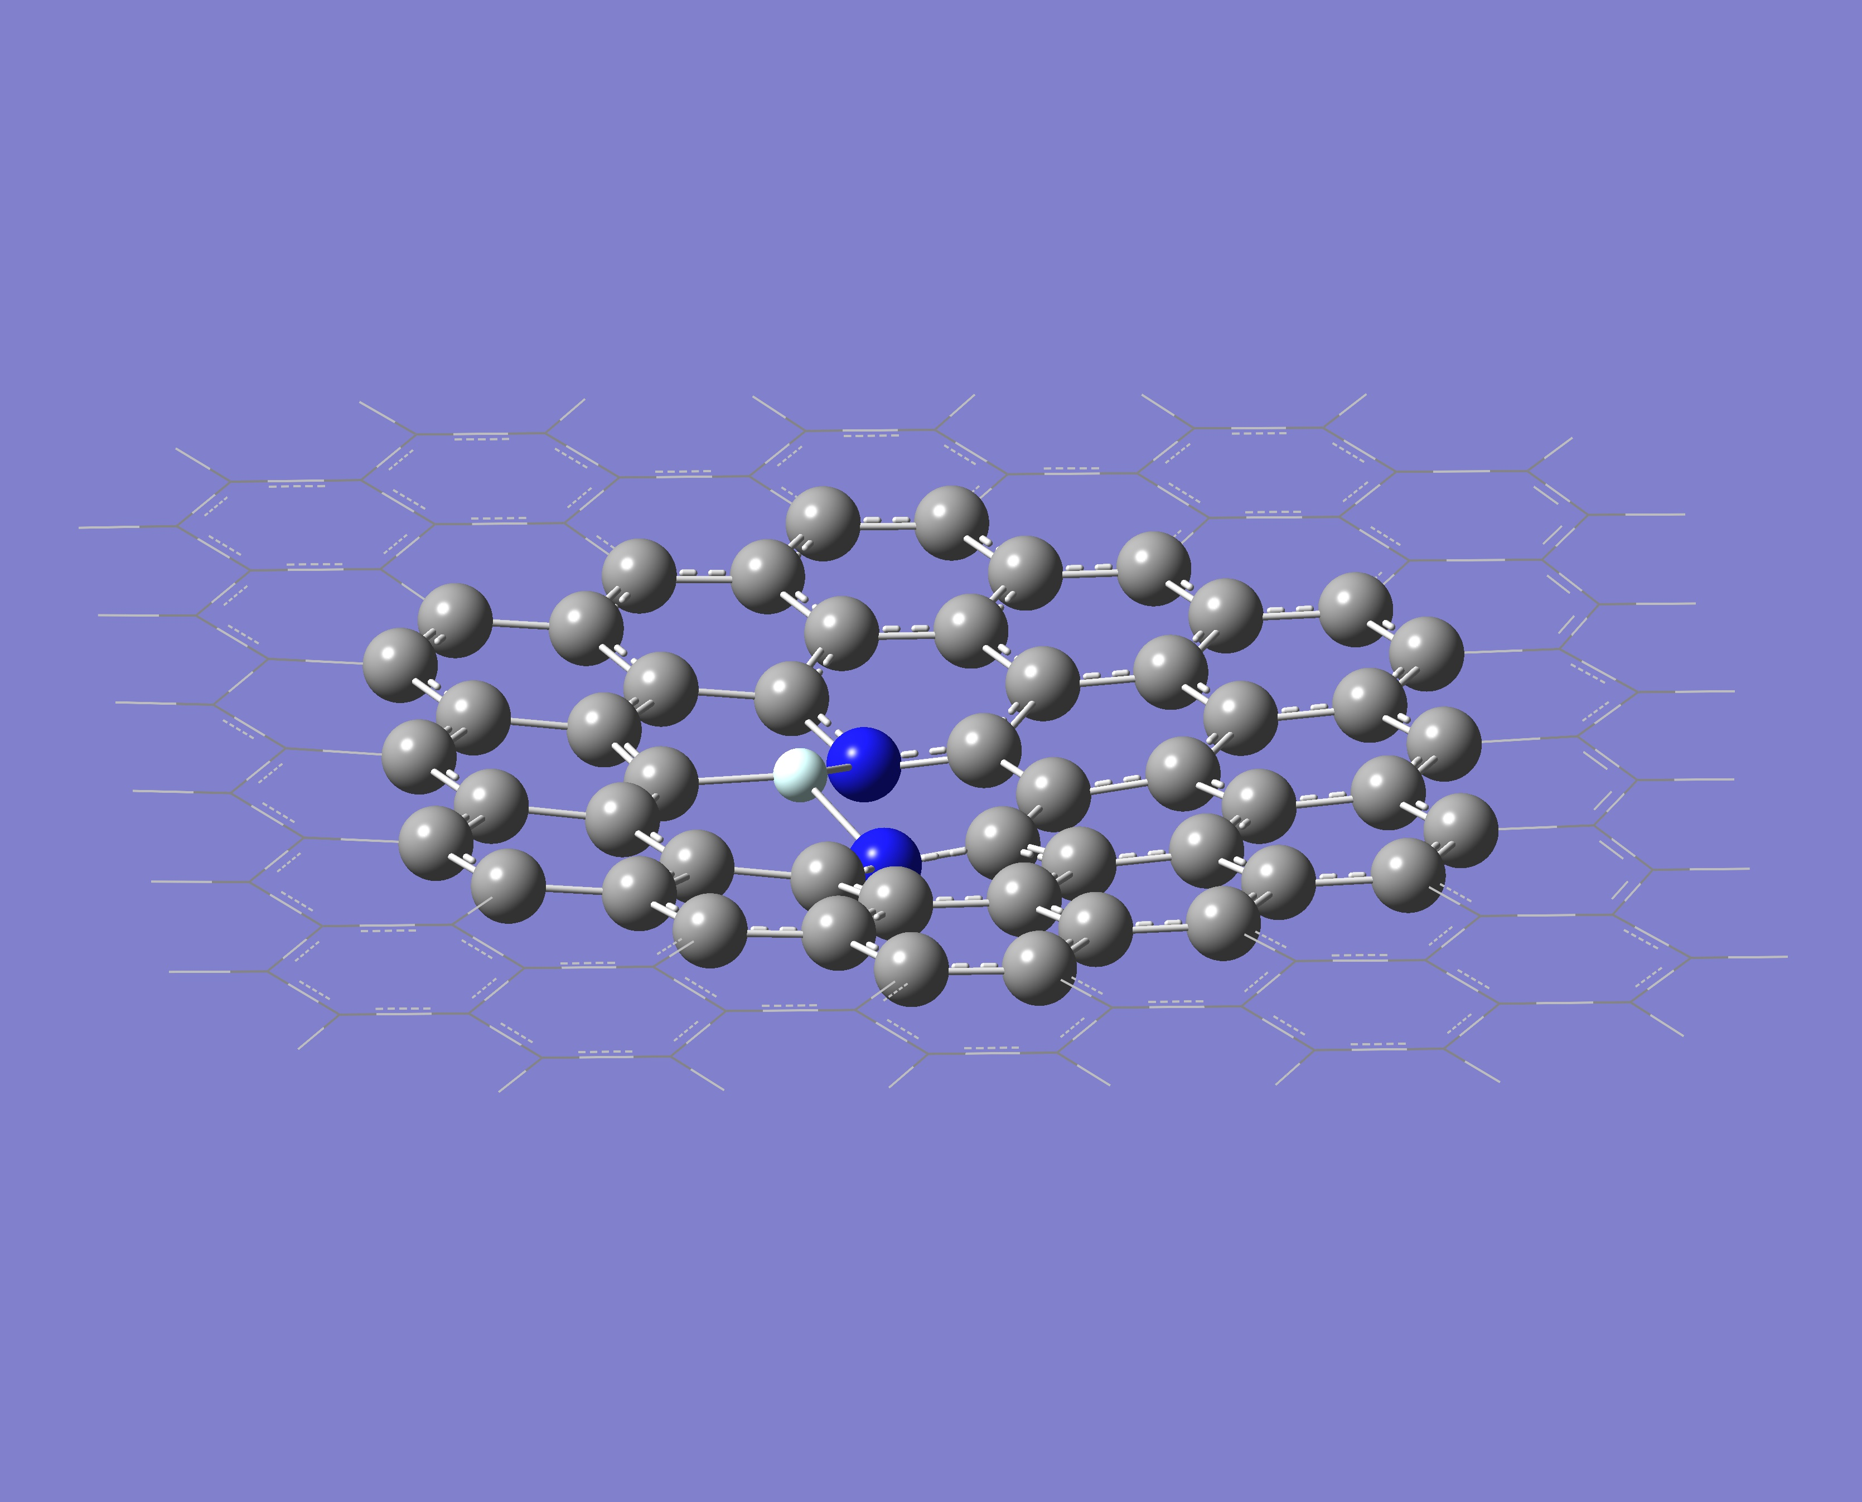
2N-He (1 C vacancy)
Top view, d=5.0 A
D=-0.4 A
Barrier: ~ 3.5 eV

Slide 15
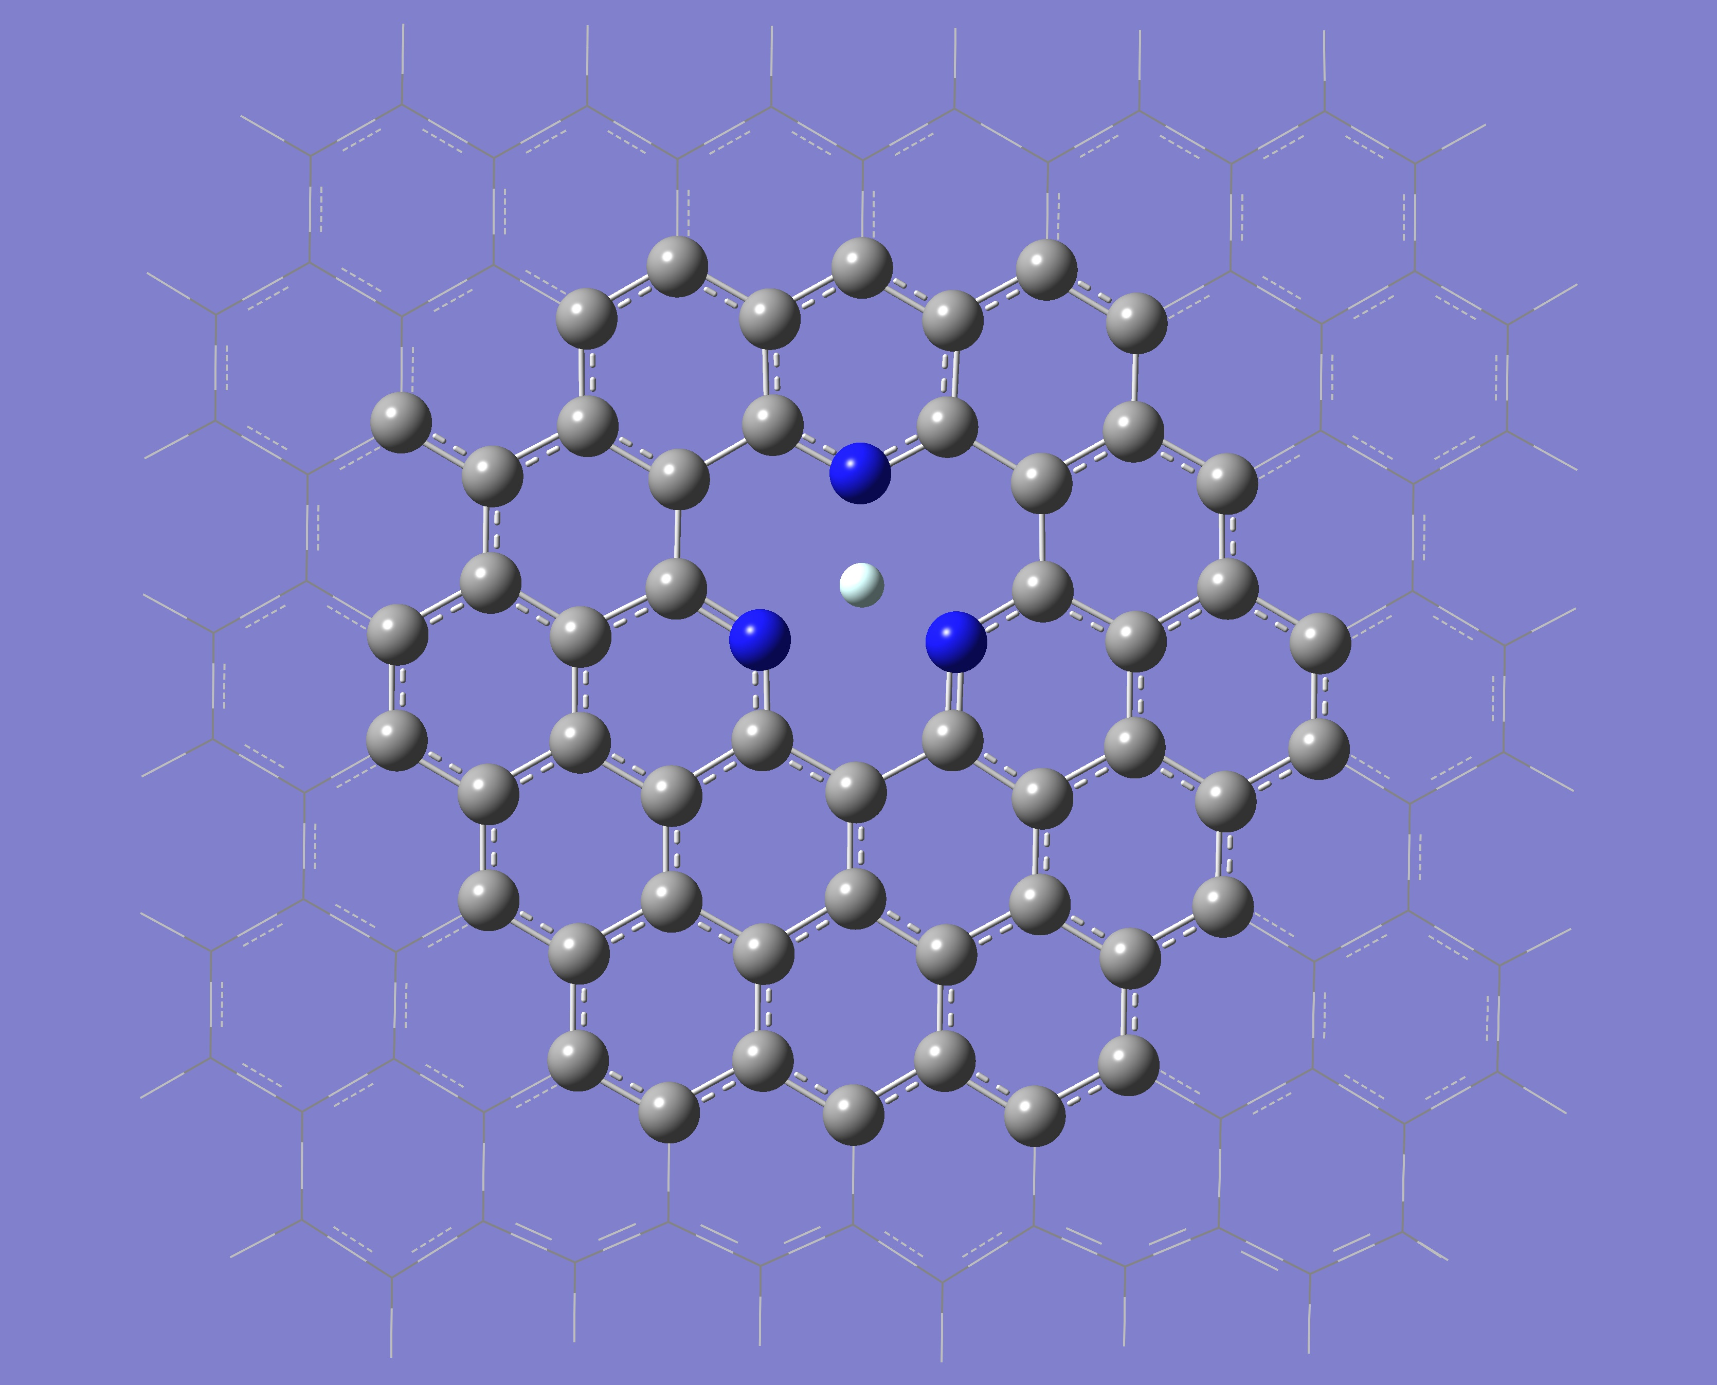
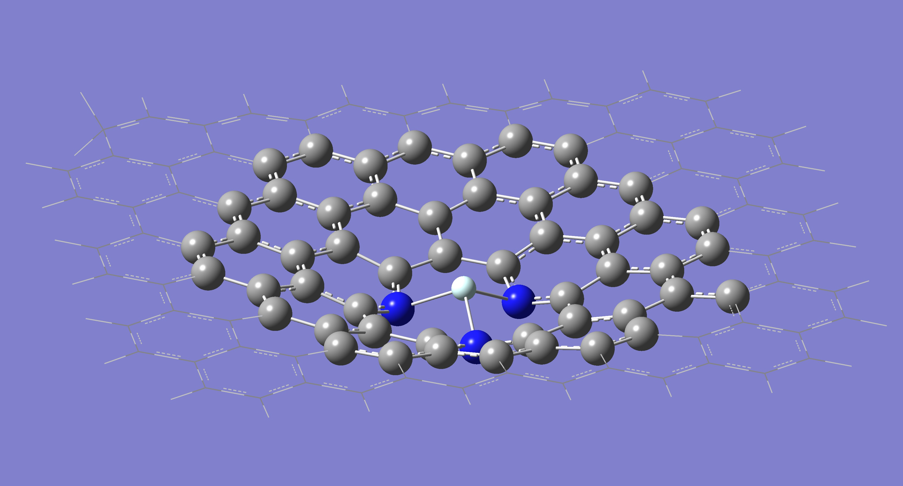
3N-He (1 C vacancy)
D=-0.4 Å
Top view, d=5.0 Å
Barrier: ~ 3.7 eV

Slide 16
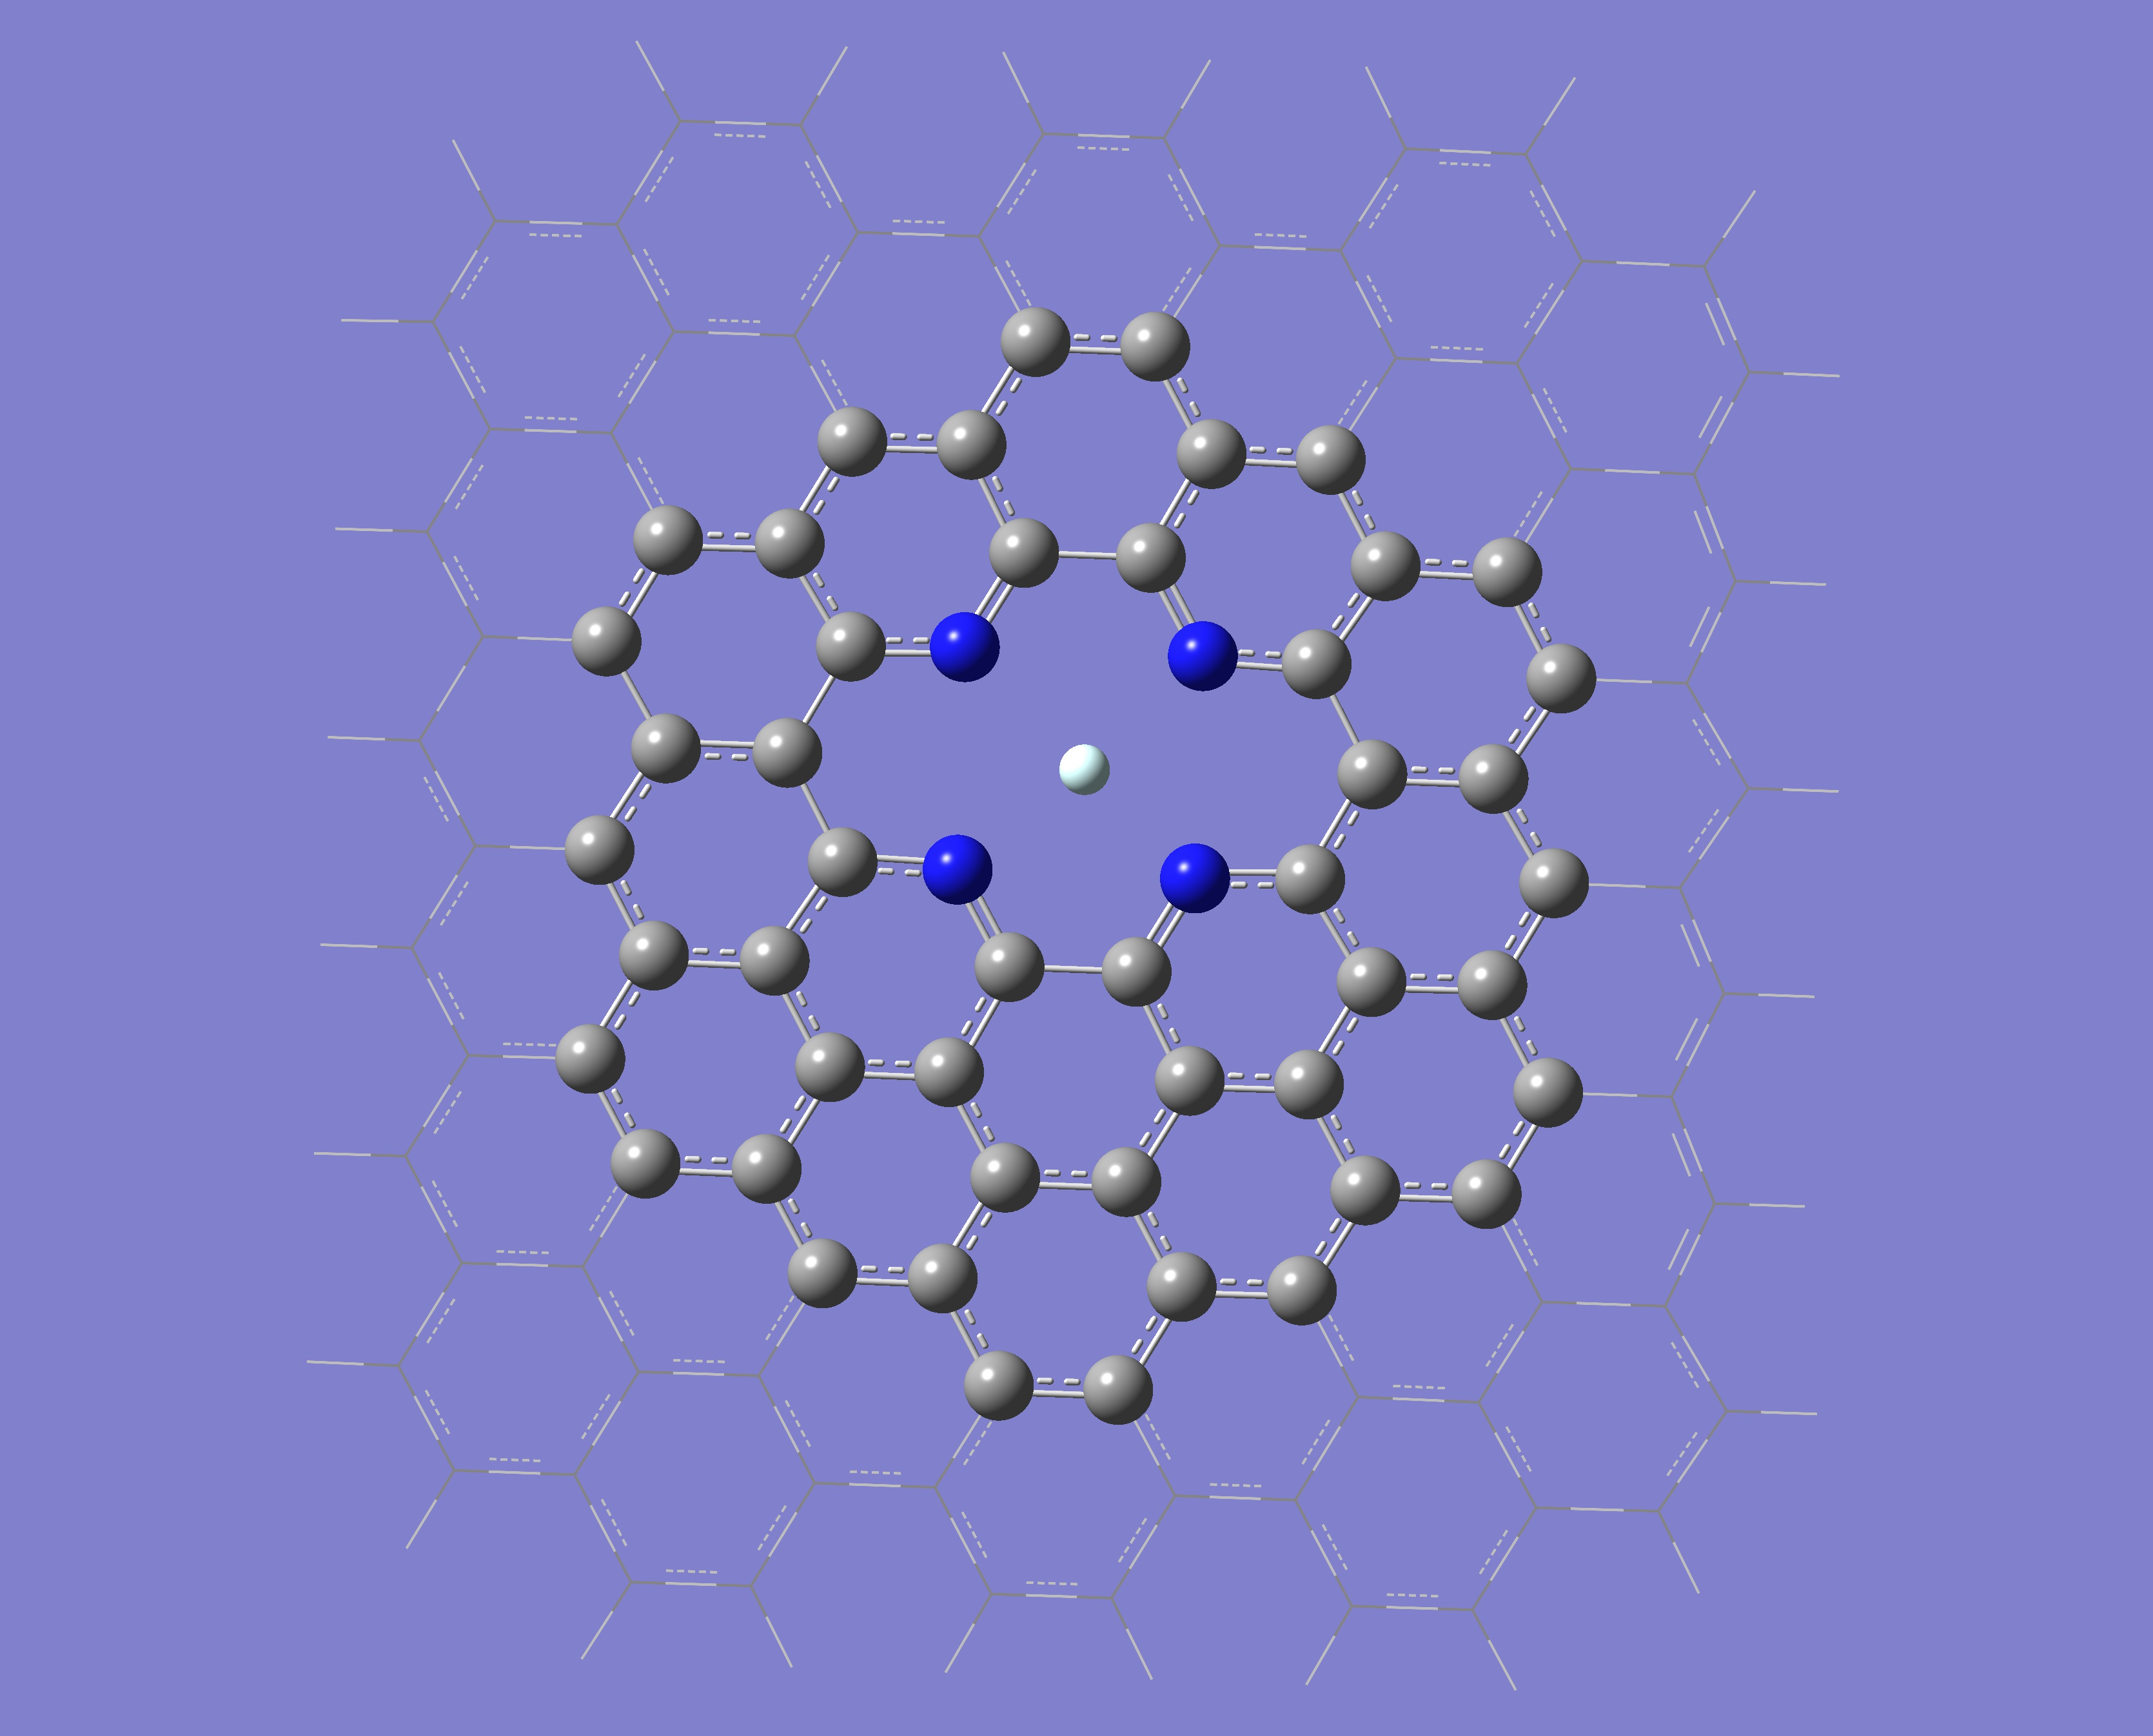
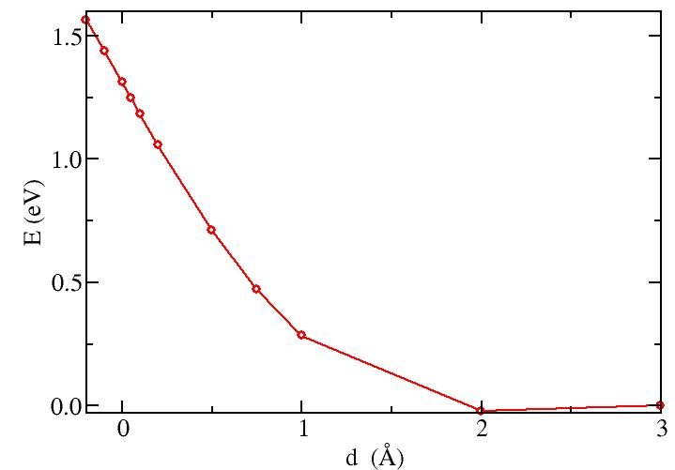
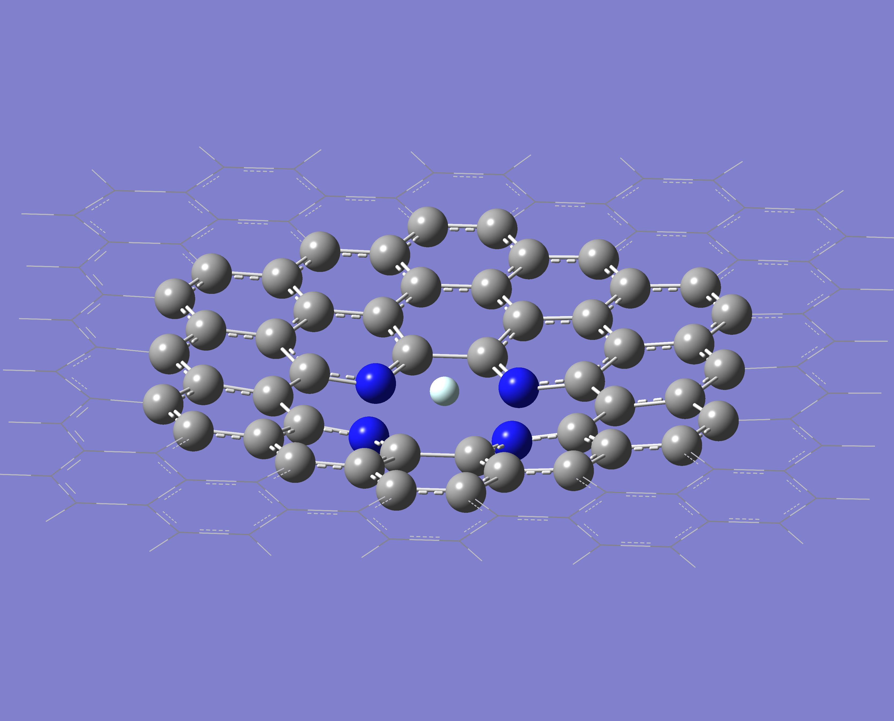
4N-He (2 C vacancies)
Barrier: 1.56 eV
There is an equilibrium distance

Slide 17
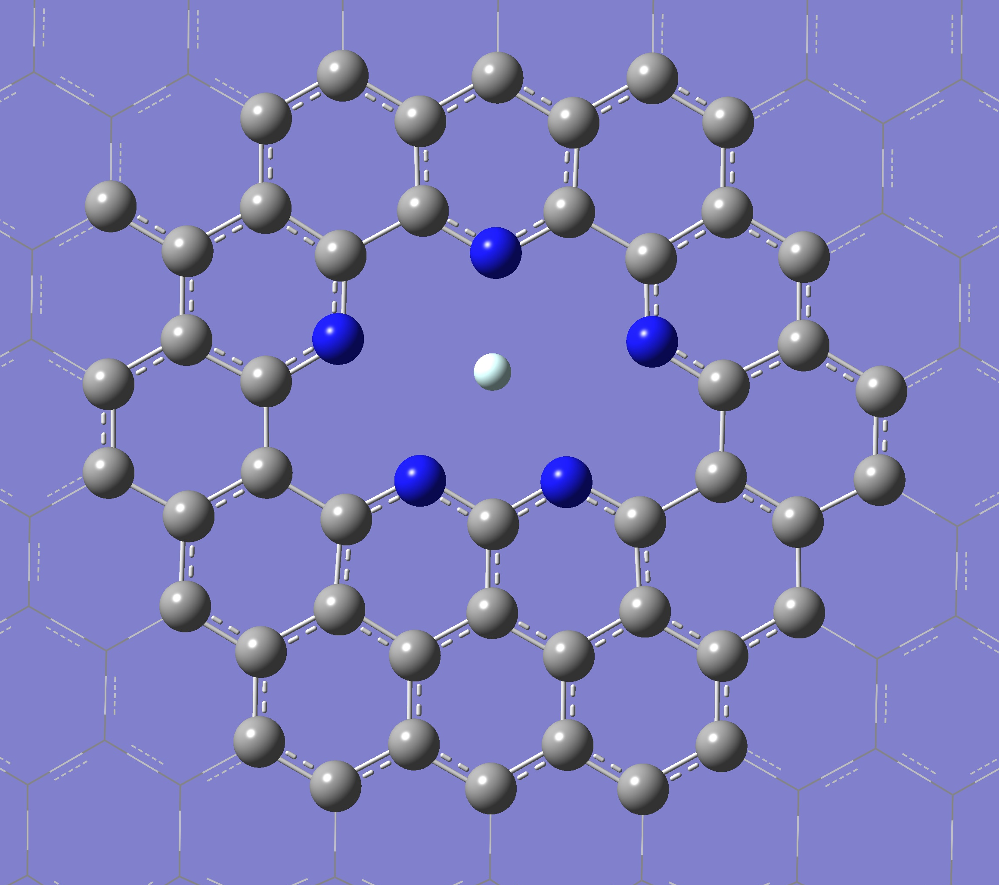
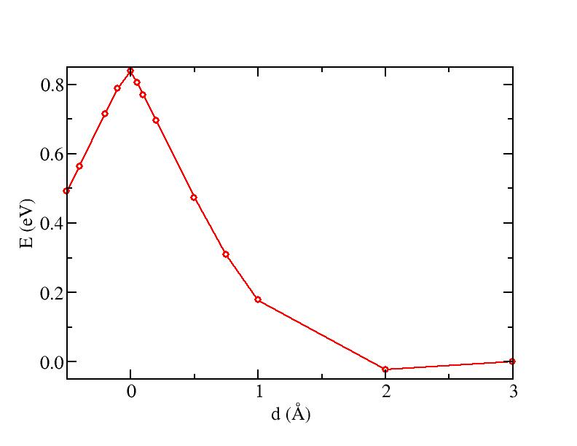
5N-He (3C vacancies)
Almost no buckling
Barrier = 0.84 eV (9750 K)
6N-He (6C vacancies)
No buckling
Almost 0 Barrier: 0.0072 eV (83.5 K)

Slide 18
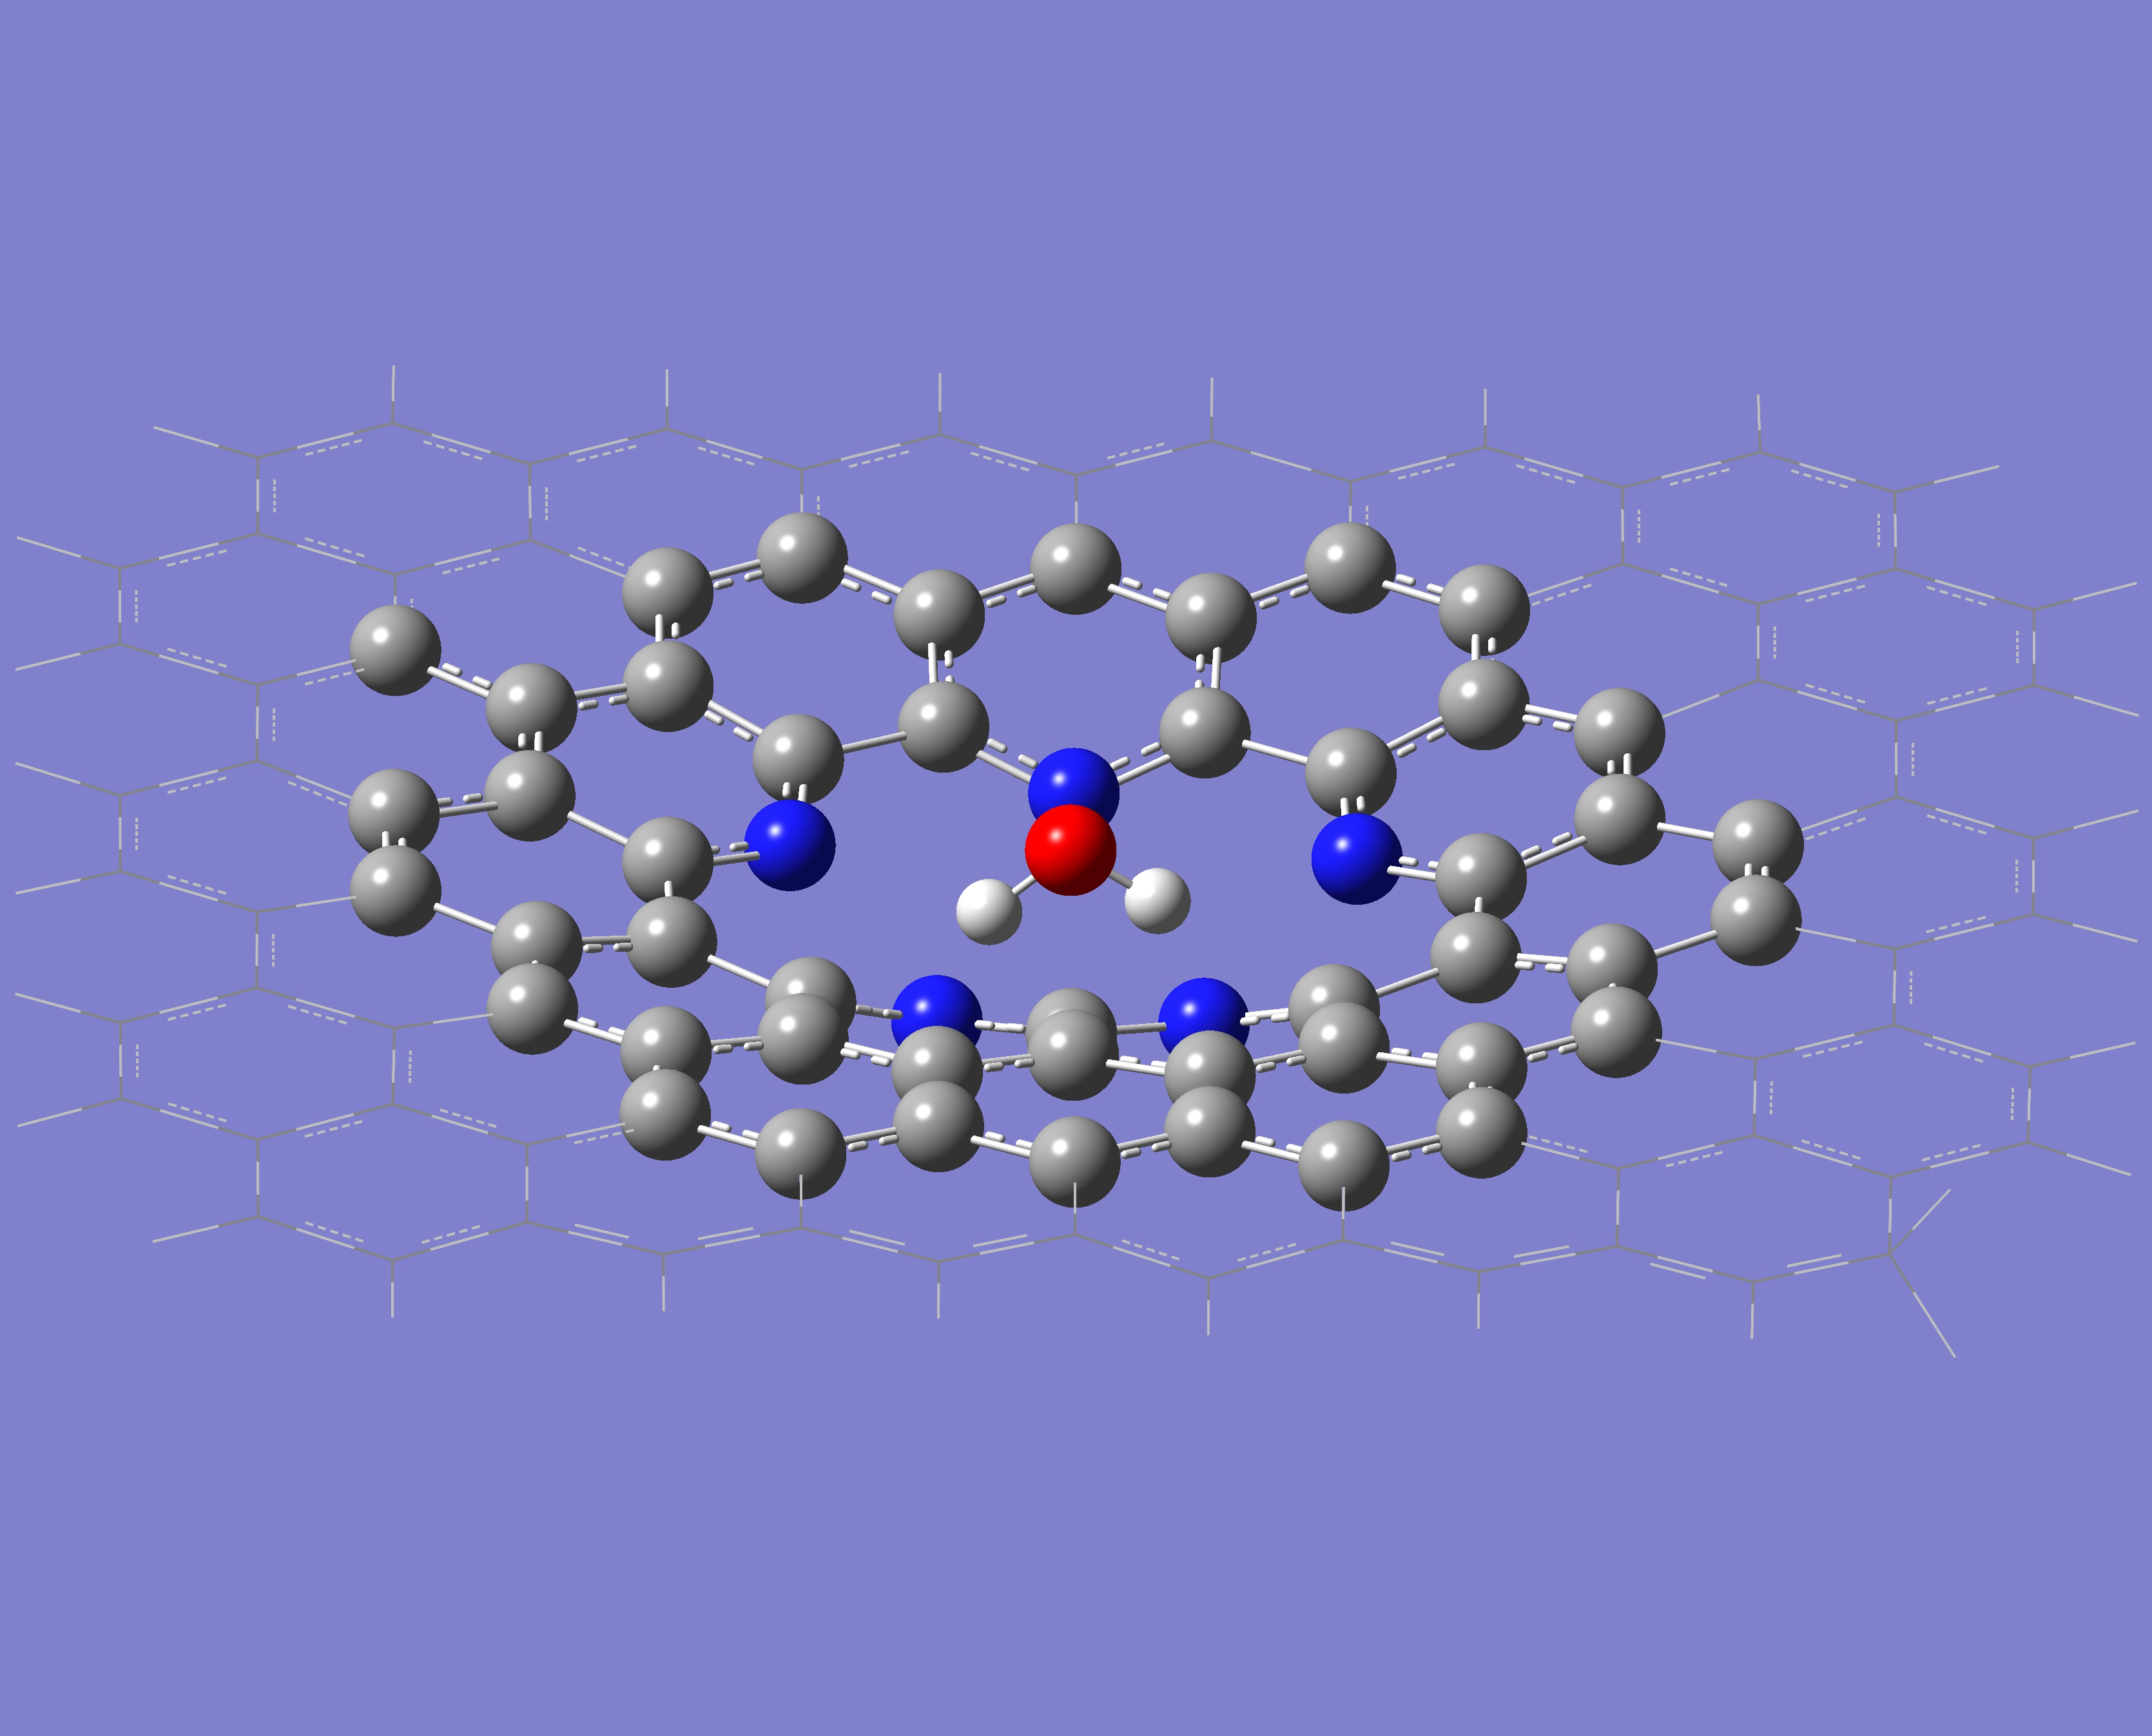
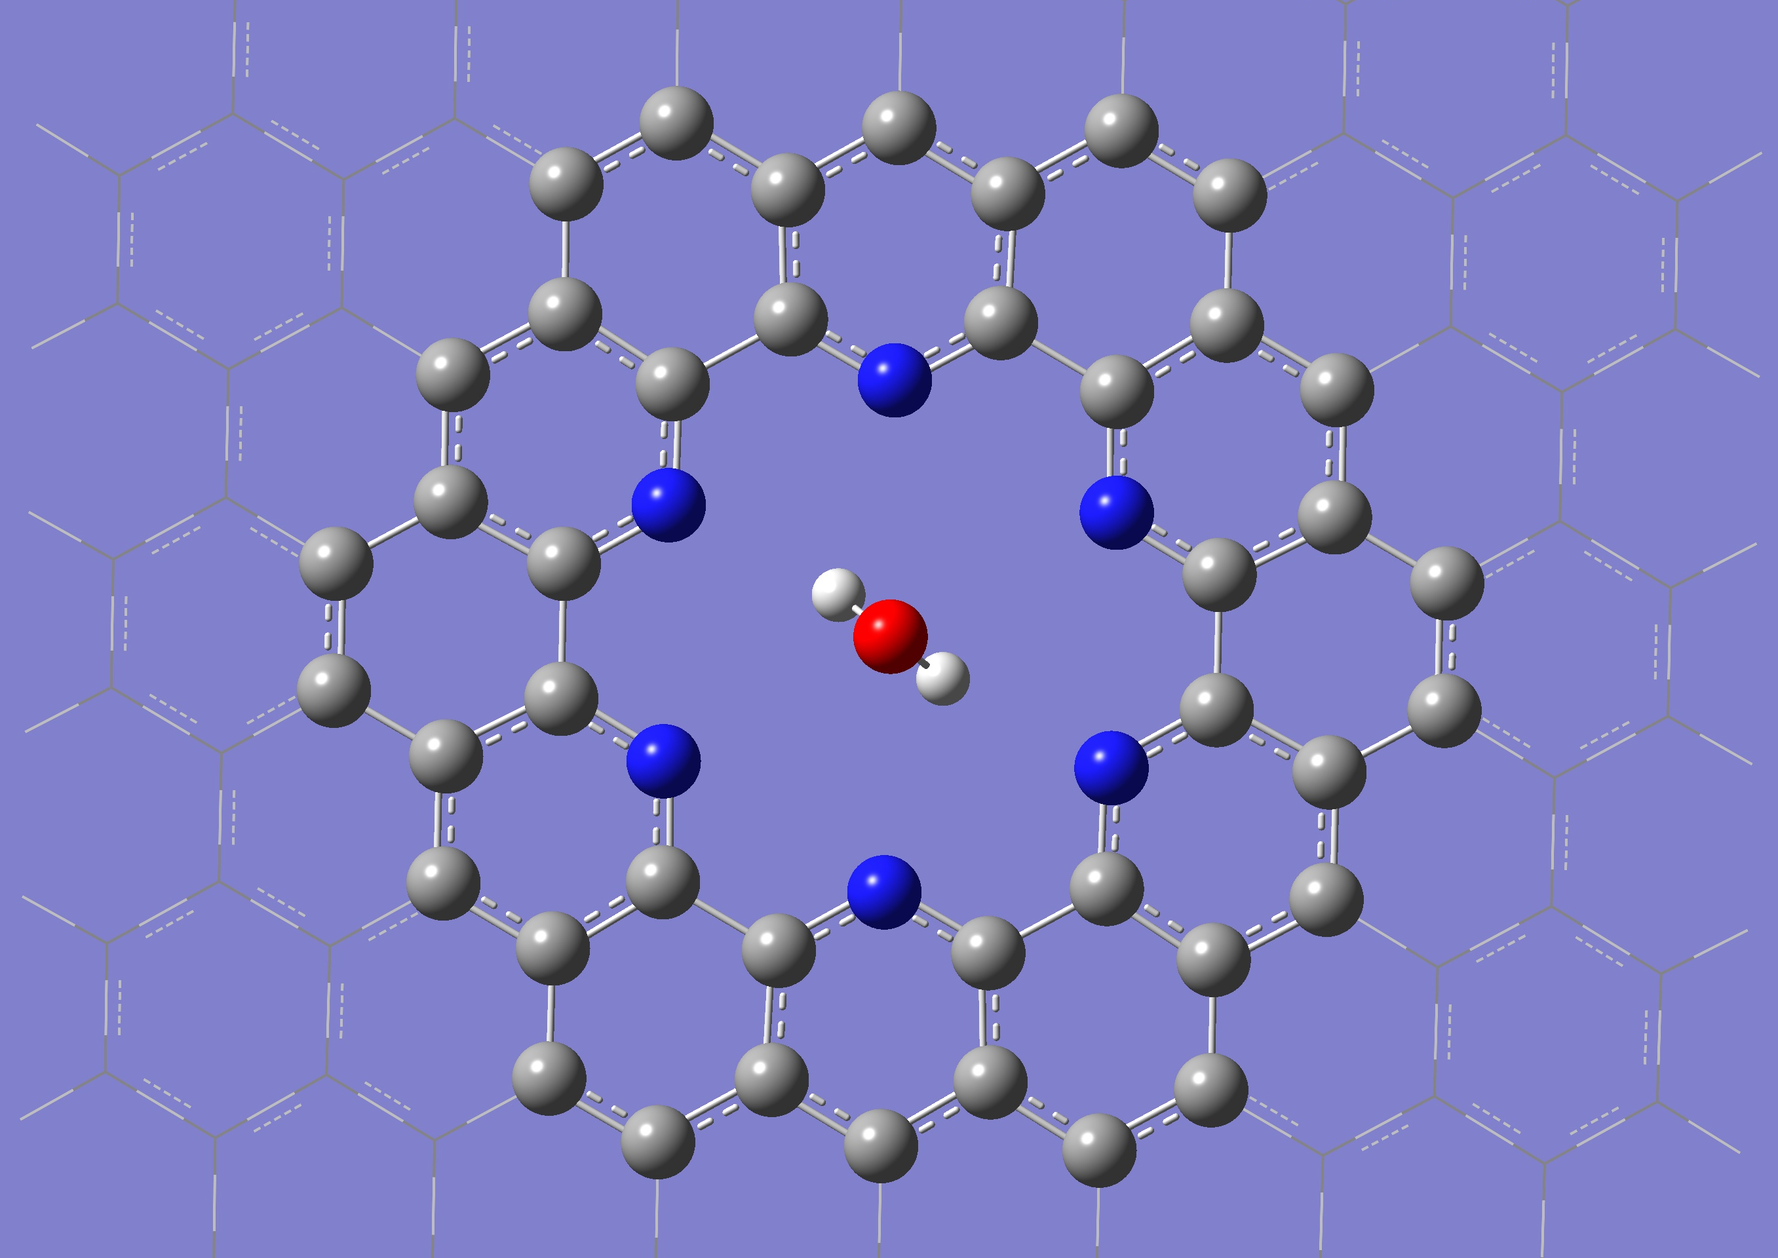
5N-H₂Ο (3 C vacancies)
D=-0.5 Å
Buckling is present
Barrier: ~ 3.52 eV
6N-H₂O (6 C vacancies)
D=0.0 Å
Barrier: ~ 0.028 eV (325 K)
There is a minimum at ~1.0 A (< -0.34 eV)

Slide 19
5N-CH₄ (3 C vacancies)
Buckling is present
Barrier: ~ 3.28 eV
6N-CH₄ (6 C vacancies)
Buckling is present
Barrier: ~ 1.37 eV
A minimum at around 2 A

Slide 20
Conclusions
Significant permeability is found for the 6N pyridinic pore.
Smaller pores are impermeable even for He.
6N pore: selectivity
Mol | Barrier (eV)
He | 0.007
H₂O | 0.028
CH₄ | 1.37
CO₂ | ~ 0

Slide 21
Atomistic potentials

Slide 22
Reax-FF
Reax-FF potentials (dispersion+covalent interactions)
(npj Comp. Mater 2, 15011 (2016))
LAMMPS simulation code
Reax-FF potentials that are supplied with LAMMPS do not reproduce accurately the structural properties of graphene (RDX potentials: Phys. Rev. Lett. 91, 098301, (2003): bonds differing by 5% ).
Reax-FF potential for graphene: C-2013 (Srinivasan et al, J. Phys. Chem. A 119, 571, (2015)).
A combination of C-2013 and RDX was adopted.
Comparison with ab-initio

Slide 23
Comparison with ab-initio
Barriers (eV)
Molecule | 3C vacancies 5N Reax-FF DFT |  | 6C vacancies 6N Reax-FF DFT
CH₄ | 3.6 | 6.5 | 0.17 | 1.4
H₂O | 2.0 | 3.5 | 0.06 | 0.03
CO₂ | 1.7 | 1.9 | 0.07 | ~0.0
CO | 2.5 | 3.0 | 0.08 | ~0.0
Atomistic potential underestimates the barriers compared to DFT
The trends are very similar
Linear molecules: no barrier for 6N structure

Slide 24
Acknowledgements:
Advanced Materials and Devices, MIS: 5002409
GATES
Nanoporous GrAphene membrane made withoutTransfEr for gas Separation,
MIS: 5041612

