Slide 1
Plan of the session on
RNA Sequence Covariation
Simona Cocco: Direct coupling analysis on riboswitches
Zhichao Miao: Protein RNA co-evolution sites are close in 3D space
Vladimir Reinharz: A disordered RNA chaperone protein charged positions covariations.
Jérôme Waldispühl: Reconstruction of ancestral RNA sequences under
multiple structural constraints
Rémi Monasson: Learning constitutive motifs from sequence data with
restricted Boltzmann machines
Florian Eggenhofer: Visualization of RNA and Protein family models and their
comparisons
Benasque, July 2018
Notes:
Sequence covariations and inverse models from multi-sequence alignement data

Slide 2
& on RNA
Sequence Covariation and
Direct Coupling Analysis on Proteins
S. Cocco, Statistical Physics, CNRS & Ecole Normale Supérieure
Benasque, July 2018
Notes:
5 riboswitches families

Slide 3
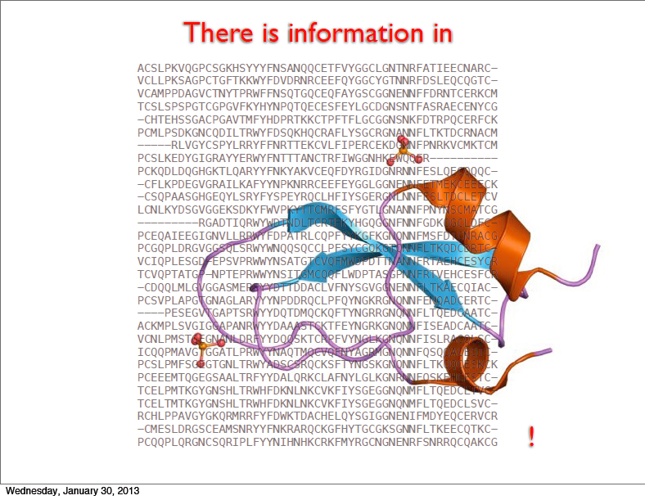
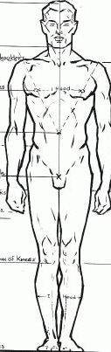

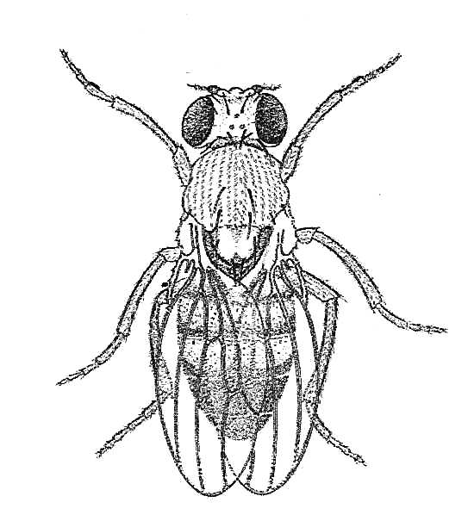
Multi-sequence alignements (MSA)
Information on:
Structure
Mutational Landscape
Big data bases!
PFAM/RFAM
15,000 protein families
thousands of sequences
for each…
Model Probability for
Sequences in the MSA
P(A₁,...,A_{N}) ?

Slide 4
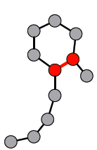
Statistical Physics of Inverse Problems
Structural, functional constraints
R
F
H
K
R
T
K
R
I
L
E
Y
R
Q
Q
L
D
N
R
R
A
K
Q
N
G
G
Q
T
M
E
E
G
R
R
E
R
E
E
E
R
L
L
T
L
V
L
V
A
K
R
G
T
G
A
E
D
N
D
E
D
N
N
N
D
T
T
L
L
L
L
A
L
D
D
K
D
K
K
K
D
H
H
H
H
H
H
Q
H
f_{ij} (A_{i},A_{j})
Correlation
Covariation
Frequency f_{i} (A_{i}):
Conservation
Notes:
Pairwise Potts model
Catalitic /binding sites in a protein or RNA

Slide 5
Statistical Physics of Inverse Problems
Structural, functional constraints
R
F
H
K
R
T
K
R
I
L
E
Y
R
Q
Q
L
D
N
R
R
A
K
Q
N
G
G
Q
T
M
E
E
G
R
R
E
R
E
E
E
R
L
L
T
L
V
L
V
A
K
R
G
T
G
A
E
D
N
D
E
D
N
N
N
D
T
T
L
L
L
L
A
L
D
D
K
D
K
K
K
D
H
H
H
H
H
H
Q
H
Inverse Statistical
Modeling
Correlation
f_{ij} (A_{i},A_{j})
Frequency f_{i} (A_{i})
Inverse Questions:
Are structural constraints we infer from data indicative of residue-residue contacts
Can we infer a good generative model of sequences in the same family?
Notes:
Model which tell us if a mutations will be neutral deleterious or advantageous

Slide 6
Statistical Physics of Inverse Problems
Structural, functional constraints
R
F
H
K
R
T
K
R
I
L
E
Y
R
Q
Q
L
D
N
R
R
A
K
Q
N
G
G
Q
T
M
E
E
G
R
R
E
R
E
E
E
R
L
L
T
L
V
L
V
A
K
R
G
T
G
A
E
D
N
D
E
D
N
N
N
D
T
T
L
L
L
L
A
L
D
D
K
D
K
K
K
D
H
H
H
H
H
H
Q
H
Inverse Statistical
Modeling
Correlation
f_{ij} (A_{i},A_{j})
Frequency f_{i} (A_{i})
Least constrained, maximal entropy model (Jaynes 1957) reproducing
frequencies f_{i}(A_{i}) and correlations f_{ij} (A_{i},A_{j})
of empirical distribution
Σ h_{i}(A_{i})+ Σ J_{ij} (A_{i},A_{j})
e
i
i<j
P(A₁,...,A_{N}) =
Z[{J,h}]
Notes:
Fields tp reproduce the conservation for each site and each amminoacid and the couplings to reproduce the covariations observed in the data for each pair of sites and pairs of aa

Slide 7
Statistical Physics of Inverse Problems
Ising/Potts Problem Direct
Graphical Model
Interactions
Correlations
Ising/Potts Problem Inverse
Boltzmann Machine (BM)
Difficulties
Large numbers of fields h_{i}(A_{i}) (10³-10⁴) and of coupling parameters J_{ij}(A,A’) (10⁶-10⁸)
Hard Computational Problem : Several Techniques eg. Boltzmann Machine Learning,
Gaussian Model, Pseudo-likelihood, …
Limited sampling (sequences in protein database form small and biased samples
Notes:
Explain names: Graphical model Ising, Potts, Boltzmann Machine
Explain inverse Tehnique: Gaussian Approximations, Pseudo-Likelihood, Clusters Expansions, Boltzmann Mahine Learning

Slide 8


Couplings as predictors of sites in contact in a protein structure.
Trypsin inhibitor (small protein, N=52 residues, contact if distance < 0.8 nm)
Strongest Coupled sites: by Frobenious Norm sof Couplings
An important correction to improve contact
prediction: Average Product Correction
[Morcos … Weigt, PNAS 2011 ]
Large scale validation
[Hopf, Colwell et al Cell (2012),
Baker(2014), [S. C. et al ROPP 2018]
Notes:
30 strongesst correlations vs 30 strongest contacts

Slide 9

Correlations as predictors of sites in contact in a protein structure.
Trypsin inhibitor (small protein, N=52 residues, contact if distance < 0.8 nm)
Strongest Correlated sites: by Mutual information
An important correction to improve contact
prediction: Average Product Correction
M_{ik}
M_{kj}
[Gobel, Sander et al., Proteins 1994]
M_{ij}^{APC}
= M_{ij}
k
k
M_{kl}
Notes:
30 strongesst correlations vs 30 strongest contacts
APC on remove from the MI an average MI term to avoid sites with many more correlations from others.

Slide 10
Couplings are better predictors of sites in contact in a protein structure.
Trypsin inhibitor (small protein, N=52 residues, contact if distance < 0.8 nm)
[Gobel, Sander et al., Proteins 1994]
[Morcos … Weigt, PNAS 2011 ]
c_{ij} = + + +…..
For Gaussian variables J=-C⁻¹
J_{ij}
∑ J_{ik} J_{kj}
∑ J_{ik} J_{kl} J_{lj}
k
k,l
but C is affected by sampling noise, need for regularization
Notes:
30 strongesst correlations vs 30 strongest contacts

Slide 11
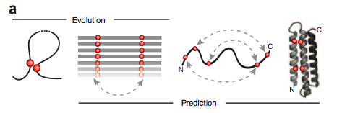
Contact Prediction and Protein Folding
[From D.Marks et al Nat. Biotech. 2012]
Folding simulations+ attractive potential for pair of amino acids in contact
-> structures with very high resolution in the range of 2-6 Å
-> blind prediction for transmembranar proteins that are hard to crystallize
[Hopf, Colwell et al Cell (2012)]
Notes:
New hope in solving protein folding problem not from one sequence but from many sequences

Slide 12
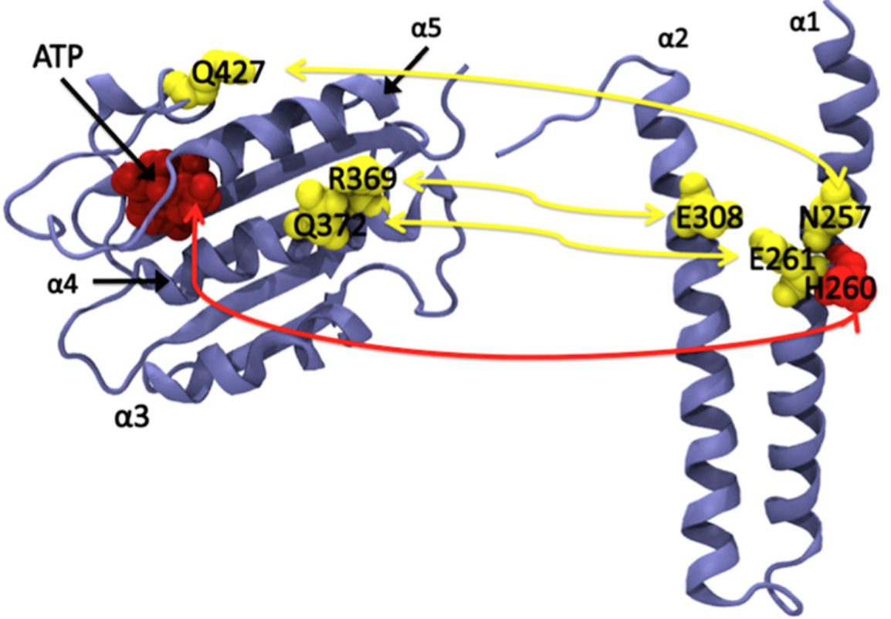
Protein – protein coupling predictions
Inferring protein-protein contacts
[Dago et al. PNAS (2012)]
[S. Ovchinnikov et al elife (2014)]
Inferring Interaction Partners from Protein Sequences
[A.F. Bitbol et al PNAS (2016)]
[T. Guedre et al PNAS (2016)]
2 domains of the
sensor histidine kinases
Notes:
Group of D Baker
Eddy 2004, AnnuREv. Biophys

Slide 13
Sequence Covariation and
Direct Coupling analysis on RNA
In collaboration with:
E. De Leonardis Statistical Physics, CNRS & Ecole Normale Supérieure
R. Monasson Theoretical Physics, CNRS & Ecole Normale Supérieure
B. Lutz Karlsruher Institute for technology
Shug Karlsruher Institute for technology
M. Weigt Sorbonne Université
[E. De Leonardis et al. NAR (2015)]

Slide 14
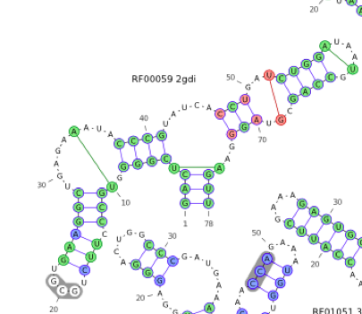
Direct Coupling analysis on
6 Riboswitches
TPP riboswitch
RF00059
104 nucleotides
CCAAACGACUCGGGGUGCCCUUCUUGAAGGCUGAGAAA..........UACCCGUAUCACCUGAUCUGGAUAAUGCCAGCGUAGGGAAGUCACGGACCACCAGG
AAUUUCUUGUCGGAGUGCCUUA...ACUGGCUGAGACCGUUUAUUCGGGAUCCGCGGAACCUGAUCAGGCUAAUACCUGCGAAGGGAACAAGAGUUAAUCUGCU
CCAAACGACUCGGGGUGCCCUUCUUGAAGGCUGAGAAA..........UACCCGUAUCACCUGAUCUGGAUAAUGCCAGCGUAGGG.GGCCAAAAUAGUCUUGA
CCGUUCUCAACGGGGUGCCACGCAGCGUGGCUGAGAAA.........AUACCCGUCGAACCUGAUCCGGAUAACGCCGGCGAAGGGAUUGAGGCUCCUUCUCAA
GAAUGCAUGAGCCGGUGCCAAUCCGAGCGGCUGAGAUU.........AUACGGCAGUAACUUGAUCUGGAUAAUACCAGCGAAAGGAUCAUGCUUCUUGUCUCU
AAUGAAGCAGCCGGGUGUUCGGCA..CGUUCUGAGAAA..........UACCGGUCGAACUUGAUCUGGAUAAUACCAGCGAAAGGAAUGCUUCUUAGCCUCCC
AAUAUUUUUCAGGGGAGCUUGUUU.UCAGGCUGAGAGGAAGUACUUCGAUCCAU.AU.ACCUGAUUUGGAUAAUGCCAACGUAGGAAAUAGGUUACUUGAUUUA
UAUUUUAGCUAGGGGUGCCUUUUAUUUAGGCUGAGAGGAGAA...UCCAACCCUUUGAACUUGAUGUAGUUAAUACUACCGUAGGGAAGCAGUGCAUUGUAUAU
AAUAUUUUUCAGGGGAGCUUGUUU.UCAGGCUGAGAGGAAGUACUUCGAUCCAU.AU.ACCUGAUUUGGAUAAUGCCAACGUAGGAAAUAGGUUACUUGAUUUA
UAUAUGUGCUAGGGGUGCCUU.....UAGGCUGAGAAACAGUCACGUUAACCCUUA..ACCUGAUCUGGAUAAUACCAGCGUAGGGAAGCAGUUUGAAUUUUGA
10000 sequences
We have chosen 6 Riboswitches with:
At least 1000 sequences on RFAM
No more than 100 nucleotides
Known structures

Slide 15
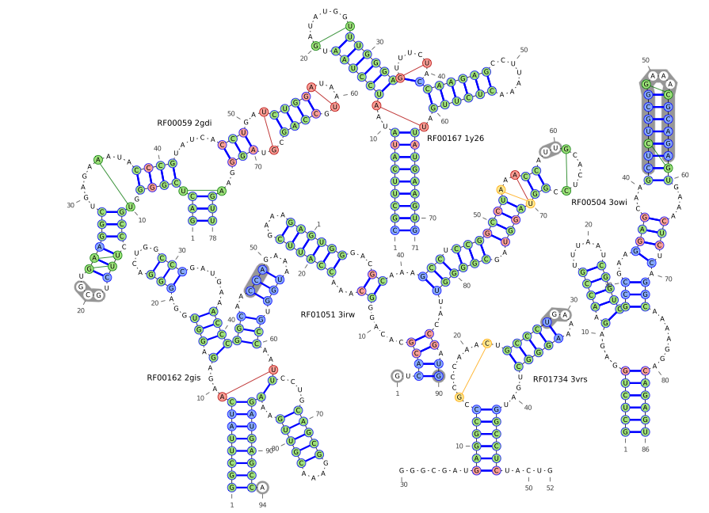
Secondary Structure Predictions
Nussinov type Dynamic Programming Algorithm with DCA instead of MI to score base pairing
True
DCA &MI
Only DCA
Only MI
DCA versus MI:
same precision ( ≈0.9), larger sensitivity (0.86 vs 0.8)
[Probabilistic inference method for RNA secondary structure and alignment algorithms ]
[Eddy 2004, Annu. Rev. Biophys ]

Slide 16
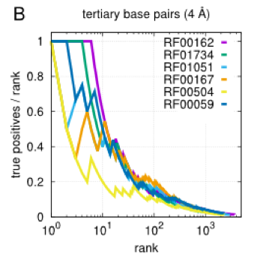
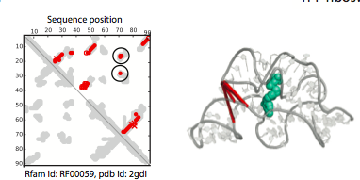
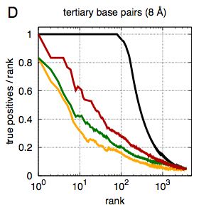
Tertiary Contact Prediction
TPP riboswitch
RF00059
Positive Predicted Value
True
DCA
MI
MI+APC
Almost All highest DCA scores correspond to secondary contacts
Tertiary contacts more difficult to detect
DCA outperforms MI
Positive Predicted Value
[De Leonardis .. Weigt, NAR (2015)] ,[C. Weinreb ..Marks, Cell (2016 )]
Notes:
Removing secondary structure and neighboring pairs

Slide 17
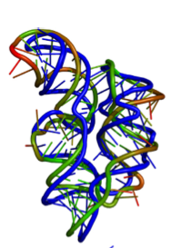
Tertiary Structure prediction : DCA+Rosetta
Rosetta (Baker group): Effective Potential.
Monte Carlo: bond angles are chosen among library of
known structures.
+ Lennard Jones attractive potentials for pairs in contact
Rosetta alone RMSD ≈16 Å
Rosetta + First 25 Coplings:7.5 Å
Rosetta+ All contacts: 6.3 Å
Riboswitch:
2gdi (RF00059)
But how many coupling predictions should be chosen?
+ new structural predictions
[De Leonardis .. Weigt, NAR (2015)] ,[C. Weinreb ..Marks, Cell (2016 )]
Notes:
Eddy 2004, AnnuREv. Biophys: Probabilirtic inference method for RNA secondary structure and alignment algorithms
[De Leonardis et al. NAR (2015)]

Slide 18
Conclusions
Direct Couplings inferred from covariations in MSA for RNAs are good predictors
of secondary and tertiary contacts and may be used in structural predictions
But..
Tertiary couplings are weaker than secondary couplings.
Better infer tertiary contacts by 2 –level inference starting from secondary contacts
Next:
RNA-Protein Interactions [Weinreb et al Cell 2016.]
[cfr Zhichao Miao and Vladimir Reinharz talks]
RNA design from the generative model inferred from the data [cfr works on proteins]
Other architectures for the inferred network of covariations: RBM
[cfr Remi Monasson’s talk]

Slide 19
Maximum Entropy modeling
Σ J_{ij} (A_{i},A_{j}) + Σ h_{i}(A_{i})
e
i<j
i
Ising/Potts Model :
P(A₁,...,A_{N}) =
Z[{J_{ij}(A,B),h_{i}(A)}]
Parameters
To be inferred
From data:
h_{i}(A_{i})
Local Fields: : to reproduce a.a. conservation for each site i and amino acid Ai.
Couplings: J_{ij} (A_{i},A_{j}) : to reproduce covariations
for each pair of sites and each pair
of amino acid
Inference is difficult: high dimensional: a lot of parameters, few data ,
Inverse problem is not exactly solvable.

Slide 20
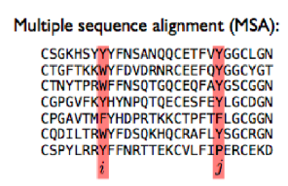
Inference of couplings and fields for Potts model
{A_{i}^{m}| i=1,..,N ;m=1,..M}
P(A₁,...,A_{N}) δ = f_{i}(A)
{A}
A,Ai
⇒
P(A₁,...,A_{N}) δ δ = f_{ij}(A,B)
{A}
A,Ai
B,Ai
f_{i}(A)
f_{J}(B)
Σ J_{ij} (A_{i},A_{j}) + Σ h_{i}(A_{i})
i<j
i
f_{ij}(A,B)
e
Potts Model :
P(A₁,...,A_{N}) =
Z[{J_{ij}(A_{i},A_{j}),h_{i}(A_{i})}]
⇒
21 N+21² N (N-1)/2 Coupled equations to solve!!
Problem rewritten as the Minimization of the Cross Entropy
S = log Z[{J_{ij}(A,B),h_{i}(A)}] - Σ J_{ij} (A,B) f_{ij}(A,B) - Σ h_{i}(A) f_{i}(A)
i<j,A,B
i,A
Regolarization is needed !
Notes:
L=100-500 10⁶-10⁸ parameters

