Slide 1


Coherent spectroscopy
in the single molecule limit
Kevin Crampton
Alex Fast
Alba Alfonso-Garcia
Christopher Syme
Ara Apkarian
Eric O. Potma

Slide 2
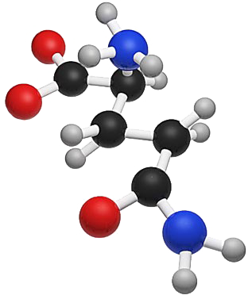
Talking optically to a single molecule
1. plasmonics
2. EM force

Slide 3
Confinement in 1 dimension:
Surface plasmon polariton
ω₃
ω₄
ω₁
ω₂
30 nm Au film

Slide 4
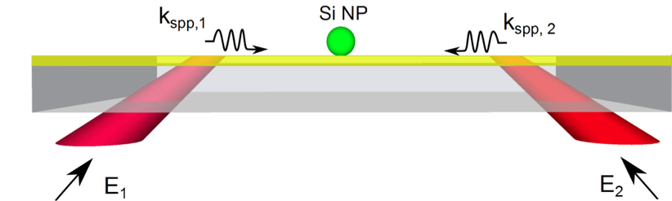
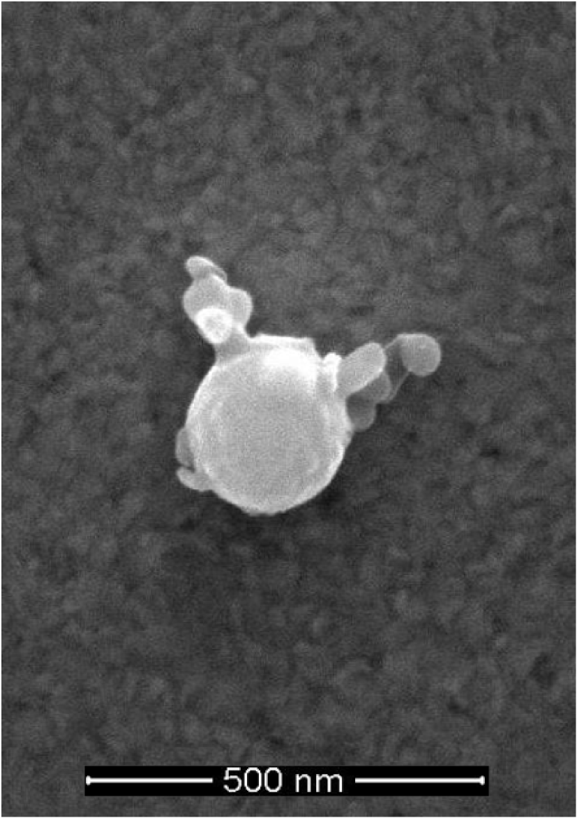

Confinement in 1 dimension:
Surface plasmon polariton
Coherent FWM process can be driven by surface plasmon mode
Liu et al., Opt. Lett. 36, 2348-2350 (2011).

Slide 5
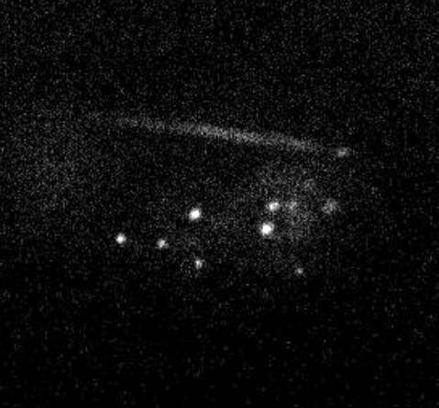
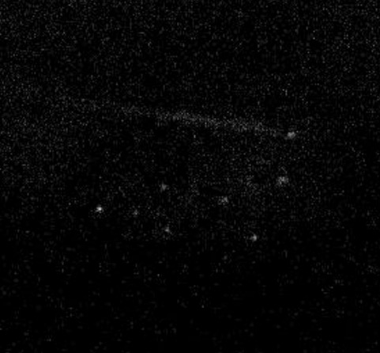
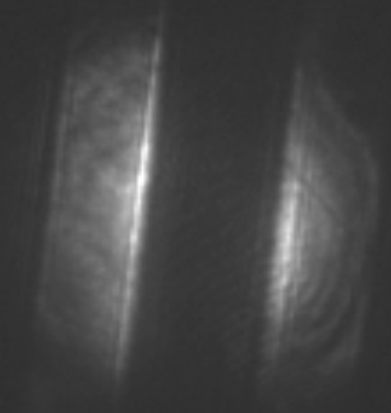
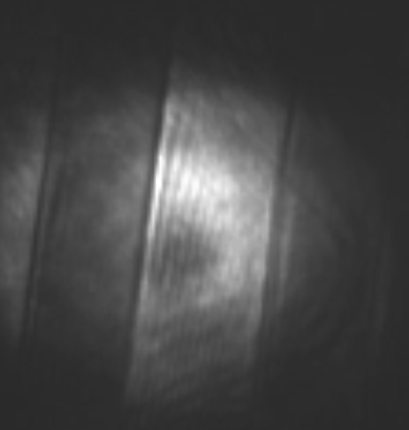
Wide-field SE-CARS
ON
2880 cm⁻¹
OFF
2762 cm⁻¹
ω₂
ω₁
angle = 42.0º
angle = 42.8º
Au
Au
Au
Au
glass
glass

Slide 6
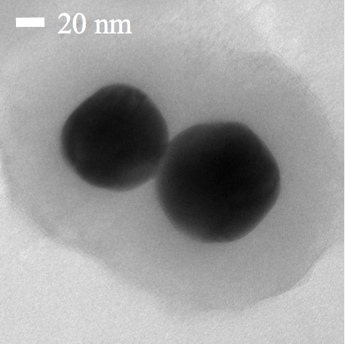
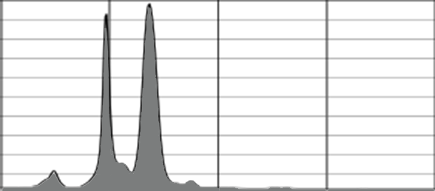
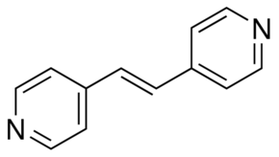
Confinement in 3D:
Localized surface plasmon
1600
1700
1800
Wavenumber (cm⁻¹)

Slide 7
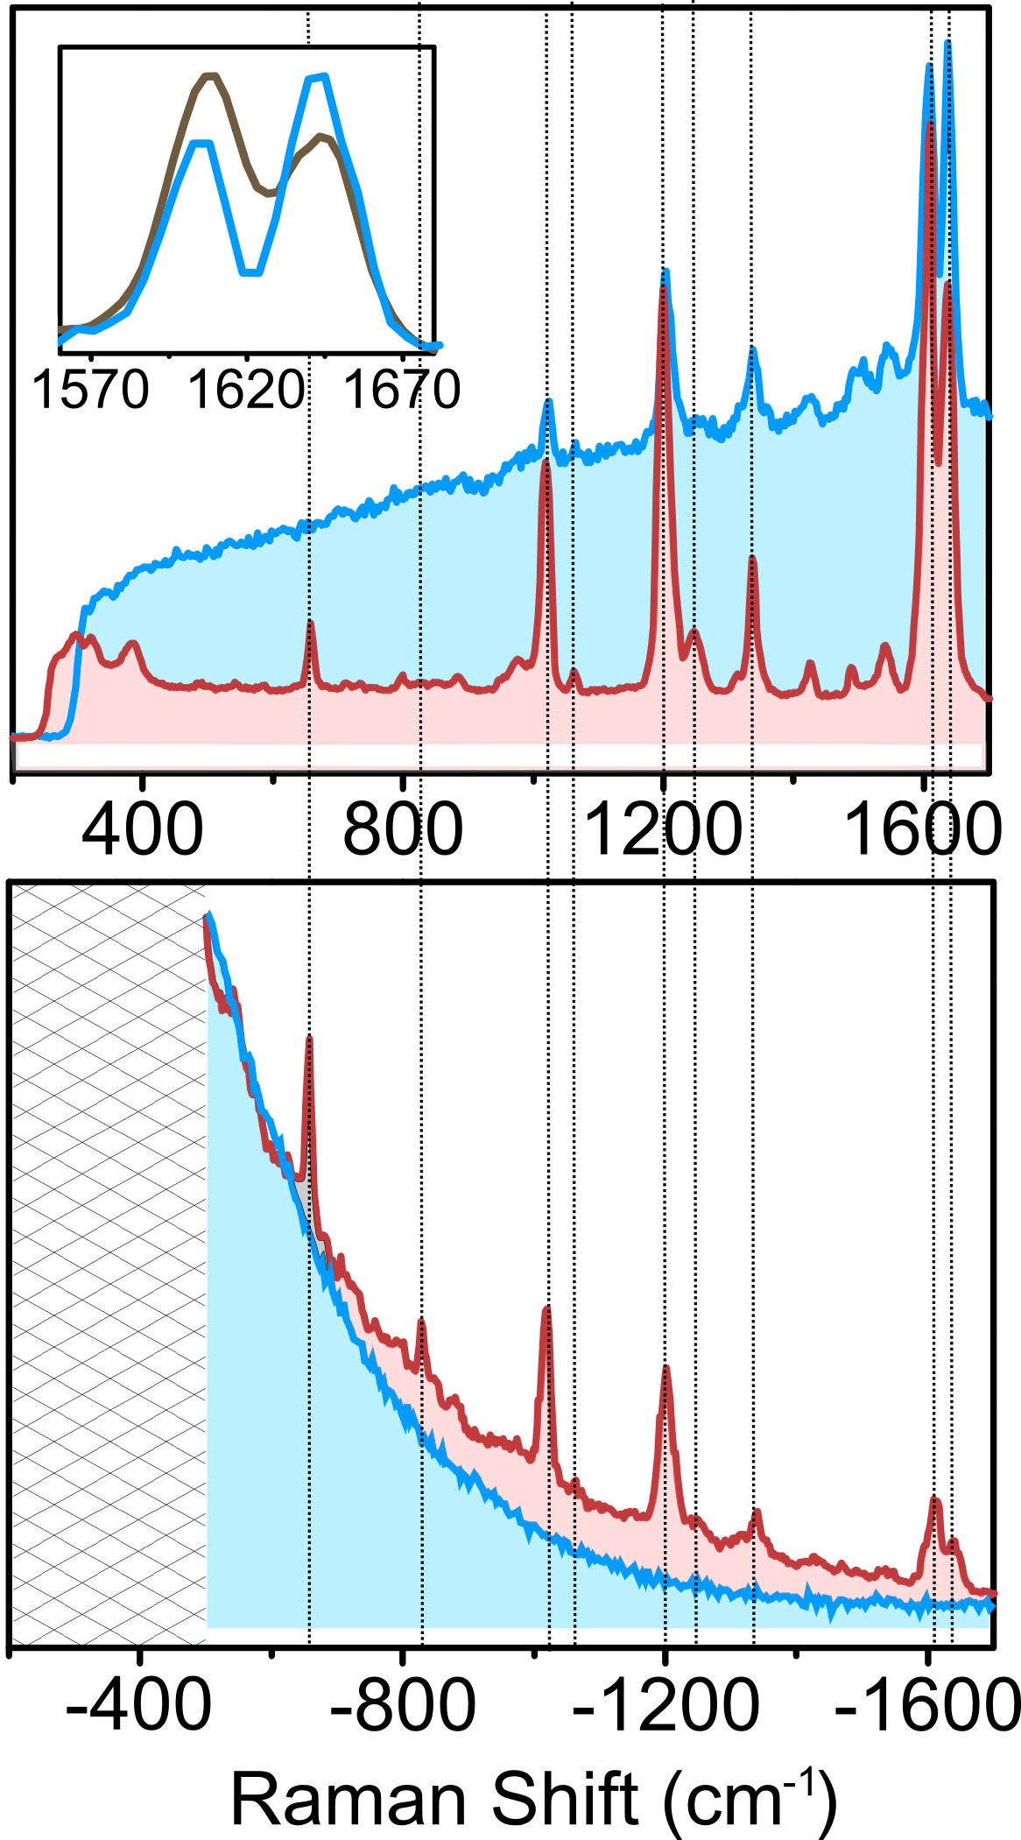
Electronic and vibrational SERS
532 nm
633 nm

Slide 8
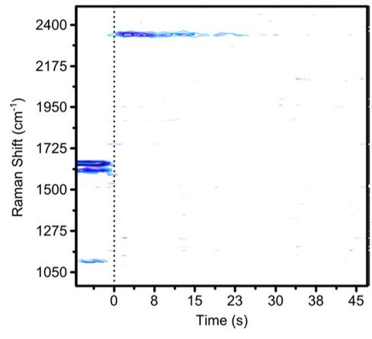
Ultrafast illumination: damage
fs laser on
CN stretch
Peak power limit: 10¹² W/cm²

Slide 9
CARS versus Raman (single molecules)
Spontaneous
2
ω₃
ω₄
=
X
ω₁
ω₂
=
X
SRS
as-Raman

Slide 10
CARS versus Raman (single molecules)
2
ω₃
ω₄
=
X
ω₁
ω₂
SRS
as-Raman
SRS step
Raman step
saturated!

Slide 11
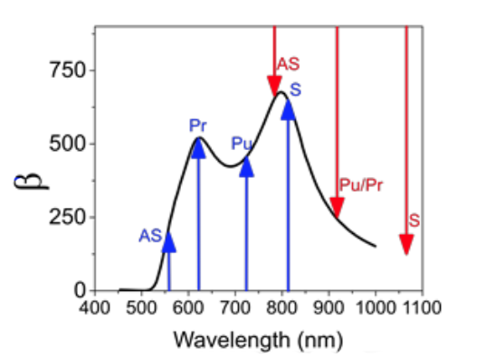
Surface-enhanced CARS: colors
ω₃
ω₄
ω₁
ω₂
Instantaneous thermal loading needs to be avoided
Single dipolar mode excitation, avoid excitation of multi-modes

Slide 12
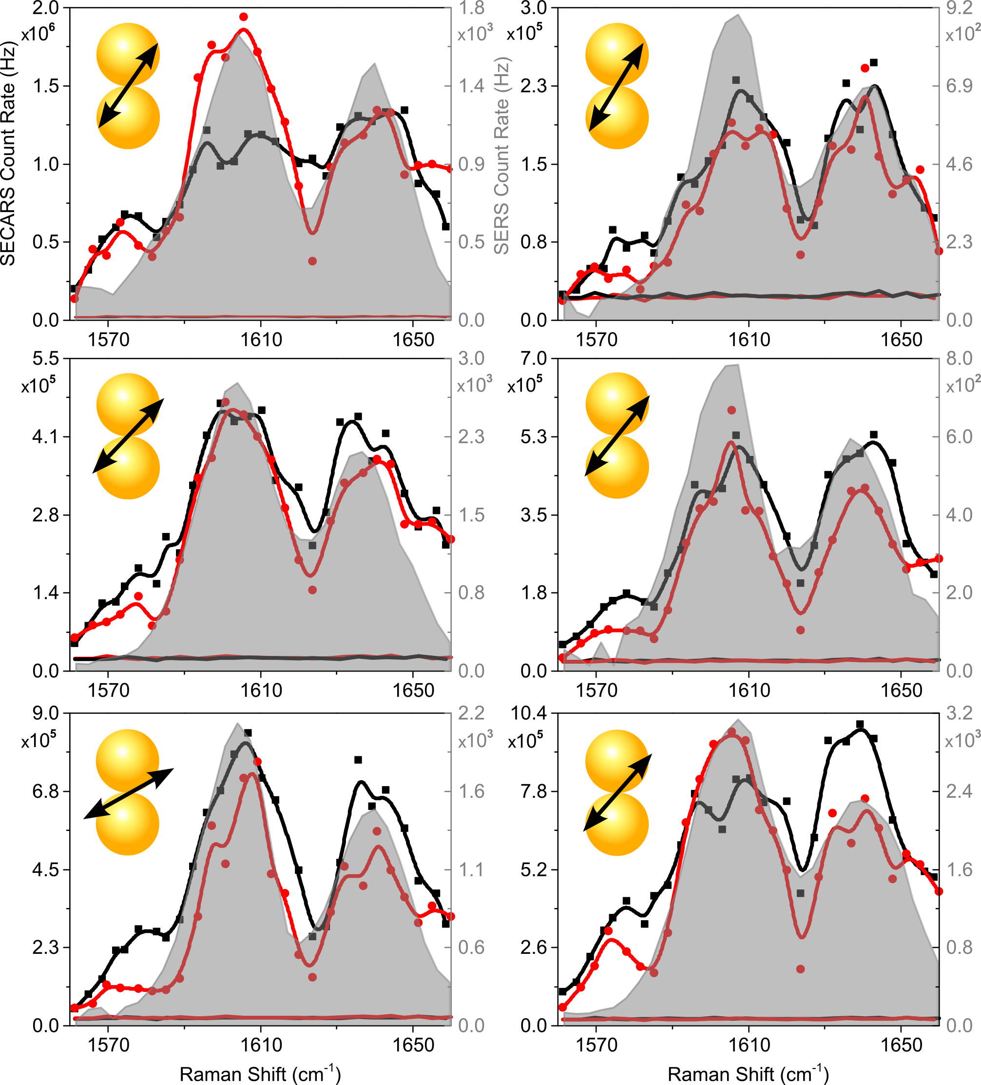
SE-CARS and SERS (frequency domain)

Slide 13
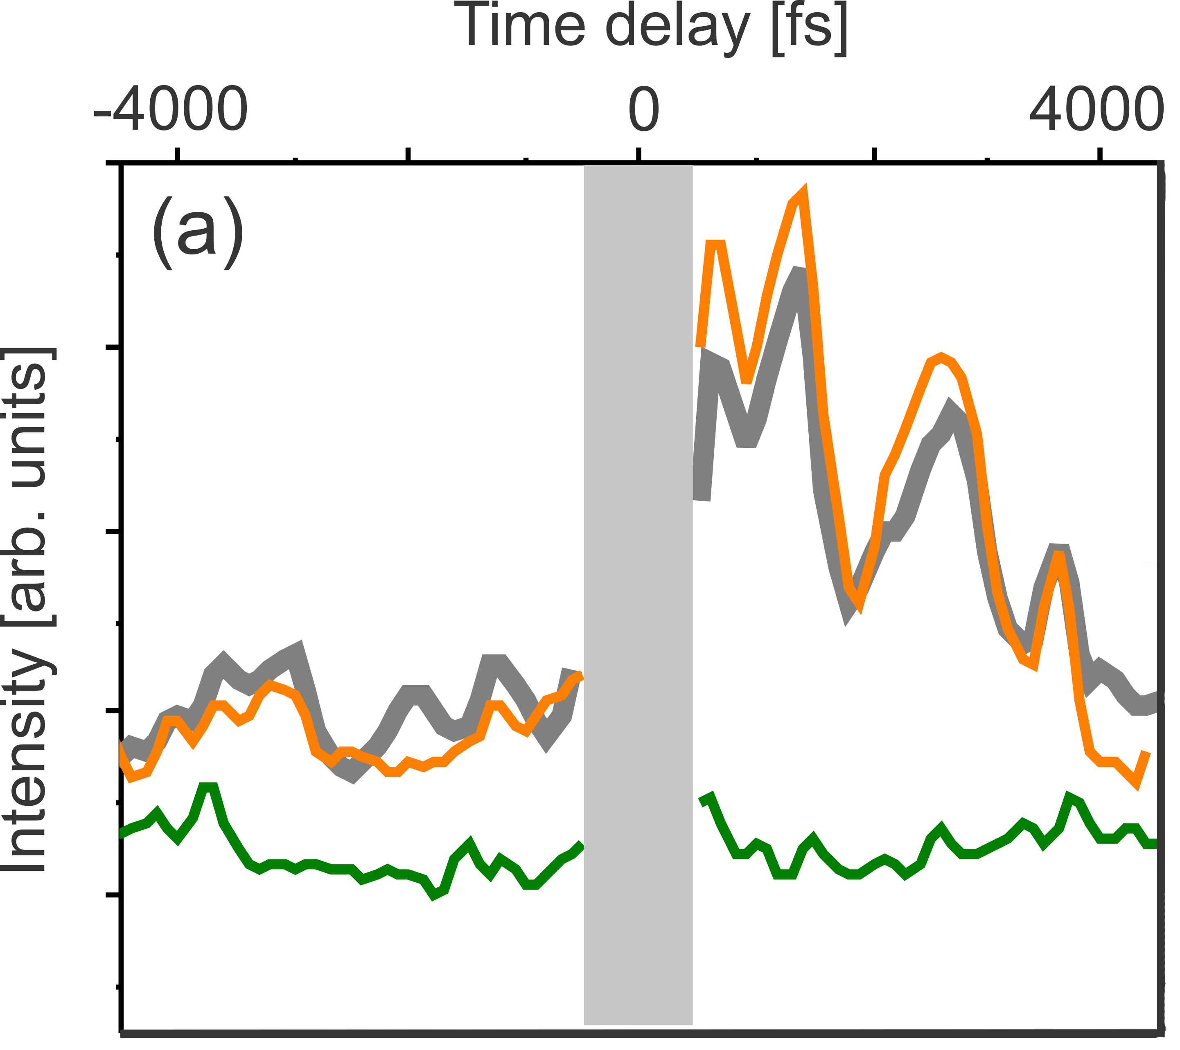
SE-CARS (time domain)
ω₃
ω₄
τ
ω₁
ω₂
ω_{vib}
Yampolsky et al, Nat. Photon. 8, 650-656 (2014)
1600
1700
1800
Wavenumber (cm⁻¹)

Slide 14
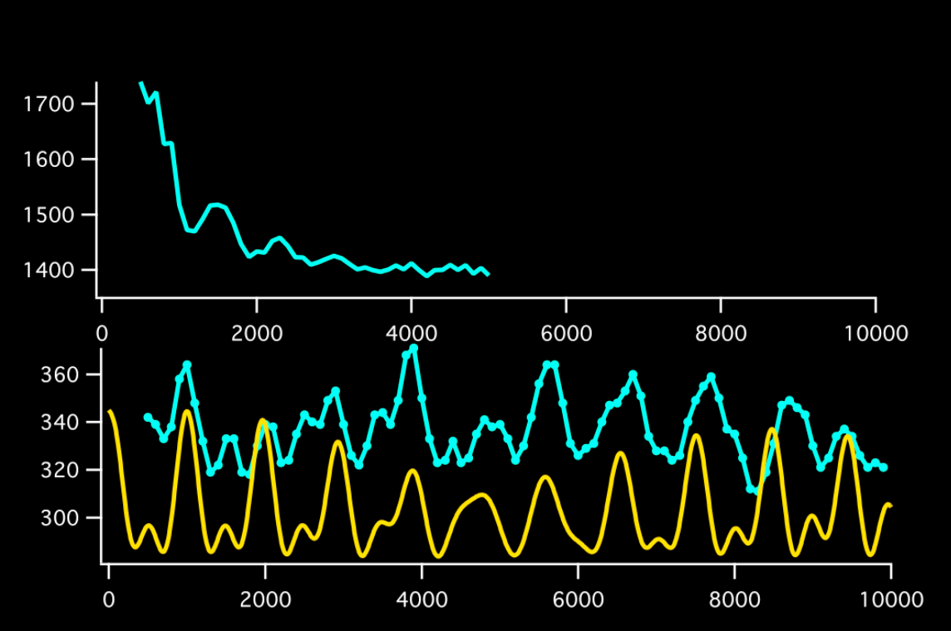
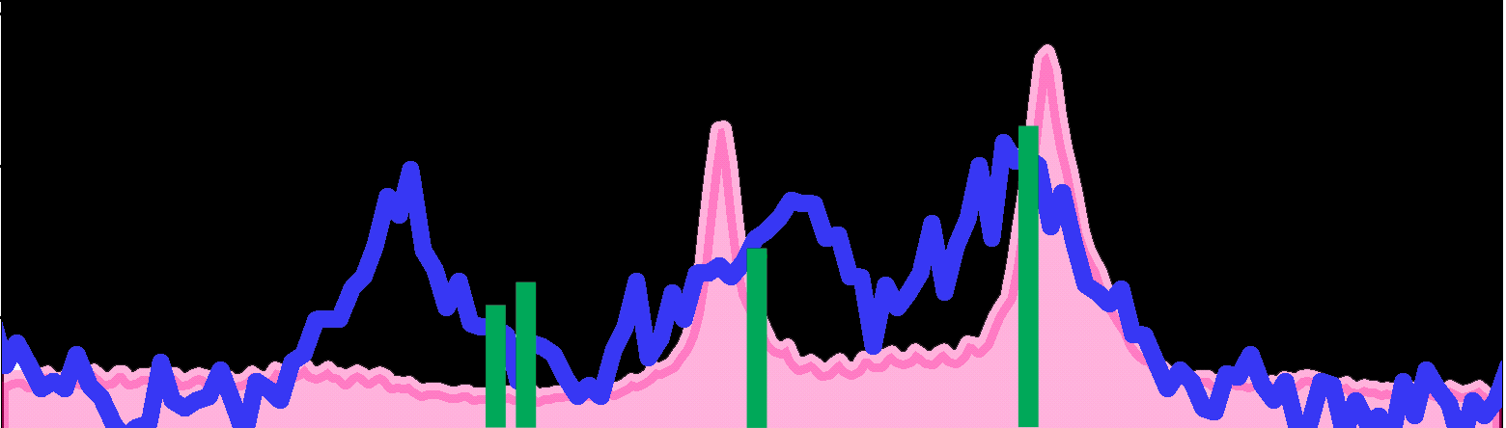
Time-resolved SE-CARS
ensemble
1550
1600
1650
Wavenumber (cm⁻¹)
‘single’

Slide 15
Non-optical detection: near-field force

Slide 16
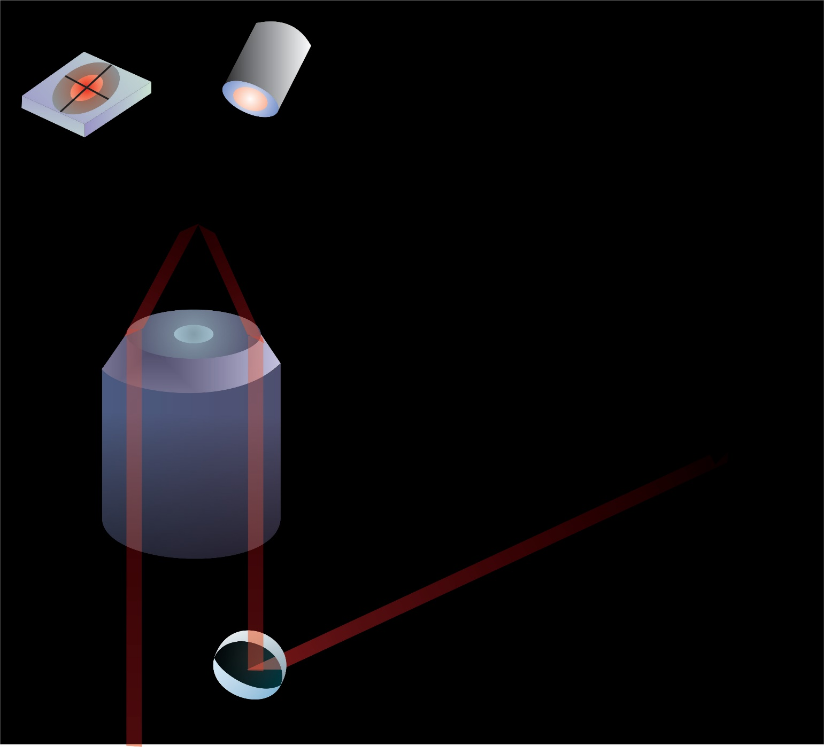
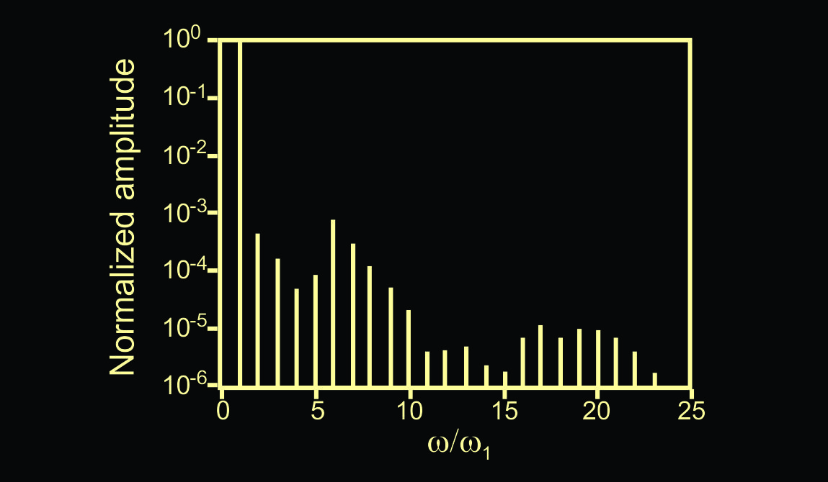
Non-optical detection: near-field force
Topography
PiFM
f₀₁
f₀₁
f₀₂
ν₁
f_{m} = f₀₂

Slide 17
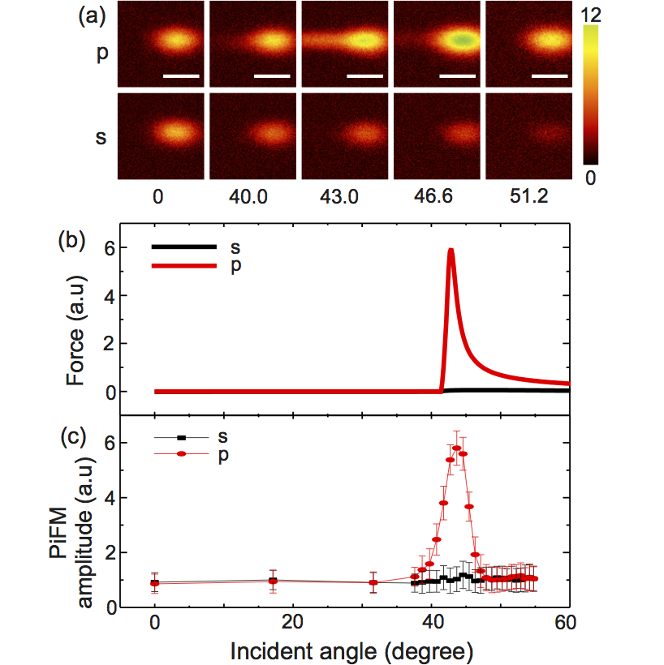
PiFM: visualizing near-field
Au
J. Jahng et al, Opt. Lett., 40, 5059 (2015)

Slide 18
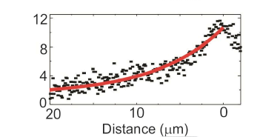
PiFM: visualizing near-field
5um
PiFM amplitude (a.u)

Slide 19
PiFM of molecules: optical binding force

Slide 20
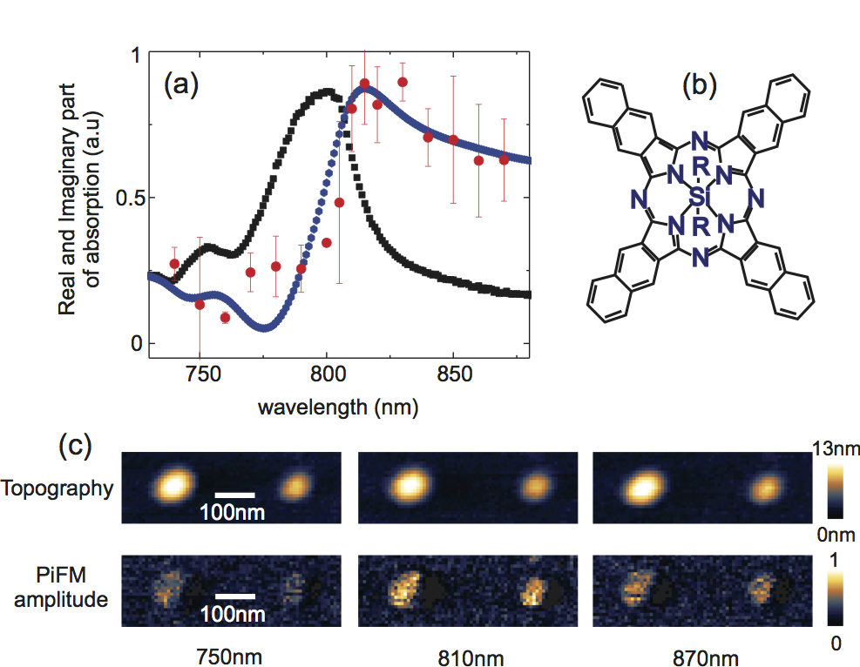
Spectroscopic imaging at the nanoscale

Slide 21
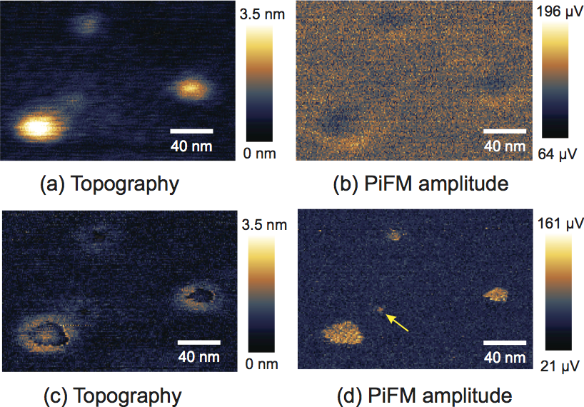
Nanoscopic imaging with PiFM
Topography
PiFM
z = 18 nm
z = 18 nm
z = 5 nm
z = 5 nm
Jahng et al., Acc. Chem. Res. 48, 2671-2679 (2015).

Slide 22
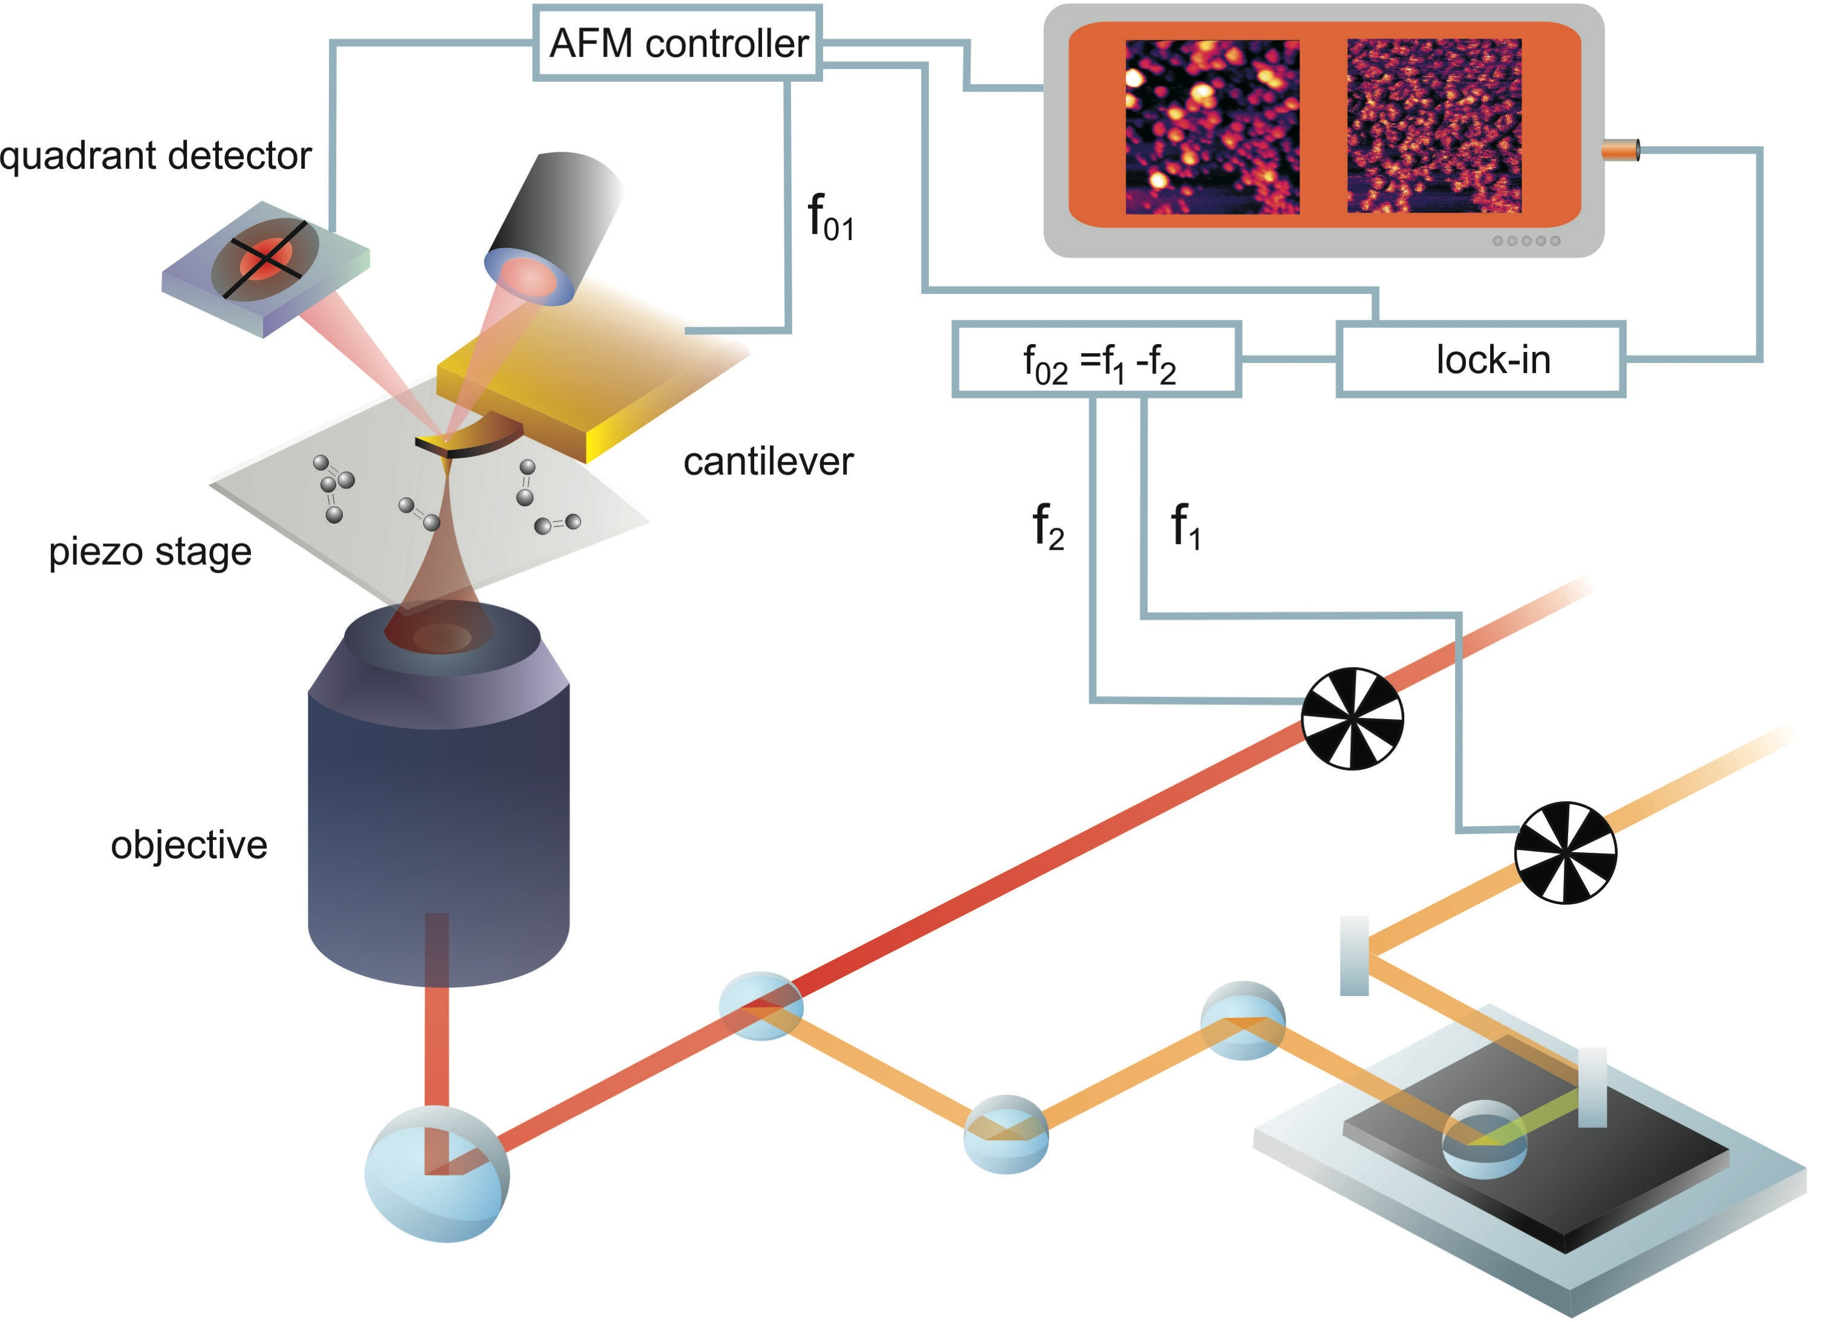
Pump-probe with force detection

Slide 23
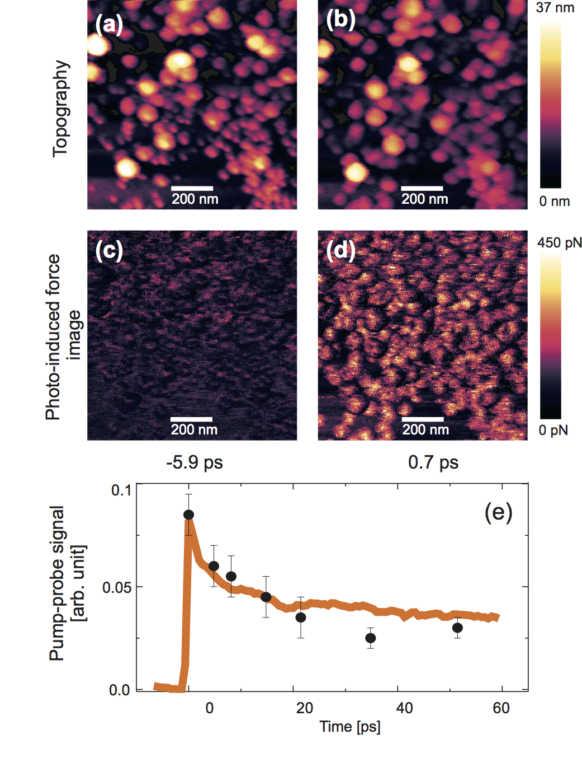
Time-resolved pump-probe at nanoscale

Slide 24
Take home messages
Optimized excitation of antenna-equipped molecules enables SE-CARS.
SE-CARS in the single molecule limit reveals information not directly accessible in ensemble measurements.
PiFM offers a non-optical detection scheme for absorption and pump-probe measurements in the few molecule limit.
Gracias.

Slide 25
CARS versus Raman (single molecules)
Spontaneous
2
ω₃
ω₄
=
X
ω₁
ω₂
=
X
SRS
as-Raman

Slide 26
CARS versus Raman (single molecules)
CARS
X
=
SRS
as-Raman
Raman
=
s-Raman
SE-CARS ~ SERS when stimulated (SRS) step is saturated

Slide 27
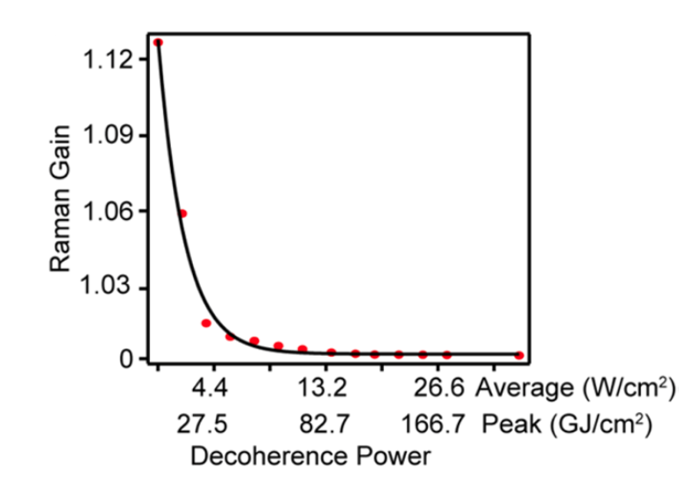
Raman saturation?
Depletion of Raman gain by SRS saturation
in bulk liquid
Saturation achieved for peak powers << 10¹² W/cm²
Silva, Graefe & Frontiera, ACS Photonics 3(1), 79-86 (2016)

Slide 28
