Slide 1
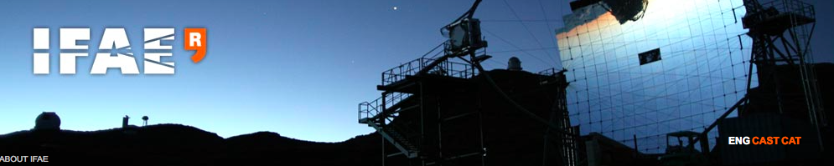

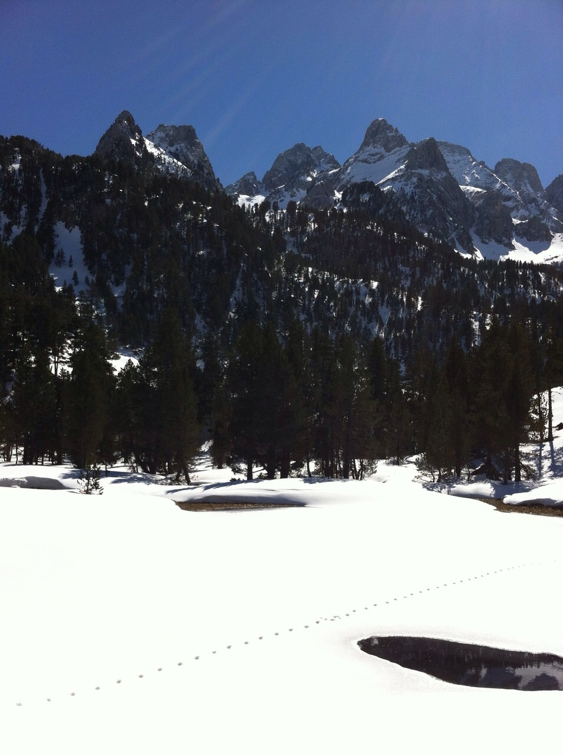
Present and future of VHE gamma astronomy
Manel Martinez
43rd Winter Meeting
March 2015-Benasque

Slide 2
Outline
1) Introduction
2) Basics on VHE Gamma Astronomy physics
3) VHE gamma observatories
4) CTA
5) Conclusions

Slide 3
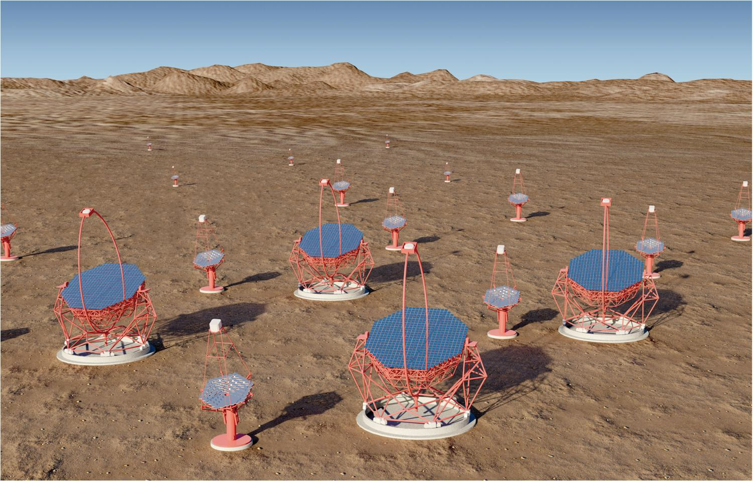

Slide 4
Summary and outlook
CTA will be a key instrument in the field of Astroparticle Physics in the coming years for addressing many open questions and it is the natural follow-up to the current very successful Cherenkov telescopes (in which Spain is playing a very important role)
CTA ranks high in the roadmaps of all relevant European forums (ESFRI, ASPERA, ASTRONET) and American reviews (PASAG, Decadal Review) and during the past years has being recognized as a high priority infrastructure in Spain as well.
Spain is one of the leading partners in CTA and Spanish groups are already contributing visibly to the CTA effort in subjects where they have strong and well-recognized expertise.
There are very good chances for Spain to host the CTA-North site

Slide 5
OUTLINE:
Status of CTA in a nutshell
CTA will be an observatory
3) Status of CTA in Spain
4) The LST prototype at ORM
5) Summary and Outlook

Slide 6
1) Status of cta in a nutshell

Slide 7
What is CTA?
An advanced facility for very-high energy gamma-ray astronomy
10 fold sensitivity and energy range w.r.t. current installations
Improved angular and spectral resolution
-> A mixed array of Cherenkov Telescopes:
Small-Size Telescopes (SSTs)
~10 km² effective area at
multi-TeV energies
Mid-Size Telescopes (MSTs)
mCrab sensitivity in 0.1 - 10 TeV
Large-Size Telescopes (LSTs) energy threshold of O(10) GeV

Slide 8
CTA sensitivity in units of Crab flux for 5 σ detection & N_{γ} > 10 in each 0.2-dex bin in E, in 50 h
----- MAGIC 2010

Slide 9

All-sky coverage: two observatories
Low energy array (4 LST + 15 MST)
~70 MEuros
Mainly
extragalactic
science
North site
Total cost ~ 200 MEuros
LST cost ~ 70 MEuros
Galactic plus
extragalactic
science
South site
Full energy array (4 LST + 25 MST + 70 SST)
~130 MEuros

Slide 10
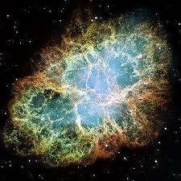
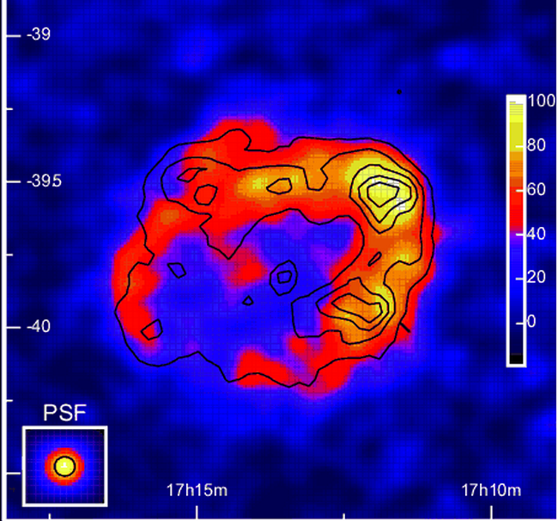

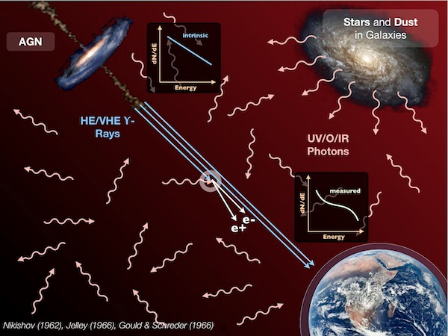
CTA research topics
Cosmic Rays
  sites of acceleration in our galaxy and beyond
  search for pevatrons
  CR interactions within galaxies & clusters
Probing extreme environments
  relativistic jets & winds in the vicinity of neutron stars & black holes
Probing the intergalactic medium
  B-fields, background radiation fields
Physics frontiers
  indirect DM searches (WIMPS, axions)
  testing the invariance of the speed of light

Slide 11
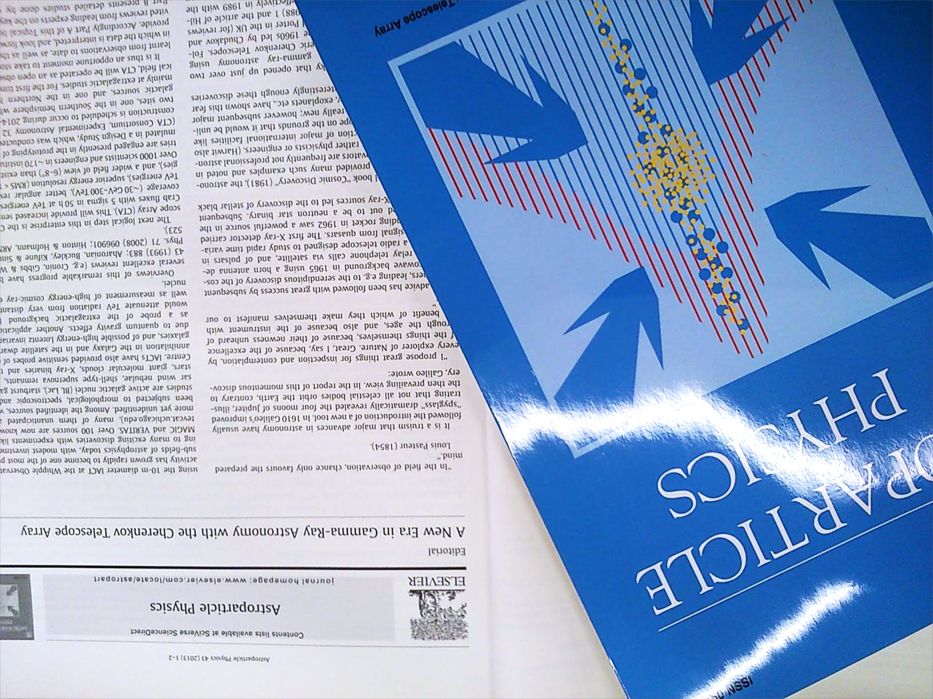
Astroparticle Physics CTA special issue
March 2013

Slide 12
CTA: a world-wide effort
Numbers from mid 2014. Keep steadily increasing.

Slide 13
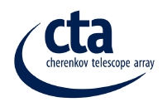









HIGH LEVEL ORGANISATION
Resource Board
(Agencies)
Scientiﬁc and
Technical Advisory STAC
Committee
Consortium Board
Chair:J.Knoedelseder
Spokespersons
W. Hofmann
M. Martinez -> R. Ong
EC
Administrative and
Financial Advisory AFAC
Committee
Project Manager
C.Townsley
Project Scientist
J. Hinton
…
…
Site Selection SSC
Committee

Slide 14
CTA Management renewal
* Change of Consortium Board Chair: Johannes Knapp ->
Juergen Knoedelseder since May 2013.
* Change in Project Manager: John Carr -> Christopher Townsley since Jan. 2014
Spokespersons mandate terminated after FP7 grant extension (June 2014)
-> Werner Hofmann reelected CTA spk. (April 2014) -> Rene Ong elected cp-spk election (Sep. 2014)

Slide 15
The RB advisory Committees
What and how to build and operate ? -> STAC
How to organize and fund the construction ? -> AFAC
Where to build ? -> SSC

Slide 16

CTA TIMELINE
Preparatory /
Pre-construction
Phase
2011-2015
Construction
Phase
early 2016-2021?
Design Phase
up to 2010
Operation Phase
-TDR
-Interim Legal Entity (iLE)
-Site Decision
Milestones:

Slide 17
Towards the CTA TDR
Notes:
17

Slide 18
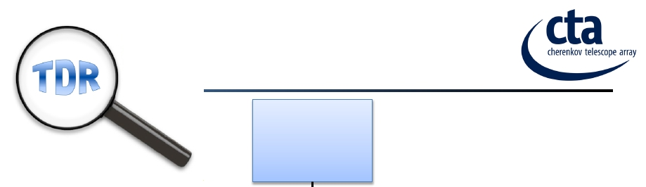









FOCUS TDR
CTA
Observatory
Proposal
Observatory
TDR
Infrastructure
TDR
Systems Eng.
& Safety TDR
Array Control
TDR
Data
Management
TDR
LST TDR
MST TDR
SST TDR(s)
SCT TDR*
STAC felt that design of telescopes was basically there;
emphasis on WBS, risk register, cost …

Slide 19
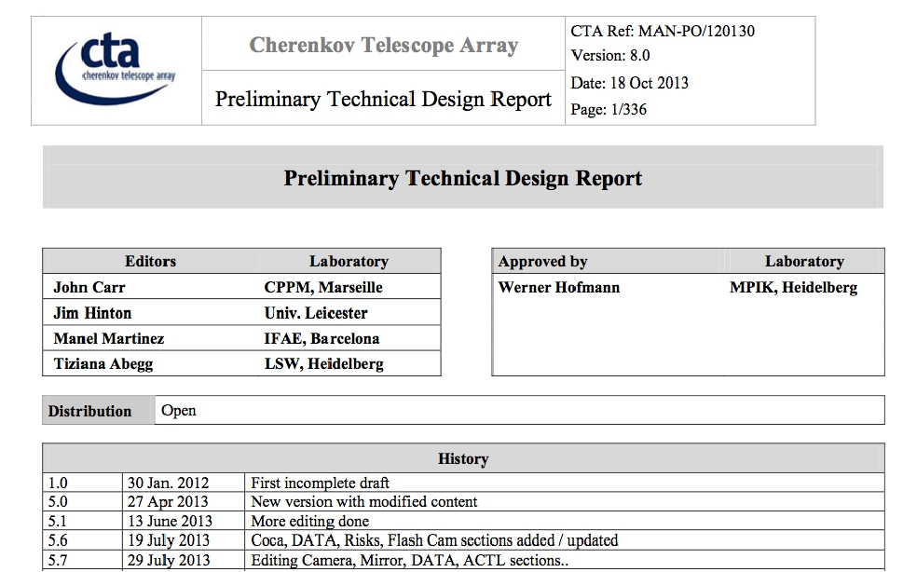
PTDR SUBMITTED TO STAC (OCT. 18 2013)

Slide 20
CRITICAL DESIGN REVIEW (CDR)
Ready for production? Final versions of
- Design
- Qualiﬁcation and validation of readiness for the
construction phase
- Processes for hardware/software manufacturing,
assembly, integration and testing
- Cost estimate including margins and uncertainties
- Operating scenario and operating cost
- Funding scenario for the CTA construction and operation
Main document: Technical Design Report -> Done !
=> CDR in July 2015

Slide 21
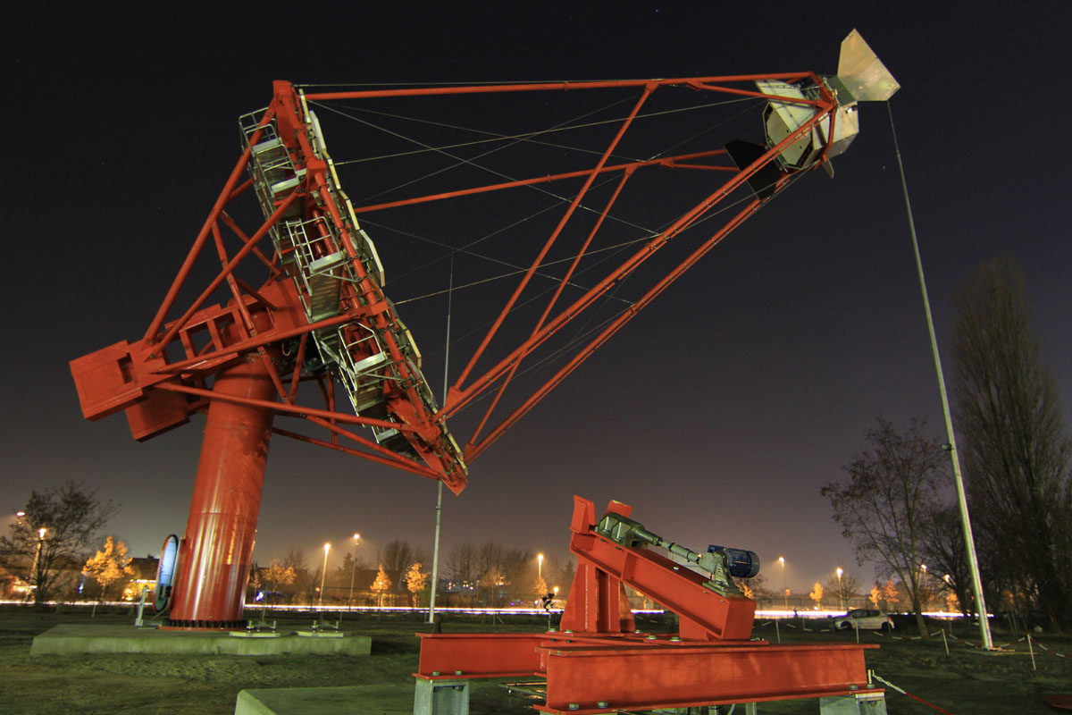
MST Inauguration, berlin Oct.2013

Slide 22

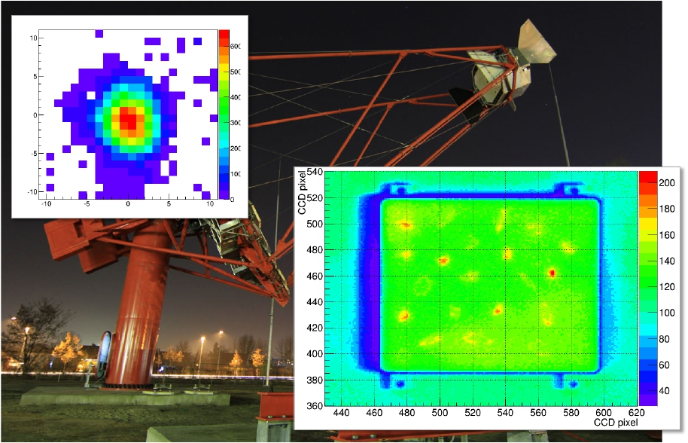
CTA TELESCOPE DESIGN & PROTOTYPING: MST
Software superposition
R80 = 6.2 mm
21 individual mirror spots taken
when tracking Jupiter

Slide 23
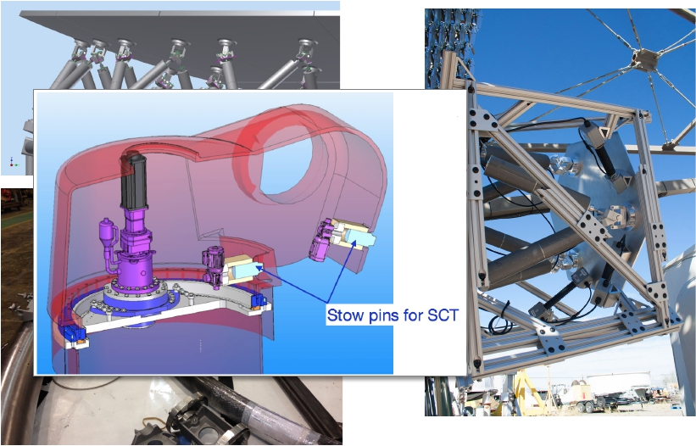
CTA TELESCOPE DESIGN & PROTOTYPING: SCT
Field test of mirror panel Stewart
platform and edge sensors at
VERITAS T4
Prototyping of mirror panel
mounting is underway

Slide 24
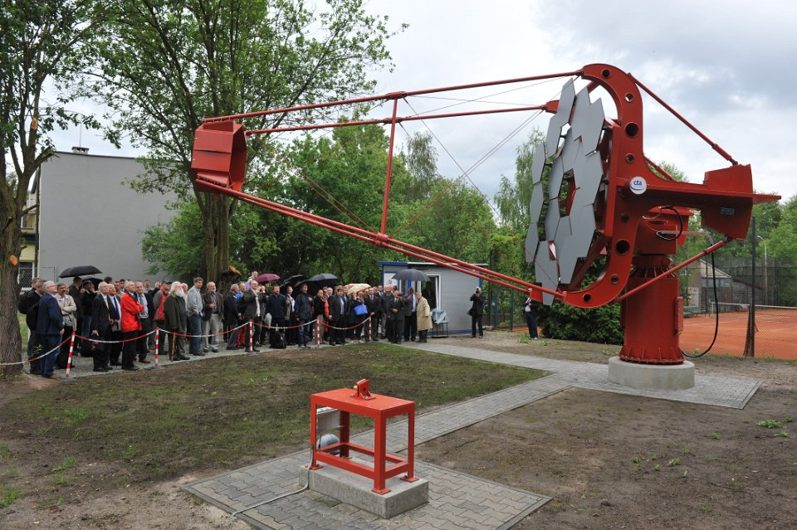
SST-1M inauguration, krakow june 2 2014

Slide 25
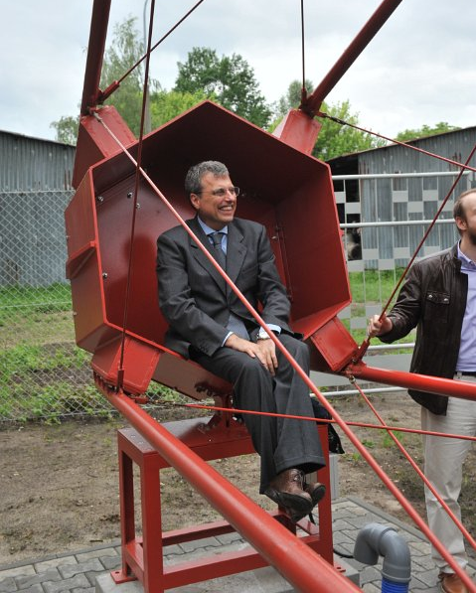
CamerA not final
Planned upgrades:
more than 2 pixels
faster readout
digital interface
but less intelligence

Slide 26
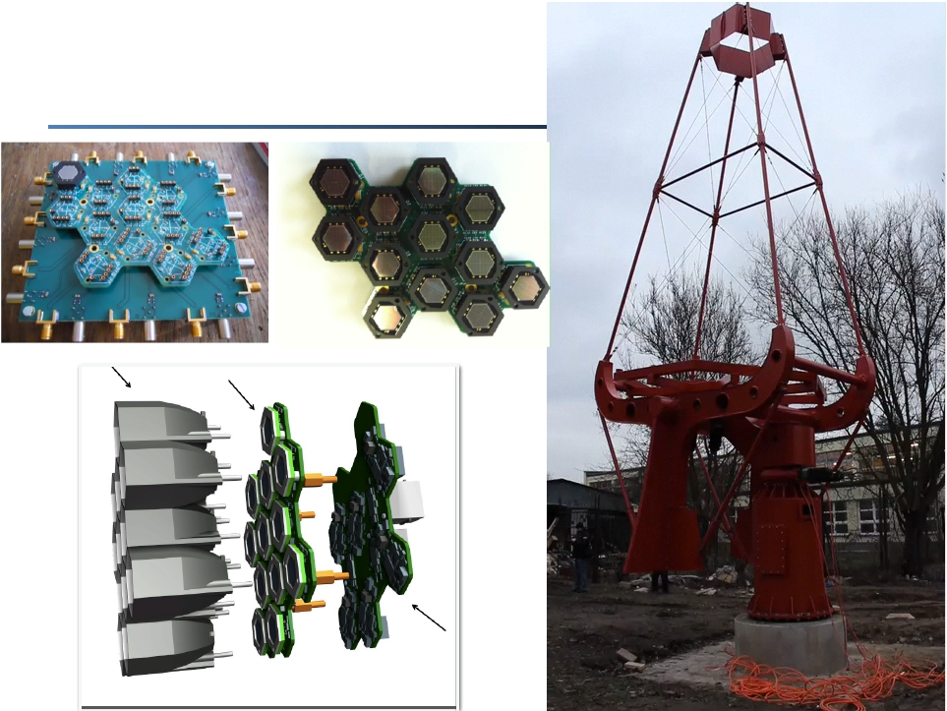
CTA TELESCOPE DESIGN & PROTOTYPING: SST-1M

Slide 27
SST-2M inauguration, catania sep.24 2014

Slide 28
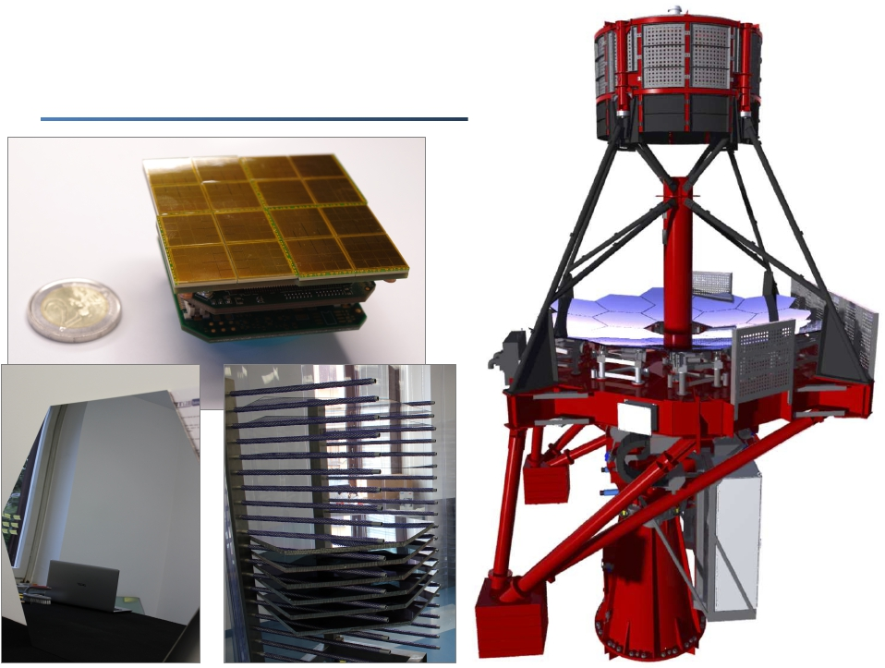
CTA TELESCOPE DESIGN & PROTOTYPING: ASTRI

Slide 29
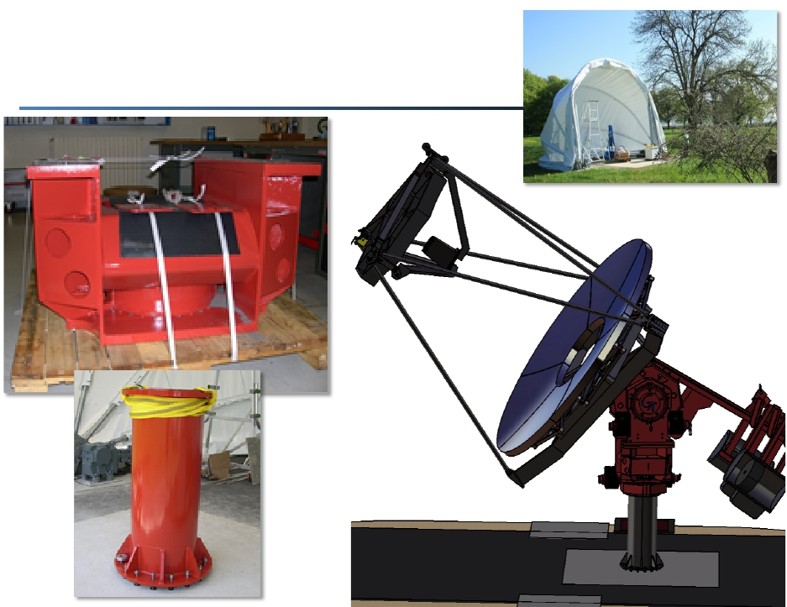
CTA TELESCOPE DESIGN & PROTOTYPING: GATE

Slide 30
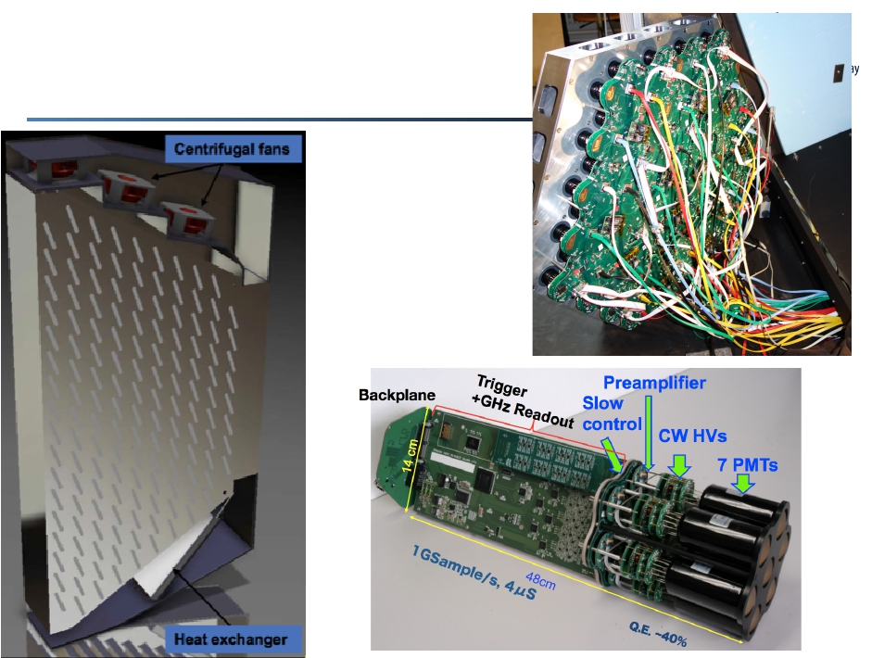
CAMERAS
NectarCam
cooling studies
FlashCam
144 pixel
focal plane
LST camera
cluster

Slide 31
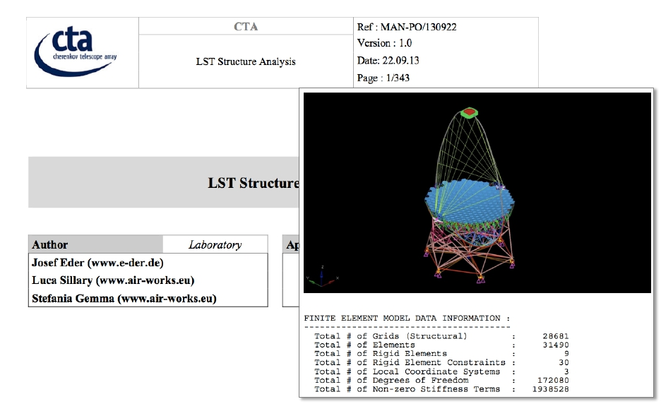
CTA TELESCOPE DESIGN &
PROTOTYPING: LST

Slide 32
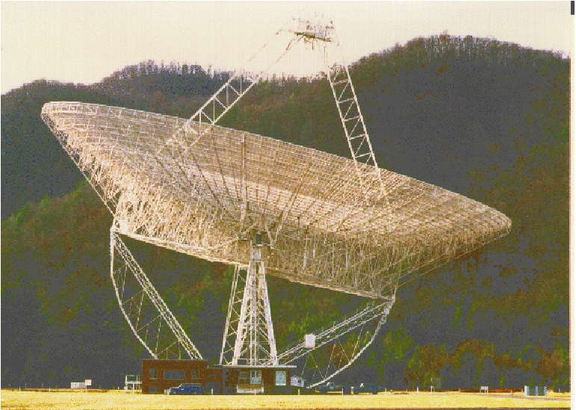
STANDARD TELESCOPE VERIFICATION (& TESTS ?)
300-foot Green Bank radio telescope on November 15, 1988

Slide 33
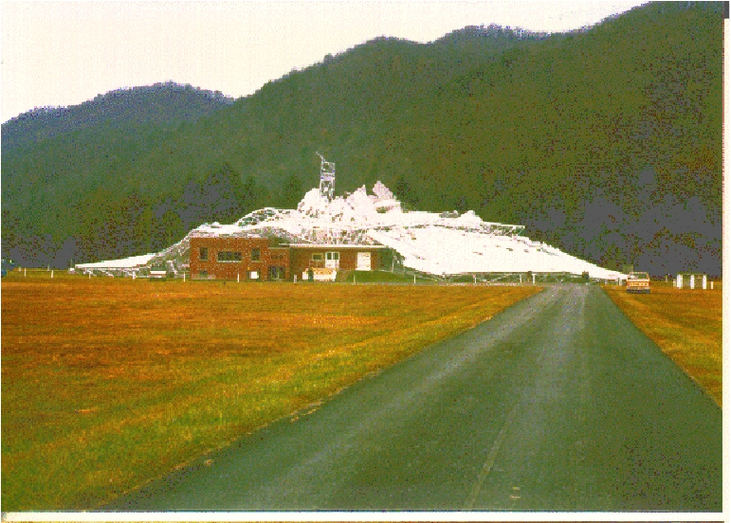
STANDARD TELESCOPE VERIFICATION (& TESTS ?)
300-foot Green Bank radio telescope on November 16, 1988

Slide 34
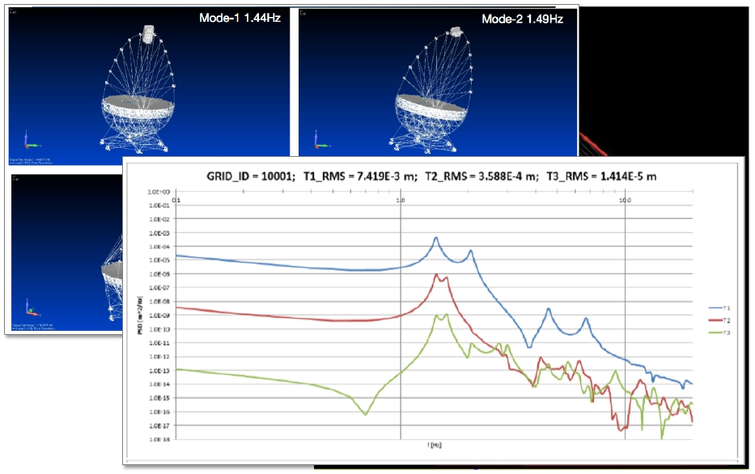
CTA TELESCOPE DESIGN & PROTOTYPING: LST
10 Hz
100 Hz

Slide 35
Towards the CTA iLE
Notes:
35

Slide 36
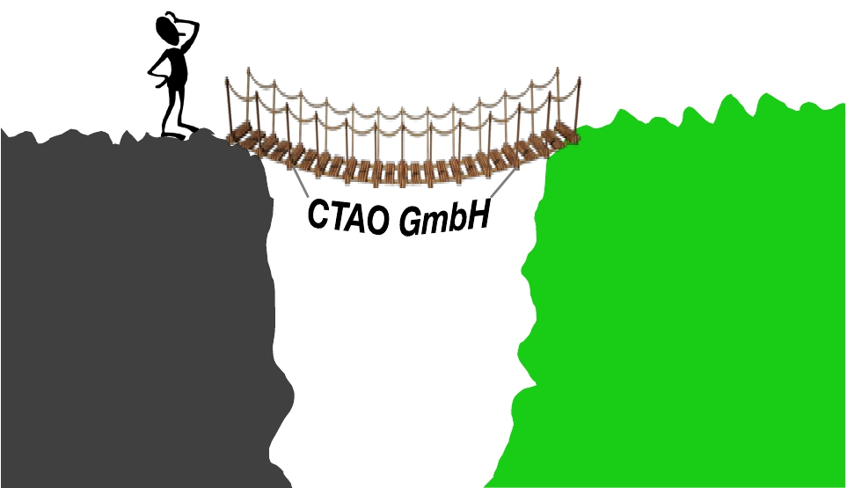
CTAO INTERIM LEGAL ENTITY
?
CTA
Prep Phase
The
(funding, legal)
gap
CTA
Observatory

Slide 37
INTERIM LEGAL ENTITY =
CTA OBSERVATORY
- German non-profit CTAO GmbH
-Operate Project Oﬃce
-Site negotiations
-Agreements regarding in-kind contributions
- Based at Heidelberg
- Shareholders: Countries/agencies or organisations
representing agencies
- Financial contributions to operate project
- iLE be replaced by ﬁnal legal entity (different options
being explored –for instance ERIC-) in ~2016-2017
Constituted already in July 2014 (initially by 3
shareholders: Germany, Italy and Switzerland).

Slide 38
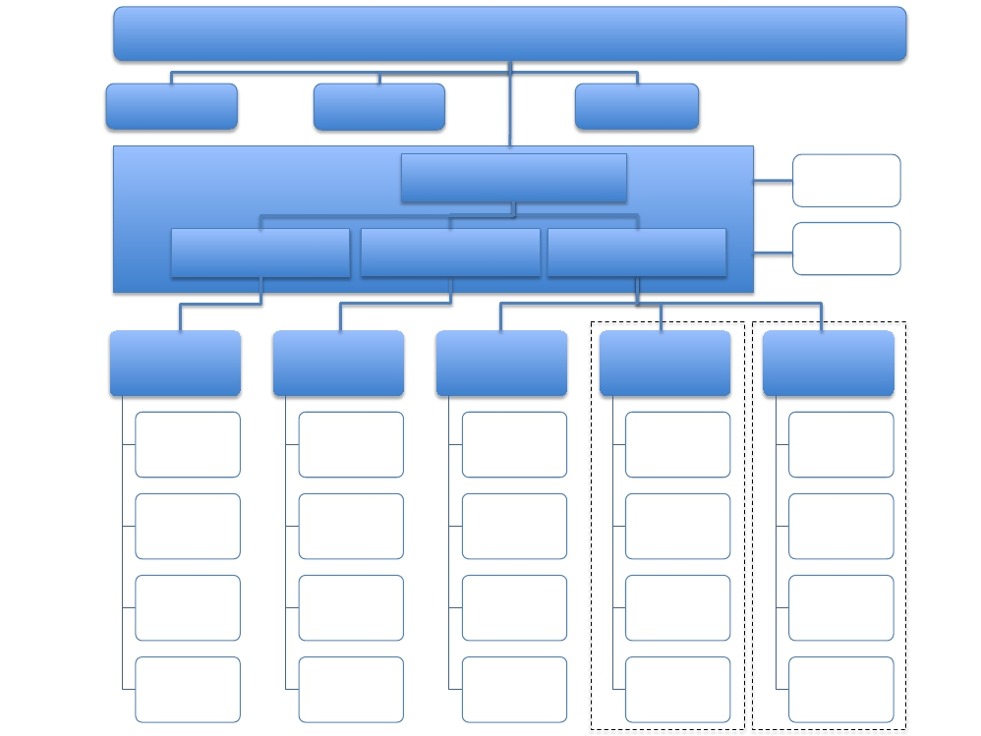
CTAO Council
Finance
Committee
a possible
organization
of CTAO
Science / Pr.
Committee
Technical
Committee
Directorate
Director General
Safety
Admin director
Scientiﬁc director
Technical director
DG unit:
Outreach, …
Central
administration
Personnel
Finance
Purchasing and
shipping
Contracts & legal
issues
Science
support
division
Science program,
proposal handling
Data man. &
dissemination
User support
Science data
analysis & MC
Technical
division
Operations
scheduling
Operations
monitoring
Tech. support
and maintenance
Instrument R&D
North site
Site
administration*
Technical
services
Shift operation
Local outreach**
South site
Site
administration*
Technical
services
Shift operation
Local outreach**

Slide 39
Towards the CTA site decision
Notes:
39

Slide 40
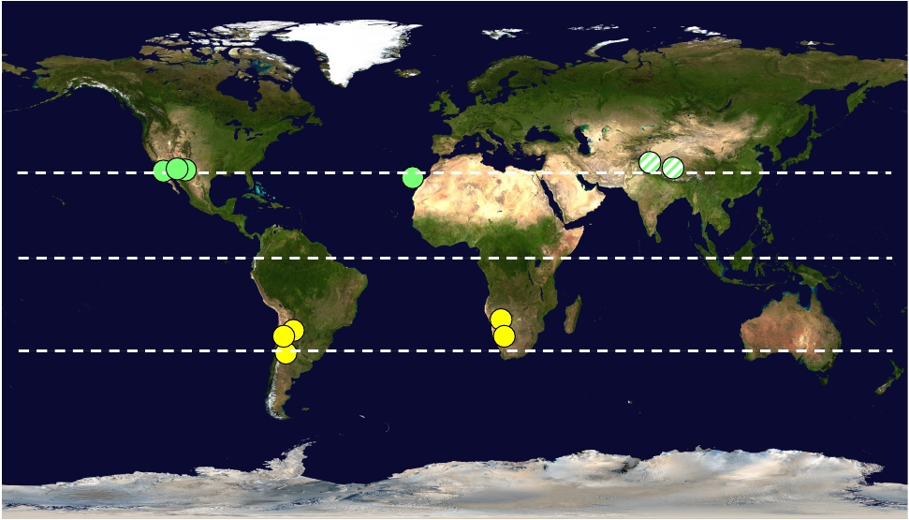
WHERE TO BUILD ?: SITE CANDIDATES
two sites to cover full sky
at 20º-30º N, S
+30
-30
Warning: map not quite accurate

Slide 41
SITES UNDER INVESTIGATION
Country | Location | Latitude | Elevation | Priority
Argentina | ElLeoncito | 31.7S | 3600m | medium
 | SanAntonio | 24.0S | 2700m | high
Chile | ESOarea | 24.3S | 2500m | high
Namibia | Aar | 26.2S | 1700m | high
 | H.E.S.S. | 23.3S | 1800m | medium
Mexico | SanPedro Martir | 31.0N | 2400m | high
Spain | Teneriﬀe | 28.3N | 2300m | high
US | MeteorCrater | 35.0N | 1700m | high
 | Yavapai Ranch | 35.1N | 1700m | medium
Basic requirements: 10 km² (S), 1 km² (N)
1500 – 3800 m elevation
>70% clear nights
not listed: low-priority sites
in India and Tibet

Slide 42
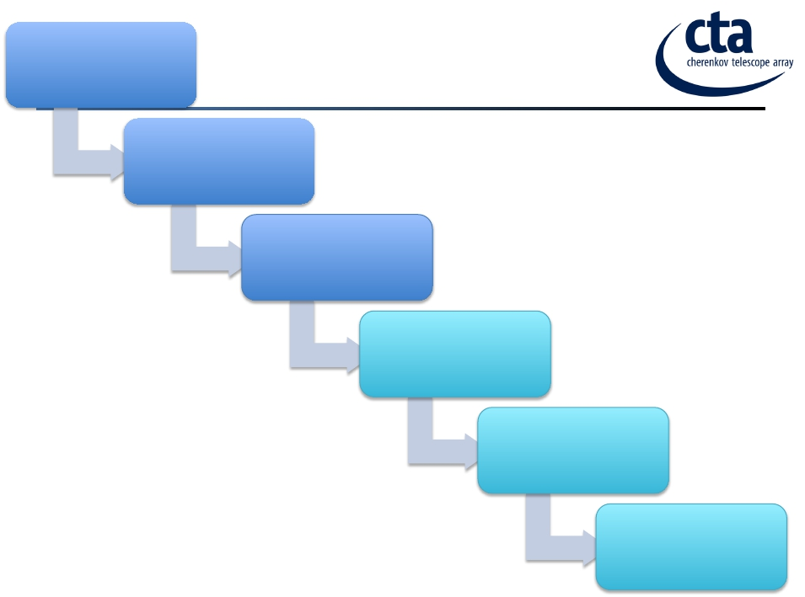
CTA PP site evaluation
Started in 2011
A LENGTHY PROCESS…
CTA scientiﬁc site
ranking
Sept 2013
Site Selection
Committee ranking
and recommendation
Mar. 2014
Resource Board
selection of sites for
negotiations
April 2014
Both for North and South
proceed in parallel
Site negotiations
Half year
Final site selection
2015

Slide 43
Surprises FROM CTA CONSORTIUM SITE EVALUATION…
Unexpectedly sizable effect on performance due to
* Site altitude
* Geomagnetic field
-> southern sites at lower altitude being explored in
* Argentina (Leoncito++)
* Chile (Armazones 2000)
Unexpected site constraints due to requirements
* San Pedro Martir violates survival temperature reqs.

Slide 44
SITE SELECTION COMMITTEE
Established by CTA Resource Board (RB)
Members:
Ian Corbett
Secretary General of the International Astronomical
Union; SKA site selection
Roland Gredel
Andreas Kaufer
Stefan Michalowski
Former Director of CAHA, E-ELT site evaluation
Director of the La Silla Paranal Observatory
Executive Secretary, OECD Global Science Forum;
SKA site selection
Sergio Ortolani
Massimo Tarenghi
E-ELT site evaluation
ALMA Director (2003-2008)
“The key criterion for the site choice should be to optimize the
scientiﬁc output of the CTA observatory, within ﬁnancial boundary
conditions imposed by the agencies and countries funding CTA.”
SSC recommendation for RB meeting spring 2014
Site decision by RB/CTAO during 2014

Slide 45
2) cta will be an observatory

Slide 46









7!
CTA Observations Plan
Best effort
Priority on
commissioning
“Guaranteed” minimum performance
Observatory-mode operation
SV
SV
SV
Science Verification
SV
ES
ES
Early (Consortium) science
Deployment
status
KSPs
Trial
open
time
Open time
time
Detailed scheduling tbd

Slide 47
9!
PHYS Proposed KSPs
● Galactic Survey
● Galactic Centre
● Galactic Deep Fields
Initially Inner galaxy, options for continuation
Deep survey
Key fields and key accelerators
● Star Forming Systems
● Active Galaxies
● Galaxy Clusters
● Transients
● Extragalactic Survey
● Dark Matter Search
Stellar clusters up to ULIRGs
ToO, Monitoring, blazars, radio gals.
2-3 Clusters deep obs.
GRBs, GW alerts, +++
Using divergent pointing mode*
Post-GC observation:
best target circa 2022

Slide 49
… just brute force ?
No !
actually, smart force…

Slide 50
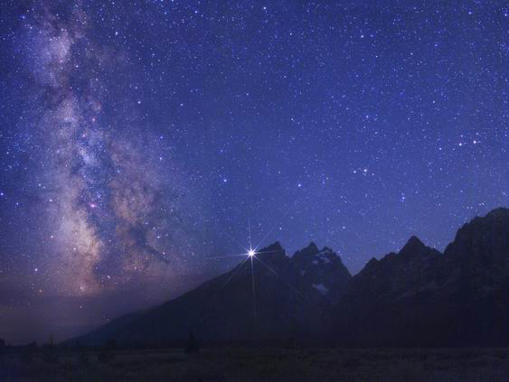
CTA observation modes
Very deep field

Slide 51
CTA observation modes
Monitoring
4 telescopes
Monitoring
4 Telescopes
Monitoring
4 telescope
Deep field
~1/2 of telescopes
Deep field
~1/3 of telescopes
Monitoring
1 telescope

Slide 52
CTA observation modes
Survey mode:
Full sky at current
sensitivity in ~1 year

Slide 53
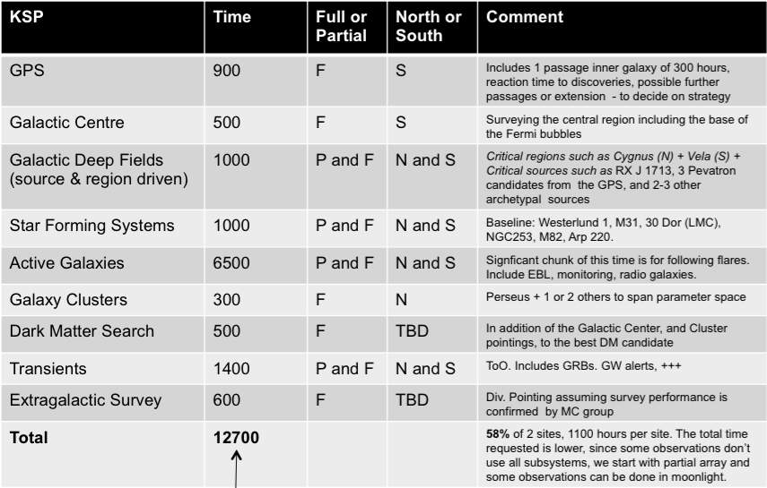
12!
Proposed Time Allocation
From 10 years on both sites

Slide 54
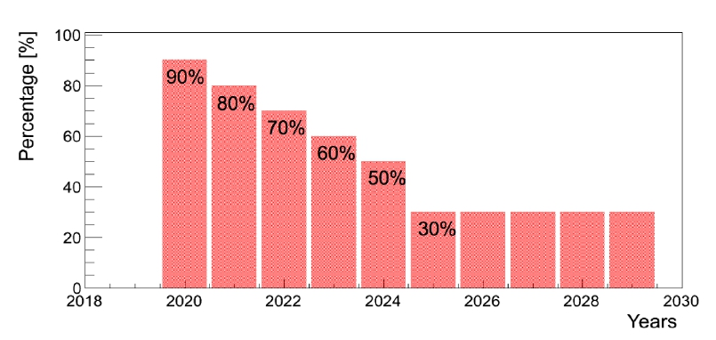
14!
Time Distribution
● PHYS work package is studying in detail the
impact of different distributions on the
programmes, e.g. Model A:
Main ideas: maximum science impact in 1st 2-3 years, external access early, long term
guaranteed time to exploit transients and variable sources / long-term monitoring programmes

Slide 55
3) Status of cta in Spain

Slide 56
The CTA–Spain consortium
About 70-80 people involved/interested:
ICE-CSIC - Astrophysics (D. Torres)
IAC - Astrophysics (R. García - López)
UJA – Astrophysics (J. Martí)
UB-ICC - Astrophysics (JM Paredes) + Particle Physics (M. Ribó)
IFAE - Astroparticle Physics (M.Martínez, A.Moralejo, O.Blanch)
UCM-GAE - Astroparticle Physics (J. L. Contreras)
CIEMAT - Astroparticle Physics (C. Delgado, E. Carmona)
UAB - Radiation Physics (Ll. Font)
UCM-ELEC - Applied electronics (J. M. Miranda)
GROUPS IN FPA APPLICATION

Slide 57
Main involvement of CTA Spain
Mechanics for the LST
Camera electronics (LST & MST)
  Trigger, signal processing
  Auxiliary systems
  SiPMs
Physics prospects, MC
Data management
Site studies
  Characterization
  Atmospheric monitoring
RAMS & QA
- SIZE

Slide 58
CTA-Spain
➔
Management and Coordination positions in CTA:
Co-Spokesperson *
Physics Coordinator *
Chair Speakers and Publication Office
Deputy Monte Carlo coordinator
Deputy PI LST
Chair LST Executive Committee
Project Manager LST *
LST-CAM Coordinator
Data Model Coordinator
CCF Coordinator
➔
Technical developments:
Undercarriage LST
Camera Trigger
Camera electronics & Control
Schedule
Data Model
LIDAR
Camera Mechanics & Cooling
+ Monte Carlo & Physics & Site
Spain is playing an important role inside CTA

Slide 59
MINECO interest/involvement:
CTA probably the only truly large international research infrastructure with any chance of being built in Spain. Moreover in the “exclusive” ESFRI list !.
CTA supported by MINECO in FPA, (also AYA) and specific ESFRI infrastructure calls (EUI and AIC).
Spain amongst 13 countries signing DoI (Declaration of Intent for Pre-construction phase in 2012).
IAC very interested/committed -> has convinced the Canarian authorities to give full support to the project -> trigger MINECO strong support.

Slide 60
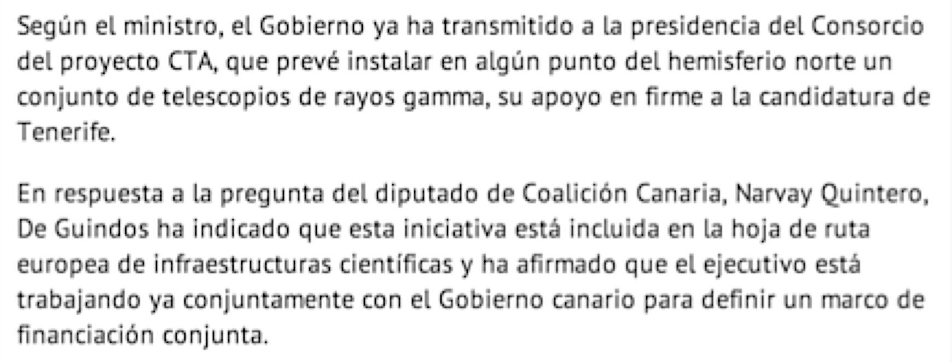

Slide 61
Spanish bid for CTA North
Spain is ready to invest up to 40 M€ in CTA North (> 60% of total cost) if built in the Canary islands:
- 25 M€ MINECO (Research FEDER funds for Canaries)
- 10 M€ Canarian Government (Research FEDER funds)
- 6 M€ Co-funding (*) -> does not look like a problem !
This money should be expend in 2015-2020
Official letter to CTA RB from SEIDI Carmen Vela
(*) FEDER funds need 15% co-funding in the Canaries

Slide 62
Spain and the CTA iLE
Spain has expressed its will to participate as shareholder in the CTAO GmbH. Spanish groups through a MoU, and MINECO through a letter of the SEIDI have agreed to ask IAC to sign as shareholder.
The foreseen budget for running CTAO during the next exercise (summer 2014 – summer 2015) is about 2 MEuros and Spain may have to contribute 10% of it.
=> Signature foreseen for March 26th

Slide 63
BUT…

Slide 64
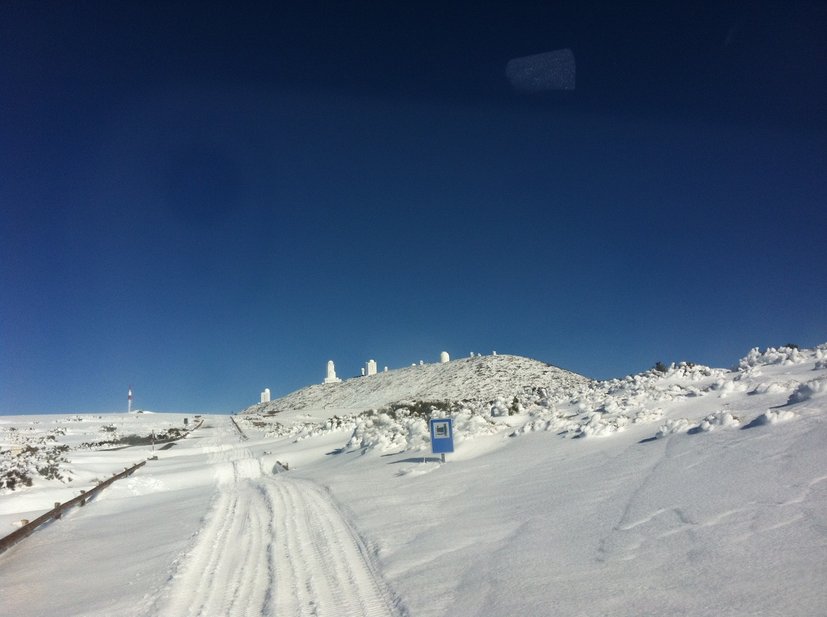
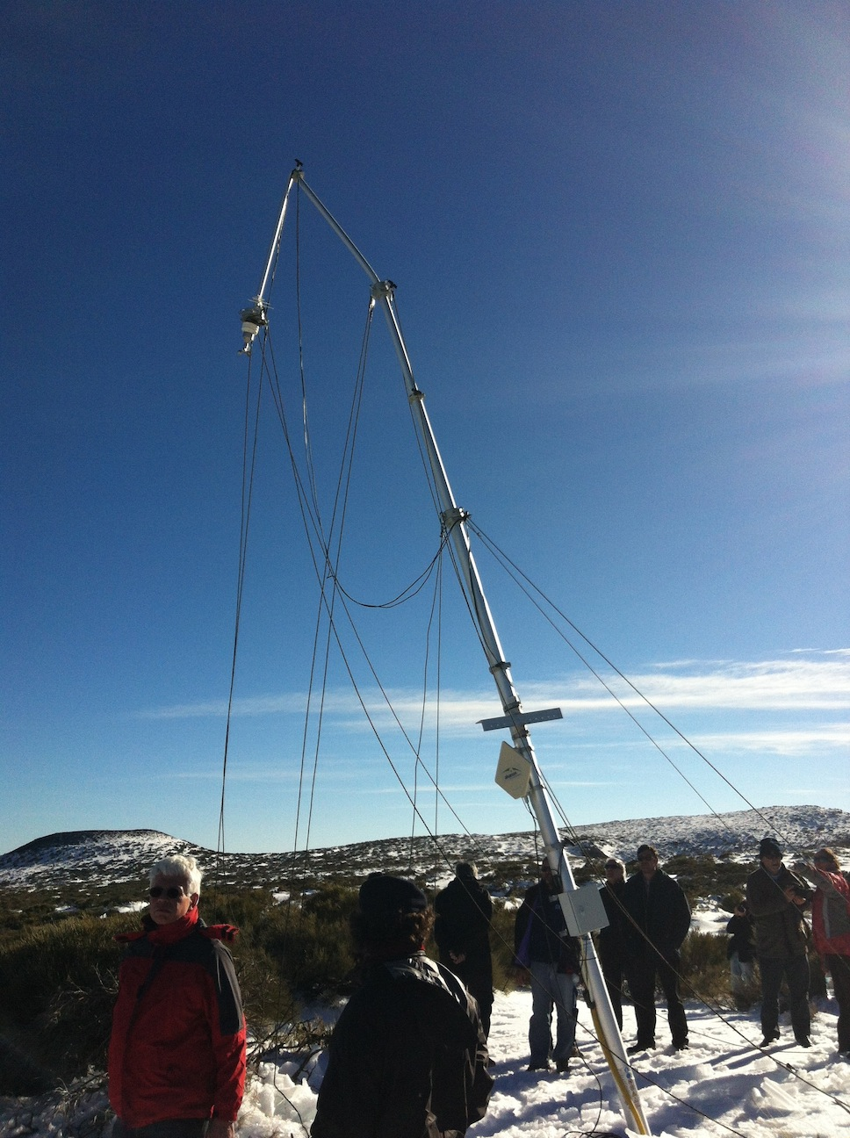
SSC Tenerife site visit
SSC composed of 6 experts, mainly optical astronomers; visited all candidate sites
Three members of CTA-Spain (J. Cortina, C. Delgado, J.M. Paredes) accompanied the SSC in the Canary islands (Tenerife and La Palma), along with an IAC delegation.
Visit took place in February 2014, unfortunately right after a strong snow storm (access to Teide observatory required the use of a military vehicle)
SSC very negatively impressed by extreme climatology and light pollution in Tenerife.
-> Tenerife considered a second (third) class level site for nocturnal Astronomy.

Slide 65
Surprises FROM SSC SITE RECOMMENDATION
SSC strong support for ESO sites (not really a surprise…). Southern SSC ranking:
1 - Chile ESO site
2 - Namibian sites
3 – Argentina sites (adviced against)
SSC recommendation for the North in disagreement with CTA Consortium evaluations:
1- Mexican site
2- USA sites
3- Tenerife site (adviced against)

Slide 66
RB decisions
Vote of 12 DoI-signing countries in April 2014:
CTA-South: Follow SSC recommendation and start immediately negotiations with ESO and Namibia in parallel. Argentina left as a backup but with very little chances.
Negotiations with ESO very advanced
=> Final decision on CTA-South in July 2015
CTA-North: Set up a mixed SSC (2 members)-CTAC (3 members) committee to clarify discrepancies and make a recommendation in the next CTA RB meeting in October 2014.

Slide 67
CTA Spain (RE)Actions
Revive La Palma-ORM candidacy:
- Baseline CTA North fits in ORM
- ORM first class worldwide nocturnal observatory
-> only north site shortlisted for E-ELT
- Gamma Astronomy at ORM since >20 years
- MAGIC telescopes key to help/speed-up CTA North
- Infrastructure already there
- EU funds available to all European parties

Slide 68
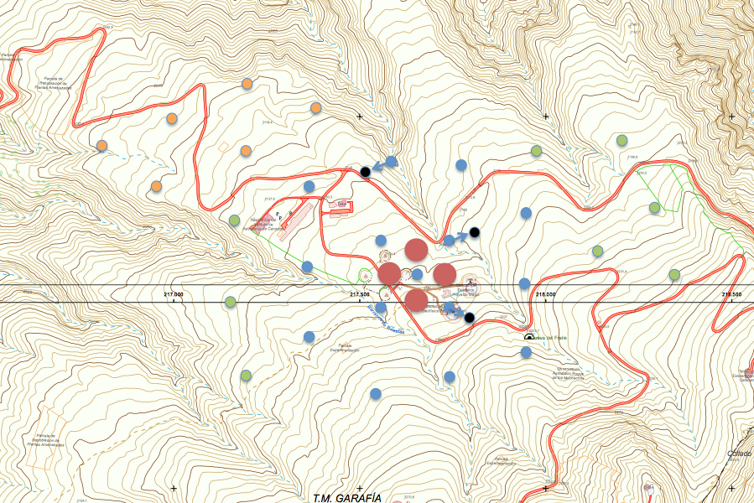
Possible telescope arrangement for CTA North at ORM
INFRA-SITE-140731
Road to Sta Cruz
Road To Garafía
Red: LST
Blue: MST in baseline CTAN array
Green and orange: possible extensions of baseline array (total >1 km²)
Residence
Internal road
MAGICs

Slide 69
CTA in Spain
Spain offers two sites in the Canaries for CTA North:
Teide Observatory (OT) – Tenerife
Roque de los Muchachos Observatory (ORM) – La Palma
(approved officially by the CTA CB in Sept 2014)
In case CTA North is built in the Canaries, Spain will invest up to 40 M€ in CTA North (mostly Regional Funds). That contribution shall be determinant in making CTA North viable.
Regardless on the CTA North site decision the LST prototype (first LST) will be built at the ORM observatory during 2015-2016
(approved officially by the CTA CB in Sept 2014)

Slide 70
4) The lst prototype at orm

Slide 71
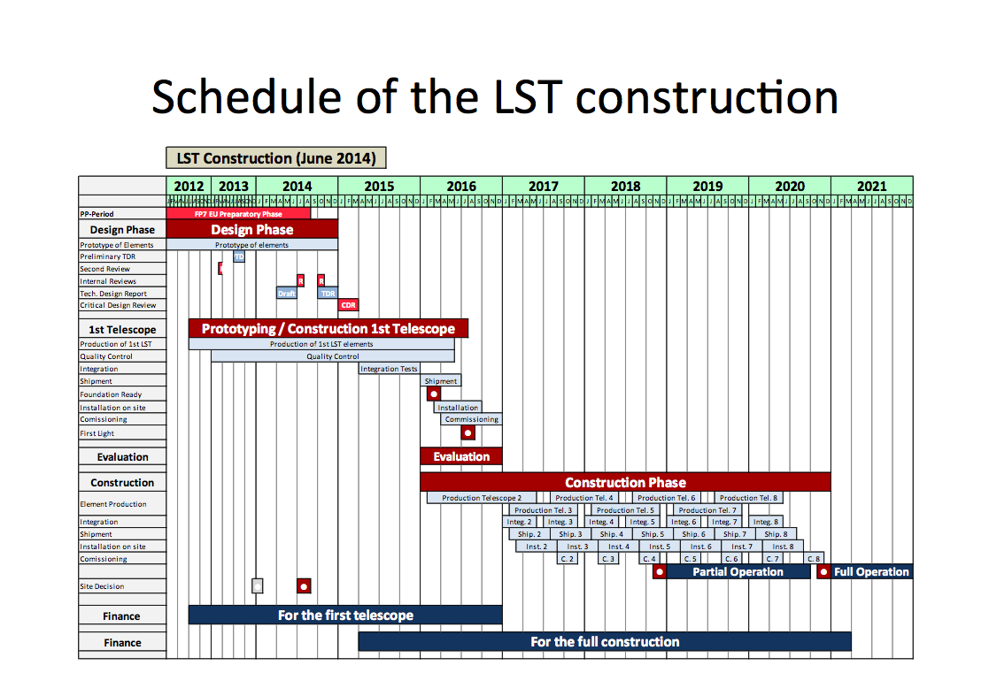

Slide 72
LST prototype at ORM
The LST prototype timing is in the critical path for CTA.
-> Installation must happen in Q1-2016
ORM is the optimal place for the LST prototype construction:
Infrastructure available -> immediate construction possible.
Close to main project countries (Europe).
MAGIC can provide a vital help for LST commissioning/testing.
Given the cost of a LST (>8 MEuros) the LST prototype shall be the first LST for CTA.
CTA has approved LST prototype immediate construction at ORM. Condition: move that LST to the final CTA-North site (~1 MEuro)
IAC has approved LST prototype immediate construction at ORM. Condition: LST should stay at ORM for at least 5 years and produce scientific output.

Slide 73
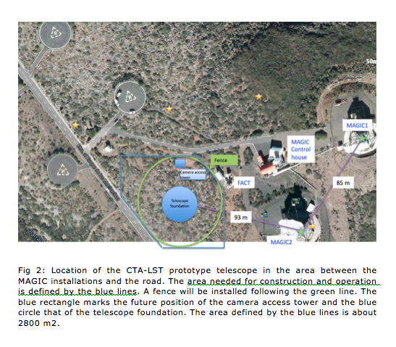
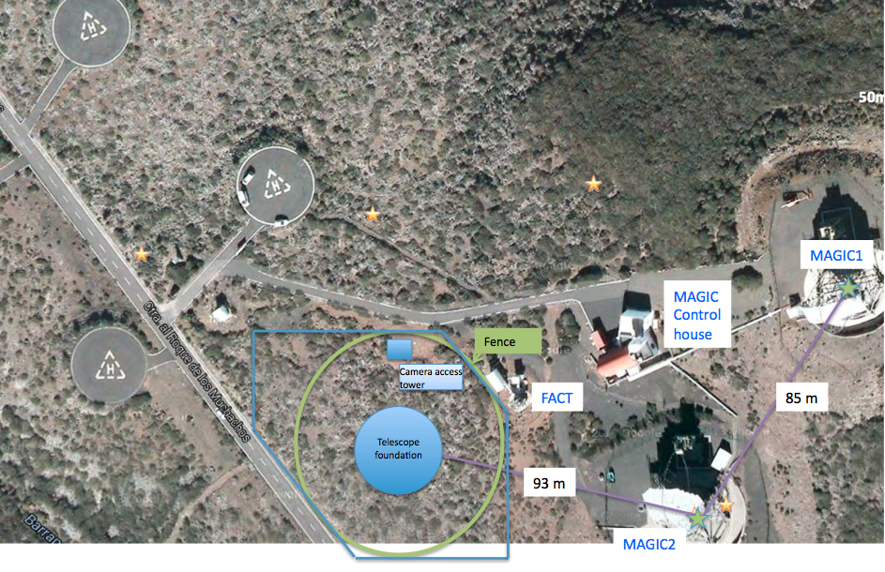

Slide 74
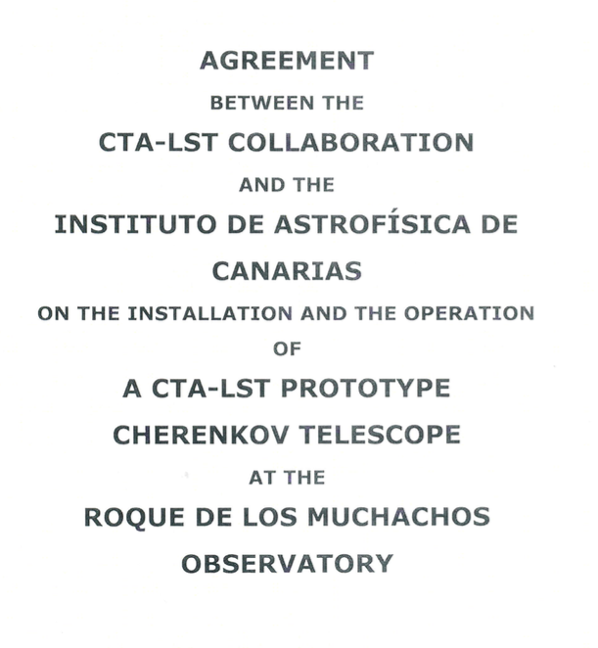
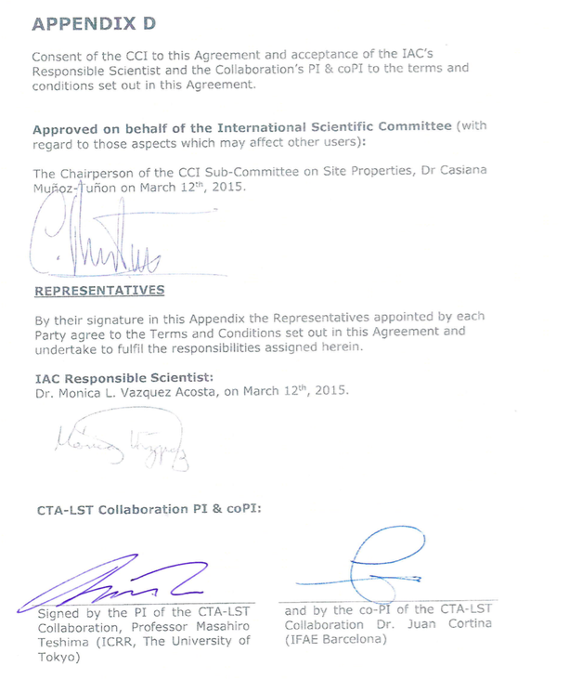

Slide 75
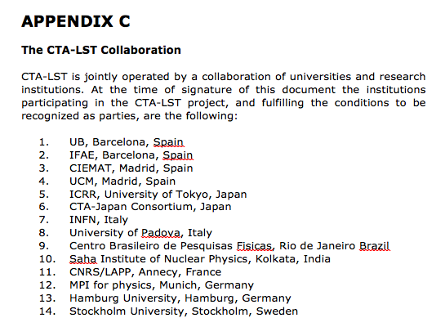

Slide 76
(Updated) CTA-Spain strategy in CTA:
Focus on construction of first LST and CTA-North at ORM
Key roles in the LST project:
* Chair of LST Steering Committee -> Manel Martinez
* LST Co-PI -> Juan Cortina
* LST camera coordinator -> Oscar Blanch
Key role in MAGIC <-> LST:
* MAGIC Co-spk -> OB
Key role in the ORM site for CTA North:
* Interaction of CTA-Spain with IAC and MINECO -> MM
* Lead ORM proposal for CTA-North -> JC

Slide 77
5) Summary and outlook

Slide 78
        Summary of CTA critical dates in 2015
        March 25-26 -> Down-selection for CTA-North
        March 26th -> Spain signs 10% share CTAO GmbH
        July -> Critical Design Review -> approval of the CTA TDR -> green light for construction
        July -> Final selection for CTA-South
        ~ Sept-Oct. -> Final selection for CTA-North
        ~ Oct-Nov -> Foundations for LST1 at ORM
Notes:
78

Slide 79
CTA is probably at present the largest and most important project in Astroparticle Physics worldwide.
CTA is progressing successfully following the original plans, and Spaniards have played a key role on that.
Spain is ready to host CTA North on the Canaries and, should that happen, it is committed to make an investment in CTA North that will make CTA North viable. That contribution shall boost the impact of CTA-Spain in the project.
At any rate ORM will host the first LST (prototype) that Spain co-leads.
After a very tortuous path that has been redressed thanks to our will, determination and unity, we feel that:
“There are very good chances for Spain
to host the CTA-North site.“
        We’ll know by March 26th 2015
Notes:
79

Slide 80

AND
We’re still working hard for all that to happen ! .

Slide 81
Backup
Notes:
81

Slide 82

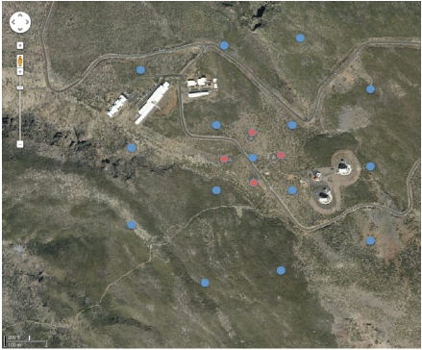
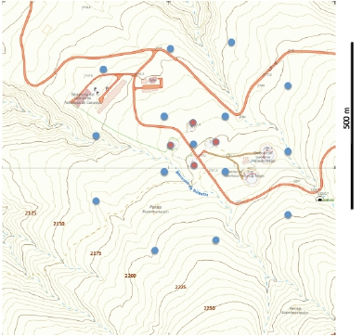
Site Location
The area has a maximum global slope of 90 m/600 m, i.e. 15% or 8.5 degrees. Two
of the outermost MSTs are in areas with a signiﬁcantly higher slope and could be
relocated by 25-50 m to ease up the civil engineering. Due to signiﬁcant slopes to
the west and south-east of the site, the area can only expanded by as much as
20% for further extensions.
An exercise to show that ORM would be able to host CTA-North

Slide 83
