Slide 1
Accelerator physics
Caterina Biscari
Alba-CELLS

Slide 2
Outlook
Introduction
Historic details
Particle beam description
Accelerators in the world
Colliders
Medical Applications
Synchrotron Light Sources
Conclusions

Slide 3
~30000 accelerators in the world
Driving Accelerator R&D
Generation of energetic particle beams for investigations of the structure of matter e.g. nuclear and particle physics, ion beam analytics, structural analysis in biology and chemistry, kinetics and dynamics of reactions
Generation of secondary radiation for specific reactions e.g. neutrons, photons (x-rays), positrons

Slide 4
Particle accelerators are a major invention of the 20th century. In the last eight decades, they have evolved enormously and have fundamentally changed the way we live, think and work.
Of about 30,000 accelerators at work in the world today, a majority is for applications in industry.There are two major categories of industrial applications: materials processing and treatment, and materials analysis. Accelerators are also applied for environment protection, such as purifying drinking water, treating waste water, disinfecting sewage sludge and removing pollutants from flue gases. Industrial accelerators continue to evolve, in terms of new applications, qualities and capabilities, and reduction of their costs. Their impact on our society continues to grow with the potential to address key issues in economics or the society of today.
Medical accelerators account for the other 8-9000 units.
Accelerators dedicated to research complete the panorama.
The R&D is driven by high energy physics, photon and neutron production, in the quest for higher energies, higher intensities, smaller beams, new acceleration techniques

Slide 5
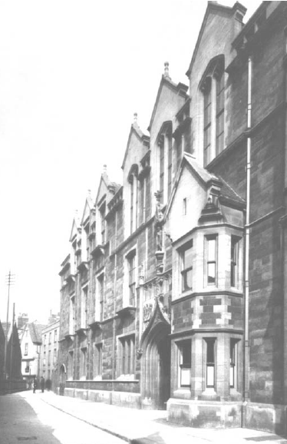
First Particle Accelerators
Rutherford in 1928, during his presidential address as president of the Royal Society of England, said:
“I have long hoped for a source of positive particles more energetic than those emitted from natural radioactive substances.”
These words focused the attention of many new minds as well as encouraged others who were already working on the problem.
Rutherford was using alpha particles obtained through radiative decay to study the atom structure.
Cockcroft and Walton (Nobel in 1951) built the first high voltage electrostatic generator in 1930: 300 keV (Gamow had predicted that were needed for nuclear particles to enter the nucleus). Voltage multiplying column to go to 600 keV. Protons were accelerated and used for nuclear reactions
Cavendish Laboratory
1927:
directed by Rutherford

Slide 6
Basics of accelerator physics

Slide 7
Electromagnetic field on charged particles
ACCELERATION
BENDING & FOCUSING
Electric field
Beam

Slide 8
Charged particles
Electrons, positrons,
Protons, antiprotons,
Ions
 | e-, e+ | p, ap
m_{o} (kg) | 9.11 10⁻³¹ | 1.67 10⁻²⁷
E_{o} (joule) | 8.2 10⁻¹⁴ | 1.5 10⁻¹⁰
E_{o} (..eV) | 0.51 MeV | 0.94 GeV
Particle energy at rest
Range of particle (kinetic) energies in accelerators:
From few KeVs to fewTeVs
1 eV = 1.602 x 10⁻¹⁹ joules

Slide 9
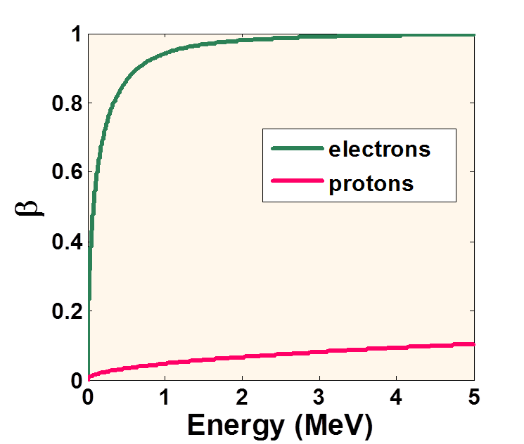
Electric fields accelerate charged particles
F = acceleration =
kinetic energy increase
Is there velocity increase?

Slide 10
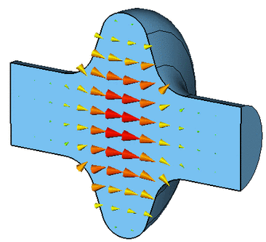
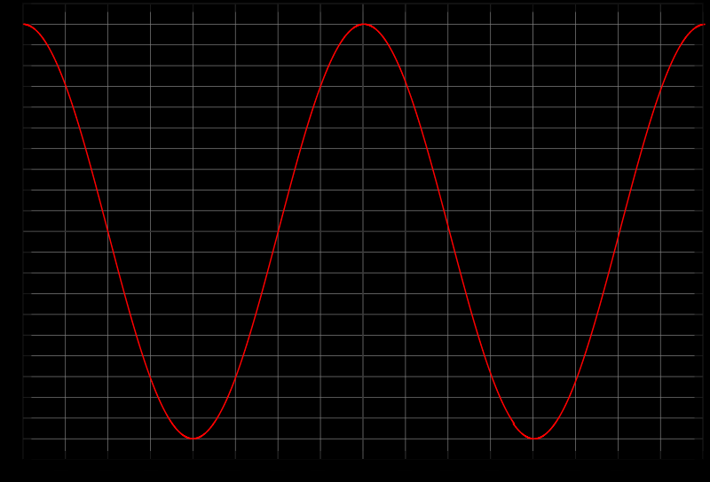
Radiofrequency cavities, powered by klystrons or Solid State Amplifiers
E
t
Particles gain energy passing through the cavity, in phase with accelerating field. The maximum possible energy gain is given by

Slide 11
Magnetic fields deflect charged particles
Deflection : Proportional to bending magnet and particle charge, and inversely proportional to total energy of the particle.
Magnetic rigidity
Magnetic Field (Tesla) * bending radius(m) = 3.3 * Energy(GeV)

Slide 12
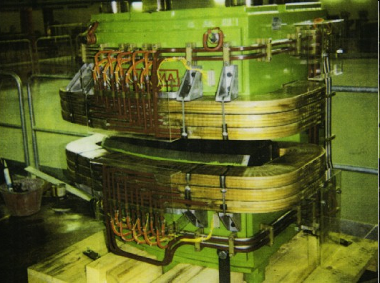
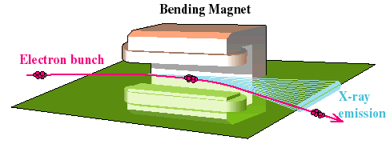
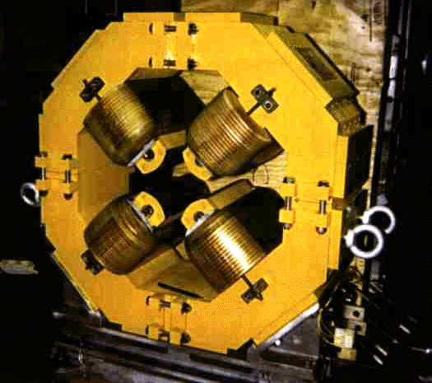
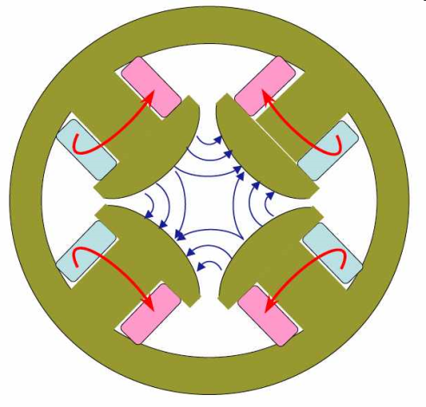
Main magnets of an accelerator
Dipoles for bending trajectories
Quadrupoles to focus trajectories on central orbit

Slide 13
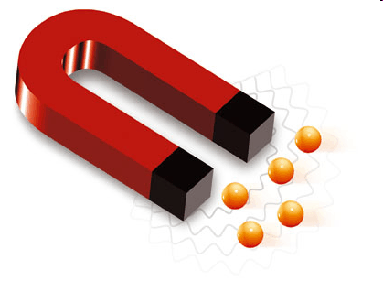
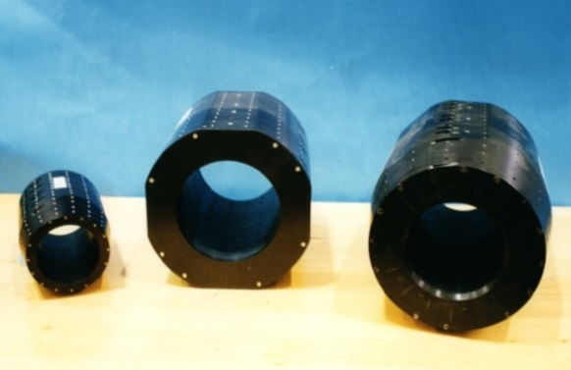
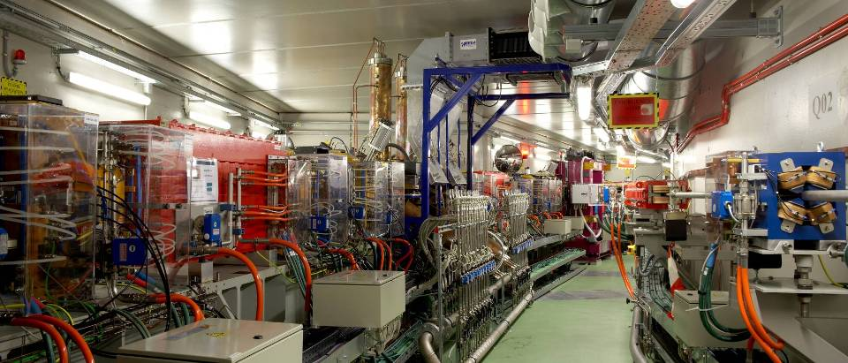
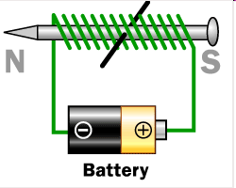
Magnetic fields
Permanent magnets
Natural magnetic materials
In accelerators
Permanent magnet quadrupoles
Small dimensions
No flexibility
Elettromagnets
Iron surrounded by coils
Electromagnetic magnets,
B tuned by current in coils

Slide 14
Main types of accelerators

Slide 15
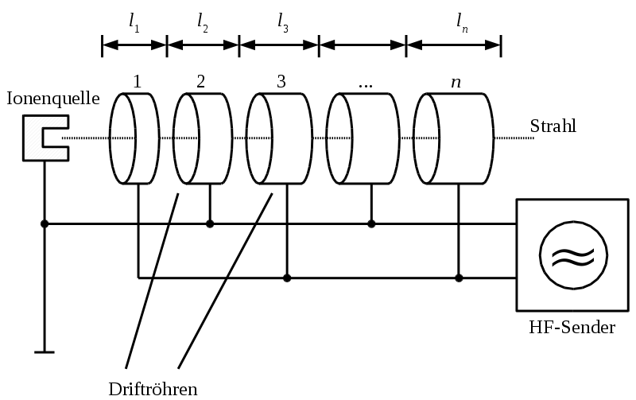
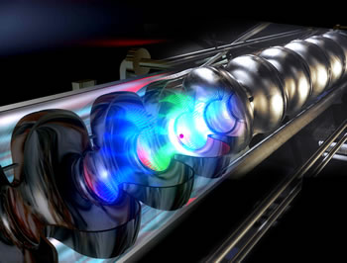
Linear Accelerators : Series of accelerating cavities
Idea and first prototypes in the’30s, (drift tubes suspended in a non-conducting tube by Wideroe, Particles gaining energy in the gaps). Only low frequency rf power was available (kHz regime). Need of very long structures.
Klystrons development during World War II: high frequency rf (up to GHz)
DTL: Drift Tube Linac. Alvarez in the ‘50 developed the ‘Alvarez type’, using conducting waveguides.
Today most powerful Linacs based on SC cavities, both for e-, or p

Slide 16
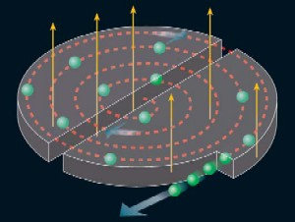
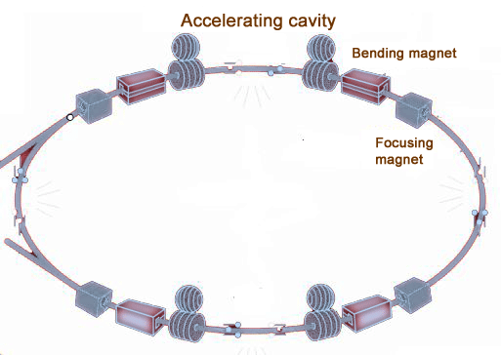
Circular accelerators
Cyclotrons
Synchrotrons
M. Oliphant, in the forties, joined three ideas in a single concept: the sinchrotron. Accelerate with rf cavities, change the frequency, pulse the magnets.
First synchrotron was built in UK, in Woolwich Arsenal Research Laboratory
Most actual HE physics, Synchrotron lights sources
Invented by Ernest Lawrence in the ’30.
Bend and accelerate with constant revolution frequency.
Nuclear physics, particle therapy,..

Slide 17
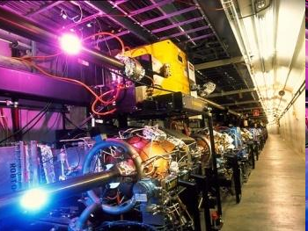
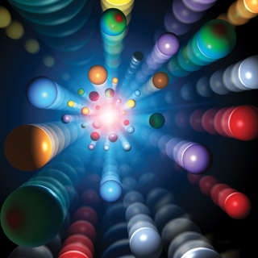
Particle beams
Beams are grouped in bunches travelling along the vacuum chambers
Every bunch contains billions of particles (N =10⁹ – 10¹¹)

Slide 18
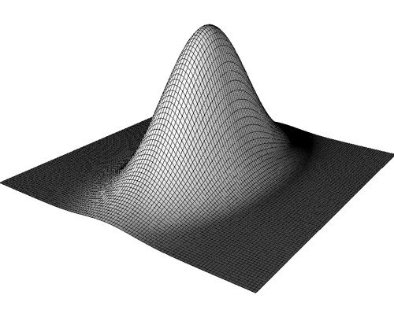
Beam description
Particles in the bunch have different positions and energies
Energy, longitudinal position, transverse position and momentum have usually gaussian distributions
The bunch can be described as an ellipsoid in 6 dimensions
Longitudinal position- Energy
Vertical position and momentum
Horizontal position and momentum
y
s
x
X
X’

Slide 19
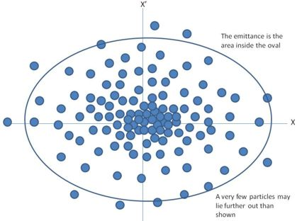
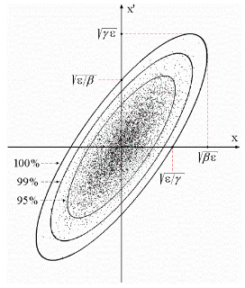
Beam phase space in each plane
Ellipse area = Invariant if no dissipative forces are present
Twiss parameters define orientation and form of the ellipse, the emittance its area, α, β, γ vary along the accelerator

Slide 20
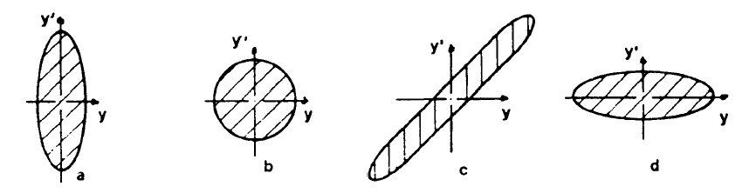
The volume occupied in the phase space of a system of particles is constant in the presence of conservative forces
Liouville’s theorem
The emittance is measured in m rad (position – divergence)
Magnetic field acting on the beam do not modify the emittance, but modify the phase space orientation
Low beta position
High beta position
Phase space in different positions along the accelerator

Slide 21
BEAM DYNAMICS DESCRIPTION
Matrix formalism
The way the particle coordinates change when passing through an element is described by the element matrix, which contains its characteristics
Vector of
Particle coordinates
Drift, quadrupole, bending,…
The accelerator is described by the product of its element matrices

Slide 22
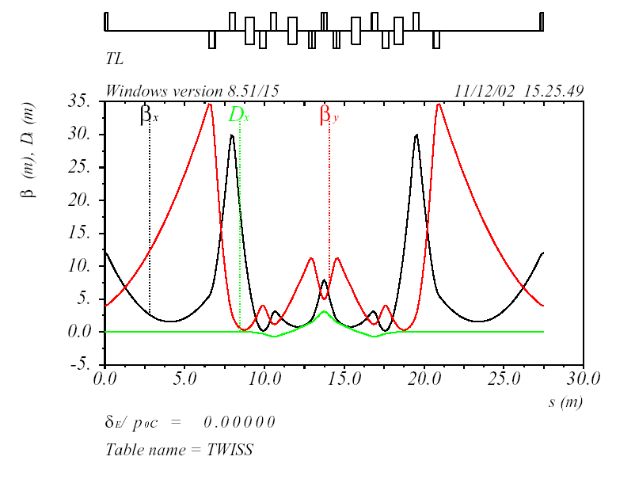
Matrix formalism is also used to describe Twiss Parameters behaviour along an accelerator
For the design, the simulation, the control, standard codes are used by researchers in all accelerator-based laboratories
Example of Twiss Parameter behaviour in a section of a synchrotron

Slide 23
Synchrotron radiation
A charged particle in a magnetic field emits photons, whose energy spectrum depends on the particle mass and energy, and on the magnetic field.
The particle looses energy. In a synchrotron the energy loss is compensated by rf cavities
Energy emitted per turn
Particle rest mass
rf cavity
Bending radius – related to B
Lighter particles emit more energy. Electrons and positrons used as photon sources.

Slide 24
Synchrotron radiation emission
 | particle | ρ (m) | E (GeV) | ΔE/turn = U (MeV)
DAΦNE | e- e+ | 1.4 | 0.51 | 0.004
ALBA | e- | 7.1 | 3.0 | 1.0
LEP | e- e+ | 3026 | 100 | 2923
LHC | p | 2812 | 7000 | 12.2
Energy lost per turn

Slide 25
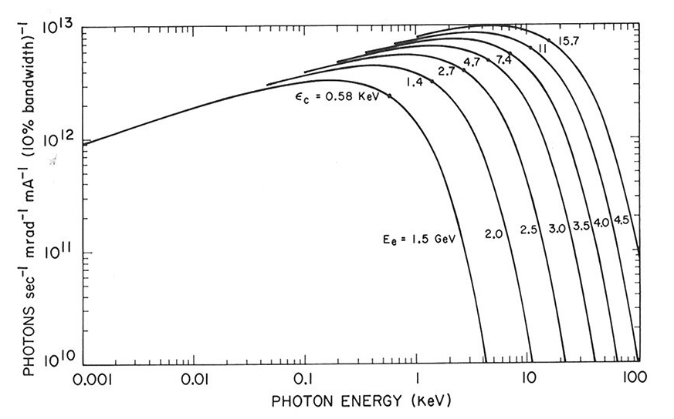
Synchrotron radiation emission as a function of the beam energy
No dependence on the energy at longer wavelengths
Notes:
;

Slide 26
Examples
Colliders – LHC, LC
Medical applications – CNAO
Synchrotron Light sources - ALBA

Slide 27
Collider energies
Leptons
Hadrons
Hadron-Lepton

Slide 28
Collider luminosities
Leptons
Hadrons
Hadron-Lepton

Slide 29
Luminosity versus Energy
Leptons
Hadrons
Hadron-Lepton

Slide 30


Particle Colliders - 2013
Hadrons
Leptons
Leptons-Hadrons
In operation
In construction
VEPP 4M
VEPP 2000
RHIC
LHC
SUPER KEK-B
DAFNE
Tau-Charm

Slide 31
Luminosity in a collider
High luminosity:
High intensity + small beams

Slide 32

LHC

Slide 33
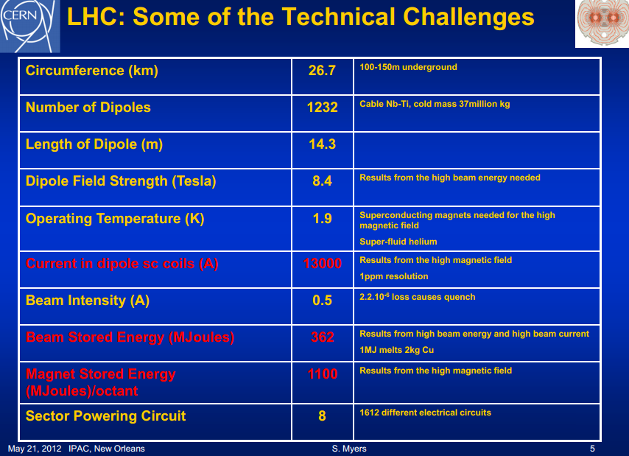

Slide 34
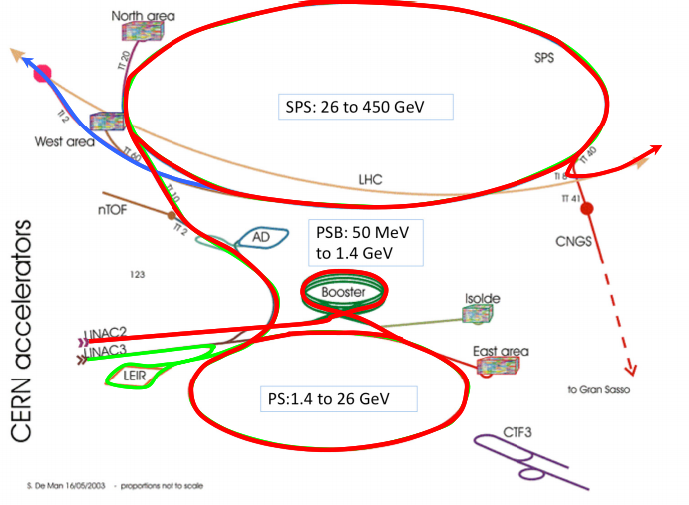
LHC complex

Slide 35
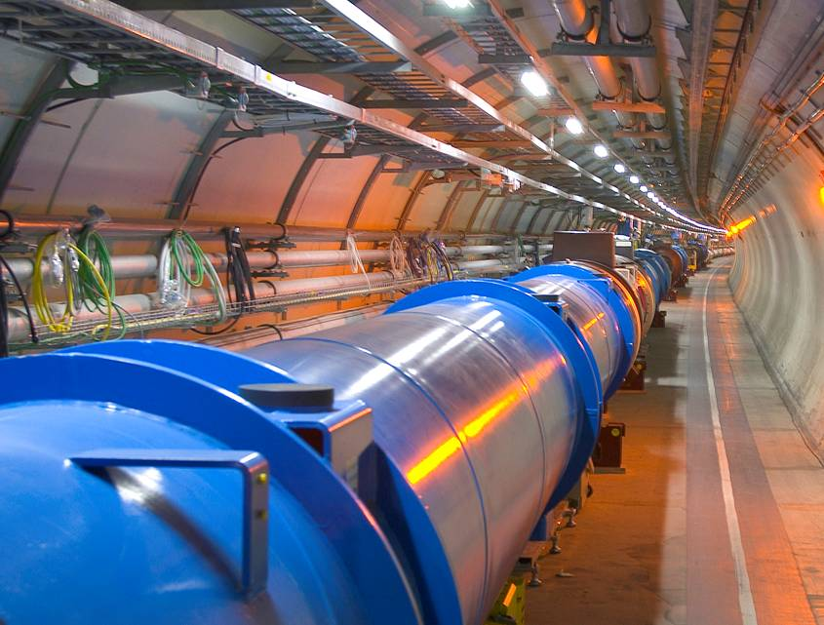
  LHC arc view
27 km cooled down to 2K
The coolest place in the world

Slide 36
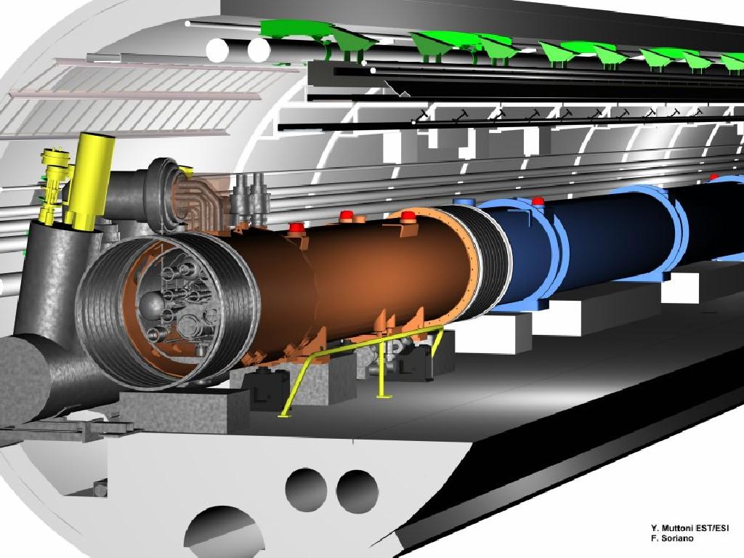
LHC arc
Magnets
1232 dipoles
392 quadrupoles
6200 correctors

Slide 37
LHC arc:
Cryogenic
Helium bath at 1.9K (-271° C)
Pipe for He transport and recovery
(26 km)

Slide 38
Regular arc:
Vacuum
LHC arc:
Vacuum
Vacuum chamber for the two beams
Vacuum system for cryostats
Vacuum system for cryogenic pipes

Slide 39
LHC arc:
Electronics
Regular arc:
Electronics
Many thousands of electronic units to control
Quench, correction, beam diagnostics, vacuum, cryogenics,…

Slide 40
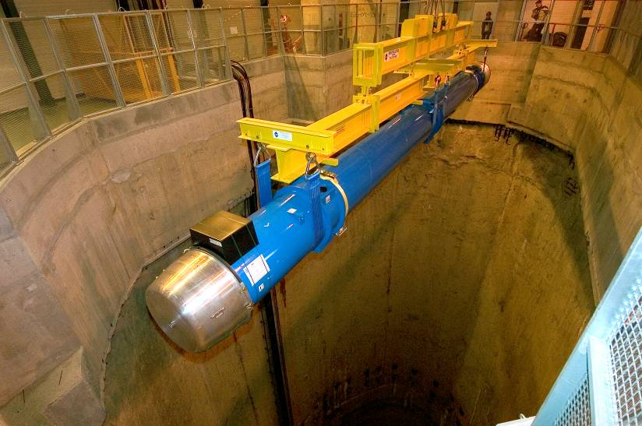
Lowering of First Dipole Magnet - 7 March 2005
A single point to lower dipoles,
15 m long and 35 Tons weight
Notes:
Es gibt nur einen Schacht, inn dem die Magnete in den LHC Tunnel abgesenkt werden koennen, aufgrund der Laenge von ueber 15m.

Slide 41
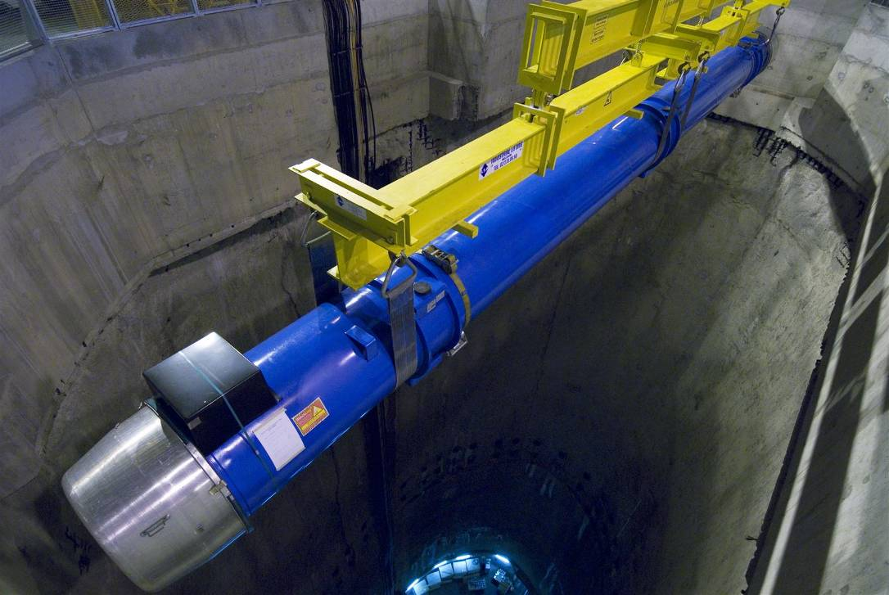
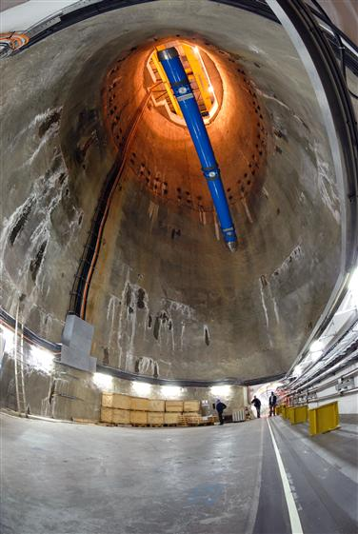
Lowering of Last Dipole Magnet
26 April 2007
~ 1700 cryo-magnets assemblies
  1232 Main Dipoles
  474 Short Straight Sections
  16 Separation Dipoles
  32 Low β Triplets
~ 200 warm magnets

Slide 42
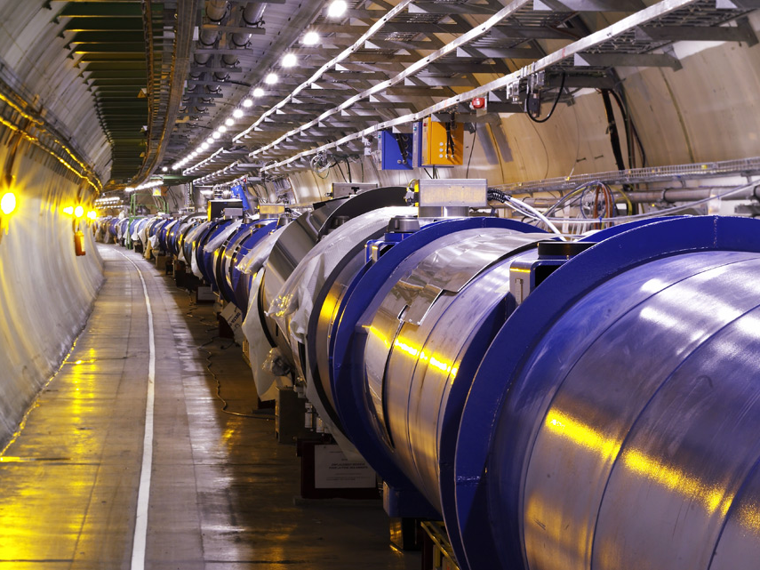
Tunnel
Filled with SC magnets, rf cavities,
Diagnostics and

Slide 43
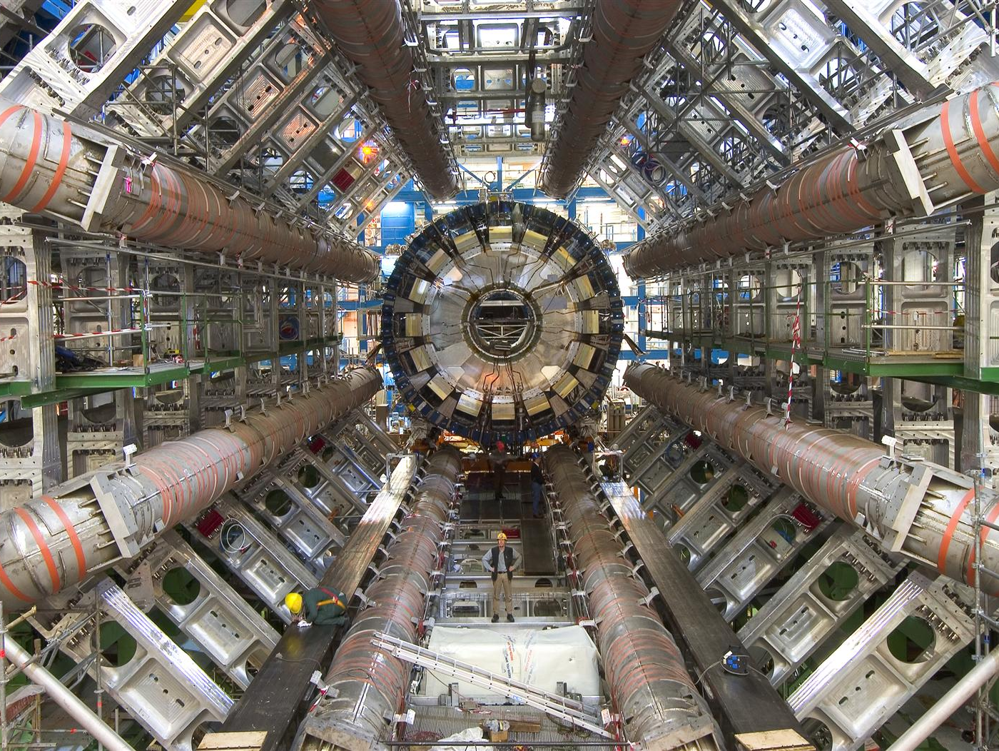
ATLAS Experiment at CERN
Experiment

Slide 44
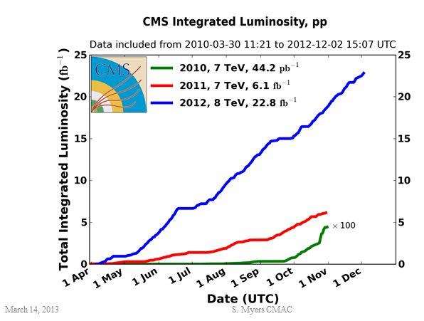
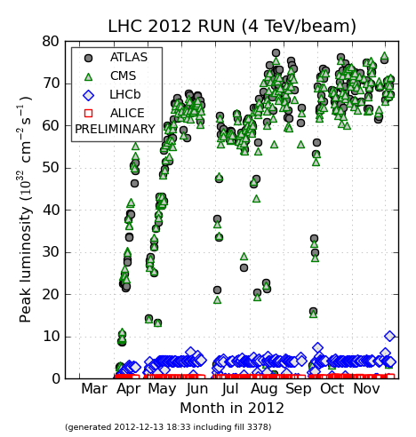
Evolution of LHC Luminosity
Peak Luminosity
7e33 cm⁻² sec-1
L_{peak} = 7.8 10³³ cm⁻² sec⁻¹
4 July
Announcement on HIGGS
4th July

Slide 45
What’s next?

Slide 46
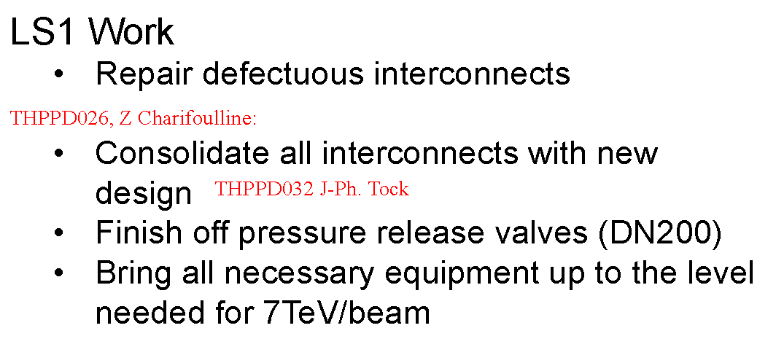
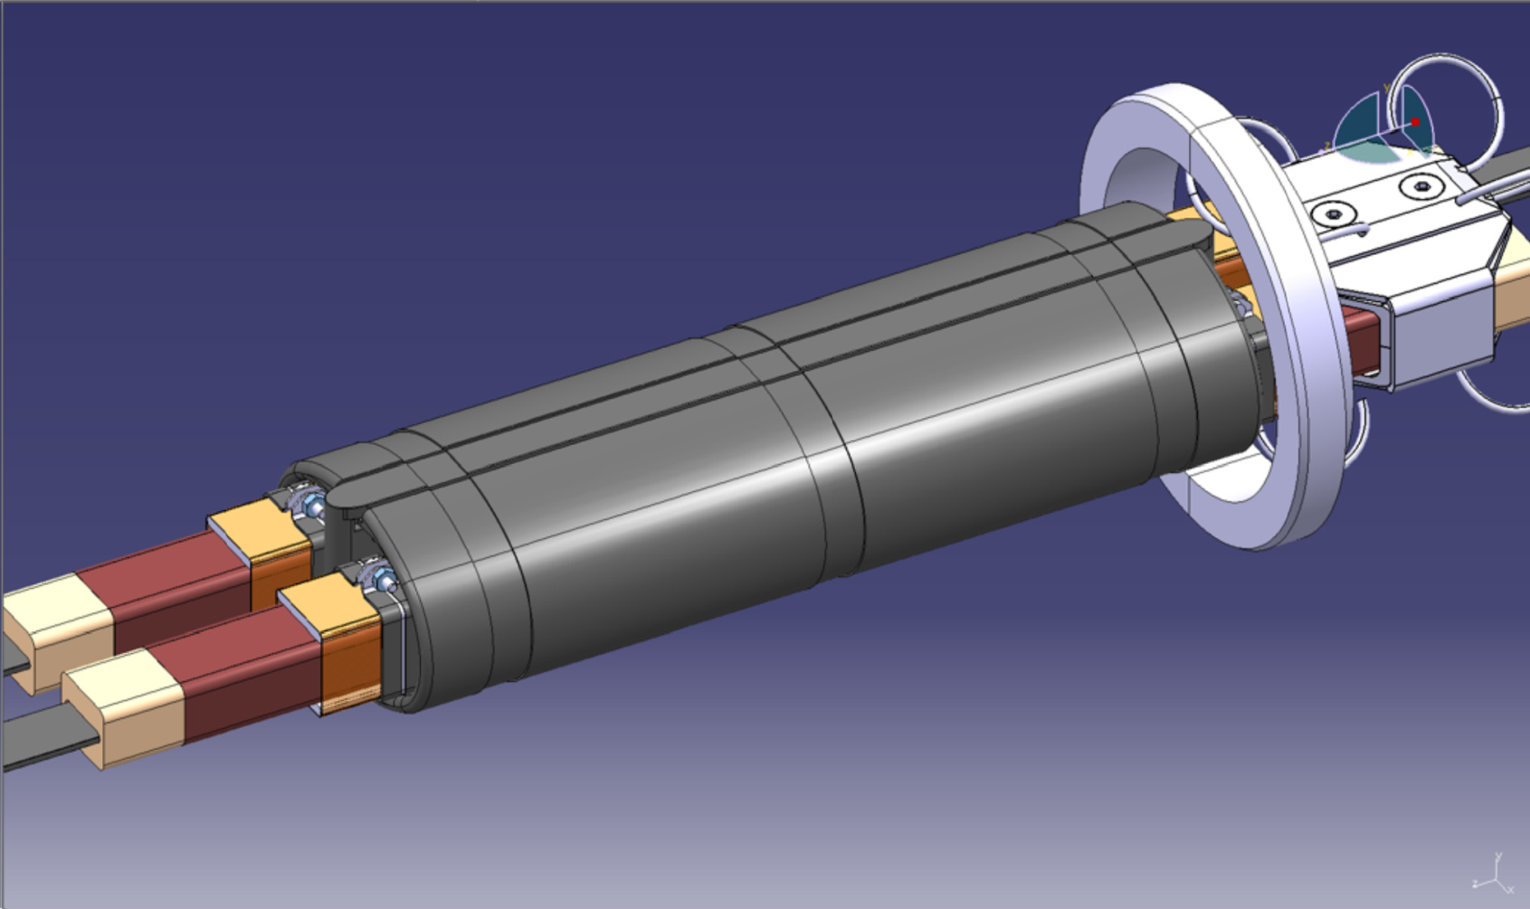
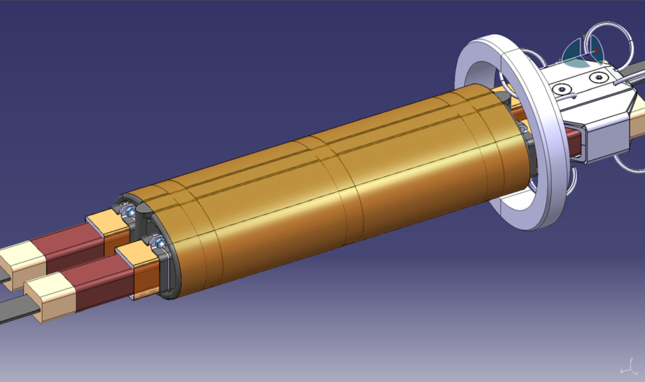
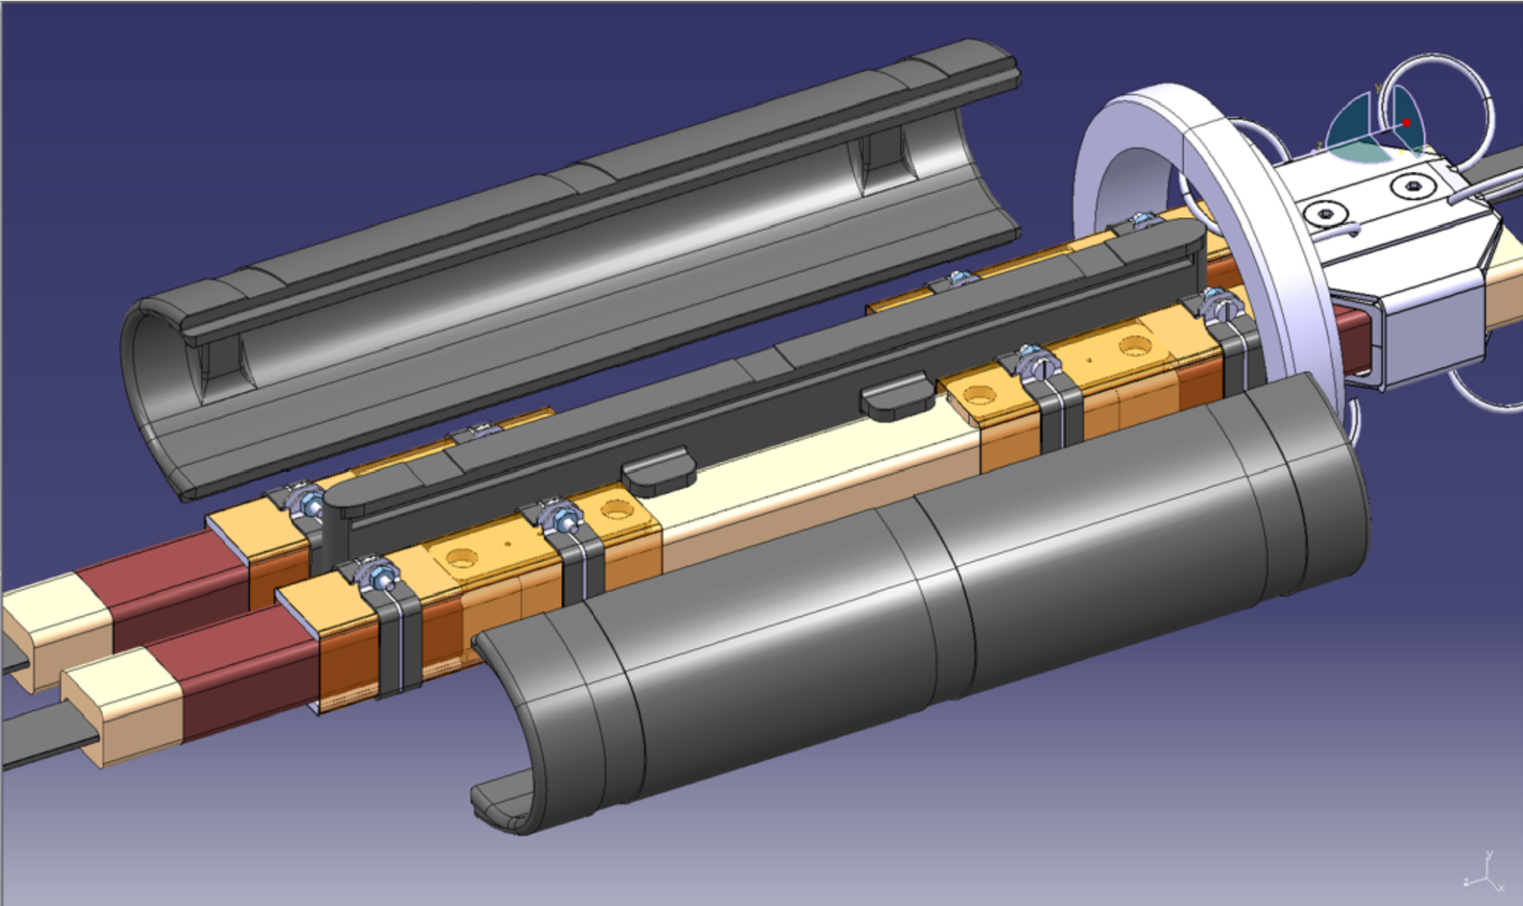
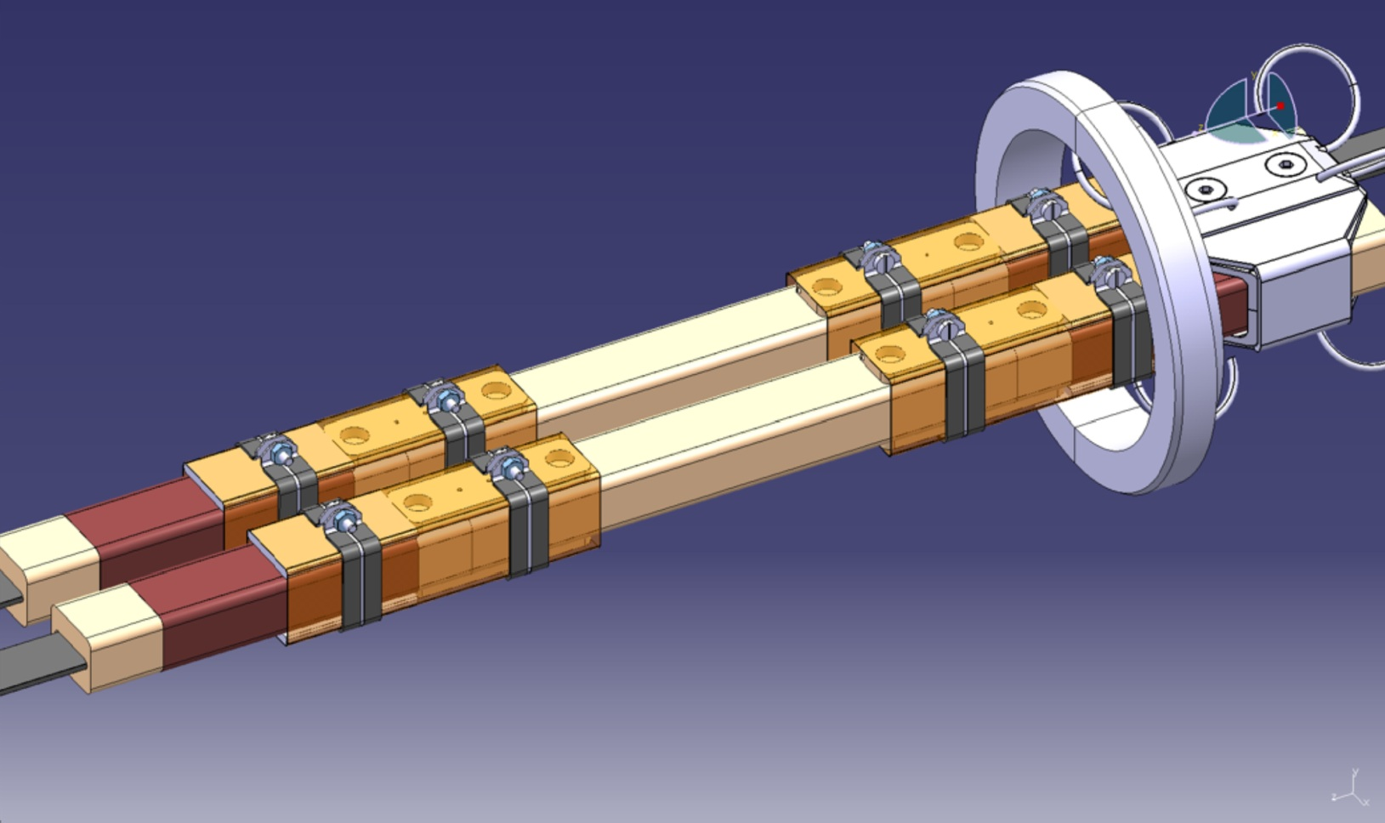
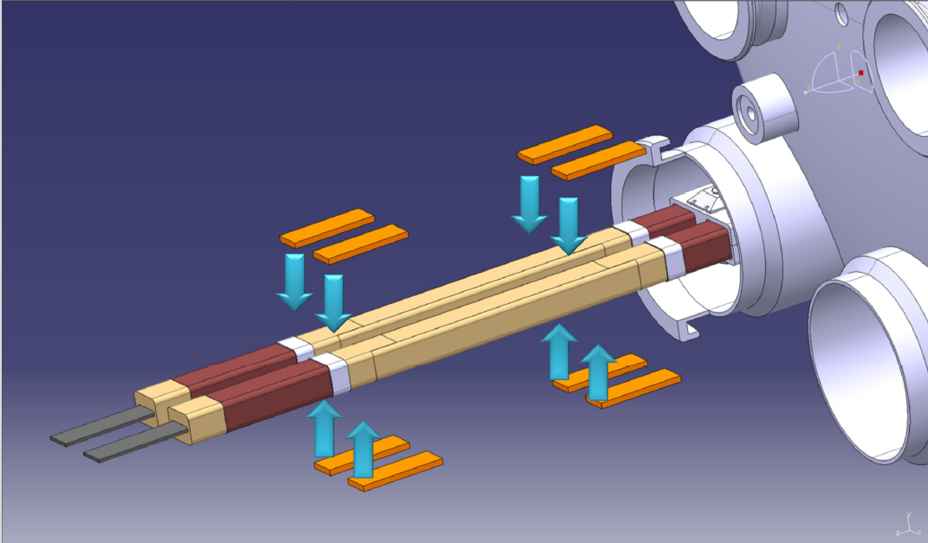
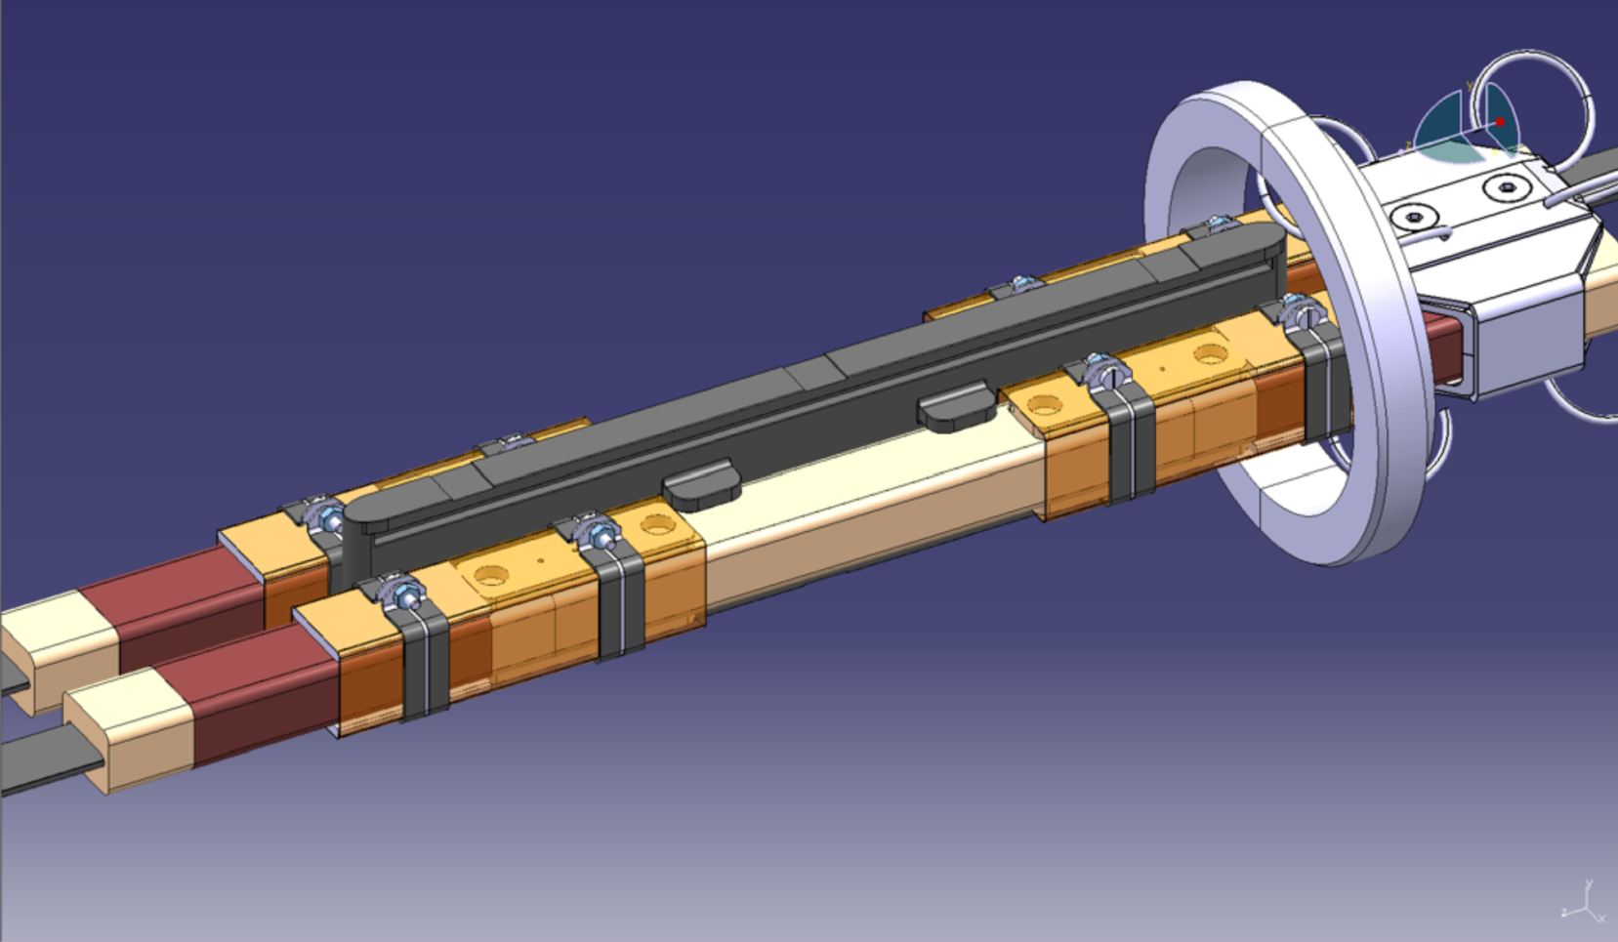
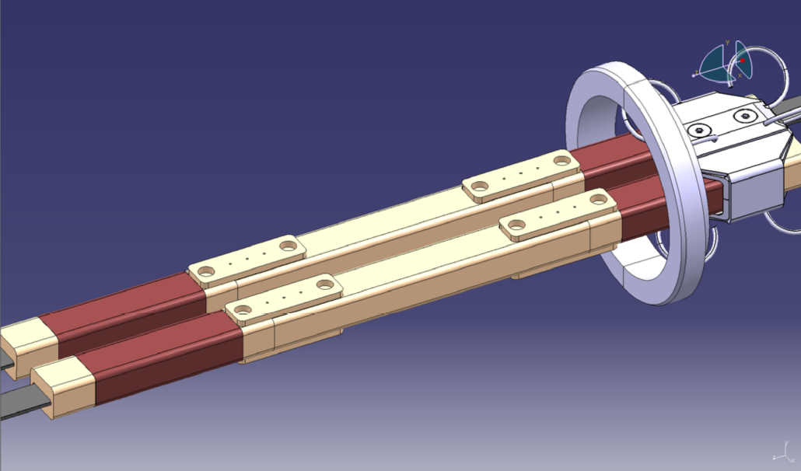
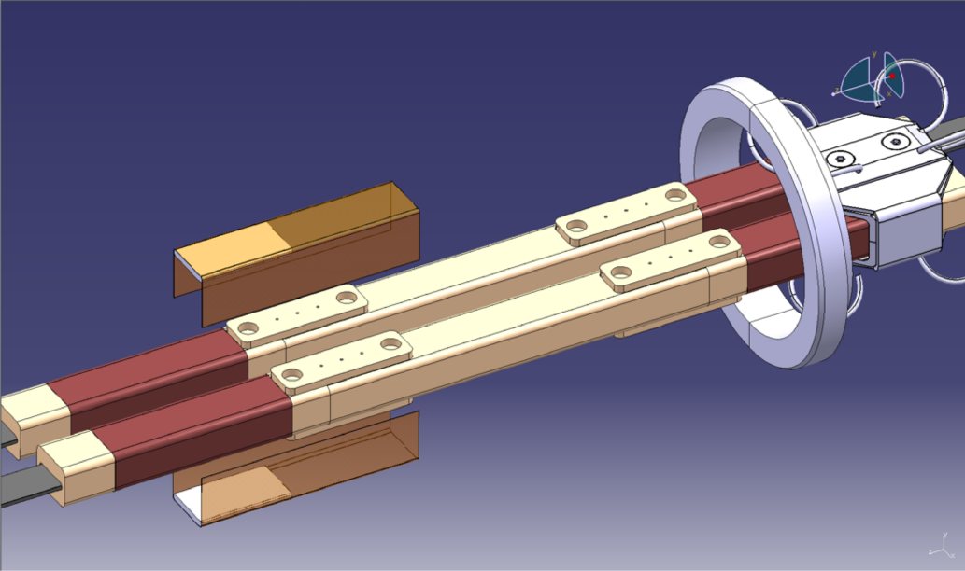
X 24000

Slide 47
HIGH FIELD MAGNETS
LHC upgrades
DLHC
Double energy
E_{cm} = 28 T
Dipoles
SLHC
Higher L
10³⁵
Low β quads

Slide 48
R&D on high field SC magnets
R&D started in view of VLHC and ITER - Multi Labs and Industrial Collaborations
examples: LARP – BNL-FNAL-LBNL-SLAC (prototype for 2012)
FRESCA - EuCARD WP7 – 12 Institutes - main involvement from CERN, FERMILAB, LBNL, BNL, KEK
NbTi
Robust, ductile, well extablished and used techology
B < 10 T
Nb₃Sn
Heat treatment, brittleness
B < 15 T
HTS
B up to 45 T
To be used in HL-LHC
R&D on wires , still long road for High fields magnets
Challenges: Mechanical weakness, unit length, quench detection and protection
Nb₃AL
KEK, Hitachi
Subscale Magnet for demonstration (B = 13 T)
Cable production advanced

Slide 49
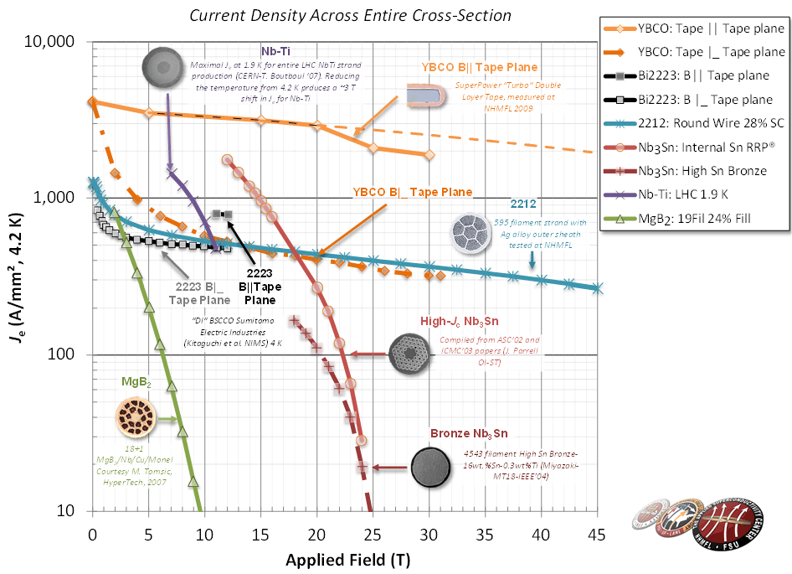
Plot maintained by Peter Lee at: http://magnet.fsu.edu/~lee/plot/plot.htm
2012
45 T
Nb₃Sn performance is influenced by mechanical stress and strain: brittle if > 15 T
>20T : HTS, fundamental and costly R&D, limited unit length
Nakamoto, IPAC12

Slide 50
Future colliders – HEP community discussion
HE-LHC (High Energy LHC)
Increasing proton energy beyond 7 TeV:
(2010: study group and workshop)
reuse of the CERN infrastructure
“ease” in producing luminosity with proton circular collider
practical and technical experience gained with LHC
Beam energy set by SC magnets dipole field:
16-20 T == 26 to 33 TeV in the centre of mass.

Slide 51
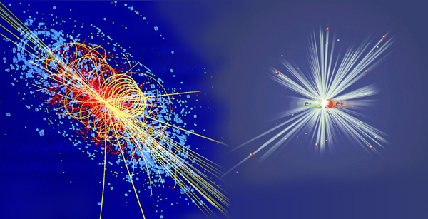
Lepton colliders

Slide 52
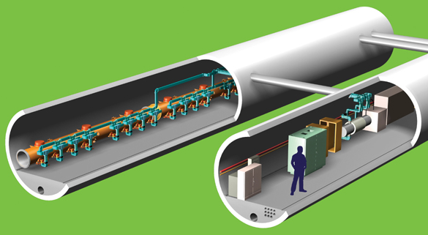
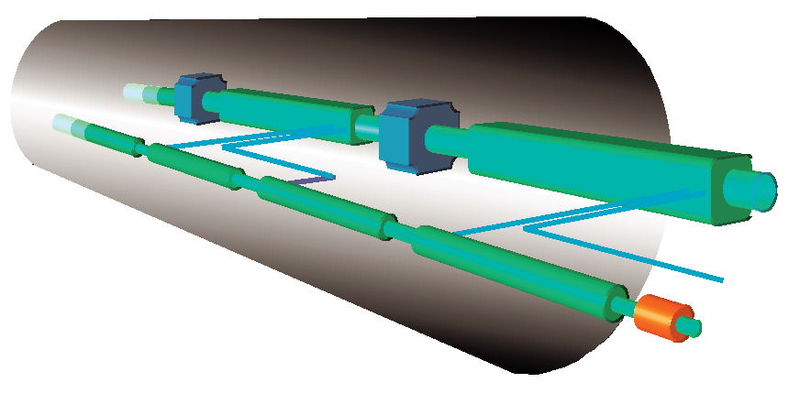
e+/e- Linear Colliders
CLIC and ILC
http://project-clic-cdr.web.cern.ch/project-CLIC-CDR/CDR_Volume1.pdf
http://www.linearcollider.org/cms/

Slide 53


ILC CLIC
Well extablished SC rf technology (TESLA, FLASH, EXFEL…)
2004: decision on technology for next linear collider up to 1 TeV
1.3 GHz, 31.5 MV/m
Maximum energy 1 TeV cm - Phase I at 0.5 TeV
GDE (Global Design Effort) - International collaboration
Site independent
Dual beam acceleration technology
R&D at CERN ~ 25 y
Normal conducting cavities
12 GHz, 100 MV/m
Maximum energy 3 TeV cm – Phase I at 0.5 TeV
International collaboration around CTF3

Slide 54
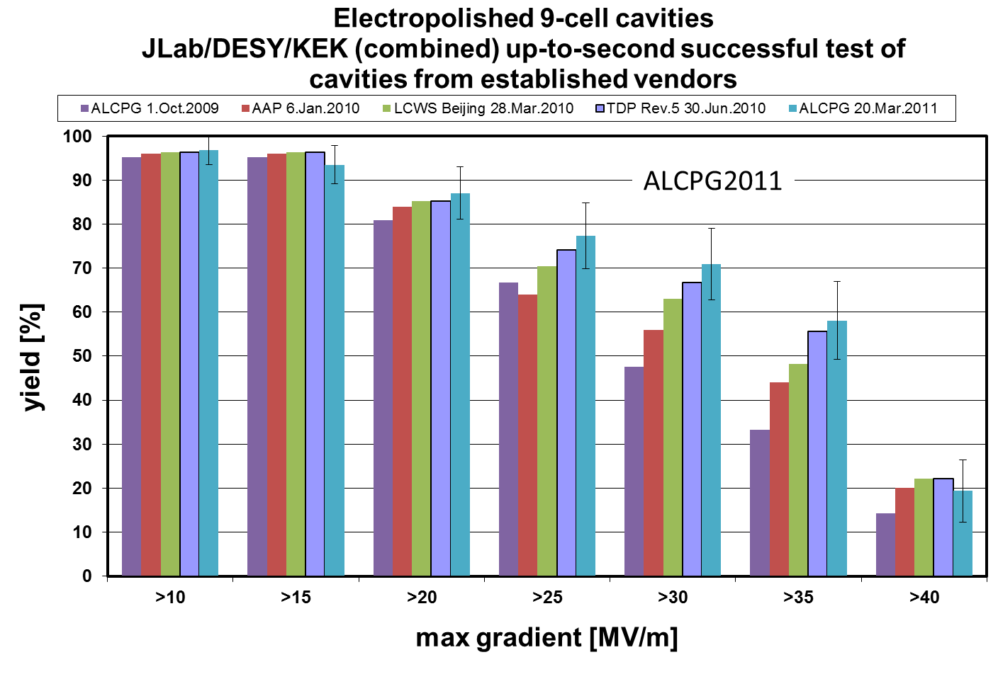
Gradient Range Yield Gain
+~15%

Slide 55
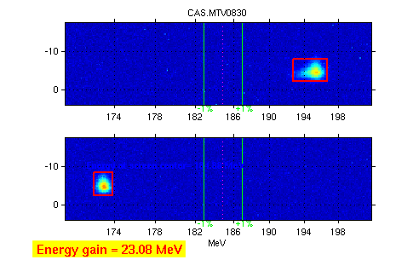


TBTS: Two Beam Test Stand
CTF3 team
Maximum gradient 145 MV/m
Consistency between
produced power
drive beam current
test beam acceleration
TD24

Slide 56


Nominal performance of Accelerating Structures
Design@CERN, Built/Tested @KEK, SLAC
SLAC
KEK
CLIC
target

Slide 57

ILC layout

Slide 58

CLIC layout
QUAD
QUAD
POWER EXTRACTION
STRUCTURE
ACCELERATING
STRUCTURES
DRIVE BEAM COMPLEX
BPM
MAIN BEAM COMPLEX

Slide 59

Beyond HE-LHC : new tunnels in Geneve area
47 km – 80 km
1) 42 TeV c.o.m. with 8.3 T (present LHC dipoles)
2) 80 TeV c.o.m. with 16 T (high field based on Nb3Sn)
3) 100 TeV c.o.m with 20 T (very high field based on HTS)

Slide 60
Hadron therapy facilities

Slide 61

Hadrontherapy in the world
Moscow
St. Petersburg
Dubna
Wanjie (WPTC)
Ilsan, Korea
Clatterbridge, Uppsala
Nice (CAL) , Orsay (CPO)
Berlin (HMI) Munich
Villigen PSI
Catania LNS since 2002
Vancouver (TRIUMF)
Darmstadt (GSI)
Kashiwa (NCC)
Hyogo (HIBMC)
WERC Shizuoka
CNAO
IMP (Langzhou)
CA., UCSF
CA., LLUMC
IN Bloomington
TX Houston
FL, Jacksonville
Hyogo (HIBMC)
Chiba (HIMAC)
Gunma
South Africa iThemba LABS
> 70000 patients treated with protons
> 7000 with carbon ions

Slide 62

Hadrontherapy first proposed by R. Wilson in 1946
In 1954: 30 patients treated with protons at LBL (Lawrence Berkeley Laboratory)
In the next years other treatments in other research centers were performed
(Uppsala, Harvard, Dubna, St.Petersburg, Moscow, PSI, Chiba, Tsukuba)
In 1990 the first dedicated hospital facility has started treatments at Loma Linda (LLUMC)

Slide 63


Cancer therapy: X-rays
1937: first X-rays irradiation from van de Graaff electrostatic machine
1956 : first patient treated with radiotherapy at Stanford – eye tumor
Since then 40 millions patients have been treated
Today 50% of cancer patients are X-ray treated, either alone (25%) or in combination with other techniques.
Electron Linacs (4 – 22 MeV) produce e- to be shot on a metallic target and produce X-rays
Commercially produced
Thousands of compact and fully reliable Linacs are daily treating patients in all the world
Control of radiation dose and radiation fields decrease collateral effects

Slide 64

Radiotherapy and hadrontherapy
Hadrontherapy uses hadrons (protons and heavy ions) – Bragg peak
Very localized depth-dose deposition

Slide 65
Macroscopic advantage of hadrons
X rays
protons
Rapid fall-off

Slide 66
Accelerator design criteria for hadrontherapy
The kind of the accelerator depends mainly on:
The species to be accelerated
The radiation shaping and delivery method
particle | Penetration range | Energy range | Brho range
Proton | 30-300 mm | 60-250 MeV/u | 1.16-2.31 Tm
Carbon | 30-300 mm | 120-400 MeV/u | 3.18-6.34 Tm
Passive Scanning
Active Scanning

Slide 67

CNAO synchrotron hall

Slide 68

CNAO - Accelerator and Treatement Rooms
Davide Bianculli

Slide 69
Orders of magnitude
Dose uniformity required: ± 2.5%
Treatment session duration: 30 min
Irradiation duration: 3 min
Slice thickness: 2 – 4 mm
Spot size: 4 - 10 mm
Position precision: 0.1 mm
Energy precision: 10⁻⁴
Spot duration: 5 - 10 ms
Beam current: 0.1 - 1 nA
Measurement time: < 100 ms

Slide 70


3D Real-time IR Optical Tracking (OTS)
Real time reconstruction of spherical markers and surfaces
Sub-millimeter accuracy : peak 3D errors <0.5 mm
3D data flow @70 Hz
X-ray Patient Verification System (PVS)
2 X-ray tubes (deployable) ,
2 flat panels (deployable)
Supporting structure rotation: ±180°
Rotation and deployment accuracy: ± 0.15mm, ± 0.1°
Patient Positioning System (PPS)
Automatic couch or chair docking
Absolute accuracy: ≈ 0.3 mm
Markers, low density fixation materials

Slide 71
CNAO medical activity
1st patient protons: September 2011
1st patient Carbon Ions: September 2012
Three treatment rooms operational
62 Patients treated with protons
62 treated with Carbon ions
Cranium chordome and chondrosarcoma
Sacral chordome and chondrosarcoma
Intracranial meningioma
Salivary glands carcinoma
Trunk sarcoma
Prostate carcinoma
Aero-digestive mucosae melanoma

Slide 72
Hadrontherapy history: Rapid Growth. doubled in last decade
Patients
.
Centres
.
80000
40
70000
35
60000
30
50000
.
25
.
40000
20
30000
.
15
20000
.
.
10
.
.
.
10000
.
.
.
5
.
.
0
1950
1960
1970
1980
1990
2000
2012

Slide 73

Photon
factories
The higher the photon energy, the shorter the wavelength, the higher the resolution
E = hν

Slide 74

Synchrotron radiation facilities in the world > 50
High brilliance and flux (combined with high collimation)
Wavelength tunability
Polarization (linear, elliptical or circular)
Time structure
Collimated (partially) coherent radiation

Slide 75

3 Generations of Light Sources
1970s : 1st Generation – HEP rings used parasitically for X-ray production
1980s : 2nd Generation – Many dedicated X-ray sources
1990s: 3rd Generation – Several radiaiton facilities with wigglers, undulators, high brilliance
2000s: 4th Generation – Free Electron Lasers driven by Linacs
ALBA
Light source brilliance
photons/s/mm²/mr²/0.1%BW
photons per time, space, energy definition

Slide 76

XFEL – 4th generation

Slide 77

H. Braun

Slide 78

ALBA, the Spanish 3rd Generation Light Source

Slide 79

Accelerator layout
Synchrotron
Linac
Booster

Slide 80
ALBA Storage ring and Booster main parameters
 | Storage Ring | Booster Extraction
Beam Energy | 3 GeV | 3 GeV
Natural Hor Emittance | 4.6 nm*rad | 9 nm*rad
Tunes (h / v) | 18.15 / 8.36 | 12.42 / 7.38
Natural Chromaticity (h / v) | (- 40.0 / -25.6) | (-17.0 / -9.6)
Momentum Compaction Factor | 0.88 x 10⁻³ | 3.6 x 10⁻³
Energy Spread | 1.05 x 10⁻³ | 0.96 x 10⁻³
Revolution Time | 896 ns | 832 ns
Damping Times (h / v / l) | (4.6 / 8.0 / 6.4) ms | (4.6 / 8.0 / 6.4) ms
Partition Numbers (h / v / l) | (1.3 / 1.0 / 1.7) | (1.75 / 1.0 / 1.25)
Energy Loss per Turn (no IDs) | 1.2 MeV | 0.625 MeV
Harmonic Number | 448 | 416
ALBA accelerators

Slide 81

Phase I Instruments in ALBA
Photoemission
Spectroscopy and Microscopy
CIRCE: PEEM & NAPP
Resonant Absortion and Scattering
BOREAS: Hector & MARES
Material Science & Powder Diffraction
MSPD: HR & HP
Non cristalline
Diffraction
NCD
Core Level Absorption and Emission
Spectroscopy
CLAESS
Soft X-Ray
Microscopy
MISTRAL
Macromolecular
Cristallography
XALOC

Slide 82
2012 and 2013 proposal nationality
2012
2013
Average Overbooking factor: ~ 2
Industrial Users start to use the facility

Slide 83

One of ALBA Beamlines (CIRCE)

Slide 84

Protein resolved in the
XALOC Beamline at ALBA

Slide 85

Accelerator physics is not only Maxwell and Lorentz equations
Beam instrumentation
CONTROLS & COMPUTERS
Genetic algorithms
Impedances
Feedback systems
Simulation codes
Landau damping
Advanced Electronics
Conventional cooling and electrical systems
Simplectic codes
Plasma Physics
Hill equation
Statistical and collective effects
Hamiltonian treatment
Vacuum technology
Vlasov equation
Laser technology
Schoedinger equation
Cryogenics

Slide 86
History:
Andrew Sessler and Edmund Wilson –”Engines of Discovery”, World Scientific Editors
Accelerator physics:
CAS (Cern Accelerator School) proceedings - http://cas.web.cern.ch/cas/
USPAS (US Particle Accelerator School) - http://uspas.fnal.gov/course-materials/most-recent-school.shtml
Recent papers on accelerators
Joachim Stohr - The Scientific Revolution Enabled by X-ray Free Electron Lasers – IPAC 12 Conference Proceedings
Mats Lindros – European Startegy Group Symposium
Caterina Biscari – European Strategy Group Symposium
Hans Braun - The Future of Xray FELs
Mike Lamont – The first years of LHC Operation for Luminosity Production
Sandro Rossi - http://link.springer.com/article/10.1140%2Fepjp%2Fi2011-11078-8#page-1
Some references

