Slide 1
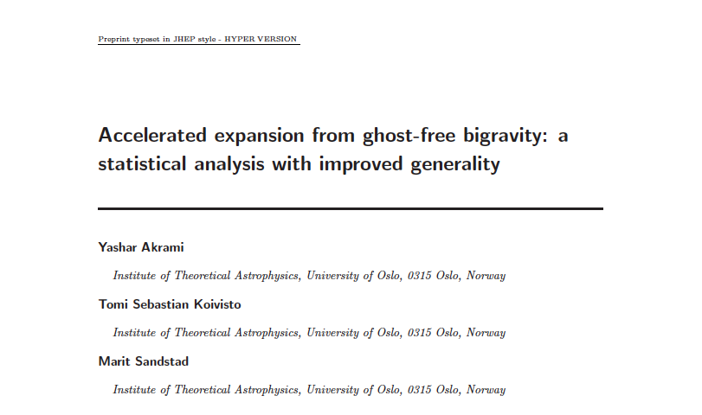
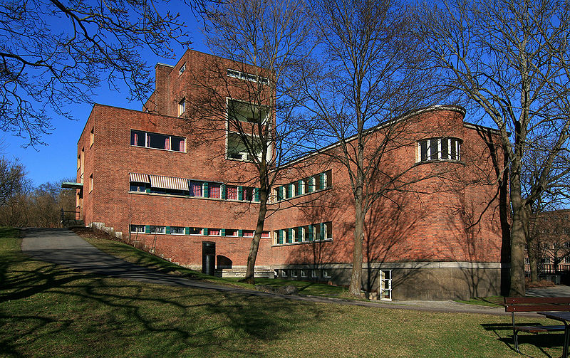
Cosmic Acceleration
from Ghost-free, Massive BiGravity:
A Statistical Analysis with Improved Generality
Modern Cosmology: Early Universe, CMB and LSS/ Benasque/ August 17, 2012
Yashar Akrami
Postdoctoral Fellow
Institute of Theoretical Astrophysics
University of Oslo, Norway
(Hans Kristian Eriksen, David Mota)
with:
Tomi S. Koivisto & Marit Sandstad
[arXiv:1208.xxxx]

Slide 2
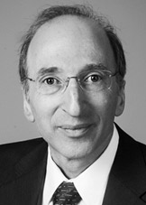
2011 Nobel Prize in Physics
+1
Motivation
Late-time Acceleration
=0
- Symmetry
- Degravitation,
- …
Saul Perlmutter
too big:
CC problem
Adam G. Riess
Brian P. Schmidt
“…for the discovery of the accelerating expansion of the Universe through observations of distant supernovae”
Yashar Akrami / Modern Cosmology: Early Universe, CMB and LSS/ Benasque / August 17, 2012

Slide 3
+1
Motivation
Dark Energy
or
Modified Gravity
Any
Alternatives?
Example:
Scalar Fields:
Horndeski Lagrangian
The most general 4D scalar field theory with second order equation of motion:
[Luca’s talk]
Yashar Akrami / Modern Cosmology: Early Universe, CMB and LSS/ Benasque / August 17, 2012

Slide 4
+1
Demand for Massive Gravity
Fierz & Pauli (1939):
(linearized metric fluctuations around flat space-time)
The only ghost-free mass term:
Consistent Non-linear Completion?
Theoretically challenging, cosmologically interesting.
2011: breakthrough
de Rham & Gabadadze [arXiv:1007.0443]
de Rham, Gabadadze & Tolley [arXiv:1011.1232]
Hassan & Rosen [arXiv:1103.6055]
[arXiv:1106.3344]
[arXiv:1109.3515]
[arXiv:1111.2070]
Hassan, Rosen & Schmidt-May [arXiv:1109.3230]
The only ghost-free, massive gravity
The only ghost-free, bimetric gravity
Yashar Akrami / Modern Cosmology: Early Universe, CMB and LSS/ Benasque / August 17, 2012

Slide 5
+1
Theory(general)
Hassan-Rosen bimetric gravity based on de-Rham-Gabadadze-Tolley massive gravity:
Action:
Yashar Akrami / Modern Cosmology: Early Universe, CMB and LSS/ Benasque / August 17, 2012

Slide 6
+1
Theory(general)
Equations of Motion:
Bianchi Identities + Energy-Momentum Conservation :
Yashar Akrami / Modern Cosmology: Early Universe, CMB and LSS/ Benasque / August 17, 2012

Slide 7
+1
Theory(the case for an isotropic and homogeneous universe)
Metrics:
Bianchi Identities + Energy-Momentum Conservation:
Yashar Akrami / Modern Cosmology: Early Universe, CMB and LSS/ Benasque / August 17, 2012

Slide 8
+1
Theory(the case for an isotropic and homogeneous universe)
Generalized Friedmann Equations:
Yashar Akrami / Modern Cosmology: Early Universe, CMB and LSS/ Benasque / August 17, 2012

Slide 9
+1
Theory(the case for an isotropic and homogeneous universe)
Hubble Parameter:
Evolution Equation:
Initial Conditions:
one-dimensional phase space
Yashar Akrami / Modern Cosmology: Early Universe, CMB and LSS/ Benasque / August 17, 2012

Slide 10
+1
Observational Constraints:
Model Parameter:
B₀, B₁, B₂, B₃, B_{4,} Ω_{m}⁰
(no Ω_{ϒ}, no curvature)
(B₀=0)
Data:
(purely background)
1. Luminosity distances from Type Ia SNe: 580 points
(Union 2.1)
2. Position of the 1st CMB power-spectrum peak (angular scale of sound horizon at recombination era): 1 point
(WMAP 7)
3. BAO: Ratio of sound horizon scale at drag epoch to dilation scale: 6 points
(2dFGRS, 6dFGS, SDSS and WiggleZ)
4. Constraints on H₀: 1 point
D_{L}, D_{V}, D_{A}, H(z)
Scanning Method:
State-of-the-art scanning algorithm: MultiNest (nested sampling): MCMC-like (both Bayesian and frequentist statistics)
Yashar Akrami / Modern Cosmology: Early Universe, CMB and LSS/ Benasque / August 17, 2012

Slide 11
+1
Some Results:
Minimal Non-linear Extension of Massive Fierz-Pauli Action without CC:
B_{1,} Ω_{m}⁰:
Best-fit χ²: 551.6
P-value: 0.8355
Log-Evidence: -281.73
ΛCDM:
Best-fit χ²: 546.54
P-value: 0.8709
Log-Evidence: -278.50
both consistent with the data (less than 1σ deviation)
Yashar Akrami / Modern Cosmology: Early Universe, CMB and LSS/ Benasque / August 17, 2012

Slide 12
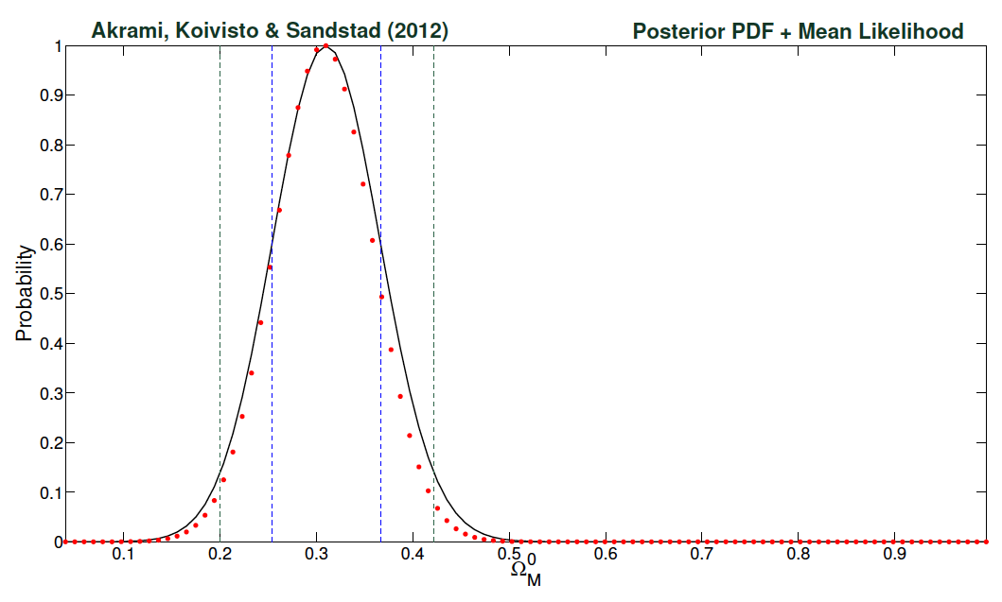
+1
Some Results: (B₁, Ω_{m}⁰)
Independent of Priors
Yashar Akrami / Modern Cosmology: Early Universe, CMB and LSS/ Benasque / August 17, 2012

Slide 13
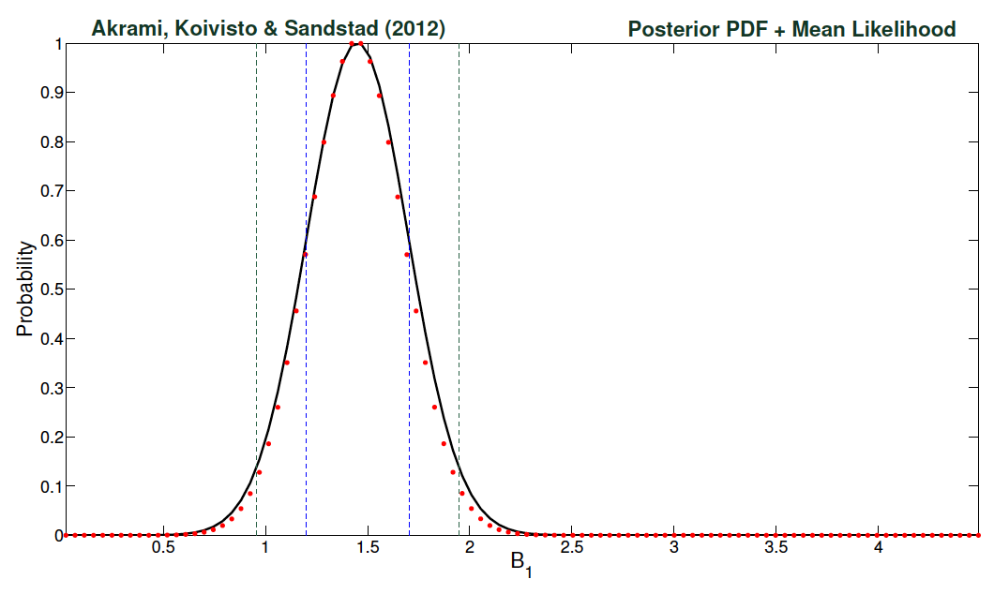
+1
Some Results: (B₁, Ω_{m}⁰)
Graviton Mass:
m² = 1.45 H₀² ± 0.25 H₀²
Independent of Priors
Yashar Akrami / Modern Cosmology: Early Universe, CMB and LSS/ Benasque / August 17, 2012

Slide 14
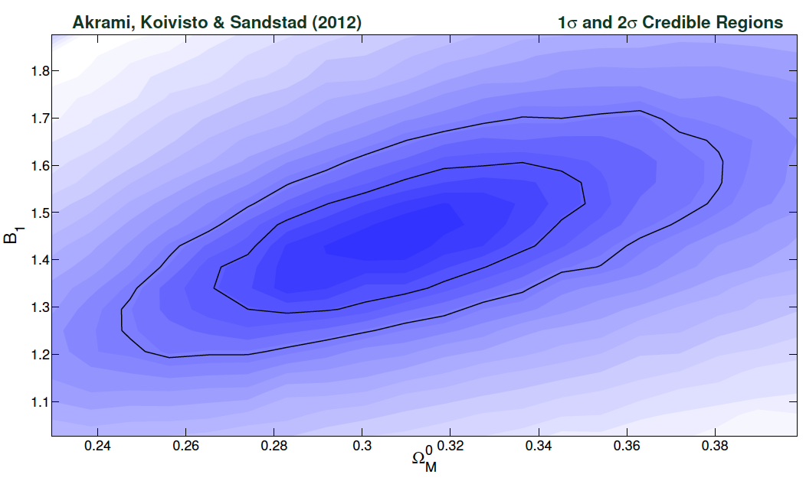
+1
Some Results: (B₁, Ω_{m}⁰)
Yashar Akrami / Modern Cosmology: Early Universe, CMB and LSS/ Benasque / August 17, 2012

Slide 15
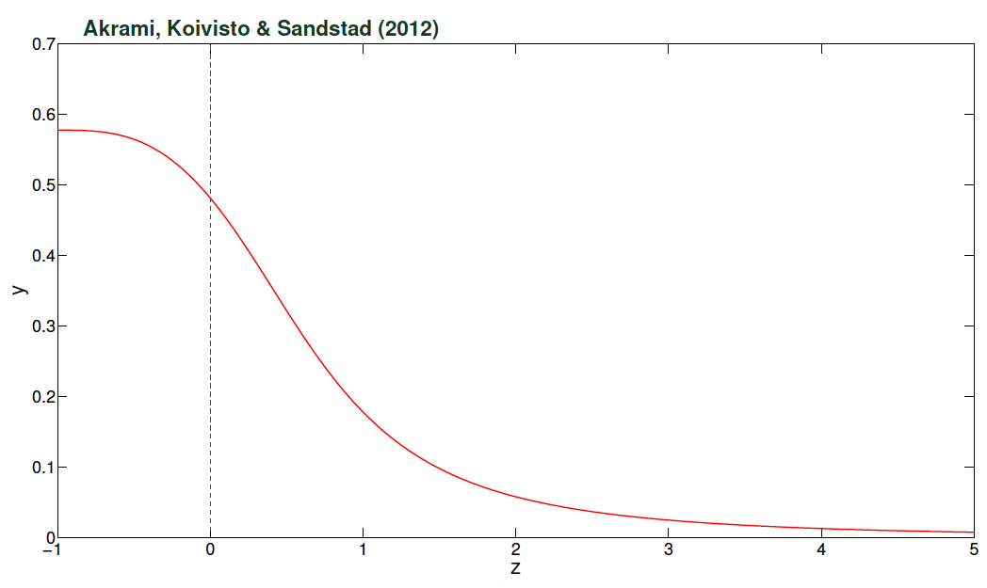
+1
Some Results: (B₁, Ω_{m}⁰)
Ω_{Λ} = B₁y
Yashar Akrami / Modern Cosmology: Early Universe, CMB and LSS/ Benasque / August 17, 2012

Slide 16
+1
Some Results:
B_{2,} Ω_{m}⁰
Best-fit χ²: 894.0
P-value: < 0.0001
Log-Evidence: -450.25
B_{3,} Ω_{m}⁰
Best-fit χ²: 1700.5
P-value: < 0.0001
Log-Evidence: -850.26
considered to be extremely statistically significant
Excluded!
Yashar Akrami / Modern Cosmology: Early Universe, CMB and LSS/ Benasque / August 17, 2012

Slide 17
+1
Some Results:
complexity of the model increases considerably when we increase the number of model parameters
B₁, B_{2,} Ω_{m}⁰
Best-fit χ²: 546.52
P-value: 0.8646
Log-Evidence: -279.77
{0.8355 for (B₁, Ω_{m}) & 0.8709 for ΛCDM}
{-281.73 for (B₁, Ω_{m}) & -278.50 for ΛCDM}
B₁, B_{3,} Ω_{m}⁰
B₂, B_{3,} Ω_{m}⁰
Best-fit χ²: 542.82
P-value: 0.8878
Log-Evidence: -280.10
Best-fit χ²: 548.04
P-value: 0.8543
Log-Evidence: -280.91
consistent with the data within 1σ
Yashar Akrami / Modern Cosmology: Early Universe, CMB and LSS/ Benasque / August 17, 2012

Slide 18
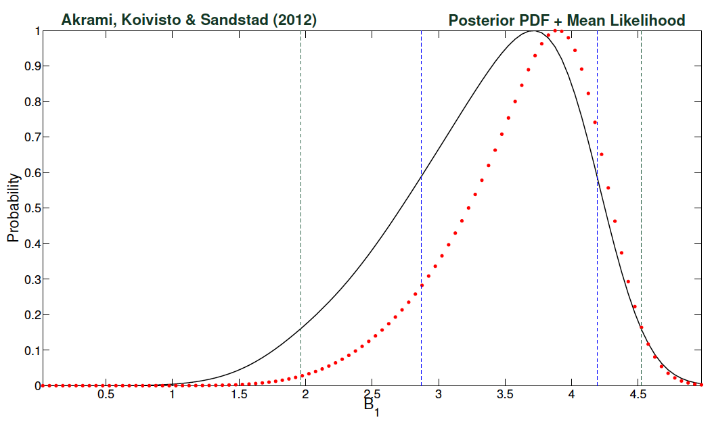
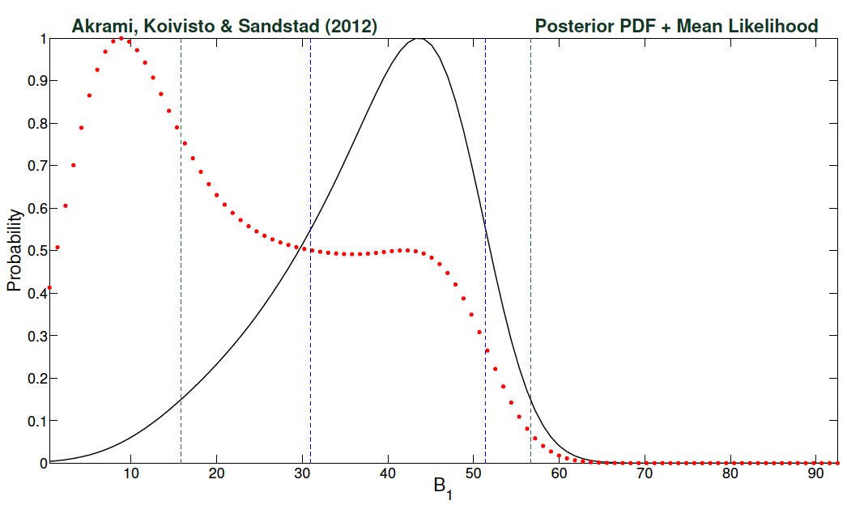
+1
Some Results: (B₁, B₂, Ω_{m}⁰)
Enlarged
prior ranges:
18
Yashar Akrami / Modern Cosmology: Early Universe, CMB and LSS/ Benasque / August 17, 2012

Slide 19
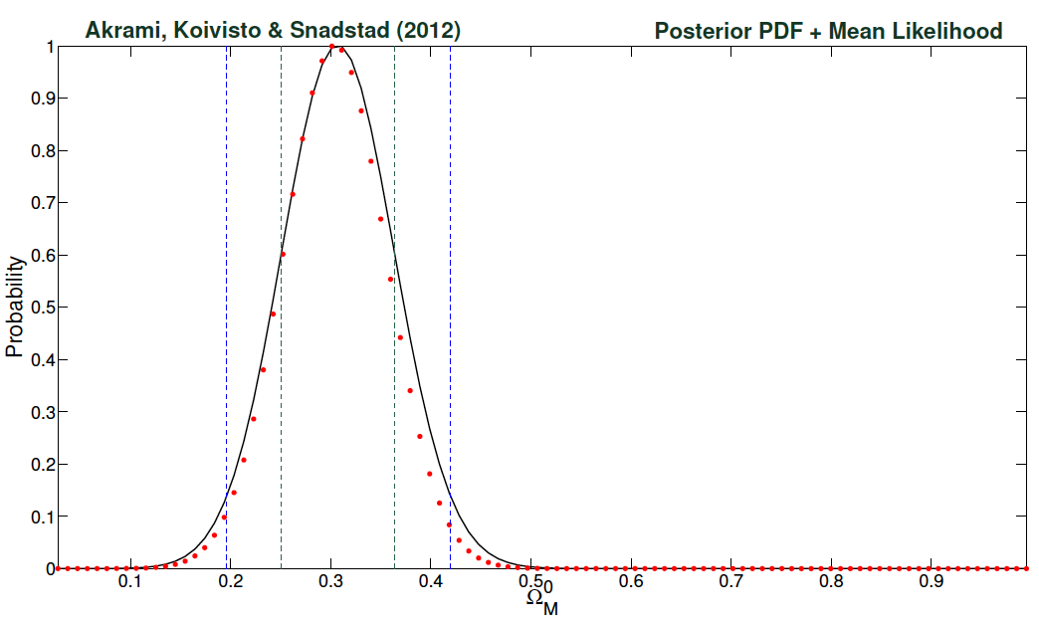
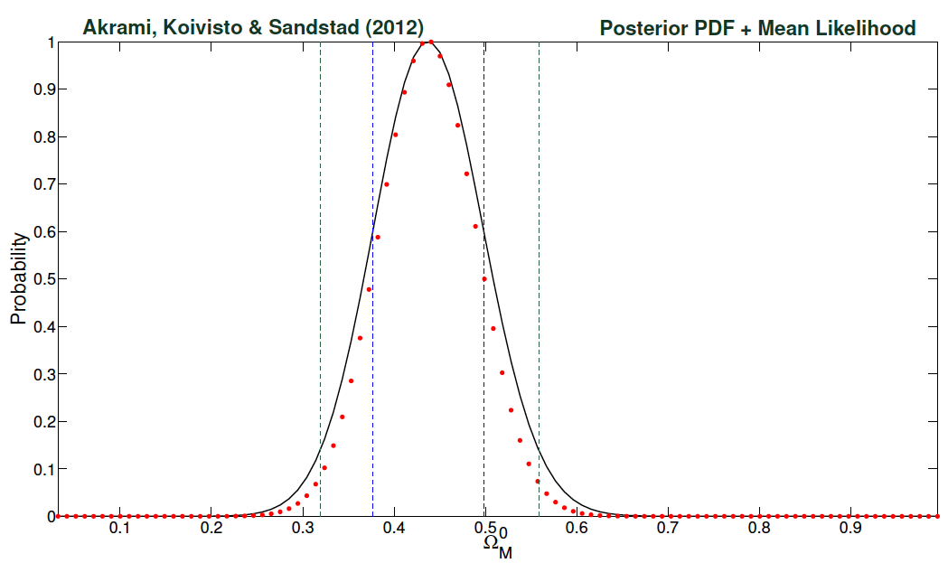
+1
Some Results: (B₁, B₂, Ω_{m}⁰)
Enlarged
prior ranges:
Yashar Akrami / Modern Cosmology: Early Universe, CMB and LSS/ Benasque / August 17, 2012

Slide 20
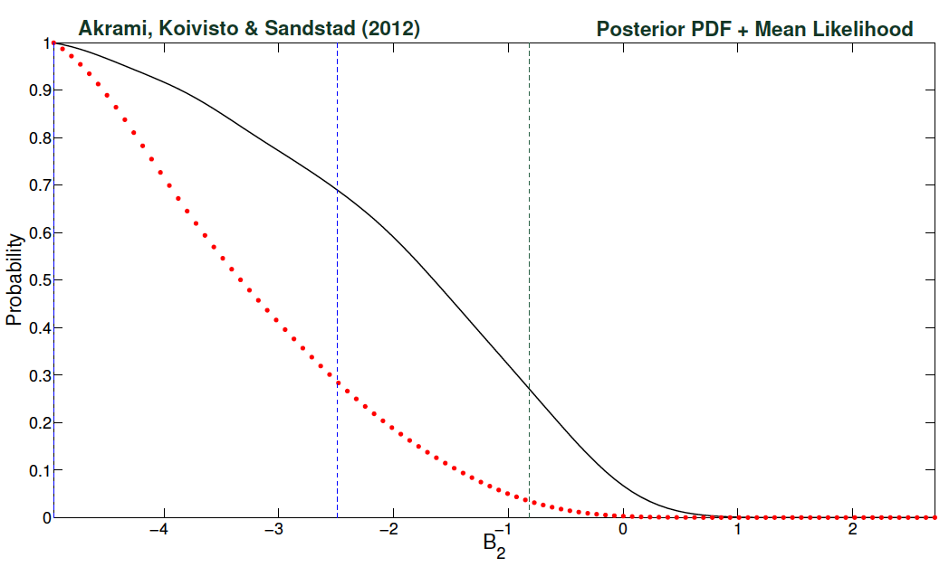
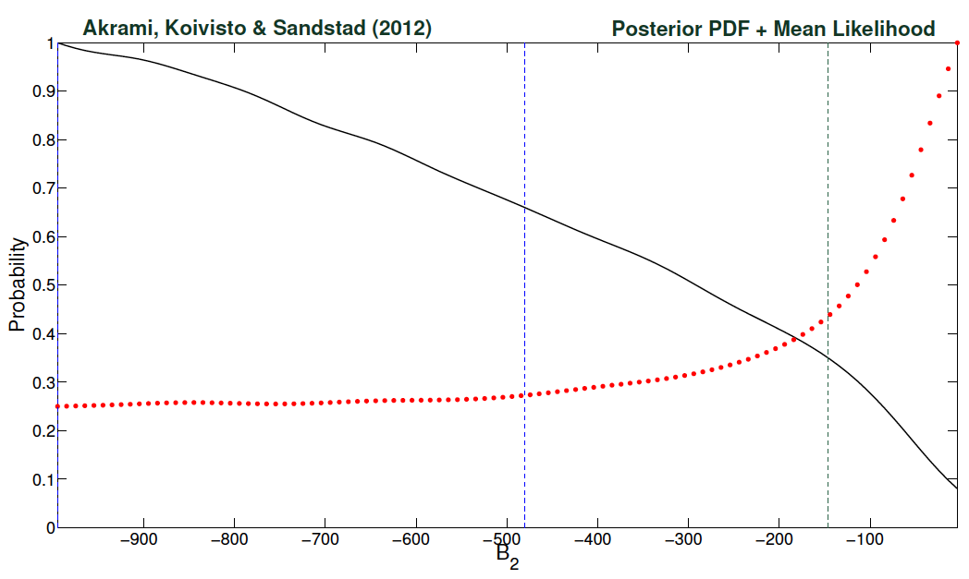
+1
Some Results: (B₁, B₂, Ω_{m}⁰)
Enlarged
prior ranges:
Yashar Akrami / Modern Cosmology: Early Universe, CMB and LSS/ Benasque / August 17, 2012

Slide 21
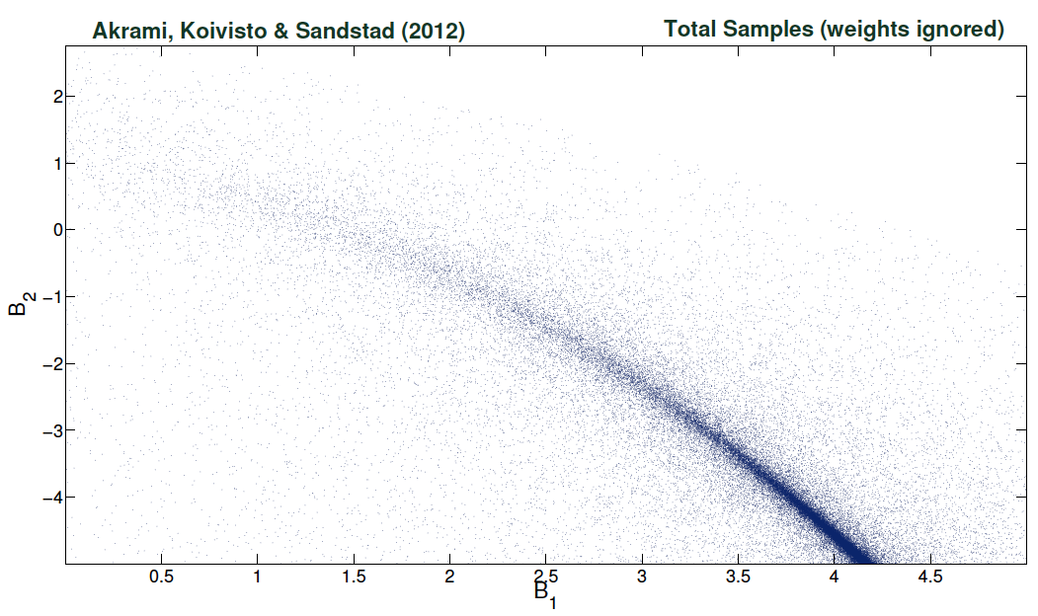
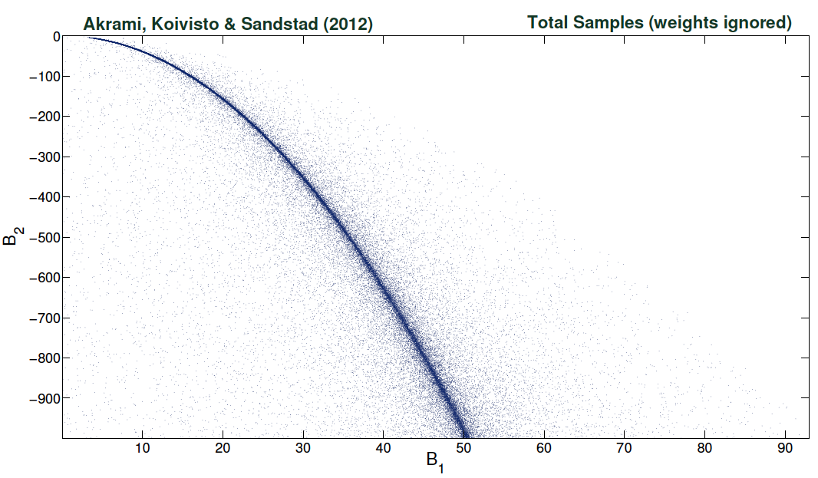
+1
Some Results: (B₁, B₂, Ω_{m}⁰)
Enlarged
prior ranges:
Yashar Akrami / Modern Cosmology: Early Universe, CMB and LSS/ Benasque / August 17, 2012

Slide 22
+1
Some Results: (B₁, B₂, Ω_{m}⁰)
Yashar Akrami / Modern Cosmology: Early Universe, CMB and LSS/ Benasque / August 17, 2012

Slide 23
+1
Summary & Conclusions
A comprehensive statistical analysis of Hassan-Rosen ghost-free, massive, bimetric gravity (for cosmology at background level) + several analytical explanations of results,
Massive gravity can give “Accelerated Expansion” with no explicit Cosmological Constant,
Very good fit even in the 1-parameter case,
Parameters are correlated for the full model,
Background data are not enough to constrain the full model (not robust and prior-independent),
Analysis of perturbations and other astrophysical probes needed to break degeneracy and constrain the model,
Further theoretical generalizations, e.g. curvature, coupling of “f” to matter, other background metrics, etc.
Yashar Akrami / Modern Cosmology: Early Universe, CMB and LSS/ Benasque / August 17, 2012

Slide 24
Thank You
for your attention

